Slide 1
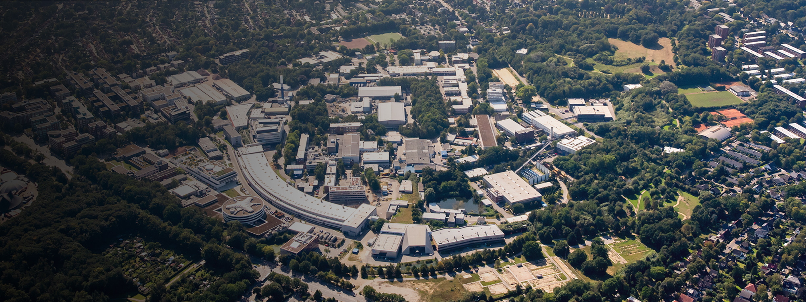
Mechanical design studies of the pulsed solenoid for positron sources
Possible methods for manufacture
C.Tenholt, G.Loisch, G.Moortgat-Pick, N.Hamann, S.Doebert, G.Yakopov
Valencia
LCWS2025
Mechanical design studies of the pulsed solenoid for positron sources | Grigory Yakopov, Valencia

Slide 2
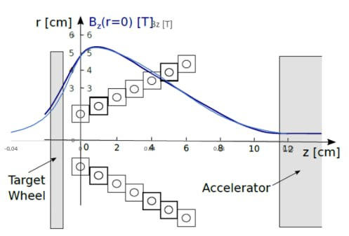
Concept and Motivation
Mechanical and thermal stress on a pulsed solenoid for positron capture at the ILC undulator-based positron source \ C. Tenholt, G. Loisch, M. Mentink, M. Fukuda, G. Moortgat-Pick, T. Okugi, S. Riemann, P. Sievers, K. Yokoya \ LCWS2023, SLAC, US
Mechanical design studies of the pulsed solenoid for positron sources | Grigory Yakopov, Valencia

Slide 3
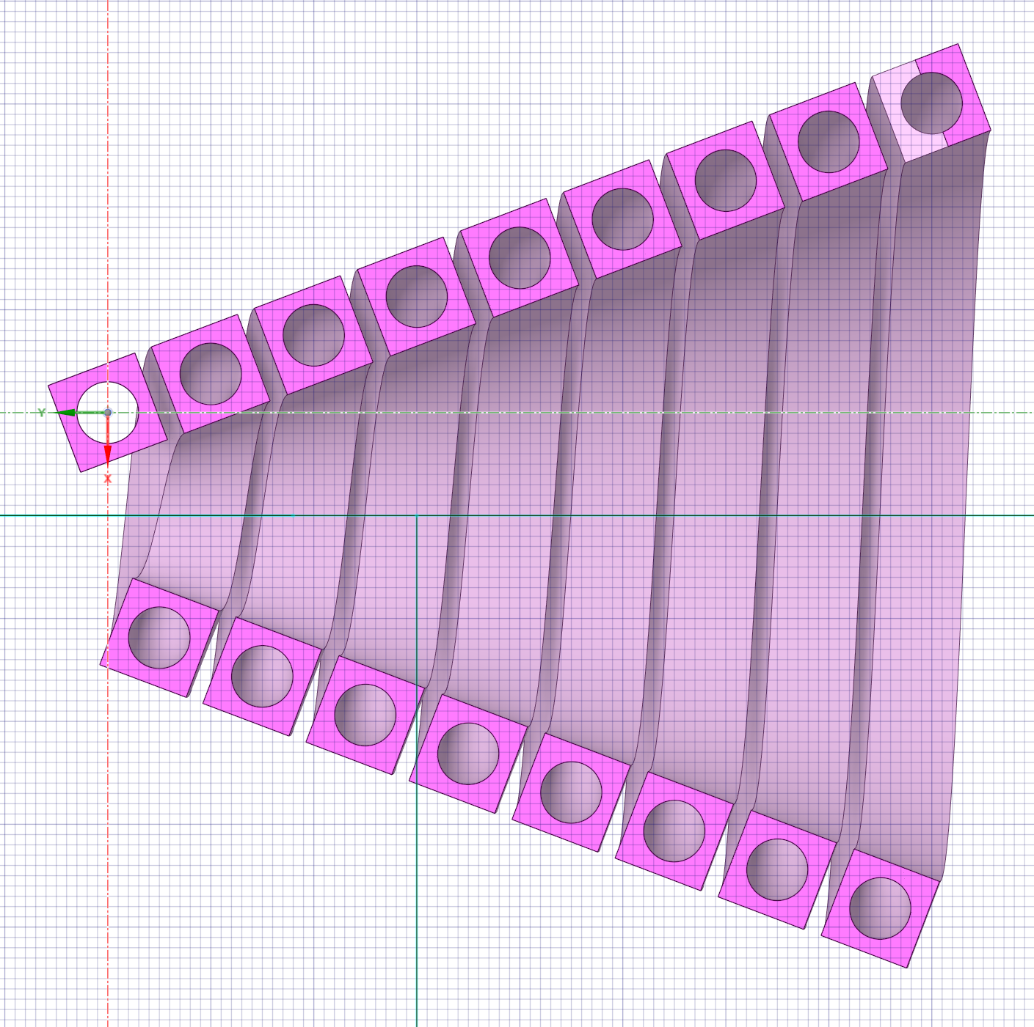
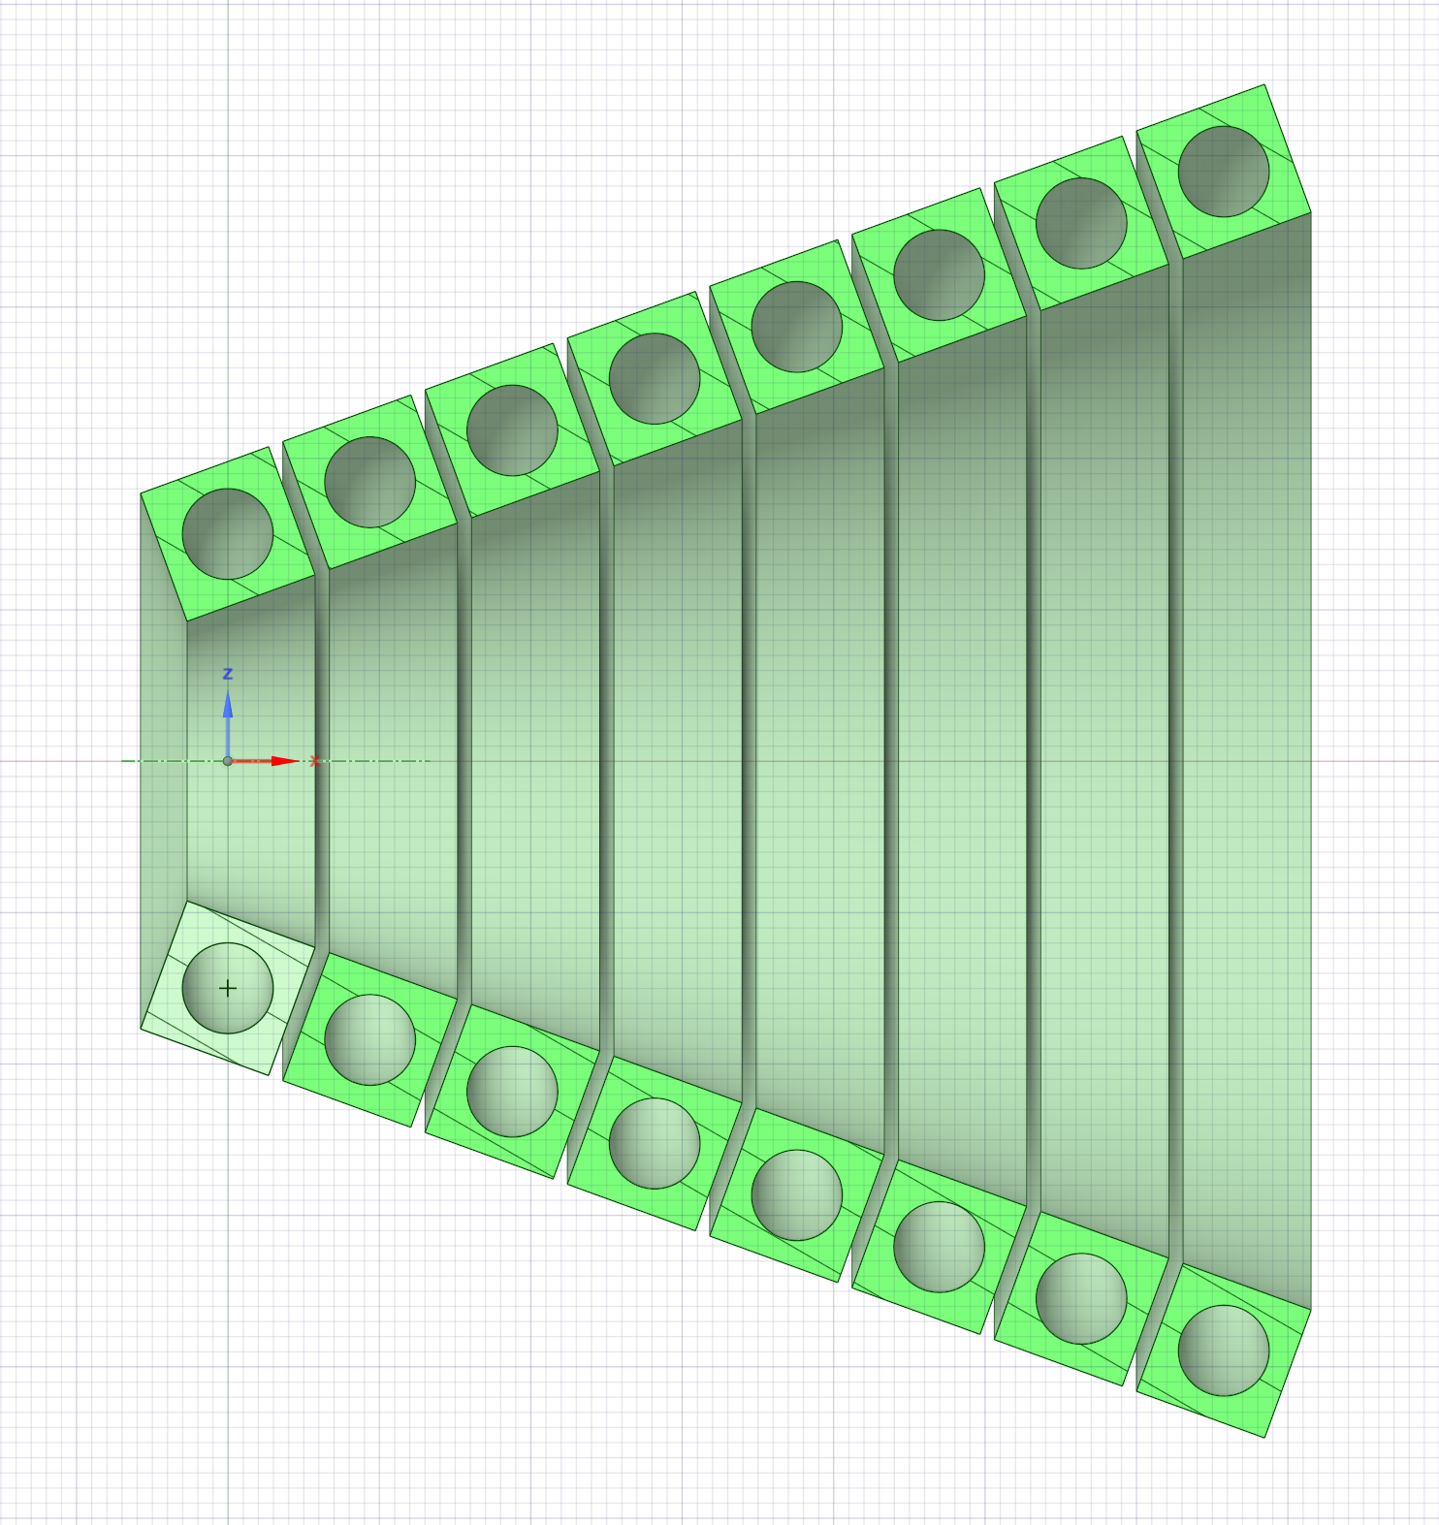
Focal plane parallel to the target plane
Classic Helical
Proposed design
Mechanical design studies of the pulsed solenoid for positron sources | Grigory Yakopov, Valencia

Slide 4
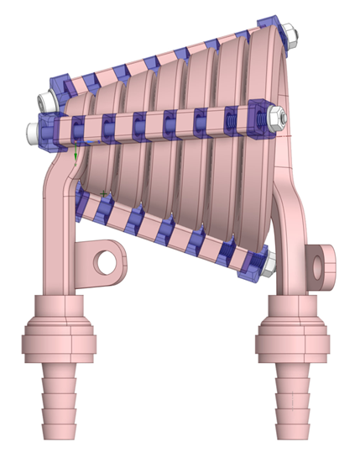
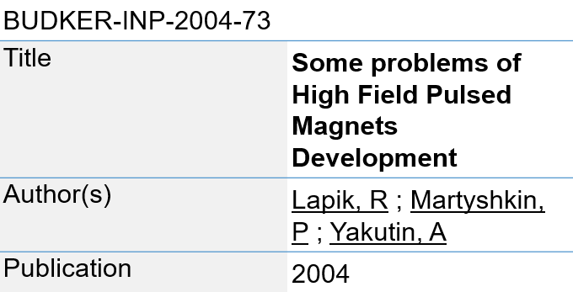
Mechanical Fixation Concept
Mechanical design studies of the pulsed solenoid for positron sources | Grigory Yakopov, Valencia

Slide 5
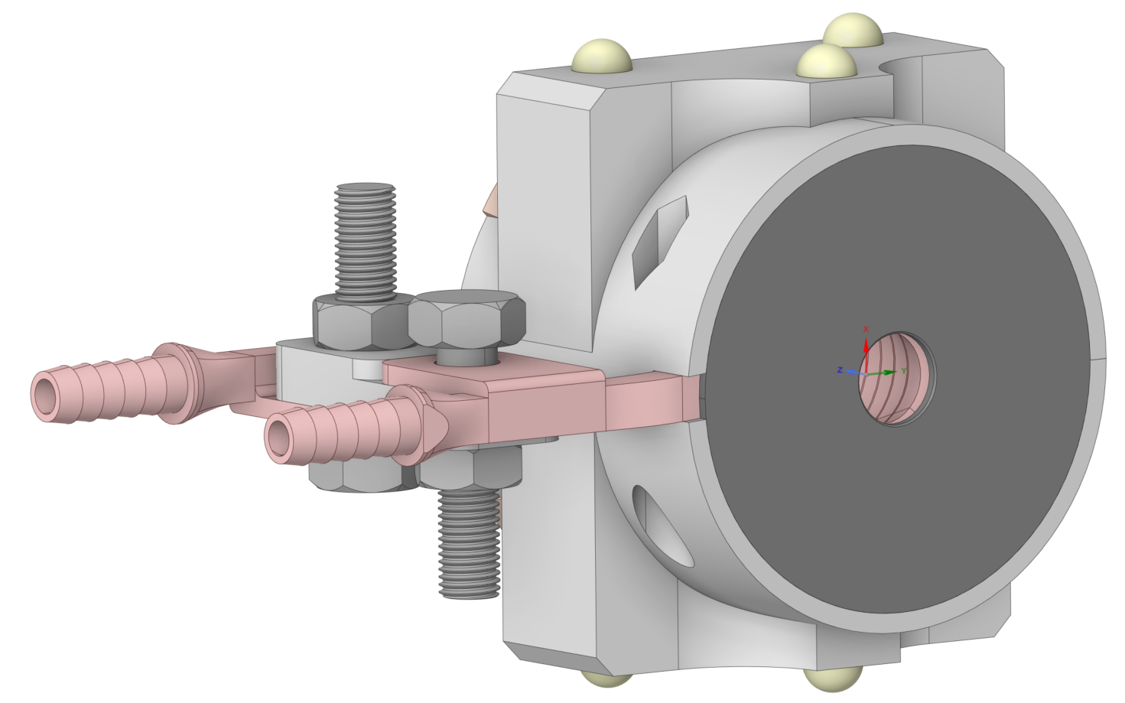
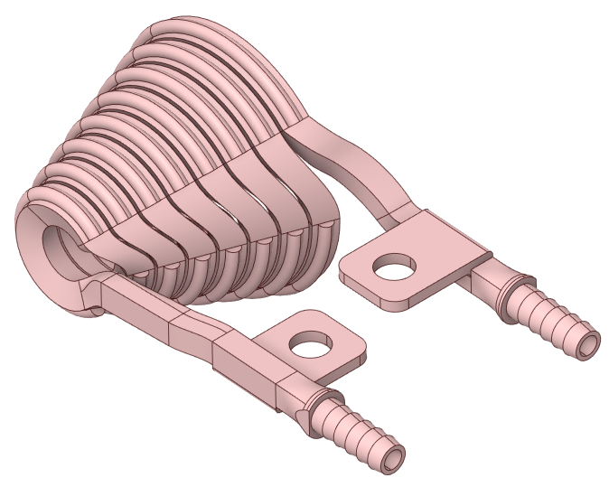
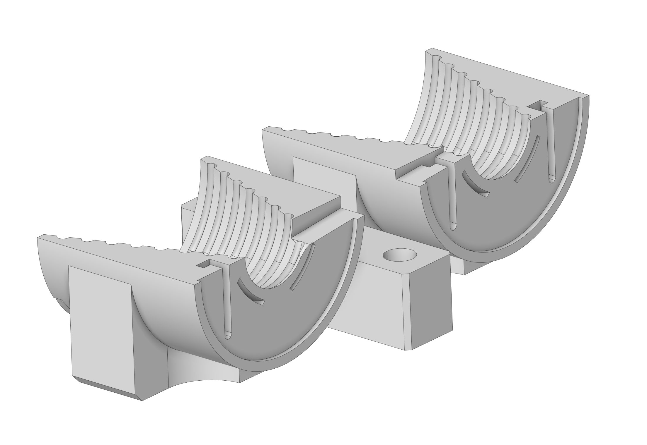
Manufacturing
ILC Pulsed Solenoid Prototype
Mechanical design studies of the pulsed solenoid for positron sources | Grigory Yakopov, Valencia

Slide 6
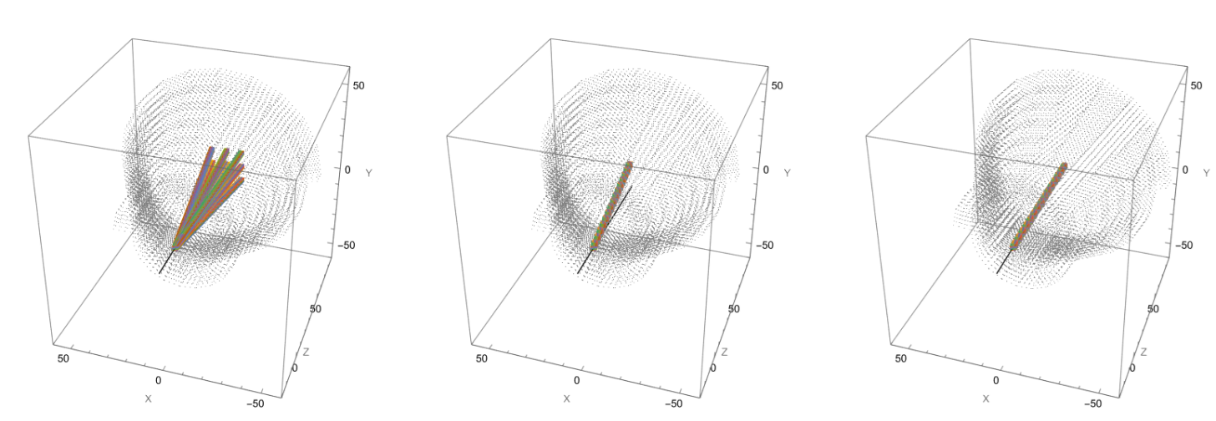
Magnetic Field Considerations
Field off
Field on
Solenoid tilted
* Simulation in Wolfram RadiA by Pavel Vagin from DESY Undulators group
Mechanical design studies of the pulsed solenoid for positron sources | Grigory Yakopov, Valencia

Slide 7
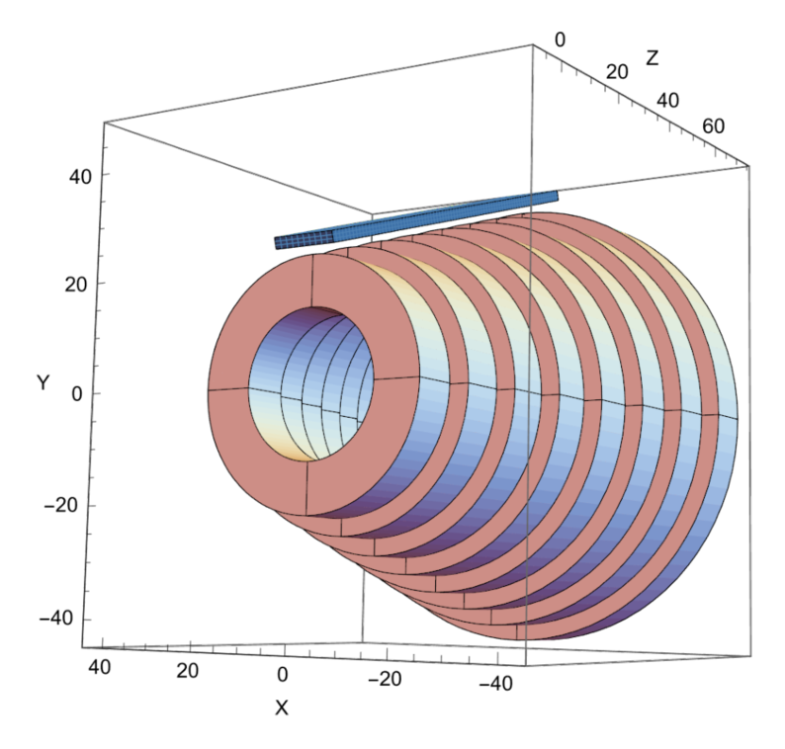
Shimming and Magnetic Alignment
Mechanical design studies of the pulsed solenoid for positron sources | Grigory Yakopov, Valencia

Slide 8
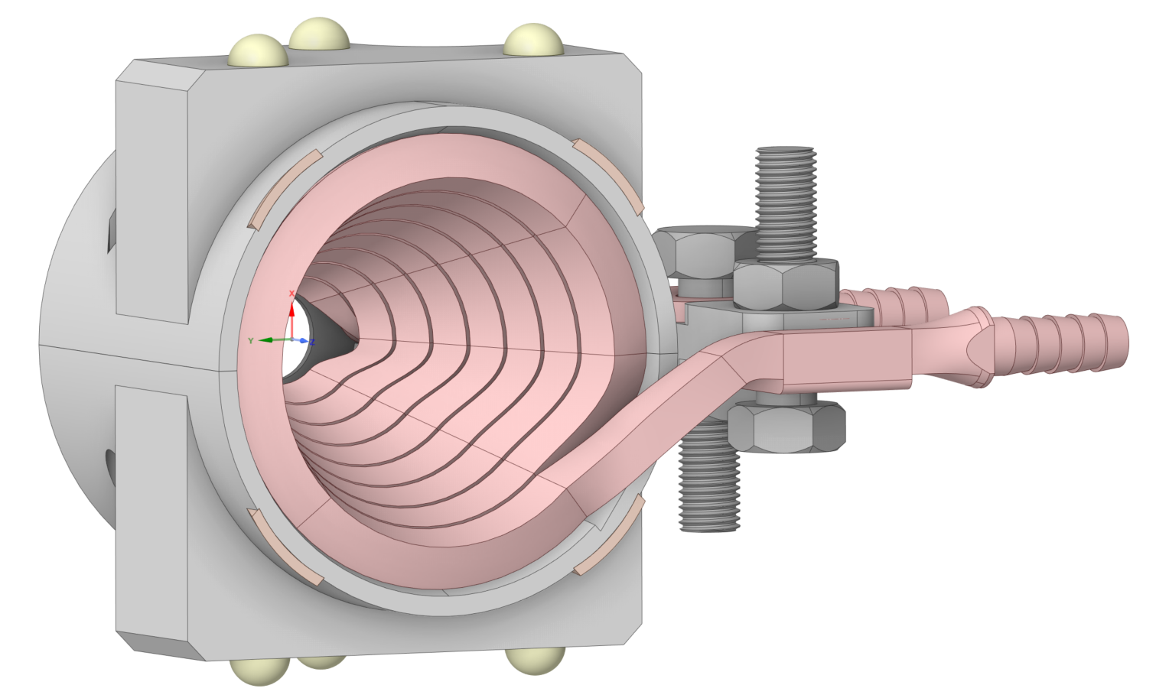
Mechanical design studies of the pulsed solenoid for positron sources | Grigory Yakopov, Valencia

Slide 9
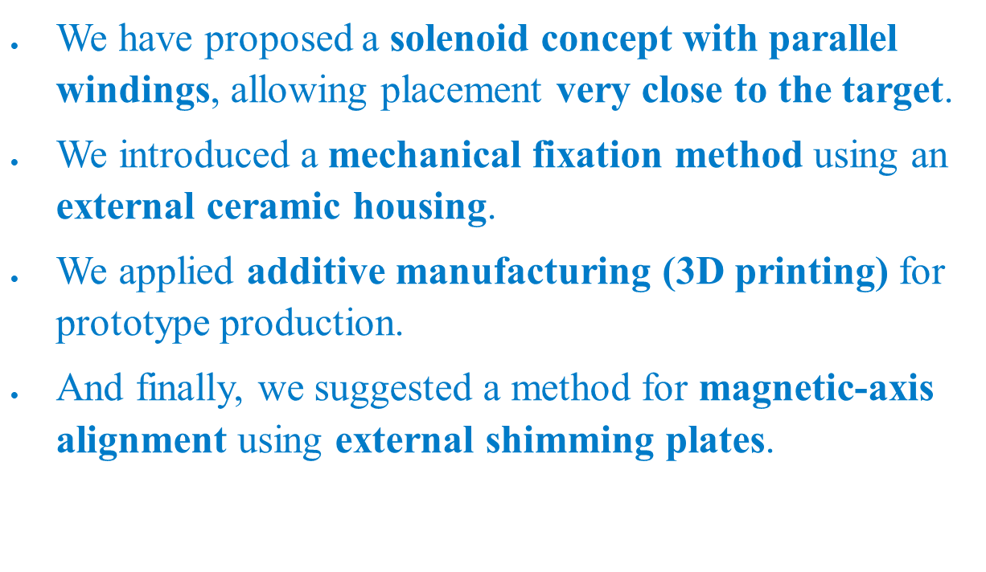
Conclusion
Mechanical design studies of the pulsed solenoid for positron sources | Grigory Yakopov, Valencia

Slide 10
Backup slides
Mechanical design studies of the pulsed solenoid for positron sources | Grigory Yakopov, Valencia

Slide 11
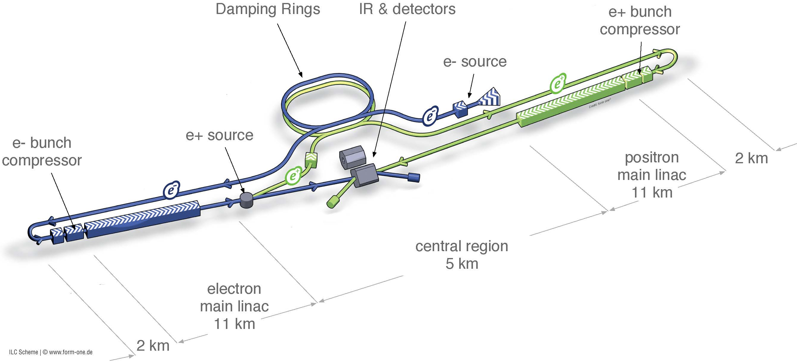
Polarized positrons for ILC are generated with a helical superconducting undulator by interaction of high-energy circularly polarized gamma photons with a titanium target.

Slide 12
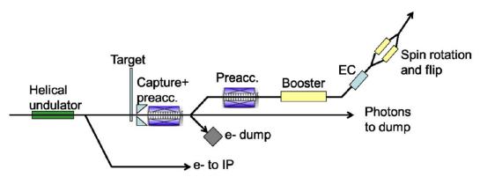
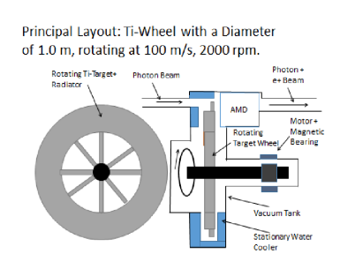
The target is produced in the form of a rotating wheel.
A pulsed solenoid is used to match the emittance of the positron bunch with the acceptance of the accelerating-focusing channel.

Slide 13
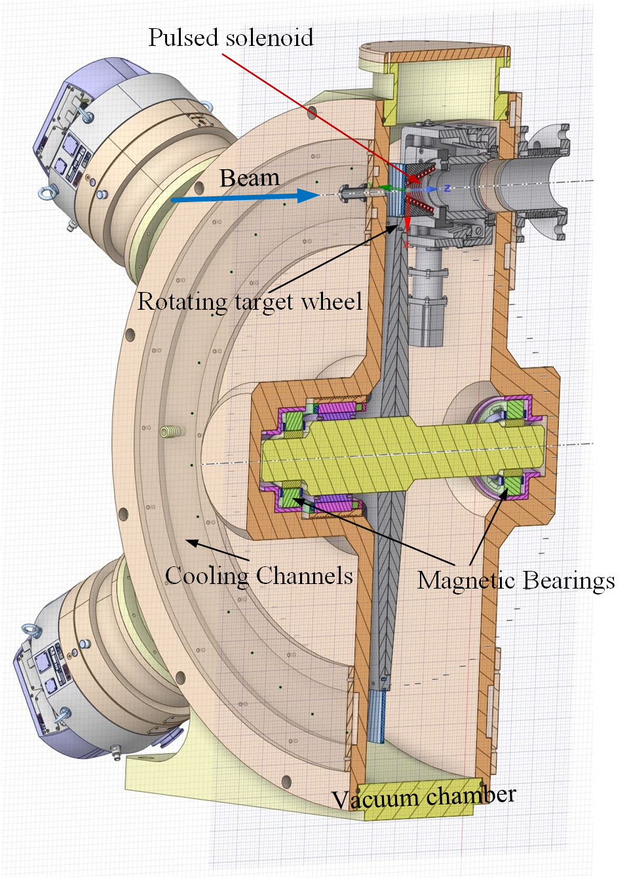
Cross-section of the vacuum chamber with rotation target wheel, magnetic bearing system, and pulsed solenoid
Diameter of wheel: 120 cm, 2000 rpm
Tangential velocity at r=50 cm: 100 m/s
The mass of the wheel 50 kg (without shaft)
Ti-alloy target 7mm thickness
The repetition rate of the beam pulses is 5 Hz
Heat input around the wheel is about 2 kW
Thermal radiation cooling from both sides of the target

Slide 14
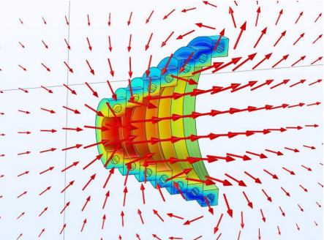
Basic concept of the pulsed solenoid
The concept of the solenoid has already been developed and presented in the relevant papers
[G. Moortgat-Pick, C. Tenholt, S. Riemann, G. Loisch].
From a mechanical point of view, the solenoid should have a conical shape with the corresponding geometrical dimensions.

Slide 15
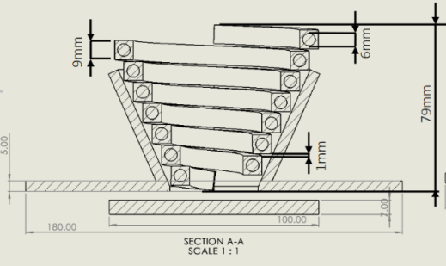
Requirements
The solenoid will be made of a copper conductor with a cross-section of 9x9 mm and have a channel with a diameter of 6 mm for cooling. It must be equipped with current and water leads.

Slide 16
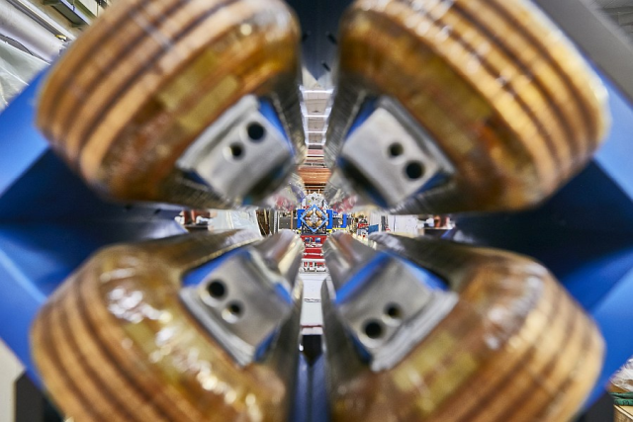
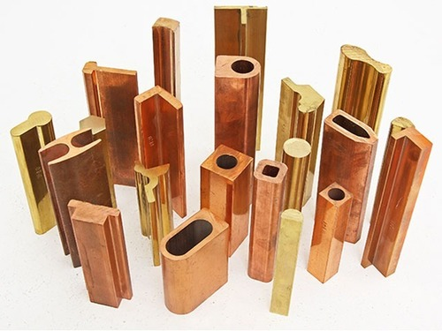
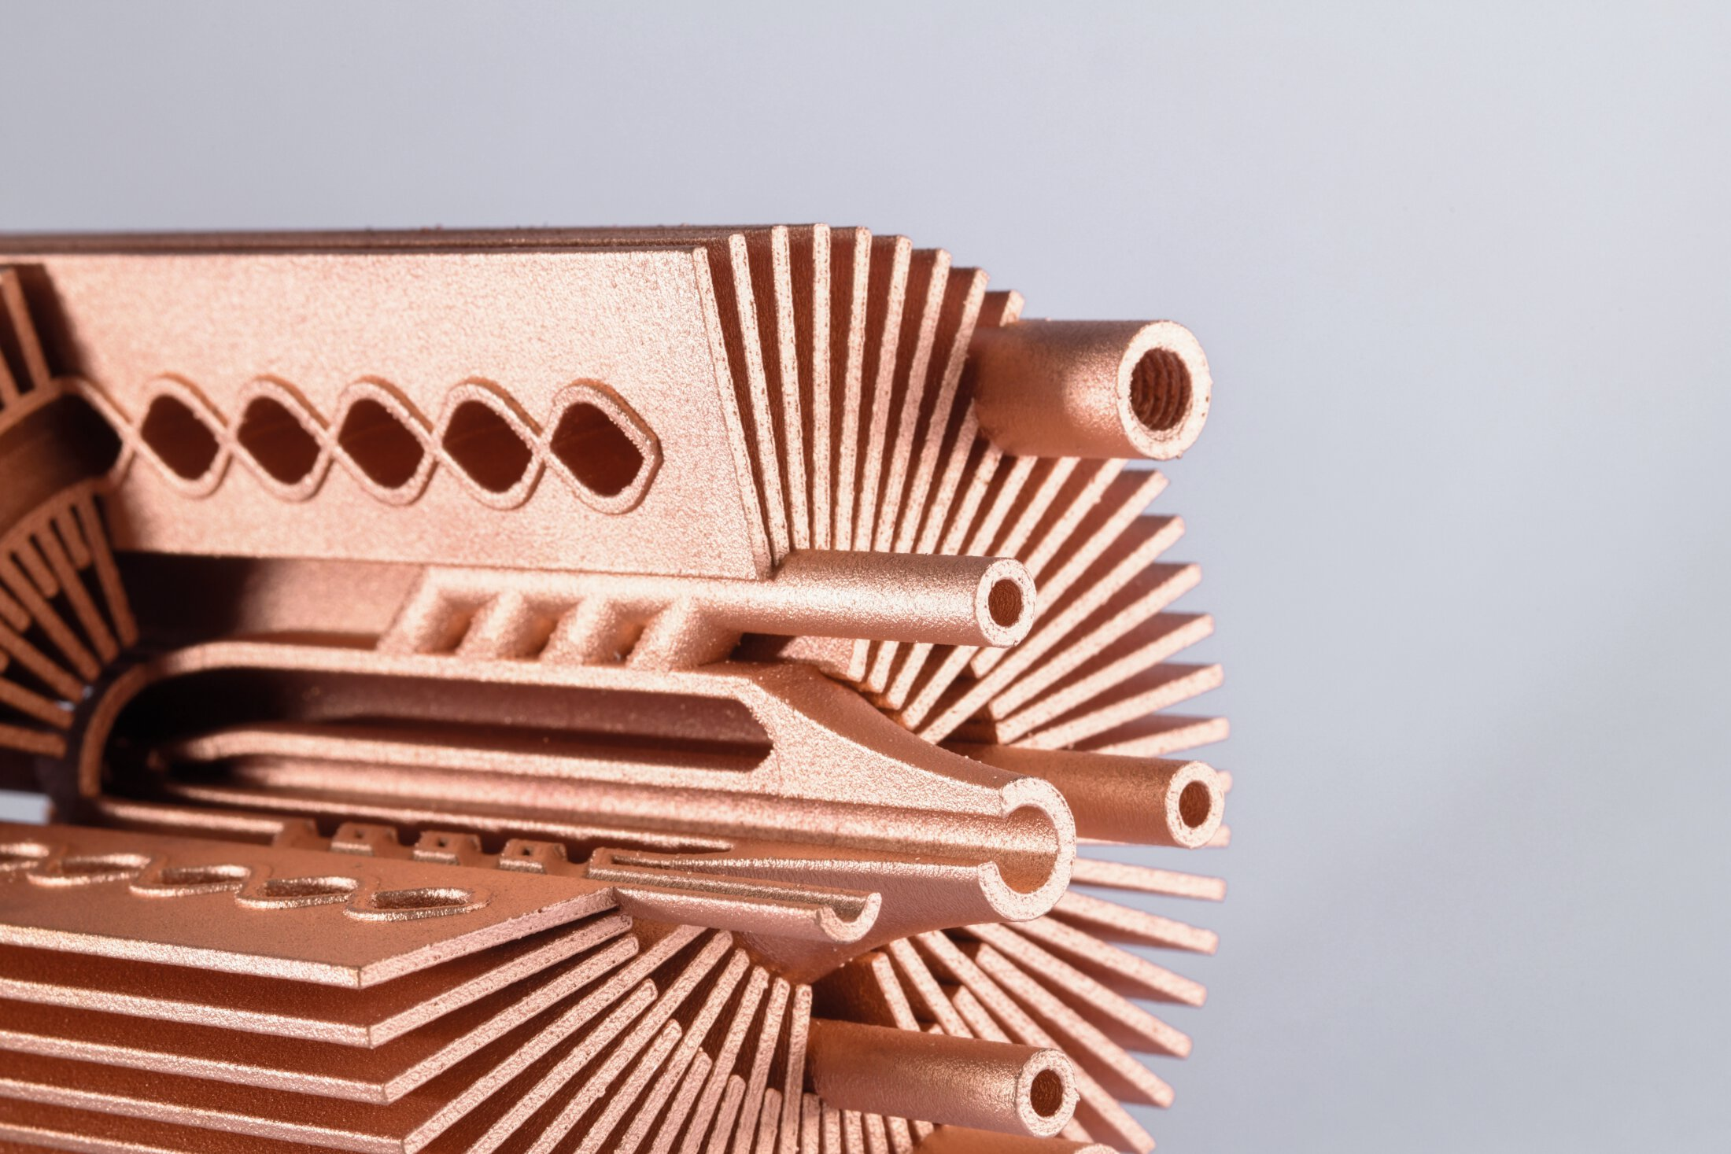
Three possible approaches for manufacturing the solenoid coil
Using a standard conductor from the optics used in the accelerator (cross-section 9x9mm with a hole diameter of 6mm).
Manufacturing a special conductor of the required cross-section using the extrusion method of copper.
3D printing with copper (proposed by Martin Lemke)

Slide 17
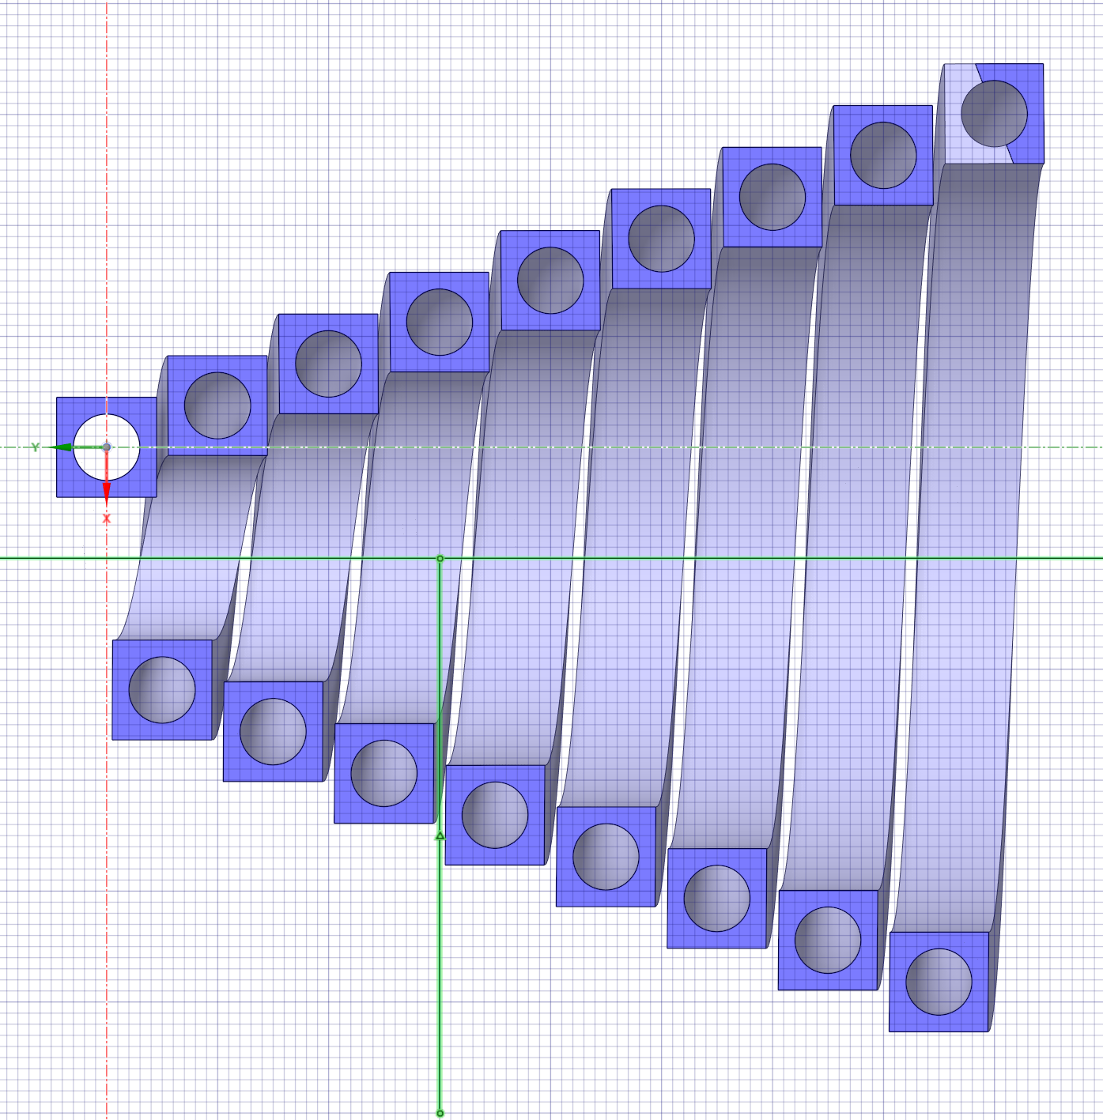
Coil turns turned at the angle of the solenoid cone

Slide 18
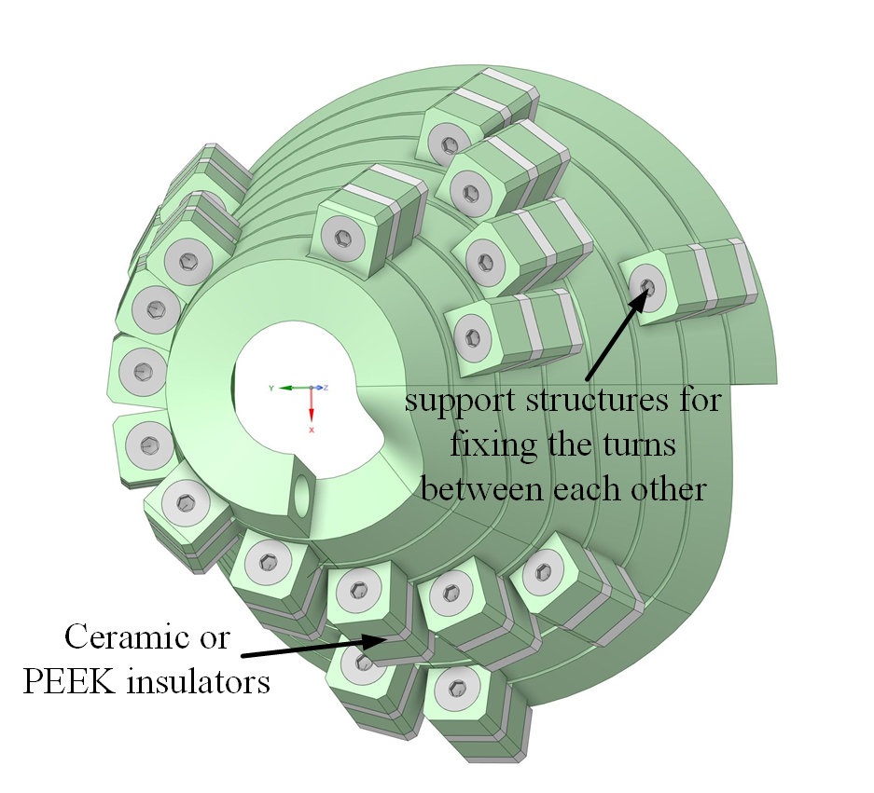
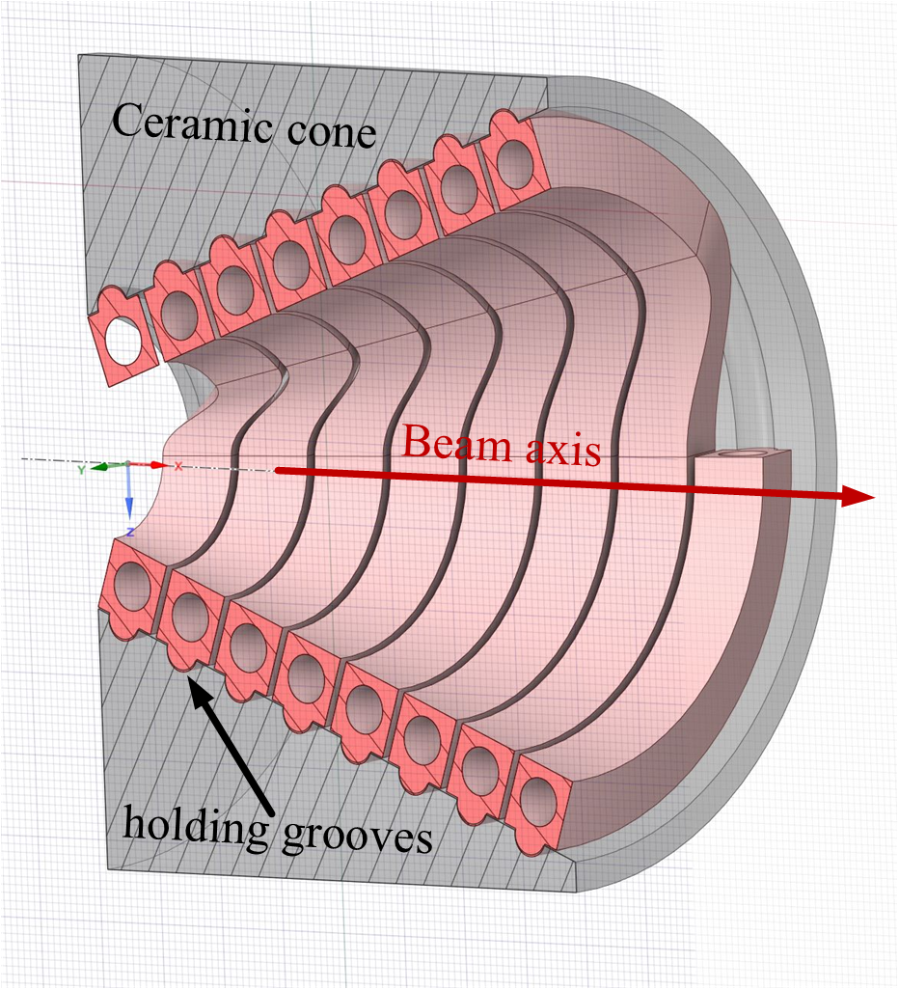
As a result, the prototypes proposed today looks like this:

Slide 19
BUDKER‘s article
The problem of the mechanics of such a pulsed device is the result of the action of electrodynamic forces in the elements of the magnet, primarily in its conductive units. Pulsed mechanical action during operation of the magnet should not lead to unacceptable mechanical stress in its elements. Usually this problem can be solved by applying external mechanical connections.
In relation to PS, the problem of mechanical fastening of winding turns is exacerbated due to the impossibility of using organic insulation under conditions of intense flows of ionizing radiation. Here it is possible to use, in essence, only ceramic insulation, and in limited quantities.

Slide 20
Powering of the Cu-Conductor.
length l=1 m,
pulsed with half sine pulses of 4 ms, 50 kA peak at 5 Hz.
Av. Ohmic resistance: 2.38 10^-4 Ω.
Av. d.c.Voltage: 12. V.
Av. Pulsed power: 5.95 kW.
PEDD(el): 1.86 J/g pulse, well below the accepted limit of 10 J/g.
ΔT=4.66 K/pulse.
Av. Power density: 83 W/cm^3.
*Use high quality, oxygen free Copper with high electrical conductivity: σ=5.85 10^5 (1/Ωm).

Slide 21
Cooling of the Conductor.
Water flow with a velocity of 6 m/s through the conductor gives a mass flow of 0.17 l/s.
• Pressure drop ΔP=6 Bar/meter.
• ΔT in water over the conductor length of 1 m: 8.35 K.
Water inlet at 20 oC.
Peak temperature rise in the coil above the water temperature just after a pulse, during steady state cycling: 18.3 K.
Peak temperature in the conductor: at the inlet 38.3 oC, at the outlet 46.7 oC.

