Slide 1

The Ghost Collider
An Innovative Higgs Factory
Andrew Hutton¹
Peter Williams ², Rob Apsimon³, Bamunvita Gamage¹, Balša Terzič⁴
¹Jefferson Lab, ²STFC,Lancaster³, ⁴ODU

Slide 2
The Ghost Collider
The Ghost Collider is a 550 GeV center-of-mass, 275 GeV per beam linear collider with four interaction regions, each with the design luminosity
“Ghost bunches” have equal numbers of electrons and positrons and are electrically neutral
In the linacs, energy is transferred between electrons and positrons in the same bunch, decelerating one type of particle and using the energy to accelerate the other
At the interaction points (IPs), collisions between two neutral ghost bunches occurs with no electromagnetic interaction
There are four serial IPs; chromatic errors in one IP are canceled in the following IP
All interaction points have the nominal luminosity per IP of 1.6 x 10³⁴ cm⁻²s⁻¹
The facility luminosity is 6.3 x10³⁴ cm⁻²s⁻¹ @ 100 MW electrical power for the RF systems
It has been developed from previous work by Valeri Telnov* and Erk Jensen**
* V. Telnov, Journal of Instrumentation 16 (2021) P12025
* https://indico.cern.ch/event/1040671/#9-energy-recovery-and-sustaina

Slide 3
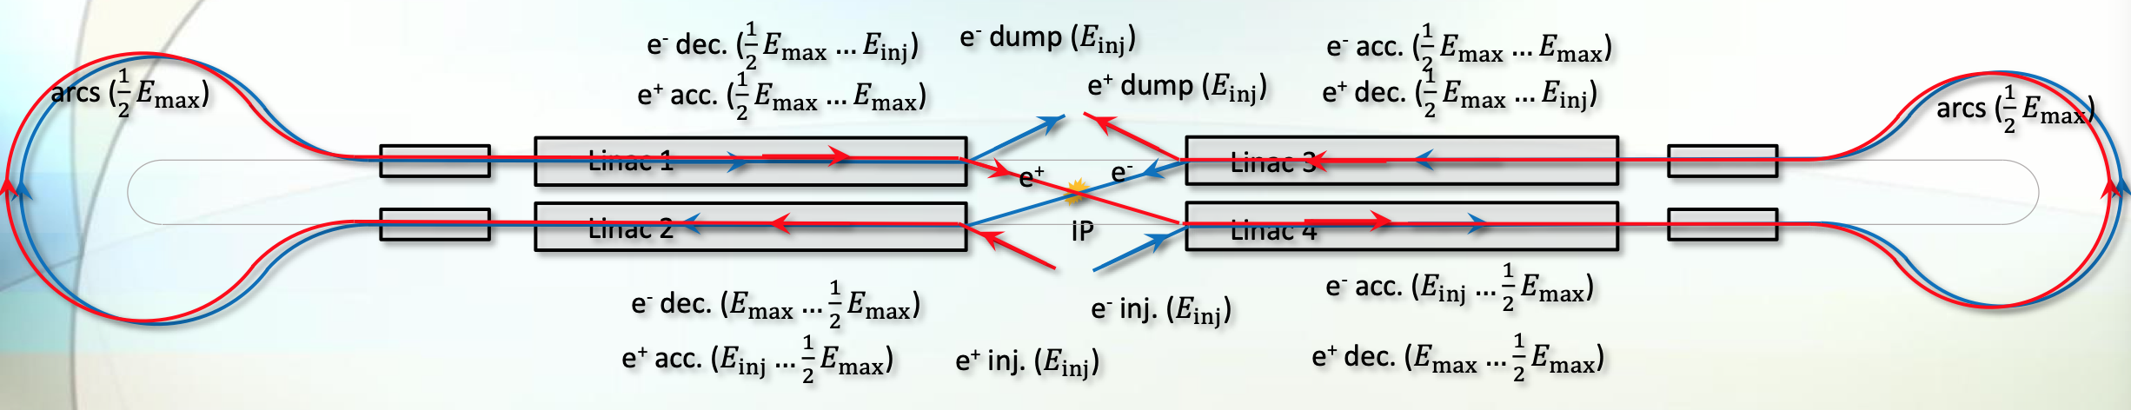
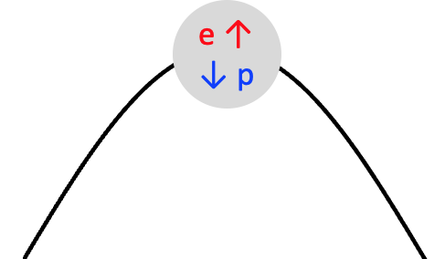
Ghost Bunches in the Linac
Each side of the IP, the linacs are split in two and joined by an Arc
Electrons and positrons are in the same bunch – one accelerating, the other decelerating
Ghost bunches do not interact electromagnetically with their environment
  No excitation of higher modes (HOMs)
  No Multi-bunch Beam Break-Up (MBBU)
Energy is transferred between electrons and positrons in each bucket
  Intra-bunch energy recovery
  A new class of Energy Recovery Linac

Slide 4
Further Opportunities – The Ghost Collider
Positrons and electrons in a single bunch are brought into collision with positrons and electrons which are also in a single bunch
This was first tried (unsuccessfully) at Orsay by Joel Le Duff and the DCI Storage Ring Team*
This was followed by several papers showing that the plasmas are in an unstable equilibrium**
All of them considered a regime where the uncompensated disruption coefficient was high (between 5 and 10) as the beams would be dumped after collision
The Ghost Collider is aiming for a smaller uncompensated disruption coefficient because the beams will be recovered after collision
The previous work indicates that this regime should be stable, which will be confirmed with simulations
* The Orsay Storage Ring Group, IEEE Transactions on Nuclear Science, Vol. NS-26, No.3, June 1979
** V. E. Balakin and N. A. Solyak, “VLEPP Beam-Beam Effects,” SLAC TRANS – 0226
D. H. Whittum and R. H. Siemann, “Neutral Beam Collisions at 5 TeV,” SLAC-PUB-7808, April 1998
J . B. Rosenzweig, B. Autin, P. Chen, “Instability of Compensated Beam-Beam Collisions,” ANL-HEP-CP—89-13
D. H. Whittum and A. M. Sessler, J. J. Stewart and S. S. Yu, Plasma Suppression of Beamstrahlung,” Particle Accelerators, 1990, Vol. 34, p 89-104

Slide 5


Bringing the Four Bunches into the IP Simultaneously
Inject electrons into a bunch which accelerates the electrons
Inject positrons into the bunch 𝜆_{Linac}/2 behind the electrons which accelerates the positrons
Introduce a chicane for the electrons between the Linac and the Interaction Region to delay the electrons by 𝜆_{Linac}/2
Do the same for the other linac
Collide with zero crossing angle
Arrows indicate change in energy
e ↑
p ↑
Linac

Slide 6
Linac and Chicane Layout
After collision, the electrons are sent through the opposite chicane to delay them by 𝜆_{Linac}/2
  Requires a total of four chicanes
  This layout returns the order of the bunches to its initial state
e4 ↑
p2 ↓
p3 ↑
e1 ↓
e1 ↑
p1 ↓
p2 ↑
e2 ↓
Linac 4
Linac 2
Linac 3
e1 ↑ p1 ↓
Linac 1
p3 ↑
e1 ↓
e4 ↑
p2 ↓
p2↑ e2 ↓

Slide 7

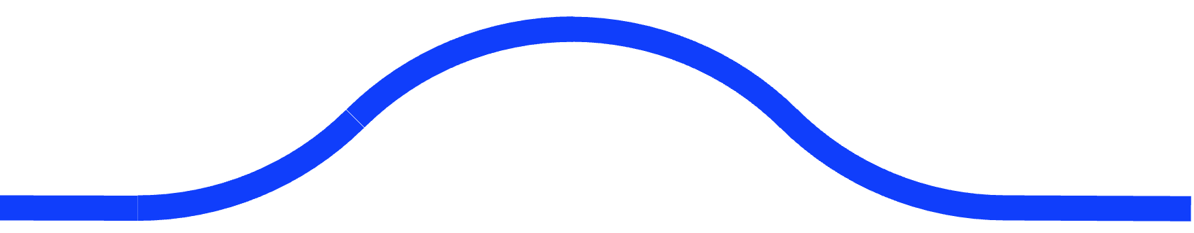


Single Linac
Ghost bunches also have no electromagnetic interaction with ghost bunches which are travelling in the opposite direction in the linac
This enables a major simplification, a single bi-directional linac on each side of the IP
  There will be head-on collisions in the linac, but the luminosity will be small with minimal loss of particles
  Electron and positrons are accelerated in both directions then decelerated in both directions
  Each linac is half the length of the ILC
SRF Linac
Chicanes
SRF Linac
Arc
Arc
IP

Slide 8

The Arcs
The shape of the Arc is a tear-drop shape which reduces the synchrotron radiation loss by 38% compared to the traditional shape
The radius of curvature of the Arc, R, is a variable to be determined by a cost optimization
Assume the Arc radius equals the LEP radius R = 3,500 m
  The bending radius ρ = 3,096 m
  Filling factor = 88%
Injection energy = 5 GeV; Maximum energy = 275 GeV
Arc Energy = 140 GeV
Synchrotron radiation loss = 8.85 x 10⁻⁵ x 140⁴ / 3,096 = 11 GeV for a full arc
Each Arc is ¾ of a full arc so synchrotron radiation loss per Arc = 8.24 GeV

Slide 9

Arc-Linac Interface
Electrons and positrons will be counter-rotating in a single vacuum chamber
They will be separated by establishing double-helix trajectories using two low-frequency RF separators at each end of the regions where electrons and positrons are counter-rotating
This configuration was successfully used in the Tevatron for many years*
p1 ↑
e2 ↓
e1 ↑
P2 ↓
Towards the Arc
Electrons
RF
Separators
SRF Linac
Horizontal
Bend
V
H
Arc
RF
V
H
e1 ↑
p2 ↓
p1↑
e2 ↓
From the Arc
Positrons
* Y. Alexahin, “Optimization of the helical orbits in the Tevatron,”
https://accelconf.web.cern.ch/p07/PAPERS/FRPMS006.PDF

Slide 10
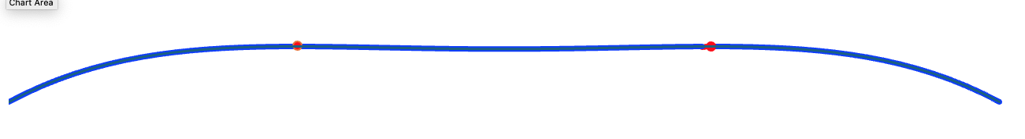
Arc Energy Replacement
Both the electrons and positrons lose energy in the Arcs
The two electron bunches in each Arc are separated by 𝜆_{Linac} /2
The two positron bunches in each Arc are separated by 𝜆_{Linac} /2
  One going to the IR, one coming from the IR
Since all the bunches lose energy in the Arcs, an RF system must accelerate both bunches
Proposed solution: RF system at 325 MHz plus a second harmonic RF system at 650 MHz, 180° out of phase
Advantage – bunches have no no energy chirp and can be decelerated without loss
Disadvantage – takes more power
  1.33 x voltage at ¼ frequency + 0.33 x voltage at ½ frequency = total of 1.66 x voltage = 11 GV/Arc

Slide 11
The Linac-Chicane Interface
To Positron Damping Ring
From Electron Storage Ring
p
e
p
RF Separators
H
V
RF Separators
RF Separators
Horizontal
Bend
e
SRF Linac
Twin-Axis
Quadrupoles
H
V
Bend
e
H
V
RF Separators
p
e
p
To Electron Damping Ring
From Positron Storage Ring

Slide 12
Chicane Design
The electrons and positrons should have the same energy at the IP, independent of whether they traversed the chicane or the straight beamline
  The chicane needs an RF system to replace the synchrotron radiation loss
There is a broad minimum total length of the chicane
Optimum is 12 km bending radius for a total length of 1.4 km
Synchrotron radiation loss = 1 GeV

Slide 13
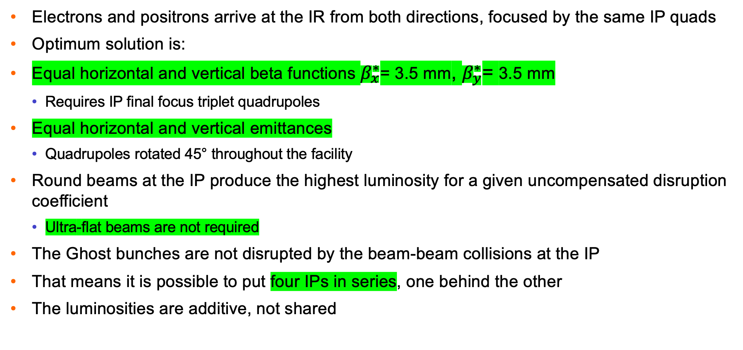
Interaction Region
Electrons and positrons arrive at the IR from both directions, focused by the same IP quads
Optimum solution is:
Equal horizontal and vertical beta functions $β_{x}^{∗}$= 3.5 mm, $β_{y}^{∗}$= 3.5 mm
  Requires IP final focus triplet quadrupoles
Equal horizontal and vertical emittances
  Quadrupoles rotated 45° throughout the facility
Round beams at the IP produce the highest luminosity for a given uncompensated disruption coefficient
  Ultra-flat beams are not required
The Ghost bunches are not disrupted by the beam-beam collisions at the IP
That means it is possible to put four IPs in series, one behind the other
The luminosities are additive, not shared

Slide 14
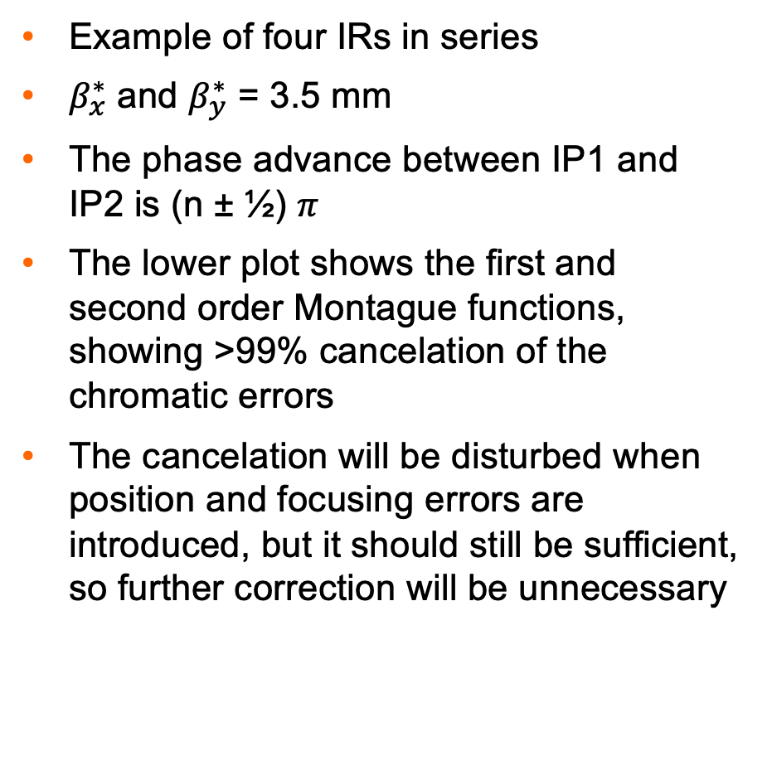
Four IPs – Unique Feature of Ghost Collider
Example of four IRs in series
$β_{x}^{∗}$ and $β_{y}^{∗}$ = 3.5 mm
The phase advance between IP1 and IP2 is (n ± ½) $π$
The lower plot shows the first and second order Montague functions, showing >99% cancelation of the chromatic errors
The cancelation will be disturbed when position and focusing errors are introduced, but it should still be sufficient, so further correction will be unnecessary
166 m

Slide 15
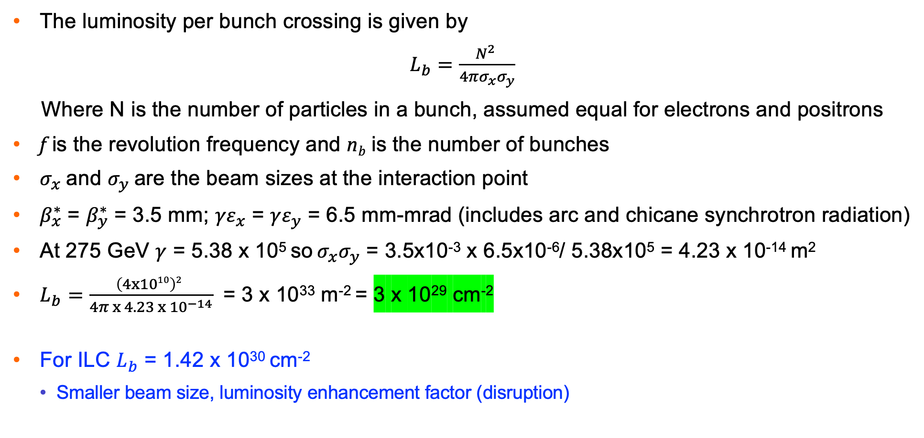
Luminosity per Ghost Bunch Crossing
The luminosity per bunch crossing is given by
$L_{b}=\frac{N^{2} }{4πσ_{x}σ_{y}}$
Where N is the number of particles in a bunch, assumed equal for electrons and positrons
f is the revolution frequency and n_{b} is the number of bunches
$σ_{x}$ and $σ_{y}$ are the beam sizes at the interaction point
$β_{x}^{∗}$ = $β_{y}^{∗}$ = 3.5 mm; ${γε}_{x}$ = ${γε}_{y}$ = 6.5 mm-mrad (includes arc and chicane synchrotron radiation)
At 275 GeV $γ$ = 5.38 x 10⁵ so $σ_{x}σ_{y}$ = 3.5x10⁻³ x 6.5x10⁻⁶/ 5.38x10⁵ = 4.23 x 10⁻¹⁴ m²
$L_{b}=$ $\frac{\left(4x1010\right)2 }{4π x 4.23 x {10}^{−14}}$ = 3 x 10³³ m⁻² = 3 x 10²⁹ cm⁻²
For ILC $L_{b}$ = 1.42 x 10³⁰ cm⁻²
  Smaller beam size, luminosity enhancement factor (disruption)
N. Phinney, “SLC: The first linear collider,”
https://www.worldscientific.com/doi/pdf/10.1142/9789814436403_0005

Slide 16
Total Power for RF
The power required is related to the train repetition rate R
  Train consists of 656 ghost bunches from an ILC-size damping ring
  The RF is pulsed at the same rate with a gradient of 32 MV/m
  The RF is equipped with FE-FRTs to reduce reflected power
Arcs and Chicanes 0.39 R MW
Linac RF 0.042 R MW
Damping Ring 13.8 MW
Cryogenics 0.66 R MW
Total 13.8 + 1.09 R MW
This does not include magnets, site power and the experimental apparatus

Slide 17
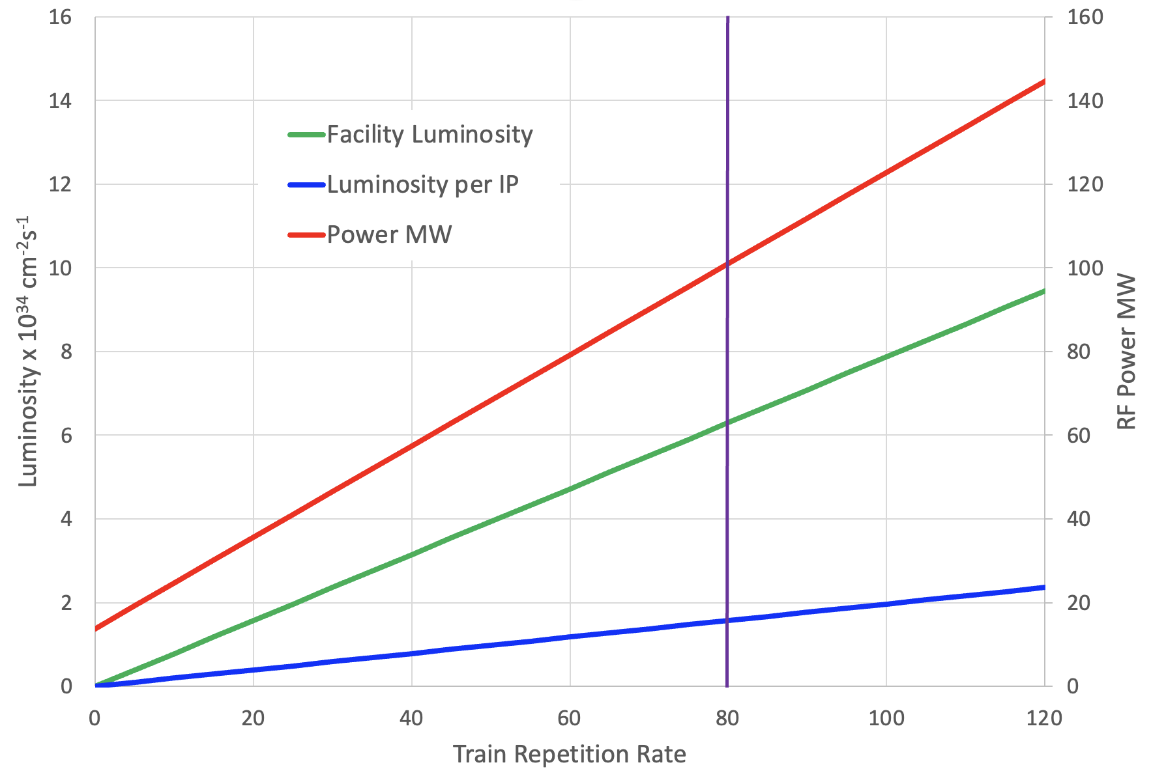
Luminosity versus RF Power
Bunch trains follow the ILC paradigm
Same damping rings as ILC
Luminosity and RF power are connected via the train repetition rate
Improvement
Remove the arcs
  Reduces energy loss
  Increases luminosity due to smaller emittance
Idea from Peter Williams

Slide 18
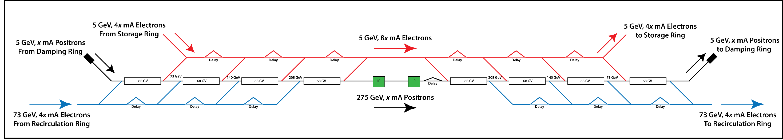
Removing the Arcs ⇒ The “Linear Ghost Collider”
Each ghost bunch comprises colliding particles of one charge, partnered with drive particles of the other
Because the companions need only have matching velocities, not energies, it is only necessary to accelerate one companion to full energy
The linac is split into n stages so the drive particles for each stage only attain an energy of 1/n of the collision energy
Colliding particles progress straight-through, never experiencing a turn-around arc
  Energy is not lost, and emittance / energy spread are not degraded
Drive particles must be recirculated in arc(s), but as SR power goes as E4 and emittance degradation as E5 , the energy loss decreases as we increase n
Example of Right-going positrons, n=4

Slide 19
Conclusions
The Ghost Collider is a viable Higgs Factory, meeting the requirements of the Linear Collider vision statement
Neutral bunches of electrons and positrons travel together in the same Linac buckets
  No excitation of higher modes (HOMs)
  No Multi-bunch Beam Break-Up (MBBU)
There is a single, bidirectional linac on either side of the IR region
The linacs are half the length of the ILC linacs
The arcs are a new shape, reducing synchrotron radiation by 35.8%
Four interaction points with the nominal luminosity
Luminosity per IP 1.6 x 10³⁴ cm⁻²s⁻¹ @ 100 MW electrical power for RF
Proof of principle solutions have been worked out for all the major components
Detailed optimization is required to validate the design
The Linear Ghost Collider may be even more efficient

Slide 20
Thank you for your attention

