Slide 1
A. D’Elia on behalf of the COLD project team:
S. Liuzzo, P.Borowiec, V.Serrière, M.Dubrulle, M.Morati, S.White, F. Ewald, N.Benoist, K.Scheidt, B.Roche, C.Benabderrahmane, G. Le Bec, R.Bourtenbourg, J.-L. Pons, D. Martin, B. Pelissier, L.Eybert, T.Brochard, C.Maccarrone, J.-L. Revol, B.Joly, Y.Gouez, H. Pedroso Marques, P.Colomp, A.Dely, F.Falaise, David Frichet, Q.Qin
International collaborators
E.Nanni, A.Dhar, W.-H. Tan, G.Aymar (SLAC),
A.Latina (CERN),
D.Alesini, F.Cardelli, A.Giribono, C.Vaccarezza, G.Silvi (LNF),
M.Andorf, J.Maxson (Cornell),
P.Craievich, R.Zennaro (PSI)
COLD Cool copper Operation Linac Demonstrator and preliminary studies for a 6GeV injector Linac at ESRF
LCWS2025, Valencia, Spain, 20-24 October 2025

Slide 2
A NEW 6GeV Linac
ESRF is presently considering a complete upgrade of our injectors with a full energy linac: limited space available, high gradient technologies could be a solution
Enable ultra-low emittance / low aperture / low gaps SR lattice design by relaxing constraint on DA.
Complete renewal of obsolete injectors providing low emittance injected beams (<1nmrad, >40 times smaller than the present injectors, <1mm bunch length >10 times shorter bunch, 0.6mA/bunch)
Demonstrate state-of-the-art compact technology for users facilities injectors
Enable transparent on-axis off-phase* accumulation with ultra short injected beam (with ultra-fast kicker).
Enable new science making use of the linac electron beam (short pulse e⁻, FEL)
60nm x 17mm
1nm x 1mm
x
Booster beam
Linac beam
t
x
stable space
2ns, 2mrad kicker
stored beam
t
on-axis,
off-phase
*M.Aiba: https://journals.aps.org/prab/abstract/10.1103/PhysRevSTAB.18.020701
standard off-axis, on-energy

Slide 3
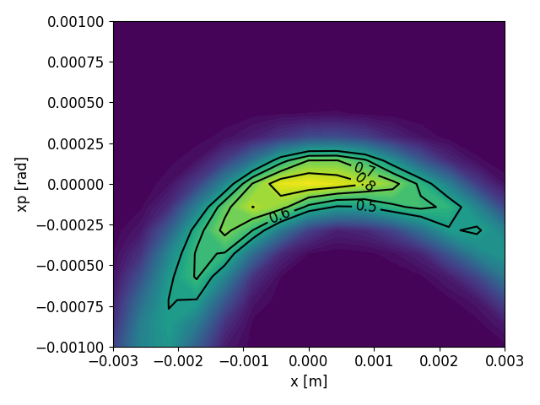
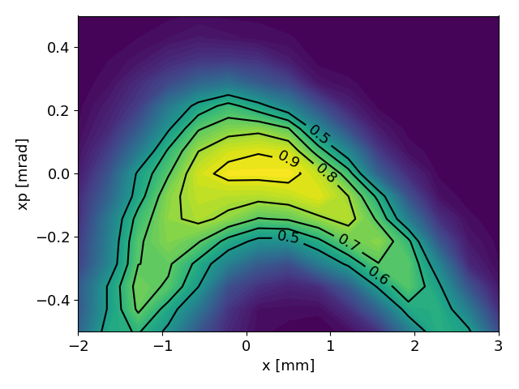
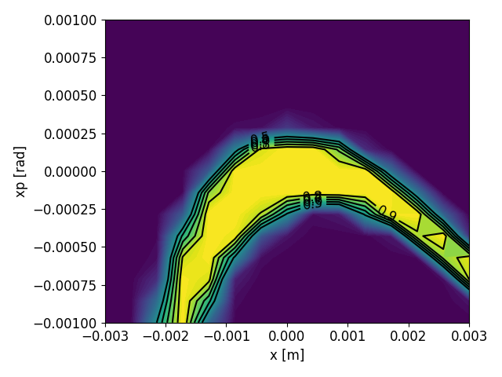
Inj. Eff. in SR with 6GeV linac beam properties
A. Sauret, PhD student, Beam Dynamics group
Bunch length = 20mm
60/30 nm.rad
Peak I.E. = 82%
Bunch length = 20mm
27/54 nm.rad
Peak I.E. = 92%
Bunch length = 2mm
1/1 nm.rad
Peak I.E. = 99.9%
Booster (2025)
Booster (upgrade)
6GeV LINAC
Normal conditions beam at -8.mm

Slide 4
Injectors
upgrade
SR Injection section
improvement
Booster
refurbishment
Linac
refurbishment
NEW
Linac
Long-term
COLD
started
✓
5 M€
Replace existing injectors with a full energy injector linac
Higher injection efficiency, lower injection perturbation, enable/facilitate future SR upgrades
6GeV + margin
> 600 pC (single bunch)
< 1 nm.rad at SR injection
< 0.1 % energy spread
< 1 mm bunch length
> 4 Hz repetition rate
Bunch spacing 2.8ns (in the SR)
Fits on site (maximum 180m)
As low energy consumption as possible
User facility grade :
Reliability
Reproducibility (turn on 1 month later and it works as before)
Maintainability easy to repair or operate with failing component for long term
FEL option to be studied
Advanced
✓
3 M€
Non-linear injector kicker
Transparent injections
Maintain injection efficiency
Advanced
design
✓
Procurement
✓
0.5 M€
1.5 M€
Lower natural emittance
Higher injection efficiency in SR
Higher extraction efficiency
More reliability
Modernization
Higher energy
Short term

Slide 5
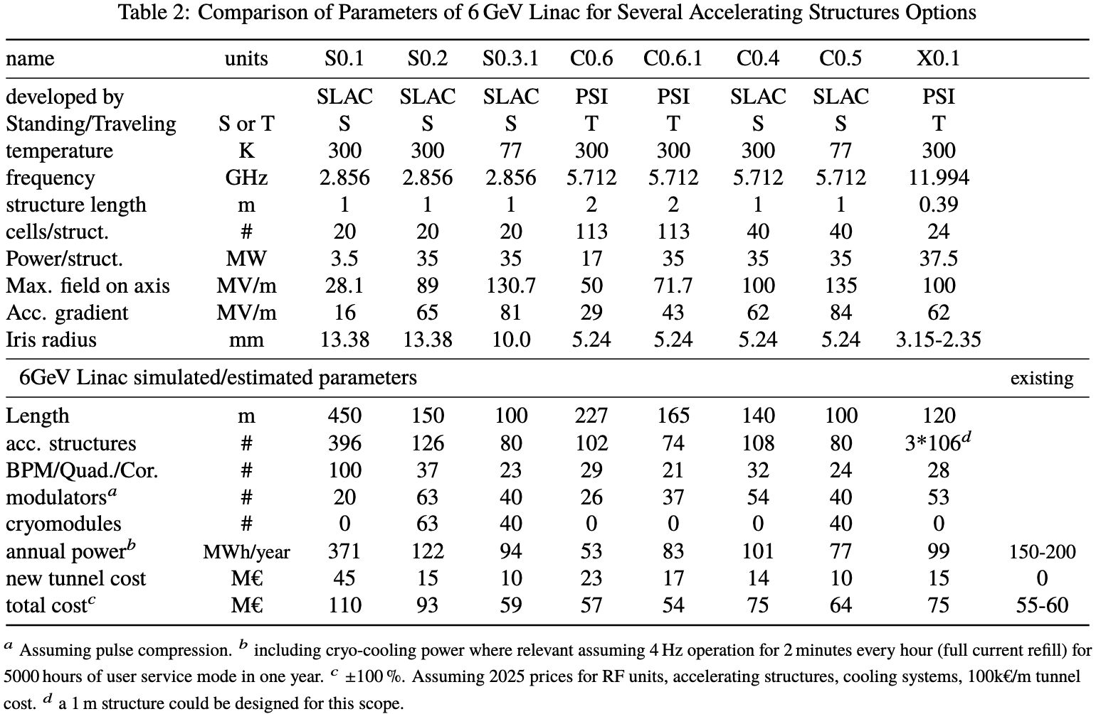
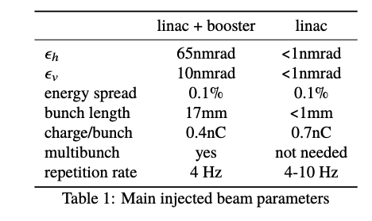
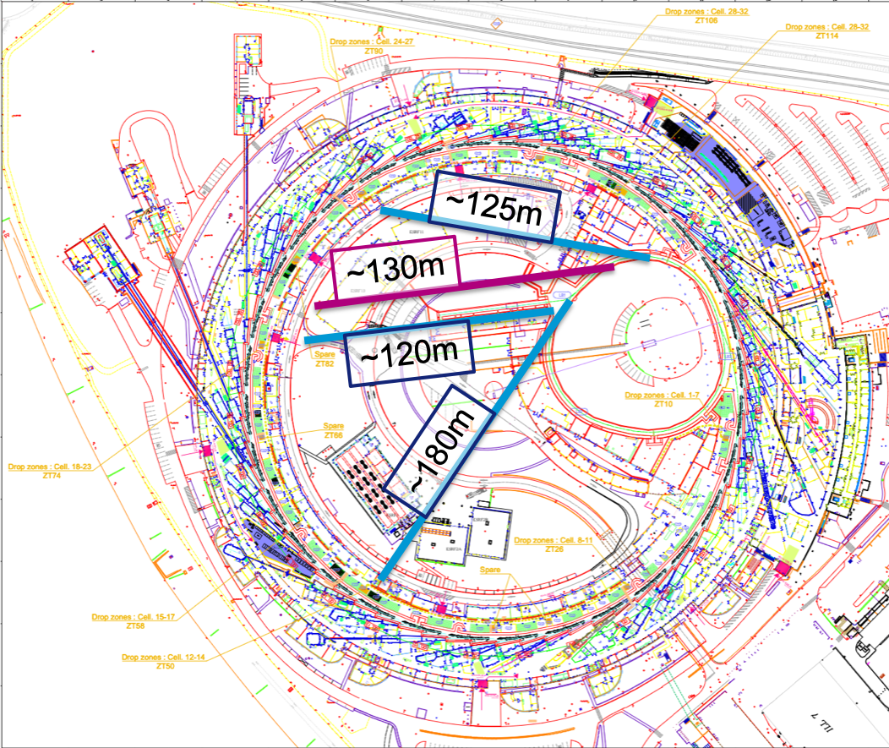
6GeV full energy LINAC: better beam, less consumption, same cost
77
Fits on site
62
Cost estimates compatible with Compact Light cost estimates.
X ”pushed” design
X High cost
x25 = 100Hz 6GeV FEL power
V BEST SOLUTION
Lowest consumption

Slide 6
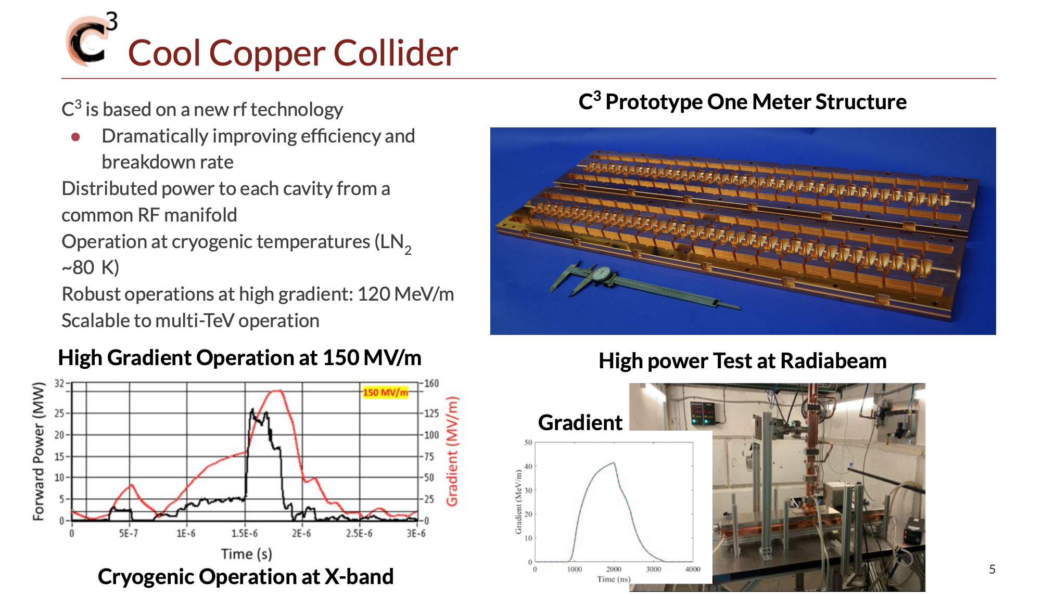

https://arxiv.org/abs/2203.09076
E.Nanni, SLAC, IPAC, Venice, 2023

Slide 7
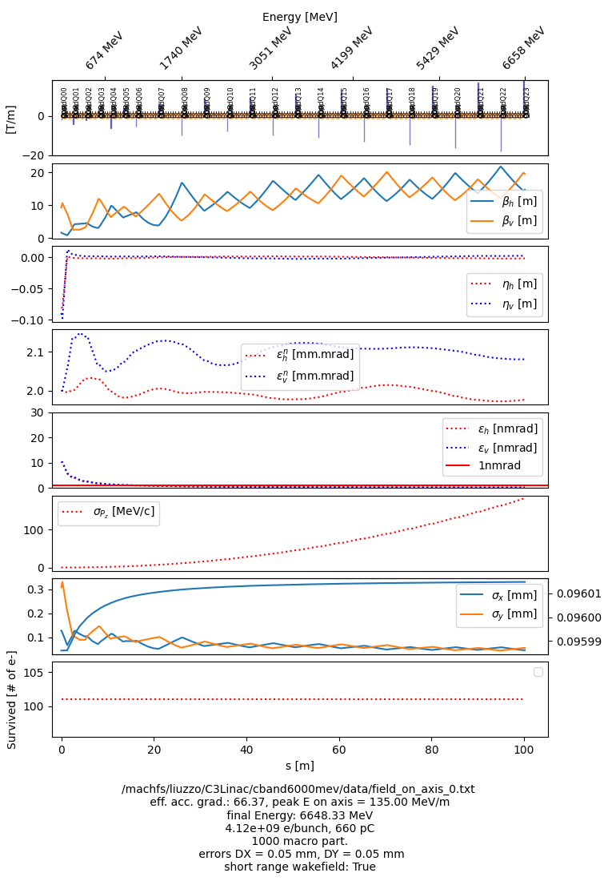
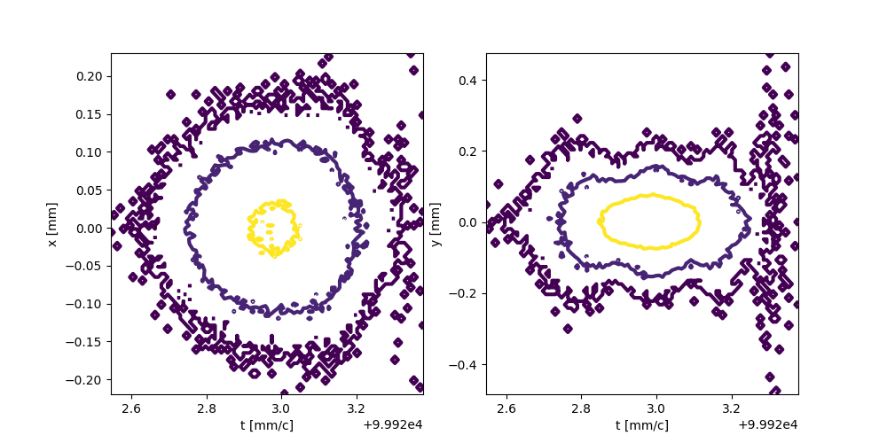
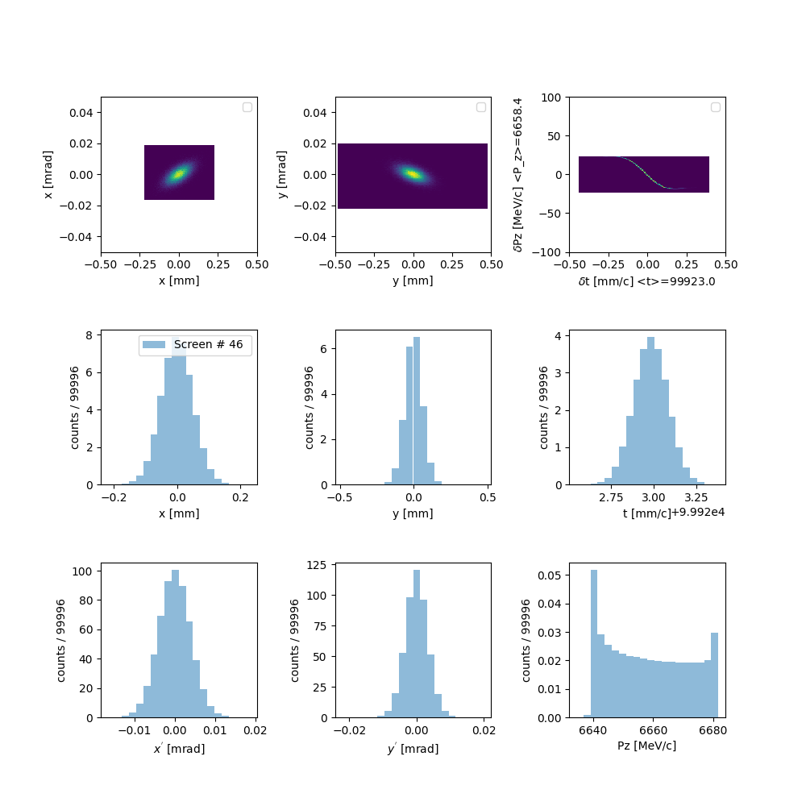
C0.5: Cband cold 35MW
Less acc. structures
Less power overall
Less magnets
Less energy spread (0.06%)
Less building
Shorter (100m)
Needs LN₂ cooling (77K)
Starting conditions
2mm mrad
0.5ps
100MeV

Slide 8
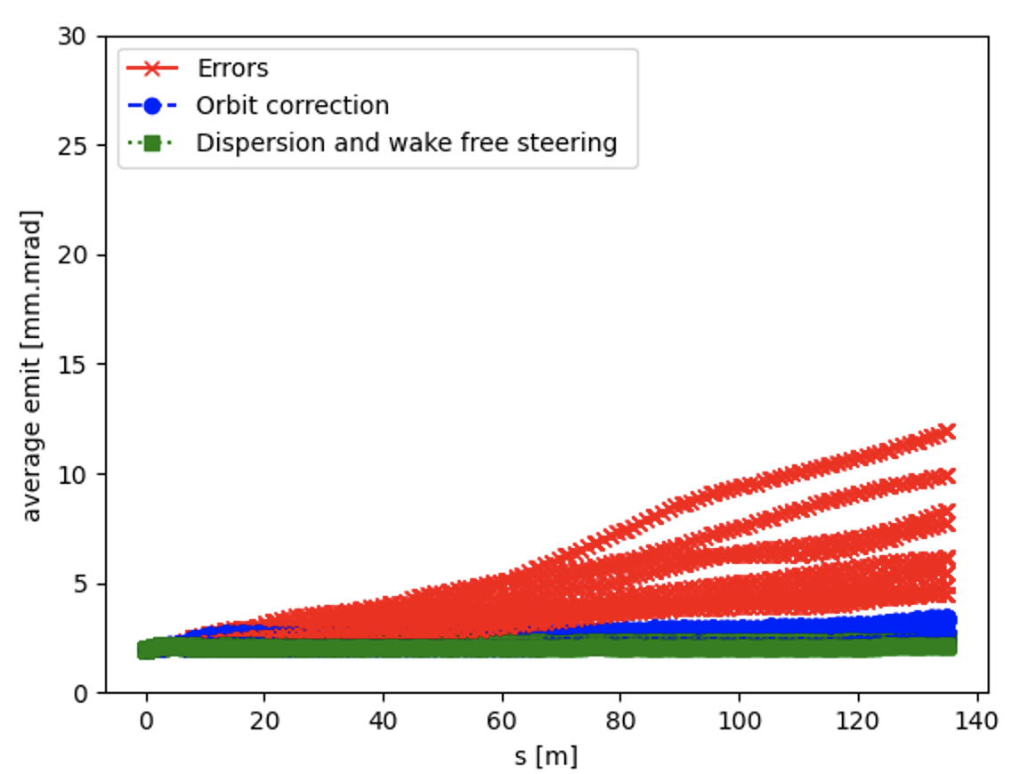
Error Studies
50 um alignment:
RF
BPM
Quadrupoles
1 deg random phase error among structures

Slide 9
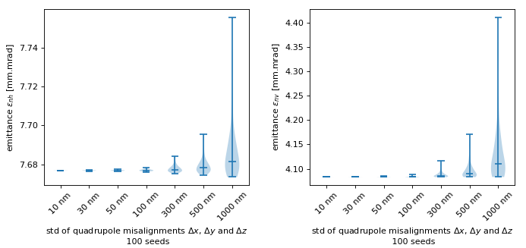
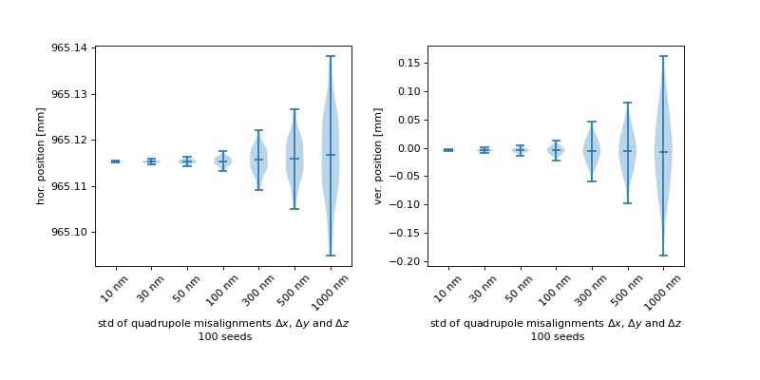
Errors sensitivity: quadrupoles
15 nanometers for C³ collider
Error sensitivities are very forgiving. ~1% emittance growth for 1 micrometer random errors (vibrations)
Since emittance is not critical, we must check also corresponding beam position jitter amplitude that could harm later transport chain and finally injection efficiency.
Plot style and analysis inspired from Wei-Hou Tan et al., Emittance Preservation in the C3 Main Linear Accelerator, SLAC, submitted for publication

Slide 10
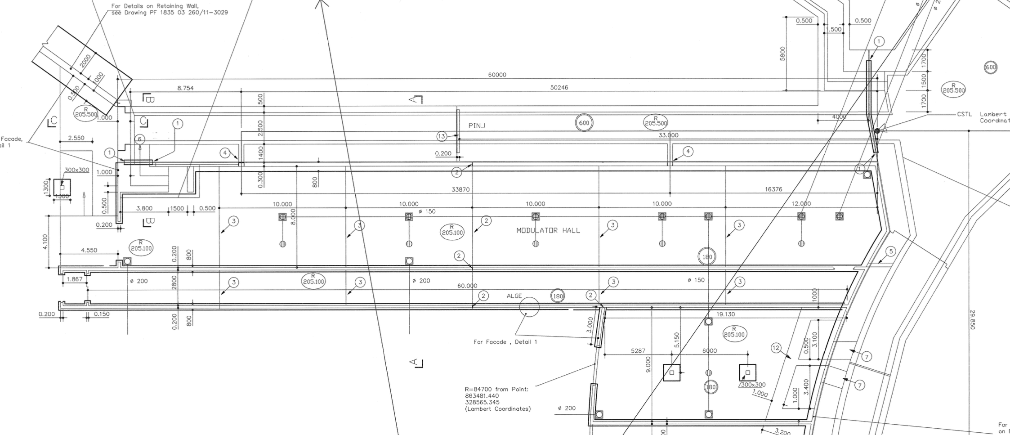
Space available
~0.5GeV C³ demonstrator could fit in the empty tunnel and allows independent EBS operation
60m long tunnel
✓
Safety
✓
Empty tunnel space 40m
Present linac 19.5m
The empty tunnel space will be used for conditioning of RF structures (S-Band, C-band, …), test of diagnostics, training of personnel with high-power, pulsed RF, UHV, laser technology…

Slide 11
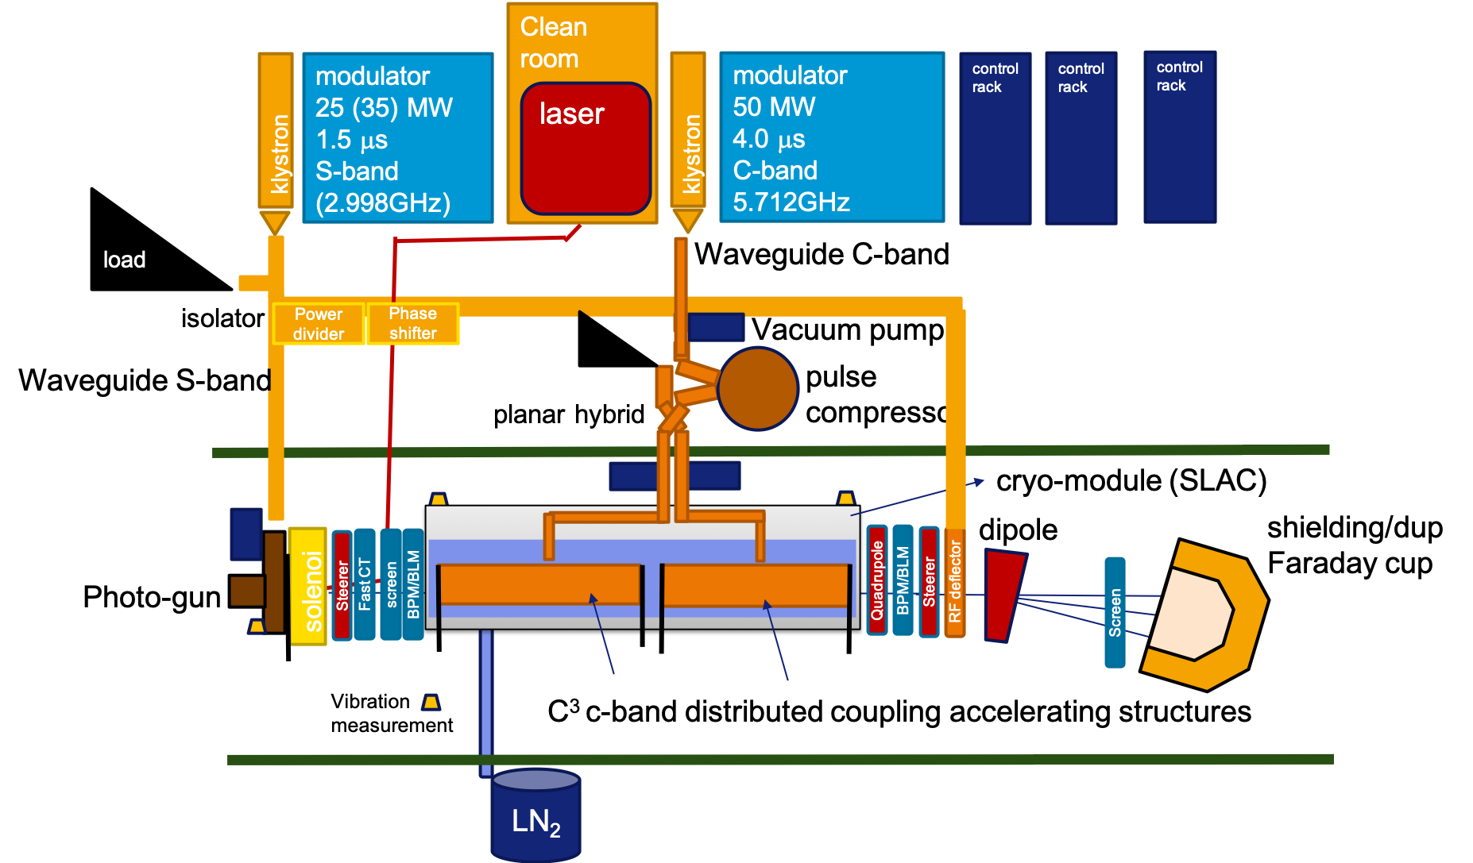
COLD
C^{2 cold copper}
Operation
Linac
Demonstrator
A demonstrator to prove
high gradient cryogenic accelerating structures
for users facility grade operation
at low repetition rate.
The pre-injector of a new 6GeV linac.

Slide 12
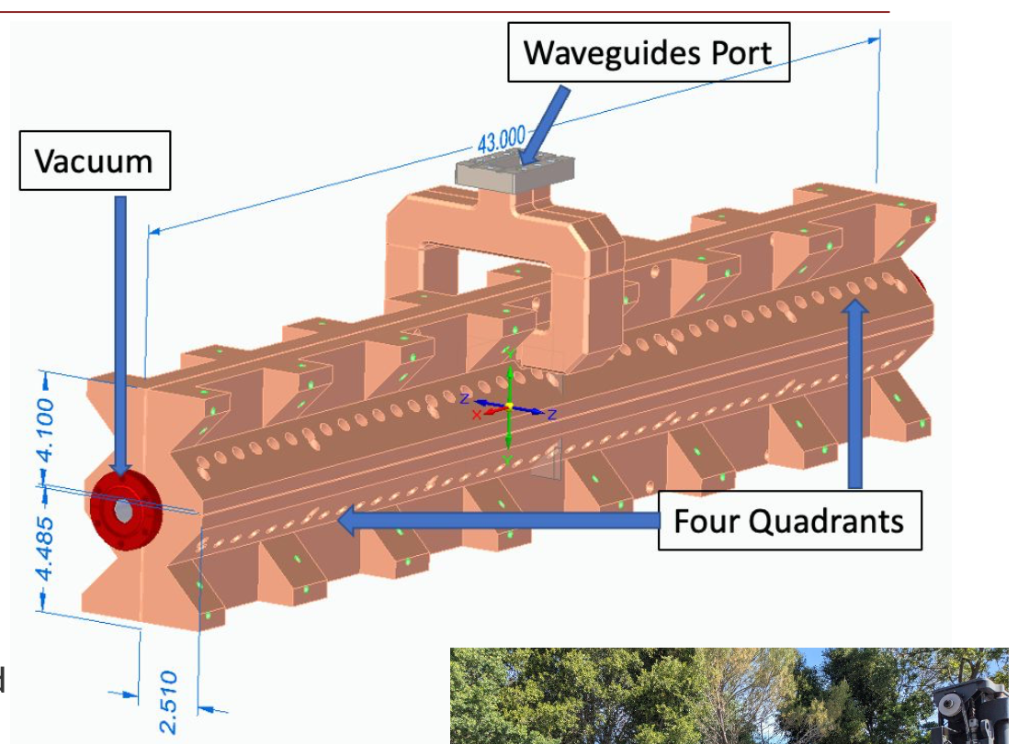
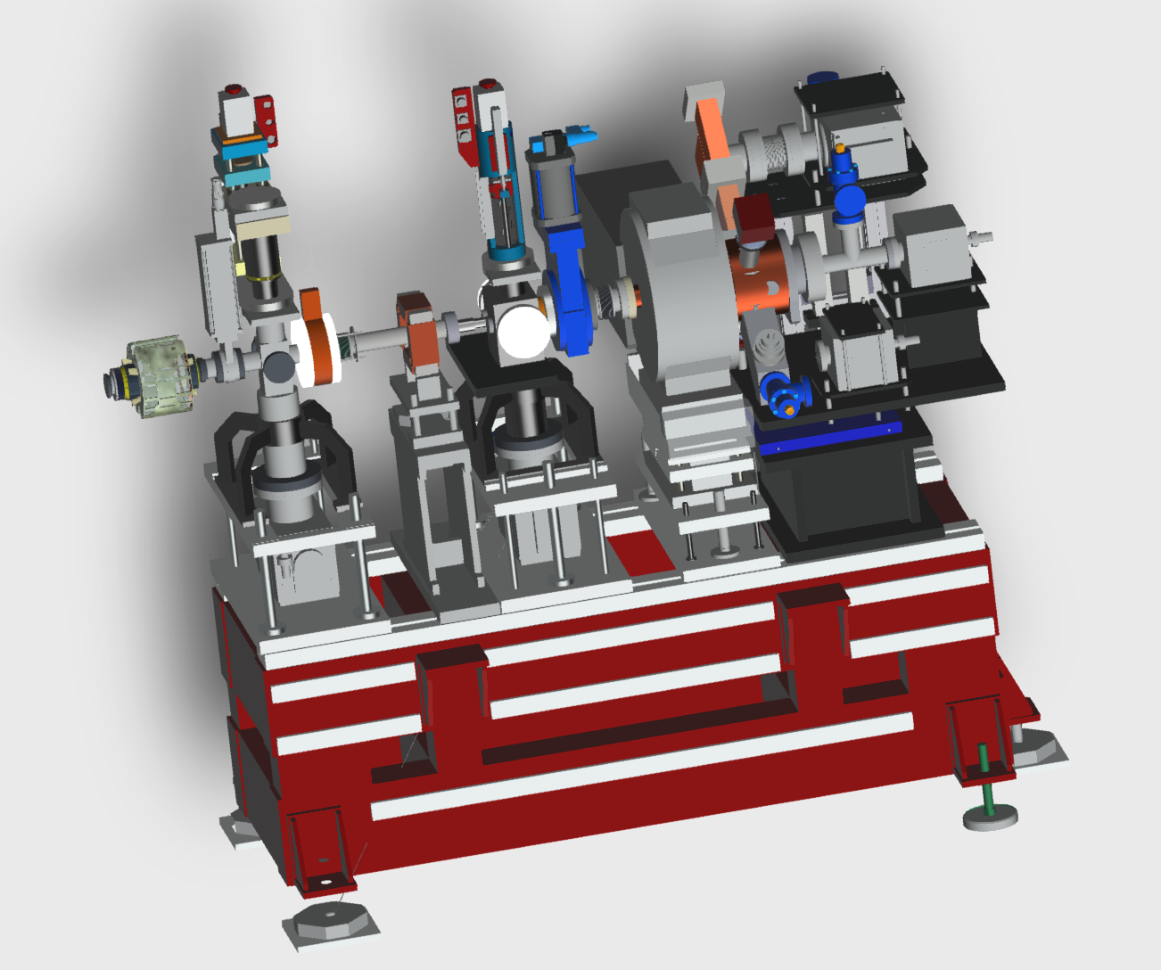
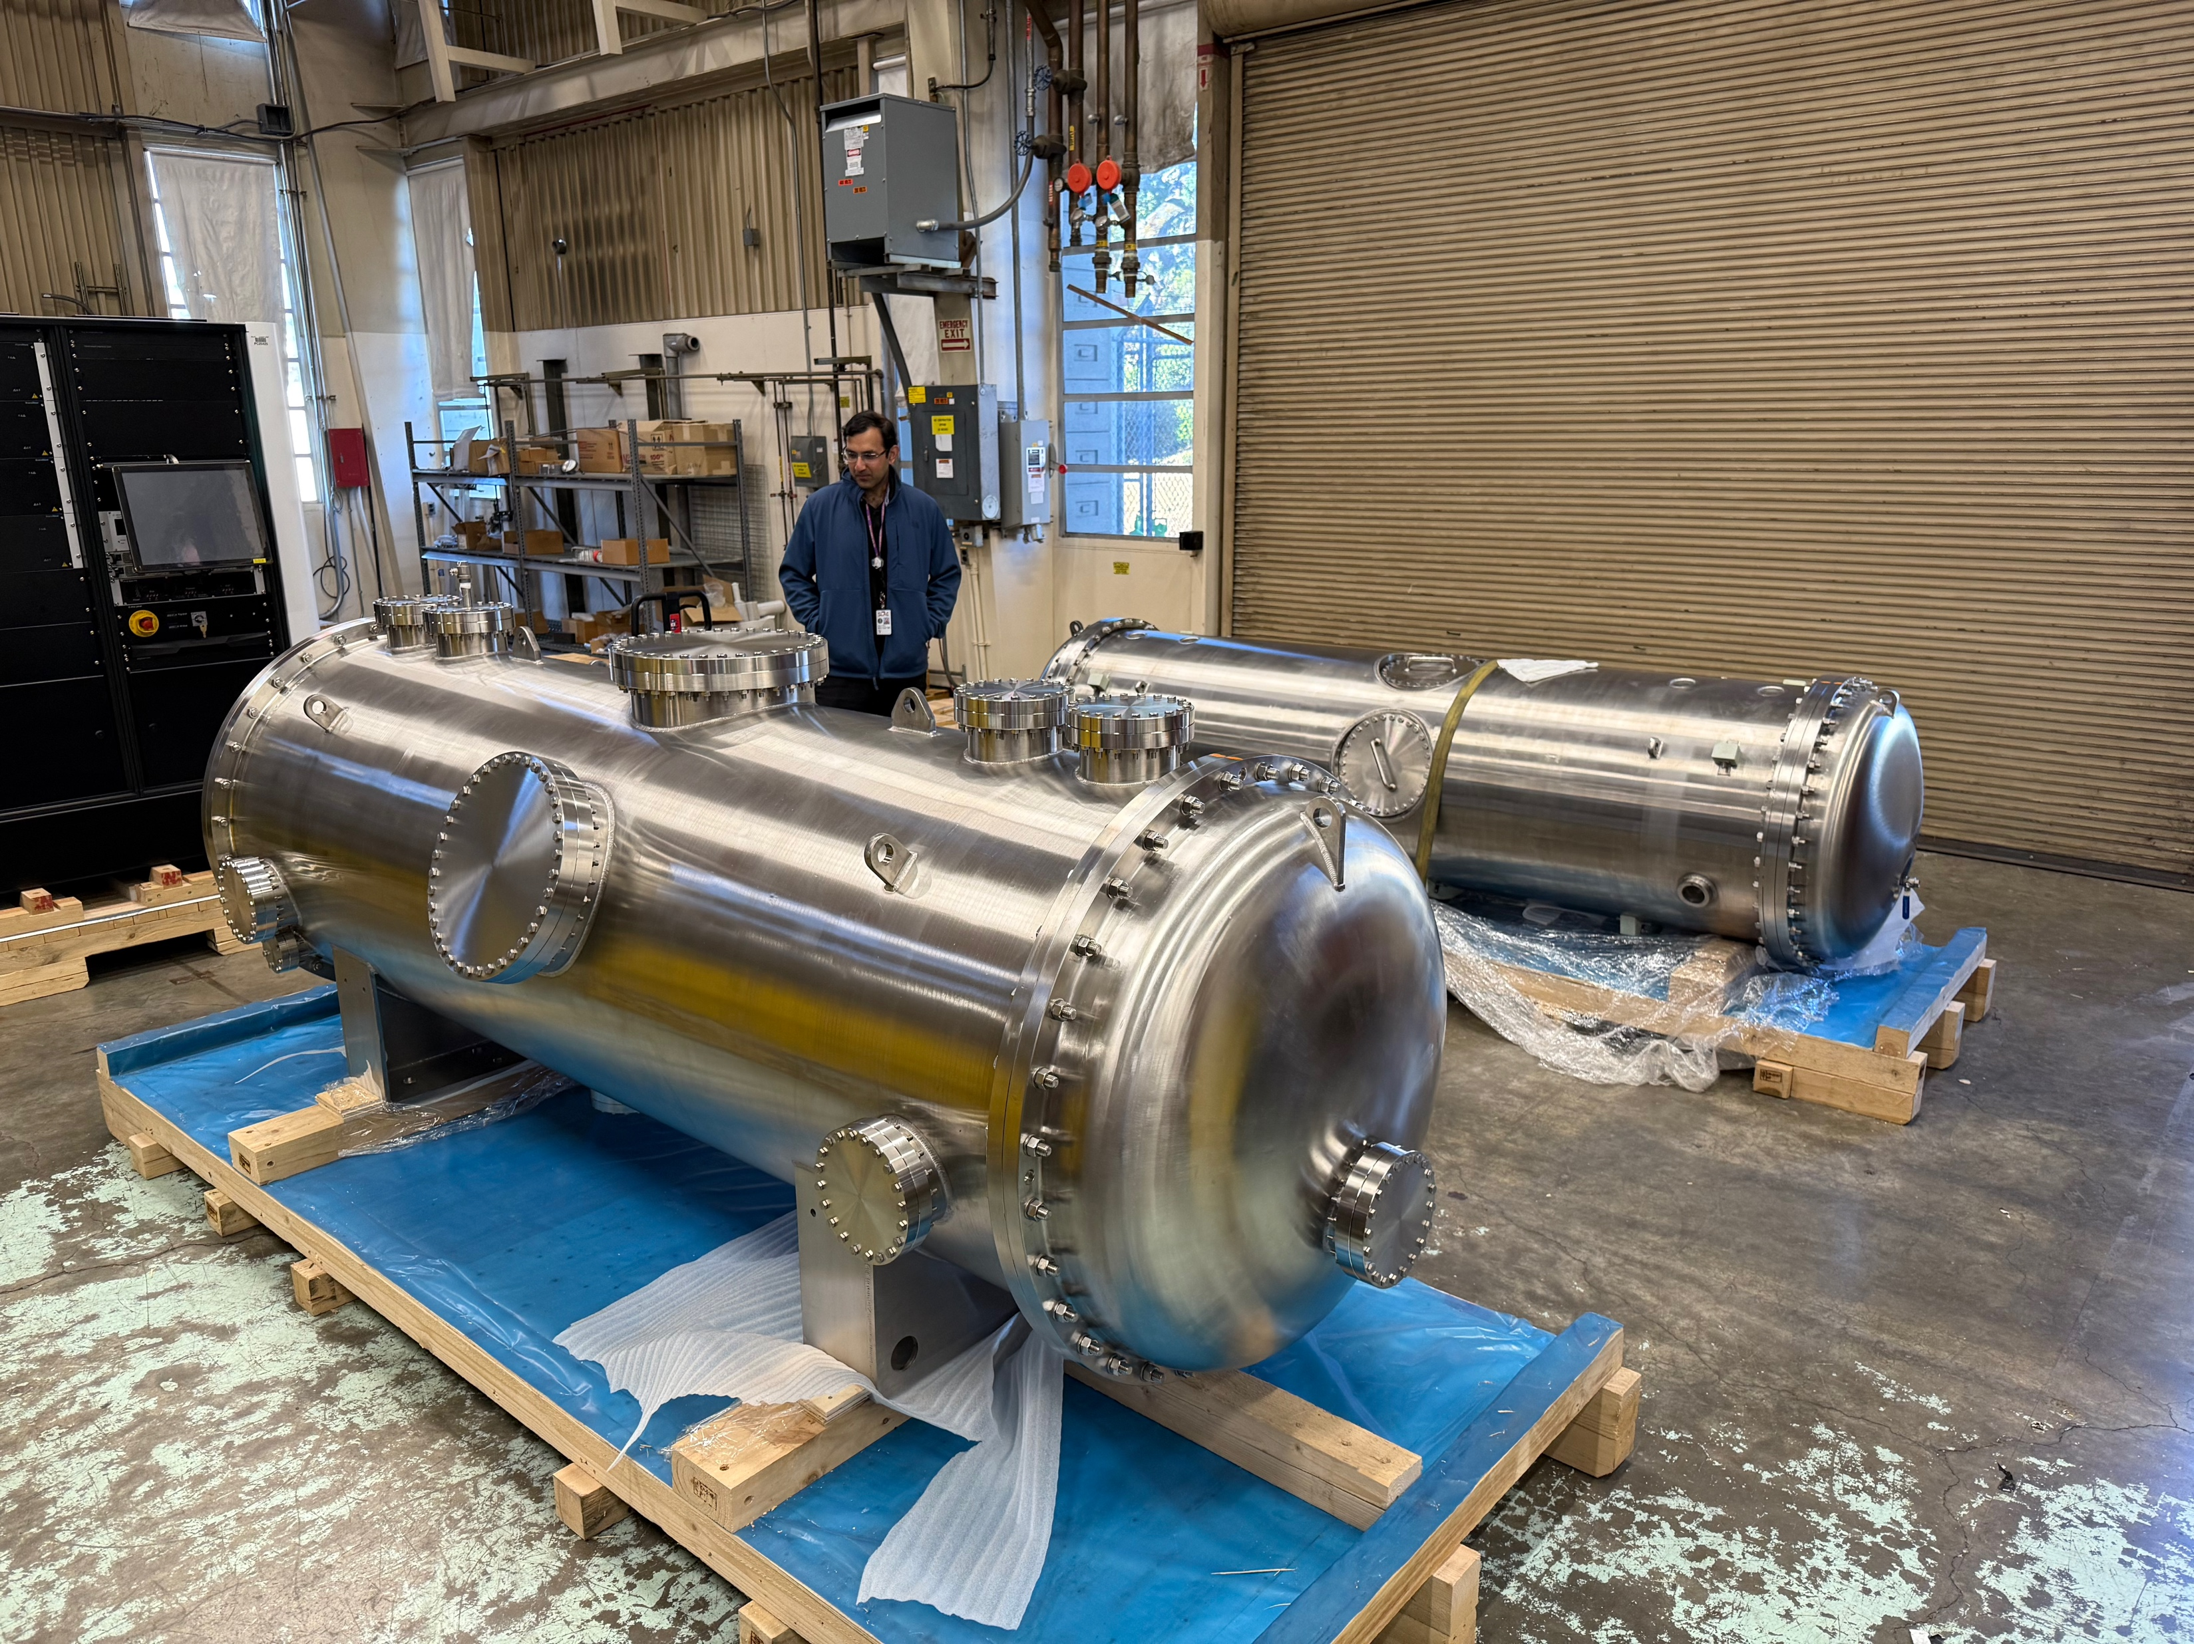
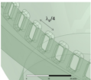
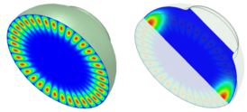
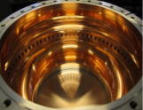
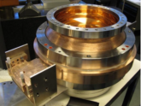
INFN-LNF SPARC (or CLEAR) photo-GUN:
Enabling technologies available from the international collaborators
SLAC distributed coupling standing wave cryogenic accelerating strucutres and cryomodule
high gradient (135MV/m)
Low breakdown rates at 77K
high charge,
small emittance, short pulse length
PSI: Pulse compression
CERN: simulation tools (RF-Track)
High quality factor C-band RF pulse compressors
CORNELL: FEL options

Slide 13
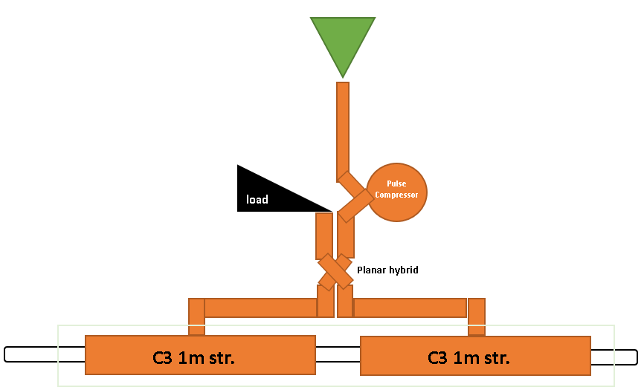
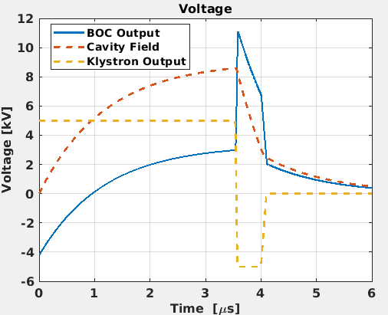
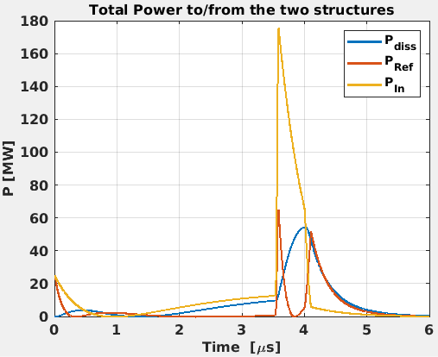
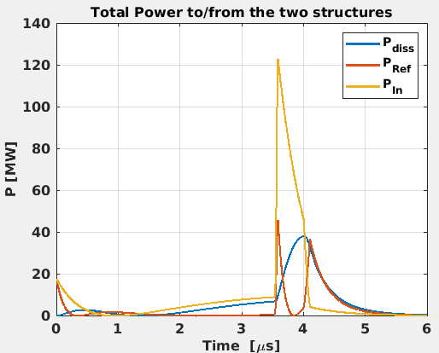
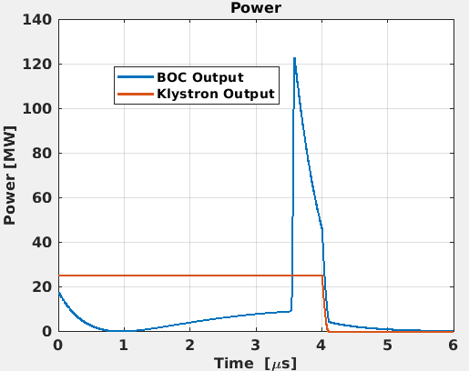
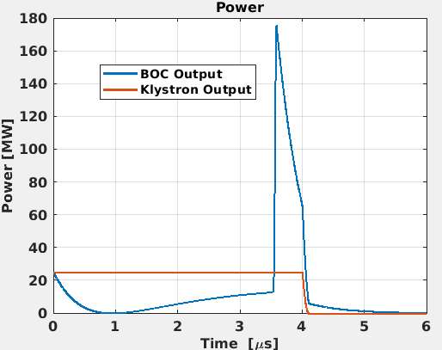
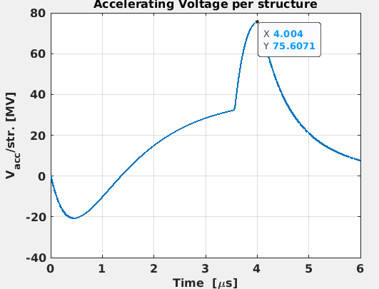
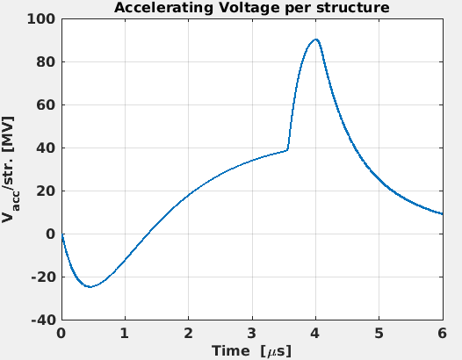
Can we reduce the number of klystron?
Freq. (GHz) | 5.712
Pin (MW) | 25
Pulse length (us) | 4
BOC
Beta | 9.4
Q0 | 220000
Acc. Structure
Beta | 2
Q₀ | 22500
Rsh (Mohm/m) | 300
42MW/3μs exists, 50MW/4μs is possible according to CANON considering our rep. rate of 4Hz
No Power reduction
-30% in power applied at the output of the BOC
No Power reduction
(PSI-BOC)
30% of power reduction at the output of the BOC to take into account WG losses and some klystron power margin.
A 50MW klystron, 4us pulse length with PSI-BOC could feed 2 cryomodules (4 x C3 structures) to get 75/80 MV/m
Thus reducing the # of RF-units needed. ~50 Meuro instead of 64
No Power reduction

Slide 14
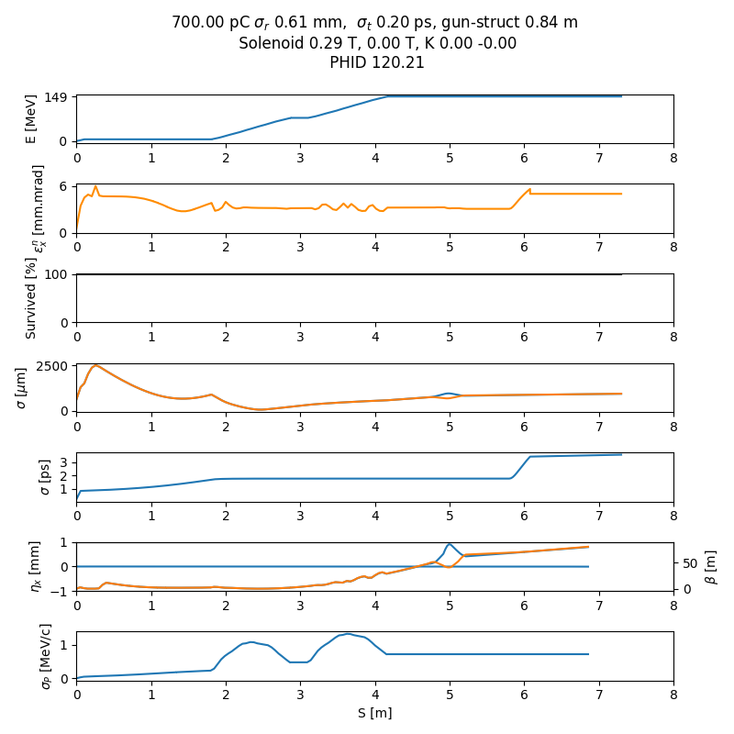
Initial part of the linac, space charge dominated (up to 150MeV) = COLD setup
Simulated particle emission
Space charge
Diag. section
Acc. struct.
in cryomodule
Diag. section and beam dump
gun
700pC
SPARC 3GHz gun
Cu cathode
120 MV/m
σ_{r} = 0.6 mm (uniform)
σ_{t} = 200 fs (gaussian)
B_{z} = 0.29 T
E_{z} C band = 135.0MV/m
~1 m drift for diagnostics
5.5 mm.mrad , 1.6 ps
desired: ~5mm.mrad, 0.5ps

Slide 15
Layout for High power RF tests, dark currents measurement, diagnostics/dump tests
2027
Not to scale
Neutron monitor
Not to scale
For energy
shielding
Faraday cup
stripline
SCREEN
BLM
BPM
gun
Accelerating structures
buncher
5.8m RI section
Dipole
shielding
shielding
shielding
RF deflector
https://doi.org/10.1016/j.nima.2006.07.050
BPM
HV corrector
Vaccum valve
Quadrupole
Faraday cup
SCREEN
Quadrupole
Quadrupole
Faraday cup
Faraday cup
bellow
bellow
BLM
For emittance with quadrupole scan
328 cm
35MW
Neutron monitor
50MW
1x 35MW S-band RF-unit
50 cm
1x 50MW C-band RF-unit
Profit of the installation to test spare acc. section with beam.

Slide 16
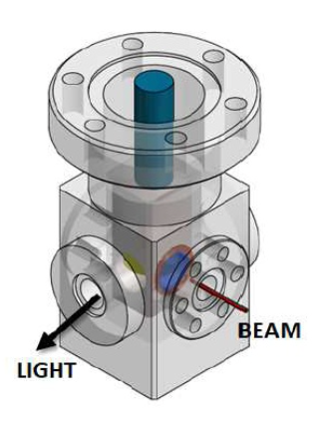
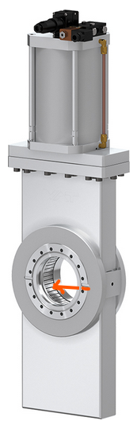
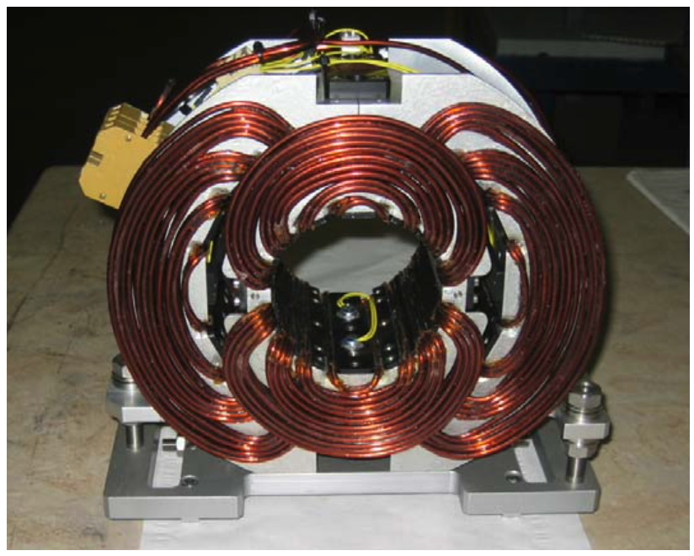
Electron Beam line Layout COLD Phase 1: 150MeV (170MeV authorization)
2029
A.Cianchi: https://jacow.org/e08/papers/MOPC068.pdf
L.Badano: https://jacow.org/d07/papers/TUPC11.pdf
Not to scale
Neutron monitor
For energy
on movers
shielding
on movers
Faraday cup
sparc-mm-06/001
From Compact Light CDR
stripline
SCREEN
destructive
stripline
stripline
BPM
Acc. structures
GUN
SCREEN
BPM
shielding
Vaccum valve
BPM
Vaccum valve
SOLENOID
HV corrector
Laser input
Current transformer
3xQuadrupole
Dipole
BPM
RF deflector
https://doi.org/10.1016/j.nima.2006.07.050
HV corrector
SCREEN
Faraday cup
bellow
bellow
BLM
Neutron monitor
For emittance with quadrupole scan
~3.9m
laser optics table
Neutron monitor
GUN SECTION
1x “6GeV linac module”, prototype
DIAGNOSTICS/DUMP SECTION
35MW
25MW
PC
1x 50MW C-band RF-unit

Slide 17
Shorter 6GeV linac unit 300MeV module
Fits on ESRF site
on movers
Neutron monitor
on movers
on movers
stripline
stripline
Neutron monitor
stripline
328cm
278cm
278cm
Acc. structures
Acc. structures
Acc. structures
Acc. structures
BPM inside quad
BPM inside quad
Quadrupole
Compact Vaccum valve
Quadrupole
screen
BPM inside quad
Quadrupole
Compact Vaccum valve
bellow
bellow
bellow
bellow
bellow
bellow
bellow
50MW
PC
50MW
PC
Screen
7.8m
5.93 m
Ideal 5.70 m
6.444 GeV in 170m, 21 x 7.8m modules
6.159 GeV in 131m, 21 x 5.93m modules
4mm.mrad, ~400pmrad@6GeV
5.6mm.mrad, ~500pmrad@6GeV
0.19% energy spread
0.18% energy spread
0.5mm bunch length
0.5mm bunch length

Slide 18
Electron Beam line Layout COLD Phase 2: 300 MeV (325MEV authorization)
2030
A.Cianchi: https://jacow.org/e08/papers/MOPC068.pdf
L.Badano: https://jacow.org/d07/papers/TUPC11.pdf
Not to scale
Optimized length
Neutron monitor
Screen or valve alternating
For energy
Neutron monitor
shielding
on movers
on movers
on movers
Faraday cup
sparc-mm-06/001
From Compact Light CDR
stripline
SCREEN
destructive
stripline
stripline
stripline
BPM
SLAC
ESRF
Acc. structures
Acc. structures
GUN
Dipole
BPM
shielding
SCREEN
BPM
RF deflector
https://doi.org/10.1016/j.nima.2006.07.050
Vaccum valve
BPM
Vaccum valve
SOLENOID
HV corrector
Laser input
HV corrector
Current transformer
3xQuadrupole
BPM inside quad
Quadrupole
Compact Vaccum valve
SCREEN
Faraday cup
bellow
bellow
bellow
bellow
Neutron monitor
For emittance with quadrupole scan
~3.9m
~3.1m
laser optics table
Neutron monitor
GUN SECTION
1x “6GeV linac module”, prototype
1x “6GeV linac module”, the #1
DIAGNOSTICS/DUMP SECTION
35MW
50MW
PC
1x 50MW C-band RF-unit

Slide 19
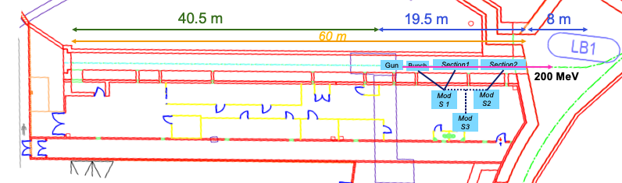
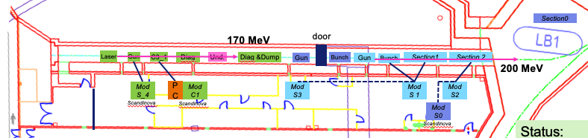
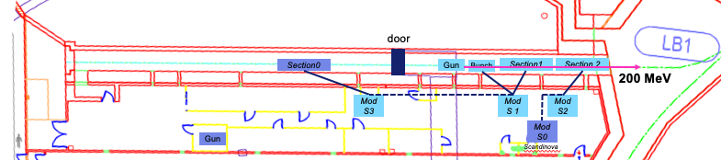
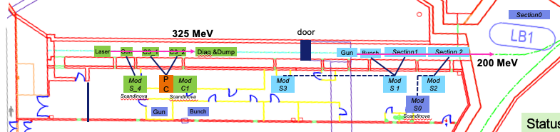
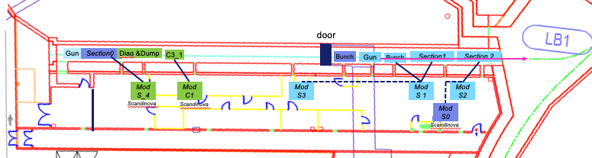
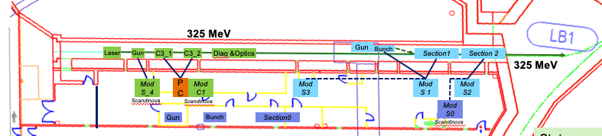
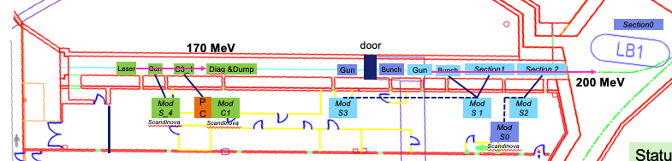
Installation in the tunnel
2030
(option) Proposed to install an undulator → WP12
2025
2030
2 cryomodules (1 from SLAC and 1 ESRF)
Phase 2
2026
Mod
S_4
2027
High power RF tests + beam in section0
Beam to ESRF booster and old linac as spare
135 MeV
2031
Phase 3
2029
Beam in C³ acc. structures.
Phase 1
2032-35
6GeV Linac construction during shutdowns and commissioning during USM
2035
2 month shutdown to install new Transfer line linac to SR and commission new injection
Take decision to continue or not toward 6GeV linac

Slide 20
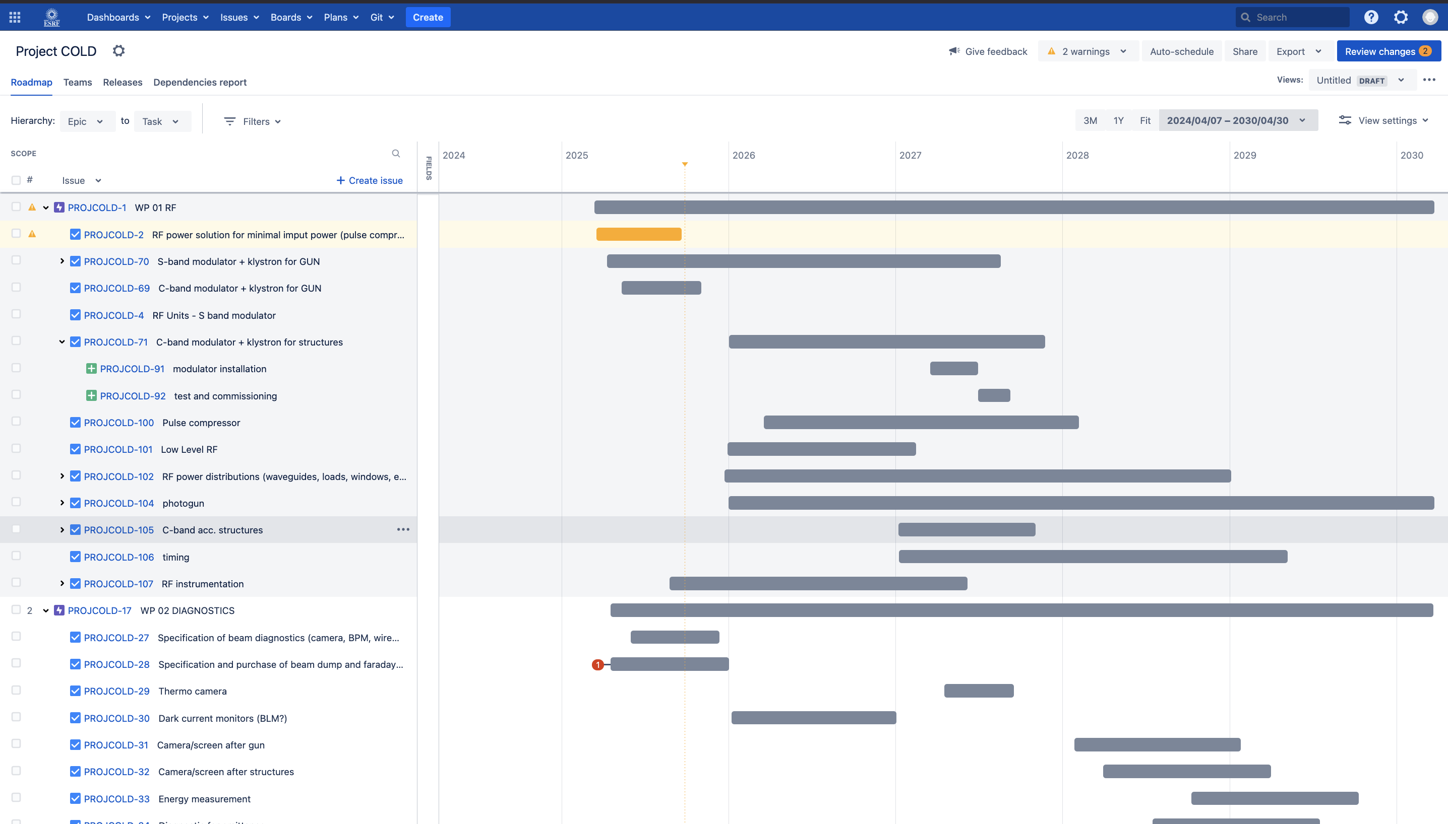
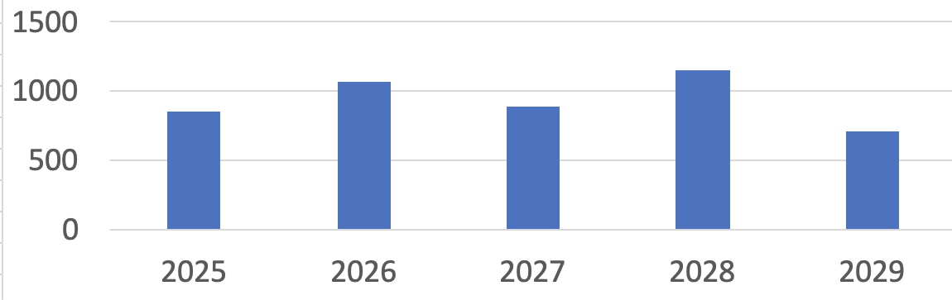
Planning
Financial profile and budget codes are set up
High power RF measurements
Beam
Diagnostics, waveguides, laser, acc.structures
Photogun,
Pulse compressor
S-band RF unit
C-band RF unit,
instrumentation
A planning (12 WPs, ~150 tasks/subtasks) including resources and following an almost flat financial profile is set up with the available tools (excel mainly). A more advanced version will be set up with Microsoft Planner
WP-01 RF
WP-02 Diagnostics and Laser
WP-03 Vacuum
WP-04 Mechanical Engineering
WP-05 infrastructure
WP-06 Operation
WP-07 Controls
WP-08 Alignment
WP-09 Safety
WP-10 magnets and power supplies
WP-11 beam dynamics
WP-12 Photons

Slide 21

RF
S-Band RF-unit CFT performed. Provider selected.
COLD photo-gun RF unit.
Fully compatible (identical) to the new RF-Units purchased for the present linac refurbishment.
In case COLD project is delayed, this equipment can be used for USM operation.
First component of COLD project purchased in 2025

Slide 22
COLD project risks
 | low | moderate | high | 6GeV show stopper | Impact USM
Lack of Human resources
Collaboration contracts / Amendments not established in time
Gradient not reached
Low reliability
Low repeatability
Low maintainability
Lack of financial resources
Pulse compression not reached
Module > 5.9m
Current not reached

Slide 23
Conclusions
To upgrade the ESRF injectors a full energy 6GeV linac is considered.
The shortest, cheapest and less consuming solution is a cryo C-band distrib. coupling acc. structure
High gradient technology leads to smaller footprint injector, thus reducing costs and fitting on site.
The new injector will consume likely a factor 2 less than the present one.
The beam properties are being studied in presence of errors. Further studies are being pursued.
Smaller iris apertures (higher gradients) seem to be acceptable.
50 micrometer static alignment errors can be corrected easily.
Up to 1 micrometer amplitude vibrations are acceptable.
All components exist (no R&D needed). COLD project started in April 2025 will prove the technology readiness and build the competences needed.
100m
~56M€
50% of present
77K

Slide 24
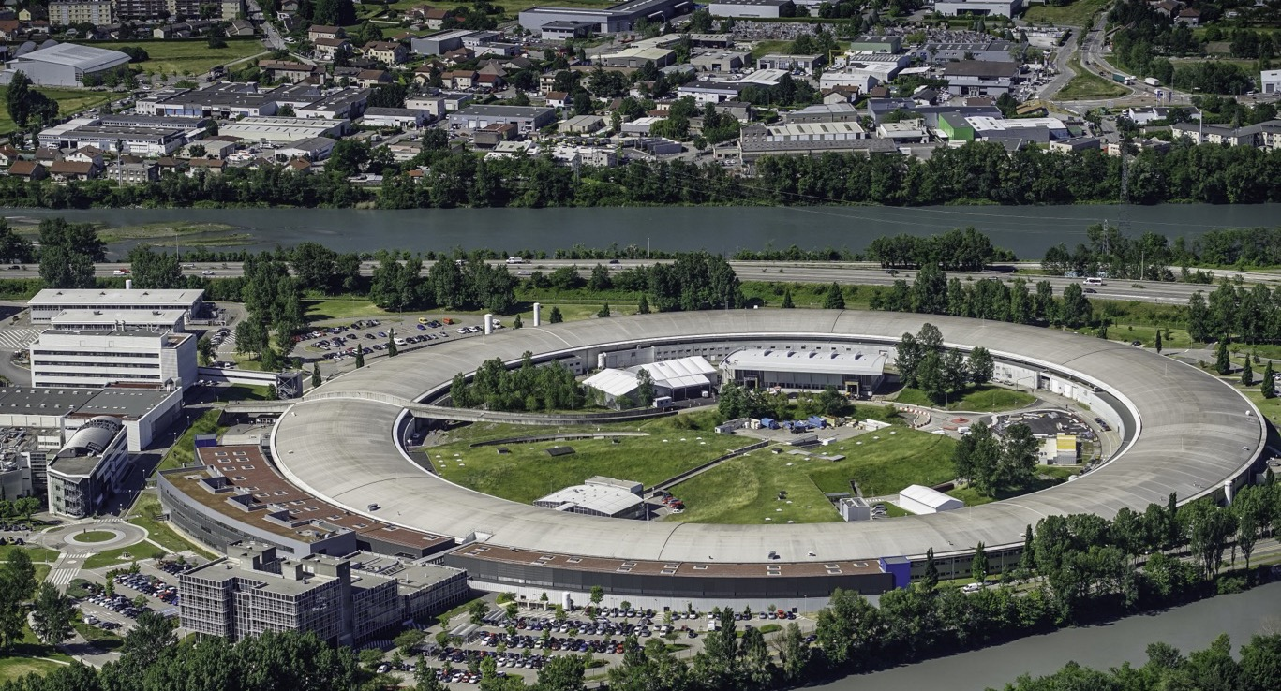
Many thanks for your attention
A.D’Elia: on behalf of the COLD project team:
S. Liuzzo, P.Borowiec, V.Serriere, M.Dubrulle, M.Morati, S.White, F. Ewald, N.Benoist, K.Scheidt, B.Roche, C.Benabderrahmane, G. Le Bec, R.Bourtenbourg, J.-L. Pons, D. Martin, B. Pelissier, L.Eybert, T.Brochard, C.Maccarrone, J.-L. Revol, B.Joly, Y.Gouez, H. Pedroso Marques, P.Colomp, A.Dely, F.Falaise, David Frichet, Q.Qin
International collaborators
E.Nanni, A.Dhar, W.-H. Tan, G.Aymar (SLAC),
A.Latina (CERN),
D.Alesini, F.Cardelli, A.Giribono, C.Vaccarezza, G.Silvi (INFN-LNF),
M.Andorf, J.Maxson (Cornell),
P.Craievich, R.Zennaro (PSI)
6GeV Linac injector
Thank you for your attention!

