Slide 1
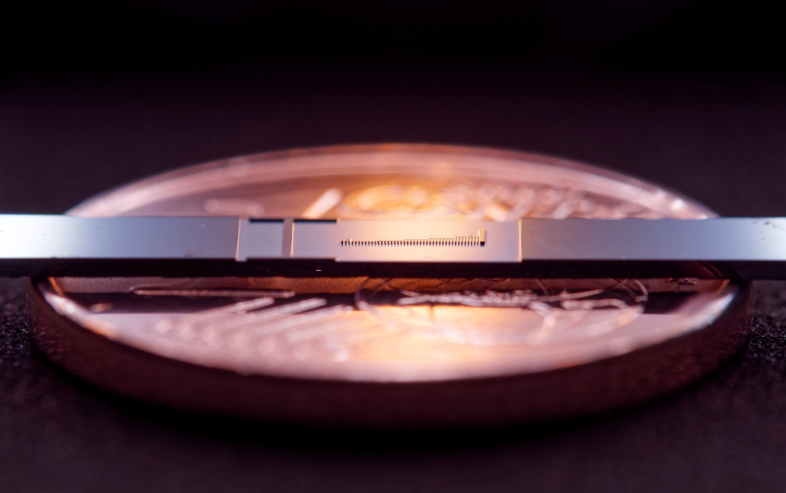
Recent Progress in Dielectric Laser Acceleration
Manuel Konrad, Stefanie Kraus, Julian Litzel, Leon Brückner, Zhexin Zhao, Julian Freier, Roy Shiloh*, Tomas Chlouba**, Peter Hommelhoff***
Friedrich-Alexander-Universität Erlangen-Nürnberg (FAU), Erlangen, Germany
* Now with Hebrew University, Jerusalem, Israel
** Now with AMOLF, Amsterdan, Netherlands
*** Now with Ludwig-Maximilian University München (LMU) and FAU

Slide 2
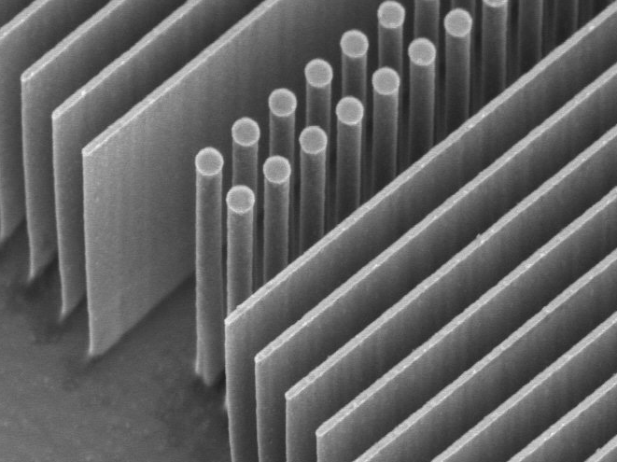
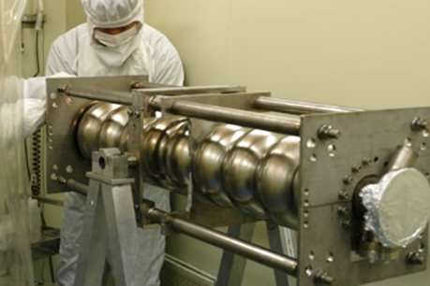
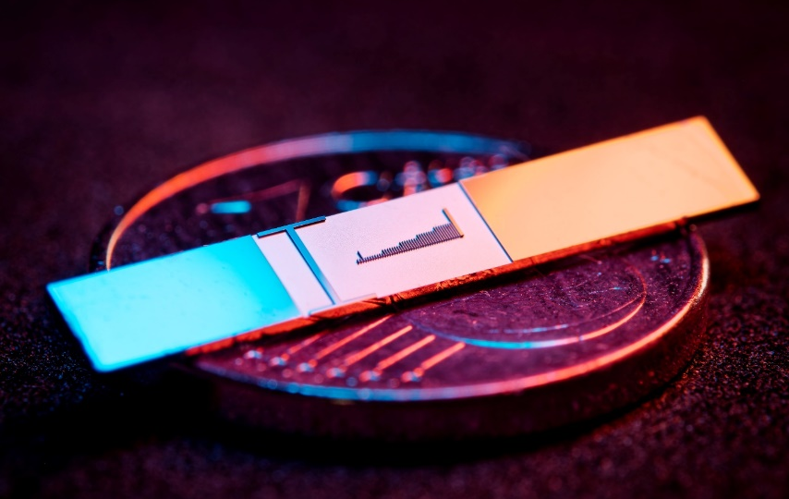
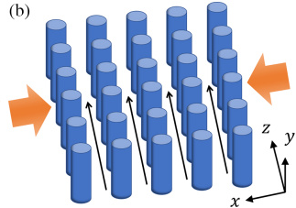

Why dielectric-based laser accelerators?
$$\text{1 }\text{μm}$$
Fermilab
Dielectric materials and optical frequencies
Higher damage threshold than metallic cavities
Higher gradients and smaller, minituarized structures
Much stricter requirements on beam properties
Lower current
per channel
Laser
Laser
DLA
f=150 THz (λ=2 μm)
τ=6.6 fs
RR ~ kHz-MHz
>3 GV/m fields
Gradient >1 GeV/m
Physical aperture: ~200 nm
Emittance <100 pm rad (norm)
fA-pA
(in single channel, many are possible soon)
RF
f=3 GHz
τ=333 ps
RR ~ Hz-kHz
<200 MV/m
25-50 MeV/m
~1cm
1 μm ~ 1 mm rad
nA-μA and larger
Multi-channel DLA:
Zhao et al., Photonics Research 8 10,
1586-1598 (2020)

Slide 3
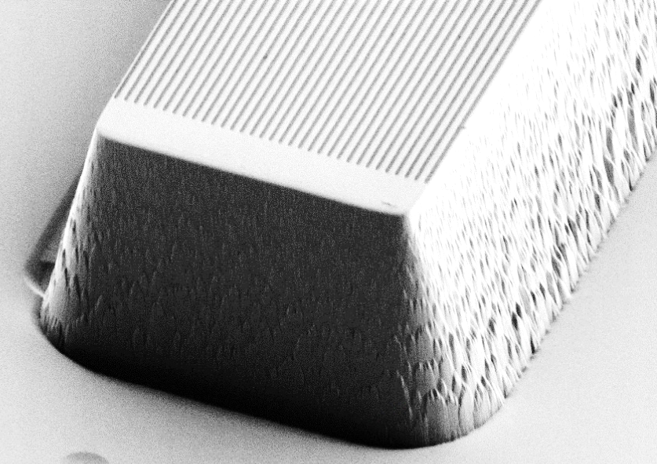







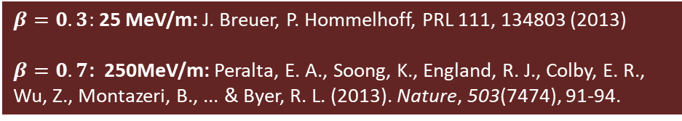
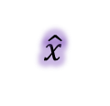


Operation principle
Synchronicity condition:
$$β=Λ_{p}/λm$$
Depending on particles position:
Acceleration
Deceleration
Deflection
1
2
3
4
1
2
$$Λ_{p}$$
3
4
$$\hat{y}$$
TM-polarized
$$\hat{x}$$
$$\hat{y}$$
Goal: generate a mode that allows momentum transfer from laser field to electrons
Use first order effect, so m=1 (efficient!)
Second order effects too already too inefficient
$$\hat{z}$$
$$\hat{x}$$
4
~620nm
$$\hat{z}$$
1
2
3
$$Λ_{p}$$
First spatial harmonic
$$λ$$
Proof of concept:
0
$β=0.3:$ 25 MeV/m: J. Breuer, P. Hommelhoff, PRL 111, 134803 (2013)
$β=0.7$: 250MeV/m: Peralta, E. A., Soong, K., England, R. J., Colby, E. R., Wu, Z., Montazeri, B., ... & Byer, R. L. (2013). Nature, 503(7474), 91-94.
Deceleration
Acceleration

Slide 4
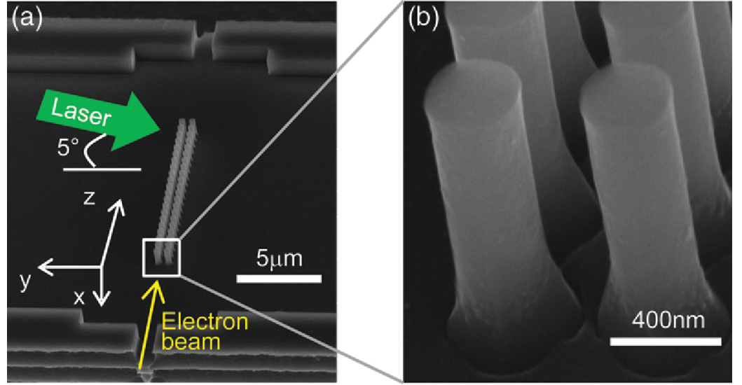
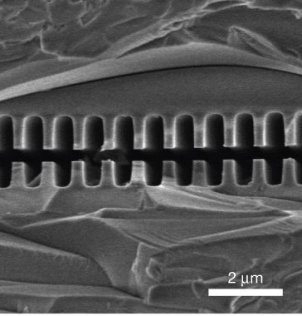
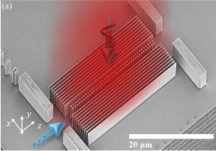
2015
Silicon pillar structures
2021
2013
Top illumination
Bonded silica gratings
Leedle, et al. CLEO, pp. FM3M-7 (2018)
Leedle, et al. Opt. Lett. 40, 4344-4347 (2018)
Yousefi et al., Opt. Lett. 44, 1520-1523 (2019)
Fishman et al., Nature Comm 14, 3687 (2023)
Black et al., PRAB 23, 114001 (2020)
Peralta et al. Nature 503, 91–94 (2013)
Koyama, K., et al. IPAC (2014)
Wei et al., Appl. Optics 56(29) (2017)
Wie et al., Physics of Plasmas 24.7 (2017)
Cesar et al., NIMA 909, 252-256 (2018)
Cesar et al., Optics Expr., 26(22), (2018)
Crisp et al., arXiv:2310.12384 (2023)
Chen et al., Proposal (1989)
Shiloh, et al., Opt. Express 29, 14403-14411 (2021)

Slide 5
Guiding of sub-relativistic electrons inside DLAs (in plane parallel to substrate)

Slide 6
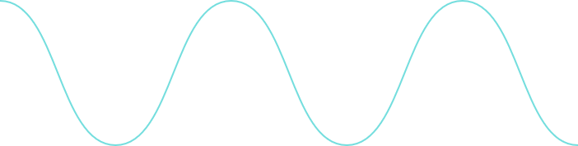
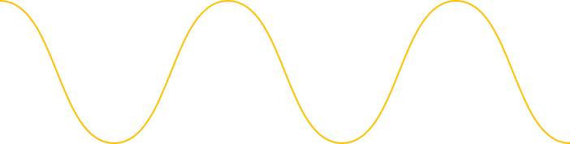
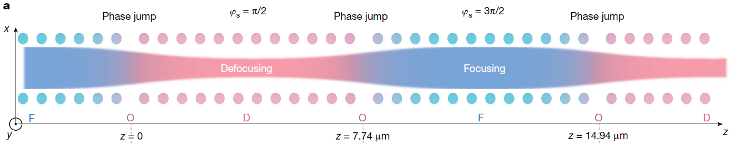










Guiding with Alternating Phase Focusing
(without acceleration)
e⁻
x
$$π/2$$
$$π$$
$$3π/2$$
$$2π$$
z
Force acting on electrons:
$${\text{F}}_{\text{z}}\text{= }−\frac{\text{e}\text{c}}{\text{βγ}}{\text{C}}_{\text{C}}\text{cosh}\left({\text{k}}_{\text{z}}\text{x}\right)\text{cos}\left({\text{φ}}_{\text{s}}\right)$$
$${\text{F}}_{\text{x}}\text{=} \frac{\text{e}\text{c}}{\text{βγ}}{\text{C}}_{\text{C}}\frac{\text{1}}{\text{γ}}\text{sinh}\left({\text{k}}_{\text{z}}x\right)\text{sin}\left({\text{φ}}_{\text{s}}\right)$$
y
$${\text{F}}_{\text{z}}$$
$${\text{φ}}_{\text{s}}$$
z<0
${\text{φ}}_{\text{s}}$: Phase between laser and electron
$${\text{F}}_{X}$$
$$Δφ_{s}=180°$$
Niedermayer, U., Egenolf, T., Boine-Frankenheim, O., Hommelhoff P., Phys. Rev. Lett. 121, 214801 (2018)
Shiloh, R., Illmer, J., Chlouba, T., Yousefi, P., Schönenberger, N., Niedermayer, U., Mittelbach, A., & Hommelhoff, P. Nature 597, 498 (2021)

Slide 7
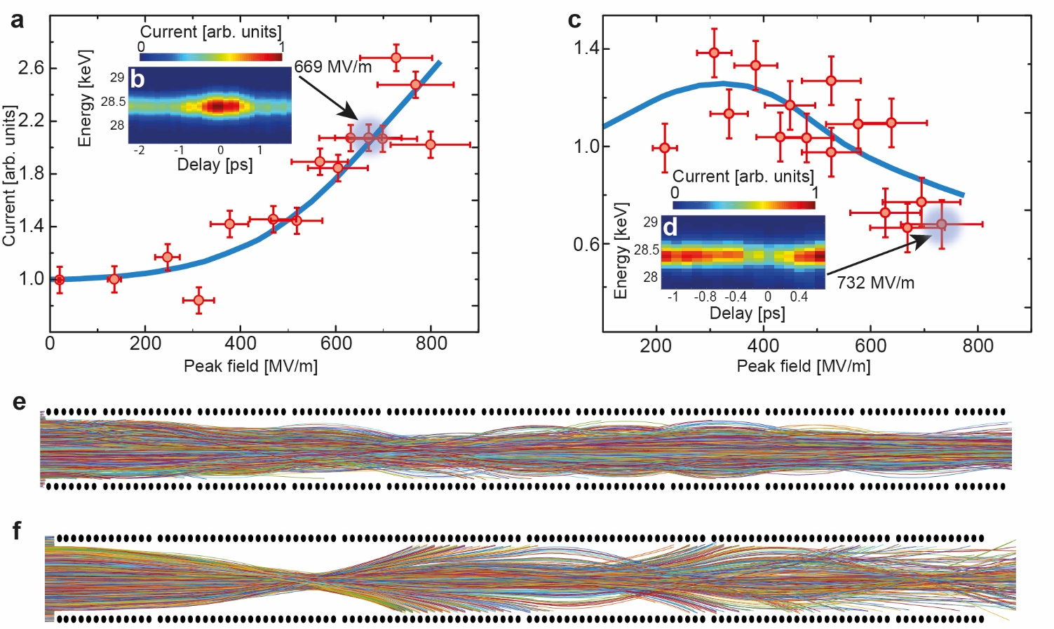

Alternating phase focusing effect: proof of principle
Overfocusing
Guiding
2.7 times larger electron current at optimal transport field strength (~700 MV/m)
Overfocusing effect (>400 MV/m)
Different structure geometry with larger macrocells
R. Shiloh, J. Illmer, T. Chlouba, P. Yousefi, N. Schönenberger, U. Niedermayer, A. Mittelbach, P. Hommelhoff, Nature 597, 498 (2021)
For Linacs: Lauber, S., Barth, W., Basten, M., Dziuba, F. D., List, J., Miski-Oglu, M., ... & Yaramyshev, S., EPJ Techniques & Instrumentation, 11(1), 5 (2024)

Slide 8
Acceleration + Guiding (guiding in plane parallel to substrate)

Slide 9
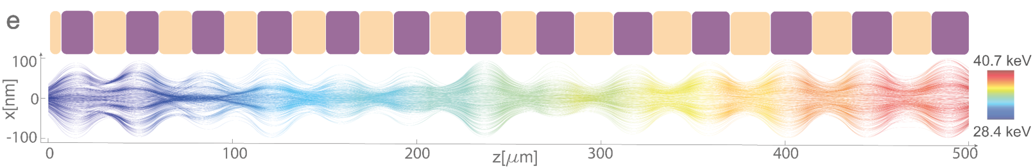


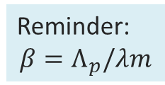







Coherent laser acceleration of electrons
So far only guiding, now: acceleration
$$π/2$$
$$π$$
$$3π/2$$
$$2π$$
Phase jumps + Tapering
=
Guiding + Acceleration
Reminder:
$$β=Λ_{p}/λm$$
$${\text{F}}_{Z}$$
$${\text{φ}}_{\text{s}}$$
$${\text{F}}_{X}$$
$$Δφ_{s}=180°$$
$$Δφ_{s}=120°$$
D: Defocusing
F: Focusing
T. Chlouba*, R. Shiloh*, S. Kraus*, L. Brückner*, J. Litzel, P. Hommelhoff, Nature, 622, 476 (2023)

Slide 10
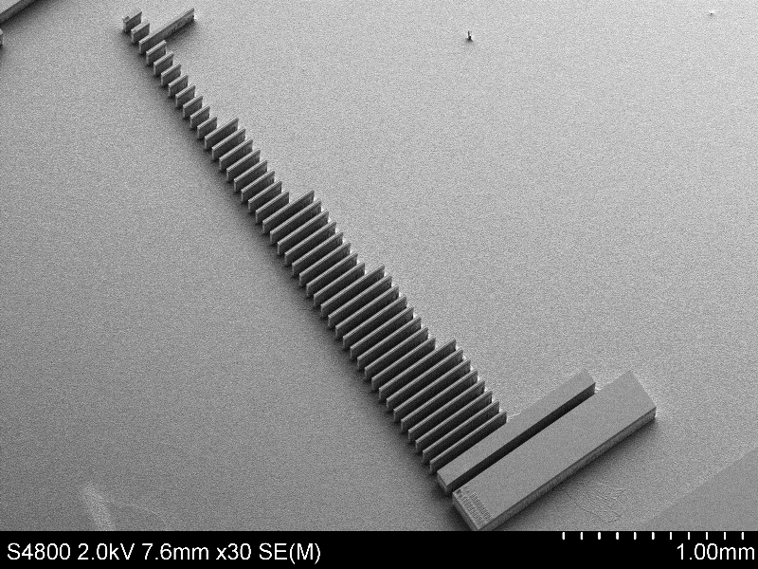
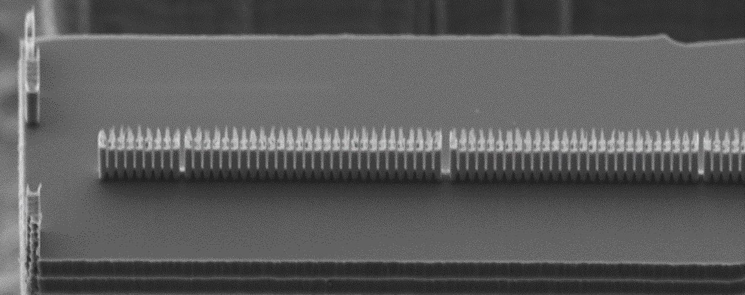
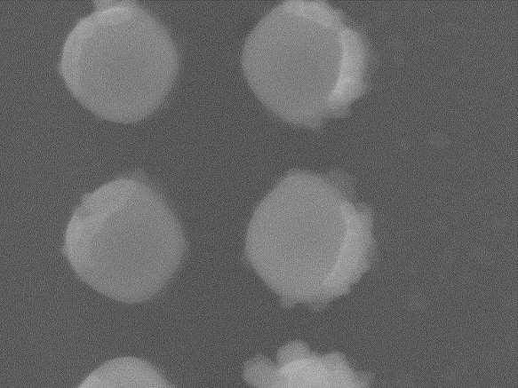





Laser
e-
Previous generation accelerating structure
2µm
200 $μm$
225nm
139 – 237nm
300 $μm$
480nm
450nm
$$\text{20}\text{0}\text{n}\text{m}$$
400 $μm$
Top view
E_{Peak} = 600MV/m - 700MV/m
Design gradient: 22.7MeV/m
500 $μm$
1mm
9

Slide 11
Laser
e-
Previous generation accelerating structure
2µm
200 $μm$
225nm
300 $μm$
480nm
450nm
$$\text{20}\text{0}\text{n}\text{m}$$
400 $μm$
Top view
E_{Peak} = 600MV/m - 700MV/m
Design gradient: 22.7MeV/m
500 $μm$
1mm
10

Slide 12
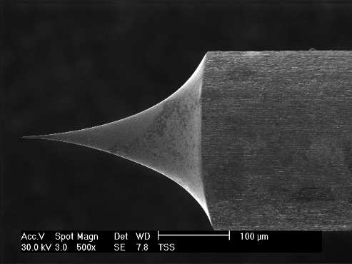
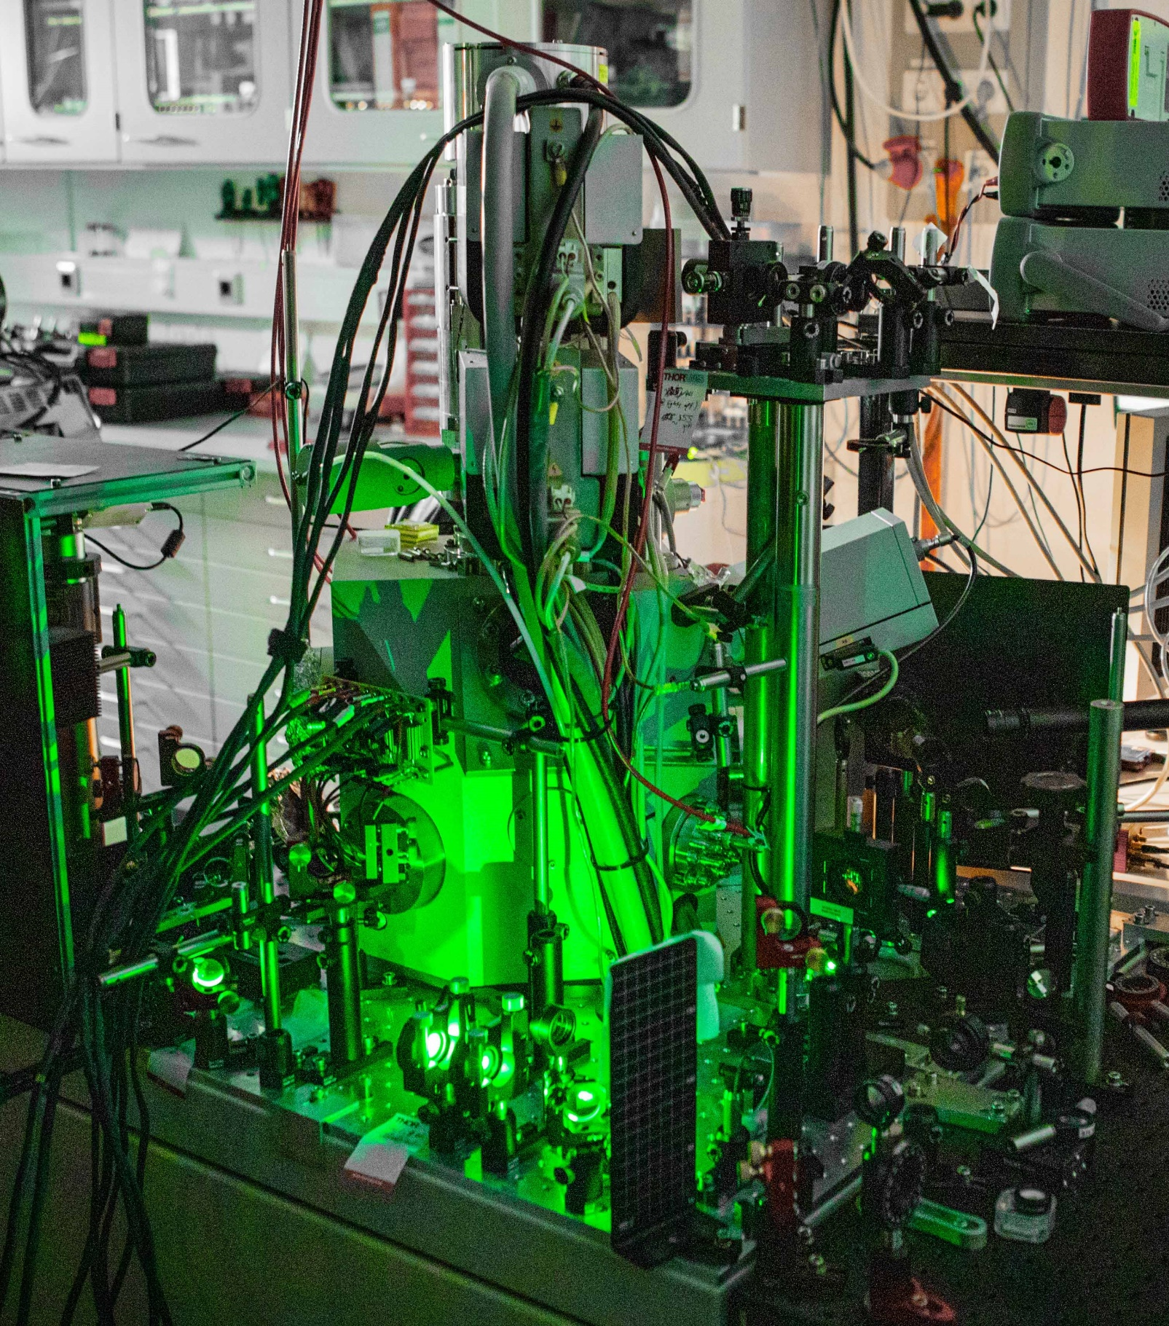
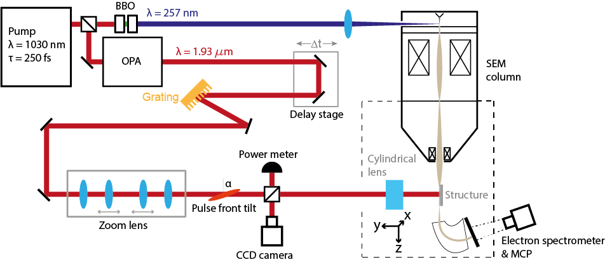
Experimental setup at FAU
Electron sources
XL30

Slide 13
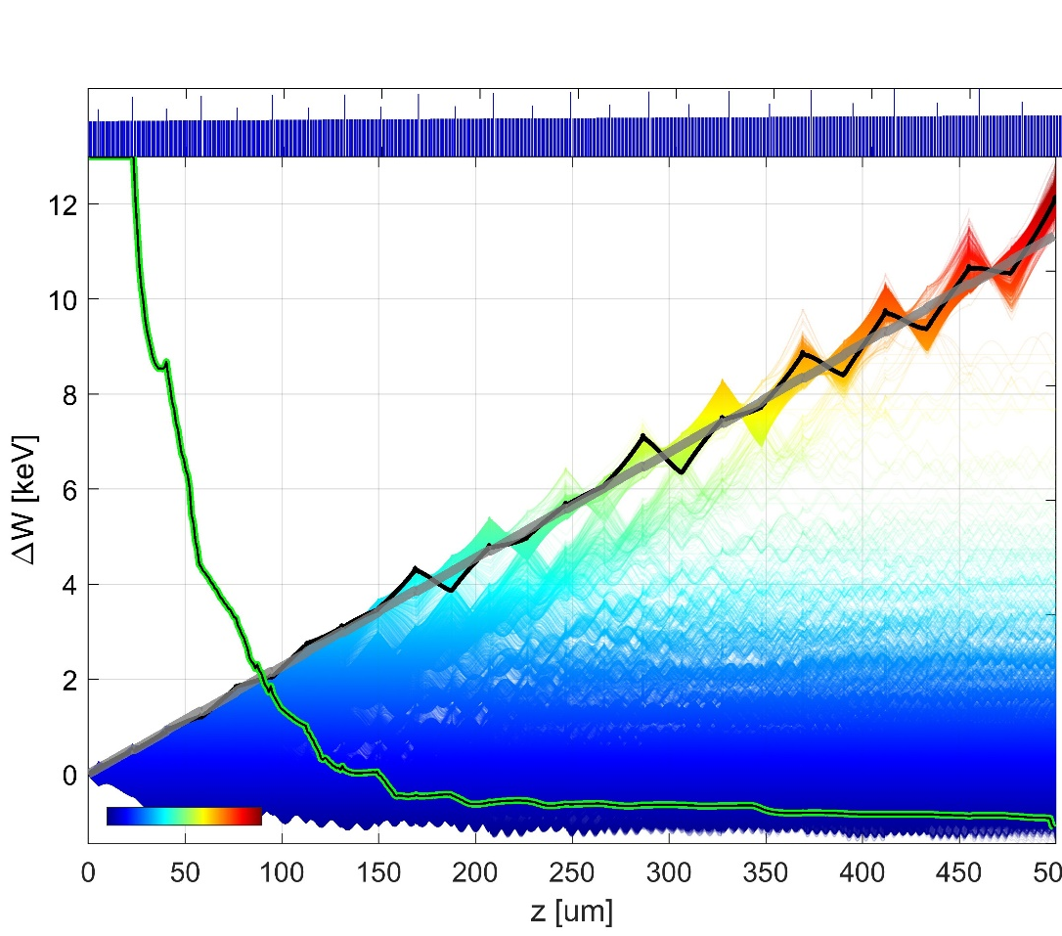
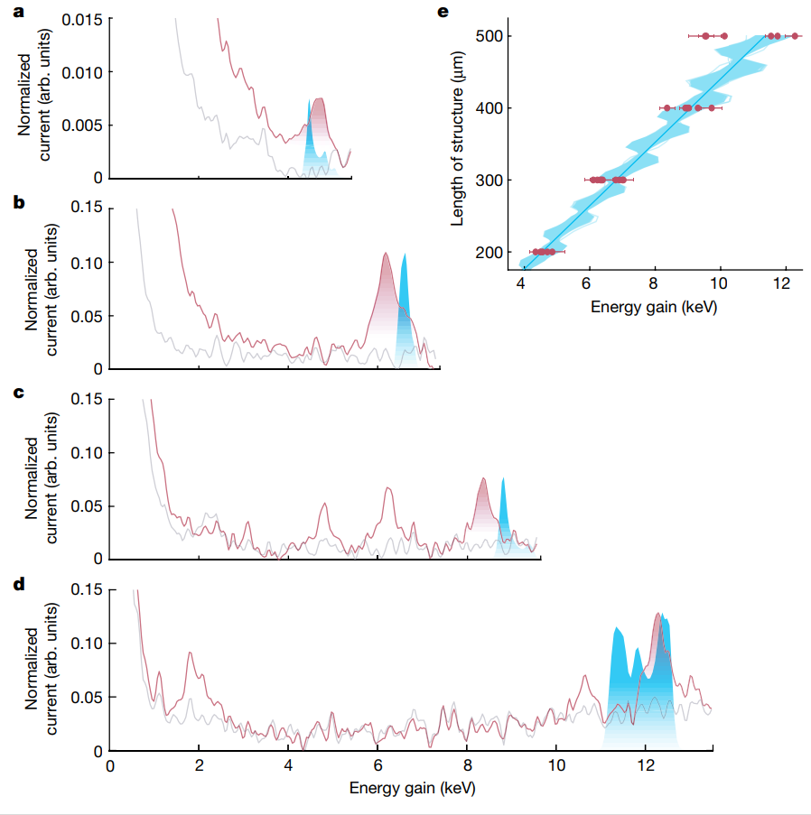
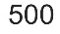




Simulation
Pillar distance
200$μ$m
1
11.9 keV
8.8 keV
Energy gain (keV)
6.6 keV
% of survived particles
0.5
300$μ$m
4.5 keV
Laser on
Laser off
Simulation
Energy
0
400$μ$m
Maximum energy gain 12.3 keV
Total energy of 40.7 keV
43% energy gain
500$μ$m
Similar results from Stanford/Darmstadt team:
Broaddus, Egenolf, …, Byer, Leedle, Solgaard, Phys. Rev. Lett. 132, 085001 (2024)
T. Chlouba*, R. Shiloh*, S. Kraus*, L. Brückner*, J. Litzel, P. Hommelhoff, Nature, 622, 476 (2023)

Slide 14
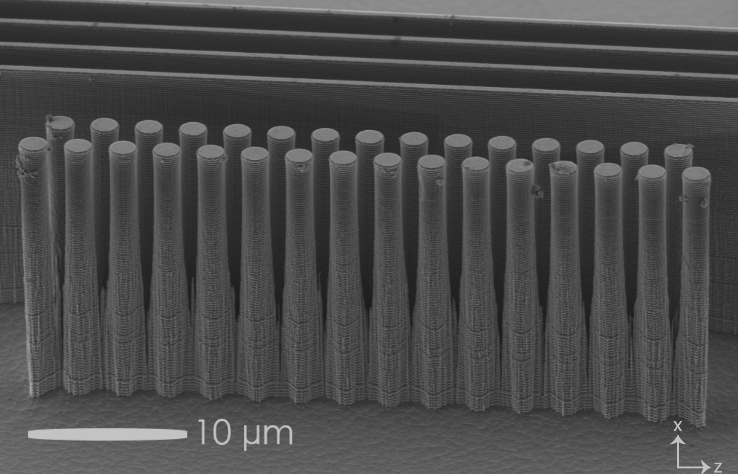
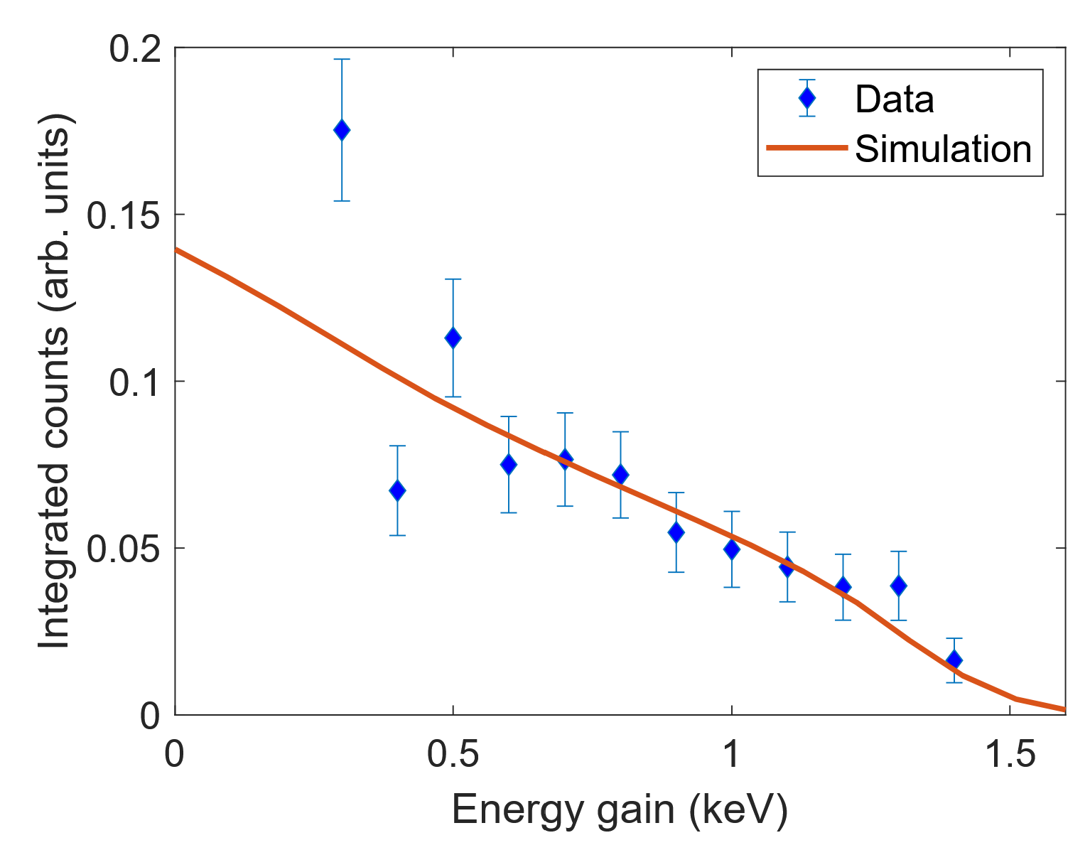
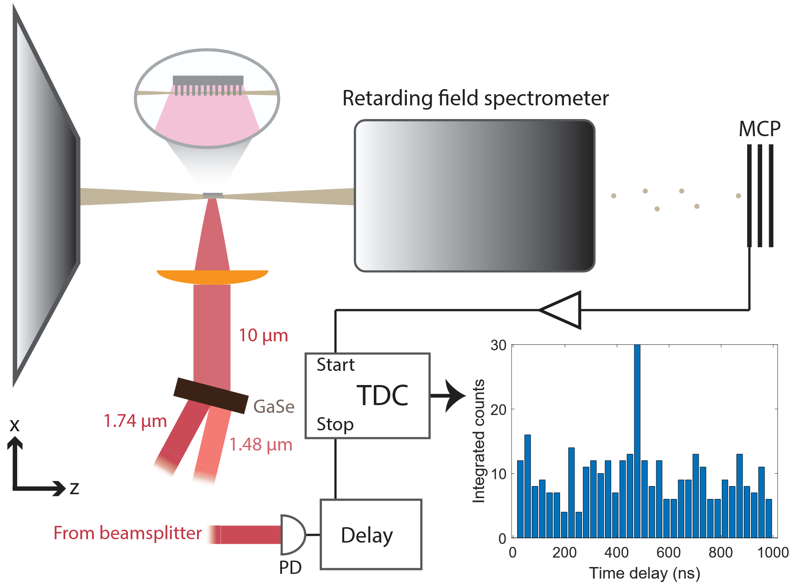
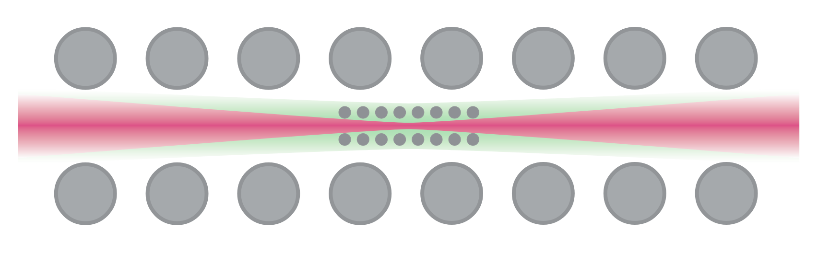
DLA @ 10 µm
Advantage of longer wavelengths:
Higher damage threshold → Higher accelerating fields
Wider channel (factor 5 for 10 µm vs. 2 µm) → Larger acceptance / less strict requirements on input beam → Larger currents possible
Easier fabrication → Additive fabrication? → More possibilities for 3D structures
L. Brückner, dissertation
L. Brückner, et al., Opt. Express 32, 28348 (2024)

Slide 15

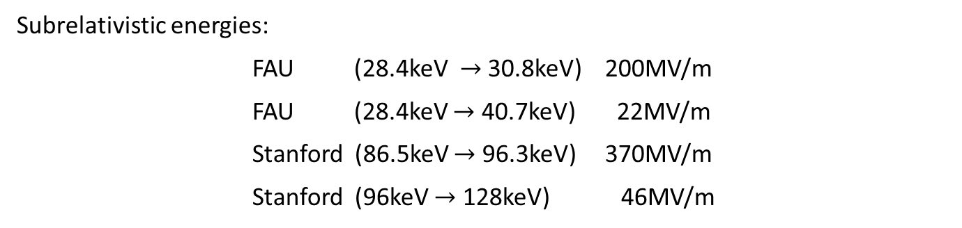


Scalability of DLA - optimistic
<50 keV: average gradient of 50 MeV/m
Up to 100 keV: average gradient of 100 MeV/m
Above: 1 GeV/m
Relativistic energies: Highest peak gradient record: 1.8GV/m (8MeV at UCLA)
Cesar, et al., Communications Physics, 1(1), 46, (2018)
Yousefi, Peyman, et al., Optics letters 44.6: 1520-1523 (2019)
Chlouba et al., Nature, 622, 476 (2023)
Leedle, Kenneth J., et al. Optics letters 40.18: 4344-4347 (2015).
Broaddus, P., et. al., PRL, 132(8), 085001 (2024).
Subrelativistic energies:
FAU (28.4keV $→$ 30.8keV) 200MV/m
FAU (28.4keV $→$ 40.7keV) 22MV/m
Stanford (86.5keV $→$ 96.3keV) 370MV/m
Stanford (96keV $→$ 128keV) 46MV/m
1MeV
1GeV
10GeV
Challenges
Excitation of synchronous mode
Conservative design (50% of the crest)
Not fully optimized structure
Try variable pillar sizes
Inverse designed structures
Structure:
Length $≈$ 1.8mm
Laser:
$→$ P_{avg} $≈180$mW
Structure:
Length $≈$ 1m
Laser:
$→$ P_{avg} $≈100$W
Structure:
Length $≈$ 10m
Laser:
$→$ P_{avg} $≈1$kW
E_{peak} = 600MV/m, 100fs pulse length, 167kHz rep. rate, 𝜔_{𝑥} = 2.5𝜇m

Slide 16
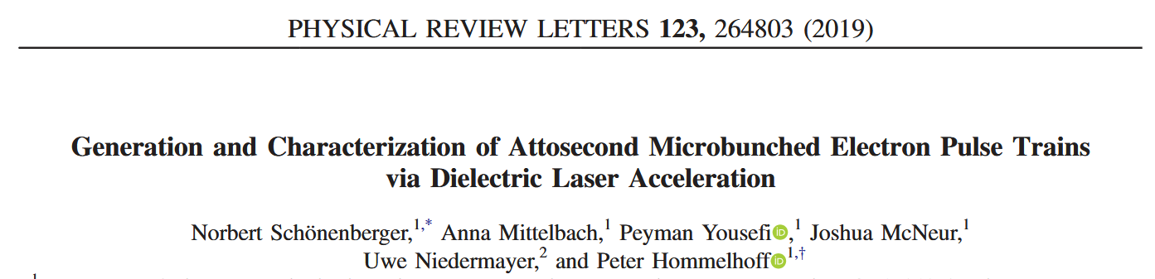
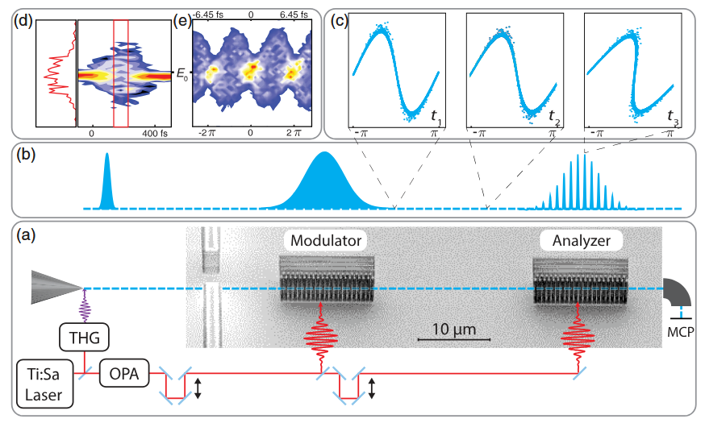
Other applications of DLA structures
At sub-relativistic energies, the phase-dependent energy spread can be used for temporal bunching

Slide 17
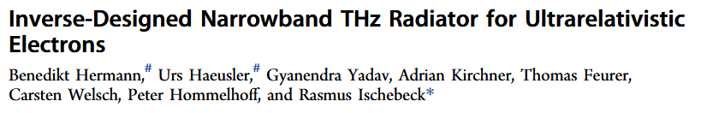
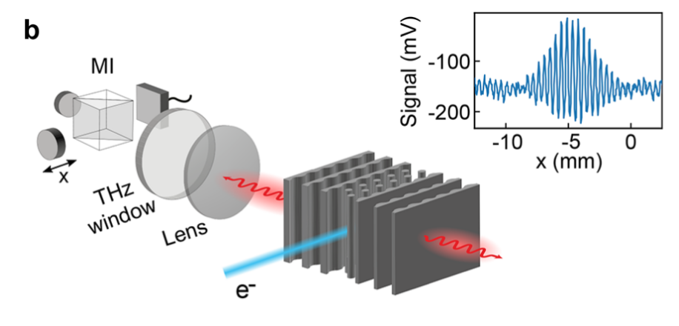
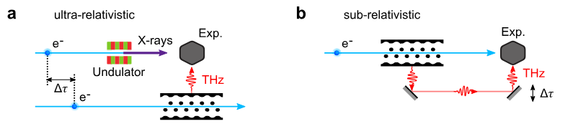
Other applications of DLA structures
ACS Photonics 2022, 9, 1143-1149
Inverse of DLA: Smith-Purcell-Effect
Emission of narrowband radiation in a highly tunable frequency range -> Narrowband: Bragg mirrors -> Tunable: Frequency depends on structure period and electron velocity
Can be put in electron beamline -> Useful for pump-probe experiments

Slide 18
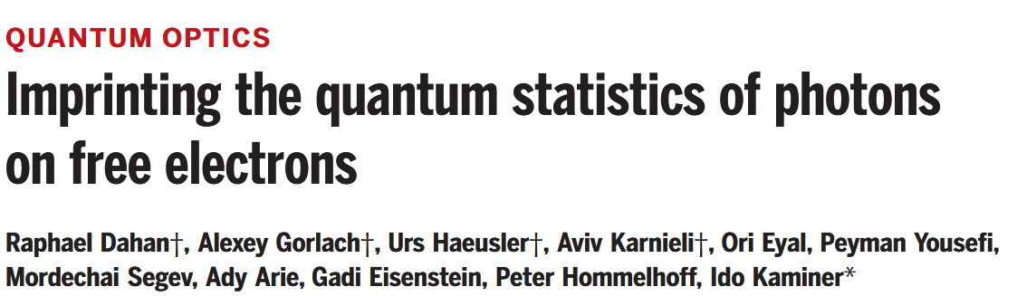
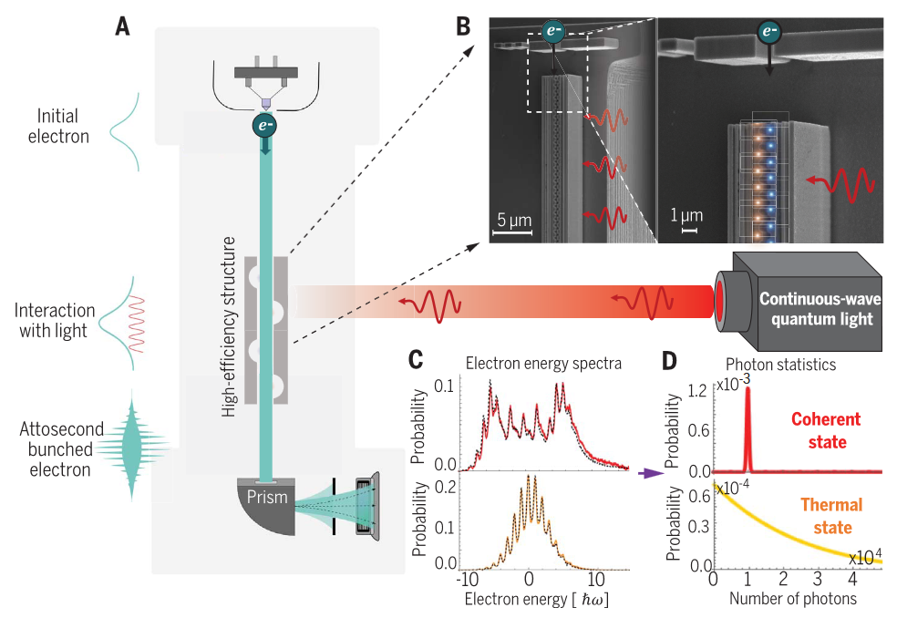
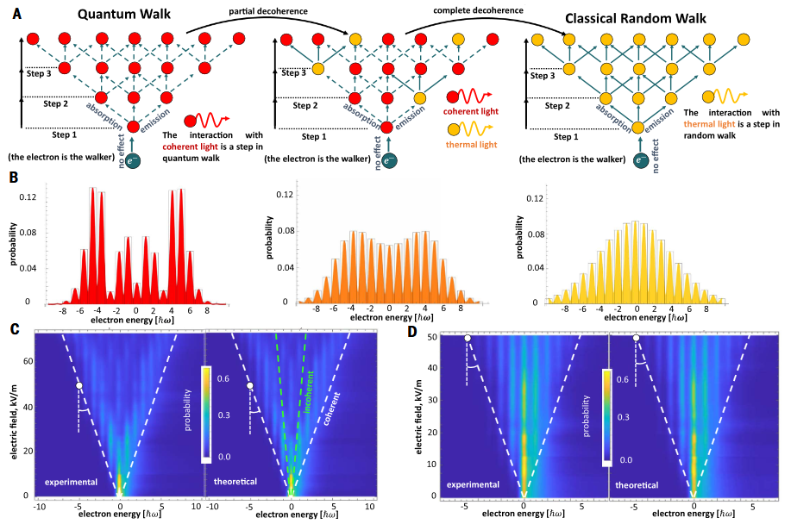
Other applications of DLA structures
Efficient, quantum coherent coupling between photons and free electrons allows entanglement between them -> Allows extraction of photon statistics from electron spectra

Slide 19
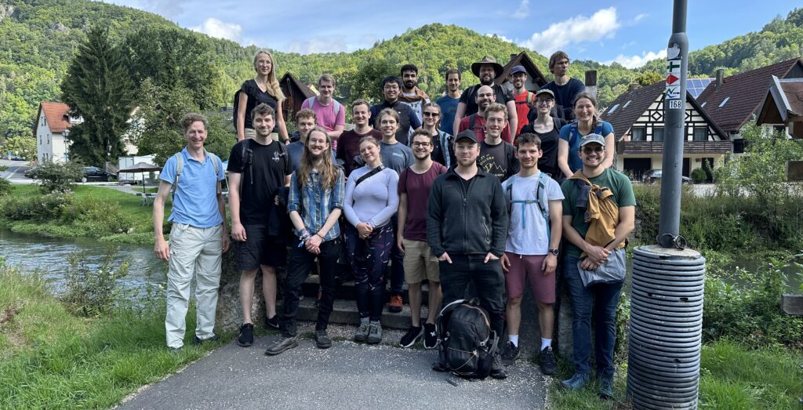











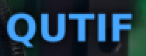
Fabian Bammes
Nils Bode
Leon Brückner
Yiqi Fang
Julian Freier
Jonas Heimerl
Celina Hüttner
Johannes Illmer
Patrick Käferlein
Manuel Konrad
Viacheslav Korolev
Stefanie Kraus
Daniel Lesko
Weizhe Li
Julian Litzel
Felix López Hoffmann
Matthias Meier
Stefan Meier
Selina Nöcker
Jonathan Pölloth
Tamara Pröbster
Martin Reh
Franz Schmidt-Kaler
Fabian Sochor
Frederic Voggel
Tobias Volk
Timo Wirth
Maria Würth
Zhexin Zhao
Partners:
iQCE collaboration
ACHIP collaboration
M. Chekhova, MPL
Y. Morimoto, RIKEN
I. Kaminer, Technion
O. Neufeld, Technion
J. Rosenzweig, UCLA
I. Franco, Rochester
F. Tani, Ph. Russell, MPL
Th. Fennel, Rostock
C. Lemell, J. Burgdörfer, TU Vienna
A. Leitensdorfer, Konstanz
FAU Applied Physics: H. Weber
M. Kling, LMU/MPQ
R. L. Byer + coll., Stanford / SLAC
M. Stockman^{Ϯ}, Georgia State
G. G. Paulus, Jena
Recent alumni:
PhDs: T. Weitz (né Boolakee) Ph. Dienstbier C. Gerner C. Heide Ang Li M. Seidling T. Paschen A. Tafel N. Schönenberger R. Zimmermann (M. Sirotin)
Postdocs: T. Chlouba M. Knipfer F. Mooshammer Y. Morimoto R. Shiloh T. Shibuya
Master students: S. Hillmann M. Knauft B. Löhrl A. Michalak
I. Probst S. Wittigschlager

Slide 20
Thank you for your attention!

Slide 21
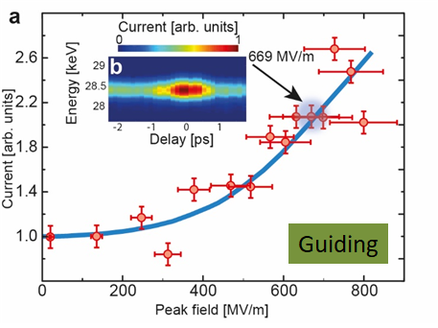
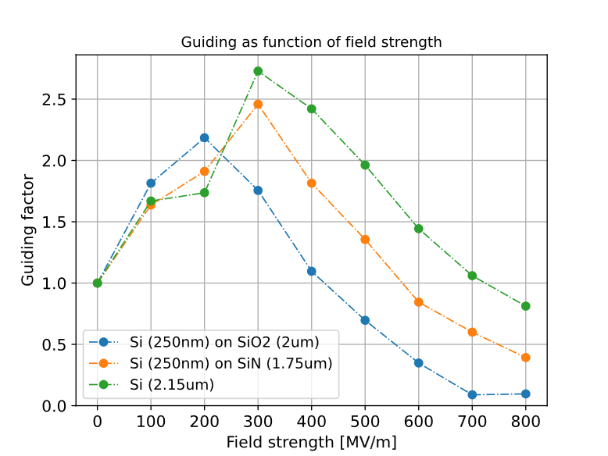
Summary
2D APF
(guiding in plane)
3D APF
(full guiding)
Preliminary!
Shiloh, R., et al., Nature 597, 498 (2021)
2D APF +
Acceleration
Long term goal:
3D APF + Acceleration -> Scalable accelerators
T. Chlouba, R. Shiloh, S. Kraus, L. Brückner, J. Litzel, P. Hommelhoff, Nature, 622, 476 (2023)

Slide 22
Guiding in 3D? (including out of plane direction)

Slide 23
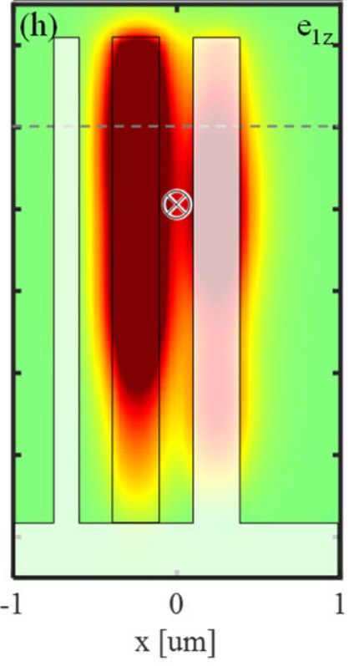
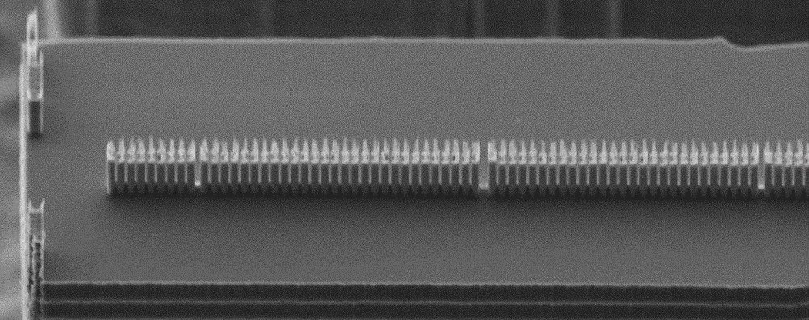
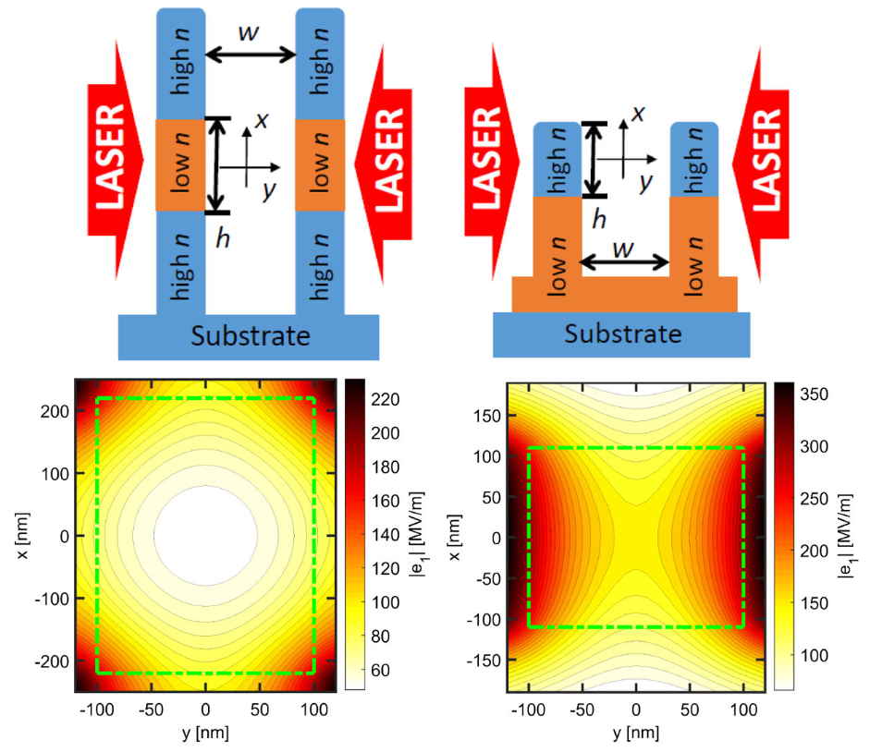
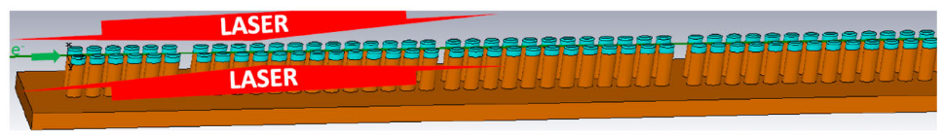
Guiding in 3D - The concept
Problem: structures etched from silicon -> field roughly invariant perpendicular to substrate -> No field component in that direction
Possible Solution proposed by Uwe Niedermayer et al.: Stacked layers of different dielectrics -> Contrast of refractive index breaks invariance
Niedermayer, et al., Phys. Rev. Lett. 125, 164801 (2020)

Slide 24
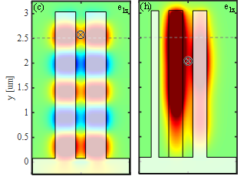
Guiding in 3D - The concept
Two questions arise:
Do we need the stacked structure or is top-illumination sufficient
If so, did we already have 3D confinement in previous measurements?
Another way to break invariance: Top illumination! -> Reflection from substrate breaks invariance -> Similar field profiles to stacked structure
Niedermayer, et al., Phys. Rev. Lett. 125, 164801 (2020)
Shiloh, et al., Opt. Express 29, 14403-14411 (2021)
For top-illumination:
Field invariance is broken -> field nodes form along channel
Transversal forces now in both directions

Slide 25
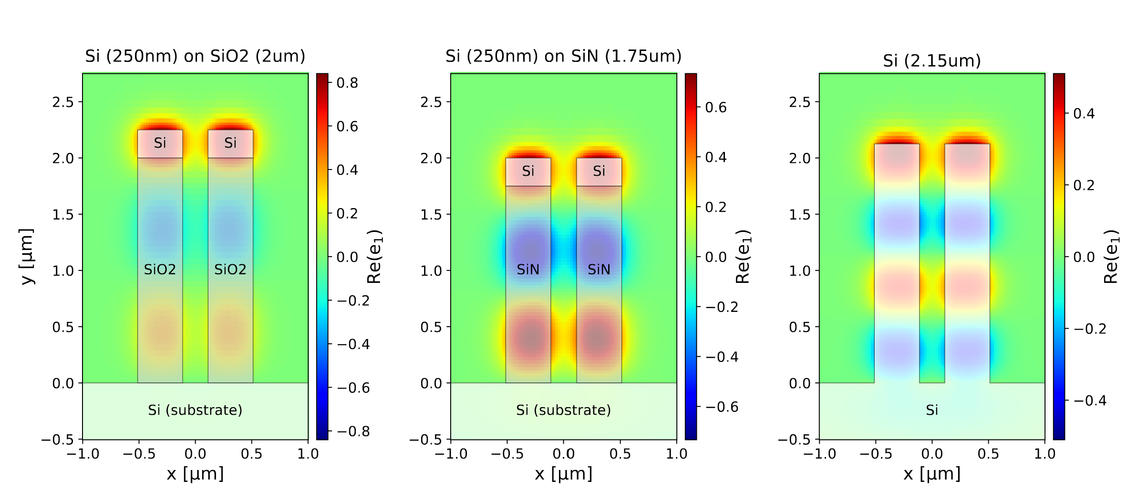
Guiding in 3D – Material combinations
How does the material influence 3D APF? -> Nodes less pronounced for lower contrast
Only Silicon: Nodes forming as well -> due to top-illumination

Slide 26
Guiding in 3D – First preliminary simulation results
First simulation data:
All structures show guiding, but is it 3D APF? -> Need to find a way to distinguish between 2D and 3D guiding
Note: Pure silicon shows strongest guiding -> Structures not yet optimized
Preliminary!
2D APF
First measurements incoming!
Shiloh, R., et al., Nature 597, 498 (2021)

