Slide 1
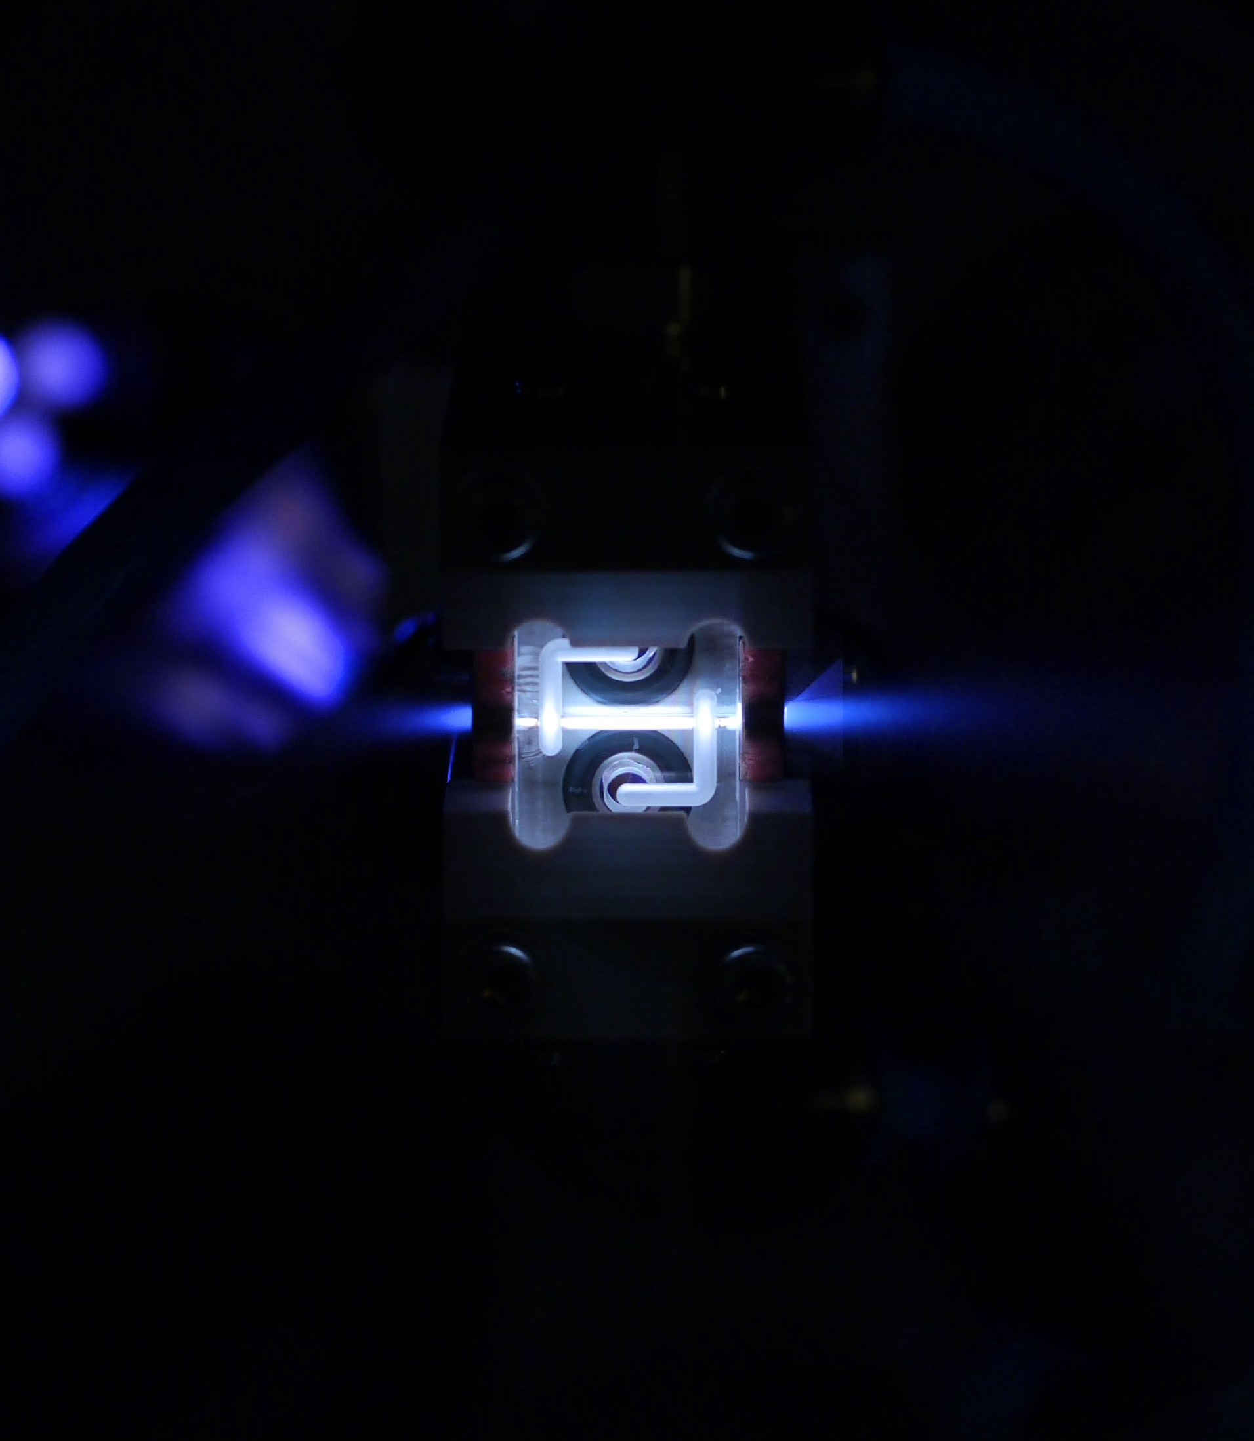




ABEL: A start-to-end simulation framework for plasma-based and conventional linear colliders
The Adaptable Beginning-to-End Linac simulation framework
Jian Bin Ben Chen
Department of Physics, University of Oslo
23 October 2025

Slide 2
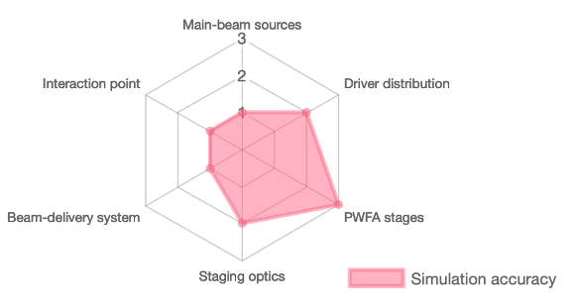
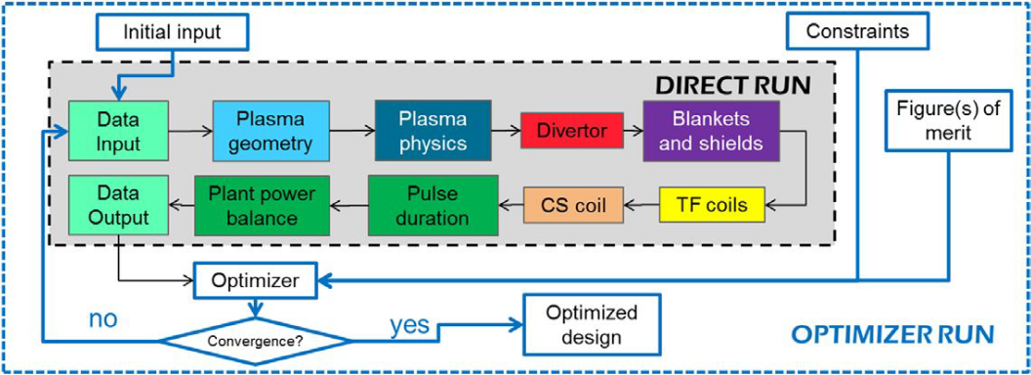
The Adaptable Beginning-to-End Linac simulation framework
Guiding design and optimisation of plasma-based linacs/colliders
A plasma-based linac or collider consists of many different beamline elements requiring specialised, often incompatible codes, limiting direct transfer of simulation outputs.
  ABEL enables self-consistent simulation of entire beamlines by linking a suite of specialised codes using openPMD.
  Supports third-party codes (HiPACE++, Wake-T, ELEGANT, GUINEA-PIG, CLICopti, ImpactX, RF-Track) as well as simplified built-in models.
  Modular structure, written in Python.
  Beamline elements represented as Python classes, with subclasses offering different speeds and levels of fidelity.
Also functions as a system-level tool for optimisation and machine design similar to system codes in the nuclear fusion community.
  Often rely on integrating reduced physics, engineering and economics models to model (or design) the entire fusion reactor facility.
  Allows researchers to explore the feasibility, optimisation, and trade-offs of reactor designs at a whole-plant level.
  But often lack modularity and flexibility.
SYCOMORE (modular) workflow
2025-10-23 | Ben Chen | LCWS 2025
Page

Slide 3
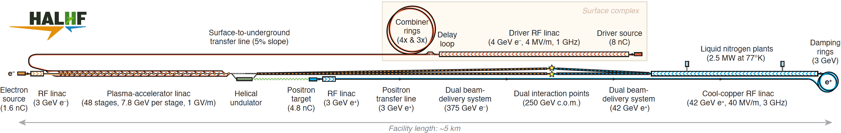
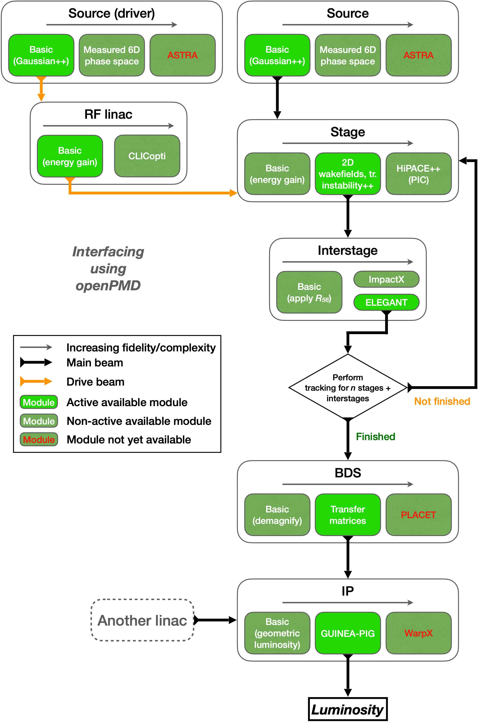
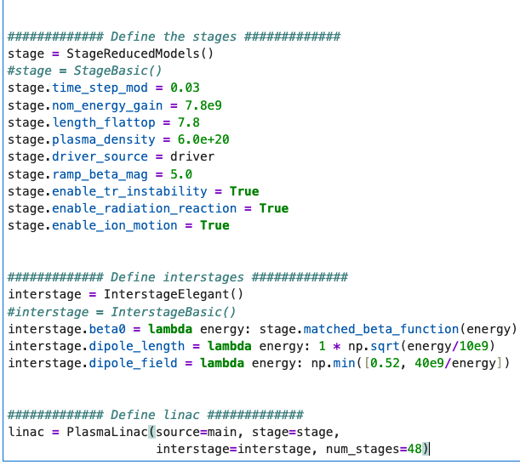

Structure
Generate the drive beam
used to excite plasma waves
in the plasma stages.
Generate the main beam
to be accelerated.
Accelerate the drive beam to desired
energy before injecting into the plasma.
Accelerate the beam.
Discard depleted drive beam,
inject new drive beam and
in-/out couple the main beam.
Can switch between
implementations with a single line,
not worrying about different
input/outputs!
Focuses and steers the beams
into the interaction point.
Beam interaction. Calculate
luminosity and background.
2025-10-23 | Ben Chen | LCWS 2025
Page

Slide 4
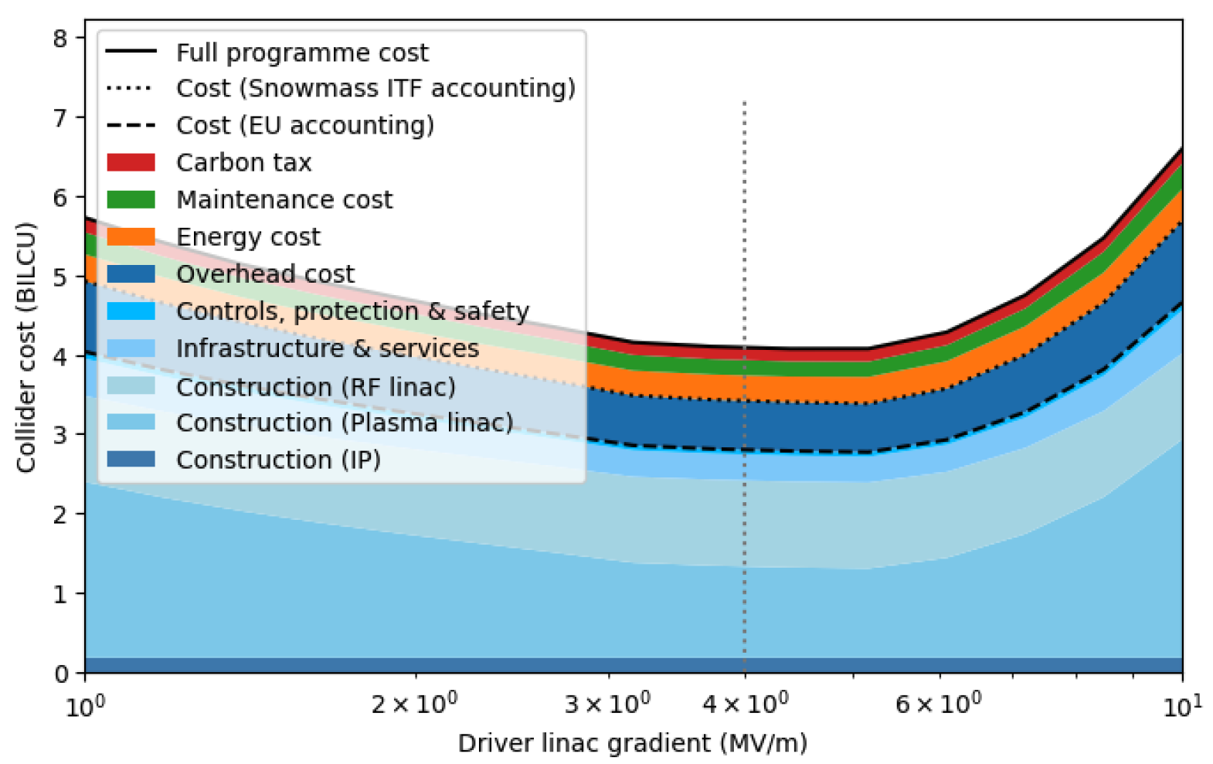
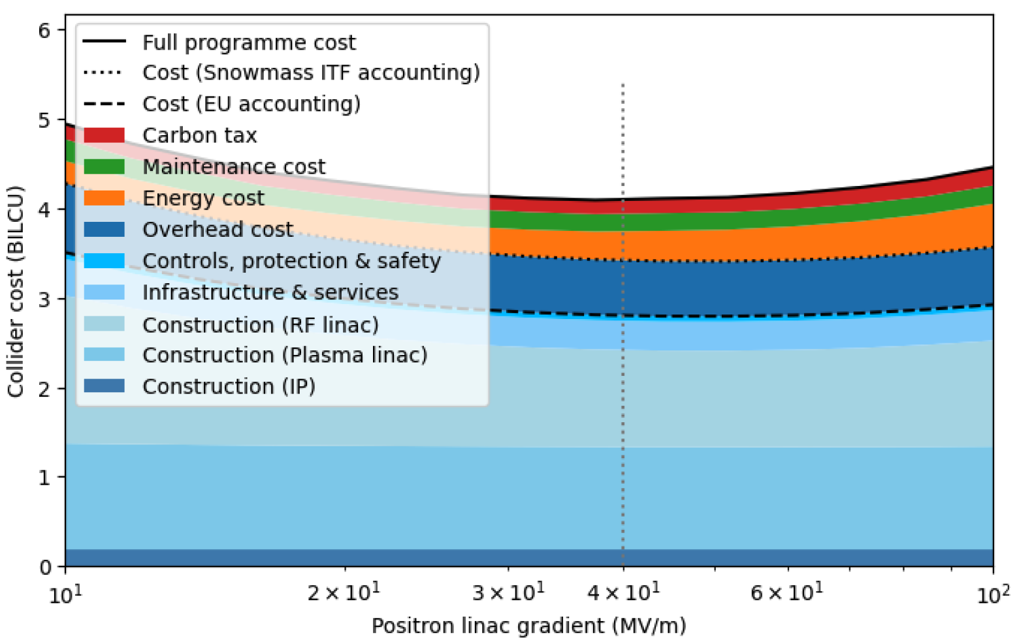
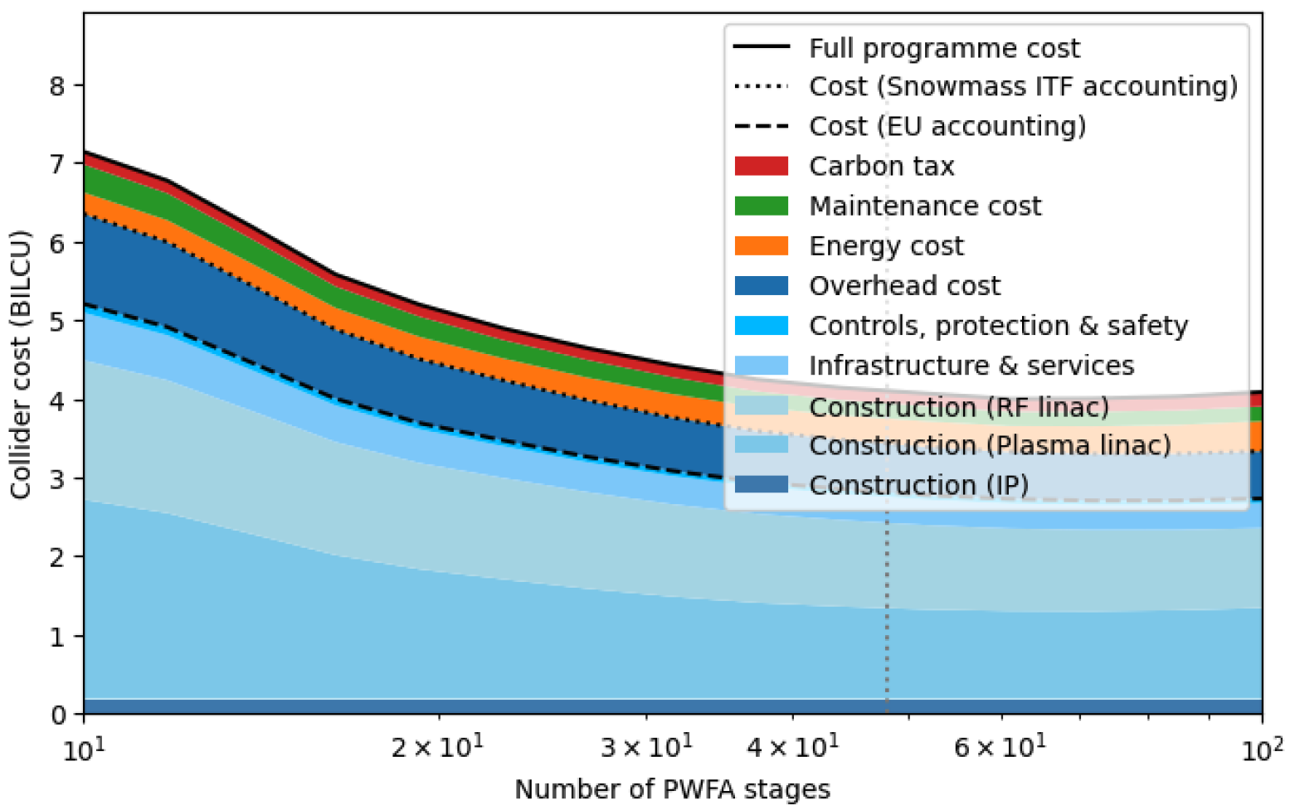
Simulation capabilities
Beam-tracking simulation in ABEL are performed as shots similar to experiments.
Single shot
Multi-shot:
  Track beam multiple times through the same machine. Can be done in parallel
  Easy to study stochastic shot-to-shot imperfections such as beam position, temporal and energy jitter.
Automated parameter scans:
  Supports multiple shots per scan step.
Optimisation
  Multi-dimensional parameter optimisation using Bayesian optimisation.
  Combine low-fidelity models and a cost model that takes into account the full programme cost to perform facility optimisation.
Example outputs of optimisation and cost model. C. A. Lindstrøm
E. Adli et al. “HALHF: a hybrid, asymmetric, linear Higgs factory using plasma- and RF-based acceleration. Backup Document”, arXiv:2503.23489
Also see arXiv:2505.21654
2025-10-23 | Ben Chen | LCWS 2025
Page

Slide 5
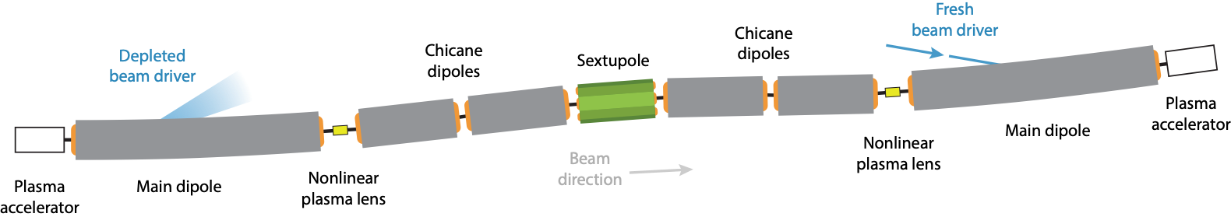
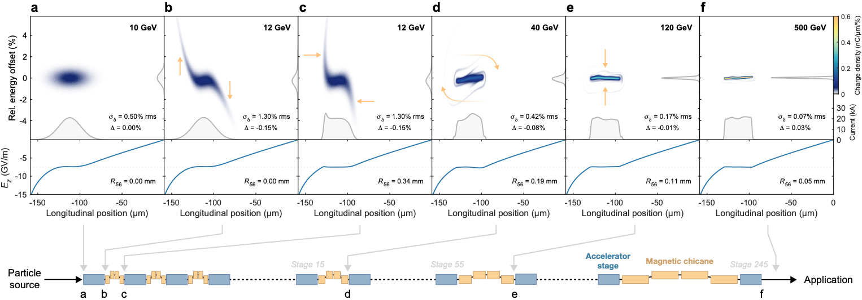
Use cases: HALHF
RF linac
  Positrons accelerated with RF-cavities to 42 GeV.
  RF accelerator module based on CLICopti under development that can calculate power requirements, gradient profile, wakefields and evaluate breakdown constraints etc. based on cavity parameters.
Plasma linac
  48 plasma stages, 7.8 GeV per stage at 1 GV/m.
  Achromatic staging lattice based on local chromaticity correction.
  Self-correction.
  6D beam quality preservation from PIC simulations.
  On-going experiments for developing and testing the nonlinear plasma lens.
Also see B. Foster and R. D'Arcy's talks.
C. A. Lindstrøm et al. Manuscript in preparation.
http://arxiv.org/abs/2104.14460
Drobniak et al. NIM A 1072, 170223 (2025)
Foster et al., Phys. Open 23, 100261 (2025)
2025-10-23 | Ben Chen | LCWS 2025
Page

Slide 6

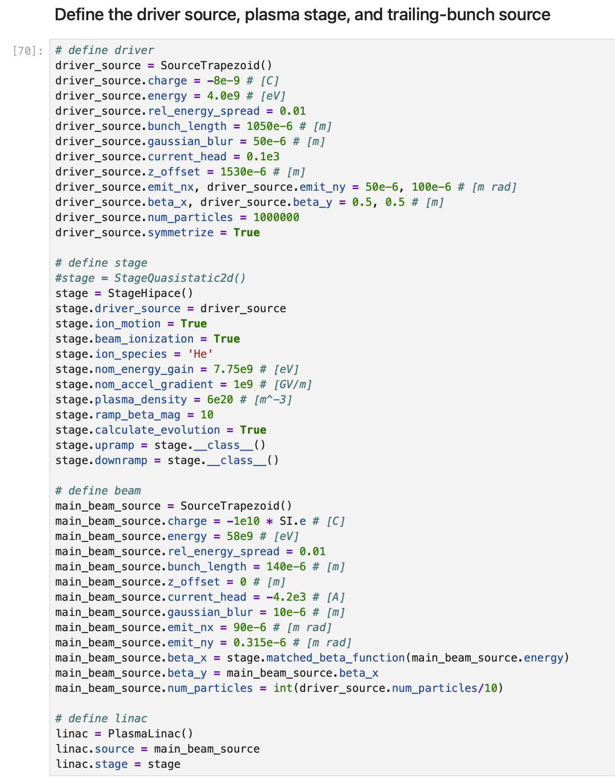
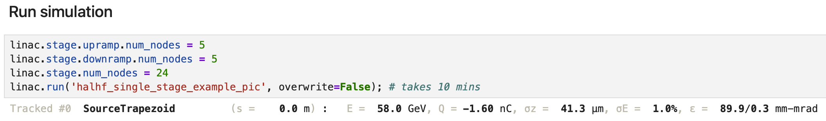
Example: single HALHF stage PIC simulation on
Automated workflow integration: Modify input files for third-party codes (e.g., HiPACE++), generate cluster job scripts according to specifications, and submit computation jobs.
Simple interface: Full setup and control directly through Python.
C. A. Lindstrøm (has been upgraded to running ramps and stage in one single job)
2025-10-23 | Ben Chen | LCWS 2025
Page

Slide 7
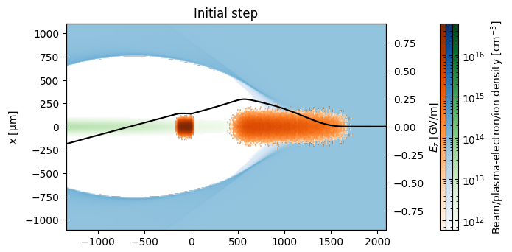
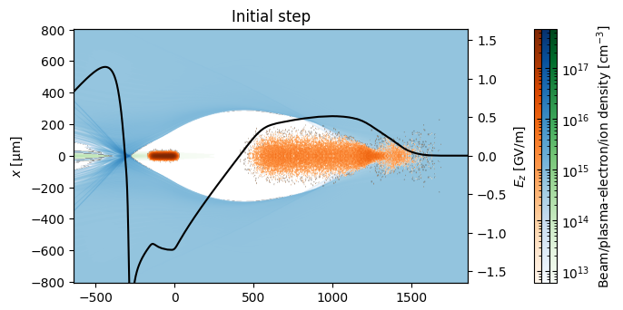
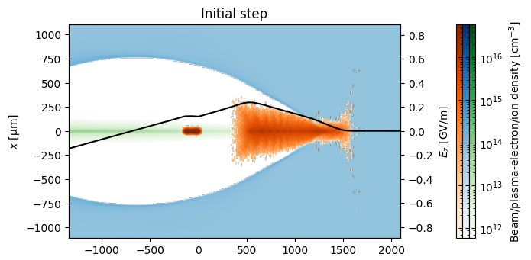
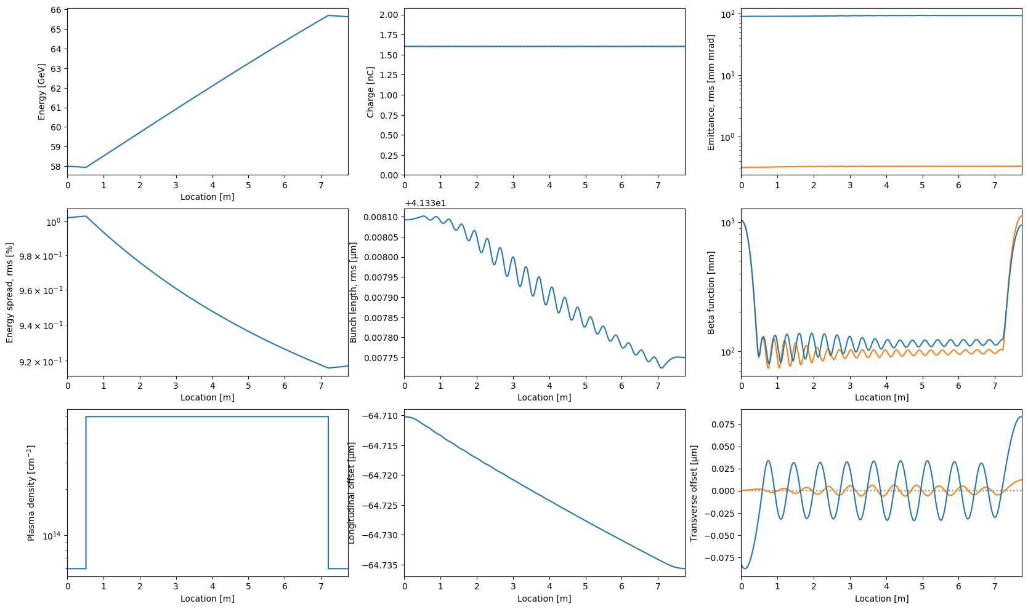
Example: single HALHF stage PIC simulation on
Data handling: Extract simulation outputs and perform analysis natively within ABEL.
Up-ramp
Flat-top
Down-ramp
2025-10-23 | Ben Chen | LCWS 2025
C. A. Lindstrøm
Page

Slide 8
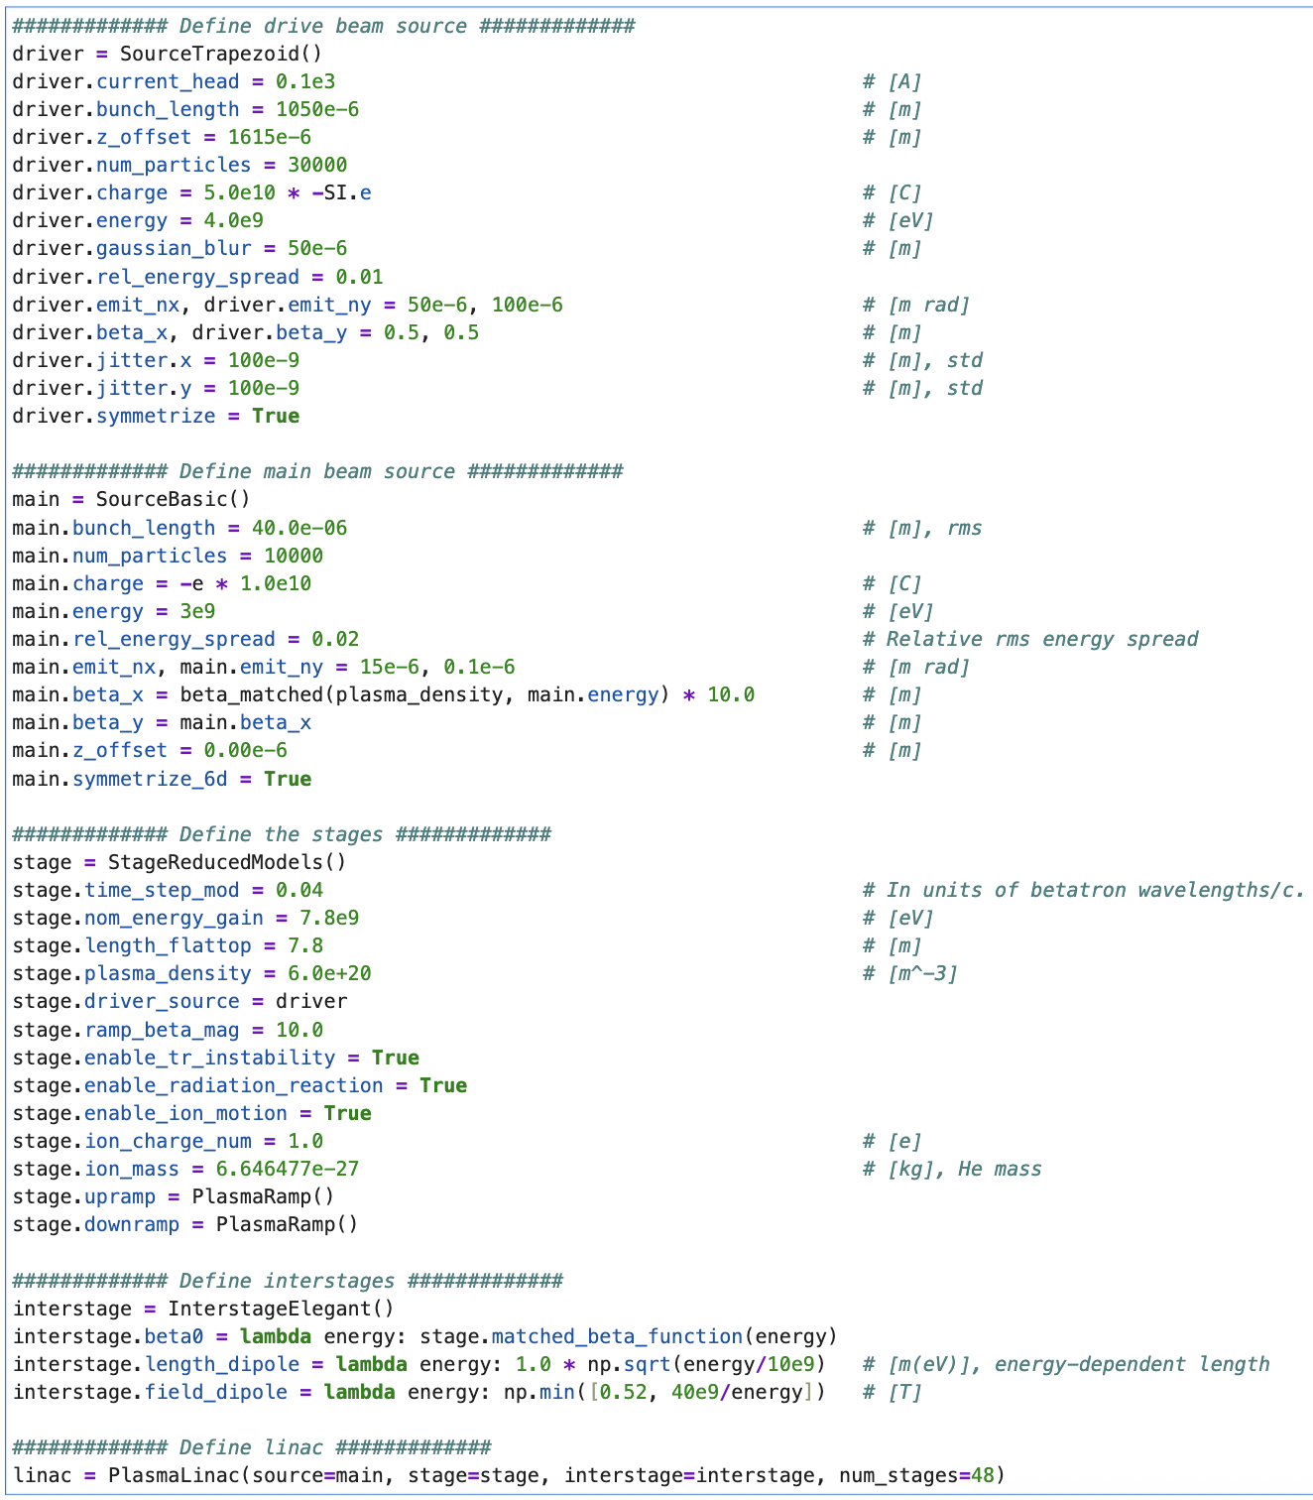
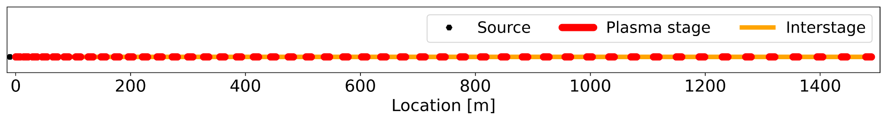
Example: HALHF plasma linac using reduced models
Reduced models: transverse intra-beam instability, radiation reaction, ion motion
Multi-shot: 5 shots for studying driver xy-jitter (Gaussian, sampled at every stage).
Affordable computational cost: Run on a laptop.
Flexible data handling: Extensive diagnostics at single stage, linac single shot and linac multi-shot level.
Wake-T + RF-Track + reduced
models
Basic Source
ELEGANT
*The standard interstage lattice has been changed since this simulation, such that this setup no longer produces the same results.
2025-10-23 | Ben Chen | LCWS 2025
Page

Slide 9
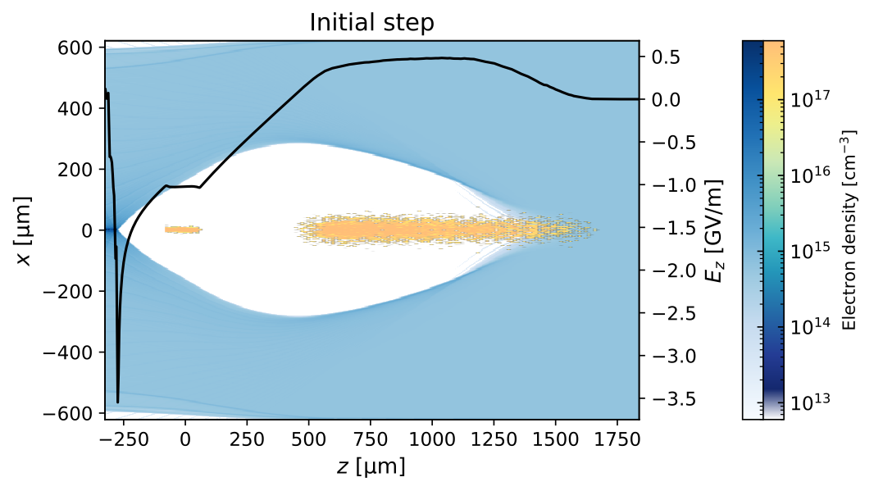
Example: HALHF plasma linac using reduced models
Single stage diagnostics:
Input beam, last stage
*The standard interstage lattice has been changed since this simulation, such that this setup no longer produces the same results.
2025-10-23 | Ben Chen | LCWS 2025
Page

Slide 10
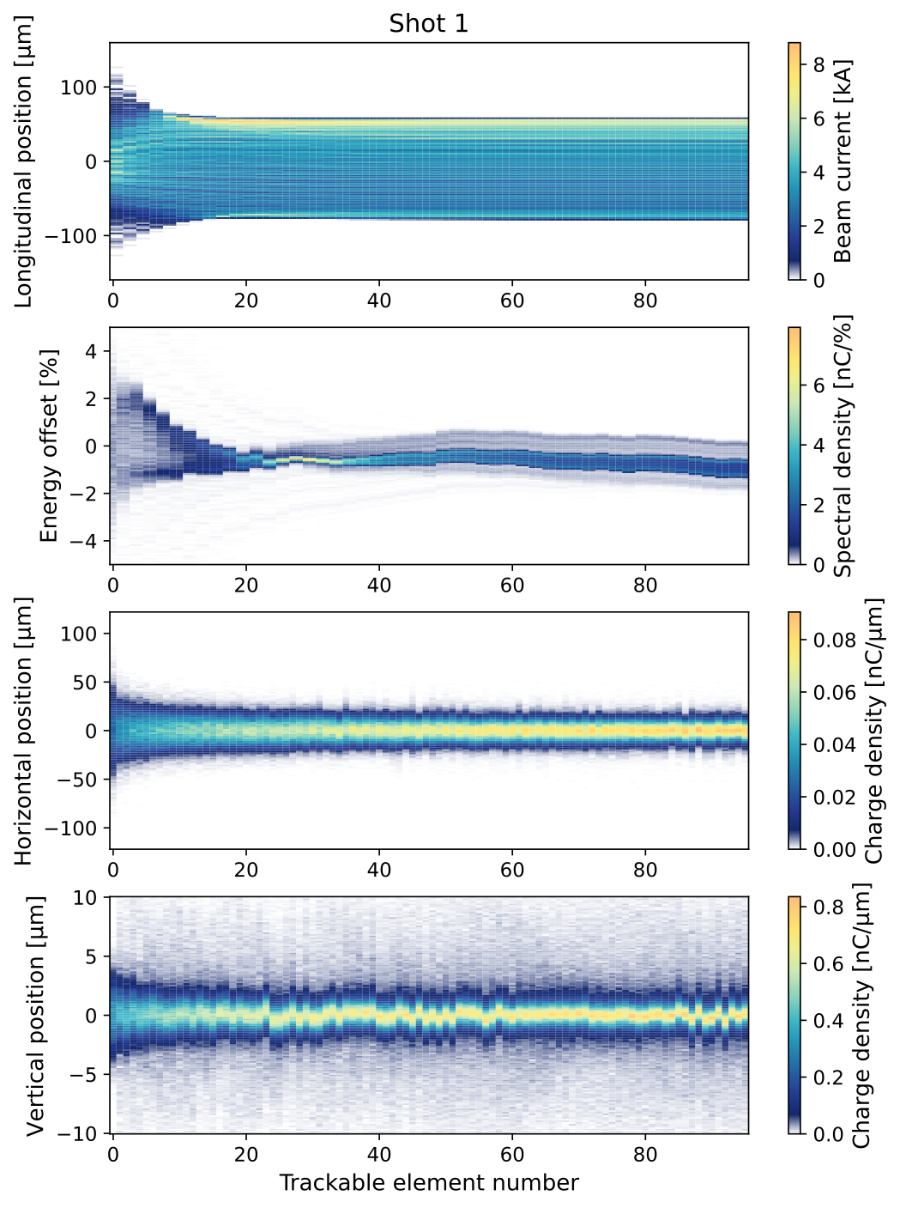
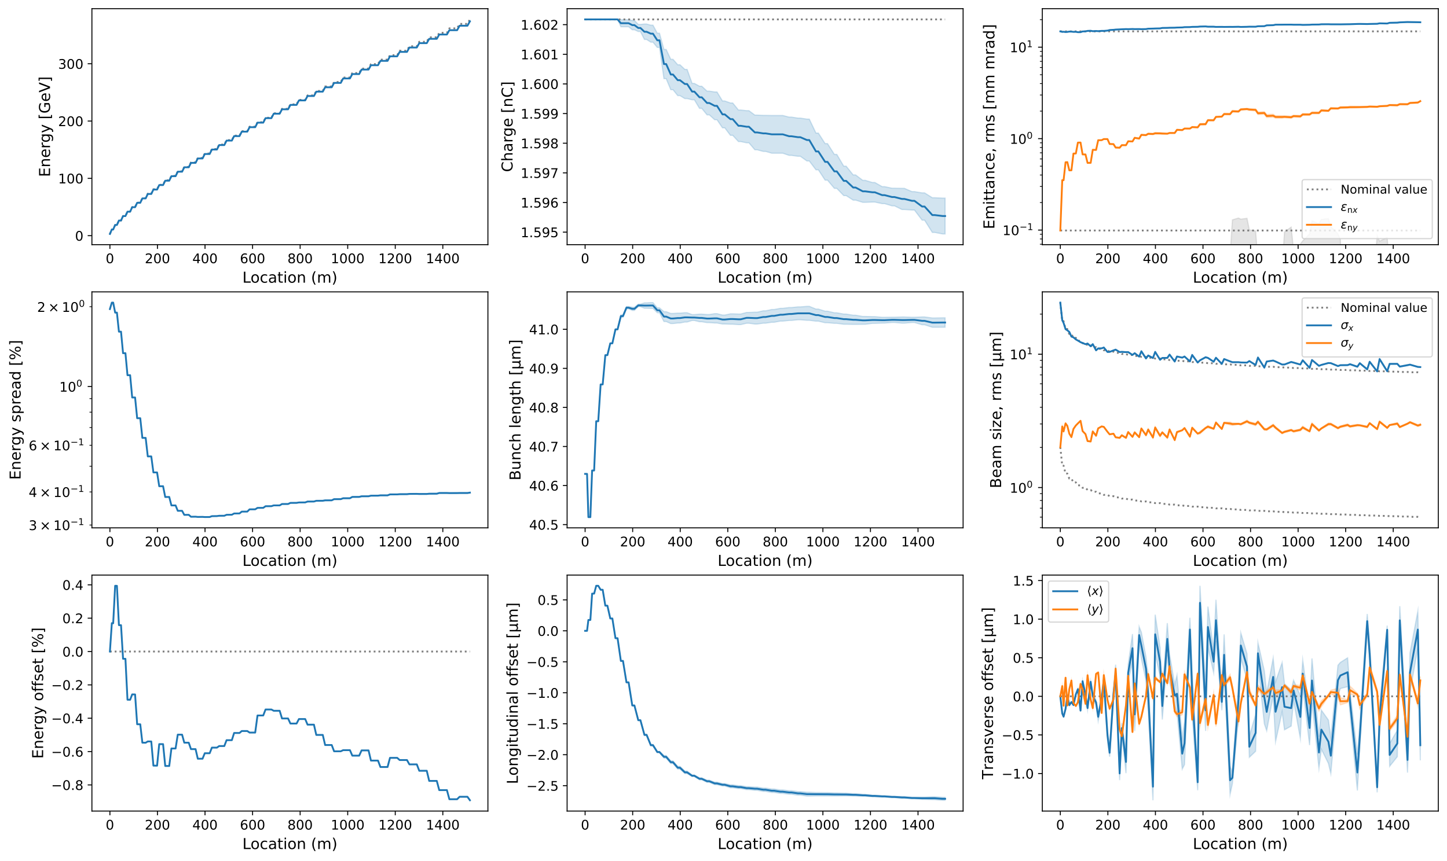
Example: HALHF plasma linac using reduced models
Linac level diagnostics:
Multi-shot diagnostics
Single-shot diagnostics
*The standard interstage lattice has been changed since this simulation, such that this setup no longer produces the same results.
2025-10-23 | Ben Chen | LCWS 2025
Page

Slide 11
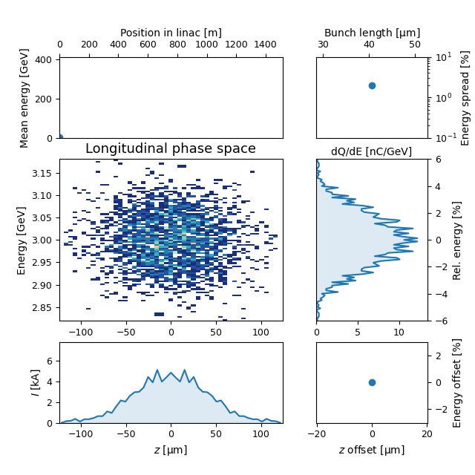
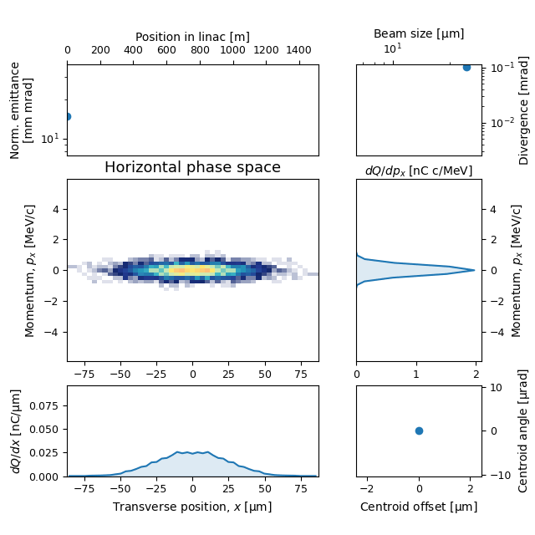
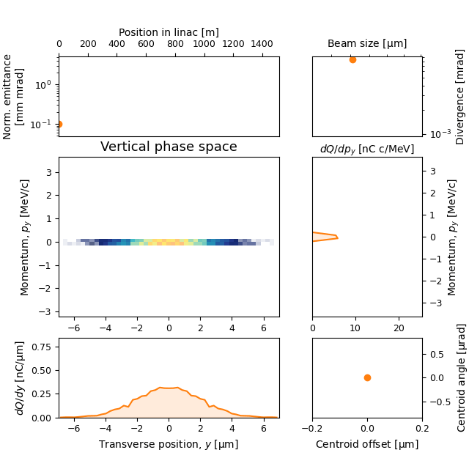
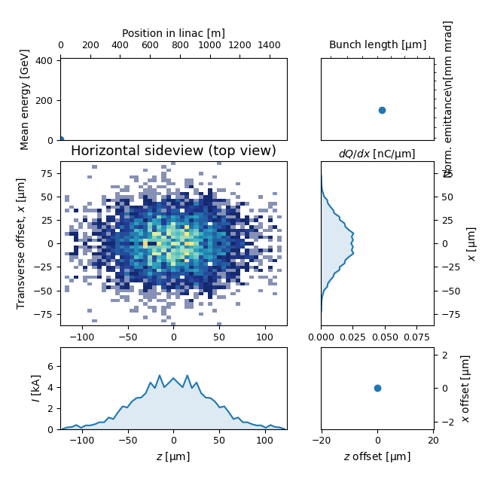
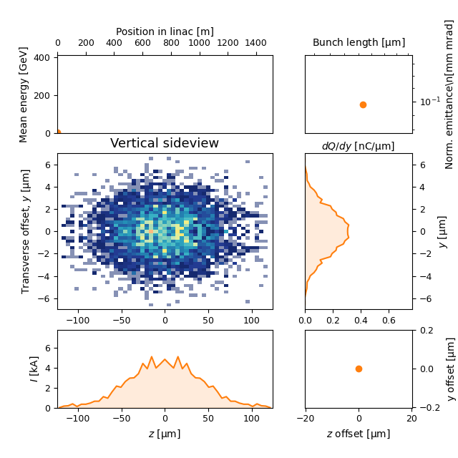

Example: HALHF plasma linac using reduced models
Linac level diagnostics:
Self-correction is applied through the interstages!
See http://arxiv.org/abs/2104.14460
*The standard interstage lattice has been altered since this simulation, such that this setup no longer produces the same results.
2025-10-23 | Ben Chen | LCWS 2025
Page

Slide 12
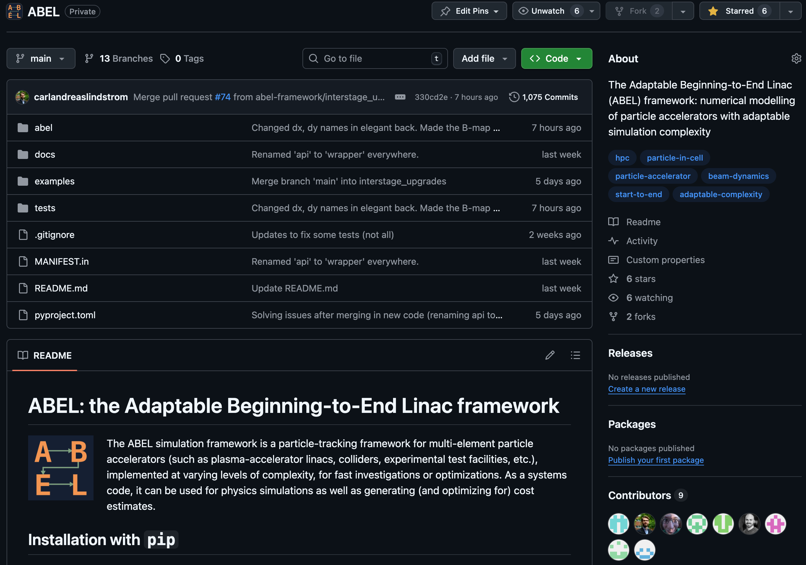
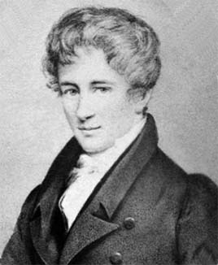
Summary
The adaptable and modular approach of ABEL allows for flexible simulation runs of entire machines with desired accuracy and speed.
Extensive simulation and diagnostic capabilities.
Integrated workflow: especially convenient for simulations on cluster.
Extendable to other applications, including FELs, strong-field QED experiments, and accelerator test facilities.
IPAC 2025 Proceeding: https://arxiv.org/abs/2505.22415
Repository: https://github.com/abel-framework/ABEL
Open source (GPL 3.0)!
Beta release available!
🥘
🕶️
N. H. Abel
2025-10-23 | Ben Chen | LCWS 2025
Page

Slide 13
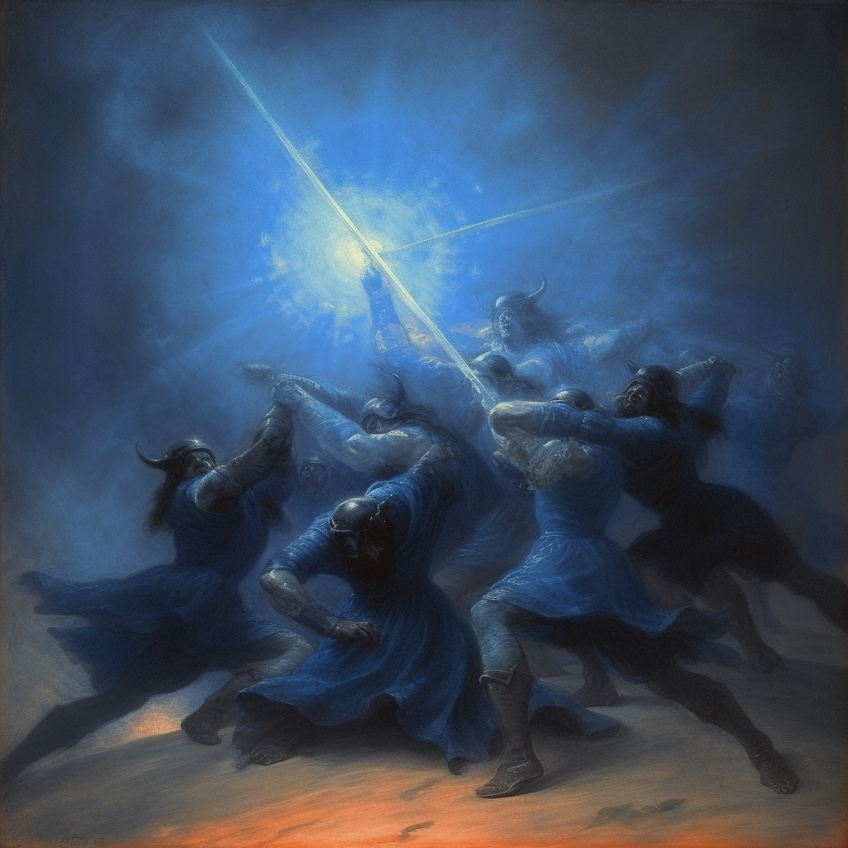

Acknowledgements
Oslo accelerator group ABEL contributors:
Erik Adli, Kyrre N. Sjøbæk, Carl A. Lindstrøm,
J. B. Ben Chen, Ole Gunnar Finnerud,
Daniel Kalvik, Pierre Drobniak, Felipe Peña, Eir E. Hørlyk
External contributors (LBNL):
Axel Huebl, Chad Mitchell
Funding:
European Research Council (ERC)
The Research Council of Norway

Slide 14
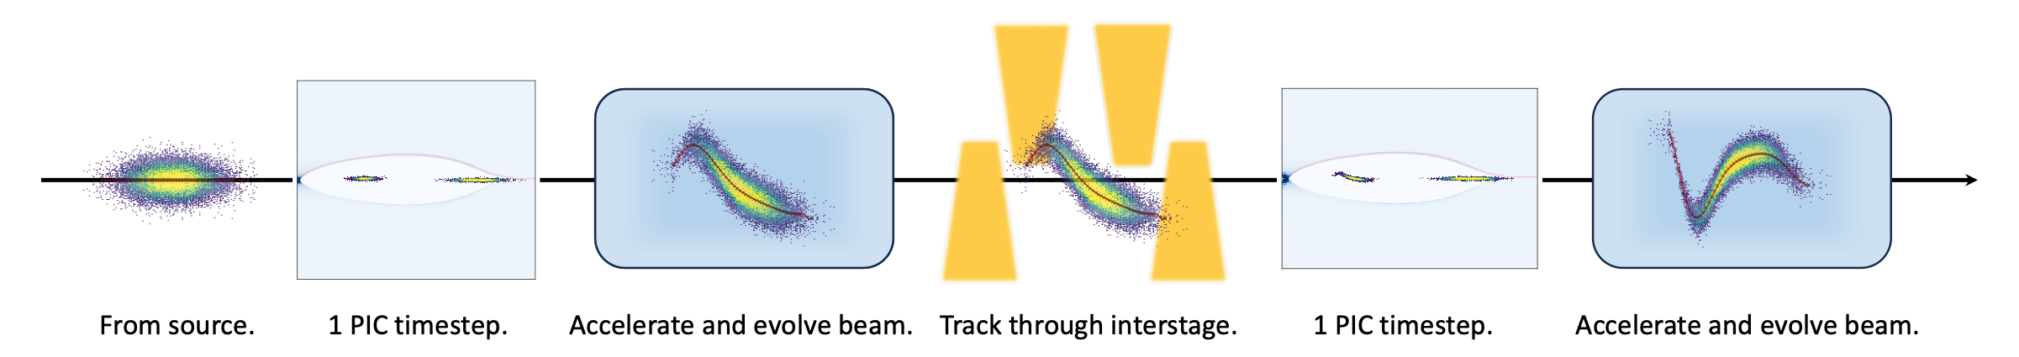
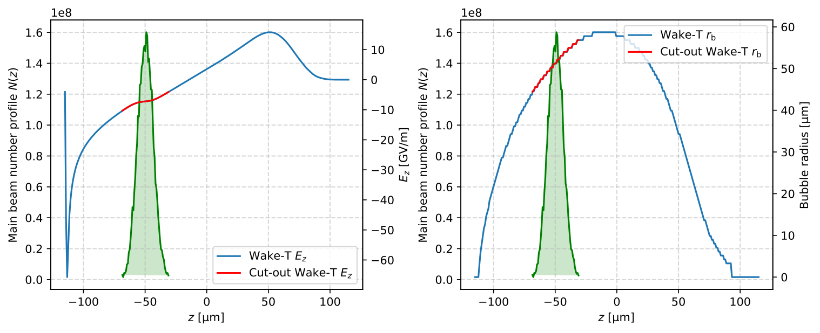
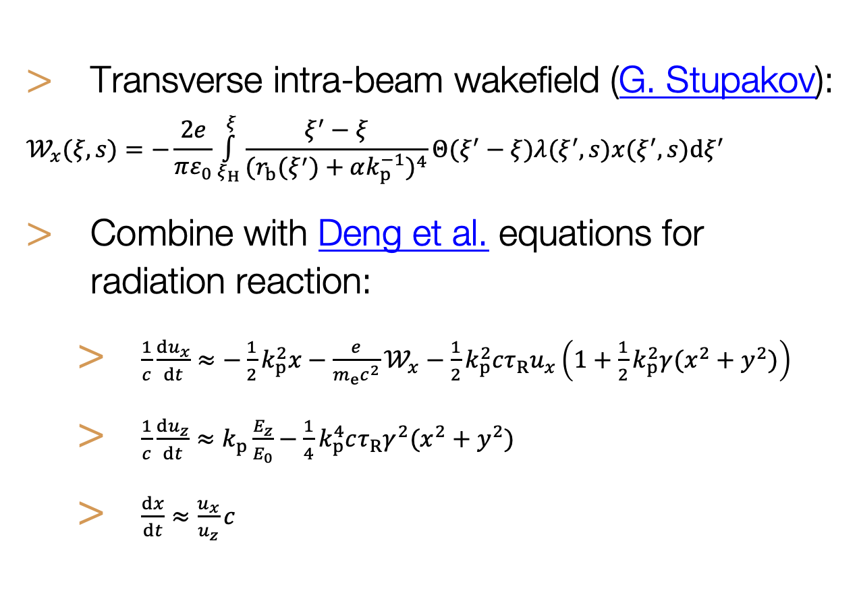
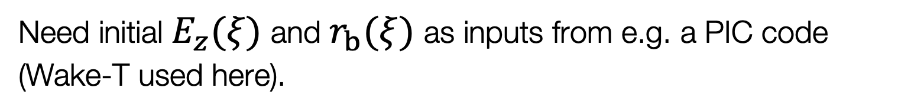

Simplified transverse wake instability model
Wakefield formalism has been used in CLIC to study the limitations on charge and efficiency.
Ansatz: for small offsets/perturbations, transverse instability in PWFA should behave similarly to BBU in conventional accelerators.
Outline for start-to-end simulation processes using simplified transverse instability model. Wake-T is used instead of PIC here.
Transverse intra-beam wakefield (G. Stupakov):
  $$𝒲_{x}(ξ,s)=−\frac{2e}{πε_{0}}\overset{ξ}{\underset{ξ_{H}}{∫}}\frac{ξ^{′}−ξ}{(r_{b}(ξ^{′})+αk_{p}^{−1})^{4}}Θ(ξ^{′}−ξ)λ(ξ^{′},s)x(ξ^{′},s)dξ^{′}$$
Combine with Deng et al. equations for radiation reaction:
  $\frac{1}{c}\frac{du_{x}}{dt}≈−\frac{1}{2}k_{p}^{2}x−\frac{e}{m_{e}c^{2}}𝒲_{x}−\frac{1}{2}k_{p}^{2}cτ_{R}u_{x}\left(1+\frac{1}{2}k_{p}^{2}γ(x^{2}+y^{2})\right)$
  $\frac{1}{c}\frac{du_{z}}{dt}≈k_{p}\frac{E_{z}}{E_{0}}−\frac{1}{4}k_{p}^{4}cτ_{R}γ^{2}(x^{2}+y^{2})$
  $\frac{dx}{dt}≈\frac{u_{x}}{u_{z}}c$
$s$: beam location.
$ξ^{′}$: long. coordinate of driving particle.
$ξ$: long. coordinate of reference particle.
$ξ_{H}$: long. coordinate of beam head.
$α$: numerical factor ~1.
$k_{p}^{−1}$: plasma skin depth.
$Θ(ξ)$: Heaviside step function.
$λ(ξ,s)$: long. beam number density.
$x(ξ,s)$: particle transverse offset.
$u(ξ,s)=p/m_{e}c$: normalised $e^{−}$ momentum.
$$τ_{R}=2r_{e}/3c$$
$E_{0}=m_{e}cω_{p}/e$: wavebreaking field.
Need initial $E_{z}(ξ)$ and $r_{b}(ξ)$ as inputs from e.g. a PIC code (Wake-T used here).
2025-10-23 | Ben Chen | LCWS 2025
Page

Slide 15
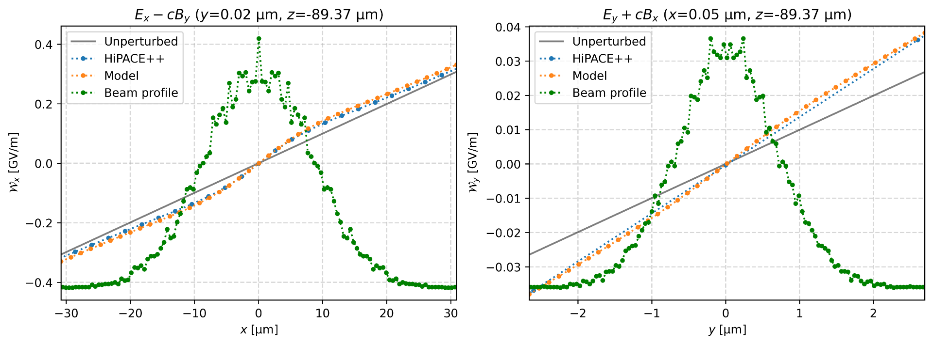
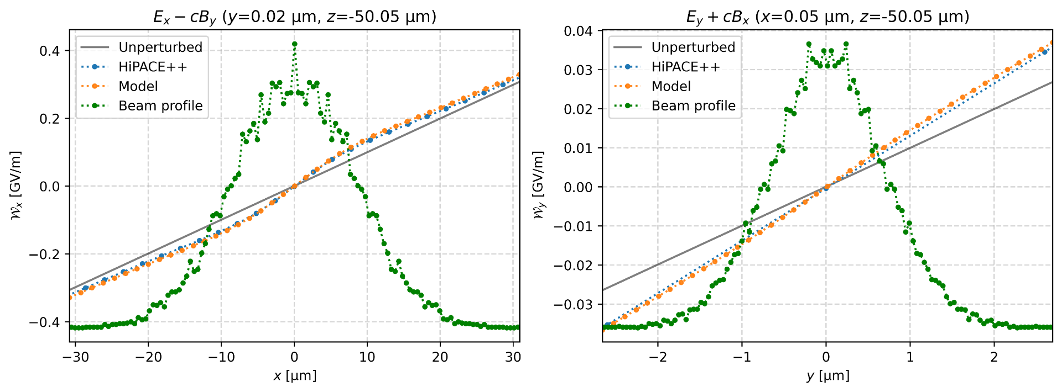
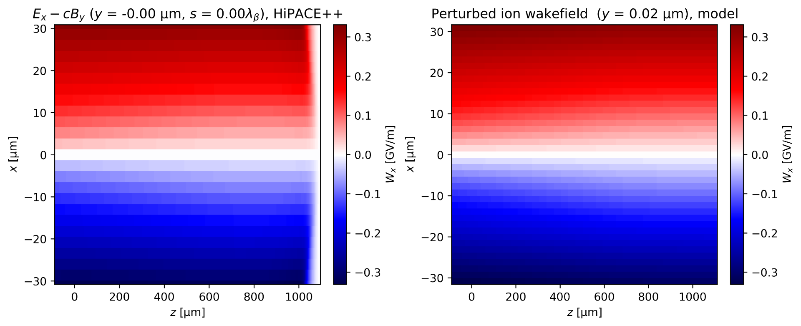
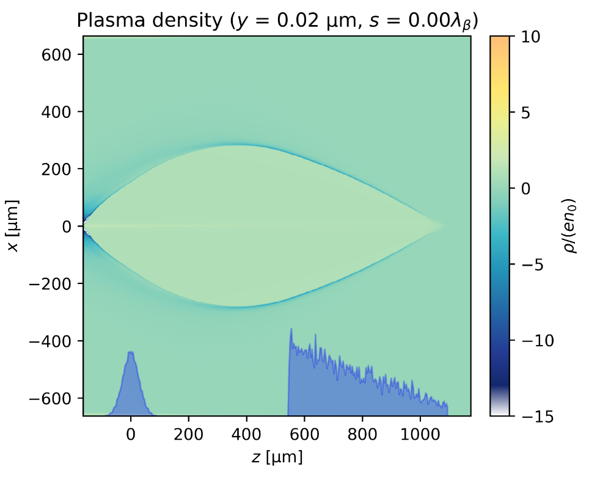
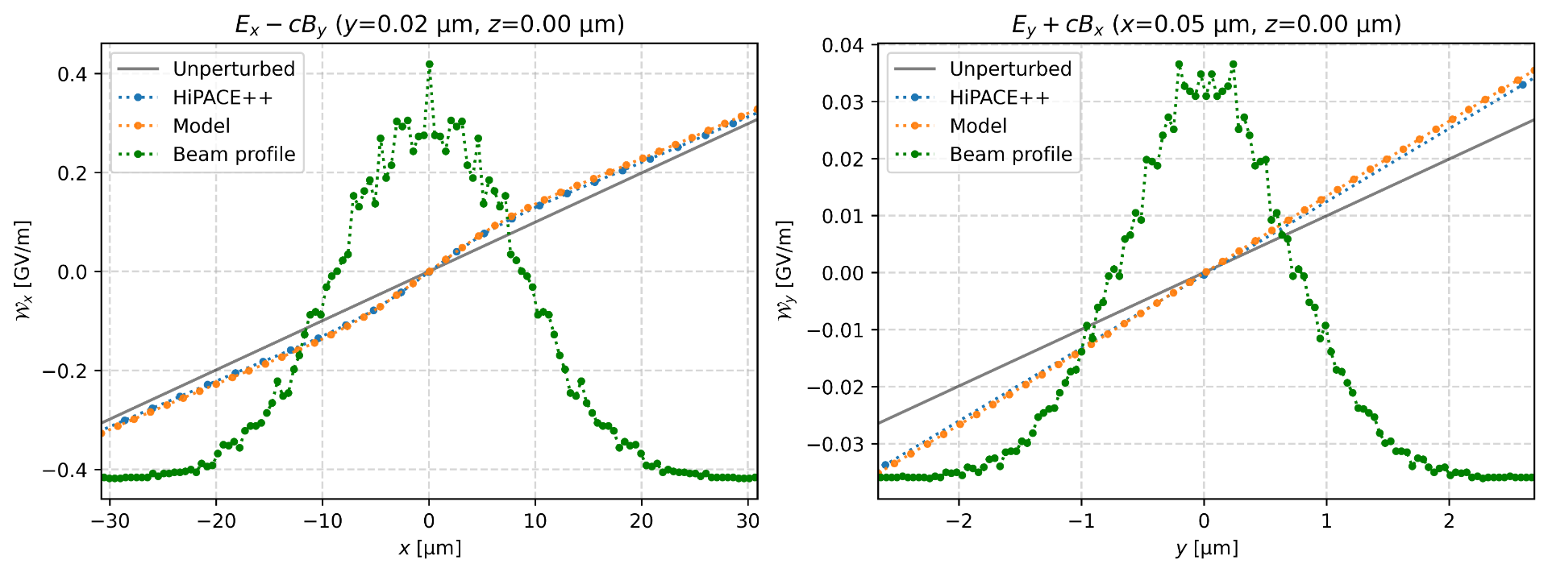
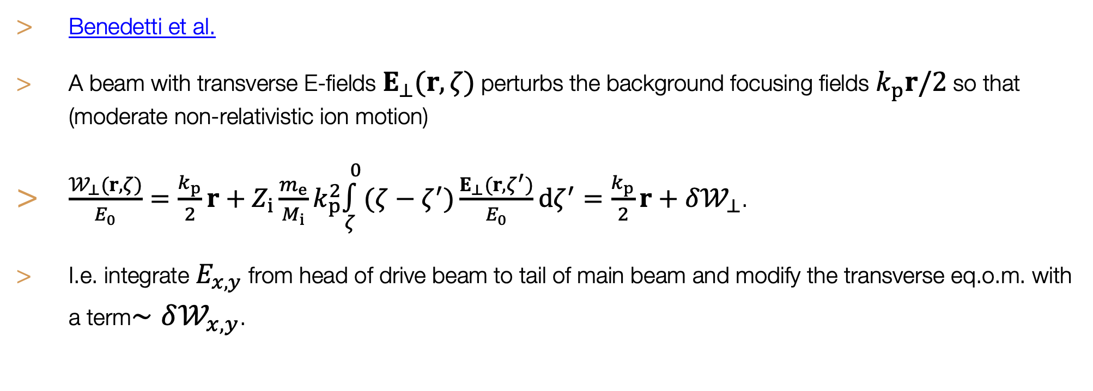
Benchmarks against HiPACE++
Benchmarks of wakefields
Benedetti et al.
A beam with transverse E-fields $E_{⊥}(r,ζ)$ perturbs the background focusing fields $k_{p}r/2$ so that (moderate non-relativistic ion motion)
$\frac{𝒲_{⊥}(r,ζ)}{E_{0}}=\frac{k_{p}}{2}r+Z_{i}\frac{m_{e}}{M_{i}}k_{p}^{2}\overset{0}{\underset{ζ}{∫}}(ζ−ζ^{′})\frac{E_{⊥}(r,ζ^{′})}{E_{0}}dζ^{′}=\frac{k_{p}}{2}r+δ𝒲_{⊥}$.
I.e. integrate $E_{x,y}$ from head of drive beam to tail of main beam and modify the transverse eq.o.m. with a term$∼δ𝒲_{x,y}$.
2025-10-23 | Ben Chen | LCWS 2025
Page

Slide 16
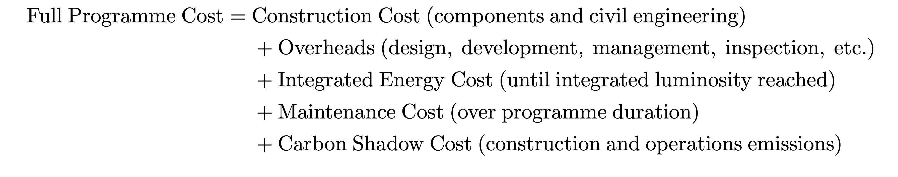
Cost model
E. Adli et al. “HALHF: a hybrid, asymmetric, linear Higgs factory using plasma- and RF-based acceleration. Backup Document”, arXiv:2503.23489
Developed a cost model, accounting for the cost of all collider subsystems—scaled per length (and/or power) based on ILC/CLIC costs
Defining a reasonable optimisation metric is non-trivial:
Used Bayesian optimisation to find minimum cost—fewer than 100 iterations typically sufficient to find the global minimum
2025-10-23 | Ben Chen | LCWS 2025
Page

Slide 17
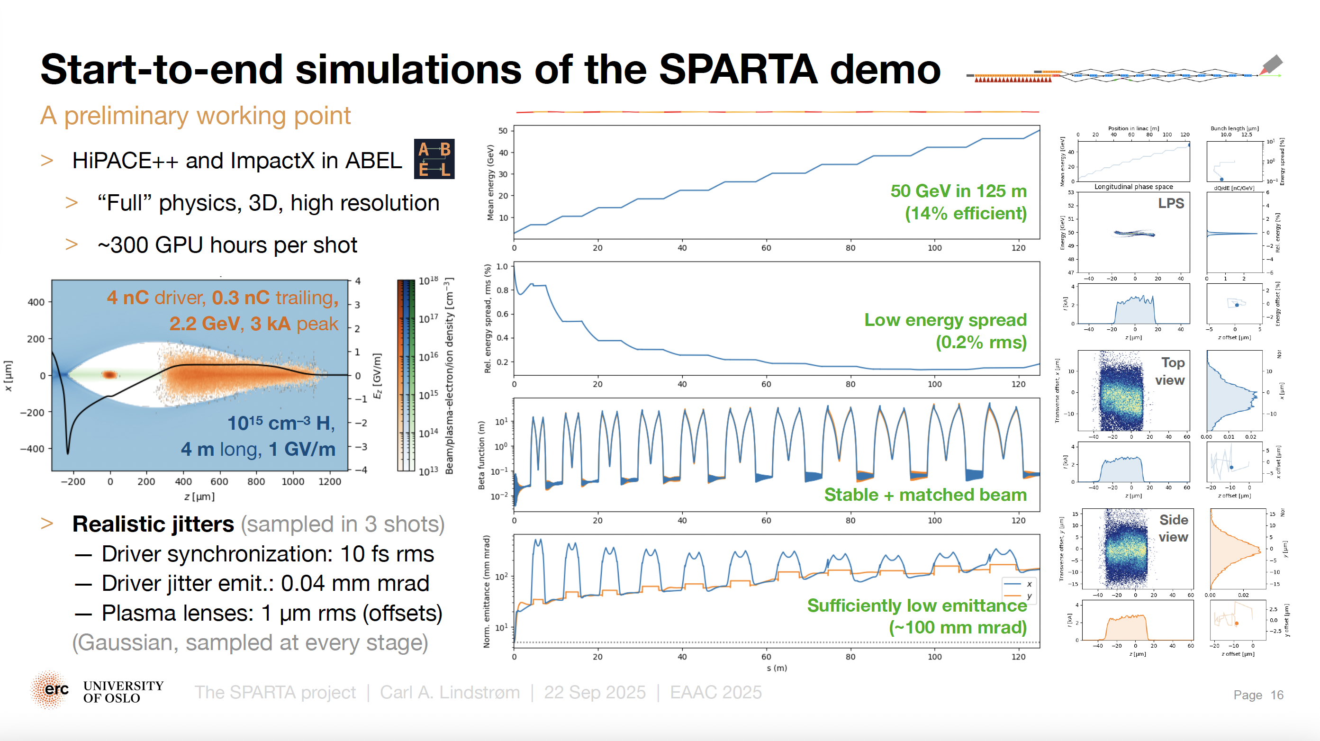
2025-10-23 | Ben Chen | LCWS 2025
Page

Slide 18

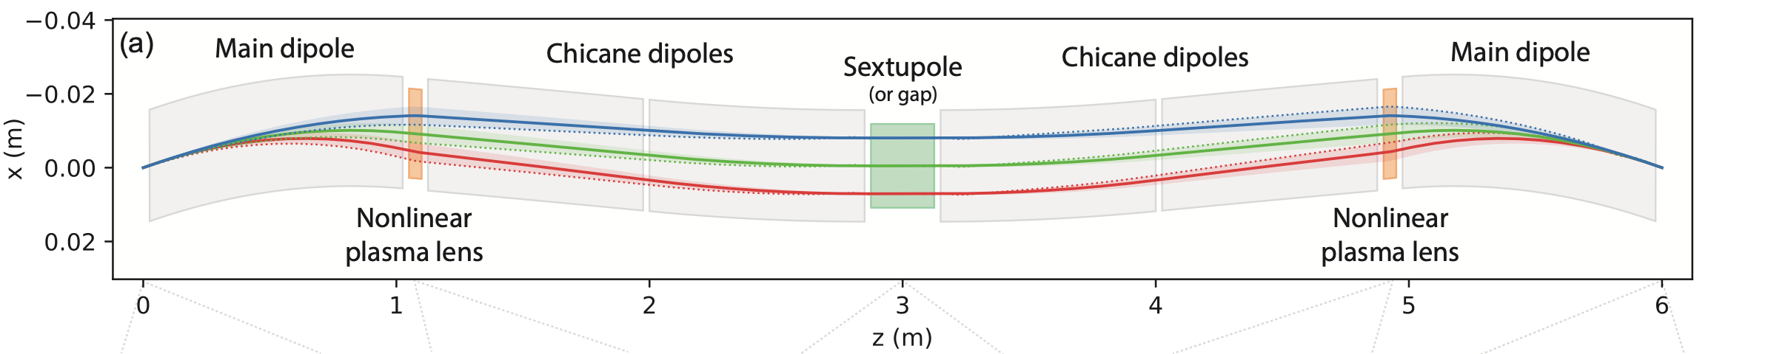
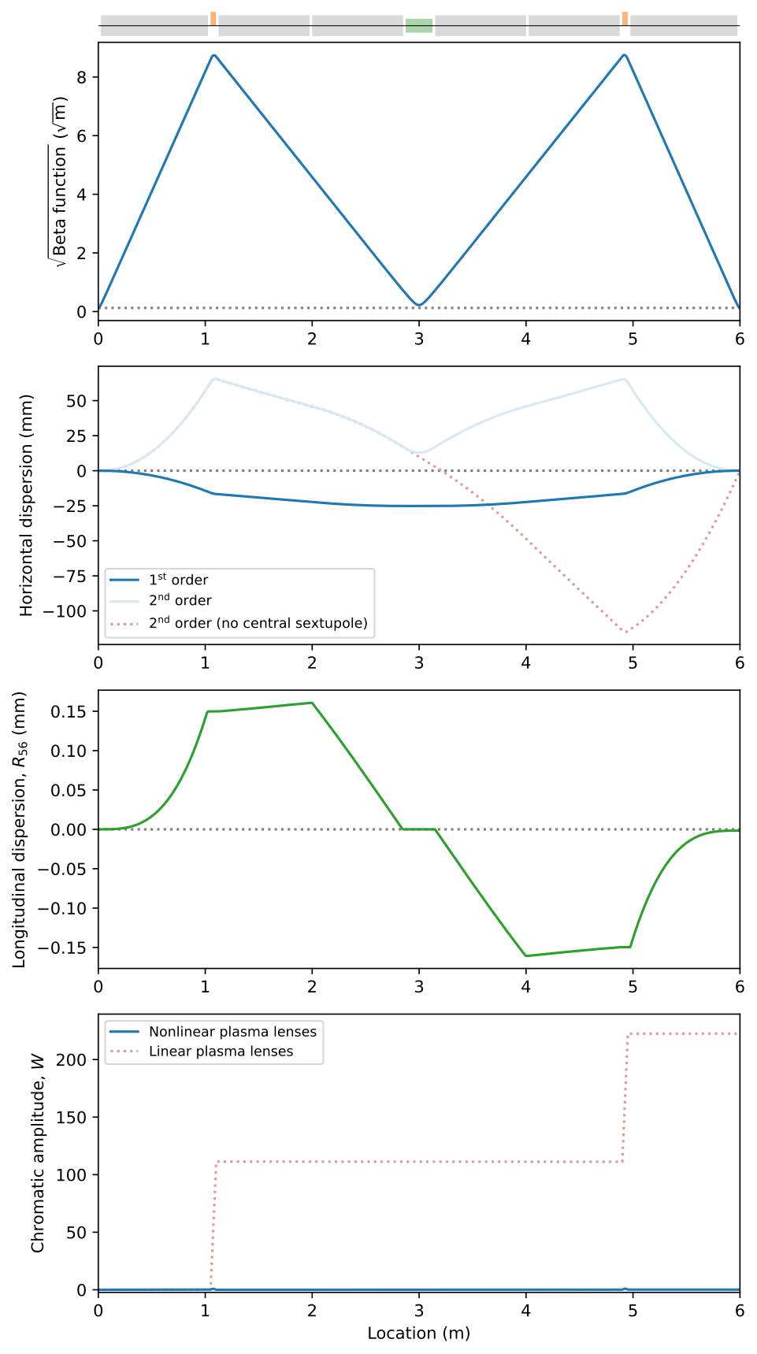
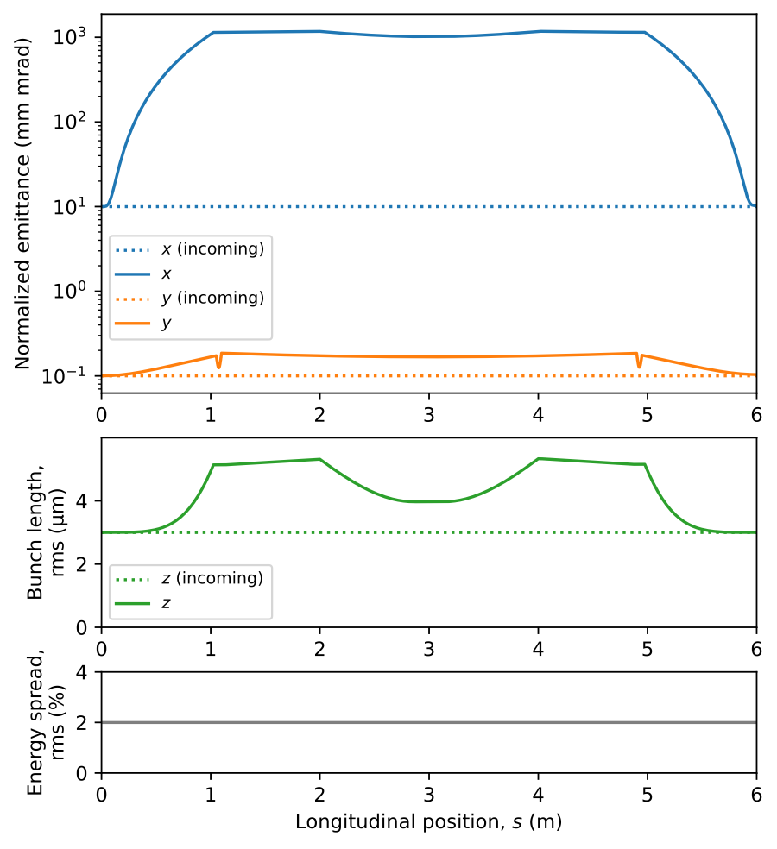
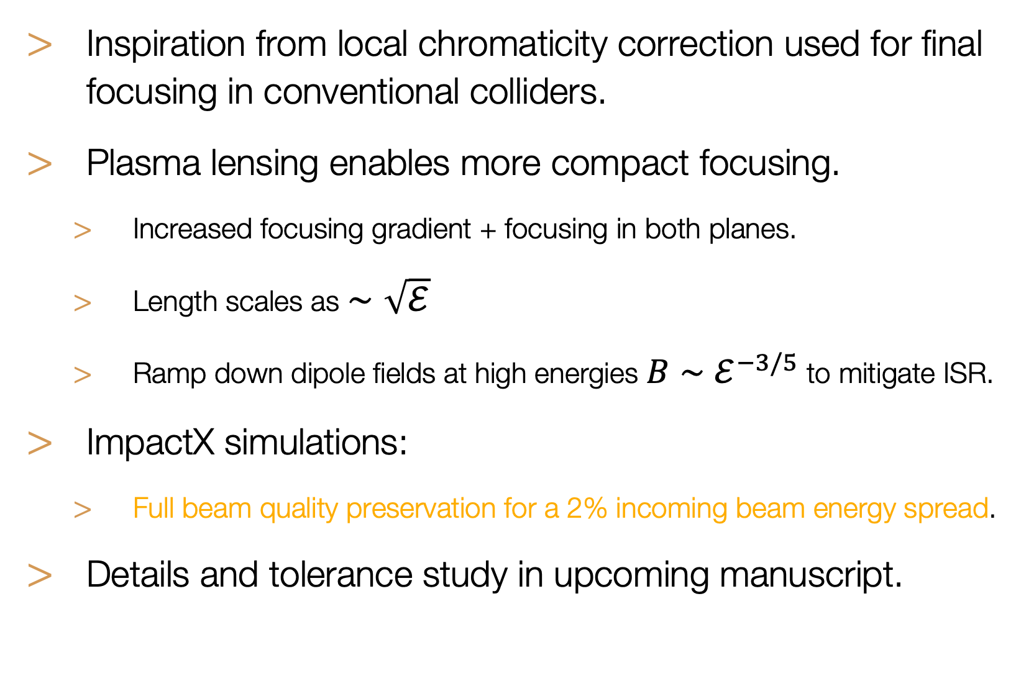
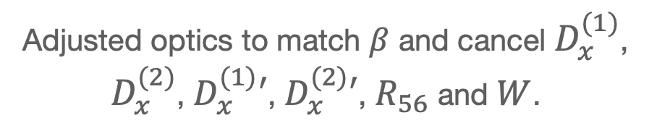
C. A. Lindstrøm et al. Manuscript in preparation.
Beam initially dispersed.
Achromatically focused.
Corrects second-order dispersion.
Refocused.
Cancel dispersion.
Inspiration from local chromaticity correction used for final focusing in conventional colliders.
Plasma lensing enables more compact focusing.
  Increased focusing gradient + focusing in both planes.
  Length scales as $∼\sqrt{ℰ}$
  Ramp down dipole fields at high energies $B∼ℰ^{−3/5}$ to mitigate ISR.
ImpactX simulations:
  Full beam quality preservation for a 2% incoming beam energy spread.
Details and tolerance study in upcoming manuscript.
Adjusted optics to match $β$ and cancel $D_{x}^{(1)}$, $D_{x}^{(2)}$, $D_{x}^{(1)}′$, $D_{x}^{(2)}′$, $R_{56}$ and $W$.
Staging optics at 10 GeV. Preliminary.
2025-10-23 | Ben Chen | LCWS 2025
Page

Slide 19
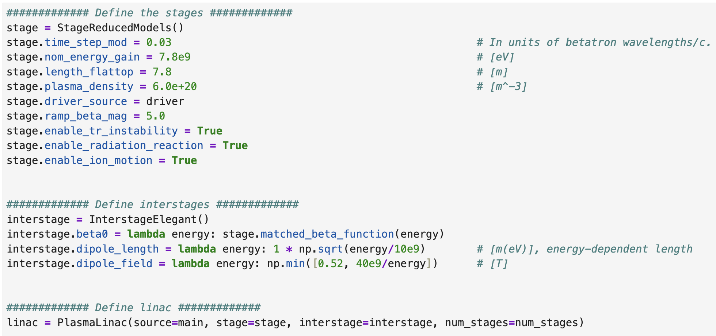
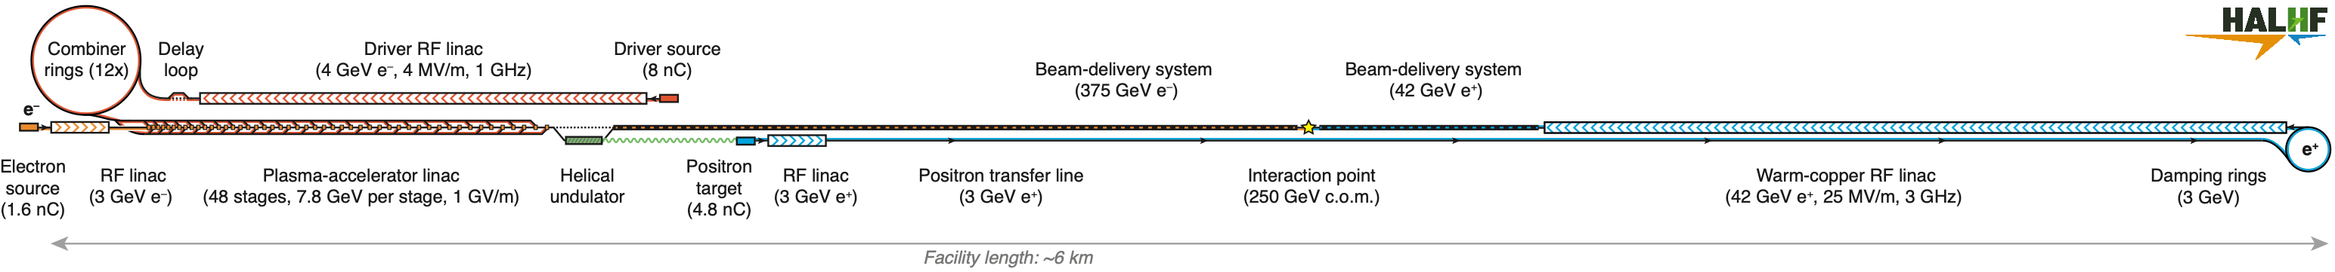


Diagnostics
One shot, single stage diagnostic
Use case: HALHF plasma linac with simplified models
Wake-T + reduced
models
ELEGANT
Basic Source
2025-10-23 | Ben Chen | LCWS 2025
Page

Slide 20




Diagnostics
Multi-shot
Multi-shot, multi-step scan
2025-10-23 | Ben Chen | LCWS 2025
Page

