Slide 1
Damping Ring and Bunch Compressor design for the C³ collider
Matthew Andorf

Slide 2

Acknowledgments
SLAC
Emilio Nanni
Marty Breidenbach
Caterina Vernieri
Wei-Hou Tan
Sophia Morton
Cornell
Nigel Lockyer
Jared Maxson
Adam Bartnik
David Sagan
Colwyn Gulliford

Slide 3
Outline
Motivation for damping ring
Damping ring design concepts
Intrabeam scattering in damping ring + performance
Bunch compressor performance

Slide 4
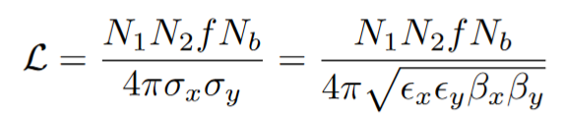
Motivation for Damping Rings
Spin Polarized Electron Production:
GaAs photocathode operated in a DC electron gun
Round beam, ~2-3 μm normalized emittance
Positron production:
Tungsten target
2-3 orders of magnitude larger beam emittance than electron beam
Damping Rings optimize beam luminosity!
Can produce ~100 nm horizontal emittances
Produce flat beams, ~1 nm vertical emittance
Beamstrahlung:
Use of a flat beam reduces beam collision induced radiative losses

Slide 5

Ring Layout
Most damping designs use a race-track layout:
Arcs consist of periodic cells designed for low emittance
Straight sections provide room for damping wigglers, RF cavities and injection/extraction lines
Damping wigglers, RF
Periodic arc-cells
Periodic arc-cells
injection/extraction lines/wigglers
From Booster Linac
(or pre-damping ring)
To Main Linac

Slide 6
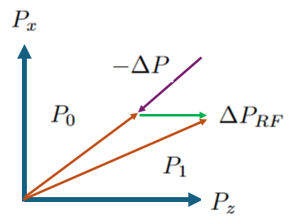
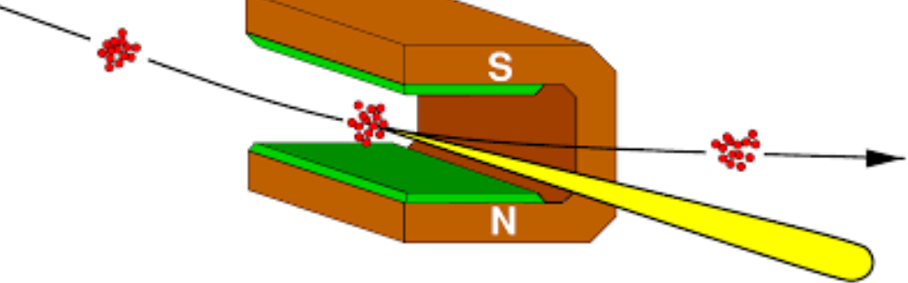
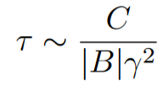

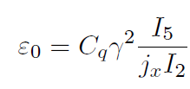


Synchrotron Radiation Damping
Synchrotron radiation damps particle motion in all three planes (horizontal, vertical and longitudinal)
Energy loss from radiation grows with particle’s energy → longitudinal damping
Damping in the transverse plane is the result photon emission (tangential to particle path) + RF energy restoration (longitudinal direction only)
SR damping is countered by quantunm excitation leading to a ‘natural’ or zero-charge beam emittance!

Slide 7
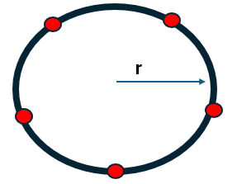


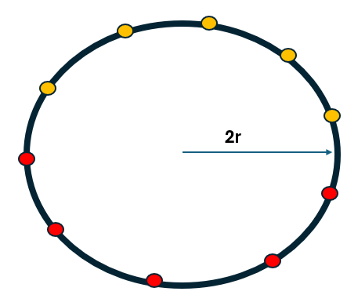
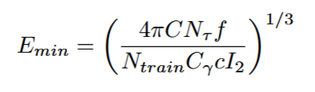
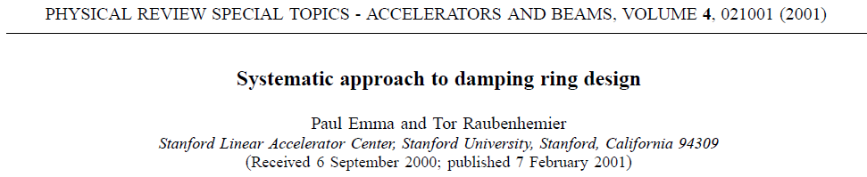
Damping Ring Basic Considerations
Givens:
Bunch structure (e.g. bunch spacing, number of bunches per train)
Collider repetition rate
Injected beam emittance
Choices:
Number of stored bunch trains (N_{train})—determines min. circumference
Stored number of damping times(Nτ )—constrains value of damping time
Lattice design, wiggler parameters
Consequences of those choices:
Beam energy
Extracted beam emittance

Slide 8
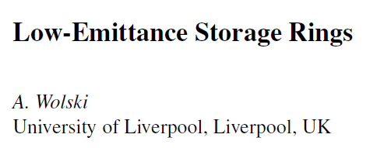
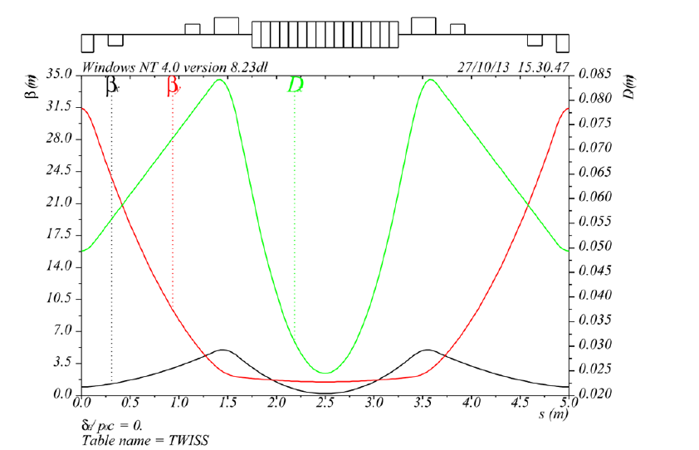

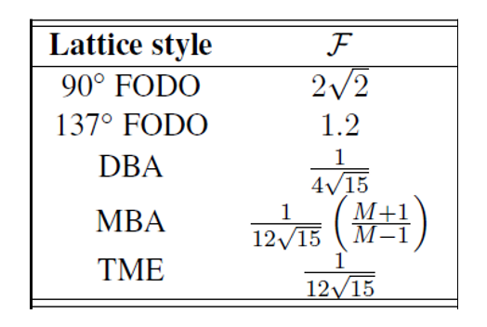


Arc cell design
Theoretical Minimum Emittance (TME) cells:
Produce lowest achievable emittance
Twiss parameters chosen to minimize I₅ integral while accounting propagation through dipole
Does not produce dispersion free section…not a problem for damping rings!
Bend magnet
Optimal values at dipole center

Slide 9
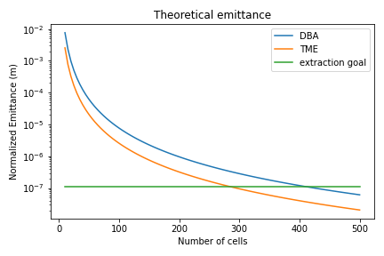
Arc Lattice design
Emittance scales as θ³.
Number of cells can be varied to achieve design emittance goal.
Wiggler can reduce emittance further
IBS will increase final achieved emittance
Some limitations to consider:
The minimum cell length needs to be achievable from magnet/vacuum design considerations
TME cells require strong focusing resulting in high chromaticity. Operating at optimum emittance may not be achievable.
Higher number of cells will result in a tighter alignment requirement (vertical emittance)
The cost and complexity of building the ring goes up with number of cells

Slide 10
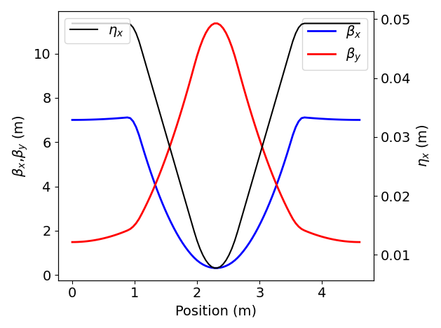
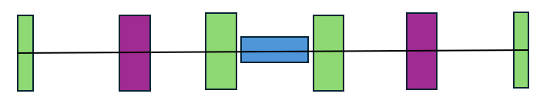
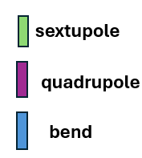
TME cell
* @ 2.5 GeV
Parameter | Value*
Bend angle (degree) | 3.6
Bend B field (T) | 0.55
Bend Length (m) | 0.7
Bend gradient (T/m) | 12.5
QF1 gradient (T/m) | -31.7
QF1 length (m) | 0.20
ξ_{x}/Q_{x} (Normalized natural chromaticity) | -1.8
ξ_{x}/Q_{x} (Normalized natural chromaticity) | -2.35
j_{x} | 1.33
ε/ε_{opt} | 3.8

Slide 11
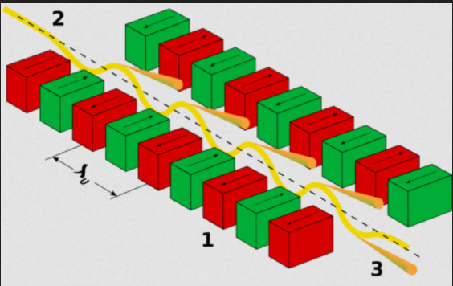
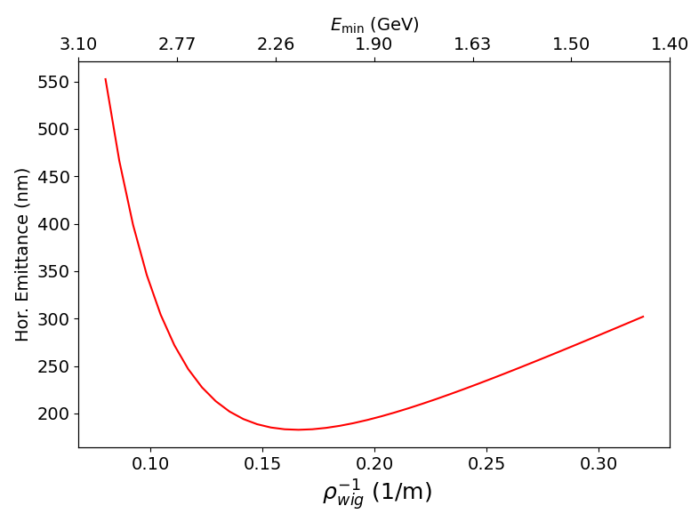
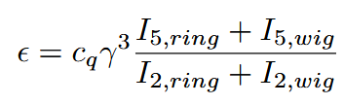
Damping Wigglers
Damping Wigglers can be used to both lower the equilibrium emittance
Damping rate is proportional to radiative losses around the ring
I₂ is increased due to extra bending (independent of ring circumference) directly lowering eq. emittance
Faster damping allows reduction in design energy, indirectly lowering eq. emittance
Wigglers are installed in dispersion free region
Wiggler ‘self-dispersion’ modifies I_{5.} Wiggler B-field can not be increased arbitrarily→ emittance growth

Slide 12
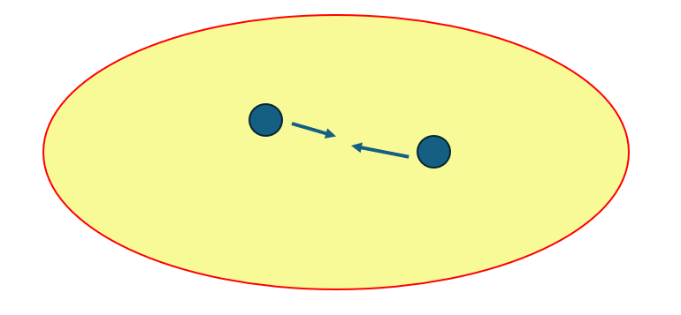
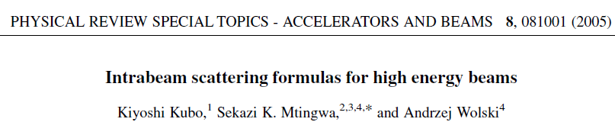
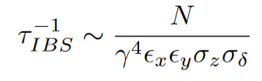
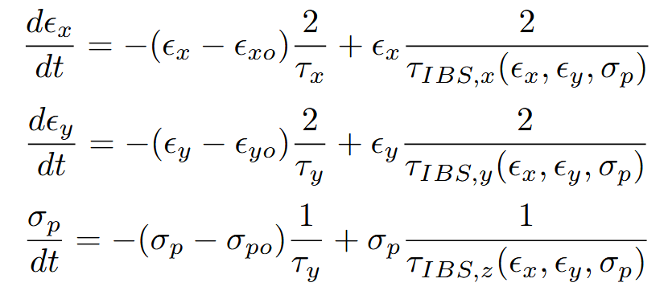
Intrabeam Scattering
IBS: Multiple small angle scattering within beam results in emittance growth in all three planes
Theory simplifies at high energy (“CIMP”), allowing fast computation of IBS effect
Rates depend only on lattice functions and beam parameters
Implemented custom CIMP code in python
Lattice functions extracted from TAO (BMAD)
IBS rates computed from weighted sum of TME cell/Wiggler (FODO) section
Eq. emittance is a balance between SR damping, quantum excitation and IBS induced growth resulting in ODE system
Solved through combination of integrating ODE and numerical nonlinear solver

Slide 13
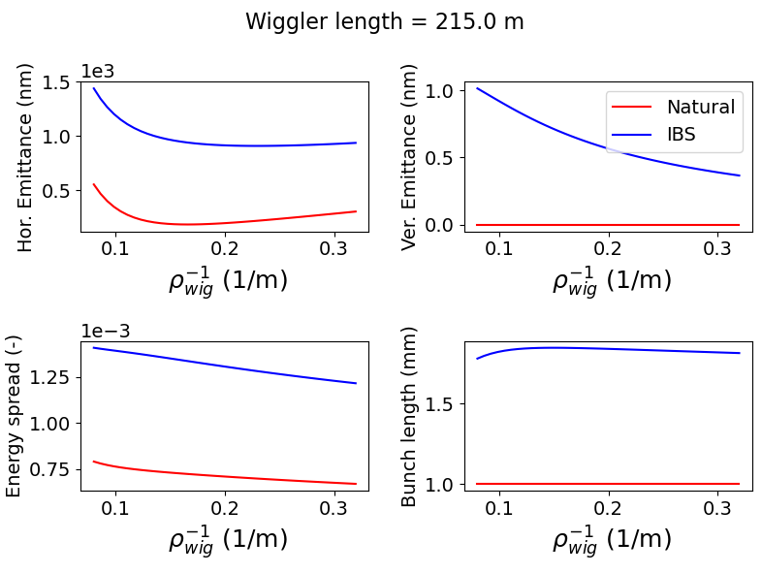
Wiggler Optimization with IBS
Wiggler bend radius and length varied with the following fixed:
Damping time 6.1 ms (5.5 damping times)
Bunch charge: 1 nC
Zero charge bunch length: 1 mm (RF voltage adjusted accordingly)
100 TME cells, length scaled to fix ring circumference
Wiggler period, 7.5 cm. Wiggler contained in FODO cell 5.3 m long

Slide 14
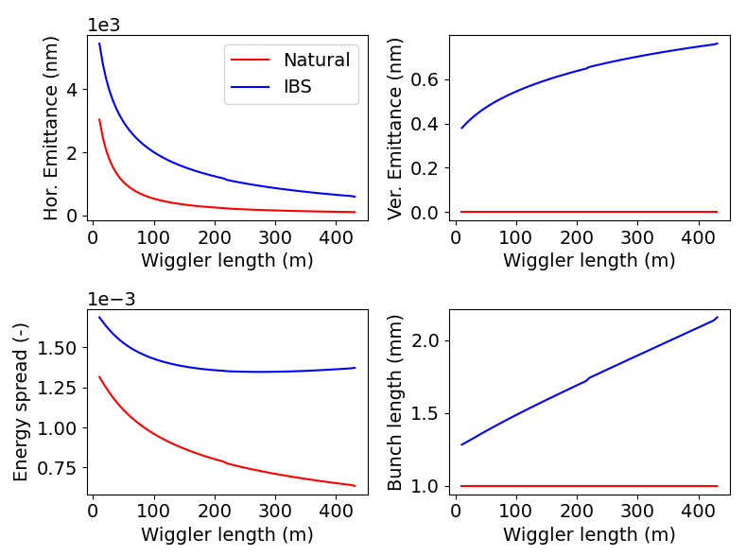
Wiggler Optimization with IBS
Wiggler bend radius and length varied with the following fixed:
Damping time 6.1 ms (5.5 damping times)
Bunch charge: 1 nC
Zero charge bunch length: 1 mm (RF voltage adjusted accordingly)
100 TME cells, length scaled to fix ring circumference
Wiggler period, 7.5 cm. Wiggler contained in FODO cell 5.3 m long

Slide 15
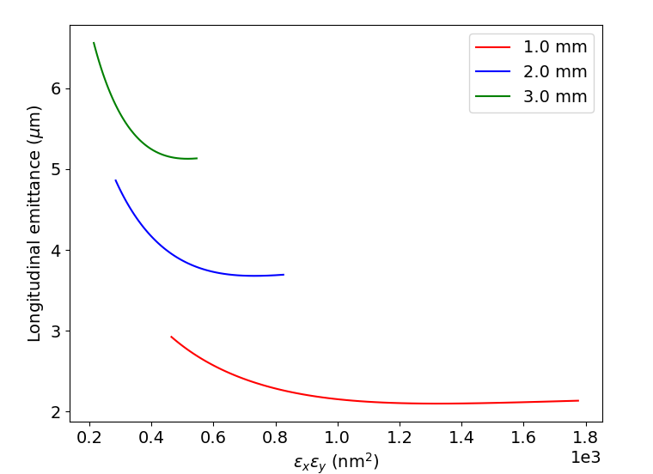
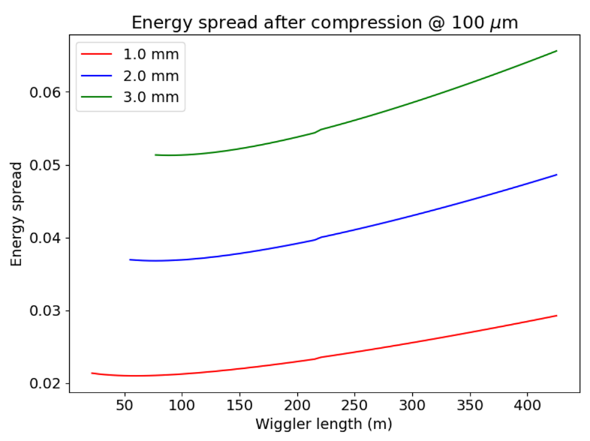

Bunch compression
Short bunch length (100 um) required for main linac
Bunch compressor (BC) between DR and main linac
Trade-off between transverse emittances and longitudinal emittance in DR
Without further acceleration in BC longitudinal emittance is conserved
Higher compression→higher resulting energy spread (percent level)

Slide 16
BACK UP SLIDES

Slide 17
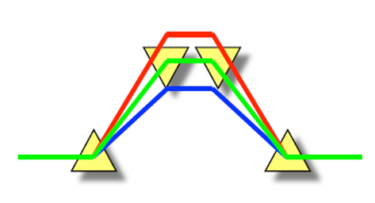
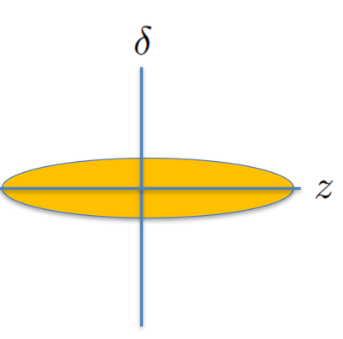
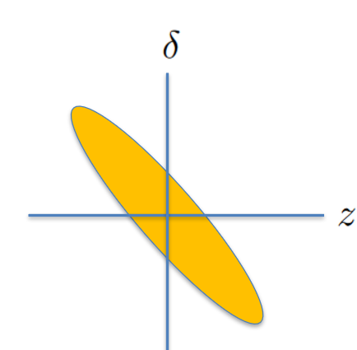
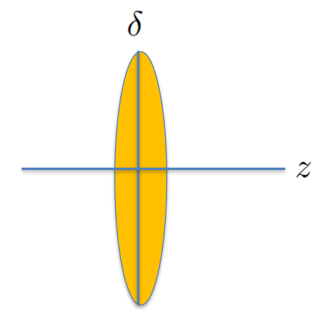
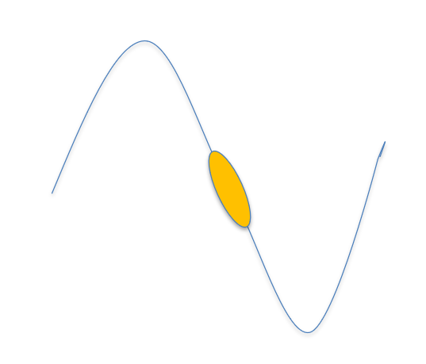
Bunch Compression
The longitudinal phase-space is uncorrelated leaving the damping ring
RF cavity imparts an energy “chirp” on to the beam correlating position and energy

Slide 18
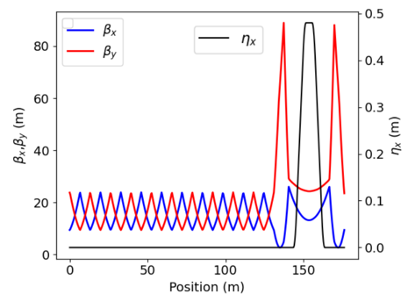
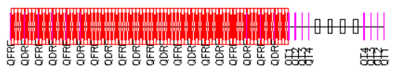
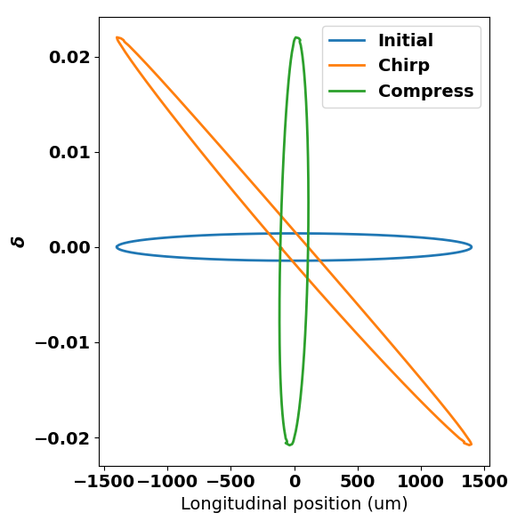
BMAD lattice design
Parameter | Value
Bunch Charge (nC) | 0.5
Initial/Final Energy(GeV)* | 4.6/3.9
RF frequency (GHz) | 2.85
L (m) | 1.57
Gradient (MV/m) | -9.17
Cells | 15
Total number of RF cavities | 80
Dipole Length | 2.0
Bend angle (Deg) | 4.58
Bend strength (T) | 0.51
Dipole separation (m) | 4
*non-zero phase chosen to compensate non-linear motion in chicane

Slide 19
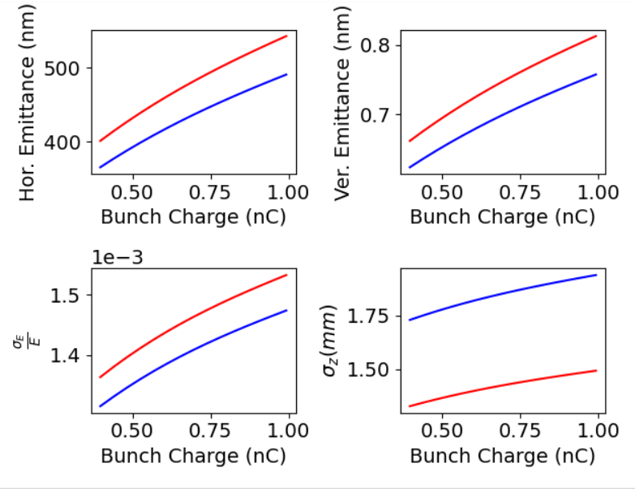
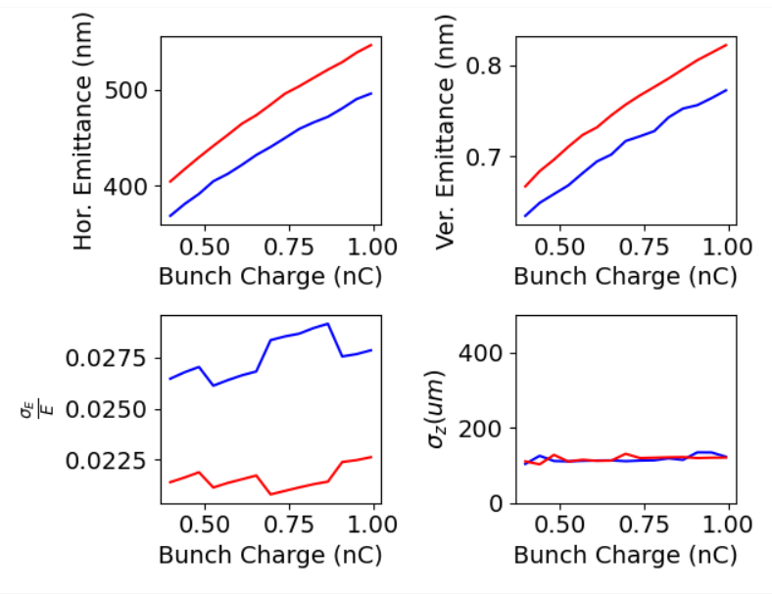
Single particle tracking
Input beam (from DR)
After compressor

Slide 20
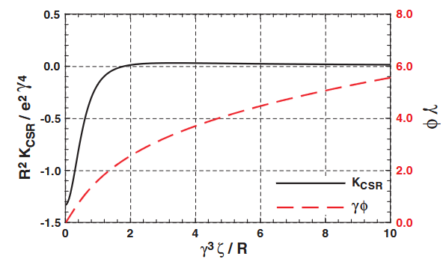




Coherent Synchrotron Radiation
A beam passing through a bend radiates broadband synchrotron radiation (UV—THz)
For wavelengths λ<<σ_{z} the radiation adds incoherently. Intensity scales as ~N
For wavelengths λ>>σ_{z} the radiation adds incoherently. Intensity scales as ~N²
Sagan et al, 2009. http://dx.doi.org/10.1103/PhysRevSTAB.12.040703
A 1-D model of CSR in a single bend-magnet gives:
Where:
For us, R/γ³=35 pm, while σ_{z}/N~0.32 pm (at the start of the chicane, 0.5 nC)

Slide 21
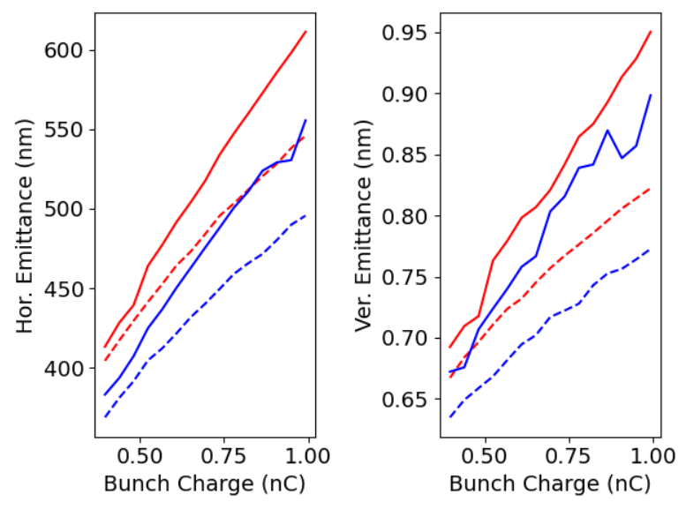
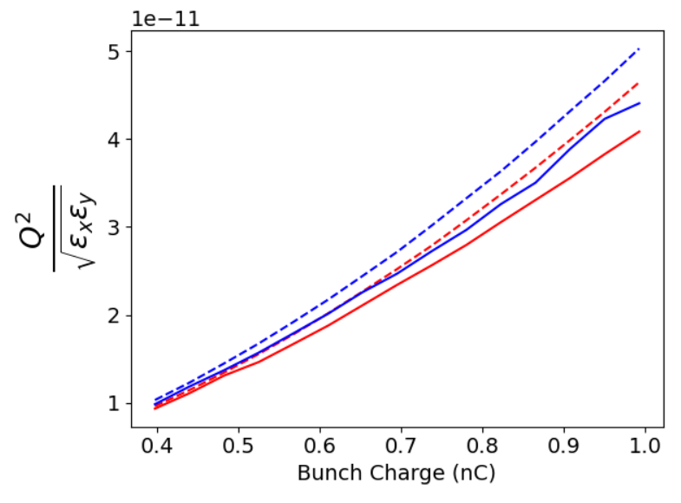
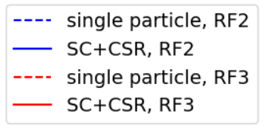
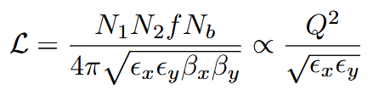
CSR/Space charge
Particle tracking with CSR and space charge performed for each bunch charge done in IBS study
Work in progress: will extend to higher charge to find maximum achievable luminosity before limited by CSR

Slide 22
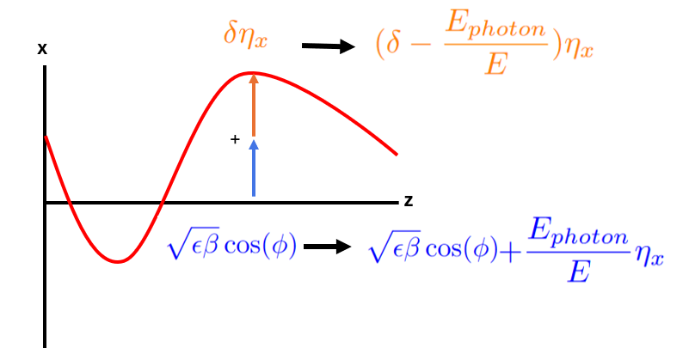
Natural Equilibrium Emittance
SR damping is countered by quantum excitation leading to a ‘natural’ or zero-charge beam emittance
The emission of a photon in a dispersive region results in an increase in betatron motion.
Optimized by layout of quads/bend magnets
In vertical plane, ultimate emittance set by opening angle of radiation emission
fixed by ring geometry
Magnet misalignments and IBS will additionally grow emittance.

Slide 23
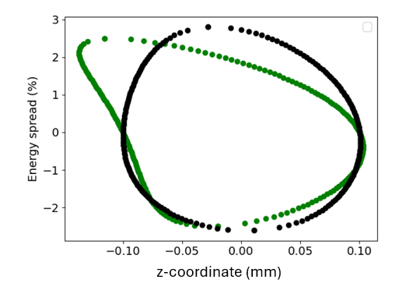

Second order path-lengthening correction
Particle motion through a chicane has a non-linear path lengthening that is quadratic in energy:
We can leverage the (time-dependent) curvature in the RF field to introduce a z²δ on energy.
After a 90 degree phase-space rotation, these correlations cancel
Requires beam to be off the zero-crossing (R₆₆<1) by a small amount

Slide 24





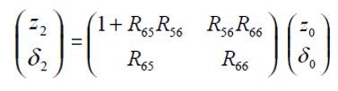


Transfer matrices
RF cavity
Provides the Energy chirp
Adiabatic damping if <1 (acceleration)
R₅₆ provides energy dependent path-length
Chicane
Total transfer
For an initially uncorrelated beam between energy and position (case for the beam leaving the damping ring):

