Slide 1


“KEK Accelerator Test Facility
Low-Level RF and Timing Systems”
Konstantin Popov
23rd October
2025

Slide 2


Presentation plan
Introduction into KEK ATF facility and research motivation;
Introduction into KEK ATF Linac and Damping Ring Low-Level RF system;
Developed and implemented phase&amplitude feedback algorithm;
Beam parameters stability at the ATF Linac injector section;
KEK ATF timing system and synchronization stability;
Summary and conclusion
2

Slide 3
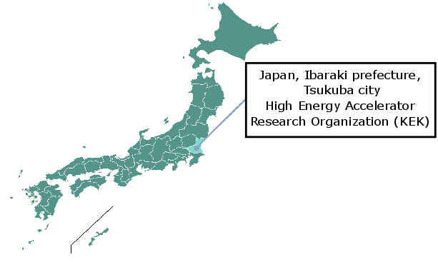
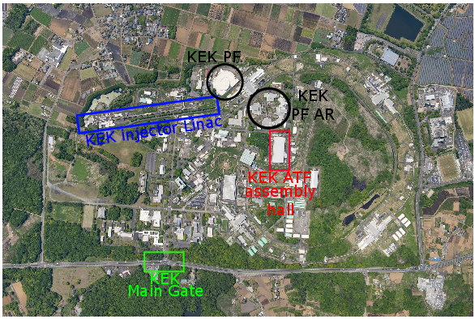

KEK Accelerator Test Facility (ATF)
Figure 1: High Energy Accelerator Research Organization (KEK) location on the map of Japan
Figure 2: KEK ATF assembly hall location at the KEK Tsukuba campus
Figure 3: KEK ATF assembly hall building photo
3

Slide 4
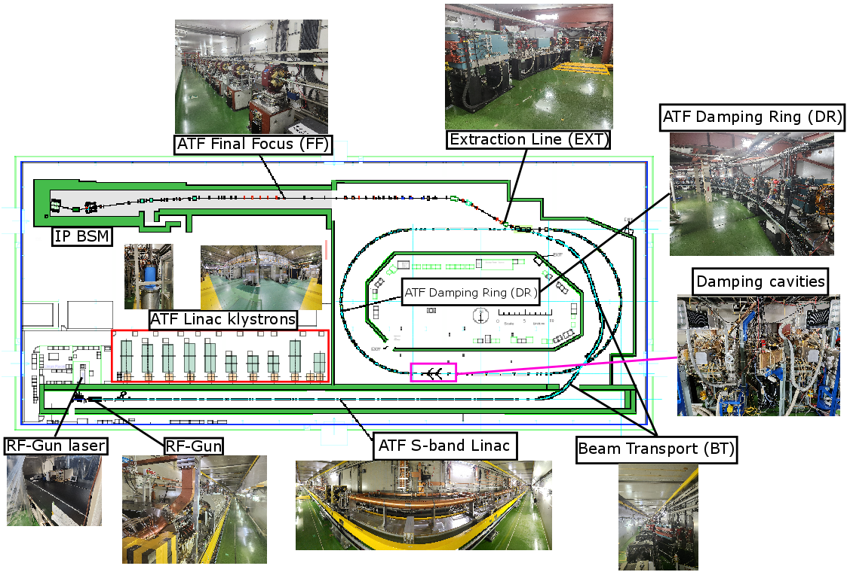
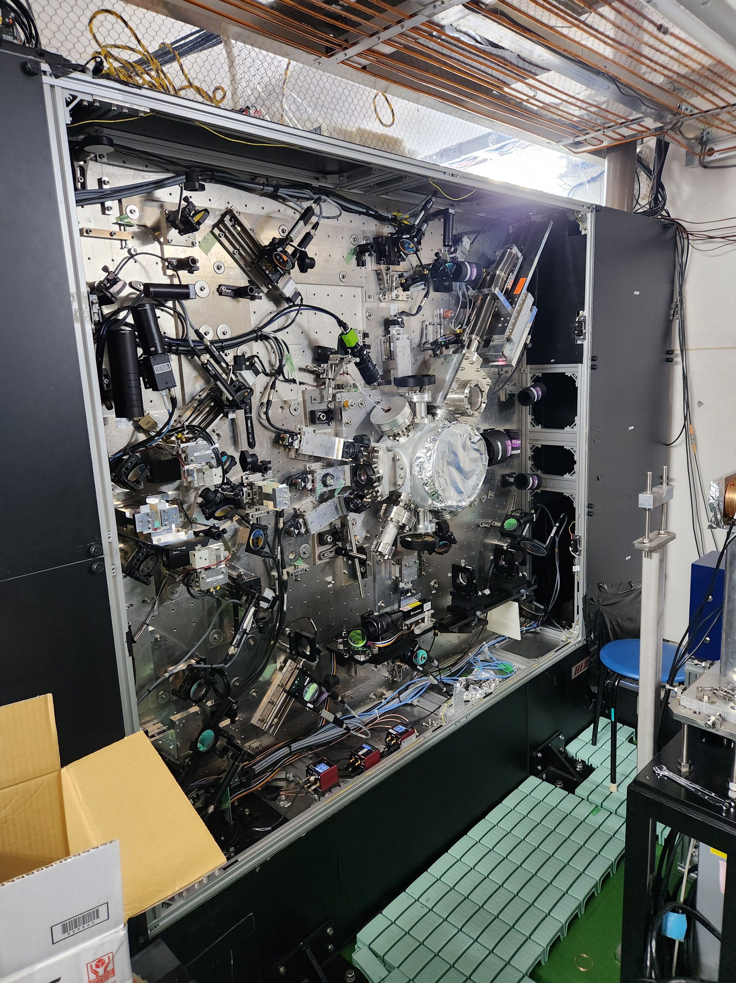
KEK Accelerator Test Facility (ATF)
Figure 4: KEK ATF facility layout
Motivation: ATF Linac and DR klystron phase&amplitude drift can affect the beam injection, extraction and transmission stability. → Goal: investigate the ATF Linac and DR klystrons High-Power RF phase&amplitude stability, RF-Gun Laser to RF synchronization stability → Beam parameters drift at the ATF Linac injector section.
4

Slide 5
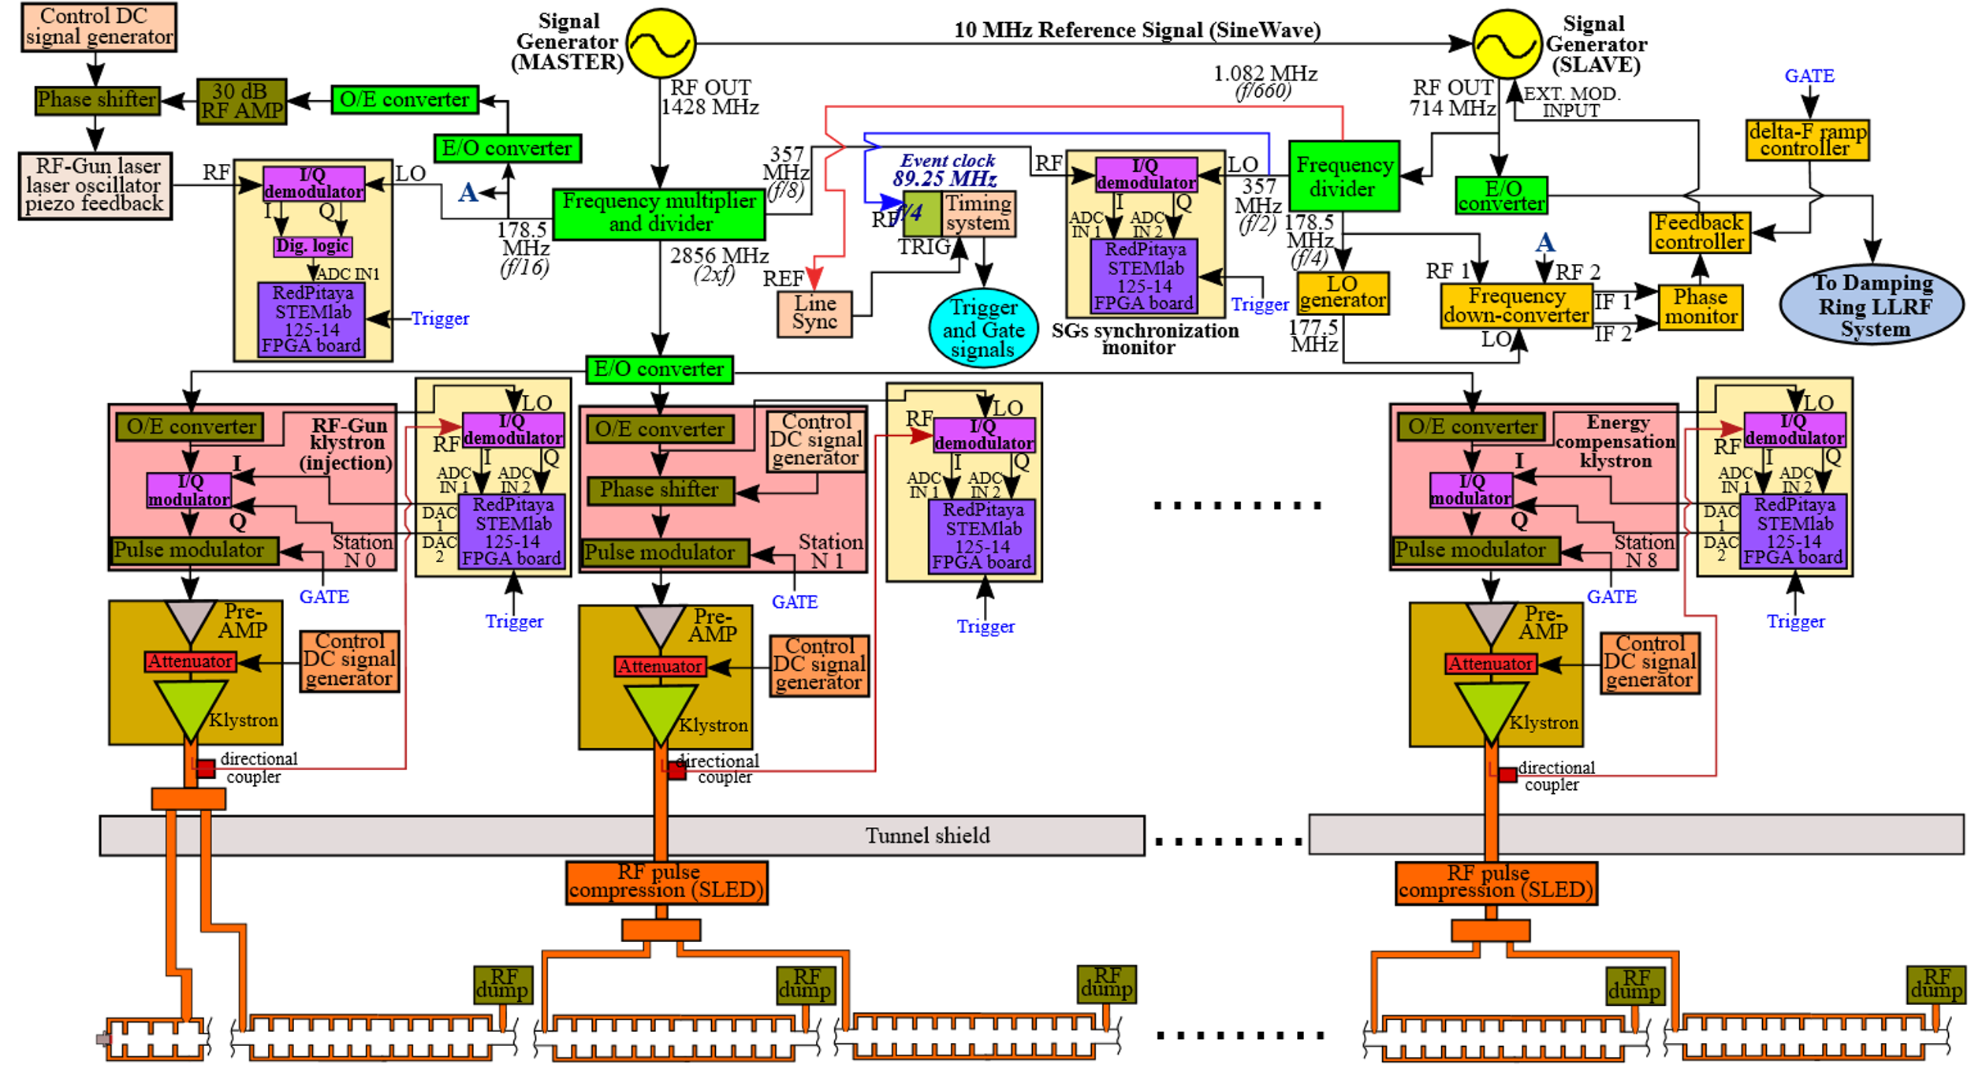
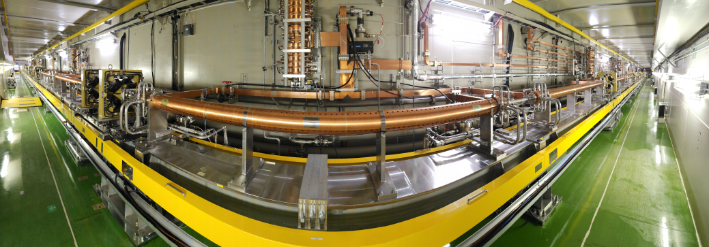
KEK ATF Linac Low-Level RF system
Figure 5: KEK ATF Linac Low-Level RF system simplified block-diagram with High-Power RF part
Figure 6: KEK ATF Linac photo
5

Slide 6
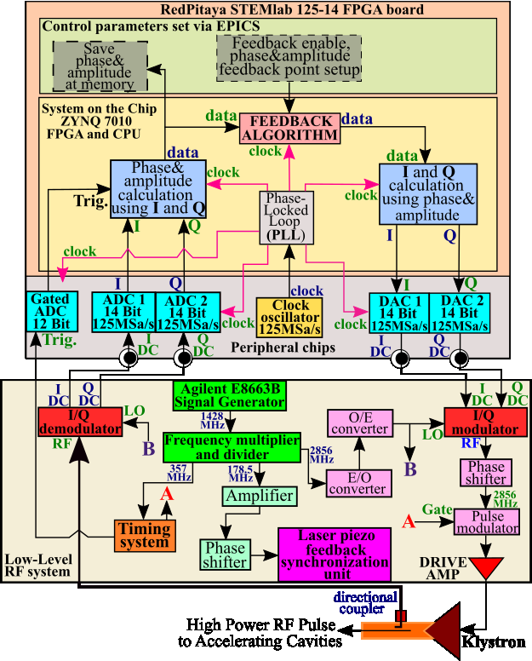
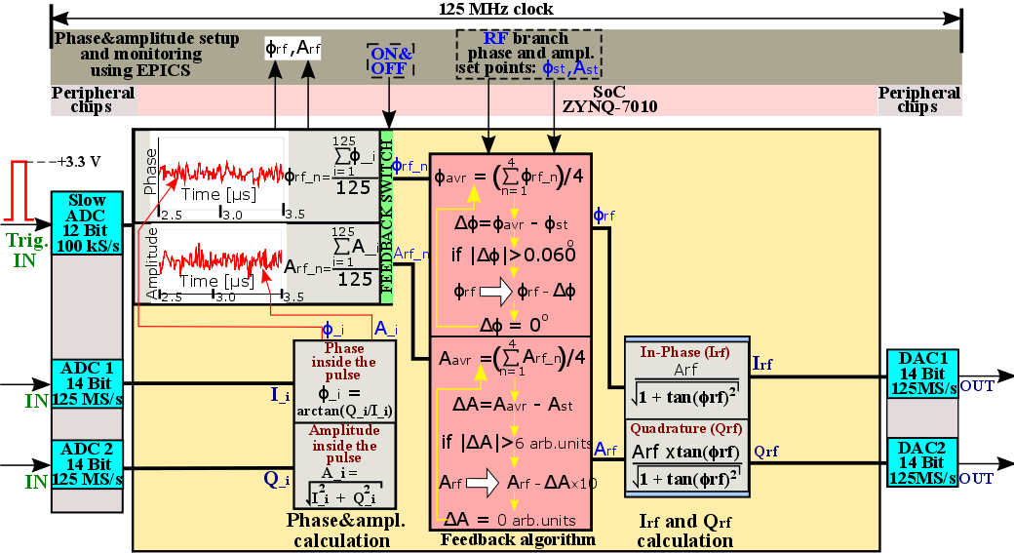
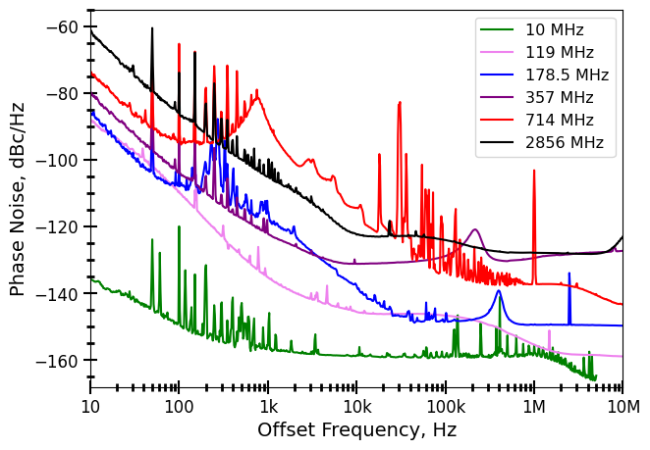
KEK ATF Linac Low-Level RF intra-pulse feedback system
Figure 8: The digital LLRF phase&amplitude feedback block-diagram with correction algorithm
Figure 7: KEK ATF Linac Low-Level RF feedback system simplified block-diagram with Low-Level RF and High-Power RF parts
Figure 9: KEK ATF Low-Level RF system signals phase noise power spectral densities
6

Slide 7
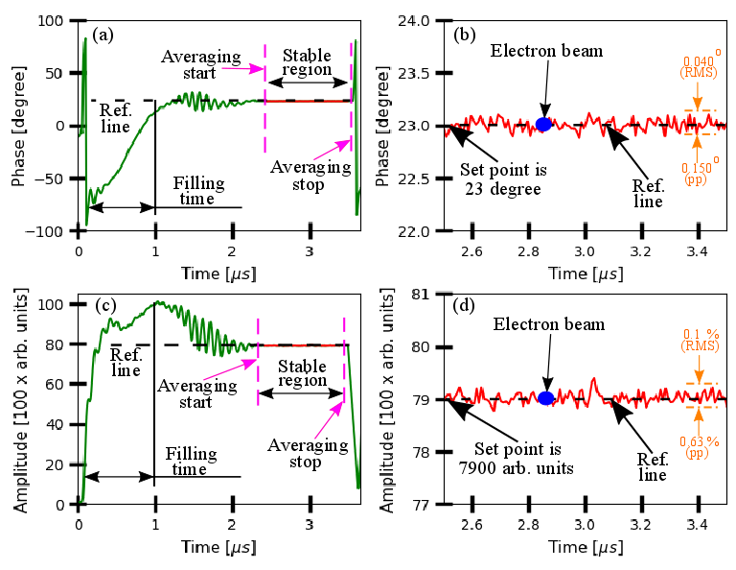
Klystron #0 High Power RF field waveform
Figure 10: Klystron #0 High-Power RF waveform: (a) and (b) are High-Power RF field phase and zoomed in stable region of the phase, (c) and (d) are High-Power RF field amplitude and zoomed in stable region of the amplitude
7

Slide 8
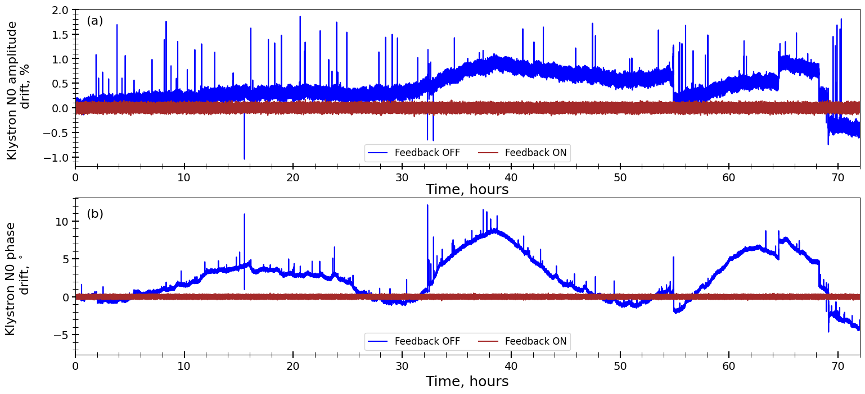
Digital LLRF phase&amplitude feedback performance results
So far, the feedback works at ATF Linac klystron #0 and #8. The feedback phase part eliminated the phase drift. The phase stability was improved from 14 degrees (peak-to-peak) to 0.5 degree (peak-to-peak). It is 28 times stabilization of phase. The identical stabilization was achieved by the amplitude side of the feedback. Achieved amplitude stability is 0.25 % (peak-to-peak).
Figure 11: Digital LLRF phase&amplitude feedback performance results (Blue line is feedback OFF, Red line is feedback ON): (a) is the klystron N0 amplitude drift vs time, (b) is the klystron N0 phase drift vs time
8

Slide 9
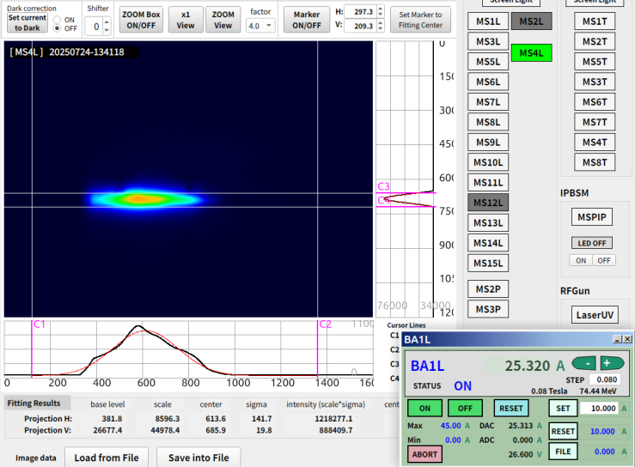
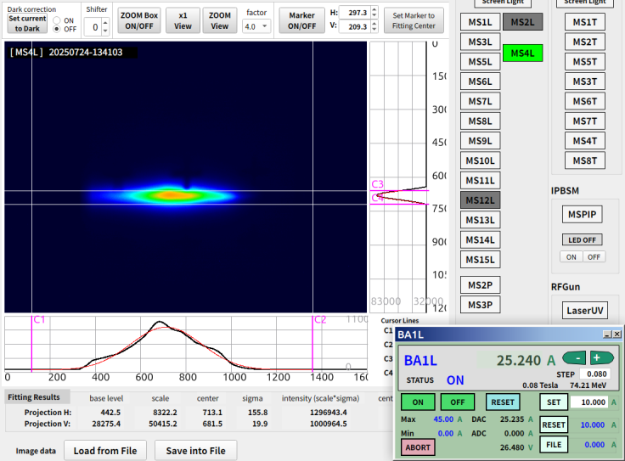
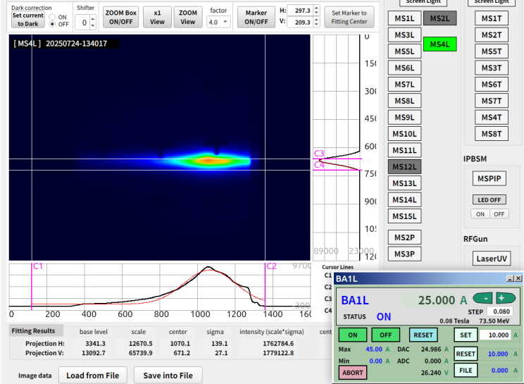
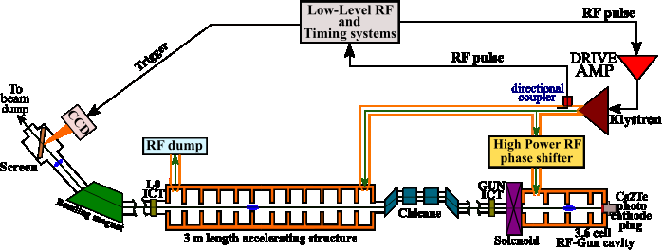
Beam stability at the KEK ATF RF-Gun section: response curve measurement setup
Figure 12: Beam centroid position response to the different beam energy
Figure 13: KEK ATF Linac injector section simplified block-diagram
9

Slide 10
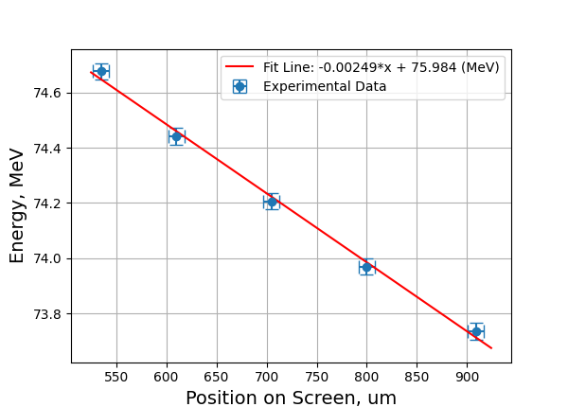
Beam stability at the KEK ATF RF-Gun section: response curve measurement results
Figure 14: Beam centroid position response to the different beam energy
Figure 15: Response curve: beam centroid vs beam energy
10

Slide 11
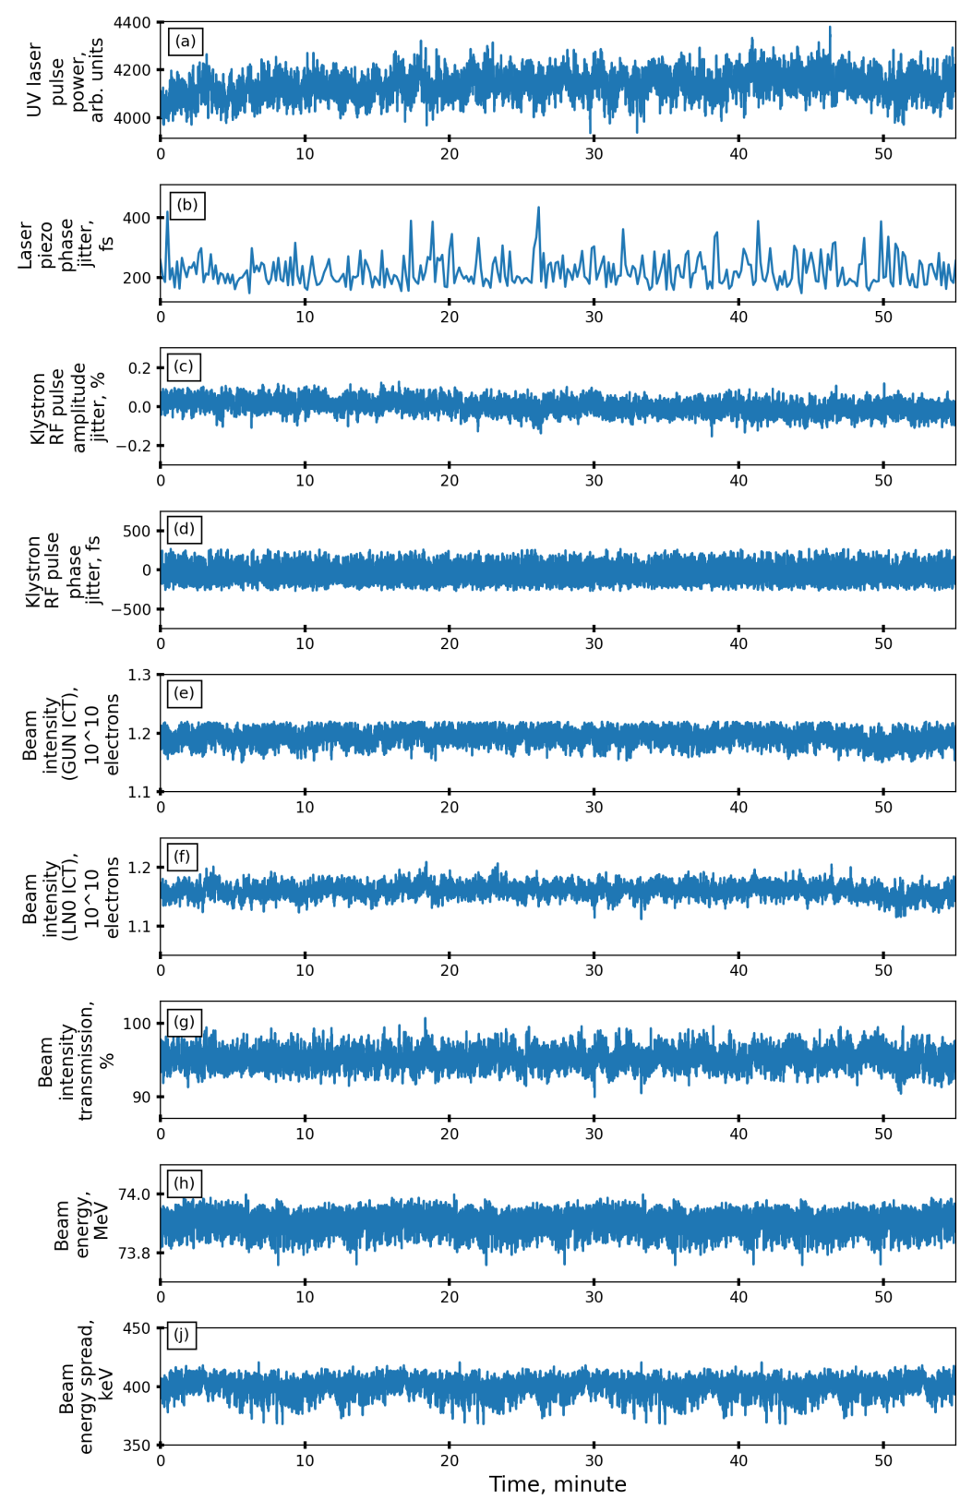
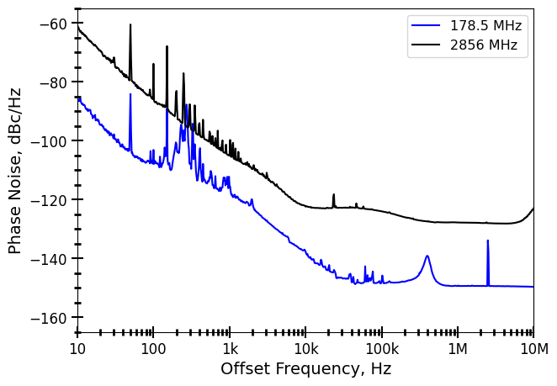
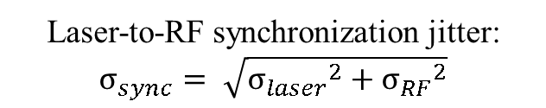
1.28 %
(RMS)
From LLRF side, factors that could affect the beam parameters jitter:
High Power RF phase jitter. Frequency is 2856 MHz. 1 ps is equal to ~1000 fs
High Power RF amplitude jitter. Frequency is 2856 MHz.
Laser reference clock jitter
Laser clock rel. klystron clock jitter
0.04 %
(RMS)
100 fs
(RMS)
1.3 %
(RMS)
1.1 %
(RMS)
Figure 17: KEK ATF Low-Level RF system signals phase noise power spectral densities
Laser-to-RF synchronization jitter:
$$σ_{sync}= \sqrt{{σ_{laser}}^{2}+{σ_{RF}}^{2}}$$
40 keV
(RMS)
In order to improve the RF-Gun section Low-Level RF system, it is necessary to improve laser reference clock quality. So, the laser piezo phase jitter will be less than 200 fs always. So far, the piezo noise can be the dominant contribution.
8 keV
(RMS)
11

Slide 12
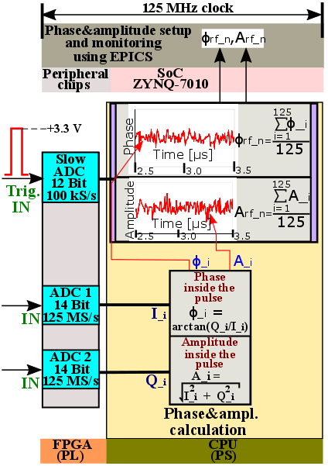
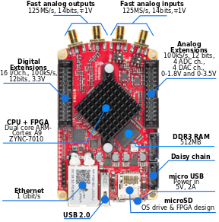
Signal processing and phase&amplitude detection algorithm
Figure 18: RedPitaya STEMlab 125-14 FPGA board
Figure 19: Block diagramm of the signal processing and phase&amplitude detection algorithm implemented into the RedPitaya STEMlab 125-15 FPGA board
12

Slide 13
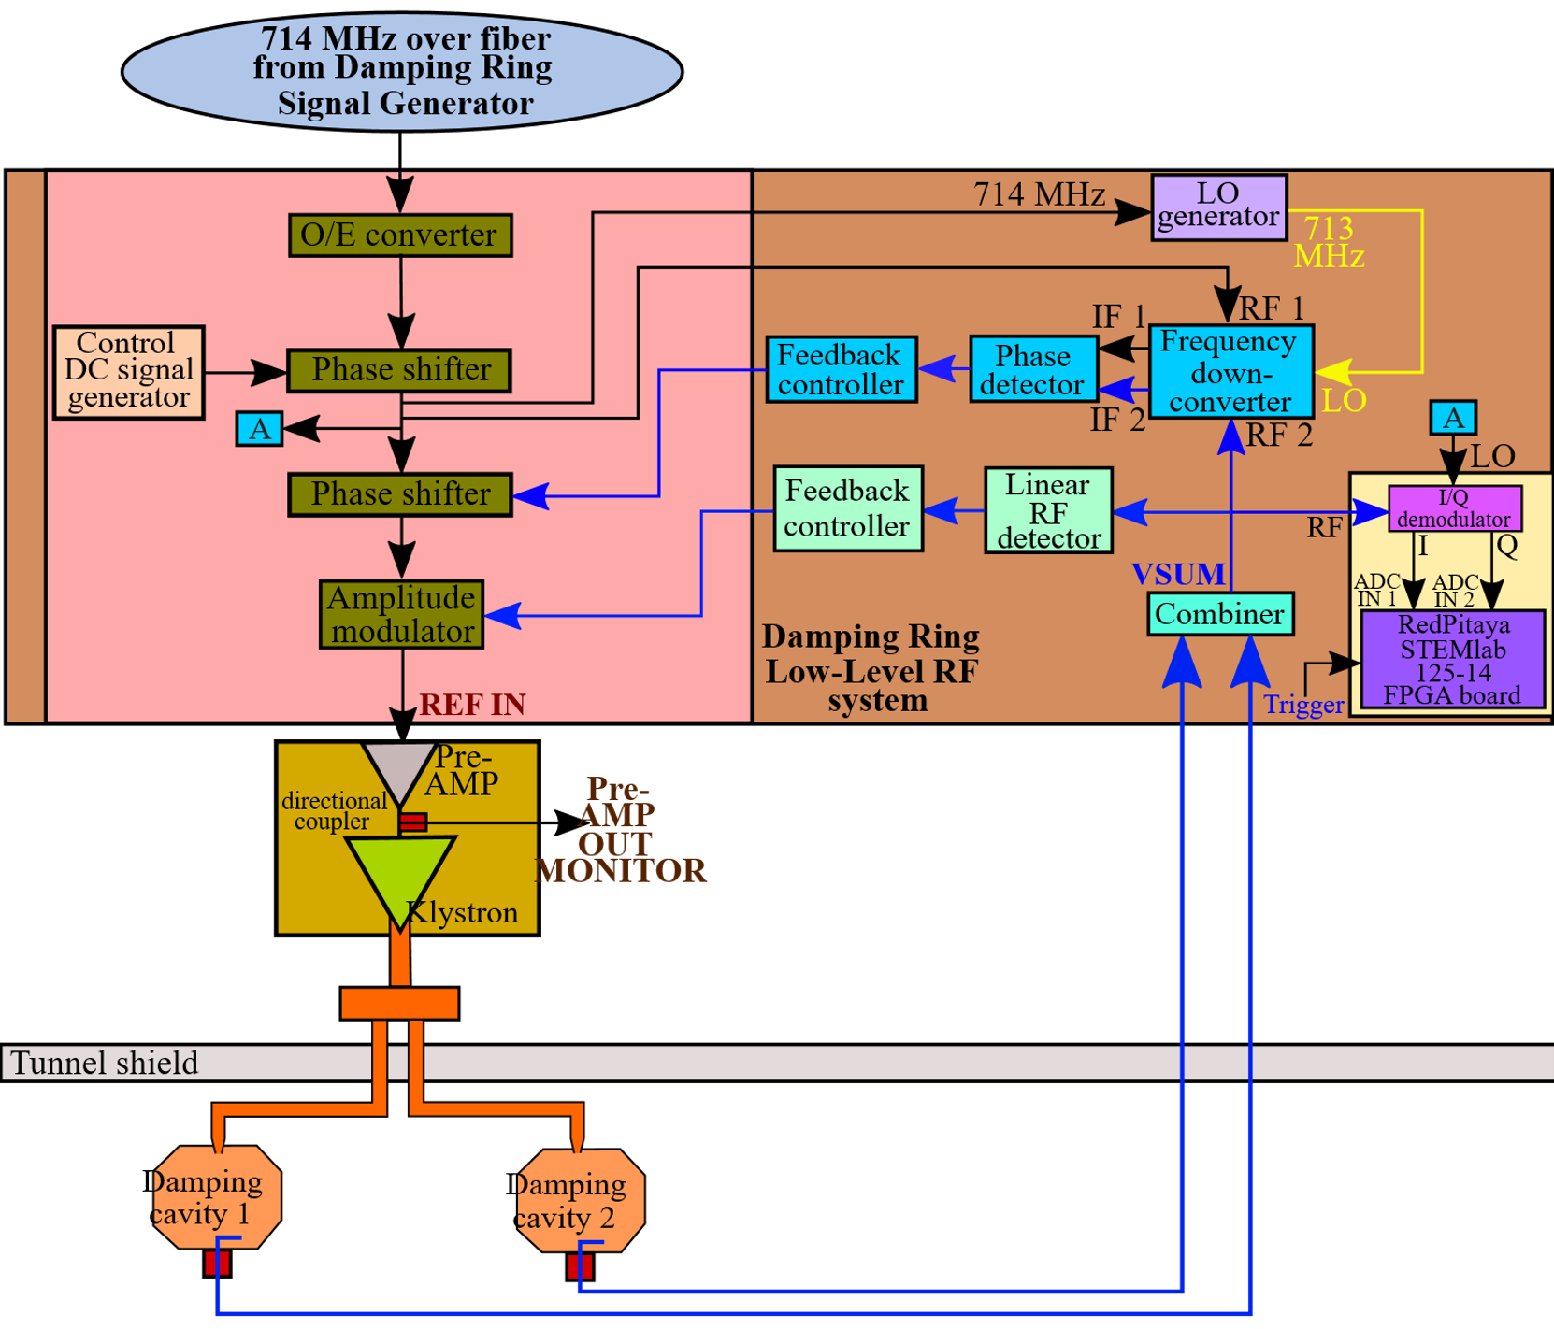
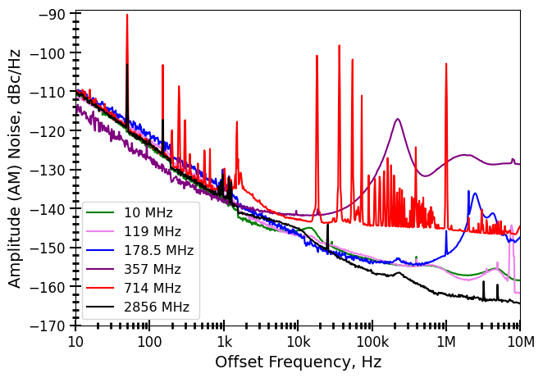
KEK ATF Damping Ring Low-Level RF system
Figure 21: KEK ATF Low-Level RF system signals phase noise power spectral density measurement results
Figure 20: KEK ATF DR Low-Level RF system simplified block-diagram with High-Power RF part
Figure 22: KEK ATF Low-Level RF system signals amplitude noise power spectral density measurement results
13

Slide 14
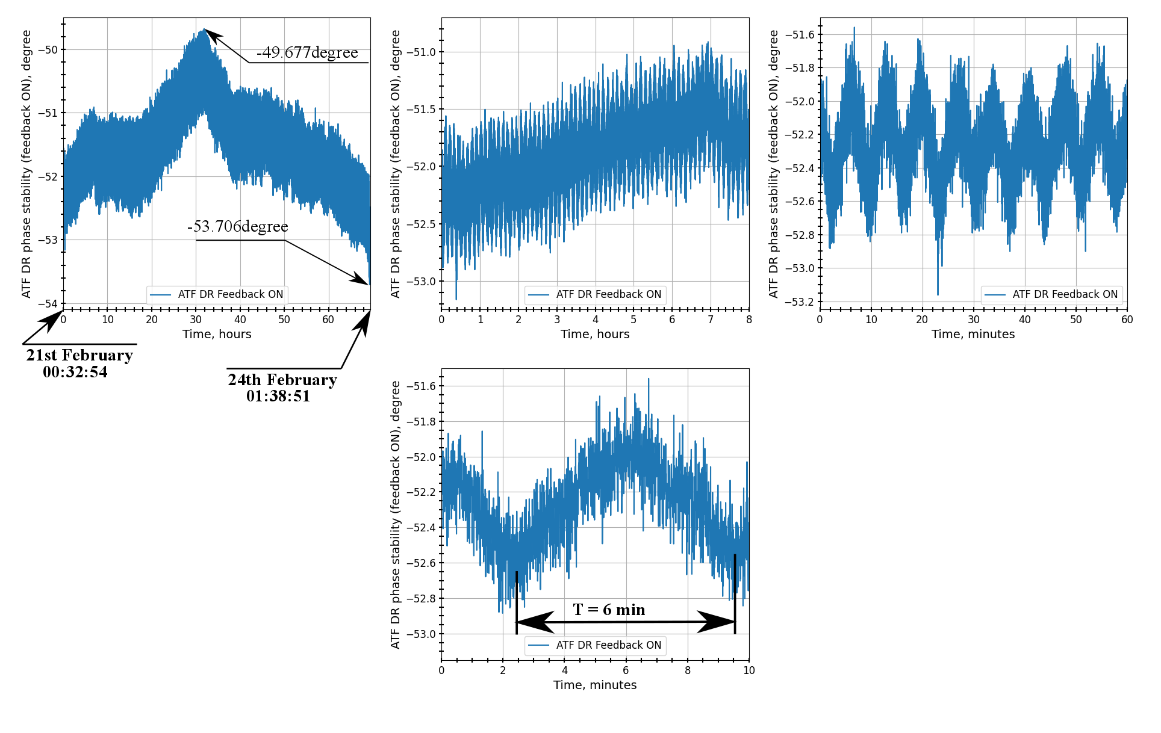
KEK ATF Damping Ring cavities RF field phase stability
(a)
(b)
(c)
(d)
Figure 23: KEK ATF Damping Ring cavities RF field phase stability study results: (a) is the phase vs time (72 hours span), (b) is the phase vs time (8 hours span), (c) is the phase vs time (60 minutes span), (d) is the phase vs time (10 minutes span)
14

Slide 15
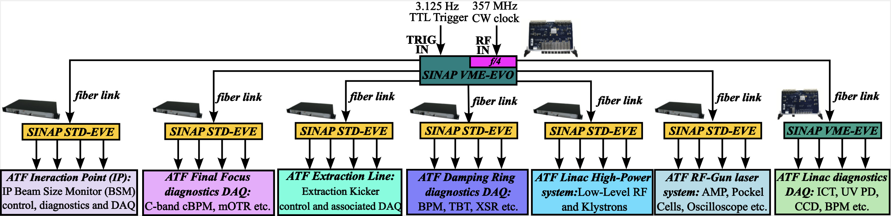
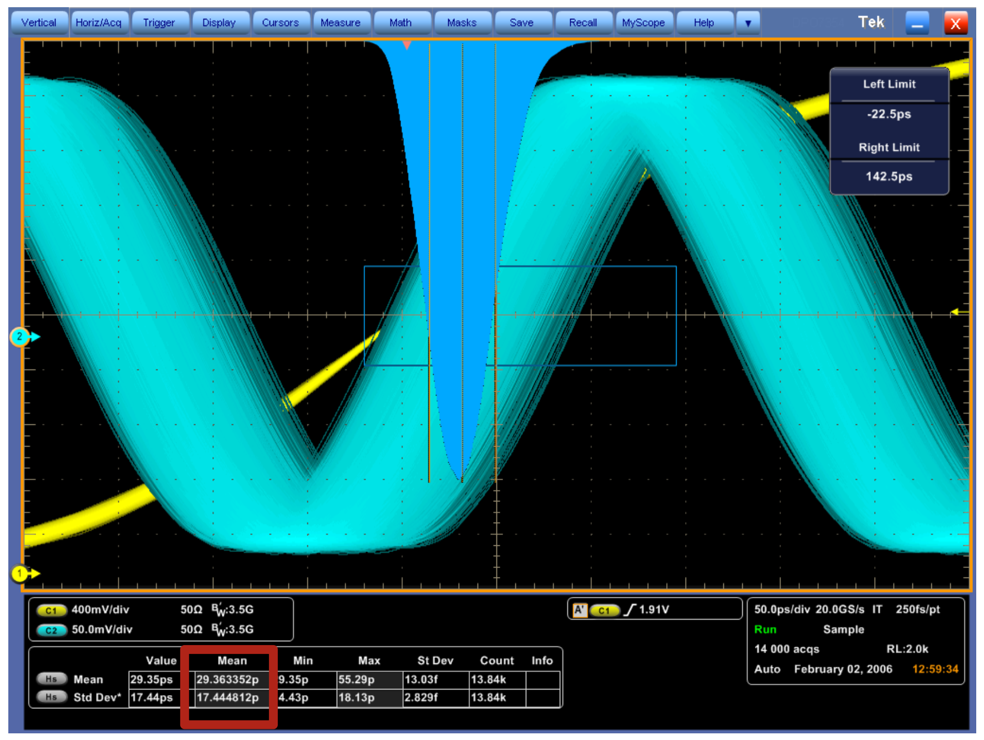
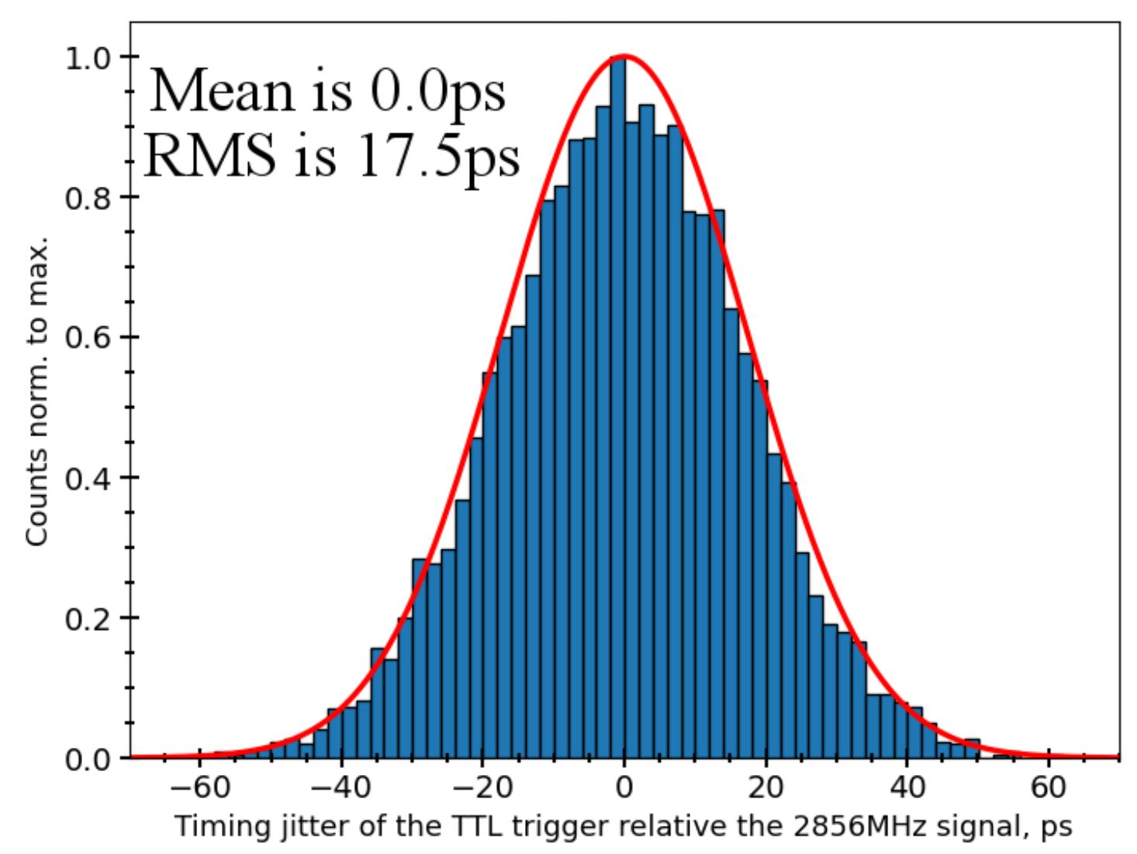
KEK ATF timing system architecture
Figure 24: KEK ATF timing system architecture block-diagram
Figure 25: Synchronization stability: 2856 MHz vs Trigger
(screenshot)
Figure 26: Synchronization stability:
2856 MHz vs Trigger (histogram)
15

Slide 16
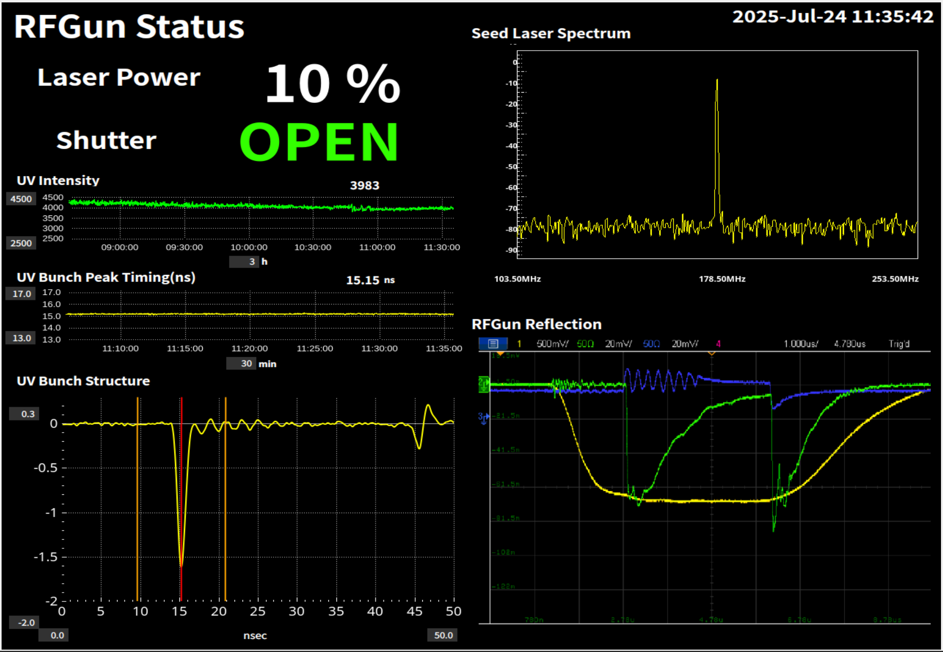
KEK ATF timing system architecture
Figure 27: KEK ATF timing system architecture block-diagram
16
Figure 28: KEK ATF RF-Gun status window

Slide 17
Summary
The digital Low-Level RF phase&amplitude feedback based on I/Q demodulator, modulator and RedPitaya STEMlab 125-14 FPGA board was developed, programmed and implemented at the ATF Linac Klystron #0 and #8 RF station. The rest of the Linac klystrons and KEK ATF Damping Ring has phase monitoring setup.
The feedback works at ATF Linac klystron #0 and #8. The feedback phase part eliminated the phase drift. The phase stability was improved from 14 degrees (peak-to-peak) to 0.5 degree (peak-to-peak). It is 28 times stabilization of phase. The identical stabilization was achieved by the amplitude side of the feedback. Achieved amplitude stability is 0.25 % (peak-to-peak).
As a result, the beam energy absolute value and its stability after the injector section are equal to 73.9 MeV and 40 keV (RMS), correspondingly. It is 0.05 % (RMS) stability.
The Damping Ring cavities RF field phase stability monitoring results shows 4 degrees (16 ps for 714 MHz) drift during 72 hours operation. The digital Low-Level RF feedback CW operation mode is under development.
KEK ATF timing system upgrade is on the final stage in 2025. Its event clock, event codes and timing distribution architecture demonstrate stable and precise operation. The long-term synchronization precision between trigger and RF clock signal is 17.5 ps (RMS). There is not sign of the synchronization drift and/or drift. Moreover, trigger timing jumps and/or ambiguity were not detected during the KEK ATF RF-Gun section test start-up on July 2025. The RF-Gun laser UV pulse arrival time data does not demonstrates several nanoseconds timing jumps too.
The KEK ATF timing system nominal and stable operation will be fully confirmed during the autumn-winter operation in 2025.
17

Slide 18
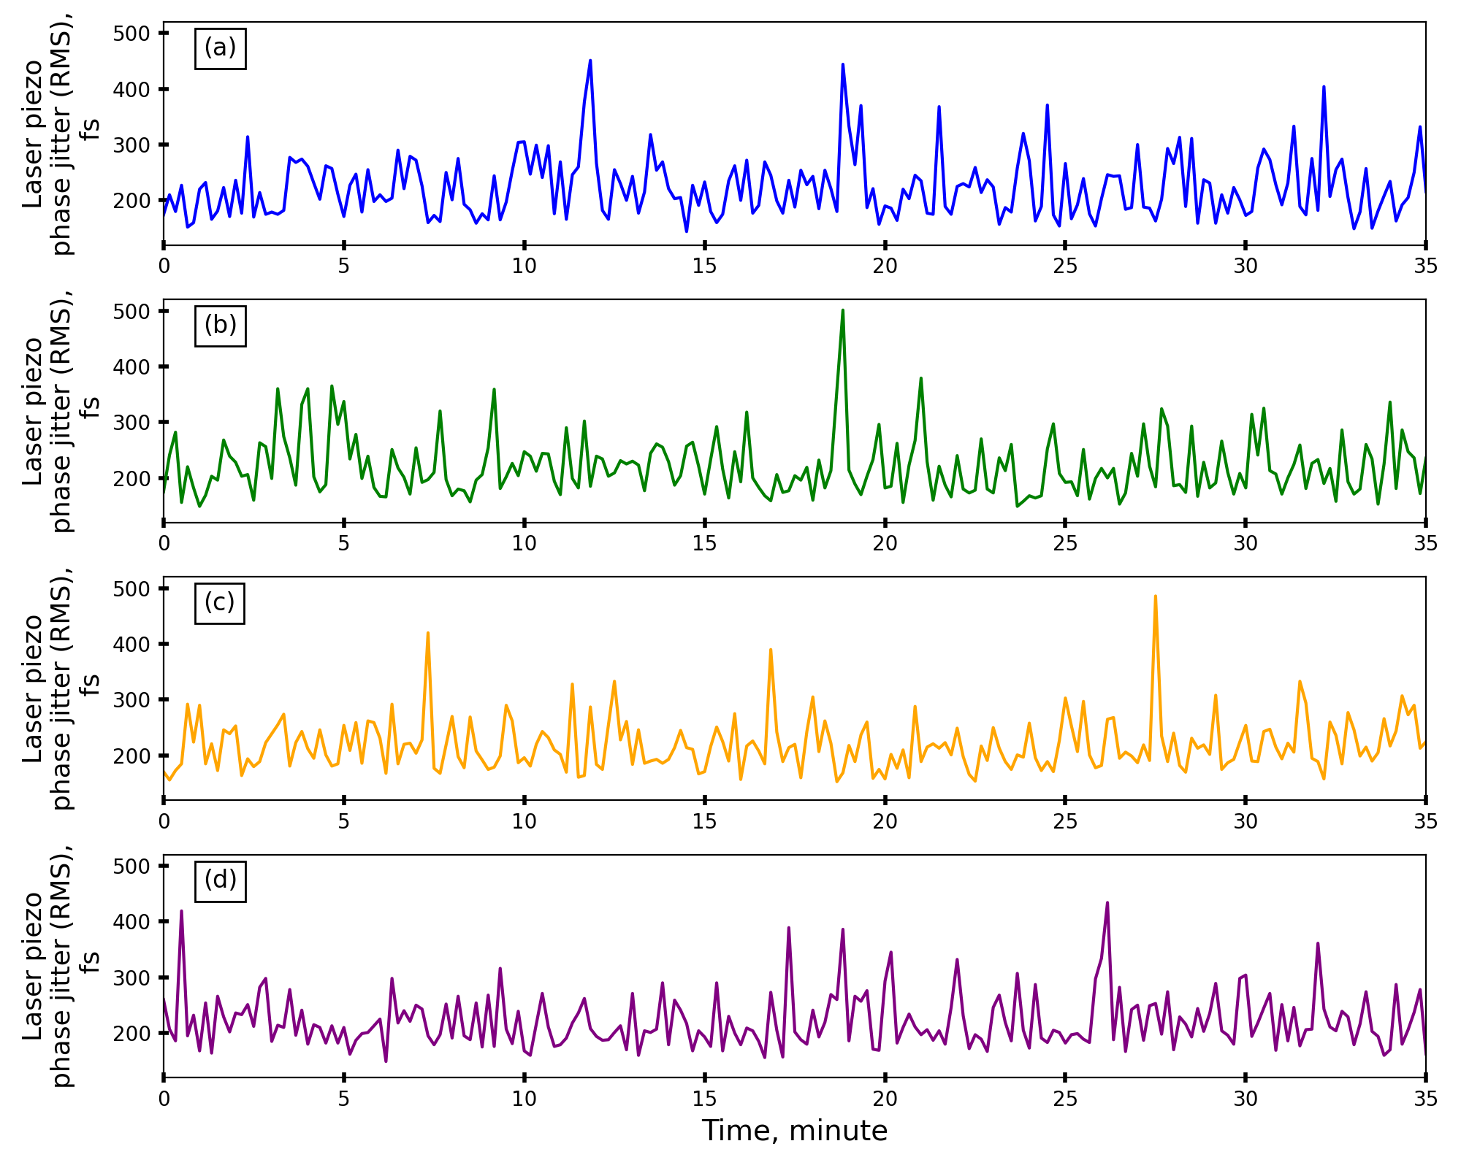
Laser oscillator synchronization stability
Laser oscillator + synchronization unit
Laser oscillator + synchronization unit + laser amplifier (PFN)
Laser oscillator + synchronization unit + laser amplifier (PFN) +
Pockell cells
Laser oscillator + synchronization unit + laser amplifier (PFN) +
Pockell cells + klystron

Slide 19
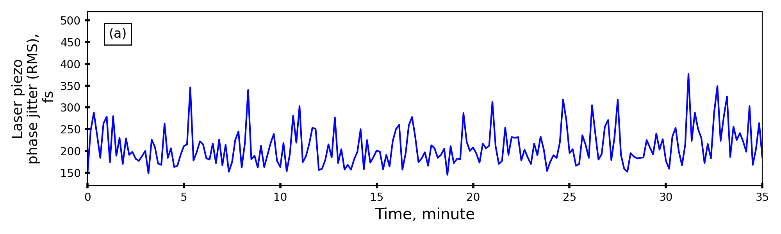
Laser oscillator synchronization stability (after)
Laser oscillator + synchronization unit

Slide 20
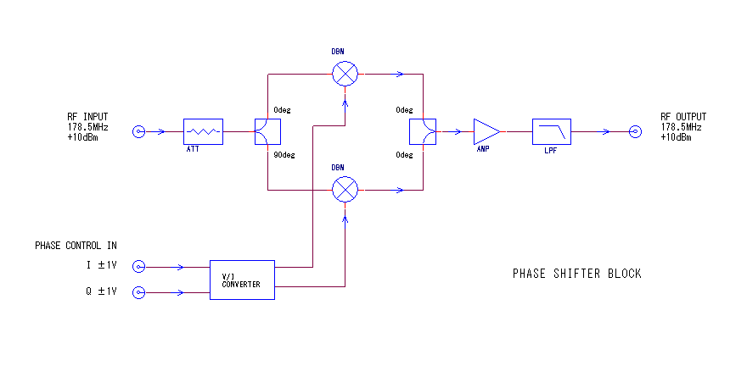
178.5 MHz new phase shifter and its quotation (laser clock)

