Slide 1


Slide 2
Commissioning of ESS superconducting linac
LCWS
Valencia, España
Presented BY cecilia Maiano, ESS LinaC Group, on behlaf of ESS/SRF

Slide 3
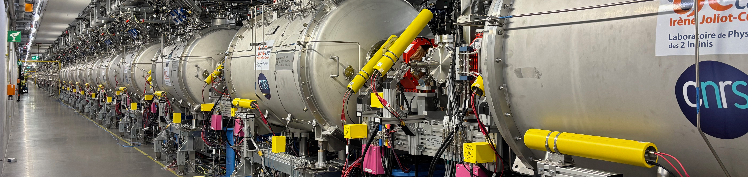
Agenda
Test and installation Phase
Linac Cryogenic commissioning
BOD Commissioning goals and achievements
Challenges towards BOT
Conclusions

Slide 4
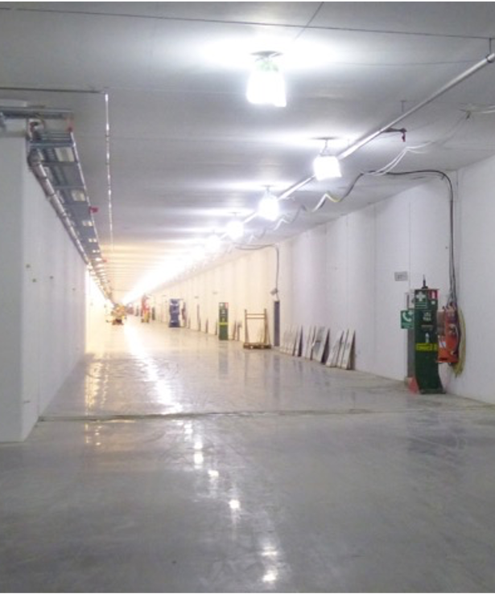






1
Test/Installation phase
CAV
ASSY
TEST
INSTALL
SPK
+
MBL
HBL
2017
[we always need an empty tunnel]

Slide 5
High Power 5 MW proton accelerator
The final goal and facility Milestones
Key parameters:
Ultimate Average Beam Power: 5 MW
Peak Beam Power: 125 MW
Beam Duty Cycle 4%
Staged deployment:
Ultimate Beam Energy: 2 GeV
Beam current: 62.5 mA peak
Beam pulse width: 2.86 ms
Repetition rate: 14 Hz
13/13 spokes
9/9 MB
5/21 HB
13/13 spokes
9/9 MB
11/21 HB
2 MW
(2024)
3 MW
(2025)
5 MW
(2030s)
Target
1
2
3
4
5
1
2
3
4
5
6
7
8
9
10
11
12
13
1
2
3
4
5
6
7
8
9
1
2
3
4
5
6
7
8
9
10
11
12
13
14
15
16
17
18
19
20
21
Tunnel
ISrc
LEBT
RFQ
MEBT
DTL
SPK
MBL
HBL
HEBT
Dump
0.9 GeV
1.3 GeV
2.0 GeV
Staged System Readiness Reviews
And Facility Milestones to operation
SOUP: Start Of User Production
SRR1
SRR TS2
SRR2A
SRR2B
SRR3
SRR4
SRR5
EOC
17 Jul, 2018
29 Aug, 2019
7 Sep, 2021
4 May, 2022
22 Mar, 2023
24 Feb, 2025
19 Jan, 2026
08 Oct, 2027
31 Dec, 2027
2018
2018
2019
2020
2021
2022
2023
2024
2025
2026
2027
2027
19 Sep, 2018
26 Nov, 2021
20 Apr, 2023
16 May, 2025
27 Feb, 2026
First LEBT Beam
First RFQ Beam
First DTL4 Beam
BOD
BOT
1 Jun, 2022
9 Apr, 2025
Hot commissioning of Neutron Instruments
First DTL1 Beam
First Protons on Dump

Slide 6
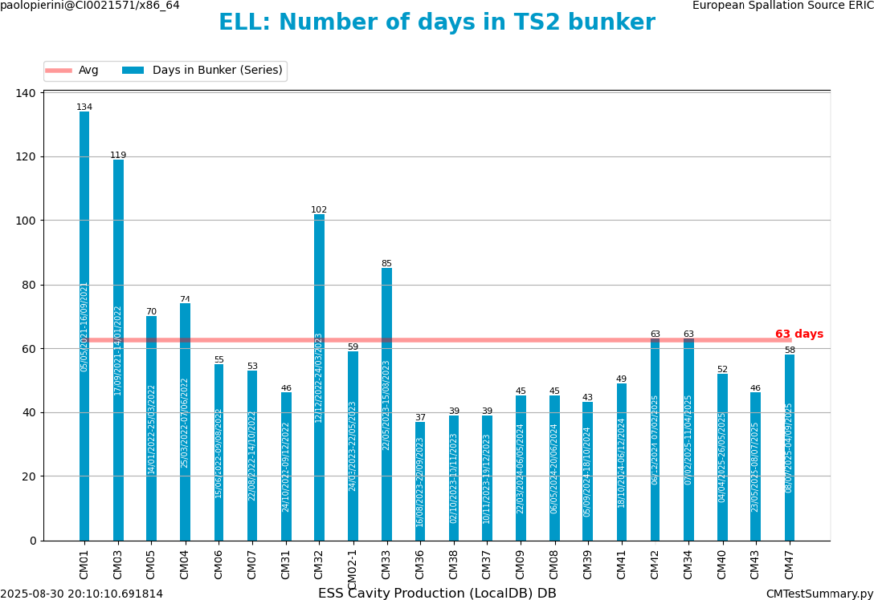
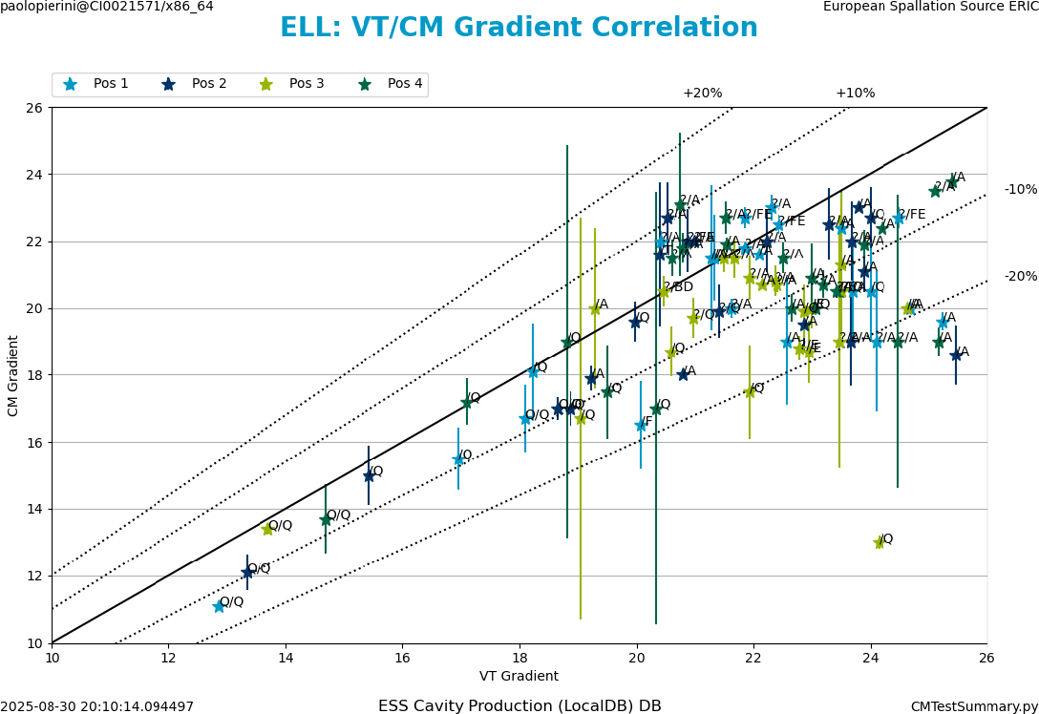
All modules tested prior to installation
SPK at Uppsala, ELL at TS2 (22 Tested, 20 Installed)
One single bunker for the test, ~60+ calendar days of average test throughput
Gauge failure
Leak in He process lines
Cryo failure during test
Admin limit on Pfwd (SW)
300 kW MBL
400 kW HBL
Learning curve
Linac installation and commissioning,
Manpower criticality for TS2
Leak
Above 20 MV/m
Fixed Ql
Agreement usually within 10% before the onset of admin limit

Slide 7
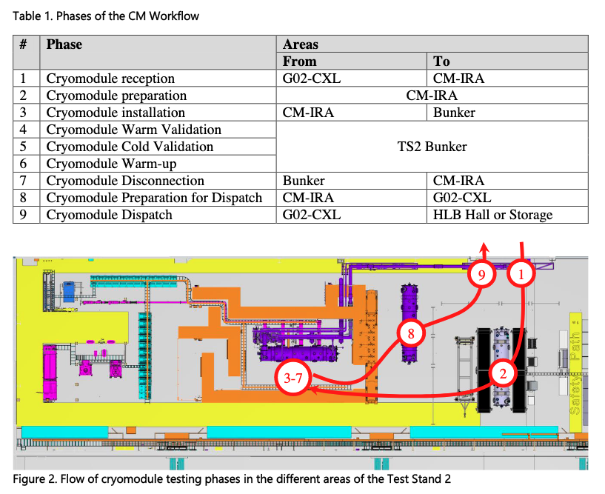
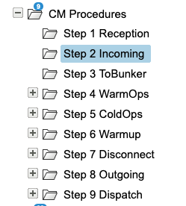
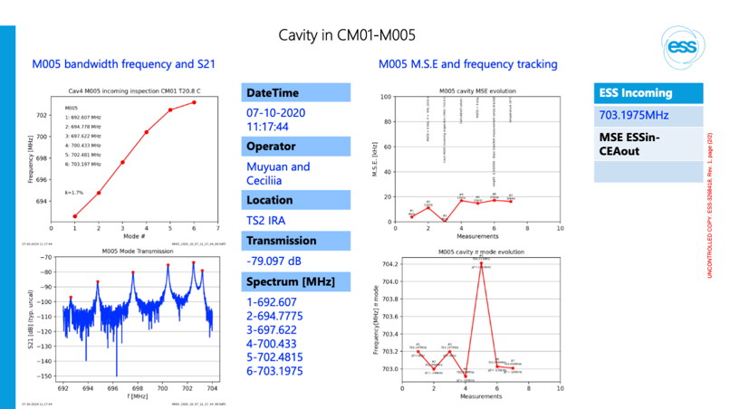
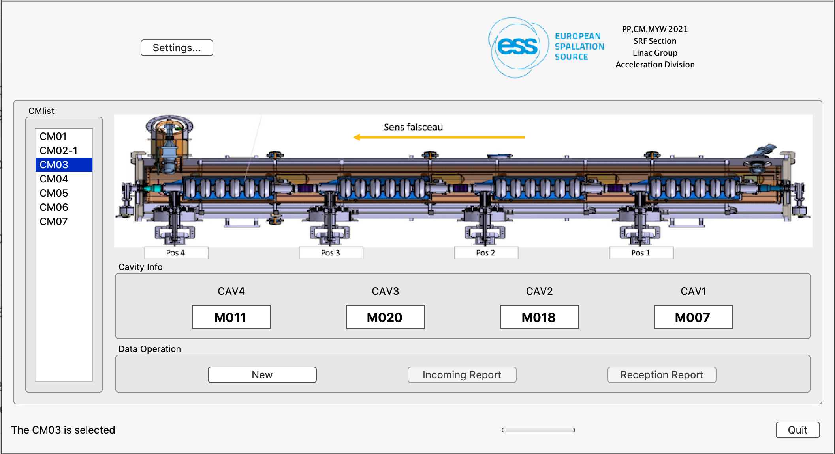
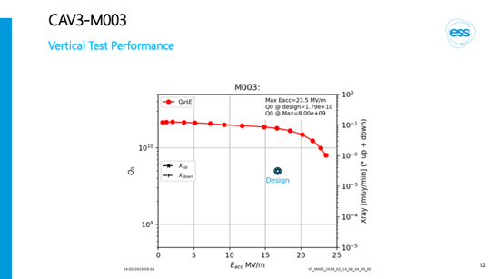
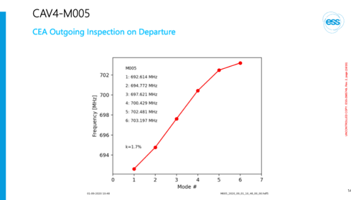
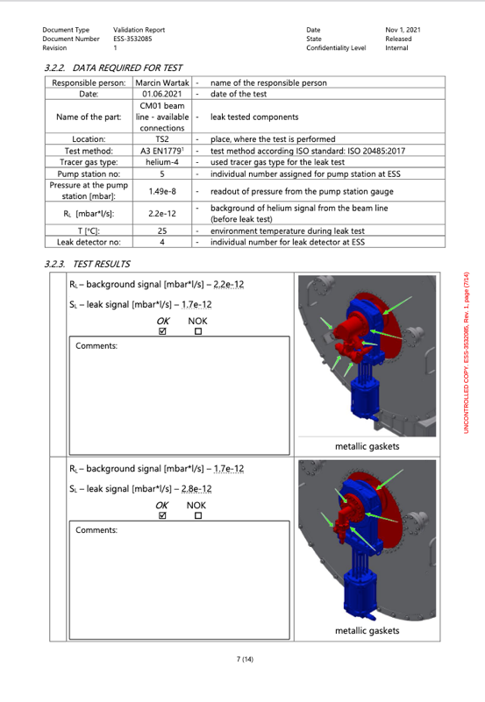
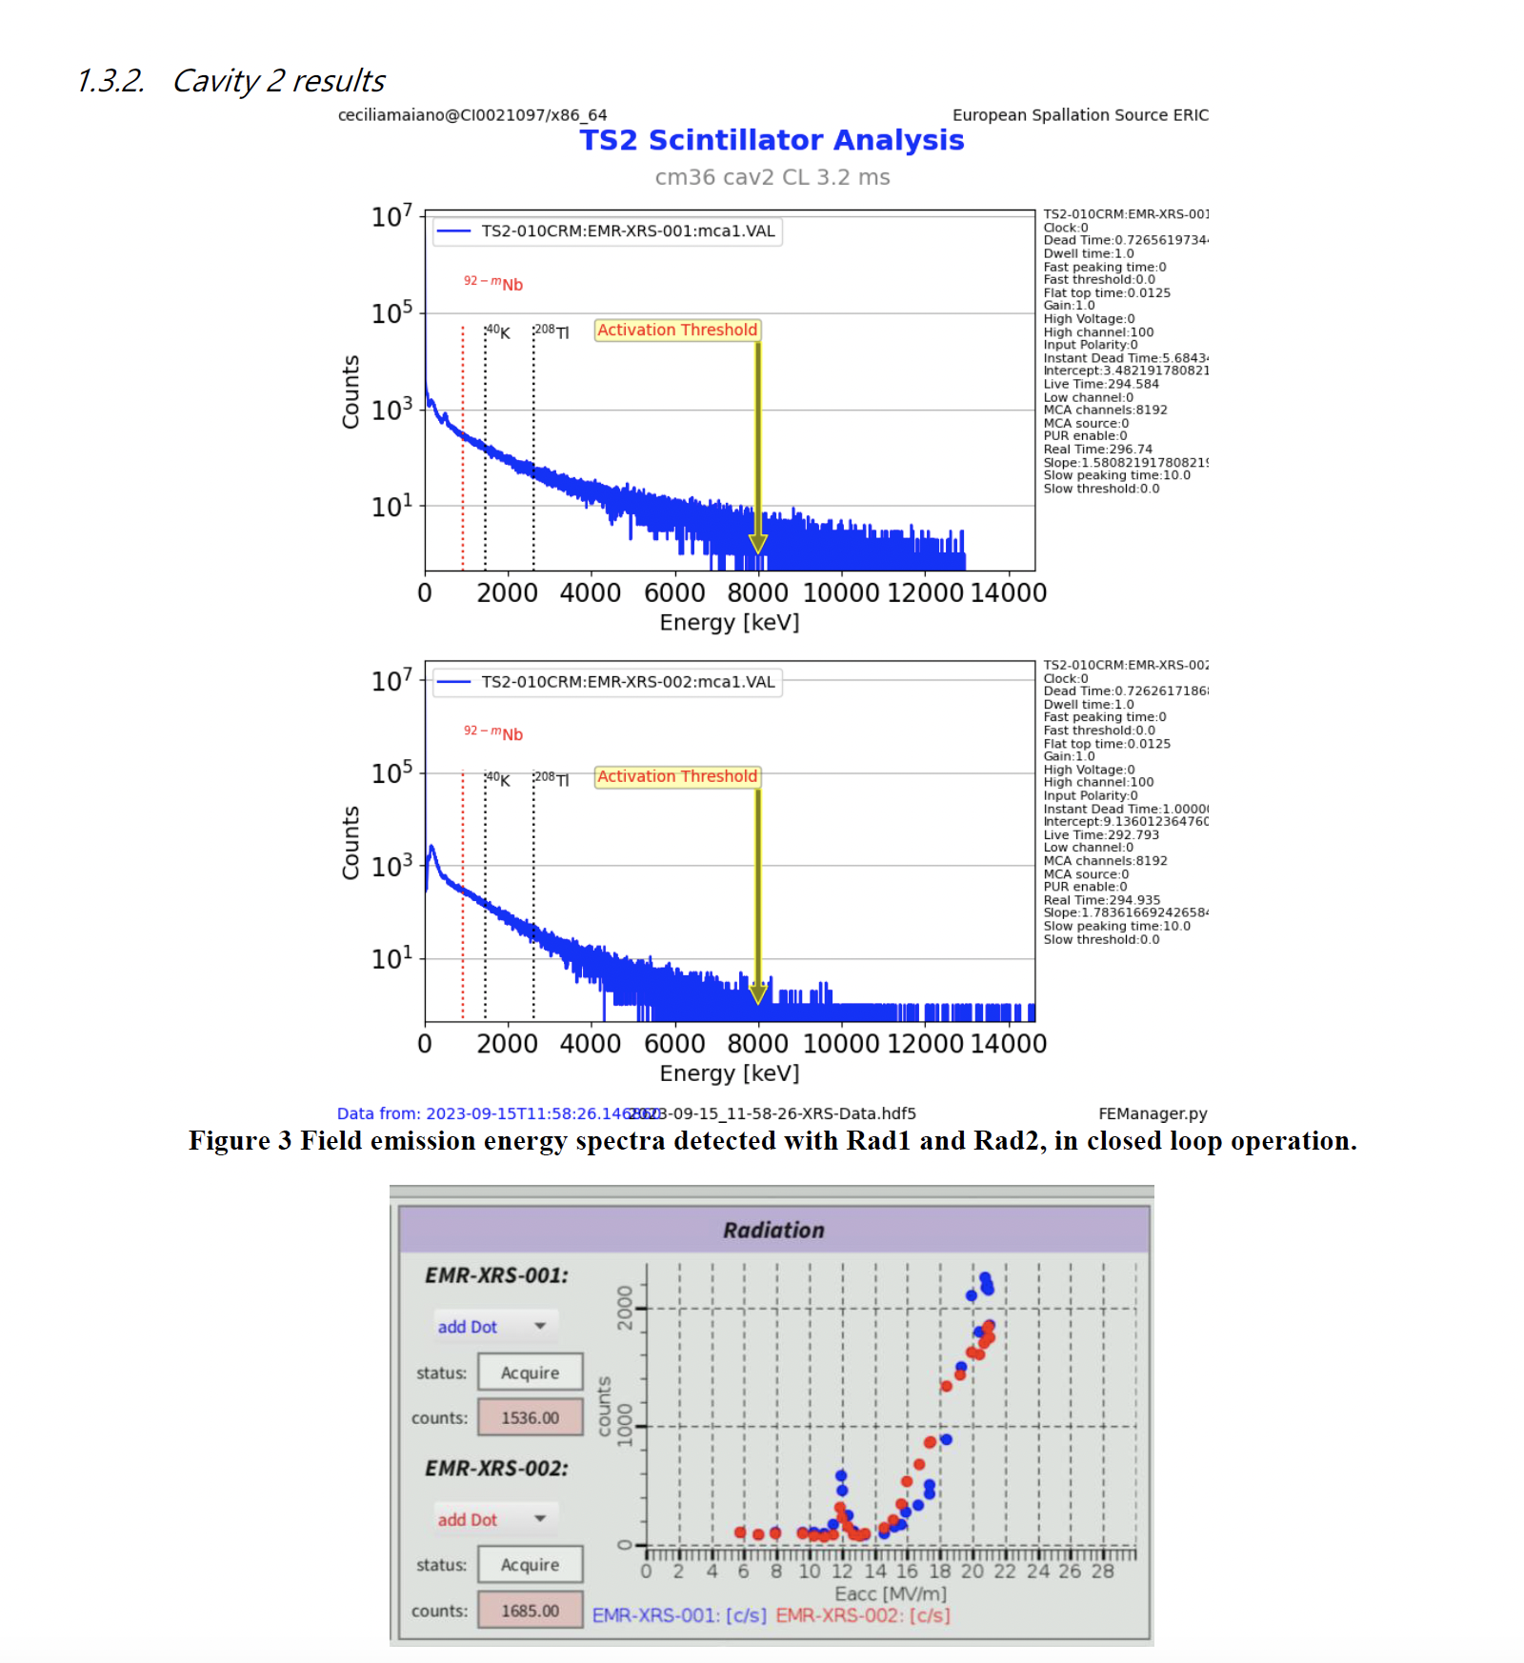
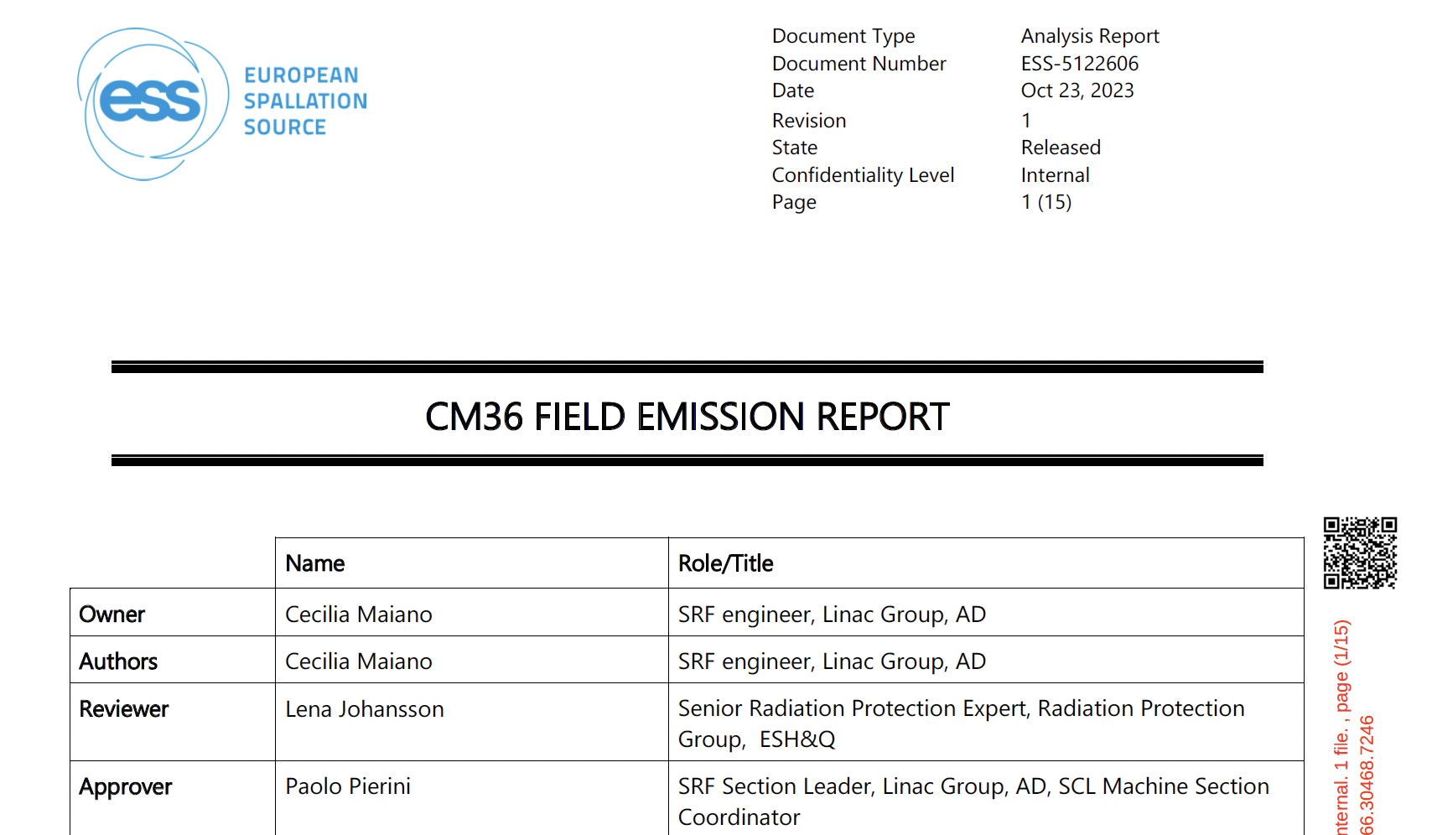
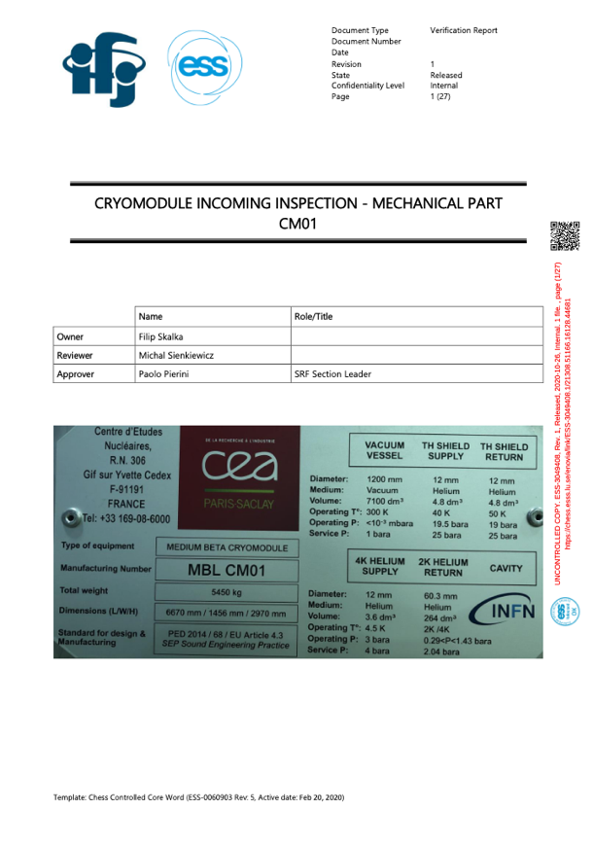
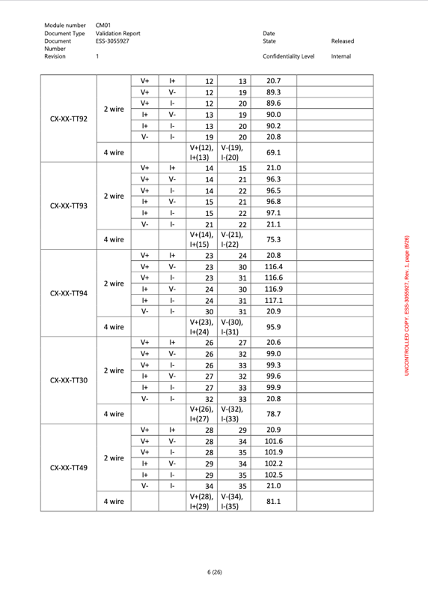
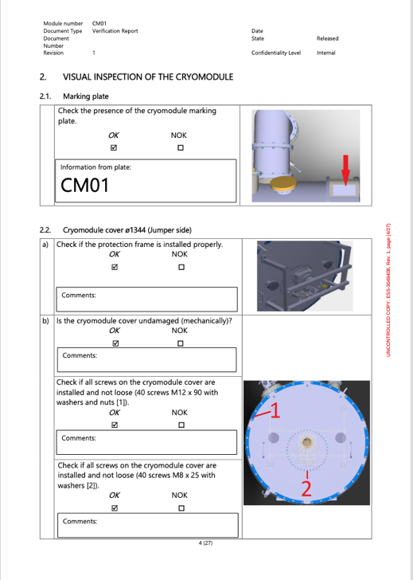
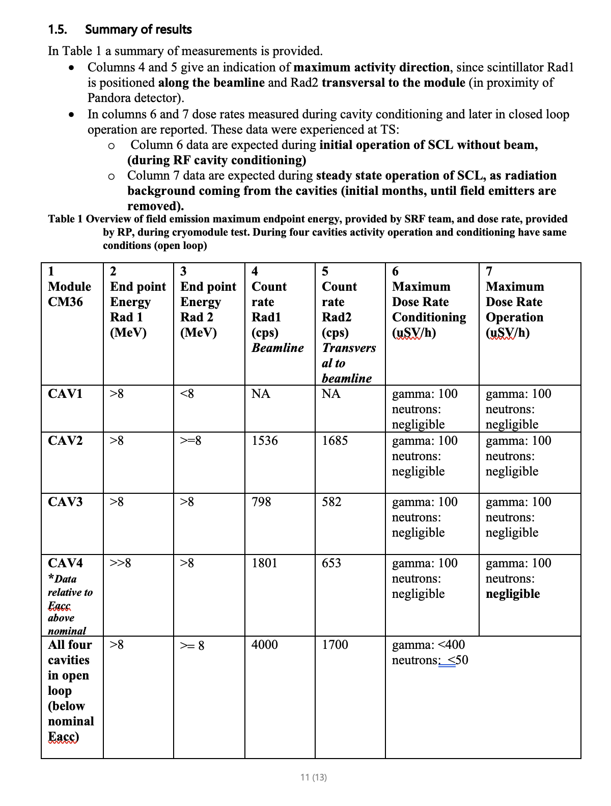
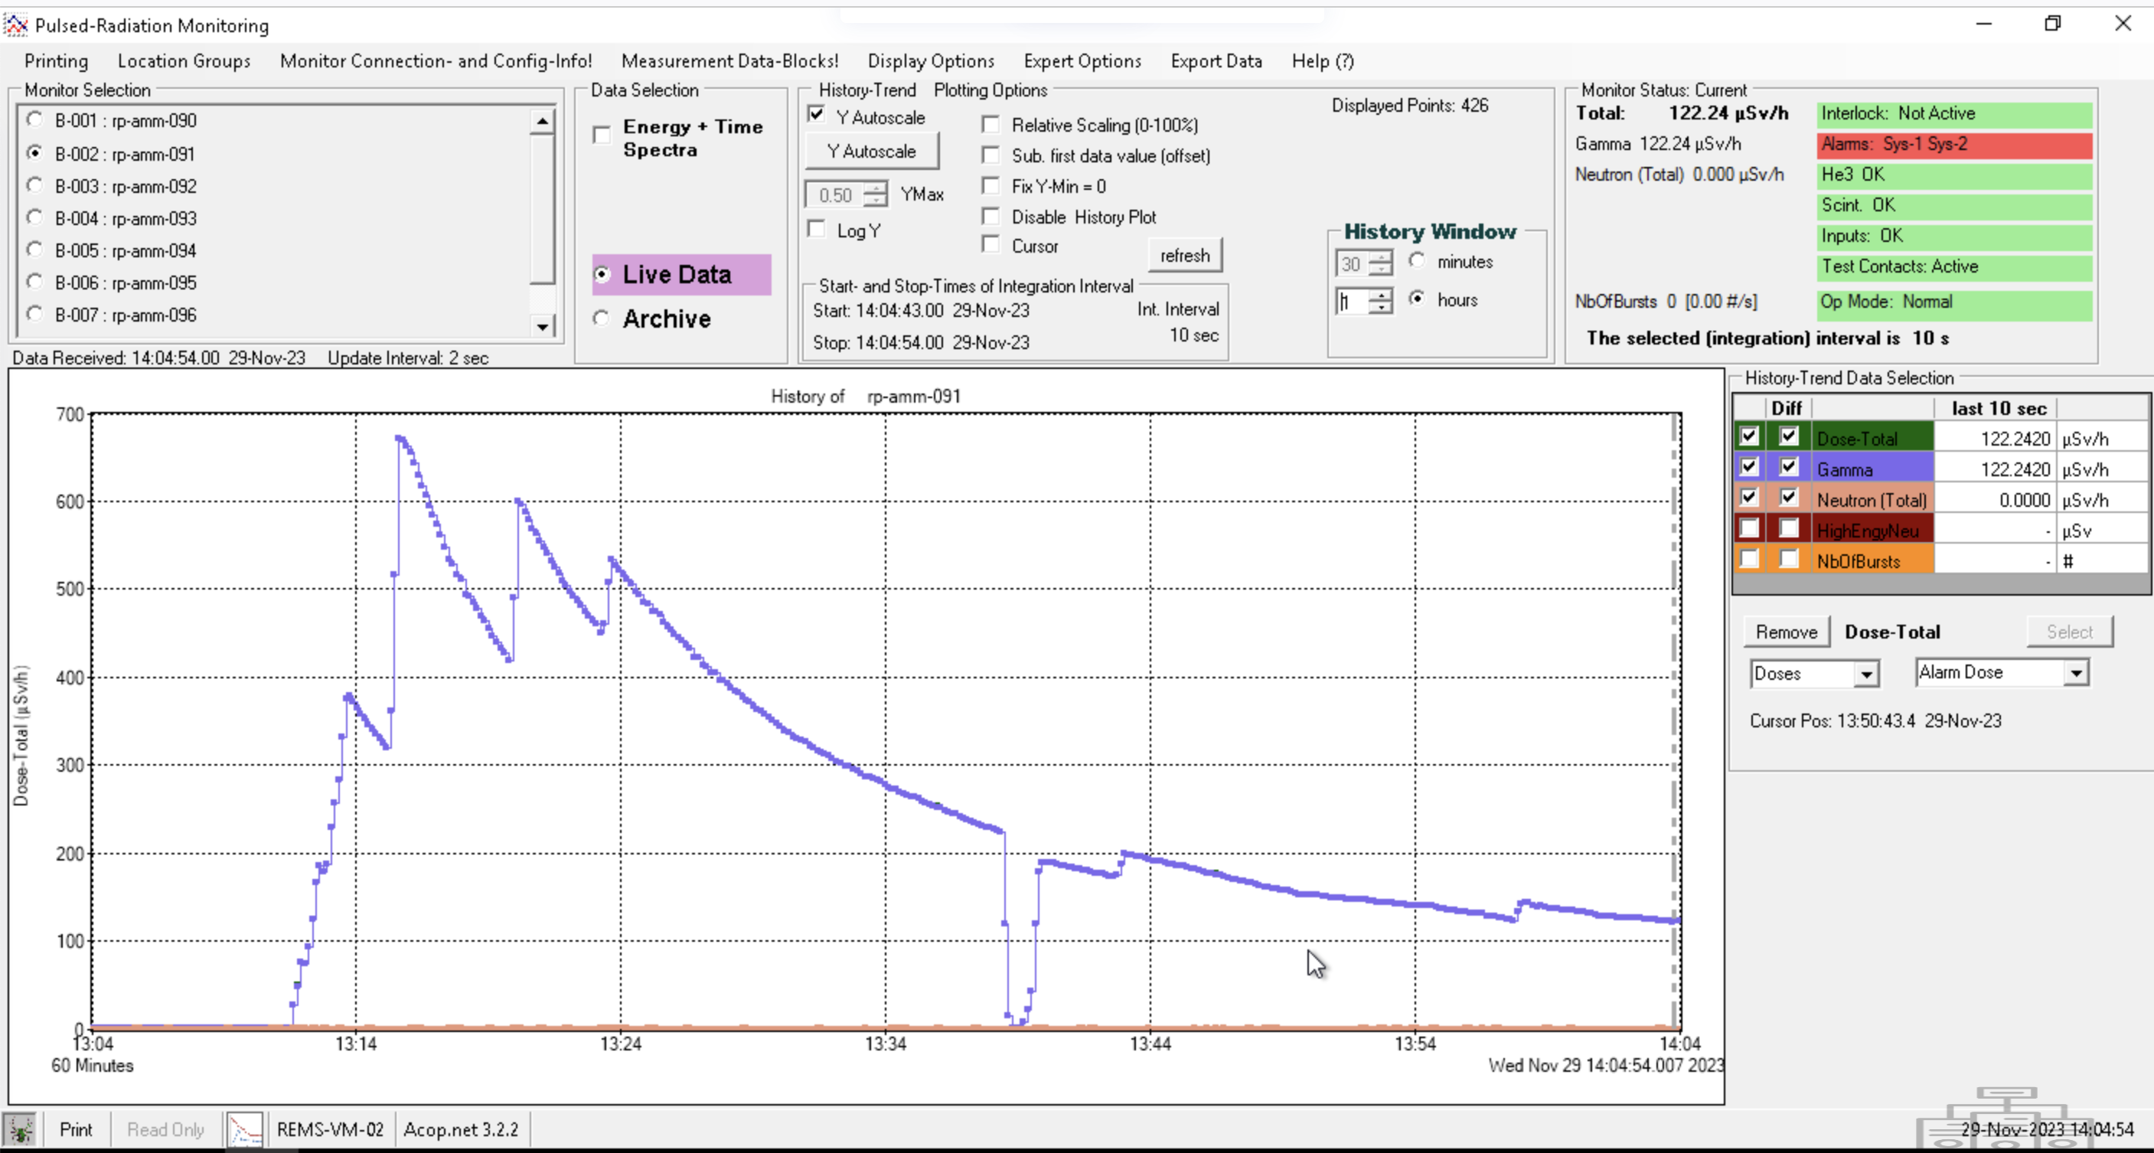
ELL CM: ESS Test Stand overview
Reminder from TAC.23
The CM workflow is split in phases from reception to installation
CM lifecycle is intensively documented [ESS Way of Working]
Cav Fab & Cryomodule Assembly from (INFN/STFC) CEA
Cryomodule testing phase (Mec/Vac/Cryo/SRF/FE)
SRF
Field Emission
Site Acceptance Test of CM
Mechanical
Vacuum
Electrical
=> RP surveys:
Always before access HB cryomodule operation 3-7.
Before moving modules from Supervised Area (max 3 uSv/h) operation 8.

Slide 8
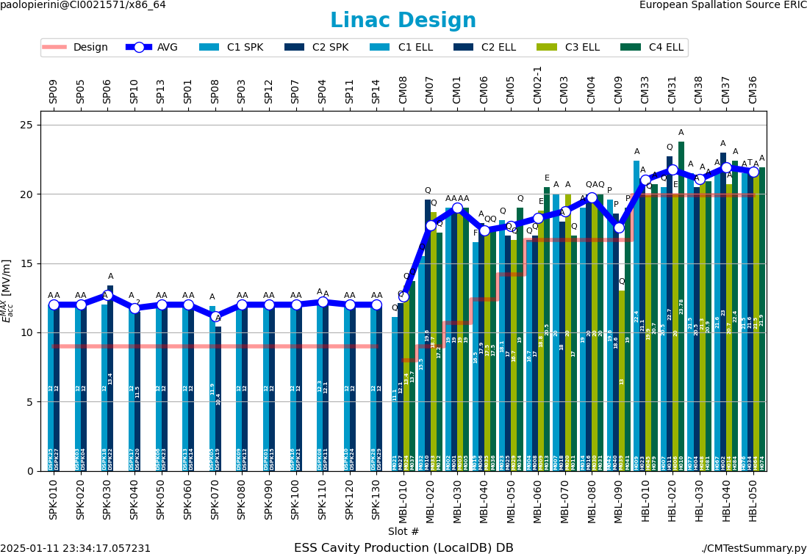
Comparision of Design vs Module Tests
BOD configuration
SPK x 13
MBL x 9
HBL x 5
Well matched!
With minor exceptions, we could configure the machine for the design gradients required by the physics design (red curve).
A few outliers or marginal cavities were known from the module tests at TS2 ( and VT at in-kinds), other suffered some minor degradation or required further conditioning (spurious Arc/EPU events)

Slide 9
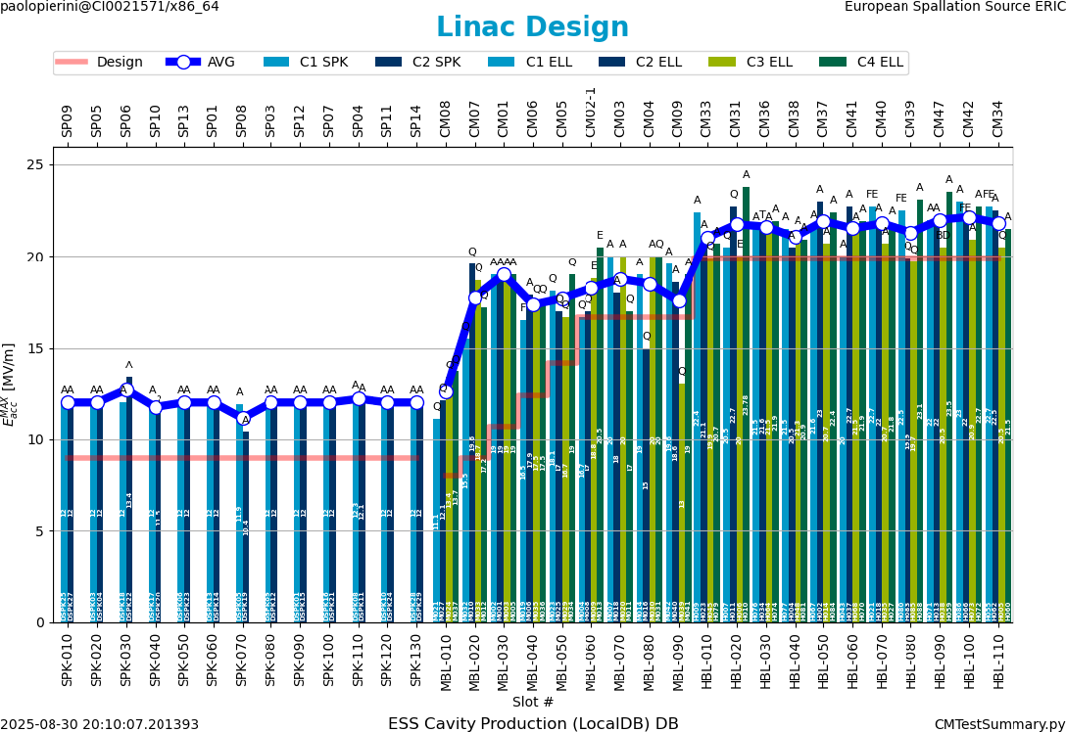
Now up to HBL-110
Nominal 1.29 GeV, for a potential of 3 MW (when RF in G02)
SPK x 13
MBL x 9
HBL x 11
Summer 2025
Installation effort
~5 CM/m
Last 6 CM will not be fed by RF during BOD2/BOT

Slide 10
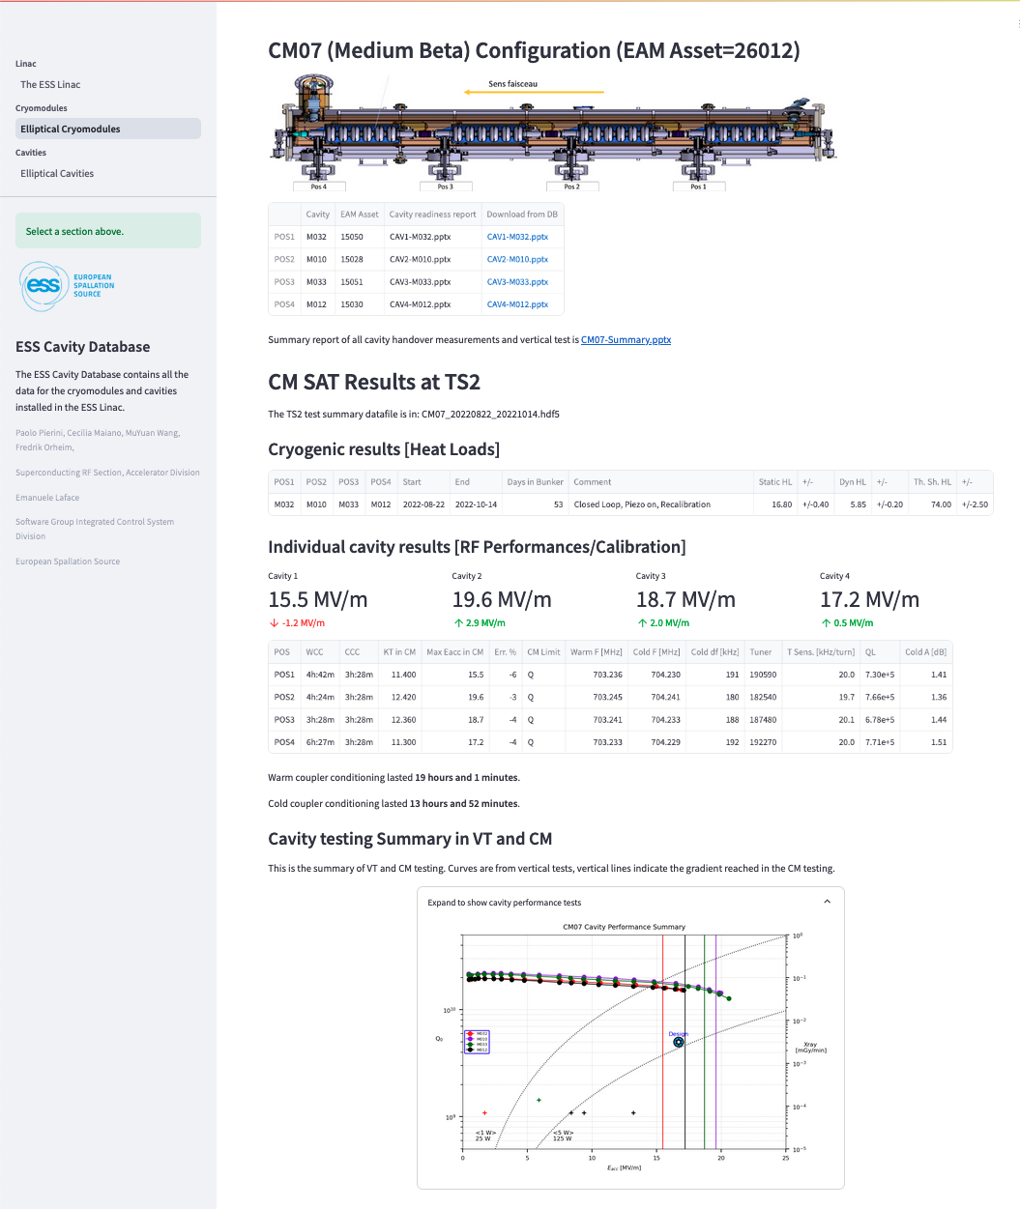
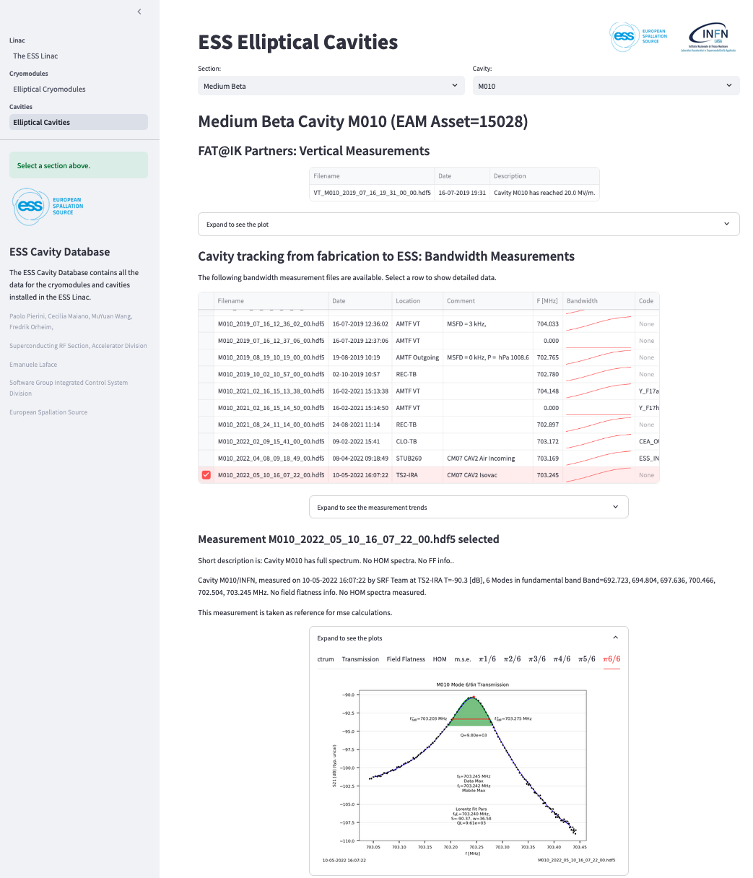
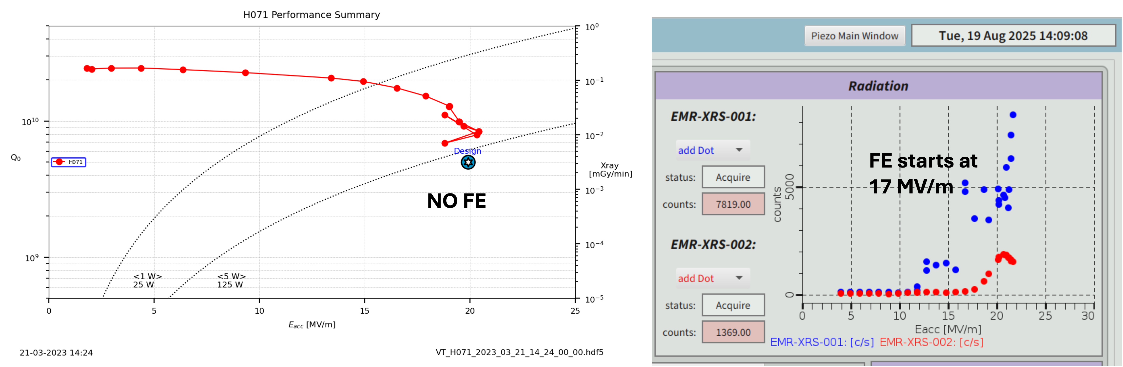
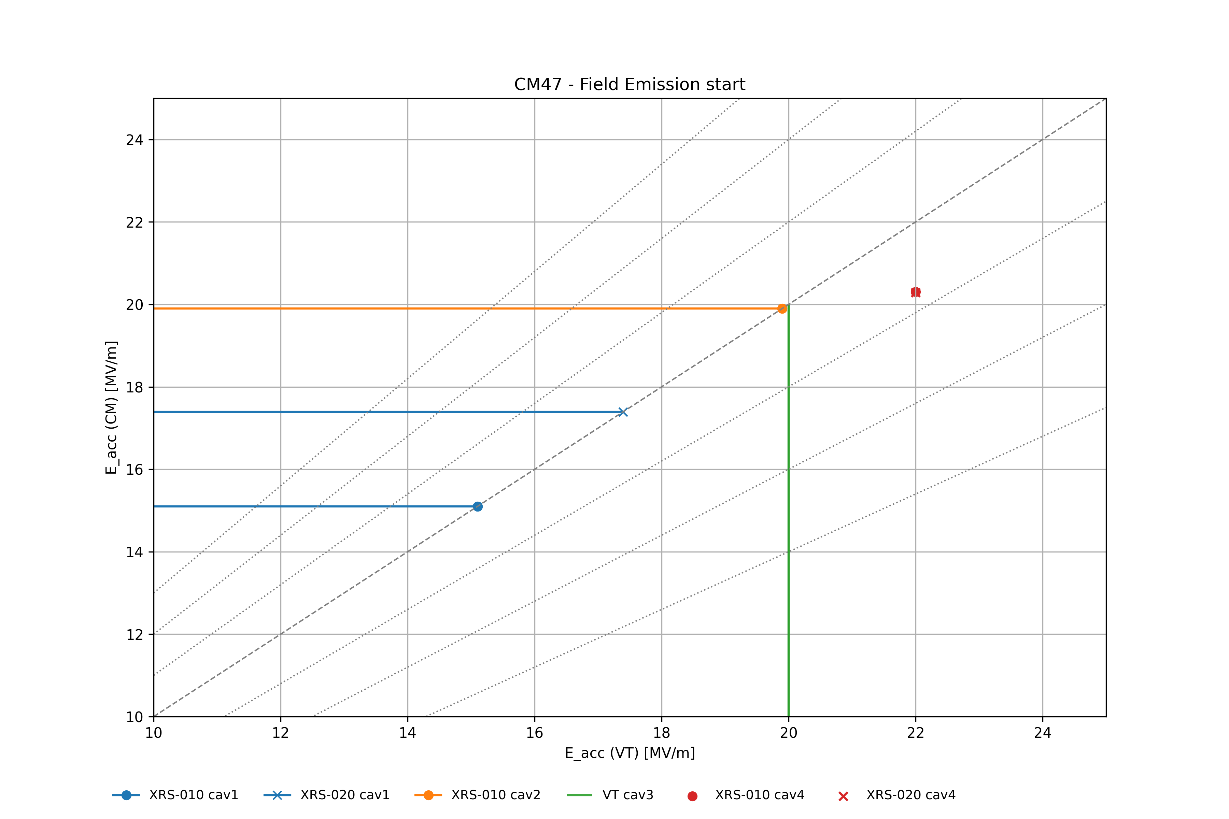
ESSCAVDB
Tracking CAV/CM from fabrication to Test
Agreement of critical measurements holdpoints at handover points from CAV IK partners to CM Assy partner and ESS, for incoming reception and CM testing
Allows
rapid assessment at handover phases
Data available on web service
Store configuration and calibration data for linac
CM
VT

Slide 11
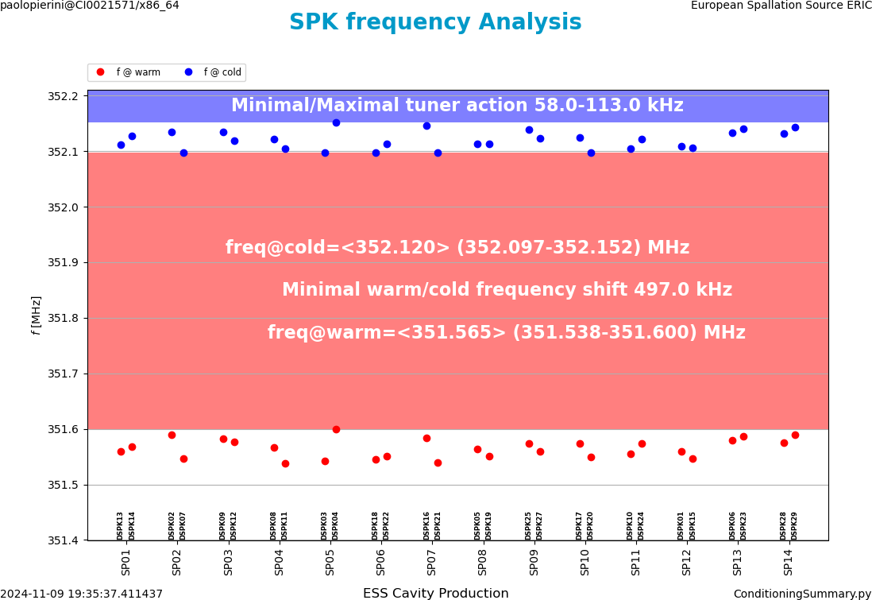
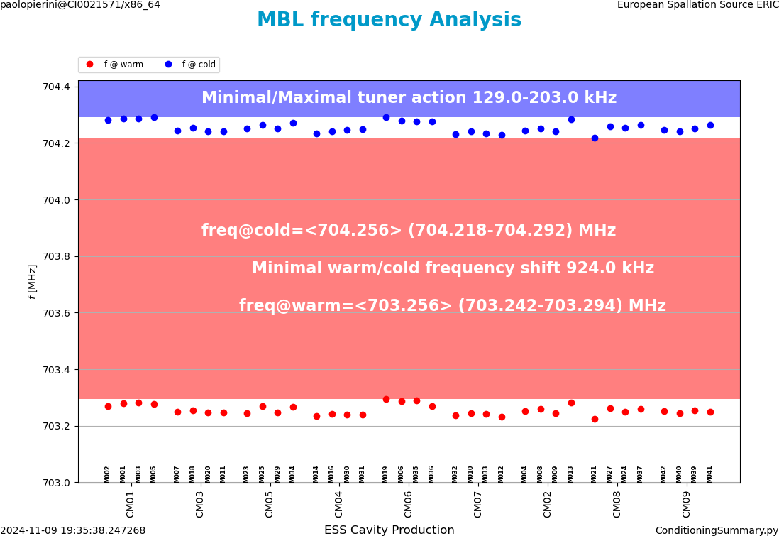
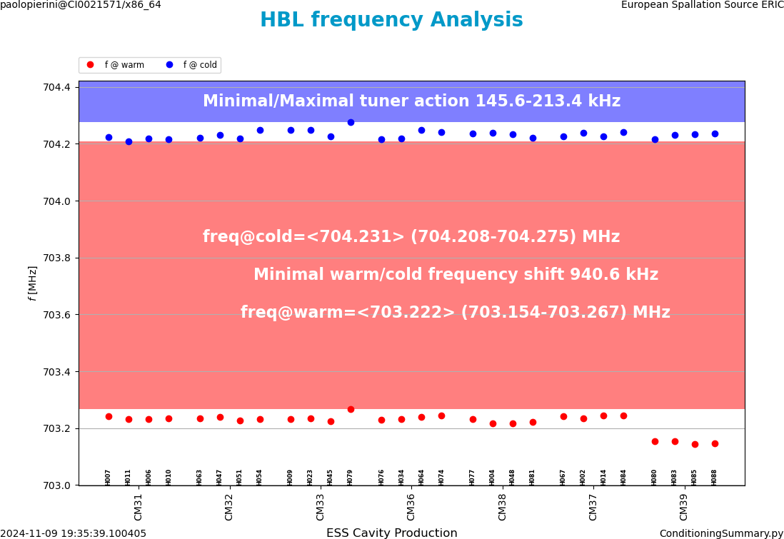
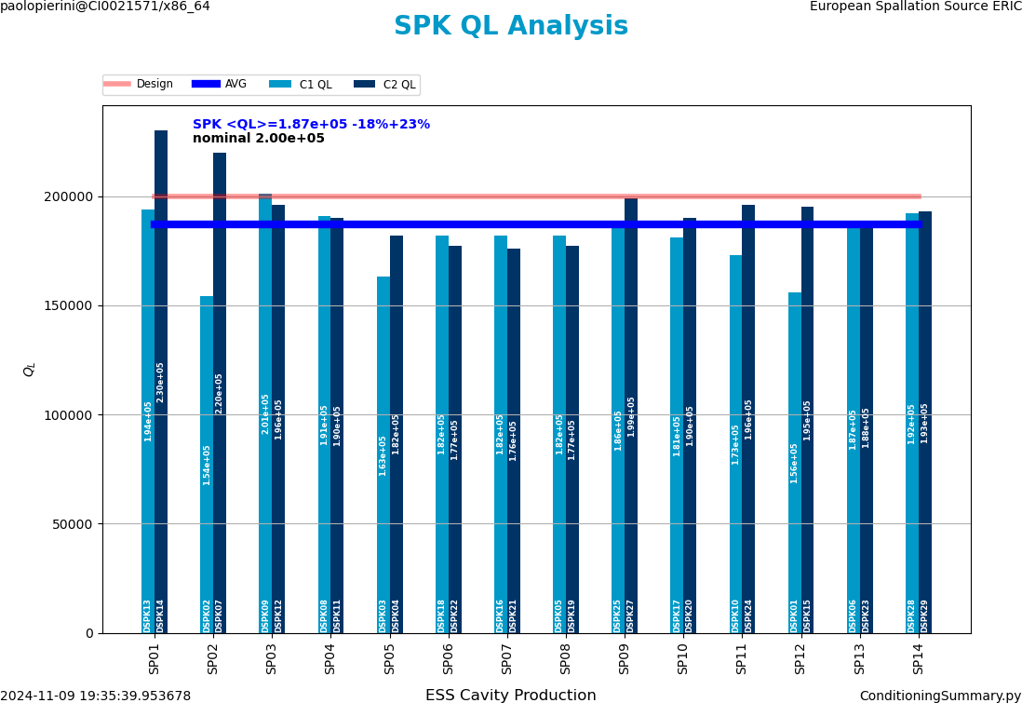
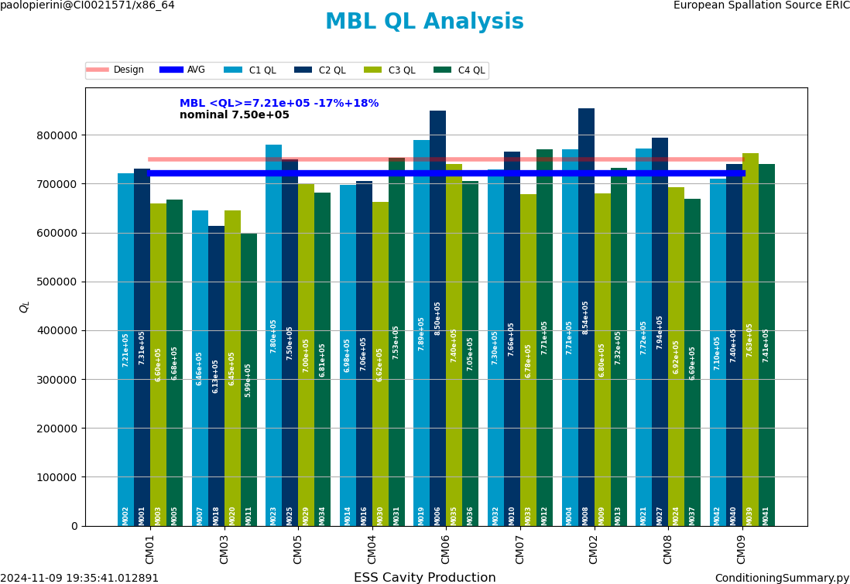
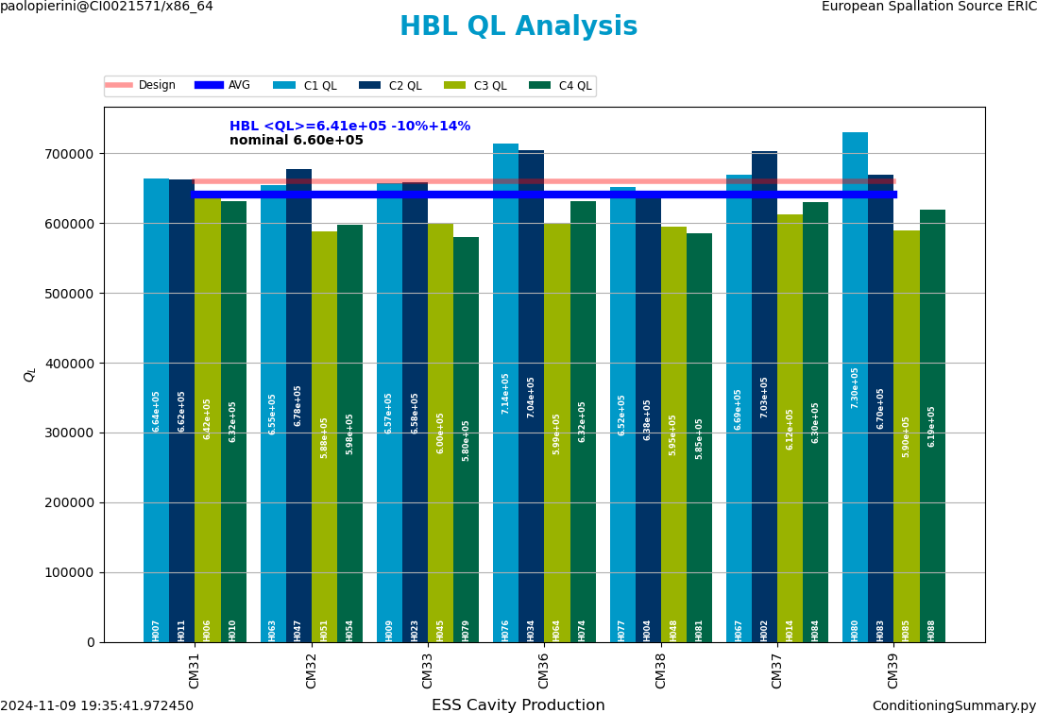
Extend to machine configuration
Data in ESSCAVDB assist machine commissioning (f, QL, Qt, Cold Cables…)

Slide 12
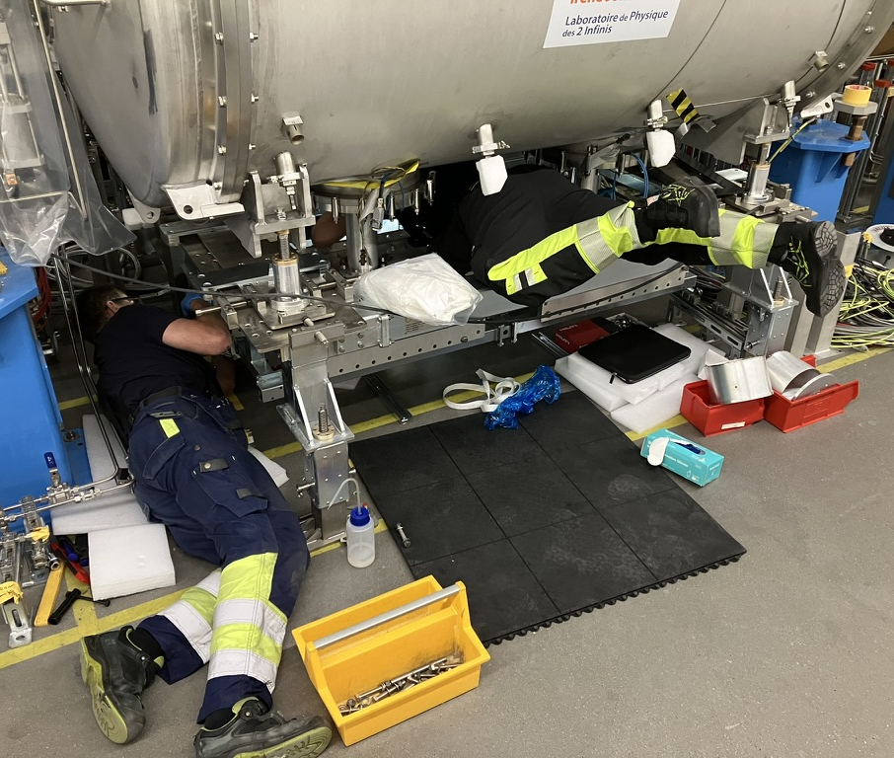
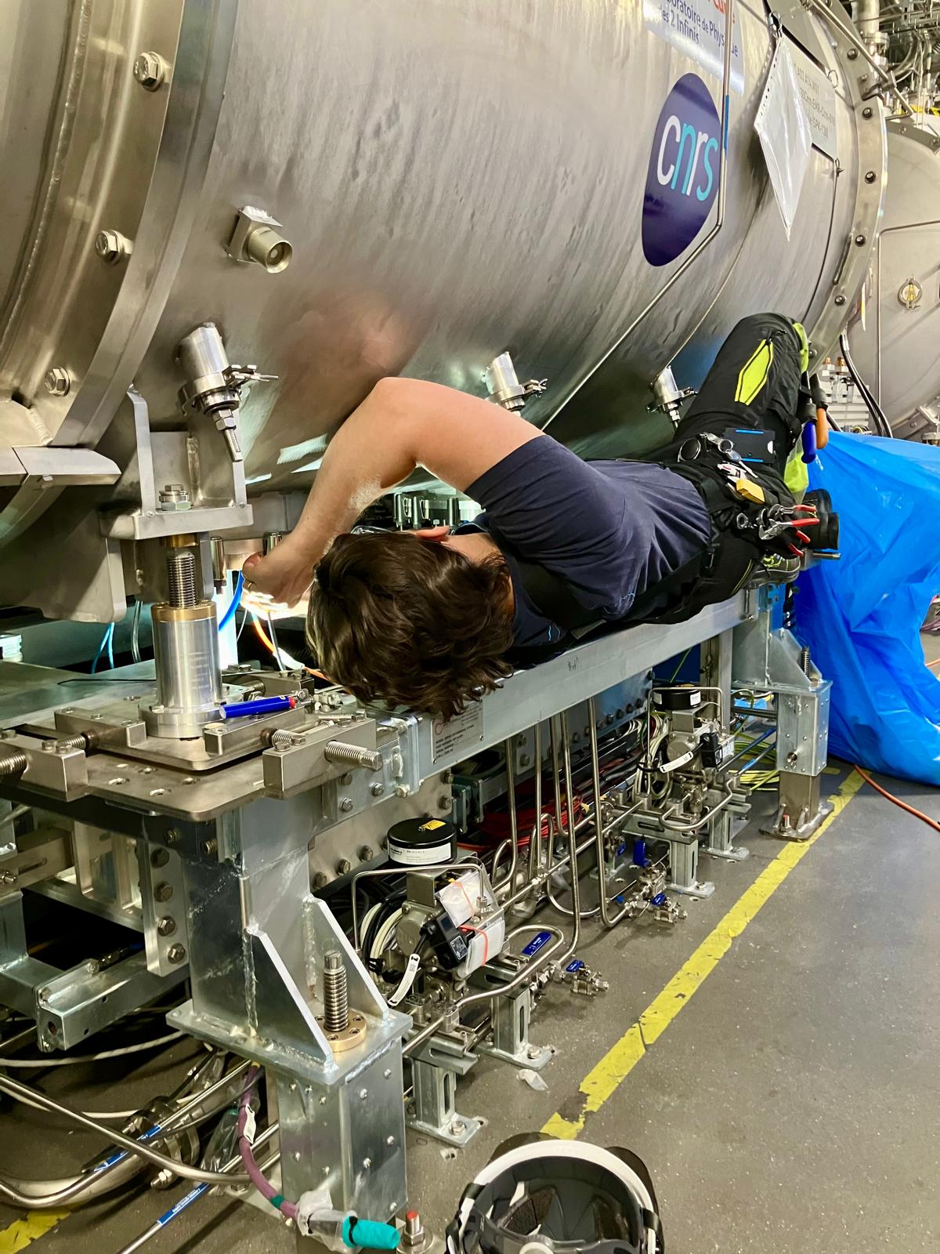
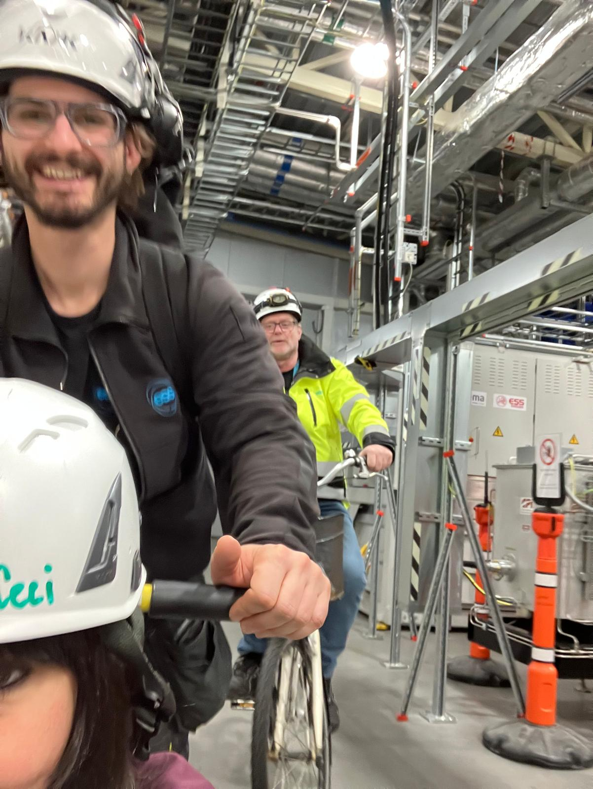
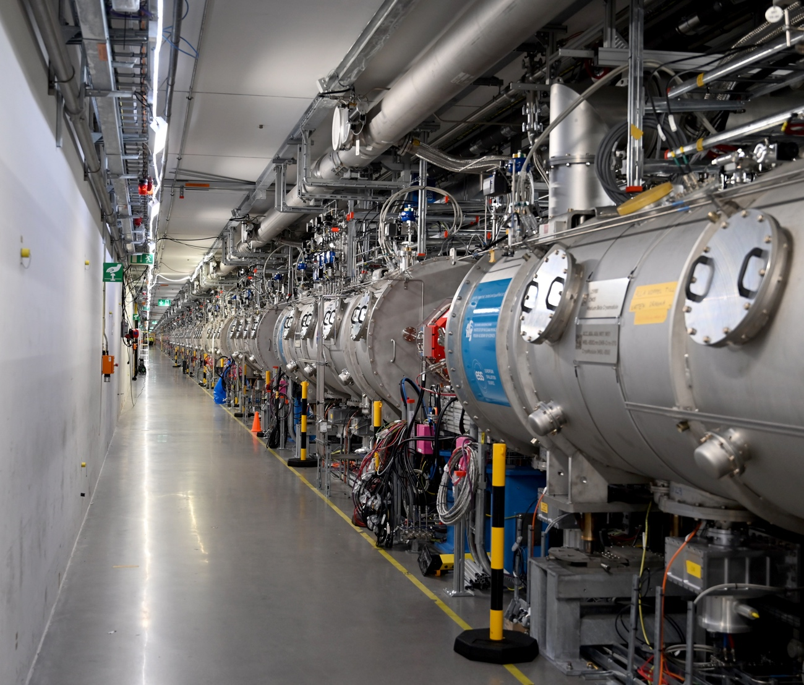
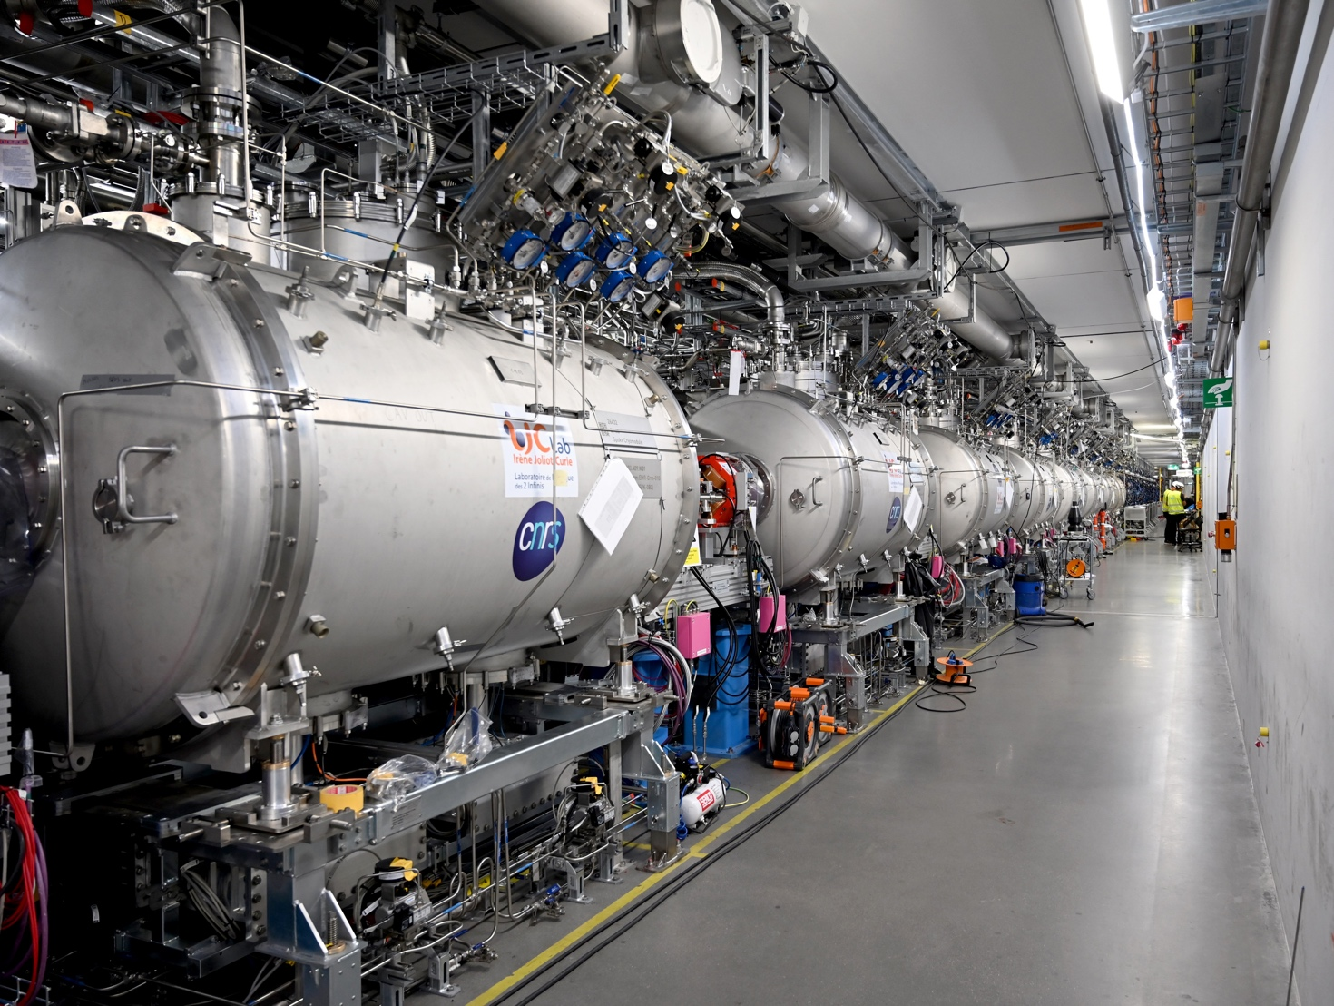
CM Installation completed in Jul 2024
2 Pilot CM Apr-June 2023, 25 CMs from Aug 2023 to Jul 2024 (~ 2/mo) now (~ 5/mo)
ELL section: towards target
SPK section: towards ion source

Slide 13
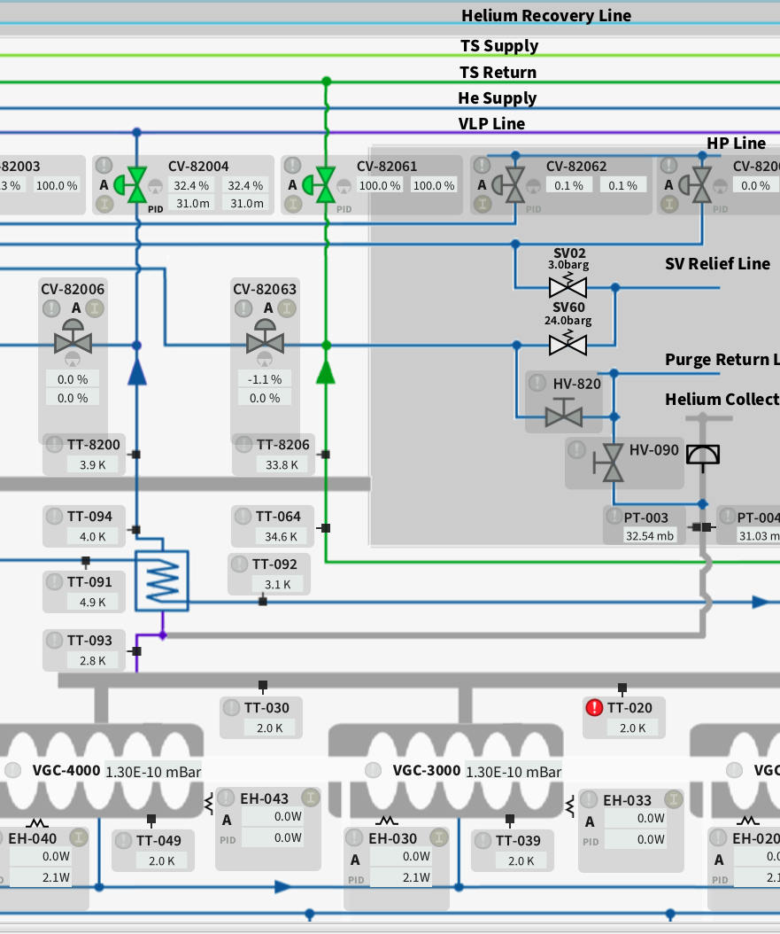
3
Linac Cryogenic Commissioning

Slide 14
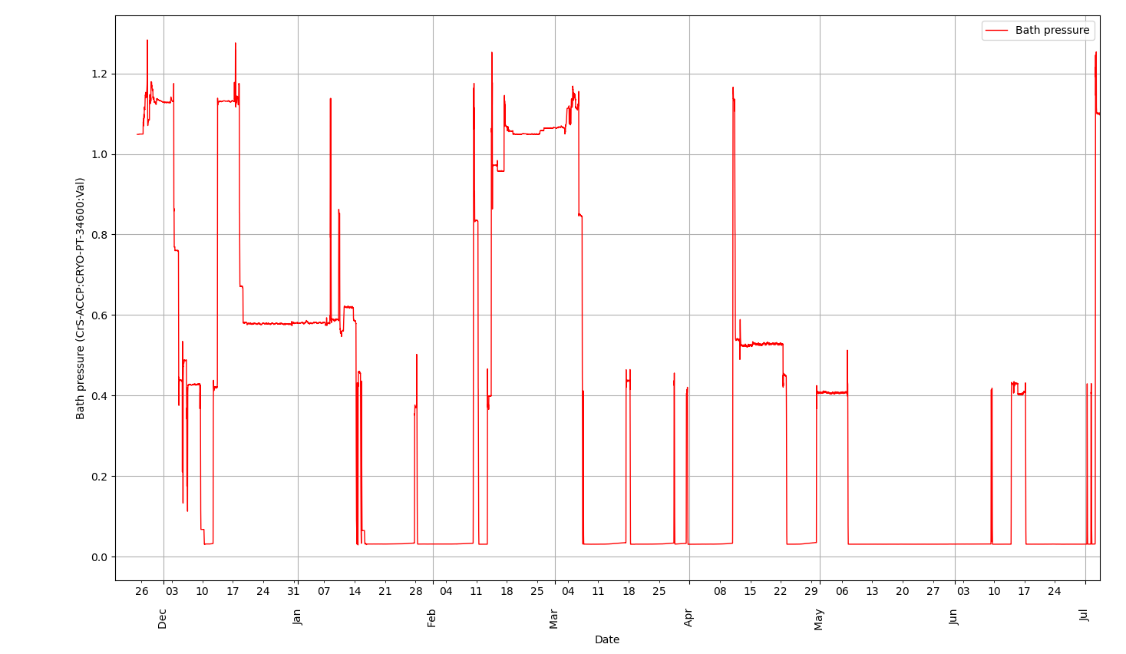
Cryogenic commissioning – in Brief
Pressure seen in the CMs 2k circuit: can be used as indicator for stable cryo operation
Many disruptions caused by several support systems in their teething phase…
Compressed air
Water systems
Network
Deployment tools
Compr. Air
Turbine Trip
VAC PLC Network error (3 burst discs in 2K set off)
Compressor trip, SV left open air ingress and clogging
ACCP PLC Update - Trip
Impurities – CC warmup
Holiday Break
Impurities – CC warmup
Impurities – CC warmup
2K proof-of-principle
Complete Warmup ACCP
Replace clogged turbine
CC Trip
First Cooldown
31 mbar

Slide 15
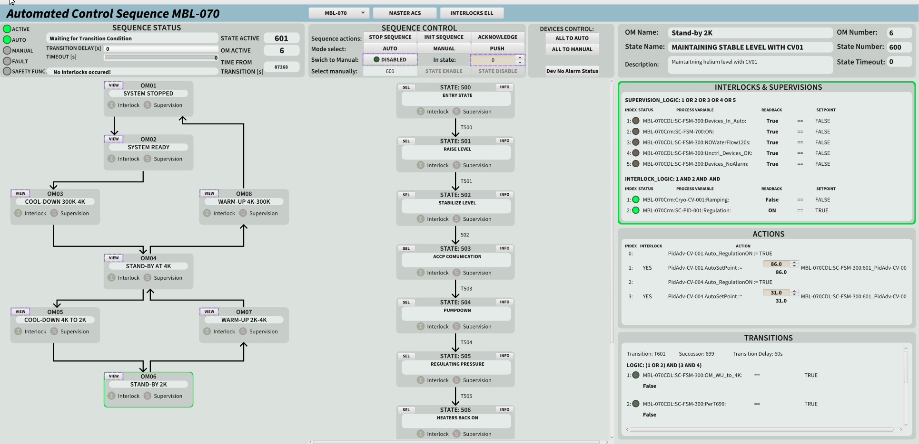
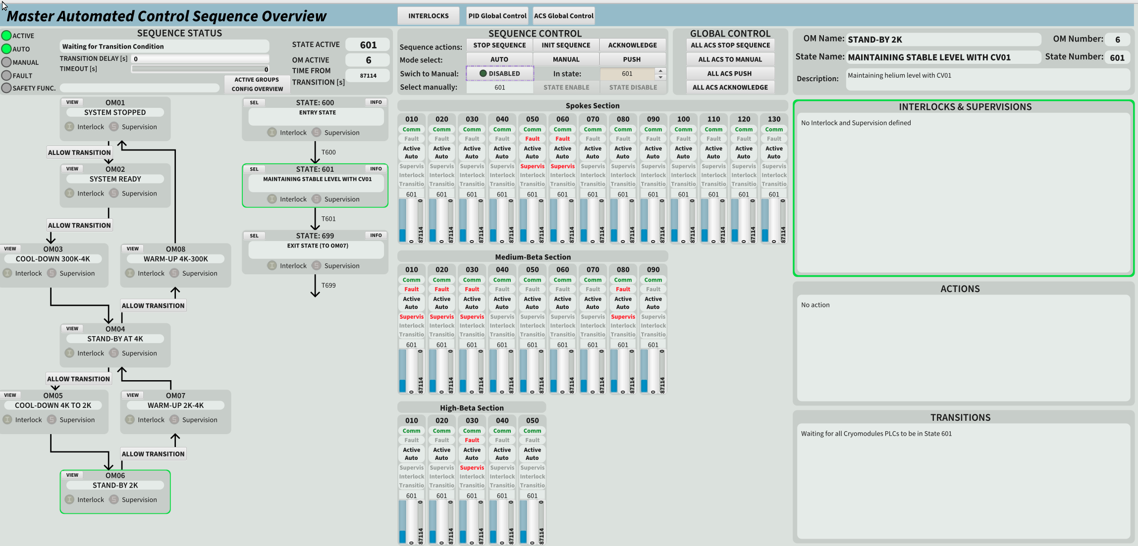
CM/VB handled by state machine (each)
With conditions for transitions/interlock handling
Master Control
Sequence
State
as a
sequence
Tracking individual SM progress for global
transitions
Individual State Machine
Joint effort SRF/CRYO/ICS
Master state machine synching with individual PLC SM and ACCP

Slide 16
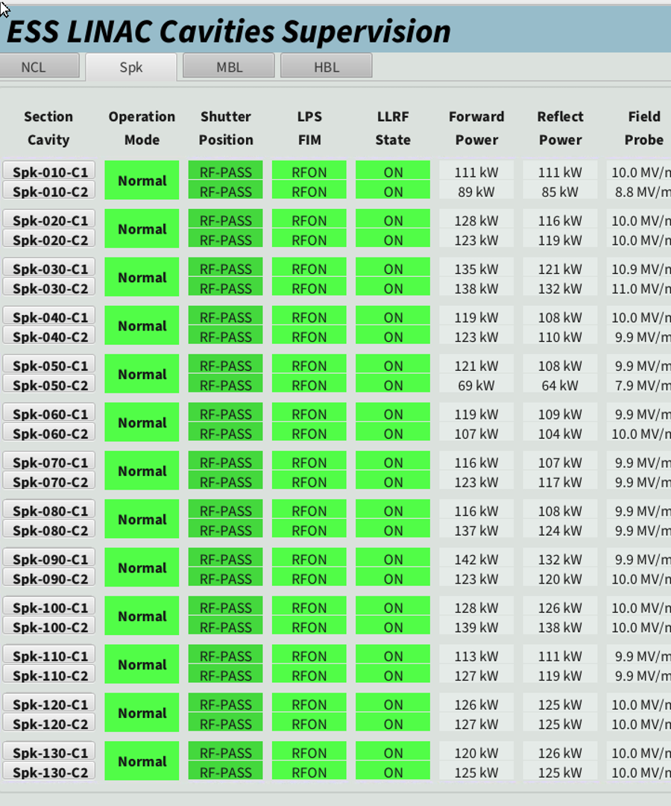
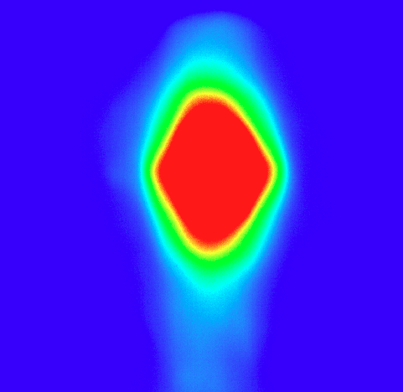
3
BOD commissioning goals and achievement

Slide 17
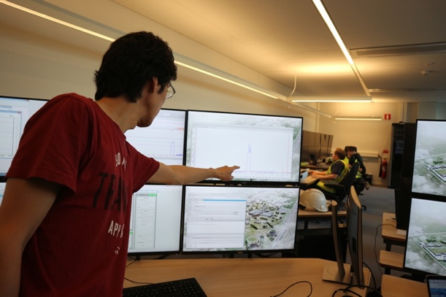
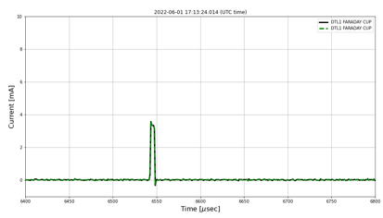
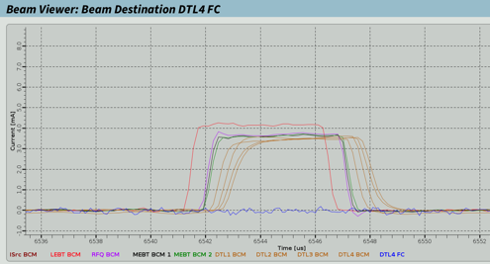
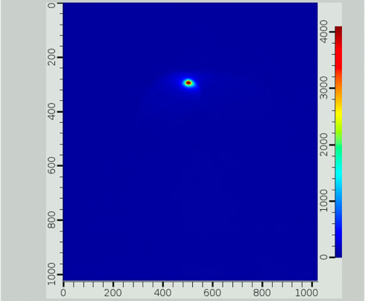
ESS ACC Commissioning History
Beam: ISrc->LEBT - 19 Sep, 2018
Beam: ISrc->MEBT - 26 Nov, 2021
Beam: ISrc->DTL1 - 1 Jun, 2022
Beam: ISrc->DTL4 - 20 Apr, 2023
Beam: ISrc->TBD - 09 Apr, 2025
Beam on Dump:
Transmit probe beam (5 mA, 5 us) to beam dump at 800 MeV
In parallel, commission BI and MPS protection for raising beam power for later stages
SRR1
SRR TS2
SRR2A
SRR2B
SRR3
SRR4
SRR5
EOC
17 Jul, 2018
29 Aug, 2019
7 Sep, 2021
4 May, 2022
22 Mar, 2023
24 Feb, 2025
19 Jan, 2026
31 Dec, 2027
2018
2018
2019
2020
2021
2022
2023
2024
2025
2026
2027
2027
19 Sep, 2018
26 Nov, 2021
20 Apr, 2023
16 May, 2025
27 Feb, 2026
First LEBT Beam
First RFQ Beam
First DTL4 Beam
BOD
BOT
1 Jun, 2022
9 Apr, 2025
First DTL1 Beam
First Protons on Dump

Slide 18
BOD phase in a nutshell
Main operation from SRF perspective
Goals from system owner (SC LINAC) perspective:
Prepare automation tools for: tuning, cavity calibration, interlock checks, save&restore settings.
Prepare supervision tools: Ultimately we will have 146 individual RF systems.
Handover cavity operational envelope and procedures to operation/beam physics teams
Practice Synchronous Data Collection of waveforms (RF, fast diag) for Machime Learning assisted degradation tracking
Cooldown in W48 2024 (28 Nov)
Proof of principle 2K ops with CC
Linac parked at 500 mbar without CC for Chirstmas Holiday break
2K operation restarted in W03 2025 (14 Jan)
A number of hiccups on Cryoplant and general services (Network, Air)
Cold RF operation since W03 2025
Cold coupler conditioning, tuning to resonance started March
Cavity conditioning to operating gradients, at reduced RF pulse length (1 ms)
Cavity phasing with beam
Beam operation in SCL delayed by the NCL reconditioning needs
First protons on dump 9 Apr (216 MeV from SPK), BOD 16 May (>800 MeV)
Warmup W26 2025, end June

Slide 19
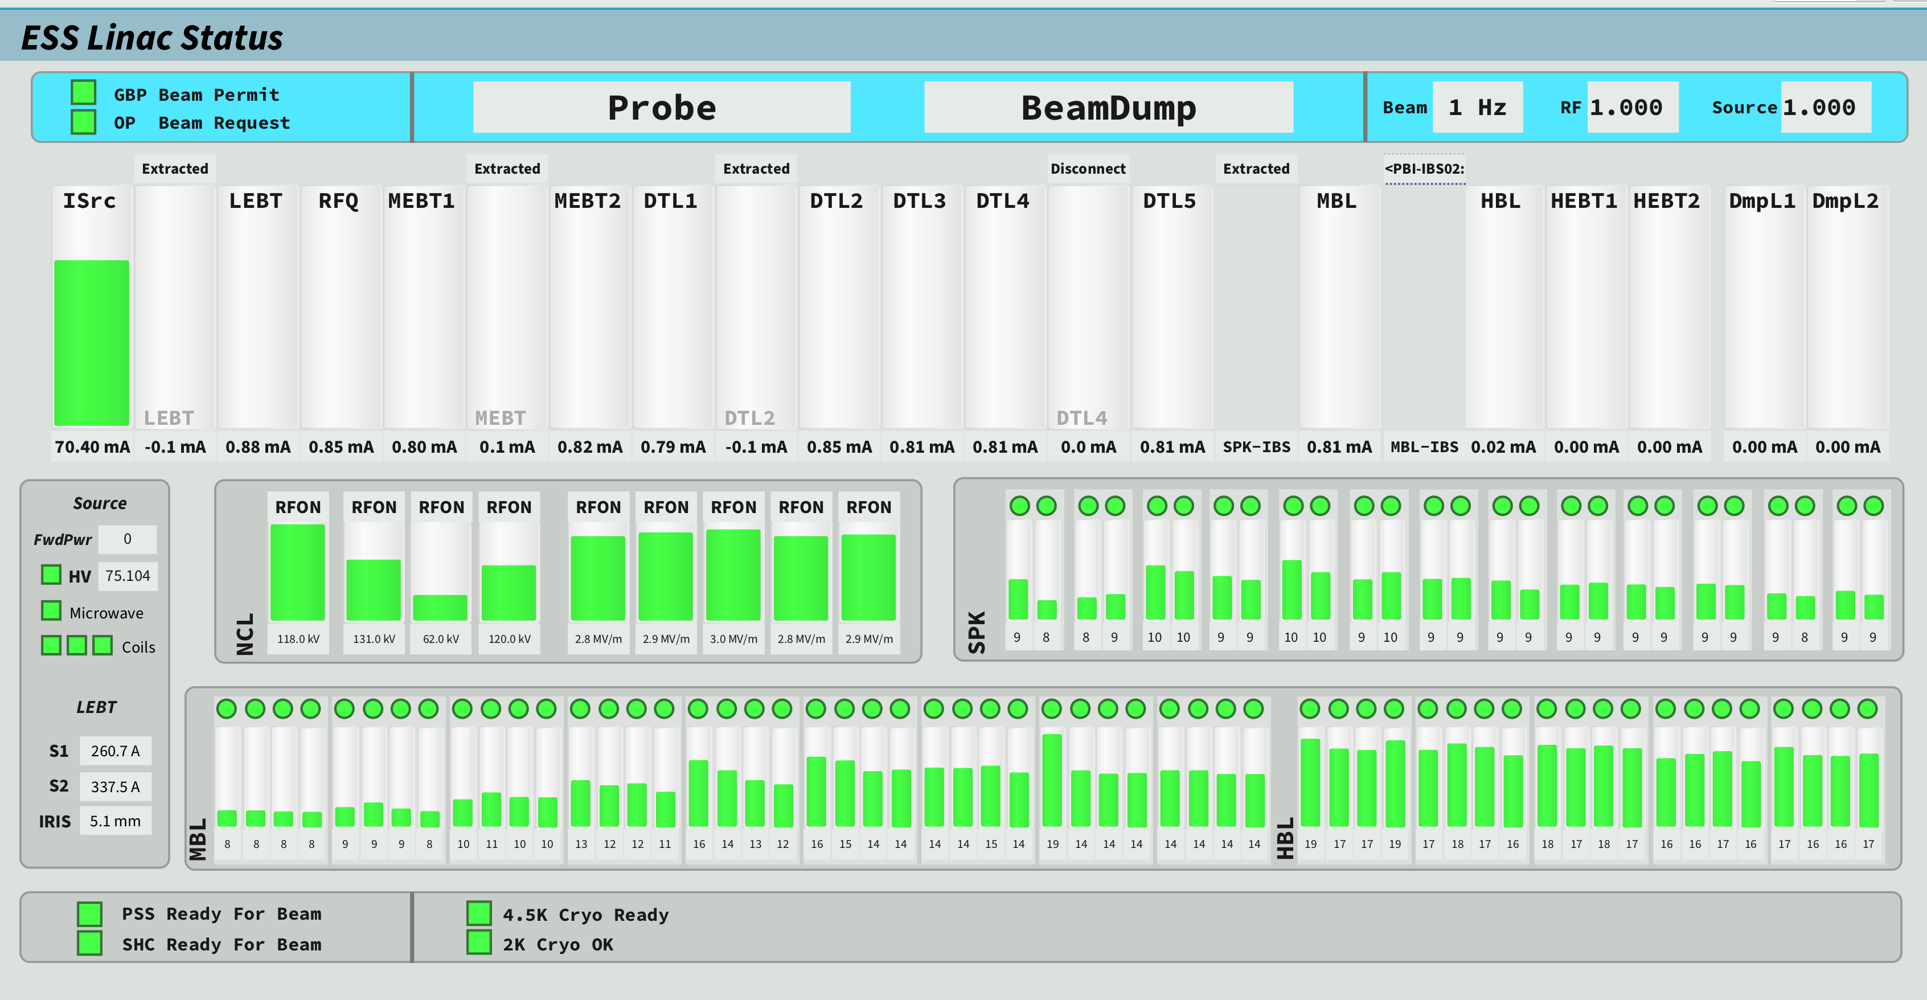
Linac Status from Control Room
“Linac Wall”: BCM on top and cavity setpoints on the bottom
All cavities powered
(during a cavity phasing so probe beam is lost in the HBL)

Slide 20
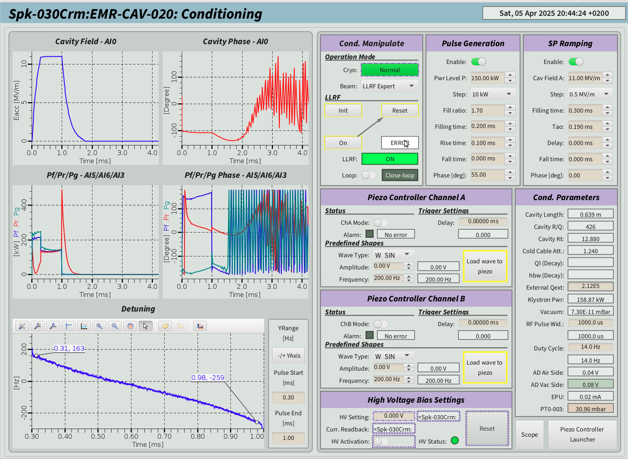
A SPK cavity in CL: SRF Expert panels
SPK @ 11 MV/m (Nominal 9 MV/m), 1 ms RF pulse
RF Pulse limited to scope of BOD commissioning – 1 ms
Not yet 3.2 ms pulses
But keep nominal 300 us filling
Operating in closed loop with no piezo control for BOD (not integrated in LLRF, manual/SRF op mode)
Implementation in LLRF ongoing for BOD2
HV PS systems for coupler bias not yet received from vendor
Tested in 5 locations
SPK ~ 400 Hz LFD along 1 ms
Dyn LFD ~ -3.5 Hz/(MV/m)^2

Slide 21
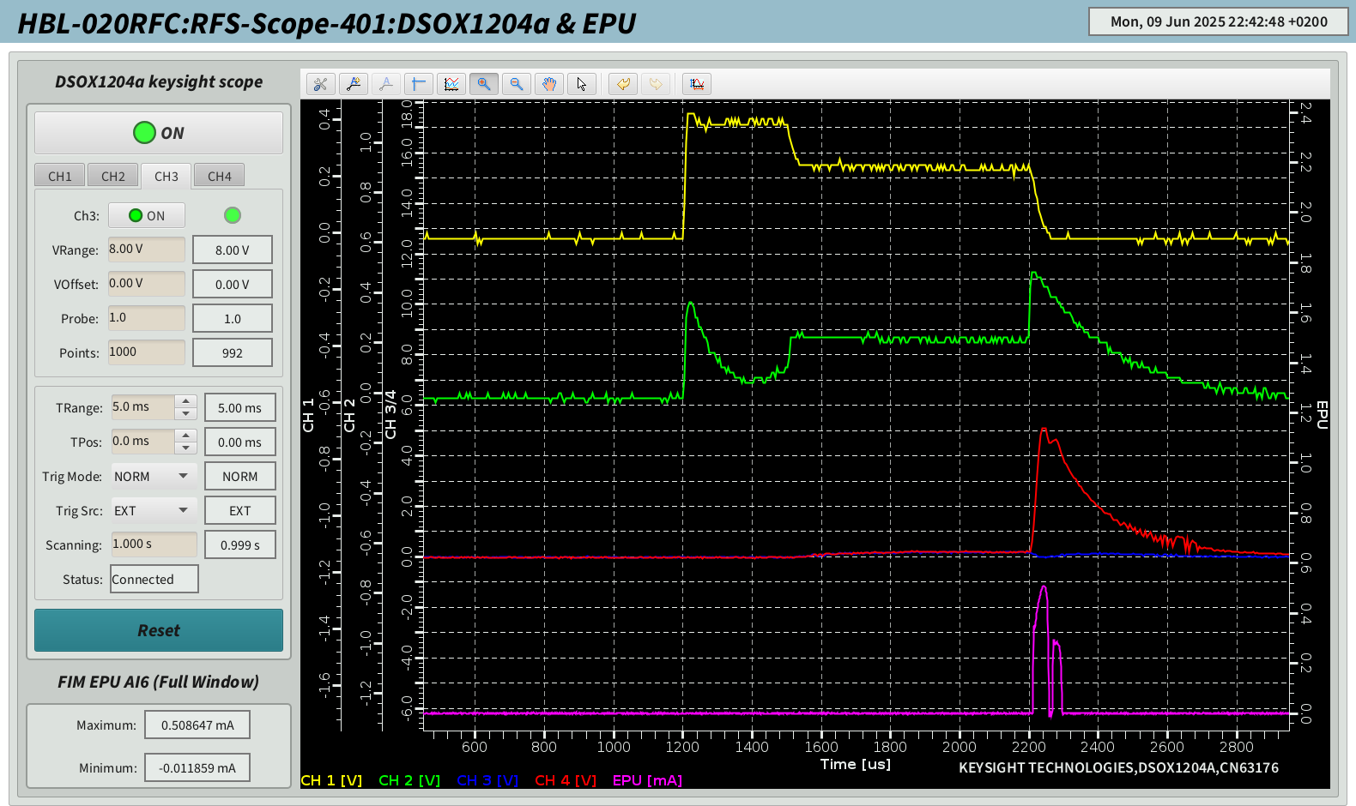

Few couplers showing MP
HV Bias PS units delivered in July, now installed
MP in the coupler region, when coupler is operating in TW mode during the fill time and the cavity decay
Typically appearing with the presence of EPU signal (47 V polarized antenna), which can show several bands.
Completely eliminated by 300-1000 V bias
All units for BOD2
Pfwd
Pref
Arc Air
Arc Vac
EPU

Slide 22
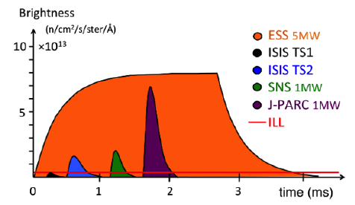
4
Towards BOD2/BOT goals
3.2 ms pulses
‘Collective Arcs’
3 MW capability

Slide 23
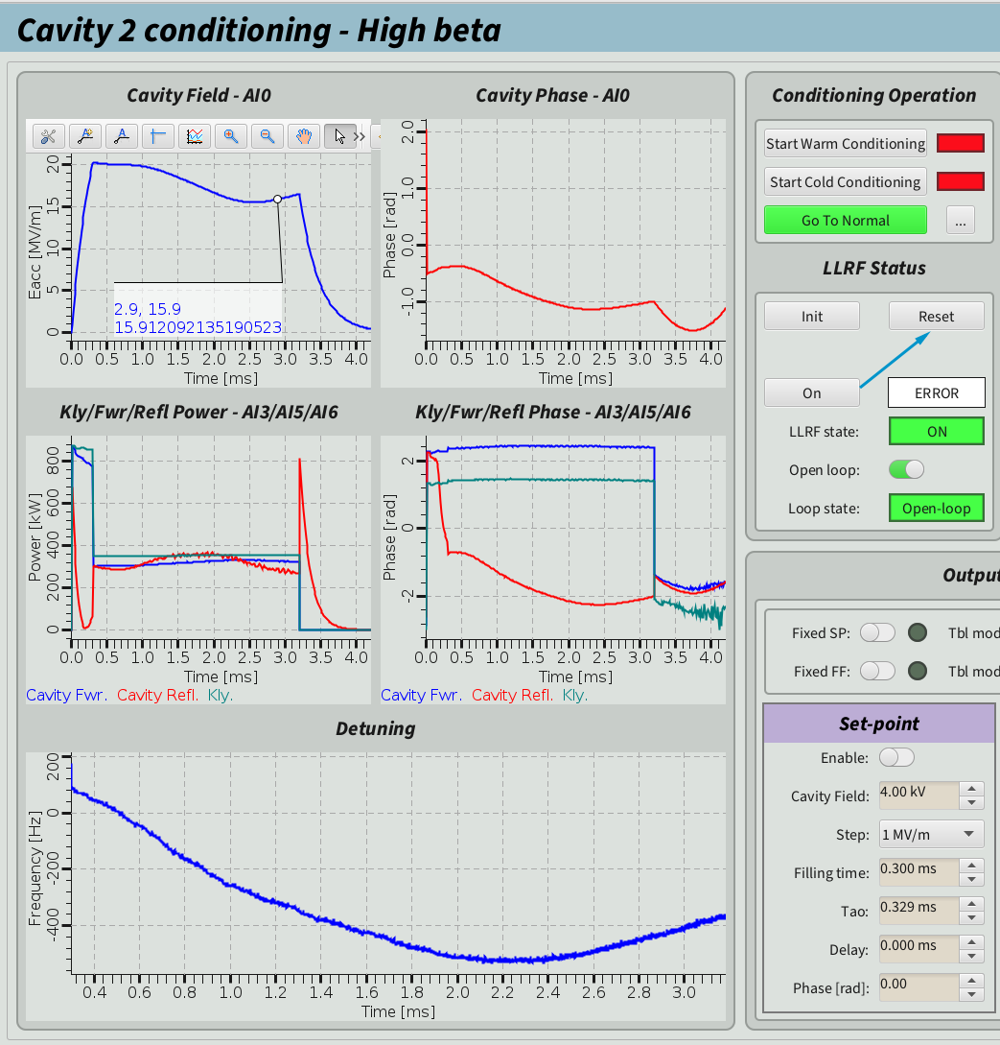
Extension to long pulses
ESS Neutron Pulse 2.86 ms
Modulator pulse limited to 3.5 ms
200 us needed for voltage stabilization
300 us max allotted to cavity fill
Large LFD detuning effect, as seen in TS2
LFD approaches almost the static detuning along the pulse
With nominal parameters Piezo are necessary to operate within power budget in the HBL section
TS2: Open Loop
Detuning is ~HBW
> 500 Hz

Slide 24


Manual piezo operation at TS2 in closed loop
Piezo OFF
Cavity detuning at high field (LFD) requires extra power at pulse end!
Piezo ON
FB loop overpower 1 BW = 2x power
Flat pulse with FB
TS2: Closed
Loop – piezo OFF
TS2: Closed
Loop – piezo ON
Proof of principle, now being integrated in LLRF

Slide 25



Ongoing work for BOD2/BOT
LFD algorithm development (by LLRF&ICS Teams)
Manual operation of piezos available since long in TS2 operation
No showstoppers
HL LFD compensation algorithms tested during last CM campaigns
Proof of principle for automation
Successful tests of LFD compensation in LLRF IOC at TS2 with CM47
Ready to be tested in linac
Goal of the RF Conditioning phase for BOD2 to achieve full RF pulse goal

Slide 26




System Characterization tools
To assist cavity and LLRF setup
Used TS2 operation within a collaborative development with Łódź/PL for the development of characterization tools to assist further commissioning stages
Piezo
Capacity vs Temperature
Capacity Monitoring (Fault Finding)
Cavity
Piezo Response Identification (Hz/V)
Cavity LFD response
Cavity Mechanical Modes
Cavity Passband modes identification

Slide 27


Collective `Arcs’
FE radiation collected by fibers of the coupler arc detectors…
During cavity conditioning we had several events of field emission bursts which “lighted” all the fibers bringing the arc detector signals to the gallery PMTs (VAC/AIR side)
Signal triggered at the same timestamp, interlocking many systems
Still happening sporadically. Seen also by BLM.
Neutron burst
observed
by pandora

Slide 28

FE buildup in the HBL section
Seen by the fibers that are installed for the Arc Detection at the couplers
Cavity field emission (along RF pulse, with no EPU)
It is Cherenkov light occurring in the fibers, triggered by FE
The worry:
Spurious arc interlocks
Masking real arc events

Slide 29











Collective arcs knowledge from TS2
Chicane PANDORA
Gen I
Developed by CEA
Gen II
Photomultiplier + fast amplifier (Hamamatsu PM Amp)
Time resolution ~ 1 ns
Torre di Pisa developed by CEA
SB1 CEA
SB2 CEA
PANDORA

Slide 30






FPC feeding FE
Dashed line= cavity field as reference
DETECTED GAMMA RAY PULSE
Scintillators SB1& SB2
FPC4 DIAGNOSTICS
ARCS and Electrons
FPC1 DIAGNOSTICS Only ARCS
•~15 MeV e-→ e-+y (Bremsstrahlungin Nb )
• y+ 93Nb → 92^{m}Nb + n
• 92^{m}Nb → 92Zr + y(934 keV)
FPC4 low energy electrons (here 100 eV ~ threshold SEY>1 ) are captured by the cavity field, generate secondary tracks
FPC diagnostics is designed to detect optical light from coupler viewports (ARC)
SB has no optical path to coupler but captures Cherenkov events from FE
e- from FPC area travel to cavity and lead to radiation
Moderate 92mNb activation (y,n) observed
thanks to 10µs time resolution, we can distinguish between FE and FPC electron emission (CEA detectors)
Courtesy of G. Devanz CEA

Slide 31


Induced beam losses: Pandora location in TUNNEL
HBL-010
HBL-020
Pandora

Slide 32

2025-06-10
80 uSV/h gammas,
up to 45 mSv/h neutron (E < 20 MeV)
Beam in SCL
– induced losses-
Beam in SCL
NO Beam in SCL, cavity induced raidation
~ 80 uSV/h gammas, 20 uSv/h neutron

Slide 33




Arc Detector fibers shape and Dose Rate (1)
08:41 NO Beam
13:17 Beam
NO Beam in SCL, cavity induced raidation
~ 80 uSV/h gammas, 20 uSv/h neutron. 08:41
Beam in SCL
~ 80 uSV/h gammas, 36 mSv/h neutron

Slide 34

Arc Detector fibers Max and Dose Rate (2)
Cherenkov light in fibers
Electrons from FE in cavities
y -> ionizing → e-
Electrons from couplers
y -> ionizing → e-
Electrons from low E neutrons scattering (beam losses)
(n,n’) -> deexcitation y-> ionizing -> e-
Collaboration with CEA and RF group to modify the ESS AD solution for immunity to Rad events (filtering/veto)

Slide 35



More installations started in July
Opportunities from delays in the Target Readiness
Beam on Dump phase ended in June.
Preparing for the BOD2/BOT goals
We have installed 6 more HB Cryomodules, reconfiguring the linac for a potential of 3 MW beam operation

Slide 36

High-power 5 MW proton accelerator
BEAM ON DUMP PHASE
Beam on Dump is a phase to declare Readiness of Beam On Target (RBOT) for accelerator Test beam parameters, but not all & not at the same time (power limit 12 kW)
2 MW
Target
2 MW
ISrc
LEBT
RFQ
MEBT
DTL
SPK
MBL
HBL
HEBT
Dump
75 keV
3.6 MeV
90 MeV
216 MeV
571 MeV
870 MeV
2000 MeV
Set in 2016 for the Beam On Target: capability for 1.4 MW at 571 MeV
For Beam On Dump, we have installed 2 MW capability at 870 MeV
3 MW
Target
3 MW
ISrc
LEBT
RFQ
MEBT
DTL
SPK
MBL
HBL
HEBT
Dump
75 keV
3.6 MeV
90 MeV
216 MeV
571 MeV
1280 MeV
2000 MeV
(~ 2/mo) now (~ 5/mo)
Set in 2016 for Start Of User Operation: capability for 2 MW at 870 MeV
We are extending now the accelerator ‘capability’ to 3 MW at 1280 MeV.

Slide 37

5
Conclusions

Slide 38
Conclusions
The first Beam on Dump Phase of the ESS linac achieved its goals
Current performance well in line with beam physics expectation
No major performance hits after installations
Full dataflow to follow VT/CM/Linac experience and monitor degradation issues
Experienced ‘greenfield’ hiccups
Infrastructure still commissioning for full RF pulse capability (goal for BOD2)
Cooling capacity affected several times the RF ramp up
A few key components for final Beam on Target operation still under development
Cryostability suboptimal until fix of the impurities buildup in the subatmospheric circuits (fixed now with filter removal)
Beam power increase: the path from 20 W to 2 MW…

Slide 39
Thanks

Slide 40
BACK UP SLIDES

Slide 41




Spoke CM installation (and challenges)
13 SPK CM
IJCLAB performed accelerated lifetime tests on CTS
Large statistical variation of lifetime
Only marginally compatible with expected facility lifetime (~20 cycles)
Pending identification of long-term solution for CTS motors
Tight installation space
After CM installation: finalization of the water manifolds for the coupler cooling circuits (antenna, window) and magnets
FREIA tests identified issues with the CTS setup
Nearly all SPK CM were opened/serviced at ESS
Removal of a clamp leading to motor seizure
Replacement of most used motors

Slide 42




Venting of Spoke CM during installation
Combination of HW malfunction and human error
1 CM had to be swapped after installation
- uncontrolled venting from LWU February’24
Spare preparation at UU March’24
Module retested. Severe field emission

Slide 43




Elliptical cryomodules installation
9 MB + 5 HB
Installation much easier than SPK in terms of accessibility
14 WtrC manifolds commissioned after CM
- Testing phase completed
- 9MB +5 HB ✅

Slide 44





Series installation: Minor challenges
He guard repair (hit by a contractor scissor-lift)
1 FAV bumped during transport 1 process pipe extension
Burst disc damaged
Burst Disc
He Guard
Bent valve
Mismatch in welded connections
Small transport clearance

Slide 45

P&ID for a CM [Up to 43]
Supervision of the CM (T, P, Level, Flows, Valves, Vac,…) and control loops
Cryogenic Distribution Line
ValveBox
2K Relief and Burst Disc
Fill Valve
JT
SPK CM

Slide 46

At each CM/VB one PLC for loops/IL
Level loop using JT-Valve in module to achieve level in 2 redundant gauges
Pressure loop, using outlet valve to regulate pressure at each CM (31 mbar) with no pressure drop from line, all CM in same conditions. CC set usually at 26 mbar suction
Slow interlocks on Temperature, water flow, Isovac, Beam vac

Slide 47



LHe level and SHL
Automated LT referencing and SHL measurements
Decrease/Increase level and take advantage of geometrical irregularities of the system to calibrate the LT

Slide 48




Impurities (air…) in subatmospheric circuit
Hitting the regulation point in 10-15 days
Pressure regulation point
Pressure rise 0.5-1 mbar/day
Not a consistent approach through the project in the complex in-kind work package structure for the protection of the subatmospheric circuit and/or we are suffering from inline leaks through SV/CV.
At the moment impurities are collected in the filters before the CC (to prevent damage) and require the WUP of the string
Effort to fix during the summer shutdown, during CM installation.
Mitigated maintain strong He backflow in lines

Slide 49




ESS is a segmented linac
Cryoline runs along linac and feeds each module
Main CDS carries the process lines from the ACCP plant. 43 Valve boxes ~ 800+ valves
Several auxiliary lines to recover gas from safety devices
CDS Cooldown in 2022
TAO in several valves
Implemented mitigations
New Cooldown in 2023
After pilot CM installation
TAO Solved
Level control in CM achieved
Linac Cooldown 12/2024

Slide 50



Other cryo challenges
Water and He leak test of the turbine cooler
Leaky safety valve (TS)
CCs trip – fast increase of pressure in CMs
Rupture disc?

Slide 51



Single window antenna
Coupler exchange in tunnel during installation phase
Fissured ceramic window
Exchange in-situ by CEA - TS2 experience, where a further window cracked after testing
Occurs ‘regularly’ at SNS

Slide 52
FPC feeding FE MC simulation
Dashed line= cavity field as reference
DETECTED GAMMA RAY PULSE
Scintillators SB1&2
FPC4 DIAGNOSTICS
FPC1 DIAGNOSTICS Only ARCS
ARCS and Electrons
FPC diagnostics is designed to detect optical light from coupler viewports (ARC)
SB has no optical path to coupler but captures Cherenkov events from FE
e- from FPC area travel to cavity and lead to radiation
FPC4 low energy electrons (here 100 eV ~ threshold SEY>1 ) are captured by the cavity field, generate secondary tracks
“thanks to 10µs time resolution, we can distinguish between FE and FPC electron emission”

