Slide 1
CEA Development of Cryomodules for Superconducting Linac
N. Bazin
2025 International Workshop on Future Linear Colliders (LCWS2025) – October 21st 2025

Slide 2
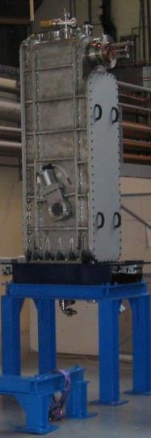
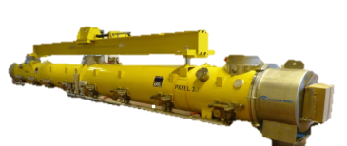
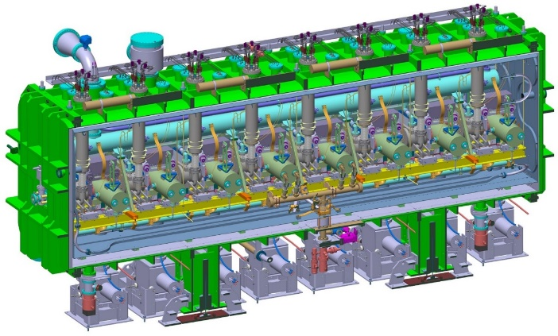
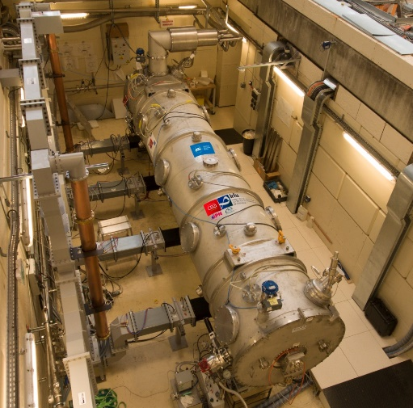




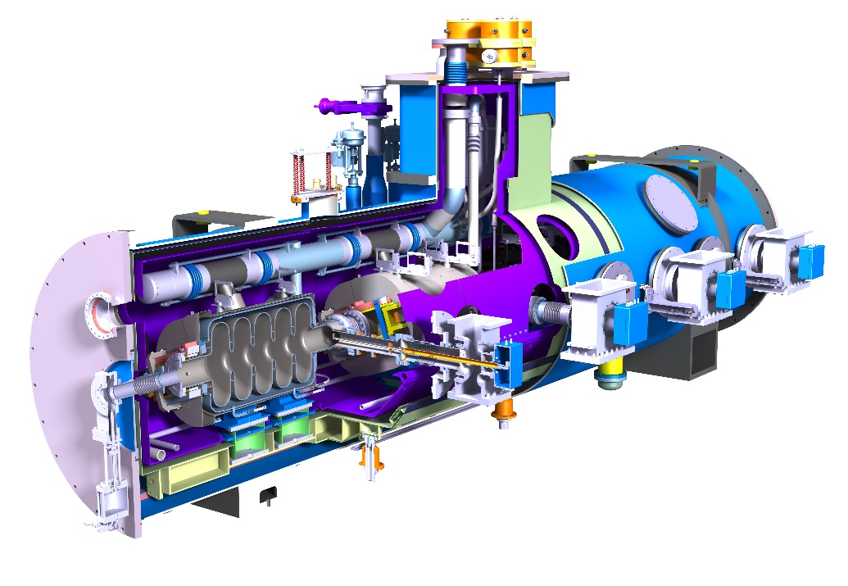
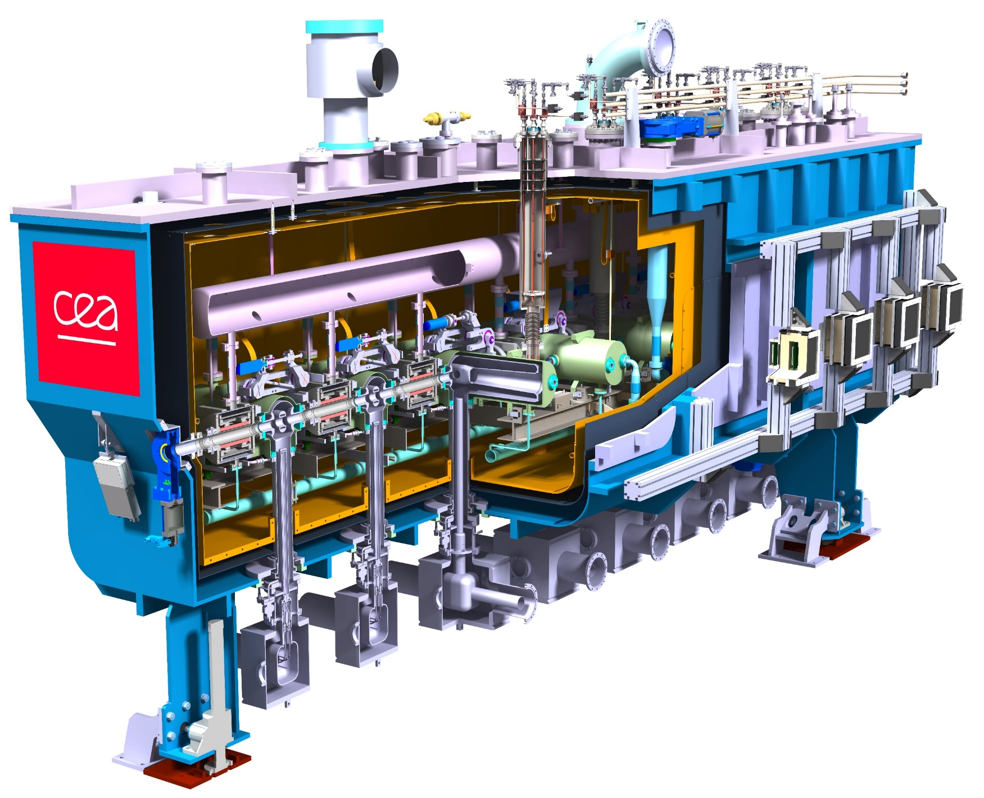
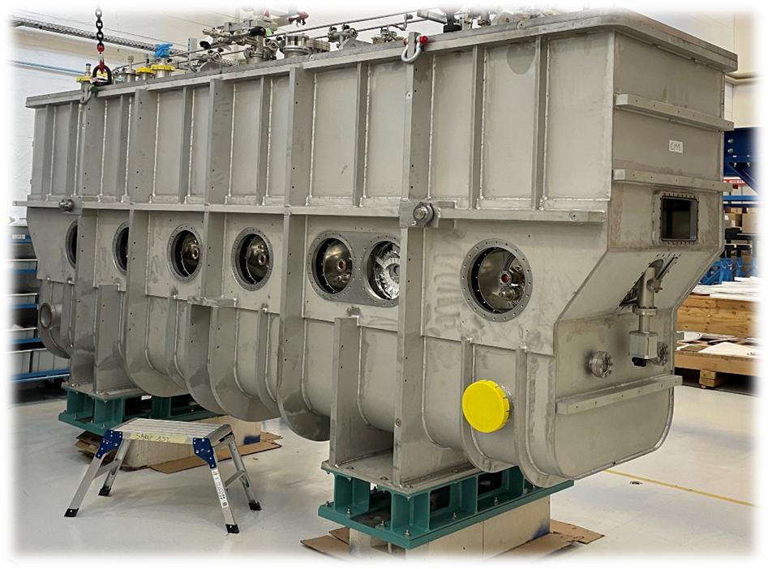





Introduction
Booster
MACSE
SOLEIL
TTF, SLS
SPIRAL2
XFEL
ESS, SARAF
IFMIF
EVEDA
PIP-II
PERLE
IFMIF DONES
Futur
SPIRAL2: design and assembly of 12 cryomodules
XFEL: assembly of 103 cryomodules (1 CM/wk)
IFMIF EVEDA: 1 cryomodule
ESS: cavity and coupler design, integration of 30 cryomodules
SARAF Phase2: 4 cryomodules
PIP-II: 9+1 cryomodules
IFMIF DONES: 5 cryomodules

Slide 3
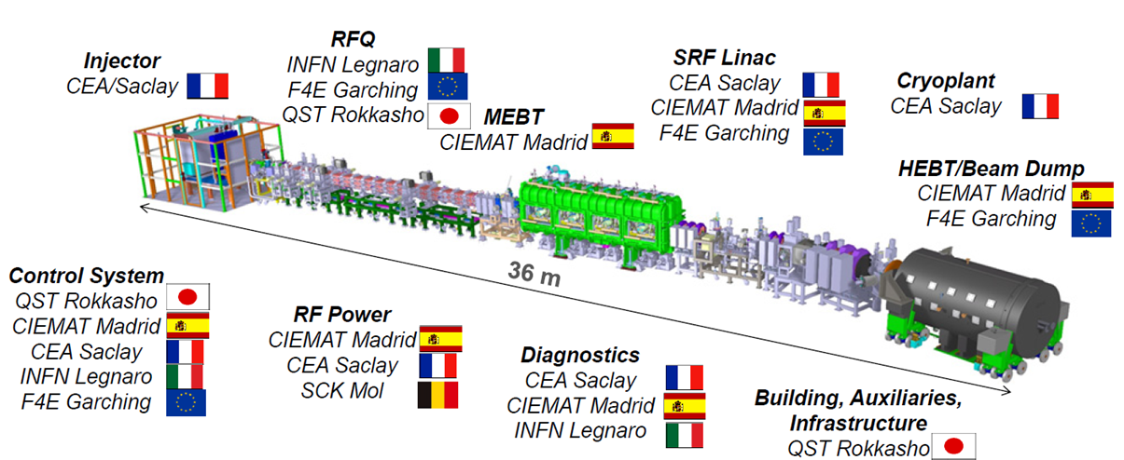
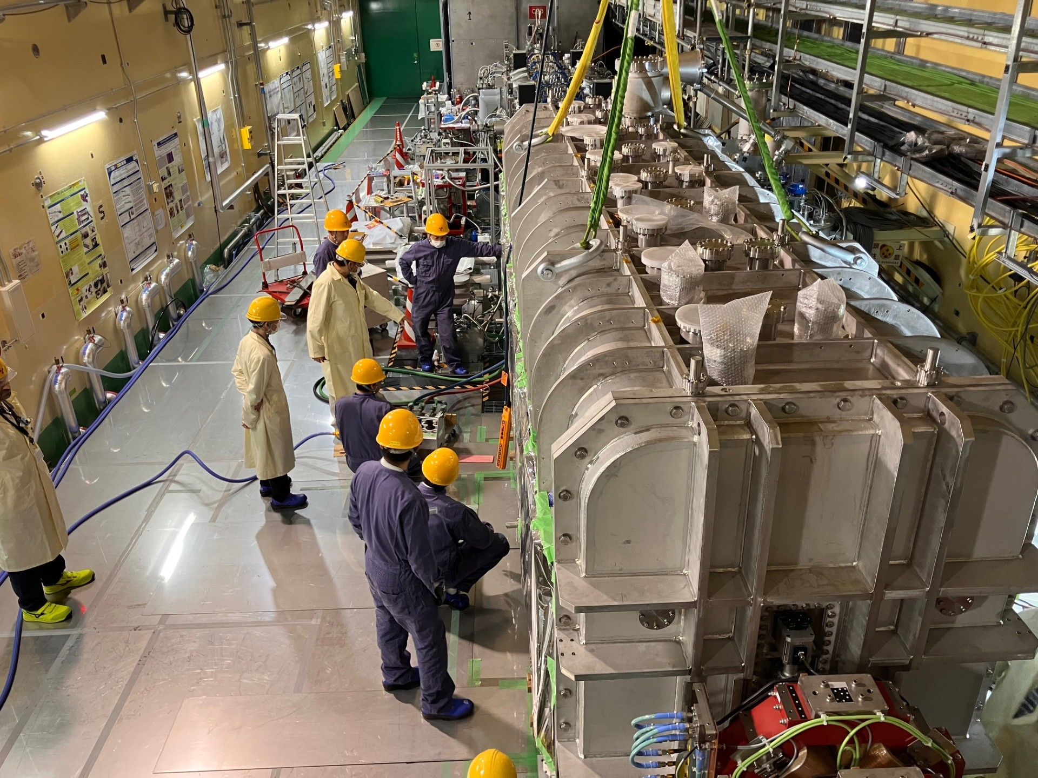
The projects at CEA: from an unique cryomodule …
  IFMIF/EVEDA
  Components manufactured and qualified in Europe: CEA for most of them (including cavities), CIEMAT for the solenoids
  LIPAc cryomodule assymbly at Rokkasho (Japan)
    QST is responsible of the infrastructure (including the construction of a clean room)
    F4E is responsible of the assembly of the cryomodule
      Subcontracted to an European company (Research Instruments)
      With support of experts from CEA and KEK
  Status: cryomodule in the vault, waiting for the completion of the assembly with the delivery of new current lead jackets for the solenoids
References:
Assembly of the LIPAc SRF Linac cryomodule
J. Chambrillon & al., SRF2025
Progress of assembly and installation of LIPAc SRF cryomodule under the EU-JA collaborative framework
T. Ebisawa & al., SRF2025

Slide 4
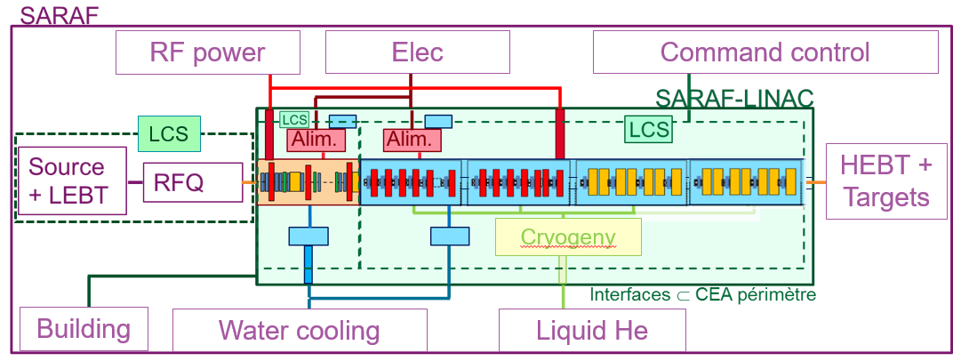
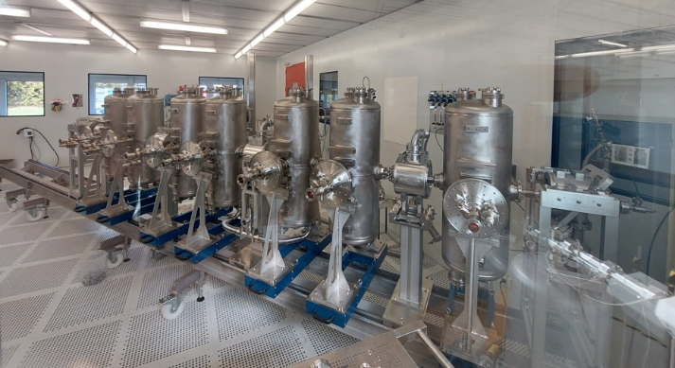
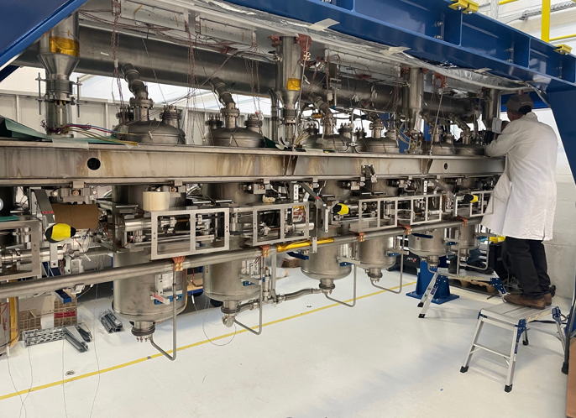
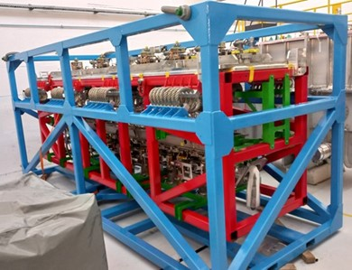
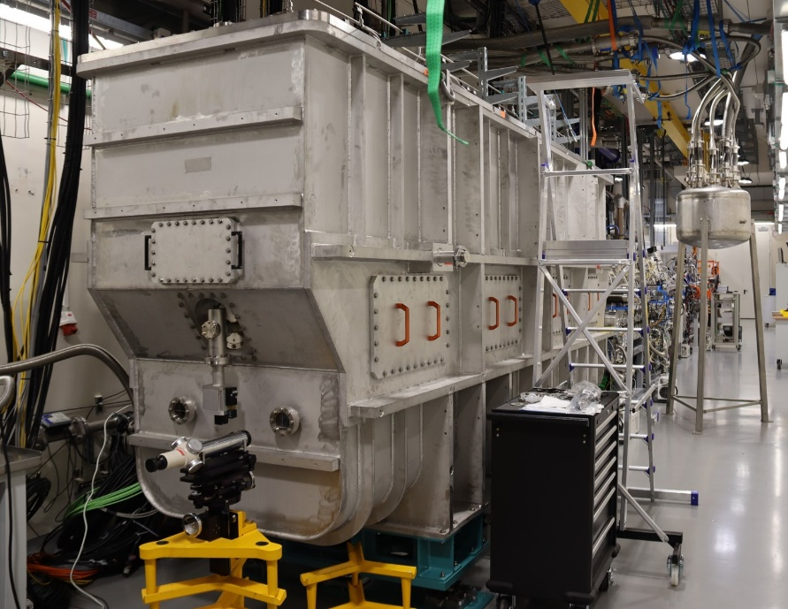
… to a complete superconducting linac
  SARAF Phase 2
  CEA collaborates with SNRC to the upgrade of the SARAF accelerator to 5 mA CW 40 MeV deuteron and proton beams (Phase 2).
  CEA is in charge of the design, construction and commissioning of the linac downstream the existing Radio Frequency Quadripole (RFQ): Medium Energy Beam Transport (MEBT), Superconducting Linac (SCL), Beam diagnostics & Control System.
  Status:
    The MEBT has been commissioned with protons (pulsed and CW) and deuterons (pulsed).
    The cryomodule have been assembled and qualified at CEA and shipped to SNRC
    The first cryomodule was installed on the beam line, the commissioning is ongoing
CM4 cavity string in clean room
Cold mass assembly
Transport frame for the cryomodules
CM1 on the beam line at SNRC

Slide 5
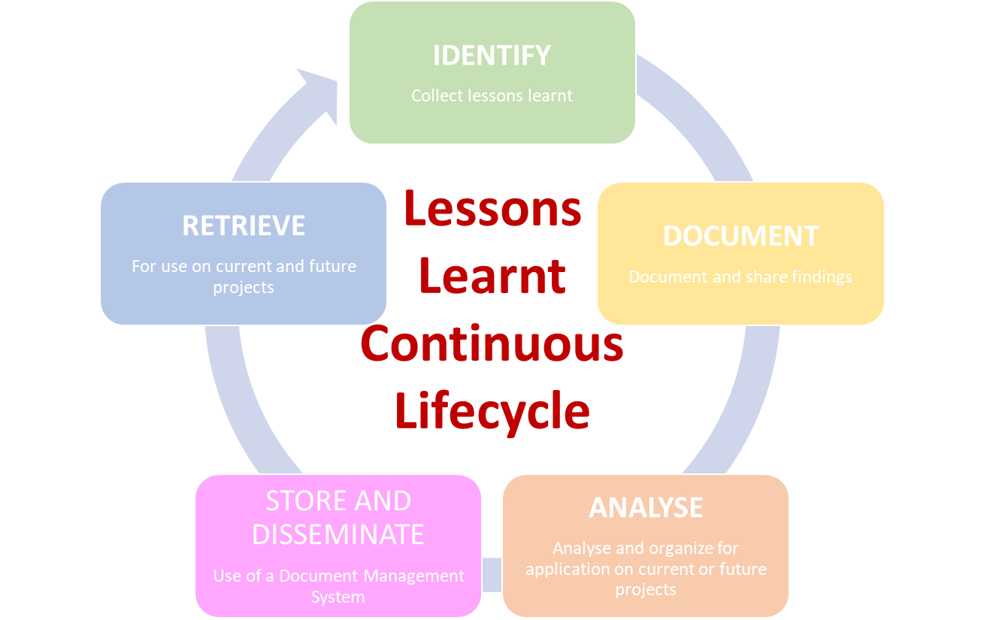
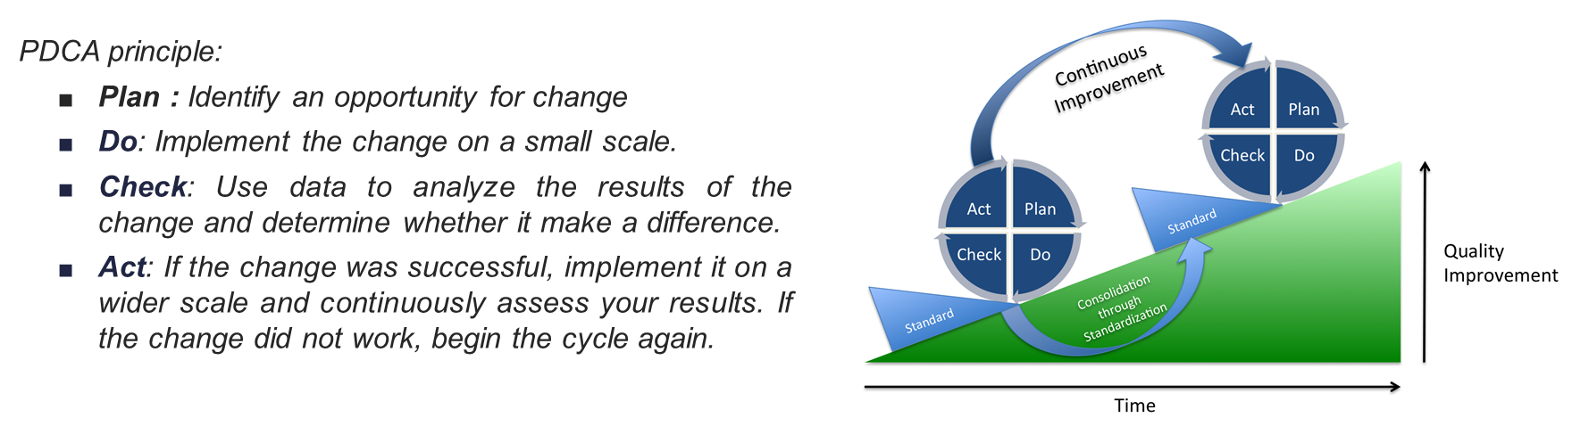
Lessons Learnt & Continuous Improvement
  A continuous improvement process is conducted at CEA, mainly based on the lessons learnt continuous lifecycle and on the PDCA principle, with the following goals:
    Informing future decisions
    Preventing repetition of mistakes
    Promoting innovation
    Enhancing efficiency and effectiveness
    Fostering a learning culture

Slide 6
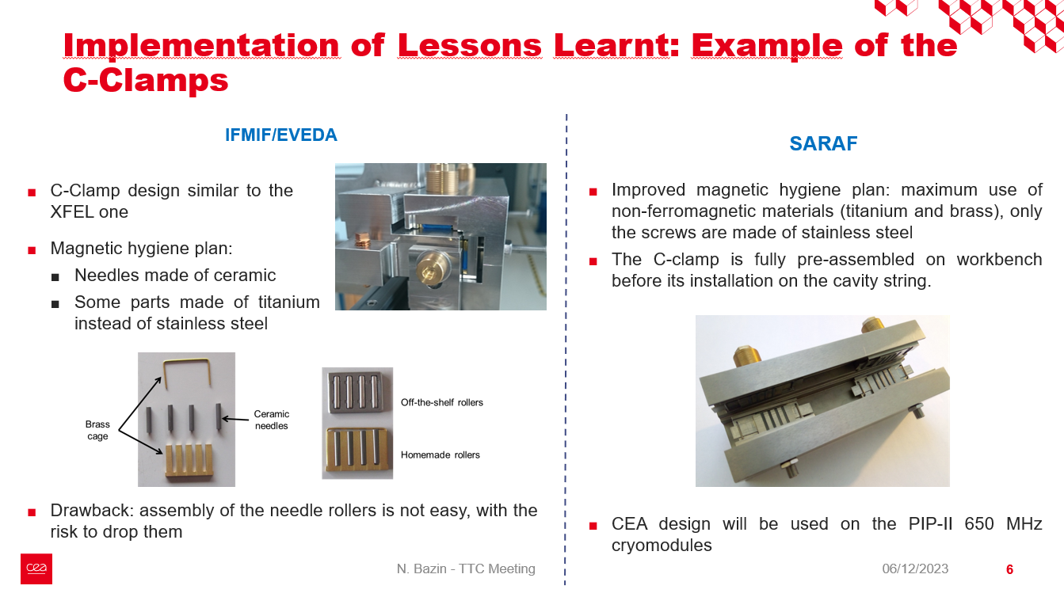
Lessons Learnt: Example of Magnetic Hygiene
  In order to proscribe presence of magnetized elements close to the cavity, magnetic hygiene is mandatory.
  Improvement of the CEA magnetic hygiene plan over the years to take into account the lessons learnt:
    Identification of the parts close to the cavities which could cause magnetic pollution.
    Material choices:
      Use of non magnetic materials whenever it is possible: brass, bronze, titanium …
      If not, use of low magnetic permeability materials: stainless steel 316L or 316LN (better).
    During the manufacturing:
      Material specification and certifications.
      Incoming inspection of raw material.
      Controls of the parts after manufacturing, annealing if deemed necessary.
  Other possibility: demagnetization of parts and complete cryomodule before cool-down
Slide taken from:
Comparison on assembly and alignment procedures & standards for the different designs CEA made in the last years
N. Bazin, TTC 2023
Other reference on magnetic hygiene:
Basics for cryomodule design, fabrication and assembly
N. Bazin, tutorials of SRF 2021

Slide 7
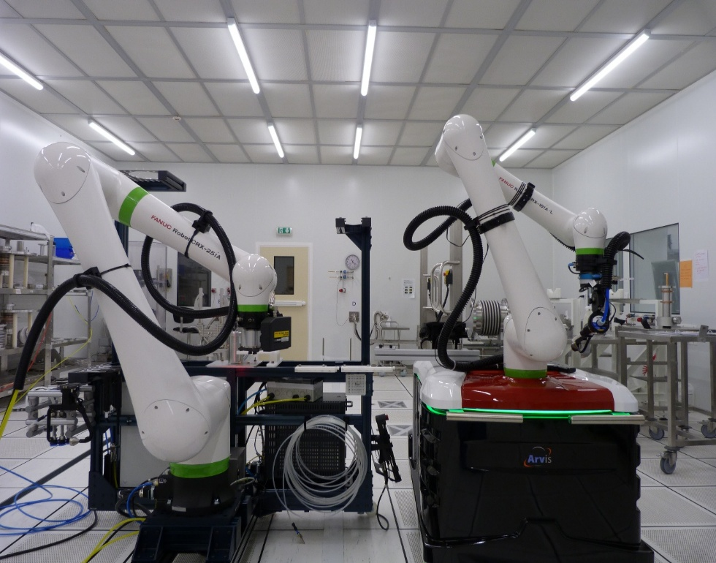
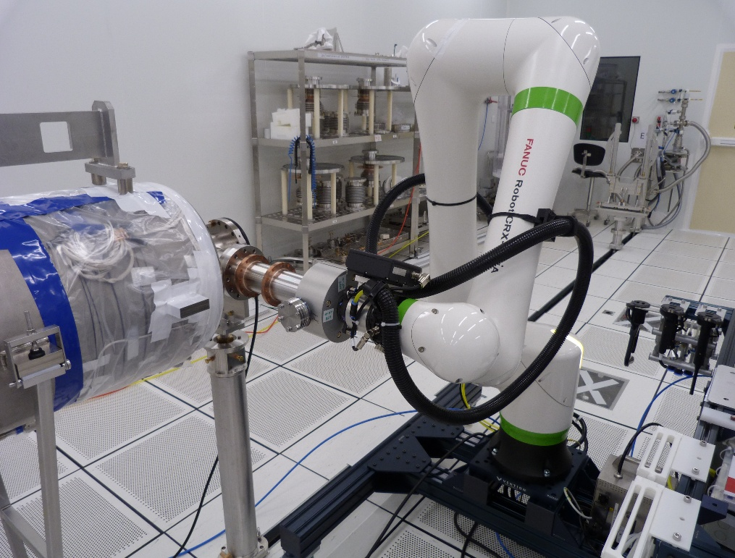
Continuous Improvement: Example of Robotics
  Since 2018, CEA has been working on R&D activities on Cobot to enable clean and accurate assembly of cavities in clean room in order to achieve the stringent performance standards demanded by modern accelerator facilities.
  More details in the talk of Julien Drant.
First coupler installation at CEA on a PIP-II LB650 cavity
Additional information and examples:
Comparison on assembly and alignment procedures & standards for the different designs CEA made in the last years
N. Bazin, TTC 2023

Slide 8
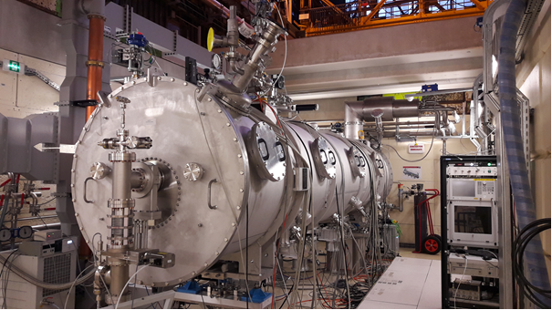
From design to production: ideal path
Design
First article
Assembly & tests
Feedback and lessons learnt
Series manufacturing
2 prototypes + 30 cryomodules (2 types)
4 cryomodules (2 types)
1 pre-production cryomodule + 9 production cryomodules

Slide 9
From design to production: real life
Design
First article
Assembly & tests
Feedback and lessons learnt
Series manufacturing
Many obstacles may appear along the way!
More details:
CEA experience on the procurements of cold mass components: lessons learnt from ESS, SARAF & PIP-II
N. Bazin, TTC 2024
  Possible design changes due to:
  Manufacturing constraints from the vendors
  Availability of raw materials / “standard” components

Slide 10
From design to production: real life
Design
First article
Assembly & tests
Feedback and lessons learnt
Series manufacturing
Many obstacles may appear along the way!
  Not always possible:
  Aggressive schedule:
    Launch the components production before the feedback from the tests to cope with the project schedule
  Not always according to the development plan:
  Design changes after the assembly and test of the first article
    Launch the series manufacturing with marginal modifications
  Different vendors for the series than for the first article
    Manufacturing constraints from the vendors

Slide 11
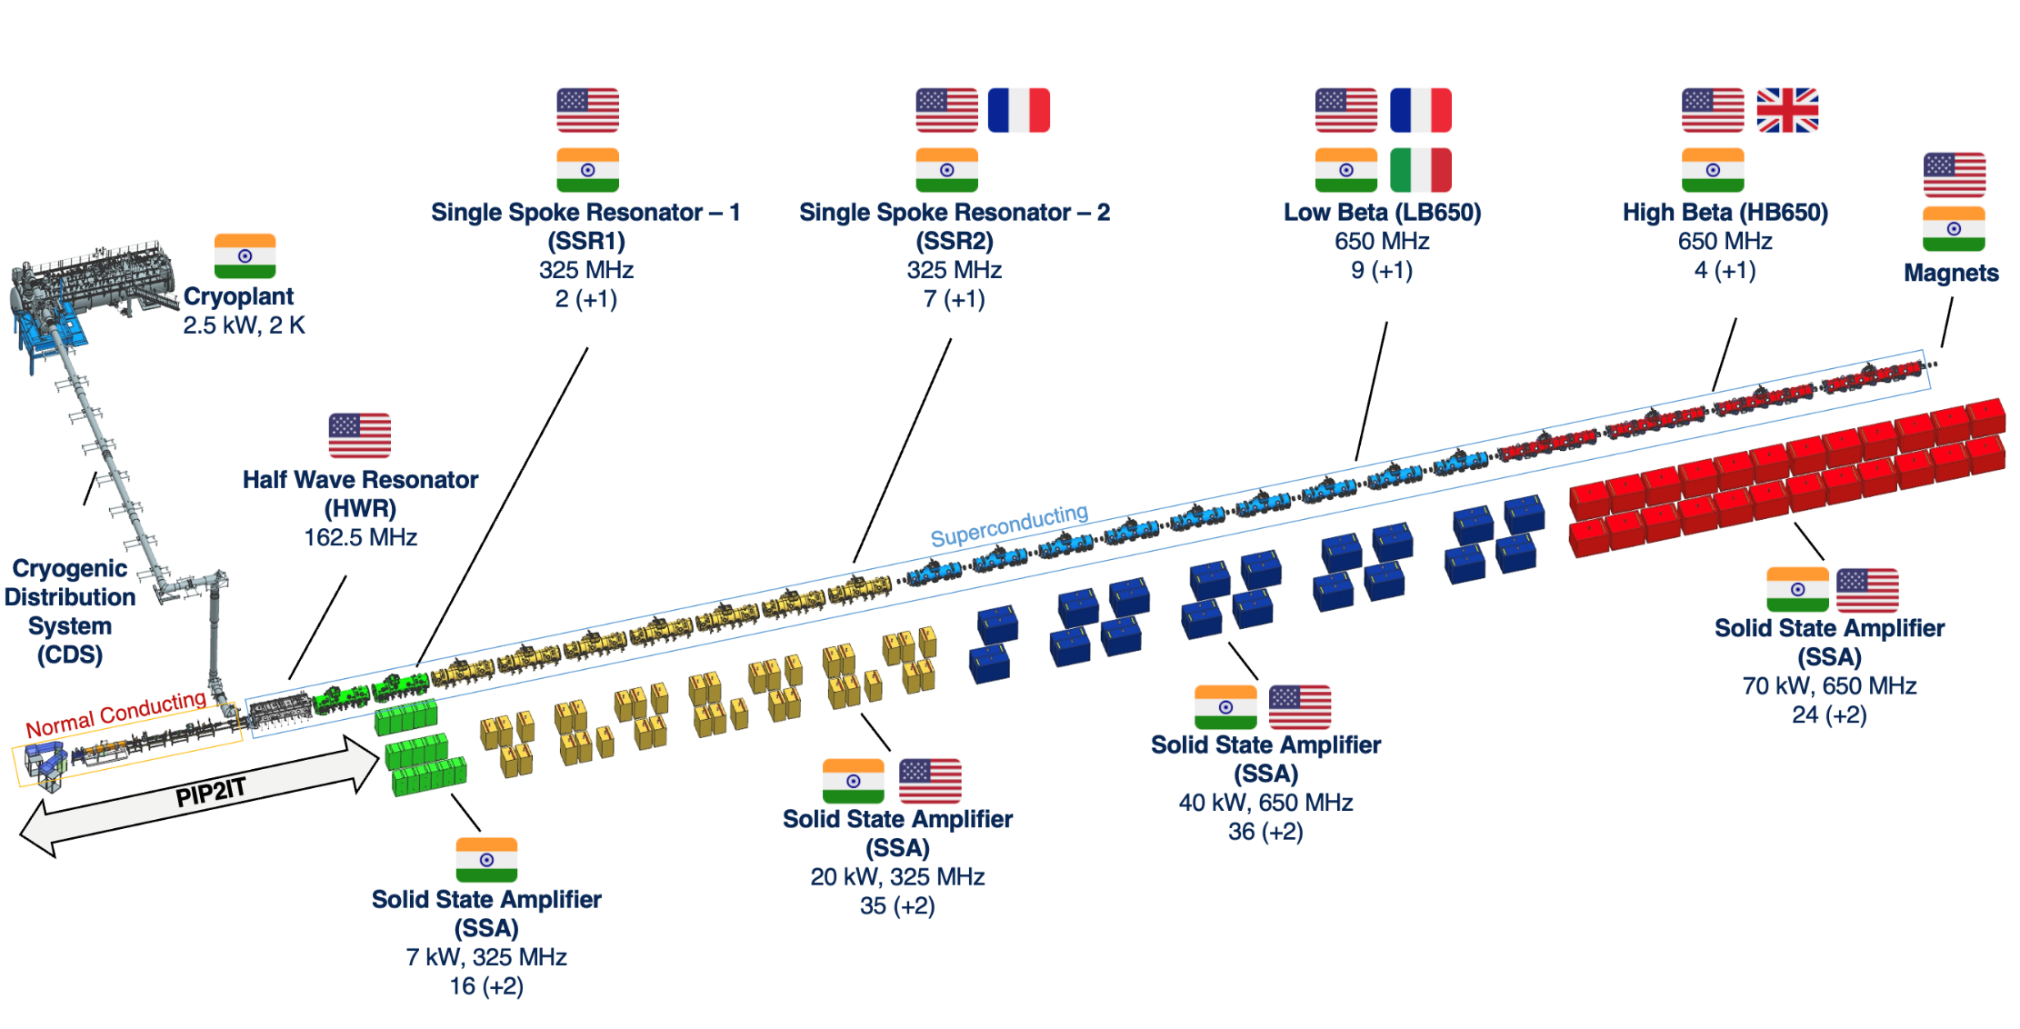
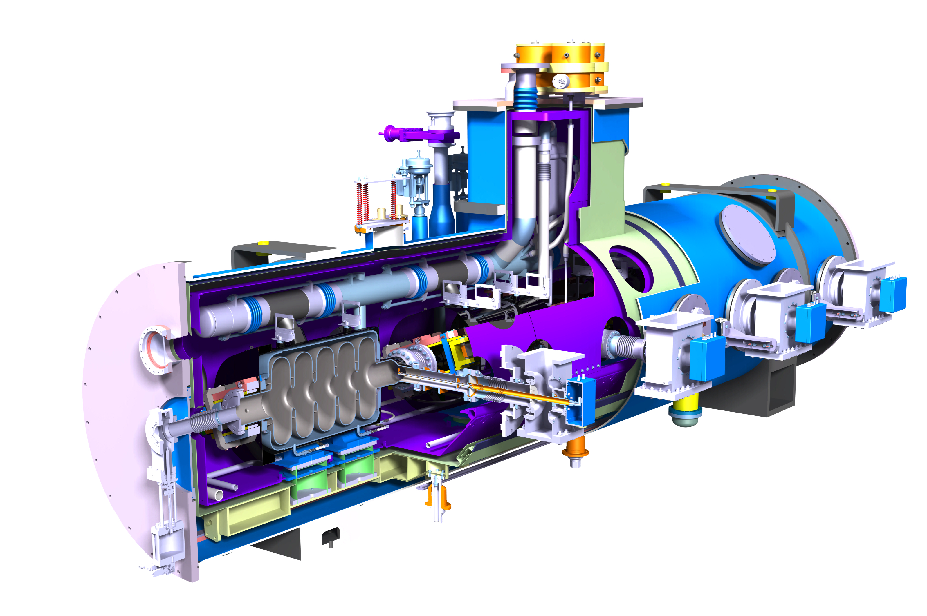
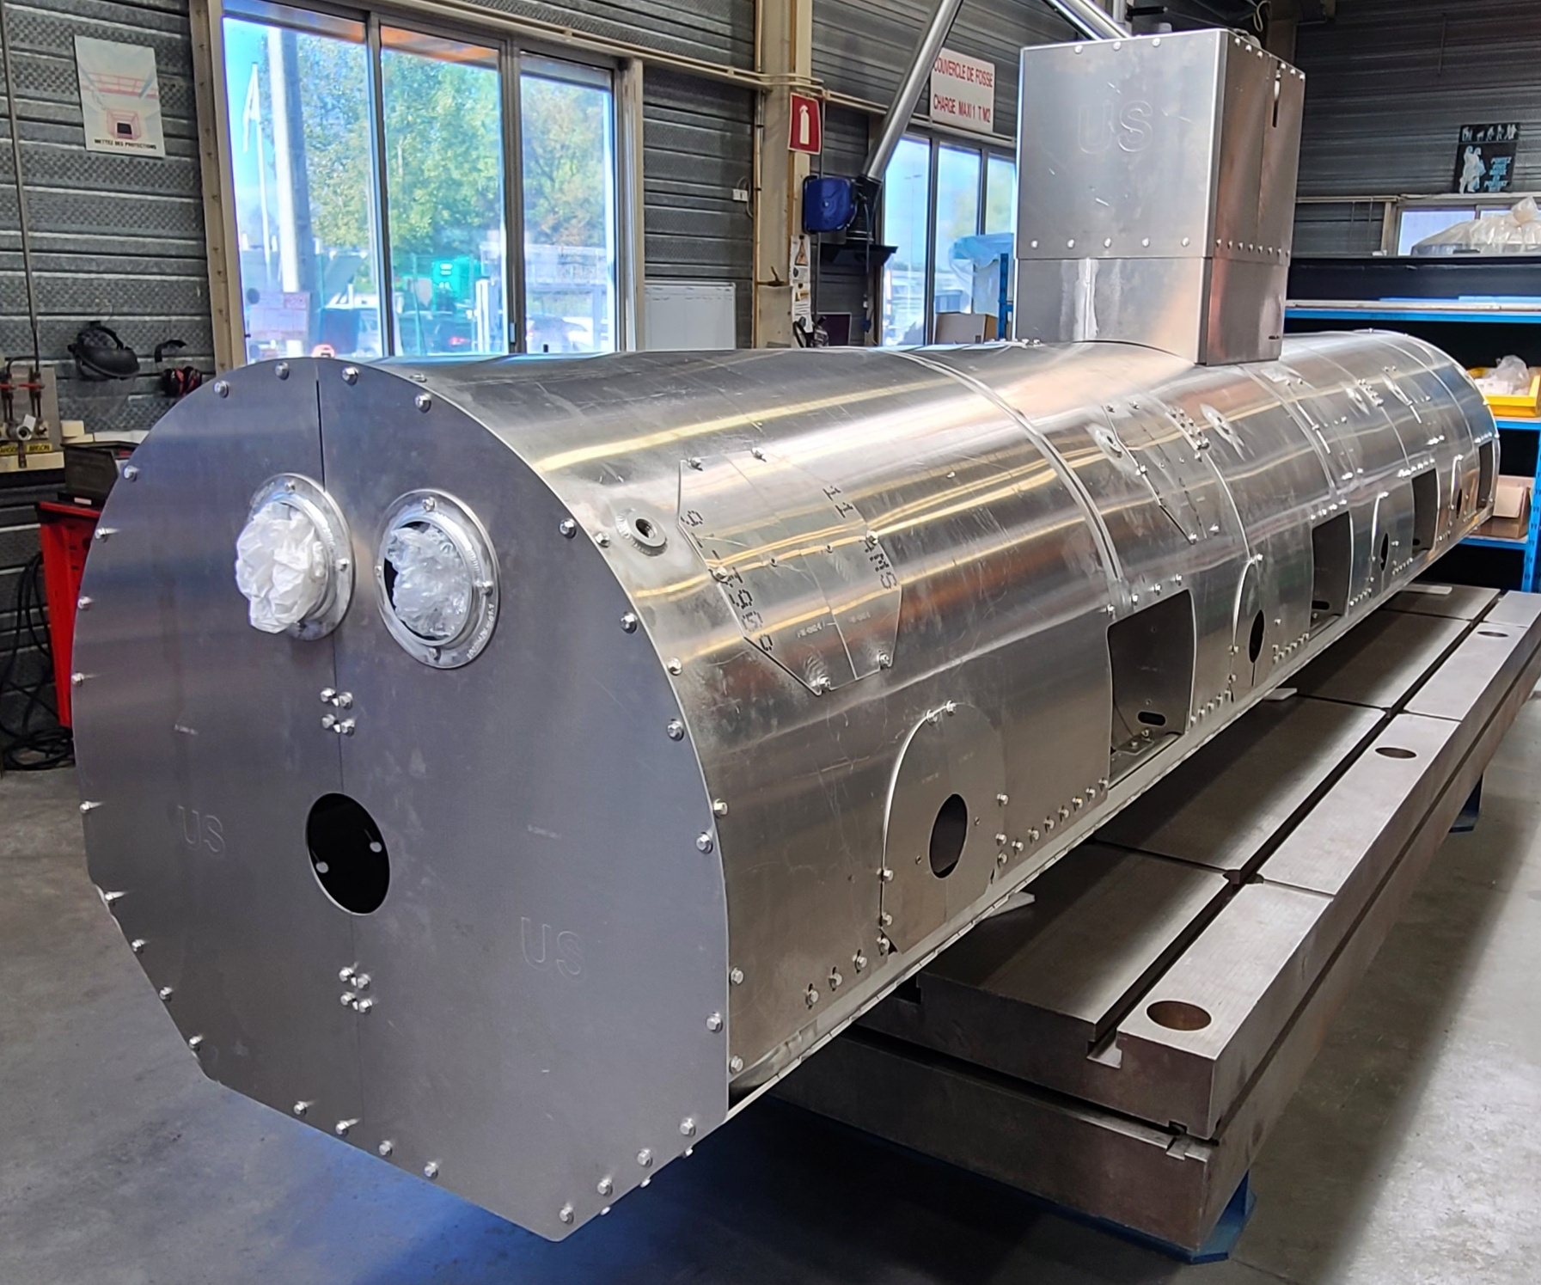
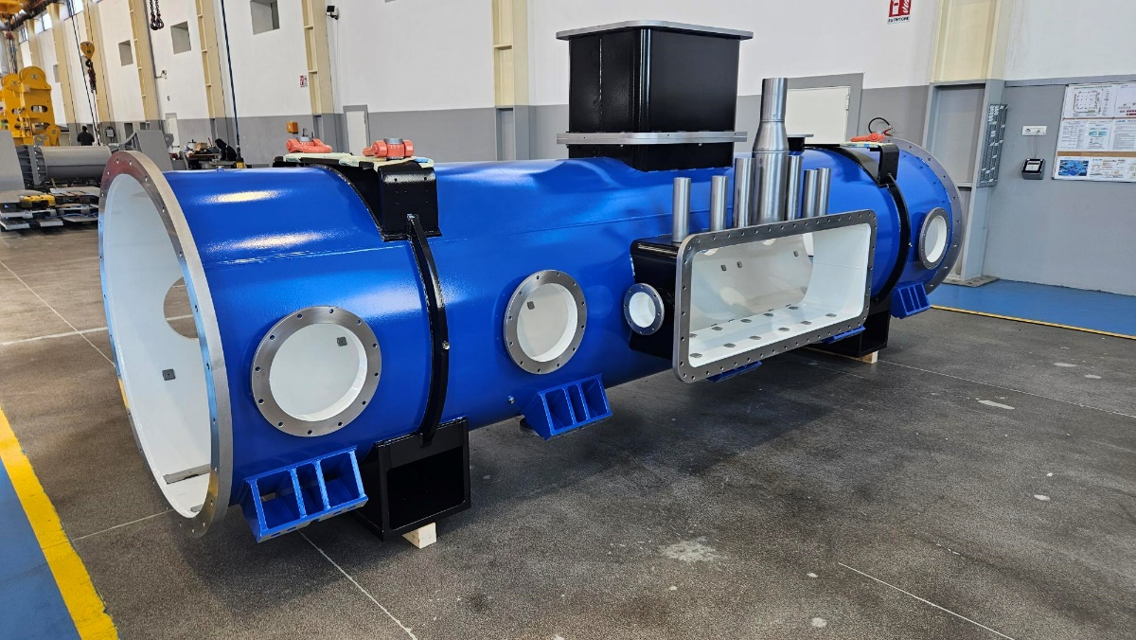
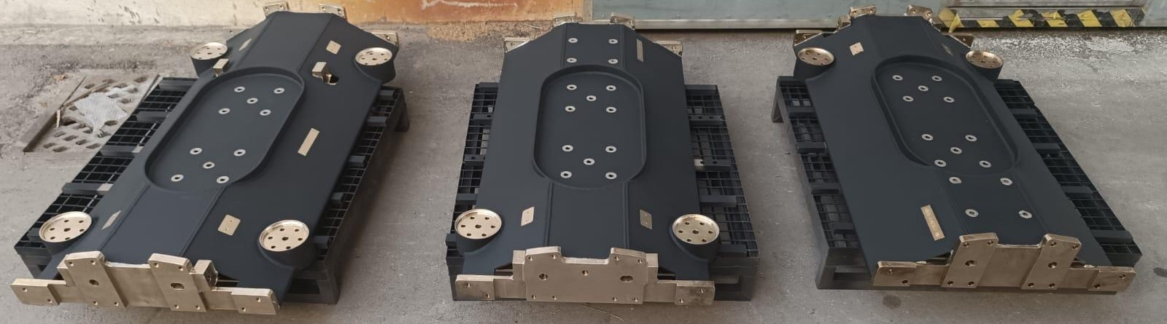
PIP-II Project at CEA: Status
  CEA contribution: design, manufacturing, assembly and test of 10 cryomodules for the 650 MHz low beta section
    One pre-production cryomodule
    Nine production cryomodule
  Procurement strategy: for the long-lead high value components, contracts are issued for all components of the pre-production and the production LB650 cryomodules in a single process divided into two stages (1 unit + 9 unit)
  Current status:
    Most of the components are manufactured, the design of several components had to be adapted following requests from vendors
    Clean room string assembly should start soon
  Lessons learnt from the manufacturing of the pre-production units and the assembly and test of the pre-production cryomodule will be implemented for the production units
Thermal shield, vacuum vessel & strongback

Slide 12
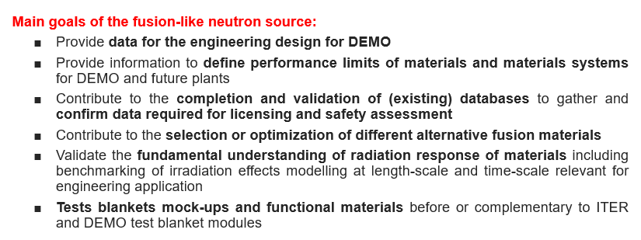
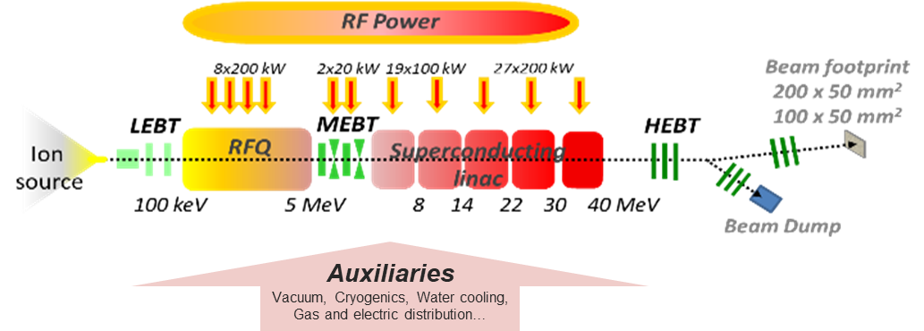
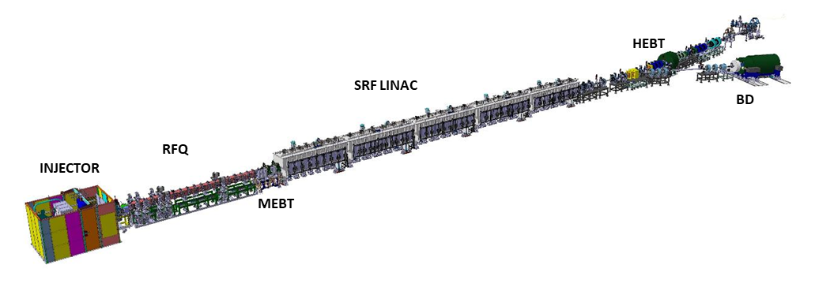
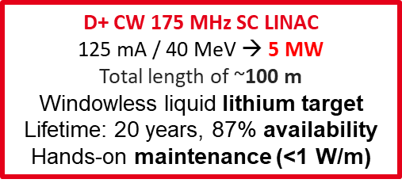
IFMIF/DONES
  In the framework of the EUROfusion Workpackage WPENS, CEA performed the engineering design of the superconducting linac of the fusion-like neutron source IFMIF-DONES, including the low and high beta half-wave resonators, the power couplers and the cryomodules
More details:
The SRF Linac for IFMIF-DONES 5MW Accelerator Project
N. Bazin, TTC 2025

Slide 13
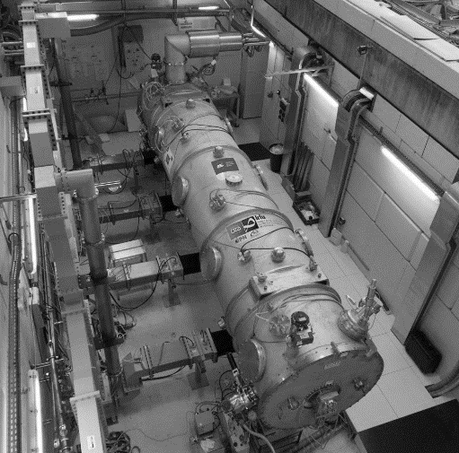
The IFMIF/DONES cryomodules: a combination of the SARAF and IFMIF-LIPAc cryomodules

Slide 14
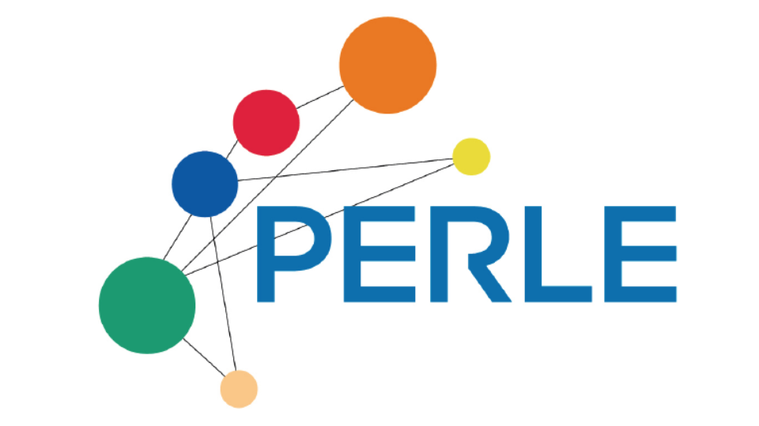
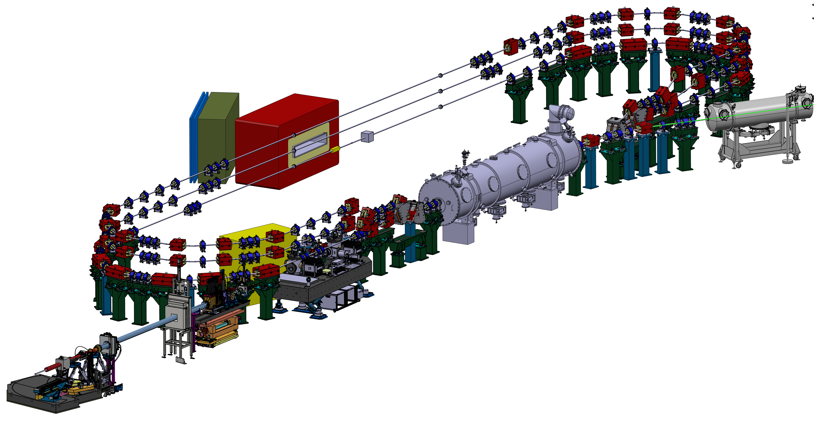
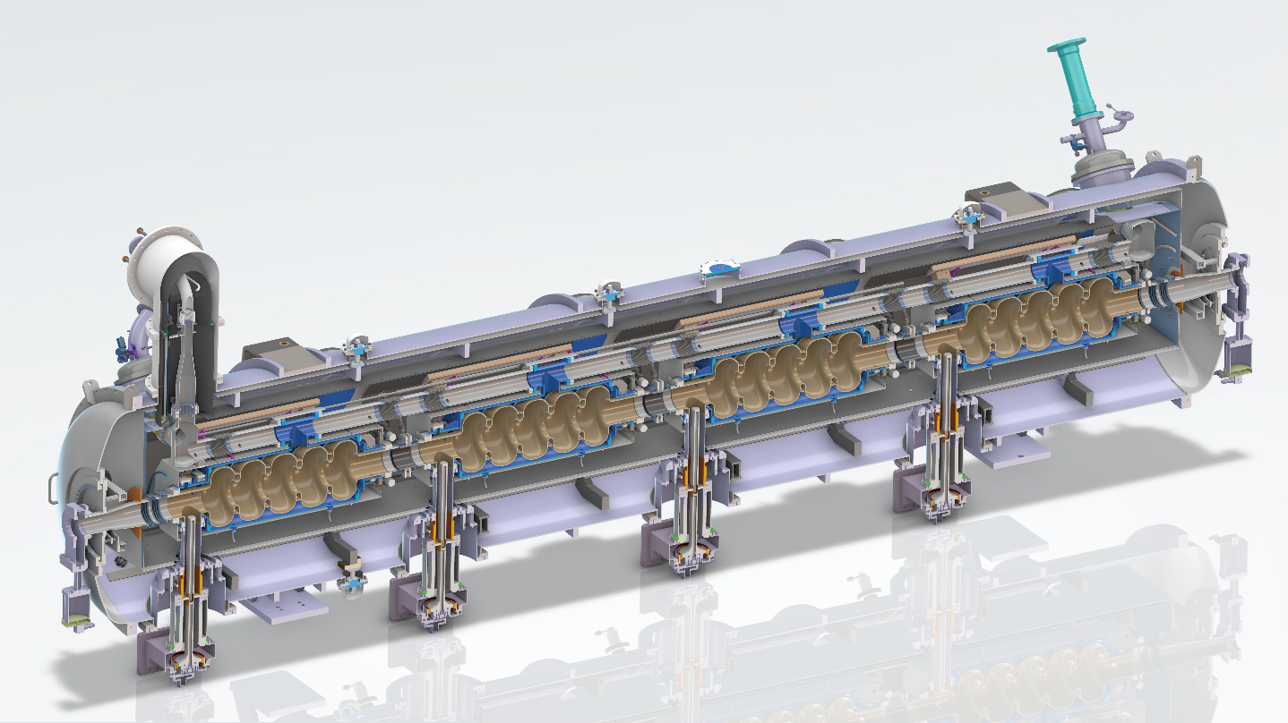

The cryomodule for PERLE
  Powerful Energy Recovery Linac for Experiments
  Energy Recovering Linac under development at CNRS / IJCLab with international partners
  The design of the existing ESS cryomodule is being adapted to the PERLE requirements
  CEA contribution – in the framework of the iSAS project (innovate for Sustainable Accelerator Systems)
    Support the design activity performed by IJCLab on the cryomodule
    Cavity preparations @ CEA
      Electropolishing process validation on a 5-cell 704 MHz ESS cavity
      Electropolishing for the four 5-cell 800 MHz PERLE cavities
    Cryomodule assembly at CEA
PERLE 250 MeV version
Image from G. Olry (IJClab) @ PERLE collaboration meeting 14/10/2025

Slide 15
SUMMARY
  CEA has a long experience of developing cryomodules for superconducting linacs depending on the requirements of partners and their regulatory constraints, including the pressure vessel regulations (ASME, European norms, Japanse High Pressure Gas Safety Law - HPGSL).
  The current projects at CEA benefit from the lessons learnt and experience of previous partnerships in the construction of superconducting linacs such as SPIRAL2, European XFEL, IFMIF/EVEDA, SARAF and ESS thanks to the continuous improvement policy.
More details:
Licensing of pressurized cryomodule components manufactured in Europe and installed in Japan: example of the IFMIF/EVEDA cryomodule
N. Bazin, LCWS 2021

Slide 16
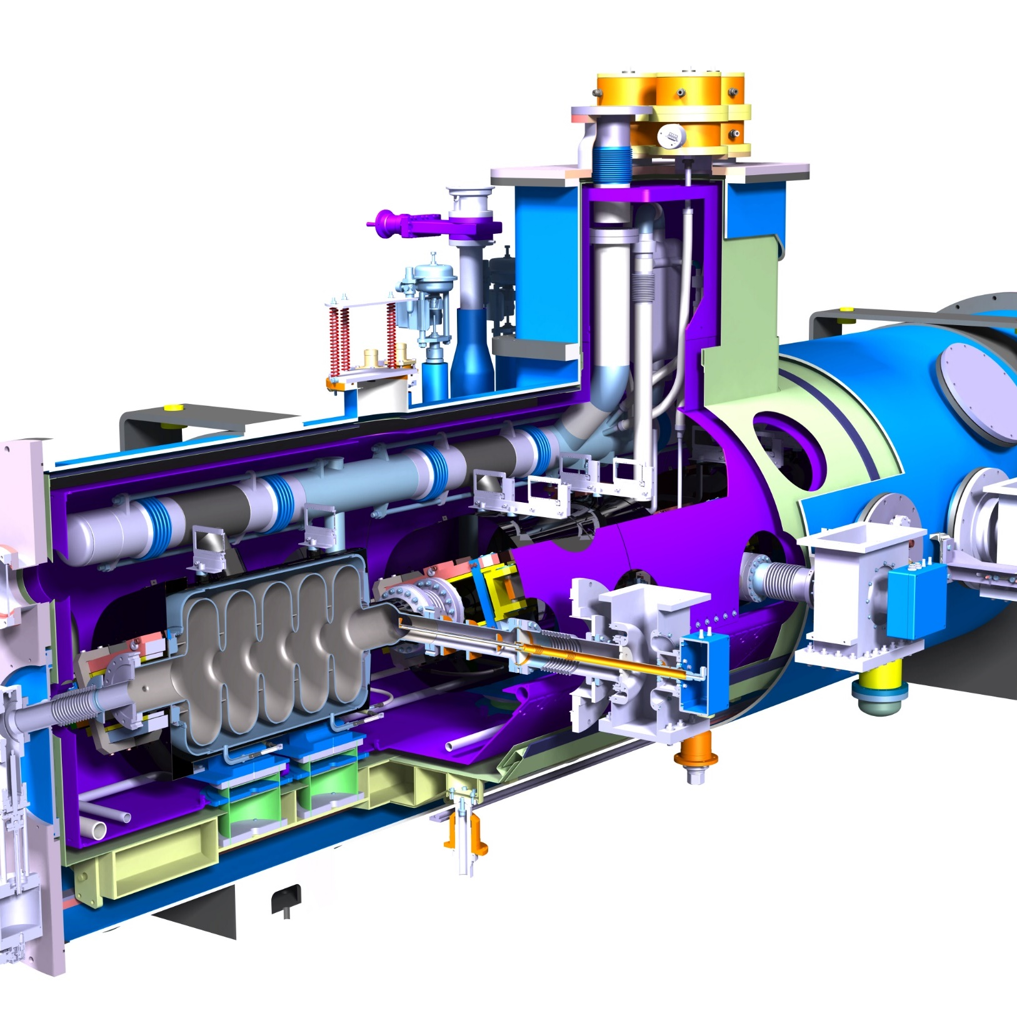






Thanks for your attention
Nicolas Bazin
CEA SACLAY
91191 Gif-sur-Yvette Cedex
France
nicolas.bazin@cea.fr

