Slide 1
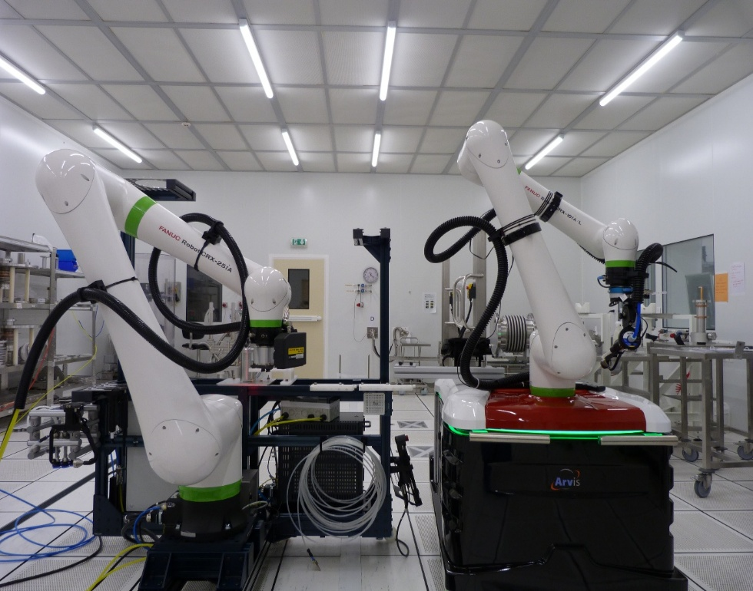

Cobot cleanroom assembly of cavity string at CEA
J. Drant on behalf of CEA robotic team

Slide 2
Outline
LCWS2024 status reminder
CEA’s cobot and assembly development methodology
Qualifications on 1.3GHz single cell assembly
Coupler assembly on PIP-II LB650 pre-production cavity
Bellows assembly on PIP-II LB650 dummy cavity
Conclusion

Slide 3


Cobotization status presented at LCWS2024
CEA’s global objective is the assembly of cavity strings with a cobot.
This objective can be detailed in 2 sub-objectives :
All the development required several steps of modeling and programming with Robotguide.
Cleaning of components
Assembly of components
Paths programming
Vision-based localization
Paths adaptation
Cobot actions (Cleaning/handling/assembly...)

Slide 4
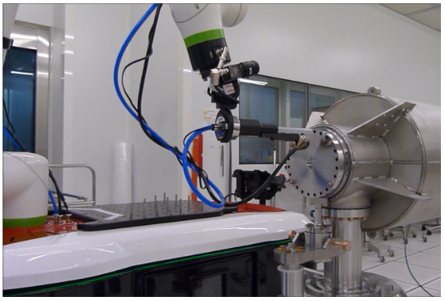
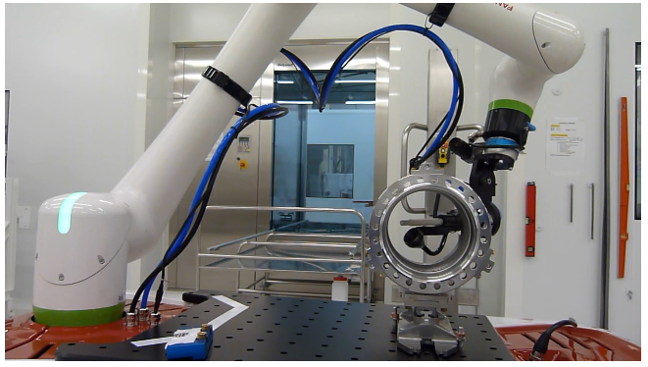
Cobotization status presented at LCWS2024
CEA’s global objective is the assembly of cavity strings with a cobot.
This objective can be detailed in 2 sub-objectives :
2022-2023 : ESS production (20 cryomodules)
Fanuc CRX10 Cobot (Ingeliance)
10 kg payload, 2D camera
Blow cleaning of cavity flanges,
Blow cleaning of inter-cavity bellows
Validation with particle count of parts
Cleaning of components
Cobot cleaning a cavity flange
Cobot cleaning an inter-cavity bellows

Slide 5
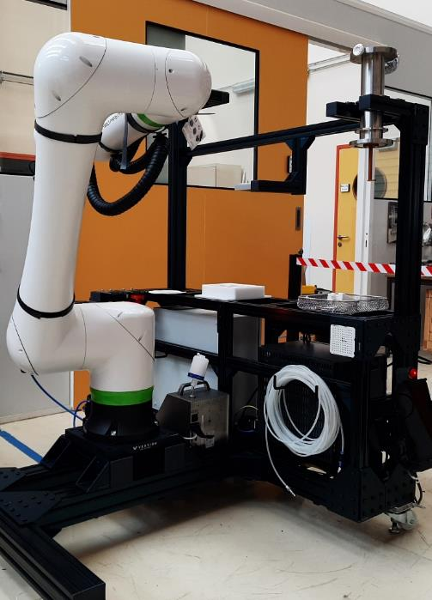
Cobotization status presented at LCWS2024
CEA’s global objective is the assembly of cavity strings with a cobot.
PIP-II R&D with Fanuc CRX25 Cobot, 25 kg payload,
tool changer, 3D vision system
Blow cleaning parts,
Particle count parts
Assembly of couplers,
Assembly of bellows
Assembly of components
J. DRANT, Cobot cleanroom assembly of cavity string at CEA, LCWS25, 2025-10-21

Slide 6
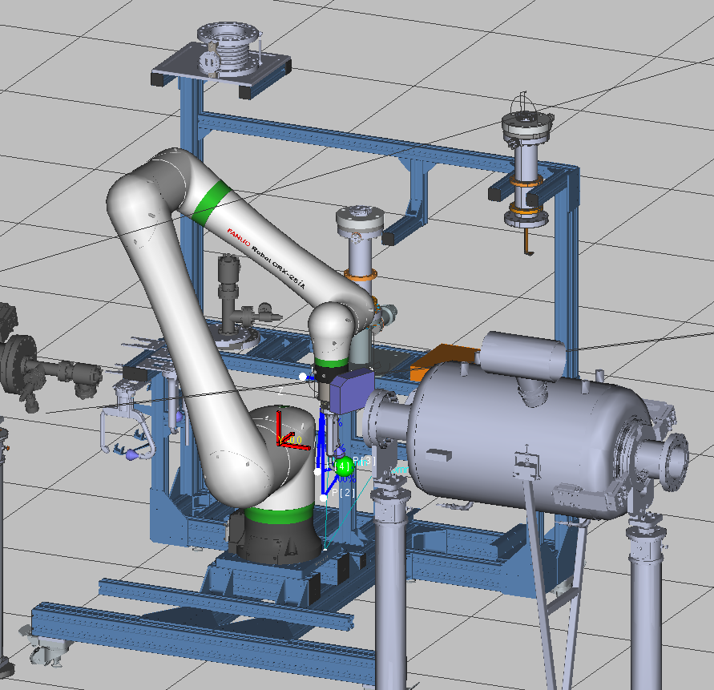
Detailed CEA robotic workstation
Modular frame to adapt to projects with various sequences planned
Tool changer (tripleA/WINGMAN)
Vision system(3DV/200 FANUC)
Particle counter 0.3µm (3100 Lighthouse)
Suction gripper
Adapted handling and blow cleaning toolings
Tooling station
Bellows holder
Coupler box station
Antenna cleaning station
Fasteners cleaning station

Slide 7
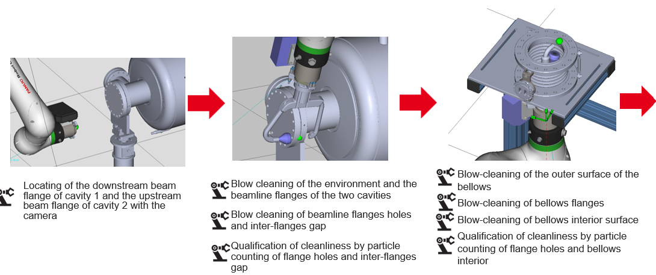
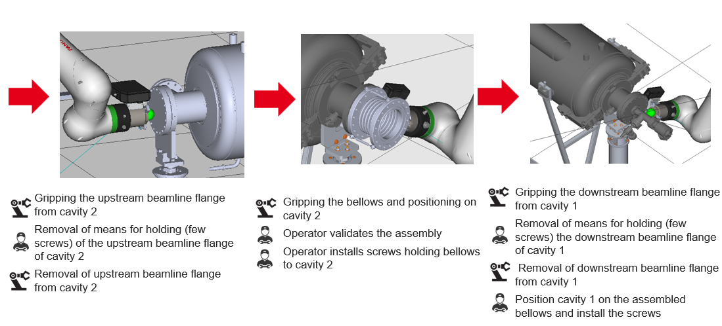
CEA methodology for cobot-assisted assembly
Definition of assembly sequence (steps realized by cobot or by human, human validation steps, …)
Development and preliminary tests of the programs with Roboguide software
Validation with the dummy components before the assembly with the “real” ones

Slide 8
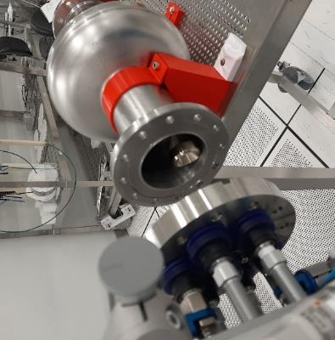
Qualifications on 1.3GHz single cell assembly
Goal : Qualify the cobot assembly processes
Development and implementation of disassembly and re-assembly steps of a blank flange on a 1,3GHz single cell cavity
Monitoring of assembly with a 0,1µm-1µm particle counter inside of the cavity (flow rate 28,3L/min)
No nitrogen flushing inside of the cavity

Slide 9
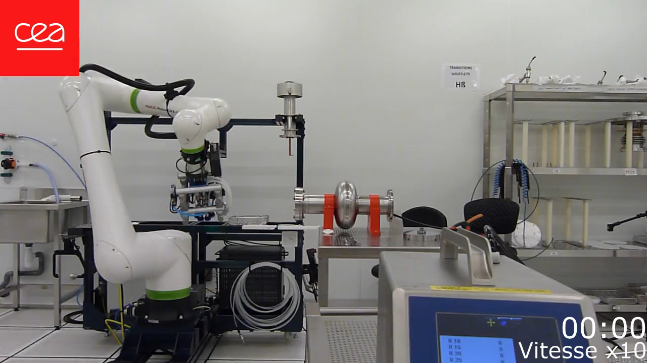
Qualifications on 1.3GHz single cell assembly
No particle bigger than 0.1 µm measured in the beam tube over the 5 minutes
from cavity closed with 4 last studs up to fully open

Slide 10
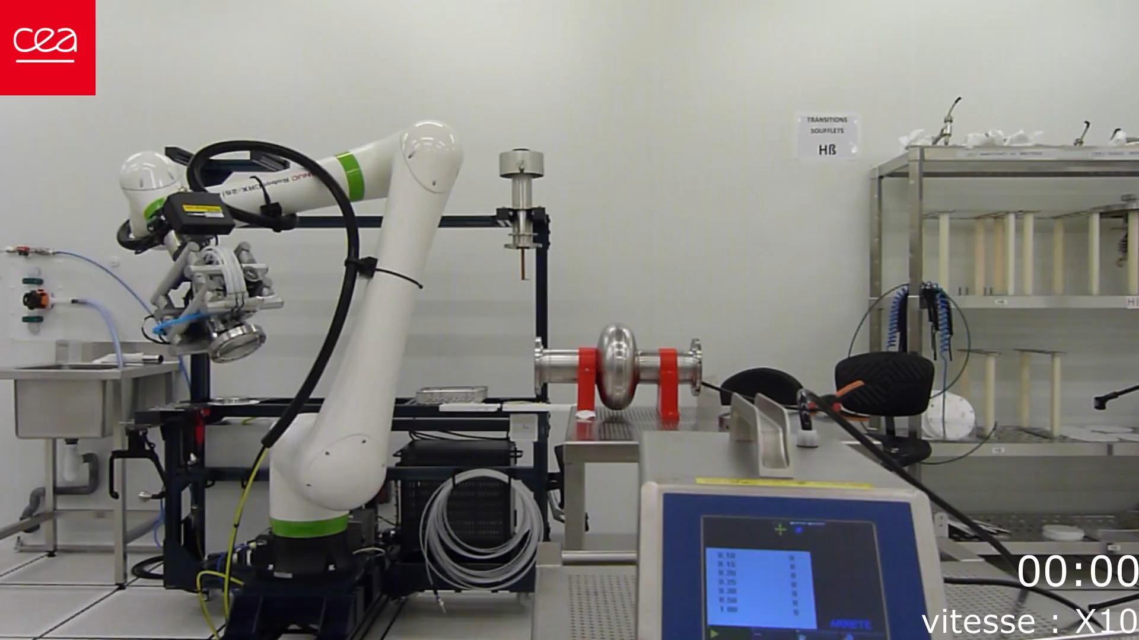
Qualifications on 1.3GHz single cell assembly
NO particle bigger than 0.1 µm measured in the beam tube over the 4 minutes
from opened cavity to 4 first studs tightened the flange

Slide 11
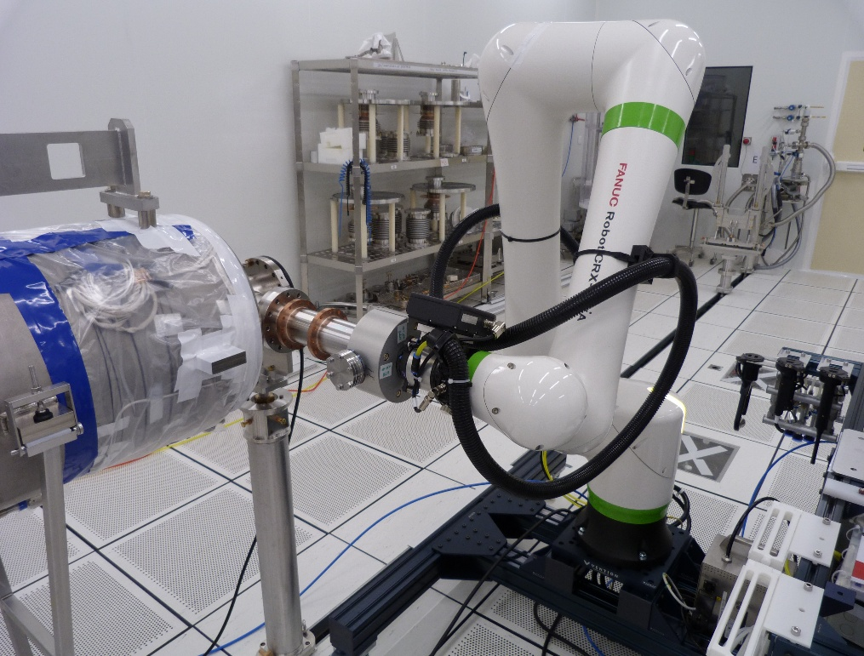
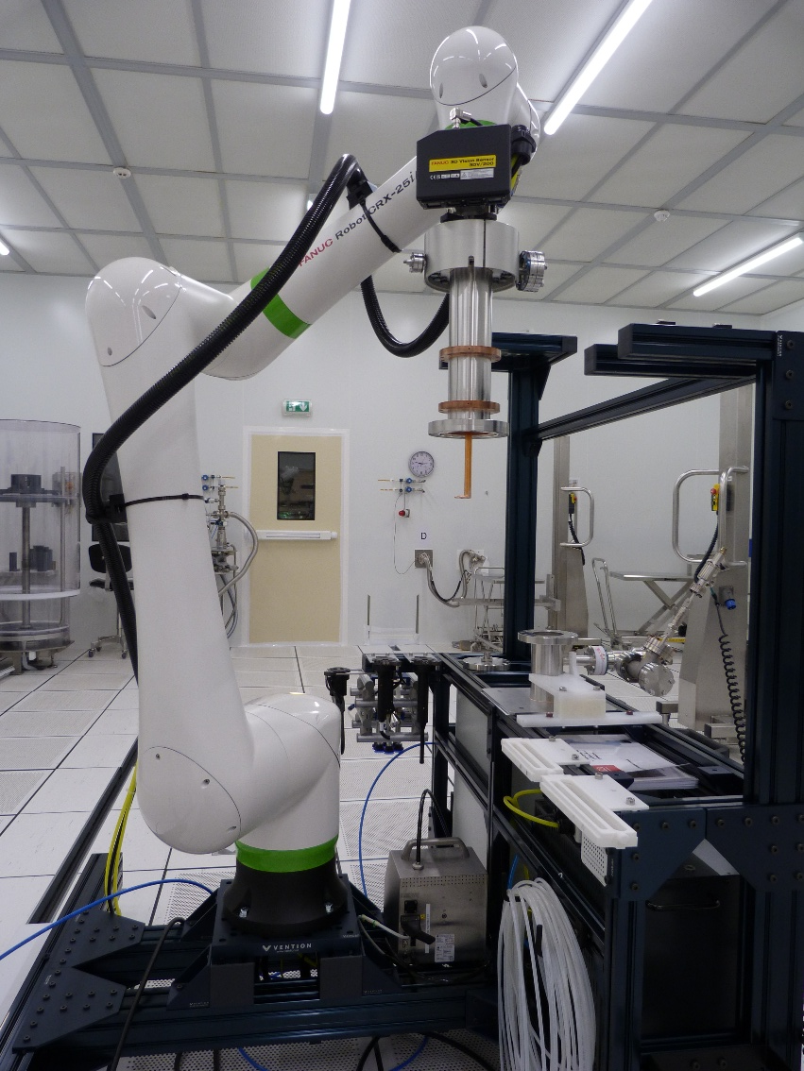
Coupler assembly on PIP-II LB650 pre-production cavity
Qualification of assembly steps with dummy coupler and mock-up cavity (particle free assembly)
The assembly went well (flushing of the cavity was performed correctly through a filter)
Cobot :
Blow cleaning/particle counting of coupler transport manifold, coupler antenna, cavity flange
Handling and alignment of coupler on cavity
Human :
Removal of screws on coupler transport manifold
Screws installation and torque tightening on cavity
Critical steps validated (remotely)
J. DRANT, Cobot cleanroom assembly of cavity string at CEA, LCWS25, 2025-10-21

Slide 12
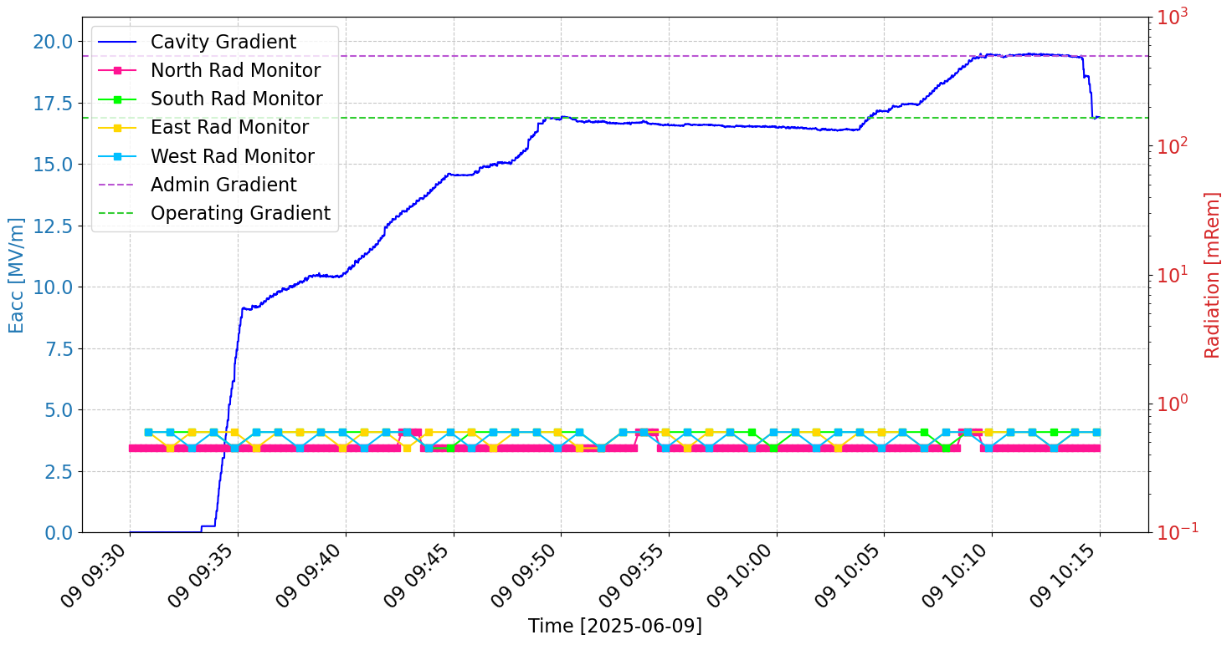
Coupler assembly on PIP-II LB650 pre-production cavity
Validation of coupler assembly with cold RF test in horizontal cryostat
Cavity test performed at Fermilab after intercontinental transportation
Reached the Fermilab administrative limit of 19,4 MV/m
No field emission observed.

Slide 13
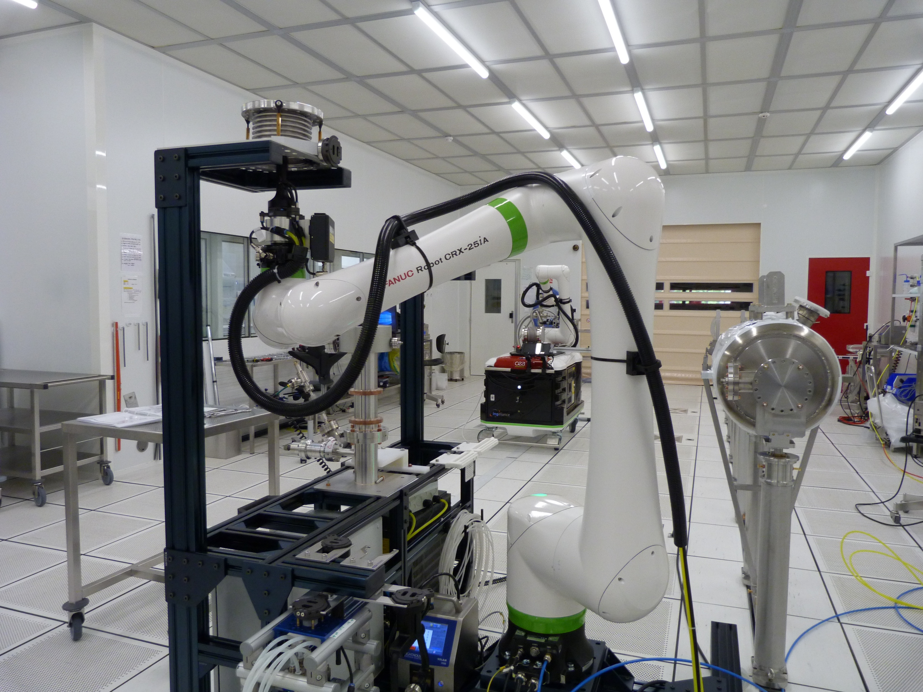
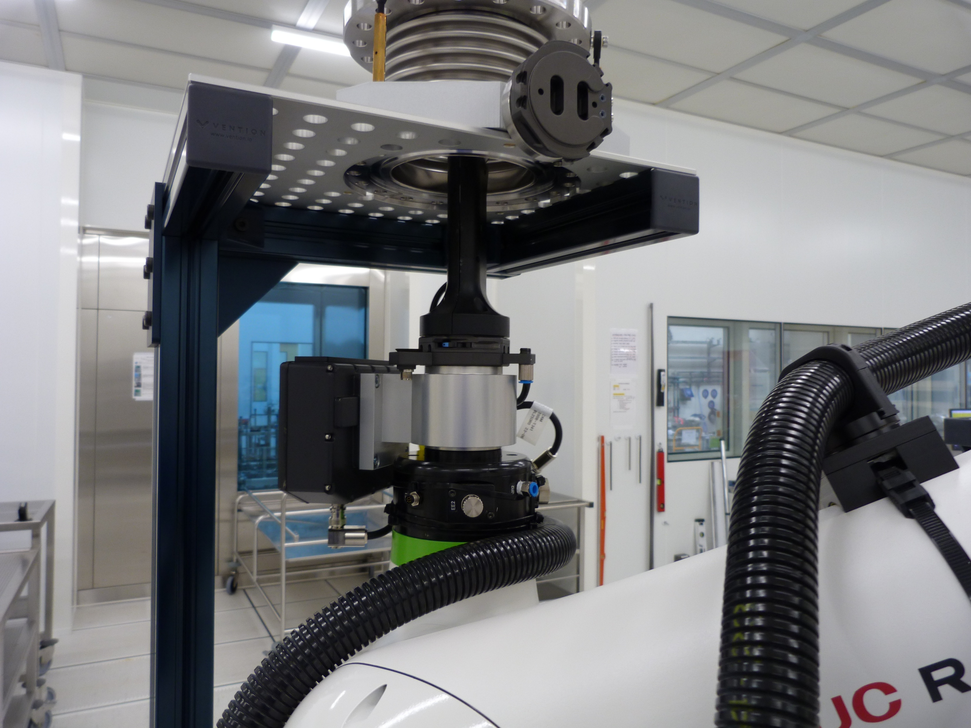


Bellows assembly on PIP-II LB650 dummy cavity
Cleaning of cavity flanges are already validated
Assembly steps performed with bellows and mock-up cavity
Installation of bellows on the cleaning area on cobot frame
Blow cleaning of the bellows
Cleaning validation by particle counting

Slide 14
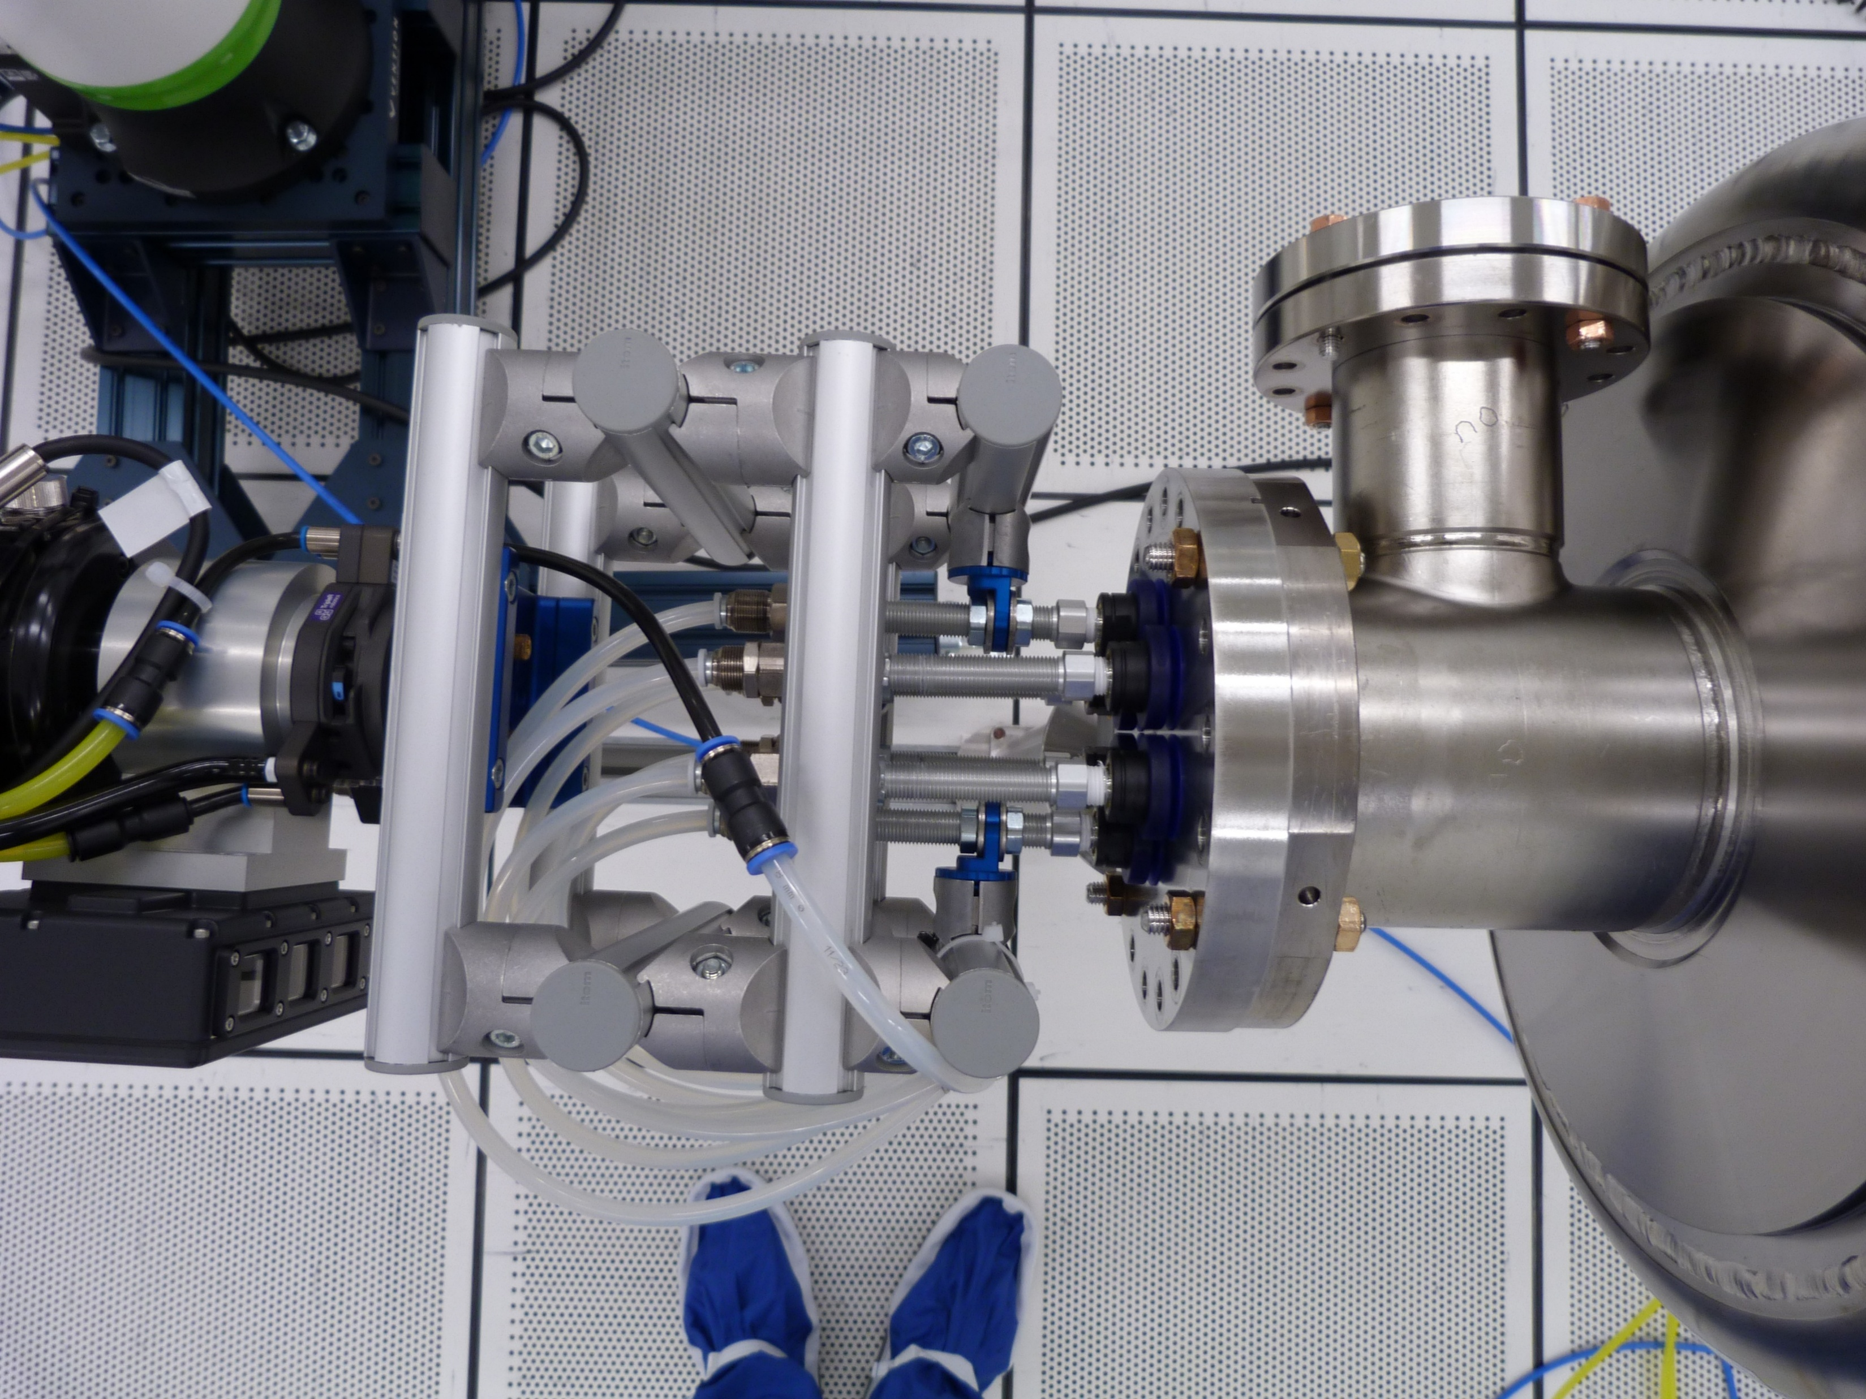
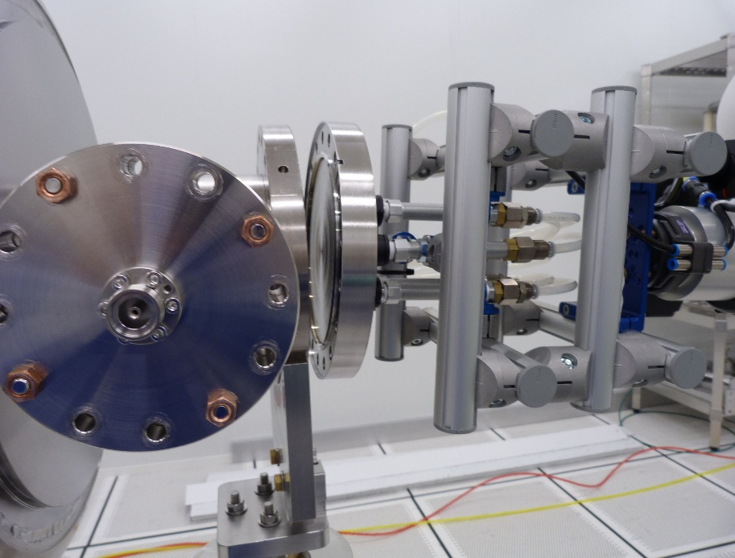
Bellows assembly on PIP-II LB650 dummy cavity
Cleaning of cavity flanges are already validated
Assembly steps performed with bellows and mock-up cavity
Gripping the beamline flange from cavity
Removal of the last few screws of the beamline flange of cavity
Removal of blank beamline flange from cavity

Slide 15
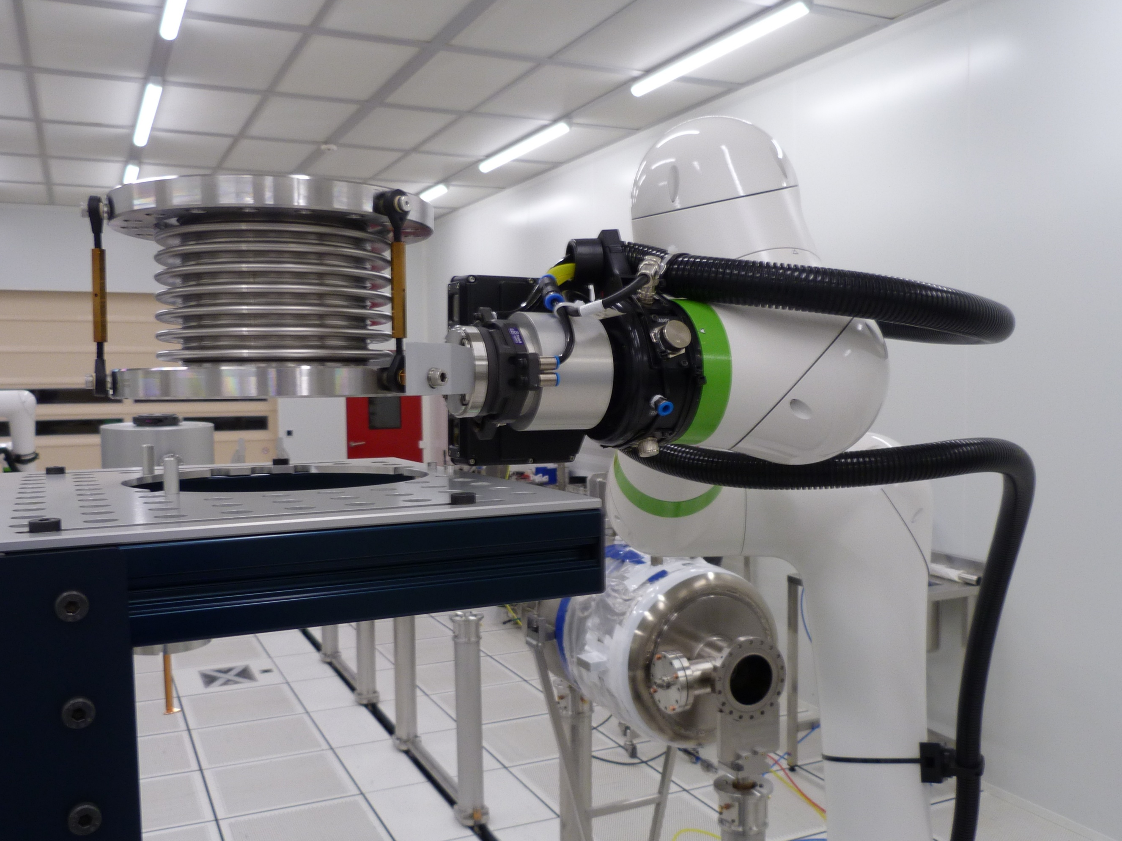
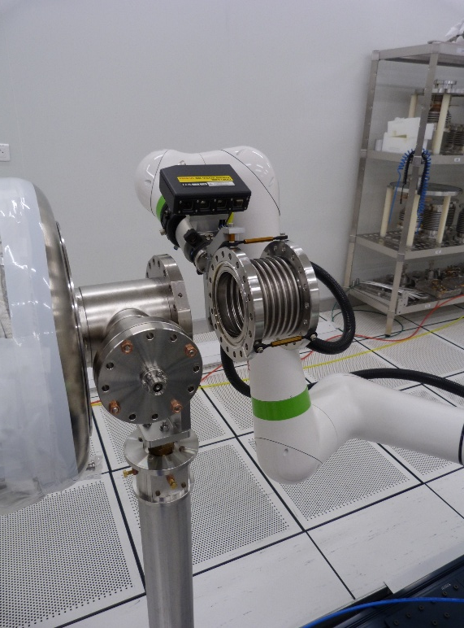
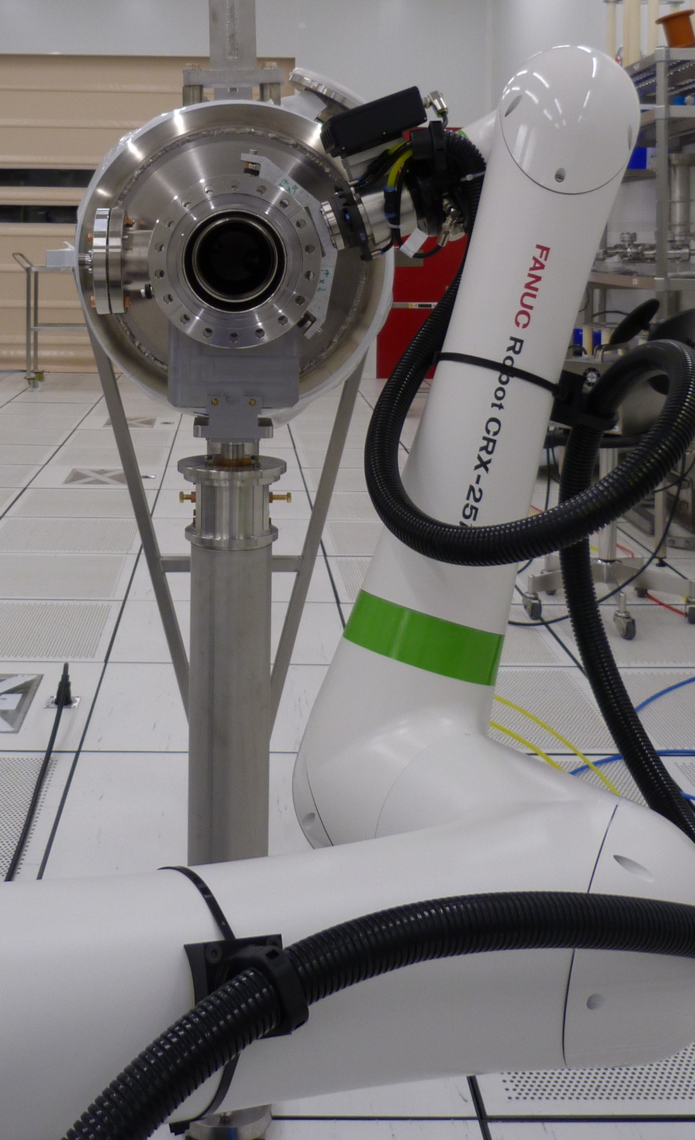
Bellows assembly on PIP-II LB650 dummy cavity
Cleaning of cavity flanges are already validated
Assembly steps performed with bellows and mock-up cavity
Handling of the bellows, alignment and positioning on cavity
Operator validates the assembly
Operator installs and torque tightens screws holding bellows to cavity

Slide 16
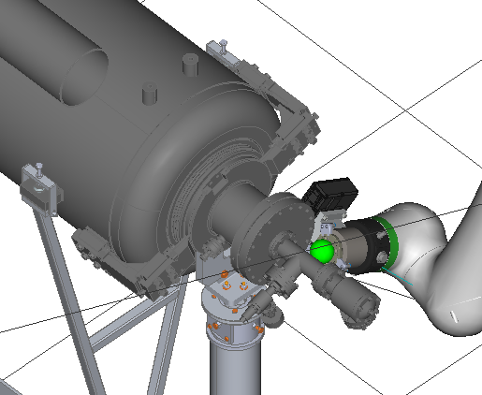
Bellows assembly on PIP-II LB650 dummy cavity
Cleaning of cavity flanges are already validated
Assembly steps performed with bellows and mock-up cavity
Work in progress on the cavity downstream beamline flange handling
Gripping the downstream beamline flange from cavity
Removal of means for holding (few screws) the downstream beamline flange of cavity
Removal of downstream beamline flange from cavity
Position cavity on the assembled bellows and install the screws

Slide 17
Conclusion
CEA cobot development methodology is defined and experimented
Collaboration between robot precision and repeatability and human validation and dexterity
CEA team is now experienced with cleaning sequence proved on ESS project
Dedicated tooling is designed to be adapted to the different components
Our first coupler to PIP-II LB650 cavity assembly had an RF cold test with NO field emission up to Fermilab administrative limit
CEA plans to extend cobot applications to full cavity string assembly and to the production of LB650 cryomodules for PIP-II, aiming to enhance both quality and operational flexibility

Slide 18
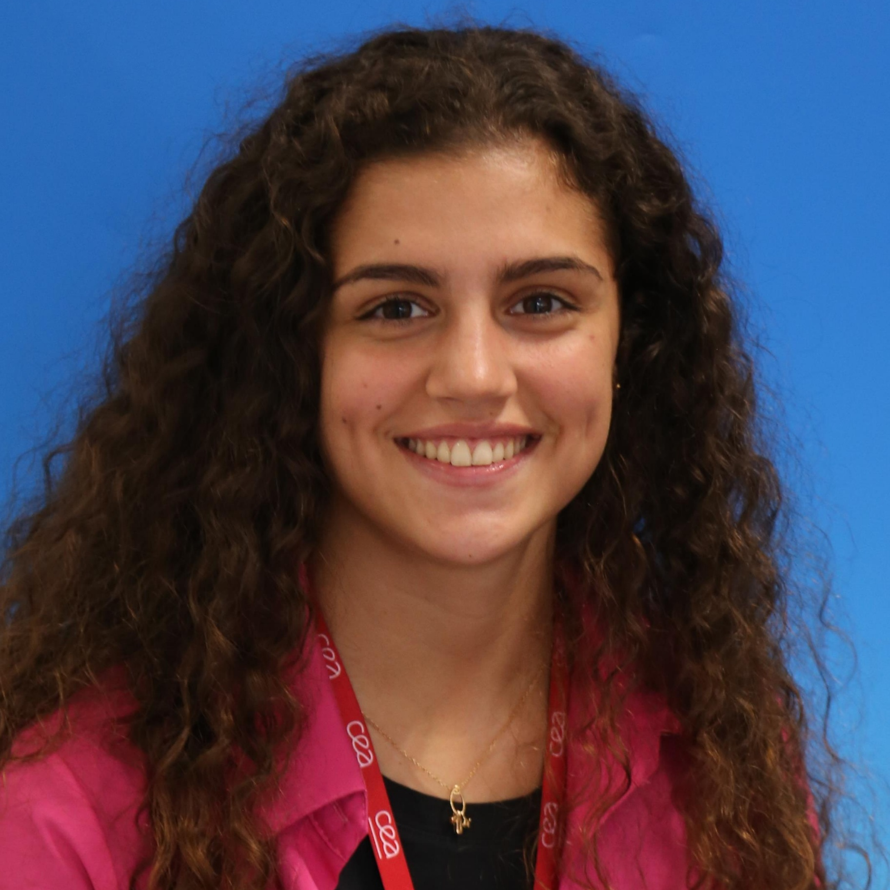
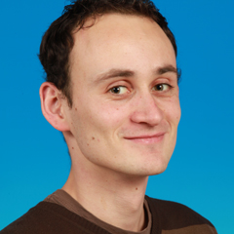
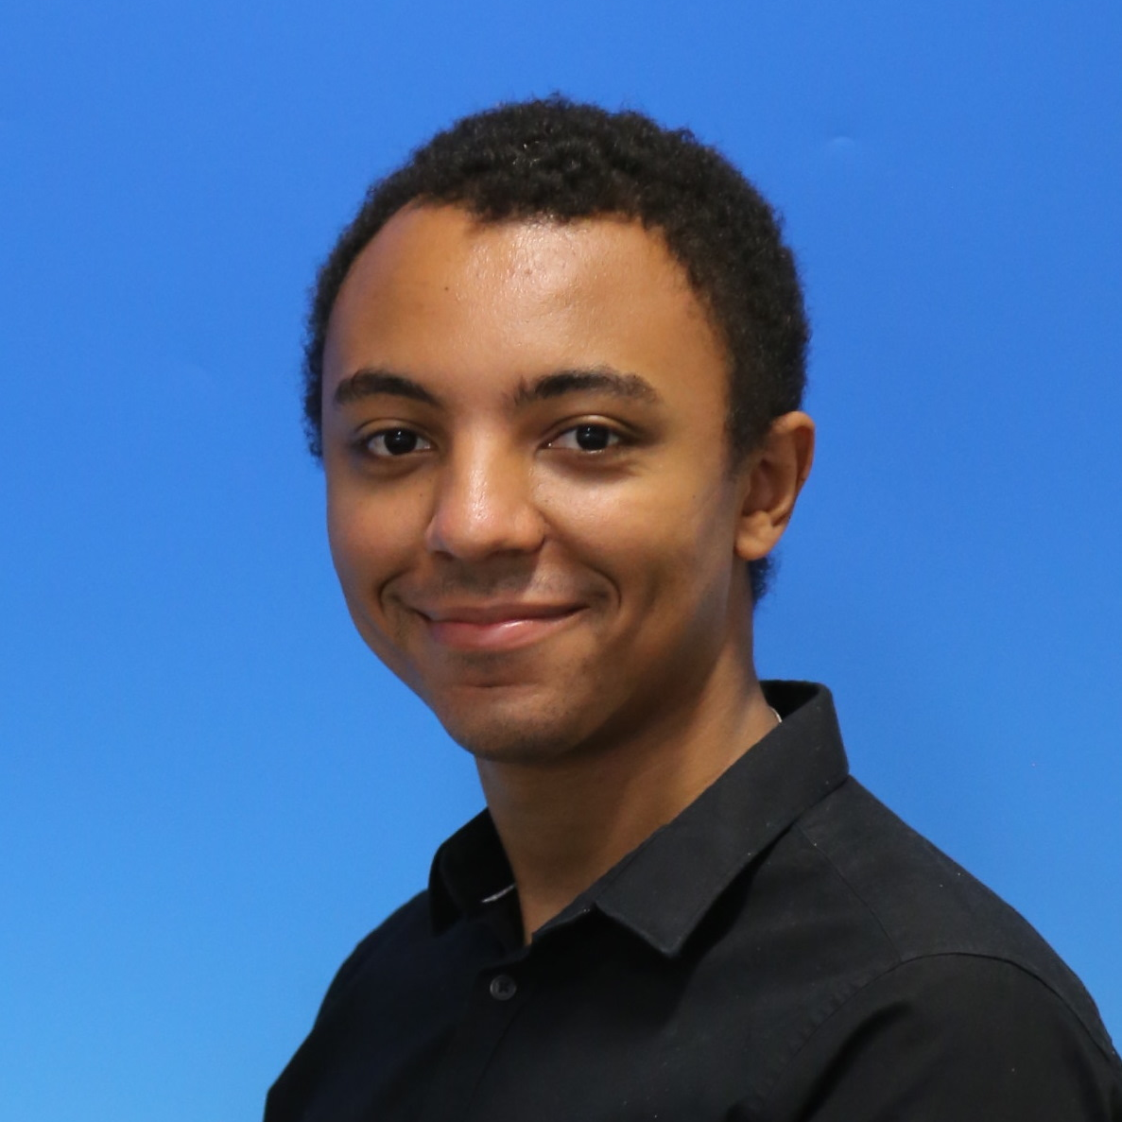
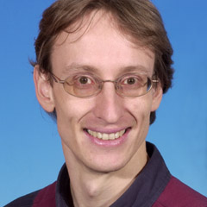
Robotic Team at CEA / Irfu
Ambre GONZALEZ--MOREAU
work-study engineer
-Flange design compatible w/robot handling (ESS)
-1.3GHz coupler assembly
Christophe SERVOUIN
Senior technician
CRX25 integration
Roboguide (visualization/simulation)
Cobot programs
Julien DRANT
Mechanical Engineer
- End of arm tooling designer
Stephane BERRY
PhD
- Development of robotic assisted assembly

Slide 19
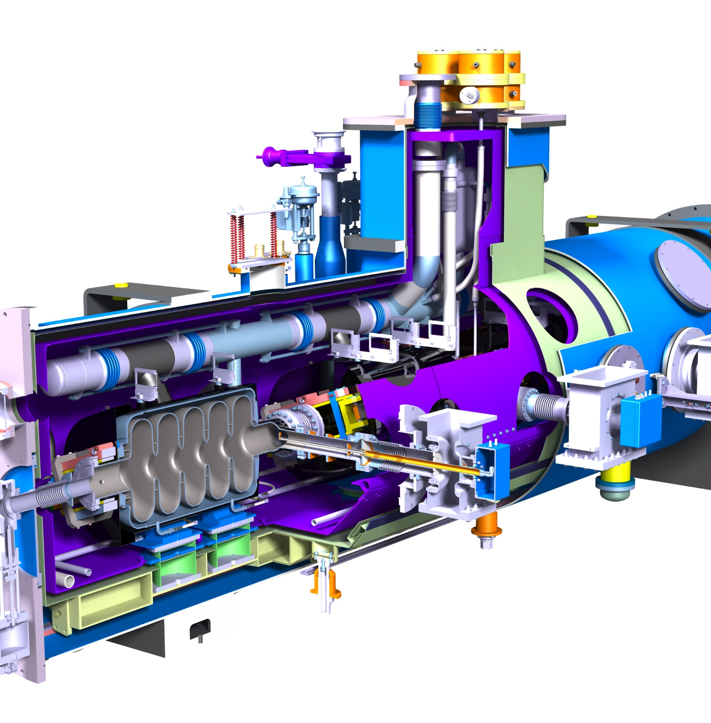






Thanks for your attention
J. DRANT
CEA SACLAY
91191 Gif-sur-Yvette Cedex
France
julien.drant@cea.fr

