Slide 1
High-Q/high-G Developments at FNAL
October 21st, 2025
FERMILAB-SLIDES-25-0281-SQMS-TD
Daniel Bafia
Associate Scientist

Slide 2
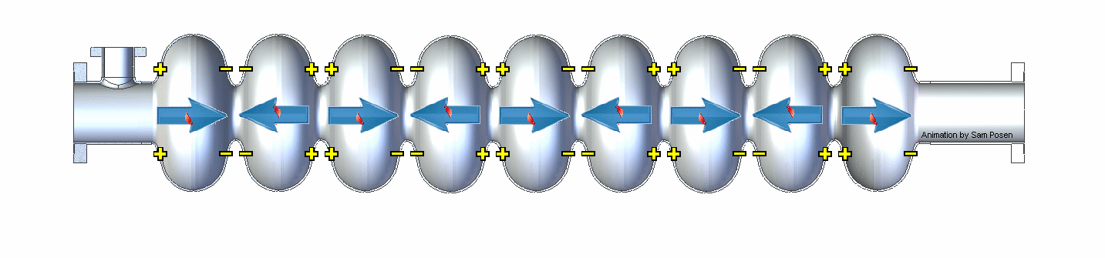
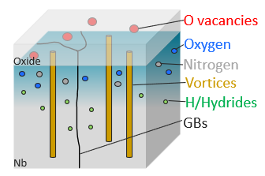
State-of-the-Art Nb SRF Cavity Performance for Accelerators
State-of-the-Art FNAL Cavities Post Various Treatments
Larger Q₀/higher gradient → lower $$
6e10
50 MV/m
RF field

Slide 3
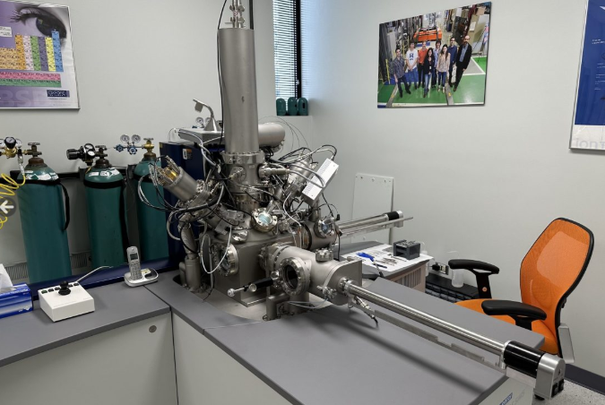
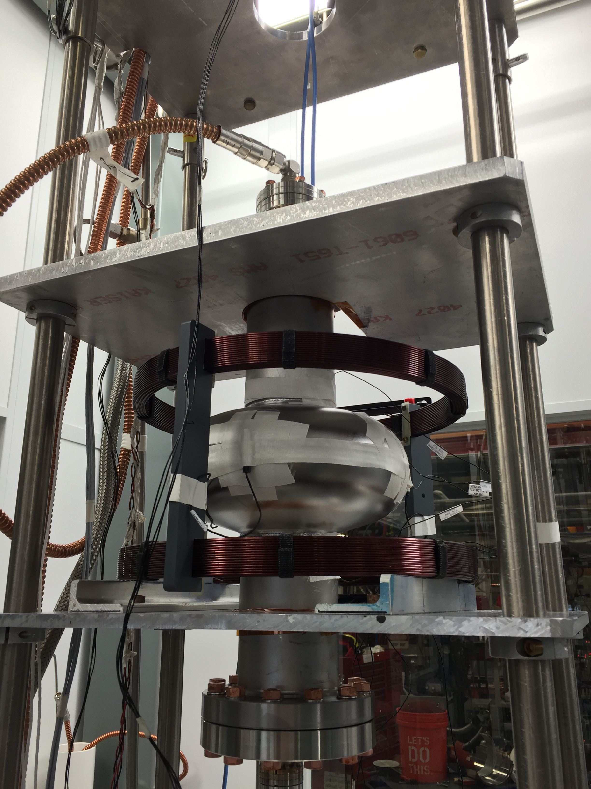
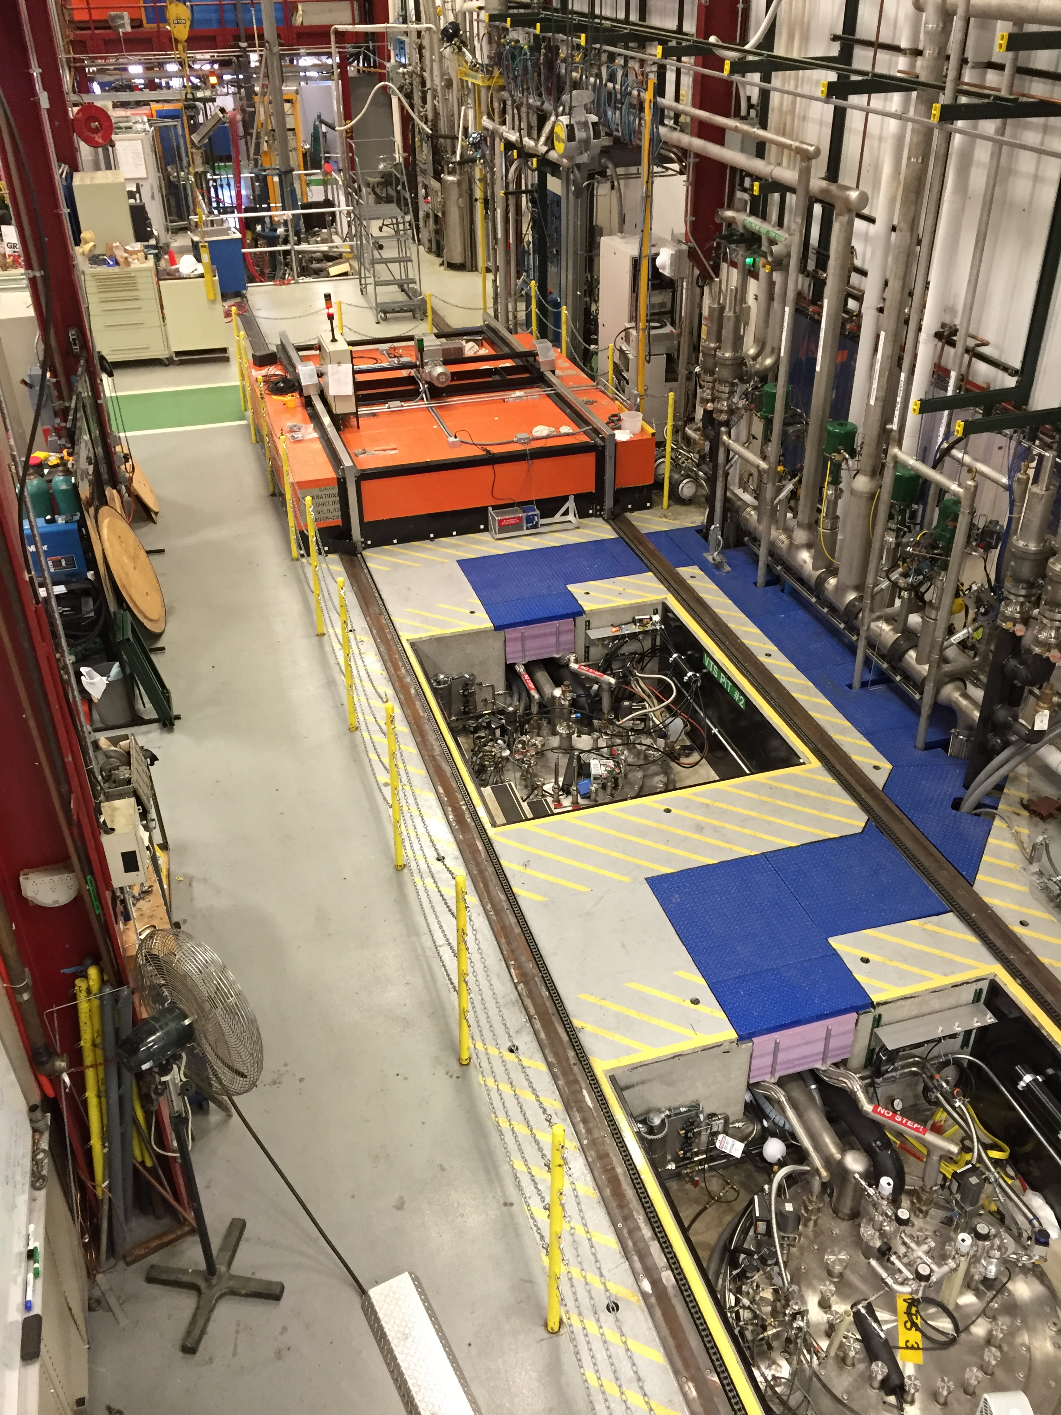
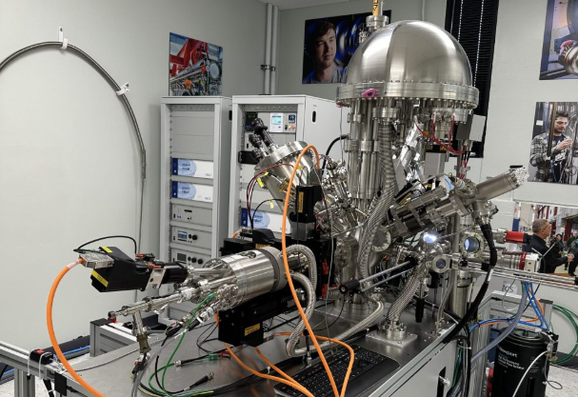
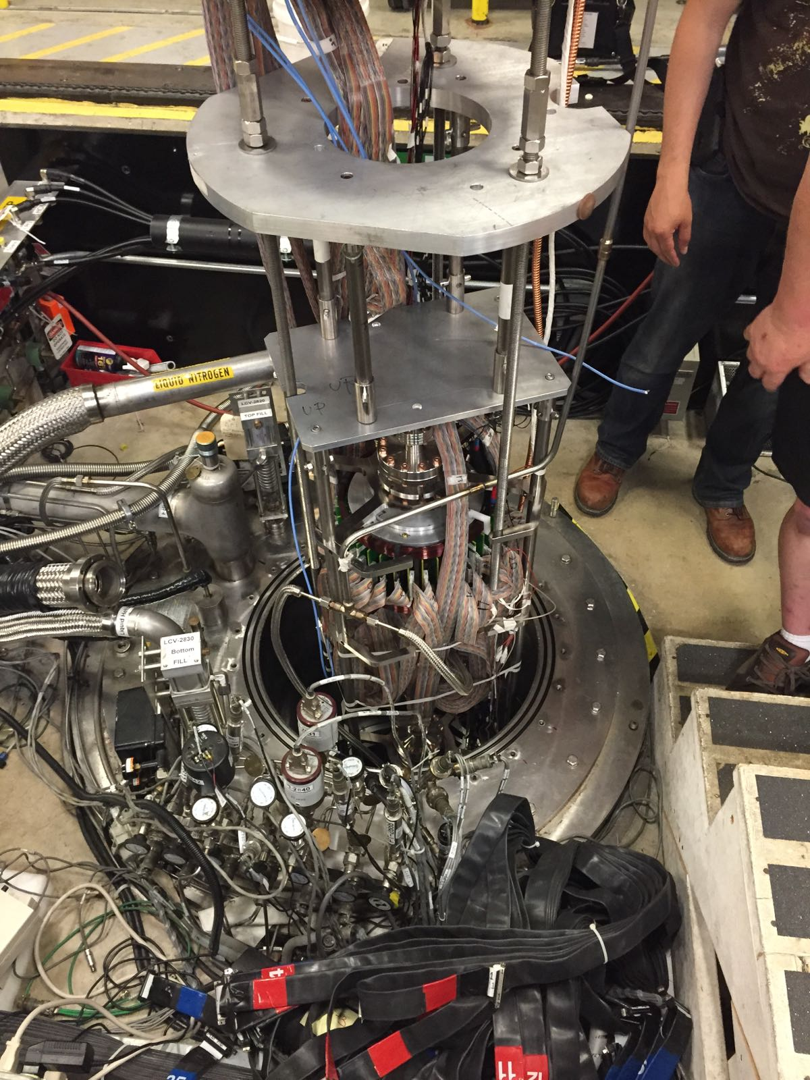
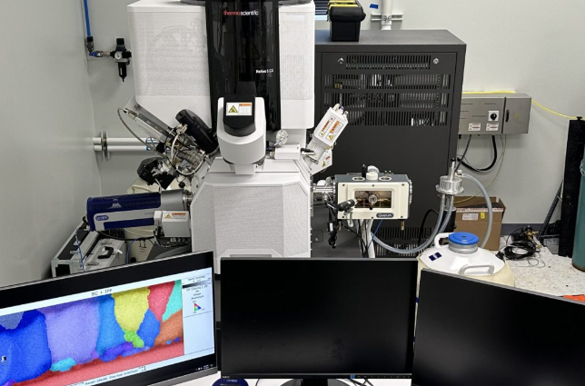
Materials Science to Identify Origins of Limitations
(Cryo) Material Studies
Cavity RF Measurements
ToF-SIMS
XPS
SEM

Slide 4
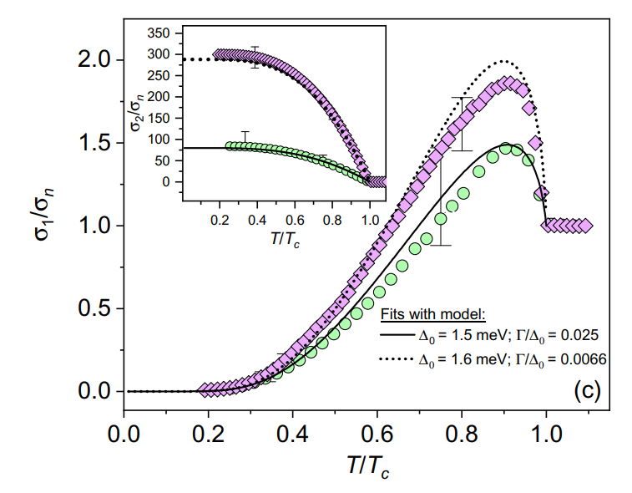
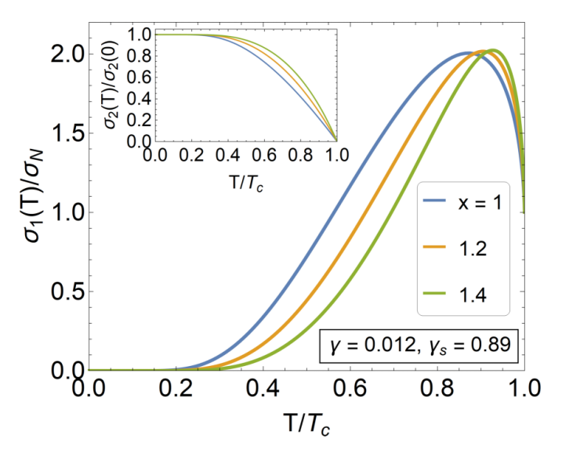
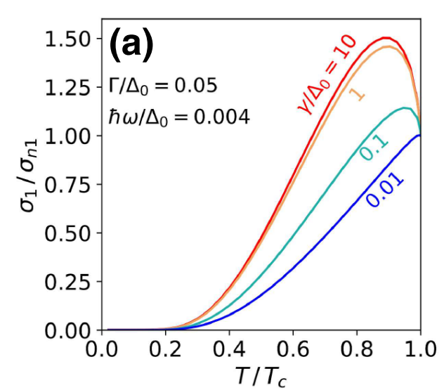
Exploring the Role of Impurities in Nb: Nitrogen
SRF Cavity Studies
Nb Cavity Conductivity
New Theoretical Models
N-Doped
F. Herman and R. Hlubina PRB 104, 094519 (2021)
EP
Why does dilute N enhance Q₀?
T. Kubo PRAppl 17, 014018 (2022)
D. Bafia et al. PRAppl 23, 054052 (2025)
Studies highlight the importance of N in optimal inelastic scattering
Dilute impurities yield homogenized gap → higher Q₀

Slide 5
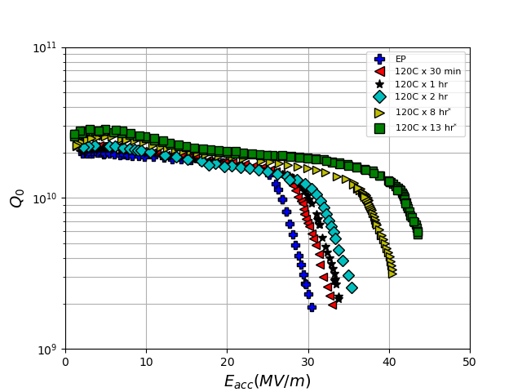
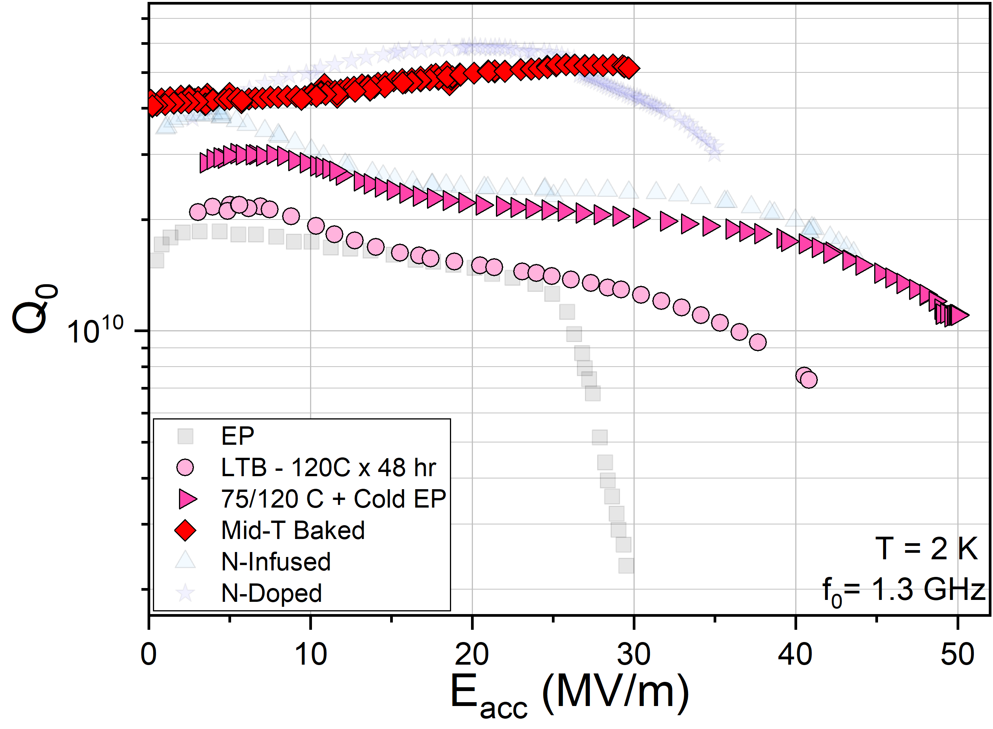
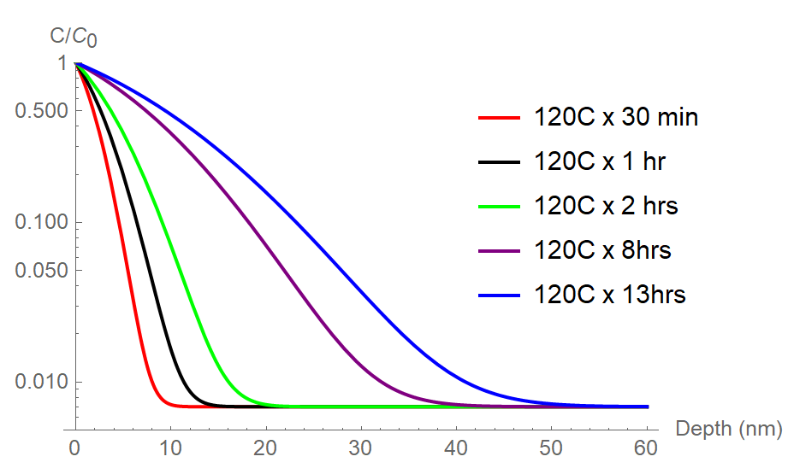
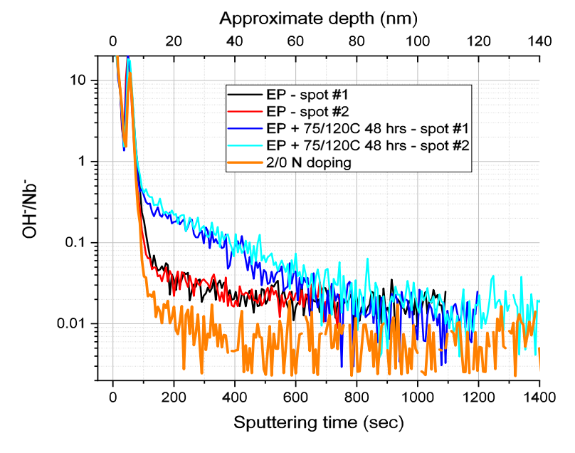
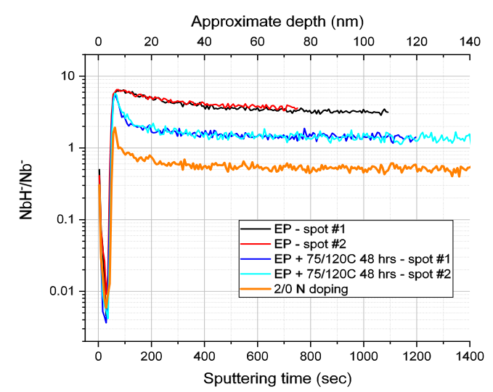
Exploring the Role of Impurities in Nb: Oxygen
Cavity Performance Post Various in situ Baking
Tracking Quench Field of 1.3 GHz Cavities with O Diffusion Depth
TE1RI003 Post Sequential 120C Baking
Mid-T Bake
D. Bafia et al. Proc. of SRF’21
75/120 C
Why does baking enable performance tuning?
120 C
Calculated O Depth Profile
T = 2K
f₀ = 1.3 GHz
D. Bafia et al. Proc. of SRF’21
Diffusion Depth
ToF SIMS Studies on Cutouts
Able to tune performance by diffusing O via baking
Tune between high Q₀ and high G
Do O and N perform the same function in Nb?
Baking drives the inward diffusion of O → reduces H!
A. Romanenko et al. Proc. of SRF’19

Slide 6

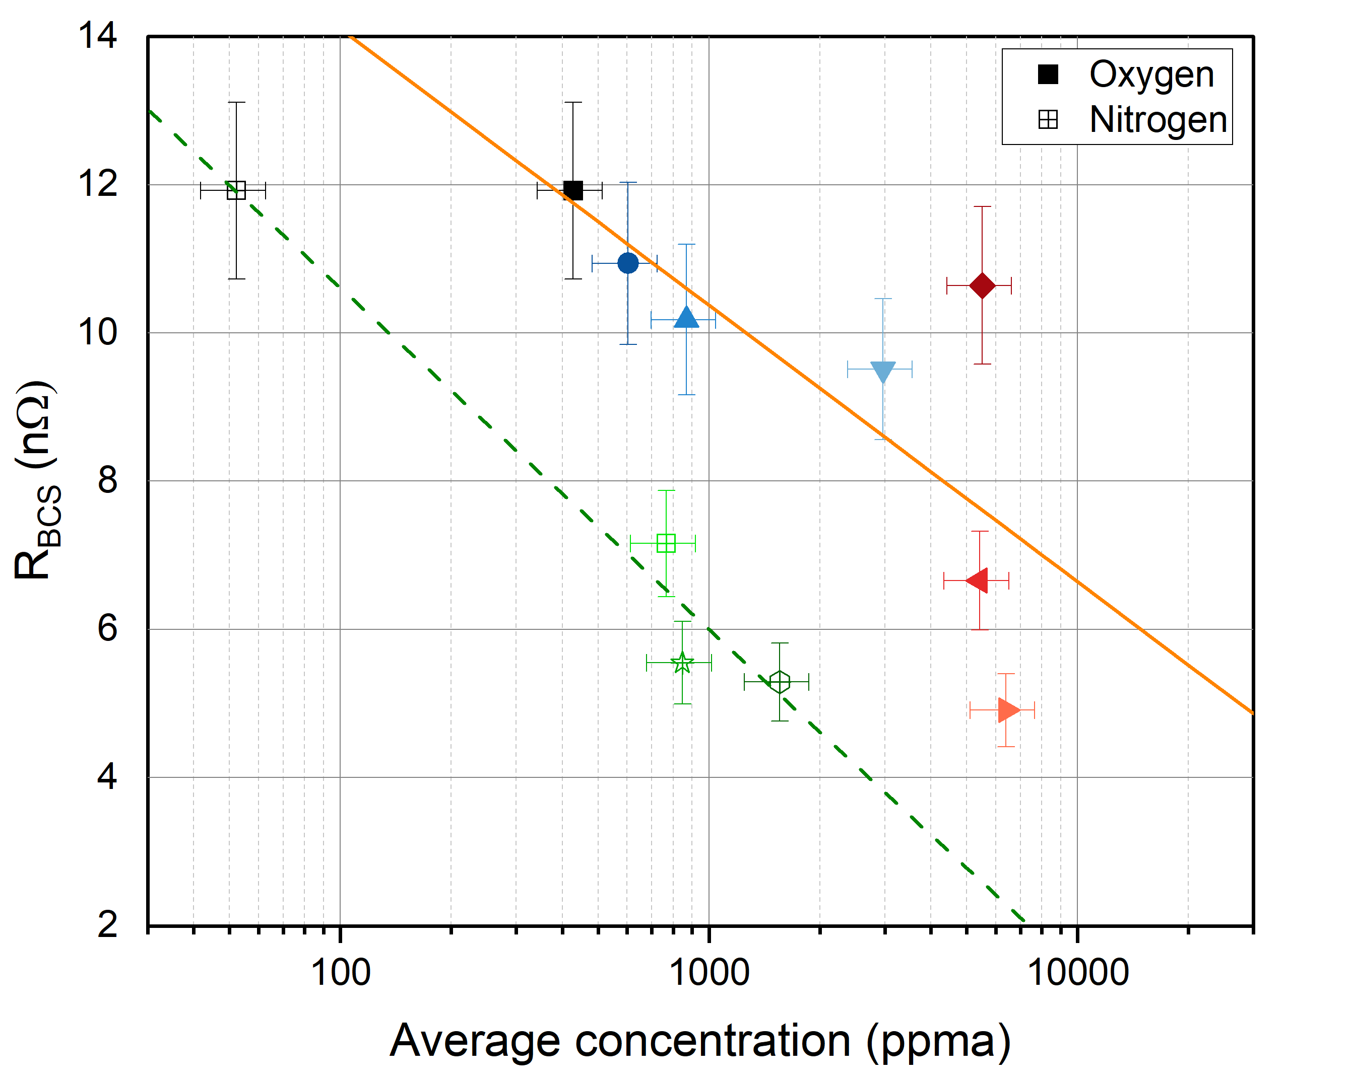
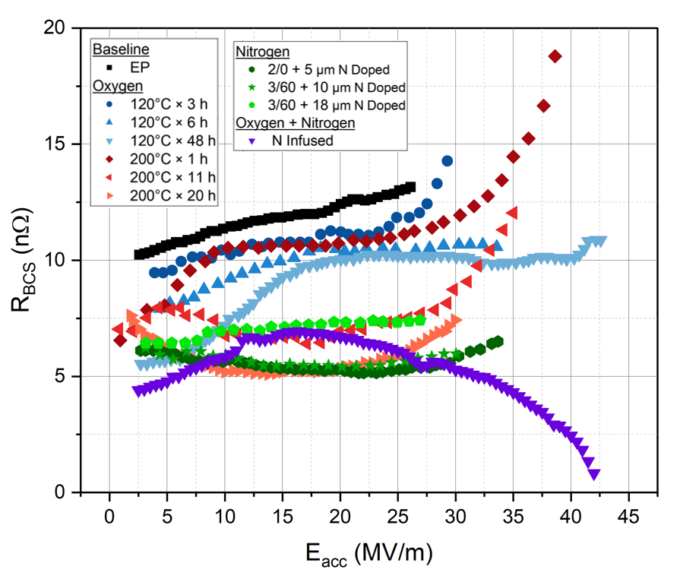
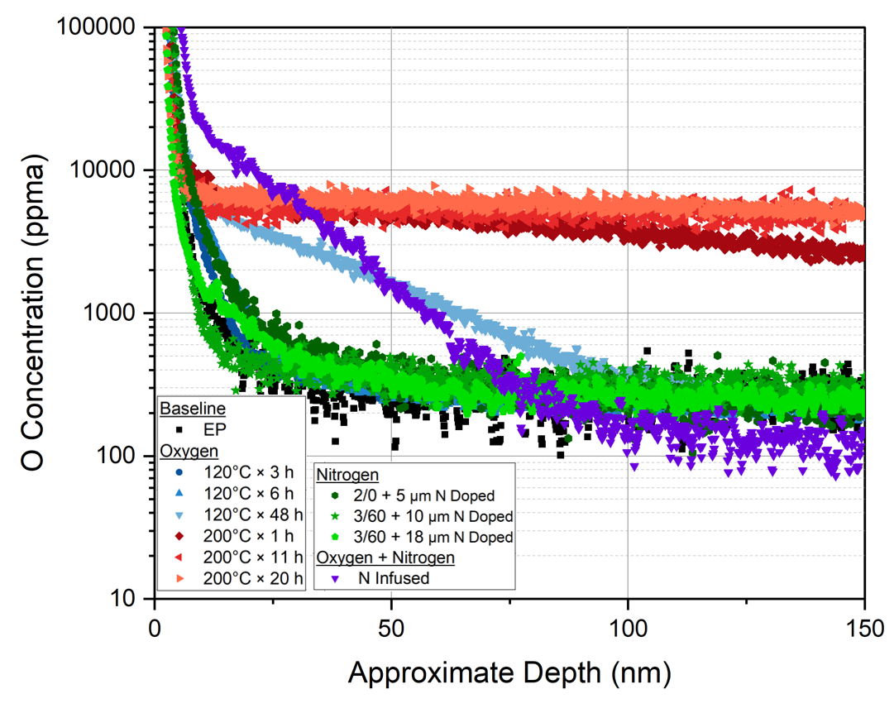
Comparing Effectiveness of O vs N Impurities
Surface Resistance vs Average Concentration of Impurities
RF and Materials Science Studies Post Various O or N Based Treatments
N is 10x more effective than O at reducing BCS!
Oxygen
Parametrically compared R_{BCS} @ 16 MV/m and measured N and O concentrations in sample post various surface treatments
Nitrogen
H. Hu et al. arXiv:2509.18564

Slide 7
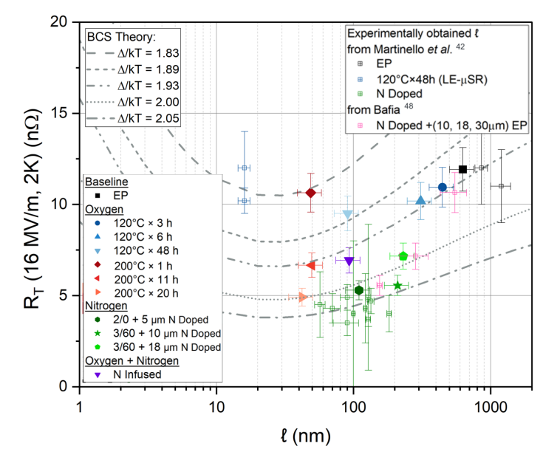
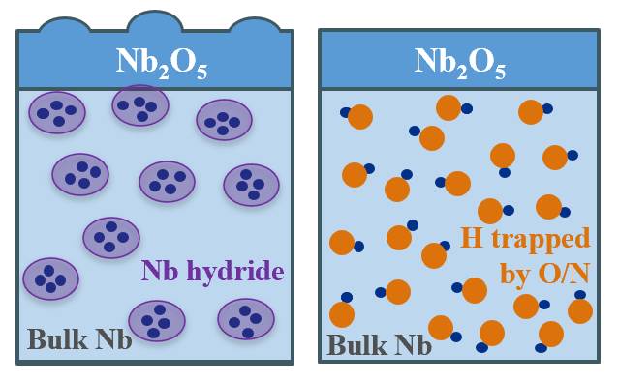
Model for Improved Performance: H Capture
Surface Resistance vs Mean Free Path: Comparison with BCS Theory
N interstitial yields a simultaneous reduction in MFP and increase in SCing gap
Binding energy of N to H > O to H¹
N might better prevent the formation of hydrides in Nb!
H. Hu et al. arXiv:2509.18564
Nitrogen is a promising impurity for higher Q₀/G!
[1] D.C. Ford et al., Supercond. Sci. Technol. 26, 095002 (2013).

Slide 8

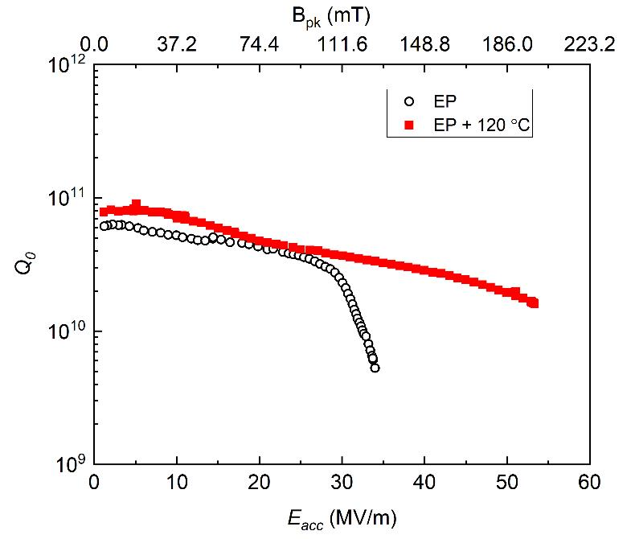
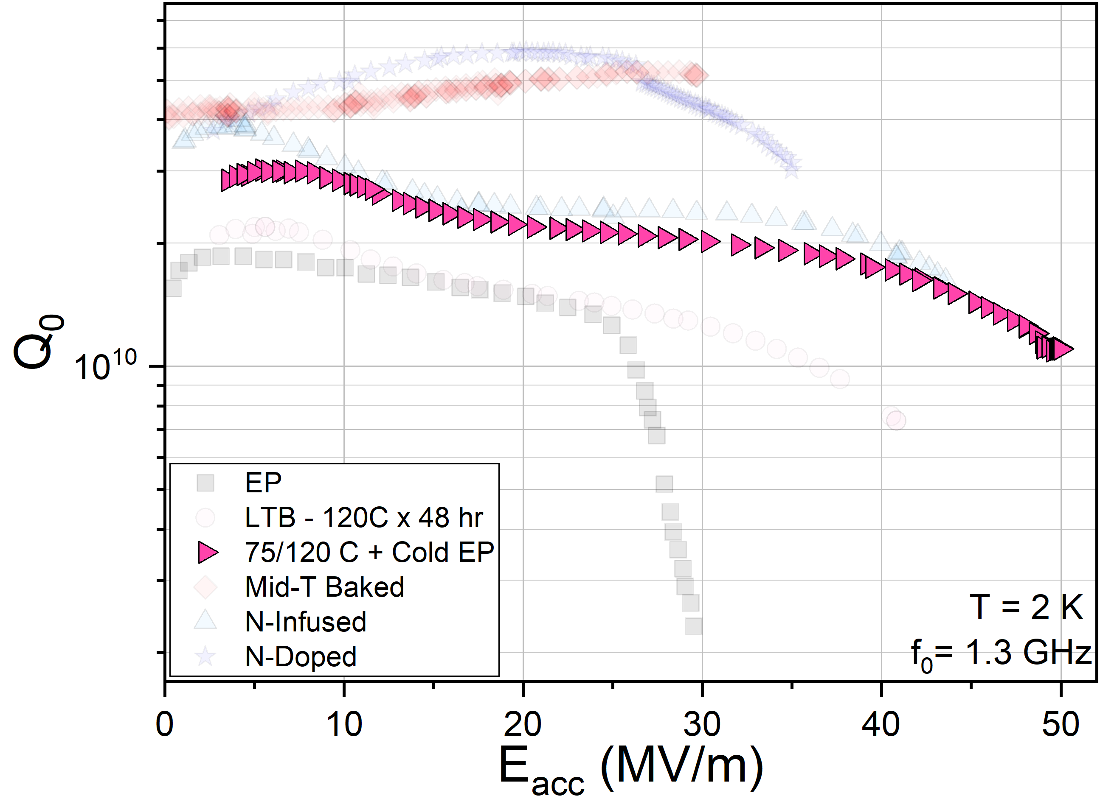
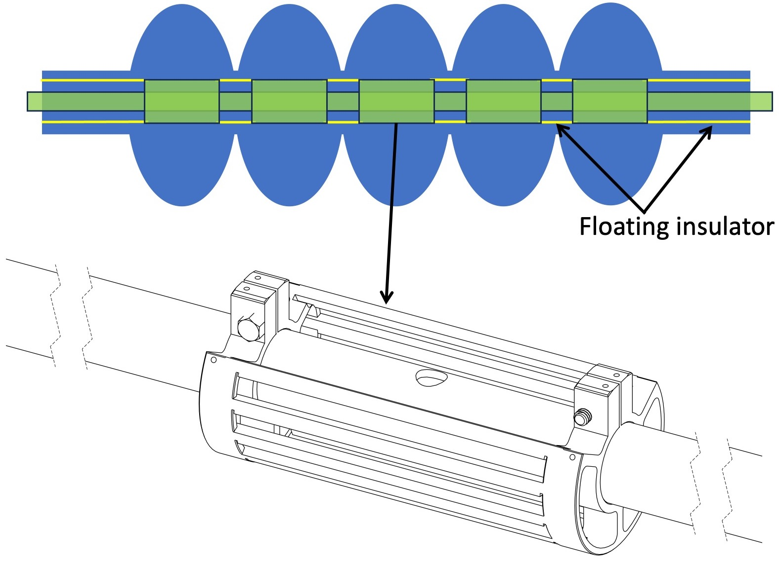
Optimized EP: Unlocking the Full Potential of Impurity Tailoring
Cold EP + 75/120C Baking on 1.3 GHz Cavity
Optimized EP + 120C baking on HB 650 MHz
V. Chouhan et al., NIMPRA 1051, 168234 (2023)
75/120 C
+50 MV/m!
+50 MV/m!
Cathode-N
Require optimized EP parameters/design to reduce H uptake and surface roughness
Optimized EP enables benefit of impurity tailoring

Slide 9
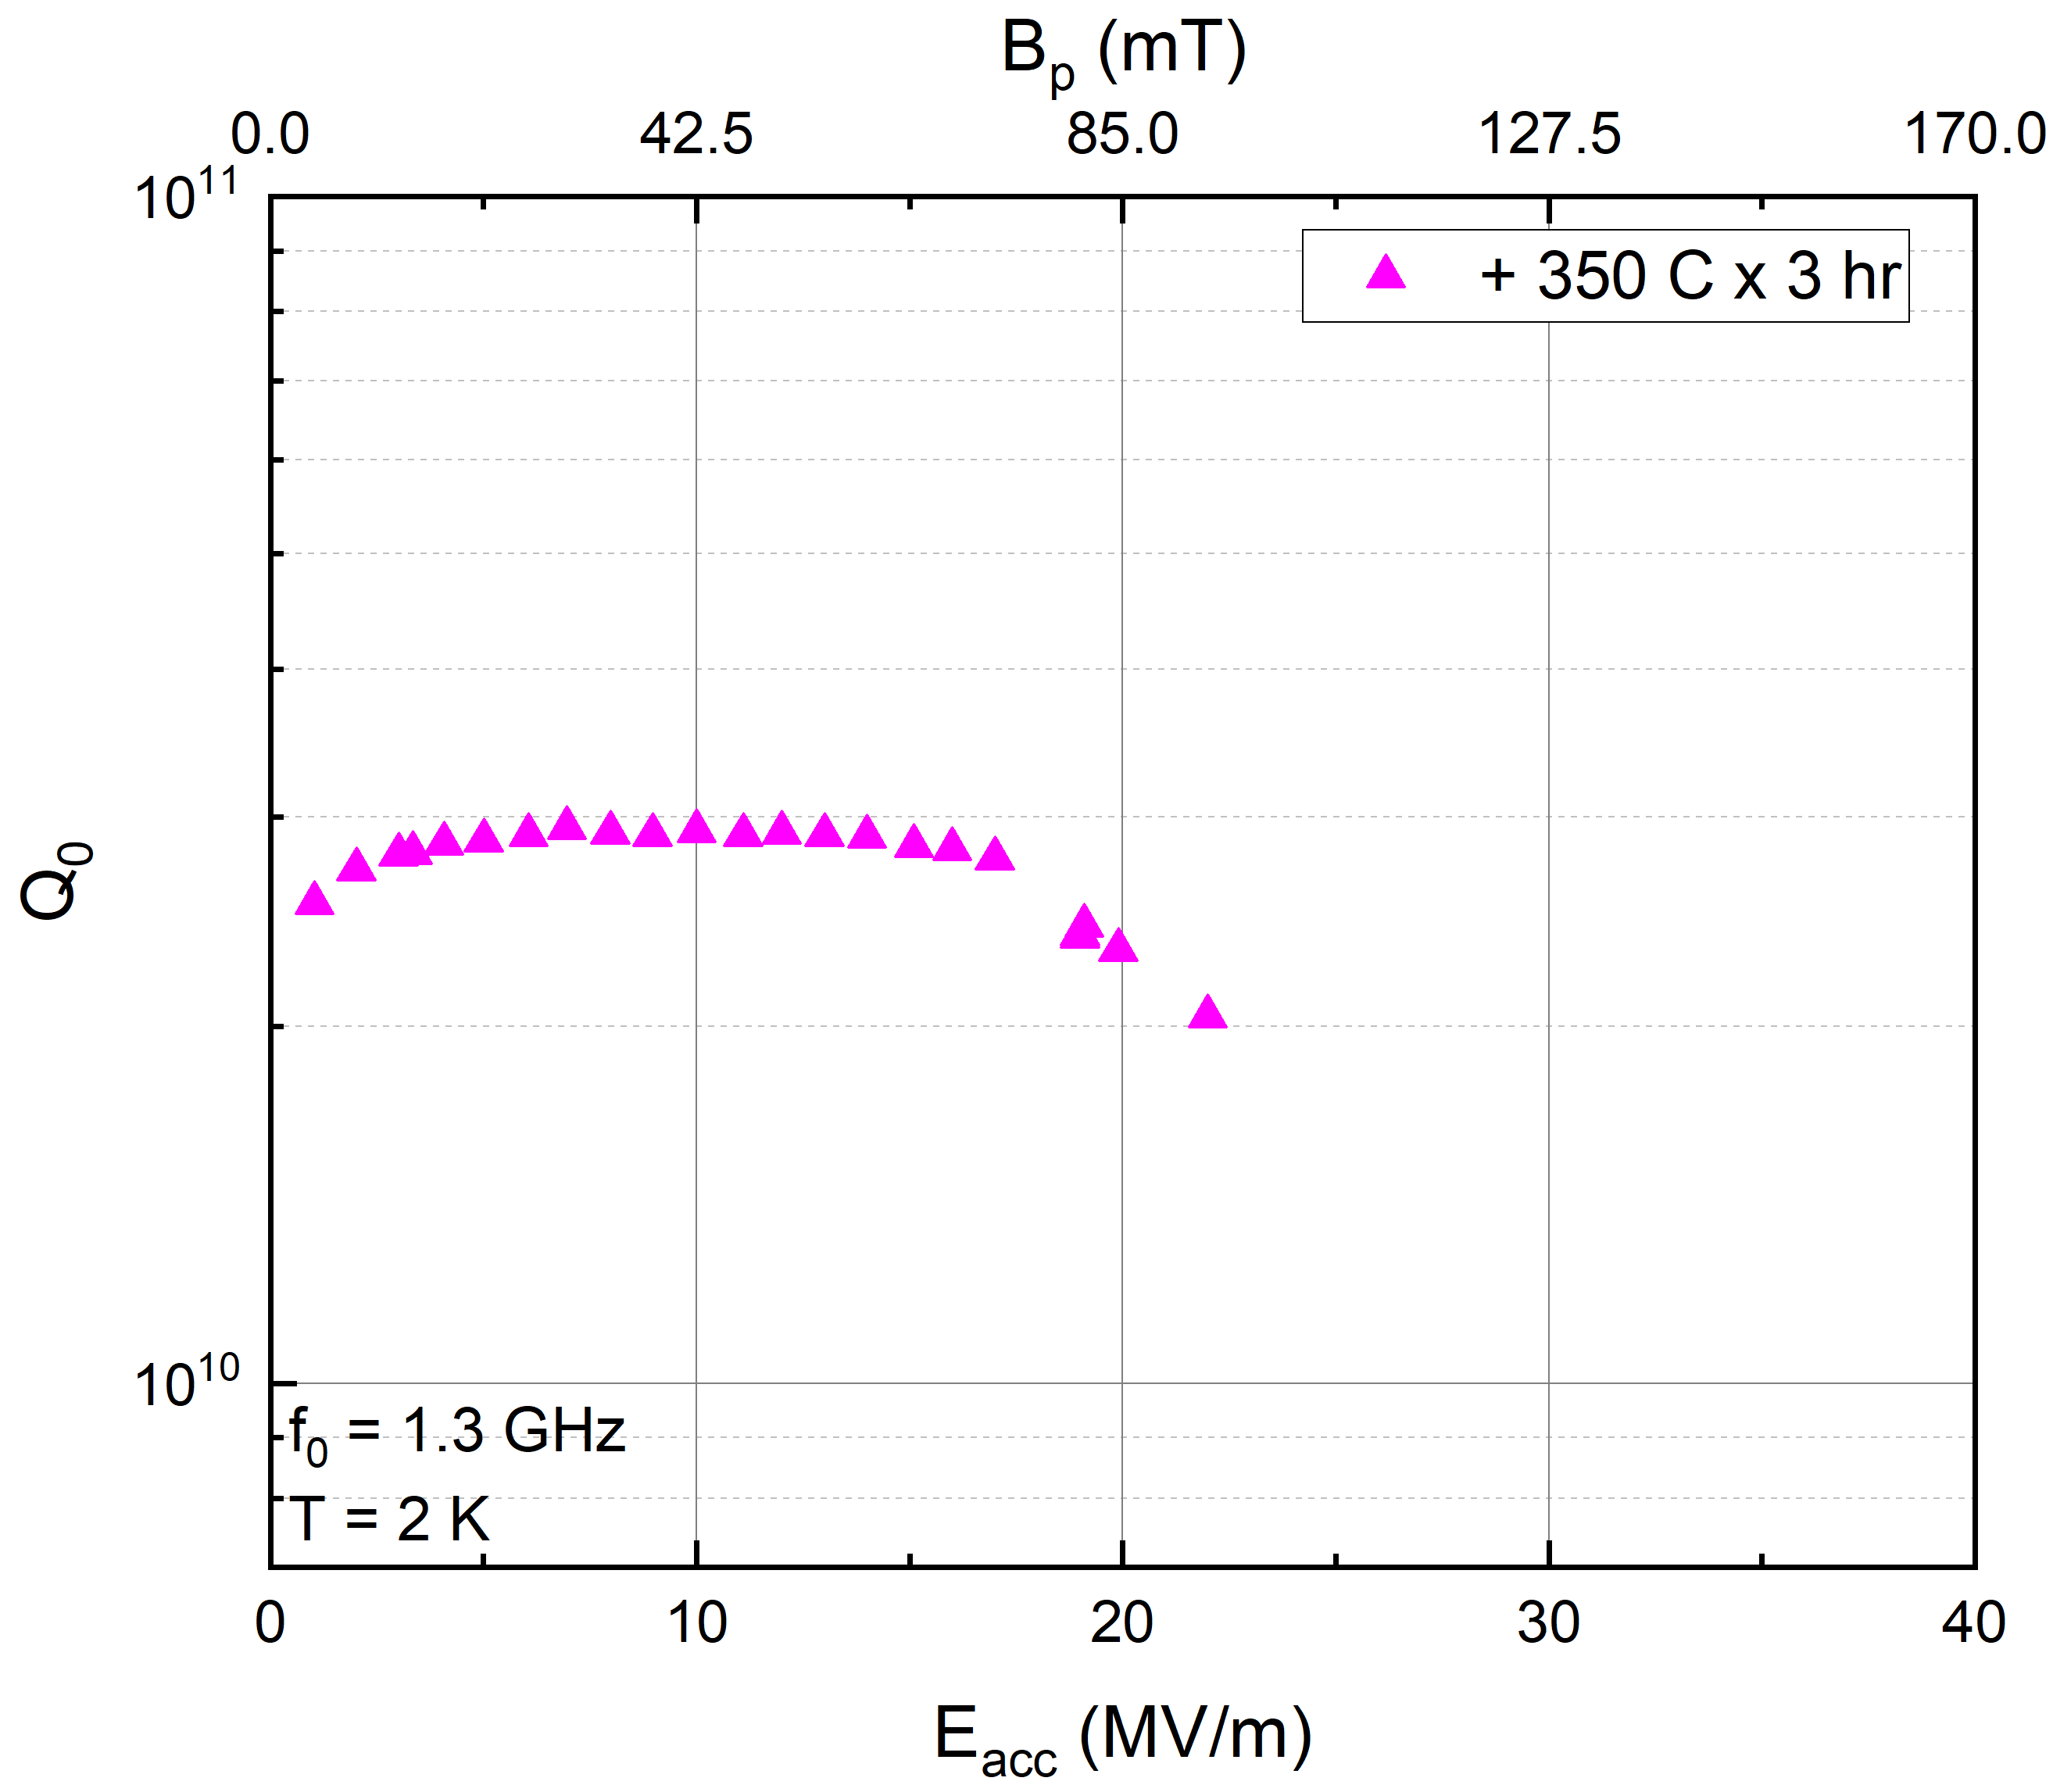
High Q₀ and G via O-Tailoring and Optimized EP
Mid-T baking: Diffuses O and gives high Q₀;
EP Nano-removal treatment: Removes 100 nm from surface
Issue: Forms lossy Nb-carbides
→ Removes NbC!
1.3 GHz Nb SRF Cavity Post Various Surface Treatments
V. Chouhan et al., WEP065, NAPAC2025
V. Chouhan et al., THP83, SRF2025

Slide 10
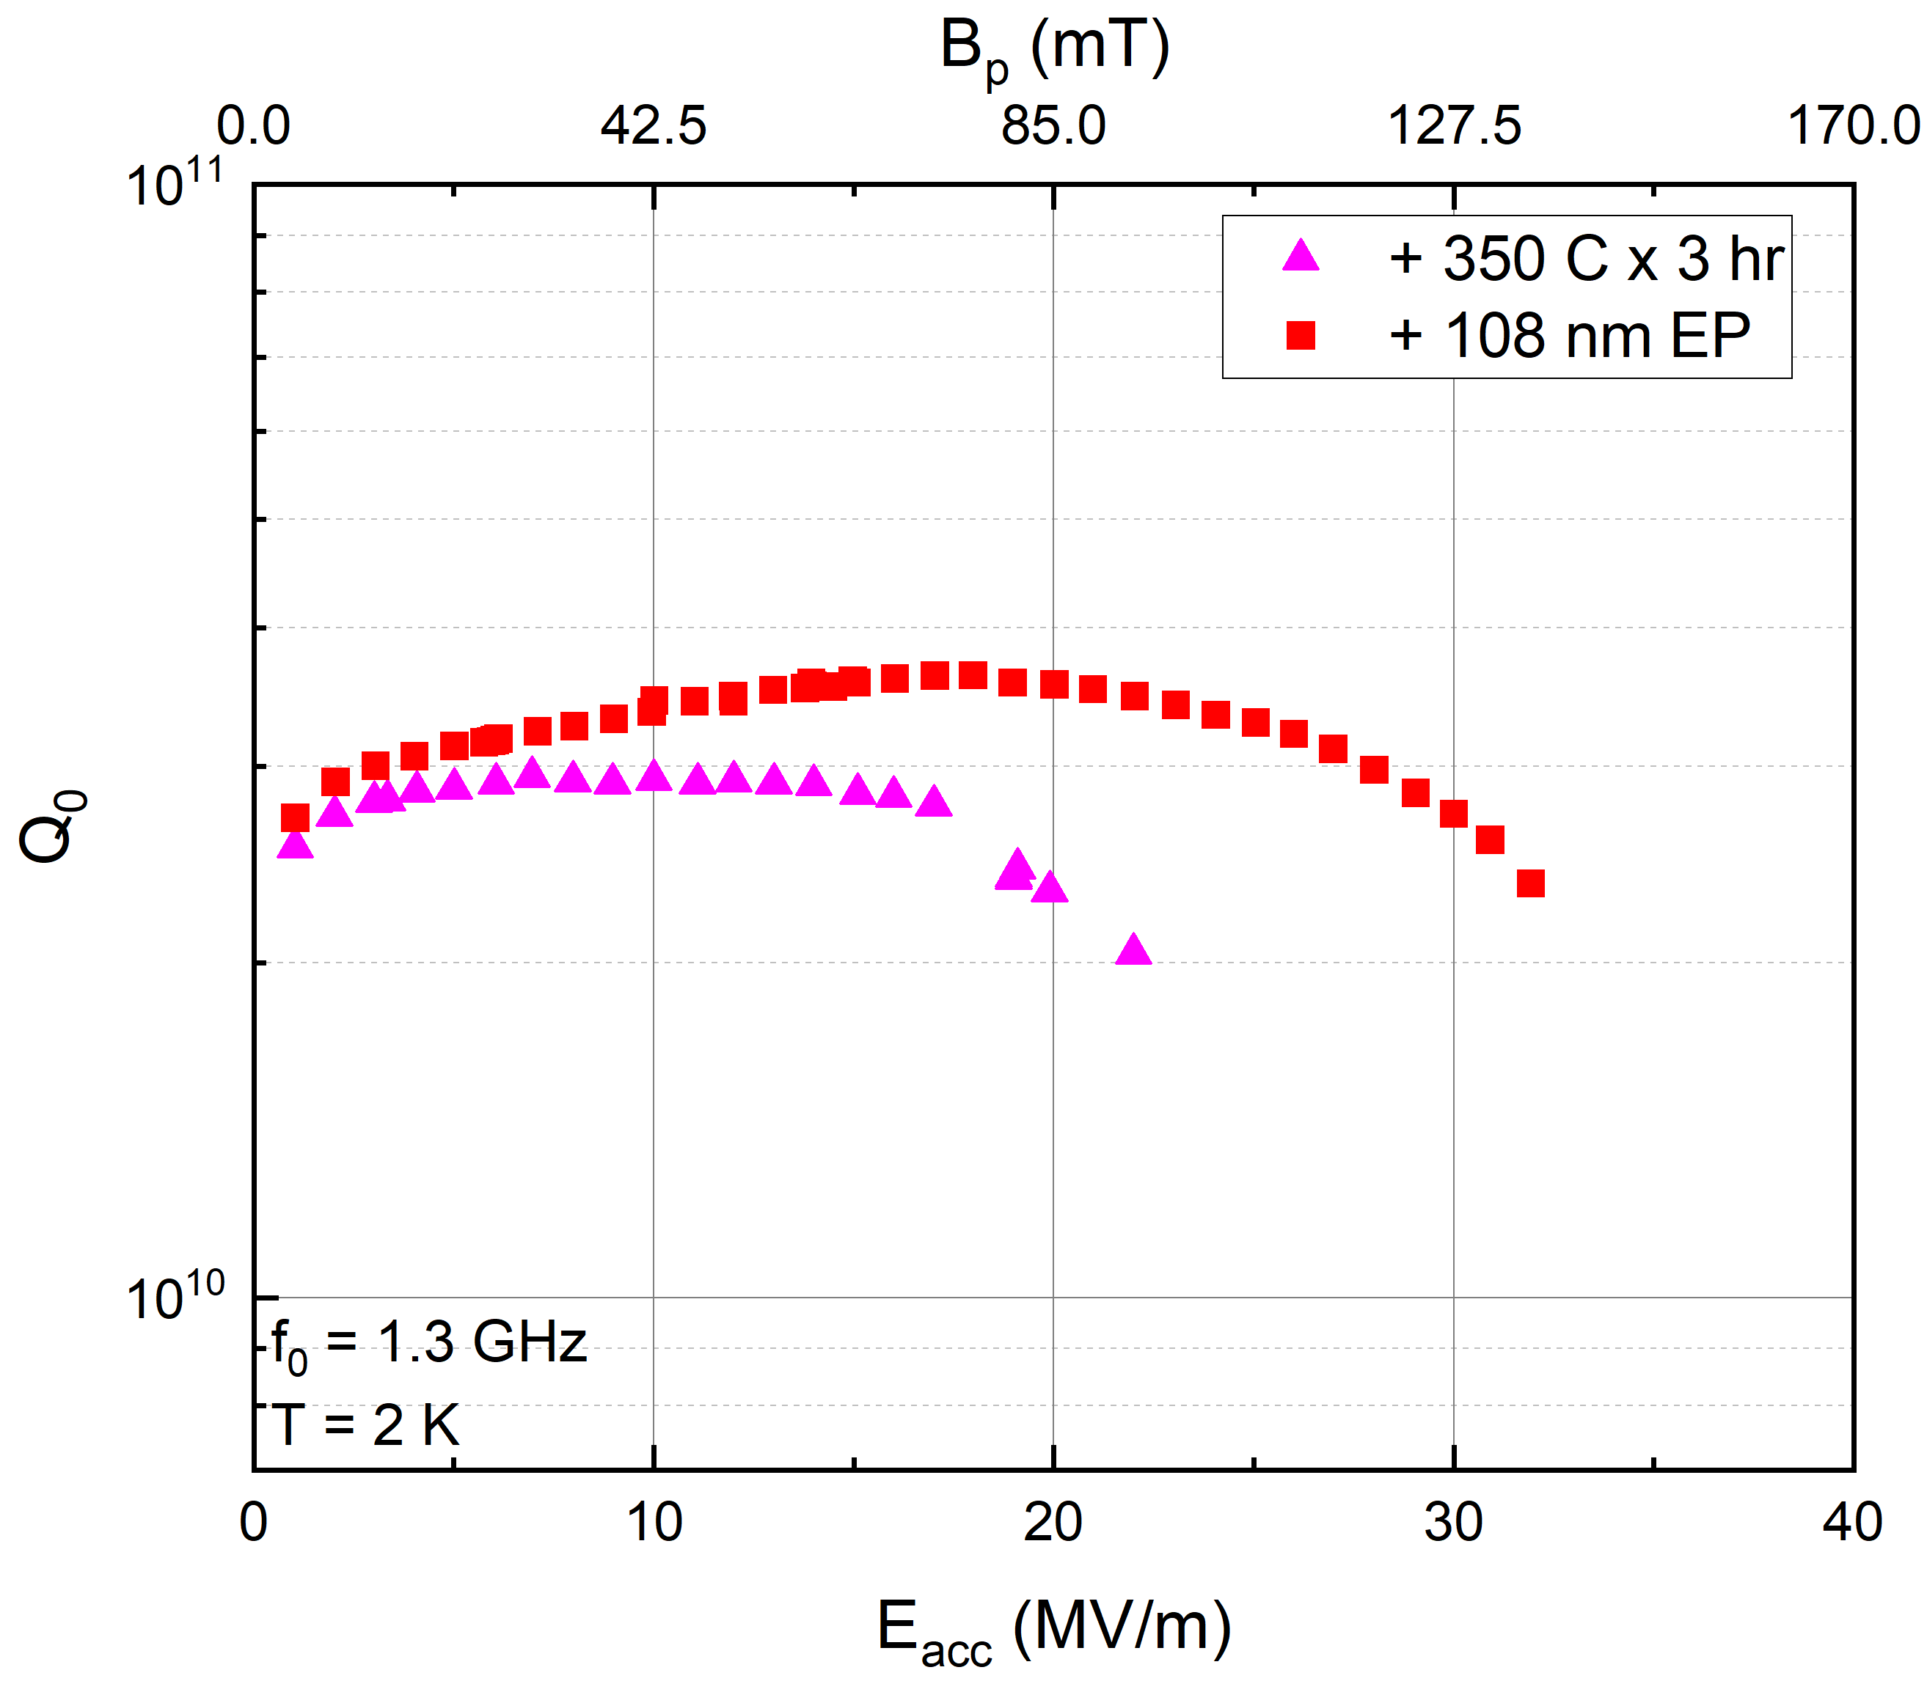
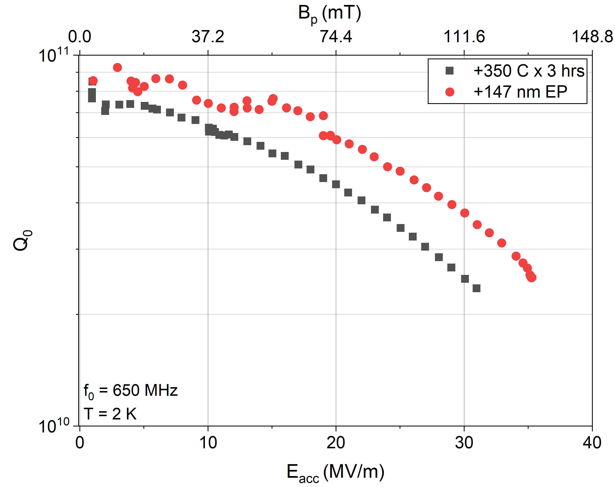
High Q₀ and G via O-Tailoring and Optimized EP
Mid-T baking: Diffuses O and gives high Q₀;
EP Nano-removal treatment: Removes 100 nm from surface
Issue: Forms lossy Nb-carbides
→ Removes NbC!
1.3 GHz Nb SRF Cavity Post Various Surface Treatments
650 MHz Nb SRF Cavity Post Various Surface Treatments
Removing NbC results in dramatic increase in Q₀ and G!
Demonstrated also on 650 MHz!
V. Chouhan et al., WEP065, NAPAC2025
V. Chouhan et al., THP83, SRF2025

Slide 11

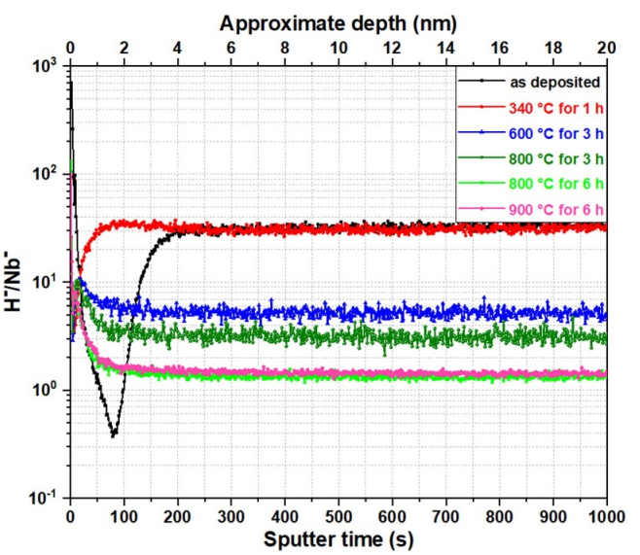
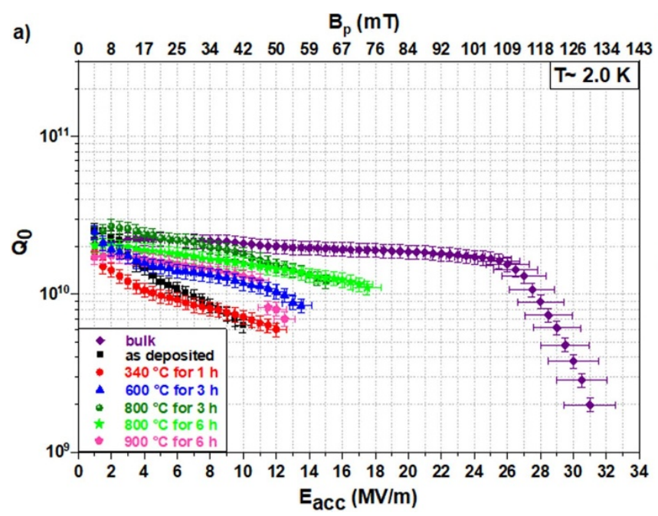
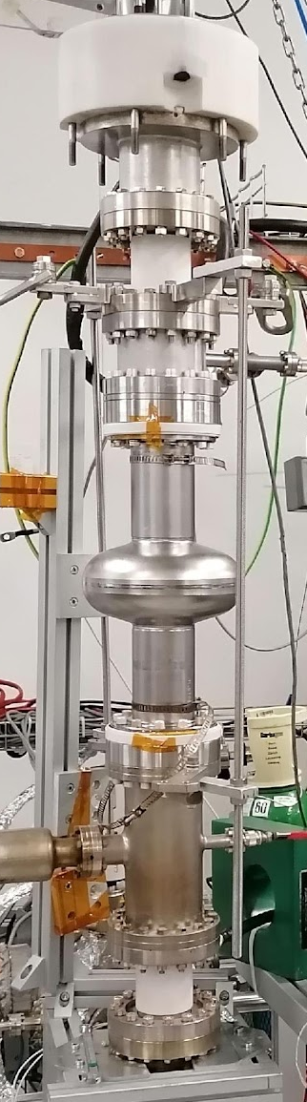
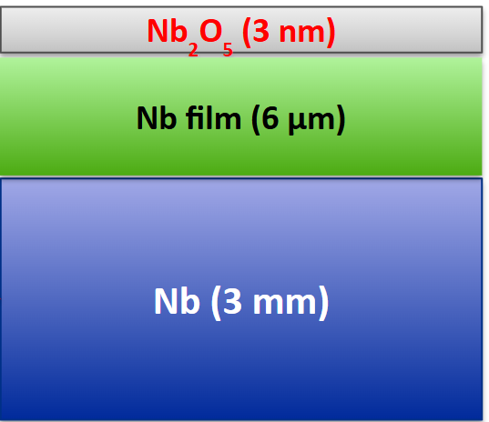
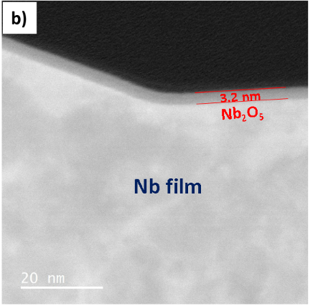
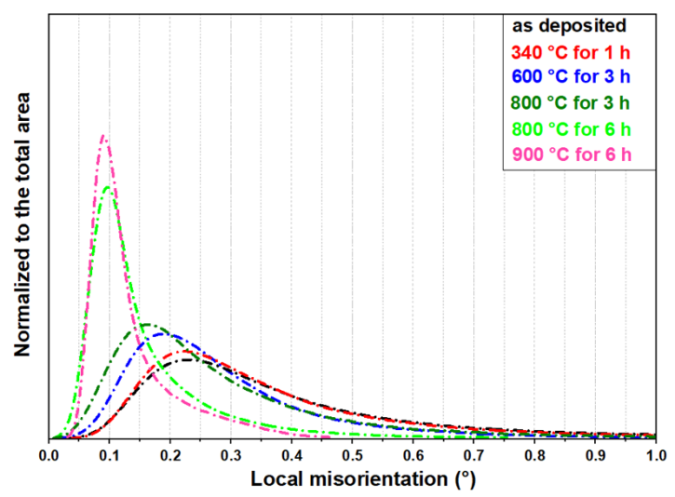
Beyond Bulk: Improving Nb Film Performance – A Fix for MFQS
Nb film on copper cavities exhibit “medium-field Q-slope” → why?
DC HiPIMS Deposition System @ CERN
Materials Studies on Nb Film on Nb Samples Post Baking
Performance of Nb Film on Nb Cavity Post Subsequent Annealing
ToF-SIMS studies reveal reduction in H upon annealing
→ Less NbH
B. Abdisatarov et al SUST 38, 075006 (2025)
EBSD reveals reduction in LMAD upon annealing
→ Heals defects
Subsequent annealing reduces MFQS!

Slide 12
Conclusions
Coupled RF and materials science studies advance microscopic understanding of SRF materials, revealing how impurities and defects govern performance.
Impurity (N or O) tailoring tunes SRF properties
N is ~10× more effective than O at lowering R_{BCS}​.
Optimized EP is critical to realize impurity-tailoring benefits
Minimizes H uptake, smooths surface and removes lossy inclusions.
H and lattice defects identified as key loss sources in Nb films
Annealing mitigates these losses and improves film performance.

Slide 13
Thank you!

Slide 14
Backup Slides

Slide 15
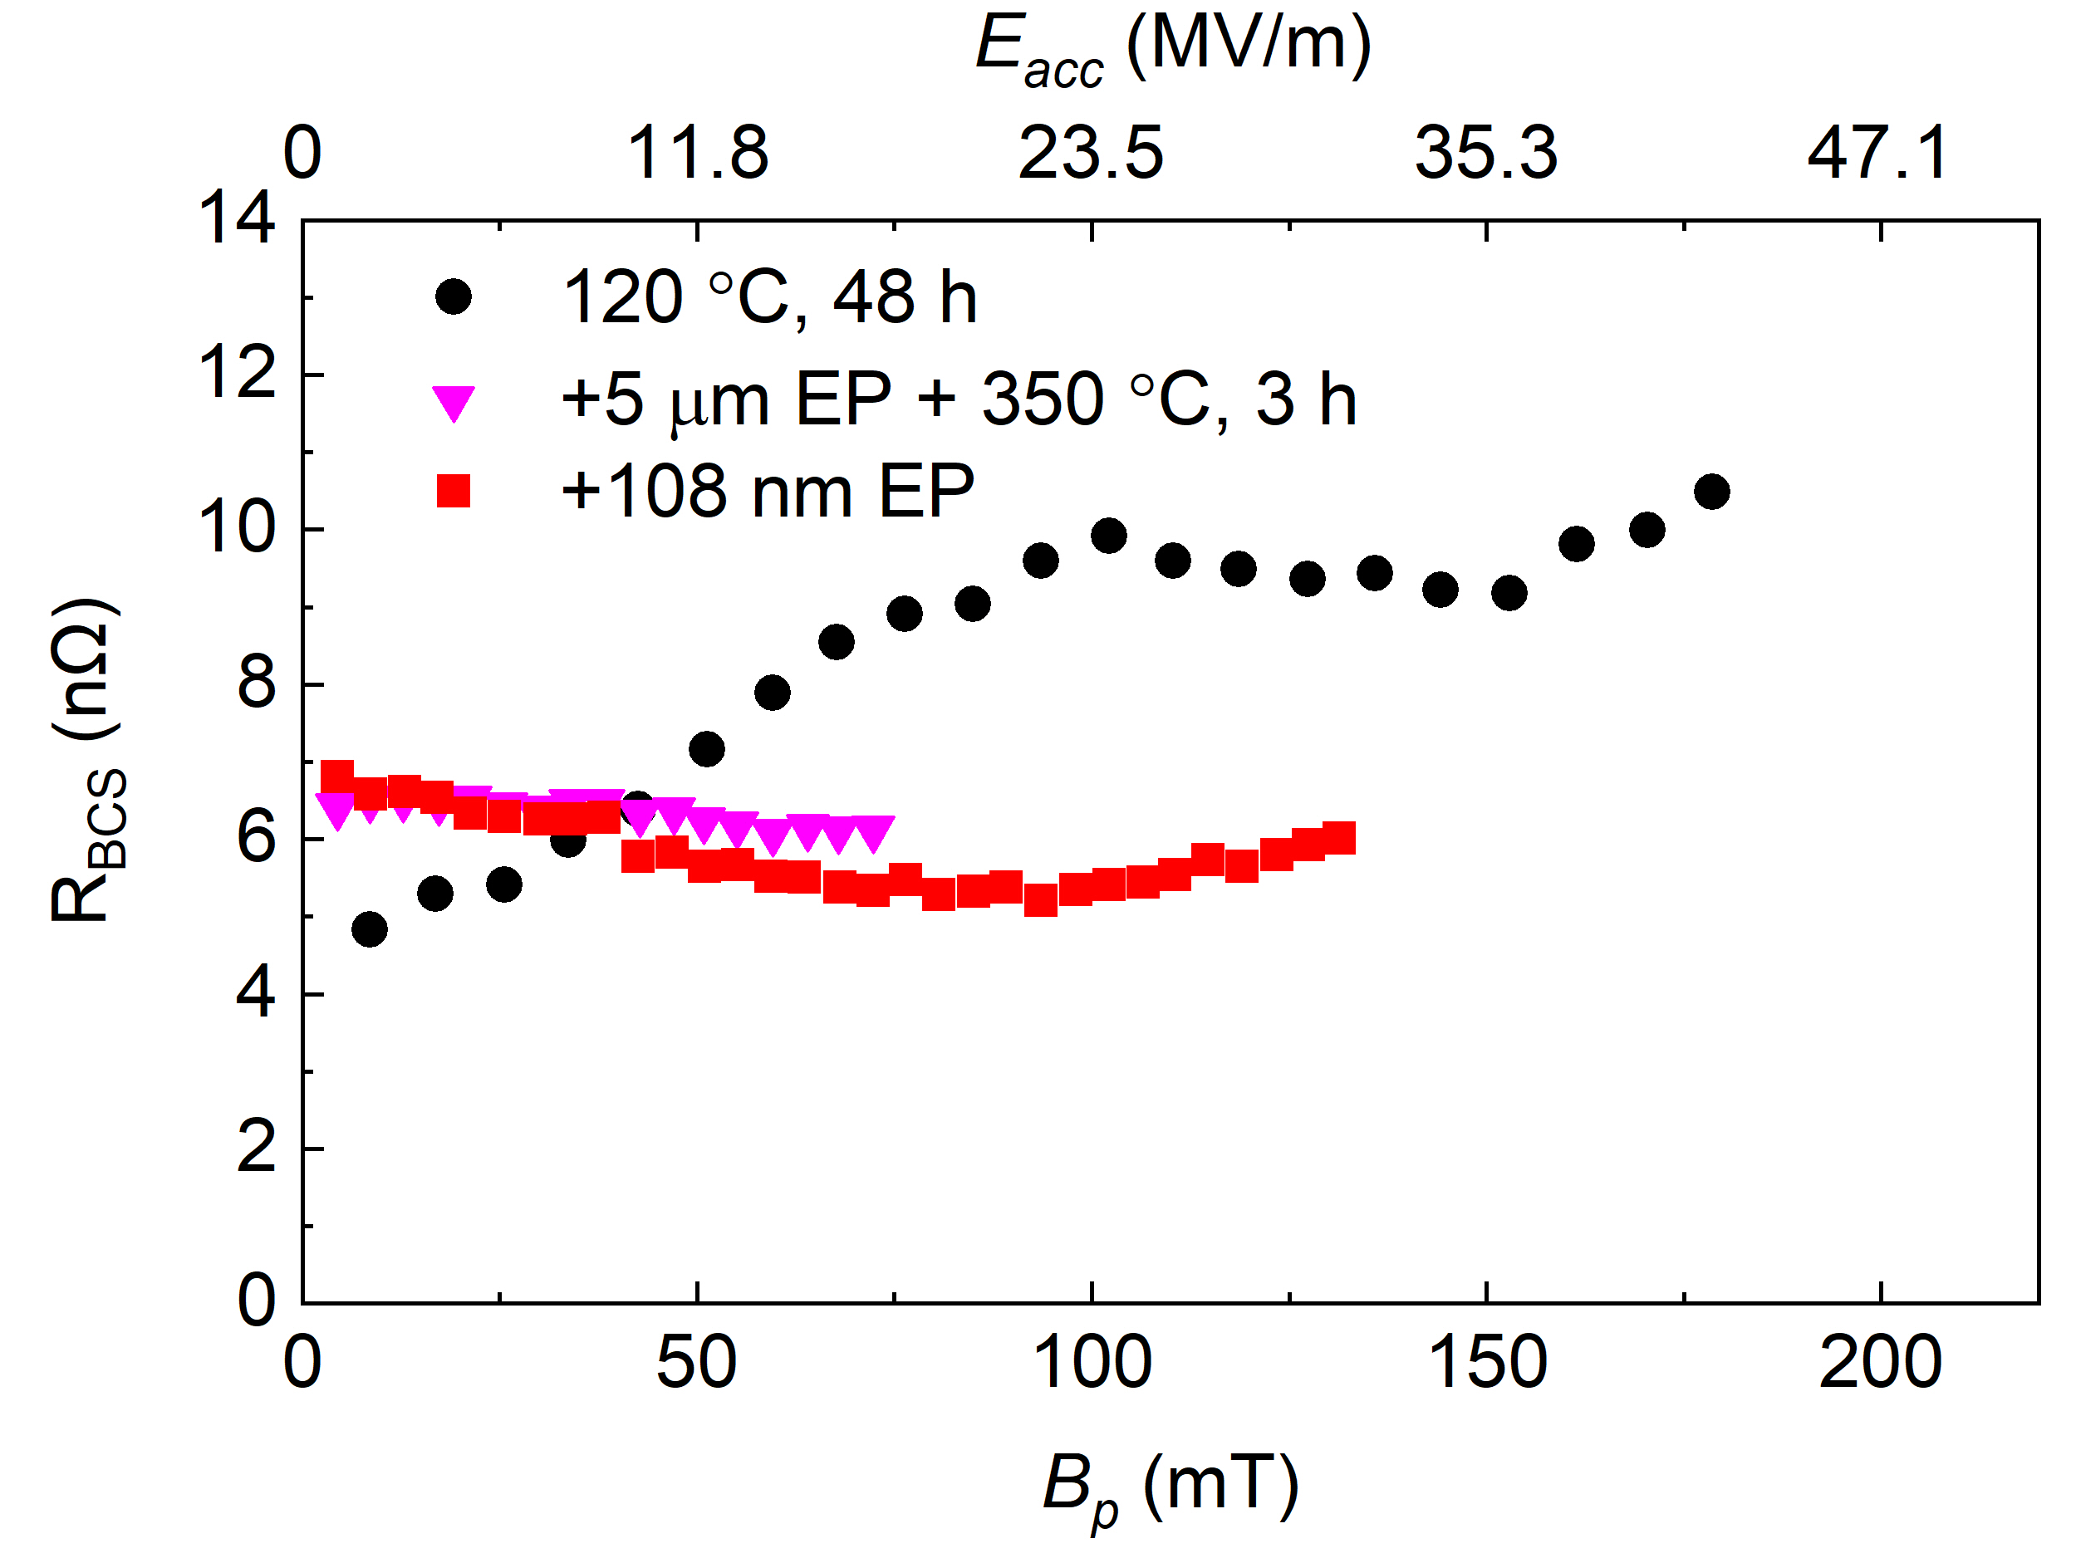
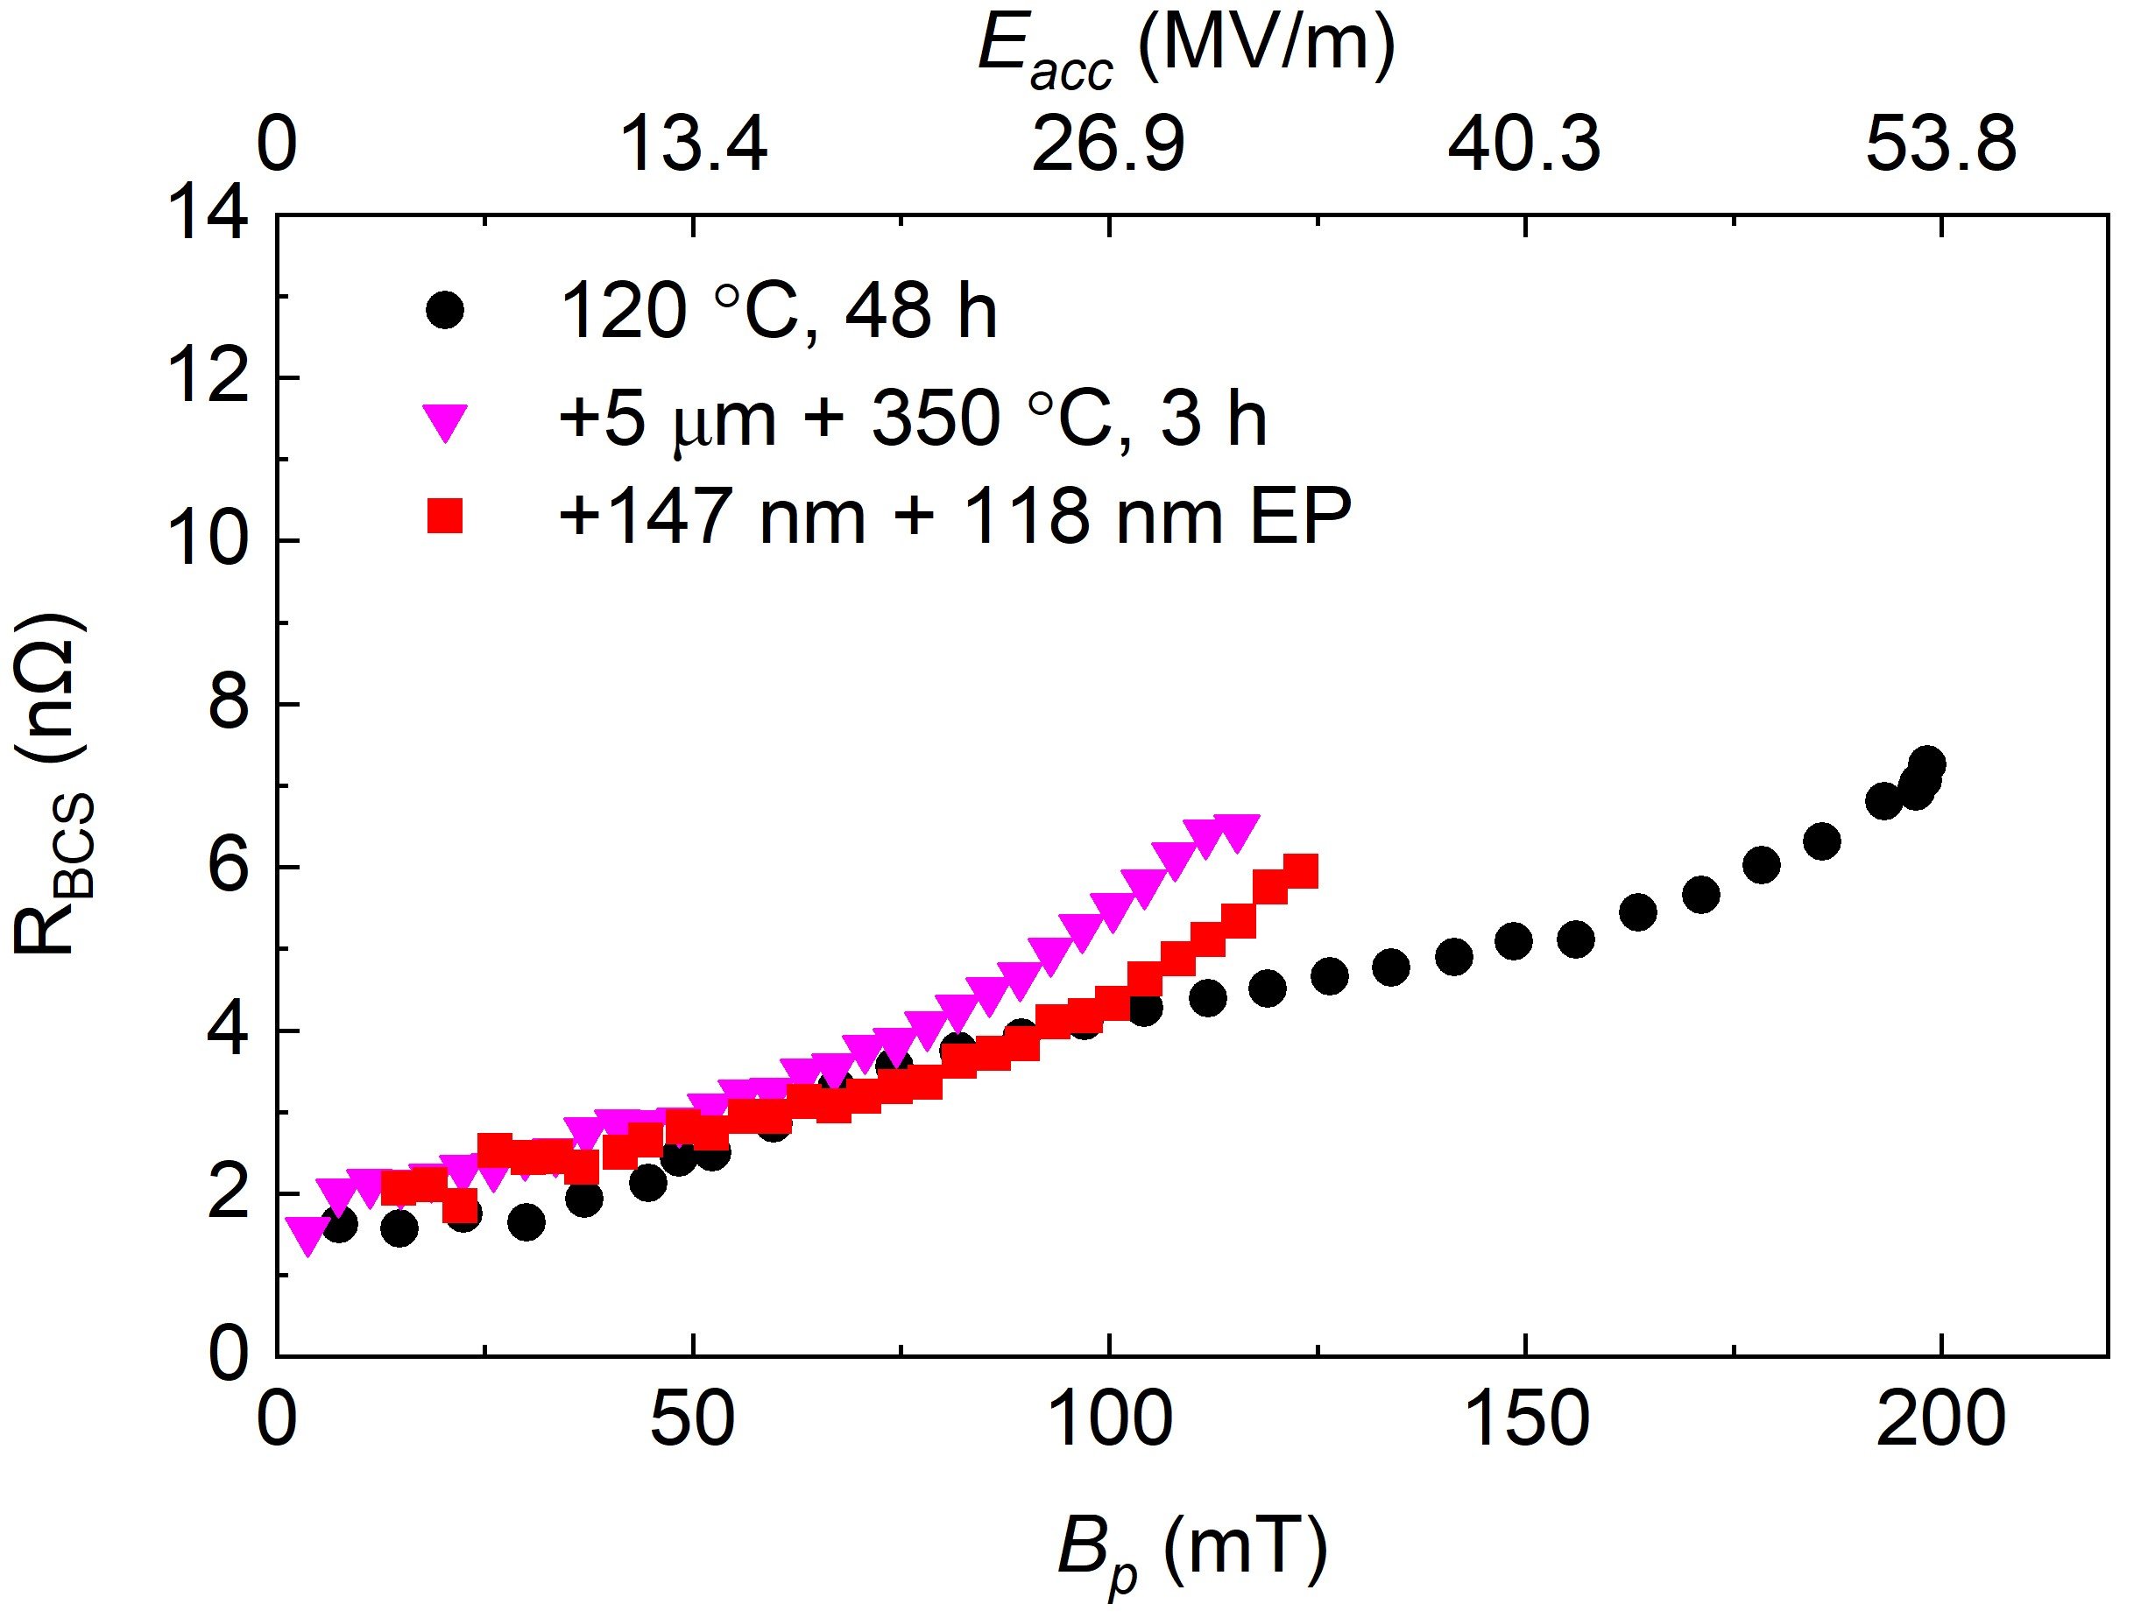
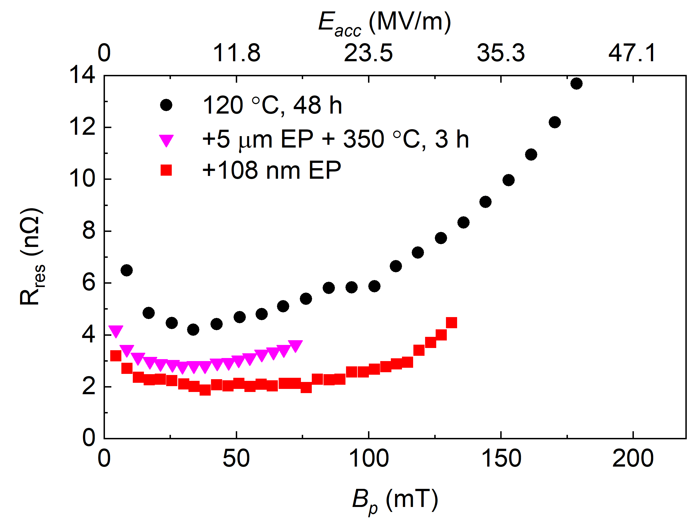
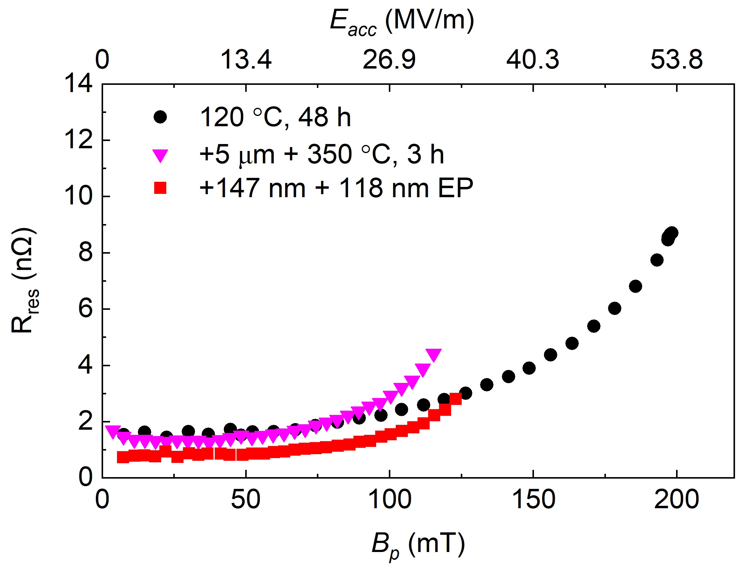
Surface Resistance
1.3 GHz Single-cell Cavity
650 MHz Single-cell Cavity
Surface contaminants, such as niobium carbides, are likely contributors to the relatively higher residual resistance (R_{res}) after mid-T baking.
Ultralight material removal reduced R_{res} and BCS resistance (R_{BCS}) of both mid-T baked cavities.
V. Chouhan et al., WEP065, NAPAC2025
V. Chouhan et al., THP83, SRF2025

