Slide 1


CERN-KEK collaboration on hydroformed Nb-on-Cu cavities
Akira Yamamoto, Carlota Pereira Carlos, Caroline Hain, Franck Peauger, Gilles Favre, Guillaume Jonathan Rosaz, Hayato Araki, Joanna Sylwia Swieszek, Kristóf Brunner, Laura Helene Hannemann, Marco Garlaschè, Masashi Yamanaka, Said Atieh, Valentin Giglia, Walter Venturini Delsolaro

Slide 2
Outline
Motivation for developing better Nb-on-Cu cavities
Seamless substrate development
Hydroforming process and Nb coating
RF measurement results
Possible improvement directions
Summary

Slide 3
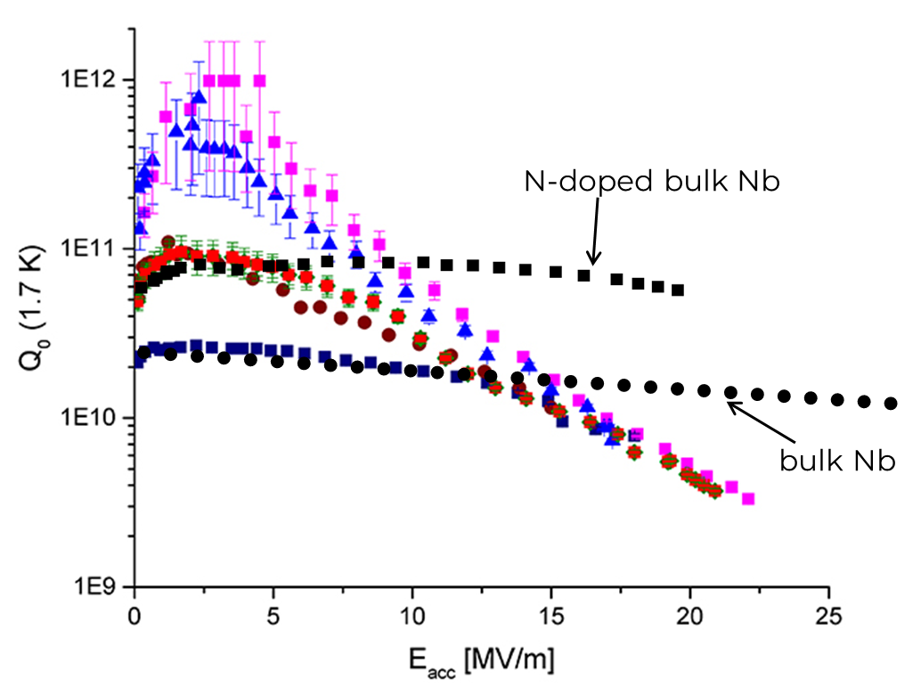
Nb-on-Cu cavities
Advantages:
By adjusting the coating process very high Q₀ is achievable
Allows operation up to 4.5 K, significantly increasing the cryogenic efficiency
Less sensitive to trapped magnetic flux
Cost of the cavity is significantly reduced
Disadvantages:
The Q slope limits the usefulness at higher than medium gradient
It is outperformed by N-doped / mid-T baked bulk Nb

Slide 4
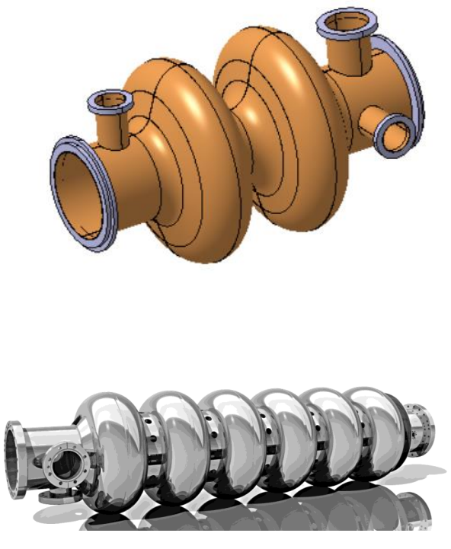
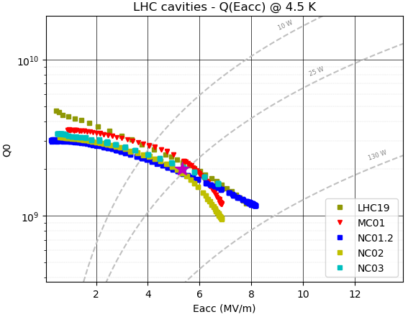
Motivation for developing better Nb-on-Cu cavities
FCC baseline:
2-cell, 400 MHz, Nb-on-Cu
264 cavities, operated at 4.5 K
6-cell, 800 MHz, bulk Nb
408 cavities, operated at 2 K
Performance requirement:
Q = 3.3 x 10⁹ (~3.7 x 10⁸ at 1.3 GHz)
E_{acc} = 13 MV/m
FCC feasibility report
Improvements required
Substrate improvement
Nb film improvement
Production industrialization
FCC requirement
LHC
Studied on 1.3 GHz cavities

Slide 5
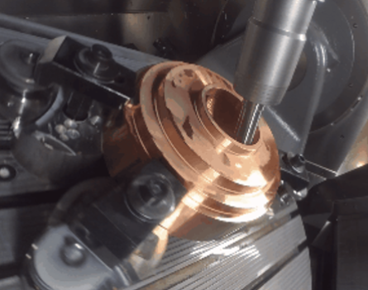
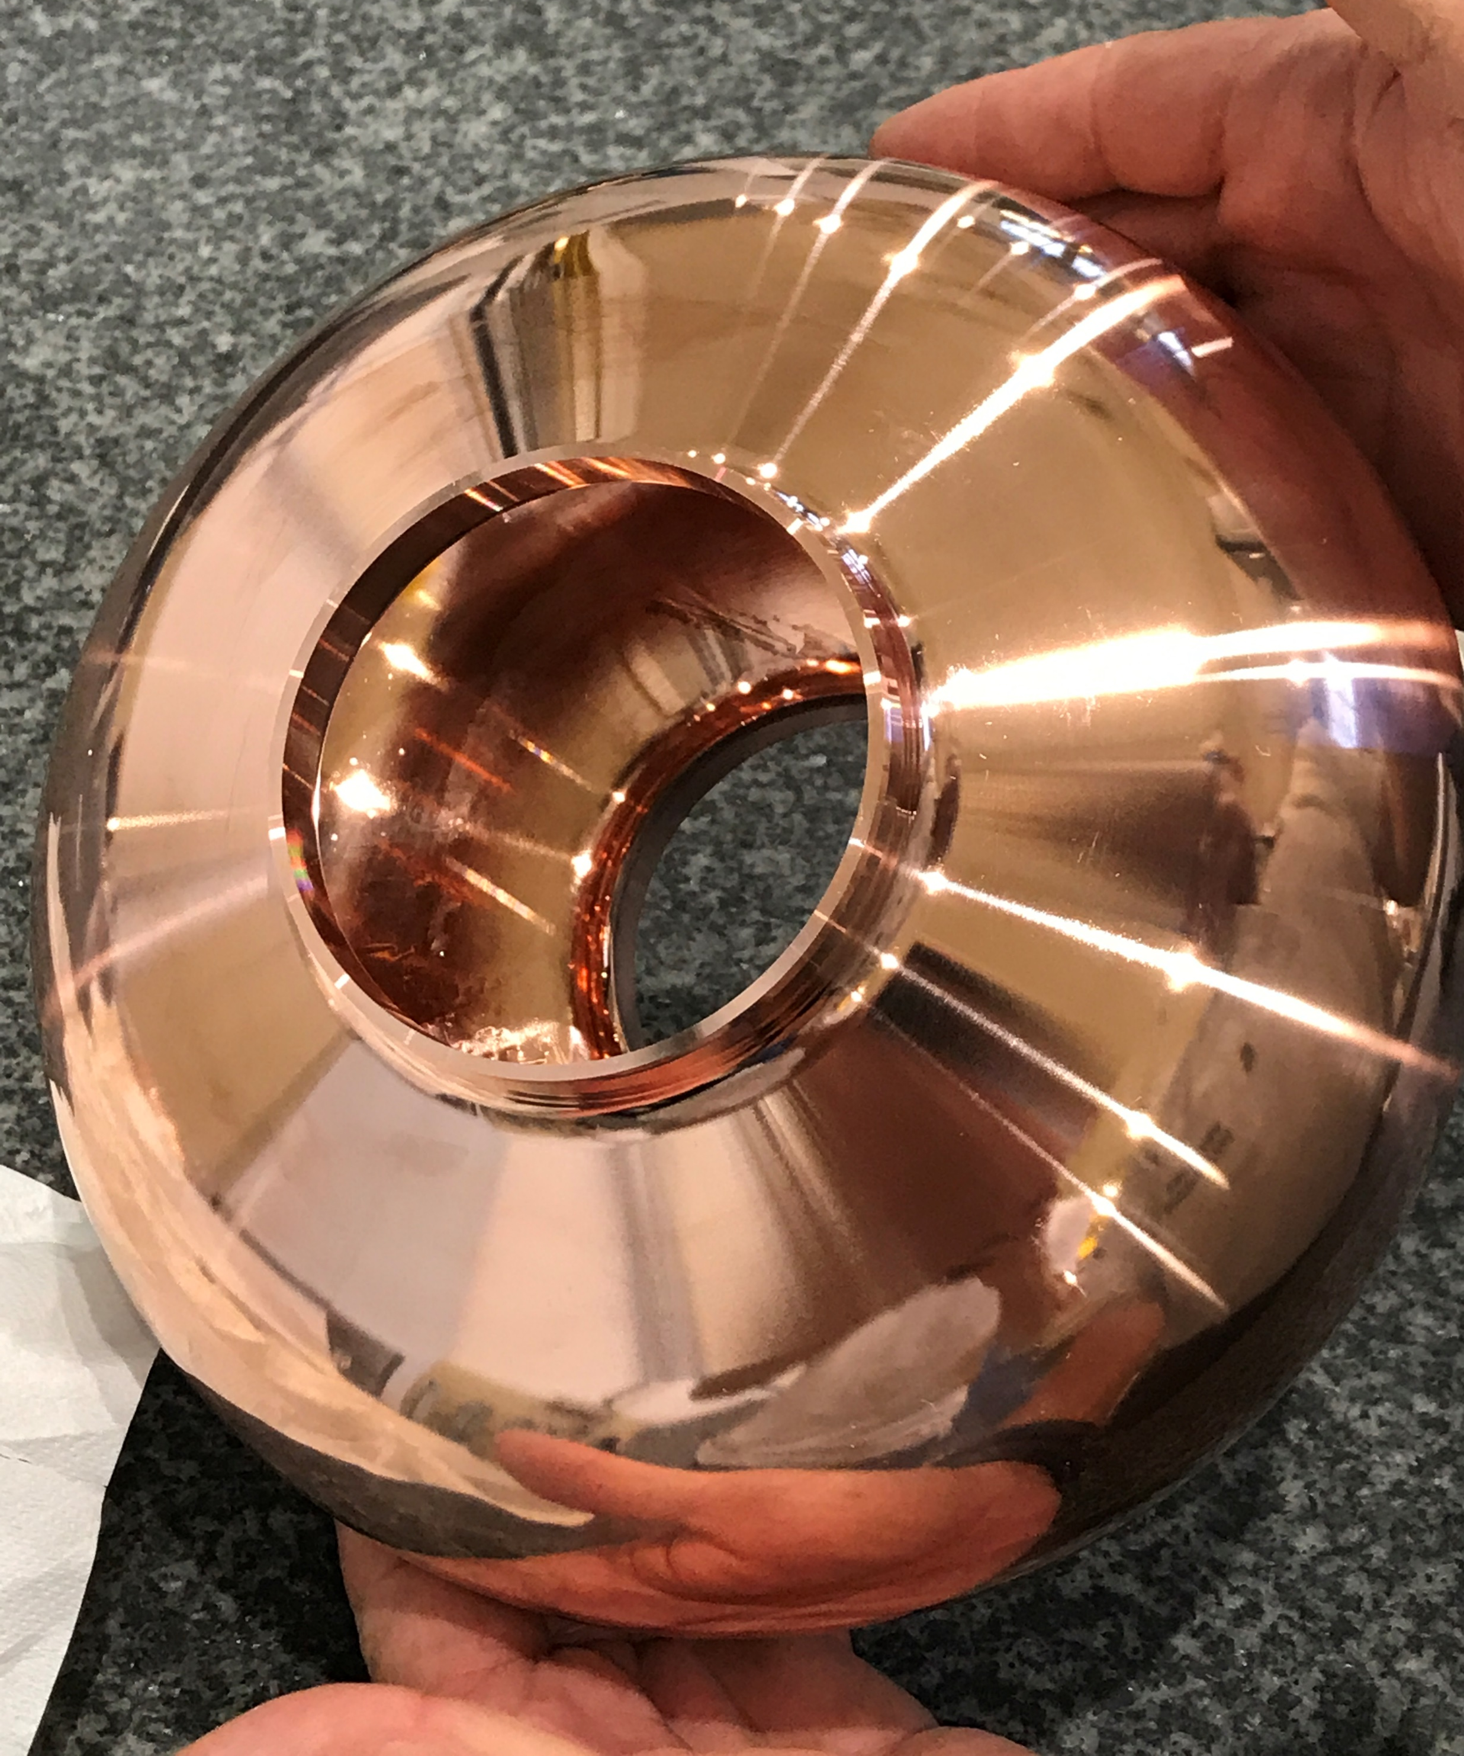
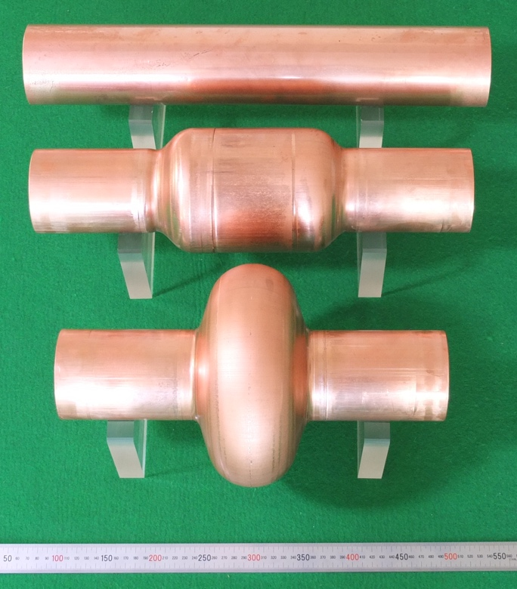
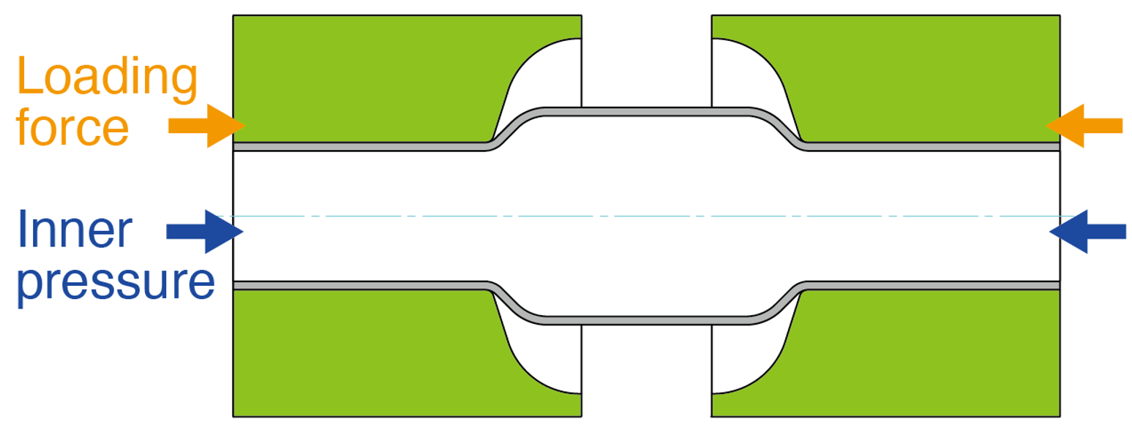
Seamless substrate development
The weld at the equator can create porosity reducing the reliability of the Nb film
4 possibilities studied:
Bulk machined
Electroforming
Internally welded
Hydroformed
Produced and tested at CERN
Bulk machined cavity
In collaboration with KEK
Hydroformed cavity

Slide 6
Seamless substrate development
Bulk machined substrate
Higher material cost
Perfect cavity geometry and inner surface quality
Homogeneous wall thickness
Hydroformed substrate
Industrial process, easily scalable
Upfront investment into the dies
Per cavity cost drops sharply at high cavity count
Seamless cut-off tube is possible
Uneven thickness profile
Inner surface is much rougher
Bulk machined substrate
Hydroformed substrate

Slide 7
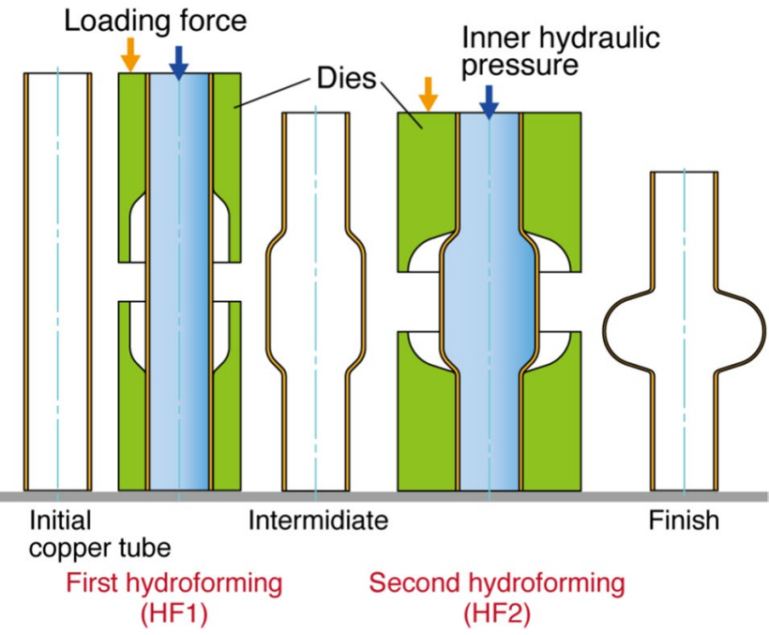
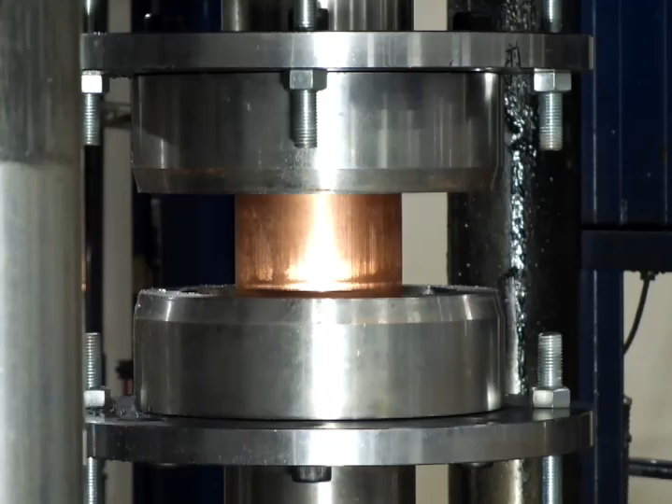
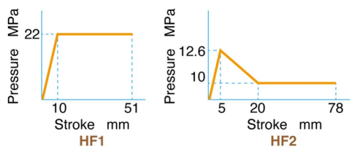
Hydroforming process
Article on the process
Forming was performed at NEURON, Japan
Two-step forming process
Annealing at 500 °C for 2h between the steps
A single forming step is ~1 minute

Slide 8
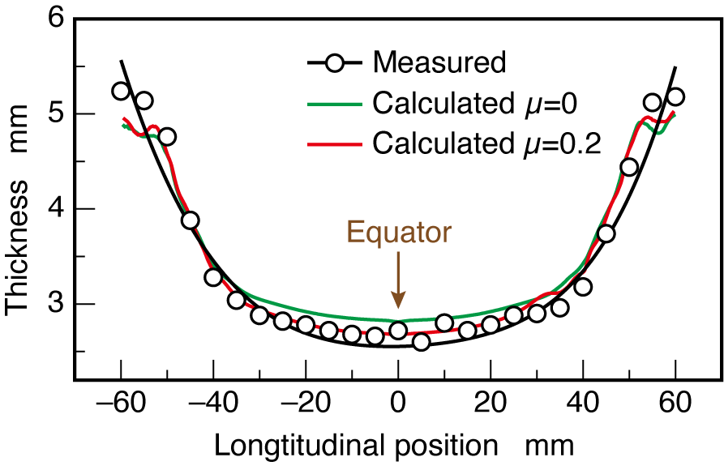
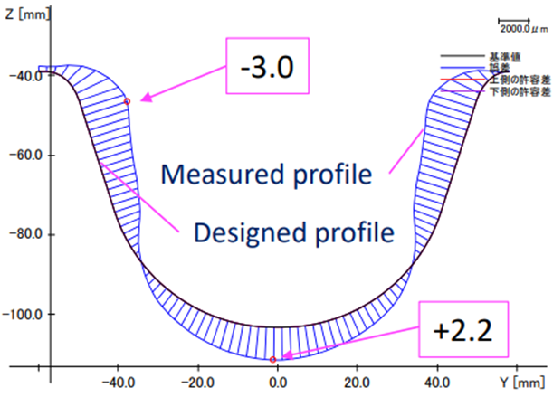
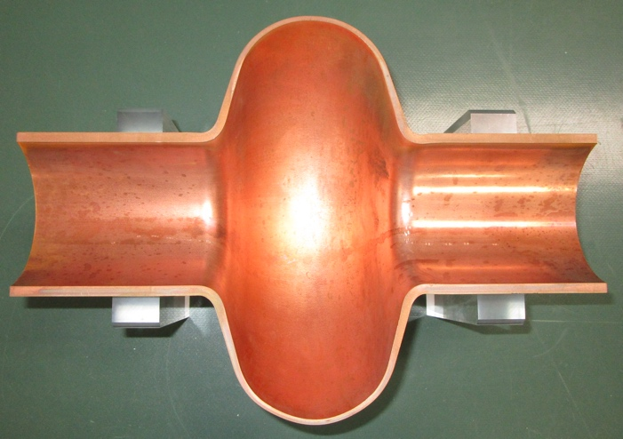
Hydroforming results
Article on the process
Original tube thickness = 5 mm
Final equator thickness = 2.6 mm
The final profile is significantly different from the design geometry, but it can be corrected for the next batch

Slide 9
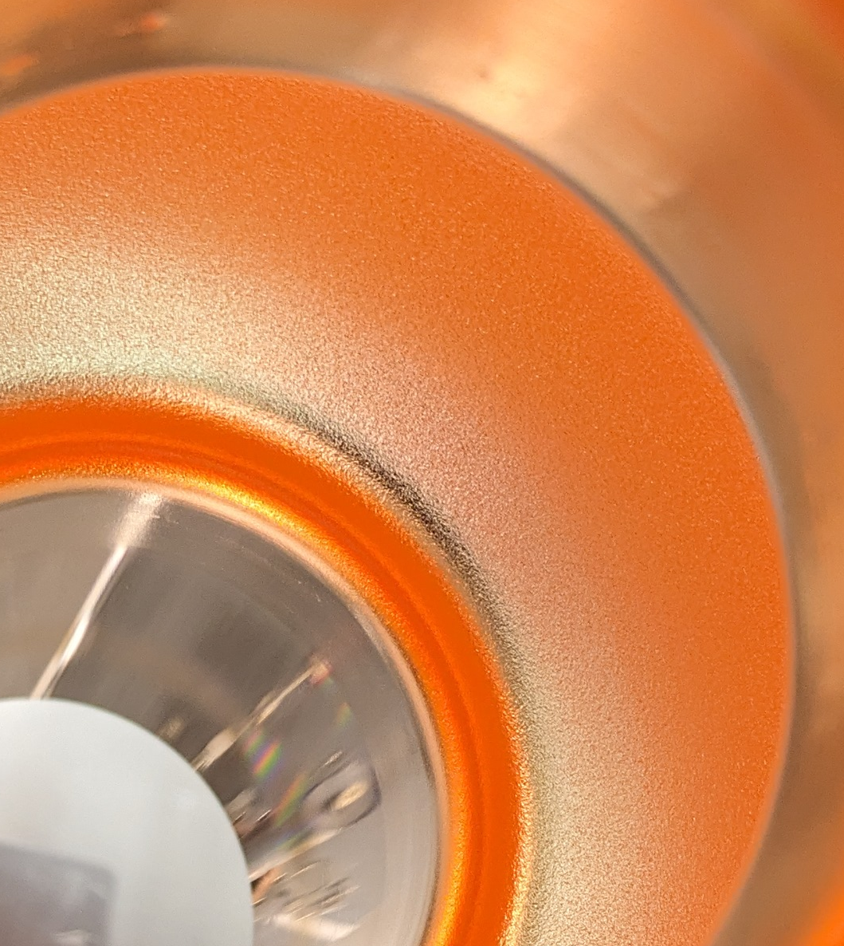
Hydroforming results
Article on the process
The inner surface roughness increased significantly in the cell
Ra_{tube} = 1.0 µm
Ra_{cut-off} = 1.0 µm
Ra_{cell} = 2.9 µm
Roughness is not removed by electropolishing
“Orange peel” surface after electrolytic polishing

Slide 10
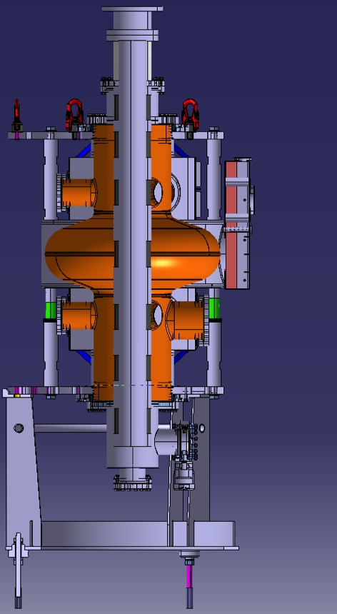
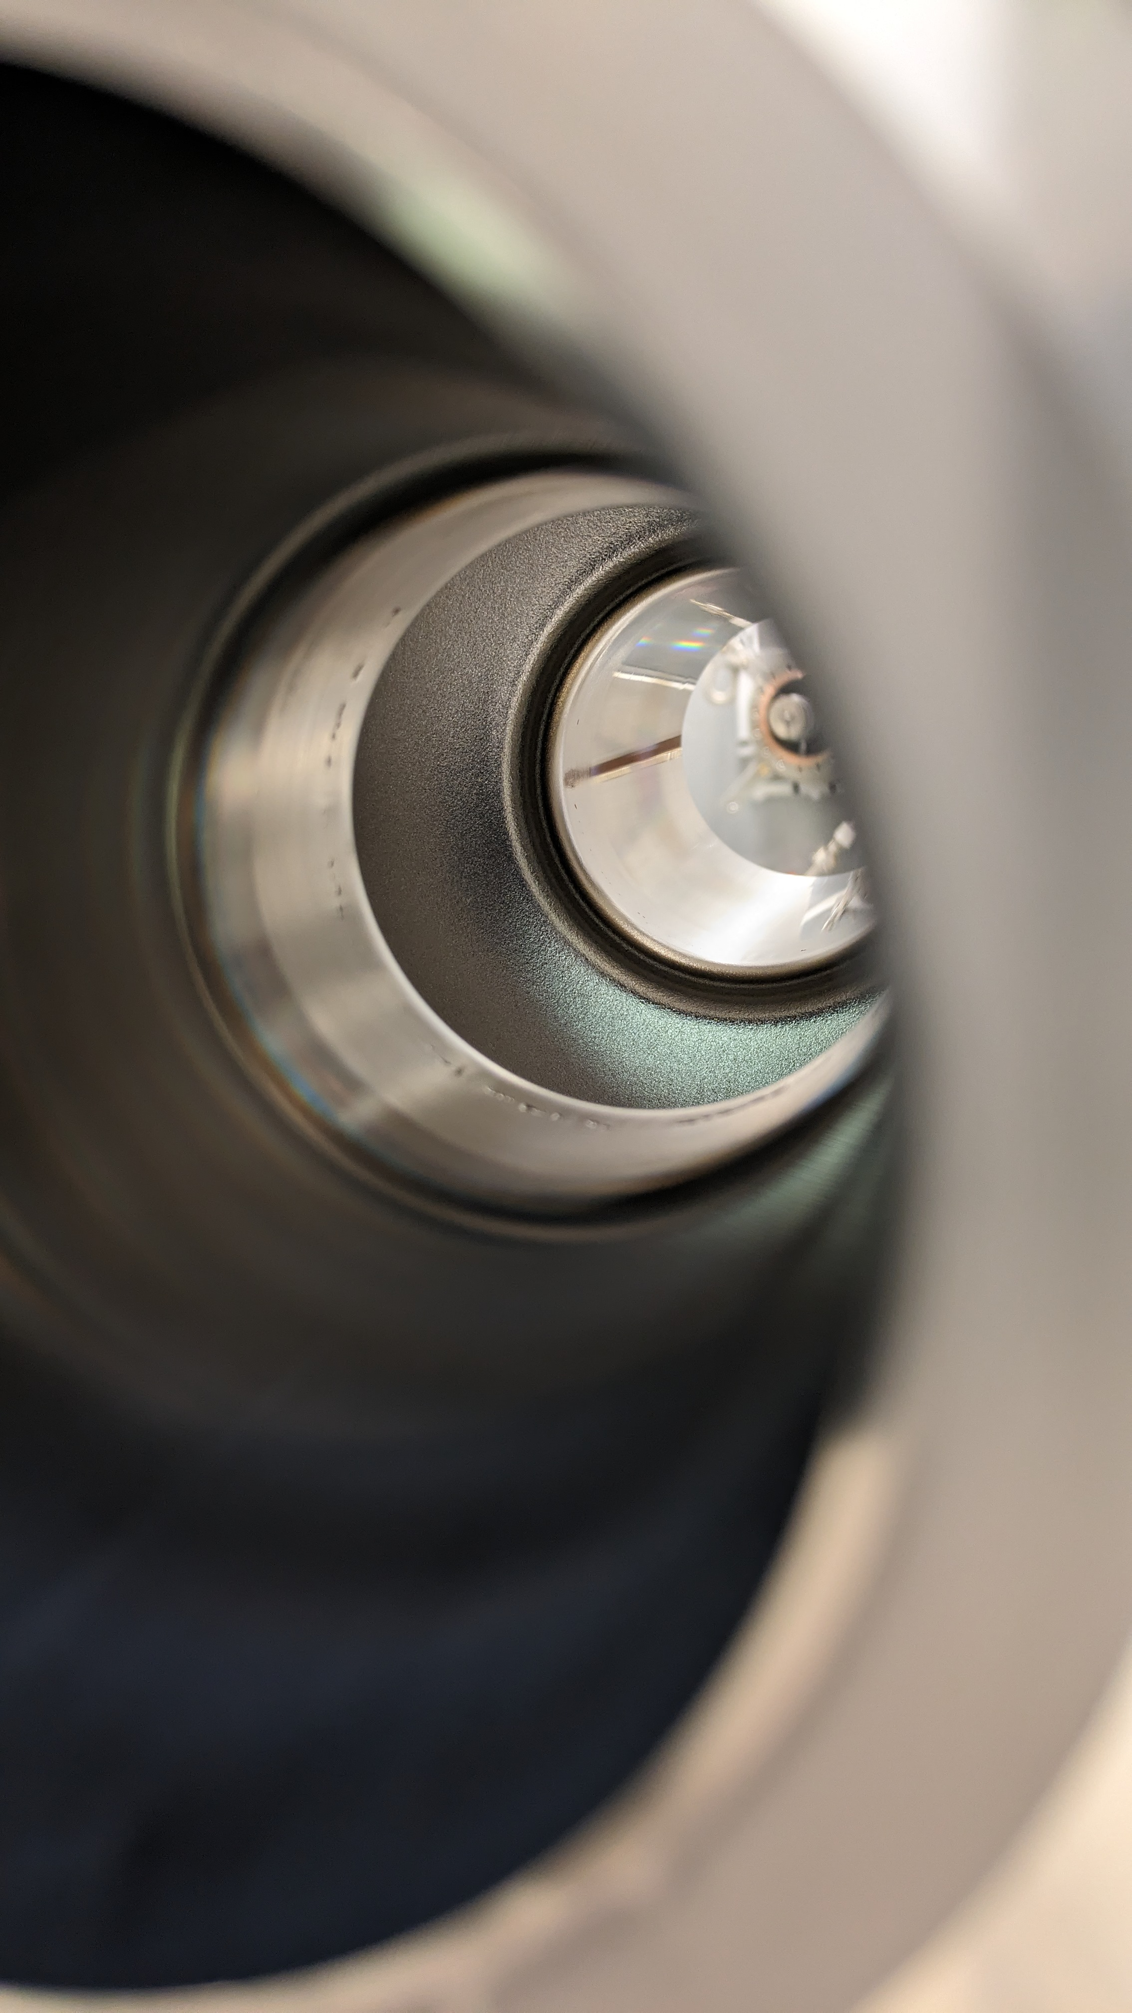
Nb coating process
Preparation and coating at CERN
Identical process to bulk machined cavities
Surface prepared using electrolytic polishing (removing ~12 µm)
Then rinsed and dried before coating
Coated using High Power Impulse Magnetron Sputtering (HiPIMS)
Targeting 6 µm Nb layer thickness
Baseline recipe:
bakeout at 200 C, 24h.
unbiased HiPIMS in cut-offs (6 positions / cut-off)
-75 V biased HiPIMS in the cell
150 C, 2.3.10⁻³ mbar Kr
Dry air venting at room temperature
Cathode
Magnet

Slide 11
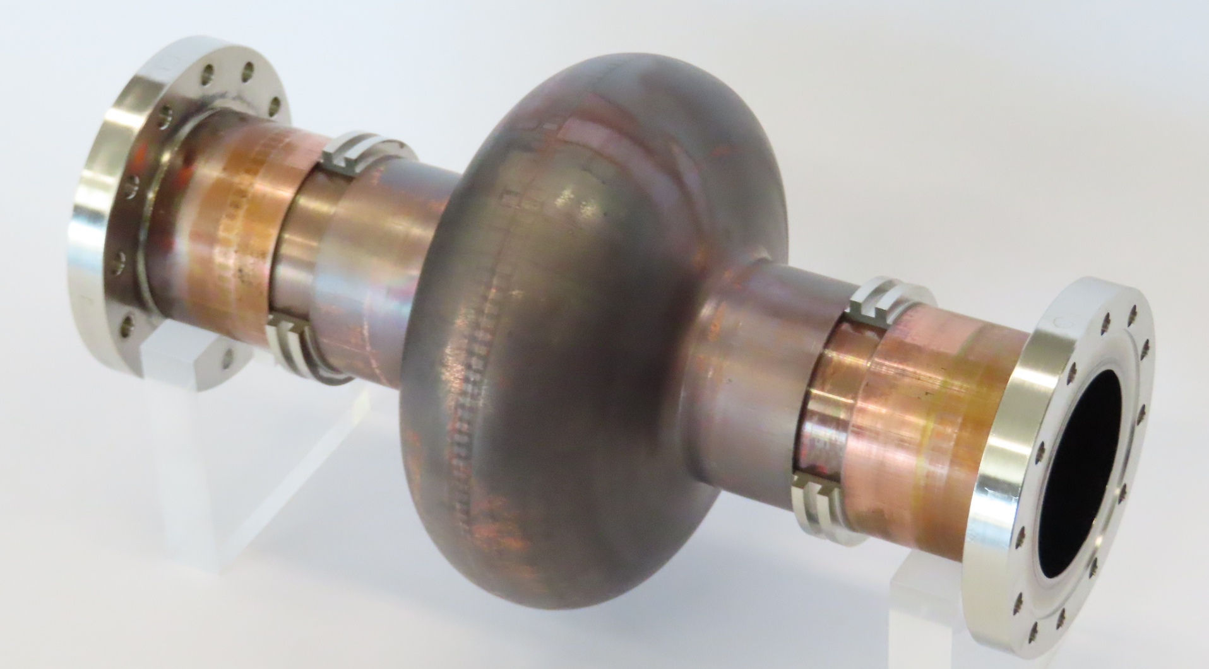
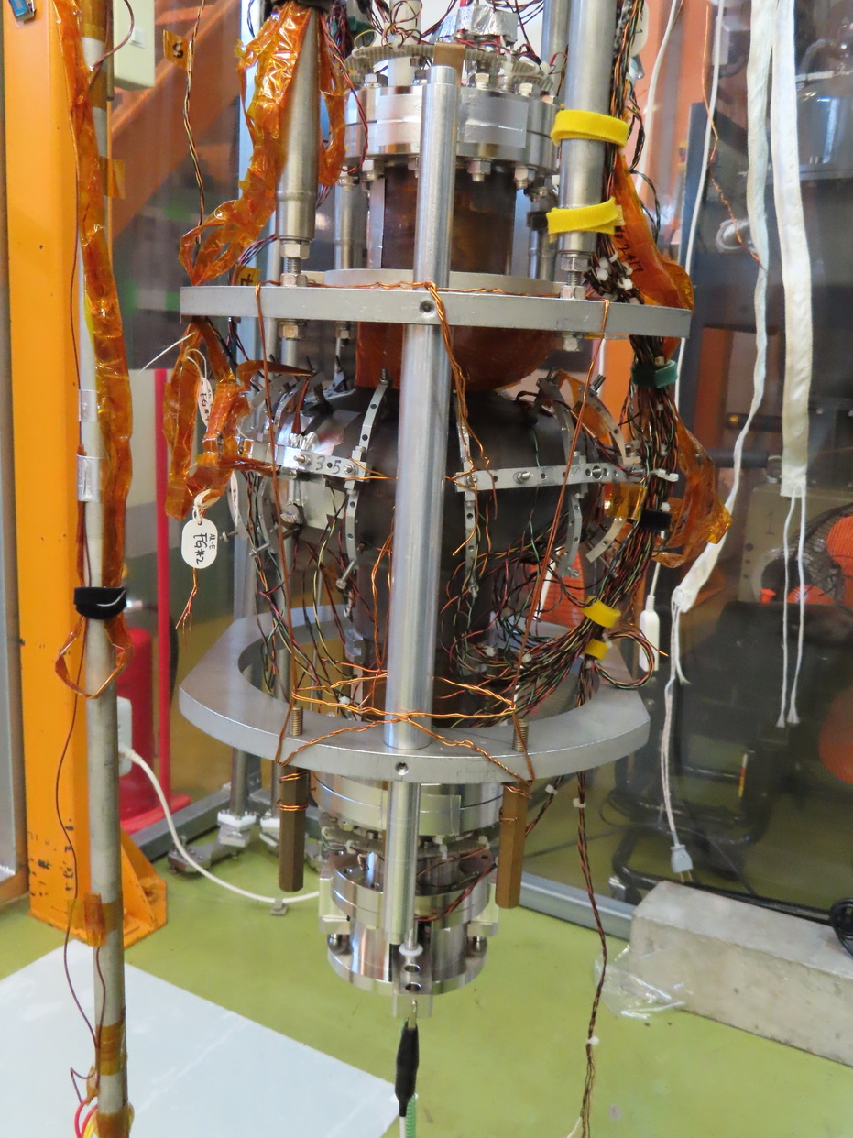
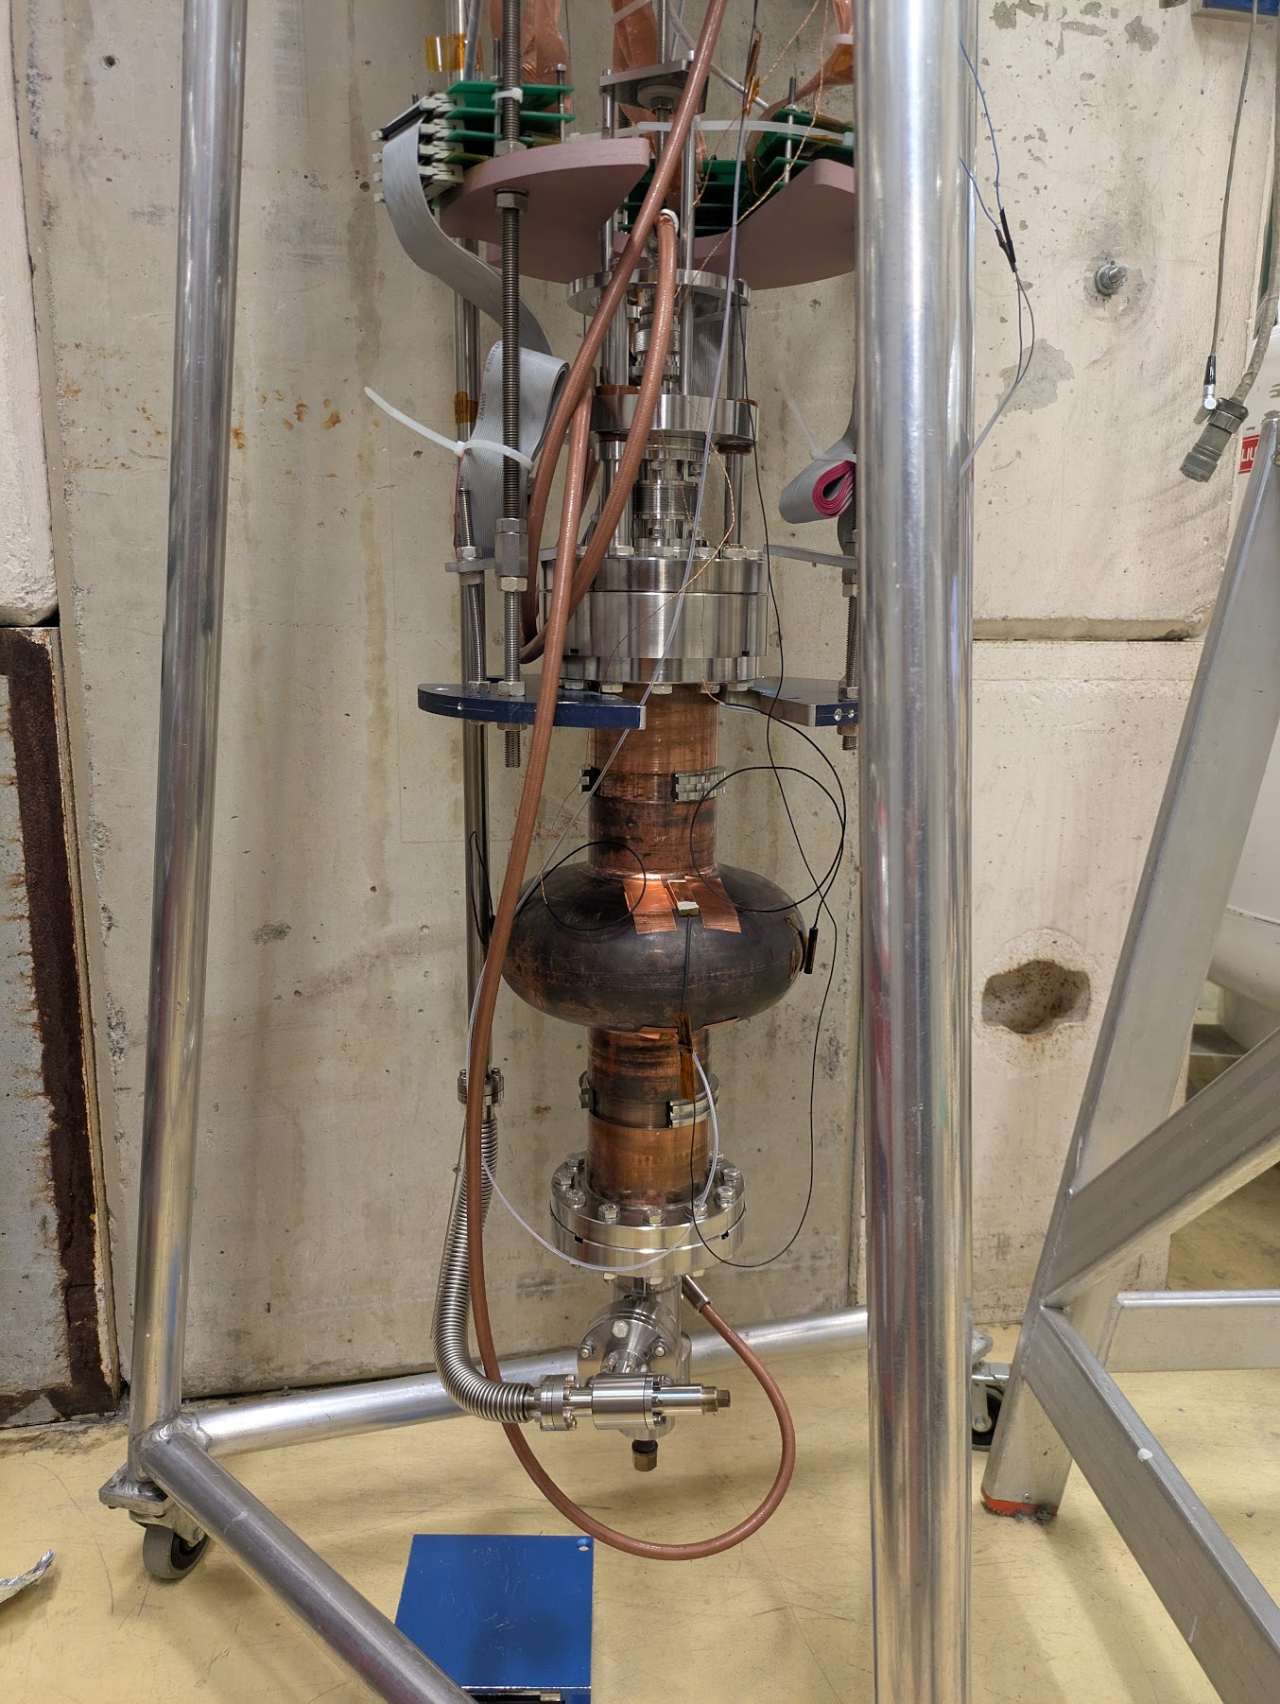
RF measurements
Two identical cavities (C1 and C1b) were measured at both KEK and CERN
Allowing cross validation of our results, and sharing measurement experience
 | KEK | CERN
Measured at | 2024-03 | 2024-11, 2025-02
Mobile coupler | ✔️ | ✔️
Coupler location | Bottom | Top
T-mapping | ✔️ | ✖️
High precision T-sensor | 8 | 2
The cavity is surrounded by | Solenoid coil | Copper shield
KEK setup
CERN setup

Slide 12
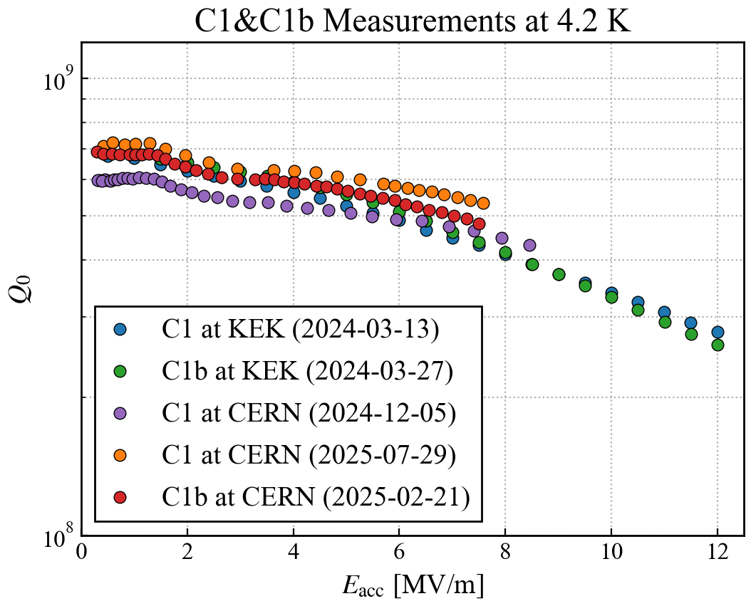
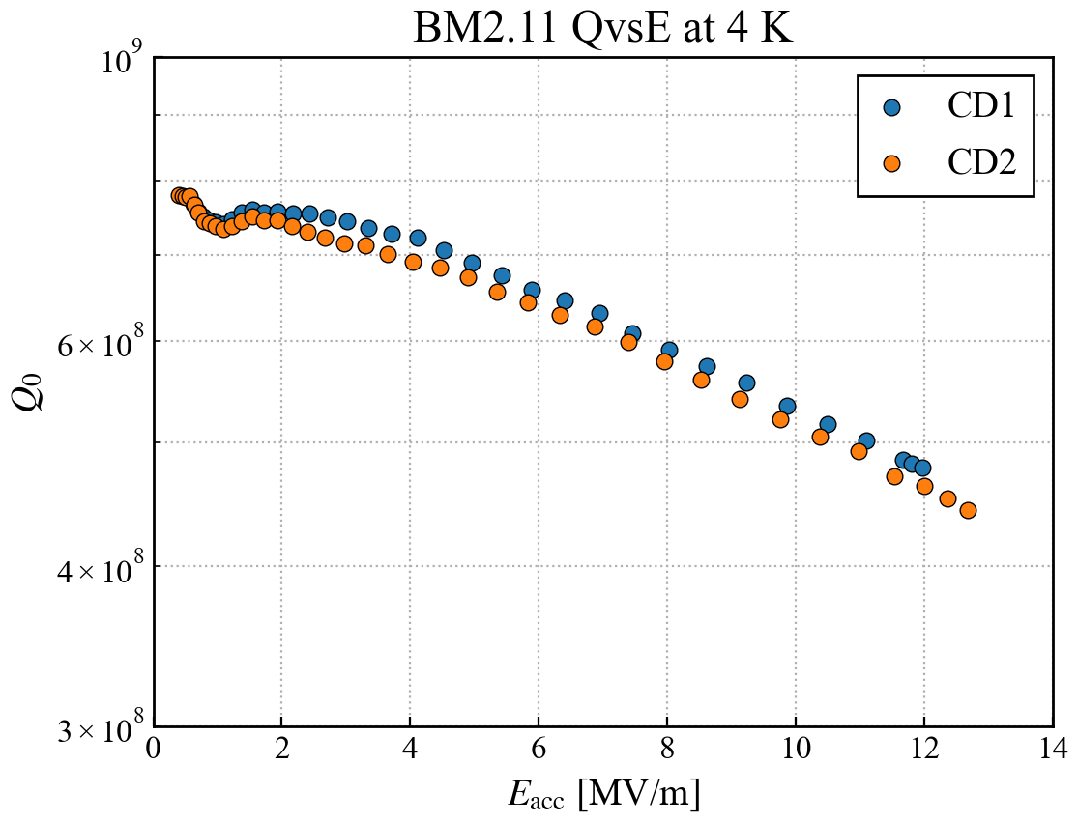
RF measurements 4.2 K
The performance was slightly below FCC requirement at 4.2 K
Around 35% worse than bulk machined cavities
(One of the best) Bulk machined
BM2.11
4.2 K

Slide 13
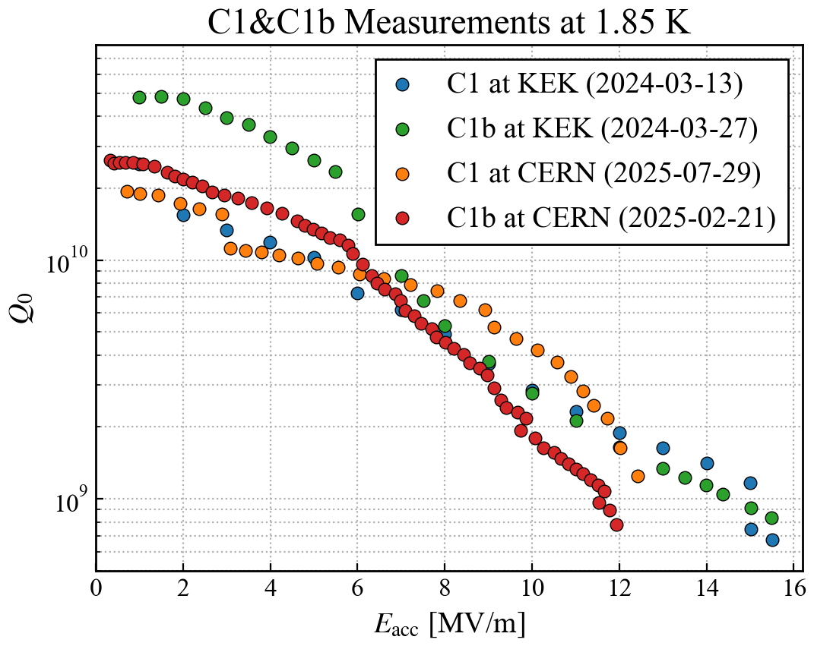
RF measurements 1.85 K
Multiple Q-switches were observed
Above 6 MV/m steep Q-slope on all cavities
Observed already on 6 different hydroformed cavities
Originally thought to be caused by the inner surface quality
But our latest result makes us rethink this evaluation
Q-switch

Slide 14
Comparison with bulk machined Nb-Cu results
Hydroformed
(One of the best) Bulk machined
BM2.11
Radiation detected
4.2 K

Slide 15
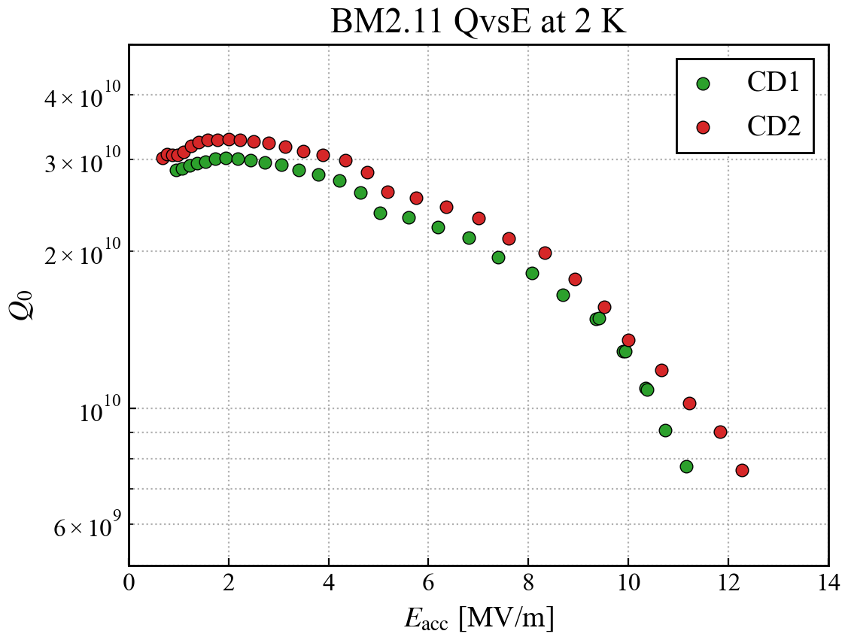
Comparison with bulk machined Nb-Cu results
Hydroformed
(One of the best) Bulk machined
BM2.11
1.85 K
Radiation detected

Slide 16
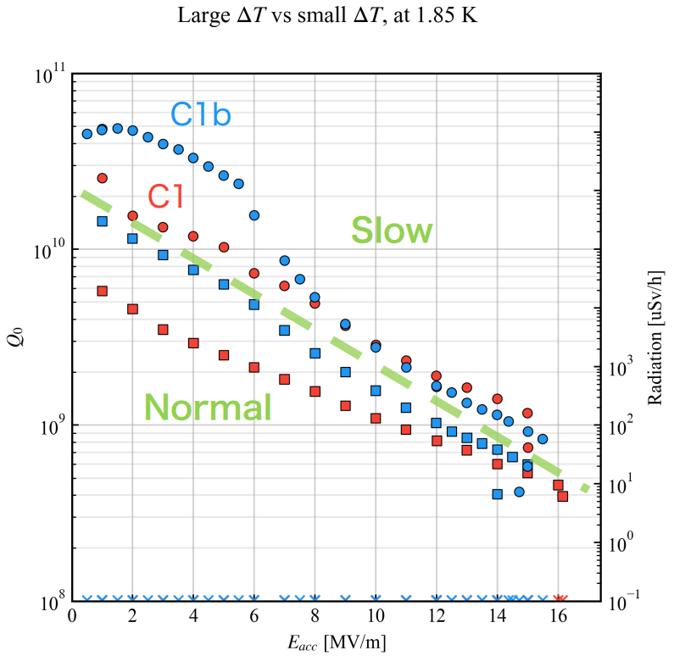
Thermal gradient during cooldown
Sensitivity to thermal gradient during cooldown
Studied at both institute, with identical findings
The residual resistance (and quality factor) at 1.85 K is very sensitive to ∆T
Low ∆T can be achieved with slow cooldown and heater control (at least in bare cavity tests…)
Also relevant for Nb₃Sn-on-Nb
see Felix Kramer’s talk on SRF 2025 (link)

Slide 17
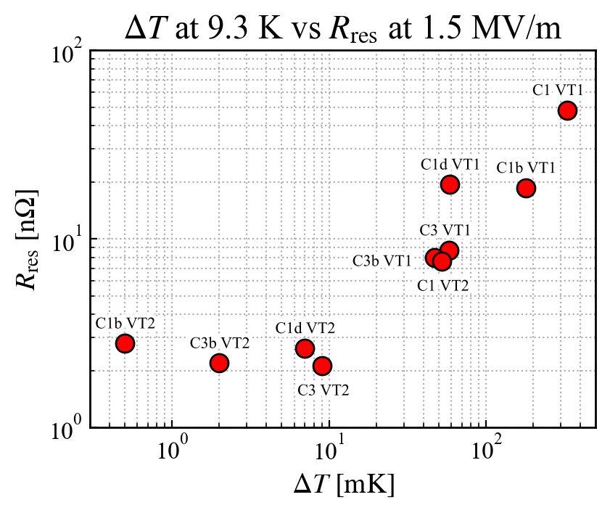
Thermal gradient during cooldown
Sensitivity to thermal gradient during cooldown
Studied at both institute, with identical findings
The residual resistance (and quality factor) at 1.85 K is very sensitive to ∆T
Low ∆T can be achieved with slow cooldown and heater control (at least in bare cavity tests…)
Also relevant for Nb₃Sn-on-Nb
see Felix Kramer’s talk on SRF 2025 (link)

Slide 18
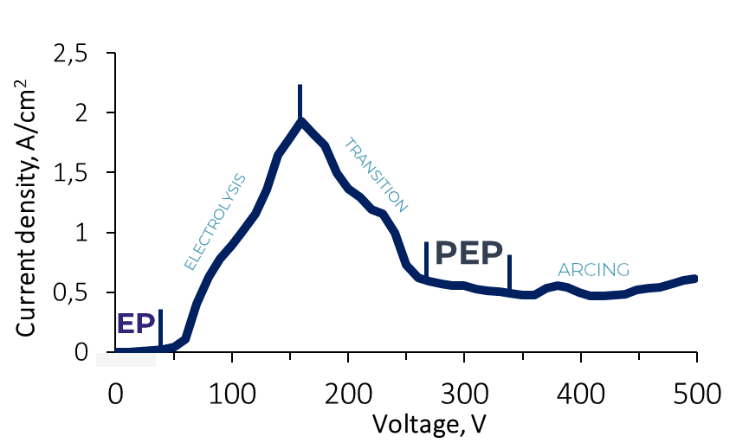
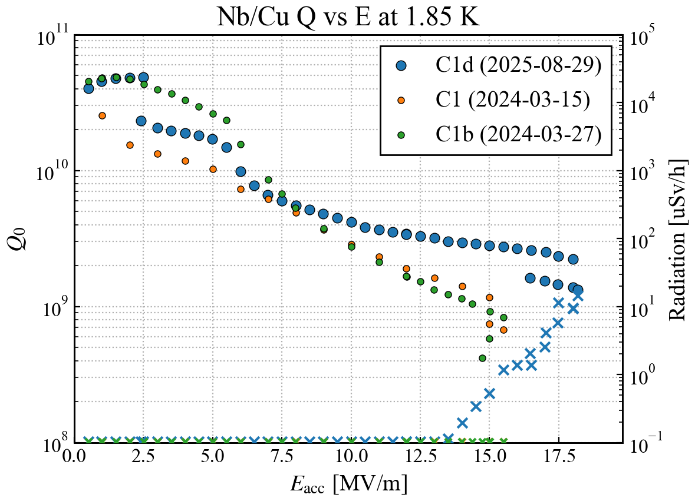
Surface quality improvement
Improving the surface quality of the substrate is of highest importance
Internal machining after hydroforming
Plasma electrolytic polishing (INFN, website)
First cavity was prepared and tested
It showed slightly better Q-slope compared to the other hydroformed cavities
Mechanical polishing (KEK)
Cu tube mechanically polished then electropolished BEFORE hydroforming
The hydroforming process still introduces “orange peel”
PEP cavity

Slide 19
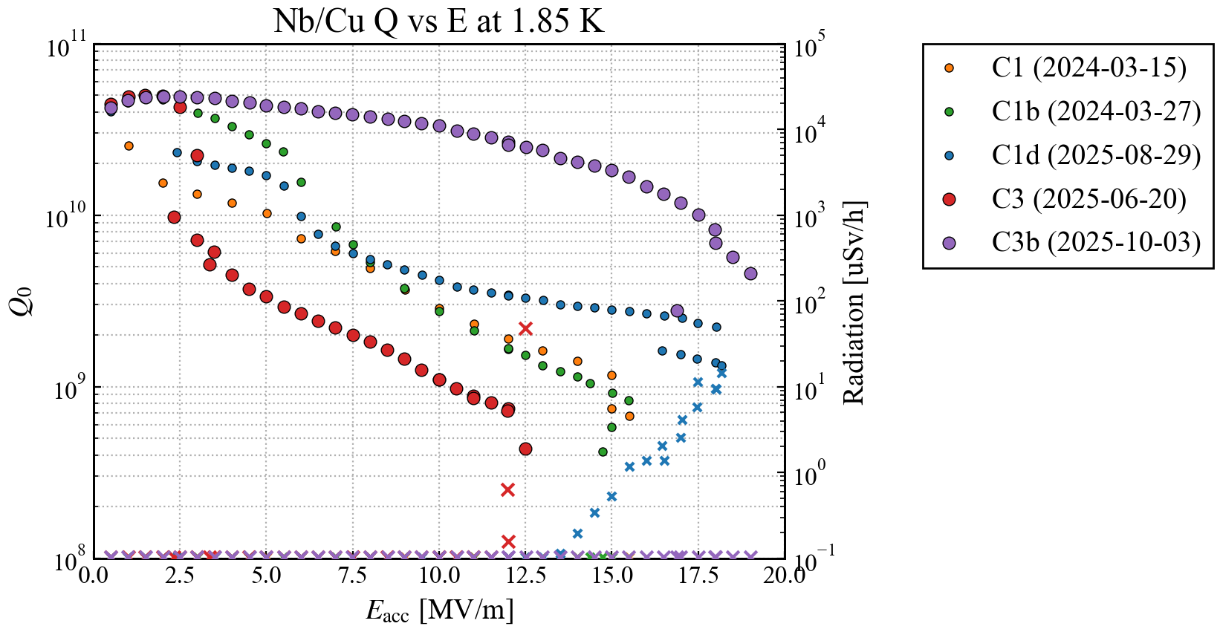
PRELIMINARY RESULTS
Two cavities (C3, C3b) hydroformed after mechanical polishing of the Cu tube
They both show low field Q₀ of 5x10¹⁰
One of them suffered several Q switches
The other showed the best Q-slope recorded on ANY of our Nb-on-Cu 1.3 GHz cavities at 1.85 K

Slide 20
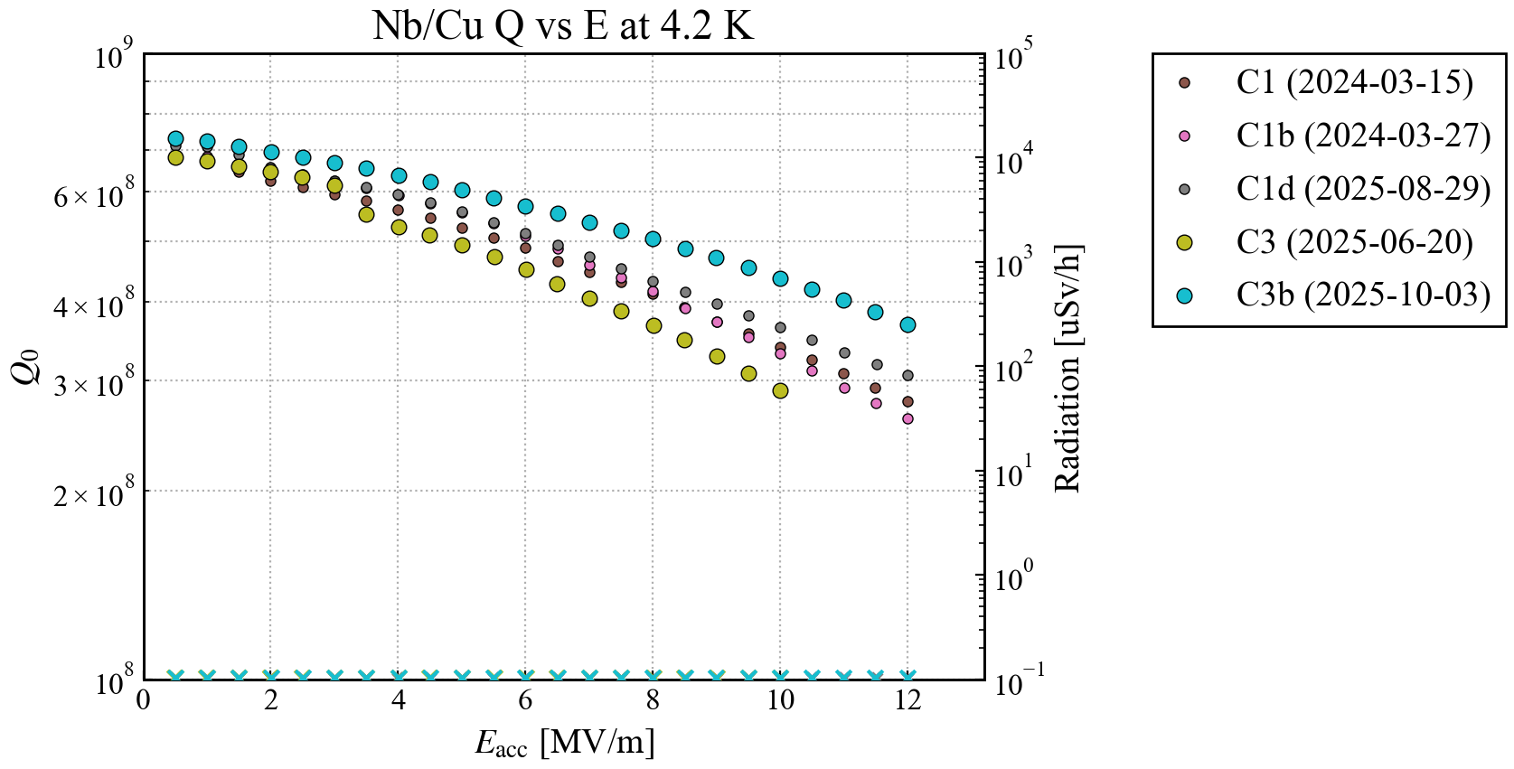
PRELIMINARY RESULTS
Two cavities (C3, C3b) hydroformed after mechanical polishing of the Cu tube
They both show low field Q₀ of 5x10¹⁰
One of them suffered several Q switches
The other showed the best Q-slope recorded on ANY of our Nb-on-Cu 1.3 GHz cavities at 1.85 K
At 4.2 K C3b is the best of the hydroformed cavities, but it is still ~20% worse than bulk machined cavities

Slide 21
Summary
We had a very successful 3-year collaboration between KEK and CERN
Resulting in the forming, coating and measurement of the first “full seamless” hydroformed 1.3 GHz Nb-on-Cu cavities
The substrate and coating showed reproducible results
Across 7 cavities
Two different measurement stands
By improving the surface quality, we are certain to increase the performance at 4.2 K
The latest result shows mostly mitigated Q-slope at 1.85 K
New record performance of Nb-on-Cu
(Now it needs to be reproduced…)
Thanks to the successful demonstration of the technology on 1.3 GHz cavities, hydroforming is regarded as a potential method for producing 400 MHz FCC cavities

Slide 22
Thank you for your attention!

