Slide 1
US R&D toward a Higgs Factory
J. Ritchie Patterson Cornell University
The US government shutdown prevented many US scientists from being here.

Slide 2
U.S. Organizational update
Higgs Factory Coordination Consortium
Higgs Factory Circular Collider Organization
DOE instruction: shift focus to the Future Circular Collider (FCC-ee)
Near-term impact on R&D is modest, but in the longer term, research focused strictly on LC will be affected

Slide 3
Outline
Detector R&D in the Americas
Accelerator R&D in the Americas
HFCC support
Projects receiving HFCC support
Pointer to LCWS talk T 12:20 TVT

Slide 4
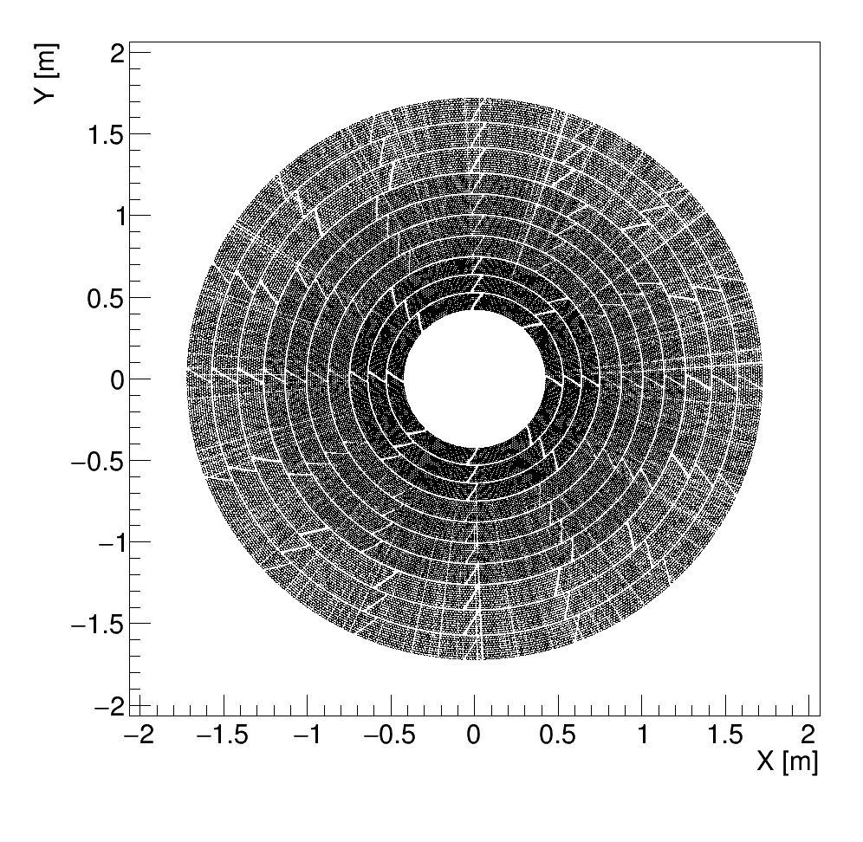
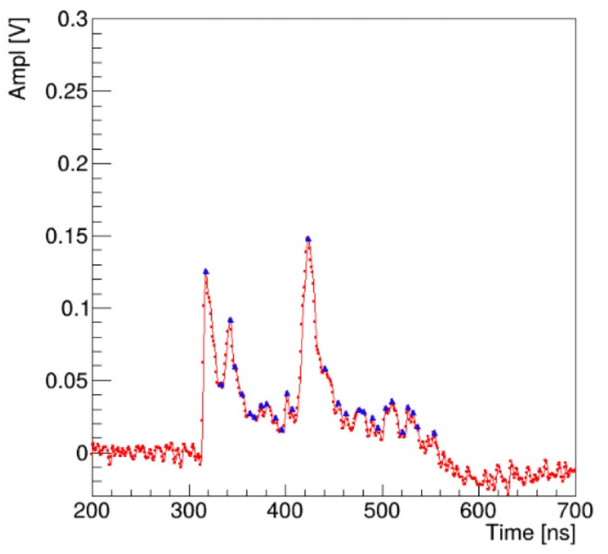


Tracking: Gaseous detectors
Long US involvement in gaseous detectors
Recent activity: Straw Tubes
Particle ID via dN/dx (primary ionizations/cm)
GEANT simulation of 5000 muon hits
Recorded electron beam waveform
CERN test beam, Aug. 2025
Ar-CO2(70:30),1bar, 293K
25 um wire radius, 7.1 mm tube radius.
HV=2100V
Next: He-Isobutane
HFCC support
Hardware development
Next: Prototype (24 straws) and helium-isobutane gas mixture system U. Michigan
Garfield simulations
Physics simulations
Test beam data
Goal: dN/dx in electronics
Tracking Detectors and Software workshop at BNL, May 2025

Slide 5
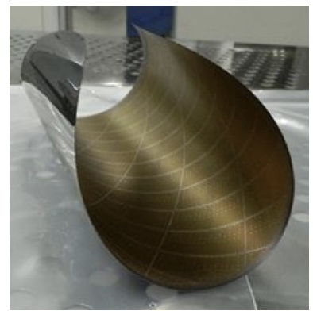
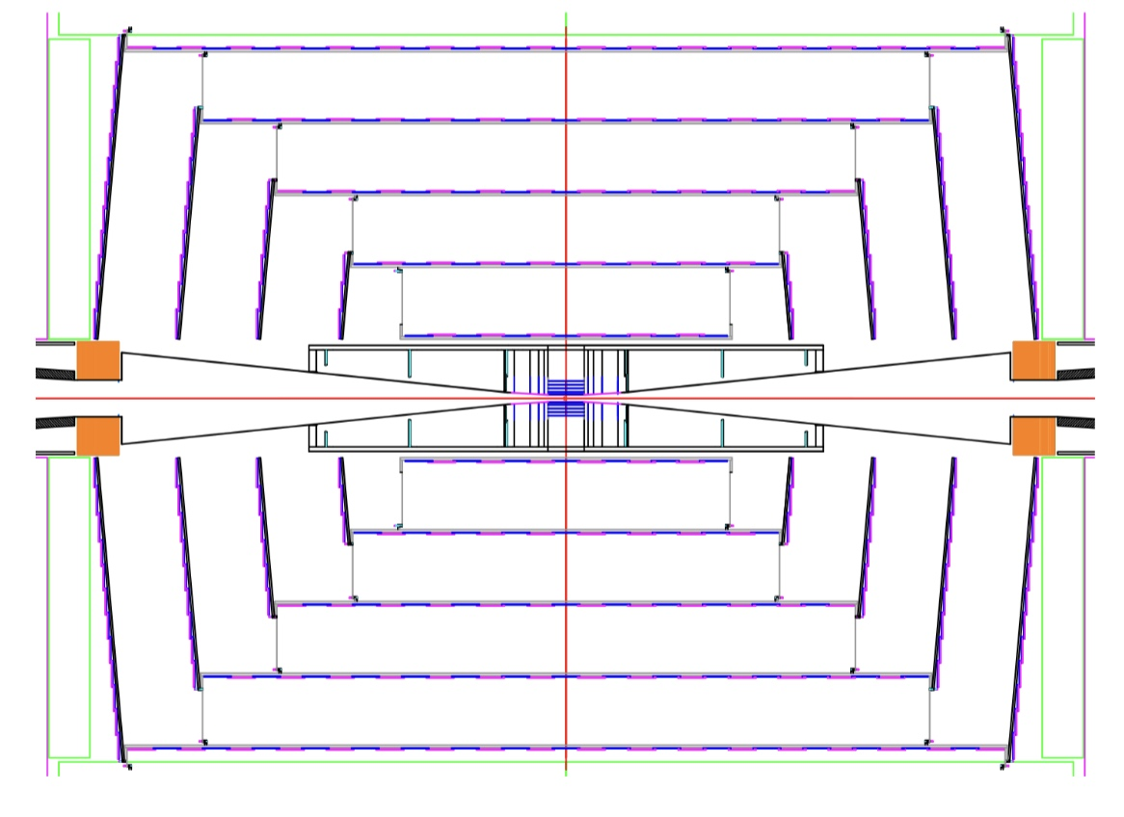
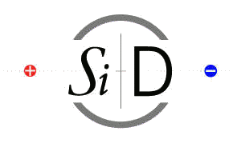



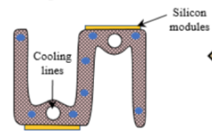
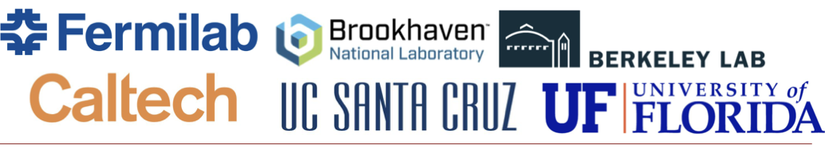


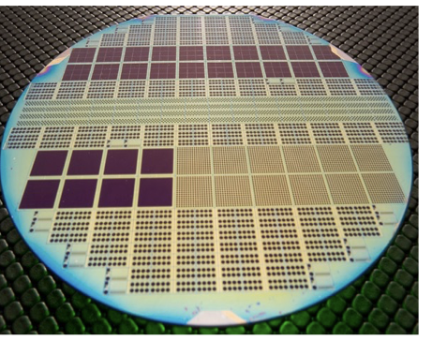
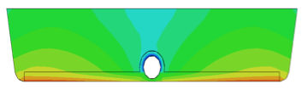
Monolithic Active Pixel Sensors (MAPS)
High granularity, lightweight, low power detector layers
Stitching for 1000 m² system
ALICE MAPS vertex detector for HL-LHC
SLAC
NAPA chip targeting 7μm resolution, ~ns timing, ¼ MIP threshold, <10 mW/cm²
using CMOS process via CERN WP1.2 for SiD tracker and ECal
3rd prototype T 12:20 TVT
MAPS tracker
Lightweight support structures
Integrate services, power management, cooling, data flow, and multiplexing
HFCC support
A. Habib et al JINST 19 C04033 (2024)
carbon fiber
Fermilab
Sensor design, simulations, vendor development, prototype tests
Proton beam test
~15 μm position res.
35 ps time res.
HFCC support
Jung, HFCC First Thursday meeting, April 2025
Vallone, FCC Tracking Detectors Workshop, BNL 5/25

Slide 6
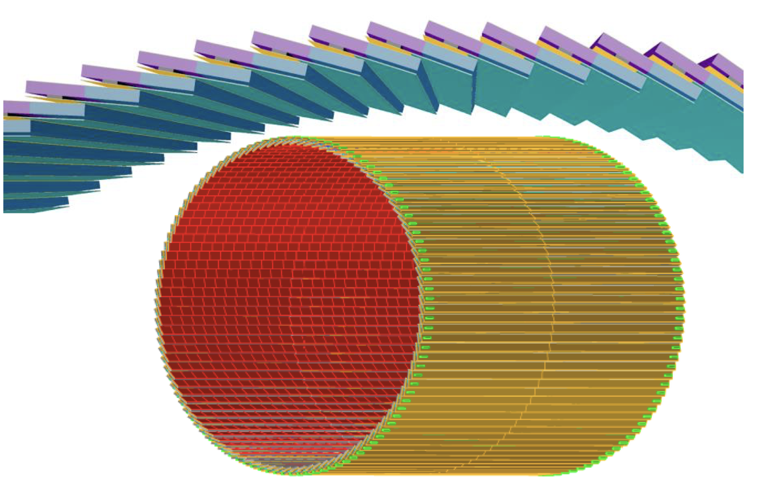
LGADs: ps timing
Pile up mitigation (HL-LHC)
Particle ID via Time of Flight Outer tracking layer
Activities sampler
Improving spatial resolution using charge sharing: → 10 μm resolution achieved in laser tests. Next: test beam Brown, BNL, Northwestern, Zurich
Radiation damage and single event burnout BNL, Brown, U New Mexico, UCSC
Commercializable design SLAC, FNAL, LBNL T 12:04 TVT
Momentum Scale determination at LC Th 13:15 Soft
CMS Endcap Timing Layer LGAD detector 30-40 ps timestamp
Read out chip and module assembly FNAL
ePIC detector at Electron Ion Collider
AC-LGADs with 25 ps timing
Design of sensors, front-end ASIC and readout electronics BNL, UIC, LANL, ORNL, UCSC, Rice, FNAL, Purdue, OSU, NCKU, IJCLab,CEA Paris-Saclay, OMEGA

Slide 7
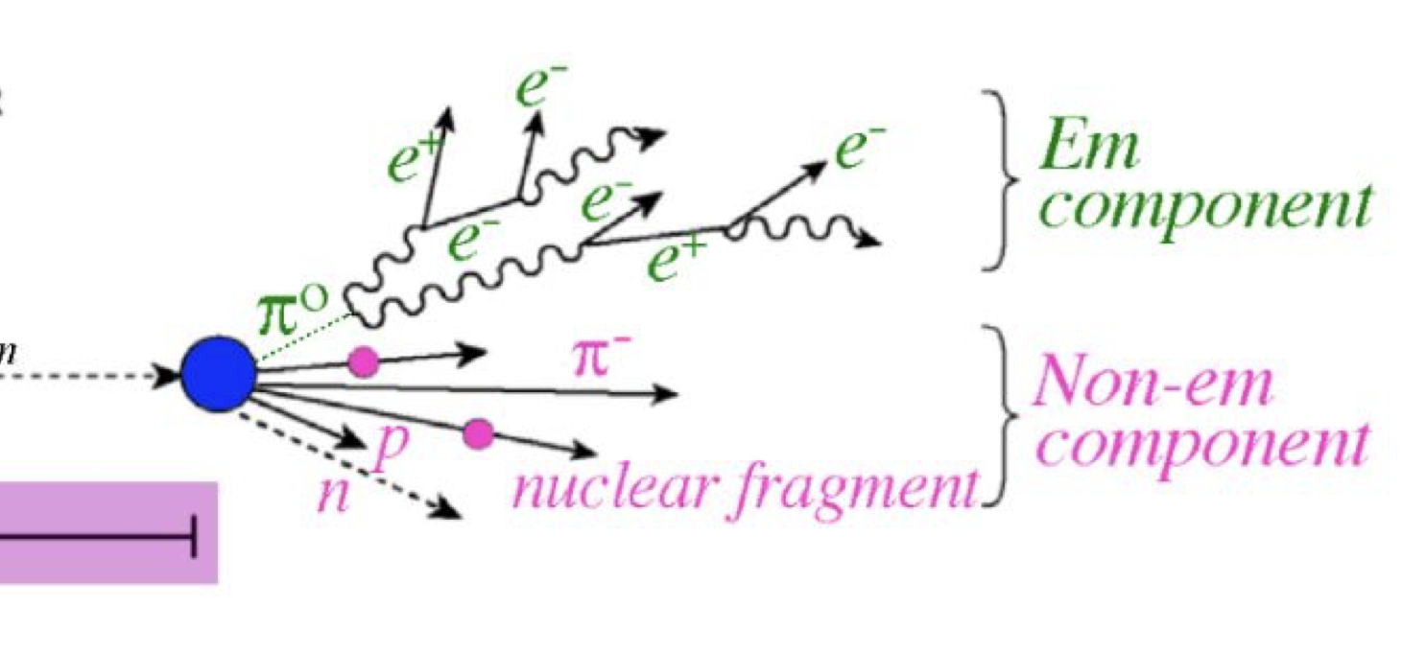

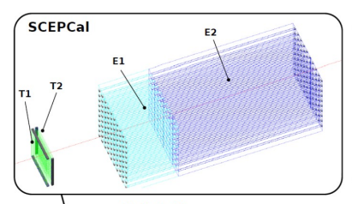
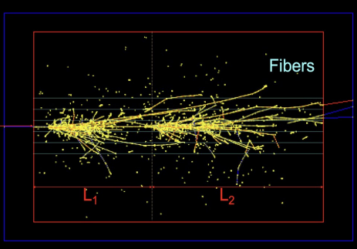


Dual readout calorimetry
High-resolution hadronic calorimetry
Crystal ECal providing high resolution for both EM and hadronic showers
Challenge is Č light yield
EM and hadronic components fluctuate shower to shower, and they have different light collection effs
Č and scint light
CalVision:
Partnering with Europe’s MaxiCC collab.
Scint only
figure courtesy B. Hirosky
→Fiber HCal with Quartz (Č emitting) fibers ~30%/√E
RD52 collab.
SiPM readout
HFCC support
HG-DREAM
Use Č light timing to reveal the nuclear interactions
New: timing observed in test beam
New: Observed ~160 Č pe/GeV in BGO in test run at JLab, exceeding goal. Builds on prior test runs at DESY and CERN (2024).
arXiv:2408.15430v1 [physics.ins-det] Feng and Jin talks at CPAD 2025
Hirosky, Cummings CPAD 2025
Cummings, 8th FCC Physics Workshop, Jan 2025

Slide 8
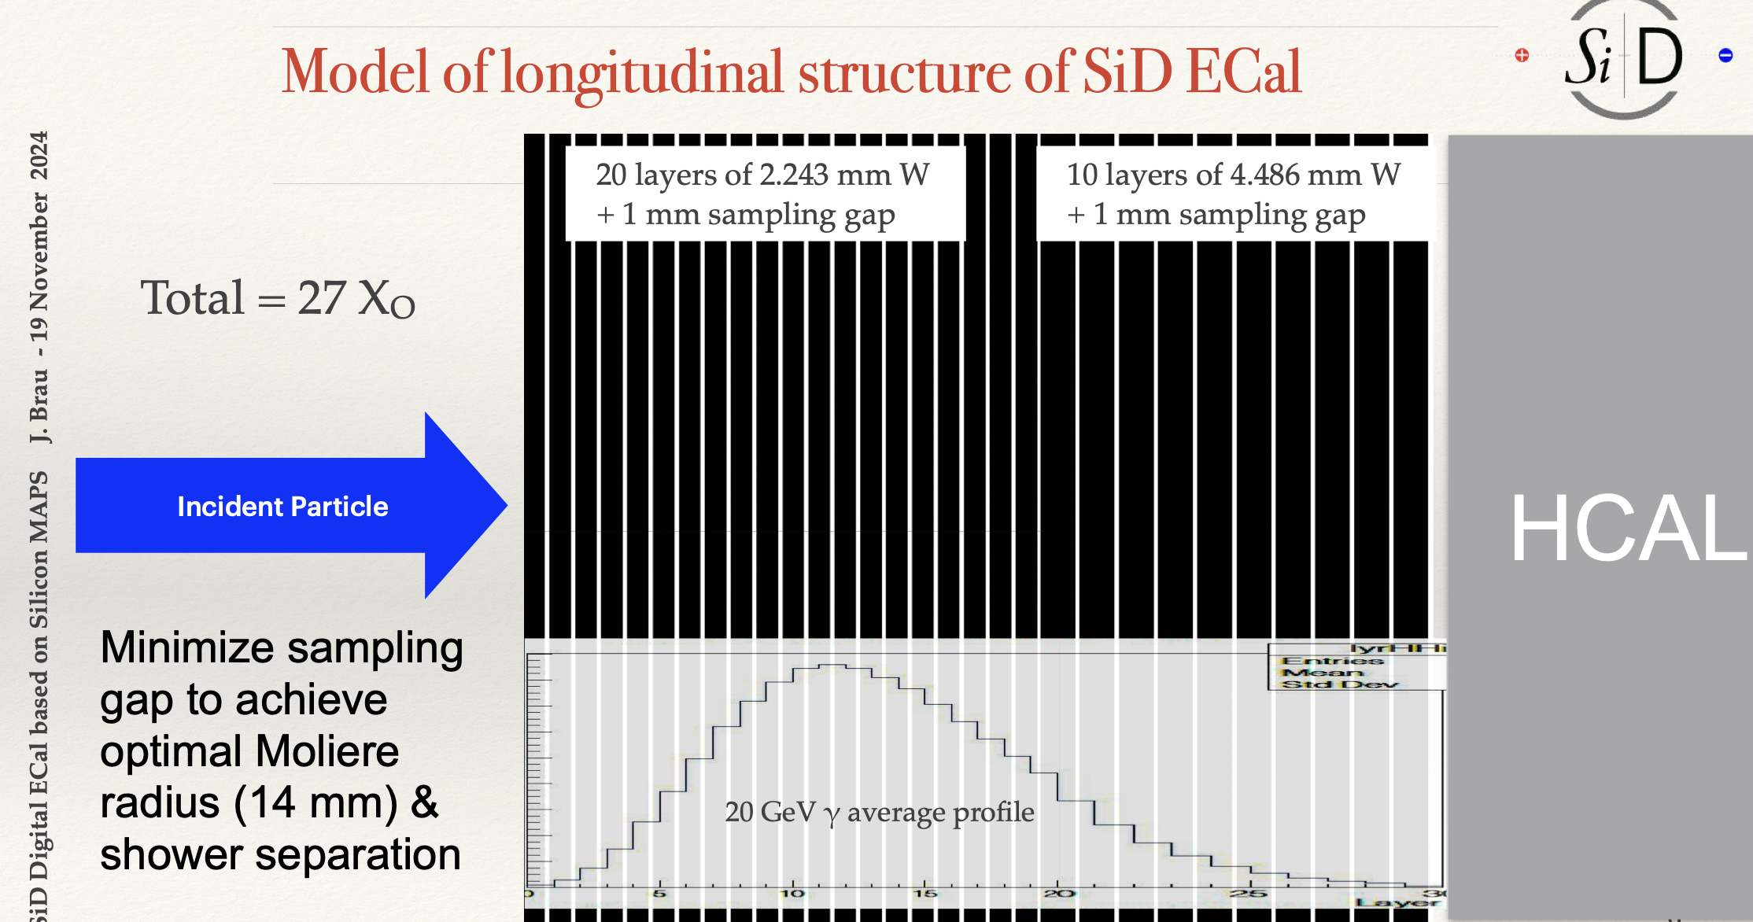
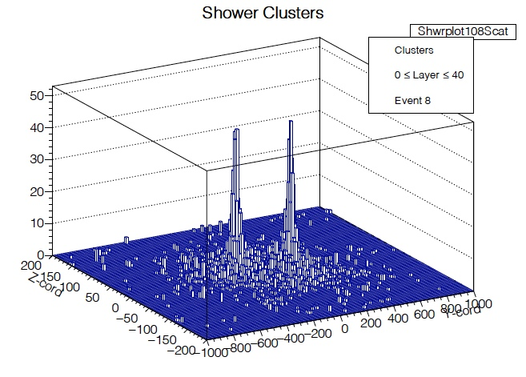
Calorimetry with MAPS
Tungsten/MAPS sampling ECAL
40 GeV π⁰ → two 20 GeV γ’s
Detailed reconstruction of particles in jet for better particle flow
Exceeds LC energy resolution requirement with digital counts
W 10:00 CalPID
SiD ECal fine pixel MAPS
25μm x 100 μm
EPJ Web of Conferences 315, 03005 (2024)

Slide 9
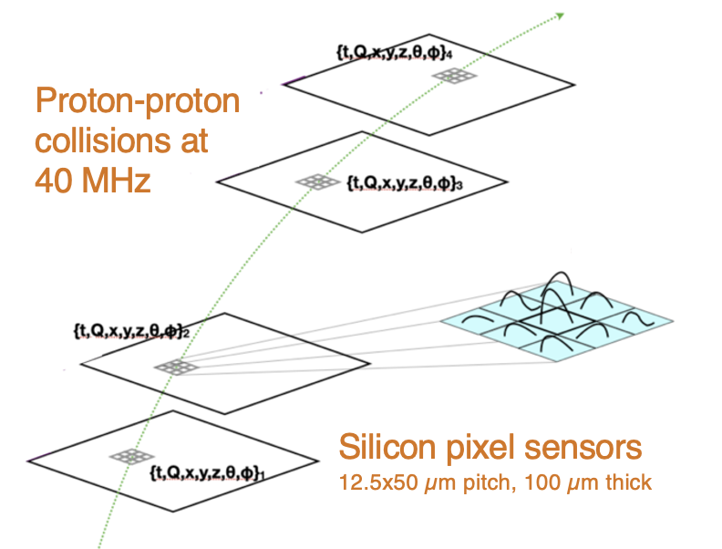
Smart detectors: AI and Microelectronics
ML-in-ASIC capabilities for “smart detectors”, e.g.
Intelligent data handling and power management
On-board calibration
On-chip processing to reduce readout
SmartPixels – ML embedded on ASIC
eFPGA – integrate FPGA-like logic into an ASIC
Dynamic readout granularity
Analog on-detector computing to reduce power load
Smart Pixels:
track parameters on a chip
Major US emphasis on AI:
new centers, new initiatives in the pipeline
See review Gouskos Th 16:15 plenary
ML for the Front-end (ML4FE) workshop, May 2025

Slide 10
Software and Computing
L. Bauerdick, M. Hance
Key4HEP software ecosystem
Analysis Tools and Generators
US Computing Resources
User facilities
Future resources for grid computing
See HFCC “First Thursday” meeting, Oct 2025
HFCC Priorities Key4HEP support/development LBNL
Simulation and Analysis Tools support Princeton
Software workshops, training events FNAL
HFCC support
Connection: Optimizing detector layouts

Slide 11
Outline
Detector R&D in the Americas
Accelerator R&D in the Americas

Slide 12




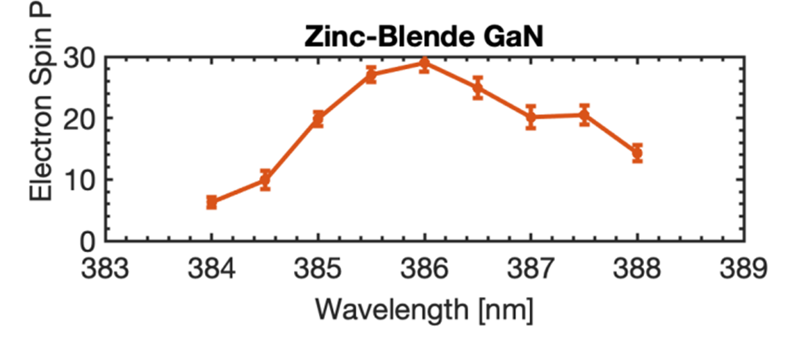











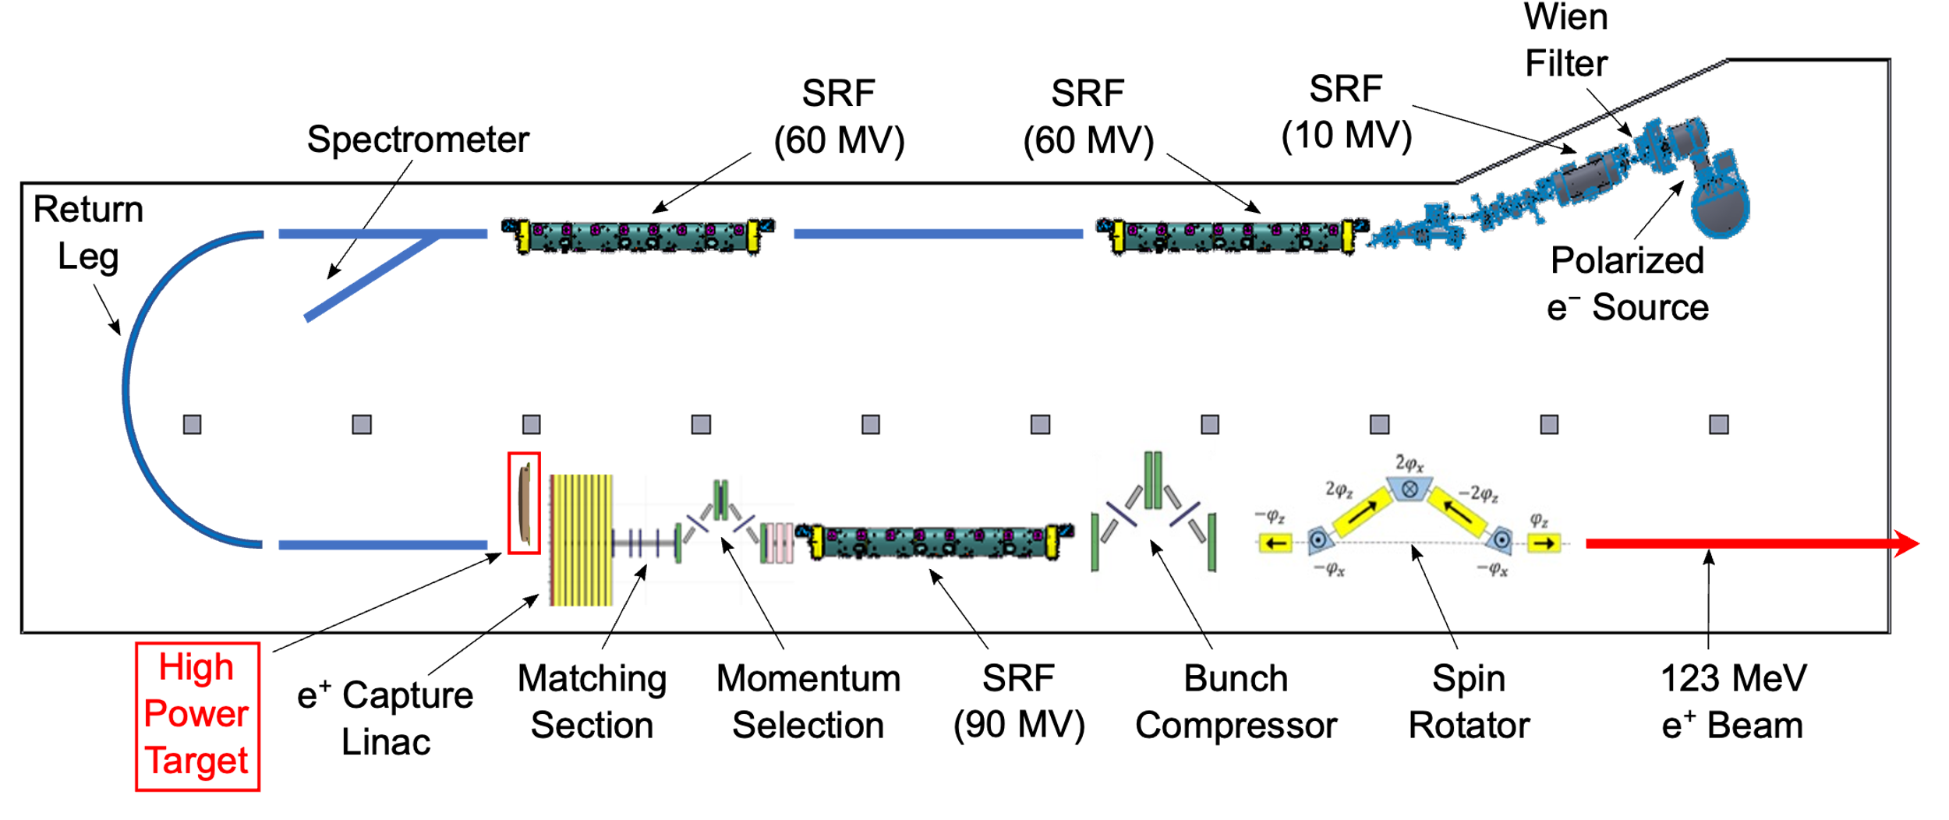
Polarized Sources
Photocathodes for polarized electrons
Workhorse: GaAs activated to Neg. Electron Affinity (NEA) with Cs+O → short lifetime due to fragile NEA coating
Improved robustness: Sb based NEA layers, CsI surface treatment
Promising alternatives to GaAs: III-Nitrides (e.g. GaN and InAlGaN) W 12:20 Sources and growth methods W 12:00 Sources
Polarized positrons
Build on Ce⁺BAF effort: 1 μA with > 60% pol’n
120 MeV polarized e–
Polarized e⁺
e⁺ capture linac
matching
SRF
bunch compression
spin rotator
J. Appl. Phys. 137, 224901 (2025)
high power target
See talks on the target W 12:40 Sources, target cooling W 13:00 Sources, and target and beam parameters W 11:20 Sources
Electron spin polarization (%)
US-Japan Collaboration
GaN matches GaAs!
unstrained
Appl. Phys. Lett. 125, 034107 (2024)

Slide 13

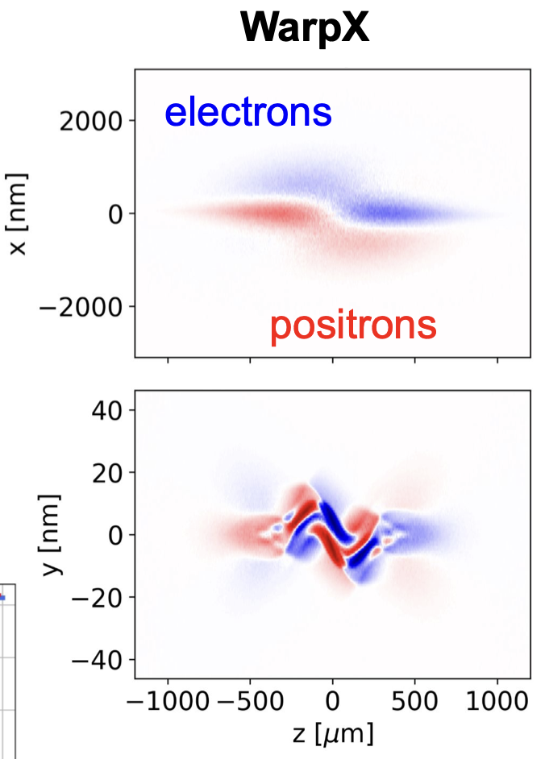
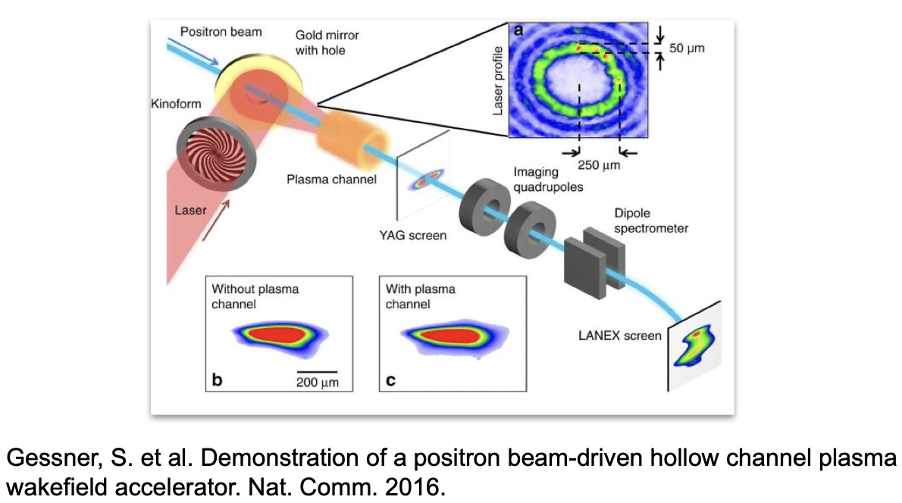
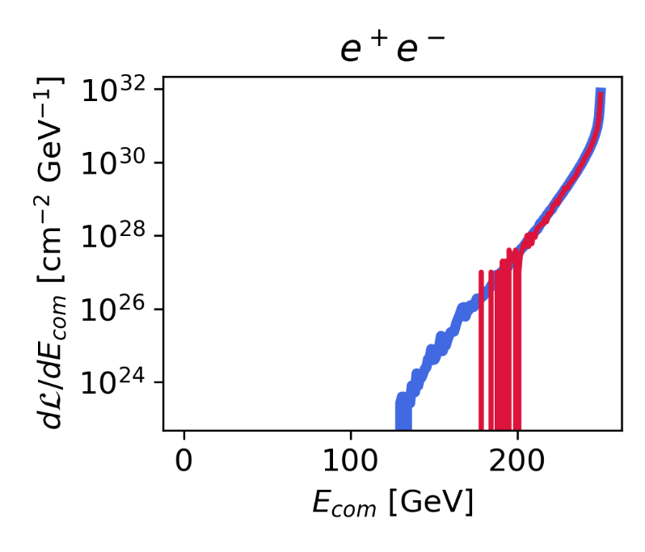
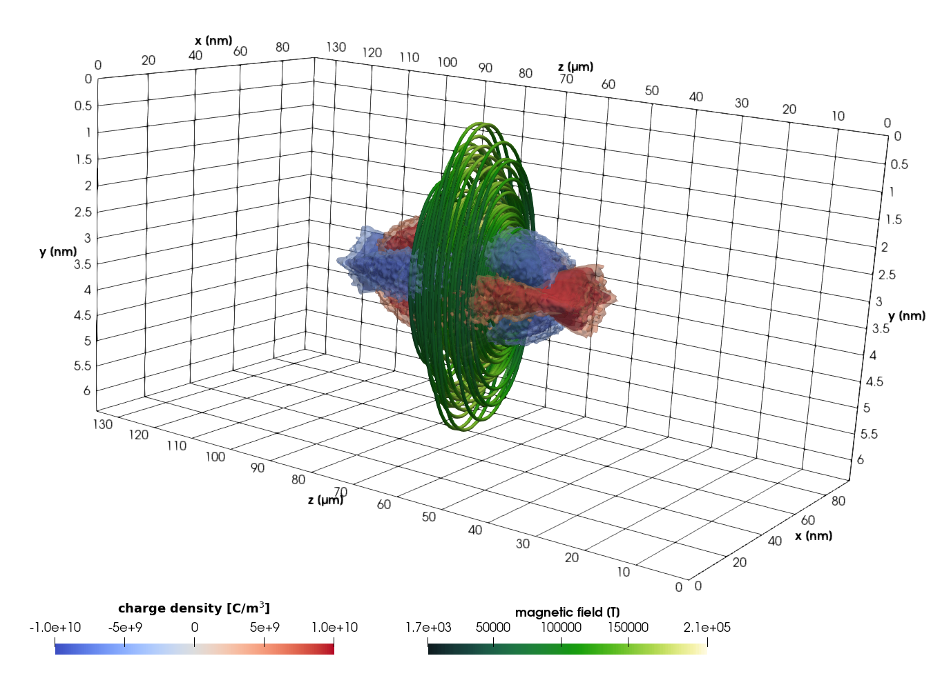
Beam Dynamics & MDI
Detailed simulations of beam-beam interactions using Warp-X
Beamstrahlung at 10 TeV Colliders T 10:20 AAT
Physics impact of beam configurations at 10 TeV T 10:40 AAT
Laser collimation of e beams and intensity control at FACET-II W 12:00 DRBD
10 TeV
Warp-X vs Guinea Pig
electron density
magnetic field streamlines
Direct-wind superconducting magnets for the IP T 10:15 MDI
Improved Luminosity detectors W 10:40 CalPID
positron
density
Beam beam simulations at LBNL, SLAC, CEA
J.Instr. 18.06 (2023): T06001

Slide 14
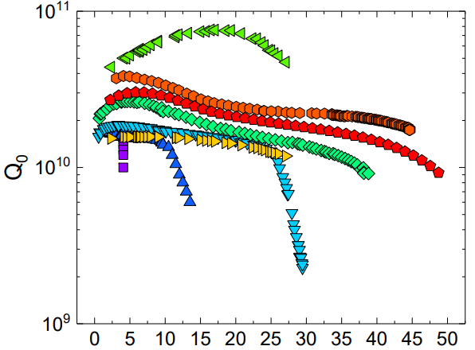

Superconducting RF cavities
ILC 1.3 GHz bulk Nb SRF cavities
TDR performance specs:
Q₀=1x10¹⁰, E_{acc} = 31.5 MV/m
Impressive progress worldwide since TDR: Impurity infusion, low and mid temp baking, cold electropolishing
Now feasible:
Q₀=2x10¹⁰, E_{acc} = 31.5 MV/m
If this can be done at scale, allows 5 Hz → 10 Hz rep rate
Nitrogen doping!
75/120 C bake/N infusion
Cavity shape+High RRR Nb
High pressure water rinse
EP+low-temperature baking
U.S. groups
Plot: A Grasselino and K. McGee
E_{acc} (MV/m)
High gradient, high Q at JLAB T 12:00 SRF and at FNAL T 12:30 SRF
Identifying electron emitters T 12:15 SRF
Can we use materials expertise to make further progress?
What about traveling wave cavities?

Slide 15
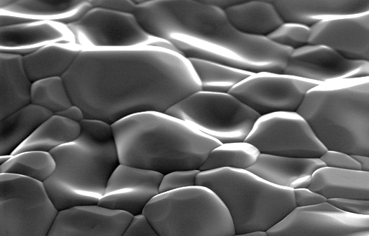
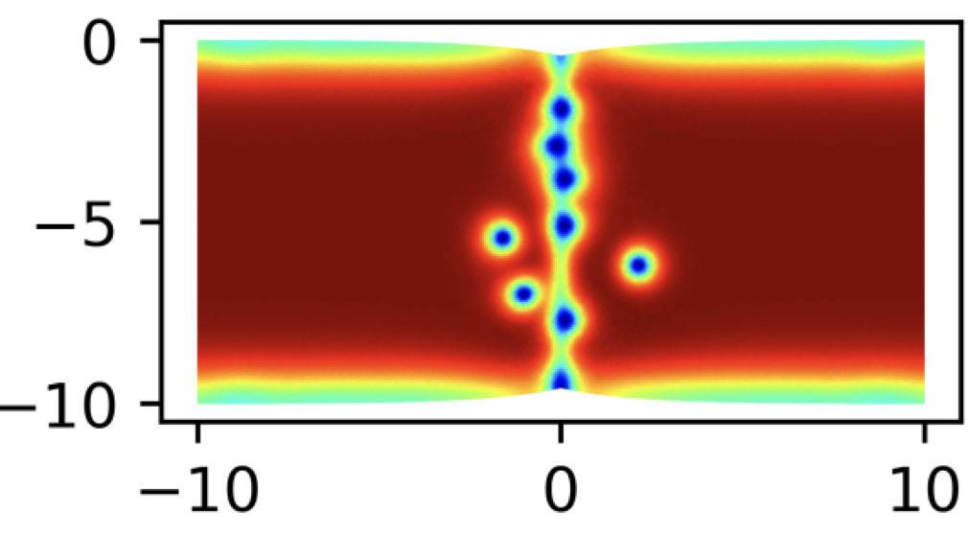
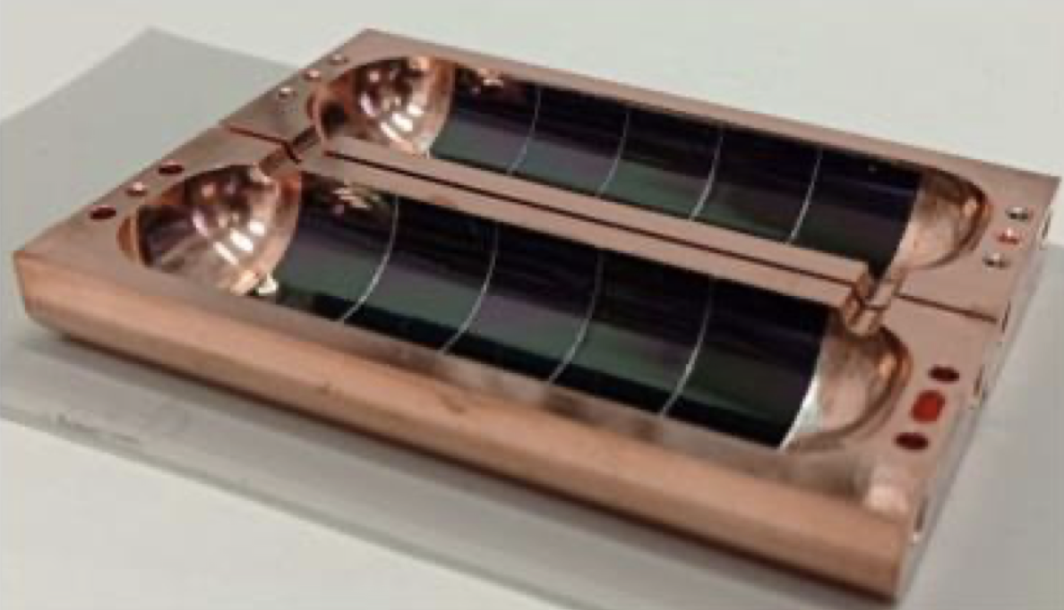
Alternative superconductors
Nb₃Sn
Higher vortex entry field than Nb
→ Higher E_{acc} 100 MV/m max rather than 55 MV/m
Higher T_{c} than Nb (18K vs 9K)
→ Achieves good R_{BCS} at 4K rather than 2K
3.2x more efficient heat extraction → smaller cryoload
2 μm
Phys. Rev. B 103, 024516 (2021)
Growth is challenging
T_{c} and vortex entry field sensitive to Nb:Sn ratio
Low thermal conductivity: 1/1000 of Nb
Exciting new result: E_{acc}=100 MV/m in a small sample using μs pulses (SRF ‘25)
Can we use high temperature superconductors for SRF? See talk T 12:45 SRF
REBCO tape

Slide 16

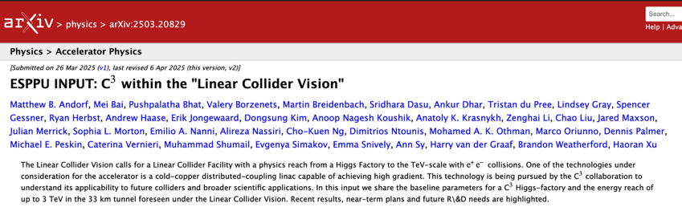
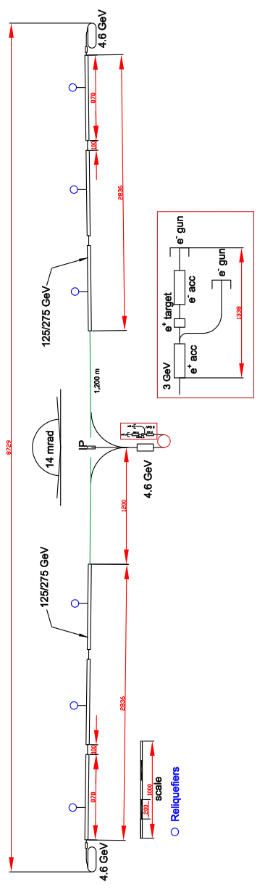
Update on the Cool Copper Collider
LC Vision, evaluated as a standalone and LCF upgrade
250 GeV in 8 km with 70 MeV/m gradient
550 GeV in 8 km with 120 MeV/m gradient
2 TeV in 20 km with 155 MeV/m gradient 230 MW site power
Recent Updates:
Improved site layout; new beam format 150 → 110 MW site power, same lumi W 3:45 PL
Optimizing damping rings and bunch compressors W 11:45 DRBD
Beam dynamics/emittance preservation W 11:20 DRBD
Beam-beam interactions Tu 10:35 MDI
C³ - 8 km Footprint for 250/550 GeV
LCWS 2025

Slide 17
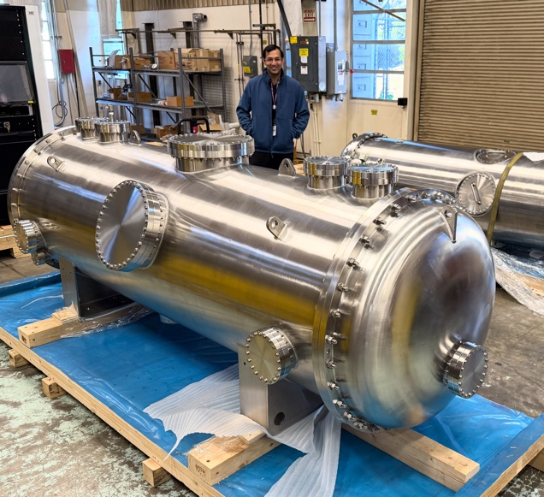
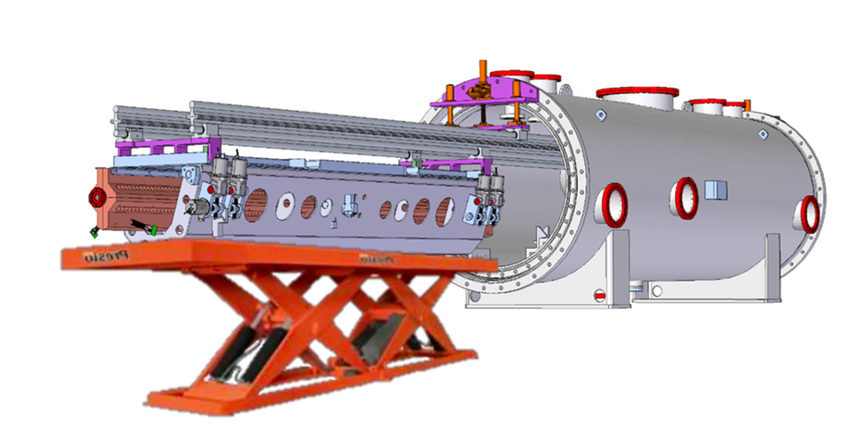
Towards a Cold Copper Demonstration
Quarter Cryomodule
Highest priority: Demo of main linac technology and specifications
Building main linac raft (~2.5), 2X structures, 1X quad, alignment and positioning W 9:20 NCRF
Planned test with beam at ESRF W 11:30 NCRF, including auxiliary systems LLRF W 9:00 NCRF, alignment W 9:40 NCRF
Leveraging synergies with other applications
injectors for storage rings
injectors for collider concepts (FCC-ee)
e-beam driven positron linac for ILC
positron linac for HALHF

Slide 18
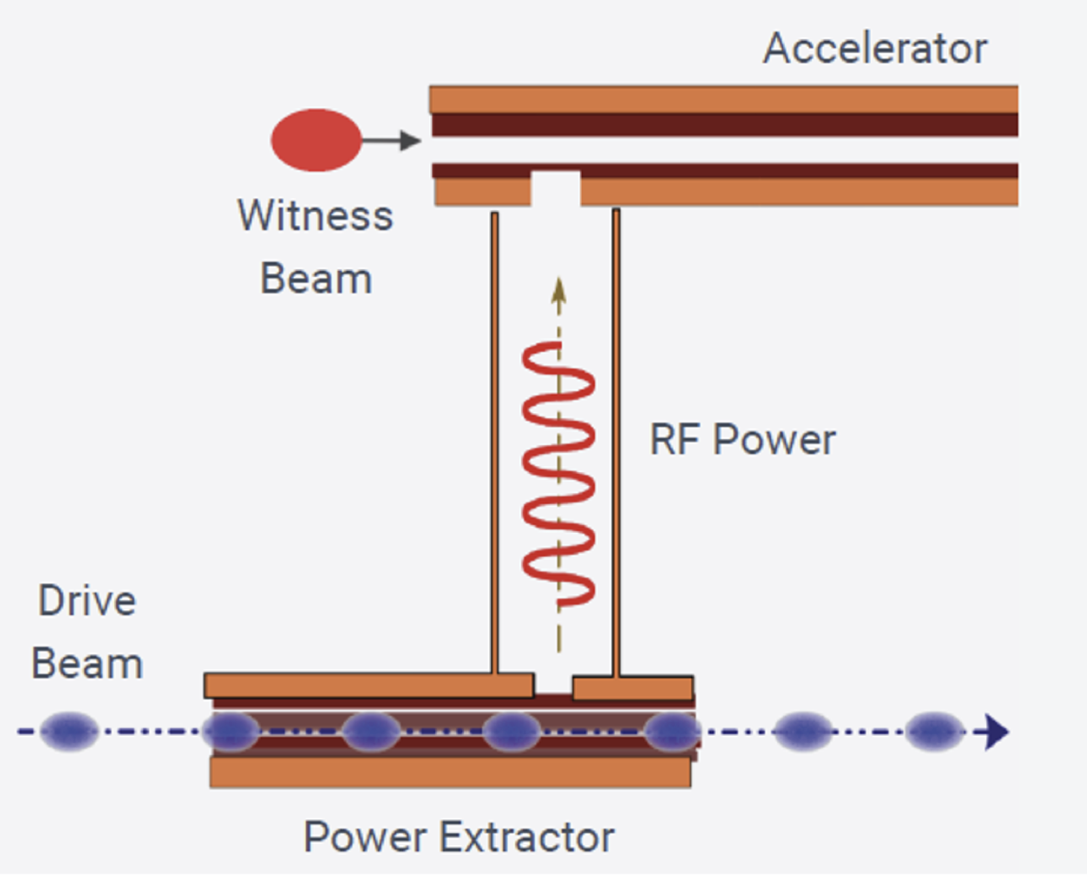
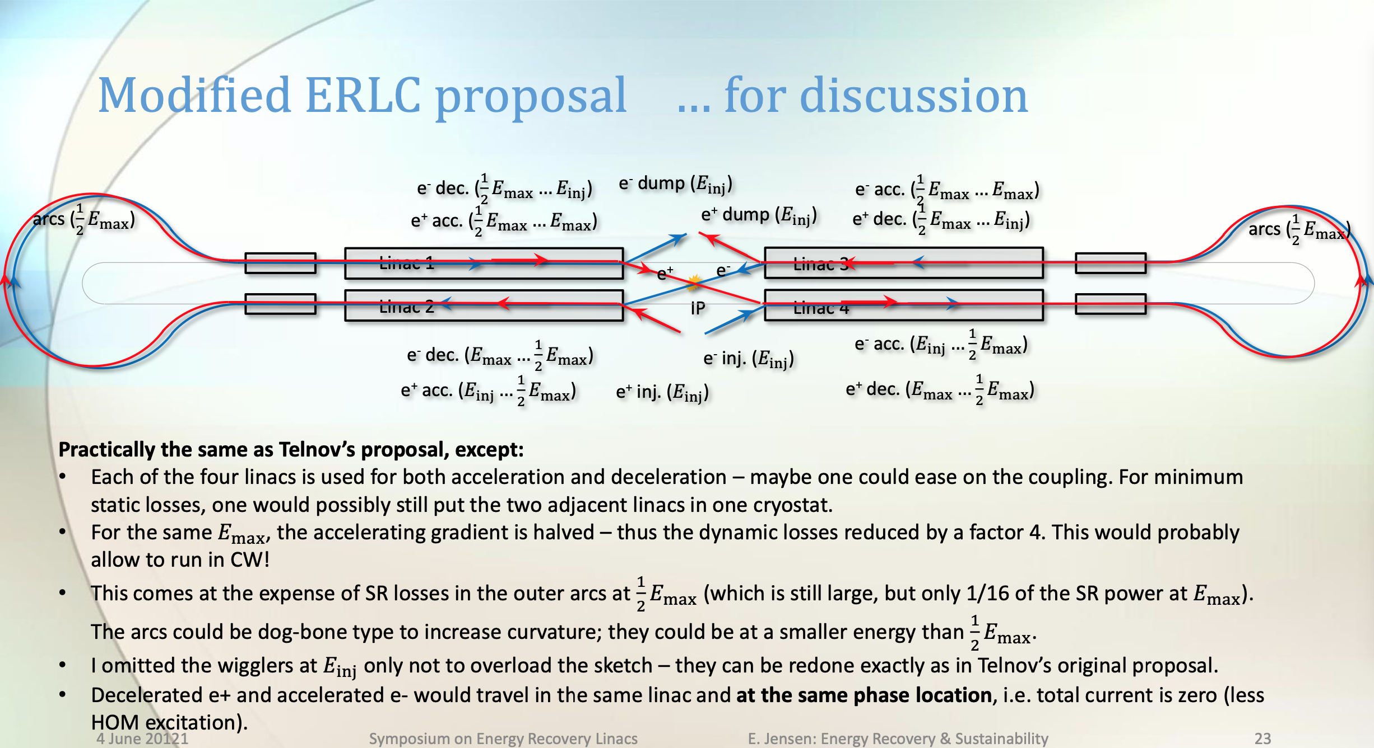
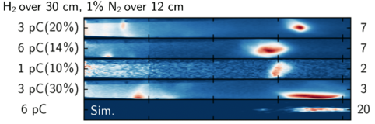

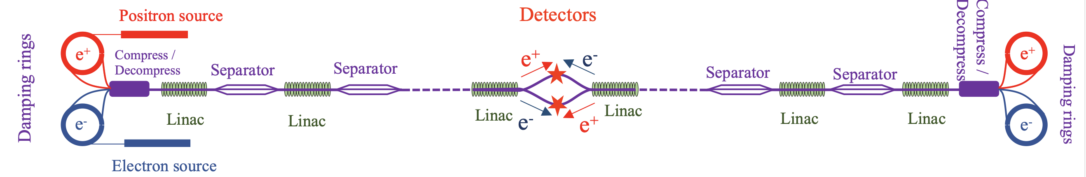
Toward Multi-TeV
CLIC-like Structure wakefield acceleration at Argonne T 10:00 AAT and Short pulse RF for high gradients (~300 MV/m) Th 12:30 AAT
Ghost collider – new ERL-based concept 550 GeV center-of-mass linear collider with four interaction regions, each with the design luminosity Th 10:00 AAT
ReLiC – ERL-based e+e- collider with c.m. energy from 100 GeV to 3 TeV and luminosity between 10³⁶ to 10³⁷ cm^{–2} s^{–1} Th 10:20 AAT
Channel-guided laser plasma WFA
Phys. Rev. Lett. 133, 255001 (2024)
LBNL, UC Berkeley, U Maryland
Laser-driven PWFA T 9:40 AAT
Compact positron source for PWFA studies at SLAC W 11:40 Sources

Slide 19
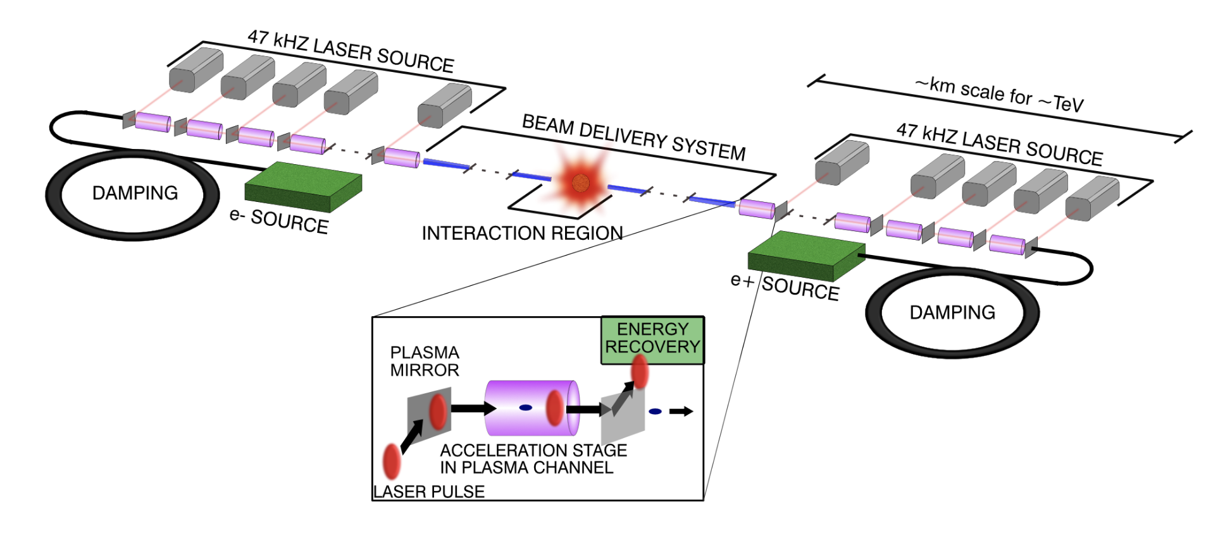

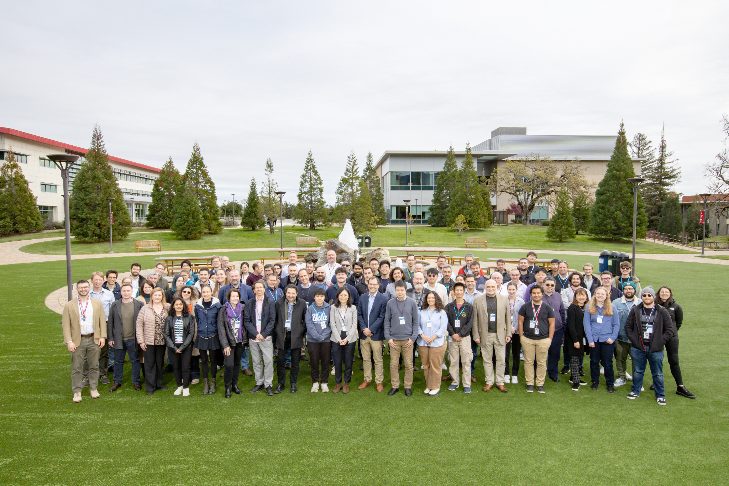

The 10 TeV Wakefield Collider Design Study
The Design Study aims to produce a unified, self-consistent concept for a 10 TeV parton-center-of-mass (pCM) collider based on wakefield accelerator (WFA) technology.
The study is Initiated by the 2023 US P5 Report, but it is a global undertaking.
We will collaborate with on-going design efforts, including ALEGRO, HALHF, ALIVE, and XCC and contribute to the LC Vision program.
This is an HEP-wide community effort. The study involves theorists, experimentalists and Linear Collider experts.
Laser-Plasma Collider
JINST 2023
Overview T 9:00 AAT
Join the Study!
https://indico.slac.stanford.edu/event/9402/

