Slide 1
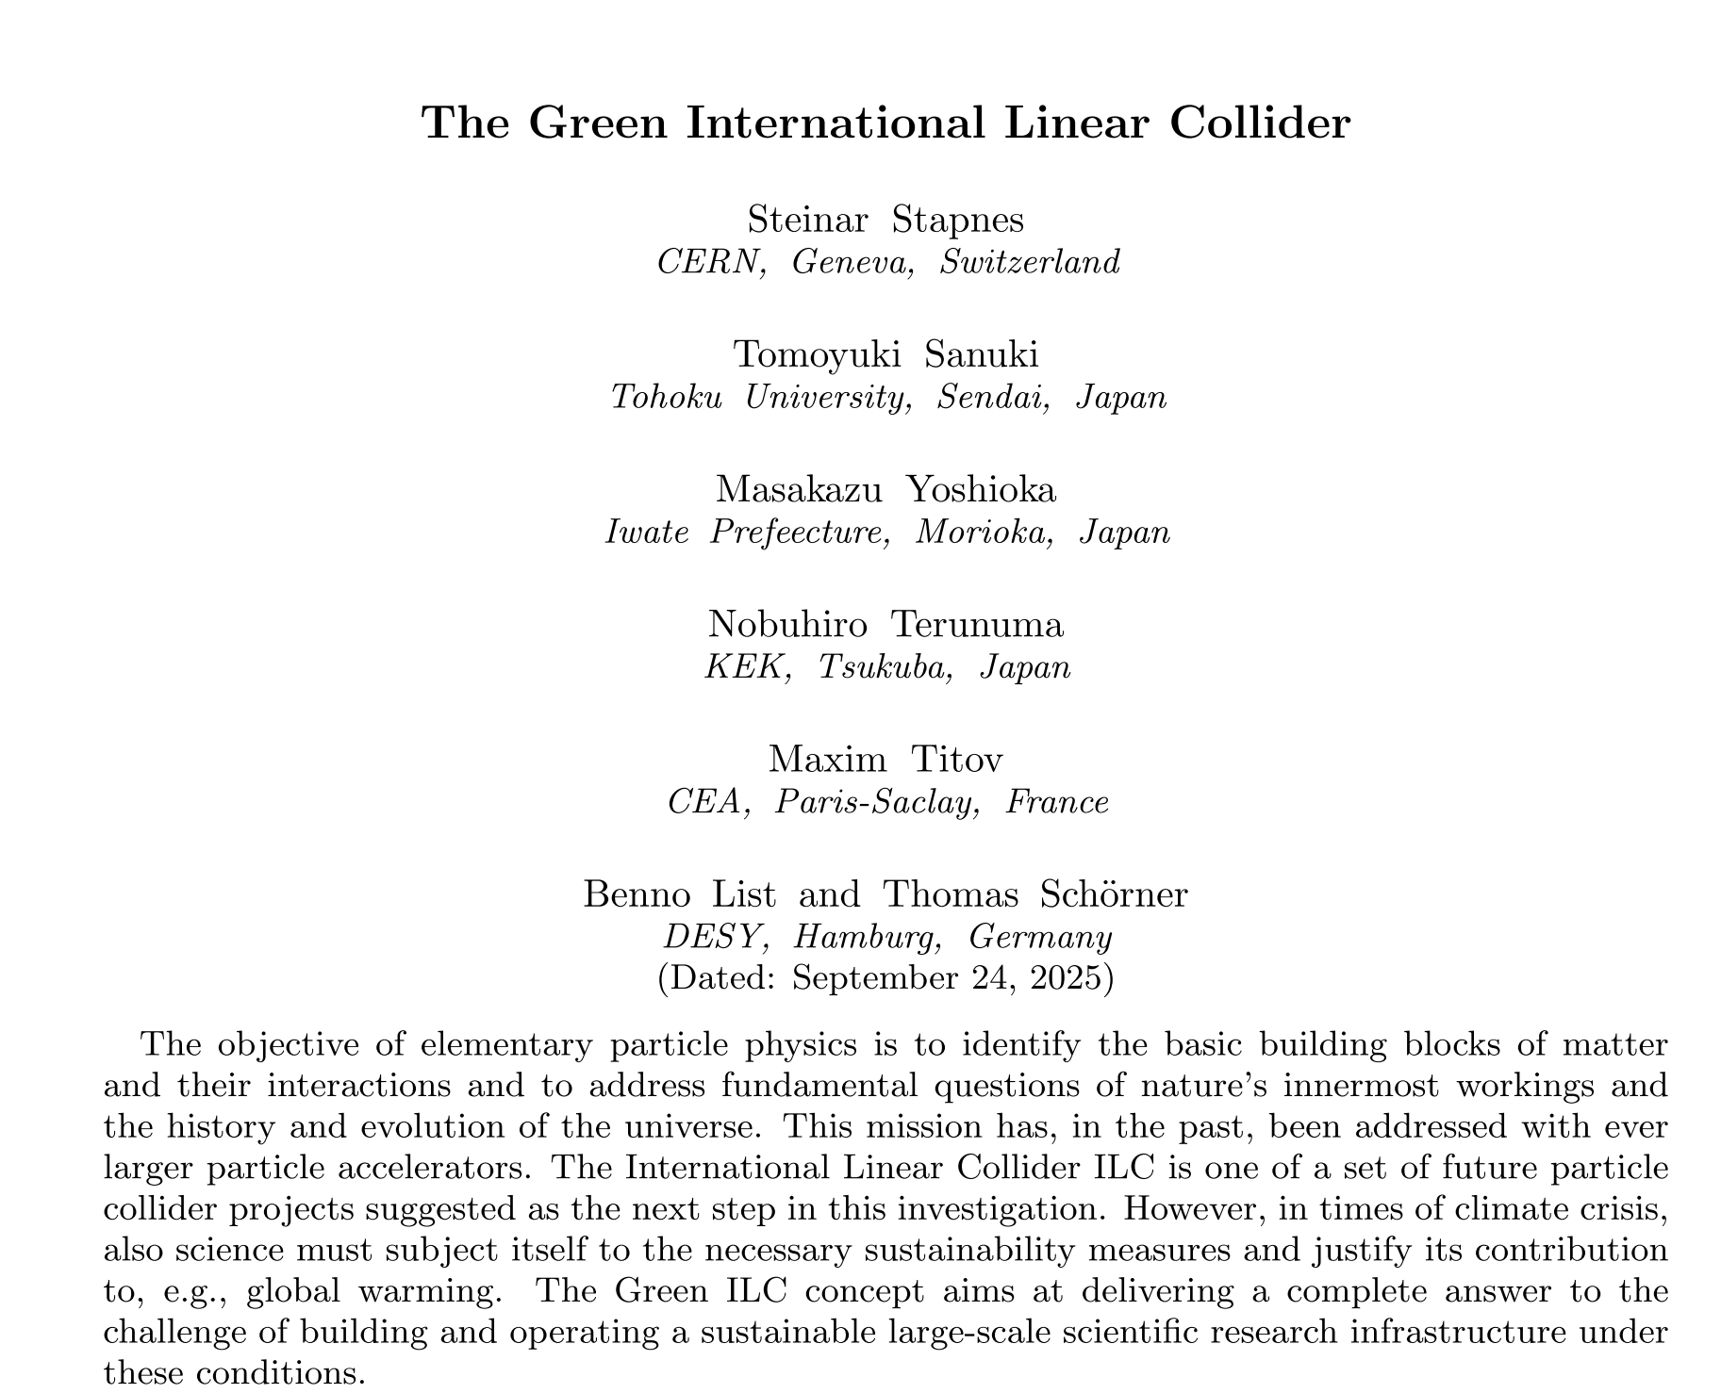
Sustainability of ILC sited in Tohoku
~Green ILC Strategy for Locating the ILC in Tohoku Candidate Site~
Masakazu Yoshioka (Iwate Univ., Morioka, Japan)
Thomas Schörner (DESY, Hamburg, Germany)
This presentation is an excerpt focusing on Japan from the paper (right), prepared by researchers from Japan and EU.
The power mix largely differs between Japan and EU. ➔ The purposes of this presentation is to explain Japan's current situation and describe its efforts toward decarbonizing the ILC.

Slide 2
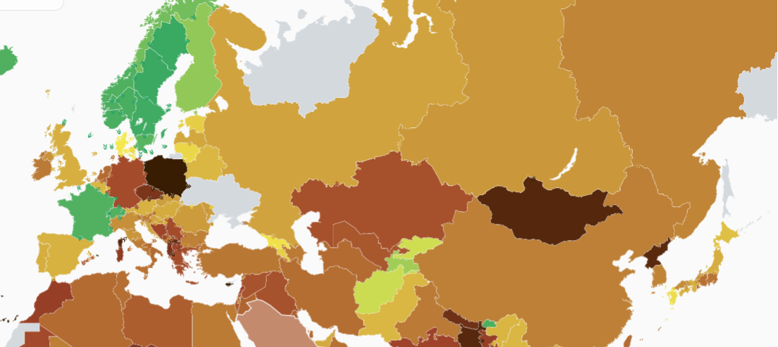
https://app.electricitymaps.com/map/72h/hourly
World Map of CO₂ Emissions (g/kWh) when Electricity Generated
(July 10, 2025, 16:00 JST)
Let's compare France, which supplies power to CERN, with Japan's Kyushu region, which has the lowest CO₂ emissions among major Japanese power companies.

Slide 3
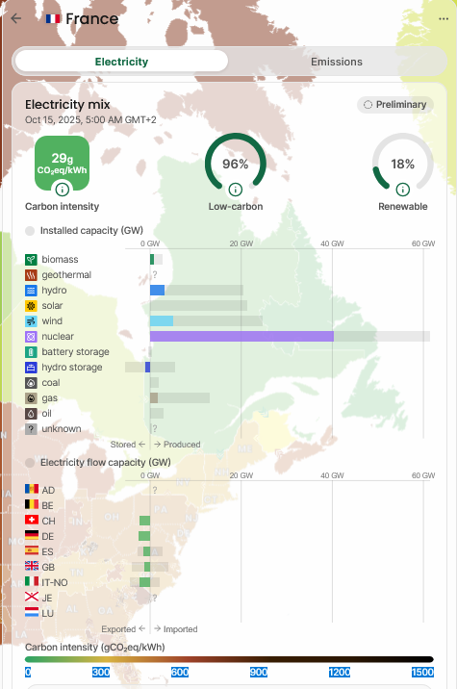
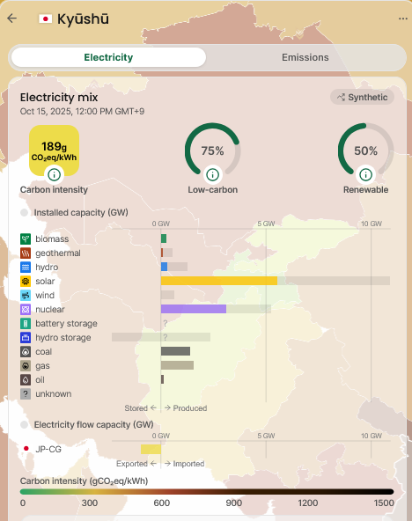
Comparing France and Kyushu (Oct. 15, 2025, 12:10 JST)
France generates 96% of its electricity from low-carbon sources, including 18% renewable energy.
In contrast, Kyushu generates 75% electricity from low-carbon sources, including 50% renewable energy. Since 46% is from fossil fuels, its CO₂ emissions (189g) are higher than France’s (29g).

Slide 4
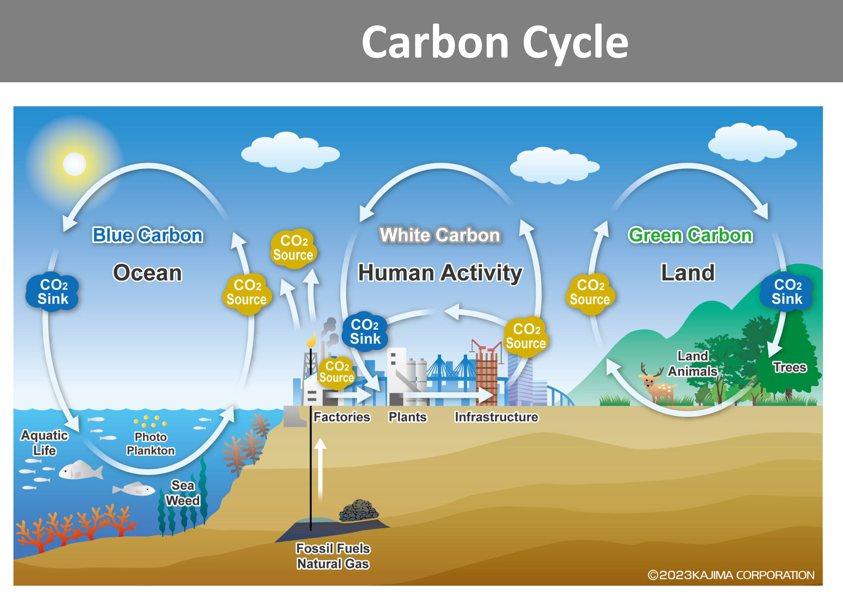
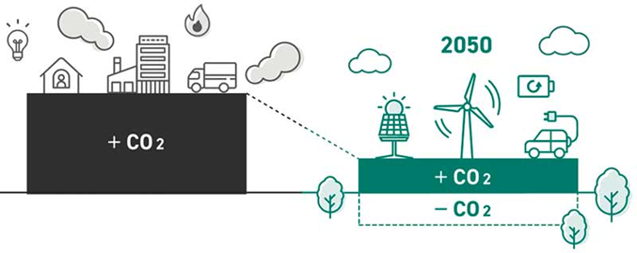
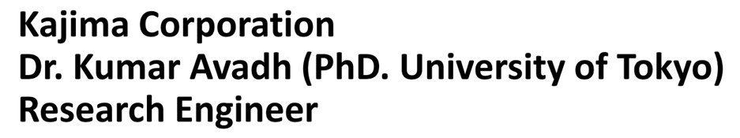
Japan's strategy to achieve carbon neutrality by 2050.
Japan is an island nation and must be a closed scenario in one country.
Japan will strive to reduce CO₂ emissions as much as possible by 2050.
However, achieving zero fossil fuel use is difficult, so an “offset” scenario using fixation of CO₂ from the atmosphere will be adopted.
This report discusses the sustainability strategy for locating the ILC at the Tohoku candidate site.
The Japanese government updates its Basic Energy Plan for Electricity every three years.
The most recent one is the 7th Plan, which was approved by the Cabinet in February 2025.

Slide 5
Japan’s 7th Plan sets targets to be achieved by 2040
Achieve a nuclear power share of 20% and a renewable energy share of up to 40~50%.
Reduce fossil fuel use by 30~40 % , adopt an LNG dual power generation system.
Japan's total electricity consumption (2030 and 2040 are predicted value)
980 TWh
930~940 TWh
1100~1200 TWh
The following discussion is based on 7th Plan, with
30% thermal,
20% nuclear and 50% renewable.

Slide 6
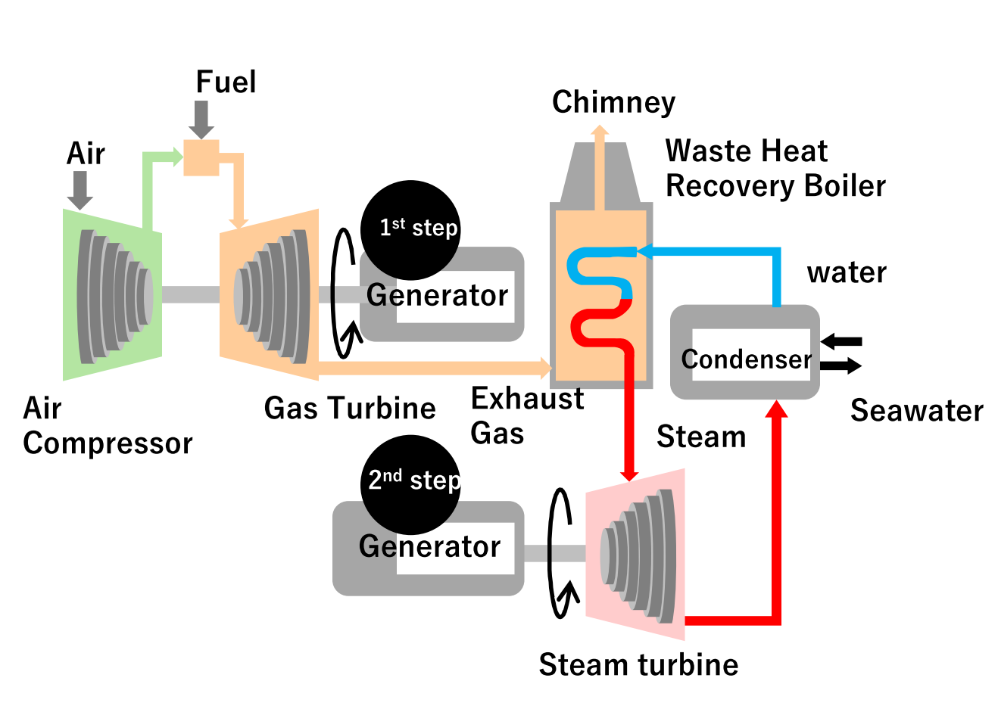
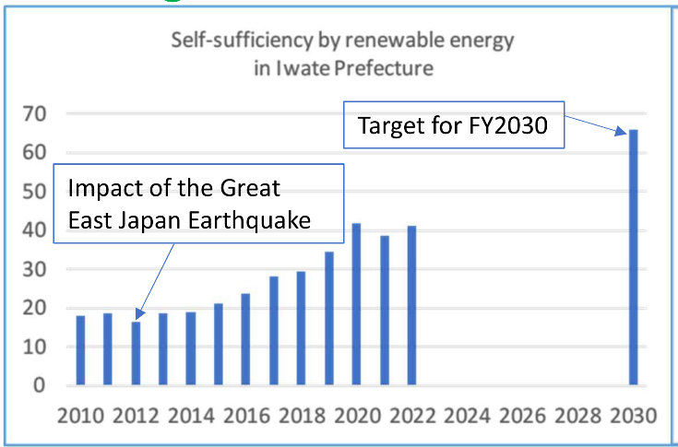
For comparison with CERN, CO₂ emissions are assumed to be 5g/kWh for nuclear and 20g/kWh for renewable energy.
Furthermore, LNG-generation is assumed to be 376g/kWh based on estimates by “the Electric Power Research Institute of Japan” in case of the “dual power generation system”.
Based on the above figures, the CO₂ emissions for electricity under the 7th Plan would be 133g/kWh.
In Iwate, the renewable energy ratio is high, with a 2030 target set at 66%. Given Iwate's high potential for renewable energy, this target is achievable.
%
Dual power generation system combining gas turbines and steam turbines.

Slide 7
Annual electricity consumption in Iwate is about 10 TWh.
ILC's annual electricity consumption ➔ 0.74 TWh (IDT) ➔ a significant portion of Iwate's total consumption.
Iwate hosts semiconductor factories and automobile plants. In the future, renewable energy power is expected to compete for supply with these companies, including the ILC.
To secure renewable energy power, it is necessary to establish the ILC Pre-Lab. at an early stage.
In this report, we assume that ILC required power is procured 50/50 from sources aligned with the 7th Plan and from regional renewable energy sources.
➔resulting 76.5 g/kWh.
The CO₂ emissions from the 0.74 TWh electricity amount to 56.9 kilotons.
The next challenge is whether Japan can achieve carbon neutrality through its offset scenario.

Slide 8
H. Kikuchi of Ichinoseki City calculated the CO₂ absorption capacity of the city's forests (66,363 ha).
Considering various tree species, ages, and management conditions, the Green Carbon reaches 303ｋ-tons/year.
➔How big is the absorption potential of the forests!
Japanese cypress |  |  | forest area(ha) | Carbon fixed amount(t) | CO2 absorption amount(t) | Annual CO2 absorption amount(t) | Annual CO2 absorption per ha(t)
artificial forest | conifer | Cedar Japanese cypress Red pine Kara pine others | 19,618 1,004 8,928 1,521 33 | 2,680,553 54,543 1,327,513 93,234 6,655 | 9,837,631 200,173 4,871,974 342,172 24,424 | 109,412 12,177 33,537 5,999 184 | 5.58 12.13 3.76 3.94 5.58
 |  | total | 31,104 | 4,162,498 | 15,276,374 | 161,309 | 5.19
 | hardwood | oak others | 80 281 | 5,214 22,508 | 19,135 82,605 | 610 1,594 | 7.63 5.67
 |  | total | 361 | 27,722 | 101,740 | 2,204 | 6.11
 | Total |  | 31,465 | 4,190,220 | 15,378,114 | 163,513 | 5.20
natural forest | conifer | Red pine others | 3,848 8 | 512,777 1,798 | 1,881,895 6,601 | 8,635 34 | 2.24 4.25
 |  | total | 3,856 | 514,575 | 1,888,496 | 8,669 | 2.25
 | hardwood | oak others | 26 31,016 | 2,427 2,935,948 | 8,907 10,774,932 | 46 131,302 | 1.77 4.23
 |  | total | 31,042 | 2,938,375 | 10,783,839 | 131,348 | 4.23
 | Total |  | 34,898 | 3,452,950 | 12,672,335 | 140,017 | 4.01
Total |  |  | 66,363 | 7,643,170 | 28,050,449 | 303,530 | 4.57

Slide 9
Left image: Three elements of CO₂ fixation
Green carbon, White carbon (long-term CO₂ fixation by wooden buildings) and Blue carbon.
Furthermore, we make efforts to recover and effectively utilize waste heat from the ILC facility (next presentation by Hareyama).
We conclude that it is possible to offset the 56.9 k-tons of CO₂ by the ILC using these carbon cycles.
Conclusion
We demonstrated that the differences in CO₂ /kWh due to different electricity mix between Japan and Europe.
Japan presented an offset scenario for achieving carbon neutrality by 2050.
Japan’s 7th Plan still allocates 30% of its 2040 target to fossil fuel.
Conversely, the region hosting the ILC candidate site has a high renewable energy share, which should be effectively utilized.
We estimated CO₂ emission assuming a 50/50 ratio of procurement from the 7th Plan and regional renewable energy: ➔ 76.5g/kWh and total 56.9 k-tons/year.
The potential annual CO₂ absorption capacity of Ichinoseki’s forests ➔ 303 k-tons/year.
We believe that through carbon cycle efforts, achieving carbon neutrality for the ILC by 2040 is feasible.

Slide 10
Thank you for your kind attention.

