Slide 1
Japanese (Regional) Company Contribution to ILC
Mutsumi Hareyamaª, Rie Ueda^{a, b}
ª Tohoku ILC Project Development Center
^{b} NTT URBAN SOLUTIONS RESEARCH INSTITUTE, INC.
  Contents
Opportunities for regional companies to engage in accelerator-related industries.
Recovery and utilization of low-grade thermal energy from the ILC facility.
Town planning for ILC candidate sites based on wooden architecture.

Slide 2
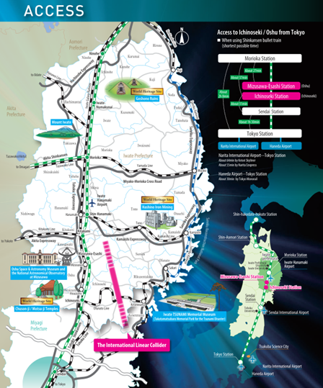
When considering locating the ILC in Japan, Japanese researchers determined the Kitakami Highlands in Tohoku as the candidate site based on scientific surveys in 2013. This decision was subsequently recognized internationally.
In response, regional governments and researchers established the “Tohoku ILC Project Development Center”. Various activities are underway to accept the ILC at the Kitakami candidate site.
Today, we report on the following efforts among these activities.

Slide 3
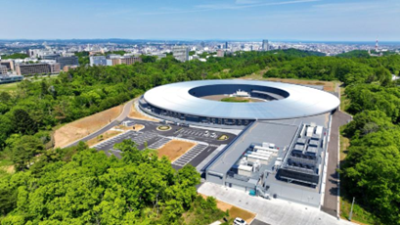
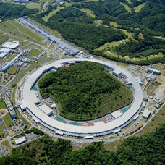
Opportunities for regional companies to engage in accelerator-related industries.
The construction of two large-scale synchrotron radiation facilities in Japan from 2019 to 2028 has created an opportunity for small and medium-sized enterprises in Tohoku to enter the accelerator-related industry.
One is Tohoku University's 3GeV high-brightness synchrotron radiation facility called “NanoTerasu” (construction period: 2019–2024). Companies in Tohoku secured contracts worth 20% of the total construction budget (¥20 billion).
The second is the upgrade plan for SPring-8, Japan's largest synchrotron radiation facility located in Harima, Hyogo Prefecture (2025–2028, total construction budget: ¥50 billion).
NanoTerasu
Construction: 2019~2024
SPring8-II
Upgrade: 2025~2028

Slide 4
Small and medium-sized enterprise managers in Tohoku recognize the following benefits of participating in accelerator-related industries:
Opportunities to enhance technological capabilities beyond merely being a supply chain company, with particular expectations for technological advancement through technical discussions with researchers.
Indeed, gaining experience in accelerator-related projects has led to increased orders in the semiconductor business and fusion-related fields.
WPP | 1 | Cavity production
WPP | 2 | CM design
WPP | 3 | Crab cavity
WPP | 4 | E-source
WPP | 6 | Undulator target
WPP | 7 | Undulator focusing
WPP | 8 | E-driven target
WPP | 9 | E-driven focusing
WPP | 10 | E-driven capture
WPP | 11 | Target replacement
WPP | 12 | DR System design
WPP | 14 | DR Injection/extraction
WPP | 15 | Final focus
WPP | 16 | Final doublet
WPP | 17 | Main dump
Regarding the ILC, we are closely monitoring the R&D activities conducted by KEK as part of the ITN (International Technology Network) initiative, and companies in Tohoku have secured multiple contracts to date.
Since contracts are fundamentally awarded through competitive bidding, we provide support to enable companies in Tohoku to win contracts.

Slide 5
2. Recovery and utilization of low-grade thermal energy from the ILC facility.
We have established a collaborative research framework involving companies, the Iwate Prefectural Government, and research institutions. At its core is
Higashi-nihon Kidenkaihatsu Co., Ltd. of Iwate Prefecture, a small company with 52 employees.
(2) 70% of the exhaust thermal energy is less than 200℃ .
Most of them are not reused and thrown away.
Collaborators and their responsibilities:
National Institute of Advanced Industrial Science and Technology (AIST): Invention and development of HASClay (Adsorption-based thermal energy storage material).
Takasago Thermal Engineering Co., Ltd.: Research on large-scale HASClay applications.
Iwate University: Analysis of HASClay using synchrotron radiation.
Iwate Prefectural Government: Support for commercialization efforts.
(1) This graph shows total annual thermal energy exhaust at the factory in Japan.
Source: Tomohiro Akiyama, Journal of the Japan Institute energy，86，101-187(2007)
This figure is provided courtesy of HKK

Slide 6
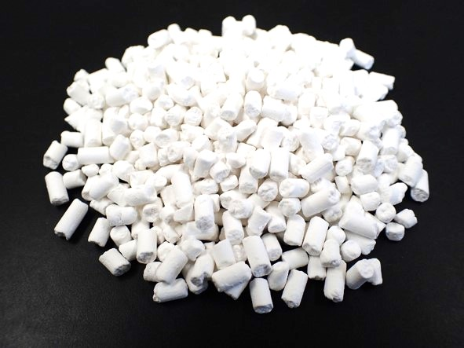
HASClay: Adsorption-based thermal storage material named by its inventor, Masaya Suzuki of AIST
Hydroxyl aluminum silicate
「HAS」
Low crystalline clay
「Clay」
10mm
Composite: HASClay
HASClay possesses numerous nanometer-sized pores, achieving a specific surface area of 500 m²/g (equivalent to approximately two tennis courts).
When water molecules adsorb within the pores (physical adsorption: van der Waals forces), heat is generated.
写真提供：産業技術総合研究所
水
H₂O
水
H₂O
Heat generation
水
H₂O
水
H₂O
Heat Generation Process
500MJ/m³
水
H₂O
Water vapor
Dry hot air
Repeatable
50~100℃
水
H₂O
水
H₂O
水
H₂O
水
H₂O
水
H₂O
Heat Storage Process
Dry hot air
Water vapor (Desorption)
This figure is provided courtesy of HKK

Slide 7
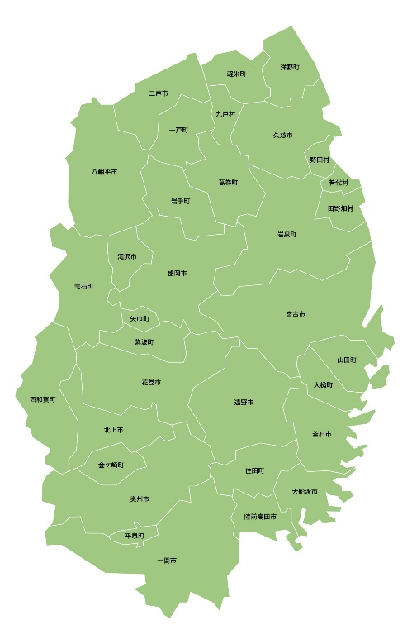

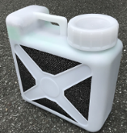
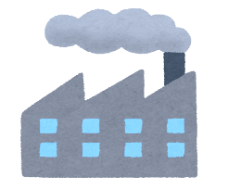




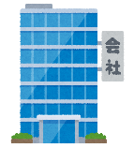
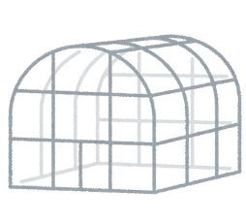






Autonomous intra-regional circulation
Iwate Pref.
Hot spring
Heat source
Heat source
Existing transportation system
Existing transportation system
Factory, Plant
Management
Transporting thermal energy
Delivery base
Transporting thermal energy
It is mostly mountainous areas
Heat user
Heat user
Agriculture
house
Transporting thermal energy
Wood
drying
Transporting thermal energy
Last one mile
Last one mile
We anticipate the ILC will begin operation around 2040. By that time, we aim to complete a regional thermal energy circulation system as a business venture, utilizing the recovery and utilization of low-grade waste heat.
We plan to place an air-cooled cooling tower upstream of the ILC facility's water-cooled cooling tower and install HASClay within it. We are proceeding with design work targeting the recovery of approximately 20% of the ILC's waste heat energy.
This figure is provided courtesy of HKK
Notes:
弊社が目指す「地域熱エネルギー循環システム」について解説します。岩手県には小規模で分散している多くの排熱施設と熱を必要としている需要先があり、これらをネットワーク化し、多くの人が排熱利用を可能にする仕組みを目指しています。岩手県内の工場や温泉施設の排熱をハスクレイで回収し、近隣の熱需要先に搬送して再利用します。例えば農業ハウスで冬の暖房に用いたり、木材乾燥などに使うことを想定しています。
しかし、私たちが暮らす岩手県はその面積の多くを中山間地域が占めており、仮に大規模な排熱源があってもその近隣に熱需要施設を集約することは困難です。
世の中の排熱利用技術は、一般的にはオンライン、つまり配管を使って、高い温度域の排熱を周辺の施設に送るものです。ただ、経済性が成り立つのはせいぜい2km以内の距離と言われています。
弊社が考える熱搬送は、配管を使わない車を使ったオフライン搬送です。ハスクレイは水分を遮断しさえすれば半永久的に熱を保存することができることから、未利用排熱をロスすることなく離れた場所に搬送することが可能であると考えています。
ハスクレイを搬送する際は、輸送費用が増えたり、CO2排出量が増加してしまってはいけませんので、既存の輸送形態（今生活の中で動いている車）に便乗する「ついで輸送」の仕組みを構築します。
ハスクレイは集配拠点に集積し、管理会社が需給管理などを行い、熱の利用者は集配拠点（日常通う場所、農家さんなら産直とか）から使いたい分だけハスクレイを持ち運んで利用します。ラストワンマイルは利用者が自ら担う仕組みになります。
ハスクレイを誰でも手軽に持ち運べるサイズの容器に充填して扱うことでこの仕組みが可能になると考えております。
私たちが目指す事業は、この仕組みが地域内で自律的に回るものです。

Slide 8


3. Town Planning for ILC Candidate Sites Based on Wooden Architecture.
The Tohoku ILC Project Development Center, Iwate University, and the corporate consortium established a joint research framework and initiated collaborative research based on the premise that urban planning for regions seeking to host the ILC should be examined with the same emphasis on sustainability as the ILC itself.
Specifically, a subgroup focused on urban planning based on timber construction was formed (see below for members). Here, we introduce some of its activities.
Members of the Subgroup
NTT Urban Solutions Group
Rie Ueda & Sadayoshi Hirai, Japan's largest communications company
Mutsumi Hareyama
Shelter Co.,Ltd.
Hiroyuki Adachi, Pioneer in large-scale timber construction
Asia Air Survey Co., Ltd. Hiroaki Terasawa
Takasago Thermal Engineering Co., Ltd. Takashi Kokubo
Masakazu Yoshioka
Sumitomo Mitsui Construction Co., Ltd. Jyuji Sawai
Obayashi Corp. Shoko Yashio

Slide 9
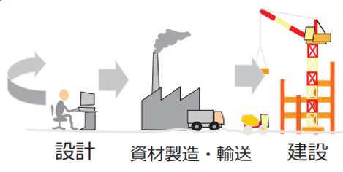
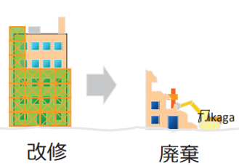
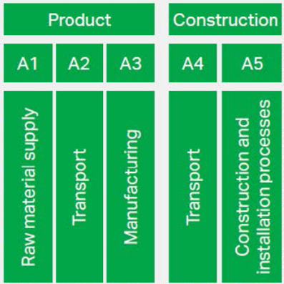
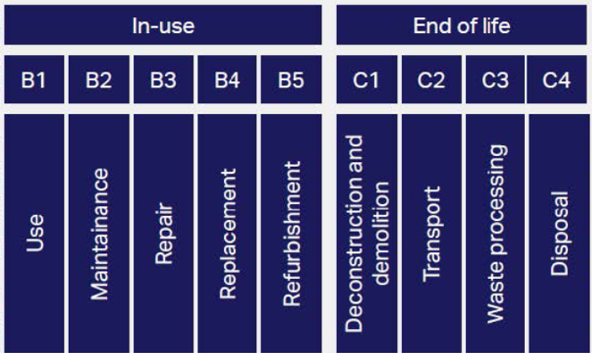
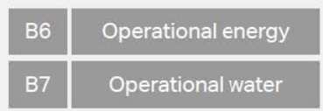
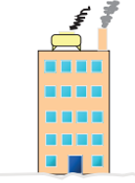
Calculation of Building Lifecycle Greenhouse Gas Emissions Using J-CAT
  J-CAT/Japan Carbon Assessment Tool for Building Lifecycle is a tool for calculating greenhouse gas emissions throughout the entire lifecycle of a building.
  J-CAT enables the calculation of whole-life carbon for buildings in Japan, covering not only upfront carbon from raw material procurement to construction, but also the use phase and the entire lifecycle from demolition/removal to waste disposal, in accordance with the notation categories defined in ISO 21930.
  This study used the ILC Collision Point Campus (Based on the ILC-TDR, the working hypothesis we formulated) as a case study and performed a preliminary calculation of CO₂ emissions during construction (upfront carbon) using J-CAT.
Whole life carbon
Upfront carbon
ISO 21930:
2017 Sustainability in buildings and civil engineering works — Core rules for environmental product declarations of construction products and services
Operational carbon
J-CAT：https://www.ibecs.or.jp/english/JCAT/index.html
Notes:
ホールライフカーボンとは、建物のライフサイクル 全体にわたるカーボン排出量のこと
・これは、製造、建設、運用、改修、廃棄の各段階での排出量を含む
・エンボディドカーボンは、運用段階の設備によるエネルギー消費を除く、建築物の資材調達から解体・廃棄段階でのCO2排出量

Slide 10
Building uses were classified into “large-scale experimental building” and “office building”. We compared two cases, steel-frame structures and timber structures.
The CO₂ reduction effect from using timber structures was 23%.
Using locally sourced timber also brings the following benefits;
  Reduces CO₂ emissions during manufacturing and transportation.
  Promotes forest management, increasing absorption capacity through proper reforestation and forest cultivation (healthy forest cycle).
  Generates economic ripple effects for related industries.
  Generates local employment
（t-CO2）
office buildings
12000 m²
Reduction of 23% through wood construction
large-scale experi-mental buildings
13000 m²
Carbon fixation:
Carbon sequestration for large-scale spatial facilities.
Notation method: ISO 21930 (2017).
Calculation method: Based on the Forestry Agency's Guidelines for Displaying Carbon Storage in Wood Used in Buildings
carbon storage
steel-frame structures
timber structures

Slide 11
Thank you for your attention
Acknowledgments:
This report is based on the contributions of numerous collaborators.
We extend our gratitude to the participating companies and individuals involved.

