Slide 1
Overview of Wakefield Acceleration Recent Progress and R&D Challenges
M. Turner
1

Slide 2
Outline
Introduction to Wakefield Acceleration
Recent Experimental Progress
Laser and Beam Driven Plasma Wakefield Acceleration
Linear Collider Design Studies
R&D Challenges
Design Studies
Towards Applications
Recent Technology R&D Progress
Summary & Conclusion
22.10.2025
M. Turner, LCWS 2025
1 / 16

Slide 3
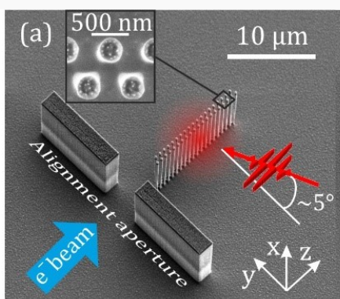
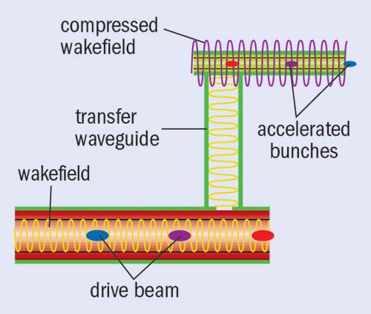
High-Gradient Wakefield Acceleration
Includes all concepts that can achieve an acceleration gradient > 1 GeV/m
High gradients → Compact accelerators → Potentially lower cost & environmental footprint
Wakefields in Dielectric Structures
Laser Driven
Beam Driven
Accelerating gradient on the order of 1 GeV/m
22.10.2025
M. Turner, LCWS 2025
2 / 16
Notes:
3

Slide 4
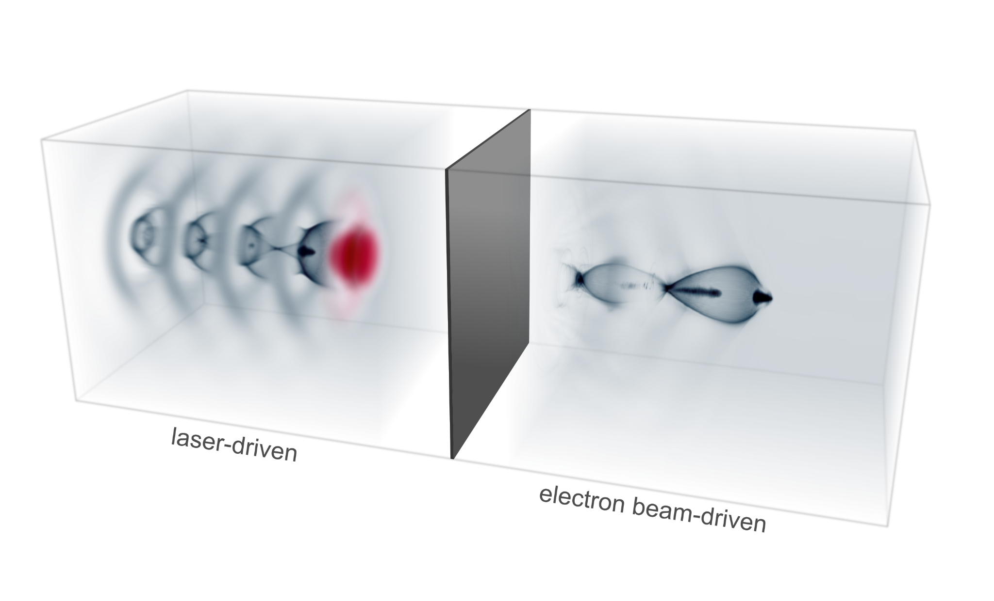
High-Gradient Wakefield Acceleration
Includes all concepts that can achieve an acceleration gradient > 1 GeV/m
High gradients → Compact accelerators → Potentially lower cost & environmental footprint
Wakefields in Dielectric Structures
Wakefields in Plasma
Laser Driven
Beam Driven
Laser Driven
Beam Driven
Session on Advanced Accelerator Technologies
Presentation by M. Konrad: Recent Progress in Dielectric Laser Acceleration → Wednesday 12h30
Session on Advanced Accelerator Technologies
Presentation by X. Lu: Progress and challenges in RF structures for short-pulse SWFA → Thursday 12h30
Accelerating gradient 1-100 GeV/m
22.10.2025
M. Turner, LCWS 2025
2 / 16
Notes:
4

Slide 5
To be a Candidate for a Linear Collider, Wakefield Acceleration Must Offer a Path To…
High
Energy
High
Luminosity
High
Efficiency
22.10.2025
M. Turner, LCWS 2025
3 / 16

Slide 6
Outline
Introduction to Wakefield Acceleration
Recent Experimental Progress
Laser and Beam Driven Plasma Wakefield Acceleration
Linear Collider Design Studies
R&D Challenges
Design Studies
Towards Applications
Recent Technology R&D Progress
Summary & Conclusion
22.10.2025
M. Turner, LCWS 2025

Slide 7
Outline
Introduction to Wakefield Acceleration
Recent Experimental Progress
Laser and Beam Driven Plasma Wakefield Acceleration
Linear Collider Design Studies
R&D Challenges
Design Studies
Towards Applications
Recent Technology R&D Progress
Summary & Conclusion
22.10.2025
M. Turner, LCWS 2025

Slide 8

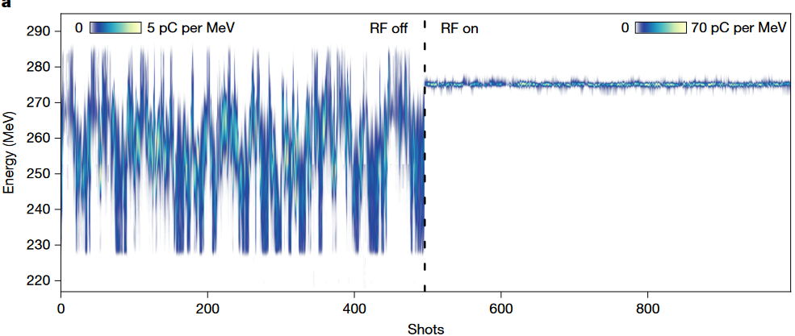
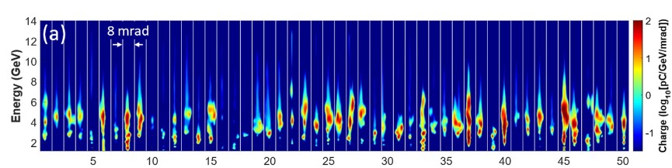
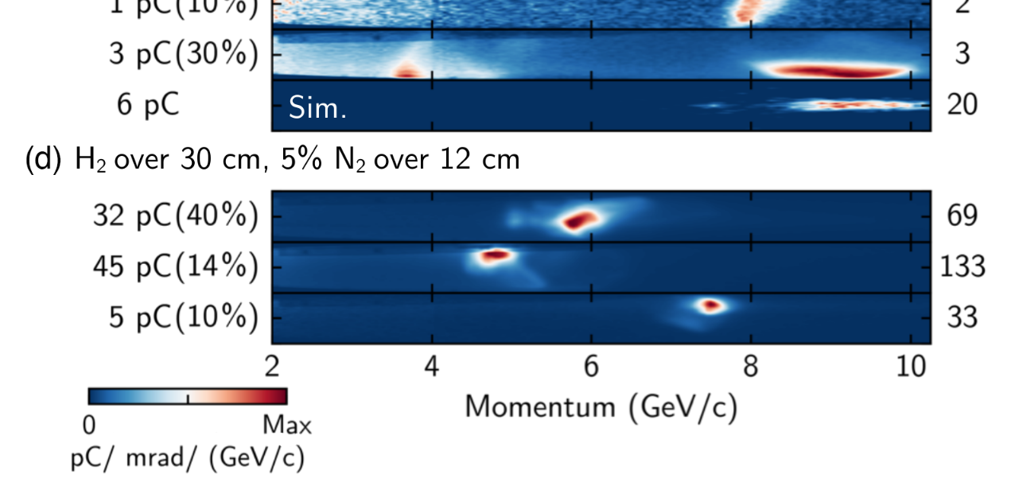


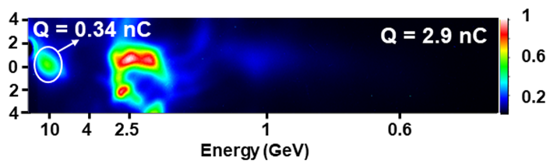

Recent Progress in Experiments Highlights from Single Stage Experiments → Laser-Driven
Energy
Beam Quality
Efficiency
Matched Guiding and Controlled Injection in Dark-Current-Free, 10-GeV-Class, Channel-Guided Laser-Plasma Accelerators
A. Picksley et al., Phys. Rev. Lett. 133, 255001 (2024)
Winkler, P. et al. Active energy compression of a laser-plasma electron beam. Nature 640, 907–910 (2025).
E. Rockafellow et a;., High charge laser acceleration of electrons to 10 GeV
NIM A, Volume 1077, August 2025, 170586
→ ~9.2 GeV energy gain over 30 cm
→ Laser-created ‘free-standing’ plasma channels that can be recreated at the repetition rate of the laser
→ Multiple independent results
→ Laser to electron conversion efficiency of at least ∼30%
→ Multi-GeV energy gain
Energy spread and jitter below permille level by employing active stabilization
C. Aniculaesei et al., The acceleration of a high-charge electron bunch to 10 GeV in a 10-cm nanoparticle-assisted wakefield accelerator. Matter Radiat. Extremes 2024; 9 (1): 014001
→ ~10 GeV energy gain over 10 cm
→ Multiple acceleration regimes that may be difficult to control
22.10.2025
M. Turner, LCWS 2025
4 / 16
Notes:
Add logos, add also desy result,
8

Slide 9
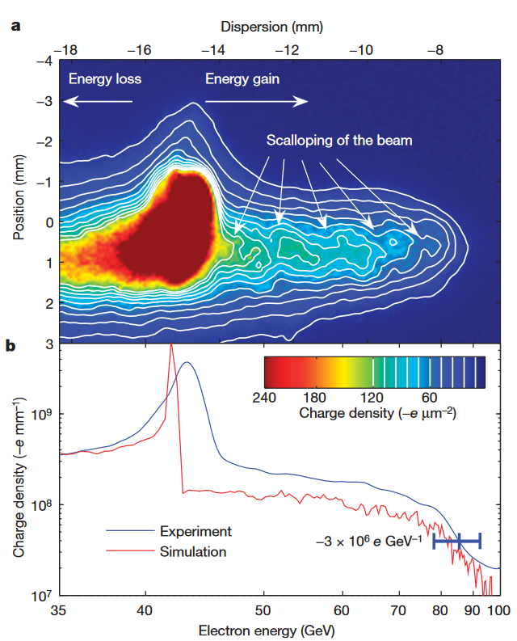

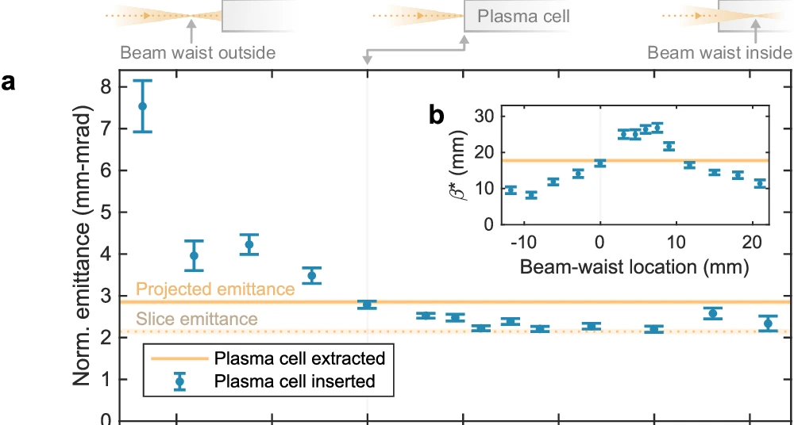
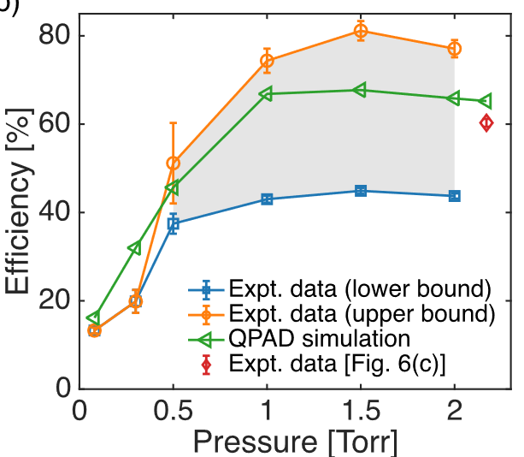
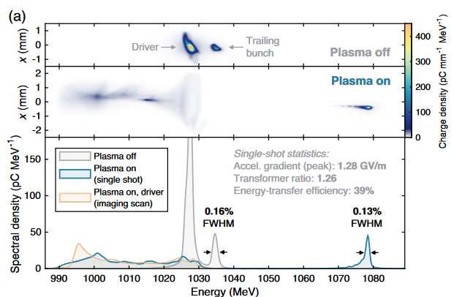

Recent Progress in Experiments Highlights from Single Stage Experiments → Beam-Driven
Energy
Beam Quality
Efficiency
I. Blumenfeld et al., Nature 445, 741 (2007):
Lindstrøm, C.A. et al. Emittance preservation in a plasma-wakefield accelerator. Nat Commun 15, 6097 (2024)
C Zhang et al 2024 Plasma Phys. Control. Fusion 66 025013
C. A. Lindstrøm et al., Phys. Rev. Lett. 126, 014801 (2021)
→ Emittance preservation at micron level for 40 MeV energy gain (on top of 1 GeV)
→ ~60% driver depletion
→ 42% local energy transfer efficiency
Session on Advanced Accelerator Technologies
Presentation by J. Wood: Progress in Experimental Plasma Wakefield Acceleration at FLASHForward, DESY → Thursday 11h50
→ 42 GeV energy gain in 85 cm
22.10.2025
M. Turner, LCWS 2025
4 / 16
Notes:
Add logos, add also desy result,
9

Slide 10

For Now In Experiments:
Choose 1, Maybe 2 (at the same time)
Energy
Quality
Efficiency
Large final energy gain
Small emittance and energy spread, high charge
Minimal power/energy consumption
22.10.2025
M. Turner, LCWS 2025
5 / 16

Slide 11

Our Community Is Working Towards Delivering Beams With…
→ Exact needs/tolerances depend on the application
&
&
Energy
Quality
Efficiency
GeV, TeV
High beam charge and quality
Low power consumption
22.10.2025
M. Turner, LCWS 2025
5 / 16

Slide 12
Outline
Introduction to Wakefield Acceleration
Recent Experimental Progress
Laser and Beam Driven Plasma Wakefield Acceleration
Linear Collider Design Studies
R&D Challenges
Design Studies
Towards Applications
Recent Technology R&D Progress
Summary & Conclusion
22.10.2025
M. Turner, LCWS 2025

Slide 13
Outline
Introduction to Wakefield Acceleration
Recent Experimental Progress
Laser and Beam Driven Plasma Wakefield Acceleration
Linear Collider Design Studies
R&D Challenges
Design Studies
Towards Applications
Recent Technology R&D Progress
Summary & Conclusion
22.10.2025
M. Turner, LCWS 2025

Slide 14
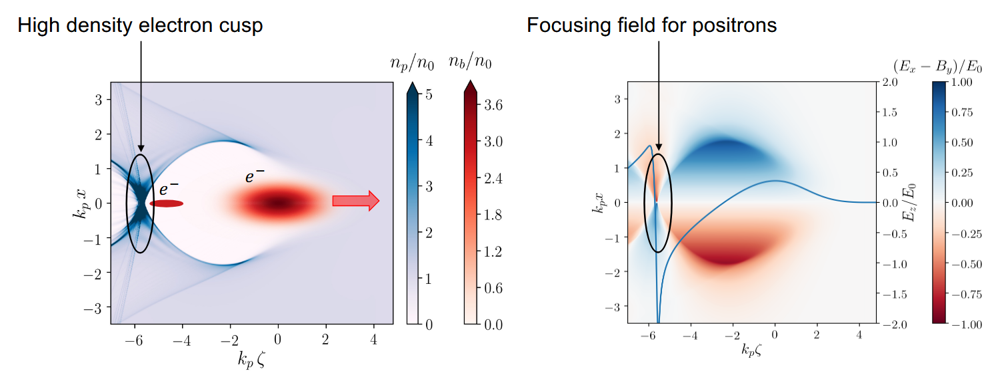
Wakefield Acceleration Comes with Unique Challenges
Including:
1) Positron Acceleration in Plasma
Acceleration in the non-linear regime is not symmetric for positive and negative charges
+
+
+
+
+
+
+
+
+
+
Images from: https://indico.cern.ch/event/1193719/contributions/5274924/attachments/2617597/4524780/SDiederichs_ALEGRO_2023_Positrons.pdf
22.10.2025
M. Turner, LCWS 2025
6 / 16

Slide 15
Wakefield Acceleration Comes with Unique Challenges
Including:
1) Positron Acceleration in Plasma
Acceleration in the non-linear regime is not symmetric for positive and negative charges
+
+
+
+
+
+
+
+
+
+
Positron acceleration: TRL 1!
Images from: https://indico.cern.ch/event/1193719/contributions/5274924/attachments/2617597/4524780/SDiederichs_ALEGRO_2023_Positrons.pdf
Session on Advanced Accelerator Technologies
Presentation by S. Zhou: Advances in plasma-based positron acceleration → Thursday 13h10
Wakefields in Dielectric Structures
22.10.2025
M. Turner, LCWS 2025
6 / 16

Slide 16
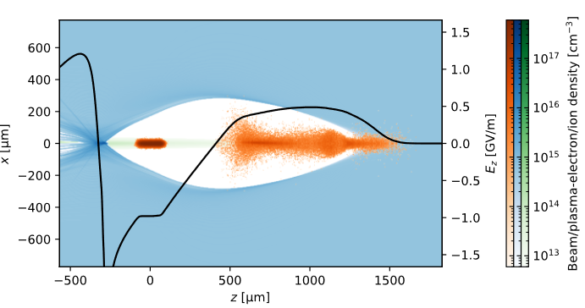
Wakefield Acceleration Comes with Unique Challenges
Including:
1) Positron Acceleration in Plasma
Acceleration in the non-linear regime is not symmetric for positive and negative charges
2) Staging
Driver 1
Witness
Plasma 1
One stage may be sufficient…
22.10.2025
M. Turner, LCWS 2025
6 / 16

Slide 17
Wakefield Acceleration Comes with Unique Challenges
Including:
1) Positron Acceleration in Plasma
Acceleration in the non-linear regime is not symmetric for positive and negative charges
2) Staging
Tight tolerances, matching
Must be compact
Refocus
Witness
Driver 1
Witness
Plasma 1
Plasma 2
Driver 2
Concepts exist.
No experimental demonstration with high charge transfer yet!
Unit cell
22.10.2025
M. Turner, LCWS 2025
6 / 16

Slide 18
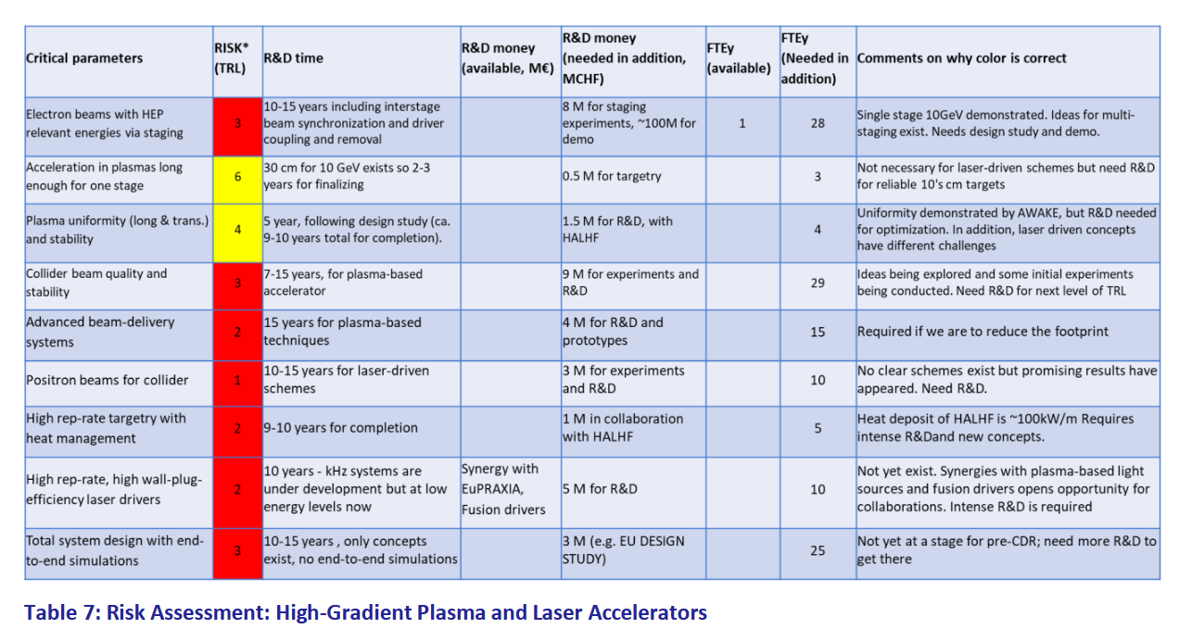
Wakefield Acceleration Comes with Unique Challenges
Including:
1) Positron Acceleration in Plasma
Acceleration in the non-linear regime is not symmetric for positive and negative charges
2) Staging
Tight tolerances, matching
Must be compact
…
ESPP Input #154: European Accelerator R&D Platform Review for the Laboratory Directors Group (link)
22.10.2025
M. Turner, LCWS 2025
6 / 16

Slide 19
Outline
Introduction to Wakefield Acceleration
Recent Experimental Progress
Laser and Beam Driven Plasma Wakefield Acceleration
Linear Collider Design Studies
R&D Challenges
Design Studies
Towards Applications
Recent Technology R&D Progress
Summary & Conclusion
22.10.2025
M. Turner, LCWS 2025

Slide 20
Strategy 1: Avoid Positron Acceleration
Positron acceleration: TRL 1!
22.10.2025
M. Turner, LCWS 2025

Slide 21

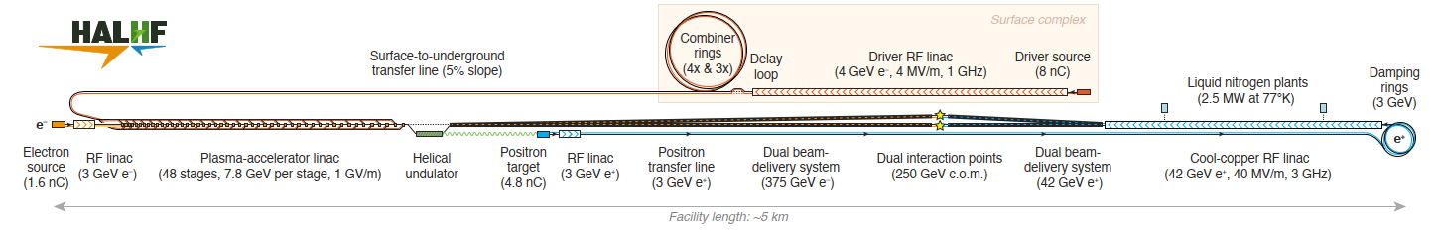
Collider Design Studies
Since 2023
HALHF Hybrid, Asymmetric, Linear Higgs Factory
e⁻ acceleration in e⁻ beam–driven plasma wakefields
e⁺ acceleration in radiofrequency cavities (C³ technology)
To make most effective use of space → collision of polarised 375 GeV e⁻ with 42 GeV e⁺
Foster et al., Phys. Open 23, 100261 (2025)
Asymmetric collisions: 375 GeV polarized e⁻ with 41.7 GeV polarized e⁺ (boost: γ=1.67), Center-of-mass energy: 250 GeV.
→ upgrades 380, 550 GeV center-of-mass energy discussed
Advantages:
+ most advanced wakefield collider concept → avoids e⁺ acceleration in plasma
+ compact footprint, ~5 km
Estimated luminosity: 1.2x10³⁴ cm⁻²s⁻¹ → two IPs
Estimated total power usage: 106 MW
Estimated cost: 3.8 BCHF (2024 Swiss francs)
Estimated R&D time (technically limited): 10-15 years
22.10.2025
M. Turner, LCWS 2025
7 / 16

Slide 22
Collider Design Studies - Challenges
Since 2023
HALHF Hybrid, Asymmetric, Linear Higgs Factory
Challenges:
High repetition rate plasma operation and cooling, Staging, Production and acceleration of polarized beams, BDS design,…
10-15 years of R&D
ESPP Input #57: HALHF: a hybrid, asymmetric, linear Higgs factory using plasma- and RF-based acceleration (link)
e⁻ acceleration in e⁻ beam–driven plasma wakefields
e⁺ acceleration in radiofrequency cavities
To make most effective use of space → collision of 375 GeV e⁻ with 42 GeV e⁺
Next:
Presentation by B. Foster: Hybrid collider concepts
Session on Advanced Accelerator Technologies
Presentation by R. D’Arcy: HALHF: Recent updates, R&D, tools, insights, and plans → Thursday 9h00
Presentation by B. Chen: ABEL, A start-to-end simulation framework for plasma-based and conventional linear colliders → Thursday 9h20
Session on Damping rings, Beam dynamics, Beam delivery systems
Presentation by R. Garcia: Towards a Beam Delivery System for the HALHF Project → Thursday 12h30
Advantages:
+ most advanced wakefield collider concept → avoids e⁺ acceleration
+ compact footprint, ~5 km
22.10.2025
M. Turner, LCWS 2025
7 / 16

Slide 23
Strategy 2: Avoid Staging
Refocus
Witness
Driver 1
Witness
Plasma 1
Plasma 2
Driver 2
Interstage: conventional magnetic optics and/or plasma lenses
Unit cell
22.10.2025
M. Turner, LCWS 2025

Slide 24

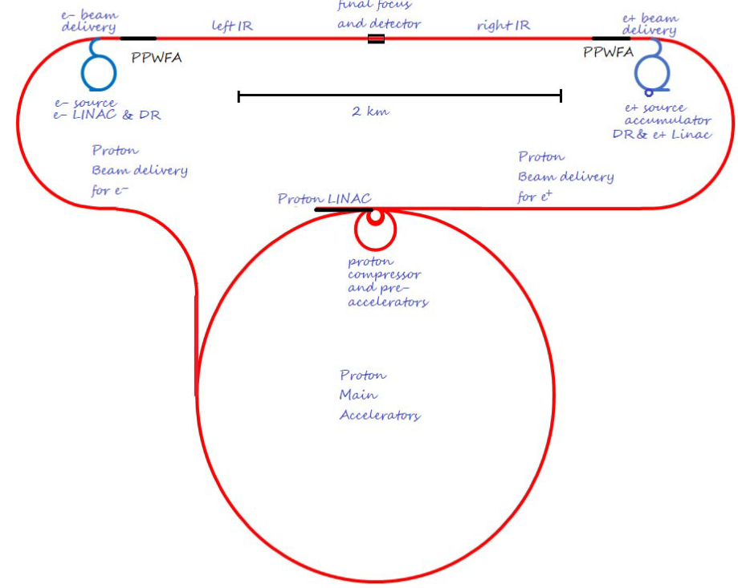
Collider Design Studies
Preliminary investigation of a Higgs factory based on proton-driven plasma wakefield acceleration J. Farmer et al., 2024 New J. Phys. 26 113011
Since 2024
ALiVE
A Linear accelerator for Very high Energies
e⁻ and e⁺ acceleration in single stage p⁺ beam-driven plasma wakefields
Enabled by the energetic and short p⁺ drivers
p⁺ drivers: high-rep.-rate 500 GeV synchrotron
Collider Parameters:
Centre-of-mass energy (CoM): 250 GeV Estimated luminosity: 1.7x10³⁴ cm⁻²s⁻¹
Footprint: ~4 x 2 km.
Advantages:
+ avoids staging
+ compact footprint
+ scaling to higher energies (10 TeV)
500 GeV p+ synchrotron
7 km circumference
high rep. rate: 14.4 kHz
Upgrade to ~7 TeV for 10 TeV collisions
22.10.2025
M. Turner, LCWS 2025
8 / 16

Slide 25
Collider Design Studies - Challenges
Preliminary investigation of a Higgs factory based on proton-driven plasma wakefield acceleration J. Farmer et al., 2024 New J. Phys. 26 113011
Since 2024
ALiVE
A Linear accelerator for Very high Energies
e⁻ and e⁺ acceleration in single stage p⁺ beam-driven plasma wakefields
Enabled by the energetic and short p⁺ drivers
p⁺ drivers: high-rep.-rate 500 GeV synchrotron
Challenges:
High power synchrotron, Proton Bunch Compression, Plasma Source Development, Positron Acceleration, Energy Transfer Efficiency, Beam Quality Preservation,…
ESPP Input #210: Proton-Driven Plasma Wakefield Acceleration for Future HEP Colliders (link)
Collider Parameters:
Centre-of-mass energy (CoM): 250 GeV Estimated luminosity: 1.7x10³⁴ cm⁻²s⁻¹
Footprint: ~4 x 2 km.
Advantages:
+ avoids staging
+ compact footprint
+ scaling to higher energies (10 TeV)
Session on Advanced Accelerator Technologies
Presentation by J. Farmer: ALiVE: Proton-driven plasma wakefield acceleration for collider applications → Thursday 9h40
22.10.2025
M. Turner, LCWS 2025
8 / 16

Slide 26
To Achieve This…
Staging
or
Energetic drivers
Repetition rate
and
Charge per bunch
and
Emittance
Wall-plug to Drivers
x
Driver to Wake
x
Wake to Witness

Slide 27
Preliminary Plasma Collider Parameters
Energy
Luminosity
Efficiency
HALHF:
e-: 48 stages x 7.8 GeV = 375 GeV
e+: RF Linac 40 MV/m x 1.05 km= 42 GeV
ALIVE:
e-: 1 x 125 GeV
e+: 1 x 125 GeV
HALHF:
Avg. rep. rate: 16 kHz
Charge per bunch: 1.6 nC (e⁻) / 4.8 nC (e⁺)
Emittance (H/V): (90/0.32) mm mrad (e⁻) / (10/0.035) mm mrad (e⁺)
Luminosity: 1.2x10³⁴ cm⁻²s⁻¹ * → two IPs
* (0.76x10³⁴ cm⁻²s⁻¹ ) in top 1%
ALIVE:
Avg. rep. rate: 7.2 kHz
Charge per bunch: 3.2 nC (e⁻) / 3.2 nC (e⁺)
Emittance (H/V): (0.1/0.1) µm mrad (e⁻) / (0.4/0.4) µm mrad (e⁺)
Luminosity: 7x10³⁴ cm⁻²s^{-1 **}
** (0.25x10³⁴ cm⁻²s⁻¹ ) in top 1%
HALHF (PWFA Linac):
Wallplug-to-driver: 55%
Driver-to-wake efficiency: 80 %
Wake-to-beam efficiency: 50 %
Driver-to-beam efficiency: 40%
Wallplug-to-witness efficiency: 22%
ALIVE:
Wallplug-to-driver: 46 % (assumed)
Driver-to-wake efficiency: 12 % *
Wake-to-beam efficiency: 50 %
Driver-to-beam efficiency: 6 %
Wallplug-to-witness efficiency: 3 %
* there are avenues to improve
22.10.2025
M. Turner, LCWS 2025
9 / 16

Slide 28
Strategy 3: Aim Longer Term
And very high energies: 10+ TeV
Higgs factories
10+ TeV
collider
Collider building block
~10 years
~5 years
Particle physics applications
250 GeV
10 TeV
First user facilities
Low-Energy
Injector
O (~10s GeV)
→ Exploratory studies
O (~GeV)
HALHF
ALiVE
10 TeV Design Study
22.10.2025
M. Turner, LCWS 2025

Slide 29

Collider Design Studies
Since 2025
10 TeV Design Initiative for a 10 TeV pCM Wakefield Collider
The Design Study aims to produce a unified, self-consistent concept for a 10 TeV parton-center-of-mass (pCM) collider based on wakefield accelerator (WFA) technology.
Assume for now that is an upgrade to another linear collider facility.
Technology candidates:
Laser-Driven Plasma Wakefields
Beam-Driven Plasma Wakefields
Structure Wakefields
Chosen design constraints:
E_{z,avg} > 500 MeV/m
ℒ/P_{tot} > 10³² cm⁻²s⁻¹ MW⁻¹
Collider type:
e⁺e⁻
e⁻e⁻
γγ
Goals include delivery of:
+ end-to-end design study report in 2028
+ roadmaps and resource estimates
22.10.2025
M. Turner, LCWS 2025
10 / 16

Slide 30

Collider Design Studies
Since 2025
10 TeV Design Initiative for a 10 TeV pCM Wakefield Collider
https://indico.slac.stanford.edu/category/138/
Broad participation: detector physicists, particle physicists, etc…
Chosen design constraints:
E_{z,avg} > 500 MeV/m
ℒ/P_{tot} > 10³² cm⁻²s⁻¹ MW⁻¹
ESPP Input #98: Design Initiative for a 10 TeV pCM Wakefield Collider (link)
Technology candidates:
Laser-Driven Plasma Wakefields
Beam-Driven Plasma Wakefields
Structure Wakefields
209 Endorsers!
Collider type:
e⁺e⁻
e⁻e⁻
γγ
Session on Advanced Accelerator Technologies
Presentation by J. Osterhoff : The 10-TeV Wakefield Accelerator Collider Design Study → Tuesday 9h00
Presentation by C. Schroeder: Design considerations for a laser plasma accelerator based linear collider → Tuesday 9h40
Presentation by L. Verra: Beam-Driven Plasma Wakefield Accelerator for a 10 TeV Wakefield Collider → Tuesday 9h20
Poster by L. Verra: Beam-Driven Plasma Wakefield Accelerator for a 10 TeV Wakefield Collider → Tuesday 9h20
Presentation by P. Piot: Concept for an Energy-Frontier Collider based on Structure Wakefield Acceleration → Tuesday 10h00
Goals include delivery of:
+ end-to-end design study report in 2028
+ roadmaps and resource estimates
22.10.2025
M. Turner, LCWS 2025
10 / 16

Slide 31
Outline
Introduction to Wakefield Acceleration
Recent Experimental Progress
Laser and Beam Driven Plasma Wakefield Acceleration
Linear Collider Design Studies
R&D Challenges
Design Studies
Towards Applications
Recent Technology R&D Progress
Summary & Conclusion
22.10.2025
M. Turner, LCWS 2025

Slide 32



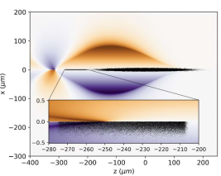


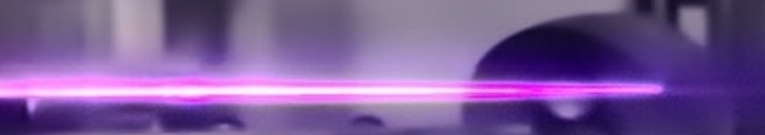


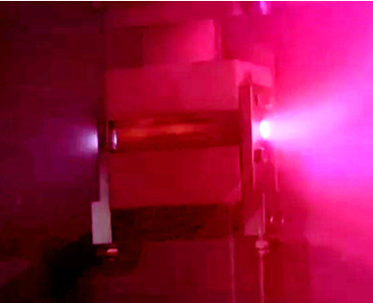
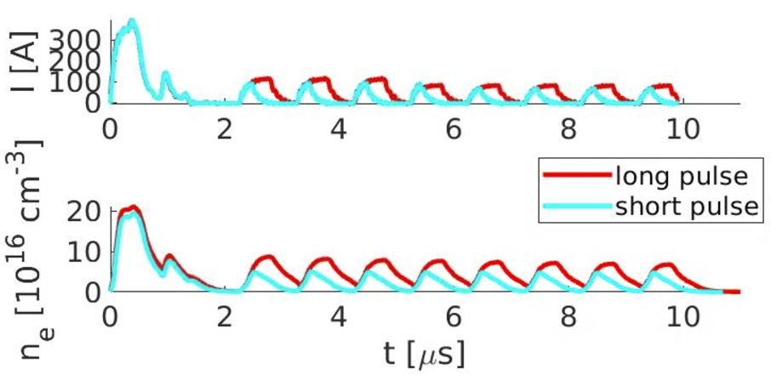
Progress on the Technology R&D Highlights
Simulation Tools
Plasma Sources
Efficient Laser Drivers
E.g. using..
Development of scalable plasma sources at CERN
Multiple technologies being investigated, e.g. Ti:Sa, fiber lasers, TmYLF, Tm-doped ceramics
S. Diederichs et al., Comput. Phys. Comm. 276 108421 (2022) Open-source: https://github.com/Hi-PACE/hipace
10 m long Discharge Plasma
HiPACE++
1 m long Helicon Plasma
Numerical convergence: few hrs on few GPU’s
Development of Joule-class kHz laser systems:
LPA Guiding channels
2x10⁷ discharges
10-150 Hz operation
KALDERA → based on Ti:Sa technology, started commissioning
kBELLA → efficient coherent combination of fiber lasers 10’s mJ at kHz, 100+ mJ in progress scheduled for next year
low voltage solid-state discharge system
→ MHz repetition rate
Multiple open source codes available to simulate collider quality beams
ceramic
22.10.2025
M. Turner, LCWS 2025
11 / 16
Notes:
Add logos, add also desy result,
32

Slide 33

+ Recent Progress in Experiments
Energy
Beam Quality
Efficiency
Matched Guiding and Controlled Injection in Dark-Current-Free, 10-GeV-Class, Channel-Guided Laser-Plasma Accelerators
A. Picksley et al., Phys. Rev. Lett. 133, 255001 (2024)
Winkler, P. et al. Active energy compression of a laser-plasma electron beam. Nature 640, 907–910 (2025).
C Zhang et al 2024 Plasma Phys. Control. Fusion 66 025013
C. A. Lindstrøm et al., Phys. Rev. Lett. 126, 014801 (2021)
→ ~9.2 GeV energy gain over 30 cm
→ Laser-created ‘free-standing’ plasma channels that can be recreated at the repetition rate of the laser
→ Multiple independent results
→ Towards delivering beams for first applications
Application will be used to mature wakefield acceleration technology
Energy spread below the permille level
Employing active stabilization
→ ~60% driver depletion
→ 42% local energy transfer efficiency
C. Aniculaesei et al., The acceleration of a high-charge electron bunch to 10 GeV in a 10-cm nanoparticle-assisted wakefield accelerator. Matter Radiat. Extremes 2024; 9 (1): 014001
Lindstrøm, C.A., Beinortaitė, J., Björklund Svensson, J. et al. Emittance preservation in a plasma-wakefield accelerator. Nat Commun 15, 6097 (2024)
E. Rockafellow et a;., High charge laser acceleration of electrons to 10 GeV
NIM A, Volume 1077, August 2025, 170586
→ Laser to electron conversion efficiency of at least ∼30%
→ Multi-GeV energy gain
→ ~10 GeV energy gain over 10 cm
→ Multiple acceleration regimes that may be difficult to control
→ Emittance preservation at micron level for 40 MeV energy gain (on top of 1 GeV)
22.10.2025
M. Turner, LCWS 2025
12 / 16
Notes:
Add logos, add also desy result,
33

Slide 34
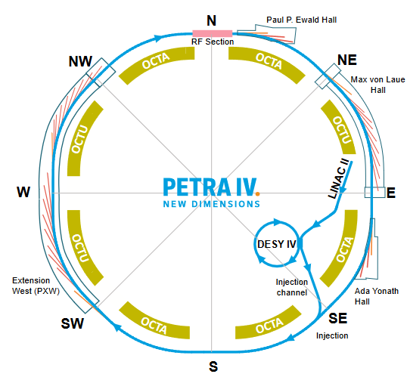
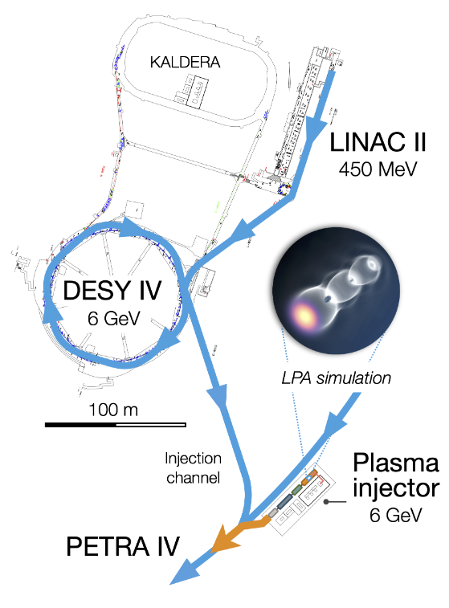
Summary of Applications Laser-Driven
Laser-Driven Plasma Wakefield Injector for PETRA IV injector complex :
Final Goal: 6 GeV injector, to decrease the spatial footprint and power requirements
PIP4 CDR A. Martinez de la Ossa et al. doi:10.3204/PUBDB-2024-06078
22.10.2025
M. Turner, LCWS 2025
13 / 16
Notes:
Add logos of labs
34

Slide 35
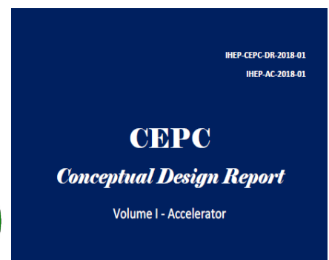
Summary of Progress on Applications Beam-Driven
Laser-Driven Plasma Wakefield Injector for PETRA IV injector complex :
Final Goal: 6 GeV injector, to decrease the spatial footprint and power requirements
(Proton-driven plasma wakefield experiment at CERN) Run 2c and d approved → First fixed-target applications after LS4
→ CEPC Injector
PIP4 CDR A. Martinez de la Ossa et al. doi:10.3204/PUBDB-2024-06078
Session on Advanced Accelerator Technologies
Presentation by W.Lu: Research platforms on plasma wakefield accelerator and future plans towards colliders in IHEP/SARI/BAQIS/THU→ Thursday 12h10
22.10.2025
M. Turner, LCWS 2025
13 / 16
Notes:
Add logos of labs
35

Slide 36


Summary of Progress on Applications Laser and Beam-Driven
Laser-Driven Plasma Wakefield Injector for PETRA IV injector complex :
Final Goal: 6 GeV injector, to decrease the spatial footprint and power requirements
(Proton-driven plasma wakefield experiment at CERN) Run 2c and d approved → First fixed-target applications after LS4
→ CEPC Injector
(Particle accelerator research infrastructure based on novel plasma acceleration)
→ FEL user facility by 2031
FEL lasing achieved by 4 groups!
Enabled by improved beam-quality and stability
PIP4 CDR A. Martinez de la Ossa et al. doi:10.3204/PUBDB-2024-06078
Session on Advanced Accelerator Technologies
Presentation by M. Ferrario: The EuPRAXIA project: a plasma-based accelerator user facility for the next decade→ Thursday 11h30
Plenary Session
Presentation by S. Barber: Applications: Near term applications of advanced accelerator technologies: compact free electron lasers→ Thursday 18h00
22.10.2025
M. Turner, LCWS 2025
13 / 16
Notes:
Add logos of labs
36

Slide 37
Outline
Introduction to Wakefield Acceleration
Recent Experimental Progress
Laser and Beam Driven Plasma Wakefield Acceleration
Linear Collider Design Studies
R&D Challenges
Design Studies
Towards Applications
Recent Technology R&D Progress
Summary & Conclusion
22.10.2025
M. Turner, LCWS 2025

Slide 38

The Wakefield Accelerator Community Supports a Linear Collider….
Because the key strength of wakefield accelerator lies in the high accelerating gradients
Wakefield acceleration could allow for exciting future energy upgrades and reuse of tunnel infrastructure
Win-win situation → Proposed by LCV for ESPP
ESPP Input #140: A Linear Collider Vision for the Future of Particle Physics (link)
16 dedicated talks @ LCWS!
22.10.2025
M. Turner, LCWS 2025
14 / 16

Slide 39




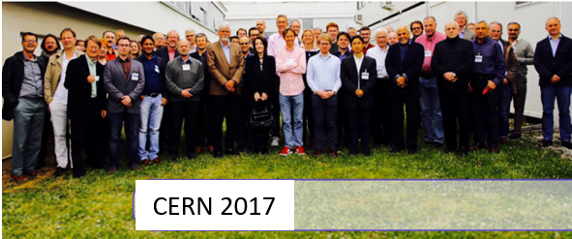
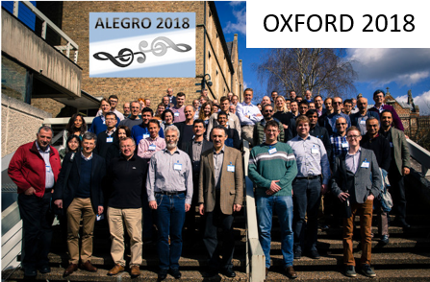
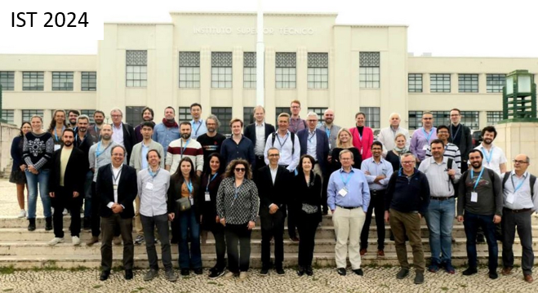
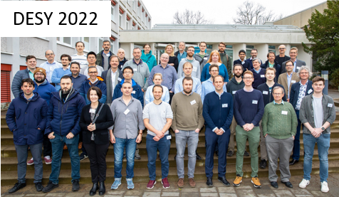


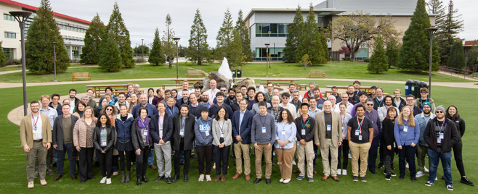
ALEGRO
ESPP Input #159: Contribution of ALEGRO to the Update of the European Strategy on Particle Physics (link)
ALEGRO: Advanced LinEar collider study GROup : An international study group to promote Advanced and Novel Accelerators for High Energy Physics applications.
Foster and trigger advanced linear collider related activities
Provide a framework to amplify international coordination, broaden the community, involving accelerator laboratories/institutes
Identify topics requiring intensive R&D and needed facilities
→ Driven by the ICFA-Advanced and Novel Accelerators (ANA) Panel
Main activities:
Organize workshops dedicated to applications of ANAs to particle and high-energy physics.
22.10.2025
M. Turner, LCWS 2025
15 / 16

Slide 40
Summary & Conclusions
Wakefield accelerators are exciting because of their high acceleration gradients
> 1 GeV/m
Plasma-based accelerators are approaching the performance levels required for applications
First applications are expected to come online within the next 5-10 years
Significant progress has been made on collider concepts, including the development of concrete parameter sets
There are remaining challenges that will require R&D
Exciting opportunity for an energy upgrade of another linear collider facility
22.10.2025
M. Turner, LCWS 2025
16 / 16

Slide 41

Thank you!

Slide 42
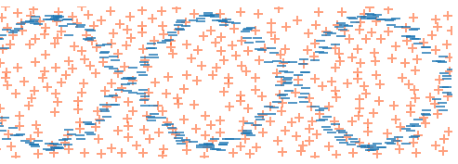
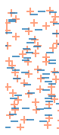
Periodicity: λ_{pe}
e-
Accelerating for e⁻
Decelerating for e⁻
Focusing for e⁻
Defocusing for e⁻
Drive
bunch

Slide 43
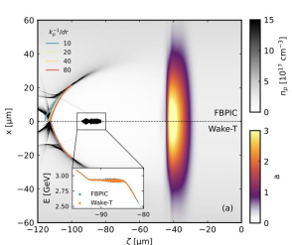
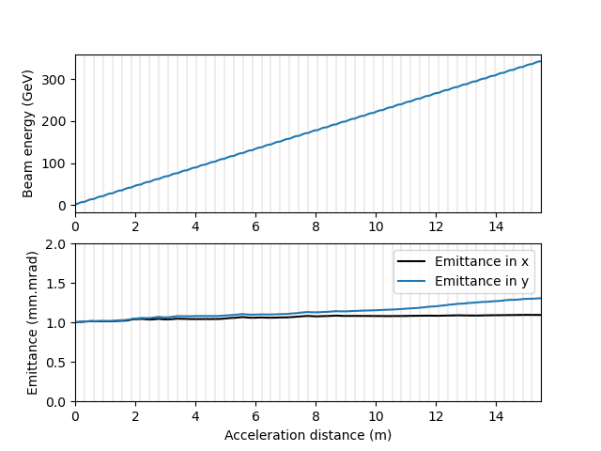

Collider-Quality Beams can Now be Simulated with Open-Source Codes
WakeT
HiPACE++
WarpX
+ collaborators
Open source https://github.com/Angel/FP/Wake-T moving soon to https://github.com/Wake-T/Wake-T
Ferran Pousa et al., in preparation
S. Diederichs et al., Comput. Phys. Comm. 276 108421 (2022) Open-source: https://github.com/Hi-PACE/hipace
J-L Vay et al., WarpX MS FY23.1 and FY23.2 (2023);
Fedeli L, Huebl A, et al. SC22: 2022. DOI:10.1109/SC41404.2022.00008
Numerical convergence: 7min on a CPU core
Numerical convergence: few hrs on few GPU’s
256 GPUs for 8h on Perlmutter (NERSC)
2D cylindrical, quasistatic
adaptive grid method → fully converged simulations of beams with nm-scale emittance including ion motion, on a laptop
3D quasistatic
Ion motion, ionisation, spin tracking included
Mesh refinement makes simulations in 3D (very) affordable.
3D full-PIC
modelling of 50 multi-GeV stages
idealized transport
low witness bunch charge
Notes:
Add logos, add also desy result,
43

Slide 44

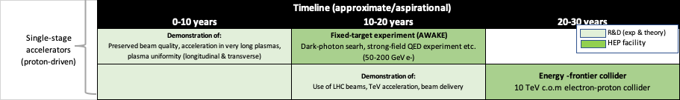

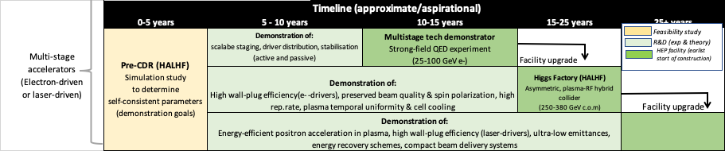
Roadmap based on LDG report findings
LDG
Defined in 2023
Recommendation #1 (link):
Ensure the timely completion of HALHF pre-CDR study and plan for an independent review
Notes:
Make this in paralle
44

Slide 45
Plasma Wakefield Linac
Driver
Witness
If the single stage energy gain is not sufficient
→ Staging until the desired energy is reached
Plasma
Refocus
Witness
Driver 1
Witness
from (link)
Witness
Driver
Plasma 1
Plasma 2
Driver 2
Driver loses energy
Witness gains energy
Energy gain per stage depends on the drive, witness and plasma parameters
One plasma stage may be sufficient
Interstage: conventional magnetic optics and/or plasma lenses
Unit cell
Notes:
If we look more closely at a plasma wakefield acceleration stage, we have the driver, which excites a plasma wakefield, and the witness which gains energy from the wakefields. When the driver is a laser pulse, one sometimes adds a guiding channel
45

Slide 46
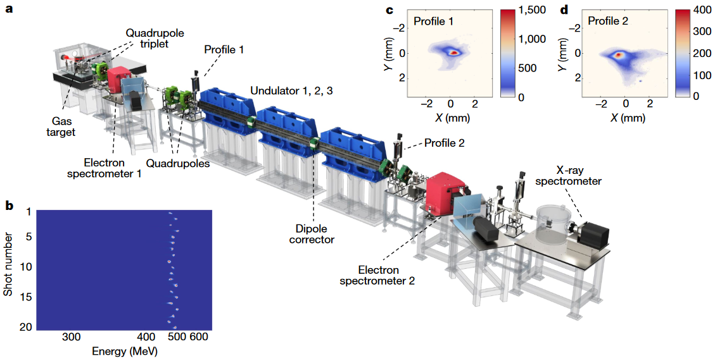

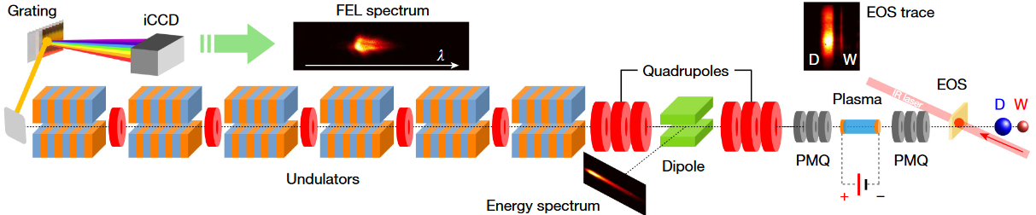



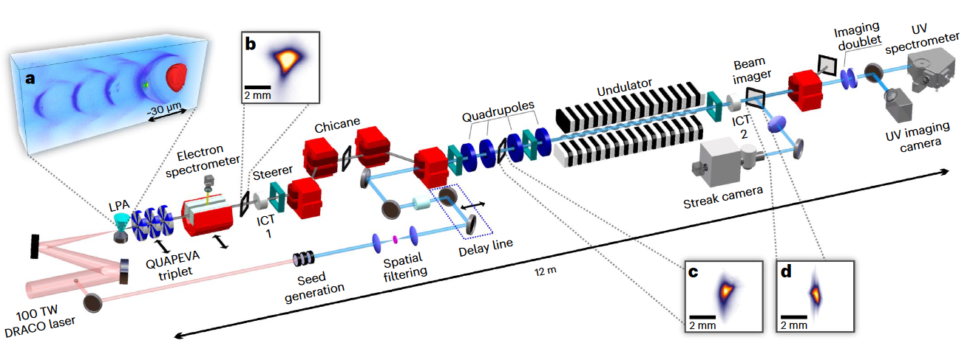
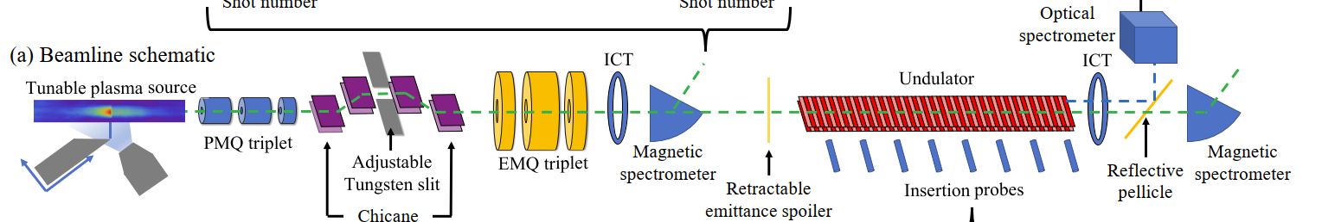
FEL Lasing Achieved by Four Groups → Enabled by Improved Beam-Quality and Stability
Lasing at 27 nm
490 MeV, ~0.5% energy spread, 30 pC
Pompili, R., et al. Free-electron lasing with compact beam-driven plasma wakefield accelerator. Nature 605, 659–662 (2022).
Beam-driven
5.8 MeV energy gain, 0.3% energy spread, 20 pC
Wang, et al. Free-electron lasing at 27 nanometres based on a laser wakefield accelerator. Nature 595, 516–520 (2021).
Labat, M., et al. Seeded free-electron laser driven by a compact laser plasma accelerator. Nat. Photon. 17, 150–156 (2023).
S. K. Barber et al., Greater than 1000-fold gain in a free-electron laser driven by a laser plasma
accelerator with high reliability, under review
Seeded free-electron laser
188 MeV, ~6.3% energy spread, ~100 pC
SASE gain >1000, some gain on >90% events
~100 MeV, 2% energy spread, ~90 pC
Notes:
Add logos of labs
46

Slide 47

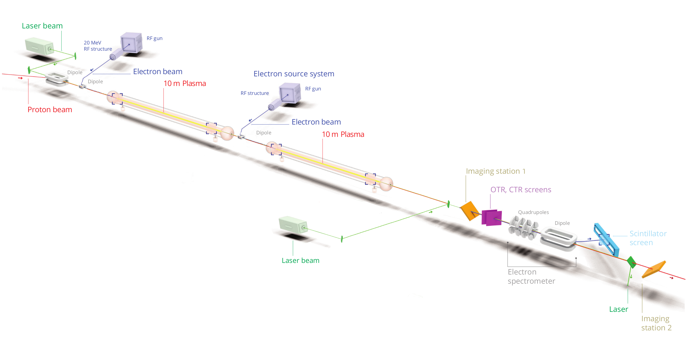
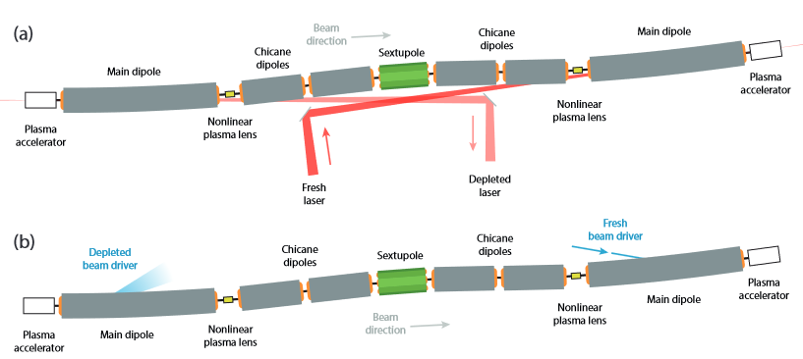
Progress Towards First Applications
Particle accelerator research infrastructure based on novel plasma acceleration
Proton-driven plasma wakefield experiment at CERN
Toward a demonstrator facility for multistage plasma acceleration
ESPP Input #172: AWAKE - Input to the European Strategy for Particle Physics Update on behalf of the AWAKE Collaboration (link)
High repetition rate plasma sources
Technology R&D and critical experimental facilities
LPA demonstrator stages (low average power, near collider emittances)
PWFA staging (including low-energy design at EuPRAXIA@SPARC_LAB)
Positron beam test capabilities
FEL user facility starting in 2029
AWAKE is the first to go
into LS3!
C. A. Lindstrøm et al., Proceedings of IPAC 2025
Run 2c and d approved
Separate Self-Modulation from acceleration to accelerate bunches with quality at few GeV energies
Experiments starting in 2029
First applications after LS4
Developing:
nonlinear plasma lenses
self-correction mechanisms
→ multistage demonstrator facility e.g., with 50 GeV for strong-field QED, to be implemented in a major accelerator lab.

