Slide 1
PATH (Plasma Accelerator towards TeV Horizon)
A China initiated effort towards future light source and collider
Wei Lu
Institute of High Energy Physics (IHEP)
Beijng, China
International Workshop on Future Linear Collider 2025
Valencia, Spain Oct. 23, 2025

Slide 2
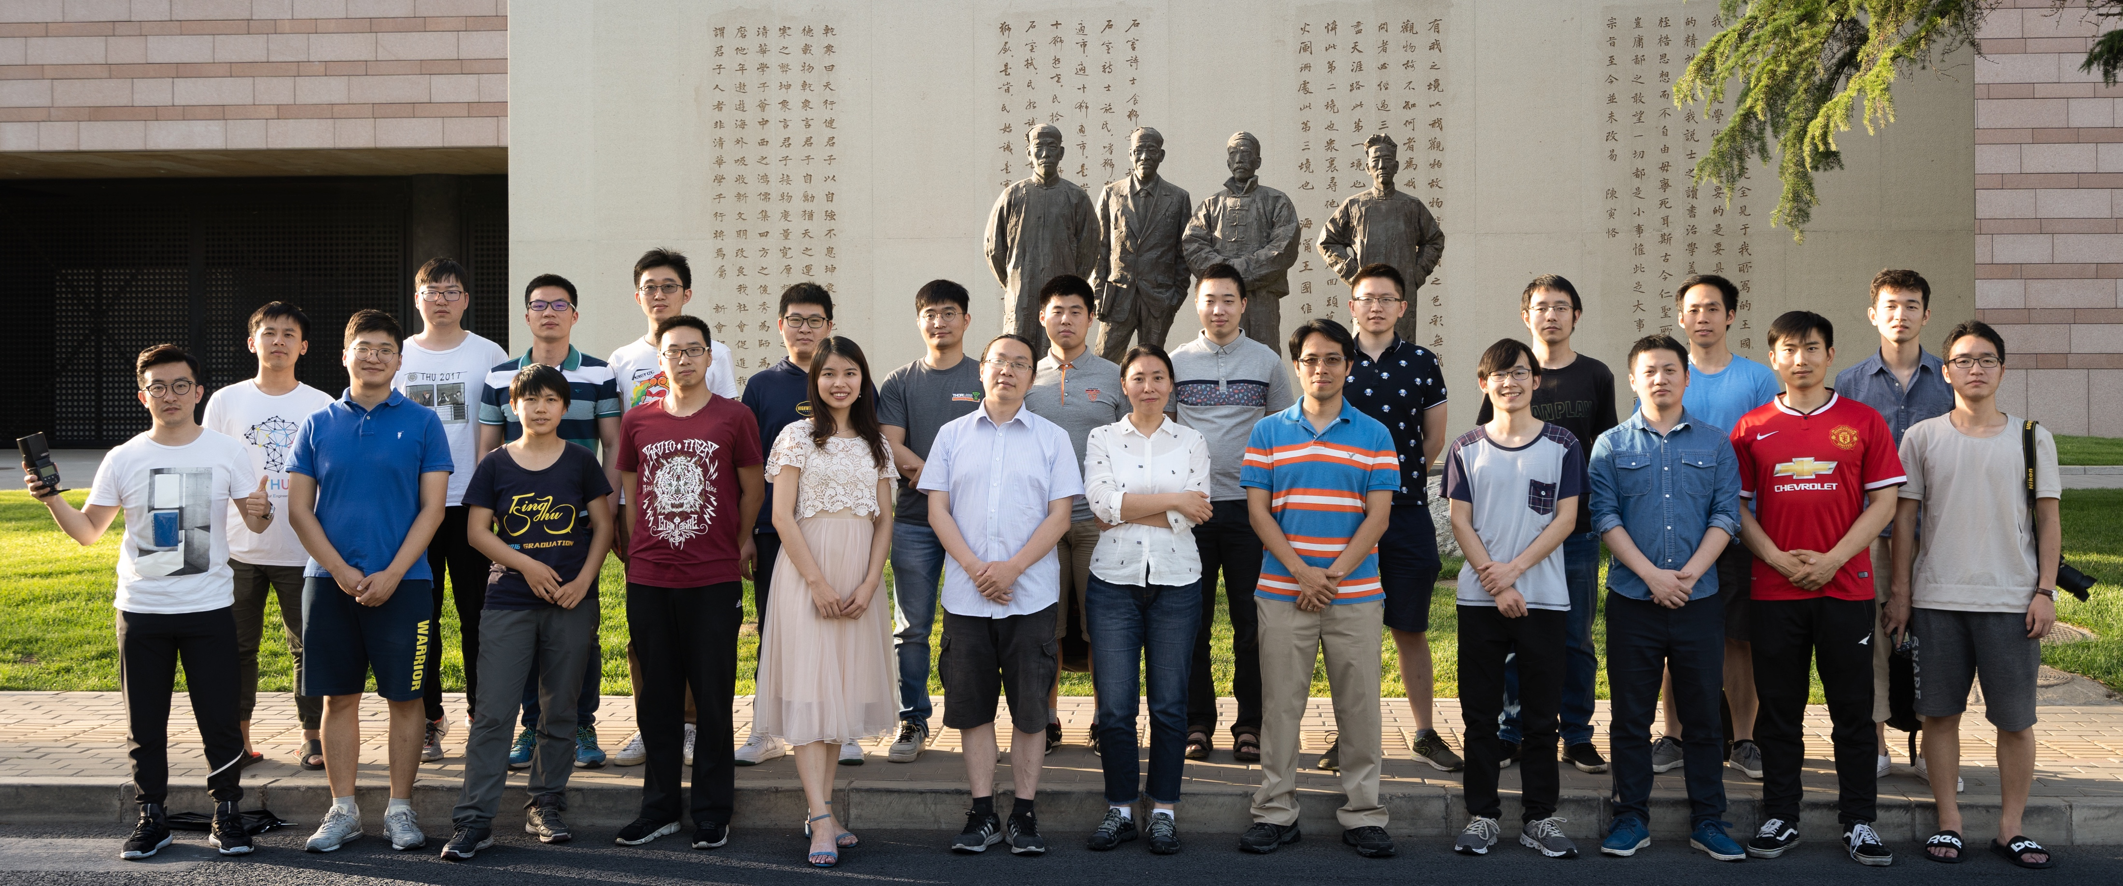

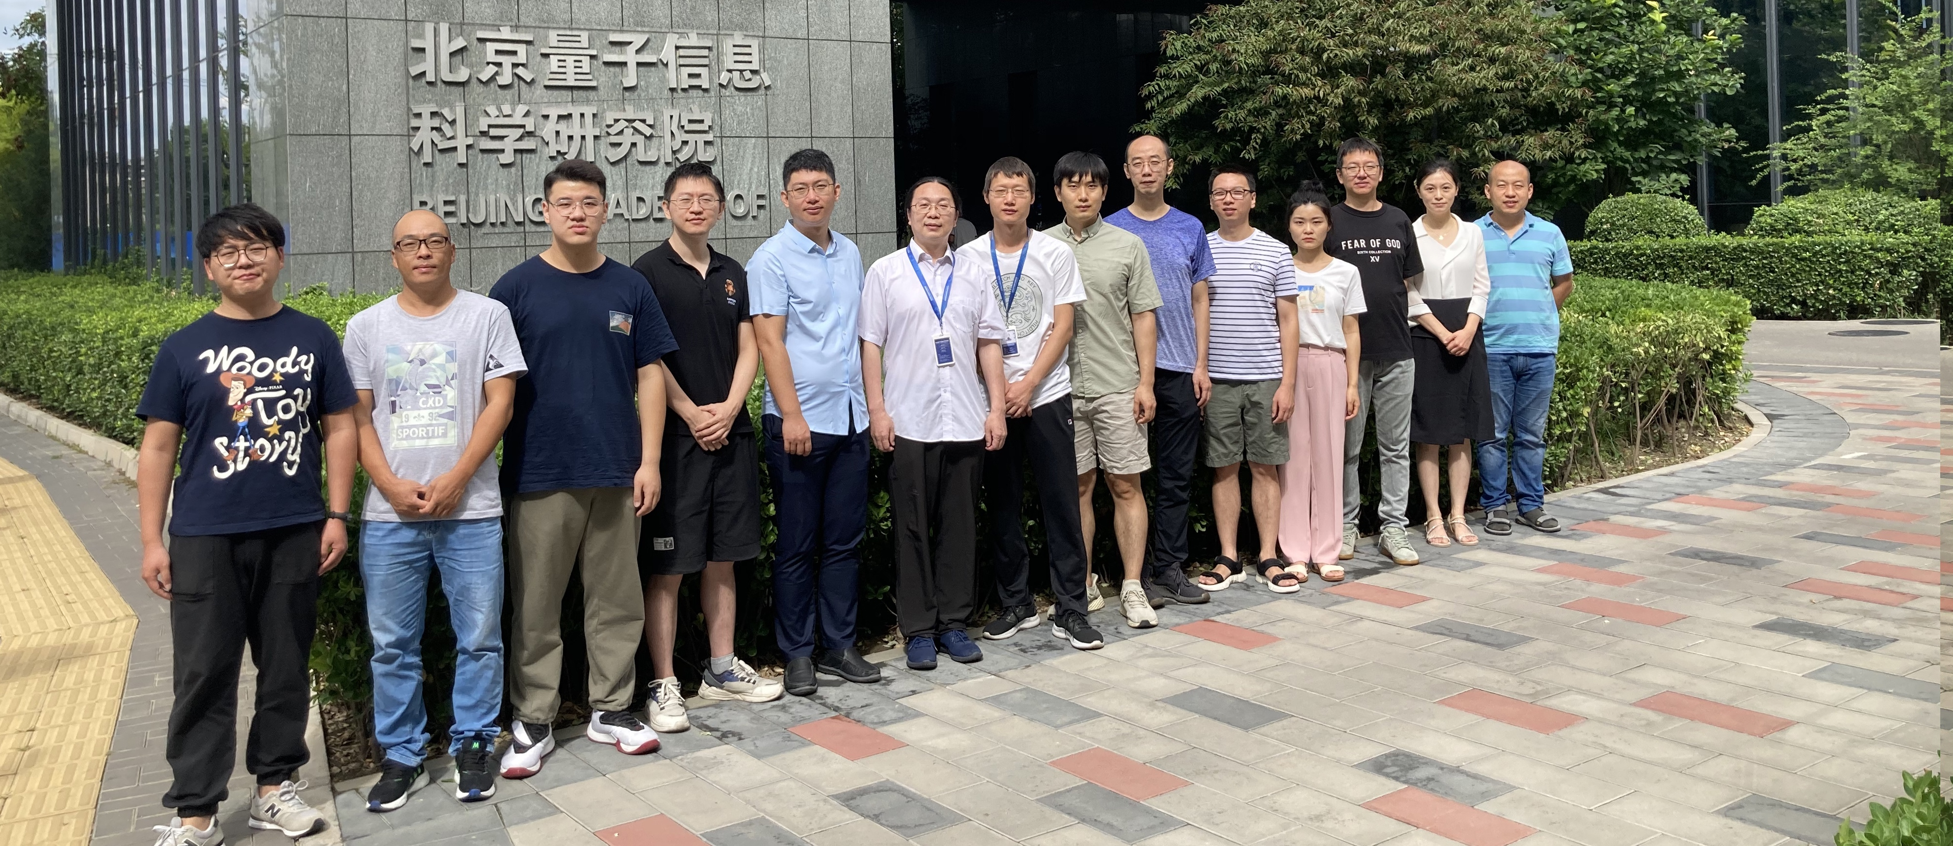

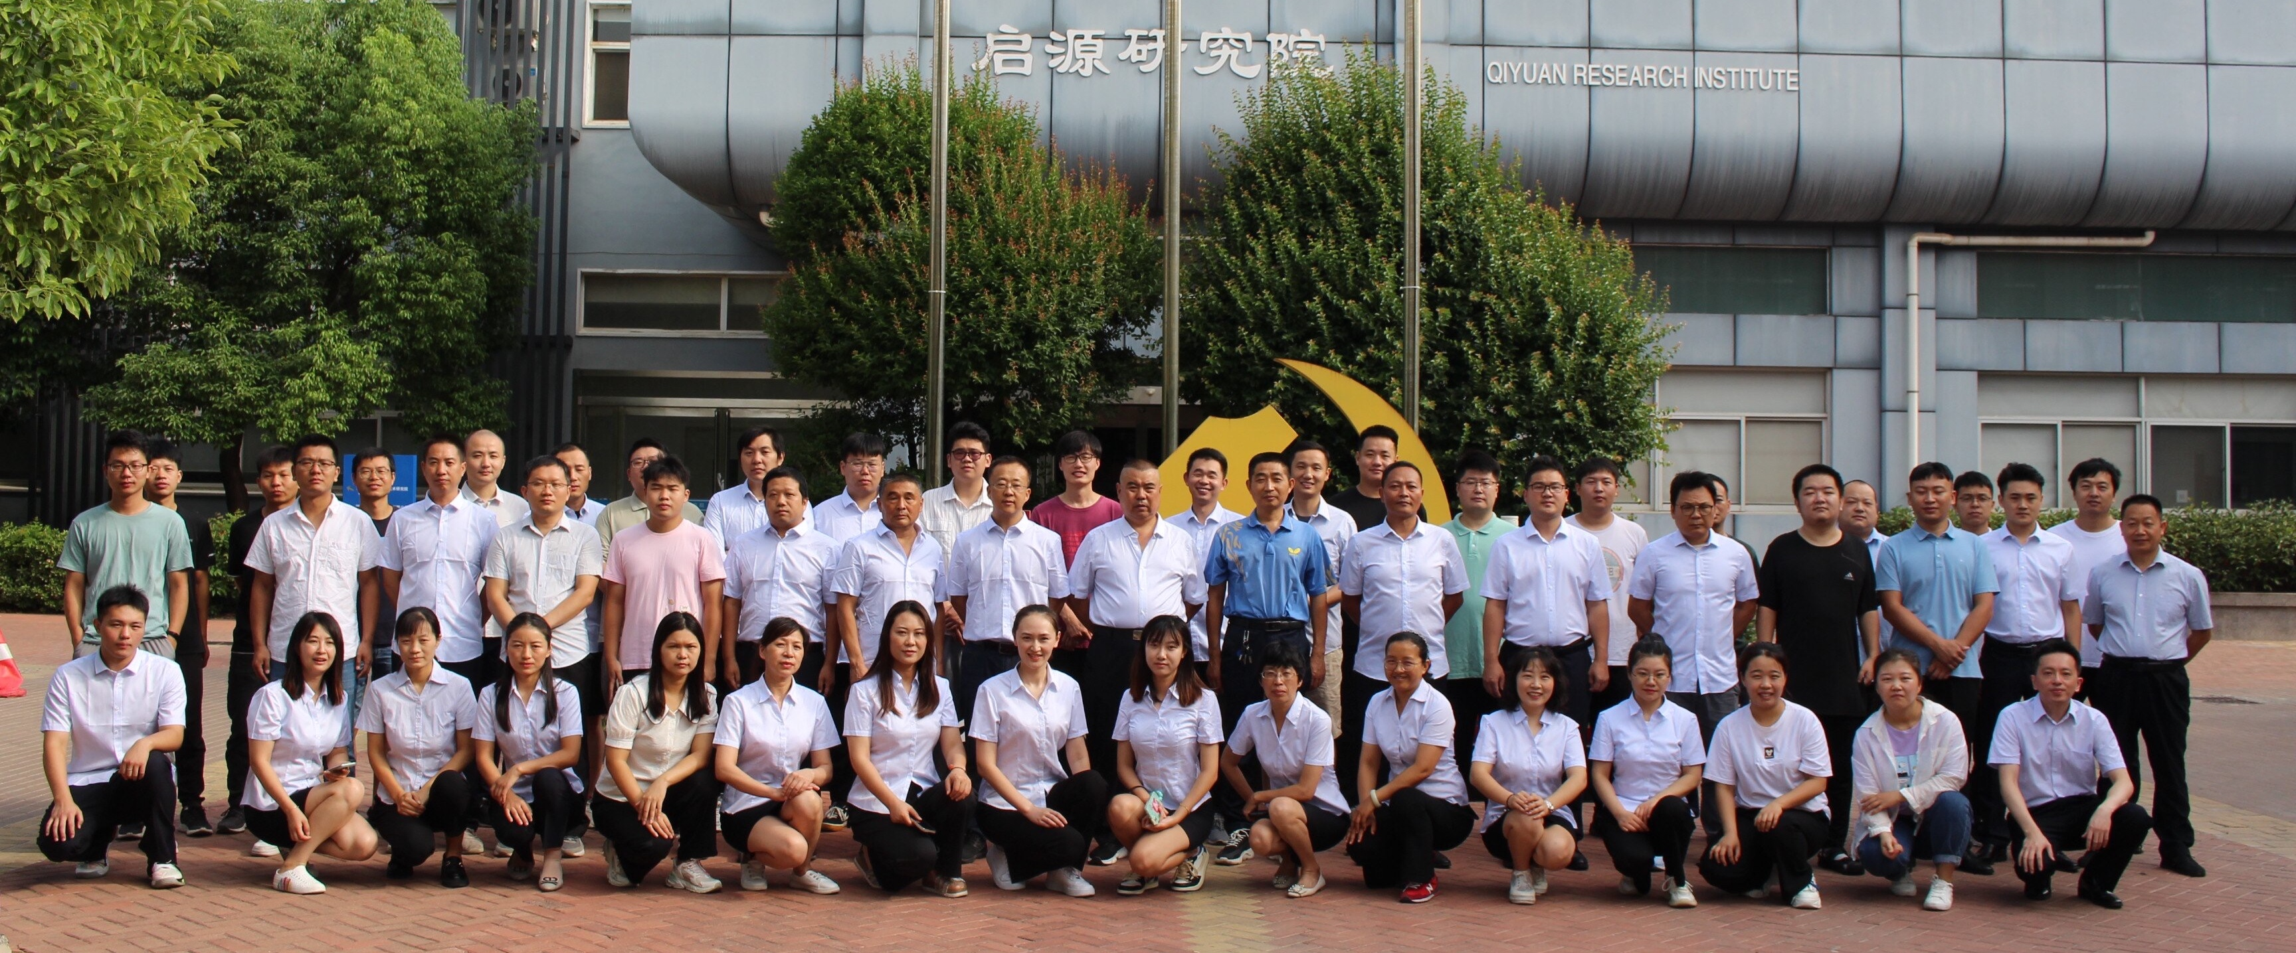

A Joint effort of IHEP, THU, SARI, BAQIS, ZZU and Qifeng
BAQIS

Slide 3
Outline
PATH: Plasma Accelerator towards TeV Horizon
Progress of PWFA-FEL on SXFEL platform
Laser Plasma Accelerator for Applications

Slide 4
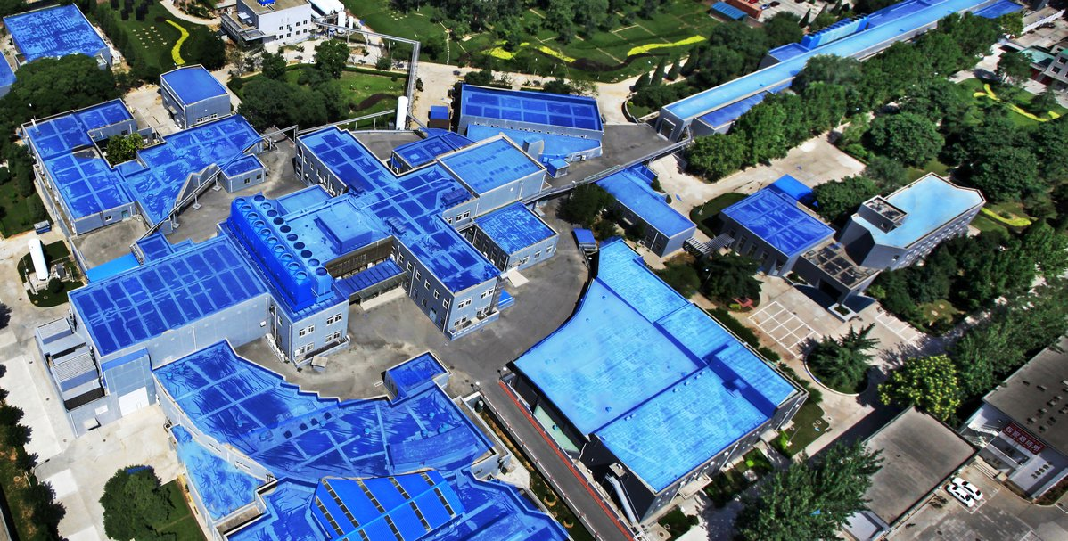
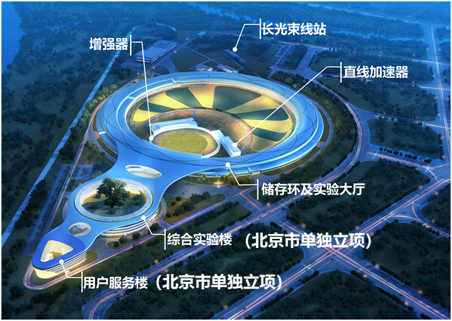
Institute of High Energy Physics: IHEP
Chinese Academy of Science
Beijing Electron Positron Collider (BEPC II)
High Energy Photon Source (HEPS)

Slide 5
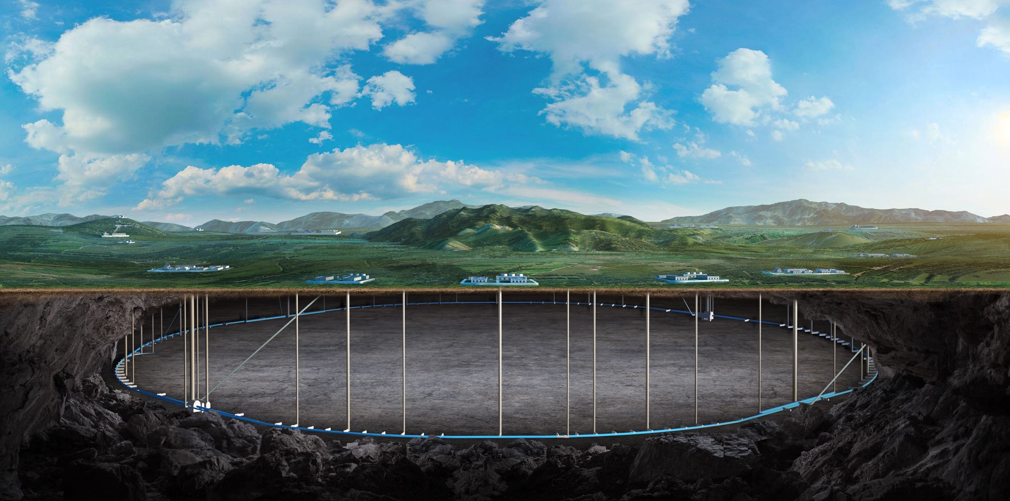
CEPC: Circular Electron Positron Collider

Slide 6
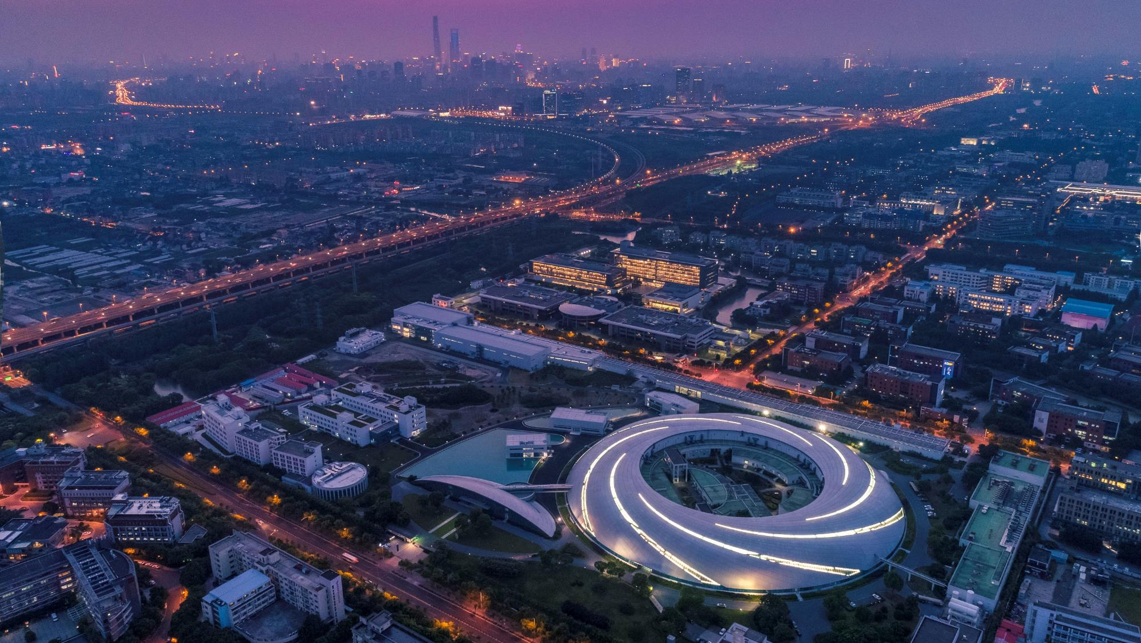
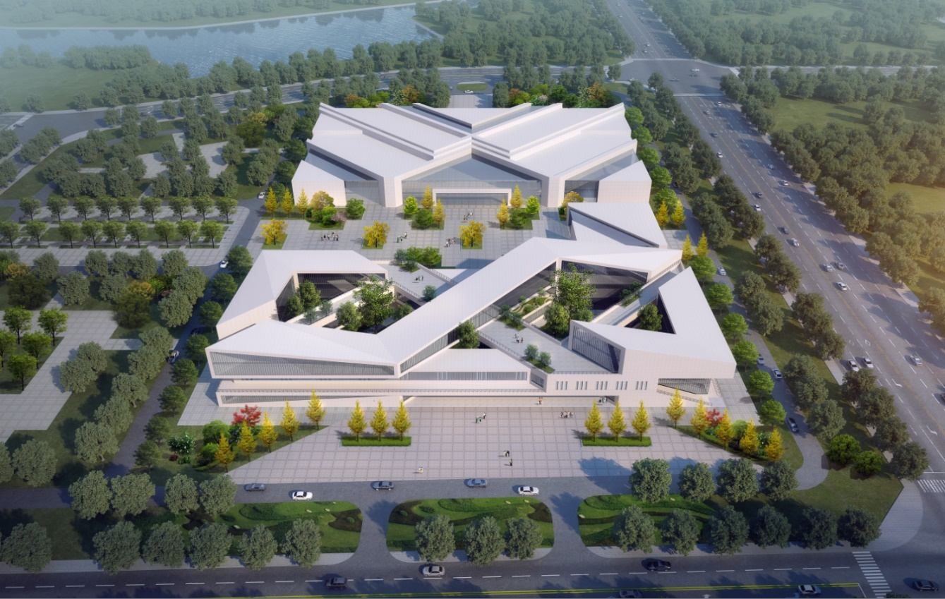
PATH: Plasma Accelerator towards TeV Horizon
A China initiated effort towards future light source and collider
PWFA/LWFA platform at BEPCII
IHEP, Beijing
PWFA/LWFA platform at SXFEL
SARI, Shanghai
LPA application platform: CCLS
ZZU, Zhengzhou, Henan

Slide 7
PATH: A roadmap with 4 phases…
Phase I: 2024-2028
PWFA/LWFA platforms based on BEPCII and SXFEL
tabletop LPA applications
Phase II: 2029-2033
A full energy plasma injector for BEPCII
PWFA/LWFA driven FELs for applications
Phase III: 2034-2038
A full energy plasma injector for CEPC or FCC-ee
Phase IV: 2039-…
1-10TeV Linear collider technology becoming mature……

Slide 8



Future High average Power PWFA
100s keV X-ray FEL 5km → 1km
e- Gun
SC RF accelerator
100keV X-ray
High TR acceleration
1-10 TeV e-/e+ Linear Collider 300km→ 20km
High quality e+ acceleration
5 TeV
e-
5TeV
e+
Staging

Slide 9
BEPCII and CEPC plasma injector
100pC 400MeV
e+100pC
2.8GeV
Gun
100pC
300MeV
4nC / 1nC 1.2 GeV
5nC 1.2 GeV
e- 1nC
2.8 GeV
Damping ring
300pC 120GeV
1.3nC 40GeV/
300pC 4GeV
Gun
5.6nC / 1.3nC 10GeV
e- 600pC 120GeV
e+ 300pC
120GeV
300pC
0.4GeV
300pC
2.4GeV
Shiyu Zhou et al.
Damping ring

Slide 10
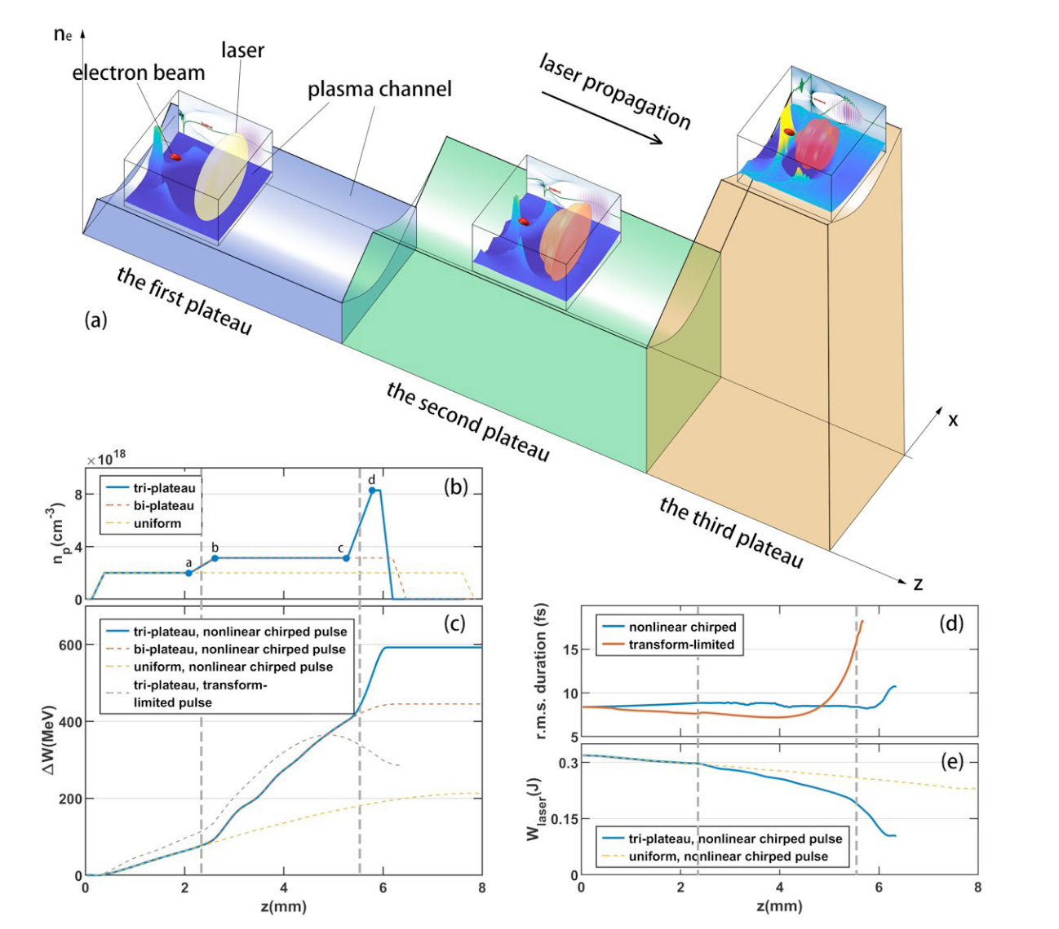
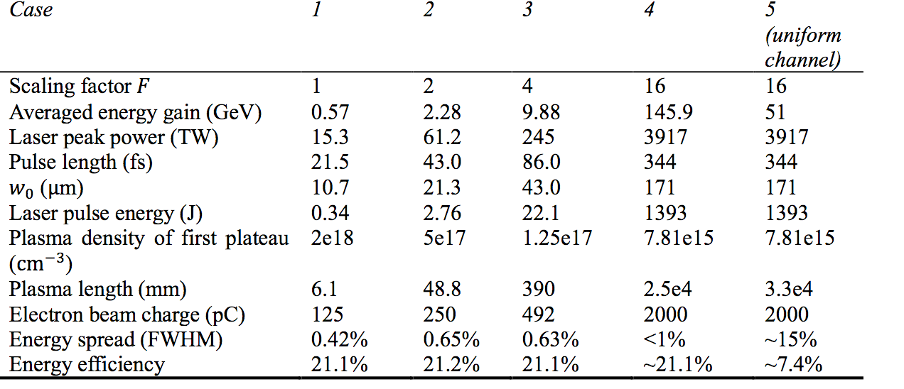
High efficiency high quality LWFA is possible
For a 1.4 kJ PW laser:
Electron beam:
energy gain >140 GeV
charge ~ 2 nC
energy spread <1%
Efficiency: > 20%
Shuang Liu, Fei Li, Shiyu Zhou, Jianfei Hua, Warren B. Mori, Chan Joshi, Wei Lu*. A Scalable, High-Efficiency, Low-Energy-Spread Laser Wakefield Accelerator Using a Tri-Plateau Plasma Channel. Research, 2024, 7:0396

Slide 11
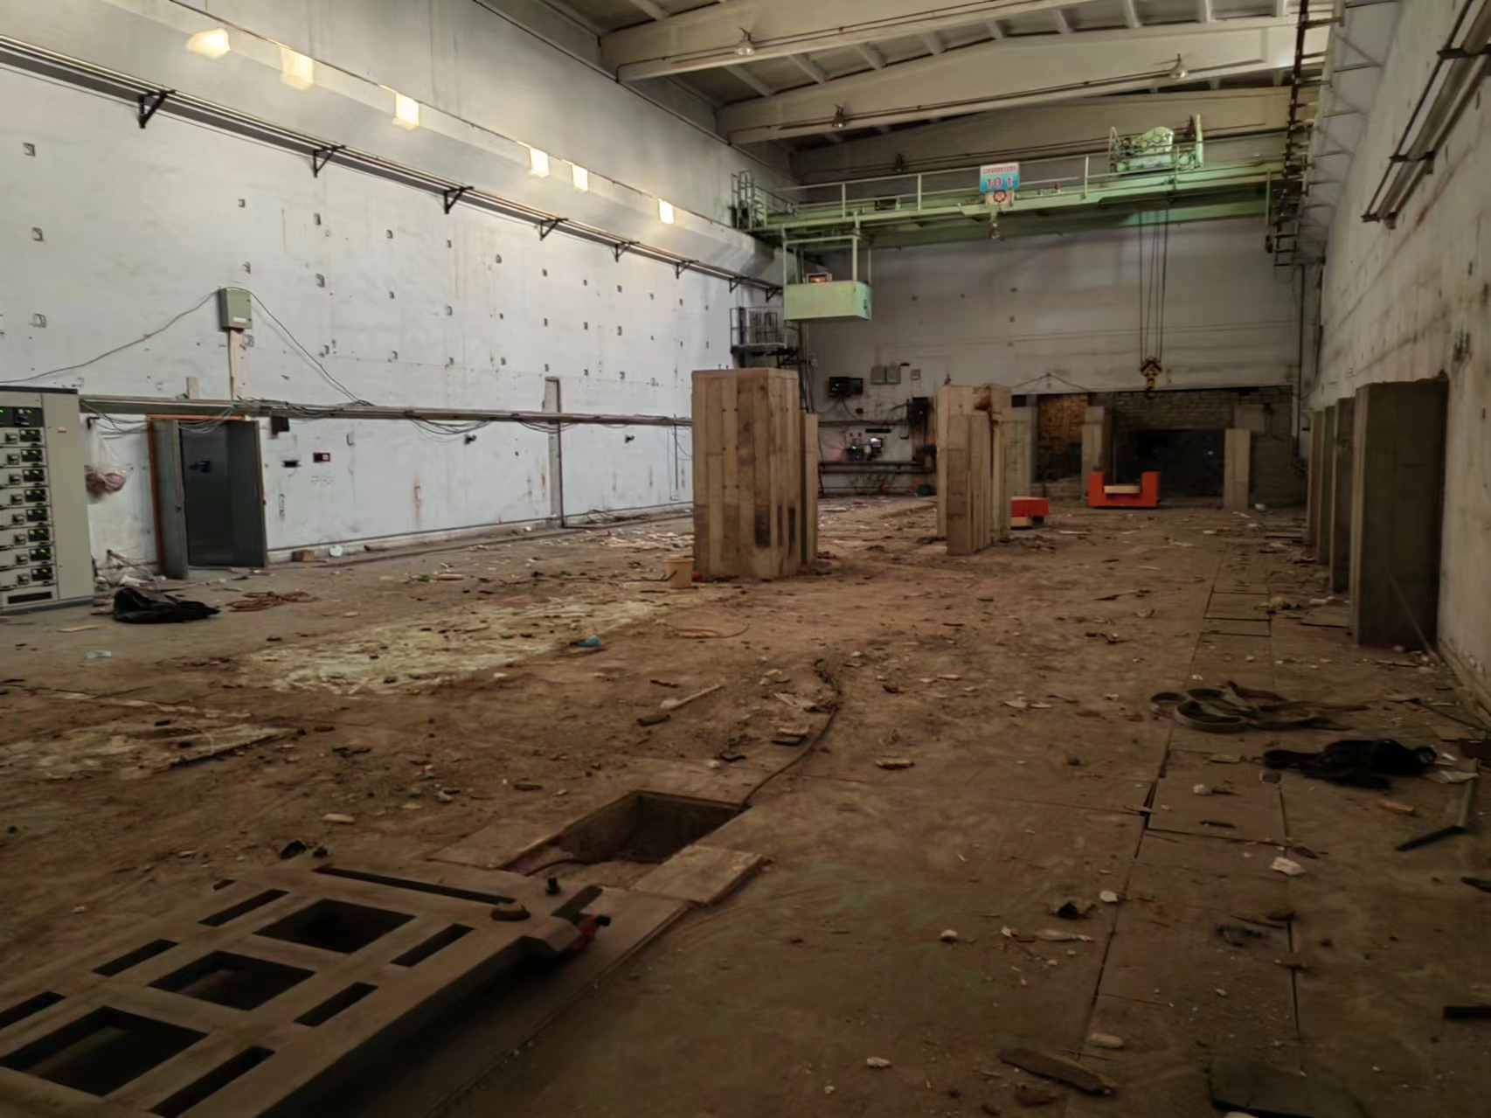
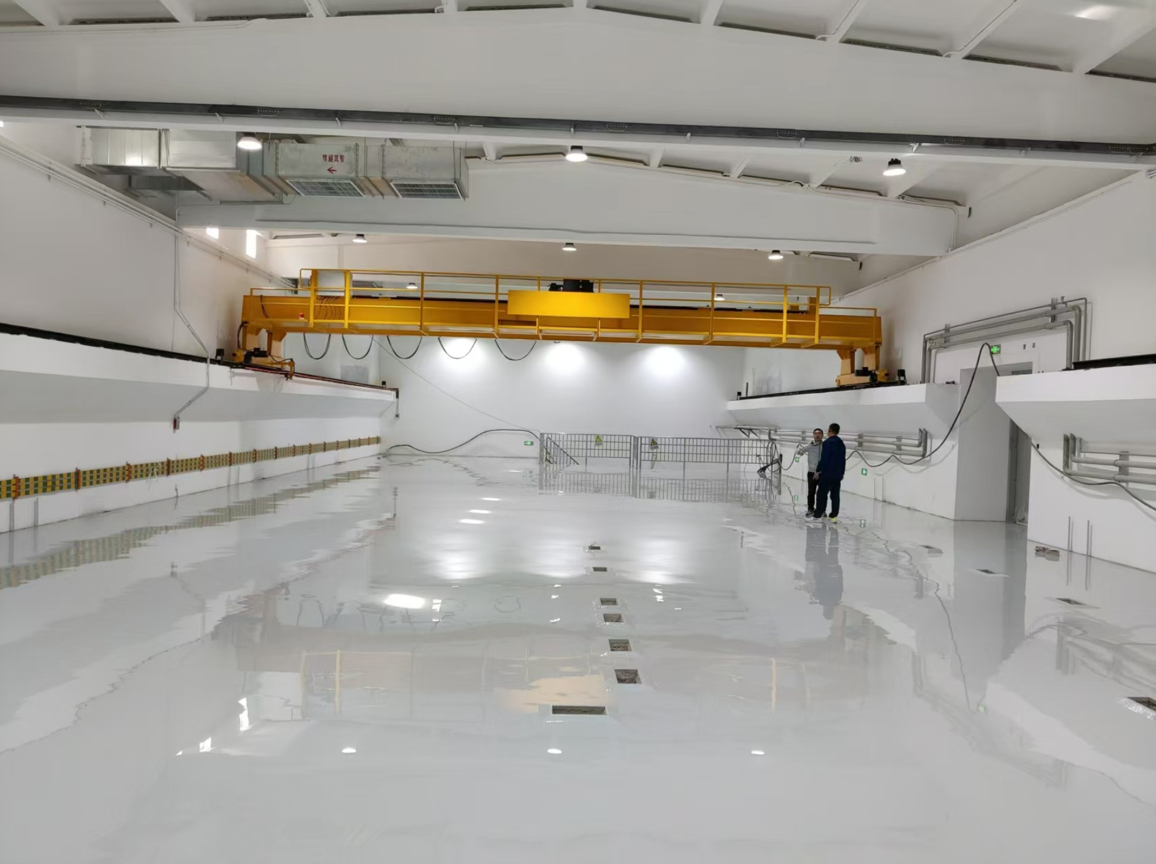
A PWFA/LWFA platform at #10 Hall of BEPCII
CAS Leading project (2023-2028) for Basic Science
”Beam Driven Advanced Acceleration and Application ”

Slide 12
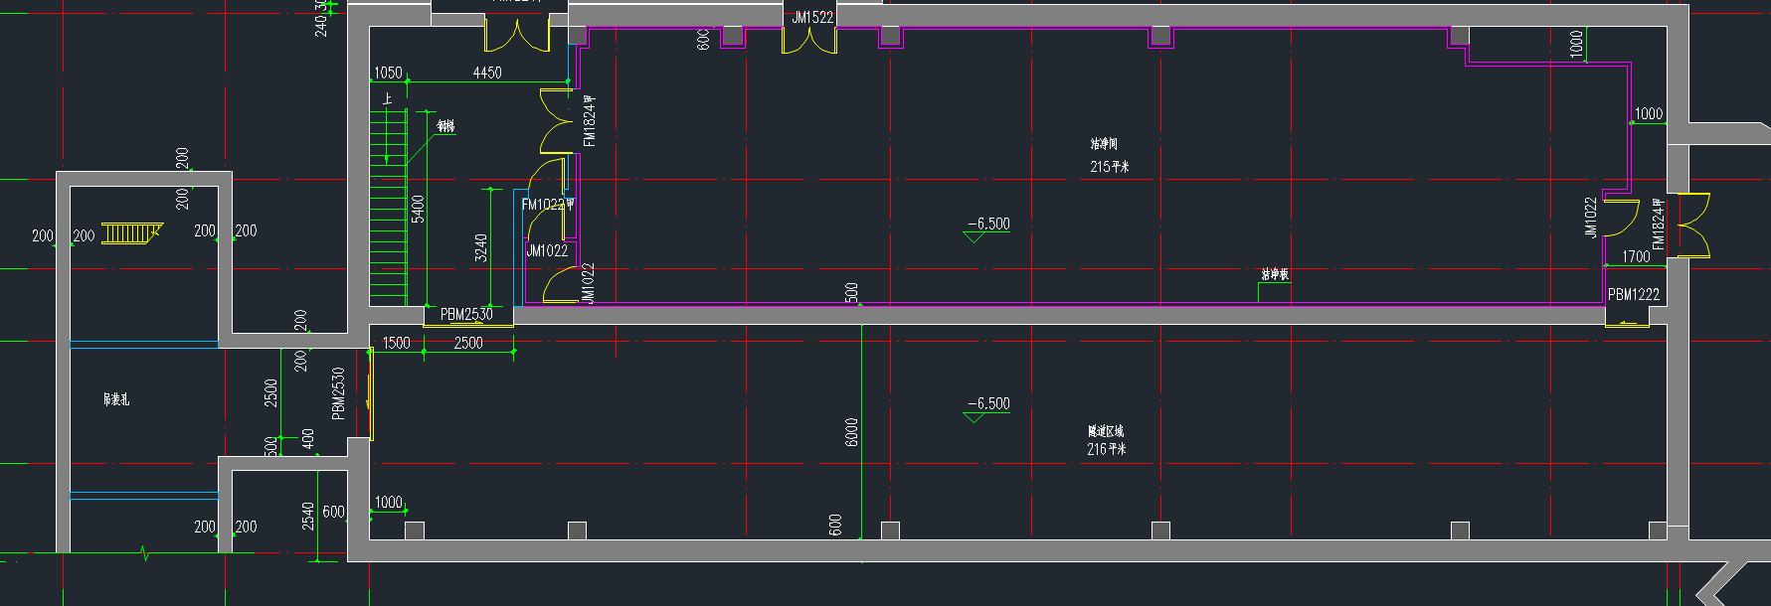
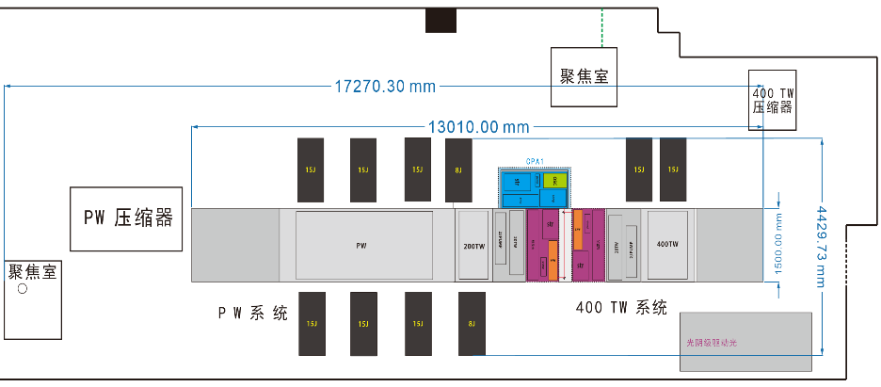
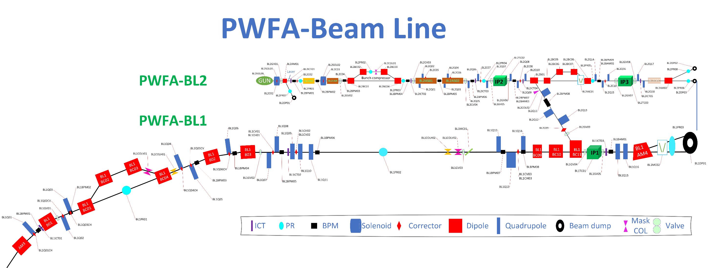
束测
LWFA靶场1
Section A
束测
LWFA靶场2
Section L

Slide 13
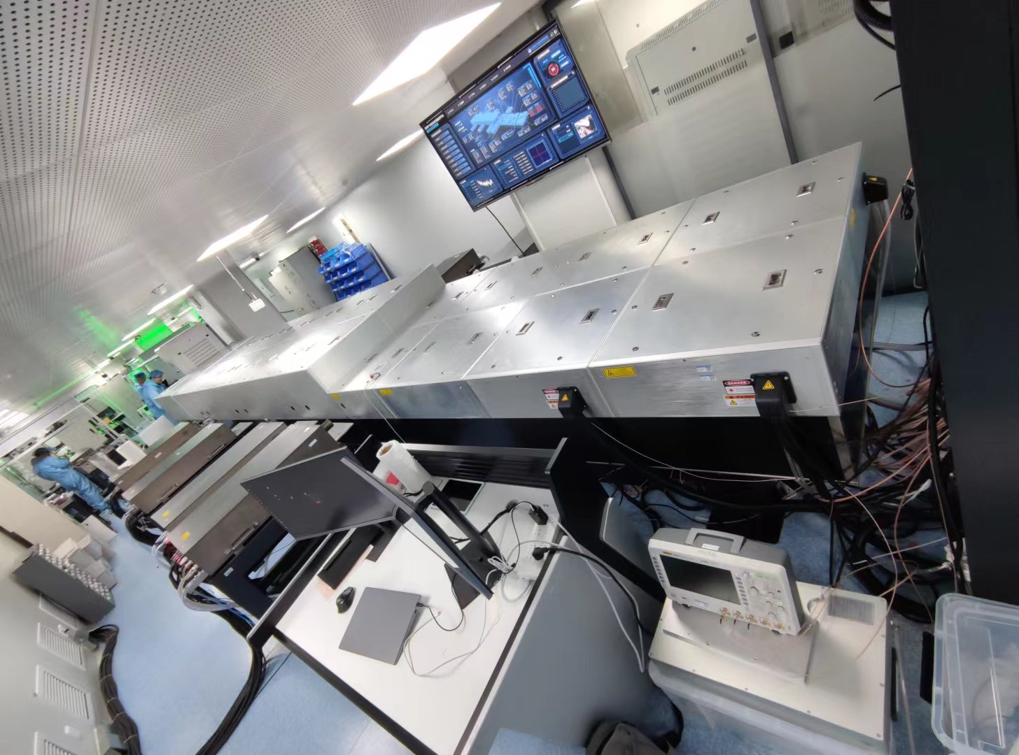
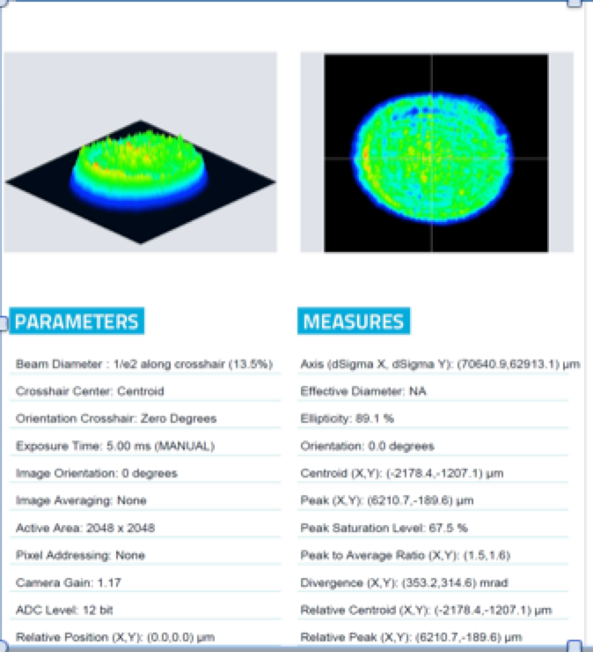
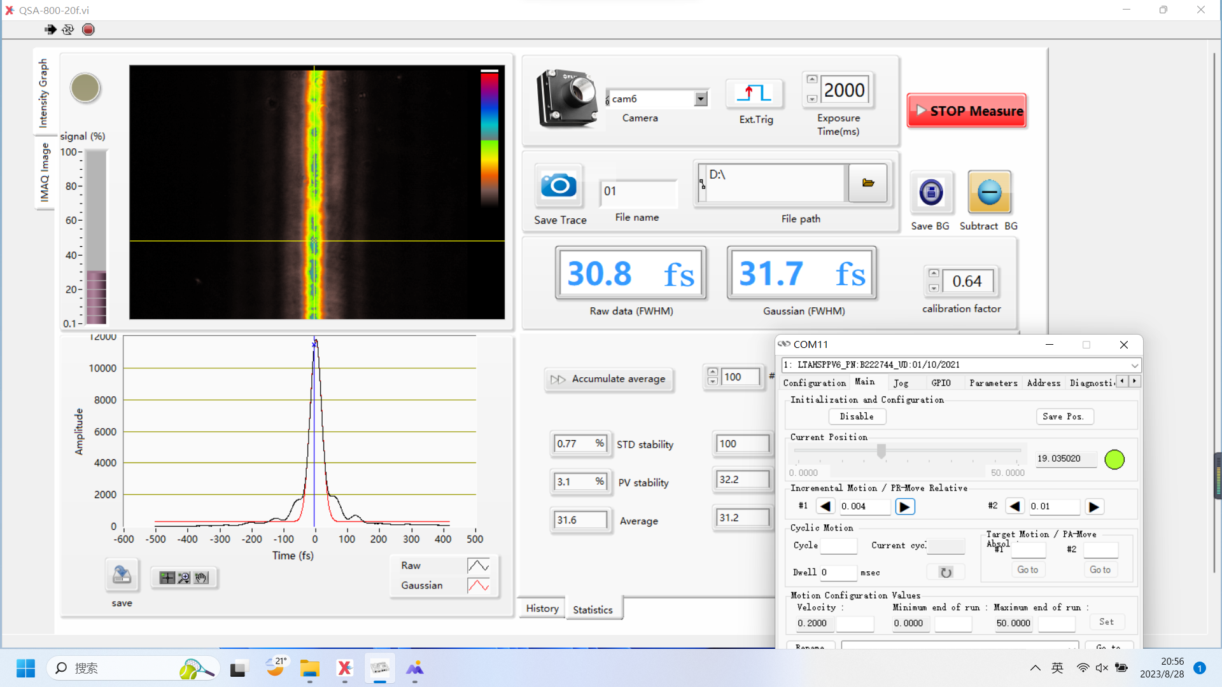
PW laser from BAQIS

Slide 14
BLI: BEPCII 2GeV e-/e+ beams with compression (~1ps)
BLII: A new 1-5nC 150MeV Linac with 2 IPs
PW laser: 1PW 30fs 1Hz compact laser from BAQIS
3 systems are synchronized and combined in IP1
Positron acceleration in electron beam driven PWFA
External injection to a PWFA
PWFA staging
External injection to a LWFA (e-/e+)

Slide 15
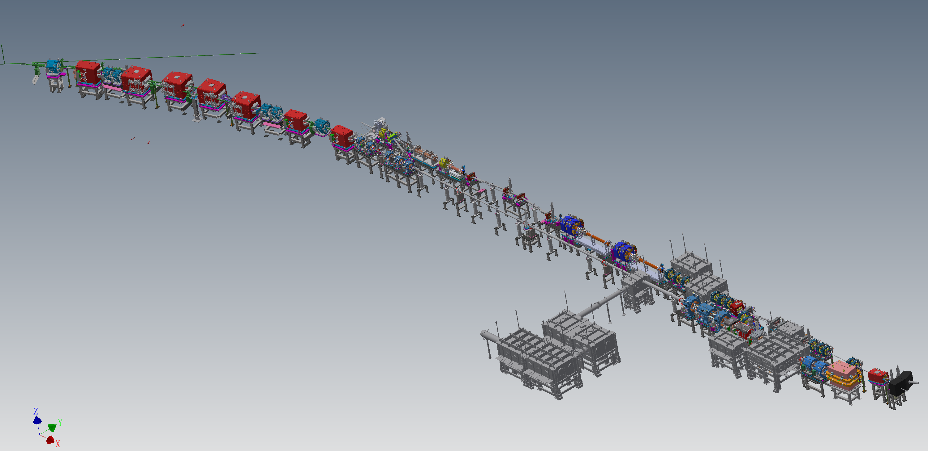

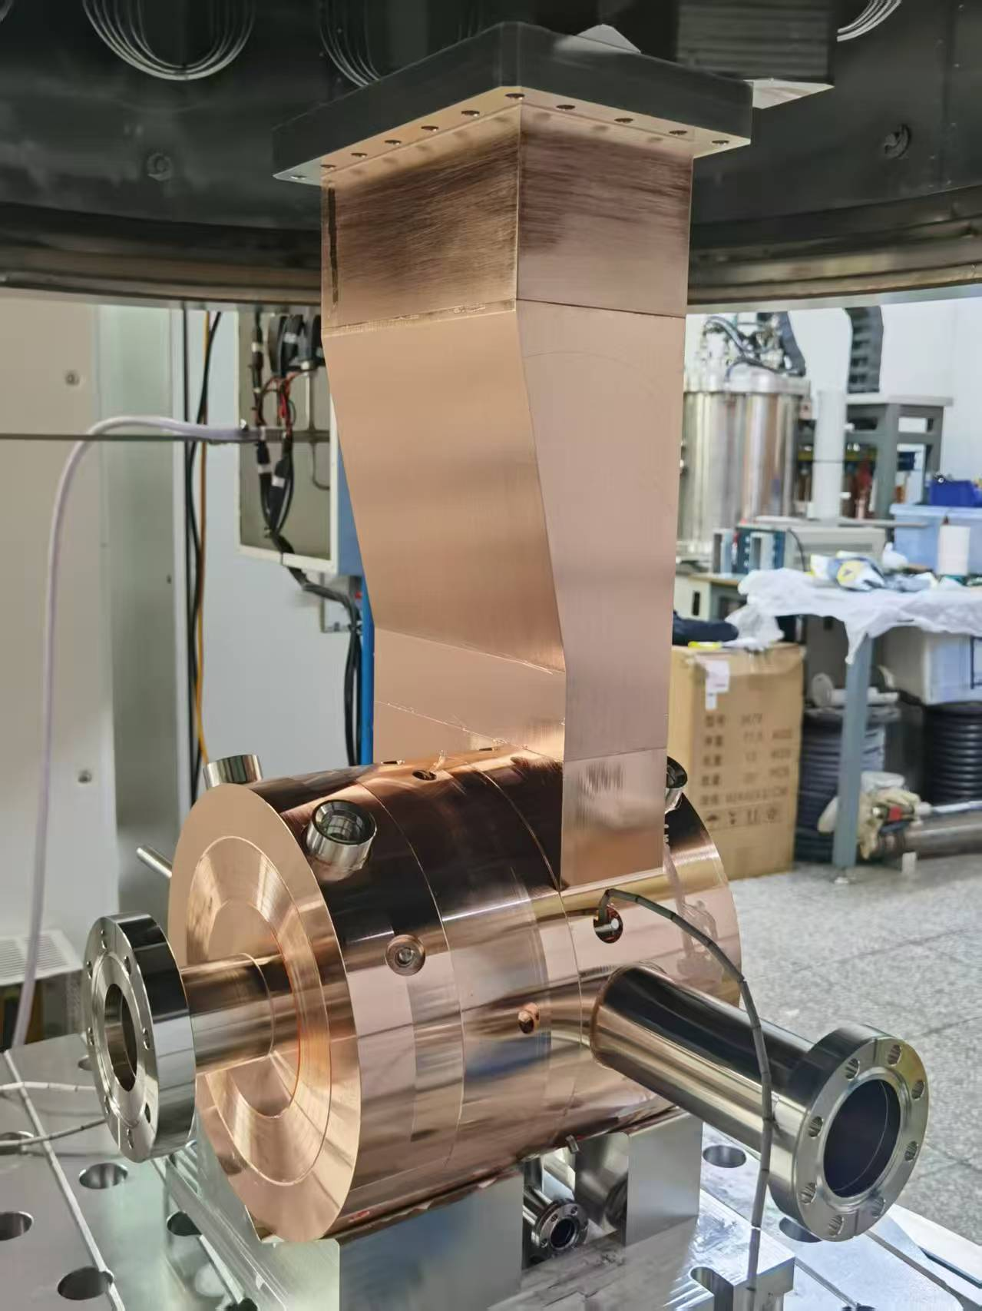
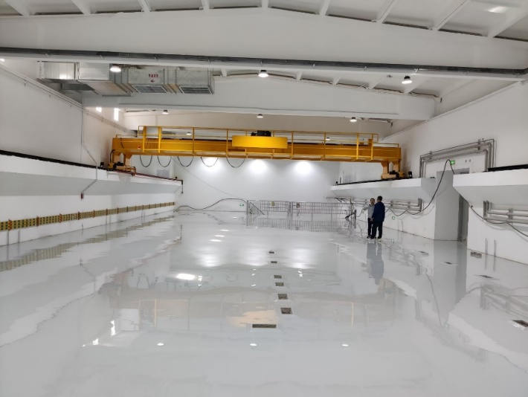
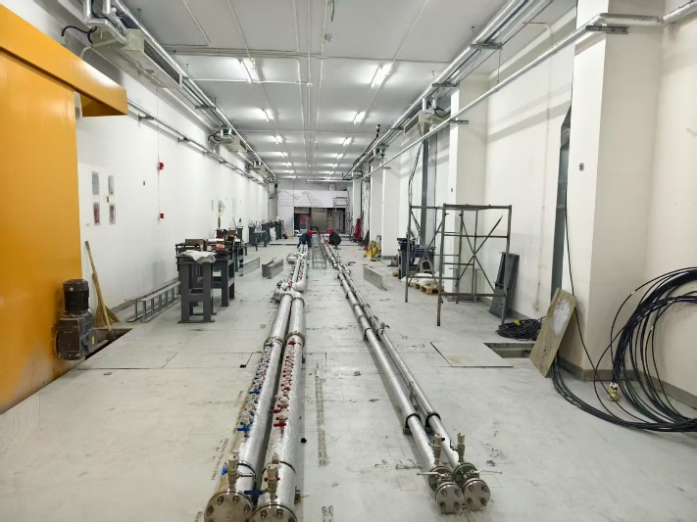
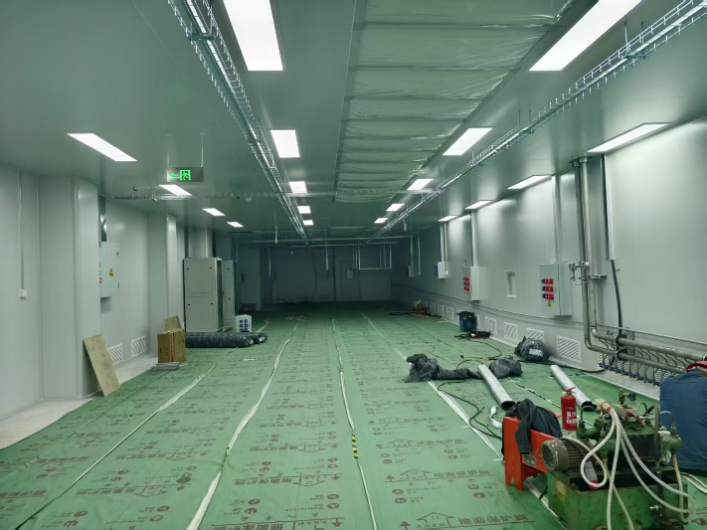
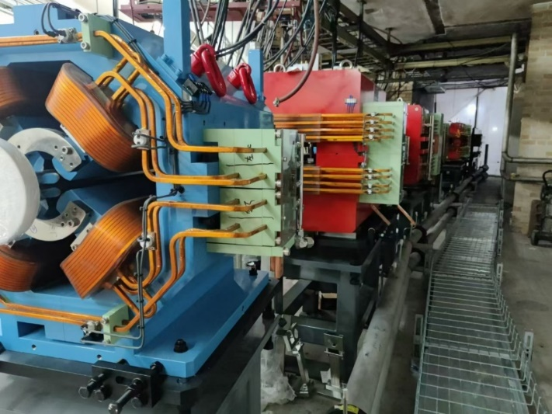
July-Oct 2025
Installed
  The lab will be ready by the end of 2025
Oct-Dec 2025
  L-band Photo-injector
Accelerator tunnel
2nd floor
Clean room for PW
BEPCII tunnel（installed）

Slide 16
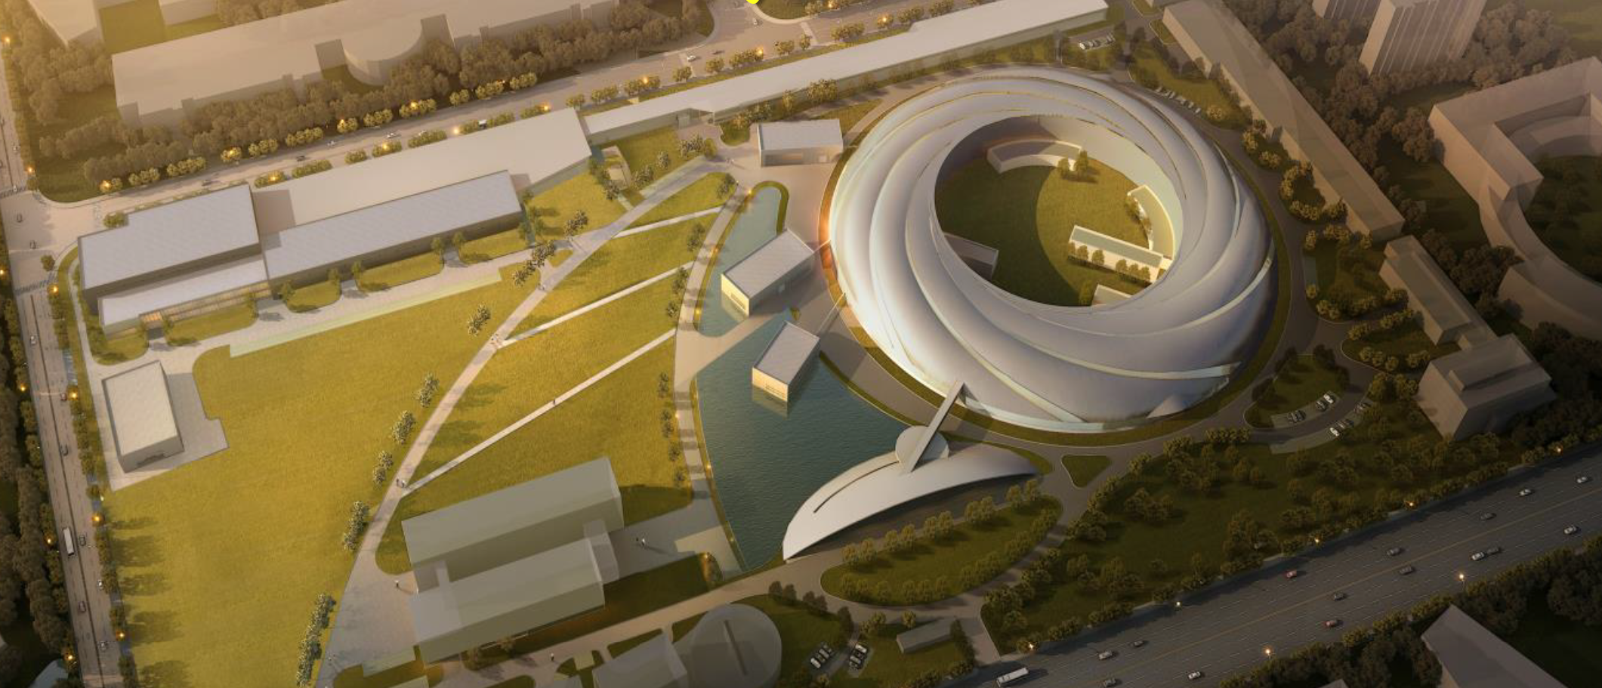
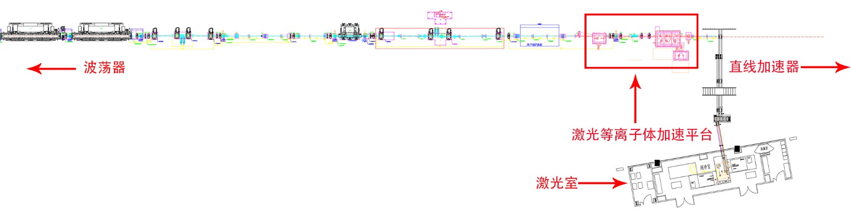
A PWFA/LWFA platform at SXFEL of SARI
Collaboration with Prof. Zhentang Zhao since 2017.
Supported by CAS leading project of Basic Science ( 2023-2028)
SXFEL: 1.5GeV Linac + 40m Undulator, an ideal test bed for PWFA-FEL and LWFA-FEL
SXFEL
undulator beamline
linac
20TW laser for plasma generation
200TW upgrade underway
plasma acceleration experiment platform
laser room

Slide 17
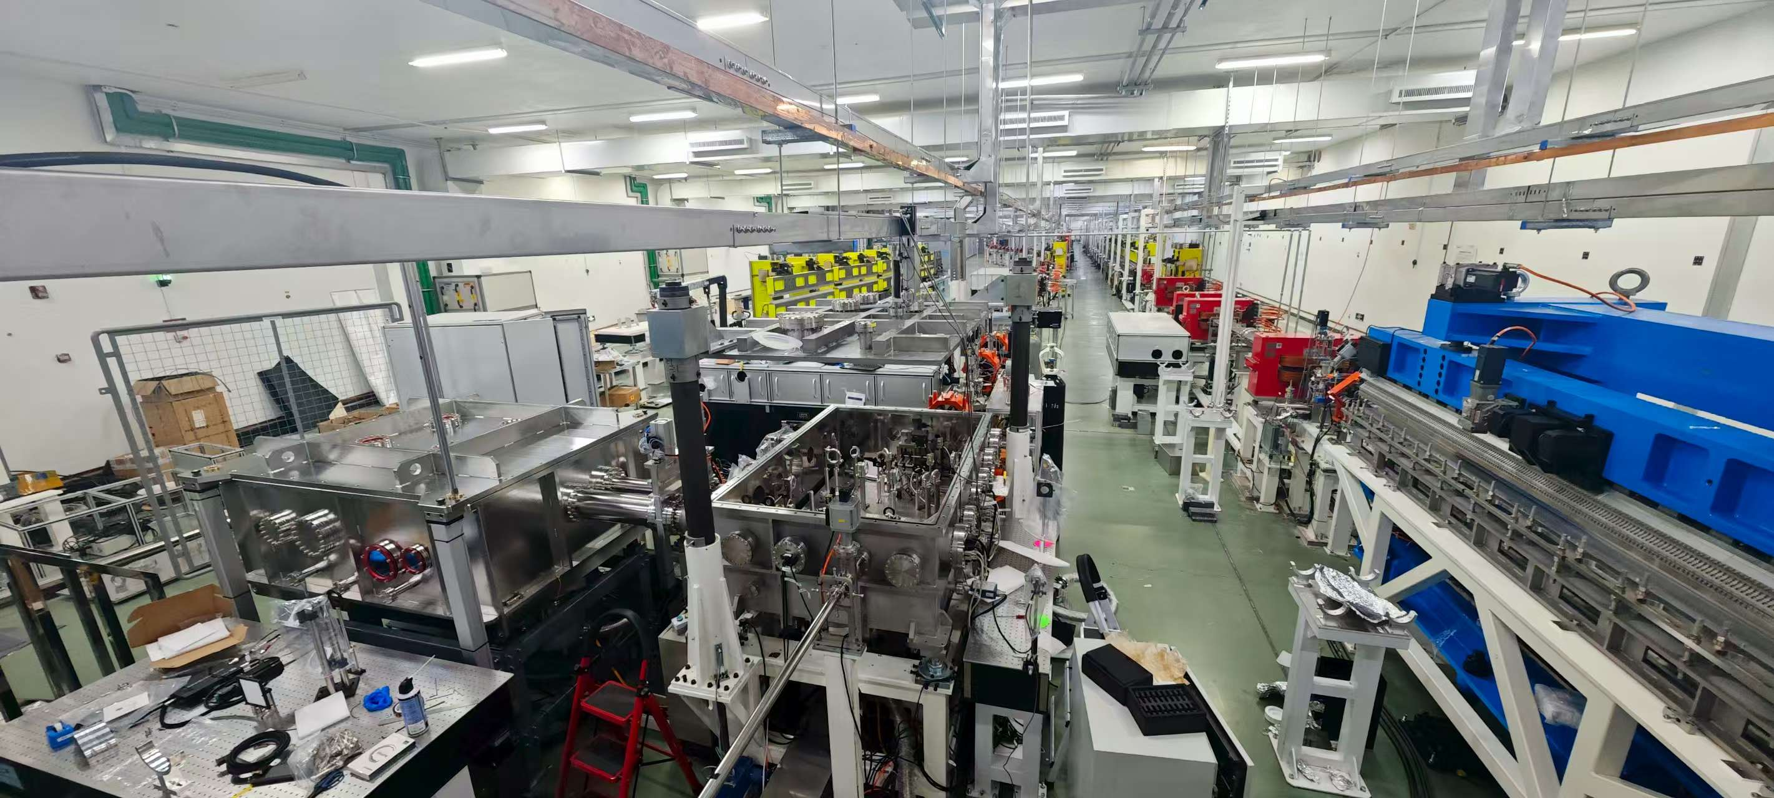
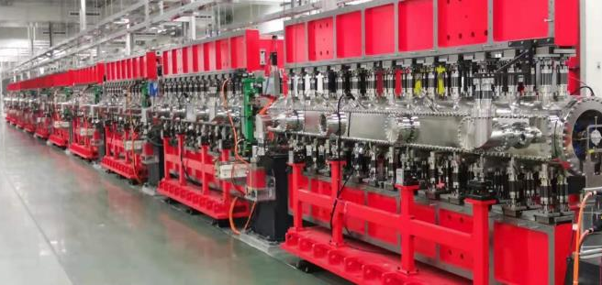

Slide 18
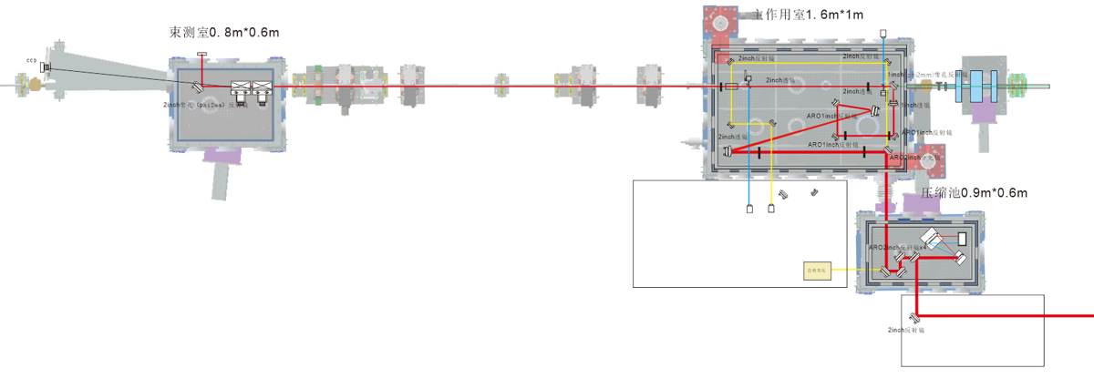
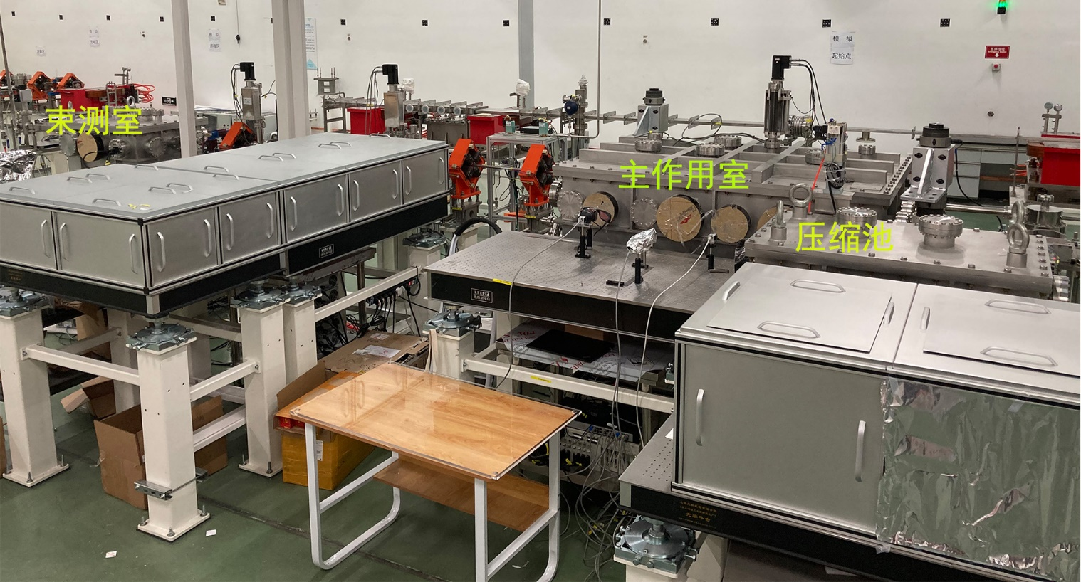
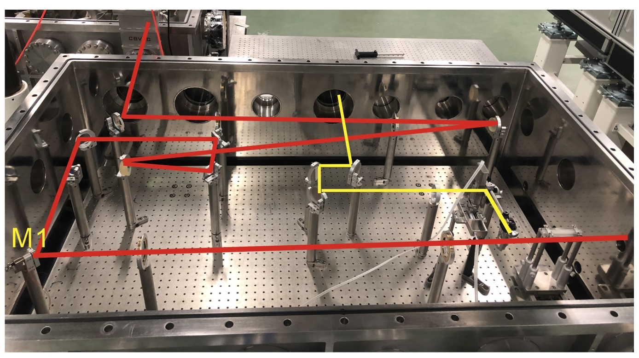
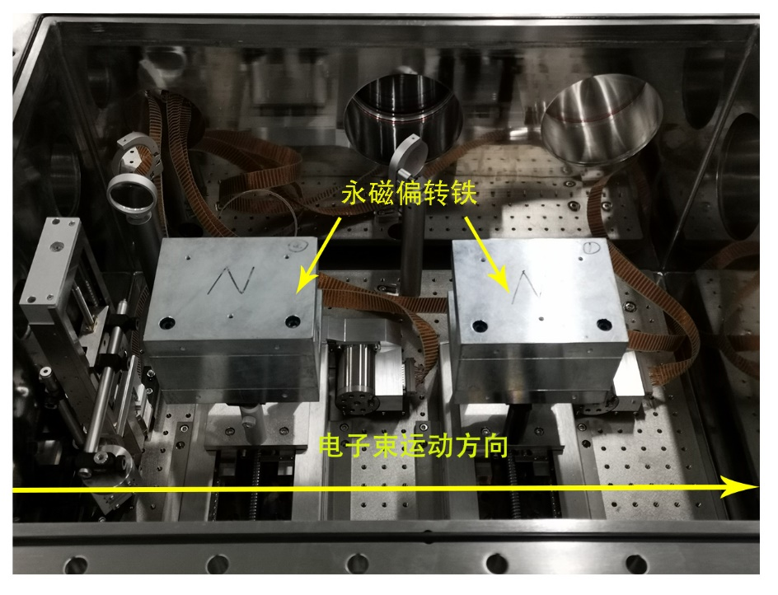
Plasma accelerator
beam diagnostics
Laser compressor
beam diagnostics
plasma accelerator
Plasma acceleration chamber
10~20cm gas cell
Laser focusing
Laser-beam coupling
Plasma diagnostics
Beam diagnostics chamber
Energy spectrometer (PM)
Beam spot monitor
laser compressor

Slide 19
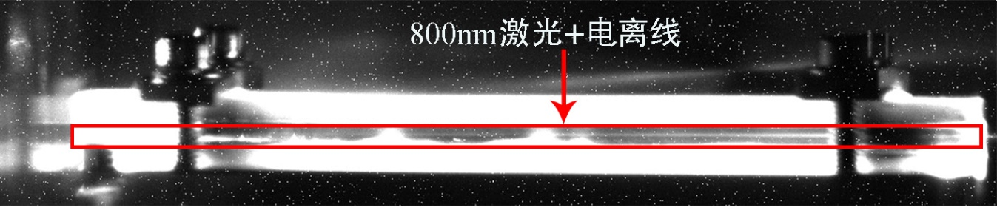
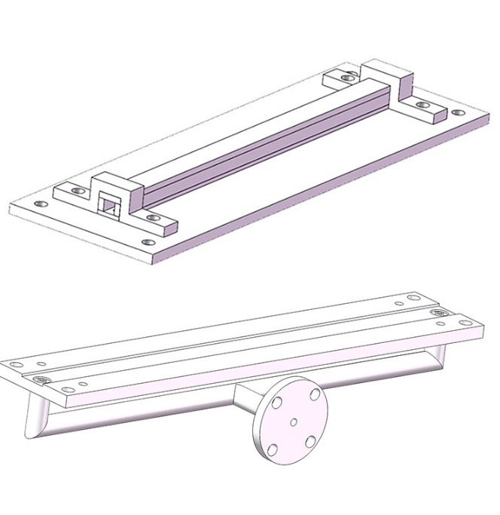
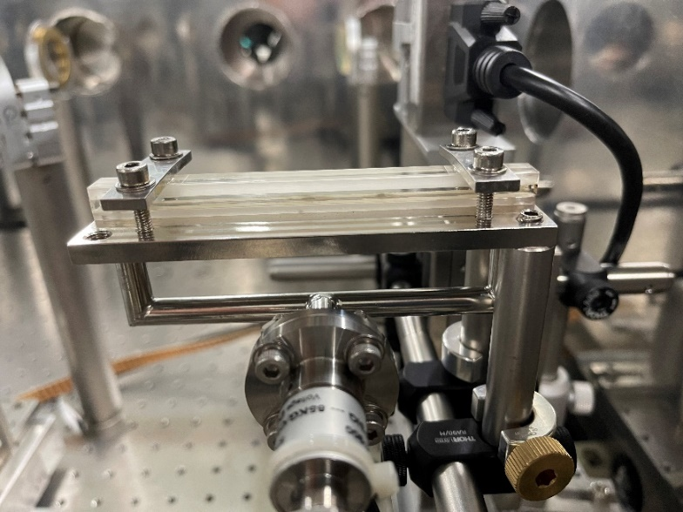
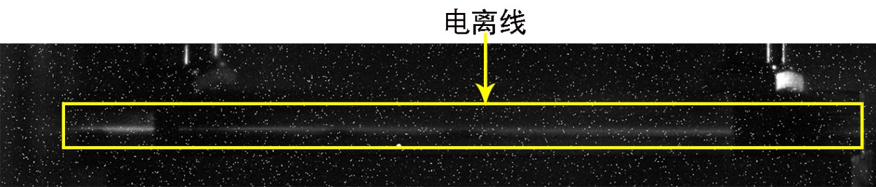
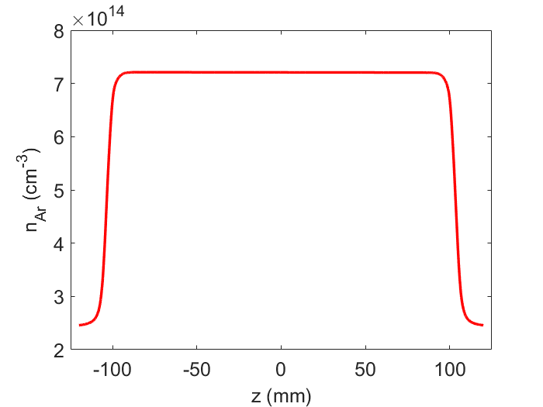
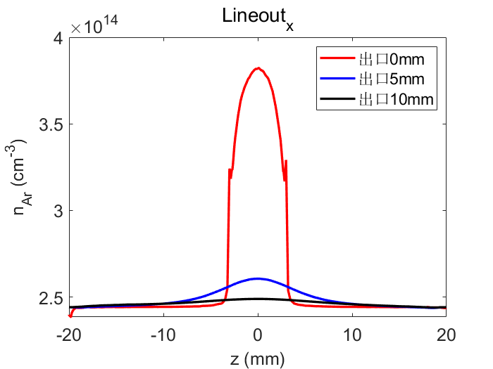
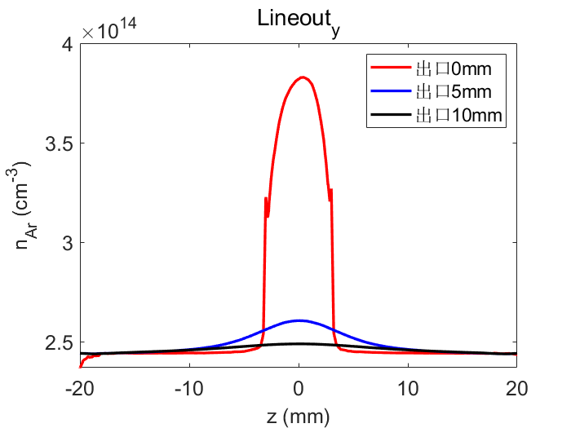
Plasma Source (20cm)
800nm laser + ionization region
Ionization
10~20cm length
reliabe and uniform plasma density profile
operated at 2Hz@0.1MPa
backing pressure 0~5MPa

Slide 20
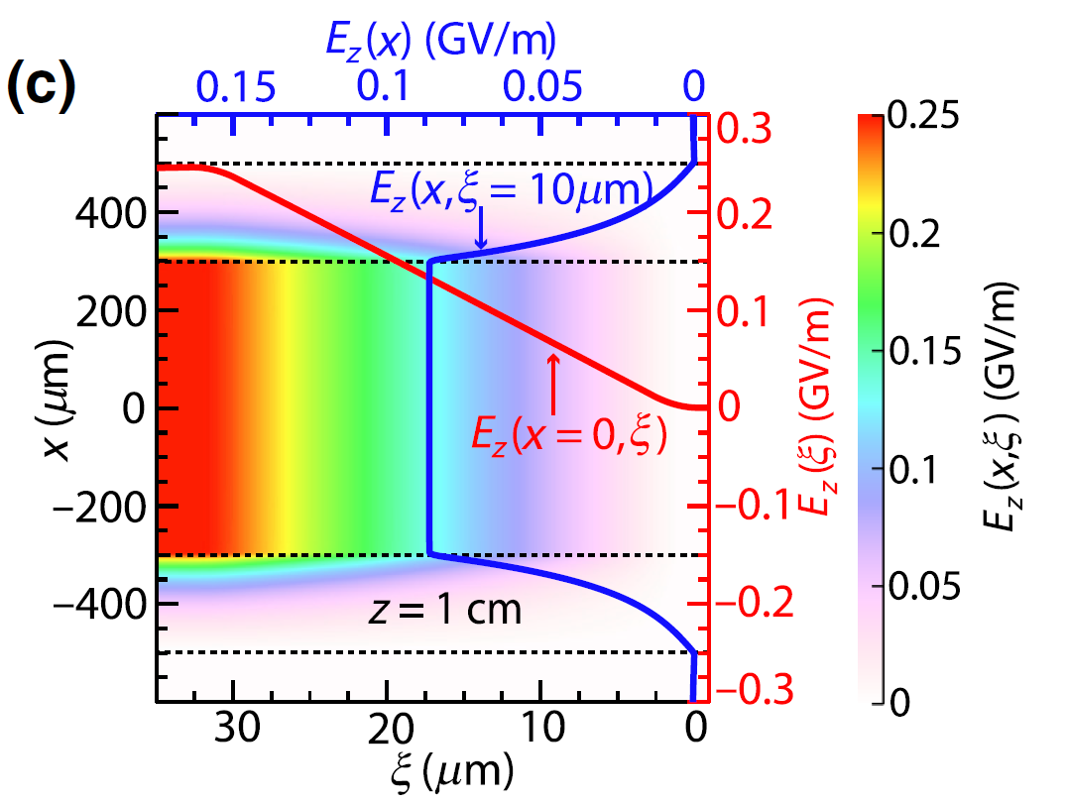
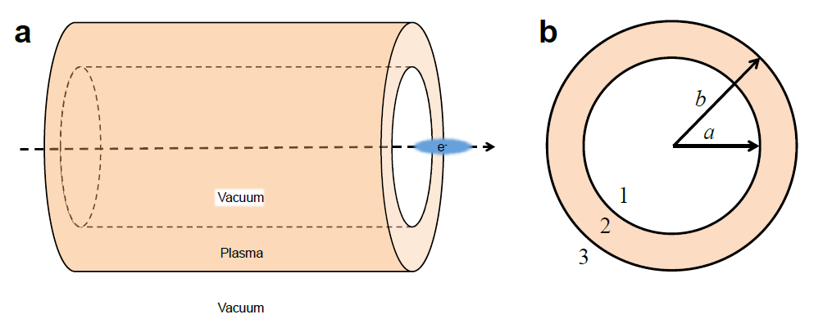
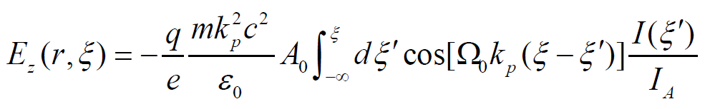
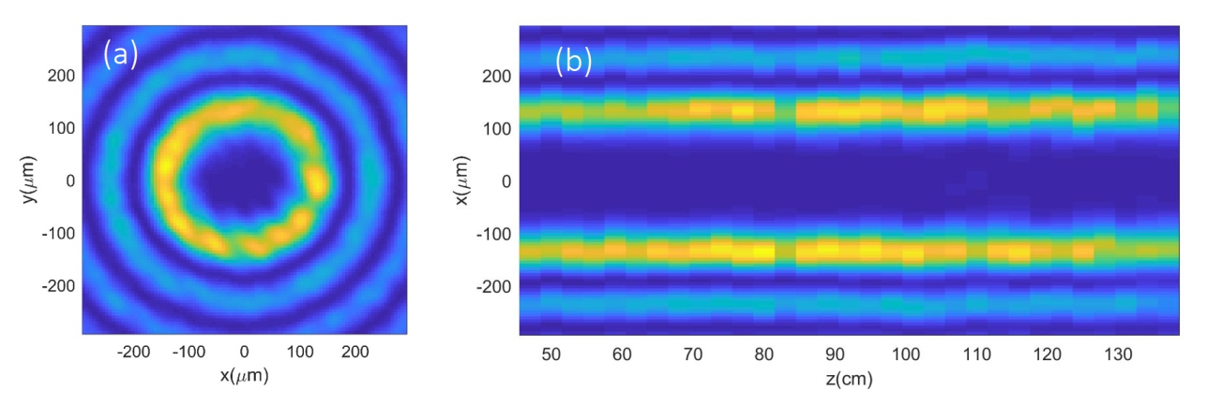
Beam Phasespace Manipulation based on HPC
Hollow Plasma Channel (HPC)
Advantages
  Acceleration field is independent of radial position, slice energy can be preserved.
  Nearly zero focusing force, slice emittance can be preserved.
hollow plasma channel generated by a high-order Bessel beam. (radius~100um, ~10cm long)
Y. P. Wu et al, PHYSICAL REVIEW APPLIED 12, 064011 (2019)
Spencer J. Gessner, PHD thesis, Standford University (2016)

Slide 21
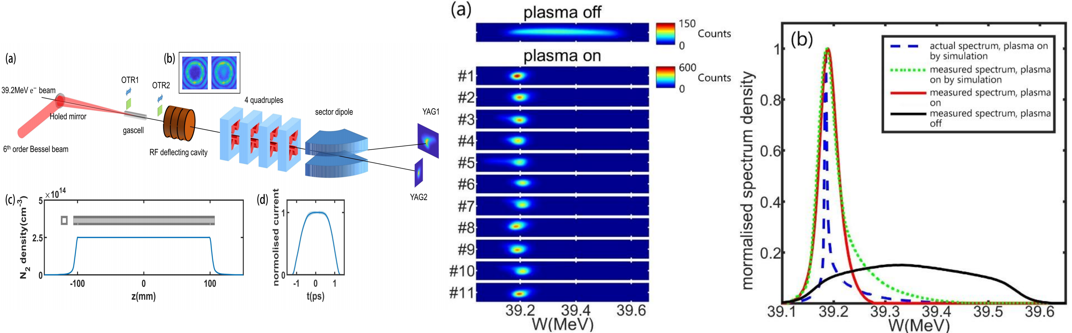
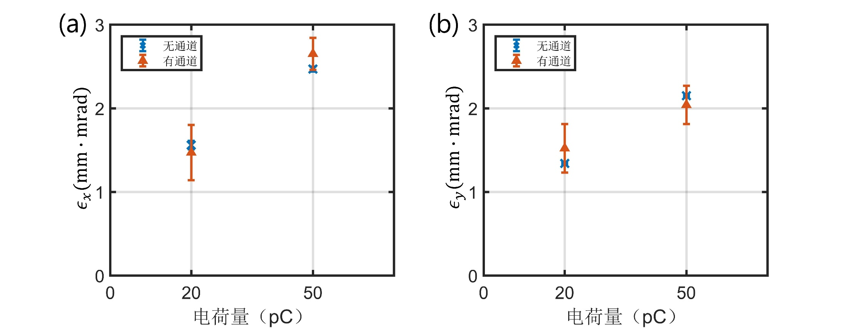
HPC Phasespace Manipulation as dechirper
A HPC dechirper demonstrated : energy chirp from ~1% to ~0.1%
Emmittance conservation confirmed through measurement
S. Liu et al, Phys. Rev. Lett. 133, 175001 (2024)

Slide 22
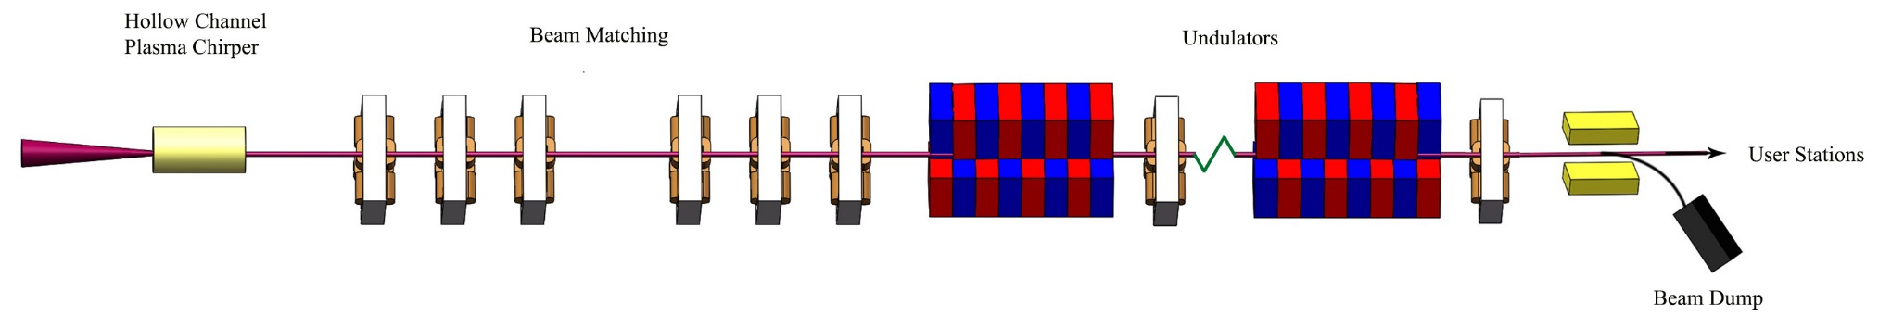
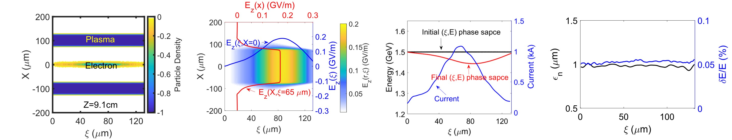
PWFA-driven Broadband FEL scheme
Beam energy | 1.5 GeV
Charge | 250 pC
Beam length | 210 fs
Emittance | 1 mm mrad
Plasma density | 5e16 cm⁻³
Length | 0.3 m
Inner radius | 75 um
Peng, B., et al. Physical Review Applied 19(5) 2023
Increasing the energy chirp while maintain the slice beam quality
Increasing radiation bandwidth
Slice energy spread and emittance can be well-preserved

Slide 23
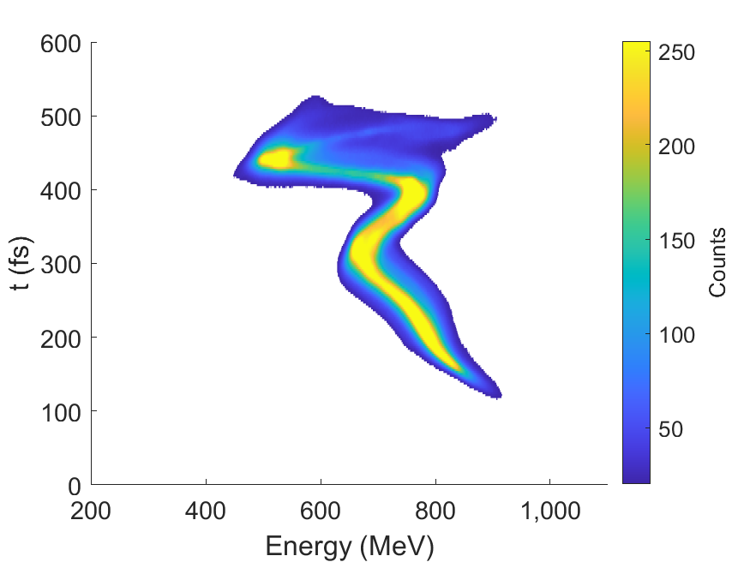
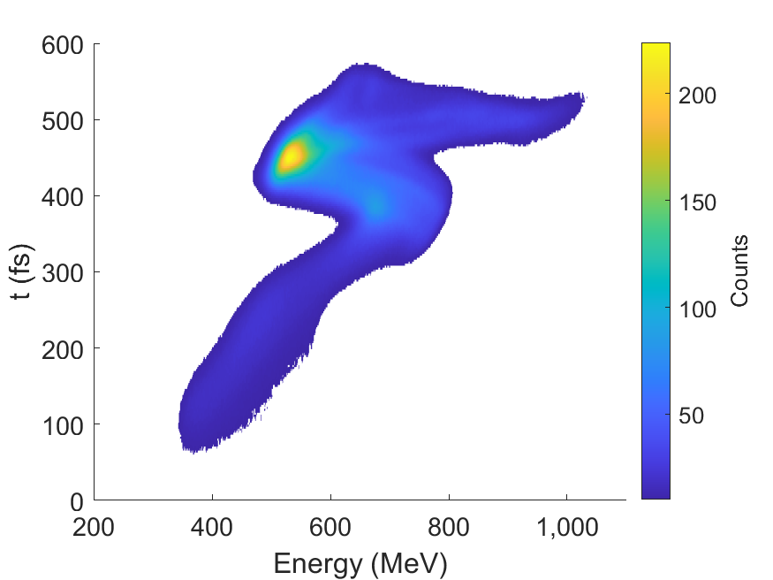
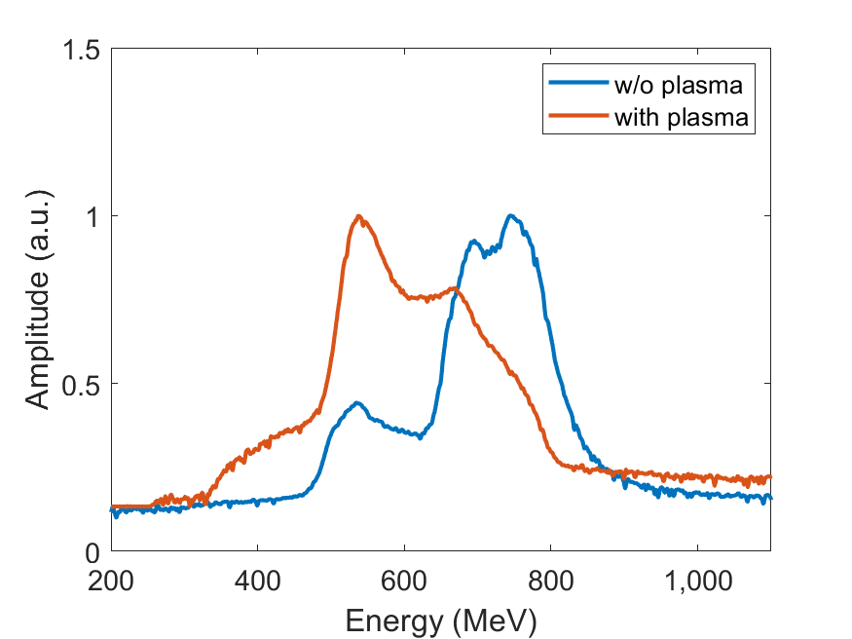


Phase Space Modulation in HPC
w/o plasma
backing pressure 21bar + laser energy 90 mJ
energy ->
energy ->
energy ->
backing pressure 7.2bar + laser energy 90 mJ
paras. | value
beam energy | 670MeV
FEL wavelength | ~9.8nm
Charge | 500pC
beam length | ~400fs
beam spot size (rms) | 80μm
energy ->
energy ->

Slide 24




XFEL lasing with good probability
7.2bar @90mJ
13.6bar @90mJ

Slide 25

Saturated Amplification of XFEL
Exponential gain of the FEL was observed, and saturation gain was achieved under certain parameter conditions.
FEL output enegy is estimated >50 uJ.
>50 uJ
PD signal (uV s)
Demonstration of XFEL saturated amplification using phase space manipulation based on PWFA.
经过通道调制后的增益，>10uJ

Slide 26


Redshift of XFEL spectra
FEL spectrum exhibits a significant redshift, with a maximum redshift of 2.61 eV (~2%), demonstrating a certain degree of tunability.

Slide 27


Spectrum Broadening of XFEL
The spectrum exhibits a clear, single-spike distribution. The multiple peak feature of SASE is suppressed.
The average bandwidth is ~3 times of the original spectra

Slide 28







Applications with table-top LWFA
Betatron X rays
ICS X-gamma ray
Gamma ray with a convertor
  0.1~20 keV
  10⁸~10¹⁰phs/shot
  Source size：1~5μm
  Imaging、XAFS
  10keV~5MeV
  10⁷~10⁹phs/shot
  Source size：1~5μm
  Imaging, nuclear physics
  0.5~100MeV
  ：5~10cGy/min@1m
  Source size：10~50μm
  High resolution Defects detection
~MeV UED
VHEE
  50-200MeV
  ~500pC/shot
  Time resolution：10-50fs
  charge：3-20fC/shot

Slide 29






Compact Robust Laser Development for Application
40TW 10Hz
1.5m×1.7m
200TW 5Hz
1.5m×3.5m
1PW 1Hz
3m×8m
BAQIS

Slide 30

Table top ultrafast synchrotron source

Slide 31


Movable LWFA system in a container
running over 180 days, 5day/week, 10-12h /day）

Slide 32

Temperature (outside)：25.5~29.5℃
Energy
1.3%@72hrs
Charge
12%（>60MeV@72hrs）

Slide 33


Compact Hard X ray ICS by two pulses
40TW laser
Two pulse
Two compressor
ICS colliding
电子束峰值能量
1hour：123 ± 8 MeV
Energy spread RMS：~8%

Slide 34






High Flux Quasi-mono Hard X Ray
Quasi-mono spectra
1Hz
2Hz
3Hz
5Hz
X ray energy：~150keV
Rms bandwidth：~25%
5Hz 100shots
1×10⁸/s
5Hz 100shots
3.7×10⁸/s
5Hz 1000shots
6.1×10⁸/s
S-T optimization
Laser splitting ratio

Slide 35



Crab
Fiber
JIMA resolution
  2mm
  5mm
Bug
mouse
  2mm
Resolution <4μm
  5mm

Slide 36



High resolution Phase-contrast CT
Head bone
Mouse brain
Nut

Slide 37


High energy Gama-ray CT for turbine blade
Resolution <50μm

Slide 38


300TW ICS system at Fudan University
Fudan University Shanghai

Slide 39






MeV UED based on table-top LWFA （~57fs）
drift
chamber
imager
compressor
laser
arXiv:2210.12093 [physics.acc-ph]
Patent: CN114975050A
Single shot 11fC
100shots

Slide 40



LWFA driven VHEE for small animals
Size: 3m*1.5m
Water body+RCF
Support for mouse

Slide 41
A Laser Plasma Accelerator Application Facility
CCLS
Zhenzhou U., Zhenzhou, Henan

Slide 42


Slide 43
Thank you for your attention

