Slide 1

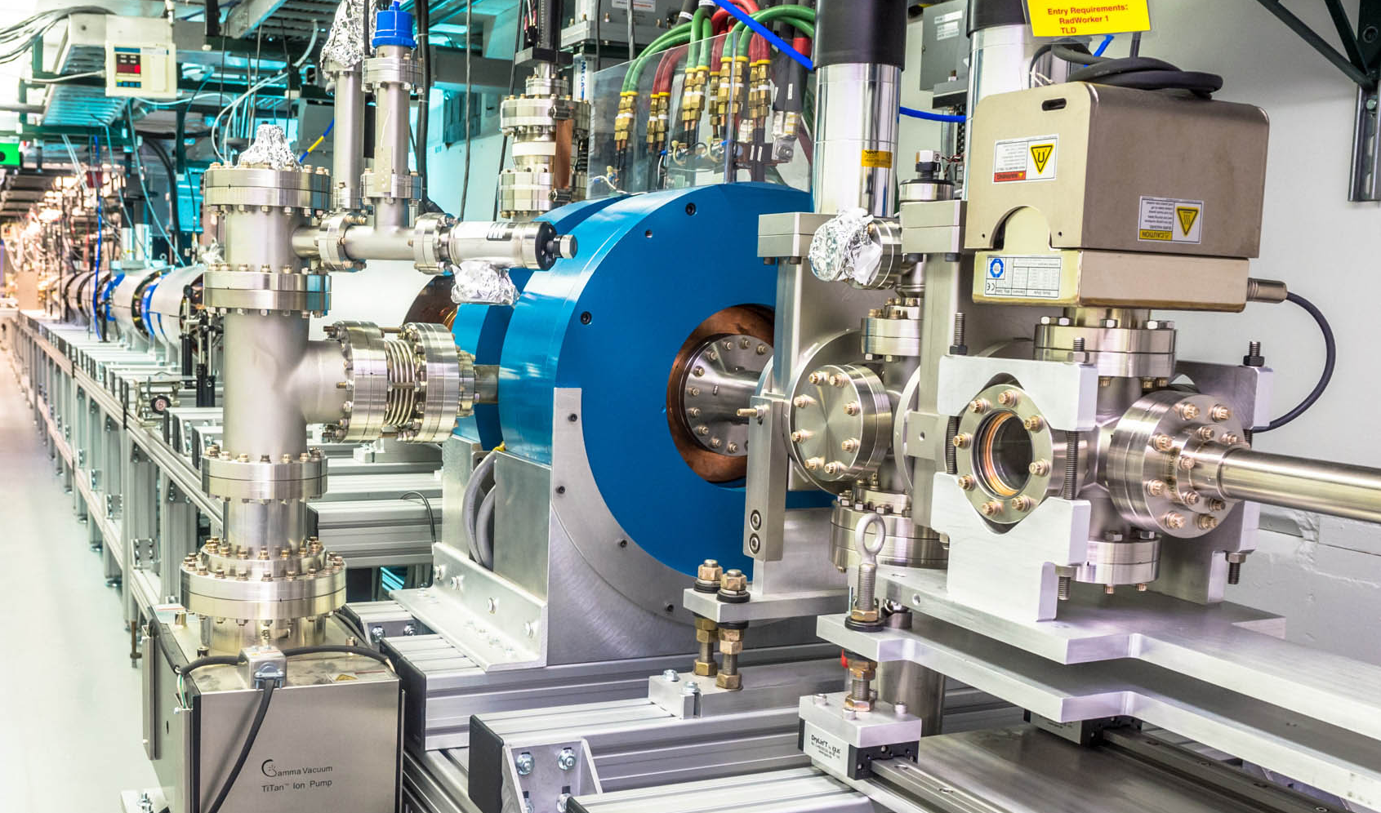
Progress and challenges in RF structures for short-pulse SWFA
Xueying Lu
Northern Illinois University (NIU)
& Argonne National Laboratory (ANL)
October 23, 2025
Valencia, Spain

Slide 2

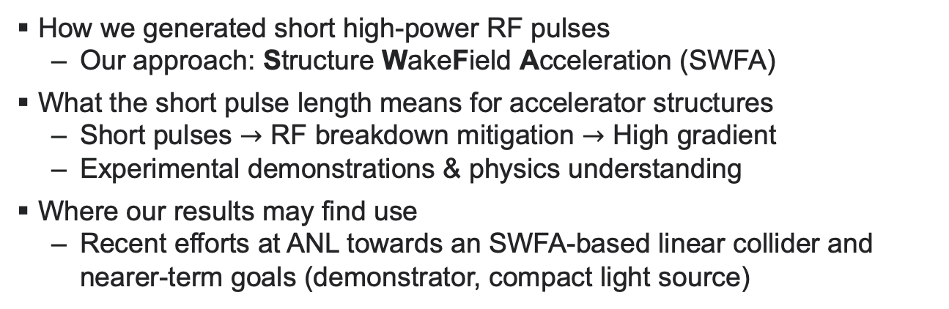
Outline
How we generated short high-power RF pulses
Our approach: Structure WakeField Acceleration (SWFA)
What the short pulse length means for accelerator structures
Short pulses $→$ RF breakdown mitigation $→$ High gradient
Experimental demonstrations & physics understanding
Where our results may find use
Recent efforts at ANL towards an SWFA-based linear collider and nearer-term goals (demonstrator, compact light source)
2

Slide 3
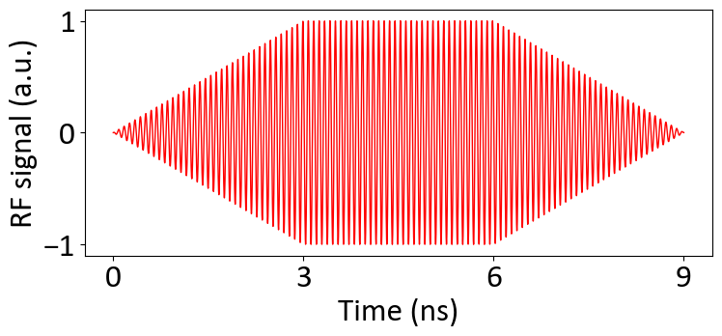
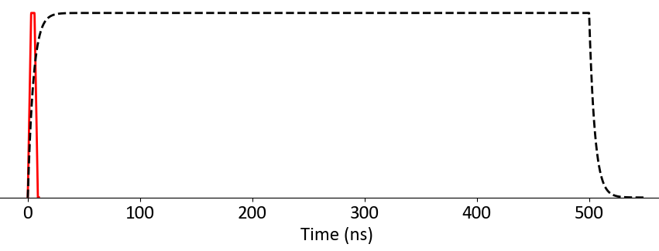
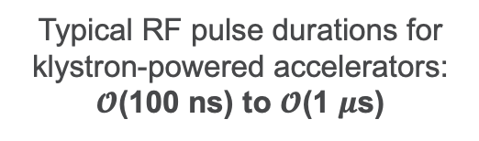
Toward high-gradient acceleration:
Shared goal across multiple accelerator communities
Advanced Accelerator Concepts community:
Various wakefield acceleration schemes
High-gradient and breakdown science community:
Recent advances in pushing the gradient:
Cryogenic temperatures
Hard copper and copper alloys
High-frequency structure
Novel structure designs
Short RF pulse duration
…
This talk
Typical RF pulse durations for klystron-powered accelerators:
$𝓞$(100 ns) to $𝓞$(1 $μ$s)

Slide 4
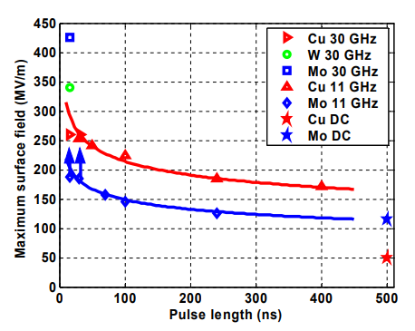


Path to GV/m with short RF pulses
Acceleration using $𝓞$(ns) RF pulses shows promise for high-gradient acceleration, suggested by:
Empirical fitting of experimental data
Breakdown rate $(BDR)∝E^{30}τ^{5}$
A. Grudiev, et al. PRSTAB 12, 102001 (2009)
Gradient
Pulse length
Early exploration of short-pulse acceleration
Under-explored
Lack of complete understanding of RF breakdown processes, especially at this timescale
S. Döbert et al., SLAC-PUB-10551 (2004)

Slide 5
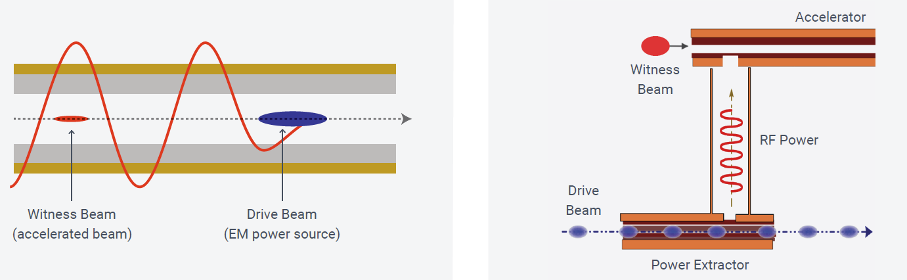
Structure WakeField Acceleration (SWFA): two schemes
Collinear Wakefield Acceleration (CWA)
Actively studied for a single-stage 180 GHz X-ray FEL at ANL
A. Zholents et al., JINST 20, 01023 (2025)
Two-Beam Acceleration (TBA)
More mature for a linear collider: CLIC
Positron acceleration (shared w/ CWA)
Staging

Slide 6
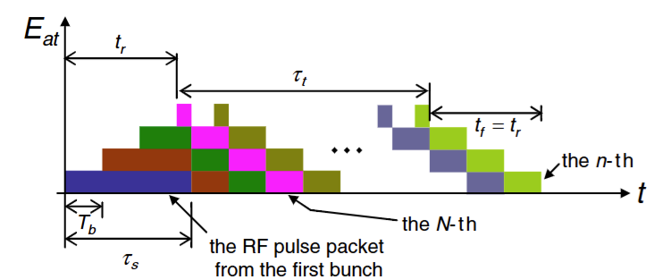
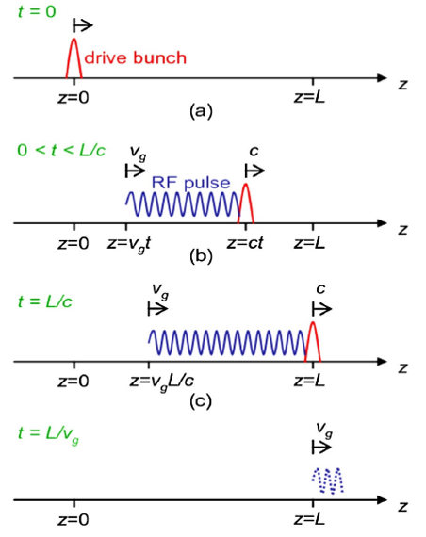
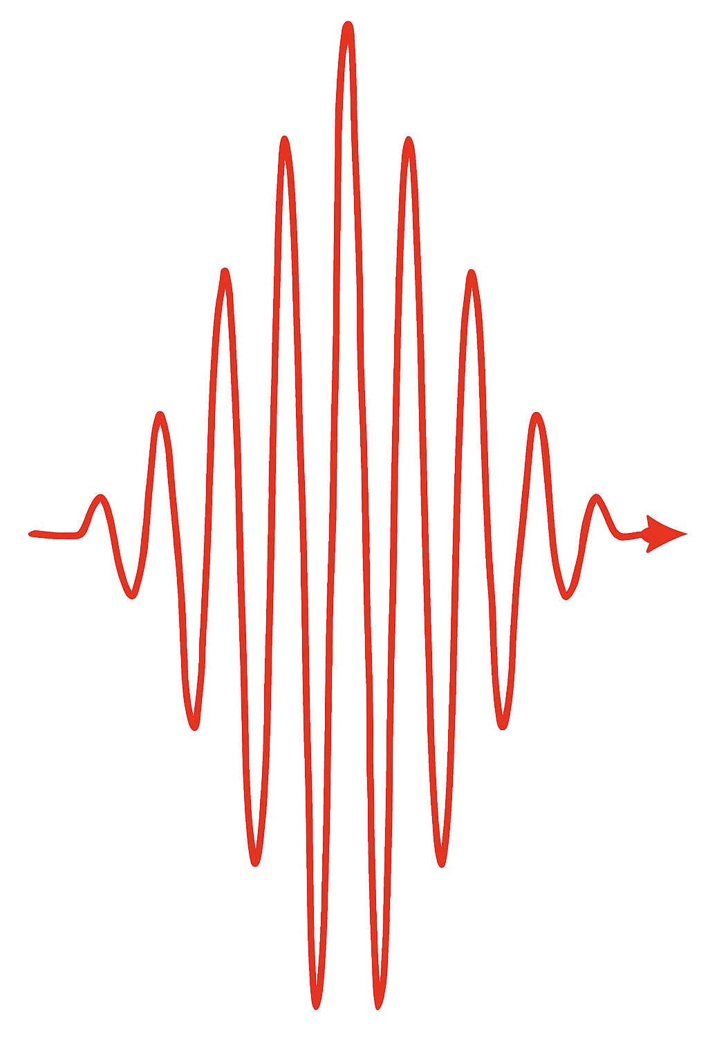
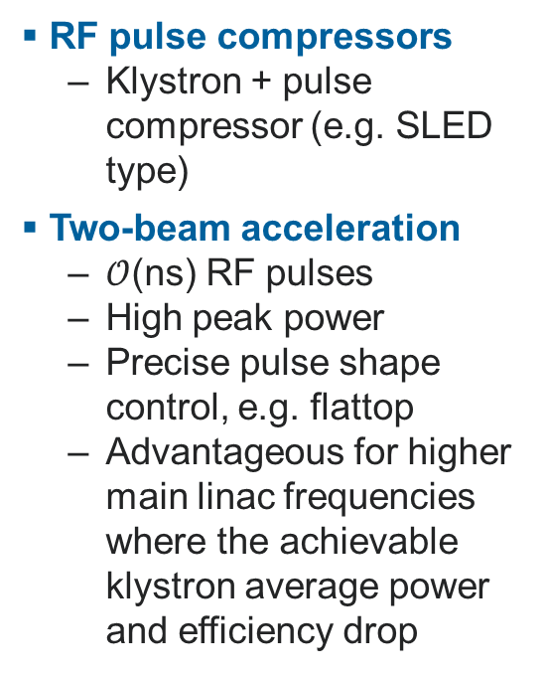
Generation of short RF pulses using:
RF pulse compressors
Klystron + pulse compressor (e.g. SLED type)
Two-beam acceleration
$𝒪$(ns) RF pulses
High peak power
Precise pulse shape control, e.g. flattop
Advantageous for higher main linac frequencies where the achievable klystron average power and efficiency drop
Drive beam linac: low frequency, low gradient
Drive beam accelerated: energy stored
Drive beam traverses power extractor: energy extracted
Power extractor: Generation of short RF pulses at high frequency…
And high peak power from coherent wakefield stacking
Result: short, high-peak-power RF pulses at high frequency for the main linac

Slide 7
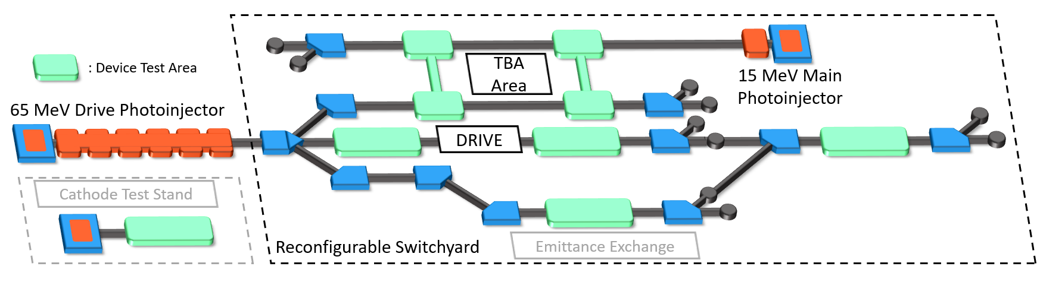
Argonne Wakefield Accelerator (AWA)
Drive Beam:
- 65 MeV drive beamline
- Trains of up to 32 bunches
- Highest-charge photoinjector
- Single bunch max. 100 nC
- Bunch train max. 600 nC
Witness Beam:
- 15 MeV witness (main) beamline
- Lower charge
- For two-beam acceleration

Slide 8
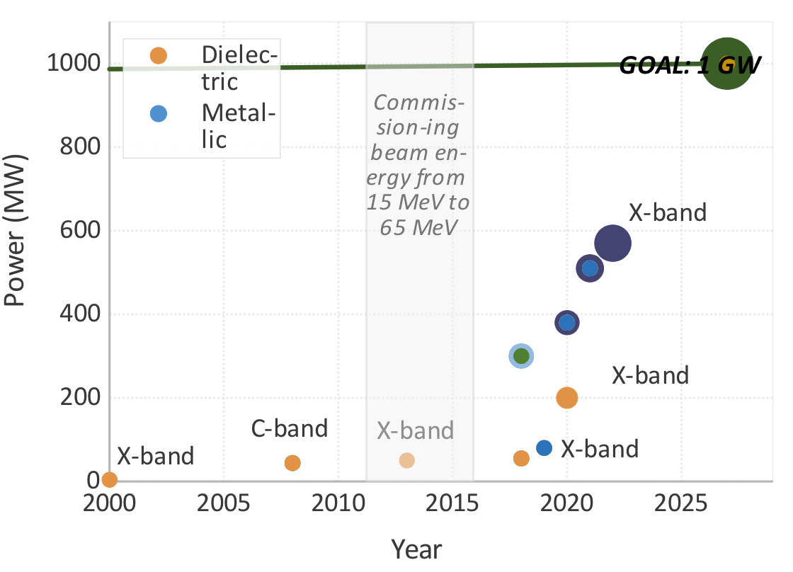
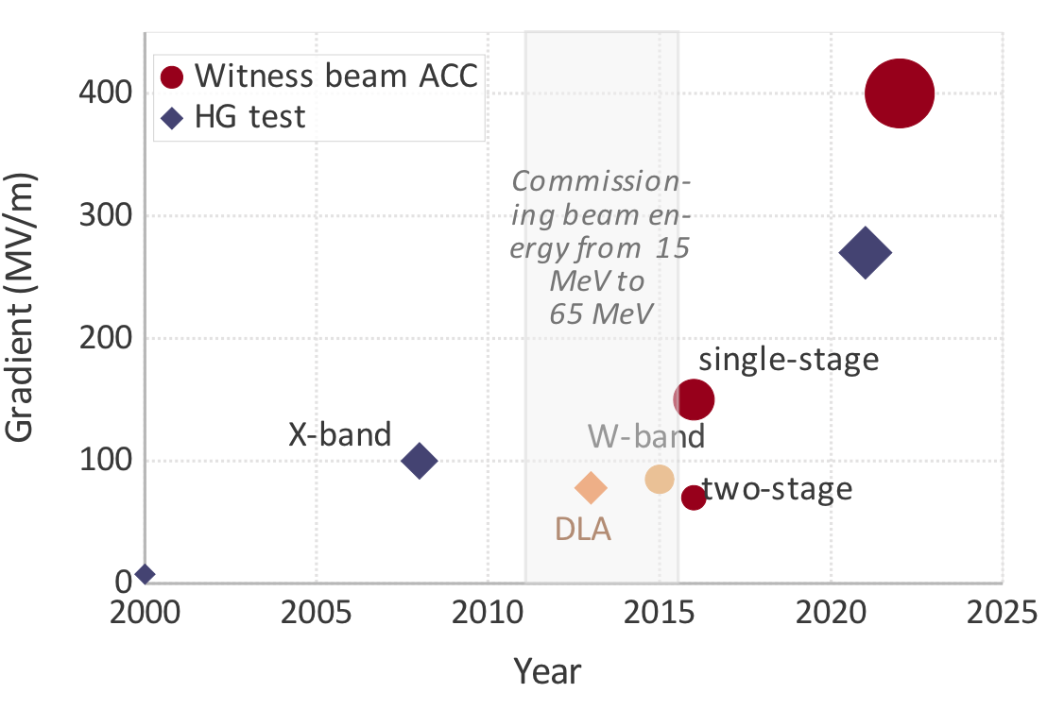

Progress in two-beam acceleration at AWA
Power Extraction
Acceleration Gradient
goal
C
dielectric
metallic
B
A

Slide 9
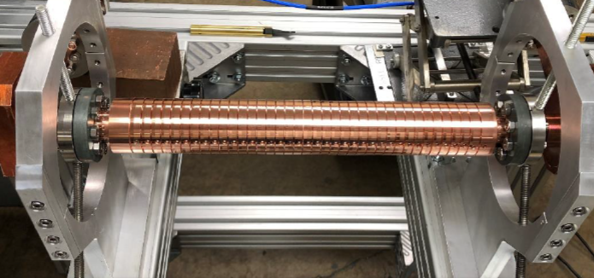
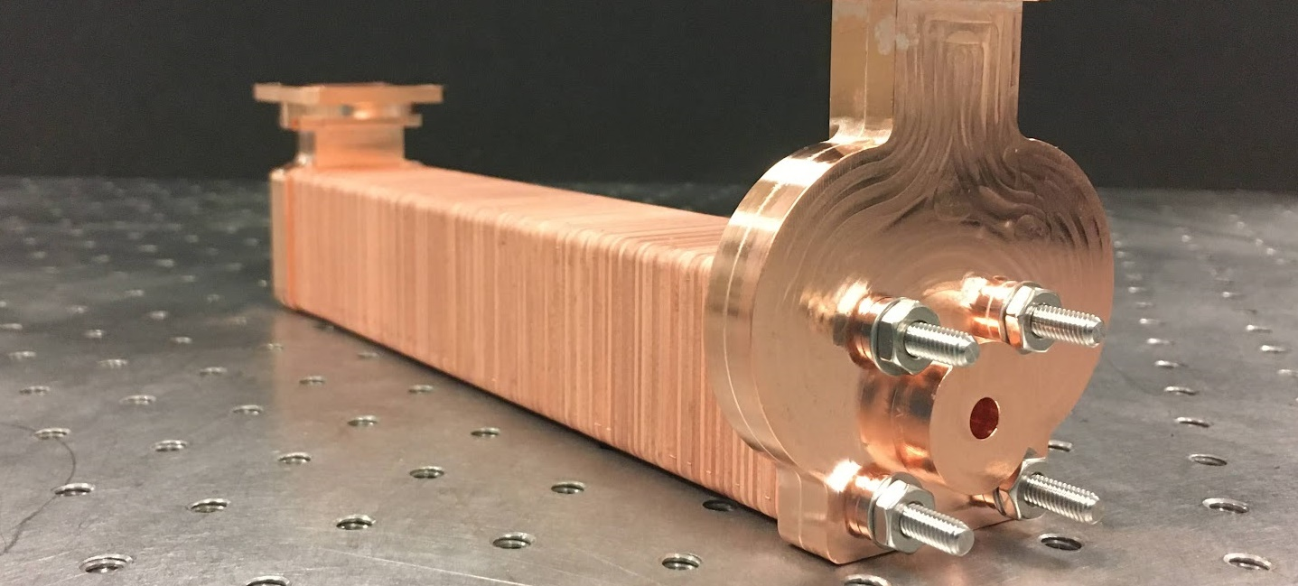
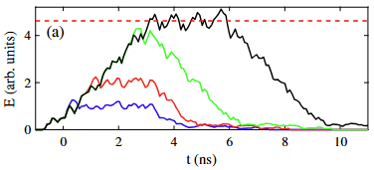
Power extractors: SWFA-based short-pulse RF sources
X-band metallic disk-loaded, 400 MW, 6 ns
X-band metamaterial, 565 MW, 6 ns
Coherent wakefield stacking
High peak power of over 500 MW from 8-bunch trains with ~500 nC total charge
Flexibility in choice of RF frequency
Harmonics of the bunch frequency 1.3 GHz
Tested at AWA (in GHz): 7.8, 11.7, 26, 91, etc.,
Wakefield stacking with 1, 2, 4, 8 bunches

Slide 10
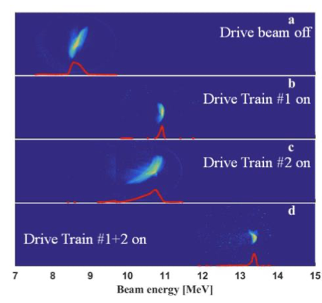
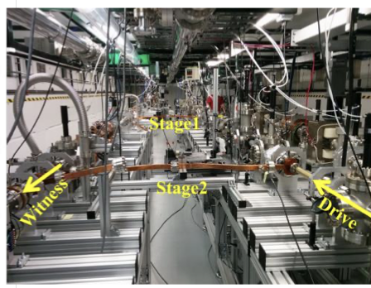
Staging in TBA: not as challenging
Advantage of TBA for staging: beam optics decoupled
Staging of a 11.7 GHz TBA SWFA accelerator demonstrated at AWA
100 MeV/m average gradient in two stages
Jing et al., NIMA 898, 72 (2018)

Slide 11
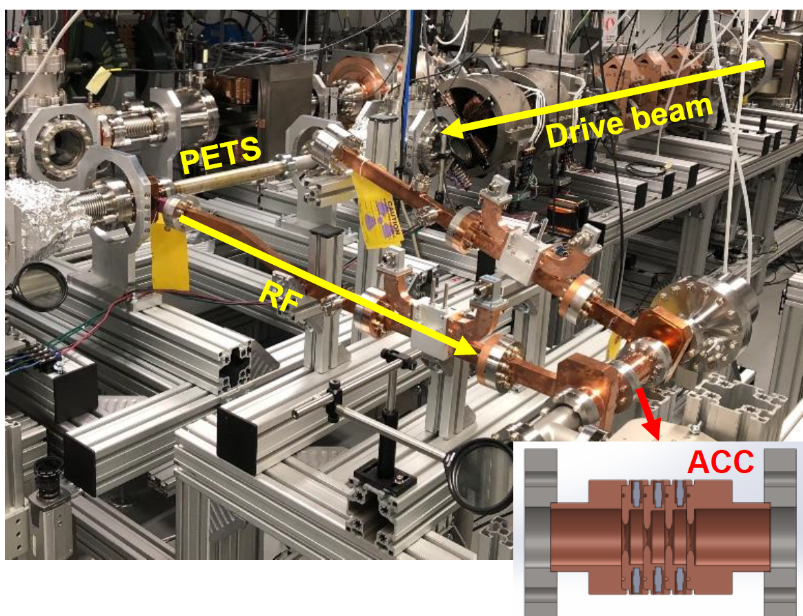
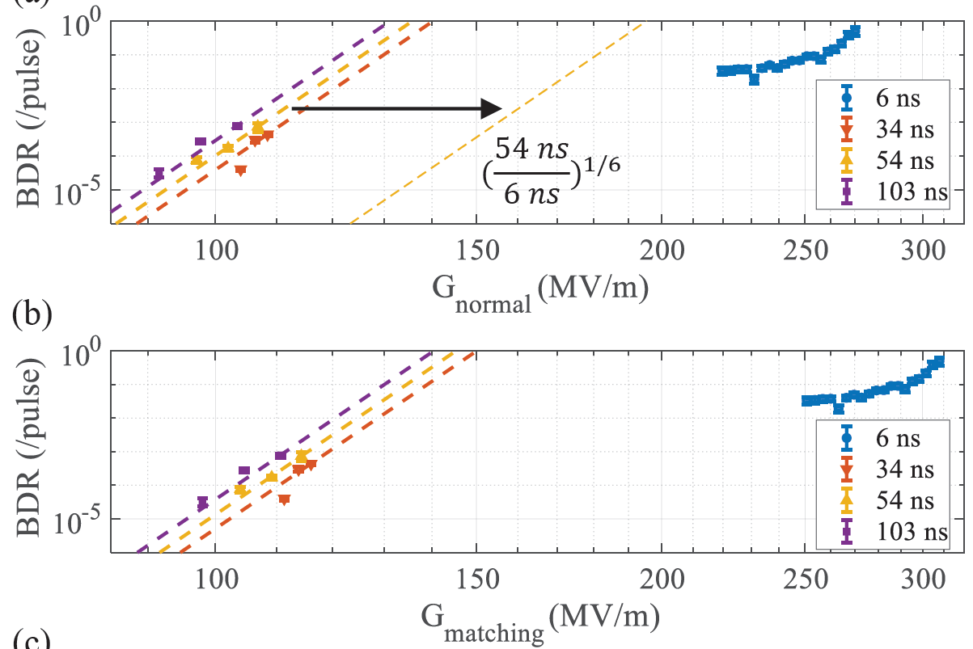

Short-pulse accelerating structure
300 MV/m in an X-band single-cell accelerating structure with 6 ns pulses
Higher gradient than predicted by the empirical law of
$$BDR∝E^{30}τ^{5}$$
Central cell
Power extractor
Matching cell
300 MV/m gradient in a single-cell accelerator

Slide 12
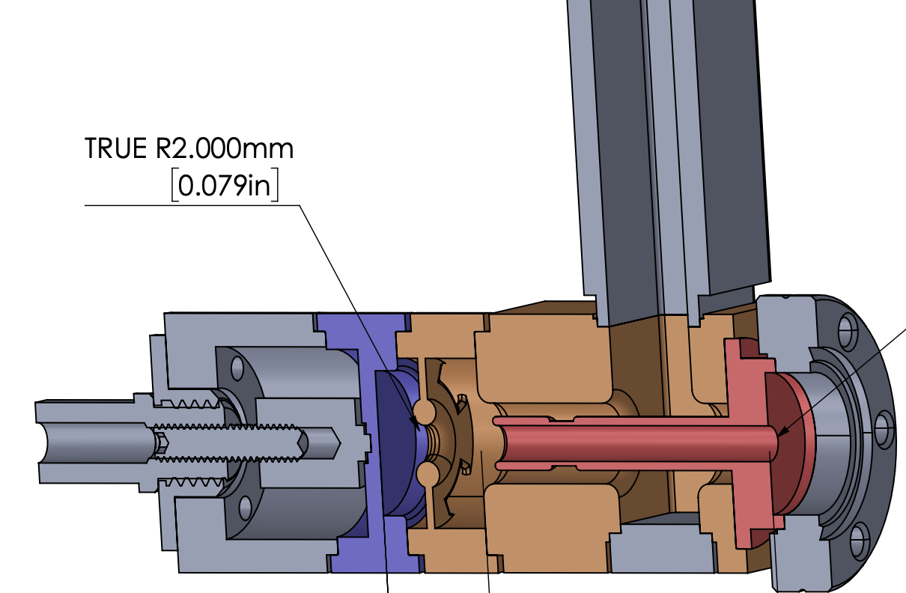
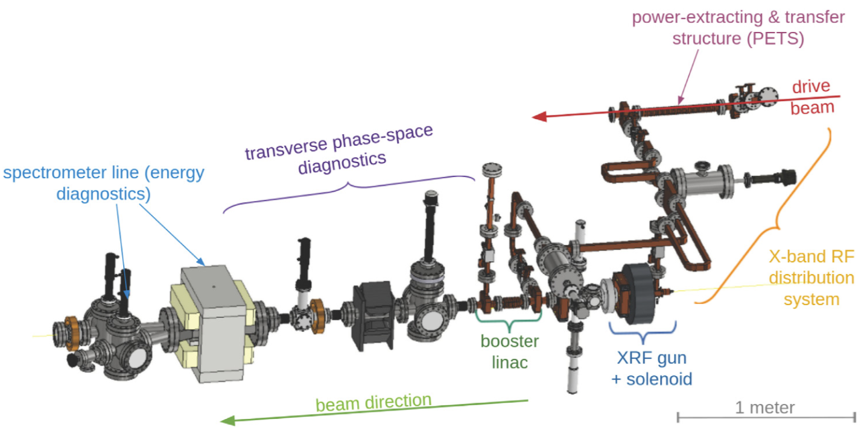
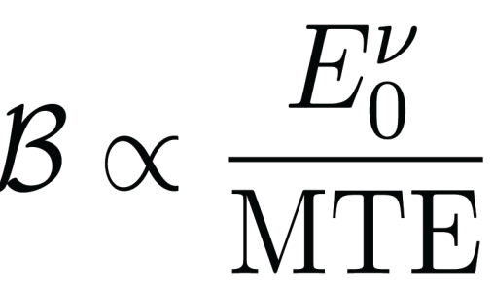
Short-pulse photogun
Close to 400 MV/m measured on an X-band photocathode surface in a photogun driven by 6 ns RF pulses
Rapid RF conditioning, low dark current, reliable operation
A reduction of emittance expected; detailed beam characterization in progress
RF
(6 ns)
power extractor
beam
Field at emission
Depends on ab-initio beam aspect radio
Mean Transverse Energy
4D beam brightness

Slide 13
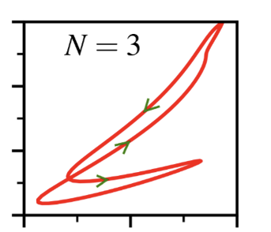
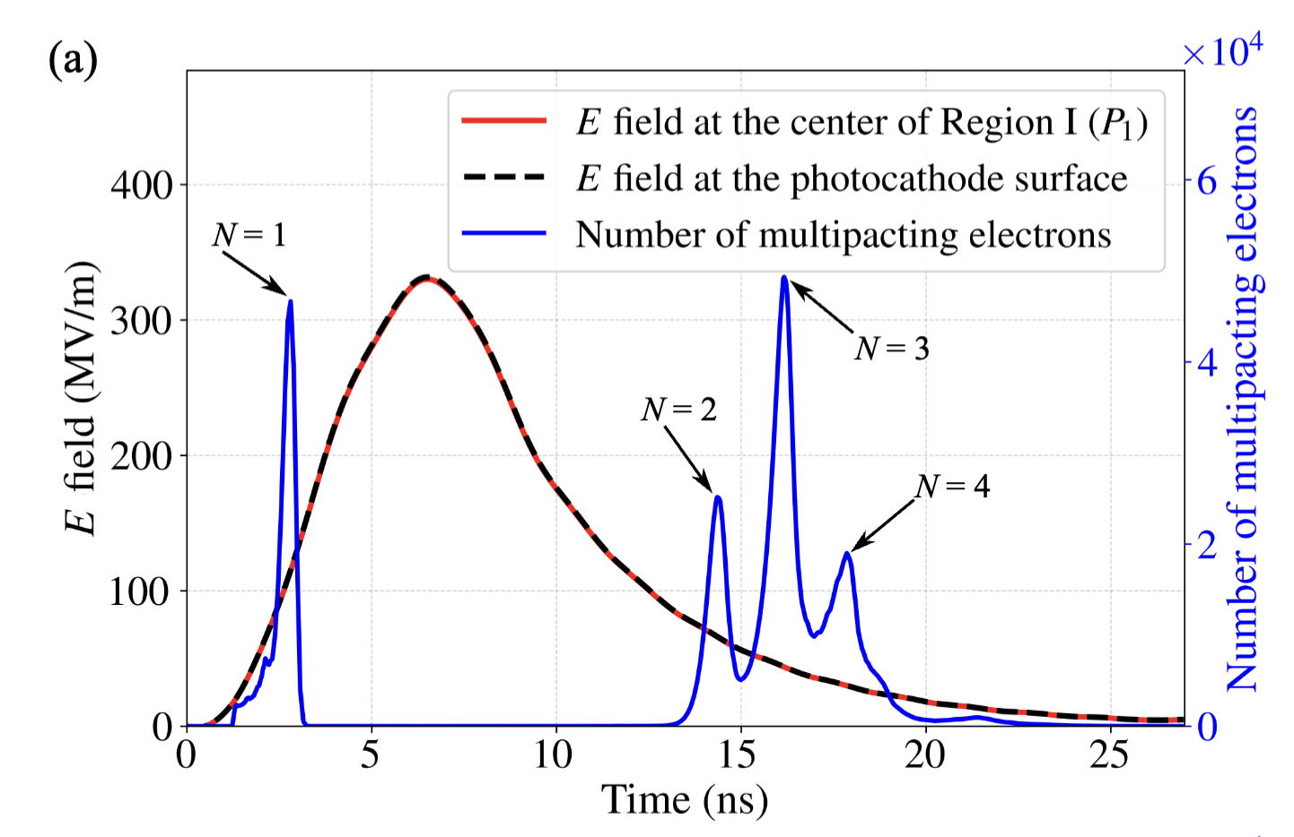
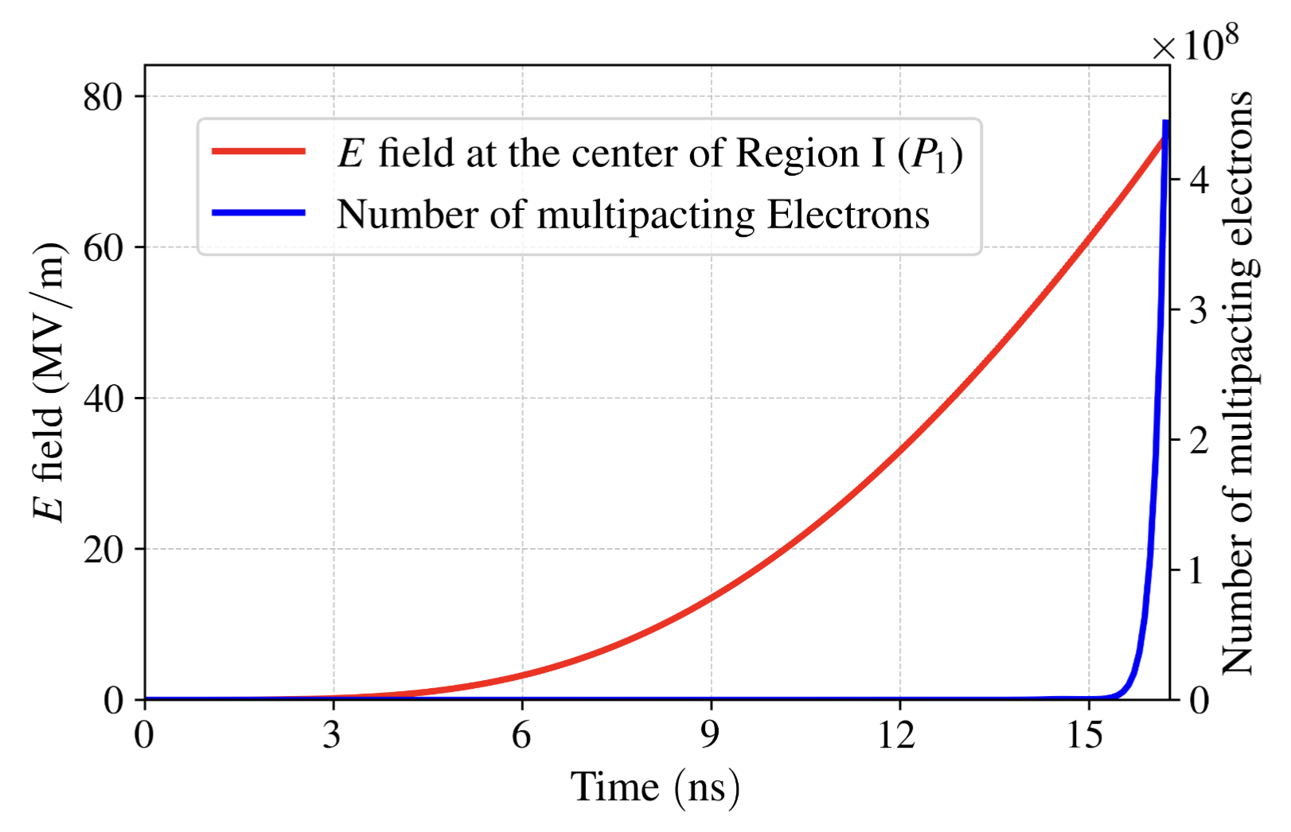
One example in breakdown mitigation with short RF pulses: electron multipacting
Electron multipacting resonances contribute to dark current growth
Fast pulse rise and fall times reduce windows for resonances to develop
Short-pulse
Long-pulse w/ slow ramp

Slide 14
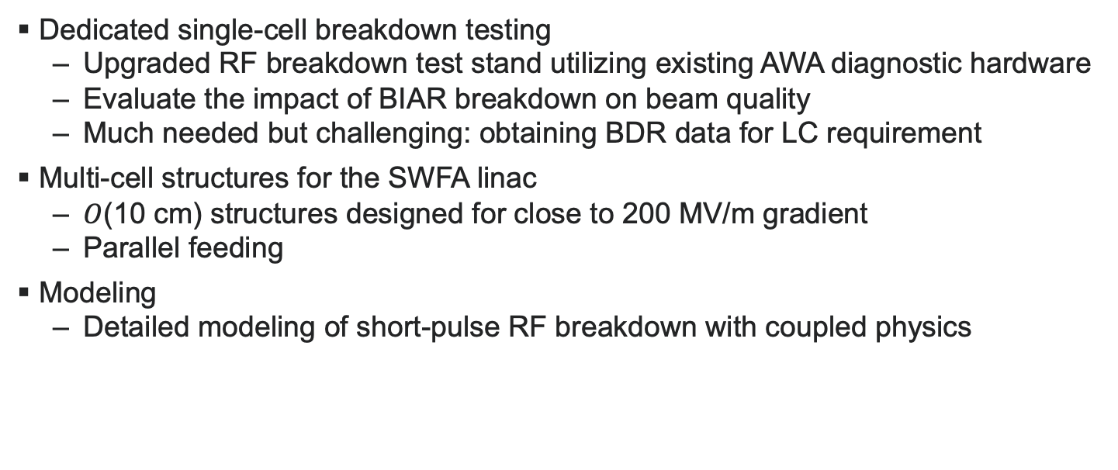
Planned studies on short-pulse RF structures
Dedicated single-cell breakdown testing
Upgraded RF breakdown test stand utilizing existing AWA diagnostic hardware
Evaluate the impact of BIAR breakdown on beam quality
Much needed but challenging: obtaining BDR data for LC requirement
Multi-cell structures for the SWFA linac
$O$(10 cm) structures designed for close to 200 MV/m gradient
Parallel feeding
Modeling
Detailed modeling of short-pulse RF breakdown with coupled physics

Slide 15
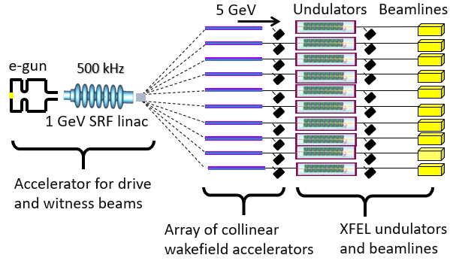
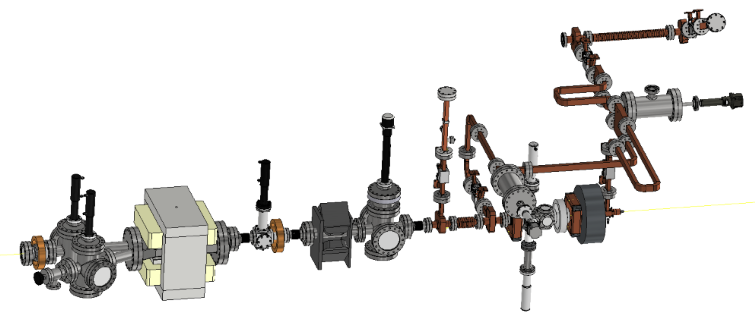
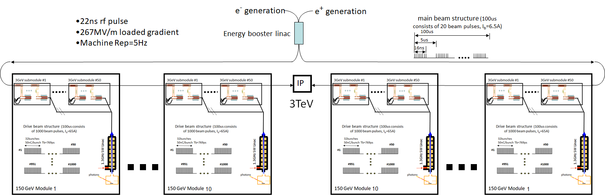
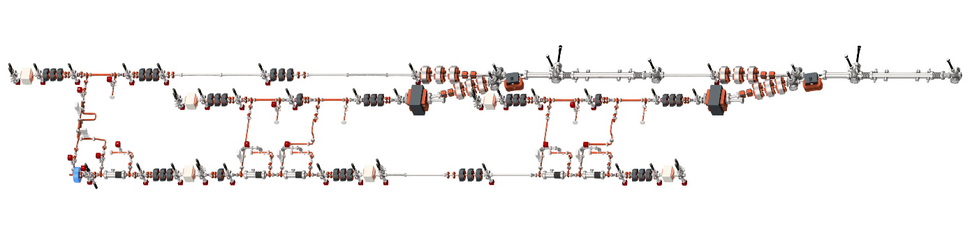
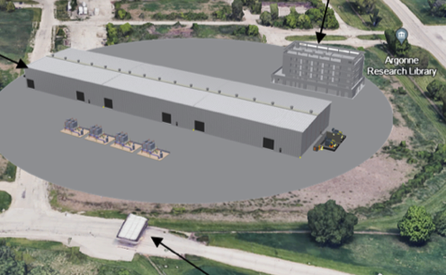
Long-term Roadmap
Now
Demonstrated staging,
high transformer ratio
0.4 GV/m field
100-MeV bright beams
AWA w/ ongoing upgrades
0.5-GeV demo
AWA-II
Integration
Small-scale facility (e.g. 1-GeV water window FEL)
Stepping-stone facility
Deploy technology to supports a user facility
(e.g. 5-GeV XFEL)
Collider applications
- Higgs-factory upgrade - 10-TeV linear collider
AWA energy upgrade
Aligning with long-term P5 recommendations
Enabling mid-term photon science opportunities
time

Slide 16
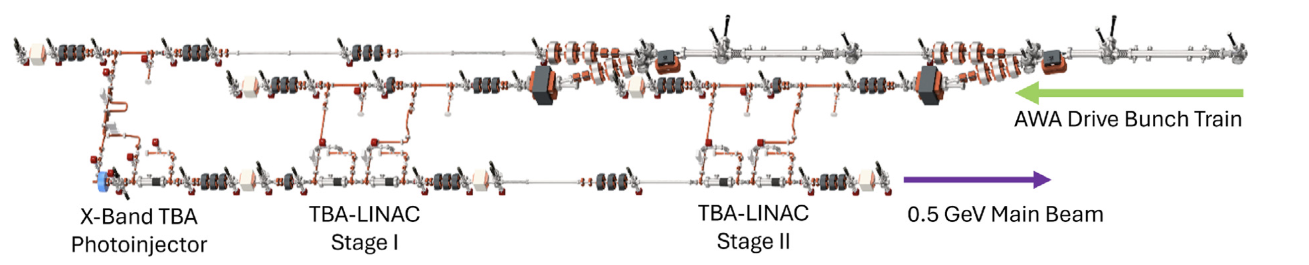
A proposed 0.5 GeV TBA demonstrator
Demonstration of key components for short-pulse TBA
High charge train generation and transportation
Drive beam distribution: fast kicker and timing
BBU control for GW power extraction
Staging at 300 MeV/m of sustainable gradient
To be identified as part of the 10 TeV design study

Slide 17
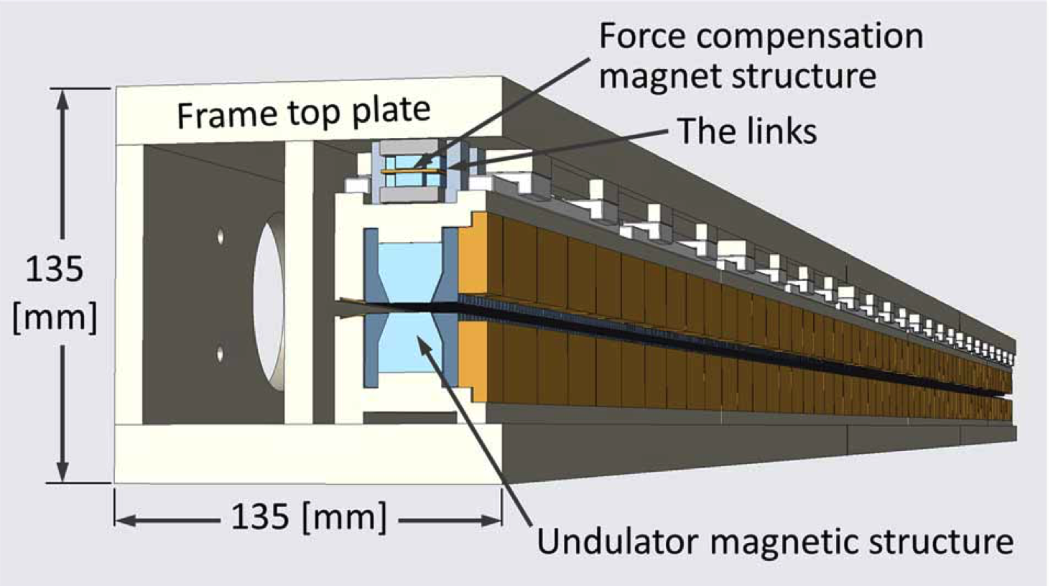
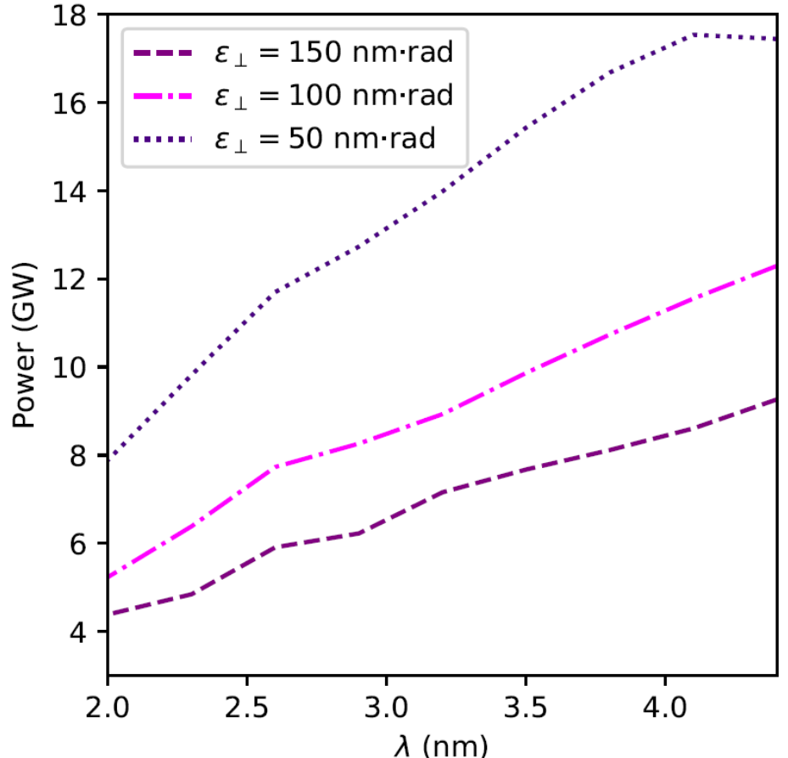
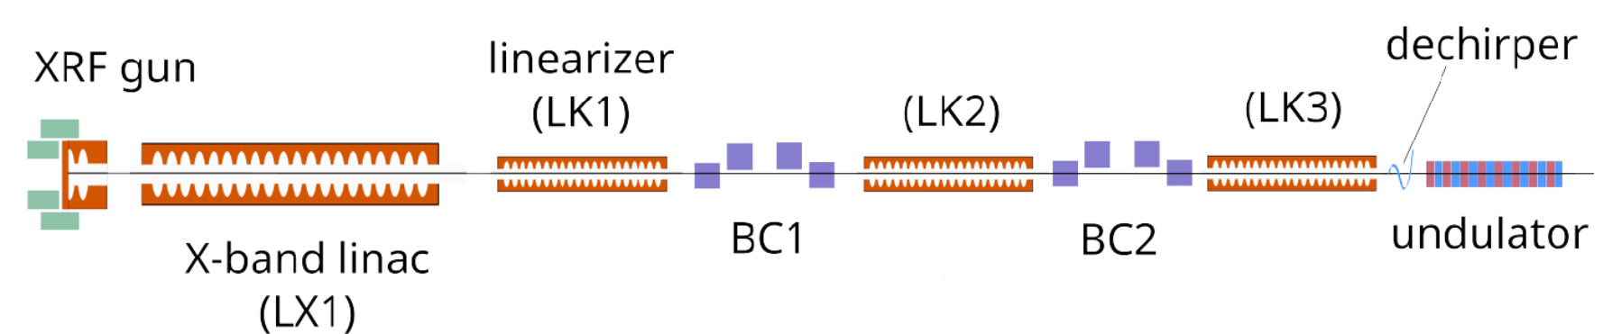
Nearer-term application in compact light sources
Compact XFEL based on short-pulse TBA:
High-field photoinjector: bright electron source to meet the beam quality demands of a short undulator period (~10 mm)
High-gradient acceleration to reduce linac length
Preliminary design studies indicate promise for:
Water-window FELs
Scalability to hard X-ray FELs
J. Xu, et al. doi:10.1088/1742-6596/2687/3/032017
Increasing
Beam
Quality
5-m undulator
Total length: ~50 m, with 1 GeV beam

Slide 18
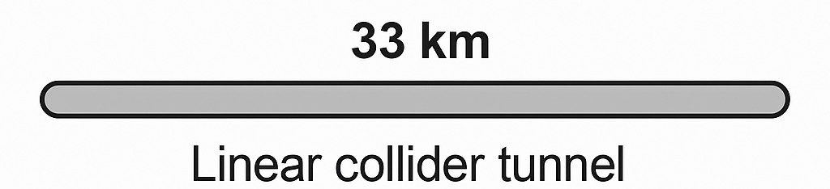
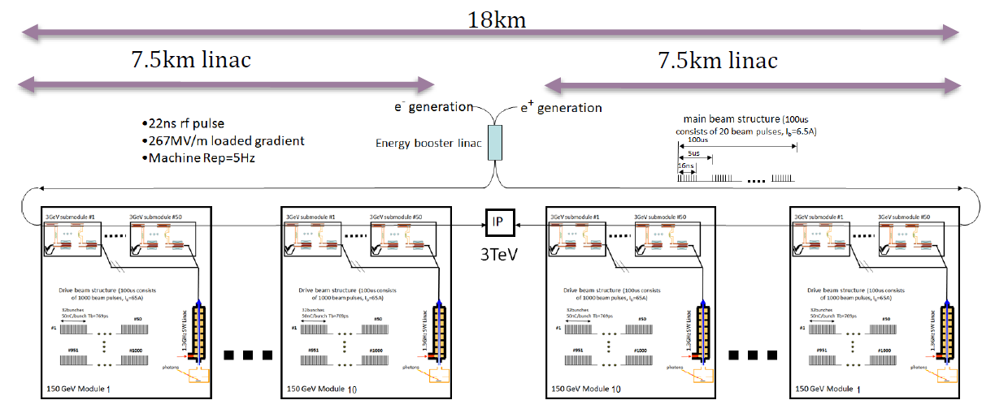


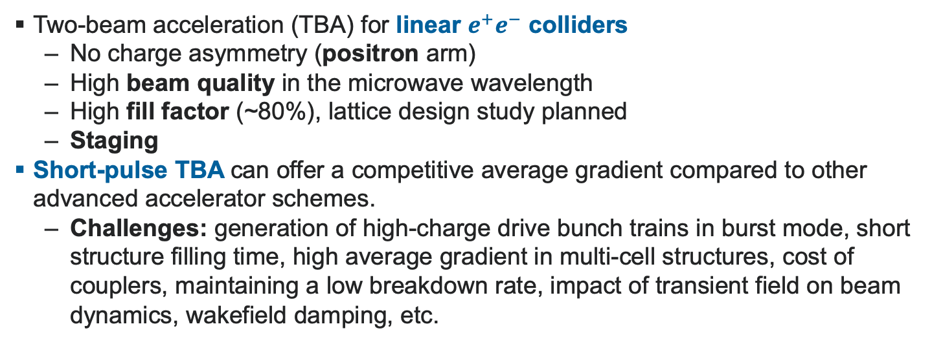
Linear collider options based on short-pulse TBA
Two-beam acceleration (TBA) for linear $e^{+}e^{−}$ colliders
No charge asymmetry (positron arm)
High beam quality in the microwave wavelength
High fill factor (~80%), lattice design study planned
Staging
Short-pulse TBA can offer a competitive average gradient compared to other advanced accelerator schemes.
Challenges: generation of high-charge drive bunch trains in burst mode, short structure filling time, high average gradient in multi-cell structures, cost of couplers, maintaining a low breakdown rate, impact of transient field on beam dynamics, wakefield damping, etc.
$e^{−}$ linac, 5 TeV
10 km, 500 MV/m
BDS
$e^{+}$ linac, 5 TeV
10 km, 500 MV/m
Argonne Flexible Linear Collider (AFLC) under revision
Optimized operating gradient
High efficiency to reduce site power
Desired luminosity through design choices

Slide 19
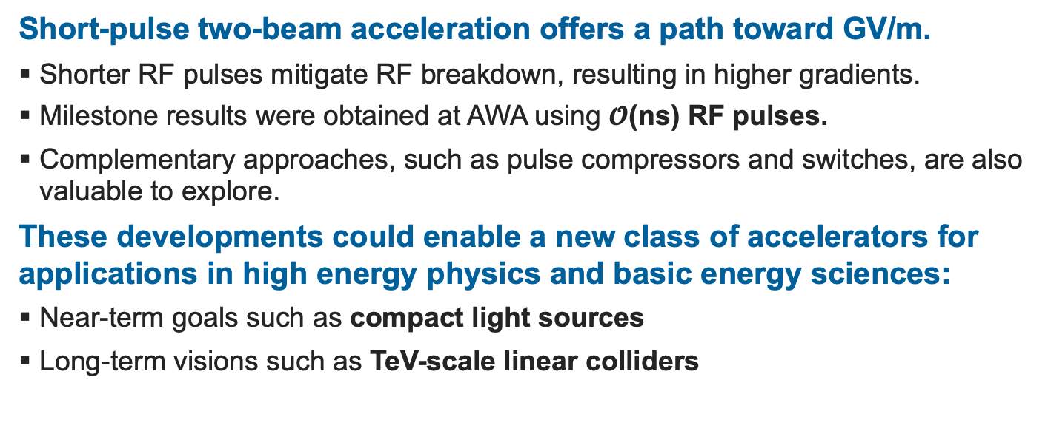
Conclusion
Short-pulse two-beam acceleration offers a path toward GV/m.
Shorter RF pulses mitigate RF breakdown, resulting in higher gradients.
Milestone results were obtained at AWA using $𝓞$(ns) RF pulses.
Complementary approaches, such as pulse compressors and switches, are also valuable to explore.
These developments could enable a new class of accelerators for applications in high energy physics and basic energy sciences:
Near-term goals such as compact light sources
Long-term visions such as TeV-scale linear colliders

Slide 20

Acknowledgments
Gongxiaohui Chen (ANL)
Salih Colmekci (NIU)
Scott Doran (ANL)
Emily Frame (NIU)
Edgar Gomez (Euclid)
Gwanghui Ha (NIU)
Chunguang Jing (Euclid / ANL)
Ernest Knight (Euclid)
Sergey Kuzikov (Euclid)
Wanming Liu (ANL)
Rachel Margraf-O'Neal (ANL)
Dillon Merenich (NIU)
Alex Ody (ANL)
Maomao Peng (was at Tsinghua)
Philippe Piot (ANL)
John Power (ANL)
Gaurab Rijal (NIU)
Jiahang Shao (was at ANL, now at IASF)
Michael Shapiro (NIU)
Wei-Hou Tan (was at NIU, now at SLAC)
Charles Whiteford (ANL)
Eric Wisniewski (ANL)
This research was supported by the U.S. Department of Energy, Office of Science, through:
Argonne National Laboratory (ANL): Laboratory Directed Research and Development (LDRD) funding provided under Contract No. DE-AC02-06CH11357.
Northern Illinois University (NIU): Awards DE-SC0018656, DE-SC0022010, DE-SC0021928, and the Chicagoland Accelerator Science Traineeship under Award No. DE-SC0020379.
Euclid Techlabs LLC: SBIR Grant No. DE-SC0018709.

