Slide 1

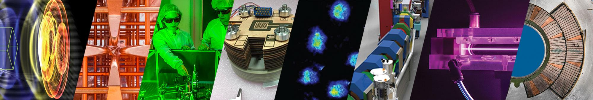
Near term applications of advanced accelerator technologies: compact free electron lasers
Sam Barber, Staff Scientist
BELLA Center
LCWS 2025, Valencia, Spain
October 23, 2025
This work was supported by the U.S. Department of Energy (DOE), Office of Science, the Office of Basic Energy Sciences,
the Office of High Energy Physics, under Contract No. DE-AC02-05CH11231, and through a CRADA with Tau Systems.
1

Slide 2
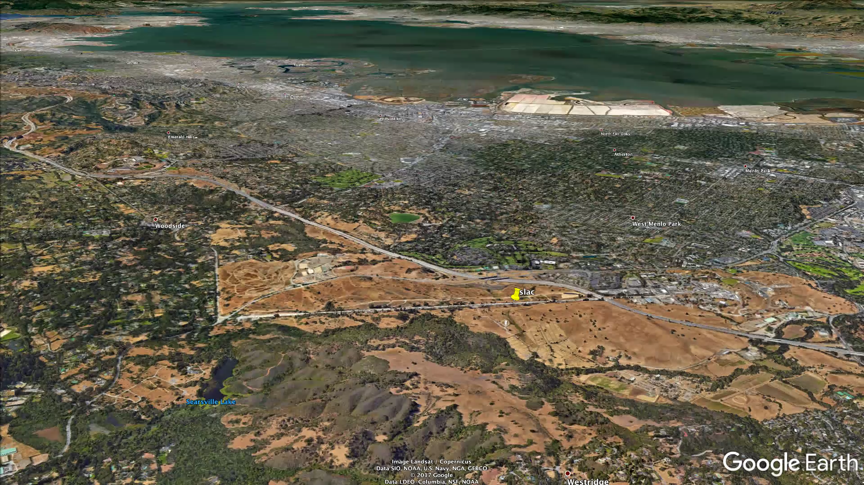
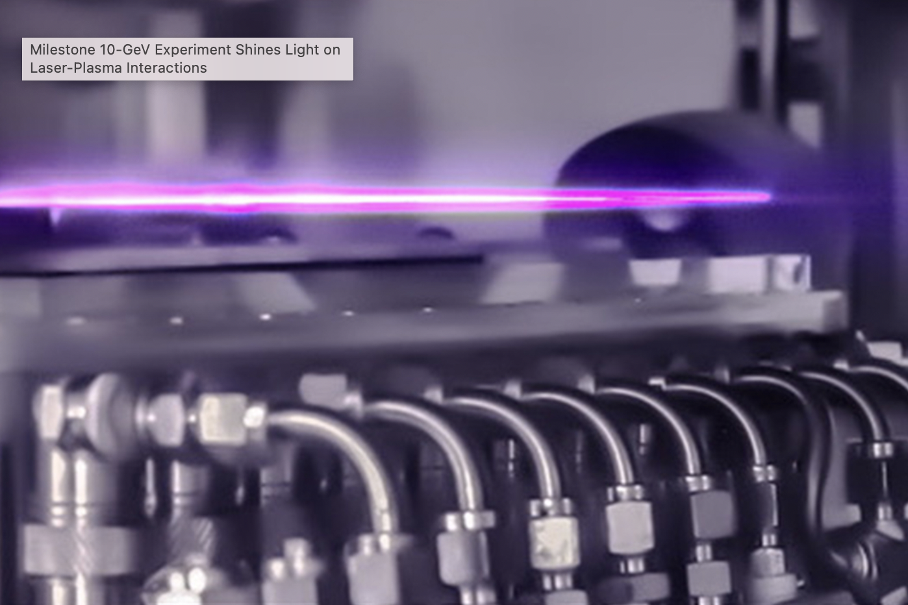
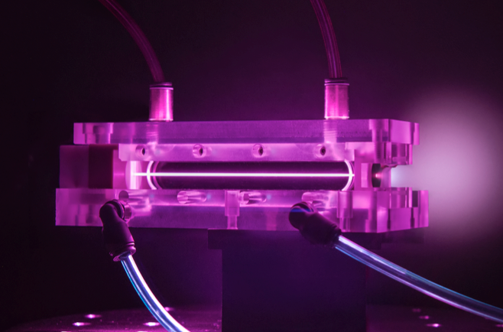
Plasma based accelerators can dramatically reduce the size of the accelerator modules
~10 GeV electrons in 1 km
~10 GeV electrons in 30 cm

Slide 3
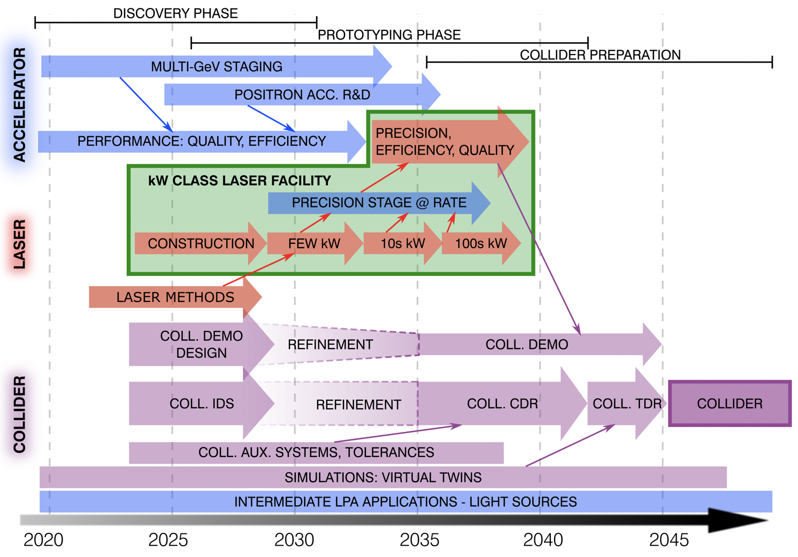
Applications are an important part of the advanced accelerator roadmap to collider development
Figure 2. Technically-limited high-level laser-plasma-accelerator-based collider R&D roadmap.
C.B. Schroeder et al 2023 JINST 18 T06001

Slide 4

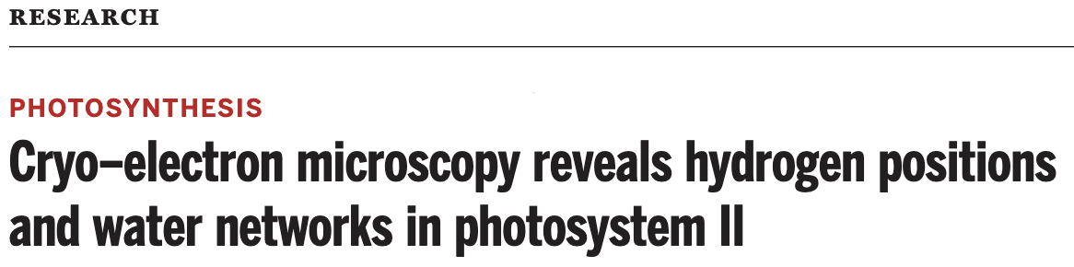

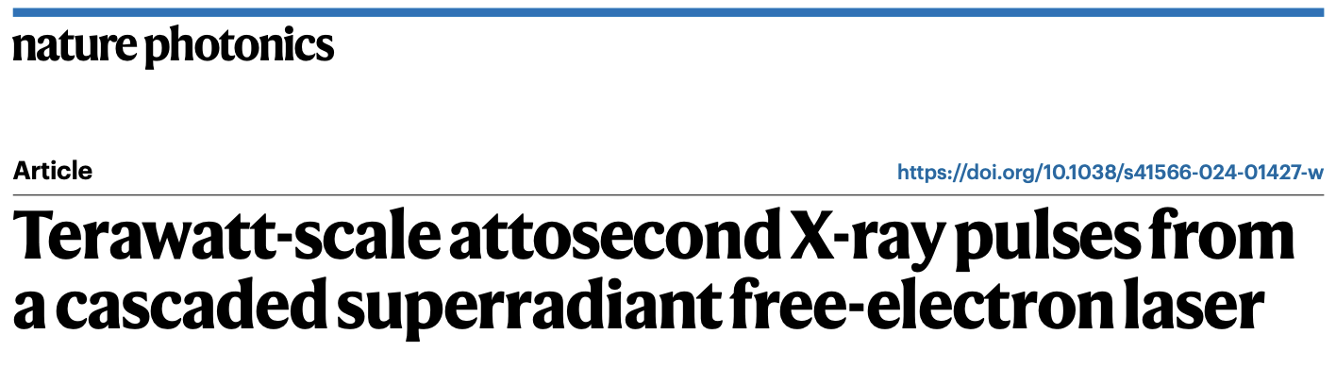


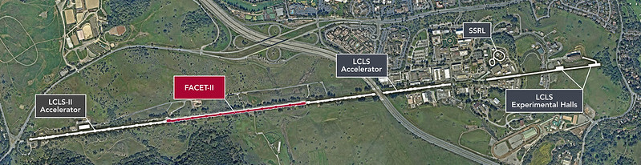

XFELs have enabled transformative science and serve broad range of scientific communities
Some metrics of success
Unique pulse properties: XFELs generate ultra-bright, atto-femtosecond x-ray pulses enabling study of atomic-scale dynamics
Wide scientific reach: XFELs support diverse fields, from physics to biology, enabling breakthroughs in molecular dynamics, crystallography, and high-energy physics.
Transformative impact: XFELs have revolutionized atomic-scale research, driving major advancements in drug discovery, materials science, and energy.
Science and Nature articles from ~6 month period
Commercialization of XFELs undergoing rapid growth
~$100 million raised by four California based companies in last few years
LCLS/LCLS II
European XFEL

Slide 5
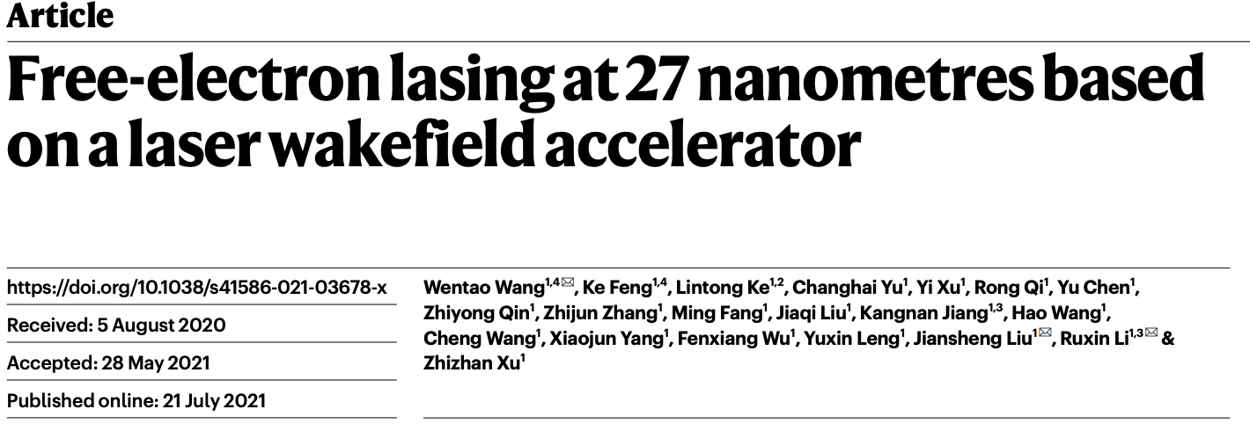

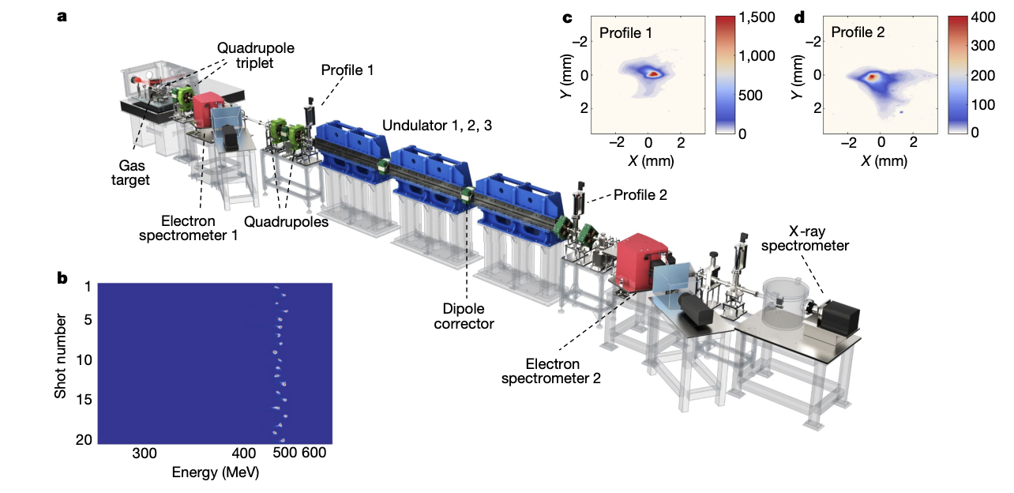


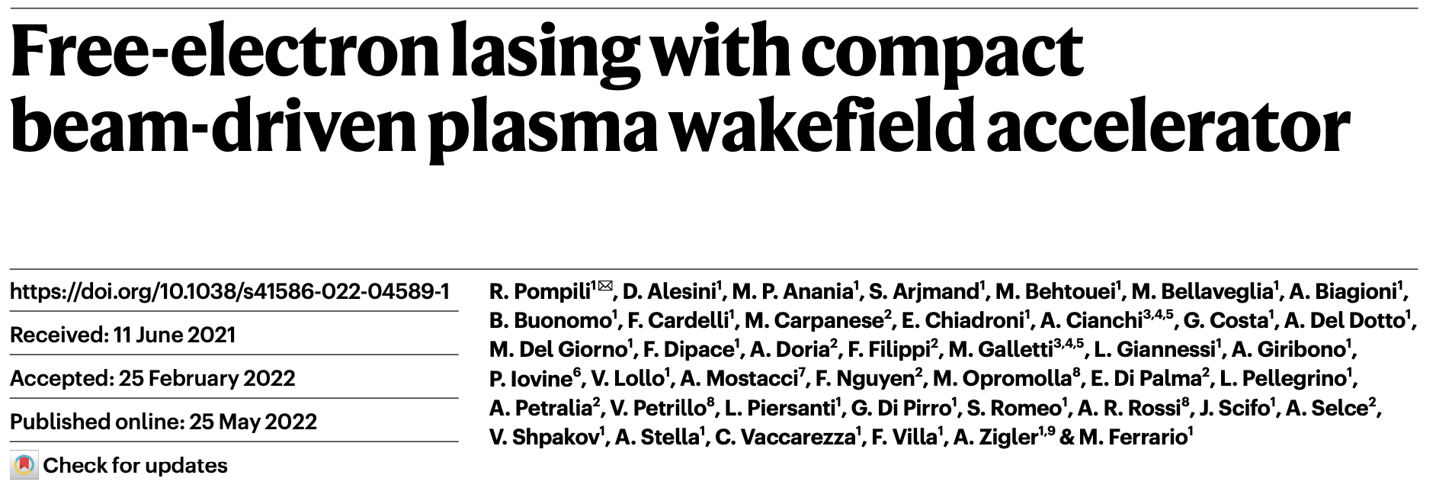


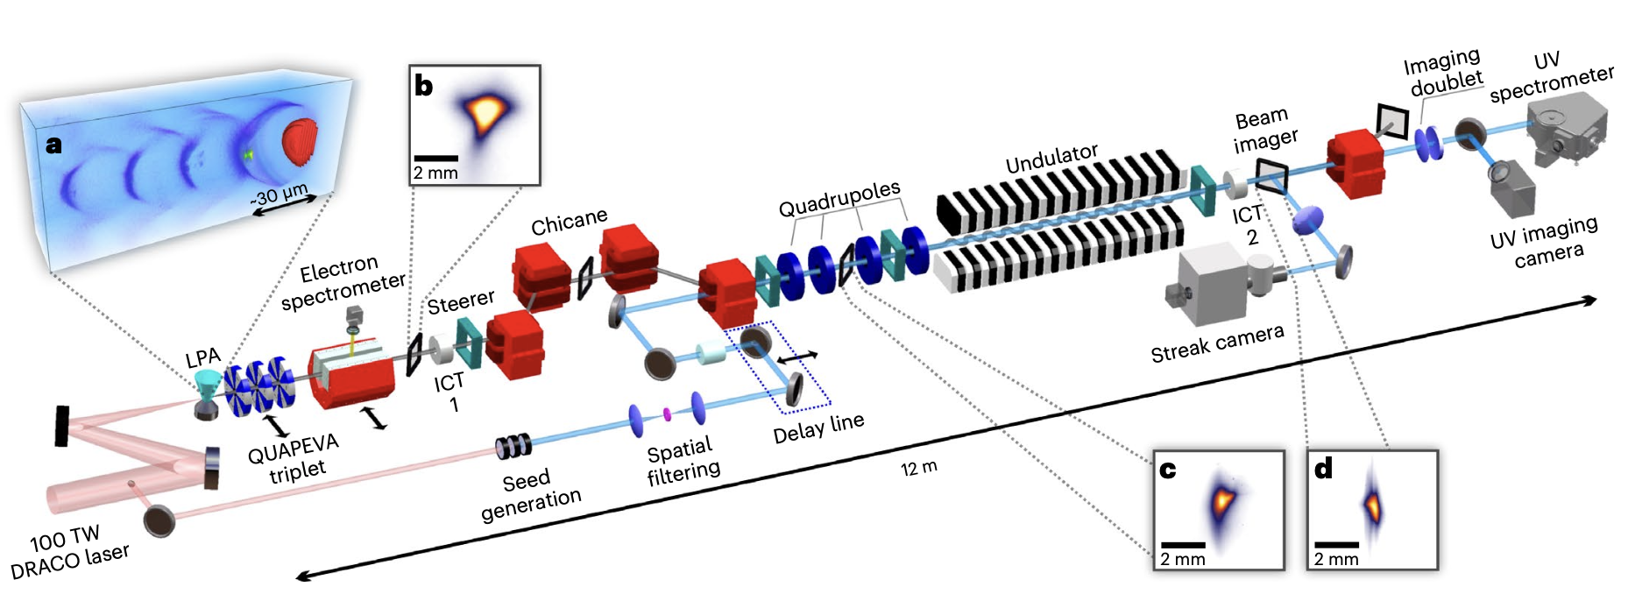
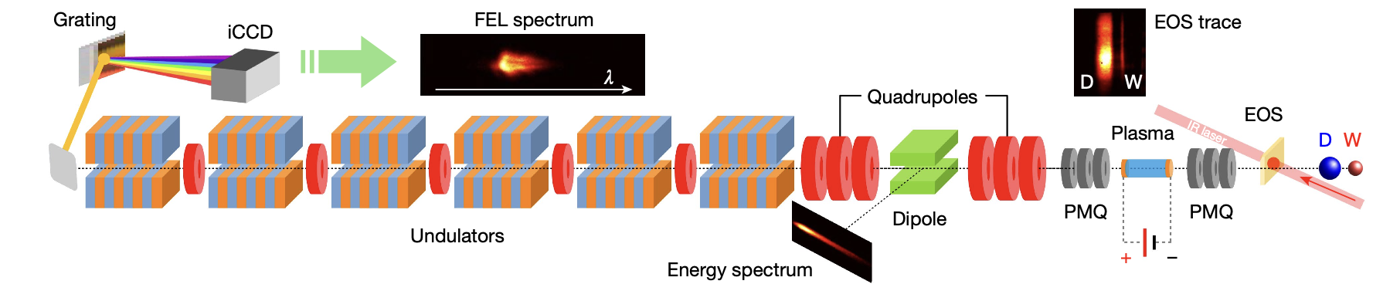
High brightness, high energy beams from compact plasma accelerators offer the potential to extend the reach of XFELs
Existing XFELs use km-scale accelerator and are billion dollar scale facilities.
With 1000x increase in acceleration gradient and potential increase in e-beam brightness, plasma-based accelerators can compactify FEL facilities, reducing cost and democratizing their accessibility
Exciting time for the field with recent milestone achievements
S. K. Barber, Research scientist ATAP

Slide 6

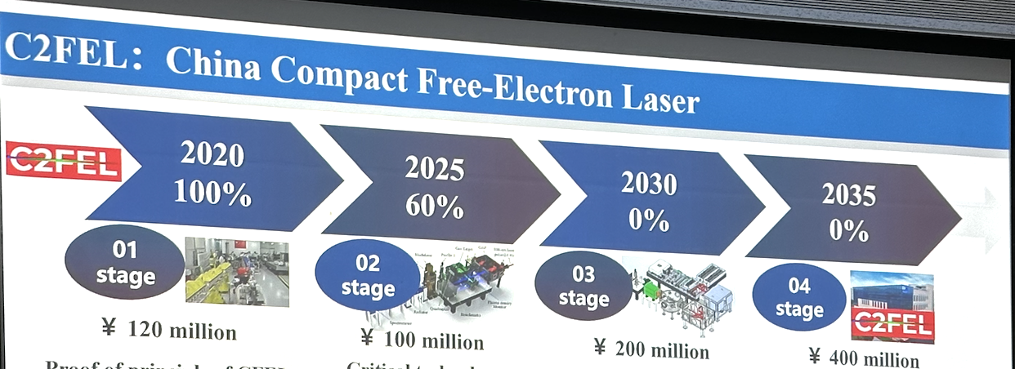
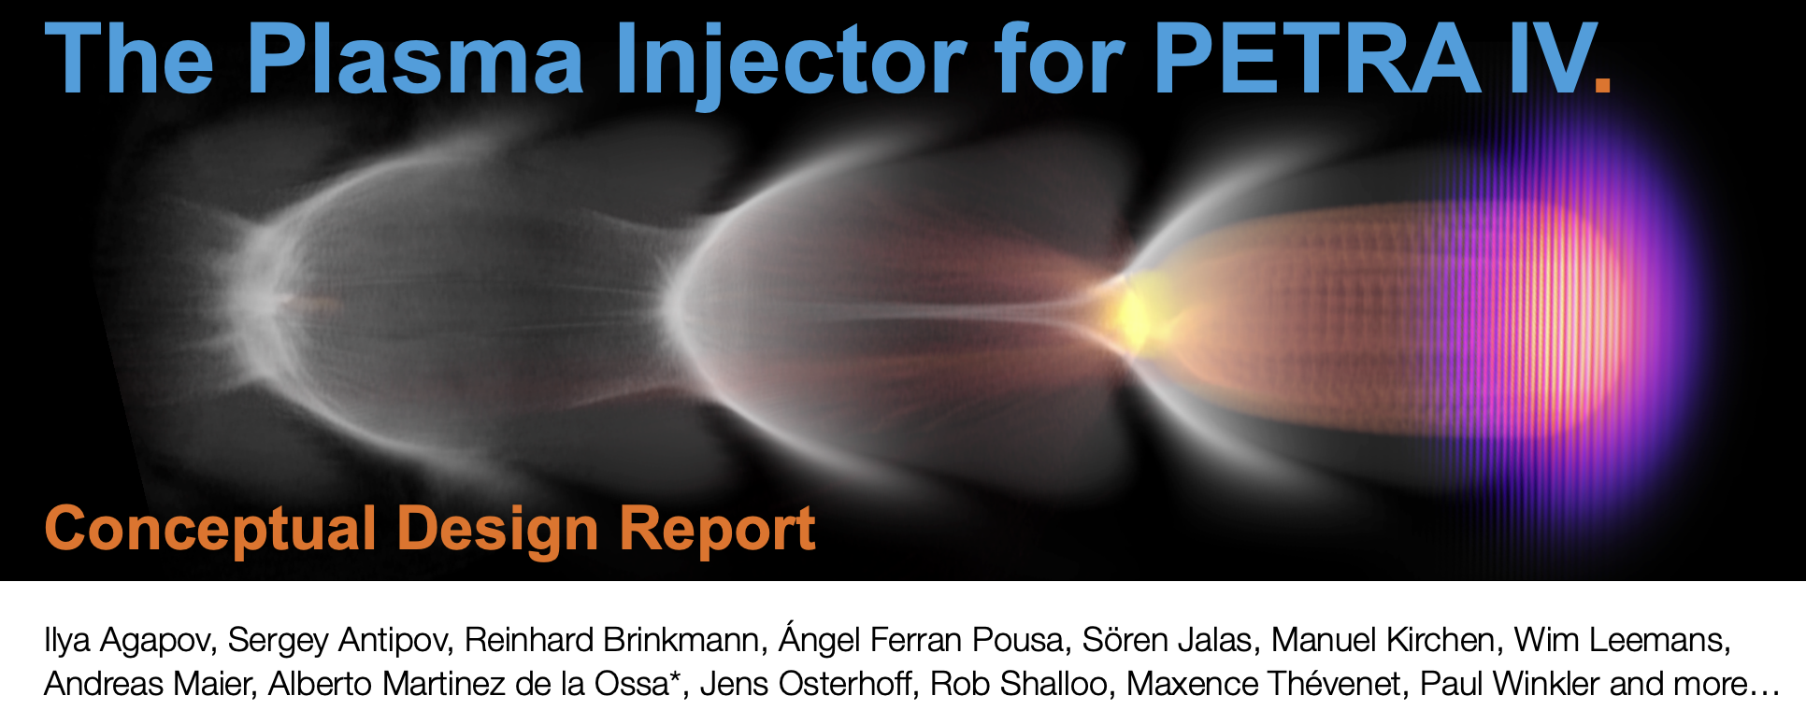
Large scale ambitious projects in development at multiple international sites
China Compact Free-Electron laser
Develop a compact, plasma-based accelerator for scientific and industrial applications.
Enable versatile research opportunities in free-electron lasers
300 million euro project
Other notable plasma accelerator-based FEL projects:
ELI-Beamlines, Czech Republic (EUPRAXIA site)
SANKEN, Osaka U,. / KPSI, QST, Japan
And more…
Serious consideration and R&D towards LPA injector for PETRA IV facility at DESY

Slide 7
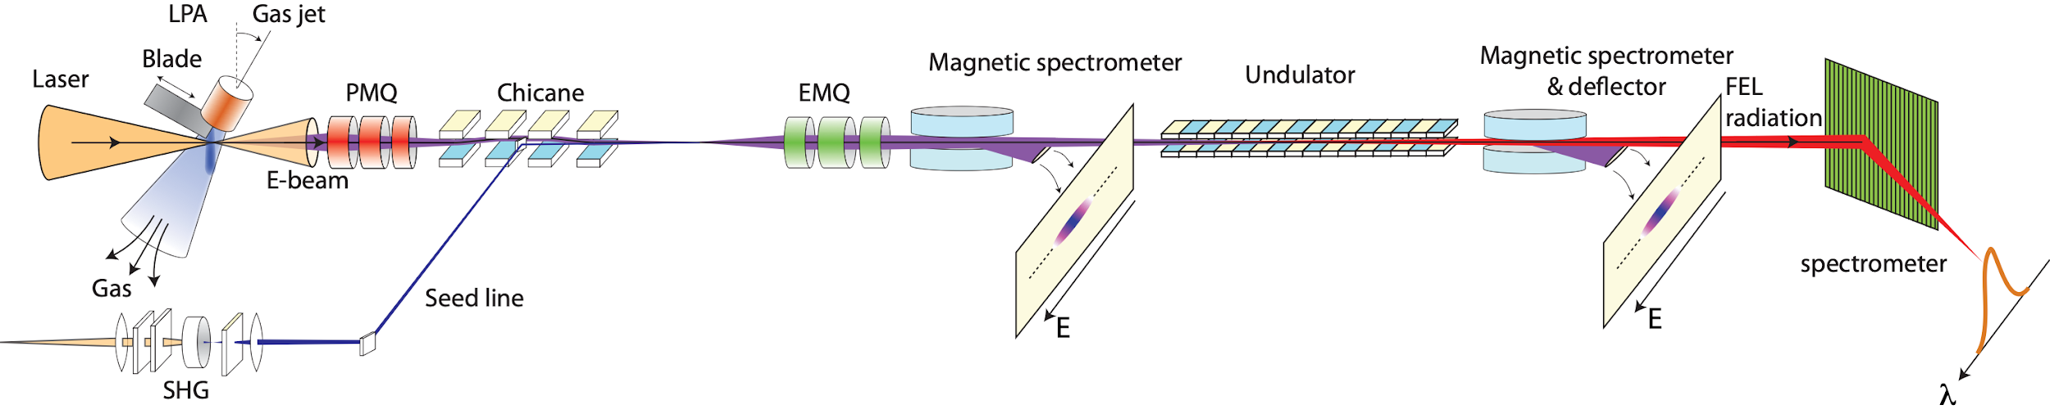
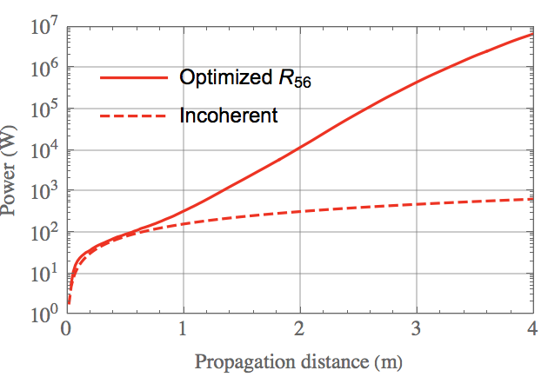
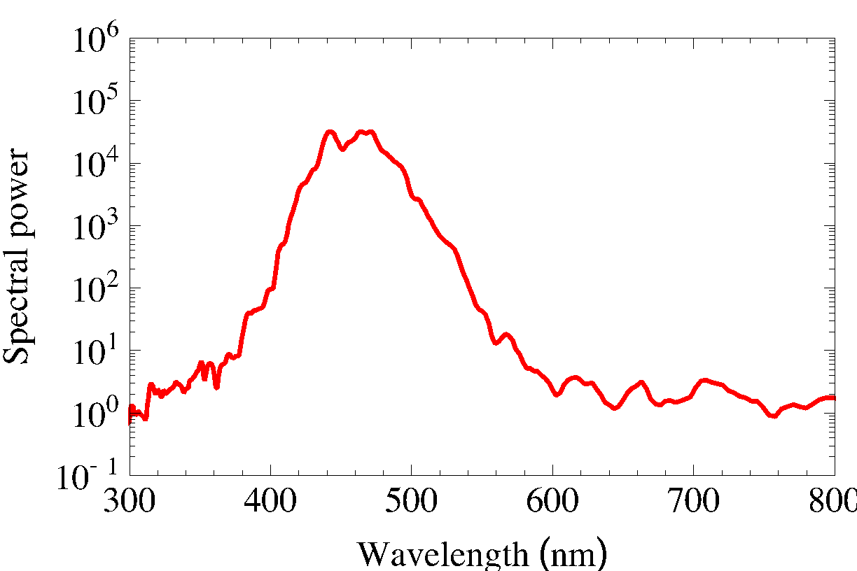
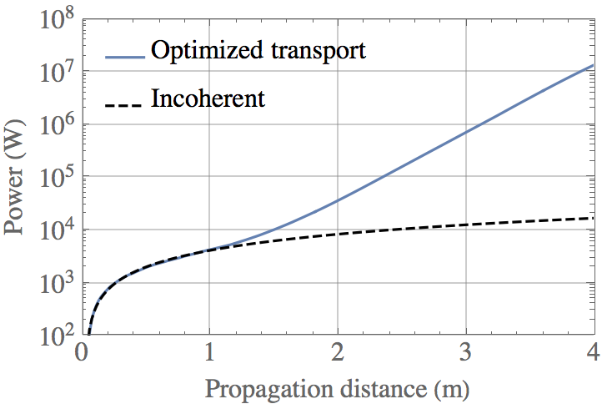
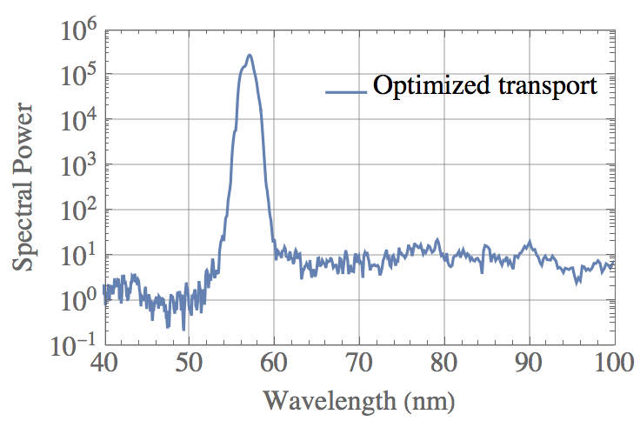
HTU system designed to establish reliable test bed for developing high-brightness beams and compact laser plasma accelerator-based FELs
Key features:
100 TW-class laser system (2.5 J, 35 fs, 40 um) @ 1-5Hz
Density downramp injection for production of tunable monoenergetic e-beams with 100-500 MeV, 50-150 pC, 1-5% RMS energy spread
Transport line with PMQs, EMQs, steering magnets, chicane, 4m 220 period strong focusing undulator
Goals: Reliable, saturated FEL operation at 100 MeV (400nm) then ramp up e-beam energy (300 MeV+) to achieve shorter wavelengths (<30 nm)
x10⁴ gain
x10³ gain
Start to end FEL simulations for HTU system for 1st and 2nd phase performance goals, e.g. 400 nm to ~<50 nm FEL

Slide 8
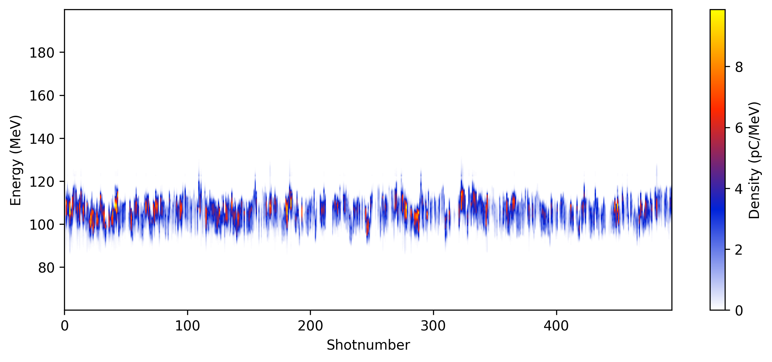
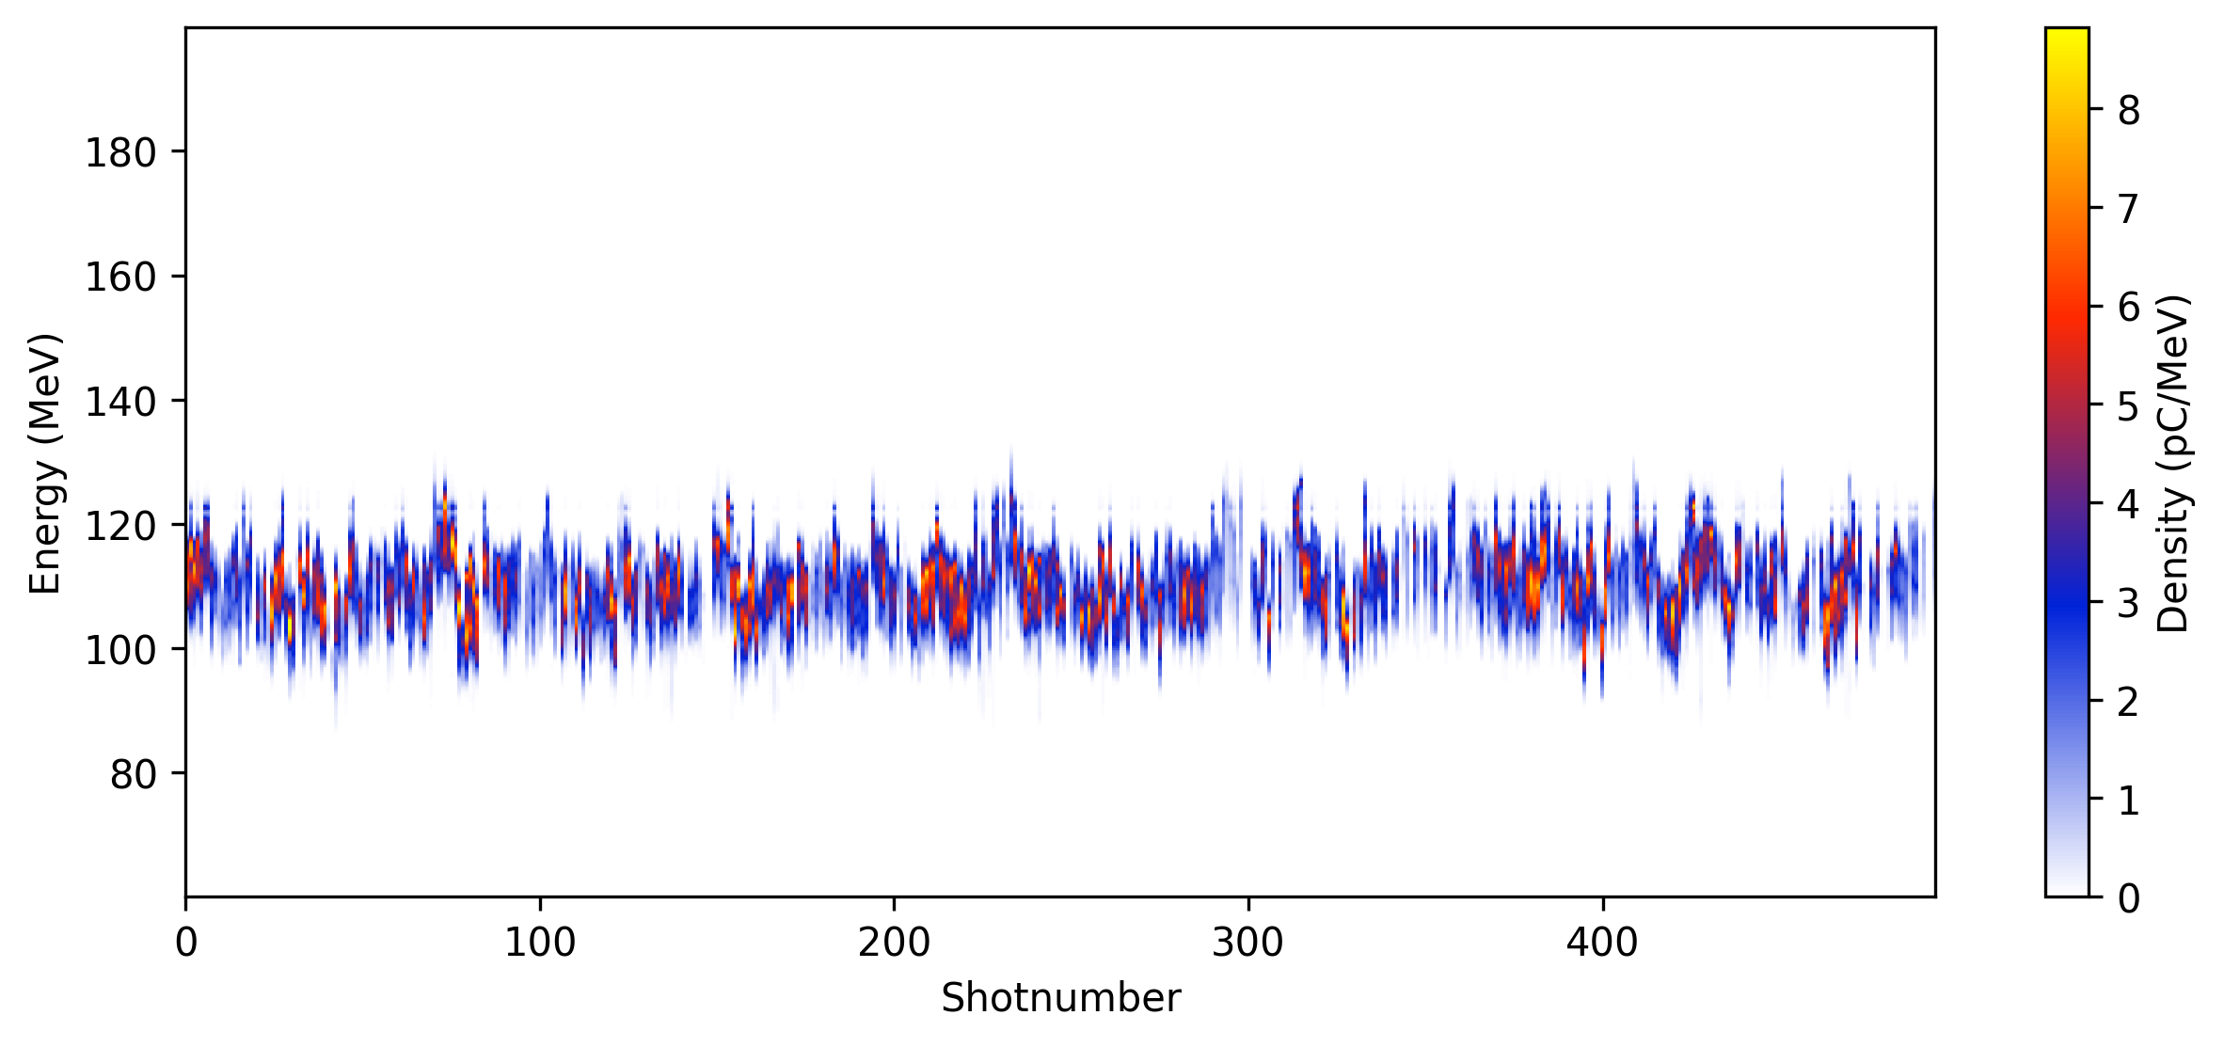
Laser and target stability enable ~days long dedicated accelerator tuning operations
125
Initial fine tuning of LPA
Stability check
100
75
Energy (MeV)
50
5 hours accelerator operations
25
0
12:00
14:00
16:00
Time
With recent efforts to stabilize e-beam on both short and long term time scales, we can use the beam for multi-hour shifts without worrying about dramatic parameter drift
Critical to enable basic accelerator operations
Notes:
Data on bottom left (right) is July 11, 2024 scan 16 (18) and scan

Slide 9

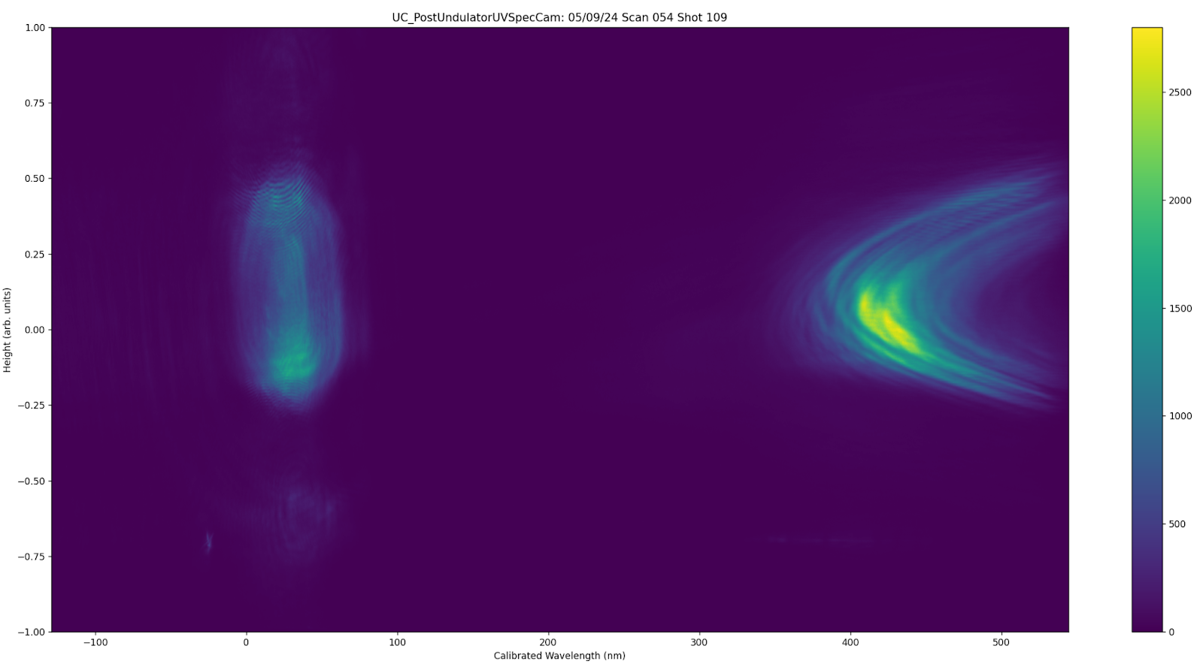
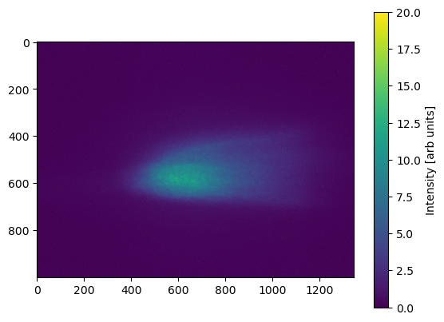
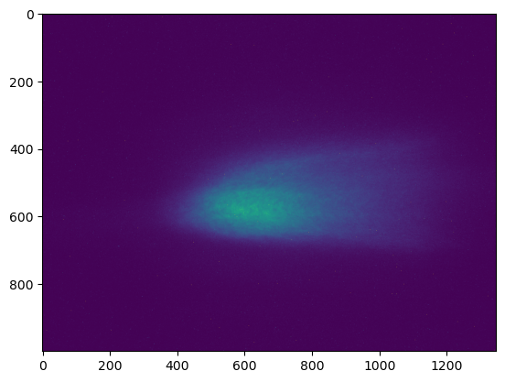
Diagnostic setup undulator radiation characterization
2000
Optical
Spectrometer
1.0
20
y (nm)
0.0
Intensity
Intensity
e⁻
1.0
300
400
500
0
0
Wavelength (nm)
ICT
Undulator
ICT
MagSpec
Retractable spoiler pellicle
Exit Pickoff Pellicle
Setup allows radiation characterization at multiple points along 4 meter undulator
Retractable pellicle enables emittance spoiling without loss of charge for confirming microbunching instability: 10 $μ$m thick pellicle → >10 $μ$m normalized emittance growth

Slide 10
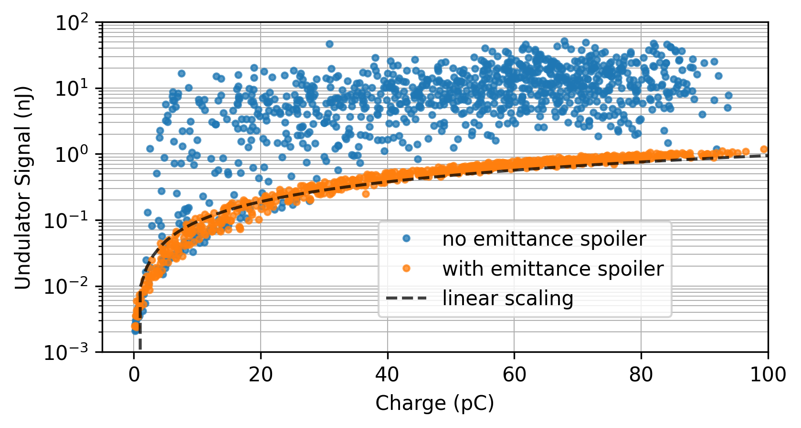
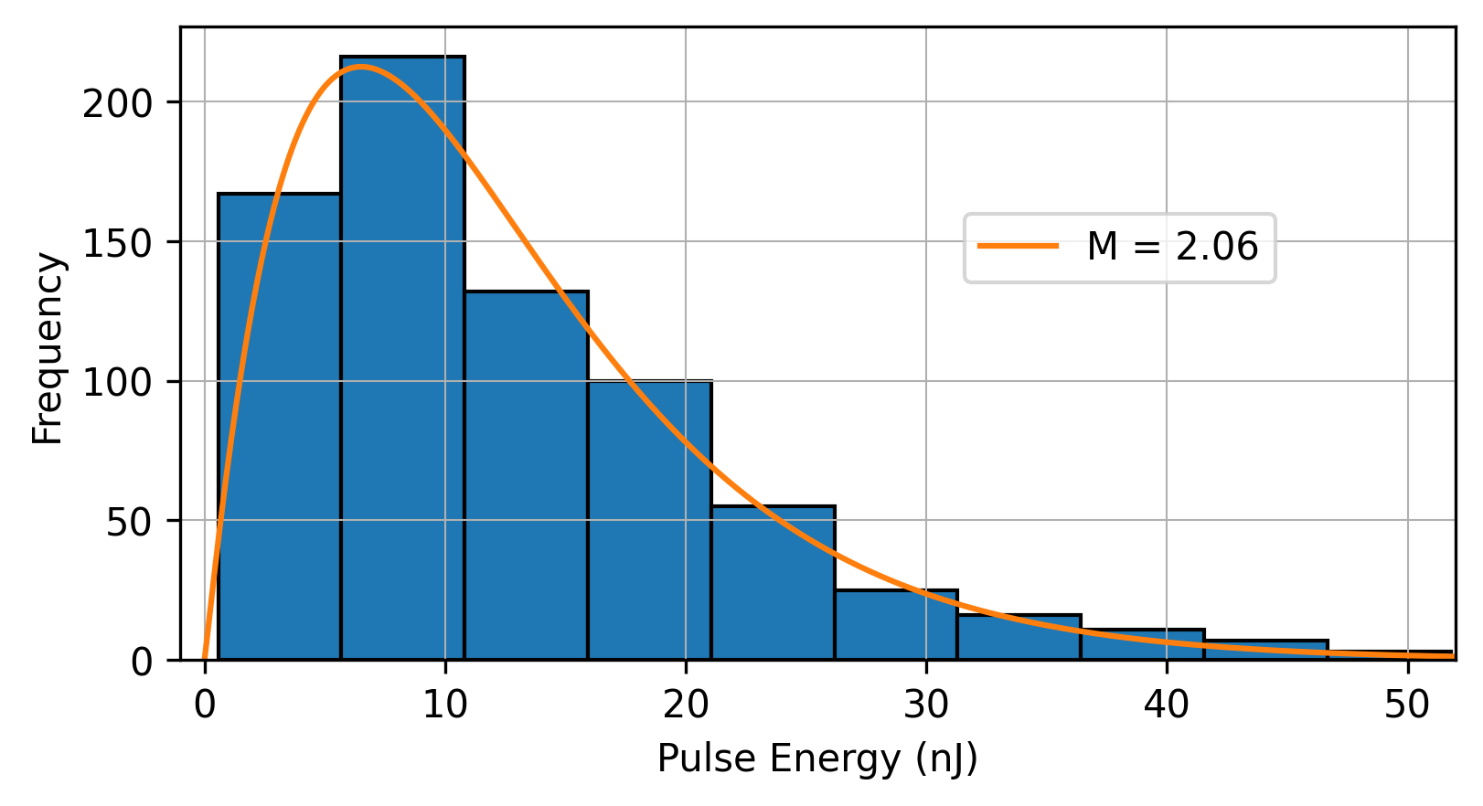
Sustained efforts on optimizing FEL signal at end of undulator through matching and alignment yielded drastic boost in performance
Undulator radiation signal vs charge for 1000 consecutive shots
Pulse energy statistics of FEL radiation
Gamma distribution fit
Statistical characteristics of high-gain SASE radiation in the exponential amplification regime follow gamma distribution
Number of longitudinal modes, characterized by M, can be used to estimate bunch length and is consistent with experimental parameters
Optimized transverse focusing and alignment using radiation signal at the end of the 4 meter undulator
Gain over incoherent undulator radiation on >90% of shots
Ratio FEL to incoherent: ~200-300x (max), 50-100x (average)
S. K. Barber et al. Phys. Rev. Lett. 135, 055001 (2025)

Slide 11
Optimizing for gain in first sections of undulator gives excellent performance
Energy vs distance measurements show clear exponential gain with 18 cm gain length
SASE gain >1000x
Gain plateaus after 1.5 meters, suspect undulator segment misalignment
Increasing the chicane strength from R₅₆ = 200 𝜇m to 400 𝜇m results in reduced gain; useful information for deducing e-beam parameters
Measured undulator radiation as function of distance along undulator with an R56 setting of 200 um.
S. K. Barber et al. Phys. Rev. Lett. 135, 055001 (2025)

Slide 12
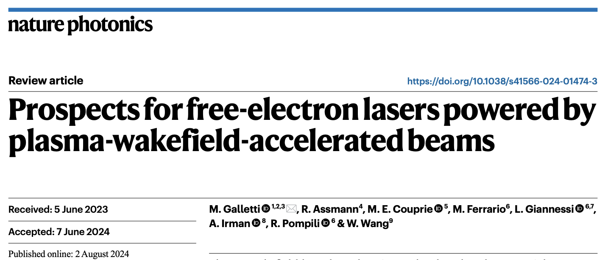
Roadmap for plasma accelerator-driven FEL shares much in common with collider objective
Plasma-based accelerators have been used to demonstrate FEL gain. Now what?
Reliability/stability of plasma based accelerators has ways to go to match conventional accelerators
Current rep rate of high energy laser plasma accelerators is ~1-10Hz, XFELs are pushing MHz. Laser technology needs to advance high rep rate ~100TW peak power laser systems
Push e-beam brightness frontier in plasma based accelerators, e.g. plasma photocathodes

Slide 13
Thank you

