Slide 1


Intensity-dependent effects in the ILC BDS at 250 and 500 GeV
P. Korysko*, P. Burrows, A. Latina
LCWS2025
October 23, 2025
*pierre.korysko@cern.ch

Slide 2
Outline
Introduction
Impact of Short-Range Wakefields
Impact of Long-Range Wakefields
Conclusions
P. Korysko - LCWS2025 - Oct. 23, 2025
2

Slide 3

Introduction

Slide 4
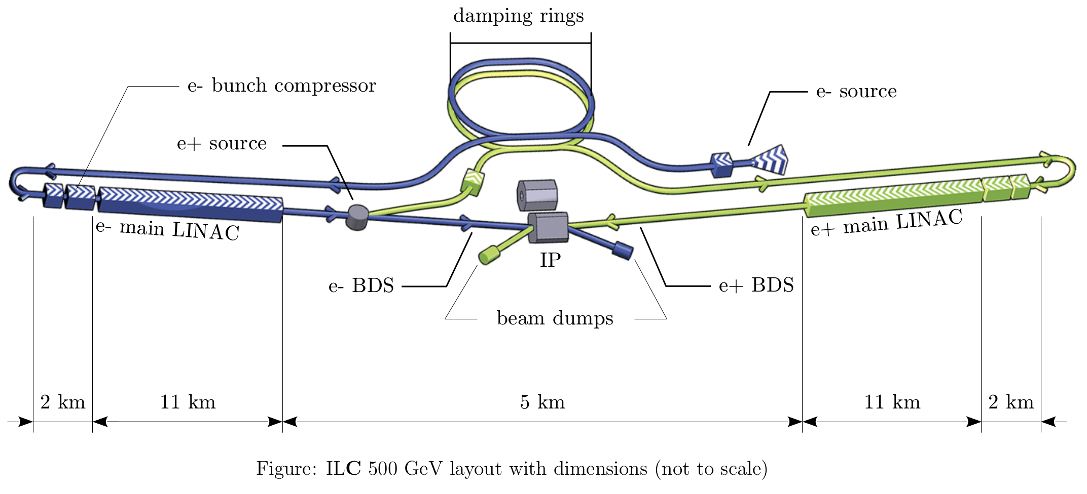
The International Linear Collider
The International Linear Collider (ILC) is a 250–500 GeV (extendable to 1 TeV) centre-of-mass high- luminosity linear electron-positron collider, based on 1.3 GHz superconducting radio-frequency accelerating technology.
ILC parameters and technologies are summarized in the ILC Technical Design Report (2013) [1].
P. Korysko - LCWS2025 - Oct. 23, 2025
4

Slide 5
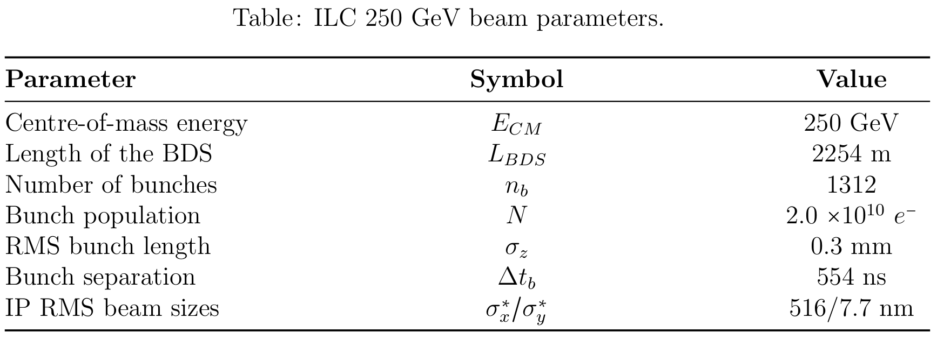
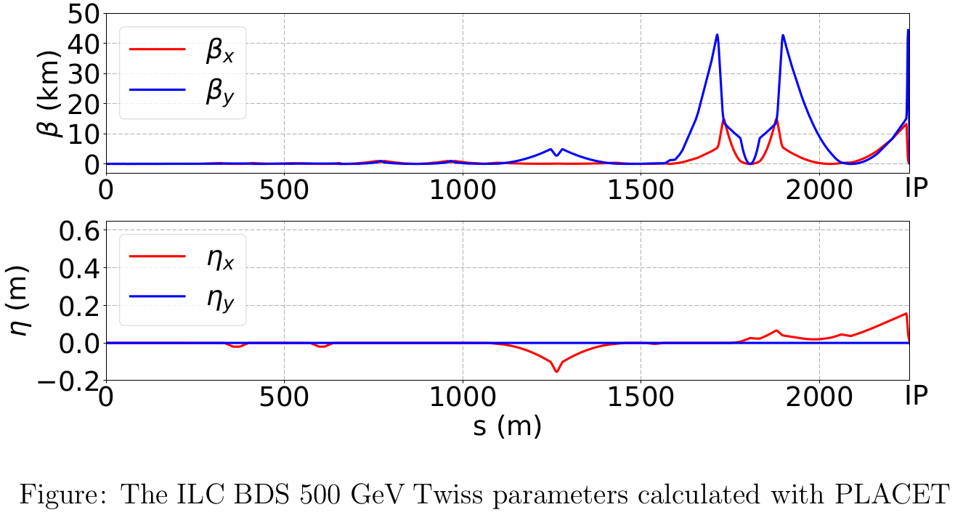
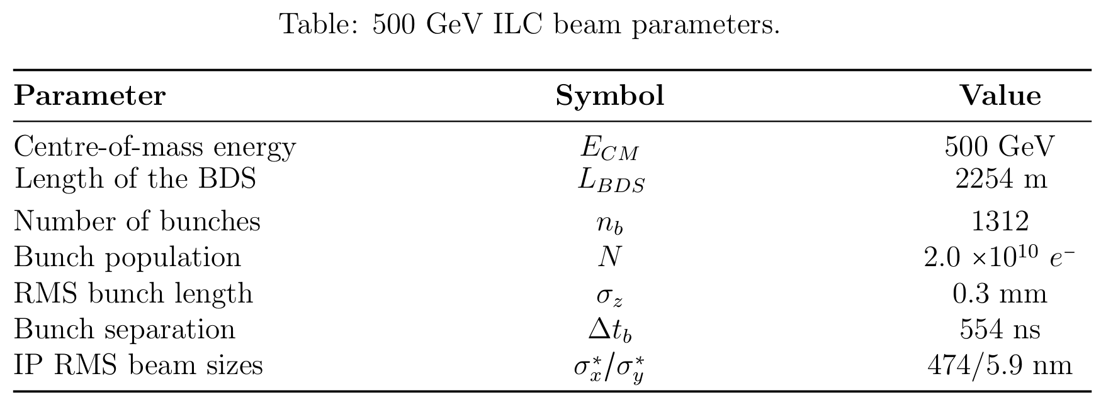
The International Linear Collider
P. Korysko - LCWS2025 - Oct. 23, 2025
5

Slide 6
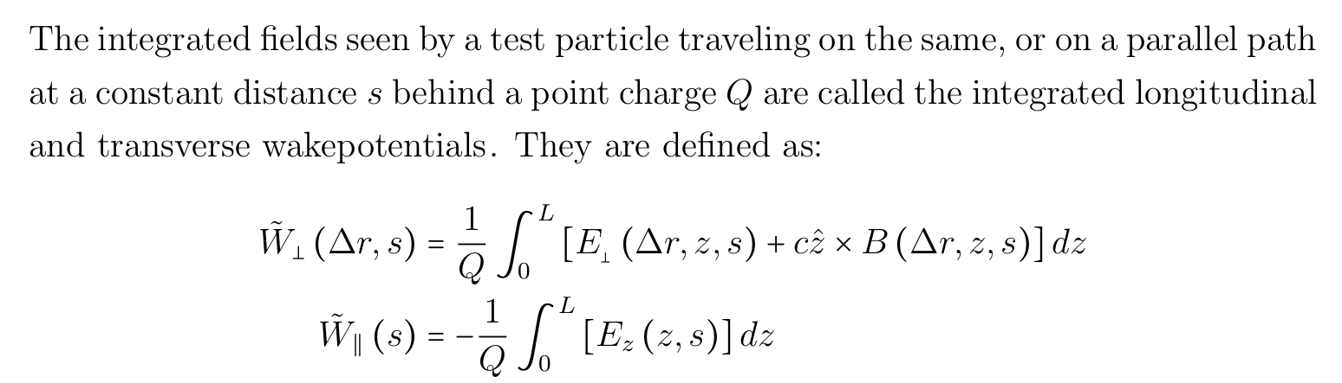
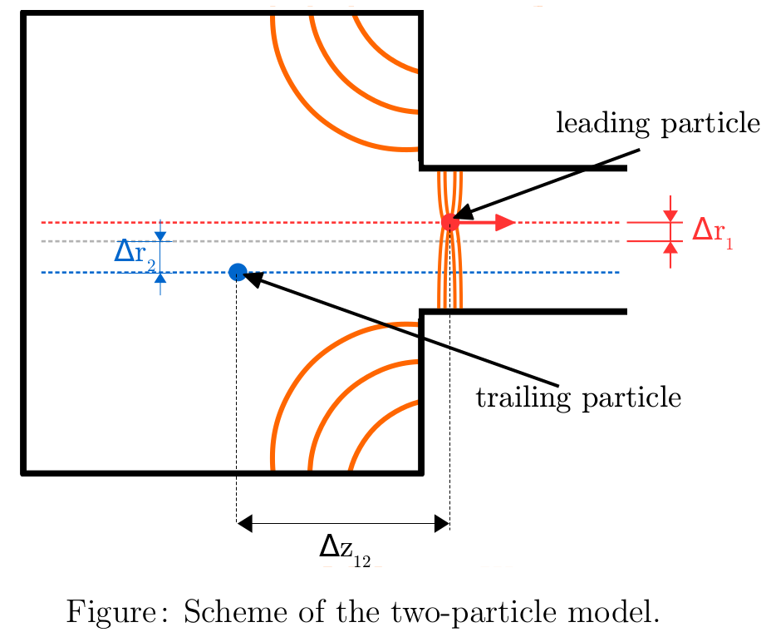
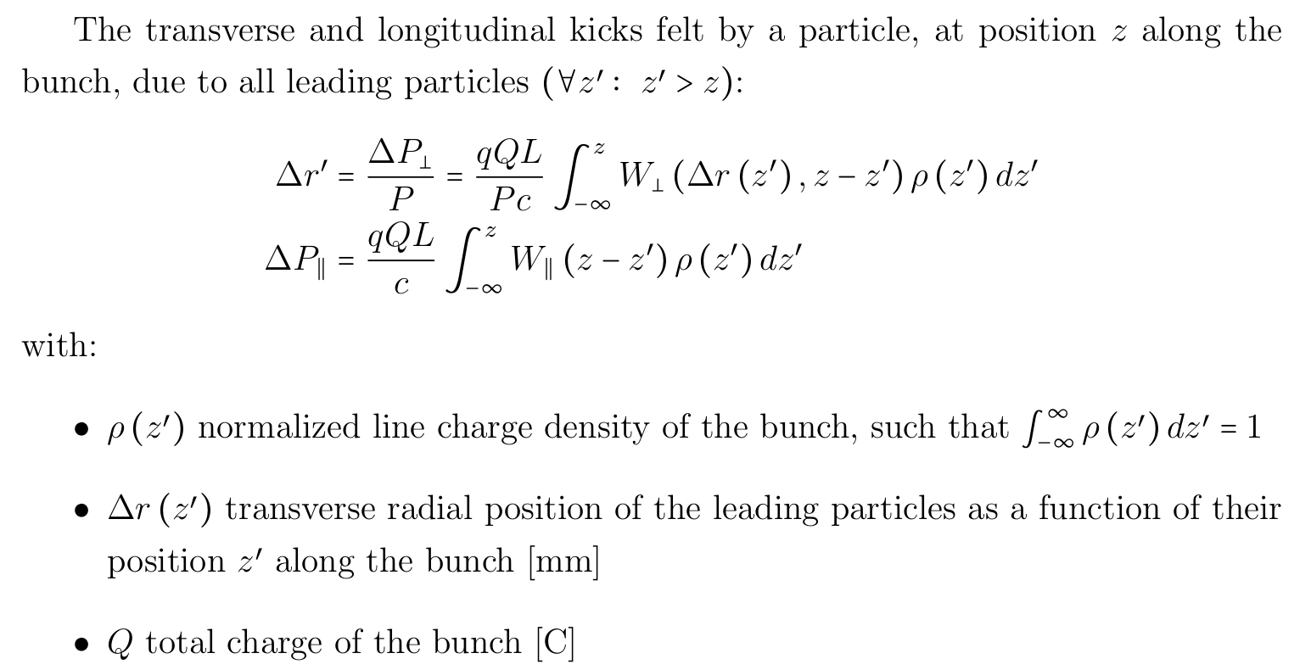
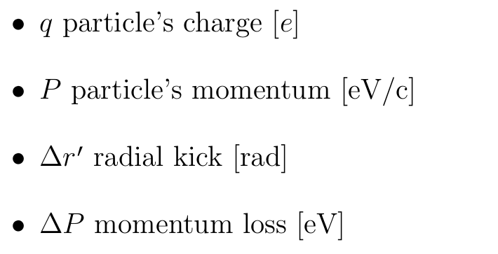
Transverse and longitudinal wakefields
P. Korysko - LCWS2025 - Oct. 23, 2025
6

Slide 7
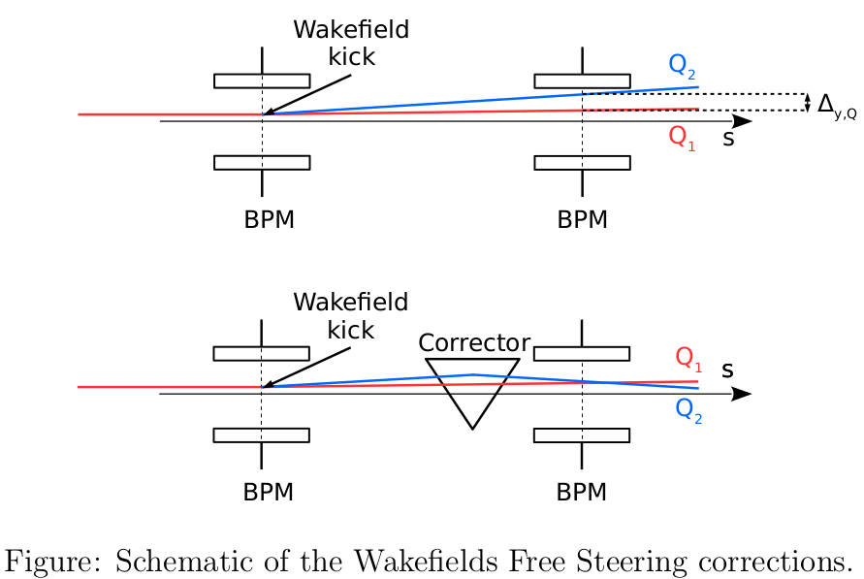
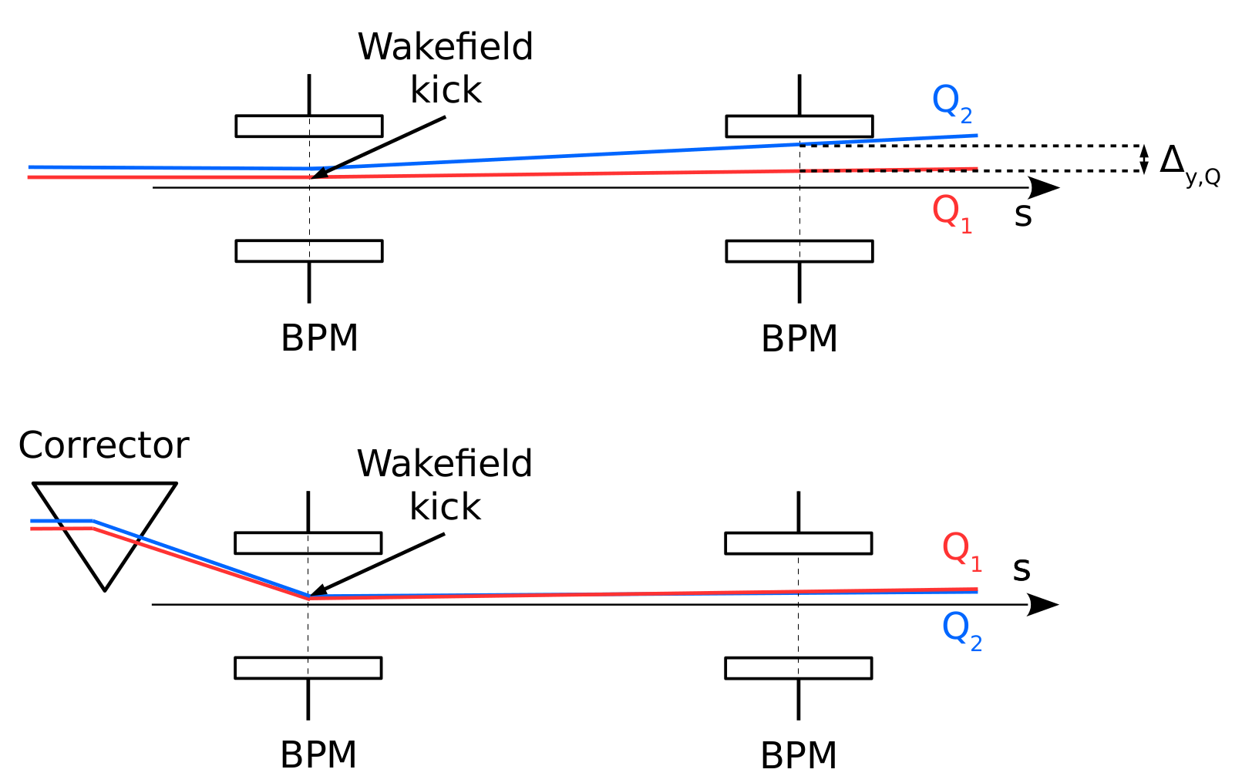
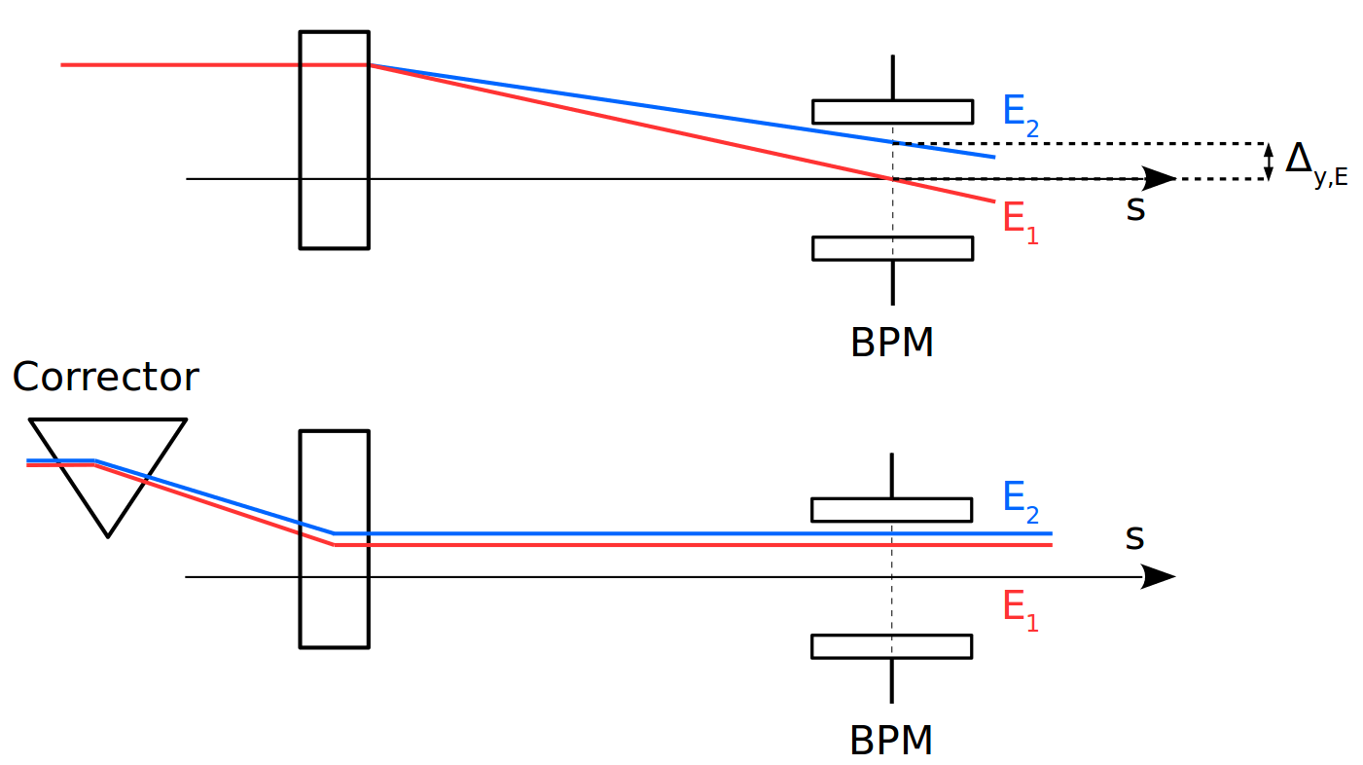
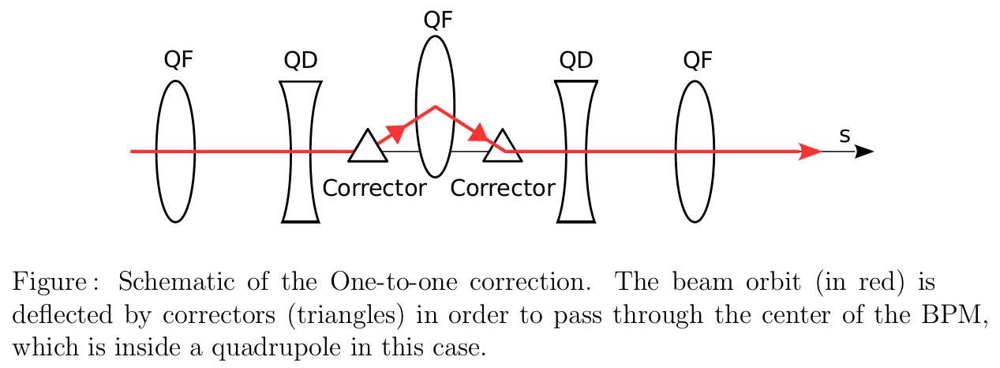
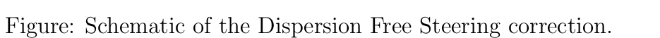
One-to-One, DFS and WFS
One-to-One
Dispersion Free Steering
Wakefield Free Steering
The One-to-One correction consists of minimizing the transverse position of the beam, with respect to the beam pipe centre measured at BPMs (inside quadrupoles in this case), using steering magnets [2].
The DFS correction consists of minimizing the dispersion effect. In practice, it reduces the orbit difference between two beams with different energies [3].
The WFS correction consists of minimizing the orbit difference introduced by wakefields. In practice, it reduces the orbit difference between two beams with different charges [4].
P. Korysko - LCWS2025 - Oct. 23, 2025
7

Slide 8
Impact of Short-Range Wakefields

Slide 9
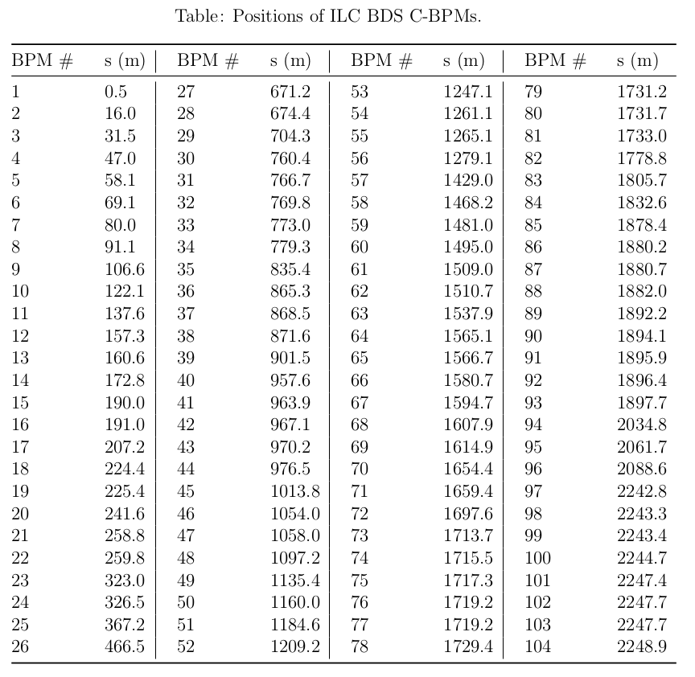
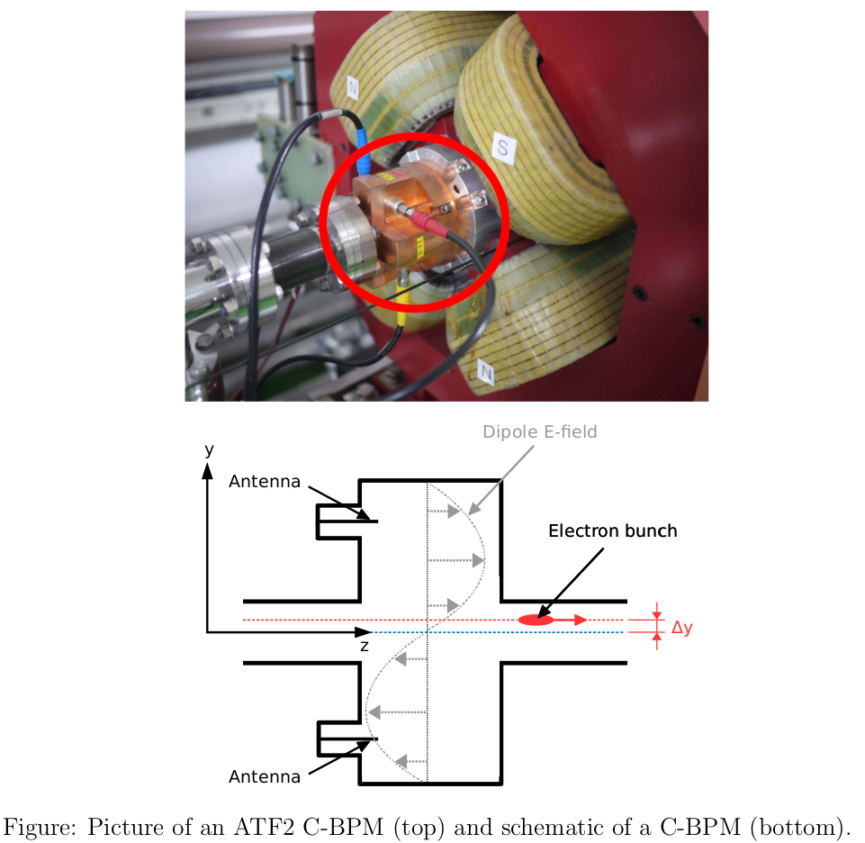
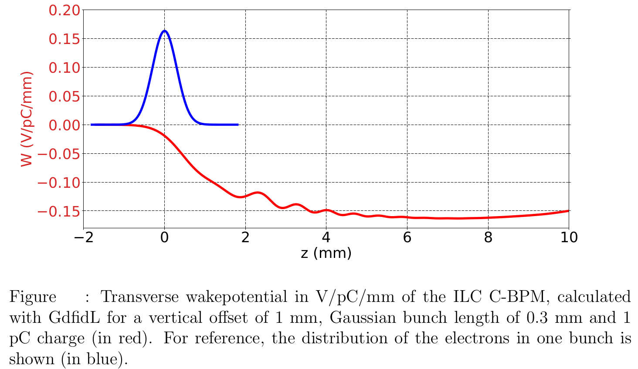
Wakefield Sources in the ILC
Wakefield sources: C-band cavity BPMs (C-BPMs), wakepotentials calcultated with GdfidL [5][6][7].
The short-range wakefield sources taken into account are the 104 ILC C-BPMs.
P. Korysko - LCWS2025 - Oct. 23, 2025
9

Slide 10
Simulation Conditions
Simulated errors:
Static errors: - Misalignment of quadrupoles, sextupoles and BPMs of 50 um RMS. - Strength error of quadrupoles and sextupoles of 0.1% RMS. - Roll error for quadrupoles and sextupoles of 200 urad RMS.
Simulation procedure:
- 100 machines with the previously cited static imperfections.
- Apply the cited corrections and the knobs on the distribution at the IP.
- Calculate the vertical beam size at the IP.
Corrections applied:
- One-to-one - Dispersion Free Steering - Wakefield Free Steering - Knobs (Y, YP D XP XP.*XP XP.*YP XP.*D)
First order*
Second order**
*First order knobs correction by changing the position of final focus sextupoles.
**Second order knobs correction by changing the strength of the final focus sextupoles.
P. Korysko - LCWS2025 - Oct. 23, 2025
10

Slide 11
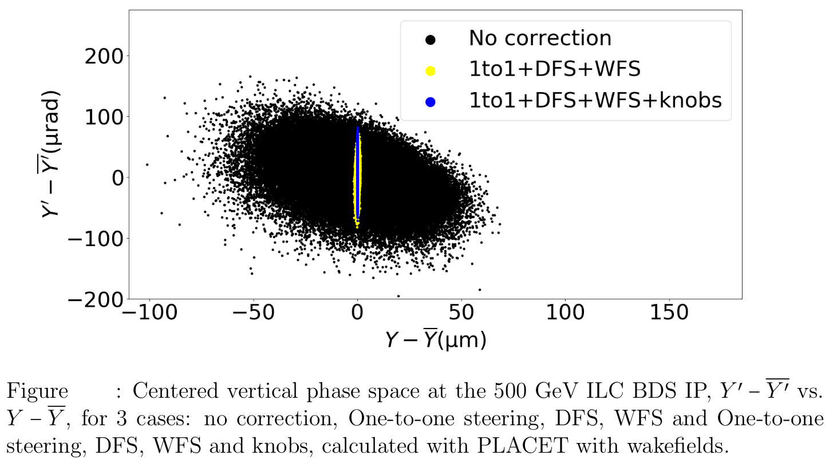
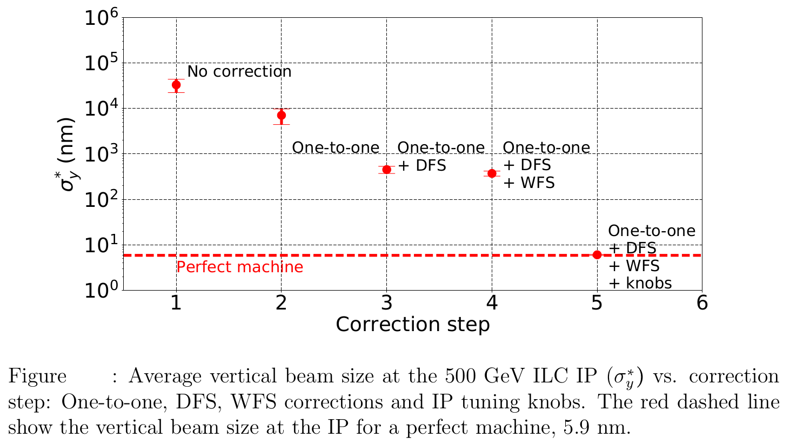
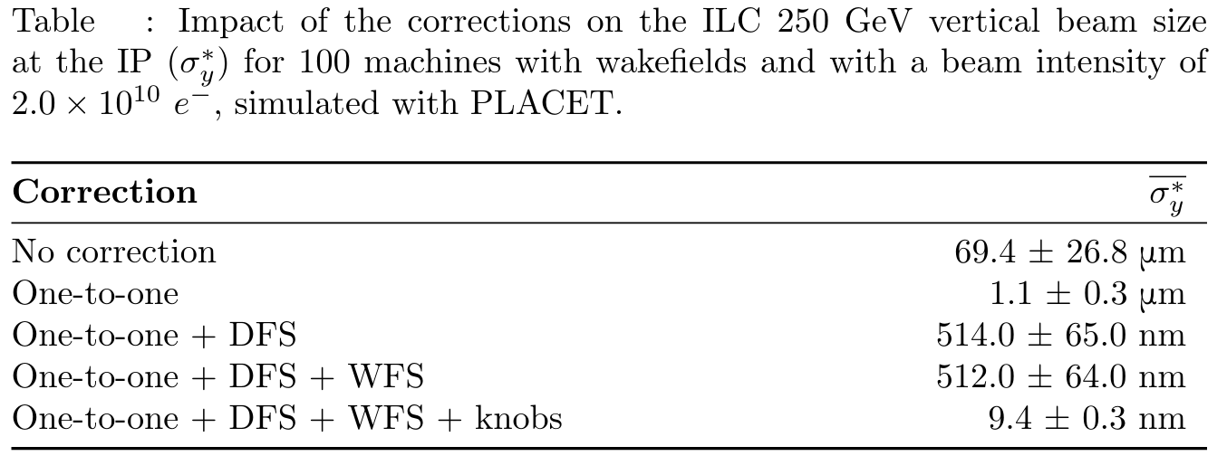
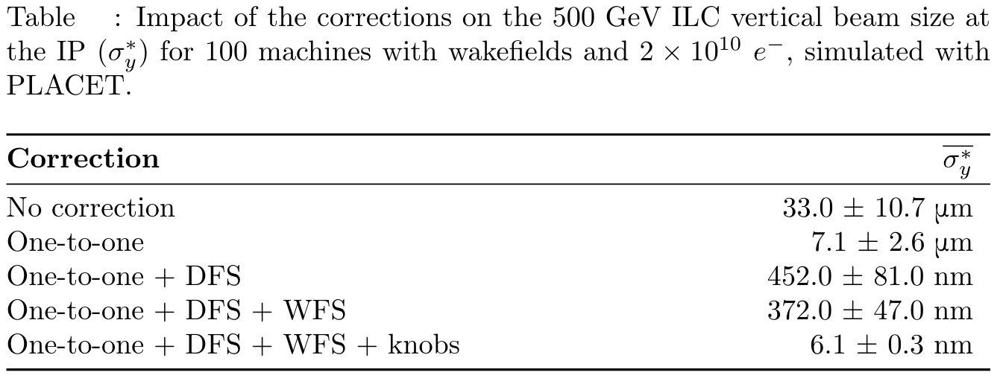
Impact of Corrections
500 GeV 1 machine
500 GeV 100 machines
250 GeV 100 machines
500 GeV 100 machines
Orbit corrections and knobs reduce the beam size by a factor 7400 for the 250 and by a factor 5400 for the 500 GeV case.
P. Korysko - LCWS2025 - Oct. 23, 2025
11

Slide 12
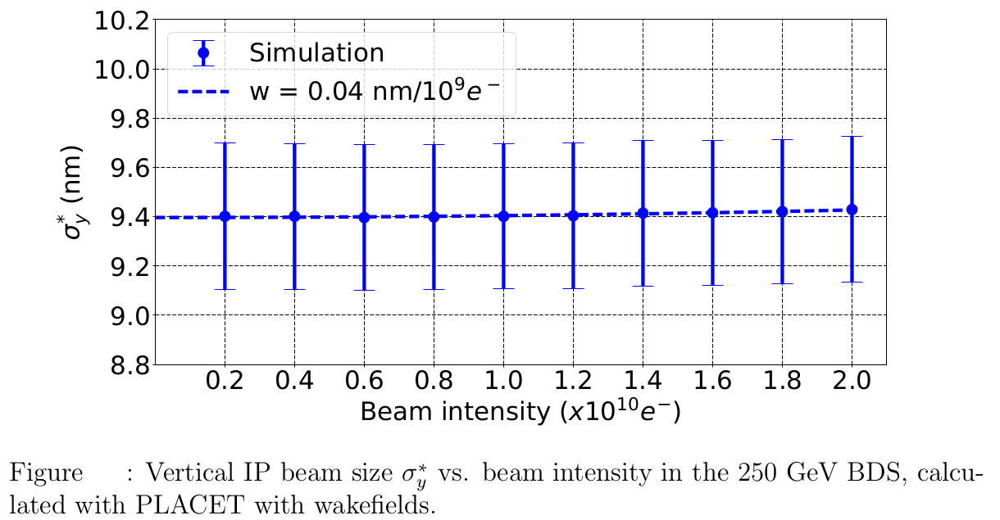
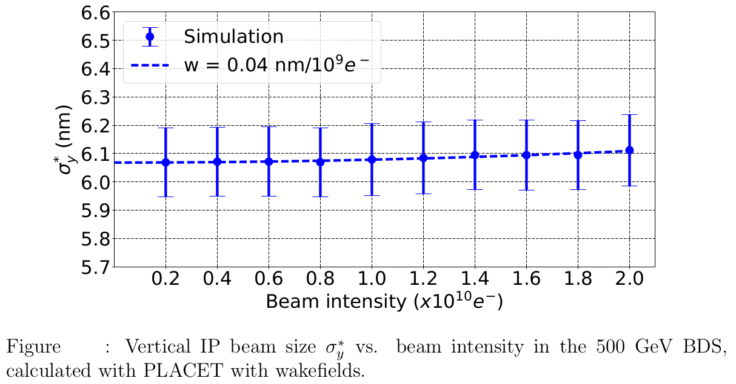
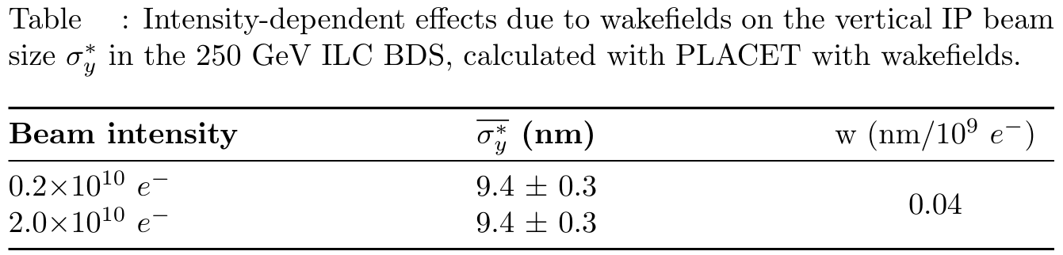
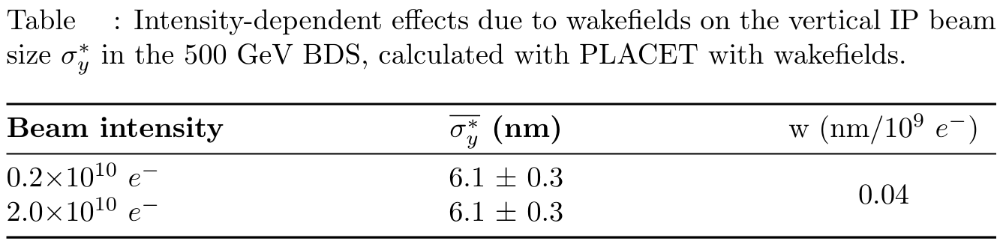
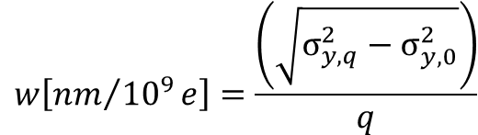
Imapact of Short-Range Wakefields
250 GeV
500 GeV
*
*
Short-range wakefield effects are negligible in both the 250 and 500 GeV ILC BDS
*
P. Korysko - LCWS2025 - Oct. 23, 2025
12

Slide 13
Impact of Long-Range Wakefields

Slide 14
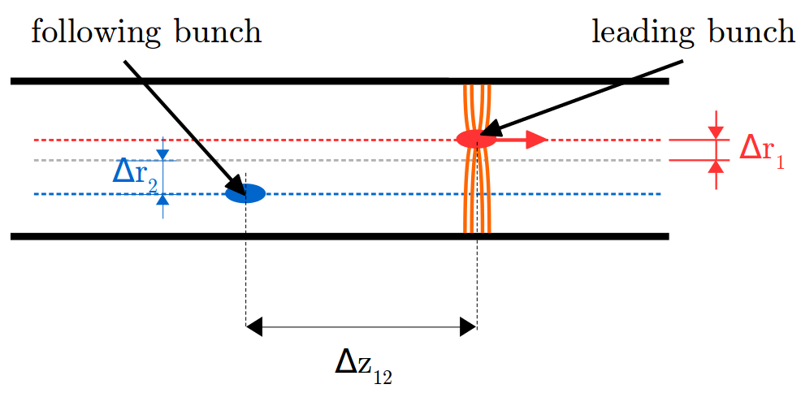
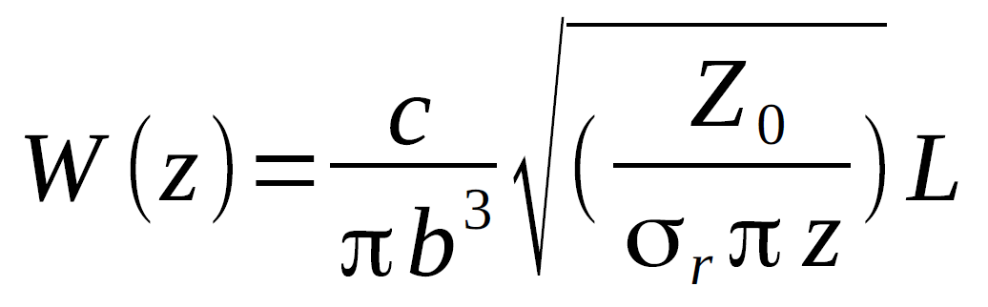
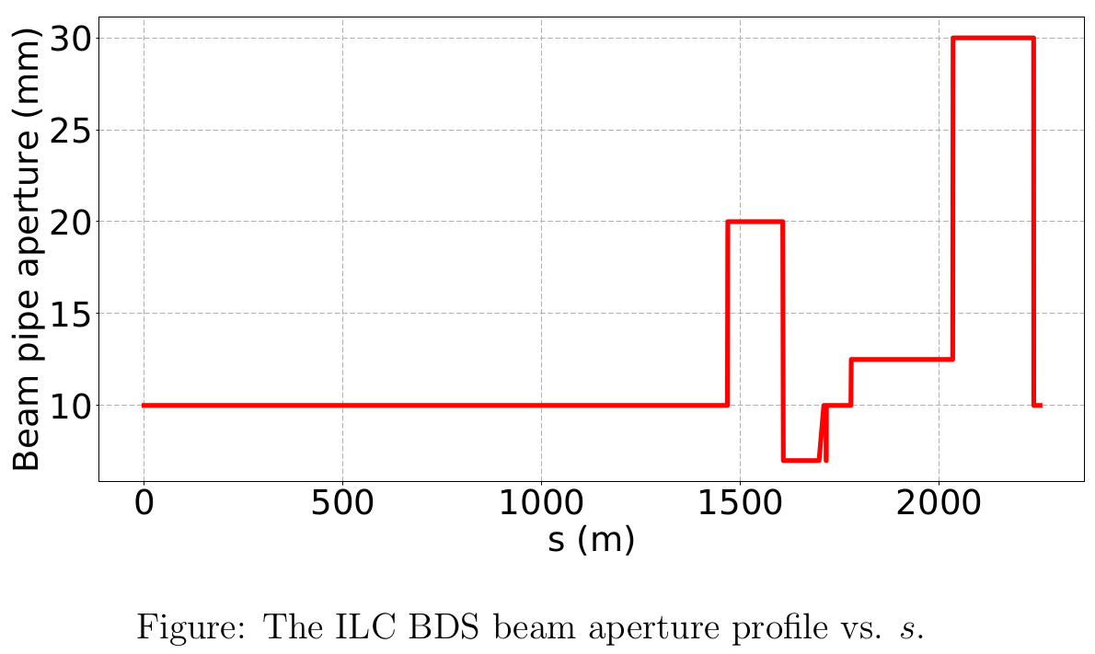
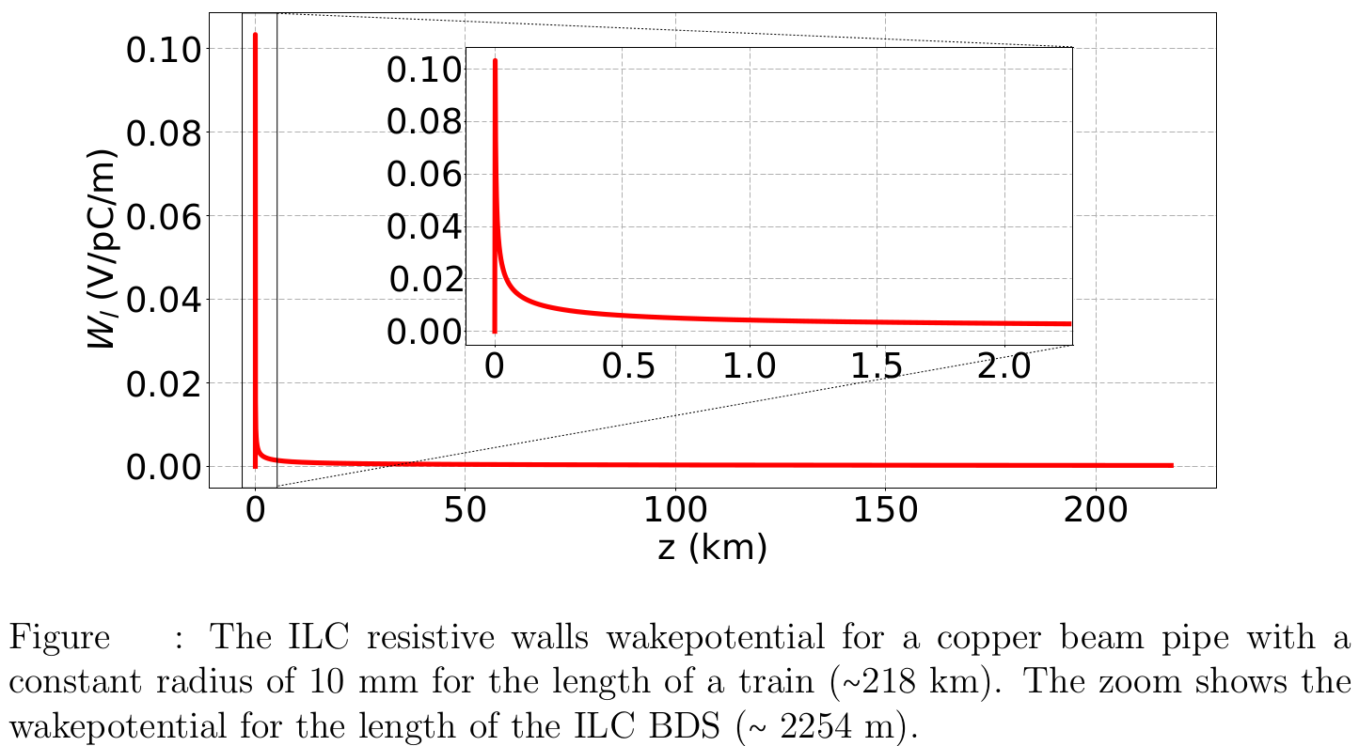
Resistive Wall Wakefields
Electrons going through the pipe interacts with the surrounding structure and generates a wakefield.
This wakefield produces a transverse kick for the following bunches.
The following model is used for the transverse wake function [8]:
with b the radius of the beam pipe, Z₀ the impedance of the vacuum, σ_{r} the conductivity of the pipe and L the length of the beam line element.
P. Korysko - LCWS2025 - Oct. 23, 2025
14

Slide 15
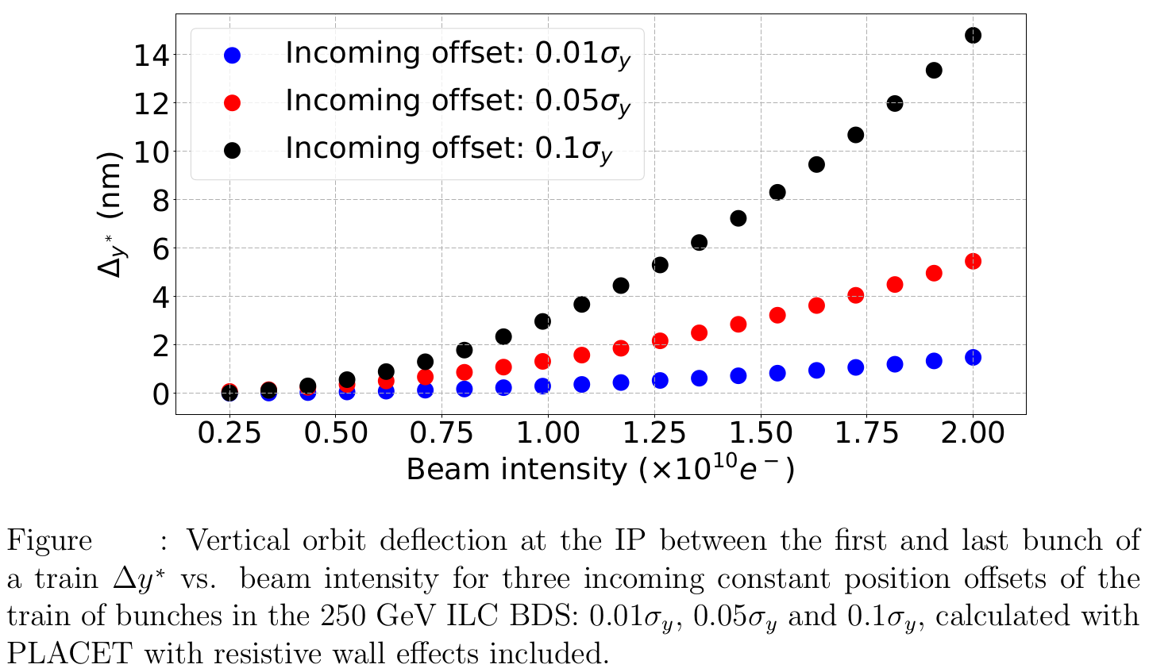
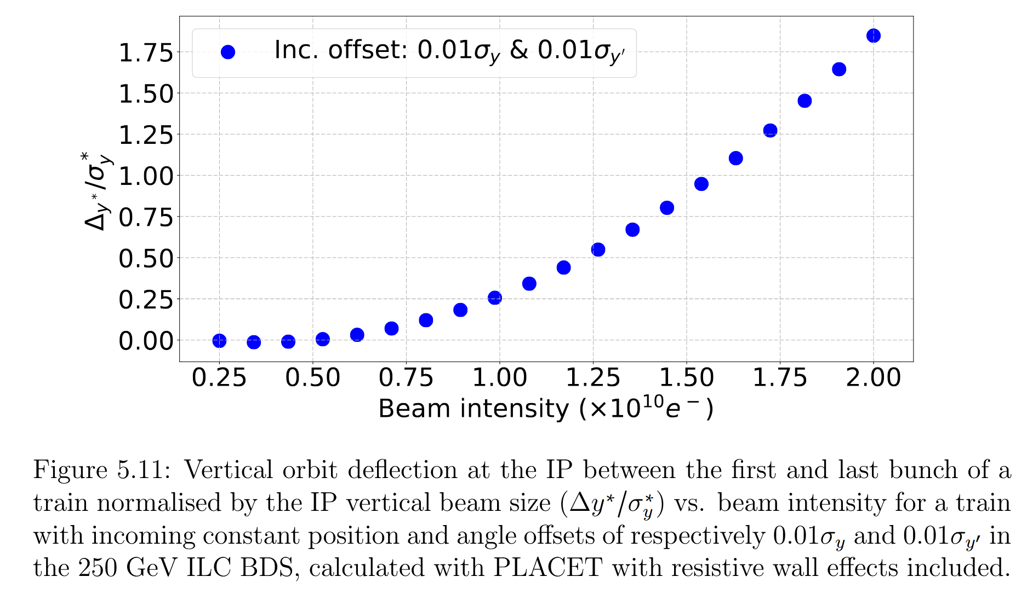

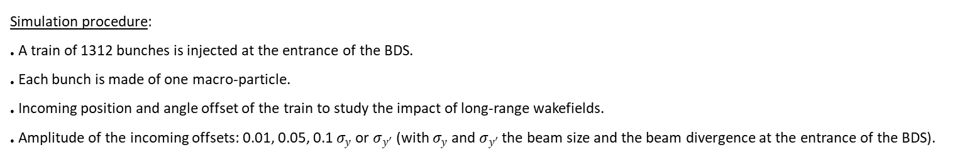


Impact of Long-Range Wakefields in the 250 GeV ILC BDS for a constant offset
Simulation procedure:
A train of 1312 bunches is injected at the entrance of the BDS.
Each bunch is made of one macro-particle.
Incoming position and angle offset of the train to study the impact of long-range wakefields.
Amplitude of the incoming offsets: 0.01, 0.05, 0.1 $σ_{y}$or $σ_{y′}$ (with $σ_{y}$ and $σ_{y′}$ the beam size and the beam divergence at the entrance of the BDS).
$$σ_{y}=0.82 µm$$
$$σ_{y′}=0.097 µrad$$
$${σ∗}_{y}=7.7 nm$$
P. Korysko - LCWS2025 - Oct. 23, 2025
15

Slide 16
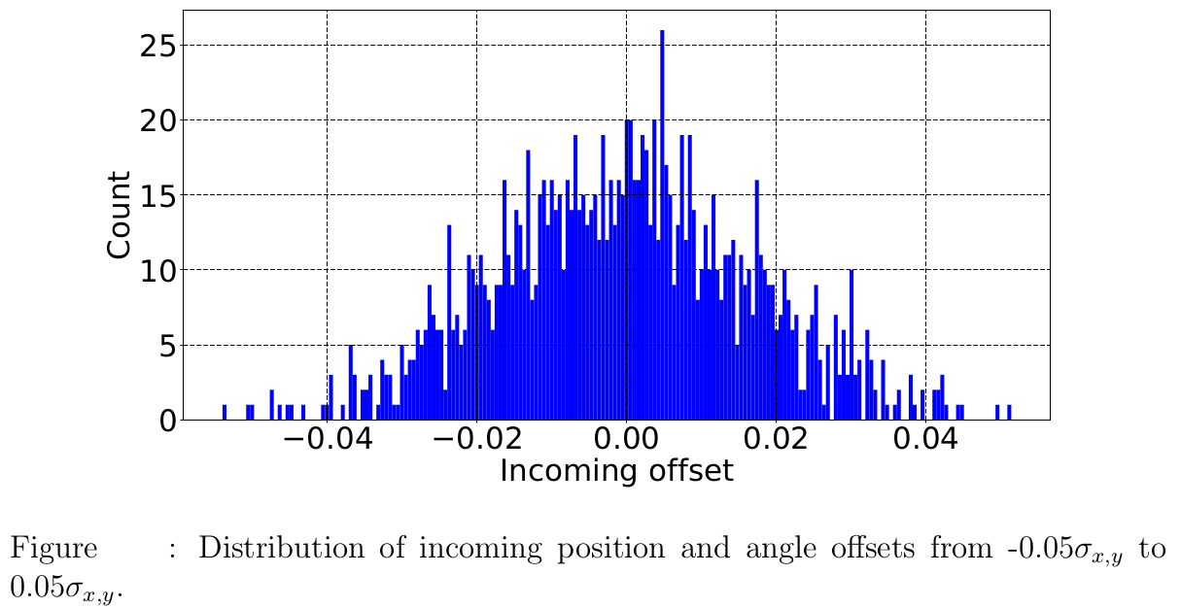
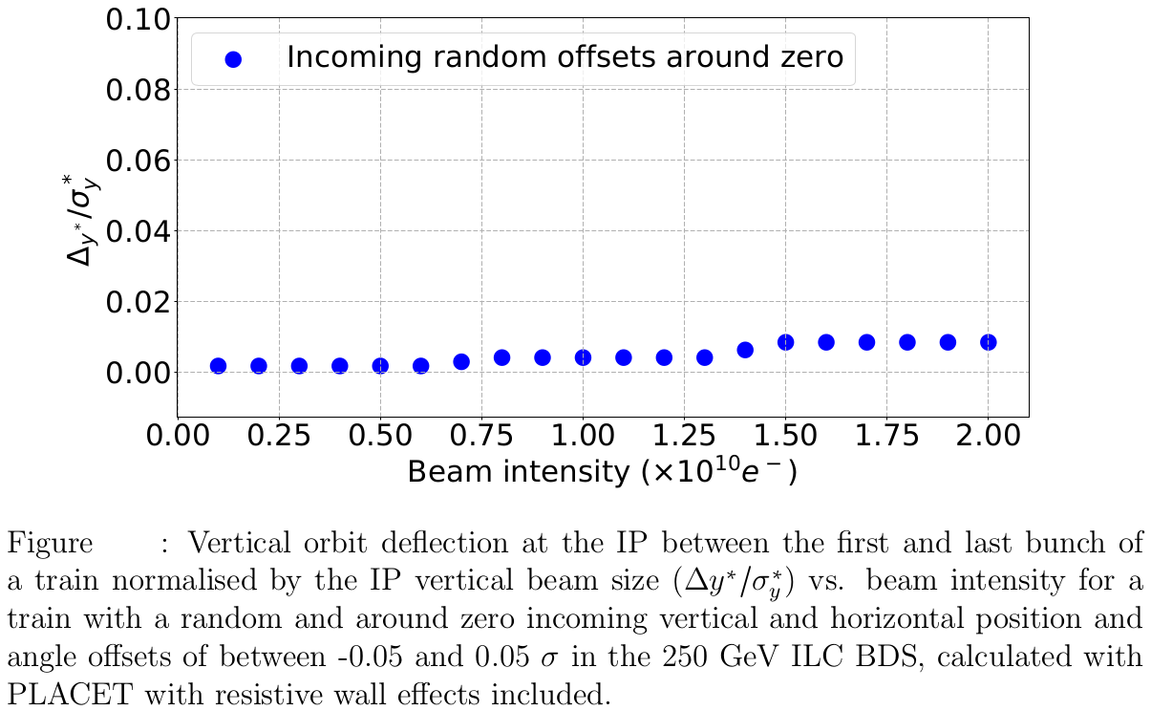
Impact of Long-Range Wakefields in the 250 GeV ILC BDS for a random offset
Study of the impact of long-range wakefields for a train injected in the BDS with a random horizontal and vertical position and an angle offsets.
The distribution of random incoming position and angle offset is a normal distribution with a zero mean and variance of 2.6x10⁻⁴, leading to a +/‒ 5% incoming vertical and horizontal angle and position offsets.
P. Korysko - LCWS2025 - Oct. 23, 2025
16

Slide 17
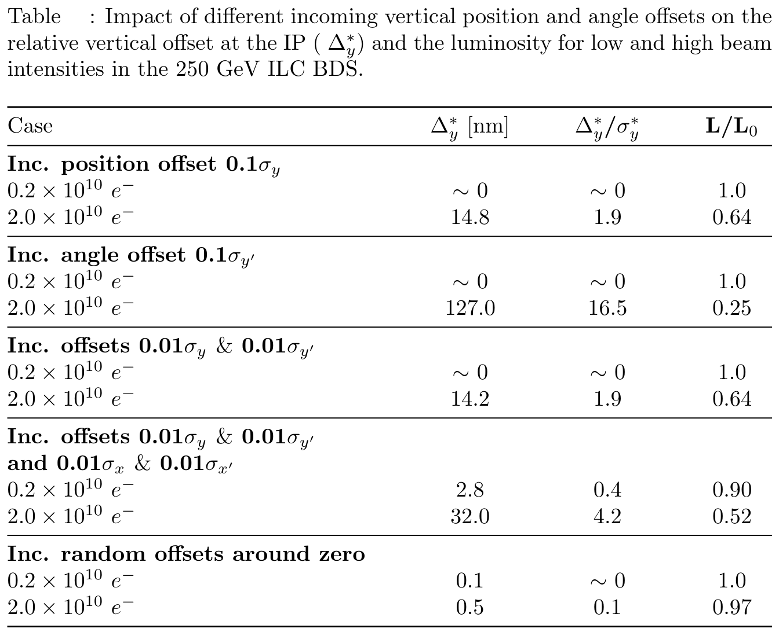
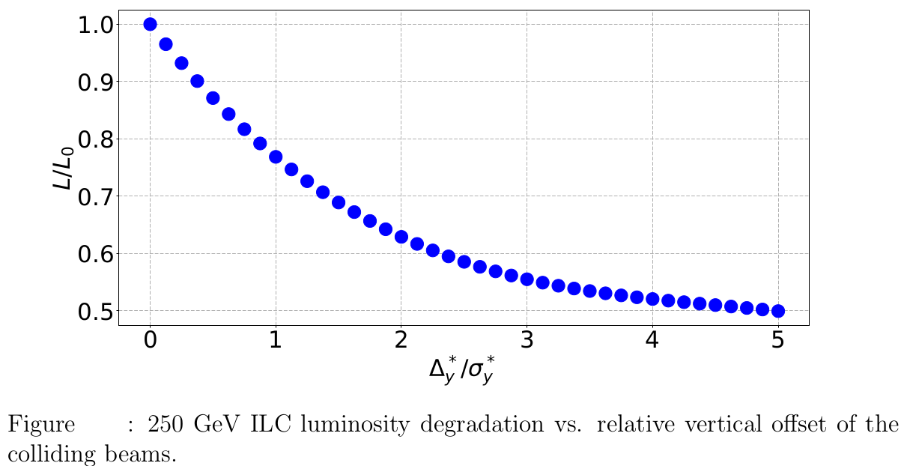
Impact of Long-Range Wakefields on the
250 GeV ILC BDS Luminosity
Study of the impact of luminosity degradation due to the vertical orbit deflection at the IP with Guinea-Pig, a code simulating the impact of beam-beam effects on luminosity and background [9].
Long-range wakefields have a significant impact in the 250 GeV ILC BDS. An intra-train feedback system would be necessary in order to achieve the luminosity goals.
P. Korysko - LCWS2025 - Oct. 23, 2025
17

Slide 18
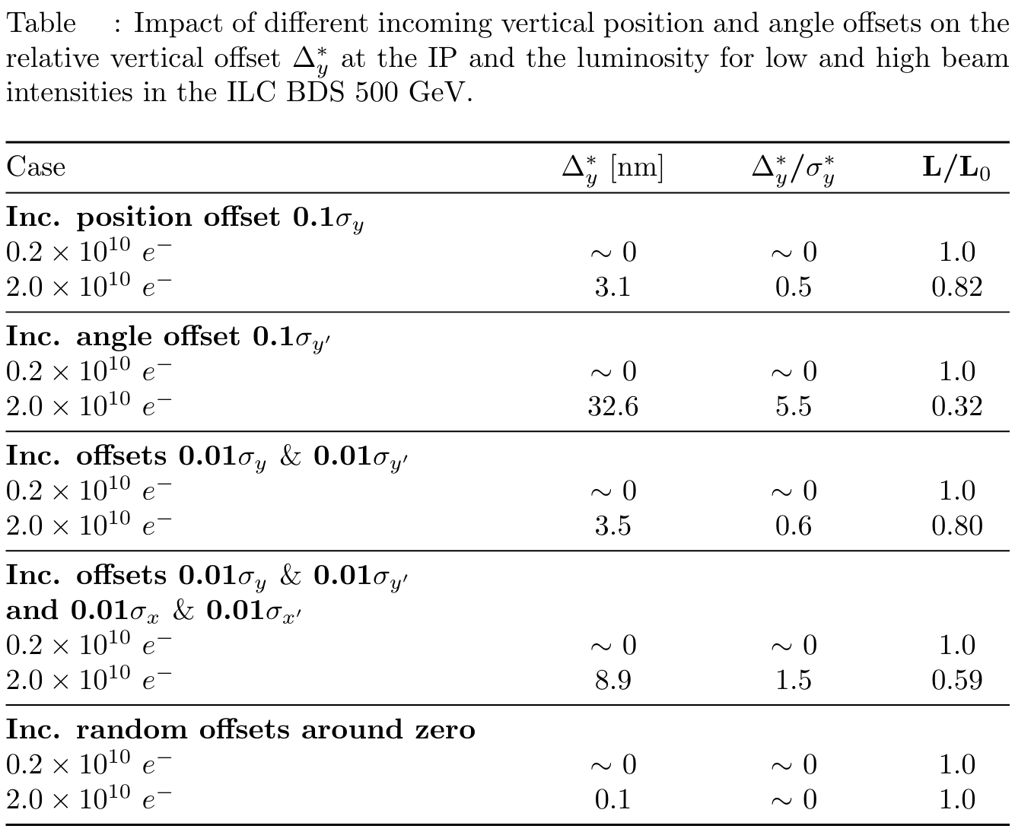

Impact of Long-Range Wakefields on the
500 GeV ILC BDS Luminosity
Long-range wakefields have a significant impact in the 500 GeV ILC BDS as well. An intra-train feedback system would be necessary in order to achieve the luminosity goals.
P. Korysko - LCWS2025 - Oct. 23, 2025
18

Slide 19
Conclusions & Next Steps
The intensity-dependent effects due to short-range wakefields are negligible in both the 250 and 500 GeV ILC BDS.
The intensity-dependent effects due to long-range wakefields have a significant impact on the luminosity. Indeed, at nominal charges, the luminosity loss can reach up to 48% in the 250 GeV BDS and of 41% in the 500 GeV BDS.
An intra-train feedback system is necessary in order to correct those effects and to achieve the required luminosity goals.
A prototype feedback system was tested at ATF2 and gave promising results [10].
The next step would be to implement this feedback and study its impact on the luminosity losses due to intensity-dependent effects in the ILC.
P. Korysko - LCWS2025 - Oct. 23, 2025
19

Slide 20
Thank you

Slide 21
References
More details can be found in the following PhD Thesis:
P. Korysko, “Intensity-dependent effects in the Accelerator Test Facility 2 and extrapolation to future electron-positron linear colliders”, University of Oxford, 2020.
[1] “The International Linear Collider Technical Design Report - Baseline Design”, arXiv.
[2] M. G. Minty et al., “Correction to: Measurement and Control of Charged Particle Beams”, DOI.
[3] T.O. Raubenheimer et al. “A dispersion-free trajectory correction technique for linear colliders”, NIMA, A302 (1991) 191-208.
[4] T.O. Raubenheimer, “A new technique of correcting emittance dilutions in linear colliders”, NIMA, A306 (1991) 61-64.
[5] http://www.gdfidl.de/
[6] W. Bruns, “GdfidL: a finite difference program with reduced memory and CPU usage”, PAC.1997.751304.
[7] J. Snuverink et al., “Measurements and simulations of wakefields at the Accelerator Test Facility 2”, PRAB 19, 091002.
[8] R. Mutzner et al.“ Multi-bunch effect of resistive wall in the beam delivery system of the compact linear collider”, CLIC-Note-818.
[9] D. Schulte, “Beam-beam simulations with guinea-pig”, CLIC-Note-387.
[10] R. Apsimon et al. “Design and operation of a prototype interaction point beam collision feedback system for the International Linear Collider”, PRAB 21, 122802.
P. Korysko - LCWS2025 - Oct. 23, 2025
21

