Slide 1


A Flight Simulator to perform BBA at ATF
P. Korysko*, A. Latina, Wiktoria Malek
LCWS2025
October 23, 2025
*pierre.korysko@cern.ch

Slide 2
Outline
The Accelerator Test Facility (ATF)
New Python ATF Flight Simulator
DFS Results in the ATF LINAC and the ATF2 Beamline
WFS Results in the ATF2 Beamline
Conclusions
P. Korysko - LCWS2025 - Oct. 23, 2025
2

Slide 3

The Accelerator Test Facility
(ATF)

Slide 4
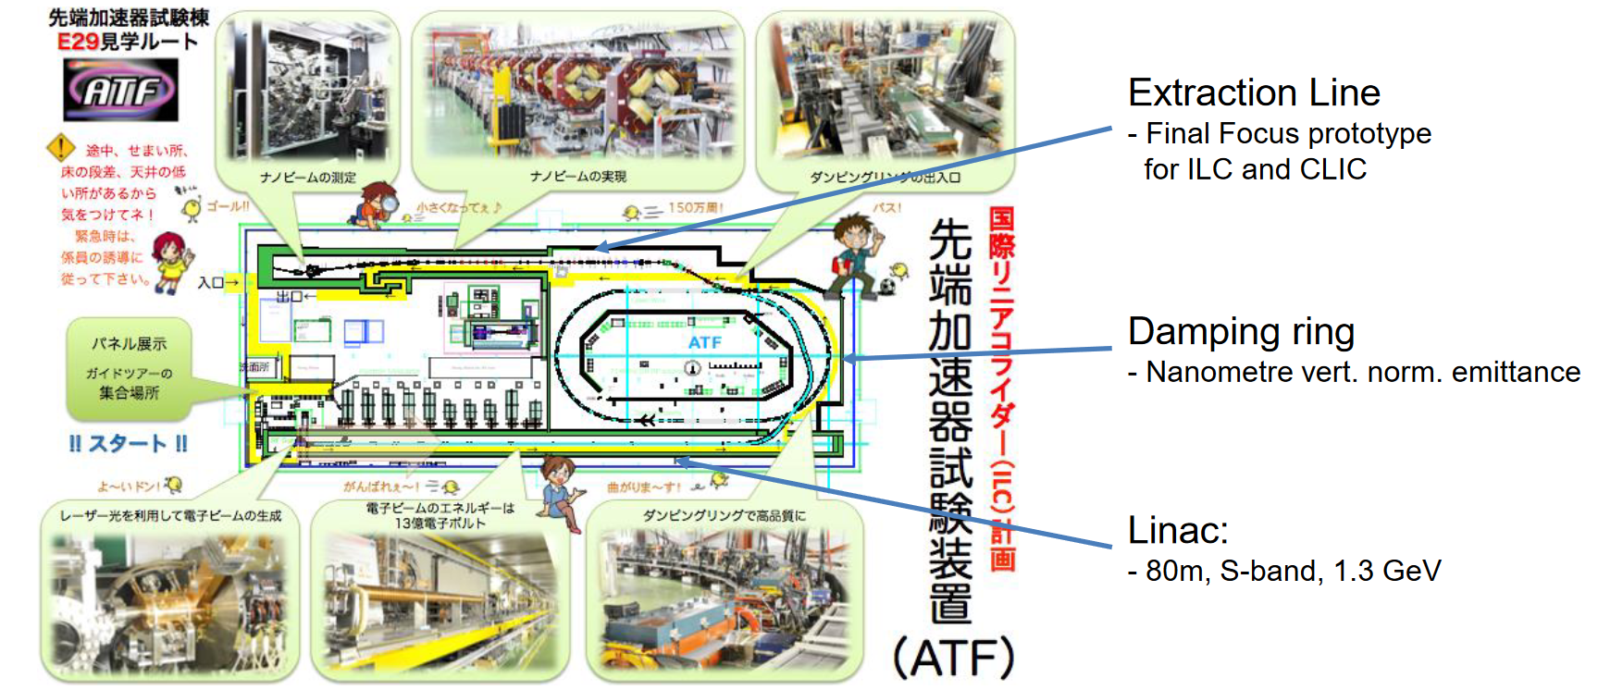
The Accelerator Test Facility (ATF)
P. Korysko - LCWS2025 - Oct. 23, 2025
4

Slide 5
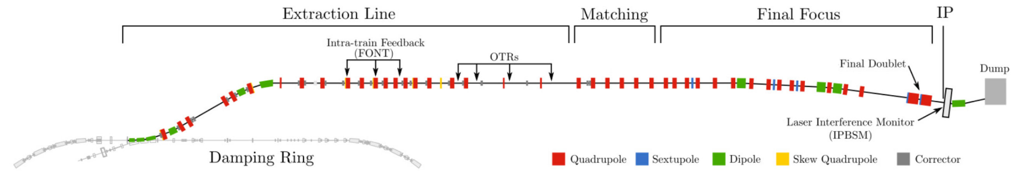
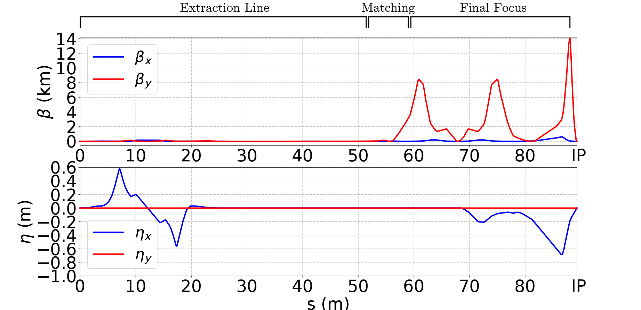
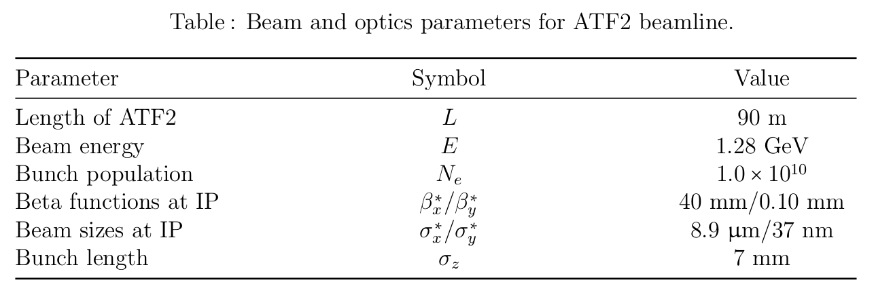
The Accelerator Test Facility 2 (ATF2)
ATF2 is a test facility to study the feasibility of the Final Focus System [1] that is envisaged in the future linear colliders ILC an CLIC.
The primary project goal is to establish the hardware and beam handling technologies pertaining to transverse focussing of the electron beams to 37 nm. All the parameters can be found in the ATF2 design proposal report [2].
P. Korysko - LCWS2025 - Oct. 23, 2025
5

Slide 6
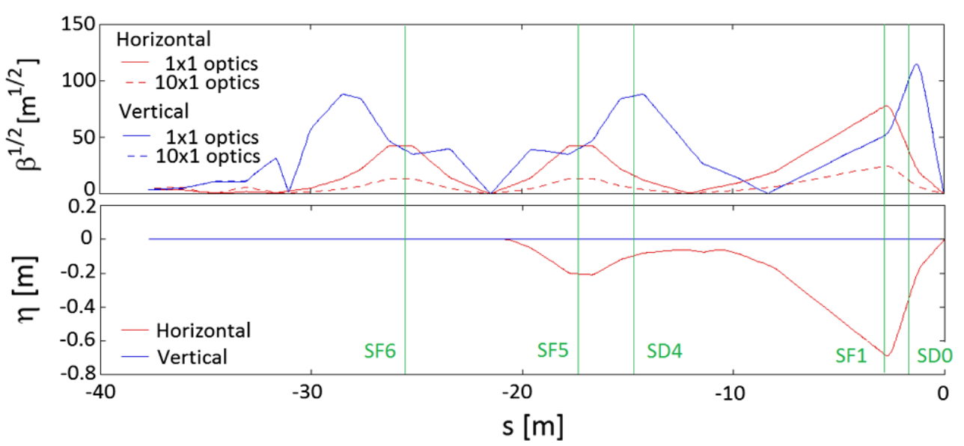
Extensive Simulations done in ATF2
Simulated errors:
Static errors:
- Misalignment of quadrupoles, sextupoles and BPMs of 100 um RMS.
- Strength error of quadrupoles and sextupoles of 0.1% RMS.
- Roll error for quadrupoles and sextupoles of 200 urad RMS.
Dynamic errors:
- Incoming pos./ang. jitter of [0.1σ_{y/y’} - 1.0σ_{y/y’}]
Simulation procedure:
- Tracking 200 bunches per machine from the ATF extraction line to the IP.
- 100 machines with the previously cited static imperfections.
- Apply the cited corrections and the knobs on the distribution at the IP.
Corrections applied:
- One-to-one
- Dispersion Free Steering
- Wakefield Free Steering
- Knobs (Y, YP D XP XP.*XP XP.*YP XP.*D)
First order*
Second order**
*First order knobs correction by changing the position of final focus sextupoles.
**Second order knobs correction by changing the strength of the final focus sextupoles.
Figure: Positions of the sextupole knobs in the Accelerator Test Facility 2 (ATF2) [5].
P. Korysko - LCWS2025 - Oct. 23, 2025
6

Slide 7
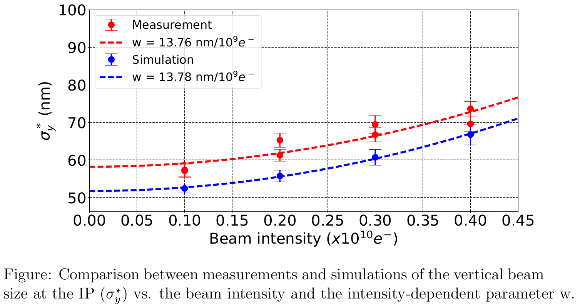
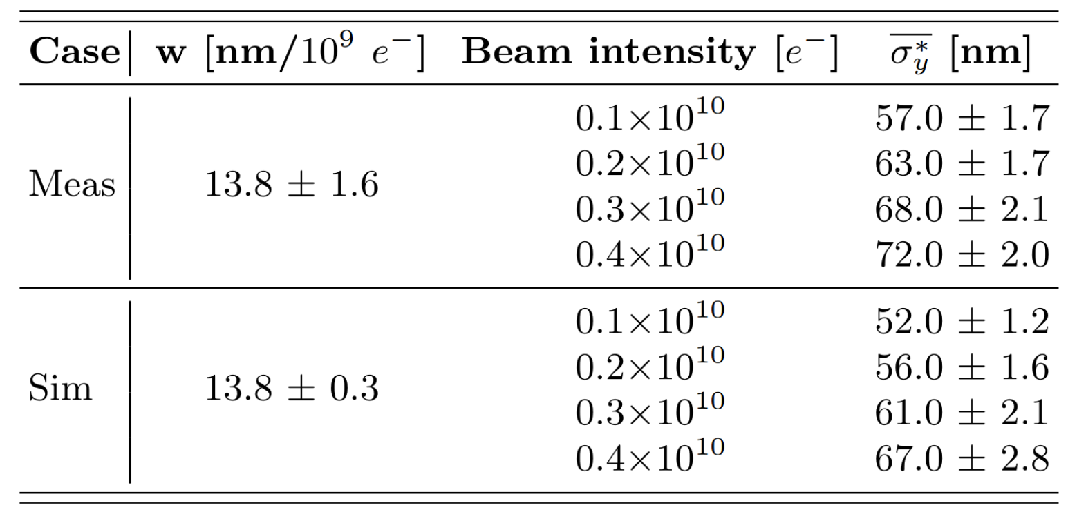
Comparison Simulations/Measurements
Simulations:
Static errors:
- Misalignement of quadrupoles, sextupoles and BPMs of 100 um RMS.
- Strength error of quadrupoles and sextupoles of 0.1% RMS.
- Roll error for quadrupoles and sextupoles of 200 urad RMS.
Dynamic errors:
- Incoming pos. & ang. jitter of 1.0σ_{y} and 1.0σ_{y’} respectively.
P. Korysko - LCWS2025 - Oct. 23, 2025
7

Slide 8
One-to-One,
Dispersion Free Steering (DFS)
and Wakefield Free Steering (WFS)

Slide 9
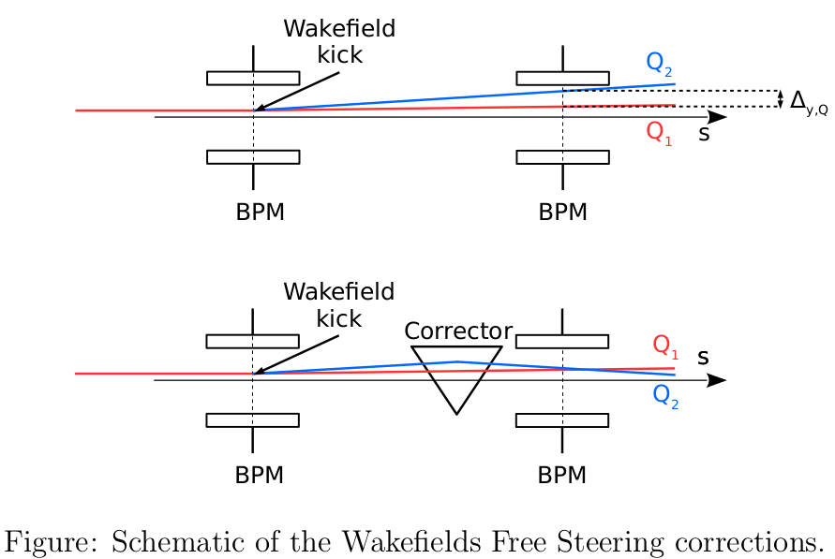
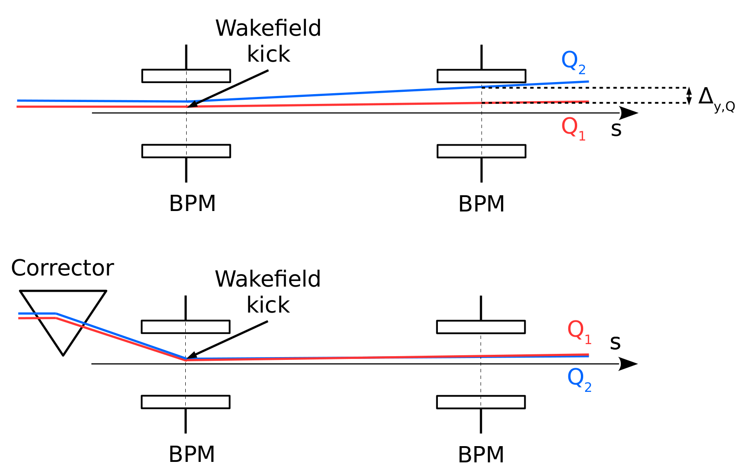
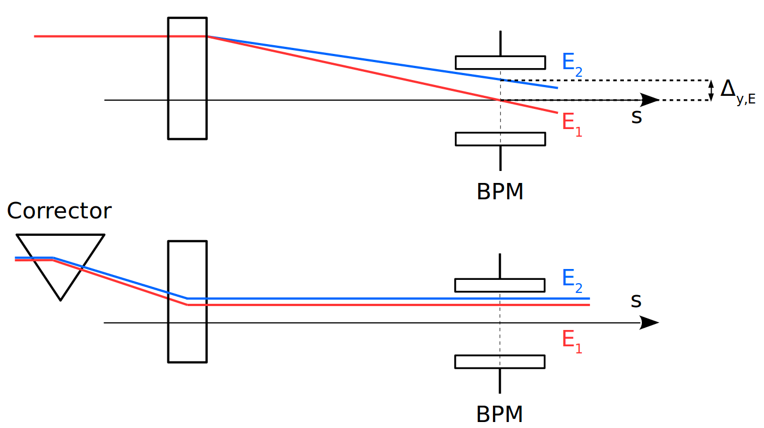
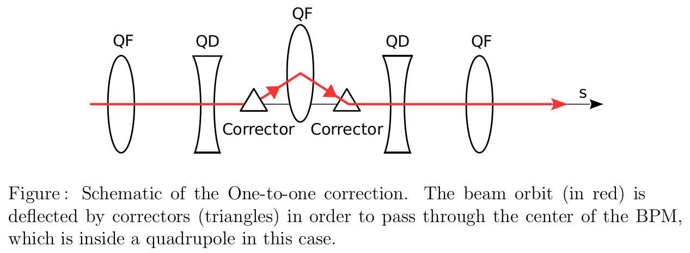
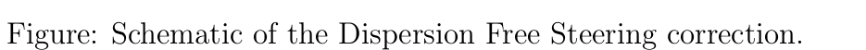
One-to-One, DFS and WFS
One-to-One
Dispersion Free Steering
Wakefield Free Steering
The One-to-One correction consists of minimizing the transverse position of the beam, with respect to the beam pipe centre measured at BPMs (inside quadrupoles in this case), using steering magnets [3].
The DFS correction consists of minimizing the dispersion effect. In practice, it reduces the orbit difference between two beams with different energies [4].
The WFS correction consists of minimizing the orbit difference introduced by wakefields. In practice, it reduces the orbit difference between two beams with different charges [5].
P. Korysko - LCWS2025 - Oct. 23, 2025
9

Slide 10
The ATF Flight Simulator

Slide 11
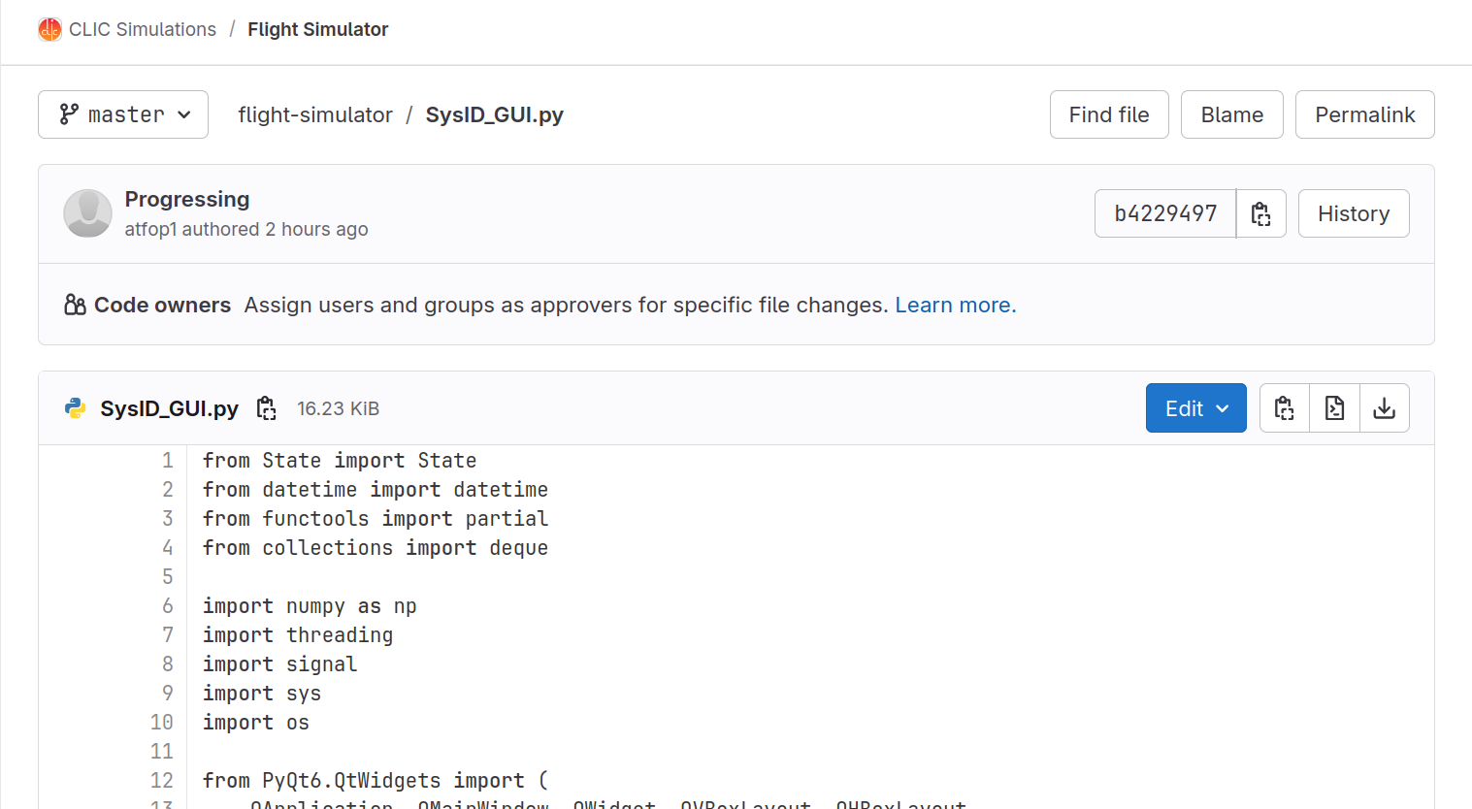
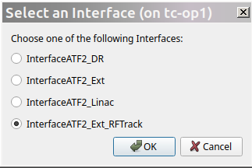
The ATF Flight Simulator
A first version of the ATF Flight Simulator has been written and tested at ATF2 (called SysID for System Identification).
4 available interfaces for now:
- ATF Damping Ring
- ATF Extraction Line
- ATF LINAC
- RF-Track Simulations
P. Korysko - ATF2 Weekly Meeting - June 20, 2025
11

Slide 12
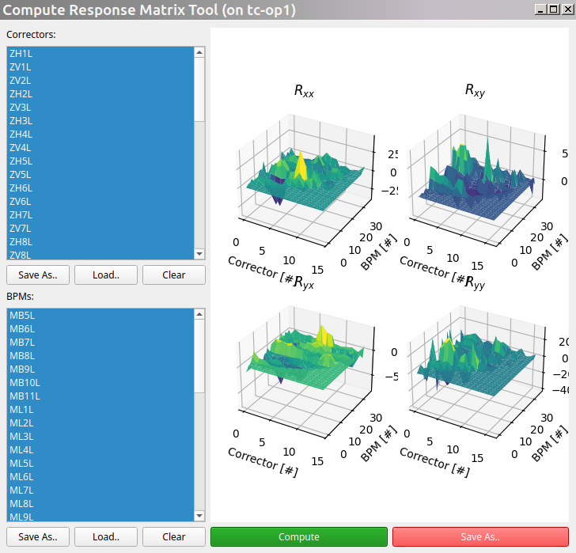
A tool dedicated to compute Response Matrices
List of
correctors
to use.
List of
BPMs
to use.
P. Korysko - ATF2 Weekly Meeting - June 20, 2025
12

Slide 13
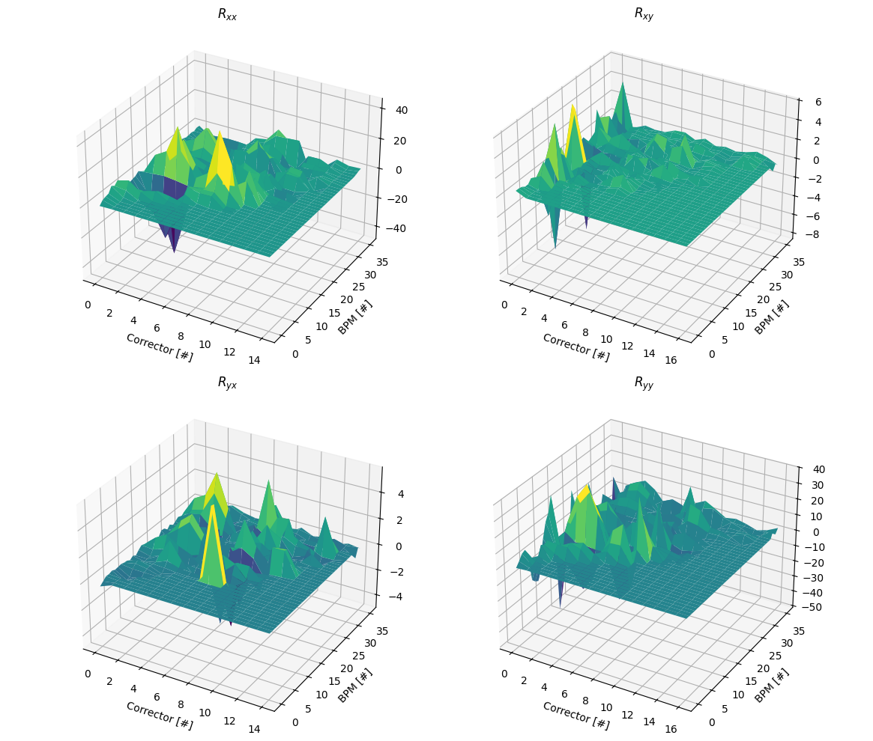
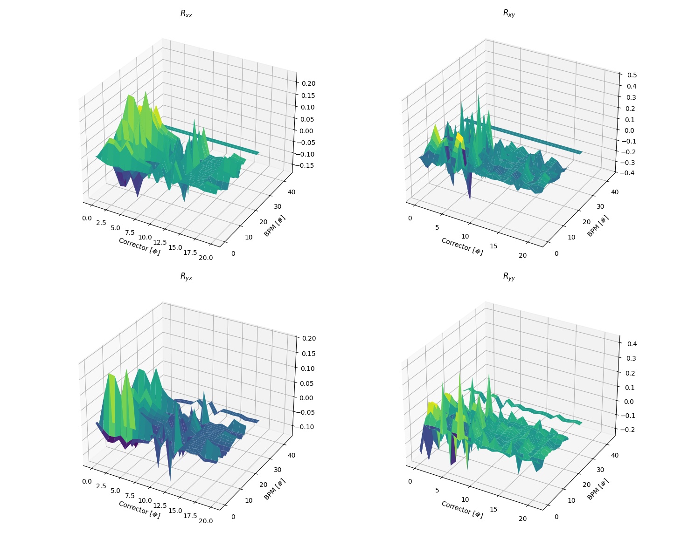
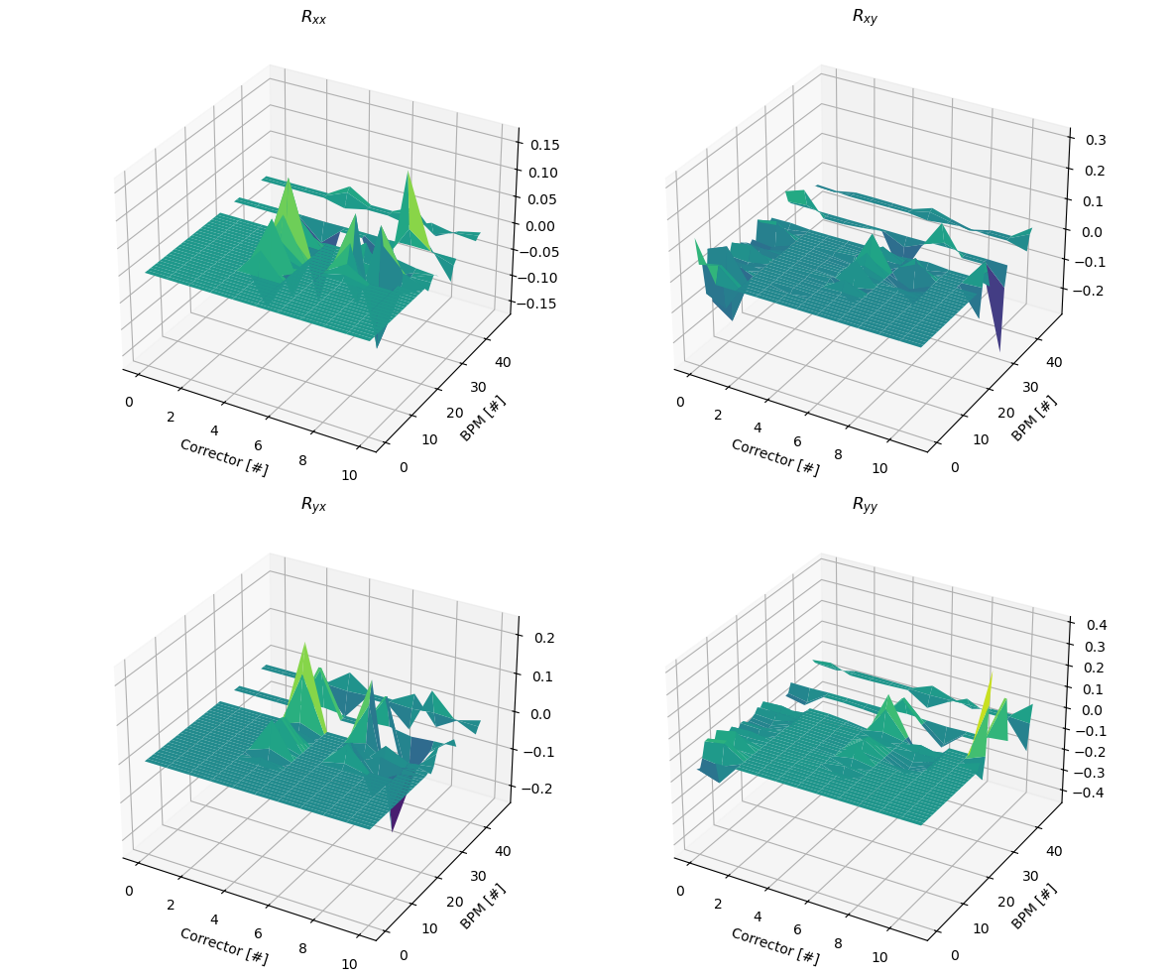
Response Matrices measured in ATF
LINAC Damping Ring ATF2 Beamline
P. Korysko - LCWS2025 - Oct. 23, 2025
13

Slide 14
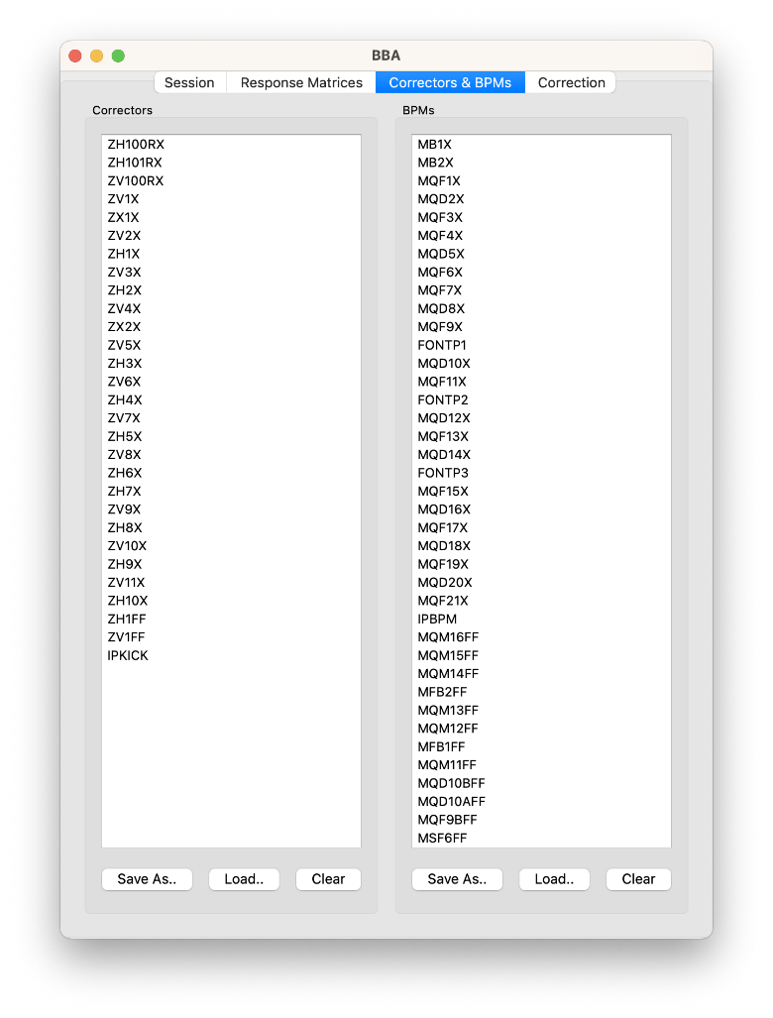
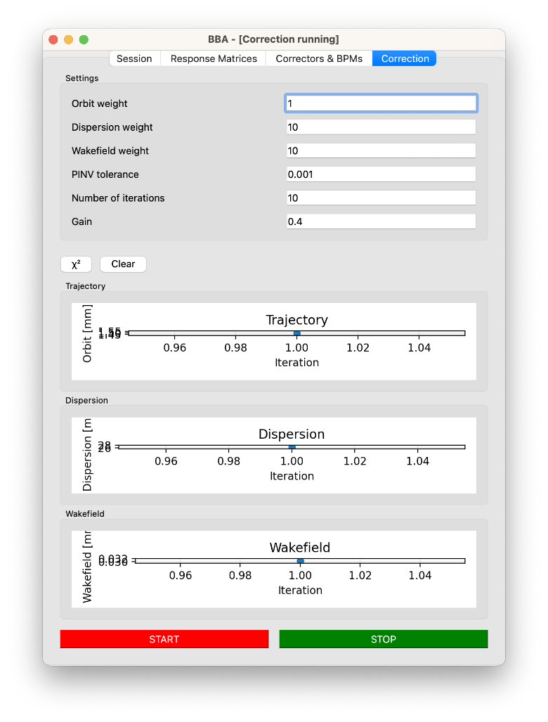
A tool dedicated to corrections
Orbit weight Dispersion weight Wakefield weight
Nb. of iteration
etc
List of
correctors
to use.
List of
BPMs
to use.
P. Korysko - LCWS2025 - Oct. 23, 2025
14

Slide 15
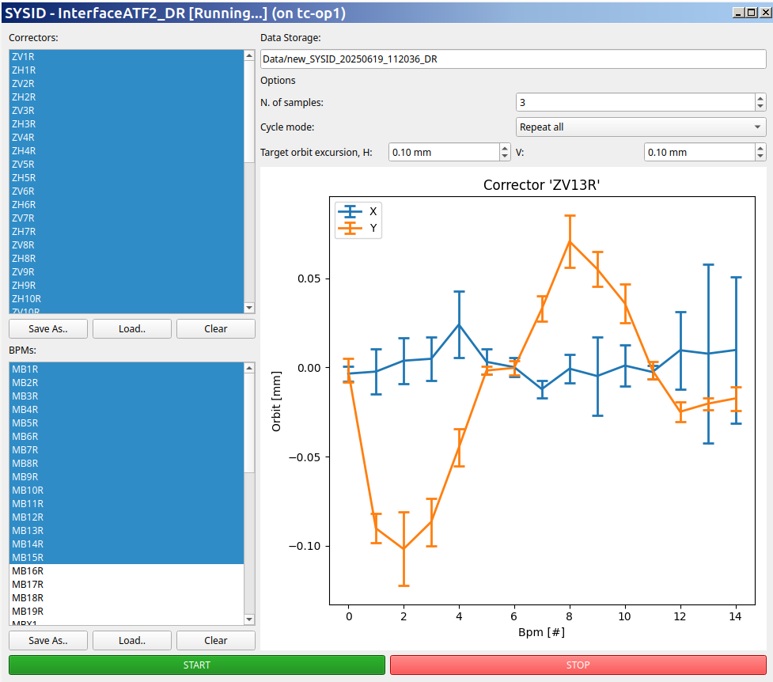
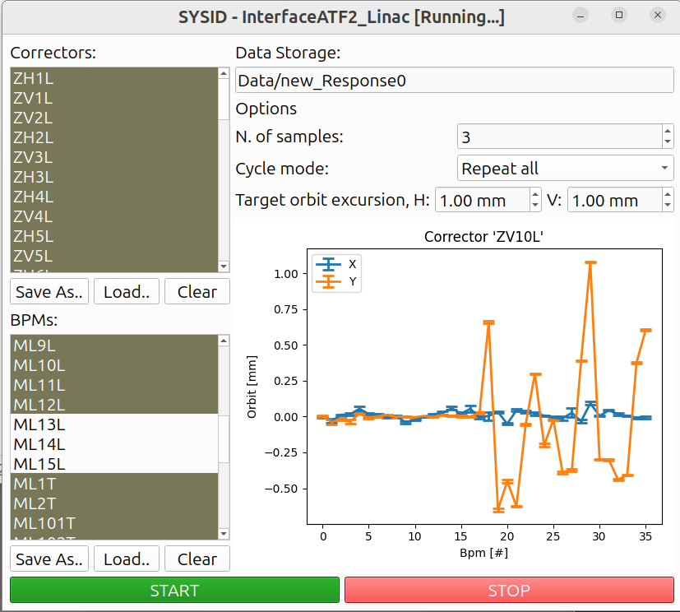
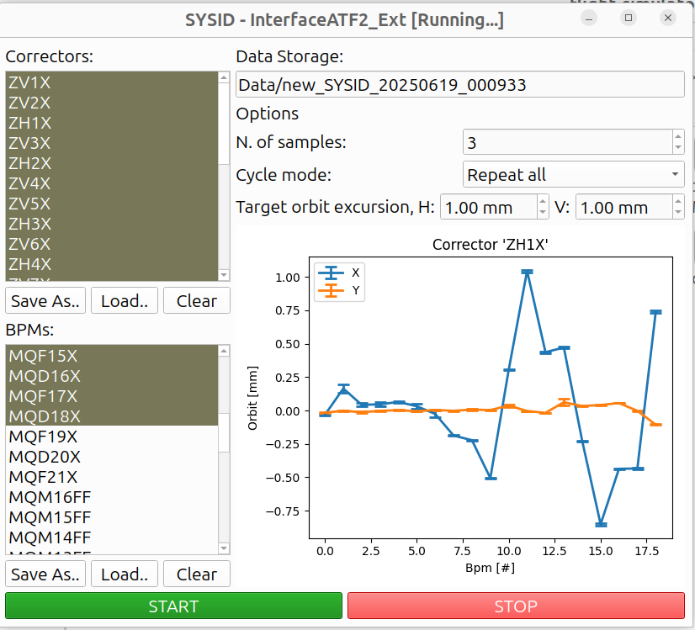
One-to-One correction in ATF
LINAC Damping Ring ATF2 Beamline
P. Korysko - LCWS2025 - Oct. 23, 2025
15

Slide 16
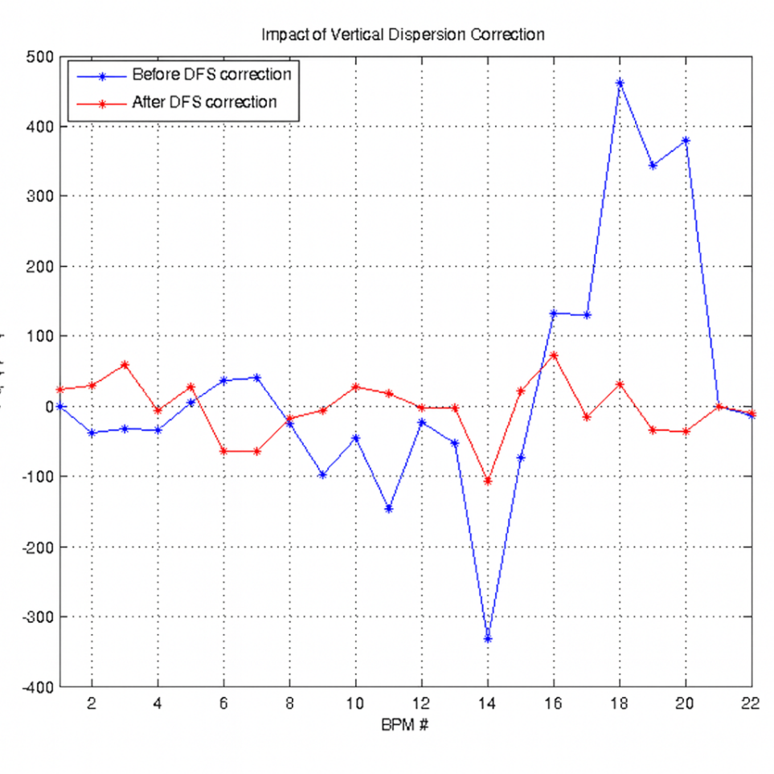
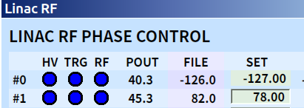
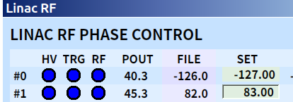
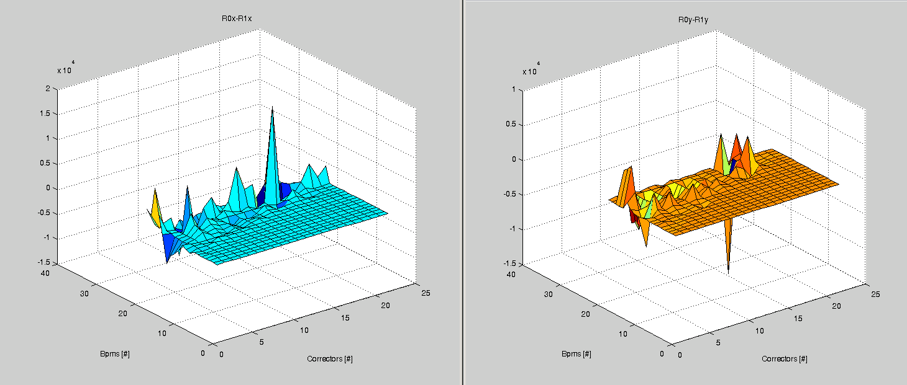
DFS in the ATF LINAC
To change the beam energy in the LINAC, the Phase of the Klystron #1 is increased by 5 degrees:
Response Matrix for DFS in the ATF LINAC with R0 (nominal energy) and R1 (lower energy)
R1 – R0
P. Korysko - LCWS2025 - Oct. 23, 2025
16

Slide 17
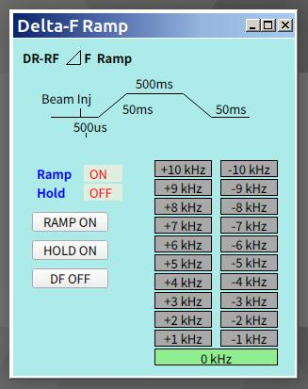
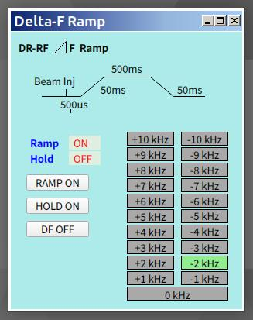
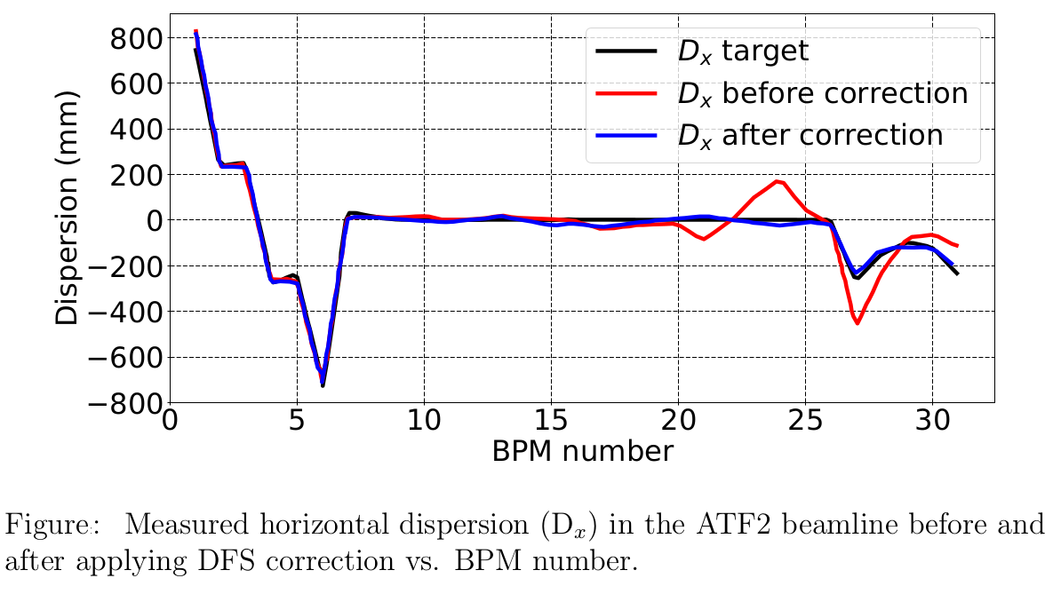
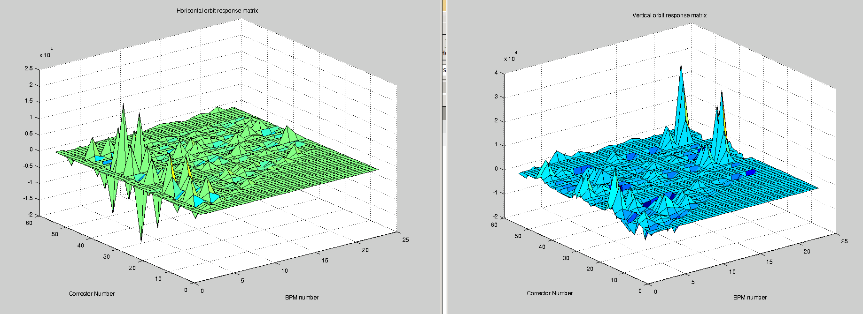
DFS in the ATF2 Beamline
To change the beam energy in the ATF2 beamline, the DR Delta-F is decreased by 2 kHz:
Response Matrix for DFS in the ATF2 Beamline with R0 (nominal energy) and R1 (lower energy)
R1 – R0
P. Korysko - LCWS2025 - Oct. 23, 2025
17

Slide 18
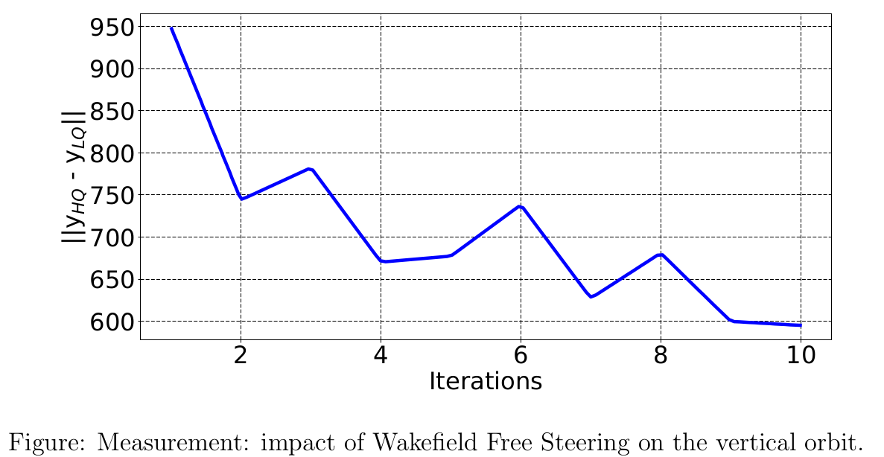
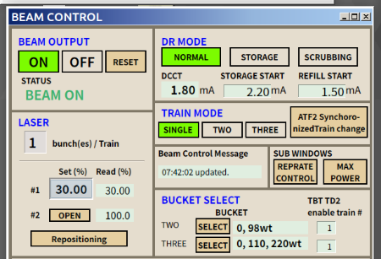

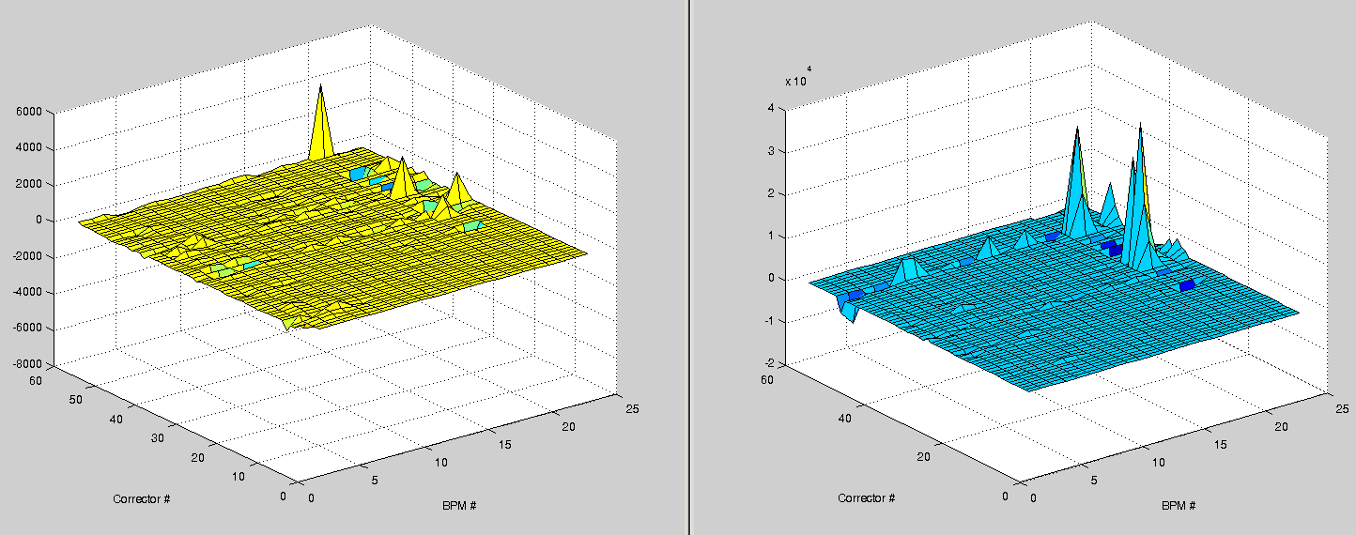
WFS in the ATF2 Beamline
To change the beam charge in the LINAC/ATF2 beamline, the Laser amplitude is decreased by 20%:
Response Matrix for WFS in the ATF2 Beamline with R0 (nominal charge) and R1 (lower charge)
R1 – R0
P. Korysko - LCWS2025 - Oct. 23, 2025
18

Slide 19
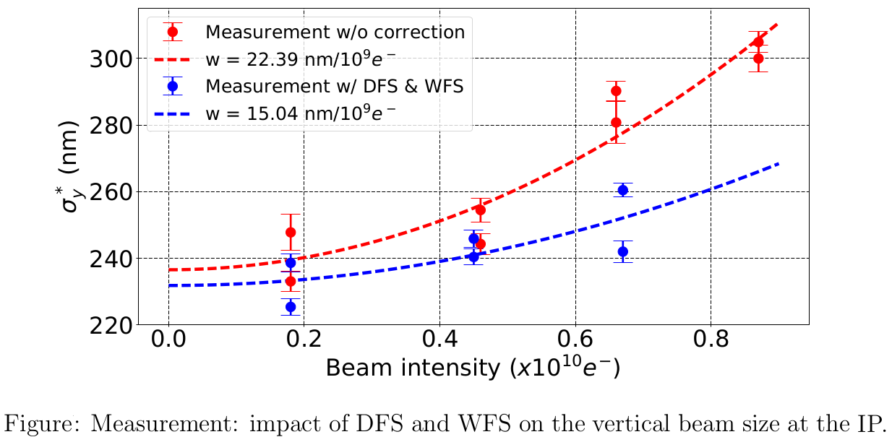
DFS and WFS Impact
P. Korysko - LCWS2025 - Oct. 23, 2025
19

Slide 20
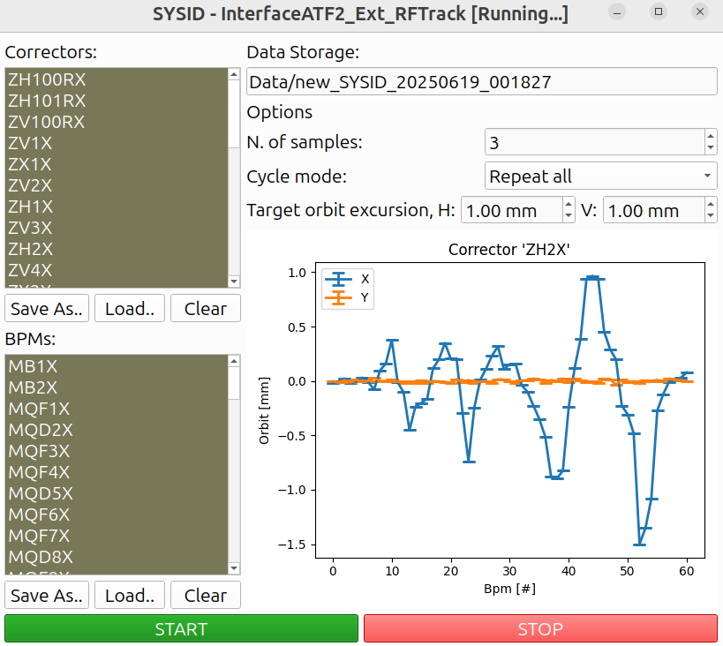
RF-Track Simulations Interface
RF-Track is a tracking code developed at CERN for the design and optimisation of particle accelerators, offering outstanding flexibility and rapid simulation speed.
Path to file
List of
correctors
to use.
Maximum transverse orbit excursion
List of
BPMs
to use.
https://gitlab.cern.ch/rf-track
P. Korysko - LCWS2025 - Oct. 23, 2025
20

Slide 21
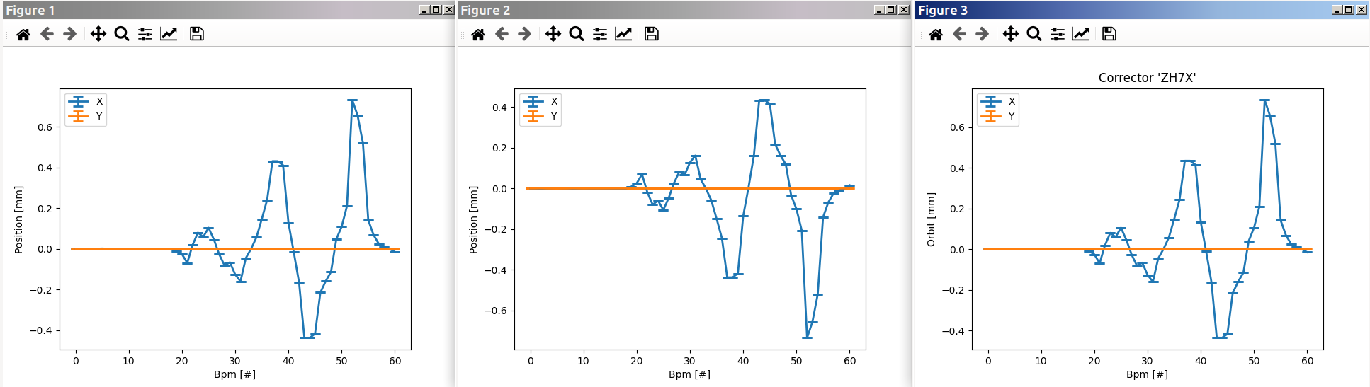
RF-Track Simulations Interface
Simulation of the excitation of ATF2 beamline correctors with RF-Track:
https://gitlab.cern.ch/rf-track
P. Korysko - LCWS2025 - Oct. 23, 2025
21

Slide 22
Conclusions
A new Python Flight Simulator has been developed and tested at ATF.
Dedicated tools for Response Matrix calculations and One-to-One correction were implemented in the Flight Simulator and give good results.
Other BBA corrections (DFS and WFS) were tested and give promising results.
They will soon be implemented in the Flight Simulator.
A new RF-Track interface has been implemented and tested to simulate, compare and optimise the results directly on the control room computers.
P. Korysko - LCWS2025 - Oct. 23, 2025
22

Slide 23
Thank you

Slide 24
References
[1] P. Raimondi, “Novel Final Focus Design for Future Linear Colliders”, PRL 86, 3779.
[2] “ATF2 Proposal”, SLAC-R-771.
[3] M. G. Minty et al., “Correction to: Measurement and Control of Charged Particle Beams”, DOI.
[4] T.O. Raubenheimer et al. “A dispersion-free trajectory correction technique for linear colliders”, NIMA, A302 (1991) 191-208.
[5] T.O. Raubenheimer, “A new technique of correcting emittance dilutions in linear colliders”, NIMA, A306 (1991) 61-64.
P. Korysko - LCWS2025 - Oct. 23, 2025
24

