Slide 1

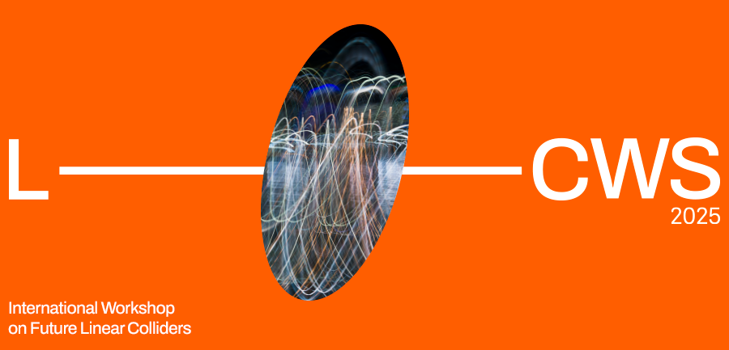

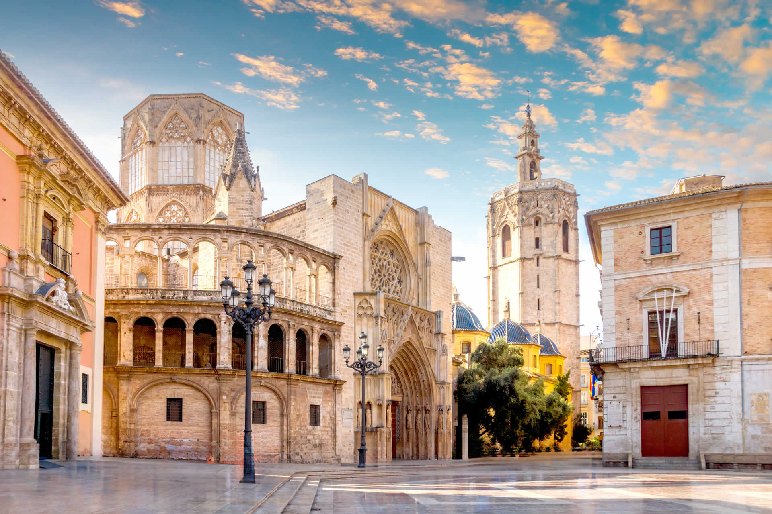



New Resonances at LHC
Alain Le Yaouanc, François Richard

Slide 2
Motivations
The HEP community has to decide on its future during this decade
Various choices are on the table which offer either high precision measurements with limited energy range or high energy exploration with limited precision
FCCee is an example of the former, FCChh of the later
Together, they would constitute an ideal cocktail for the future but financing and technical obstacles pause problem
It is therefore essential that present colliders provide some guidance for our best choice for a cheaper and well motivated scenario
We need not speculate on BSM physics since LHC is precisely exploring the mass domain which can be covered by realistic colliders !
Discoveries at HL-LHC would constitute the best opportunity, convincing our governments that we are reaching, at last, BSM physics, knowing what is needed for the future and guiding theory to provide adequate predictions

Slide 3
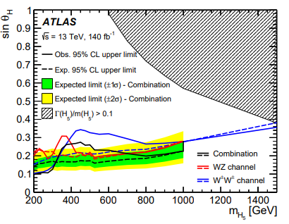
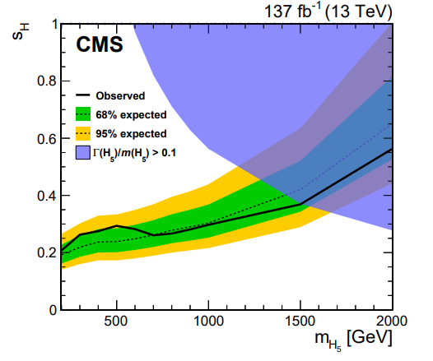
Where are we ?
So far a dozen indications for resonances (> 3 s.d. local) have been observed by ATLAS and CMS
Two of them appear very solid, crossing the 5 s.d. global:
- A toponium seen by CMS and, recently, by ATLAS, with CP-odd signature, a SM object
- Cumulative (9 modes indicated > 3s.d. local, > 5 s.d. when combined) evidence for a resonance around 650 GeV which could be a tensor (J=2) narrow resonance (10-20 GeV width)
Coupled to ZZ/WW, this resonance requires charged resonances coupled to W+W+ and ZW+ to insure unitarity
They are indicated by ATLAS and CMS and could reach 5 s.d. in individual channels in RUN3 (500 fb-1 middle 2026)
For obvious reasons, these resonances do not fit into the popular schemes MSSM, NMSSM, Georgi Machacek
2407.10798
2104.04762

Slide 4
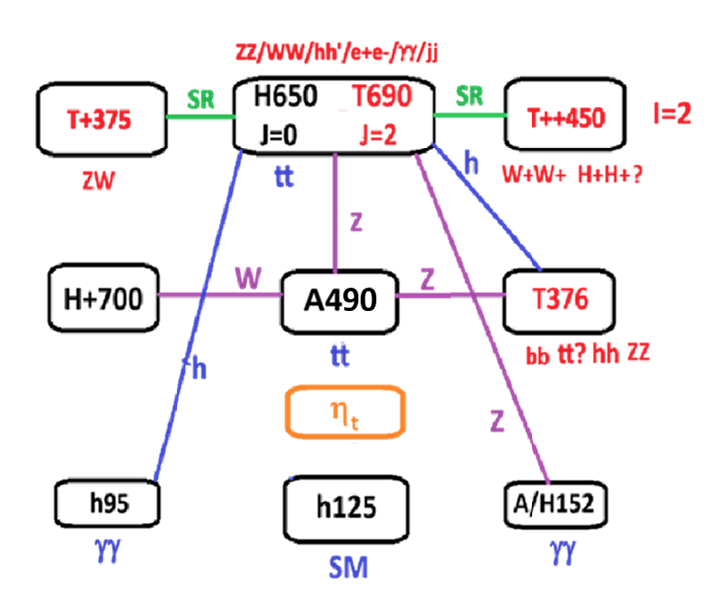
Summary diagram

Slide 5
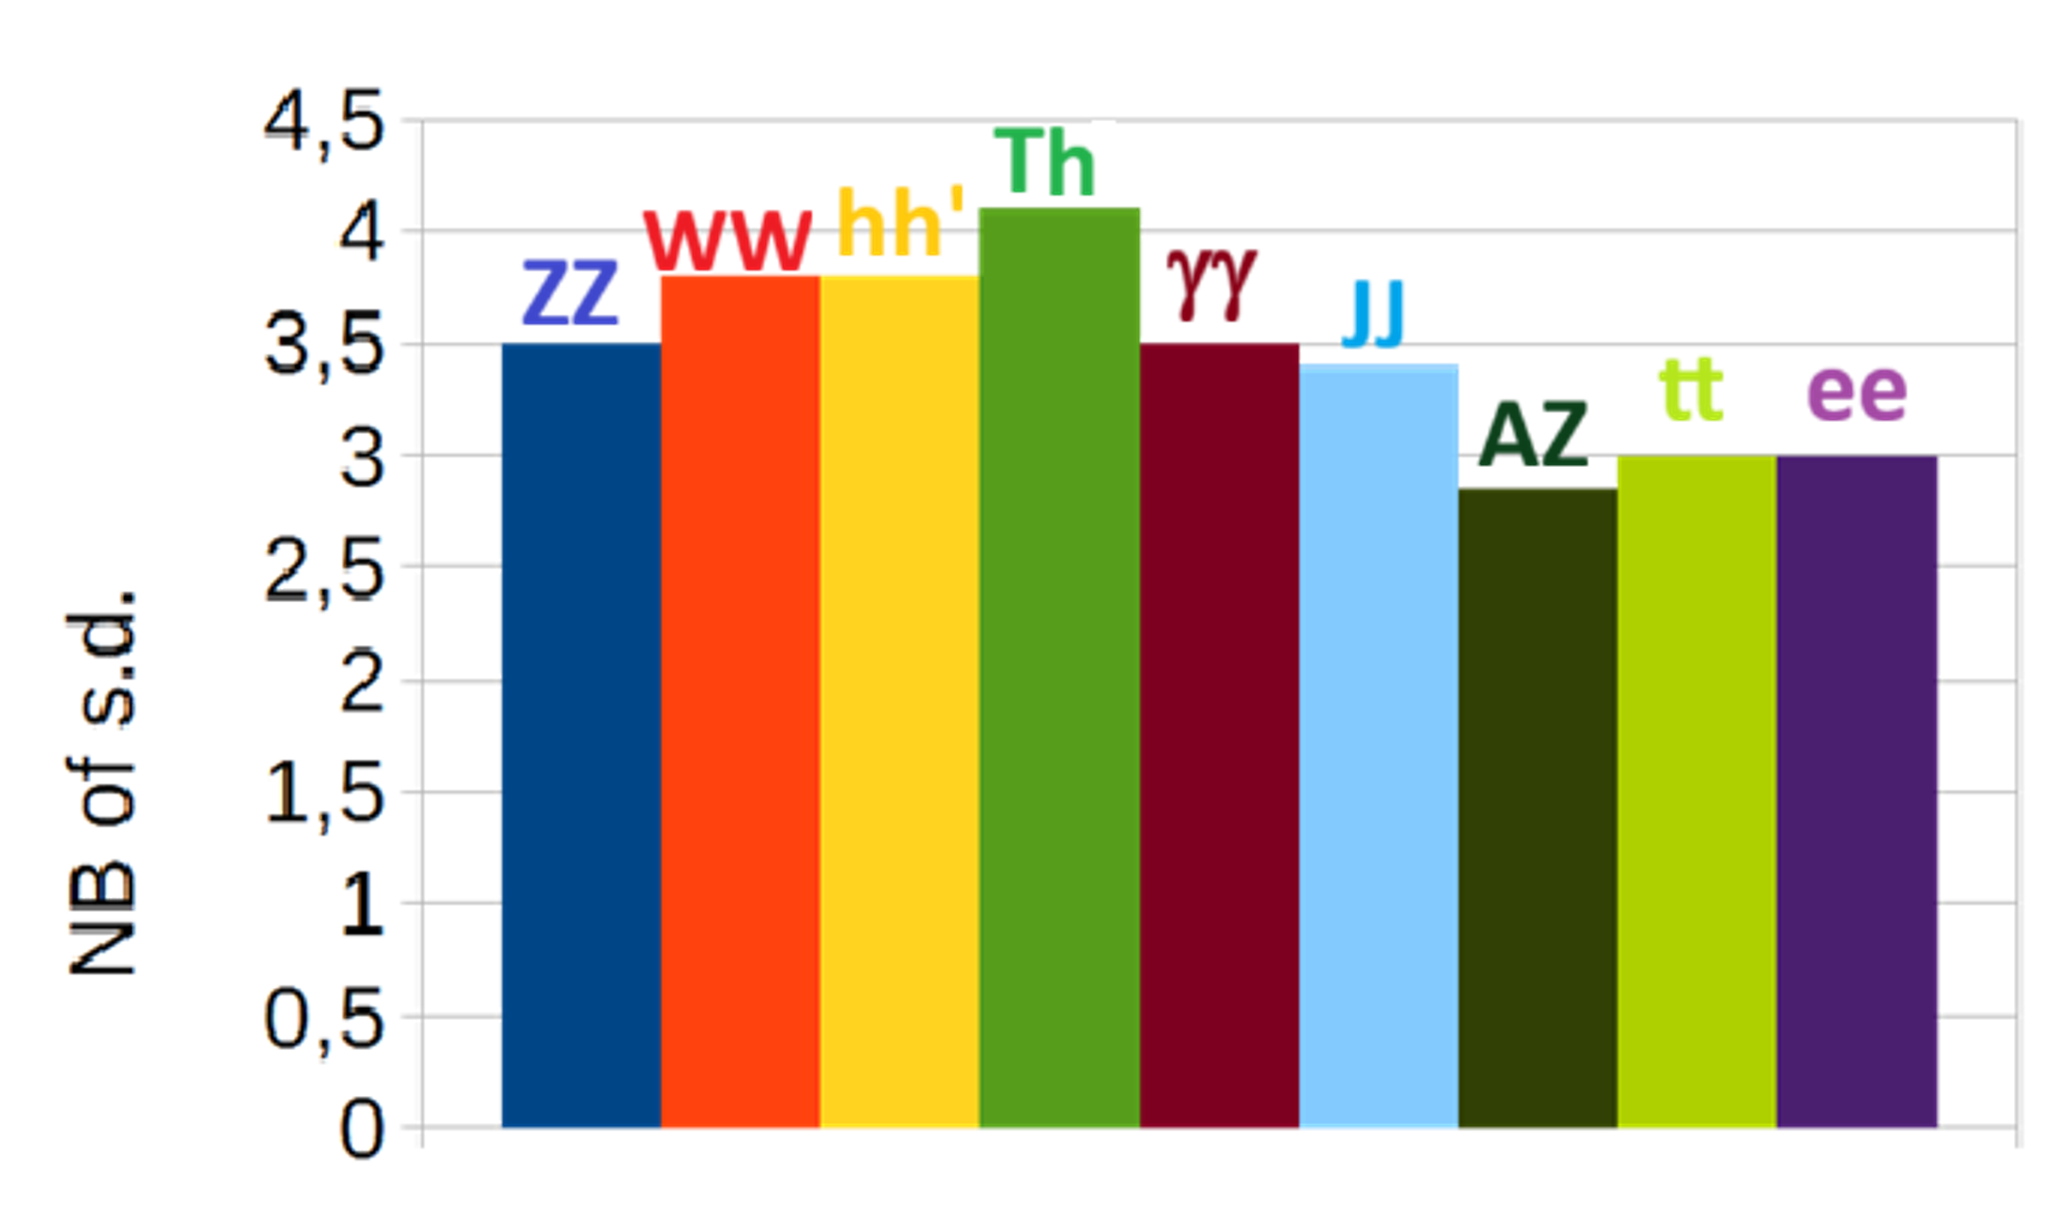
Evidences for ~650 GeV resonance(s)
Channel | Significance s.d. | Reference
ZZ 4 leptons | 3.8 ggF+VBF 2.8 VBF | ATLAS 2009.14791
WW 2leptons | 3.8 VBF | CMS-PAS-HIG-20-016
h95h125 bb/tt gg | 3.8 | CMS 2310.01643 CMS 2506.23012
T376h125 bbbb | 4.1 | CMS-PAS-HIG-20-012
gg | 3.5 | ATLAS 2102.13405
JJ | 3.4 | ATLAS 2509.01219
AZ tt 2leptons | 2.85 | ATLAS 2311
e+e- | 3 | ATLAS 1903.06248 CMS 2103.02708
tt | 3 | ATLAS 2404.18986 CMS 2507.05119

Slide 6
References [1]New resonances at LHC Alain Le Yaouanc(IJCLab, Orsay), François Richard(IJCLab, Orsay) (Jun 11, 2025) e-Print: 2506.09490 [2]X650->ZZ/WW/H125H95/A450Z -- scalar, tensor or both ? Alain Le Yaouanc(IJCLab, Orsay), (IJCLab, Orsay), François Richard(IJCLab, Orsay(Aug 22, 2024 Contribution to: 3rd ECFA workshop on e+e- Higgs, Electroweak and Top Factories e-Print: 2408.12178 [3]Triple Higgs coupling Alain Le Yaouanc(IJCLab, Orsay), (IJCLab, Orsay), François Richard(IJCLab, Orsay)(Apr 15, 2024) Contribution to LCWS24 e-Print: 2404.09827 [4]As a consequence of H(650)->W+W-/ZZ, one predicts H++->W+W+ and H+->ZW+, as indicated by LHC data Alain Le Yaouanc(IJCLab, Orsay), François Richard(IJCLab, Orsay) (Aug 23, 2023) Contribution to: 2nd ECFA Workshop on e+e- Higgs/EW/Top Factories e-Print: 2308.12180 [5] Searches for scalars at LHC and interpretation of the findings Anirban Kundu (Calcutta U.), Alain Le Yaouanc (IJCLab, Orsay), Poulami Mondal (Calcutta U.), François Richard (IJCLab, Orsay) Contribution to 2022 ECFA Workshop on e+e- Higgs/EW/TOP factories e-Print: 2211.11723

Slide 7
Some lessons to keep in mind
Contrary to current ideas, searches for heavy resonances are not just ‘bump hunting’ for scalar states as is the case for h125
Backgrounds are very severe as is the case for top pairs where ggF->tt has a cross section of 1 nanobarn while most signals are below 1 pb
Interferences can take place which distort the naive BW behaviour
Mass resolution is often quite poor with the exception of leptonic and two photon modes
In the process ggF, the top loop contribution can become imaginary leading to a ‘dip’ instead on the SM background of a ‘bump’
These resonances could also be J=2, in which case selections for isotropic J=0 could be fatal as for VBF->X650->ZZ which disappear applying these cuts
LHC experiments are now aware of these problems and a reanalysis of certain channels seems needed

Slide 8
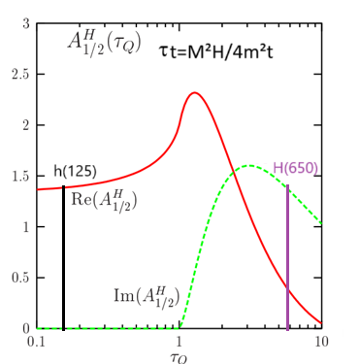
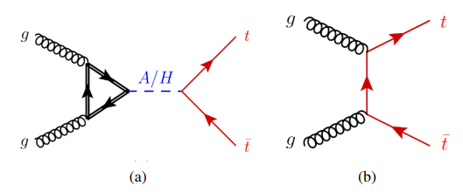
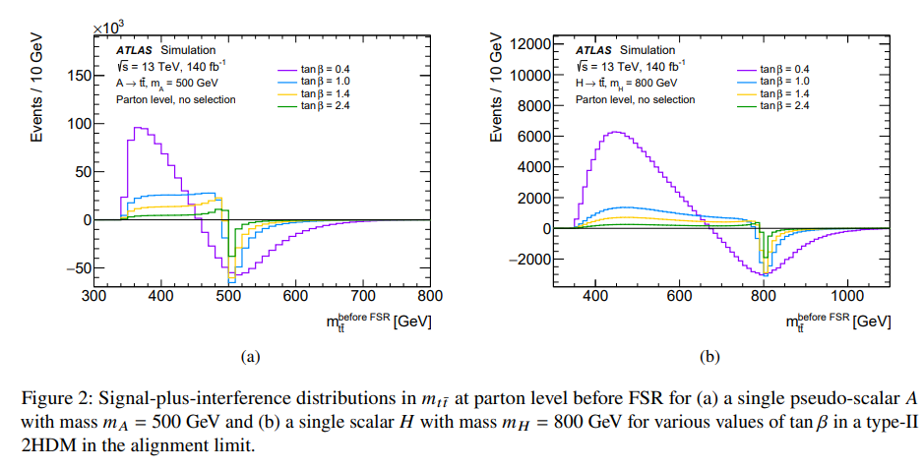
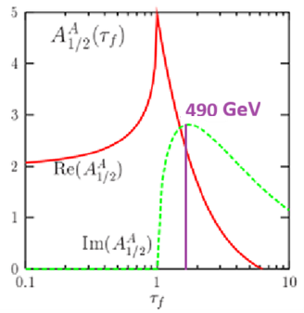
Dip instead of bump !

Slide 9
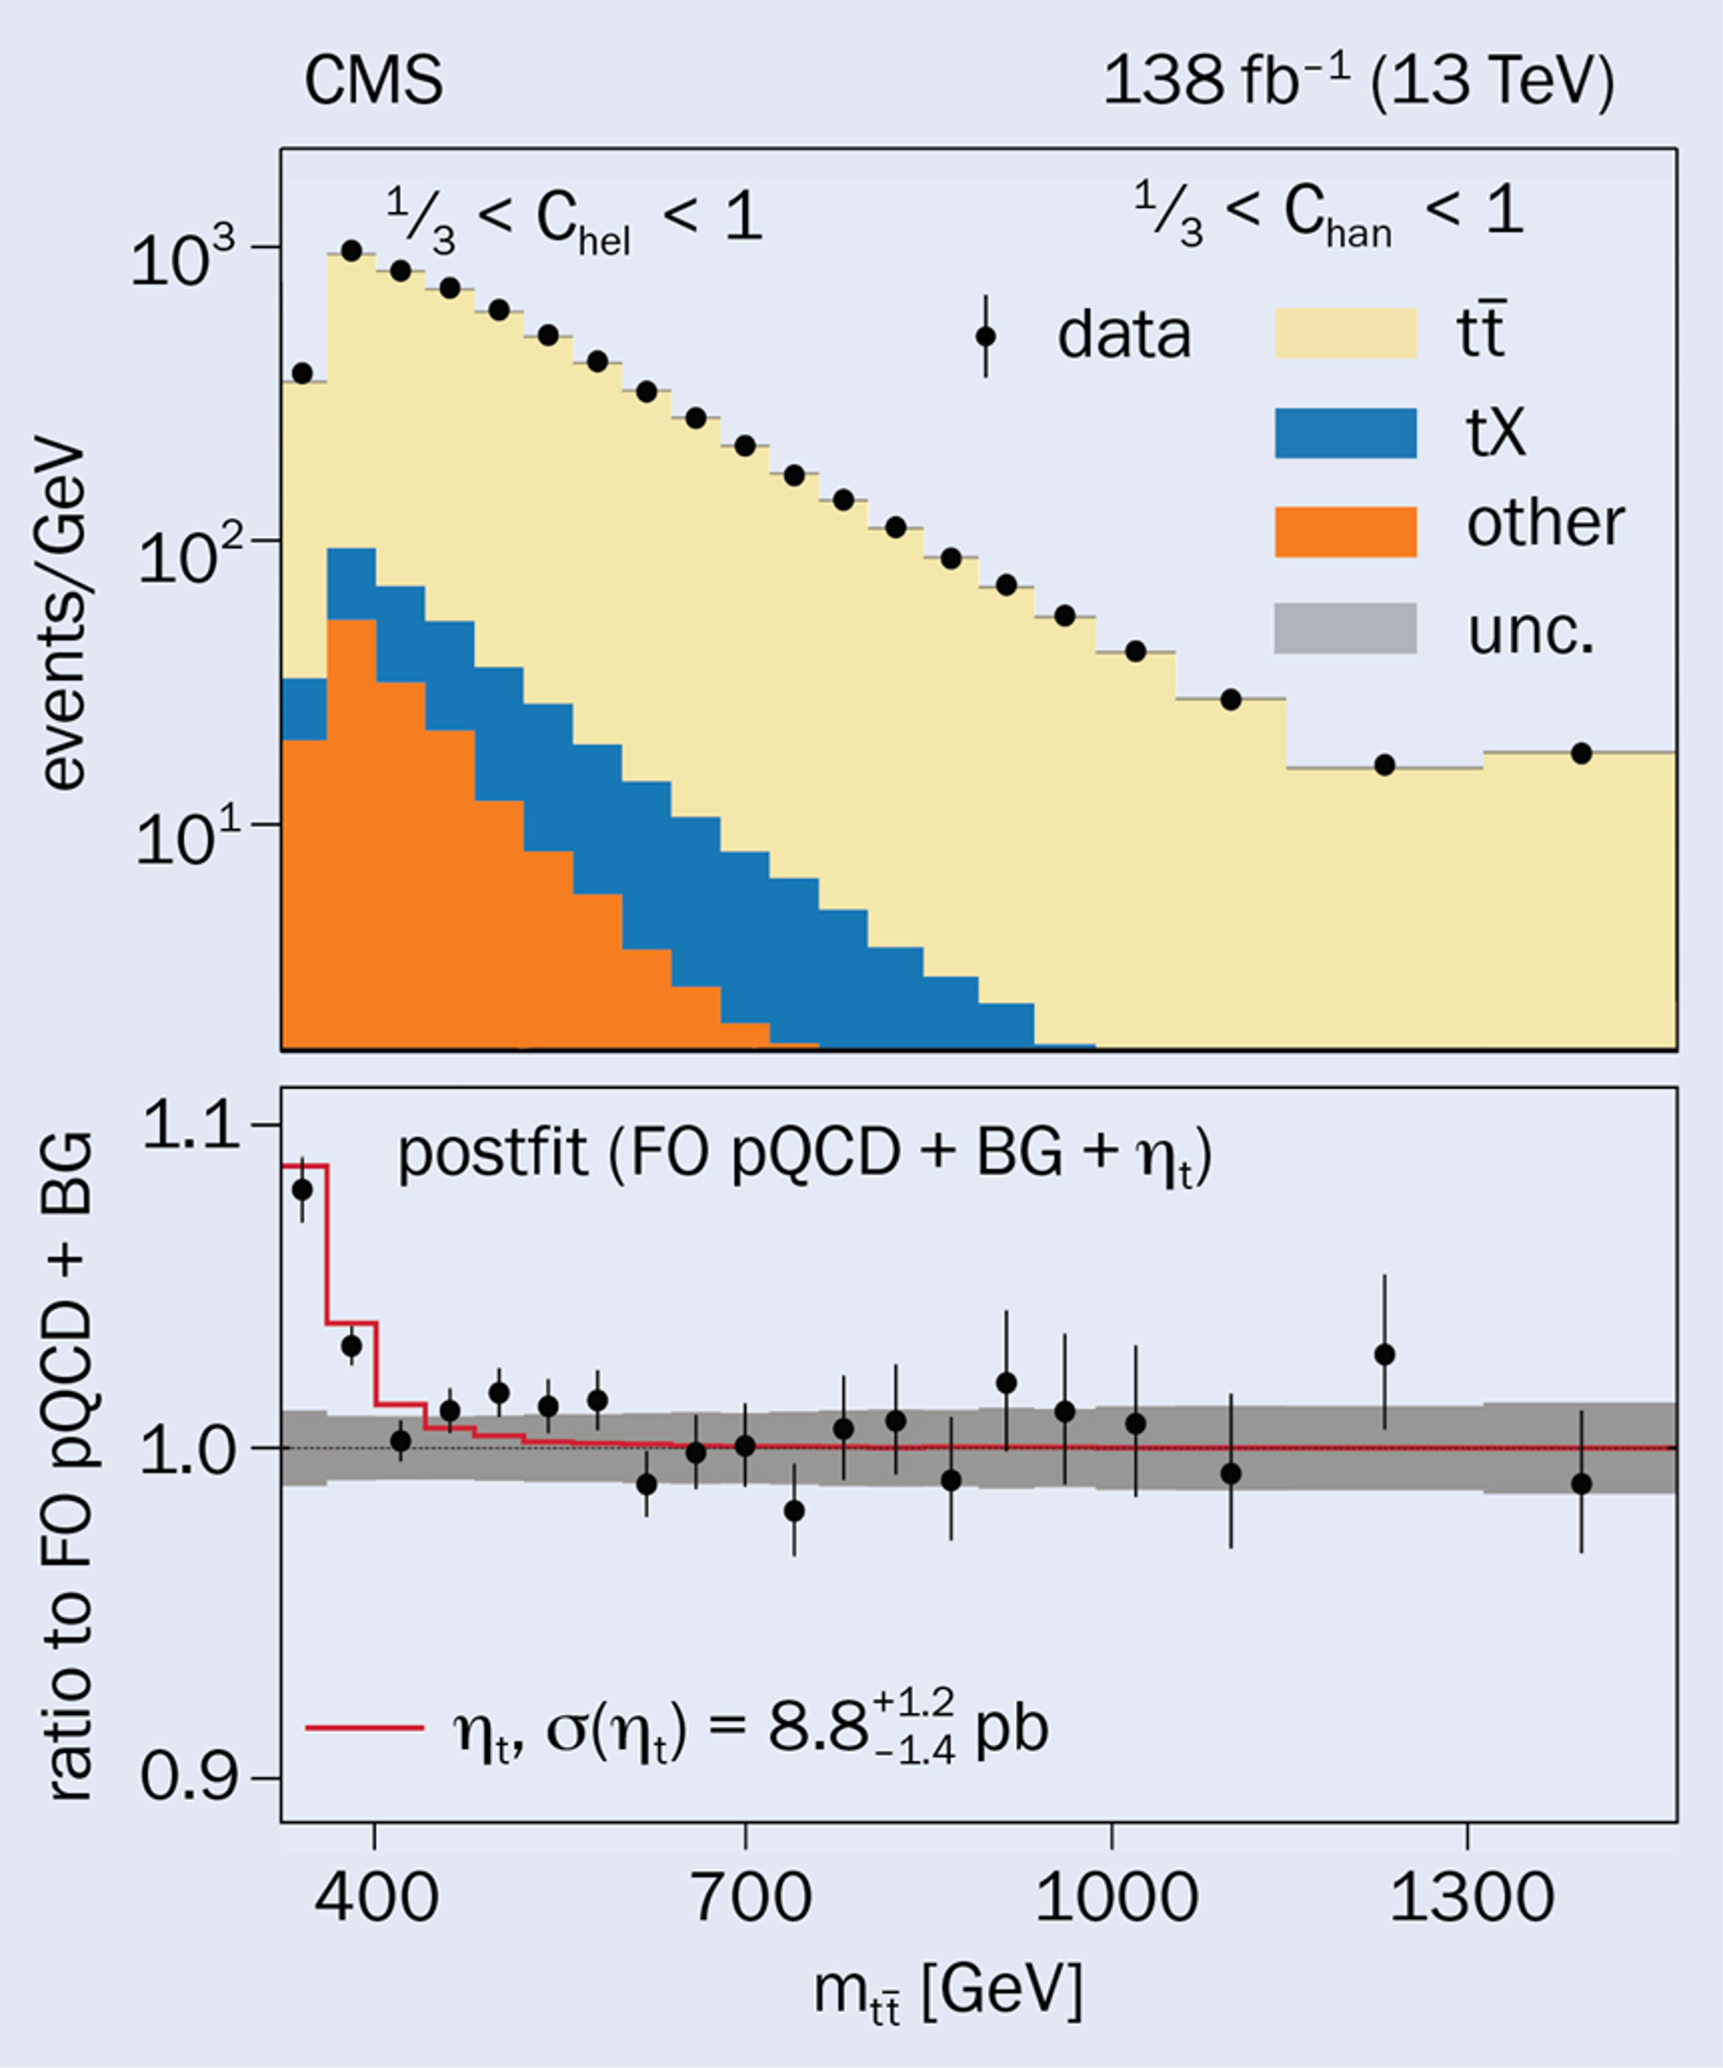
Evidence for toponium
2503.22382 2510.09070
A SM effect which provides a reference for searches
A toponium escapes to the ggF loop effect but requires angular selections to be observed
The evidence for ηt343 is now very strong, seen by both experiments
The standard toponium interpretation predicts σ=6.4 pb Γ_{ηt}=2.8 GeV
Mass resolution ~15% does not allow to separate from neighboring candidates like T376->tt
The measured cross section is below prediction and one cannot exclude that T376 contributes
-> Try VBF->tt (=0 for CP-odd) to observe T376

Slide 10
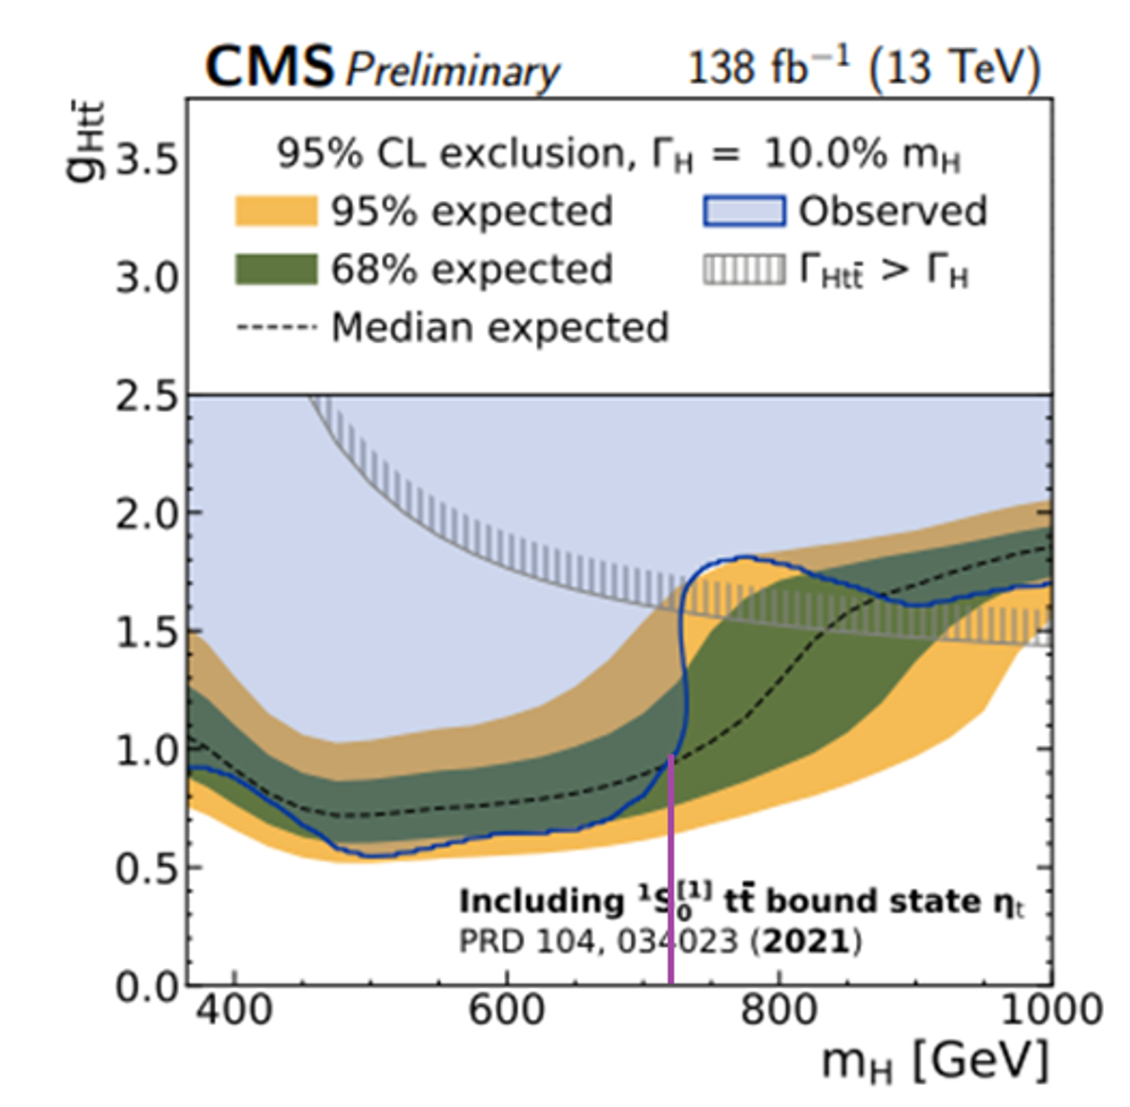
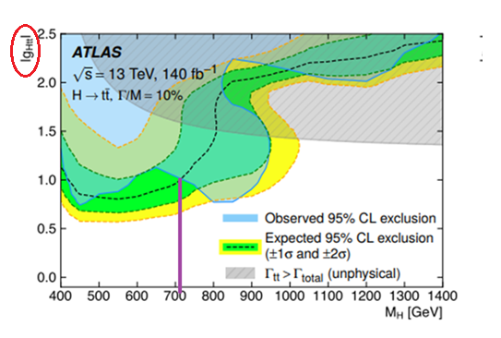
Searches for H/T->tt
Rapid variation of the observed limit which crosses the predicted limit at ~ 700 GeV
The signs reverted in ATLAS, which could be due to an allowed reversed sign of gHtt in ATLAS
Illustrates the difficult situation encountered in tt searches at LHC

Slide 11
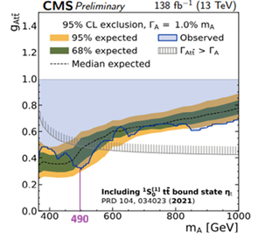
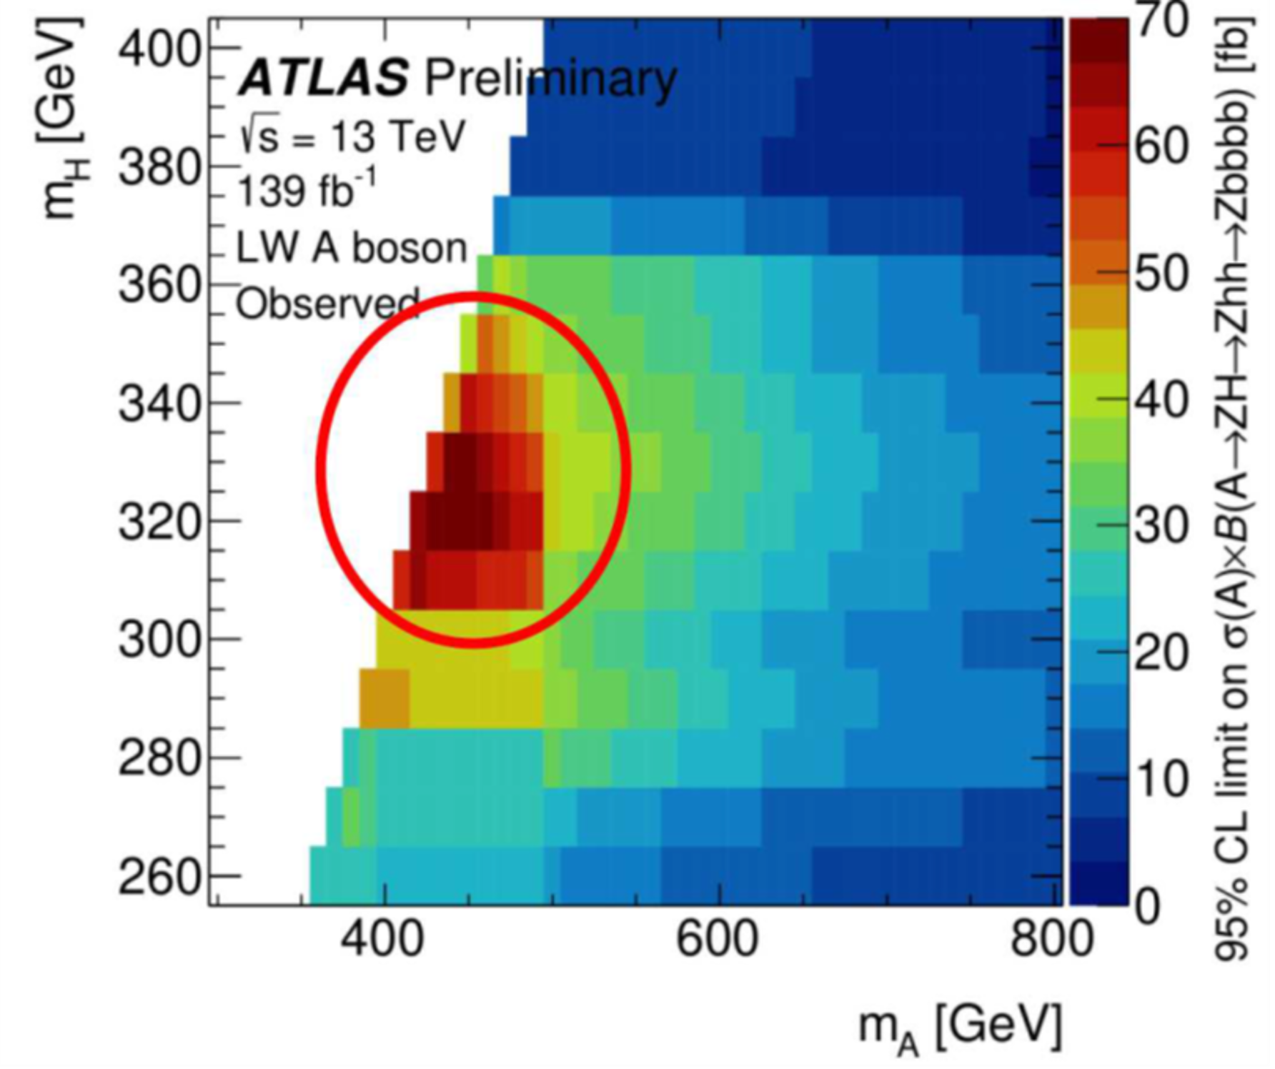
Searches for A->tt
CMS shows evidence for a CP-odd scalar
A490->tt in addition to the toponium
Seems to contradict ATLAS A420->hhZ->bbbbZ
Can be blamed on the mass reconstruction of the bbbb system where the bbbb mass peaks at 320 GeV
Would agree if bbbb mass was rescaled to ~376 GeV which does not seem excluded
T376->hh would then be mass degenerate to T⁺375->ZW⁺ suggesting they belong to the same isospin multiplet

Slide 12
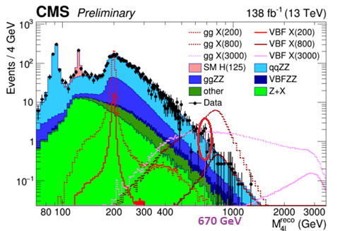
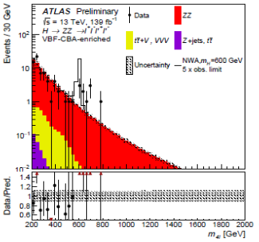
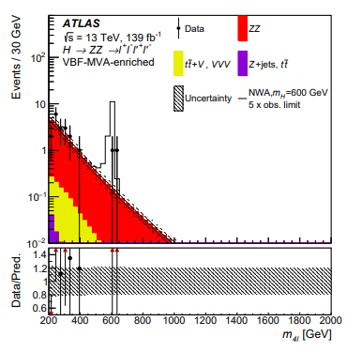
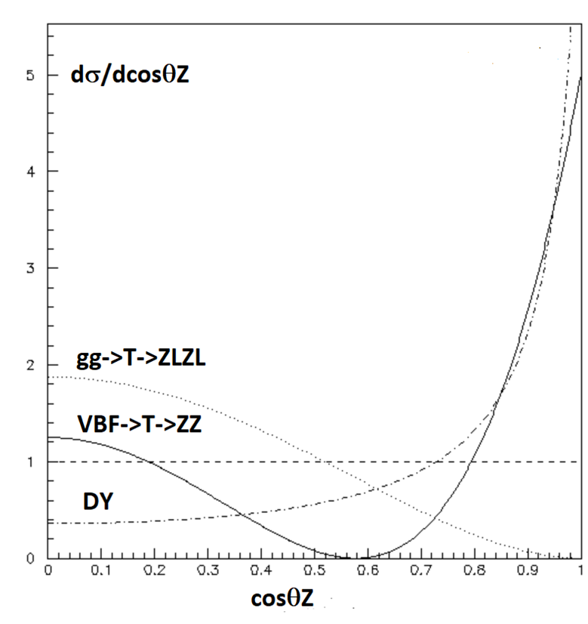
X650->ZZ-> ℓ⁺ℓ⁻ ℓ^{’+}ℓ^{’-} J=2 or J=0 ?
Naive cut based analysis
Selecting a scalar against DY
ggF+VBF
VBF

Slide 13
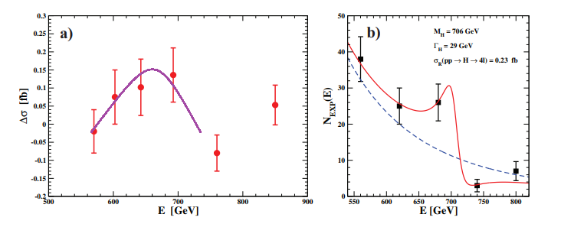
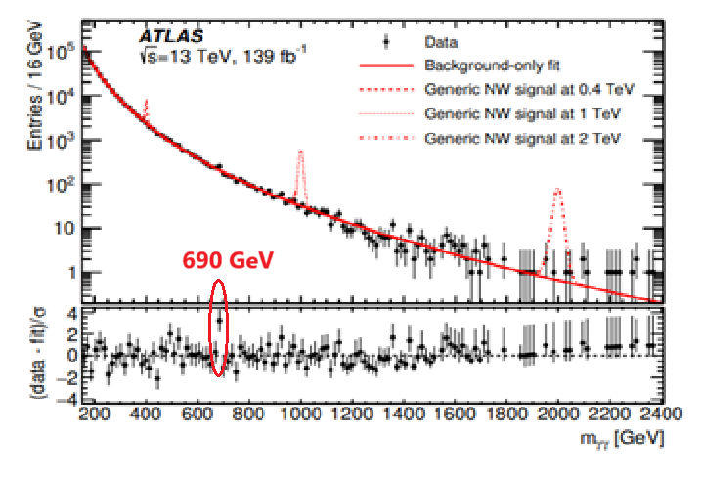
650 GeV or 690 GeV ?
2501.03708
Interference can change the mass, from 650 to 700 GeV and the total width, from 100 GeV down to 20 GeV in the ggF channel from ATLAS
Observation in γγ confirms ZZ with interference:
Narrow peak and M=690±10 GeV
ggF->ZZ could be lost due to the top loop effect ?
VBF->ZZ is lost due to angular selections if J=2

Slide 14
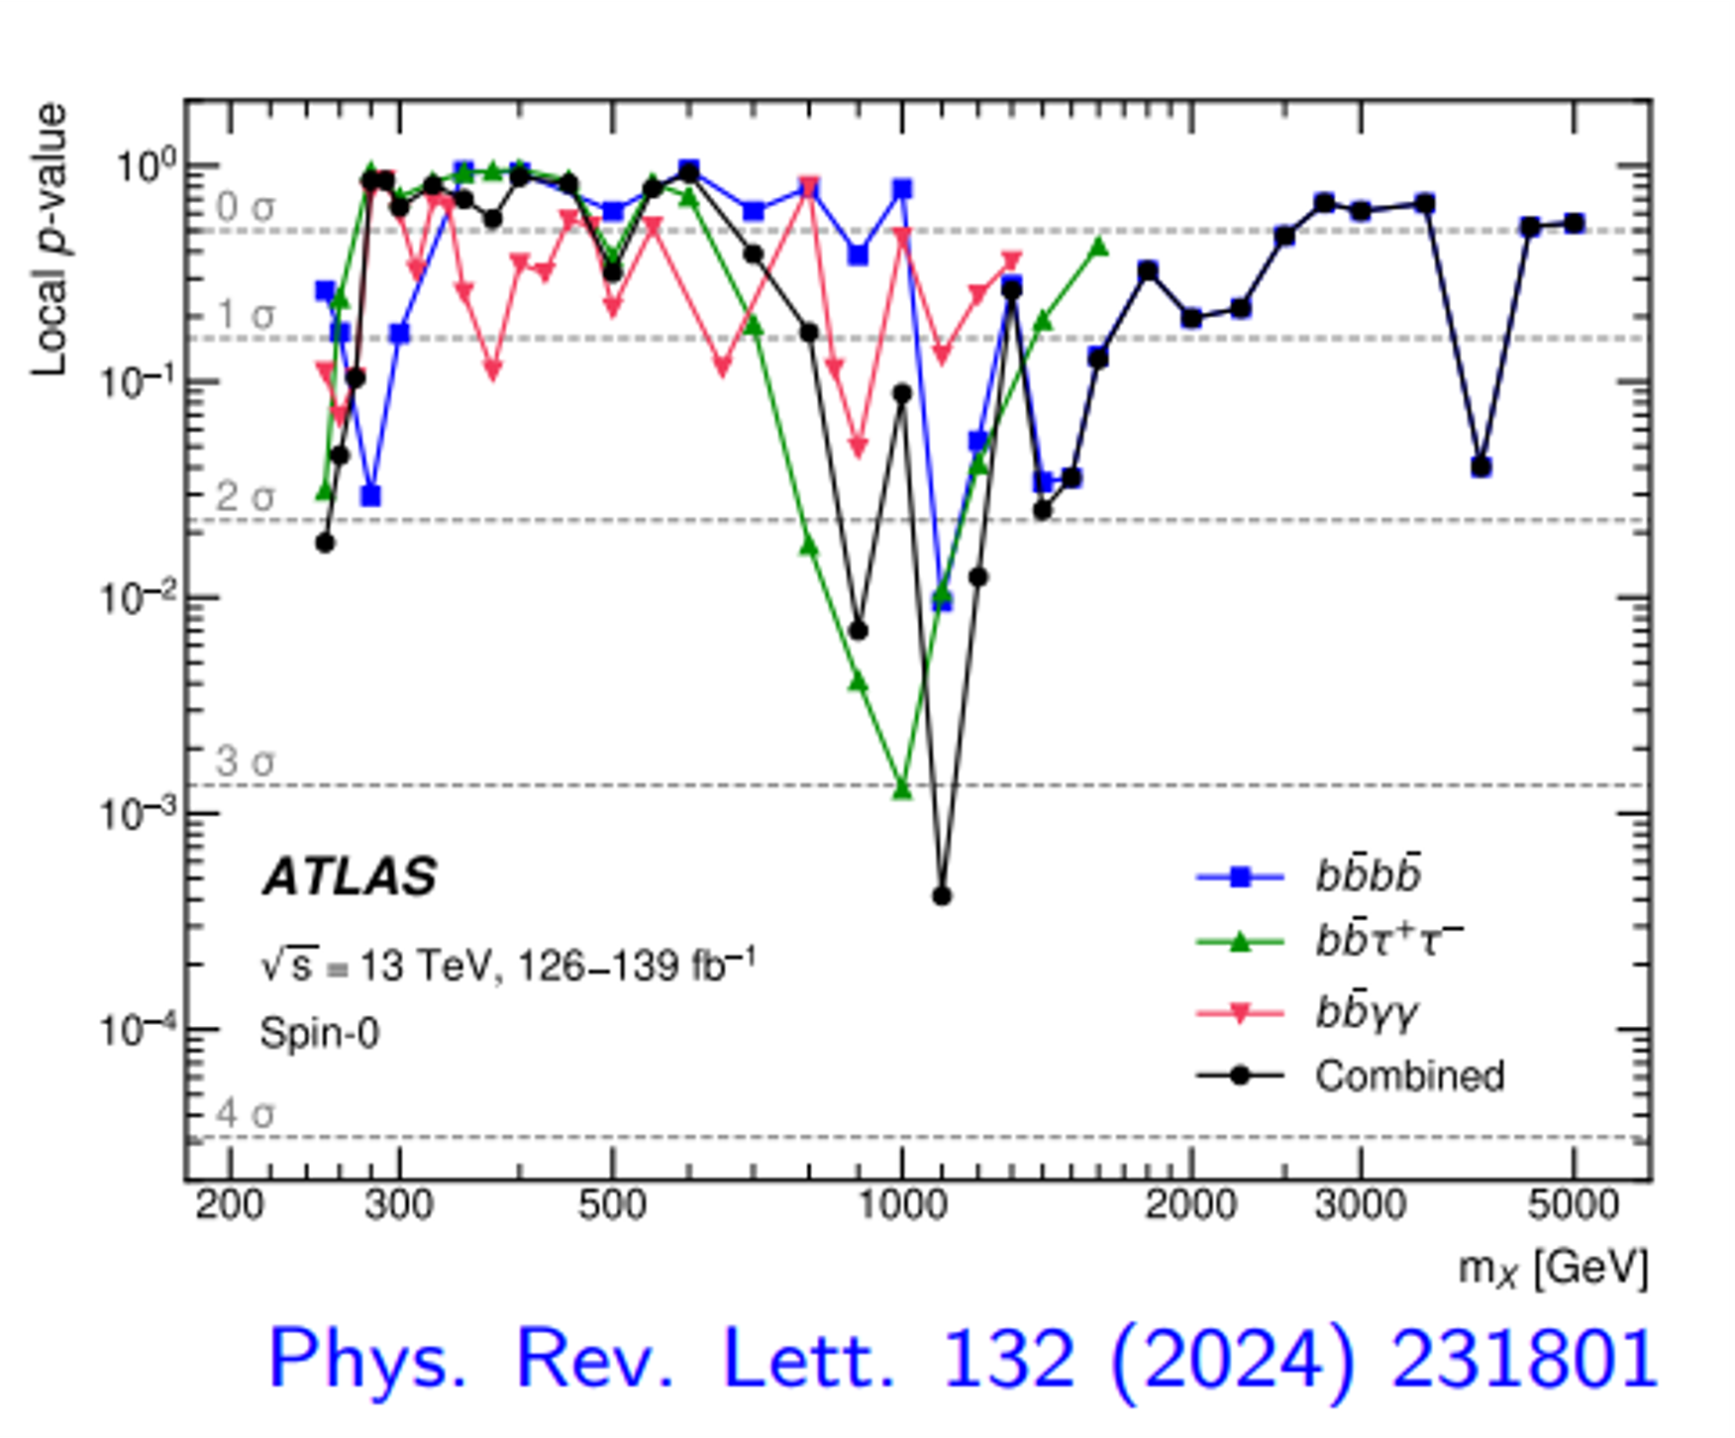
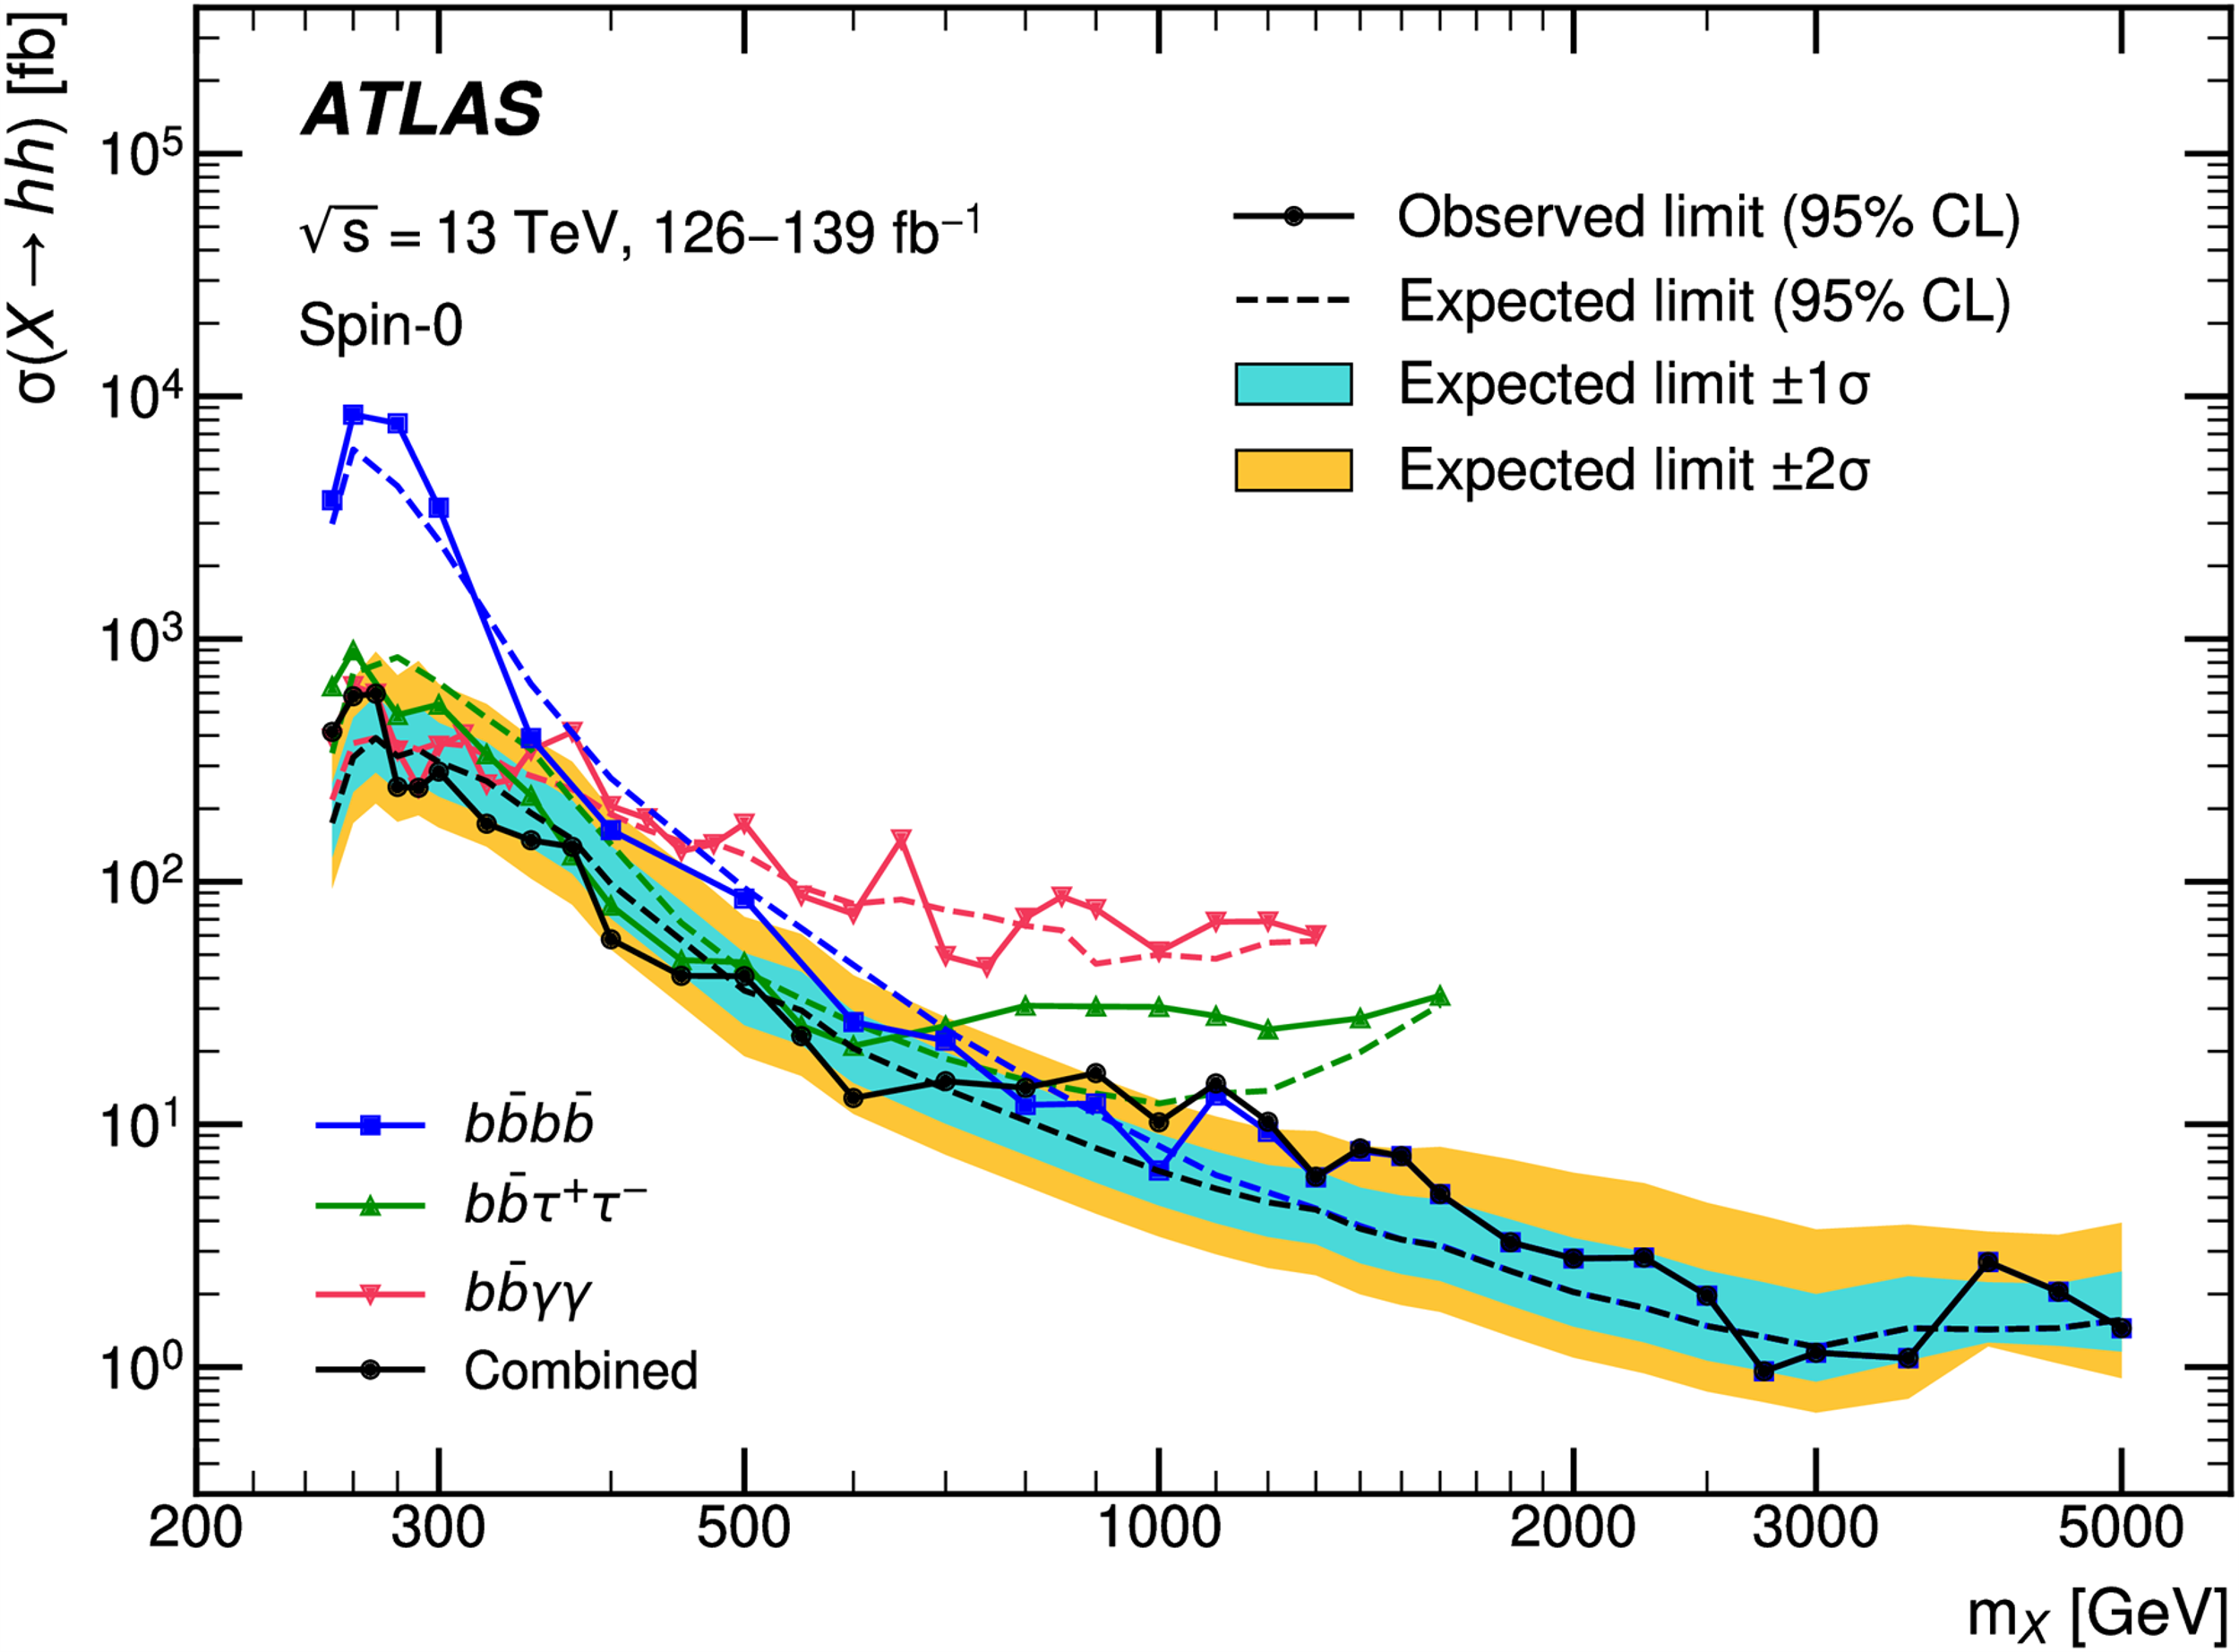
Graviton recurrences ?
T690 seems a valid tensor candidate
In the Randall Sundrum (RS) model, graviton KK resonances G_{iKK} have masses which go like mi~100x^{G}_{i} in GeV, where x^{G}_{i}=3.8,7.0,10.2,13.3... and widths which go like Γ~0.06(x^{G}_{i} )³
These numbers which govern the RS model are of geometric origin, simply given by the zeros of the Bessel function J₁(x)
Assuming that T690 is the second KK resonance, one predicts T376 as the first one, as observed and the third one T1000 , which seems indicated by ATLAS searches for h125h125
The next one should be T1300, not easy to separate from T1000

Slide 15
A preliminary interpretation of these indications
J=0
I=1/2
J=2
I=2
HD1 | h125→ SM | WL | ZL
HD2 | h95->2g | t→H⁺130 b→bcb | A152→ 2g+Z/W
HD3 | H650->A490Z->ttZ | H⁺700→A490W⁺ | A490→T376Z->hhZ
TQ1 | T⁺⁺450->W⁺W⁺ | T⁺375→ZW⁺ | T376→hh,bb,tt
TQ2 | T690→ZZ/WW/h125h95/tt/2g/e+e-
TQ3 | T1000→ZZ/WW/h125h125
Weinberg Model
Gauge Theory of CP violation, Phys. Rev. Lett, 37 (1976) 657.
Randall Sundrum
MTQ1=376
MTQ2=690
MTQ3=1000

Slide 16
More speculations
LHC indicates the presence of scalar resonances coexisting with tensor resonances of the KK type
The best known UV completion for scalars is SUSY
Here we would have both extra-dimensions and SUSY ! 2510.11771
This may be seen as a blessing given that with extra-dimensions one has the Scherk-Schwarz mechanism providing masses to SUSY particles
It is suggested that this could remove the tension in MSSM (very large stop masses needed to explain h125) 1511.04081

Slide 17
What can we expect from RUN3 ?
500 fb-1 will be provided by RUN3 mid 2026
So far we have identified more than a dozen channels which show indications for an excess above 3 s.d.
If real, on average, these channels could reach 5 s.d.
They do not suffer from the LE syndrome since they are a priori tagged from RUN2 data
Hopefully, the coincidences between the two experiments should improve as for the toponium
Critical changes needed in searches to take into account a J=2 interpretation, interferences with the SM background and loop effects

Slide 18
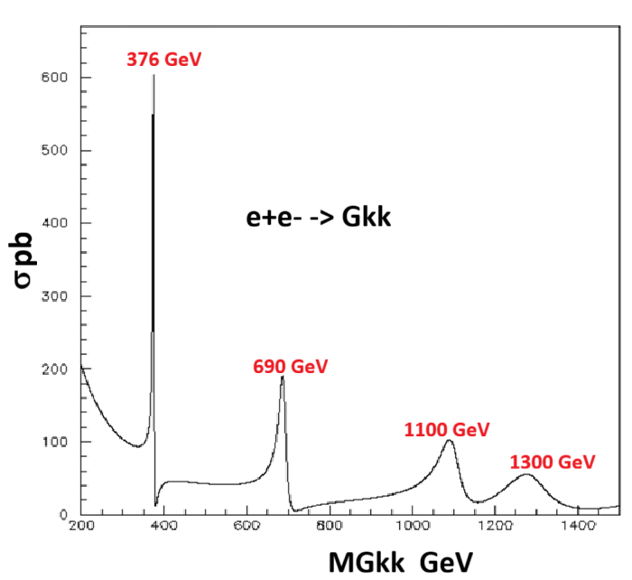
What can we expect from an e+e- collider ?
Covering the whole spectrum of scalars requires 1.5 TeV
If, as indicated by ATLAS and CMS, T690 couples to e+e-, one would have a sequence of graviton factories, two/three of them being indicated by LHC
Collecting 10⁹ events they would allow the most precise measurements of the KK graviton properties for energies below 1 TeV
The mass ratios are predicted (zeros from Bessel function) which constitutes the strongest proof against a composite interpretation (angular distributions would not differ from J=2 composite resonances)

Slide 19
Conclusions
The existence of one (or two ?) resonances around 650 GeV, with 9 significant indications, seems ‘beyond a reasonable doubt’ but still requires official ‘stamping’ from ATLAS and CMS
The loss of the ZZ channel, assuming J=0, suggest that ‘650 GeV’ is likely to be a tensor, a J=2 KK graviton predicted by RS, presumably produced by VBF
This resonance implies, through sum rules, the presence of W⁺W⁺ and ZW states as indicated by the data at 450 and 375 GeV
Together with a neutral candidate T376, they form an I=2 multiplet, presumably also J=2 , avoiding a contribution to the ρ parameter as in the GM case
There are presumably five resonances decaying into top pairs:
ηt343 T376 A490 H650 T690
If the tensor resonances couple to e+e-, as indicated by ATLAS & CMS for T690, we predict two factories (10⁹ ) accessible at a TeV LC
In one year from now there will be five times more data (at present three) which should allow definite conclusions guiding our choice for the next CERN collider

Slide 20
Acknowledgements
Thanks to Juan Fuster for inviting me to this conference
Thanks to Karl Jakobs for many very useful exchanges
Thanks to Andreas Hocker and Gautier Hamel de Monchenault for their encouragements
Thanks to Roman Poeschl and Louis Fayard for useful exchanges

Slide 21
Additional slides

Slide 22
SEARCH conference
Oct 20, 2025, 9:00 AM → Oct 24, 2025, 6:30 PM Europe/Zurich
500/1-001 - Main Auditorium (CERN)
Maurizio Pierini (CERN), Monica Dunford (Heidelberg University (DE))
Description
We are excited to introduce SEARCH, a bold new conference series designed to become a hub for exploring new physics discovery potential and breakthroughs at high-energy physics experiments. This annual event will gather leading minds from around the world for in-depth discussions and collaborations on the forefront of Beyond Standard Model (BSM) physics.
SEARCH draws inspiration from the successful workshops series of the same name held between 2012 and 2016, where the focus was on vibrant, interactive discussion sessions. These workshops created a dynamic and open environment for debate and idea exchange. The aim of SEARCH is to reignite that spirit and offer an opportunity to shape the future direction of BSM physics research.
The inaugural event, SEARCH25, hosted at CERN from October 20th to 24th, 2025, will focus on the discovery potential of today and feature a dynamic mix of open discussions and thought-provoking presentations spanning theory and experiment across a variety of subfields in HEP, designed to spark new ideas and collaborations. The preliminary version of the conference agenda is now available. Registration is open at no fee.
International advisory committee:
Nima ARKANI-HAMED
Florencia CANELLI
Monica D’ONOFRIO
Aurelio JUSTE ROZAS
Michelangelo MANGANO
Margarete MÜHLLEITNER
Mihoko NOJIRI
Shahram RAHATLOU
Geraldine SERVANT
Raman SUNDRUM

Slide 23
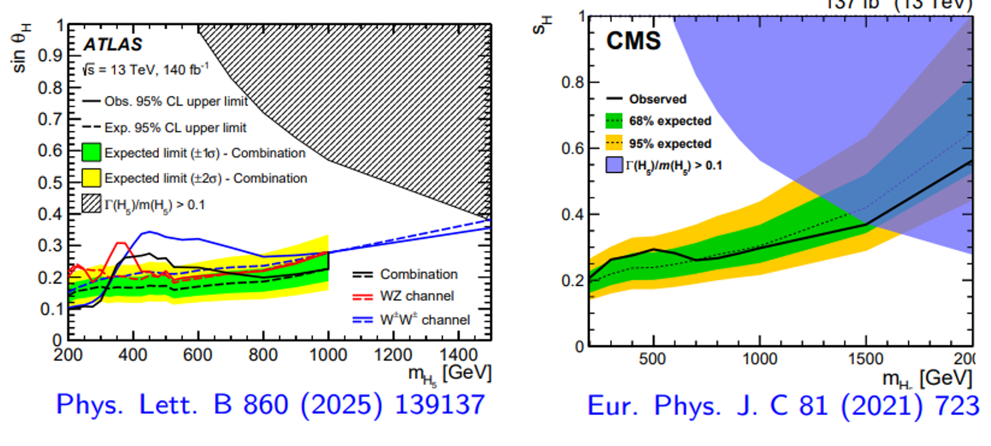
Evidence for charged states
Unitarity for WW and ZZ scattering requires that the s channel resonances be balanced by charged states
ATLAS provides a significant indication
Mass resolution for W+W+ will mix the T++376 and T++690
These states are mass degenerate with the neutral state T376 suggesting that they share an I=2 multiplet
Note that they were selected VBF with assuming J=0 while they could also be J=2 in which case angular distribution could be anisotropic as for T690

Slide 24
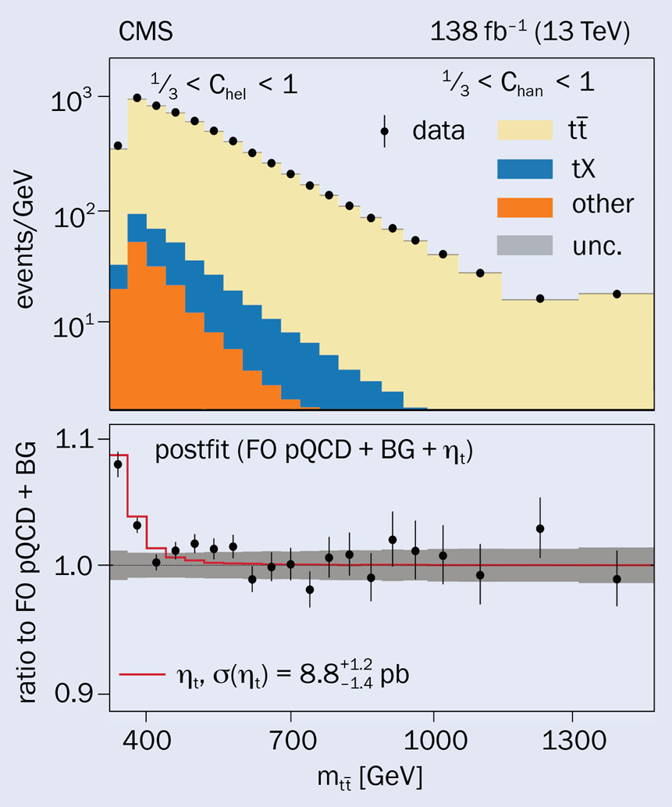
Toponium
> 5 s.d. in CMS and ATLAS
Mass and width poorly measured
Cross section in slight excess with toponium CP-odd ηt343
CP-odd also compatible with pseudo-scalar A
Graviton hypothesis not tested
ATLAS EPS:
Both in excess SM, could hide T376->tt

Slide 25
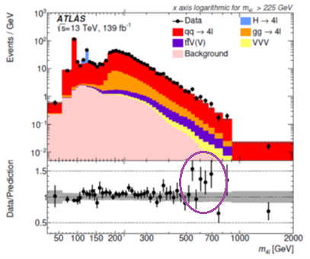
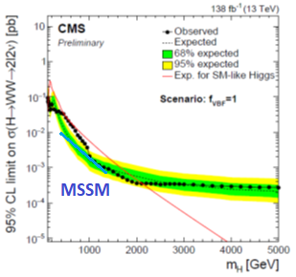
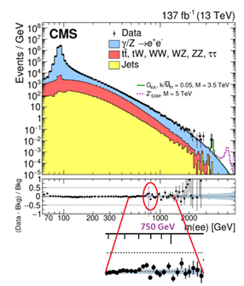
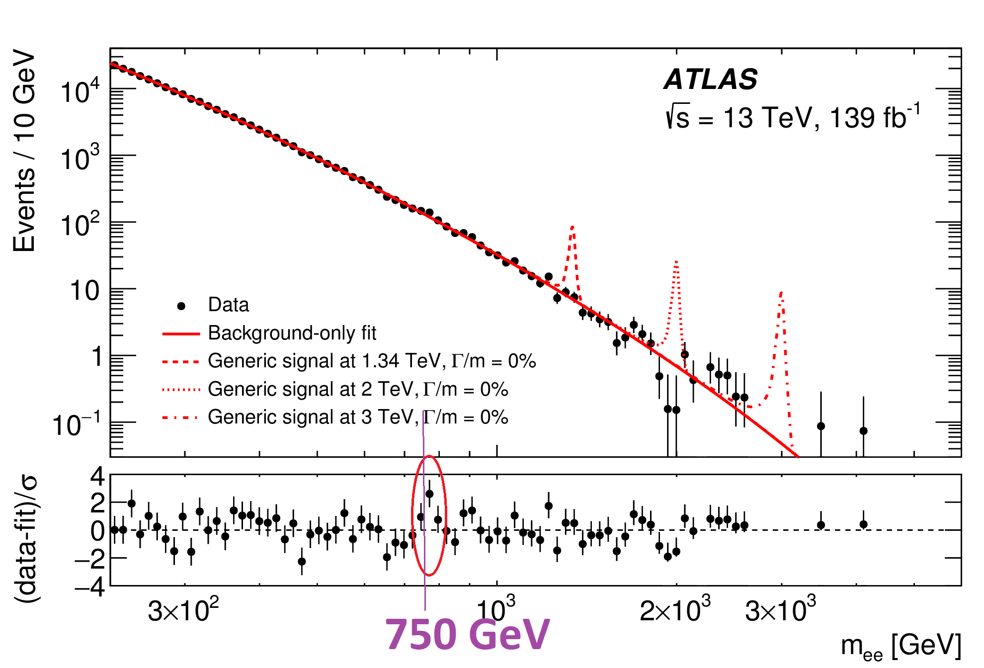
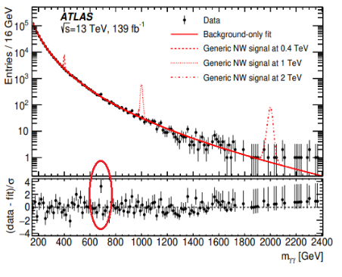
2009.14791

Slide 26
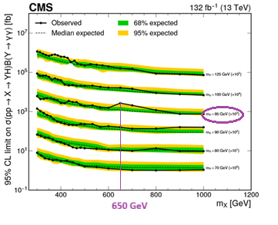
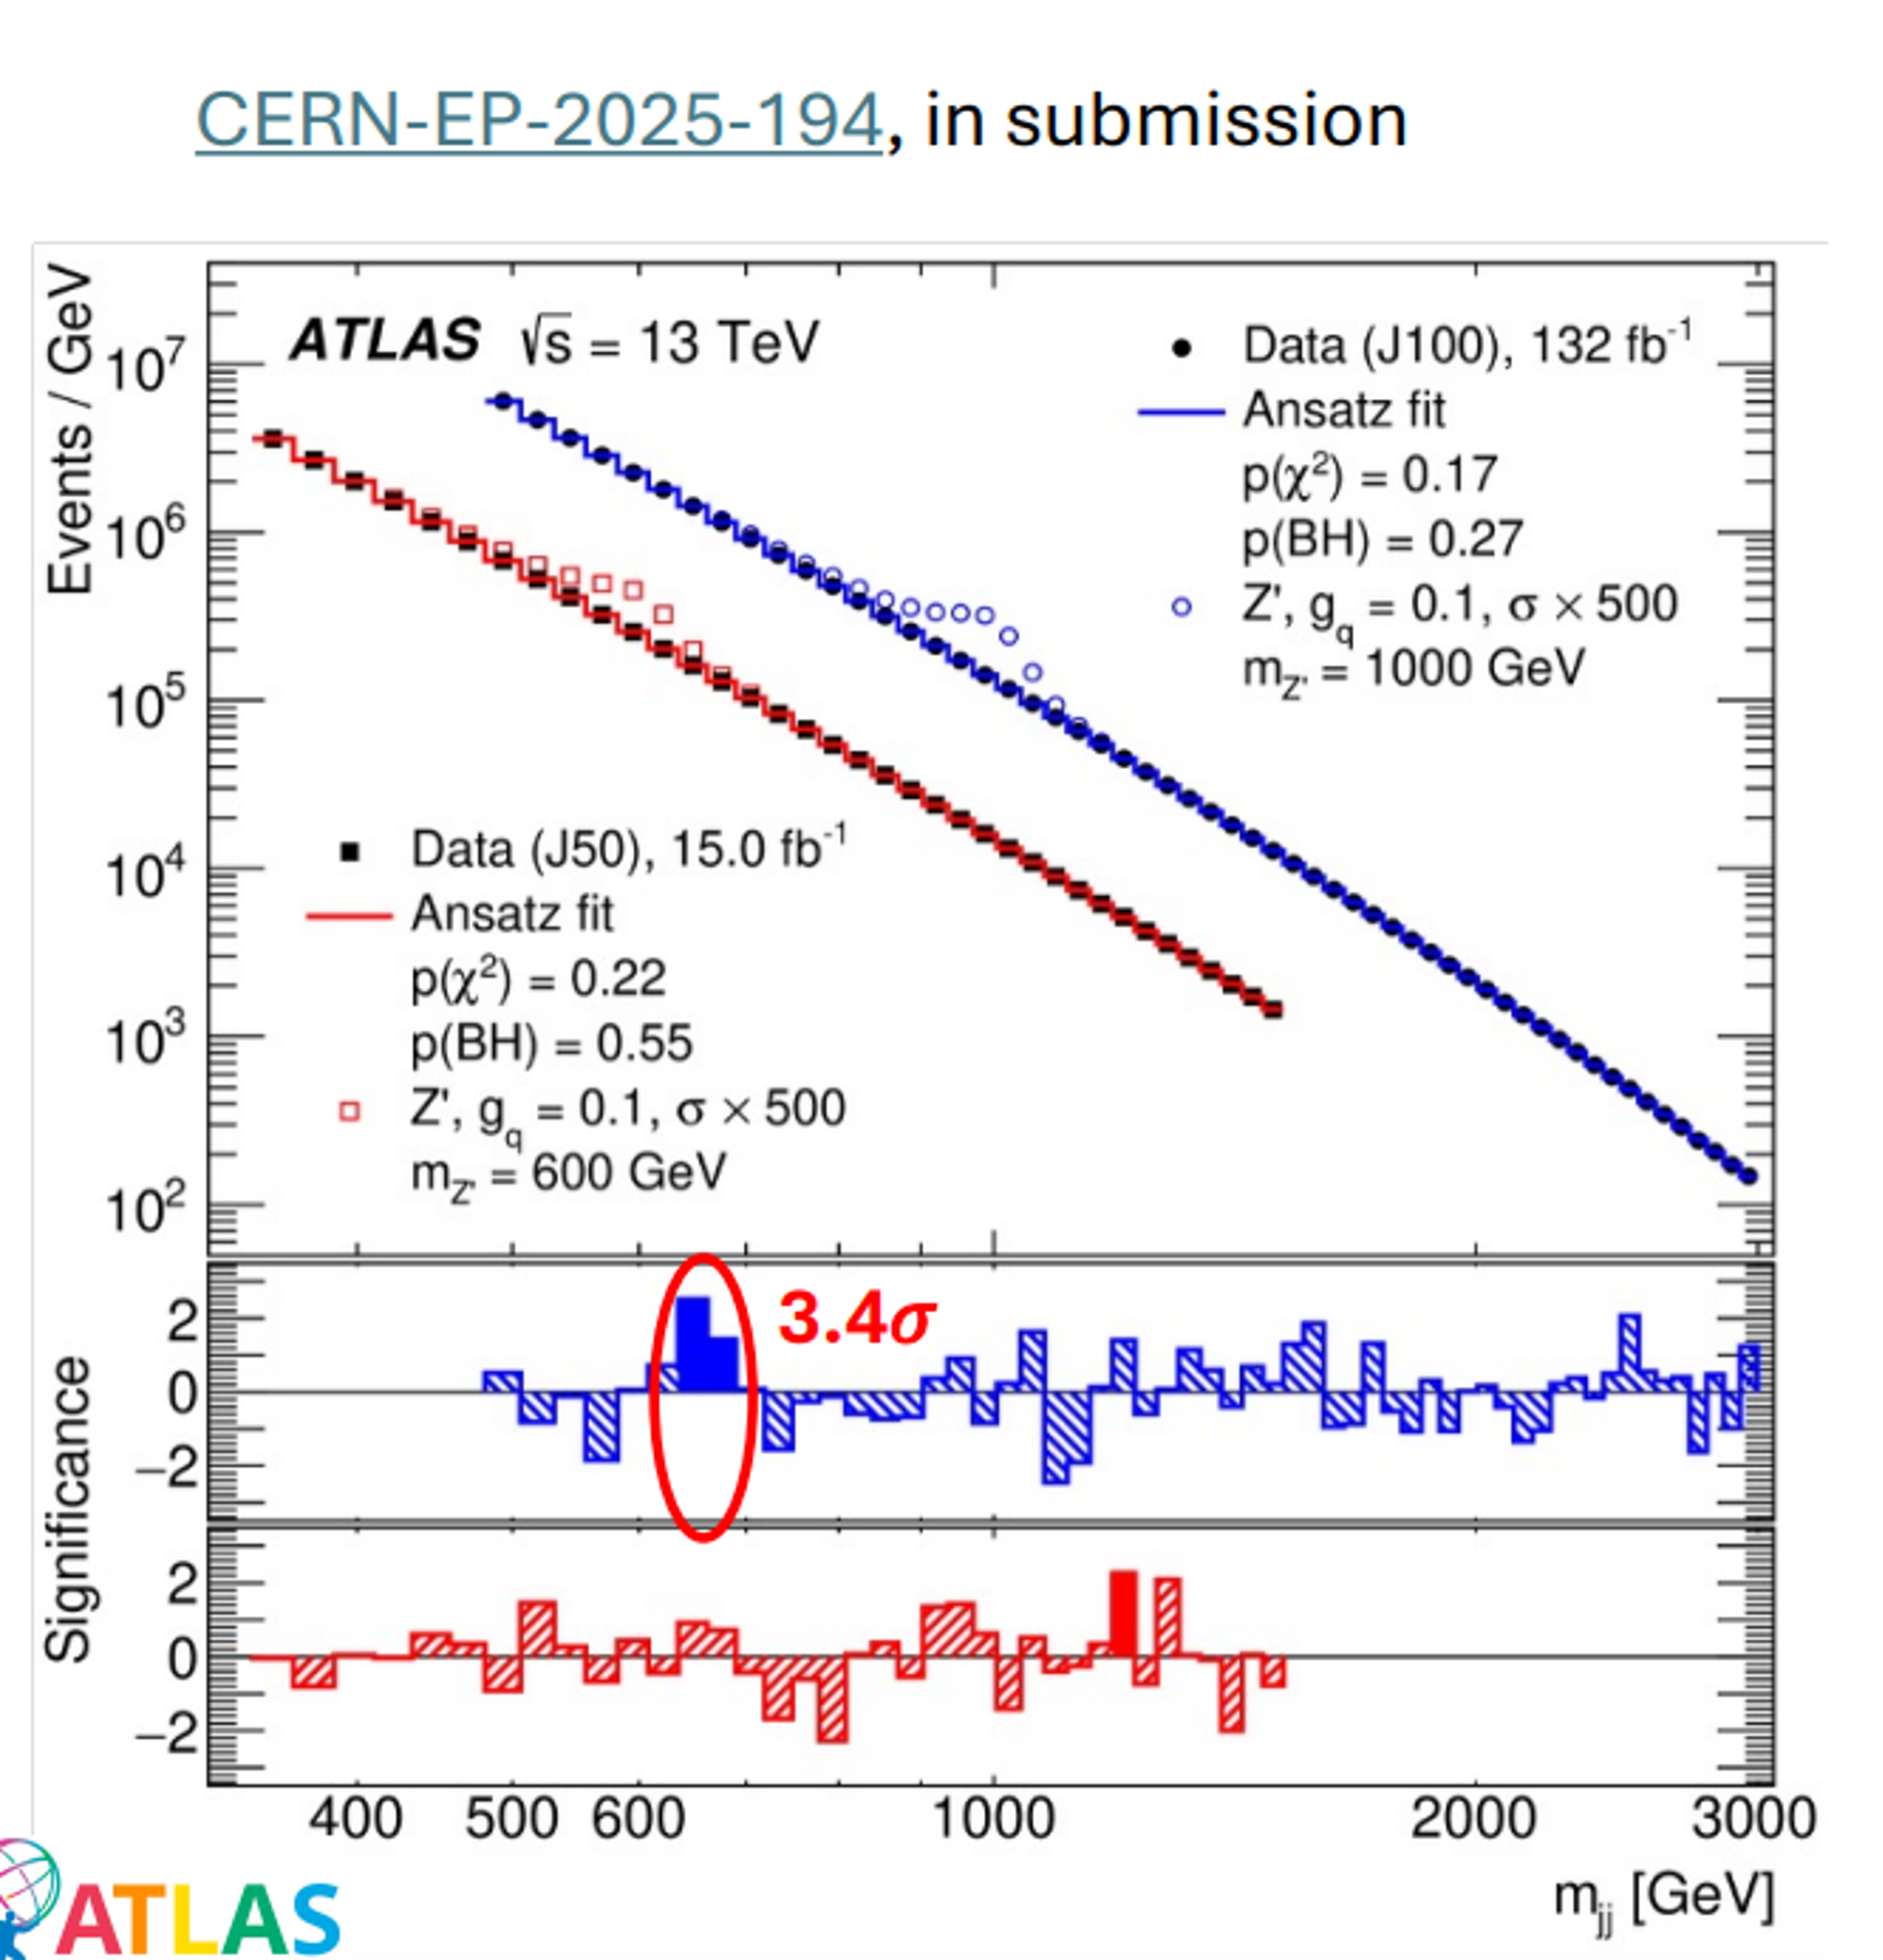
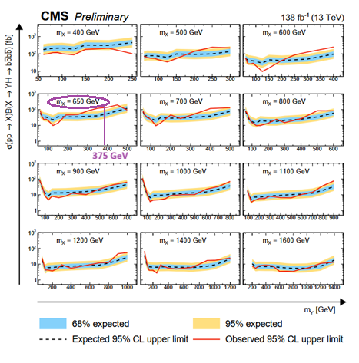
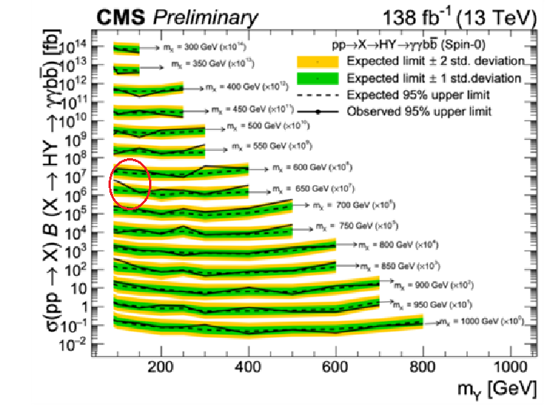
Hadronic modes
2505.23012
CMS-PAS-HIG-20-012
2310.01643
X650->2 Jets
X650->Y375+h125->bb+bb
X650-> h125h95 -> γγ bb
X650-> h125h95 -> γγ ττ

Slide 27
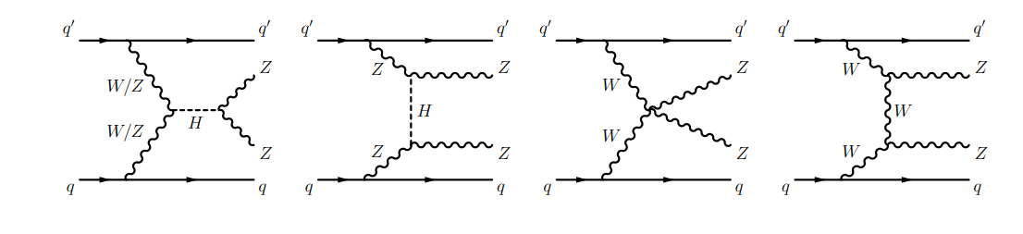
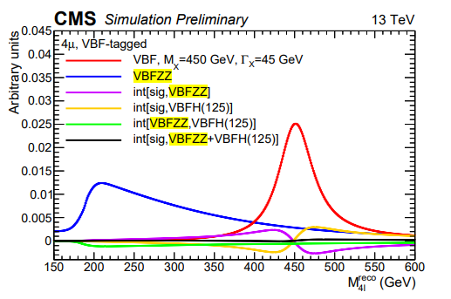
Width ?
The apparent width is ~100 GeV but one should not forget interference effects
2501.03708 claims a width 10-20 GeV
VBF interferes with:
Tends to compensate at 450 GeV but t-channel<0 dominates at 650 GeV which agrees with the fit
Preferred mass ~670-690 GeV

Slide 28

Sum Rules
Unitariy requirements predict sum rules
W+W- ->W+W- Haber et al. in P.R.D 43 (1991) 904-912
Since SM h125 saturates the SR, H(650) alone forces us to have a compensating contribution of H++->W+W+ with a coupling ~ SM=gmW
In the same way ZZ->WW forces us to expect H+->ZW+

Slide 29
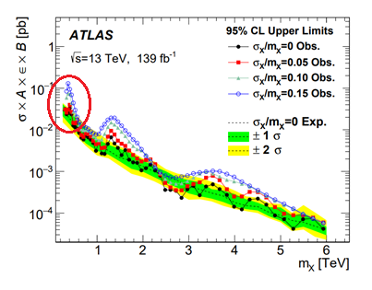
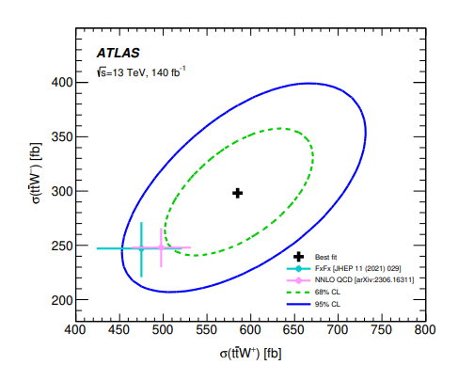
Predicting an extra H+
3HD predicts a H+ with mass > 700 GeV
By analogy with H(650)->A(420)Z->ttZ, one expects that H+->A(420)W+
An inclusive search for heavy jet-jet masses associated to a high pT lepton provides a significant candidate 2001.04770
ATLAS and CMS observe an excess in the inclusive measurement of ttW+/- 2401.05299
A(420) seems too light to pertain to the same HD

Slide 30
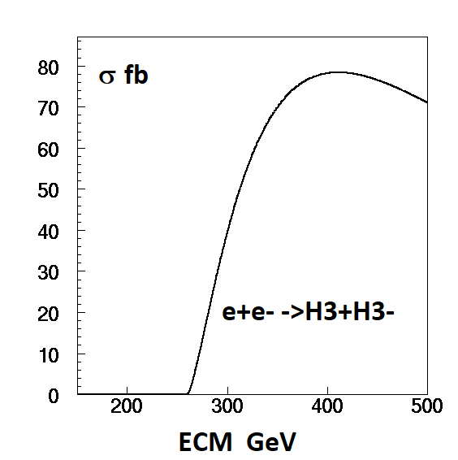
A light H1+ ?
There are few indirect hints for this
B decays into Dτ and Λτ are reduced by 1.6 and 1.4 s.d. 2305.00614 suggesting mH+~200 GeV
ATLAS has searched for t->bH+->bbc and found a 3 s.d. local (2.5 global) excess around 130 GeV 2302.11739
Not allowed within GM (b->sγ & BR(bc) inconsistent)
Allowed in a model with 3 HD 2202.03522
Predicts mH2+ > 700 GeV, BR(t→H+b)BR(H+→cb)>0.1%
Works quantitatively to explain the observed BR of H++ and H+(375) into H1+H1+ and H1+A
Good news for circular colliders

Slide 31
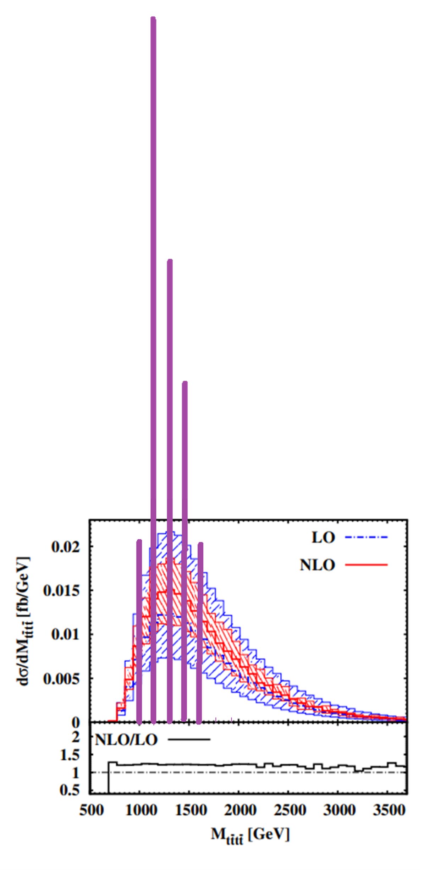
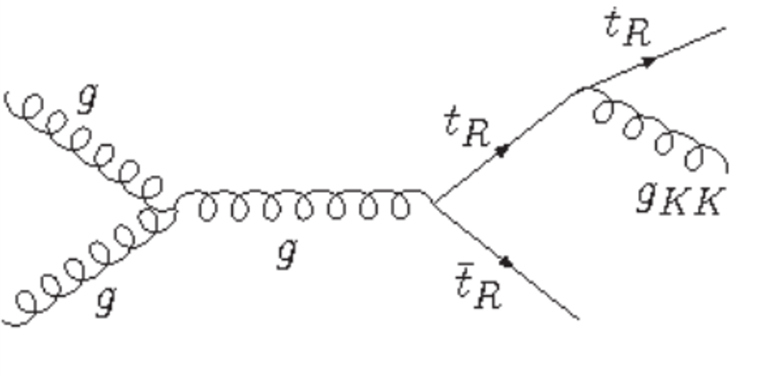
Four-tops
ATLAS 2303.15061 (2 s.d.) & CMS 2305.13439 (1s.d.) have observed a weak excess in the four top topology with respect to the SM 1206.3064
This excess is large, ~factor 2, although not yet significant
Too large to be explained by the toponium
In the initial version of RS with KK gluons mgKK>4.55 GeV 2404.04409
Can be fixed 2008.06480 by isolating top from KK bosons
Graviton KK->r+r->tttt ?
Open question
KK gluons ?
KK graviton recurrences ?

Slide 32
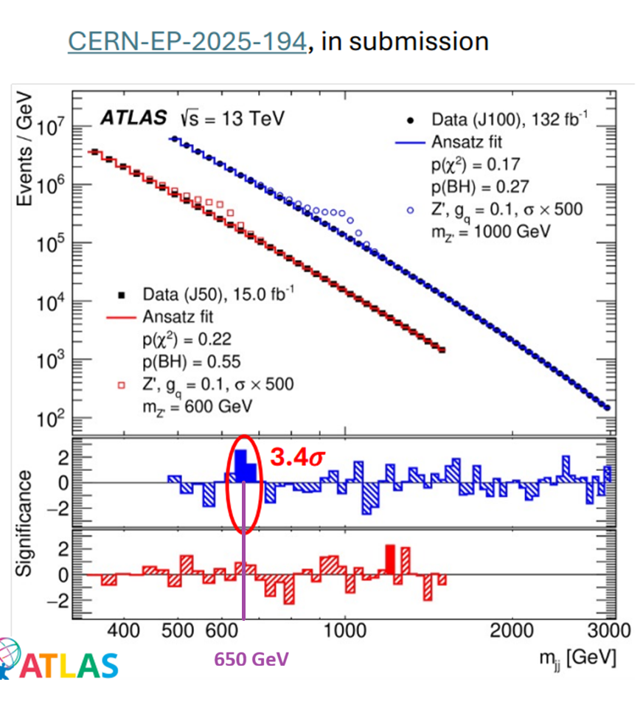
X -> 2 jets
High pT single jet triggers are inefficient for resonances < 1 TeV
A special trigger selection was performed in ATLAS for resonances decaying into two jets which allows to keep a good efficiency for masses >600 GeV
The only significant indication observed is around 650 GeV
X650->ZZ/WW/hh’/tt/gg decay in majority into hadronic modes and are compatible with a two jet topology
Our predictions can quantitatively explain this excess

Slide 33
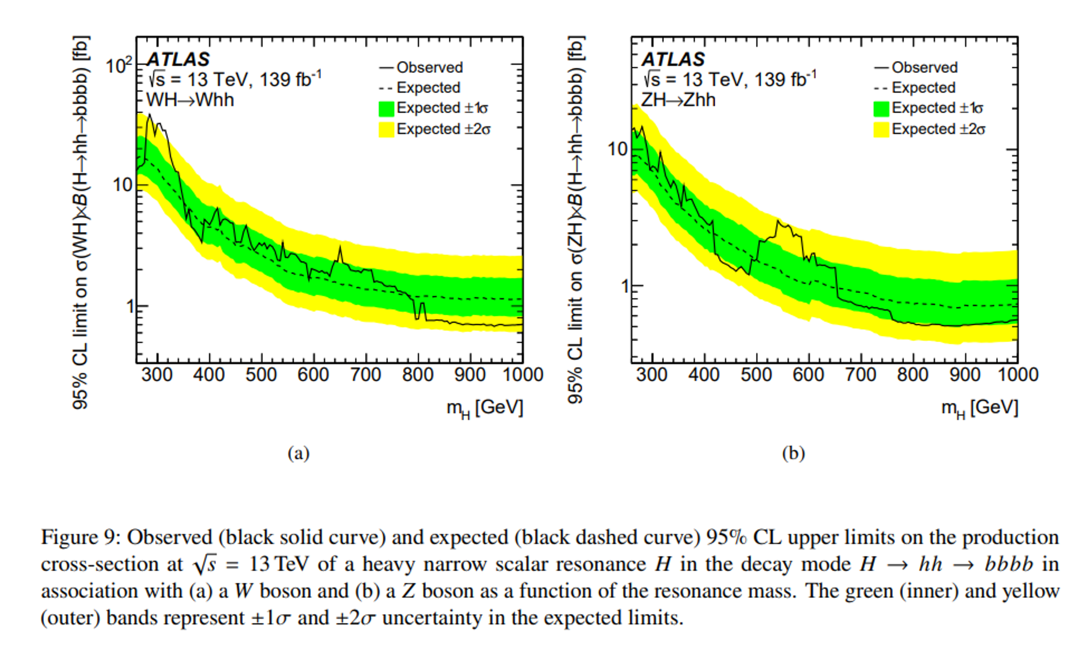
h self coupling
KK resonances are likely to decay into hh pairs and will contribute to this measurement
ATLAS 2210.05415 shows indications for some excesses of hh in Zhh and Whh for mhh=300 GeV and mhh=550 GeV with hh->bbbb
We suspect that the true hh masses are 376 GeV and 650 GeV
One predicts µhh=3.6 ±1 instead of 1 in the SM

