Slide 1

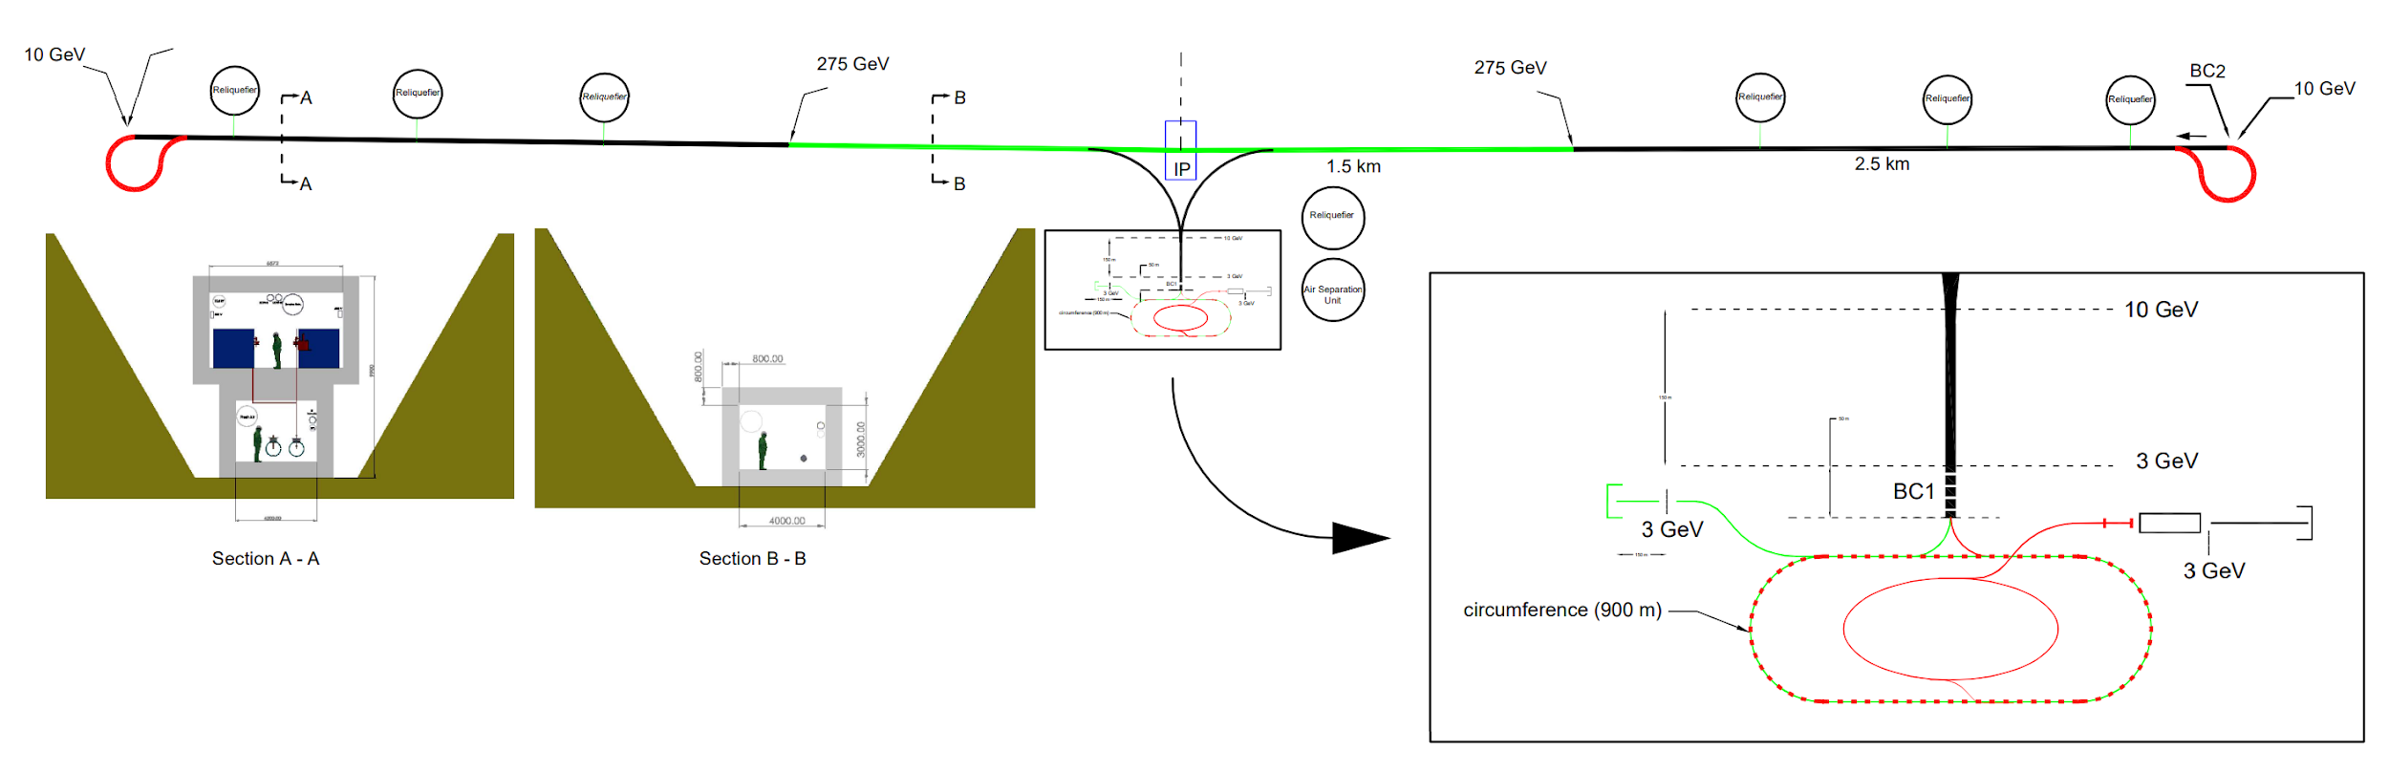
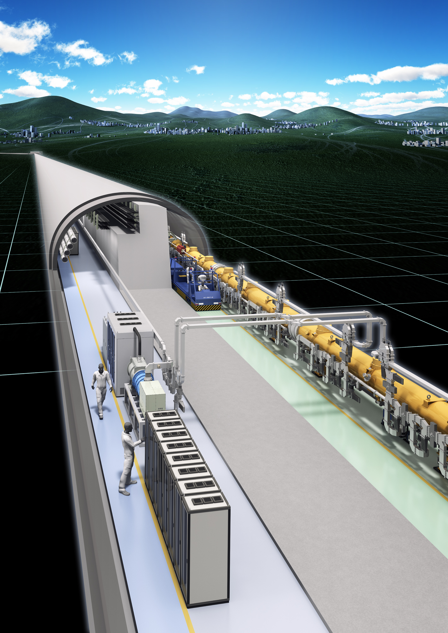


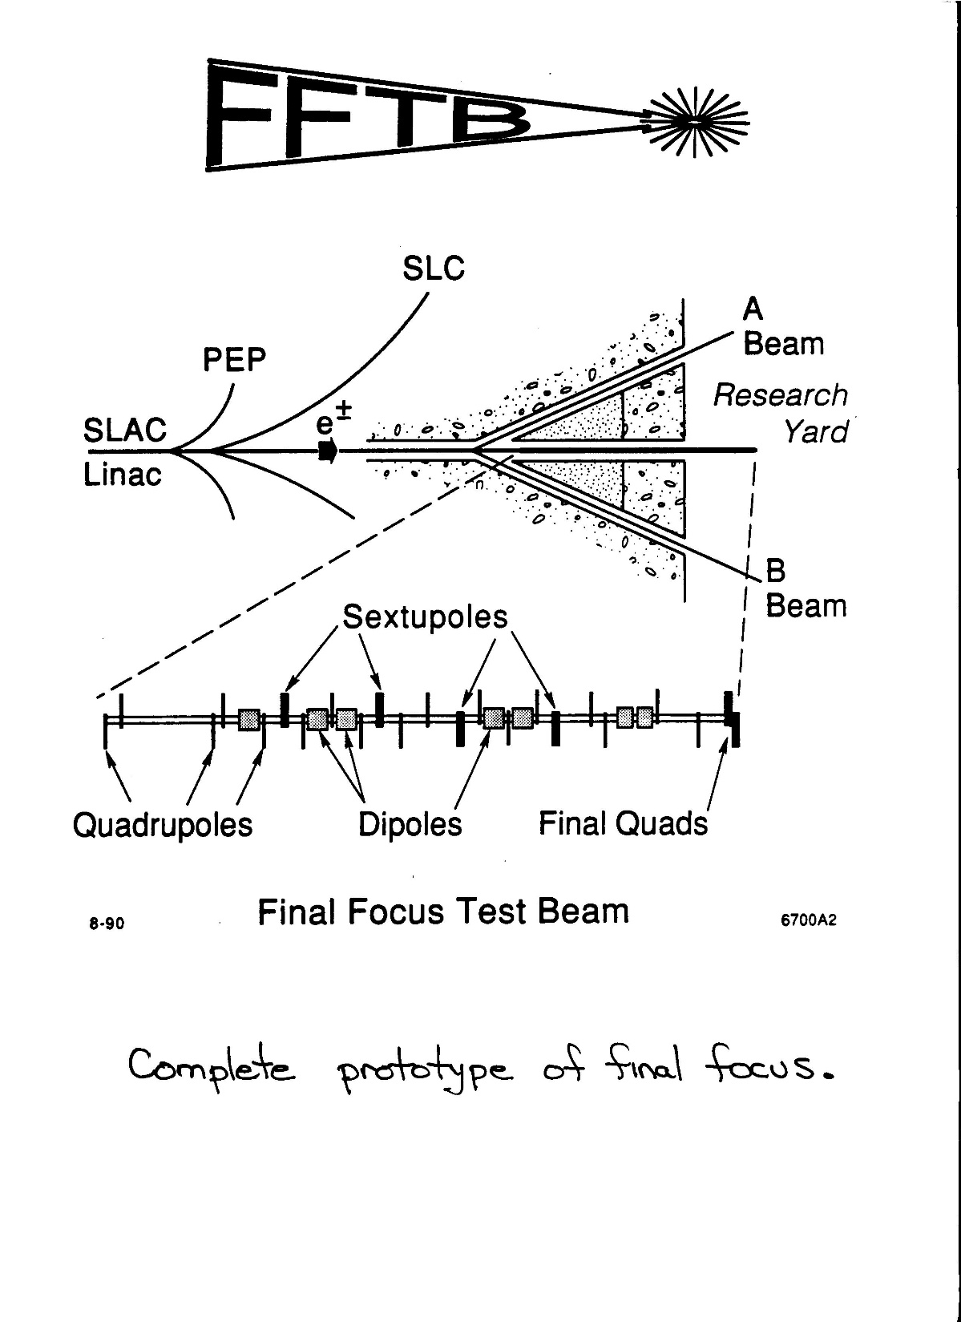
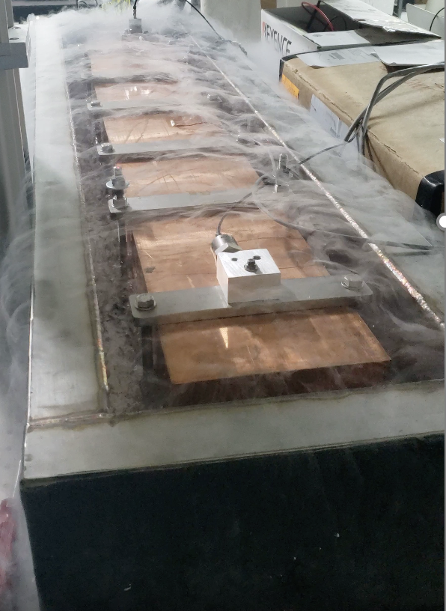
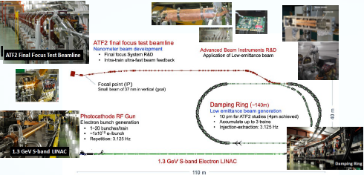
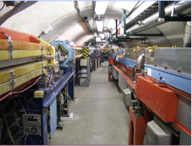
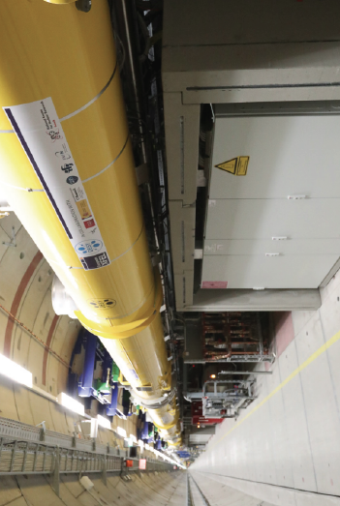
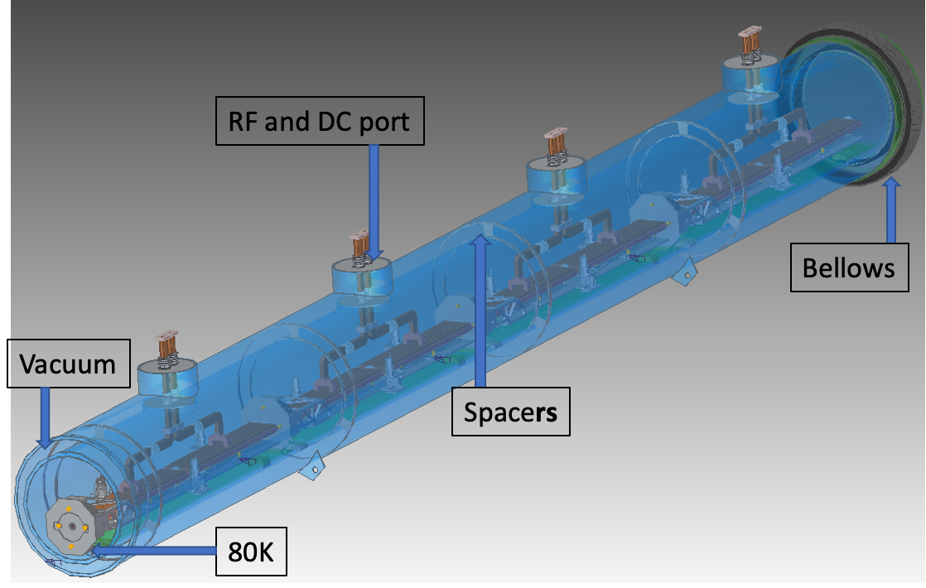
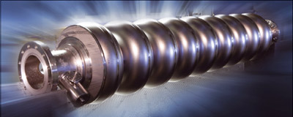
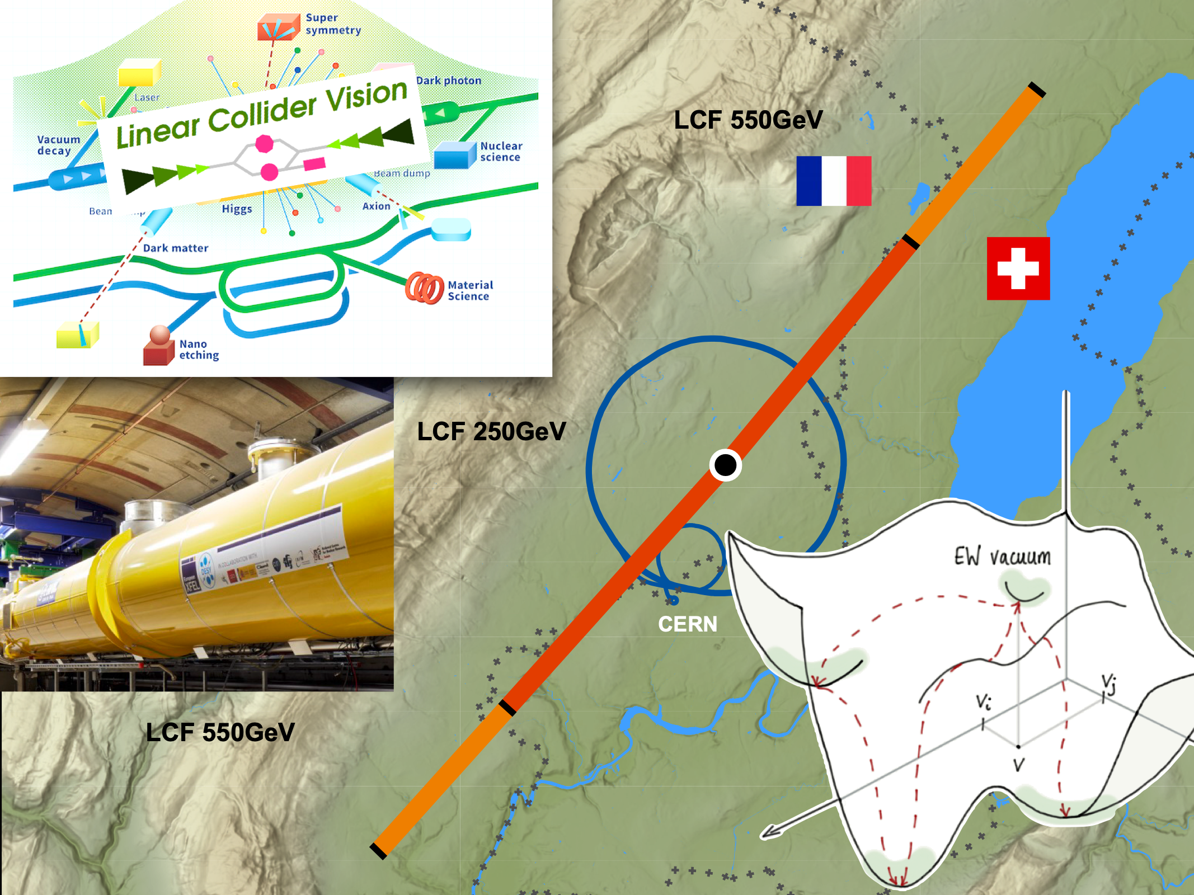
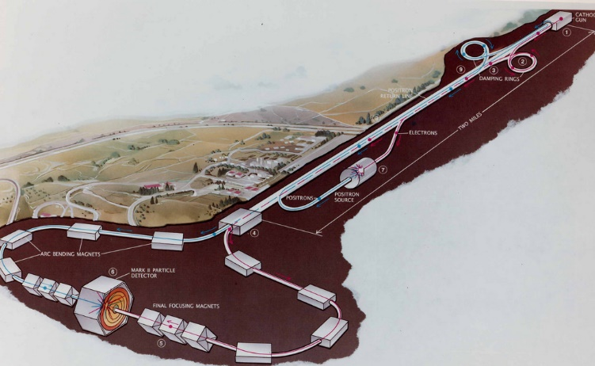

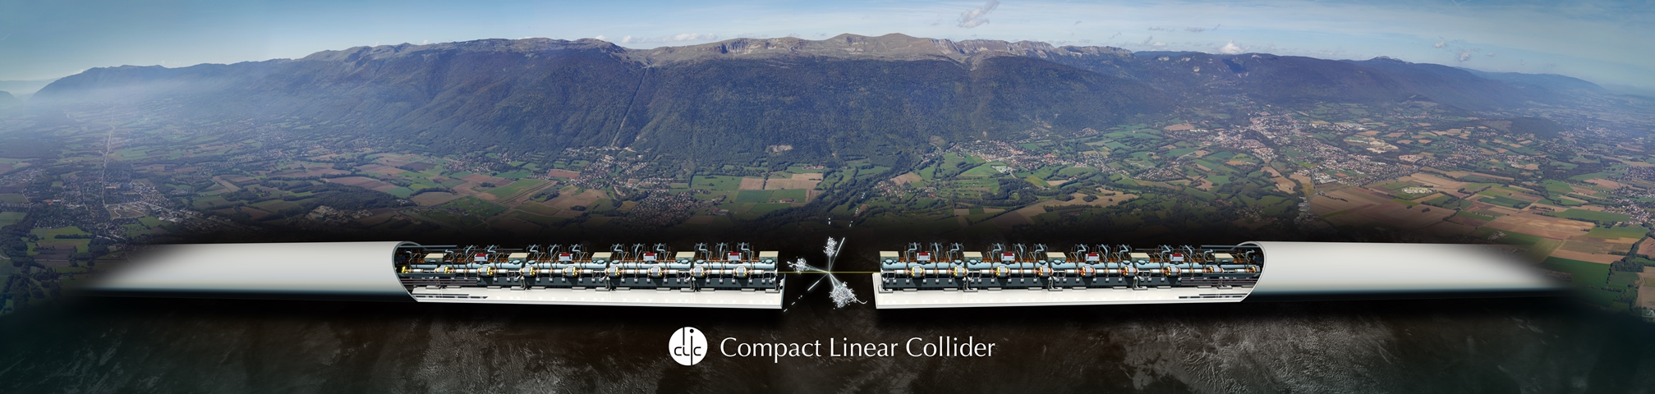

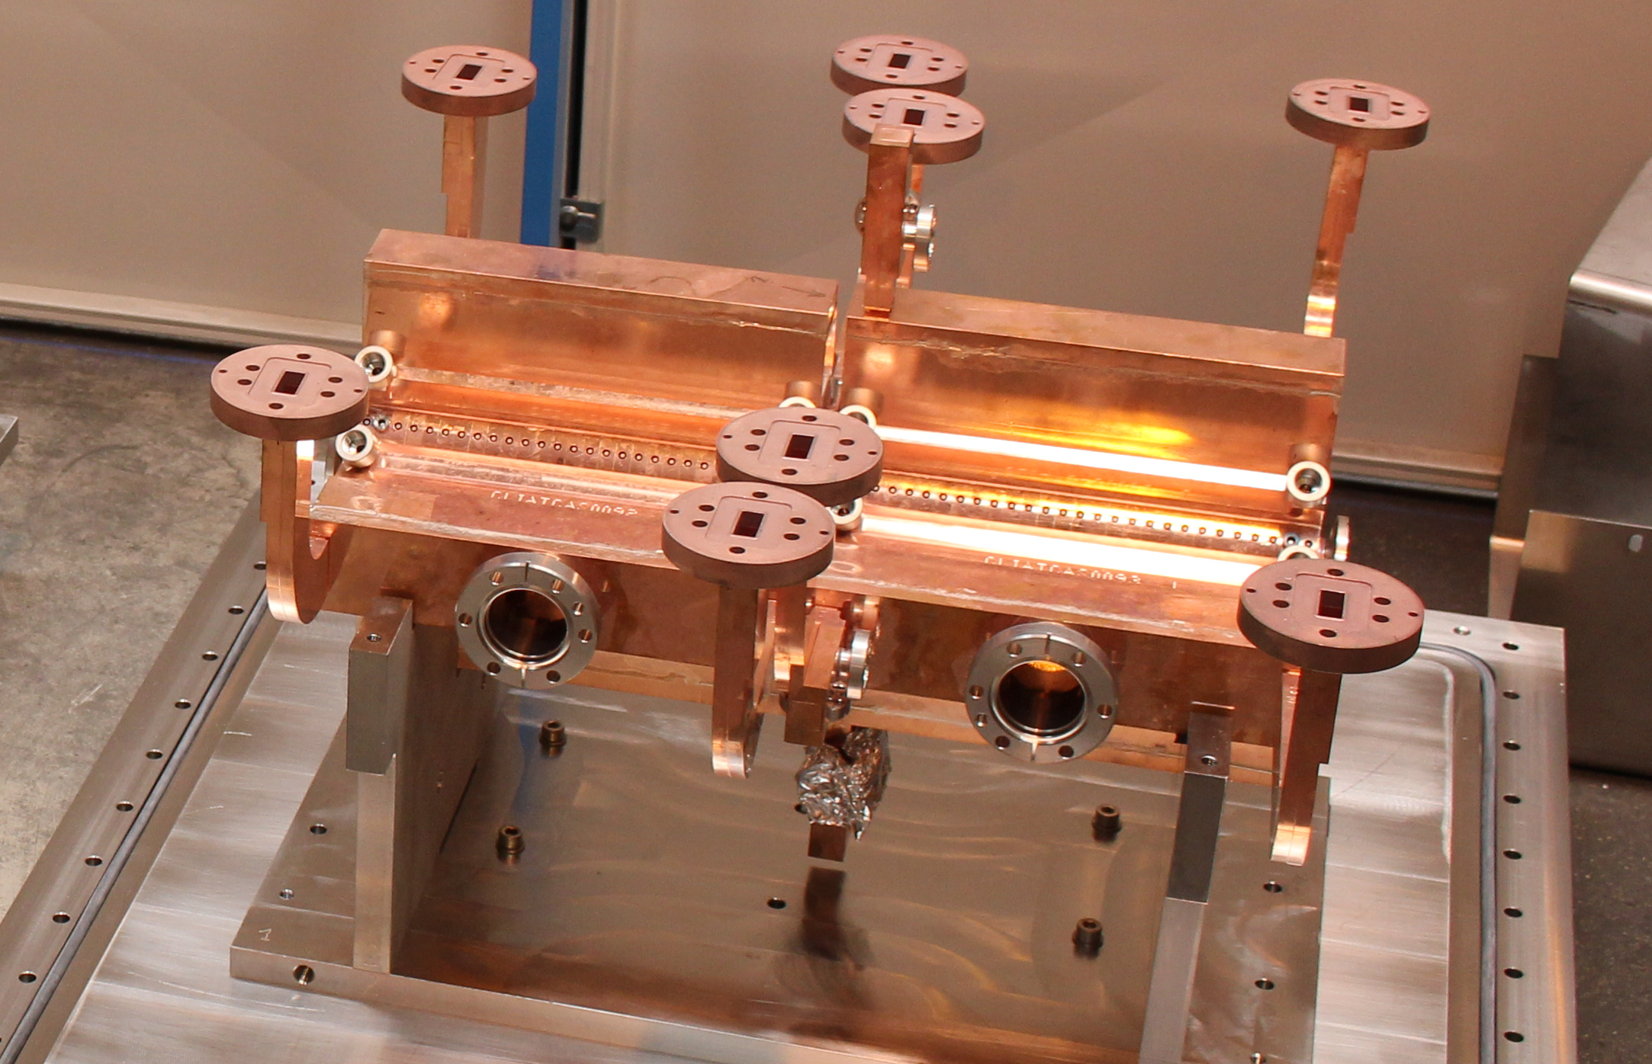


BDS and FFS in LCs
Angeles Faus-Golfe

Slide 2
Outline
FFS: the quest for nanobeam sizes in LCs
Generated a lot of discussions during the ESPPU.....
Current LC FFS designs and experiments:
- FFS in ILC, CLIC and LCF
- Accelerator Test Facility (ATF2)
MT BDS R&D and Perspectives
Notes:
I will first introduce the BDS for LCs in an historic perspective, to try to understand better what are the challenges of such a system and the issues.
In a second part I will describe the current FFS design for ILC, CLIC and LCF and the experimental program carried out in the FFS testbench facility ATF2.
I will finish with some of the possible topics for an R&D program in the Medium Term (2026-2028).

Slide 3
Where we are?
Notes:
Before we start is important to know where are we in the nanometer scale. Since the ISR where we were in the milimeter, HL-LHC in the micrometer to the tens of nanometers for SuperKEKB, FFTB and ATF2, to the nanometer in ILC and CLIC

Slide 4
Past and recent achievements in LCs
*1998
**1997
*** 2016
 | Units | SLC |  | FFTB |  | ATF2 |  | ILC | CLIC
 |  | design | achieved* | design | achieved** | design | standard***
E_{cm} | [GeV] | 50 | 50 | 50 | 46 | 1.3 | 1.3 | 250 | 380
L | [10³⁴ cm⁻² s⁻¹] | 0.0006 | 0.00014 |  |  |  |  | 1.35 | 1.5
f_{rep} | [Hz] | 180 | 120 |  |  | 3.12 | 3.12 | 5 | 50
n_{b} | 1 |  |  |  |  | 1 - 20 | 1 | 1312 | 352
N_{e} | [10¹⁰] | 7.2 | 3.7 | 1.2 | 0.6 | 1.0 | 0.1 | 2.0 | 0.52
𝜎_{b} | [μm] | 1000 | 1000 | 500 | 500 | 7000 | 7000 | 300 | 70
𝛾ϵ_{x} | [nm] | 42000 | 54000 | 32000 | 30000 | 5000 | 5000 | 5000 | 950
𝛾ϵ_{y} | [nm] | 42000 | 10000 | 3000 | 1000 | 30 | 30 | 35 | 30
𝜎_{x}* | [nm] | 1650 | 1840 | 1000 | 1700 | 9000 |  | 516 | 149
𝜎_{y}* | [nm] | 1650 | 980 | 60 | 70 | 37 | 41 | 7.7 | 2.9
β_{x}* | [mm] | 5 | 2.8 | 0.1 | 10 | 4 | 40 | 13 | 8
β_{y}* | [mm] | 5 | 1.5 | 3.0 | 0.1 | 0.1 | 0.1 | 0.41 | 0.1
Notes:
The first and unique collider has been the Stanford Linear Collider (SLC) where um has been obtained, we had after the Final Focus Test Beam Experiment where 70 nm in the vertical beam size has been obtained. Currently we are able to get of the order of 40 nm in the Accelerator test Facility at KEK. In the right part of the table we have the expected parameters for ILC and CLIC. Red is designed / Green is achieved experimentally.

Slide 5
Nanobeam Systems: FFS designs
ILC optics
FFS is among the most challenging sections of a LCs
    Chromaticity correction is the main problem
      Interleaved sextupoles (SLC)
      Non-interleaved sextupoles (FFTB)
      Local chromaticity correction (ATF2)
Very-large β and the presence of nonlinear elements make it extremely sensitive to any kind of imperfections.
Beam Delivery System
Notes:
These numbers are generating a lot of discussion during the ESSPU update, this is why I will take 5 minutes to explain what is behind these numbers.
The FFS is one of the most challenging systems of LC, we have the largest and the smallest beta twiss functions of the machine. To illustrate I take the example of different sections of ILC for comparison, in the case of the BDS the scales are in square of the betas...Because of the large beta close to the IP and to avoid the impact of chromatic aberrations we have to correct first the chromaticity by means of non-linear lenses known as sextupoles. Different schemes of correction have been proposed along these years, these schemes have been driven the design of the FFS.
If there would be no energy spread in the beam, a telescope could serve as your final focus (or two telescopes chained together). As sun light contains different colors, electron beam has energy spread and get dispersed and distorted=> chromatic aberrations
• For light, one uses lenses made from different materials to compensate chromatic aberrations
• Chromatic compensation for particle beams is done with nonlinear magnets. Problem: Nonlinear elements create geometric aberrations
• The task of Final Focus system (FF) is to focus the beam to required size and compensate aberrations

Slide 6
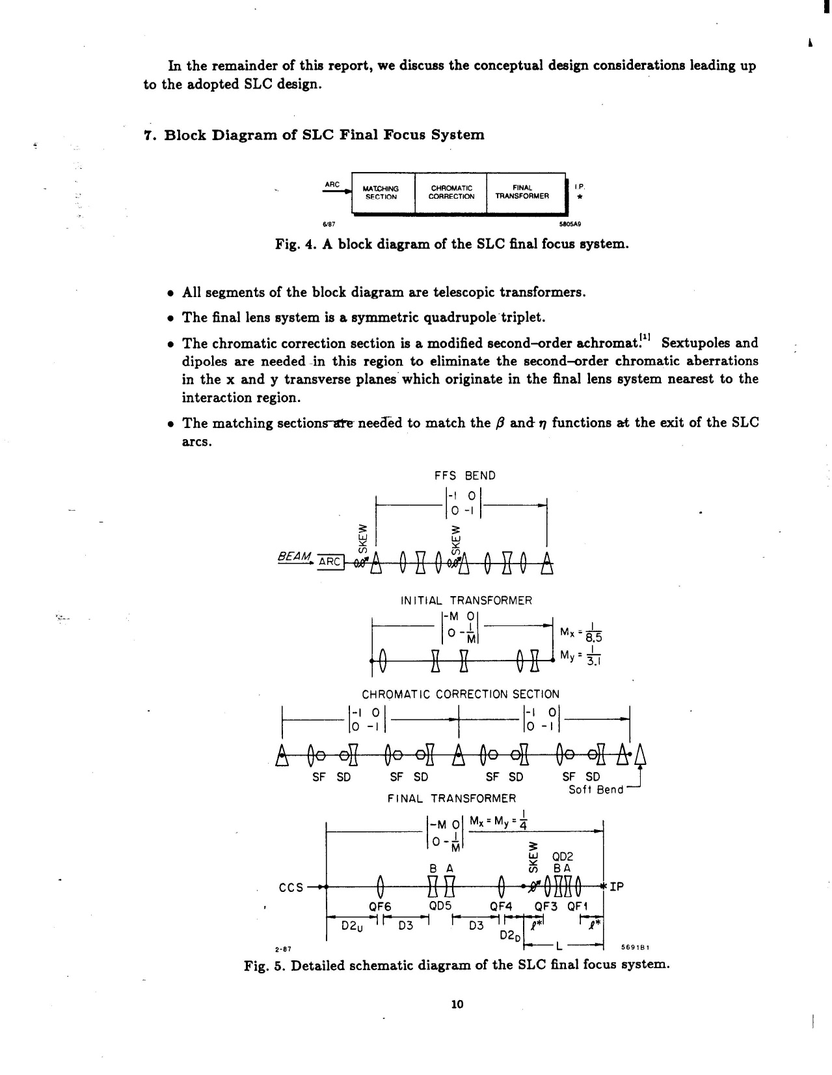
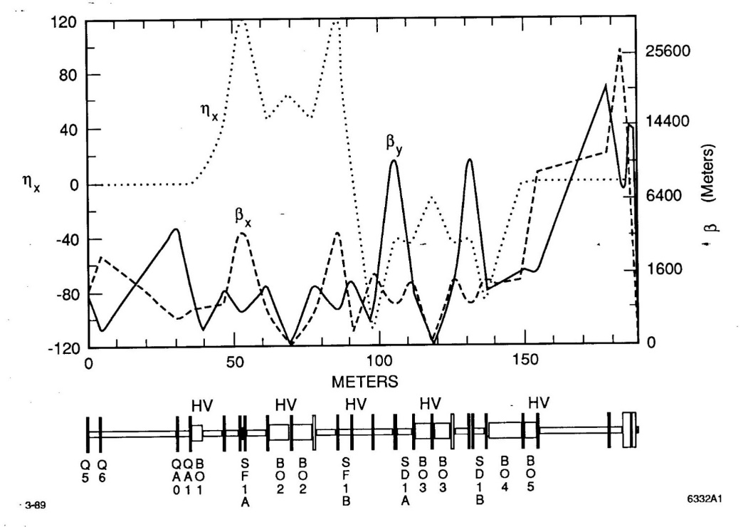
Nanobeam Systems: FFS designs
SLC type (interleaved sextupoles)
FFTB type (modular, non-interleaved sextupoles)
SLC final focus, J. Murray, K. Brown T. Fieguth, PAC1987
Non-interleaved modular final focus for the FFTB, K. Oide, IEEE PAC 1989
Notes:
The scheme proposed in the SLC was the classical one where we have a dedicated section of the BDS known as chromatic section before the FFS with interleaved sextupoles, as a consequence the system was rather long. The second one used in the FFTB was modular and use non-interleaved sextupoles.
In the two cases the FFS is a dispersion free region.

Slide 7
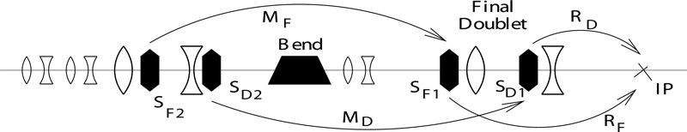
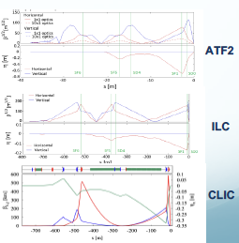
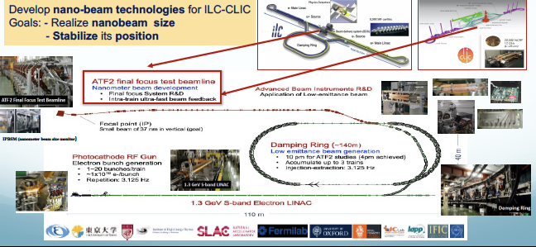
Nanobeam Systems: FFS designs
ILC/CLIC/ATF2 type (compact Local Chromaticity Correction)
Compact final focus (ATF-2/ILC/CLIC), P. Raimondi, A. Seryi, Phys. Rev. Lett. 86, 3779 (2001)
Notes:
In the case of ILC and CLIC a new concept developed in 2001 by Raimondi and Seryi with embedded sextupoles (chromatic and non chromatics) in the FFS and with dispersion in the FD region was used. The system was more compact but the correction of the chromaticity and the optical aberration is more complex.
In order to verify this kind of system, ATF2 has been constructed. In the right part we could observed the FFS optics design for ATF2 , ILC and CLIC, with the dispersion in green in the pictures. We could observe the similarities between them.

Slide 8
Nanobeam Systems: FFS designs
Compact ILC/CLIC/ATF2 Local Chromatic Correction
FFS Comparisons
In all cases, very-large β and the presence of nonlinear elements make it extremely sensitive to imperfections as: wakefields, misalignments, beam jitter and multipolar errors
    Similar chromaticities (L*/β∗_{x,y}) : 25/10000 (ATF2), 315/10000 (ILC), 750/60000 (CLIC) and similar tolerances for FD multipole field errors (ATF2 and ILC)
In ILC / CLIC, the much shorter bunch length (23 / 100 x large) and the much larger beam energy (100 / 150 x smaller) make the situation “simpler”
        ATF2 have a “virtual IP”: Measurement of the nanobeam sizes involves a complex device: Shintake monitor (IPBSM). No beam-beam
 | Units | ATF2 | ILC | CLIC
E_{cm} | [GeV] | 1.3 | 250 | 380
L | [10³⁴ cm⁻² s⁻¹] |  | 1.35 | 1.5
f_{rep} | [Hz] | 3.12 | 5 | 50
n_{bunches} | 1 | 1 - 20 | 1312 | 352
N_{e} | [10¹⁰] | 1.0 | 2.0 | 0.52
𝜎_{b} | [μm] | 7000 | 300 | 70
Δt_{b} | [ns] | 154 | 554 | 0.5
𝛾ϵ_{x} / 𝛾ϵ_{y} | [nm] | 5000 / 30 | 5000 / 35 | 950 / 30
𝜎_{x}* / 𝜎_{y}* | [nm] | 9000 / 37 | 516 / 7.7 | 149 / 2.9
IP_{Stabilization} | 𝜎_{y}* | < 0.05 | < 0.2 | < 0.08
L* | [m] | 1 | 4.1 | 6
β_{x}* / β_{y}* | [mm] | 40 / 0.1 | 13 / 0.41 | 8 / 0.1
    PRAB 17, 023501 (2014)
NIM. A 740, 131 (2014)
Notes:
The table is summarizing the main characteristics of these FFS and we could make some preliminary comparisons based on a closer examination of the table, which would improve our comprehension of the ATF2 results I will show after.

Slide 9

Current LC FFS designs
ATF2 tackles its critical task with two major disadvantages w.r.t. ILC and CLIC.
In summary...the perfect storm in a glass of water...
Compact ILC/CLIC/ATF2 Local Chromatic Correction
FFS Comparisons
Very-large β and the presence of nonlinear elements make it extremely sensitive to imperfections as: wakefields, misalignments or beam jitter and multipolar errors
    Similar Chromaticities (L*/β∗_{x,y}): 25/10000 (ATF2) , 315/10000 (ILC), 750/60000 (CLIC) and similar tolerances for FD multipole field errors (ATF2 and ILC)
In ILC and CLIC, the much shorter bunch length (23 / 100 x large) and the much larger beam energy (100 / 150 x smaller) make the situation “simpler”
        Virtual IP: Measurement of the nanobeam sizes involves a complex device: Shintake monitor (IPBSM). No beam-beam
 | Units | ATF2 | ILC | CLIC
E_{cm} | [GeV] | 1.3 | 250 | 380
L | [10³⁴ cm⁻² s⁻¹] |  | 1.35 | 1.5
f_{rep} | [Hz] | 3.12 | 5 | 50
n_{bunches} | 1 | 1 - 20 | 1312 | 352
N_{e} | [10¹⁰] | 1.0 | 2.0 | 0.52
𝜎_{b} | [μm] | 7000 | 300 | 70
Δt_{b} | [ns] | 154 | 554 | 0.5
𝛾ϵ_{x} / 𝛾ϵ_{y} | [nm] | 5000 / 30 | 5000 / 35 | 950 / 30
𝜎_{x}* / 𝜎_{y}* | [nm] | 9000 / 37 | 516 / 7.7 | 149 / 2.9
IP_{Stabilization} | 𝜎_{y}* | < 0.05 | < 0.2 | < 0.08
L* | [m] | 1 | 4.1 | 6
β_{x}* / β_{y}* | [mm] | 40 / 0.1 | 13 / 0.41 | 8 / 0.1
LCC principle demonstrated in ATF2
Notes:
First lesson....ATF2 tackles its critical task with two major disadvantages w.r.t. its bigger brothers ILC and CLIC.
In summary the perfect storm in a glass of water, but the LCC principle has been demonstrated.

Slide 10
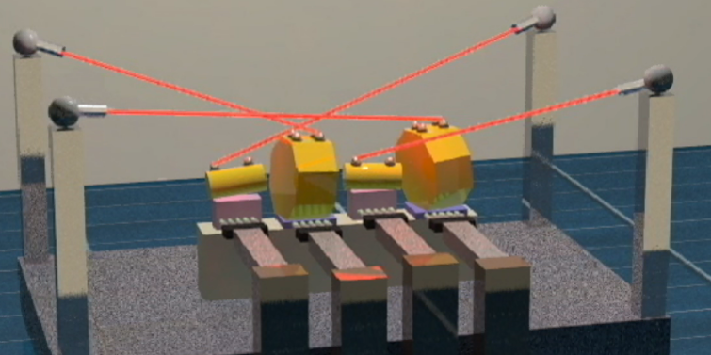
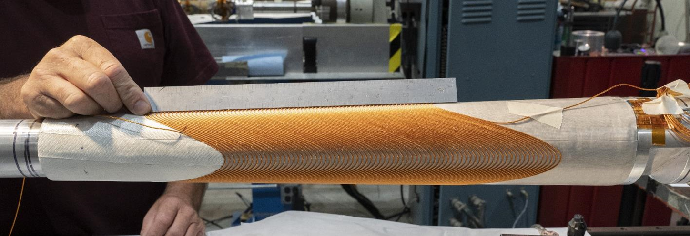
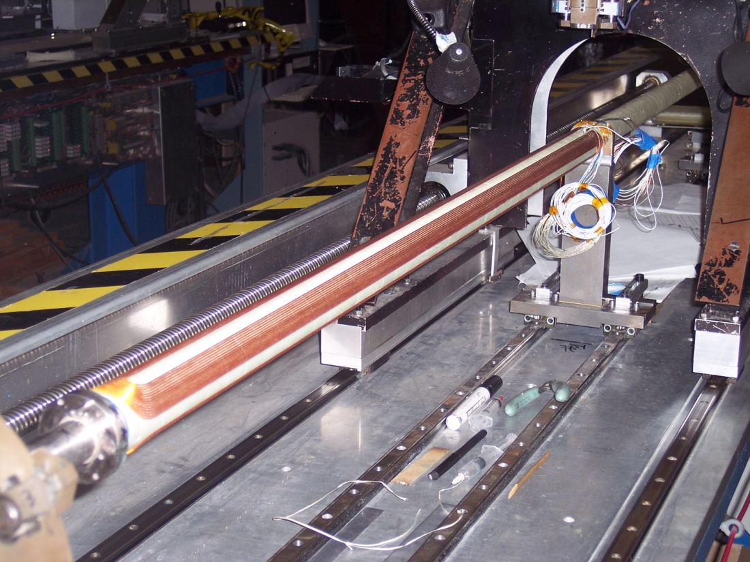
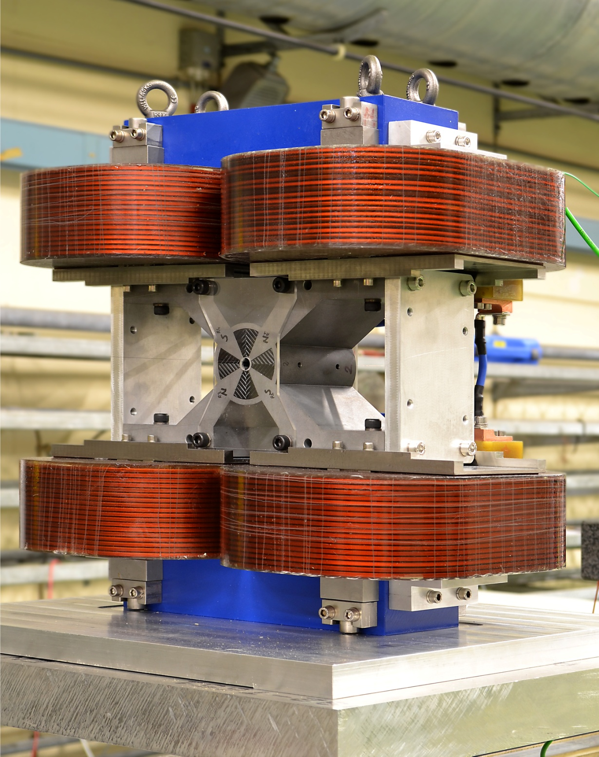
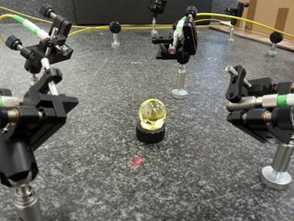
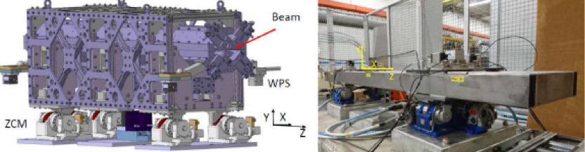

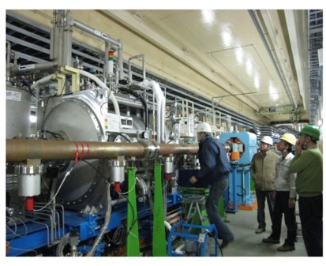
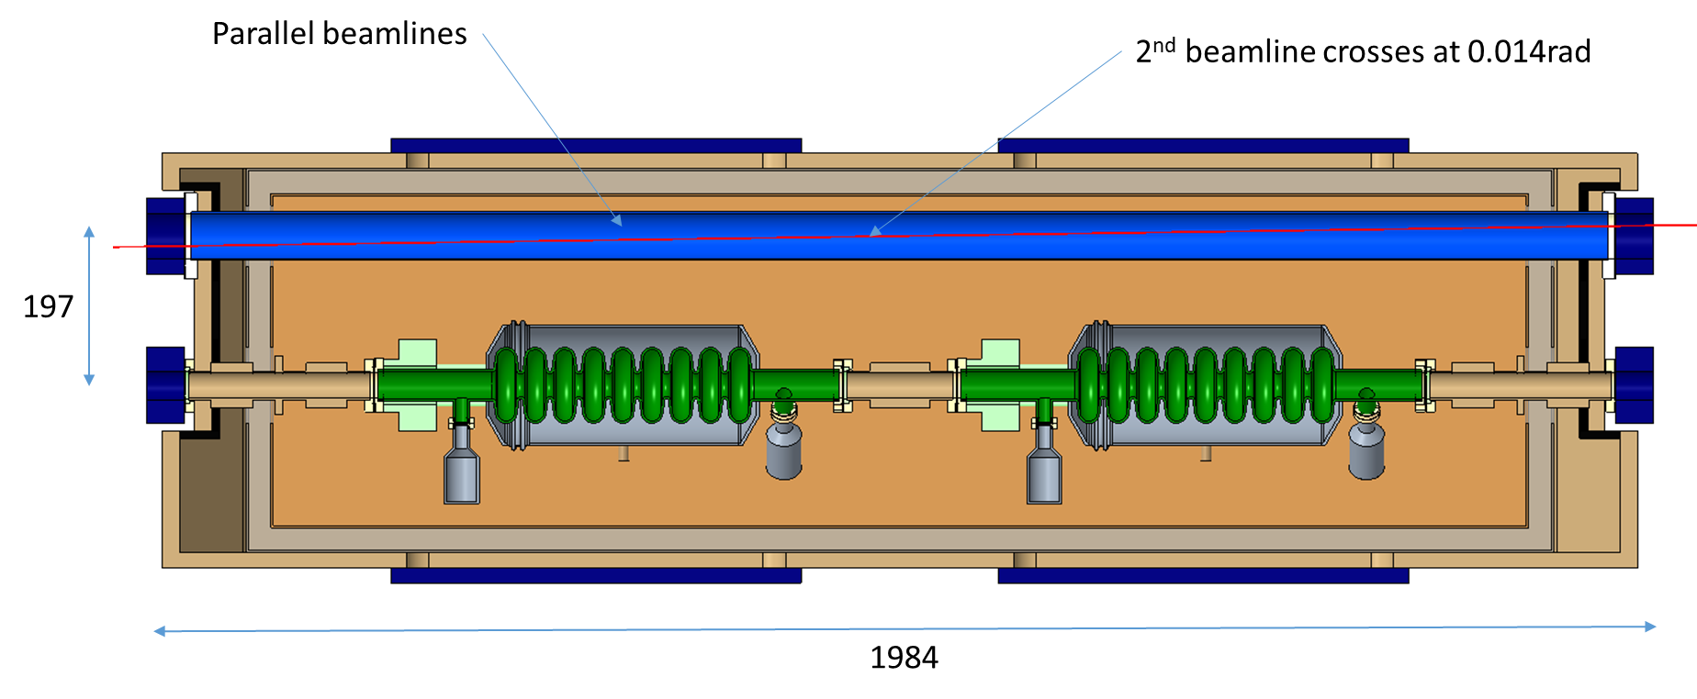
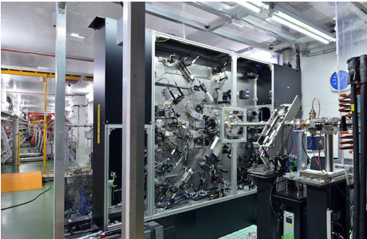
Nanobeam Technologies: devices and monitoring
Nanobeam Technologies (1-3 February 2021)
https://indico.cern.ch/event/980103/
SC and Electro PM Hybrid FF magnets
Fiduliacitaion, Alignment and Positioning
LER
Particle Accelerator Components’ Metrology and Alignment to the Nanometer scale (10 PhDs)
Crab cavities
https://pacman.web.cern.ch/pacman/
Nano BSM
Nano BPMs
Notes:
Besides, during these last years LC projects have been developing the technologies that make possible these achievements.
More information could be found in the web page of the nanobeam workshop on February 2021 for instance.

Slide 11
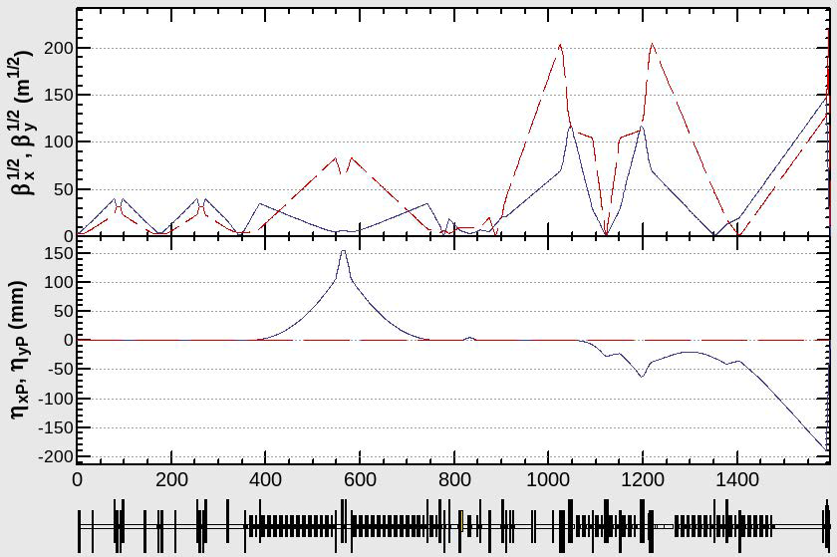
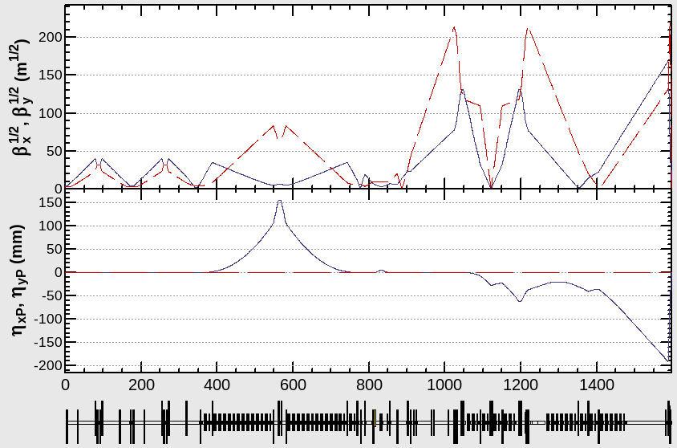
The current ILC BDS baseline design and the energy upgrades
The current baseline ILC BDS at 250 GeV (BDS-250) has been designed to be scaled until 1 TeV (BDS-1000), keeping the same geometry. The total length is around 2400 m with a crossing angle of 14 mrad.
The optics has been designed taking as starting point the BDS-250 magnet configuration. The BDS-500 optics has been matched with the same magnet configuration. The field strength of the Final Doublet (FD) quadrupoles (QD0, QF1) for the BDS-250 is half of the BDS-500.
The BDS-1000 needs some additional magnets, in dedicated locations that are free magnet areas for the lower energy operation modes.
The performance and tolerances optimization, including different bending magnets strengths compatible for all the energies, collimation depths and different possible beamline geometries between others, are ongoing.
BDS for 250 GeV with half-lenght FD (β_{x,y}* = 13 / 0.41 mm)
”Present design of ILC BDS” T. Okugi LCWS2024
https://agenda.linearcollider.org/event/10134/
BDS for 500 GeV (β_{x,y}* = 11 / 0.48 mm)
Notes:
What is the current situation for the FFS design for ILC, CLIC and LCF.
For ILC....

Slide 12
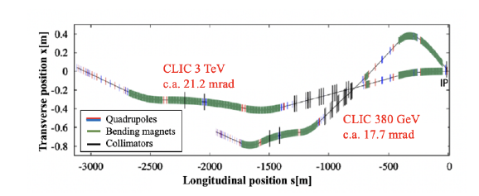
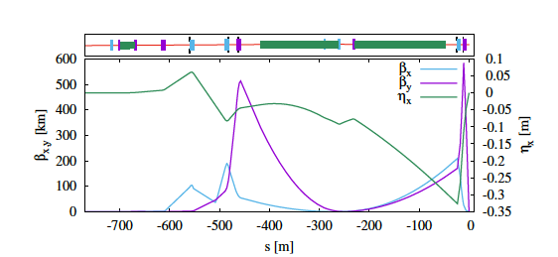
The current CLIC BDS baseline design and the energy upgrades
The CLIC BDS FFS has been extensively studied during these last years (4 Master thesis, 9 PhD Thesis and 2 in progress)
The BDS new baseline foresees an L*=6 m with Final Double (FD) (QF1 and QD0 quadrupoles), mounted outside the detector volume directly on the tunnel floor. The length of the entire 380 GeV BDS is ≈ 1950 m (with one IR) and the FFS length is 770 m.
In order to allow for the energy upgrade inside the CLIC tunnel, the end of the 380 GeV and 1.5 TeV BDS beamlines have been matched such that the axis along which the main linac is unchanged by the upgrade. Assuming that the two main linacs have a full crossing angle between them of 20mrad the IP crossing angles are: 17.7 mrad and 21.2 for 380 GeV and 1.5 TeV respectively.
The FFS dipoles, quadrupoles and sextupoles have been optimized to match the desired beam parameters at the IP while locally correcting the chromaticity generated by the FD. A pair of octupoles has been introduced in the lattice to correct the remaining 3rd order chromatic and geometric aberrations.
CLIC 1.5TeV and 380 GeV BDS layouts with L∗ = 6 m
CLIC optical functions through the FFS with L∗ = 6 m
Session “Damping rings, Beam dynamics, Beam delivery systems” LCWS2025
Notes:
For CLIC....

Slide 13
The LCF@CERN BDS baseline design and the energy upgrades
The baseline LCF@CERN BDS is a 250 GeV ILC in a 21 Km tunnel in the CERN area,with 2 IRs sharing luminosity.
After 10 years construction and 10 years data taking at at 250 GeV, the accelerator will be upgraded in stages with more advanced technologies to achieve higher-energies ( 500 GeV – 1 TeV) or higher-luminosities as: Higher-gradient SRF, NCRF CLIC or Cool Copper C3, ERL, Plasma wakefield or, γγ collider (optical or XFEL lasers). Upgrades have to be understanded like: we have a tunnel with an ILC machine available and we need R&D to see how the new technologies can fit in such a facility, where DRs exists, tunnel diameter is fixed and a cryo-system is available.
In later stages the 2IRS can be used by sharing luminosity by running parallel programs at higher and lower energy as a testbed for technology development.
The dedicated baseline LCF@CERN BDS optics is not existing and has to be developed in Mid Term period (2026 - 2028).
Notes:
For the LCF.

Slide 14
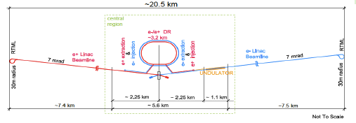
MT LCF@CERN BDS R&D (2026 – 2028)
Taking as starting point the ILC 250 GeV design a BDS with 1 IP has to be updated and optimized in detail.
IP crossing angle 14 mrad
Session “MDI & conventional systems” LCWS2025
Optics design: 2 IPs optimal choice, beam split, longitudinal detectors position and synchronization, FFS-Collimation-Beam Instrumentation systems, Energy upgrades and transition, compatibility with future options as γγ or plasma
Software developments: Xsuite and RFtrack
Beam Simulations: Wakefields, Optics tuning including Ground Motion and IP feedbacks, Collimation and Backgrounds,...
Preliminary specs: Stability, BPMs, Magnet Field quality
Notes:
The most crucial R&D to be developed in the next future from the BDS point of view the tasks are:
-optics design
-.....
Updates are also to be made for the DRs, Linacs and injection systems.
-----------------------------------------------------
1) Pues depende un poco de algunos parametros, por ejemplo, cual seria la maxima energia con la que debe ser compatible? Las emitancias horizontales de ILC a todas las E son bastante superiores a las de CLIC y aunque se que Glen White hizo las s2e simulations de ILC (hace ~20 anyos) con resultados prometedores le faltaban varios tipos de errores y el failure rate tenia que mejorar.
Incluirian estas simulaciones wake-fields, collimation, IP feedback?
Ademas, ahora tanto GuineaPig y Placet se consideran legacy codes y tenemos que migrar a Xsuite y/o RFtrack, lo que significa que tenemos que reescrbir todos los codigos que usabamos (Placet ya no hace el tracking en el solenoid y nadie lo puede arreglar...).
Asi que es mucho trabajo en various campos diferentes de expertise (optics, GM, collimation, wakefields, IP fb, software development), para hacerlo todo al completo podria ser 3 personas durante 2-3 anyos, optimisticamente.
2) Si el deadline es el 2028, si que se necesitarian ~4 personas durante este tiempo y anyadimos la seccion de instrumentacion, todos los topics son muchos de hecho:
-Optics design: Beam split (max E?), 2IPs, BI section, collimation, FFS
-Software development: Xsuite and RFtrack
-Simulations: Wakefields, optics tuning with GM & IP feedback, collimation & background
-Preliminary specs: stability, BPMs, Field quality
4 personas, claro, se entiende expertos, si hay que hacer trainings la situations es mas dificil, y tal vez se podrian anyadir 2 mas para que fueran eficientes en el 2027, pero la eficiencia se satura rapido con el numero de personas.
Esto es solo el BDS, claro, luego vienen el linac, los DRs, etc.

Slide 15
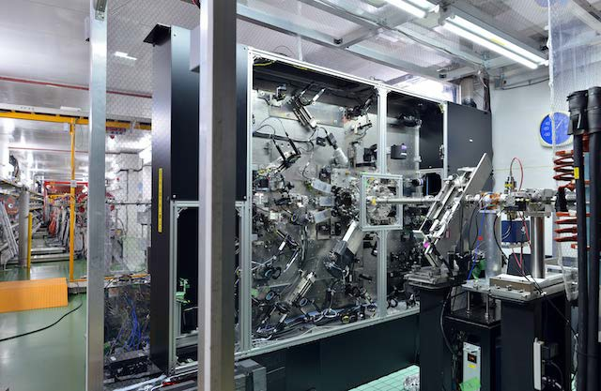
ATF2 the ILC-CLIC FFS testbench
Develop nano-beam technologies for ILC-CLIC
Goals: - Realize nanobeam size
- Stabilize its position
IPBSM (nanometer beam size monitor)
Notes:
From the experimental point of view, there has been a continuous work from many labs, in ATF first and ATF2 after to get nanobeam size and its stabilization.

Slide 16
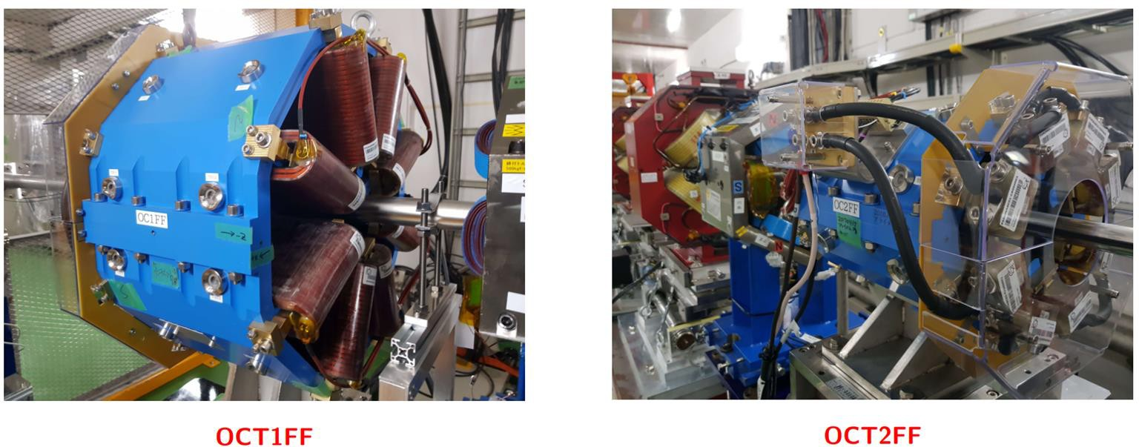
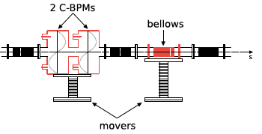
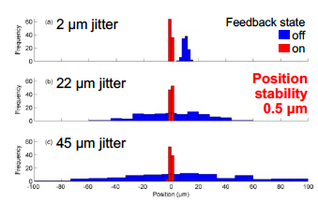
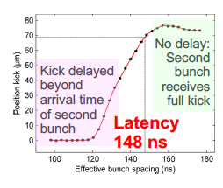
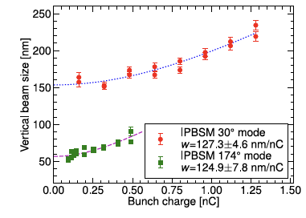
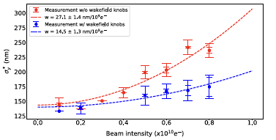

ATF2 past experimental results achieved
PRAB 19, 091002 (2016)
Wakefield model
    KEK Report 2020-4 (2020)
Major Review
Octupoles
ILC-IDT
Octupoles swap
Orbit stabilization
5 FF sextupoles
Skew sextupole modif.
FONT feedback on
4 FF sextupoles
1st wakefield setup
2013 | 2014 | 2015 | 2016 | 2017 | 2018 | 2019 | 2020
44 nm
41 nm
FB latency 133 nsec
Position jitter at ATF2 IP: 41 nm
Intensity dependence
Ultra low-b optics
PRAB 21, 122802 (2018)
Small beam sizes were obtained with reduced beam intensities of 0.5-1.5 10⁹ e⁻/bunch (10¹⁰ design value) and reduced aberration optics (10β_{x}* x β_{y}*)
10x1 optics
    PRAB 23, 121004 (2020)
Notes:
I try to summarize in a nutshell the main experimental results until 2020.
In the lower part in red I show the performances and in the upper part in blue the main hardware implementations.
I remind the two main goals of ATF2:
-Achievement of 37 nm spot size
-Control of beam position at nm level.
What we have obtained:
-Nano-beams: 41 nm
-FB latency of 133 ns and a direct stabilization of position IP jitter of 41 nm (limited by IPBPMs resolution).
However, lower bunch intensity and aberration optics were used to achieve the small beam size . This motivates a comprehensive experimental campaign to try to understand the intensity dependence.
In 2020, we conducted major ATF2 review, and we were able to gain some knowledge already.
In addition, the ILC International Development Team was established in August 2020 under the ICFA’s auspices, that gives us the possibility to implement same of the hardware issues identified and to continue with the experimental program.
Currently, the ATF2-3 beamline is the only facility in the world for testing the Final Focus System (FFS) of linear colliders and is essential for the ILC and the CLIC projects. A vertical electron beam size of 41 nm (within 10% of the target), a closed-loop intra-bunch feedback of latency 133 ns, and direct stabilization of the beam position at the Interaction Point (IP) to 41 nm (limited by the IP BPM resolution) have all been achieved at ATF2. These results fulfilled the two main ATF2 design goals, but were obtained with reduced aberration optics and a bunch population of approximately 10% of the nominal value of 1010 electrons. Recent studies indicate that the beam degradation with the beam intensity is due to the eﬀects of wakeﬁelds. To overcome this intensity limitation, hardware up-grades including new vacuum chambers, magnets, IP laser interferometer Beam Size Monitor (IP-BSM), cavity BPMs, wakefield mitigation station, as well as a comprehensive R&D program to maximize the luminosity potential are being pursued in the framework of the ILC Technology Network. This new R&D program focuses on the study of wakefield mitigation techniques, the correction of higher-order aberrations, tuning strategies, including AI techniques, as well as beam instrumentation issues for this type of collider such as the BPMs, advanced incoherent Cherenkov Diffractive Radiation monitor (iChDR), and fast feed-back systems, among others.

Slide 17
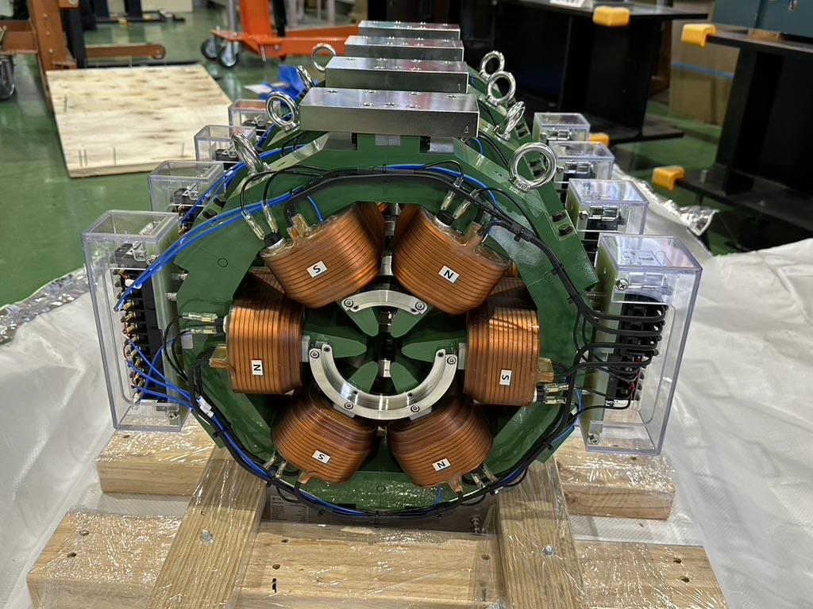
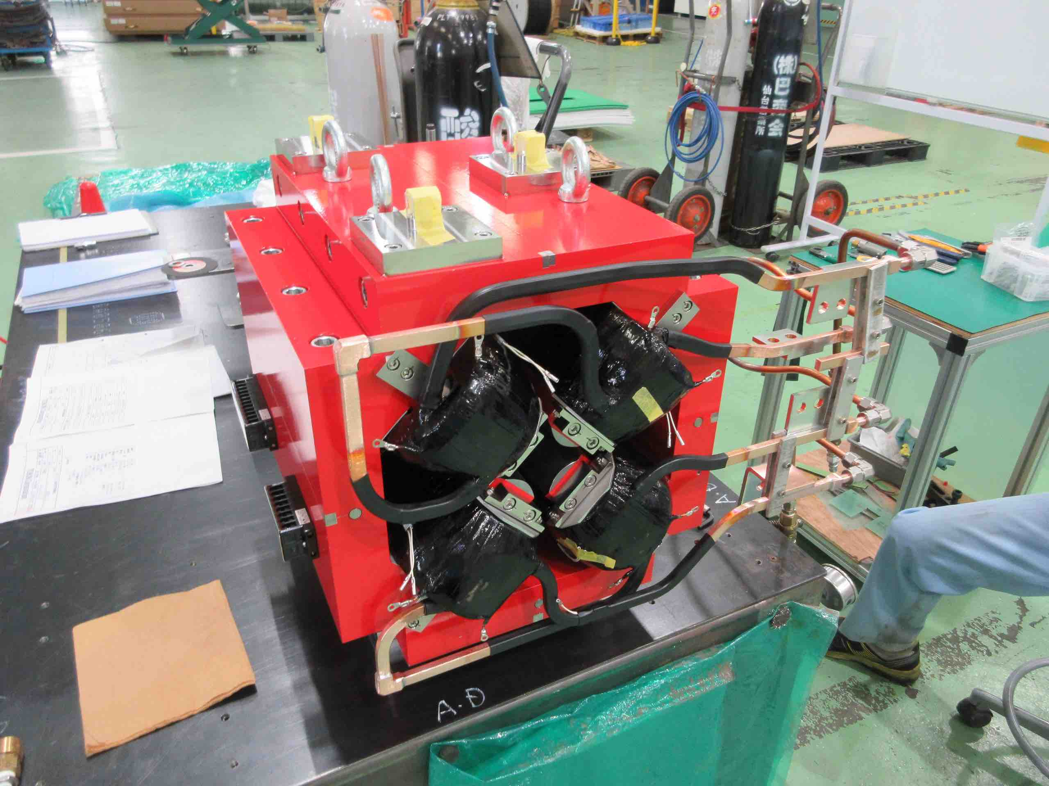
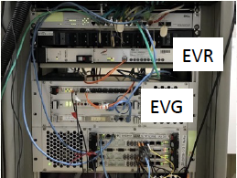
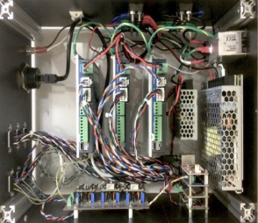
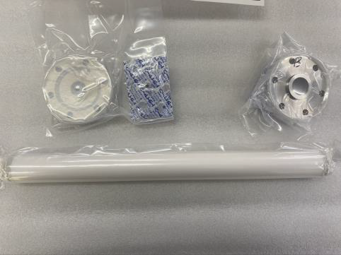
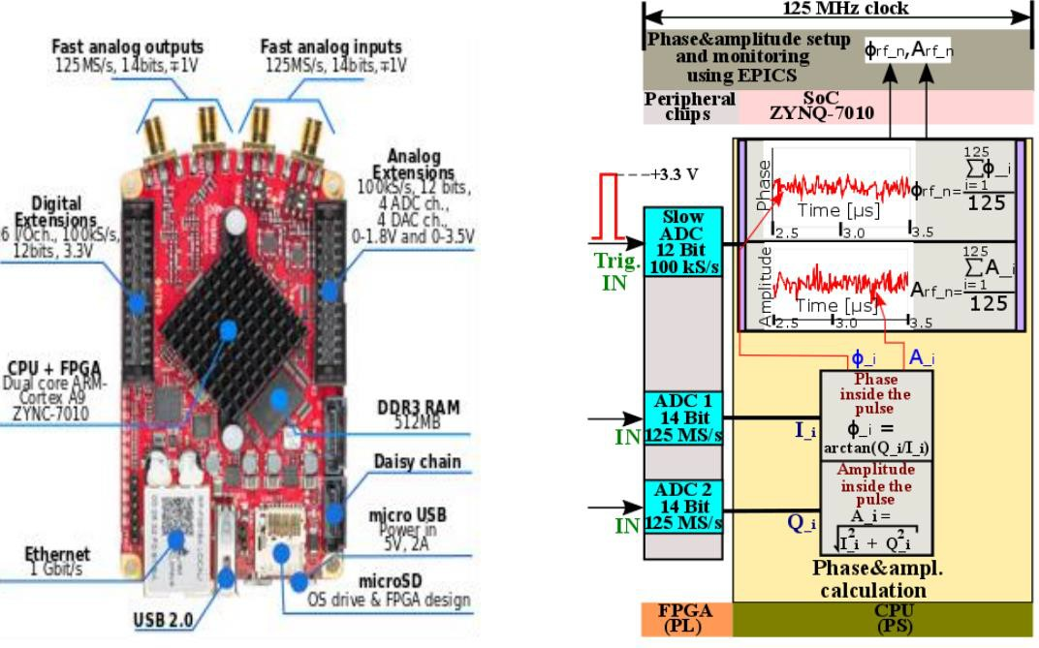
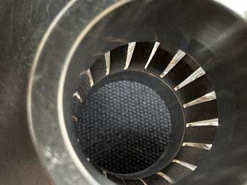
ATF2-3 recent and current status
Hardware upgrades
Lessons learned
Major Review
ATF2 beam line upgrade is ongoing in the framework of the new Advanced Accelerator Element Technology Development (MEXT ATD) grant started in April 2023 and will continue over 5 years.
ILC-IDT
Hardware ATF issues were identified (retrofitted / re-used components)
Mitigation plan is in progress (MEXT ATD)
Detailed studies to assess the ILC/CLIC FFS system design from the point of view of the technological/hardware choices are of paramount importance (wakefields, magnet field errors...)
Skew sextupole
QD0
EVR/EVG timing system
IPBSM
2013 | 2014 | 2015 | 2016 | 2017 | 2018 | 2019 | 2020 | 2021 | 2022 | 2023 | 2024 | 2025 | 2026
Magnet mover control box prototype
IPBSM laser
Kicker system
Ceramic and new chamber
Magnets:
- QD0, QF1, SD0, SD1
- Magnet movers
New ceramic chamber
Linac Klystron control
Vacuum chambers:
- Bellows shielding and flanges
- Cavity BPM tapering
- Stripline BPMs
- Dipole chamber
Low-impedance bellow
Timing systems
New VME based Event Genarator/receiver system
Renew optical signal distribution system for reference clocks linac&DR
CBPMs:
- Re-installation of all CBPMs
- Fast small movers
- Electronics & Digitizers:
Notes:
More specifically (to be more precise...)
From the point of view of hardware, we identify the major issues, and we put in plan a mitigation plan, with the financial support of a MEXT grant. The grant started in 2023 and will continue during 5 years. The main issues identified are: IPBSM laser, some magnets....
What we learned: detailed studies to asses the ILC/CLIC FFS from...

Slide 18
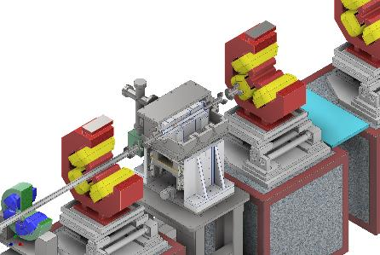
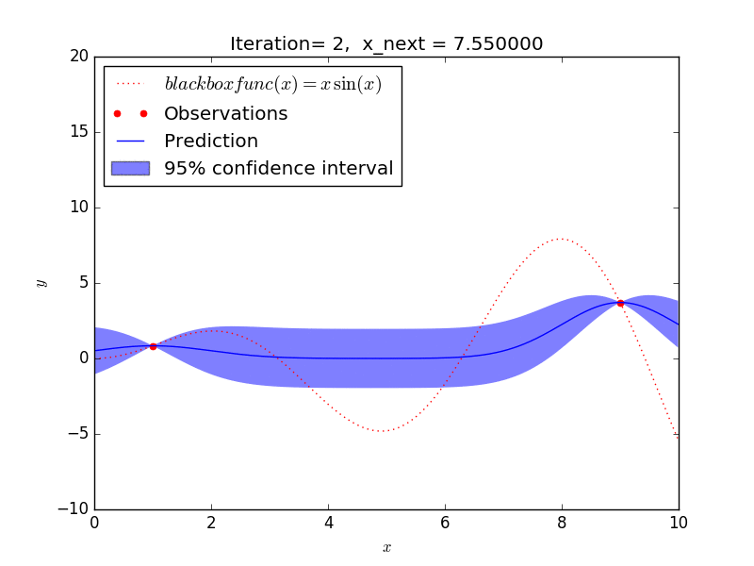
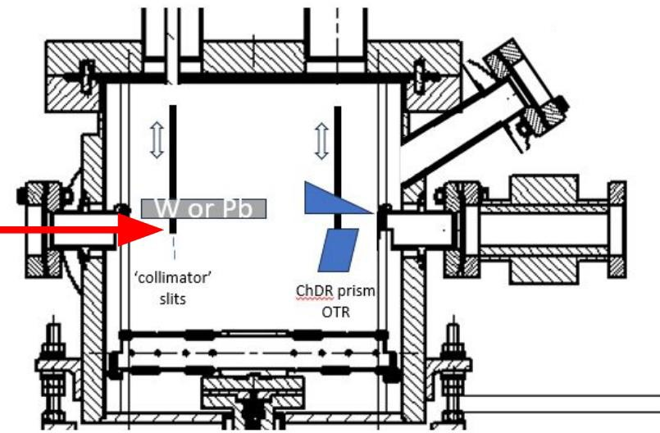
ATF2-3 recent and current status
Lessons learned
Major Review
Performance Optimization
Outstanding and unique results achieved in ATF/ATF2. Based on ATF2 achievements no showstopper for ILC has been found
ATF2 beam intensity dependence is compatible with wakefields impact and long bunch lengths. ATF2 low-intensity is “roughly” equivalent to ILC nominal intensity.
ATF2 optics limitation could be explained by alignment, jitters, and multipolar aberrations. Comparative simulations shown than ATF2 10x1 optics has closer tolerances to ILC optics than ATF2 1x1 optics.
ILC-IDT
ATF3 plan is to pursue the necessary R&D to maximize the luminosity potential of ILC. In particular the assessment of the ILC FFS system design specs and the technological/hardware choices and the long-term stability operation issues.
2013 | 2014 | 2015 | 2016 | 2017 | 2018 | 2019 | 2020 | 2021 | 2022 | 2023 | 2024 | 2025 | 2026
High-order aberrations
Octupoles
    KEK Report 2020-4 (2020)
    CERN-THESIS-2020-095 (2020)
Wakefield mitigation
Wakefield test station
beam tuning (ML based)
Long Term stability
    PRAB 17, 023501 (2014)
iChDR
Beam Instrumentation
Notes:
From the point of view of the performances, based on ATF2 achievements....(left panel)
Having this in mind the ATF3 plan is to pursue the necessary R&D (right panel) based in 3 pillars:
High-order aberrations mitigation and correction, Wakefield mitigation ang bema tunning.
Besides a beam instrumentation R&D program profiting of the ATF2 beam is also being developed.

Slide 19
ATF2-3 recent and current status
Lessons learned
Major Review
Performance Optimization
Outstanding and unique results achieved in ATF/ATF2. Based on ATF2 achievements no showstopper for ILC has been found
ATF2 beam intensity dependence is compatible with wakefields impact and long bunch lengths. ATF2 low-intensity is “roughly” equivalent to ILC nominal intensity.
ATF2 optics limitation could be explained by alignment, jitters, and multipolar aberrations. Comparative simulations shown than ATF2 10x1 optics has closer tolerances to ILC optics than ATF2 1x1 optics.
ILC-IDT
ATF3 plan is to pursue the necessary R&D to maximize the luminosity potential of ILC. In particular the assessment of the ILC FFS system design specs and the technological/hardware choices and the long-term stability operation issues.
2013 | 2014 | 2015 | 2016 | 2017 | 2018 | 2019 | 2020 | 2021 | 2022 | 2023 | 2024 | 2025 | 2026
High-order aberrations
Octupoles
    KEK Report 2020-4 (2020)
    CERN-THESIS-2020-095 (2020)
Session “Damping rings, Beam dynamics, Beam delivery systems” LCWS2025
Wakefield mitigation
Wakefield test station
beam tuning (ML based)
Long Term stability
    PRAB 17, 023501 (2014)
iChDR
Beam Instrumentation
Notes:
From the point of view of the performances, based on ATF2 achievements....(left panel)
Having this in mind the ATF3 plan is to pursue the necessary R&D (right panel) based in four pillars:
High-order aberrations, Wakefield mitigation....

Slide 20
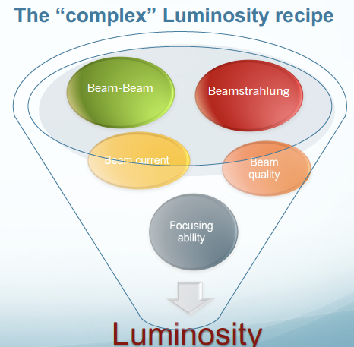

Nanobeam sizes / Luminosity salient points
See also “Lessons from current e+e- CC” (Y. Onishi) ESPPU 2025
https://agenda.infn.it/event/44943/overview
High-Intensity is a “Big Challenge”
Reduce the wakefields (Impedance) and found proper mitigation techniques
FFS design should be as simple as possible
Non-linear imperfection reduces the beam dynamics tunability
    Tuning correction algorithms (AI/ML) to be developed (sextupoles, skew sextupoles, octupoles..)
Squeezing $β$* and increasing beam currents form the basis towards higher luminosity
Luminosity cannot be fully demonstrated before project implementation.
      Luminosity is a feature of the facility not of the individual technologies
      Relying in experience, theory and simulations
      Foresee margins (“real luminosity” value is known when commissioning start and it is a learning curve...)
Notes:
To conclude just to summarize some salient points that are rather similar to the ones of the current e+e- colliders.
Finally, a few key aspects that are somewhat similar to those of the present e+e- colliders are summarised.

Slide 21

The quest for nanobeam sizes
Since SLC/FFTB, significant technological and simulation improvements have been made that facilitate the quest for nanobeam sizes.
Some tens of nanometers beam sizes have been obtained experimentally in different colliders. Based on the achievements, no showstoppers for future colliders have been found.
However, these projects show that achieving stable and repeatable operation at these low beam sizes remains a challenging endeavor. It is observed that, so far, these projects did not achieve their design targets with nominal bunch intensity and that optics/hardware modifications were adopted in ATF2/3 and SuperKEKB.
Effective normalized vertical emittance at the IP as measured from the beam size versus time
arXiv:2506.12361v1 [physics.acc-ph] 14 Jun 2025
R&D in beam dynamics and technological/hardware devices to continue the quest for nanobeam sizes, stability and reproducibility is being pursued in ATF2/3. This R&D will be of paramount importance for the training of young acceleration physicist generation that will play a key role in the future colliders.
Notes:
Having this in mind ...

Slide 22
















THE BRAVE LCs COLLABORATORS
ILC, CLIC and ATF
A. Yamamoto, S. Michizuno, T.Okugi, N. Terunuma, K. Yokoya, H. Sakai, A. Arishev. T. Abe, K. Popov, S. Stapnes, R. Tomas, Y. Papaphilippou, N. Catalan Lasheras, F. Zimmermann, A. Pastushenko, V. Cilento, R. Yang, A. Latina, P. Korysko, S. Mazzoni, T. Lefevre, W. Kaabi, I Chaivkoska, A. Korsun, R. Poeschl, F. Richard, M. Winter, M. Titov, N. Fuster, L. Pedraza, B. Gimeno, J. List, B. List, P. Burrows, D. Bett

Slide 23
CLIC BDS PhDs
MASTER Thesis
Diana Andreea Popescu, Master thesis: "Parallel Computing Methods For Particle Accelerator Design", EPFL, CERN-THESIS-2013-12
Andrii Pastushenko, Master thesis: "Beam optics calculations for CLIC", CERN-THESIS-2018-192
David Martinez, Master thesis: "MAPCLASS2: a code to aid the optimisation of lattice design", CERN-ATS-Note-2012-087 TECH
Vera Cilento, Master thesis: "Optimization of the Beam Size at the Interaction Point of the Accelerator Test Facility 2", CERN-THESIS-2018-191
PhD Thesis
Guillermo Zamudio Ascencio, Master thesis: "Final Focus System for CERN's 500 GeV and 3 TeV Compact Linear Collider", 2010:139 CIV
Eduardo Marin Lacoma, PhD thesis: "Design and higher order optimisation of Final Focus Systems for Linear Colliders", CERN-THESIS-2012-218
G. Giambeli, Master thesis: "Feasibility studies of the final focus system in the compact linear collider", Politecnico di Milano
Fabian Plassard, Master thesis: "Design optimization of the International Linear Collider Final Focus System with a long L*", CERN-THESIS-2014-301
Hector Garcia Morales, PhD thesis: "Comparative study of Final Focus Systems for CLIC and other luminosity ehancement studies for future linear colliders", CERN-THESIS-2014-230
Oscar R. Blanco Garcia, PhD thesis: "Beam dynamics in the final focus section of the future linear collider", CERN-THESIS-2015-115
M. Patecki, PhD thesis: "Optimisation analysis and improvement of the effective beam sizes in Accelerator Test Facility 2", CERN-THESIS-2016-304
Fabien Plassard, PhD thesis: "Optics optimization of longer L* Beam Delivery System designs for CLIC and tuning of the ATF2 final focus system at ultra-low beta* using octupoles", CERN-THESIS-2018-223
Andrii Pastushenko, PhD thesis: "Optimization of CLIC Final Focus System at 380 GeV and implementation studies for Ultra-low beta* at ATF2", Universite Paris-Saclay, HAL Id: tel-03721485 CERN-THESIS-2022-379
Vera Cilento, PhD thesis: "Optics Design of a novel Beam Delivery System for CLIC : the case of two Interaction Regions. First experiments for the validation of the ultra-low betay* nanometer beam size at ATF2", Universite Paris-Saclay, HAL Id: tel-03620261 CERN-THESIS-2021-34

Slide 24


MT LCF@CERN BDS R&D 2 IPs I
Taking as starting point the ILC 250 GeV design a BDS with 2 IPs has to be studied and optimized. The angle choice has not been determined, but in principle the 2 angles will be different to have physics complementarity between the two detectors. Preliminary design studies and CFS cost with 20 mrad between the MLs, and with 2 IPs with 14 / 26 mrad crossing angle with the two detectors in the same longitudinal position, are being performed but not detailed design of the optics is existing.
IP crossing angle 14 mrad
Detailed discussion in “BDS considerations for LCF@CERN” https://indico.cern.ch/event/1471891/

Slide 25
MT LCF@CERN BDS R&D – 2 IPs II
Taking as starting point the ILC 250 GeV design a BDS with 2 IPs has to be assembled. The angle choice has not been determined, but in principle the 2 angles will be different to have physics complementarity between the two detectors. Preliminary design studies and CFS cost with 20 mrad between the MLs, and with 2 IPs with 14 / 26 mrad crossing angle with the two detectors in the same longitudinal position, are being performed but not detailed design of the optics is existing. To take into account:
  In the case of 2 IPs only baseline operation will be used (baseline 554 ns bunch separation / high-lumi 366 ns).
  Concerning the crossing angle, options including a “quasi-head on” (2 mrad) are very difficult to implement from the outgoing beams.
  Options for different longitudinal positions for the 2 IPs, indeed they the advantage of allowing less separation between the 2 detectors will have timing issues due to the different lengths for the BDSs, implementation will be complex (for instance, the length has to be half-integer of the DR length).
  In the same longitudinal position for the 2 IPs, an optimization of the 2 IPs cavern have to be performed to provide a minimum distance of 30 m between two detectors.
  The beam dumps have to be reconfigured and special attention has to be paid to the photon dump location. In particular, the photon dump location at the center (between two tilted beams) becomes a critical issue in the case of the undulator positron source.
  The angle between the MLs has to be optimized to minimize the SR generated by the bending magnets of the BDS separation region, taking into account the 2 IPs crossing angle choice.
  The idea of having parallel MLs is also being considered and this option could be better for the future implementation of an upgrade by means of ERLs, nevertheless the impact of the increase of total length and the SR losses in the splitting section should be considered.
  The split location of the BDSs has to studied in detail, as well as the split magnet technology for the high-energy upgrades.
  Compatibility with a possible future γγ collision mode have to be evaluated, with both optical lasers or FEL options. Options with XFEL lasers are optimal when the crossing angle is "quasi-head on" contrary to the optical ones.

Slide 26



Luminosity and nanobeams
For any colliding beams the luminosity is given:
n_{b} = bunches / train
N = particles per bunch
f_{rep} = repetition frequency
A = effective overlap area at IP
AREA
NUMBER OF PARTICULES
For Gaussian beams and taking into account the beam-beam in the LC case:
beam-beam enhancement factor (typical value of ~2)
r.m.s. transverse beam size at IP
  σ*_{x,y}$=$ $\sqrt{ β_{x,y}^{∗}ε_{x,y} }$
β*$=$β-function at the IP
$ε=$transverse emittance
To maximize luminosity we need very small beam sizes at IP
Beamstrhalung (flat beams)
very small emittances (Damping Rings) very small β* (Final Focus)
Notes:
Basic formulas and some specific for LCs

Slide 27



Nanobeam Sizes in ATF2
e⁻ beam direction
Vertical IP beam size (1st order )
Very sensitive to:
beam waist position offset
vertical dispersion
xy coupling
multipole field errors
Linear optics tuning knobs:
beam waist knob
vertical dispersion knob
xy coupling knobs
    PRAB 17, 023501 (2014)
Horizontal and Vertical IP beam size (2nd order)
Very sensitive to:
Sextupole field errors
Tuning procedure
Second order optics tuning knobs
Similar for skew sextupole and octupole field errors....
    PRAB 23, 071003 (2020)
Notes:
To understand better the complexity of getting nanobeam sizes I would try to elucidate the intricate dependences:
At 1st order the vertical beam size is highly sensitive to beam waist position offset, the vertical dispersion, the coupling and the mutipole magnets field errors. Linear tuning knobs have been implemented to control and mitigate the impact of various errors sources, in particular the beam waist, the vertical dispersion and the coupling.
The graph shows a typical tuning procedure with the impact of each of the tuning knobs.
In a similar way this could be made for the second order implicating the sextupoles, and could be extended to high order for skew sexupoles and octupoles.
The details could be found in the two papers.

Slide 28
Reduced optics aberration conditions I
ATF2 Beam parameters
Relaxed optics (10β_{x}* x β_{y}*)
is the “new nominal”
b: Optics with (10β_{x}* x β_{y}*)
c: Optics with (25β_{x}* x half/ultralow β_{y}*)
e: Results achieved with beam stabilization in two-bunch mode
Notes:
Furthermore In order to reduce the aberrations the bx* has been relaxed in all the scenarios.

Slide 29



Reduced optics aberration conditions II
    PRAB 17, 023501 (2014)
Comparing ATF2 and ILC
Notes:
Concerning ATF2 optics limitations, simulations in [5-7] have shown that alignment, jitters, and multipolar aberrations can explain the observed beam size limitations. Furthermore, comparing multipolar tolerances between ILC and ATF2 it was observed that the ATF2 with 10x horizontal beta function has closer tolerances to ILC than the initial ATF2 design. ATF2 is undergoing hardware upgrades to mitigate alignment and multipolar aberrations with new supports and magnets.
The performance of the ILC Final Focus System under static and dynamic imperfections has been extensively studied [8], and effective mitigation techniques have been established to address different sources of imperfections: advanced beam-based alignment and tuning [8,9], fast intra-train feedback (FONT) [2], mechanical vibration isolation [3], ensuring beam stability at the tens of nanometer level. Alternatively, it has been shown that non-local chromaticity correction systems offer better tuning efficiency, particularly under realistic error conditions, than the compact FFS [4] at the cost of a longer system.
[1] P. Korysko 2020, Intensity-dependent effects in the Accelerator Test Facility 2 and extrapolation to future electron-positron linear colliders, CERN-THESIS-2020-095 https://repository.cern/records/6hyg7-9nt84
[2] https://journals.aps.org/prab/abstract/10.1103/PhysRevAccelBeams.21.122802
[3] C. Collette, S. Janssens and D. Tshilumba, Control strategies for the final focus of future linear particle collider, Nucl. Instrum. Meth. A 684 (2012). doi:10.1016/j.nima.2012.04.090 https://www.sciencedirect.com/science/article/abs/pii/S0168900212004950
[4] https://journals.aps.org/prab/abstract/10.1103/PhysRevSTAB.17.101001
[5] M. Patecki et al., “Probing half βy optics in the Accelerator Test Facility 2”, Phys. Rev. Accel.
Beams 19, 101001 (2016).
[6] R. Yang et al., “Tuning the ultralow beta* optics at the KEK Accelerator Test Facility 2”, Phys.
Rev. Accel. Beams 23, 071003 (2020).
[7] R. Yang et al., “Momentum bandwidth of the KEK Accelerator Test Facility 2”, Phys. Rev. Accel. Beams 24, 051001 (2021).
[8] G. White 2007, BDS BBA, Tuning and Beam Dynamics, ILC LET Workshop SLAC, https://agenda.linearcollider.org/event/2364/contributions/6540/attachments/4889/8239/ILC-LET2007.pdf
[9] J. Orgen et al, ``Tuning the Compact Linear Collider 380 GeV final-focus system using realistic beam-beam signals'', Phys. Rev. Accel. Beams 23, 051002, May 2020.

Slide 30
Intensity dependence (wakefields) I
But small beam sizes were obtained with beam intensities of 0.5-1.5 10⁹ e⁻/bunch (10¹⁰ design value)
Beam size History
Intensity
smallest beam size ~41 nm (2016)
Beam size shows a degradation with the increase of the intensity compatible with wakefields
Nominal (10β_{x}* x β_{y}*)
Half (25β_{x}* x 0.5 β_{y}*)
Ultra-Low (25β_{x}* x 0.25 β_{y}*)
Notes:
BUT....The smallest beam size of 41 nm has been obtained in 2016, at 10⁹ instead of 10¹⁰ designed intensity value.
But maybe this is sufficient to demonstrate the ILC and CLIC FFS feasibility???
The different colors represents the different optics.
This beam size degradation is compatible with wakefields.

Slide 31

Intensity dependence (wakefields) II
Wakefield induced IP beam size dependence was observed at the ATF2 IP. Scaling this effect to ILC is rather difficult, given the significantly different parameters, such as beam energy or bunch length.
Comparing ATF2 and ILC
Simple scaling
    KEK Report 2020-4 (2020)
Assuming the same bunch charge, relative wakefield effect at ILC FF to ATF FF will be a factor of about 0.11 for random misalignment and a factor of about 0.032 for betatron oscillation. In other words, the effect of wakefield at ILC with the designed bunch population (2 x 10¹⁰) will be similar to that at ATF with bunch population 0.22 x 10¹⁰ for random misalignment and 0.064 x 10¹⁰ for orbit distortion.
Relative effect of misalignment and orbit jitter at ILC and ATF2
ILC simulations
    CERN-THESIS-2020-095 (2020)
Some dedicated ILC wakefield studies have been carried out for short- and long-range wakes at 250 and 500 GeV [1], concluding that short-range wakefields can be effectively mitigated by beam-based alignment, while long-range wakefields affect bunch-to-bunch orbit jitter, which could be mitigated by the intra-bunch feedback system. In conclusion, more detailed and realistic simulations should be performed to assess the dynamic and hardware choices for ILC.
Based on the comprehensive simulations and the systematic experimental studies carried out over many years in ATF2, the ITN WP 15: “Final Focus” is addressing these issues and will incorporate these findings in the ILC
Notes:
Rough comparison of expected effects of wakefield in the final focus beam line at ILC and ATF can be
evaluated from simple scaling as follows. [58]
We assume there are the same wakefield sources distributed at every magnet (number of sources is
proportional to the number of magnets). For effects of random misalignment, assume the same accuracy
of component alignment. For effects of beam orbit jitter, assume the same jitter amplitude relative to
the nominal beam size. Then, expected effects to the beam size relative to the nominal beam size are
compared.
There are four factors considered as follow.
– Because of the higher beam energy, ILC beam will be more rigid than ATF.
– Different bunch lengths, 300 μm at ILC and ⇠7 mm at ATF, also gives different effects. For rough
scaling, the difference factor due to the bunch lengths was evaluated as 0.5 (smaller effect at ILC)
from wakepotential calculation of C-band cavity BPM with different bunch lengths.
- The misalignment effect scales as inverse of square-root of the emittance (the nominal beam size).
The orbit jitter effect does not depend on emittance, because jitter amplitude is assumed to be
proportional to the square-root of emittance and the effect is compared with the nominal beam size
which is also proportional to square-root of emittance.
– The misalignment effect scales as square-root of total summation of betafunctions at wakefield
sources (proportional R34 to IP) . The orbit jitter effect scales as total summation of betafunctions at wakefield
sources, since beam position offset is also proportional to square-root of betafunctions at
wakefield sources.
Wakefield induced IP beam size dependence was observed at the ATF2 IP. Scaling this effect to ILC is rather difficult, given the significantly different parameters, such as beam energy or bunch length. Indeed, a rough comparison of expected effects of wakefield in the final focus beamline at ILC and ATF can be evaluated from simple scaling of the optics and emittance and assuming similar wakefield source distribution. The details could be found in [ATF report 2020, CERN-ACC-2020-0029]. From this comparison, we could say in a first approach that, in terms of static effects influenced by the tolerances of the misalignment or the beam orbit tuning, ATF is approximately 9 times tighter than ILC, and an effect for N=2e10 in ILC corresponds to N=2.2e9 in ATF. For the dynamic effects caused by the IP angle jitter, ATF is approximately 30 times tighter than ILC, and the effect for N=2e10 in ILC corresponds to N=6.4e8 in ATF. The impact of the beam size growth of ILC is one order of magnitude smaller than that of ATF.
Some dedicated ILC wakefield studies have been carried out for short- and long-range wakes at 250 and 500 GeV [1], concluding that short-range wakefields can be effectively mitigated by beam-based alignment, while long-range wakefields affect bunch-to-bunch orbit jitter, which could be mitigated by the intra-bunch feedback system. In conclusion, more detailed and realistic simulations should be performed to assess the dynamic and hardware choices for ILC.
Based on the comprehensive simulations and the systematic experimental studies carried out over many years in ATF2, the ITN WP 15: “Final Focus” is addressing these issues and will incorporate these findings in the ILC.

Slide 32








Nanobeam stabilisation I
ATF Goal 2: position stabilization at the nm level
  Feedback On Nanosecond Timescales concept:
  intra-train interaction point feedback system
  Prototype dual-phase system installed at ATF
  consists of two BPMs and two kickers
Schematic for IP feedback system
1.3 GeV
electrons
Layout of components at the ILC
ATF schematic
Digital
board
- FPGA
- ADCs
- DACs
Stripline
kickers
K1, K2
Stripline
BPMs
P2, P3
Schematic of ATF prototype

Slide 33




Nanobeam stabilisation II
ATF provides trains of up to 3 bunches with a bunch spacing in the region of 150 ns
System operated in single-phase mode to approximate IP feedback system
ATF single-phase feedback schematic
2 μm jitter
Feedback state
off
on
No delay:
Second
bunch
receives
full kick
±75 μm
pos @ P3
Position stability
0.5 μm
Kick delayed
beyond
arrival time
of second
bunch
22 μm jitter
Linearity
±35 μrad
kick @ K2
Latency
148 ns
45 μm jitter
cf. ILC bunch spacing: >350 ns
Scaling to account for
higher energy of ILC
→ ±180 nrad kick
(req: ±60 nrad)
Angle stability
0.12 μrad
→ ILC luminosity stabilized
within 0.1%
DOI: https://doi.org/10.1103/PhysRevAccelBeams.21.122802

Slide 34





IPBSM The Shintake Monitor
The IP beam size monitor (IPBSM) used at FFTB was modified and installed at theATF2 IP. The IP-BSM uses a fringe pattern formed by two interfering laser beams. The laser fringe pitch is defined by the wavelength (λ) and crossing angle of the two laser paths (θ)∶ d = λ/2 sin (θ/2). Compton scattered photons from the transverse overlap of the laser fringe pattern with the beam are measured downstream of the IP. The signal modulation depth is written as a function of the IP vertical beam size (σy):
C expresses the contrast reduction of the laser fringe pattern.
We can measure the modulation depth of the Compton signal by measuring its strength for various relative beam positions with respect to the laser fringe. Then, we can evaluate the IP beam size from the measured modulation depth using Eq. (2).

Slide 35








ATF2-3 R&D current experimental studies I
Wakefield mitigation (new wakefield test station)
  Static: mitigation by relocating the sources in lower β-positions
  Dynamic: FONT feedback (minimization of injection fluctuation) and WFS.
High-order aberration correction and mitigation
  Measurement of FF quads mutipoles
  Impact of multipole fields errors and mitigation
  Octupole studies
Long Term Stability
  Automatic beam tuning (ML)
    Minimize the tuning parameters
    Simultaneous optimization
  Beam optimization (ML)
    “Black-box”
    Bayesian optimization
Installation of flange like structure in Abe Chamber
Static and dynamic wakefield sources compensation
Beam studies of non-linear field at the septum extraction magnet
Linac transport to DR
FF nano-beam tuning
Bayesian optimization of IP-BSM modulation
Notes:
More in detail....
- Wakefield mitigation: The static sources has been relocated to lower betas and the dynamic are being mitigated by different techniques as the Font feedback or wakefield free steering

Slide 36






ATF2-3 R&D current experimental studies II
Incoherent Cherenkov Diffraction Radiation
  Proof of concept validation in progress
Cavity BPM Calibration pulse injection
  Proof of concept validated
  Hardware specifications in progress
ILC Cavity BPM for ILC ML
  Prototype under designs
  First test with re-entrant CBPM FLASH-CEA type
Laser-electron beam sub-picosecond jitter synchronisation
  Based on White Rabbit + IDROGEN
  Application for Compton polarimeter in FCs
  DAQ capabilities for synchronous acquisition of accelerator diagnostics over km range
Flight Simulator new framework implementation
  DFS/WFS in LINAC & ATF2, next step DR
  Development of digital twin / Remote operation
IChDR tests and upgrade
Calibration pulse injection
Beam Instrumentation
ML Quadrupole end CBPM
Laser-electron synchronisation PoC
Notes:
Not mentioned before all of the R&D advancements, related to these studies that have been undertaken throughout the years; I have included the most recent ones here.

Slide 37



Smallest vertical beam sizes in HEP colliders
Effective normalized vertical emittance at the IP as measured from the beam size versus time
Emittance plot is energy normalized, we could say that important phenomena scale with .
So, the emittance plot shows one aspect of the challenge and the beam size plot shows other aspects of the challenge that indeed relate more to vibration tolerances.
Then, how the beam size challenge materializes at higher energy depends on the characteristics of the project.
From discussions with Gianluigi and Rogelio.
Notes:
1) It is not totally clear to me whether the "normalized emittance" is the right parameter to compare ATF with CLIC/ILC.
This would mean essentially that all the important phenomena scale with 1/sqrt{gamma}?
2) I can imagine that the resolution of the monitors for the feedbacks at some point saturate when going to high energies. This means that from the point of view of beam stabilization, stabilizing two beams having the same normalized emittance but different energies at the same fraction of a sigma is equivalent in terms of difficulty. I guess that when you go to high-energy, therefore you have a smaller beam size and smaller tolerances (in absolute value, say in nanometers) then at some point the resolution of the monitor that you use to measure the beam position will become critical.
In general, higher energy needs tighter tolerances in nm. This you show e.g. when quoting the QD0 0.15nm CLIC tolerance (which actually is for 3 TeV, at 380 GeV this should be larger, not sure number has been computed / distributed). ATF2 FD quads have a jitter about 5nm. Also, CLIC BPMs should have a better resolution than ATF2 ones. For the particular case of ILC BDS BPM at least sub-micron ( ~ 100 nm) level is needed (TDR Volume 3 p148, section 8.7.1). In ATF2 we get 25nm (by Stewart Boogert) without any attenuation of signal. Most of CBPM in ATF2 uses attenuator to make wider dynamic range let’s say mm order. Then resolution will be a few 100nm.
The resolution of BPM that is most required in ILC BDS is the accuracy of sextupole BBA. In the case of ILC250, it is about 7um. It is difficult for SD0 and SF1 because there are not many BPMs downstream. Although it is an estimate based on one measurement condition from quite some time ago, but there is a calculation that it can be achieved by using a BPM with a resolution of about 0.5um on the beamline (Attached some parts of ALCW2015 presentation, not calculated for 500 GeV, but in principle it would be the same as 250 GeV, or slightly easier. In the case of ATF, I think it would be about an order of magnitude easier than ILC, see next Okugi’s slide ALCWS2015 ).
For sure the trick here is relying on the IP feedback thanks to the long trains. So, the emittance plot shows one aspect of the challenge and the beam size plot shows other aspects of the challenge that indeed relate more to vibration tolerances, BPM resolutions and feedback systems. Then, how the beam size challenge materializes at higher energy depends on the characteristics of the project. In any case thorough simulations are needed for all projects to demonstrate that the different challenges are under control. E.g. one limitation to the IP feedback mitigation could be wakefields that introduce intra-train motion. Hence, all wakefield sources should be simulated (Pierre Korysko's thesis had such simulations for ILC including some of the wakefield sources but not all).

Slide 38
ILC BDS tolerances

