Slide 1
Linear
Colliders.
A Vision of a Linear Collider at CERN for the European Strategy
Benno List
KET workshop “The future of collider physics”, DESY, Hamburg, Nov 28, 2024

Slide 2
Plan of the Talk
Linear Colliders – Introduction
The Projects – ILC, CLIC, C3, HALHF
LCVision: A Vision for a Linear Collider Facility at CERN
Schedule, Costs, Organisation, and Risks
Sustainability
Conclusions and Outlook

Slide 3
Linear Colliders －
Introduction.

Slide 4
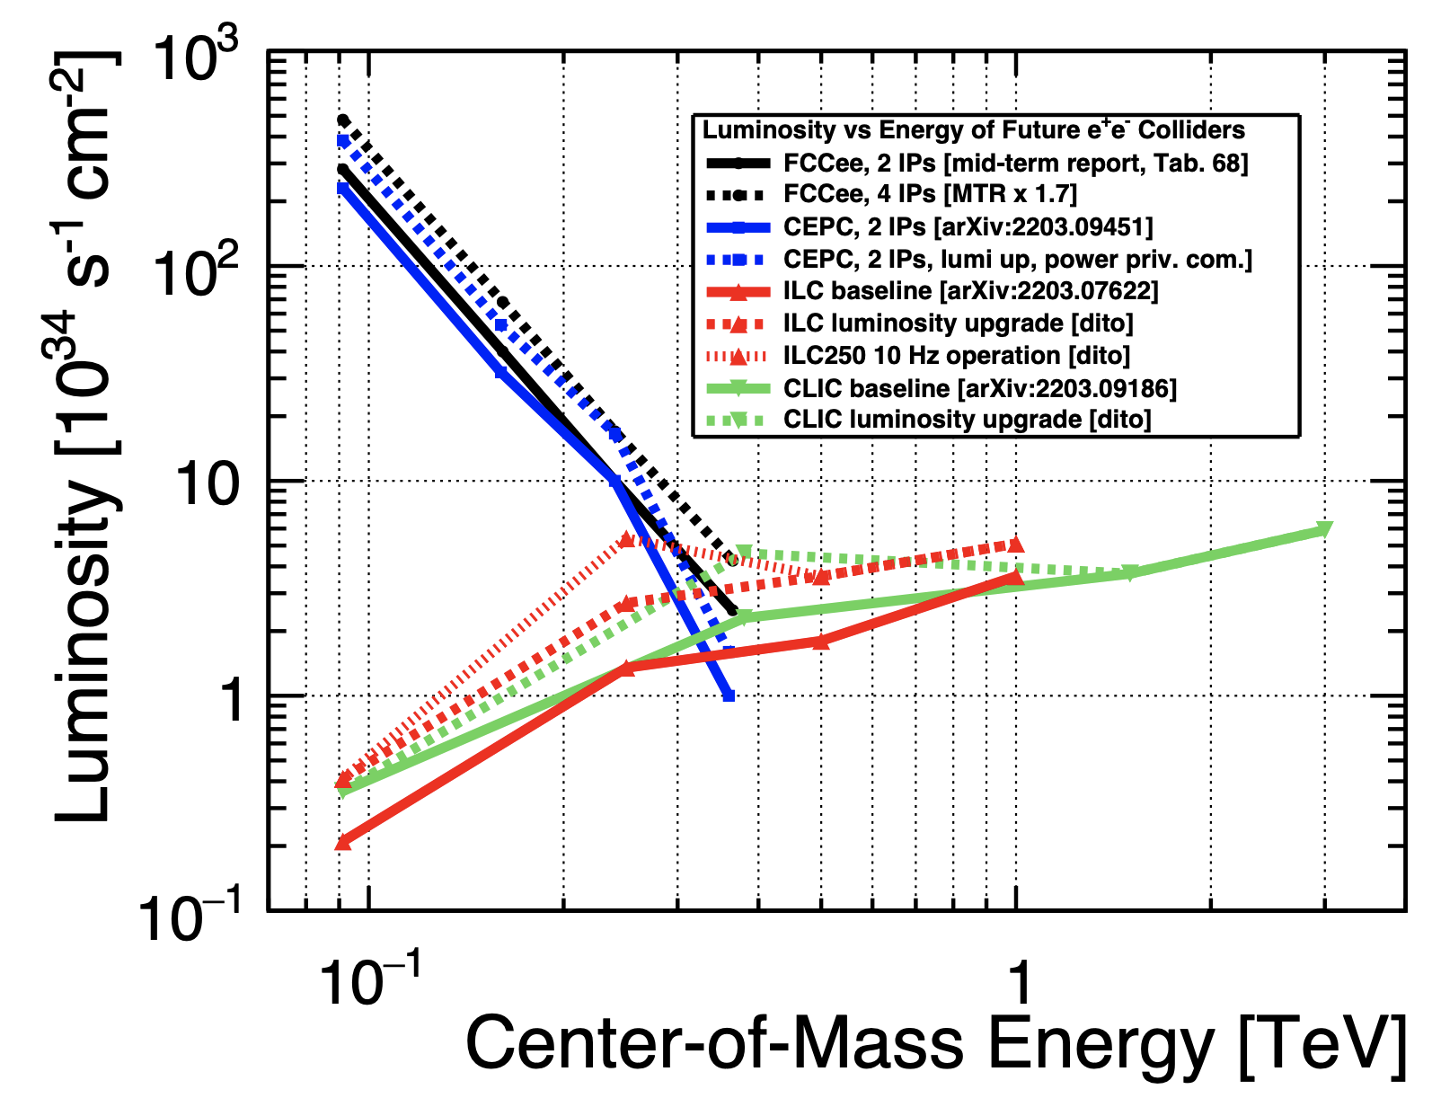
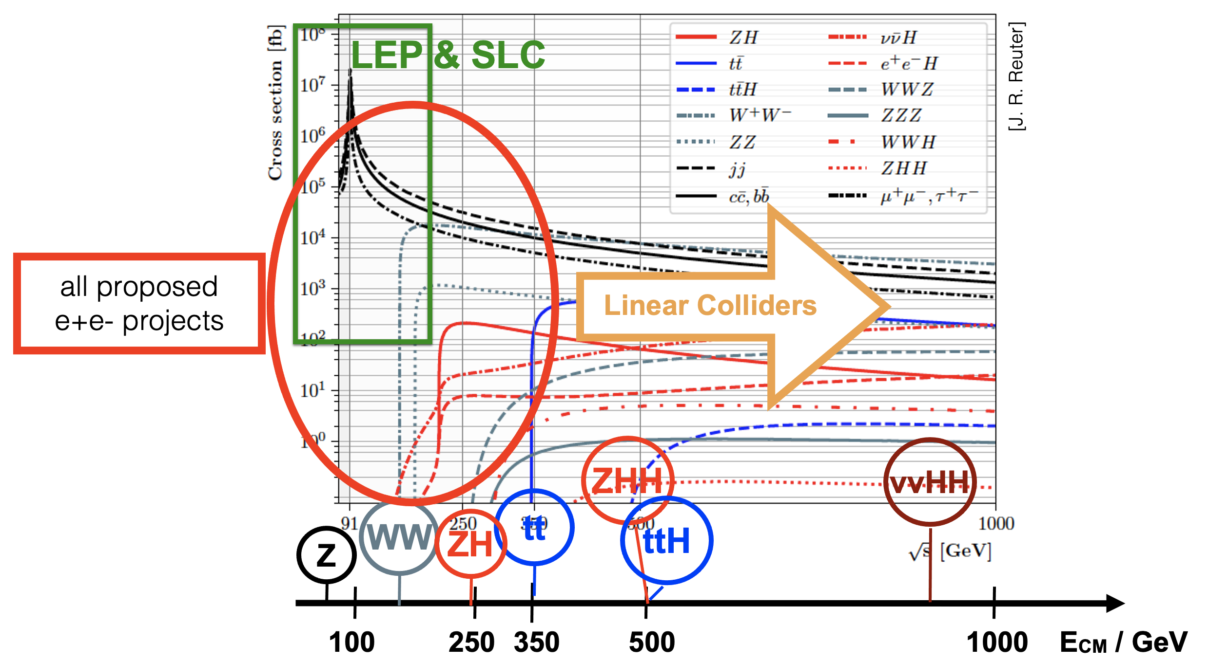
Linear Colliders
The path to the energy frontier in e+e- collisions
Linear colliders are the e+e- energy frontier machines
Linear colliders have increasing luminosity with energy, luminosity/power approx. constant
Energy frontier facility has a rich, guaranteed physics program at 250, 350, 550 GeV up to 1TeV
Z⁰ running at 100x LEP luminosity (3x10³³)
Polarisation
CLIC technology can reach 2 TeV
Complementarity between circular and linear colliders
Z⁰
Zh
tt
Zhh
tth
Circular
Linear

Slide 5

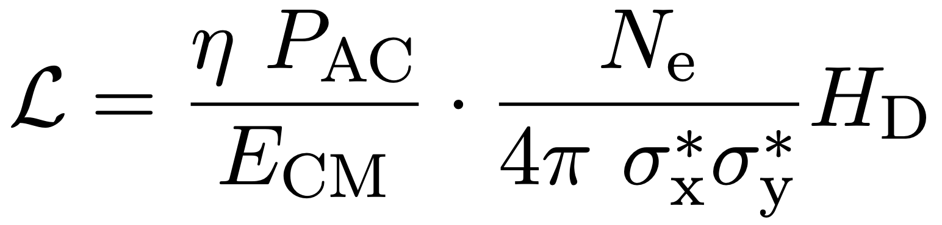
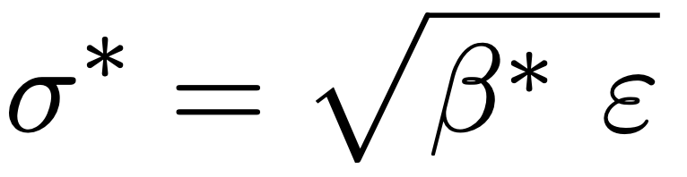
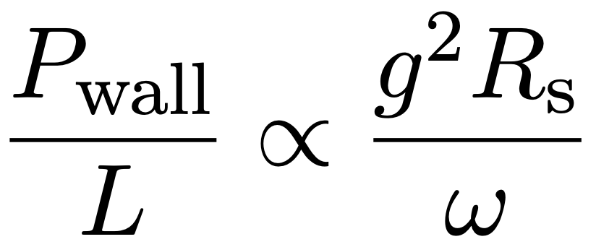
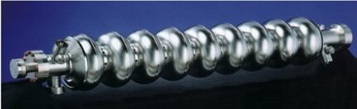
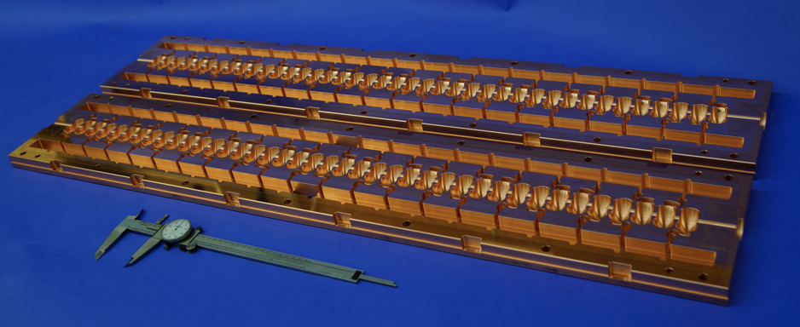
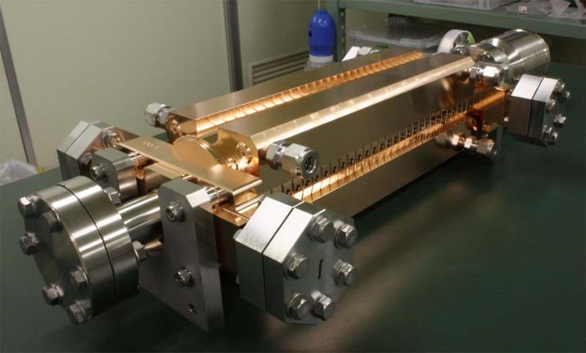
Linear Accelerator Design Challenges
Energy
Luminosity
Operation cost
$ ~ P_{AC}
Construction cost
$ ~ L
High Gradient g
High Efficiency η
Small Beamspot σ_{x}σ_{y}
Main Linac Technology
Losses in cavity walls
Nanobeam Technology
Damping ring (ε)
Final focus (β*)
Low resistivity
Small duty cycle:
Pulsed operation
High frequency &
Ultra-short pulses
ILC
Superconducting RF
CLIC
2 beam acceleration
C3

Slide 6
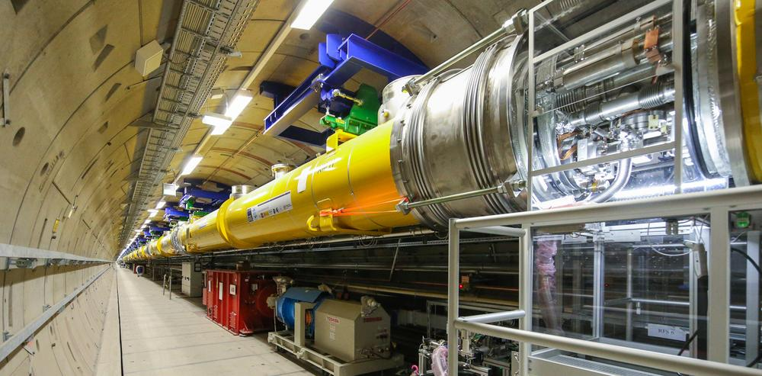
Linear Collider Project Properties
What makes a linear collider an attractive project in uncertain times
Expandable – make them longer for more beam energy
  Cost of initial configuration can be kept reasonable (staging)
  Additional contributions from outside partners directly increase beam energy or luminosity
  Upgrade with future, improved accelerator technologies
Flexible
  Project can be adjusted to changes in physics knowledge, competition, or funding
Highly modular
  Much of project value is in acceleration modules with industrial production basis in several regions
  Performance is given by sum of all modules
  -> lower performance of individual modules can be compensated -> easier ramp-up
  -> reduces risk: financial and technological

Slide 7
The Projects.

Slide 8

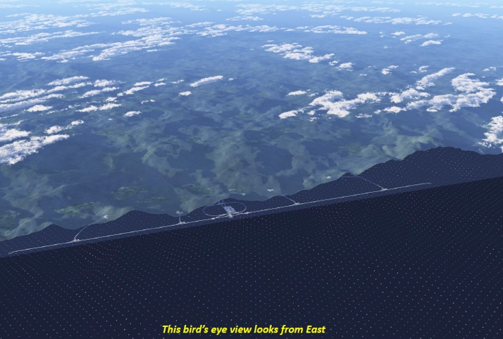
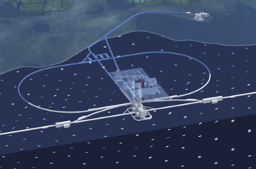
ILC in a nutshell
International Linear Collider ILC
Superconducting Cavities, Nb
1.3GHz, 31.5 (35) MV/m
Klystrons
250GeV CME, upgradeable to 500, 1000 GeV
L = 1.35 x 10³⁴ cm⁻²s⁻¹ (at initial 250GeV)
20km length, site proposal: Tohoku / Japan
Polarisation 80%(e-), 30%(e+)
Based on proven technology (European XFEL)
Item | Parameters
C.M. Energy | 250 GeV
Length | 20km
Luminosity | 1.35 x10³⁴ cm⁻²s⁻¹
Repetition | 5 Hz
Beam Pulse Period | 0.73 ms
Beam Current | 5.8 mA (in pulse)
Beam size (y) at FF | 7.7 nm＠250GeV
SRF Cavity G. Q₀ | 31.5 MV/m (35 MV/m) Q₀ = 1x10 ¹⁰

Slide 9
ILC Baseline, extension and upgrades
Luminosity upgrades:
2 x bunches, 1.5 x RF (1.35 -> 2.7x10³⁴)
Run 500GeV machine at 250GeV, 10Hz:
factor 2 (2.7x10³⁴ -> 5.4x10³⁴)
Improves power efficiency
Energy upgrades:
500GeV (31.5 MV/m Q₀=1 x 10¹⁰)
1TeV (45 MV/m Q₀=2 x 10¹⁰, 300 MW) more SCRF, tunnel extension
Kitakami site: 50km long, sufficient for 1TeV
References: arXiv:1903.01629 (EPSUU), 2203.07622 (Snowmass)

Slide 10
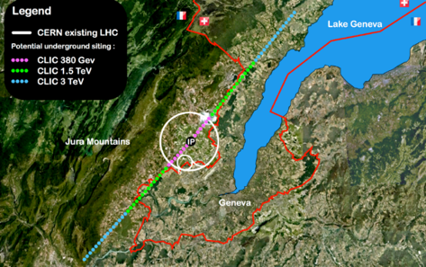
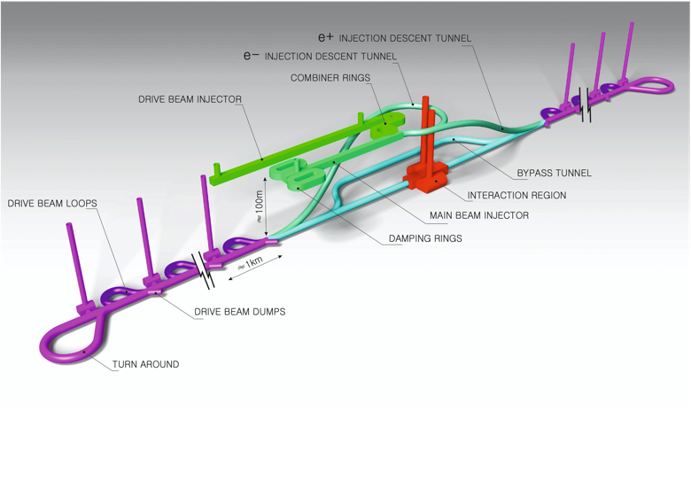
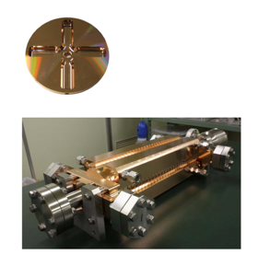
The Compact Linear Collider (CLIC)
  Timeline: Electron-positron linear collider at CERN for the era beyond HL-LHC
  Compact: Novel and unique two-beam accelerating technique with high-gradient room temperature RF cavities (~20’500 structures at 380 GeV), ~11km in its initial phase
  Expandable: Staged programme with collision energies from 380 GeV (Higgs/top) up to 3 TeV (Energy Frontier) presented in previous ESPP updates
  CDR in 2012 with focus on 3 TeV. Updated project overview documents in 2018 (Project Implementation Plan) with focus 380 GeV for Higgs and top.
Accelerating structure prototype for CLIC: 12 GHz (L~25 cm), 100 MV/m

Slide 11
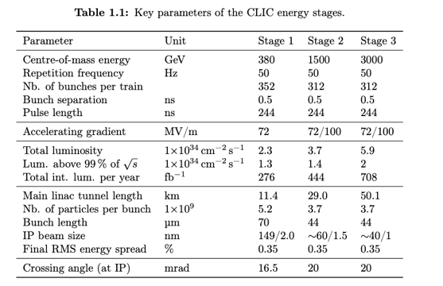
The CLIC ESPP Update
Guidelines:
Preparing “Project Readiness Report” as a step toward a TDR
Assuming ESPP in ~ 2025-6, Project Approval ~ 2028,
Project (tunnel) construction can start in ~ 2030.
However, several important changes:
Energy scales: 380 GeV and 1.5 TeV with one drivebeam
Consider also 100 Hz running at 250 GeV (i.e. two parallel experiments, two BDSs)
Several updates on parameters (injectors, damping rings, drive-beam) based on new designs, results and prototyping (e.g. klystrons, magnets) - however no fundamental changes beyond staying at one drivebeam
Technology results updates, including more on use of them in other projects (e.g. alignment, instrumentation, X-band RF is small linacs)
Update costing and power – interplay between inflation and CHF
Life Cycle Assessments
More detailed prep phase planning (next 5-7 years)
Project summary for Snowmass already include some of these changes, i.e. luminosity improvements, 100 Hz study, power update for 380 GeV: LINK

Slide 12

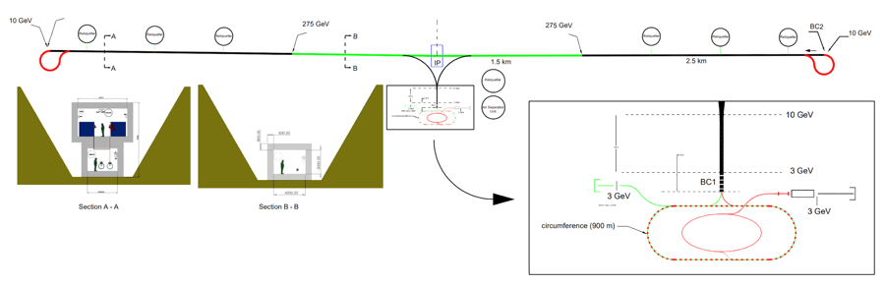
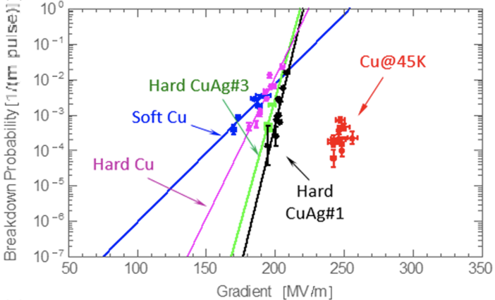
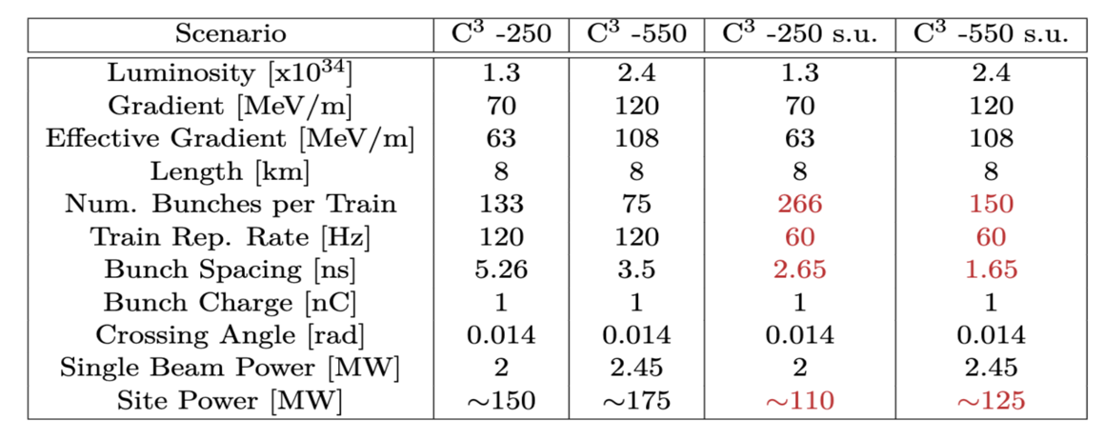
Accelerator Complex
12
8 km footprint for 250/550 GeV CoM ⟹ 70/120 MeV/m
Large portions of accelerator complex compatible between LC technologies
Beam delivery / IP modified from ILC (1.5 km for 550 GeV CoM), compatible w/ ILC-like detector
Damping rings and injectors to be optimized with CLIC as baseline
Snowmass paper: https://arxiv.org/pdf/2203.07646.pdf
Cahill, A. D., et al. PRAB 21.10 (2018): 102002.

Slide 13
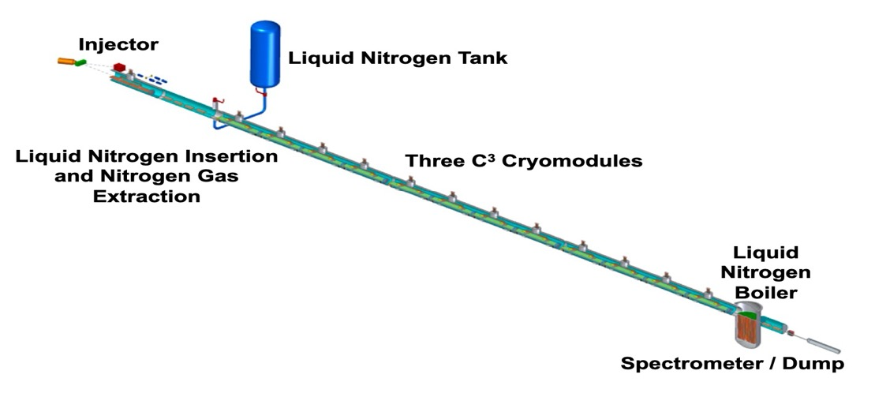
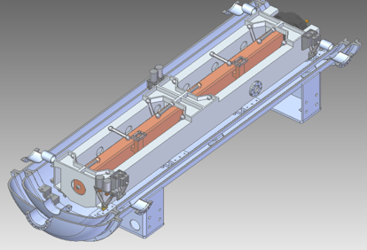
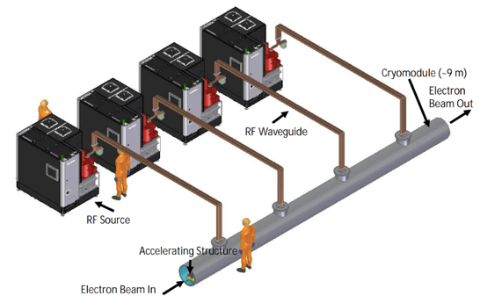
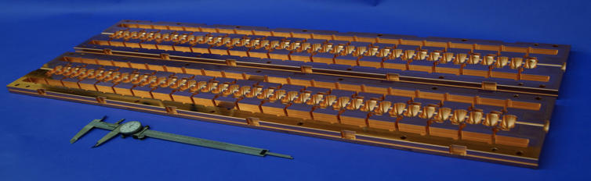
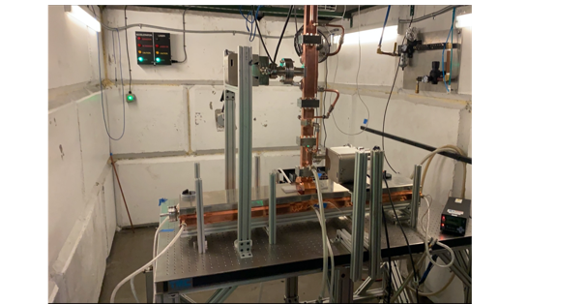
C3 Recent Developments and Immediate Plans
Towards a technology demonstrator
QCM:
Delivery of prototype quarter cryomodule (QCM) expected Fall 2024
Address Gradient, Vibrations, Damping, Alignment, Cryo, etc
Demonstrate fully engineered cryomodule
~50 m scale facility
3 GeV energy reach
C³ Main Linac Cryomodule
9 m (600 MeV/ 1 GeV)
C³ Prototype One Meter Structure

Slide 14
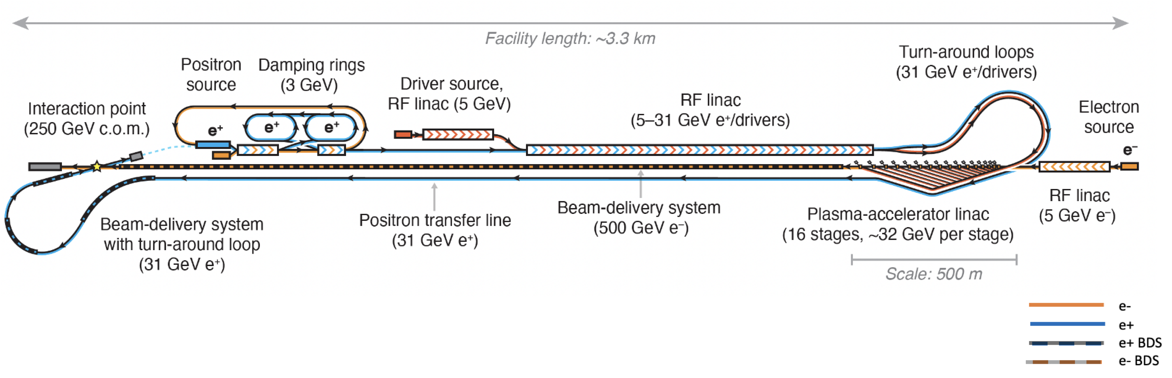
HALHF: A hybrid, asymmetric, linear Higgs factory
e⁻ e⁺ asymmetry of 4
IP boost of 2.13 (HERA 3)
e⁻ ε_{ny} of 0.56 μm
L ~ 1x10³⁴/cm²/s
Foster, D’Arcy and Lindstrøm, New J. Phys. 25, 093037 (2023)
Lindstrøm, D’Arcy and Foster, arXiv:2312.04975
E. Adli, EFCA seminar,
https://indico.cern.ch/event/1361604/contributions/6190120/
The concept enables us to work towards :
Performance of the plasma linac? (Emittance, efficiency, effective gradient, tolerances, polarization...)
How to integrate a plasma linac in a collider? (linac technology, time structure, drive-beam scheme..)
Requirements of the plasma source? (Rep. rate, time structure, heating..)
Asymmetric collisions? (Specific to HALHF)

Slide 15
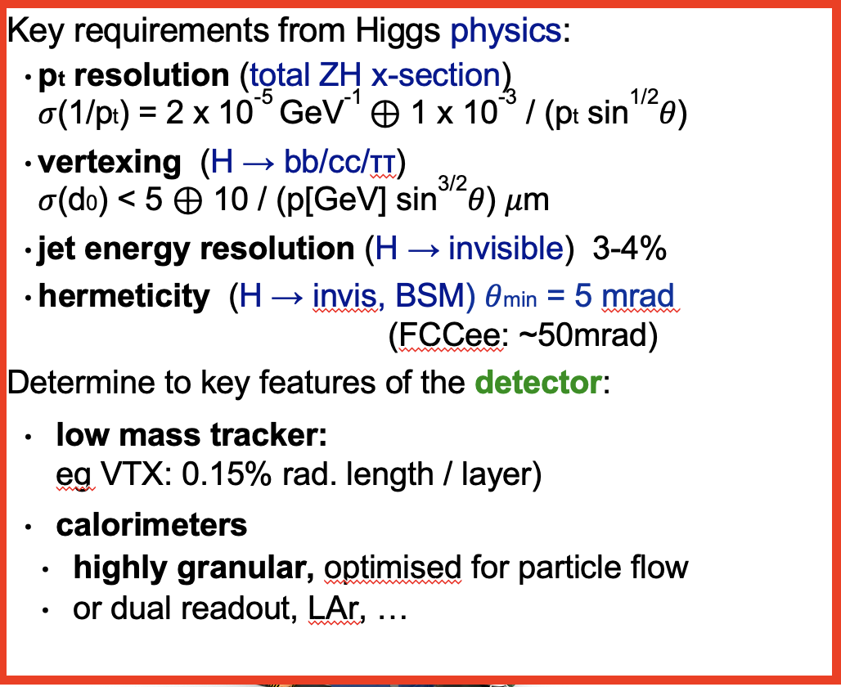
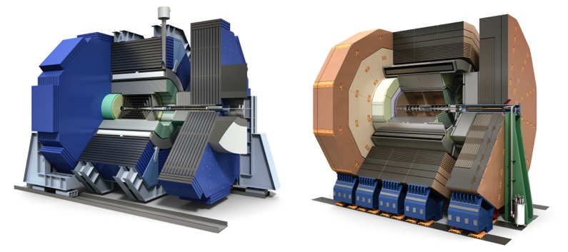
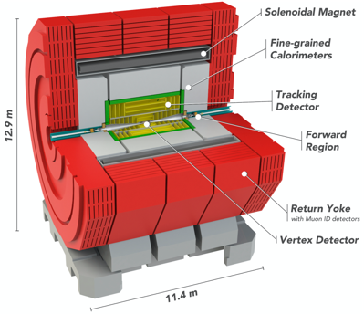
Higgs Factory Detector Concepts
For LCs, bunches inside trains
at ILC: Δtb = 554 ns; frep = 5 -10 Hz
at CLIC: Δtb = 0.5 ns; frep = 50-100 Hz
The lower collision rate enables
passive cooling only => low material budget
triggerless operation
≈ CMS / 40
≈ CMS / 4
≈ ATLAS / 2
≈ ATLAS / 3

Slide 16
LCVision: a Vision for a
Linear Collider Facility at CERN.

Slide 17
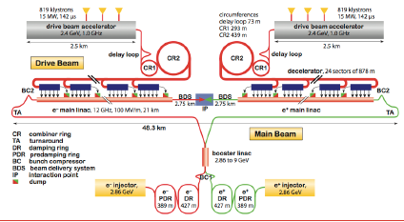
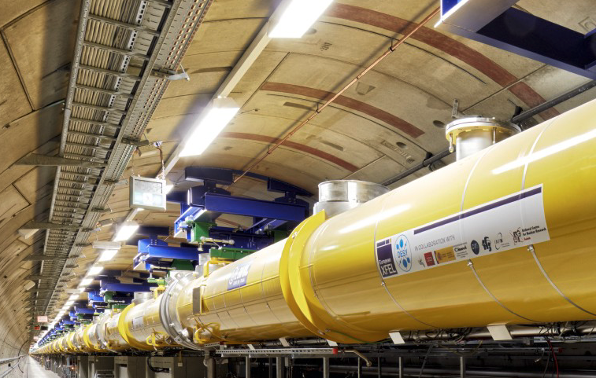
A Linear Collider Facility at CERN
A Linear Collider Vision
CLIC: e⁺e⁻ @ 0.38, 1.5, 3 TeV
Conceptual Design 2012
Updated Baseline in 2017 & 2021 for Snowmass
2-beam acceleration
What could be the initial technology?
  For many years, CERN pioneered CLIC
  — from 380 GeV to 3 TeV
    drive beam technology demonstrated
    for first stage klystron option
    detailed design and costing
    => first stage can be built within CERN budget
    (shown in CLIC Project Implementation Plan, 2018)
However, could also consider to start out with a linear collider based superconducting RF
  proven and industrialised technology
  strong general interest in technology around the world
  significant industrial production capacities in Europe (and elsewhere)
  strong lab expertise outside of CERN => could take significant load off CERNs shoulders while still busy with / paying off HL-LHC
  CERN site actually been studied for ILC TDR…
Opportunity to minimize time until next project
=> crucial for next generation of our community!

Slide 18

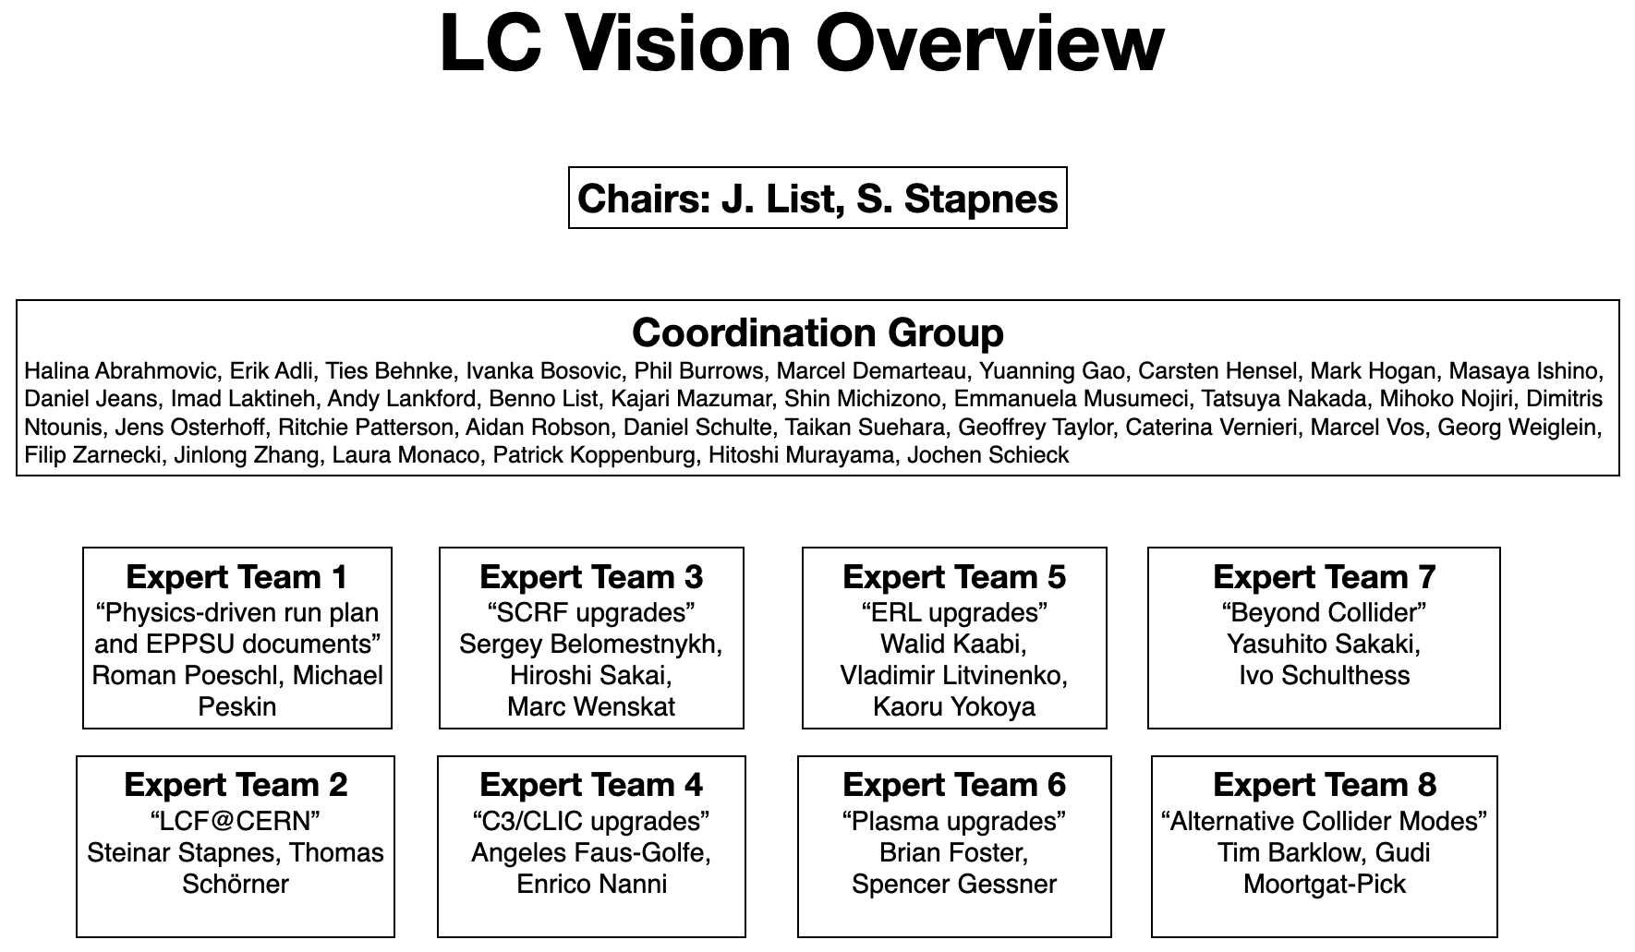
LC Vision: Preparing EPPSU inputs
A forum to make the physics case and develop a proposal for a linear collider facility at CERN
ILC in Japan (IDT)
CLIC at CERN
LC Vision
Advanced SCRF
C³
LC Physics Case & long-term vision
Technologies and upgrades
ERLs
HALHF
LCF @ CERN
10 TeV Wakefield
𝛾𝛾 / e𝛾 collider
“National Inputs”
JAHEP, US (P5), …
Spain, France, UK, Germany …
Beyond Collider
ECR representatives:
Dmitris Ntounis
Emanuela Musumeci

Slide 19
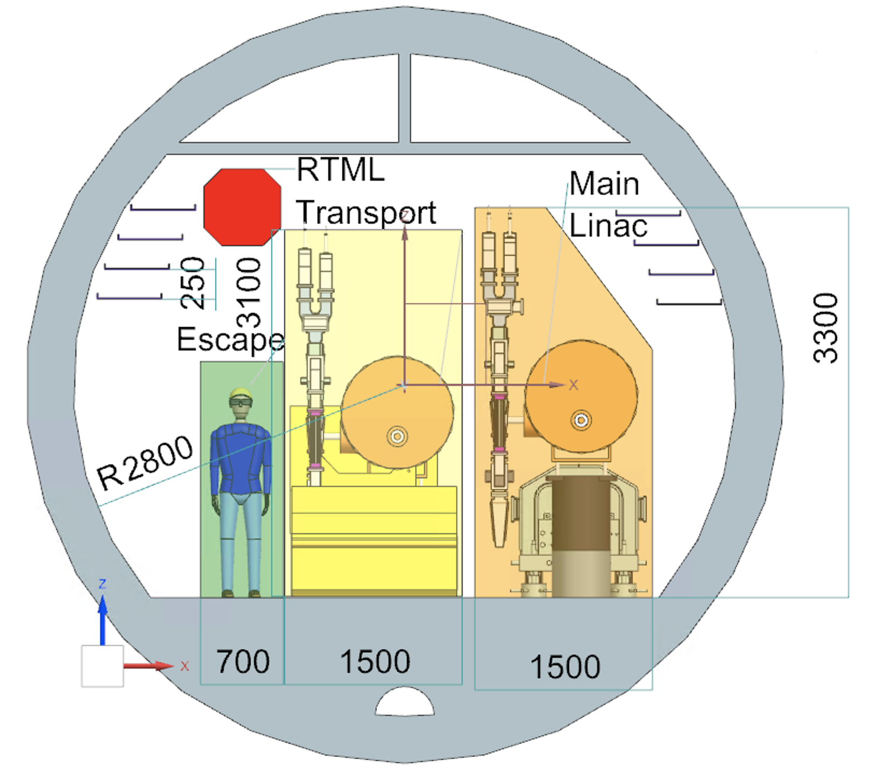
A Linear Collider Facility at CERN
Concept under discussion in LCVision team
Initially facility
  Based on superconducting (ILC) technology
  Higgs factory with 250 GeV (length: 20.5km)
  alternative 550 GeV (33.5km)
  Luminosity 2.7·10³⁴ at 250GeV, alternative 5.4·10³⁴
  Two interaction points (sharing luminosity)
  Single tunnel, TBM (tunnel boring machine),
  5.6m diameter -> suitable for Geneva area
  Space for extracted beam facilities for non-colliding experiments and R&D
  Compatible with upgrades to 1 … 1.5TeV
Upgrade paths
  Luminosity (more power, energy/particle recovery)
  Energy (new technology or extended tunnel)
  Possible technologies: CLIC, C³, plasma, ERL…

Slide 20
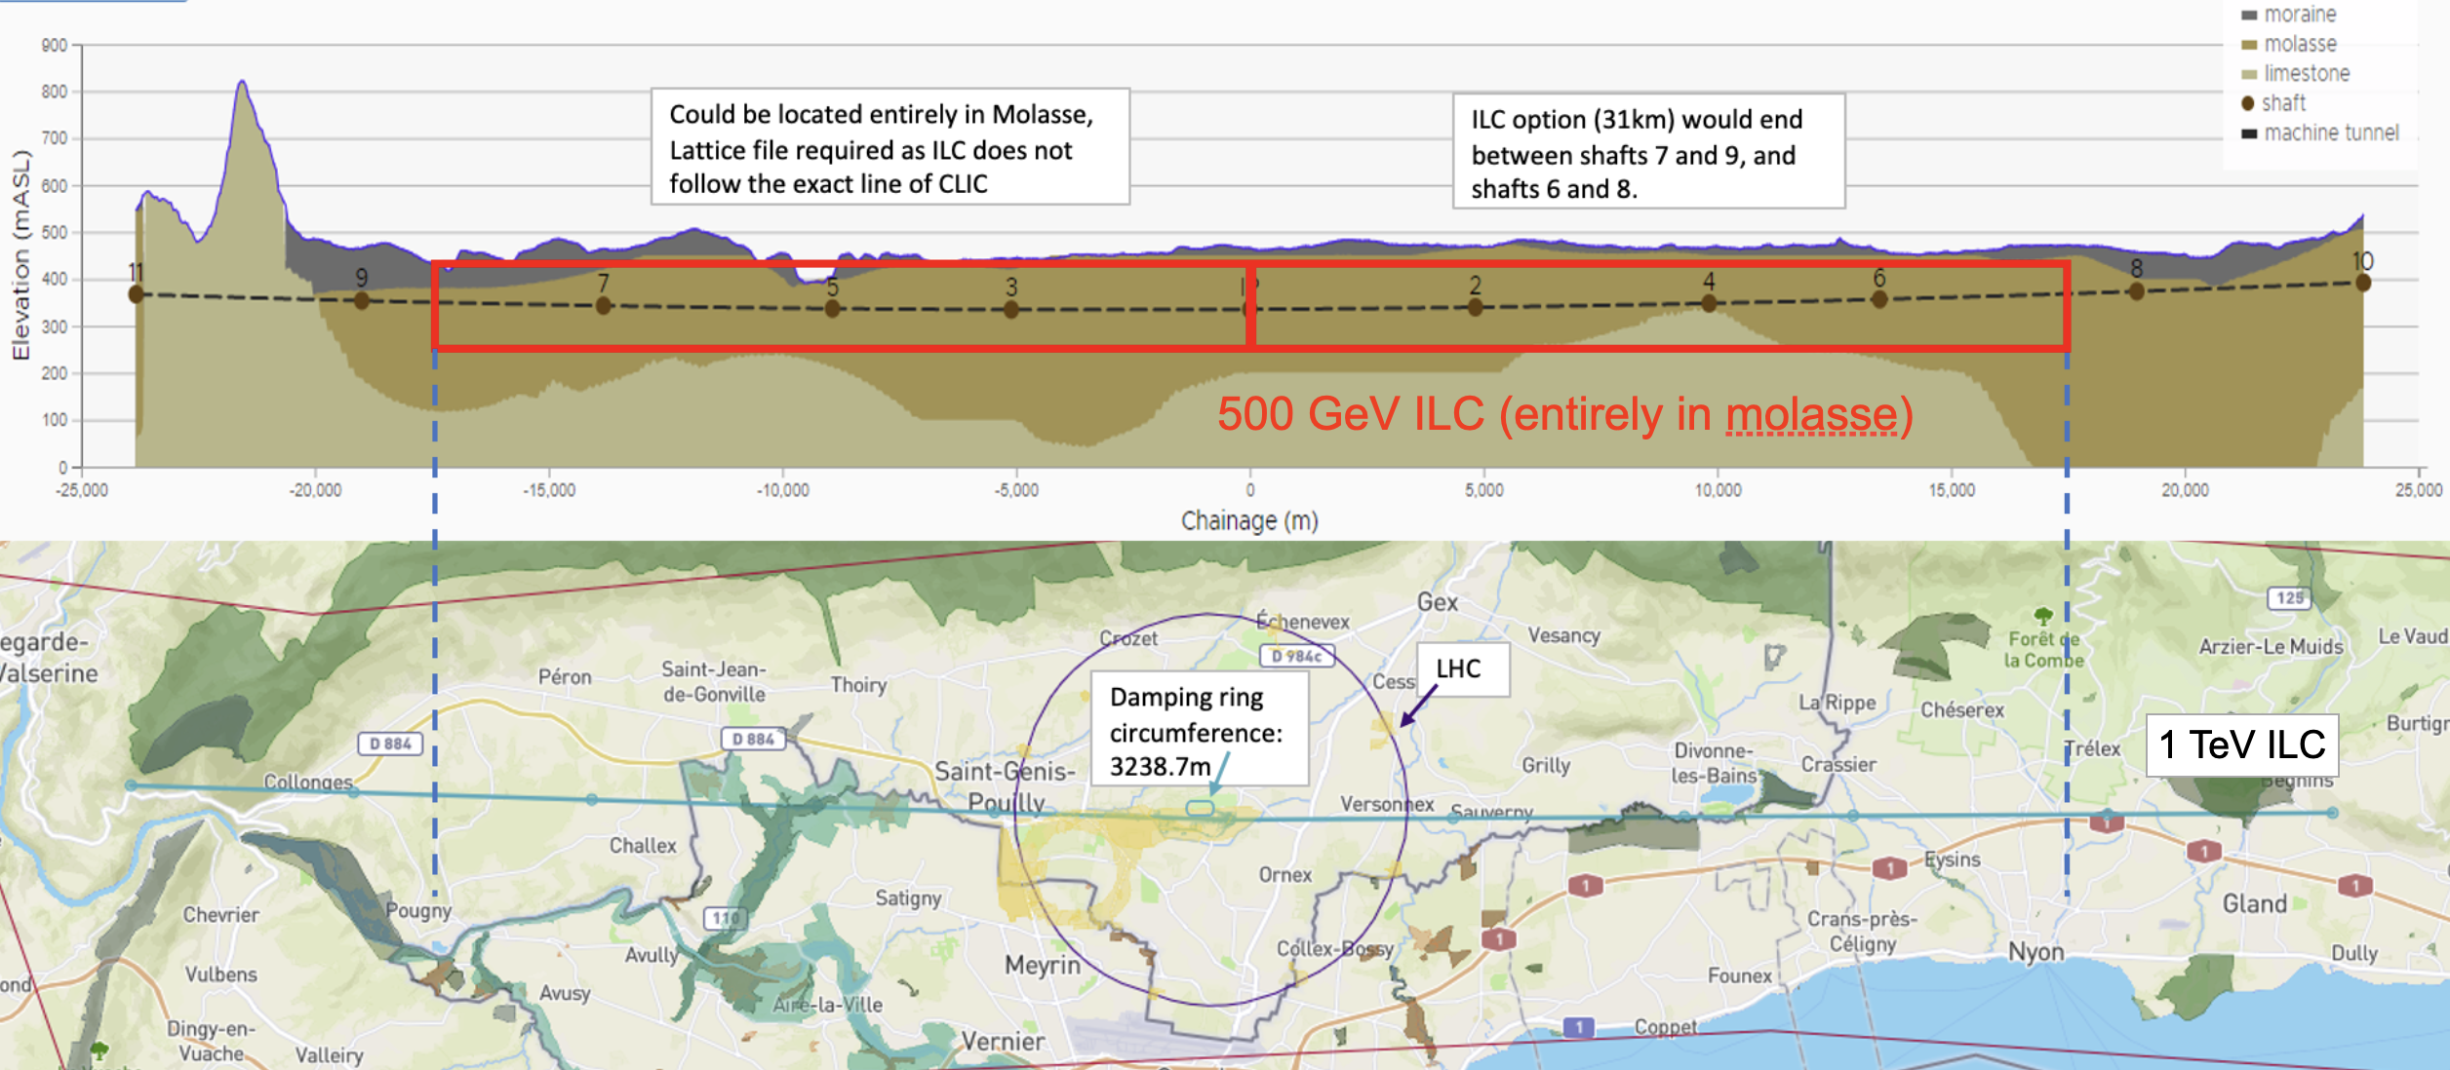
Siting Study at CERN
Siting study (including cost estimate) for CERN in preparation, based on CLIC siting
Relatively shallow,
33km completely in benign molasse

Slide 21
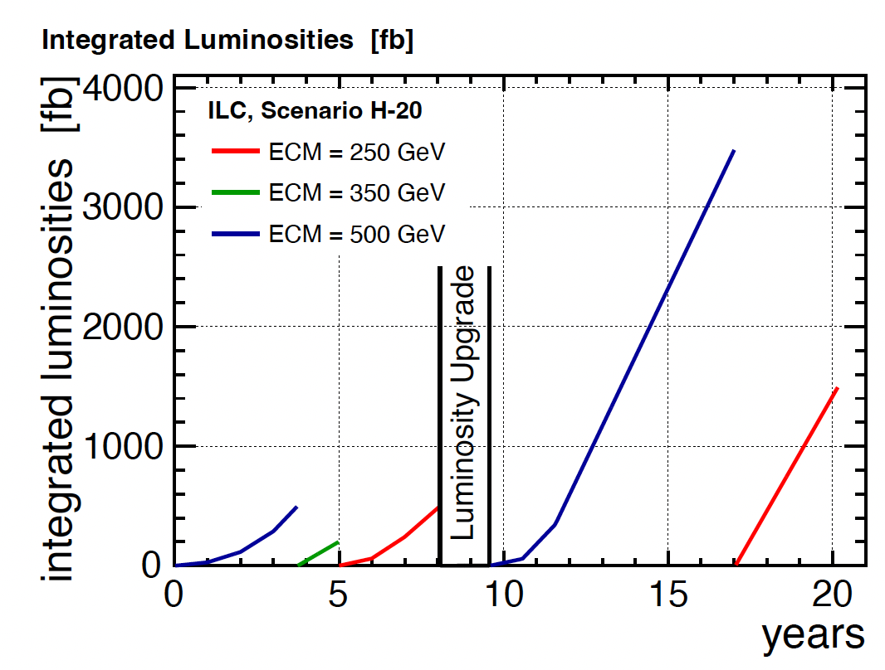
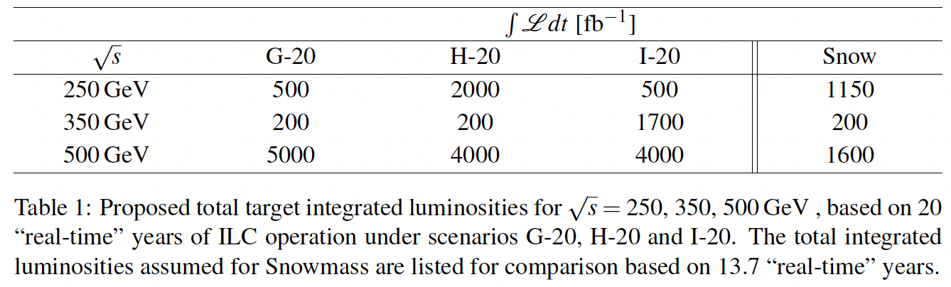
Running Scenarios
A flexible, 20 years+ program
Different scenarios:
  Start with a minimal machine at 250 GeV, upgrade later
  Or, exploit highest energies first, if full 550GeV available
All scenarios take into account ramp up time
(10%/30%/60% lumi in first 3 years)
Assumption: 75% availability, 8 months running
-> 1.6E7 seconds / year
Ref: arXiv:1506.07830, arXiv:1710.07621

Slide 22
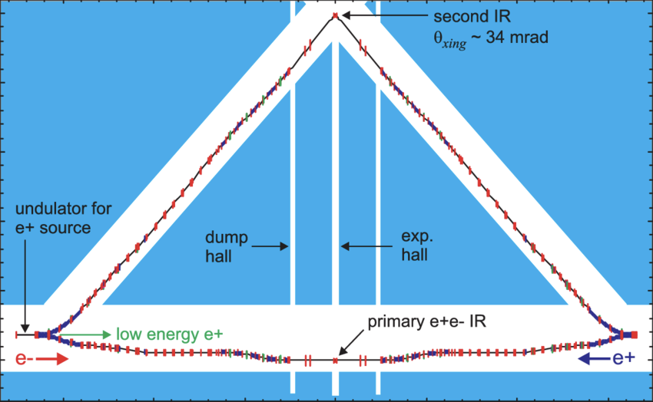
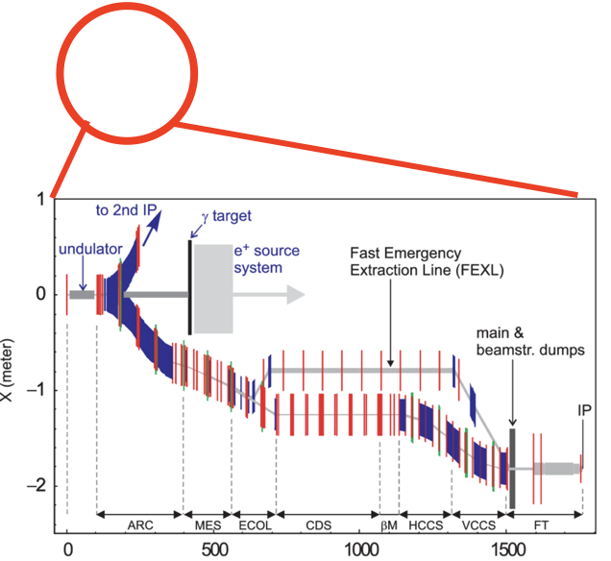
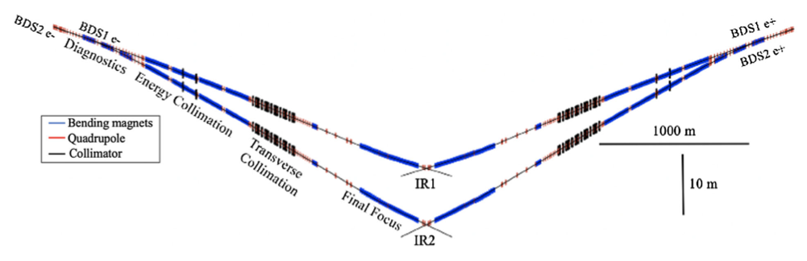
2nd Interaction Region — for 2nd e+e- detector — or 𝝲𝝲 / e𝝲 / e-e- ?
2 different interaction regions for additional physics opportunities
2nd Beam Delivery System (BDS) to 2nd Interaction Region, served “quasi-concurrently”, by switching on train-by-train basis have been designed for ILC & CLIC
eliminating it from ILC baseline “saved” O(0.250) BILCU — has been reinstantiated for a Linear Collider Facility
2 IRs are important for
  2 detectors for redundancy, technological complementarity, systematic cross-checks, competition
  special collision modes: e-e- / 𝜸e / 𝜸𝜸 , each adding specialized, unique physics opportunities
  …but do of course not double the e+e- luminosity

Slide 23
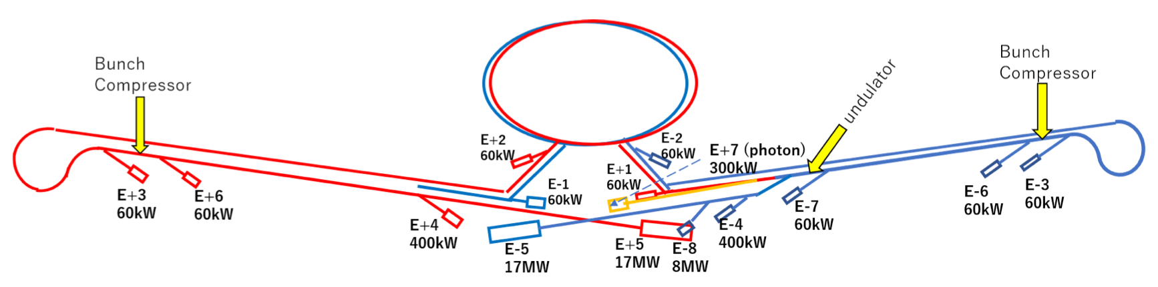
Beyond e+e- Collisions: Beam Dump & Fixed Target Experiments
Broadening the user base
Ample opportunities to foresee beam extraction / dump instrumentation / far detectors at a LCF
  extraction of bunches before IP -> mono-energetic, extremely stable, few 10¹⁰ @ 1-10 Hz
    super-LUXE (SF-QED 𝝌 = O(few hundred) & BSM search)
    super-LDMX, …
  disrupted beam after IP -> broad energy and highly divergent, but up to 10¹⁵ eot / s
    super-SHIP, generic dark photon and ALP searches
    => together with e+e- cover all Dark Sector portals
Studied for ILC around 2021
Revisit for LCF — estimate size of user community?
References:
ILCX workshop
Chap 11 of arXiv:2203.07622

Slide 24
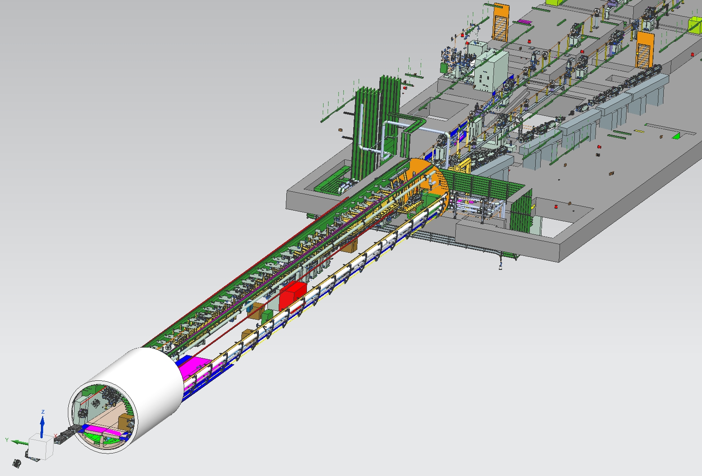
Beyond e+e- Collisions: Test and R&D facilities
low-emittance, mono-energetic beams ideal for
  high-rate detector and beam instrumentation tests
  creating low-emittance beams of photons / muons / neutrons for various applications (hadron spectroscopy, material science, irradiation, tomography, radioactive isotope production, …
  accelerator development:
    high-gradient accelerating structures, new final focus schemes, deceleration (for ERLs), beam and laser driven plasma, …
    from extracted beam to test small setups - to large-scale demonstrators for upgrades of the main facility
impact on e+e- luminosity?
  ILC: ~1300 / ~2600 bunches per train
  extracting 10 bunches per train is few-permille loss in luminosity
ILCX workshop
Pioneering this now at DESY / Eu.XFEL with ELBEX facility
(beam extraction for LUXE & other applications)
Planned LUXE experiment
at DESY

Slide 25
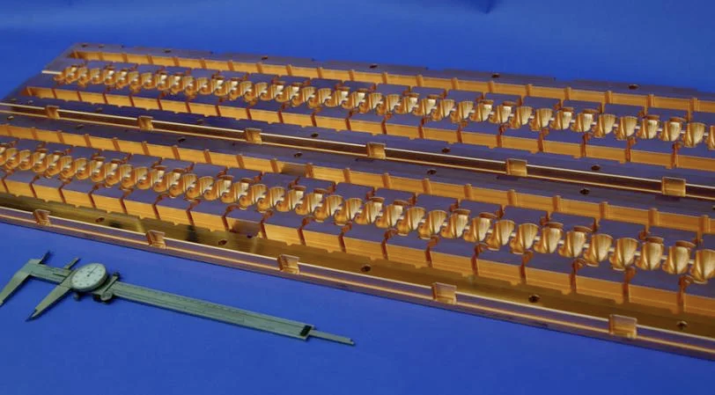
Upgrade option: Higher Energy
Increasing the energy by conventional accelerator technology
ILC TDR: upgrade of SCRF machine up to ~1 TeV
  extend tunnel to ~50 km, upgrade power to 300 MW
  => huge but unsexy? Still: guaranteed fall-back…
Advanced SCRF
  higher gradient cavities exist in the lab (> 60 MV/m vs 31.5 MV/m ILC design), though ~10..20 years until industrialisation
  => upgrade to ~ 1 TeV or less new tunnel
rip out SCRF and replace by X-band copper cavities (à la CLIC or C³)
  Raise gradient to 70-150 MV / m
  => double (3x, 4x …?) energy without tunnel extension
  sell / donate SCRF modules to build XFELs, irradiation facilities, … all around the world
Ref: Chap 15 of arXiv:2203.07622
LC Vision Baseline: higher energy by advanced technology,
tunnel extension fall-back

Slide 26
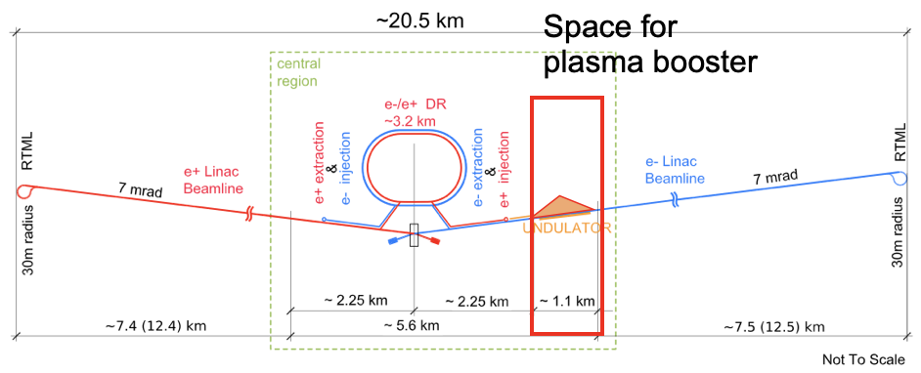
Upgrade Options - Double E_{CM} by “HALHFing” LCF
Employing novel accelerator technologies
Apply HALHF concept to eg 250 GeV ILC:
  plasma-accelerate e- to 550 GeV
  keep e+ linac (small upgrade 125 -> 137.5 GeV)
⇒ 137.5 GeV × 550GeV ⇒ E_{CM} = 550 GeV
⇒ upgrade Higgs Factory to tt / tth / Zhh factory
How?
  Reduce e- linac energy by 4 to 34.4GeV
  Drive 16 stage plasma accelerator
  Use space between electron ML and BDS to install plasma booster
  Feed boosted electrons into existing BDS (already laid out for E_{beam} ≈ 500 GeV)
 |  | E- (drive) | E- (Collide) | E+
Beam energy | GeV | 34.4 | 34.4 → 550 | 137.5
Linac Gradient | MV/m | 8.7 |  | 35
CoM energy | GeV | 550
Bunch charge | nC | 4.3 | 1.6 | 6.4
Bunches/pulse |  | 10496 | 656 | 656
Rep rate | Hz | 5
Beam power | MW | 8.0 | 0.18 → 2.9 | 2.9
Lumi (approx.) | cm⁻²s⁻¹ | ~ 1 · 10³⁴
Ref: BL, HALHF workshop Erice

Slide 27
Upgrade Options - Higher Luminosity à la “ReLiC”
Energy recovery: gateway to the highest luminosities
Energy and particle recovery by de-celaration and re-cooling
Conceptual study indicates up to O(100) higher luminosity than ILC / CLIC conceivable
Effectively no beamstrahlung => even Higgs resonance operation not fundamentally excluded (conceptual idea exists but needs verification by beam optics study)
Integrate R&D and demonstrator into initial LCF, upgrade option if successful?
arXiv:2203.06476 [hep-ex]

Slide 28

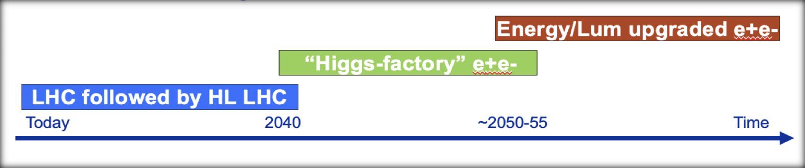

A Linear Collider Facility and the Energy Frontier
Complementarity to a O(10 TeV)-parton-E_{CM} scale facility
An e+e- Linear Collider Facility does not pre-emt the choice of how to explore the energy frontier
=> can choose independently based on scientific and technological developments
nor is it coupled to the site:
=> if technology ready fast, could start building energy frontier machine without stopping e+e- program
Important: need significant R&D program and demonstrators to bring advanced accelerators to
construction readiness - must be part of the overall picture (funding, people, facilities…)

Slide 29
The LCVision Plan
ILC very mature, in Japan, also possible at CERN
CLIC mature, studied for CERN
C3 progressing fast, HALHF new concept, Energy Recovery concept(s)
LC at CERN
Reminder: a LC can be upgraded in length and technology
From existing international projects to a new vision for a CERN facility
Evaluate cost, schedule etc based on existing projects
Transfer / adapt to CERN
Input to the European Strategy:
  Linear Collider physics case (site independent)
  Linear Collider Facility at CERN proposal
Will be based on
  Updated 2024 ILC costs
  CLIC project implementation plan
  CERN site study, updated and costed
  Design adaptions for CERN site
-> based on data presented in the following
LC Vision

Slide 30
Costs, Schedule,
Organisation, and Risks.

Slide 31
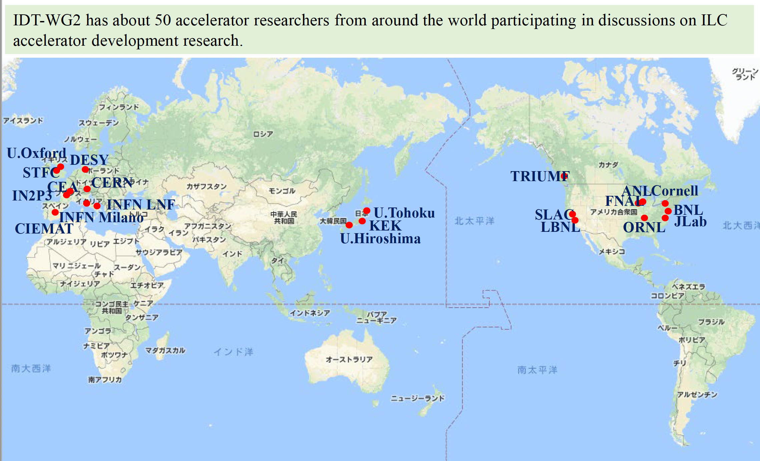
ILC International Development Team IDT and
ILC Technology Network ITN
From IDT and ITN to LCVision
2020/21: International Development Team IDT:
mandated by ICFA, hosted by KEK, to move ILC towards construction
2022/23: ILC Technology Network: Addresses critical technical developments; based on bilateral agreements with KEK, supported by MEXT
2024: LCVision: Group of interested people to formulate a linear collider vision for CERN to be submitted to the EPPSU

Slide 32
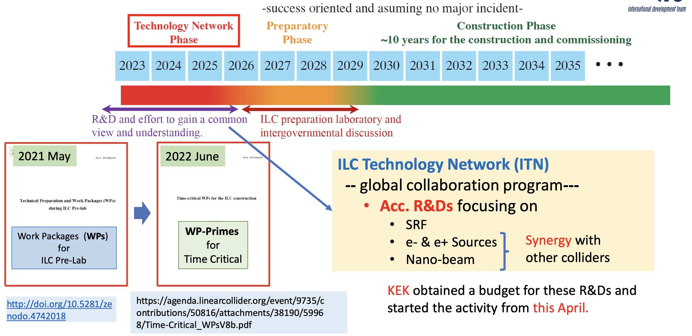
ILC Timeline
S. Michizono, LCWS 20223
4-year preparation phase to produce an Engineering Design Report and Project Implementation Plan
After project approval and construction start: 10 years of construction
=> A linear collider facility at CERN would be ready for construction in time for next project

Slide 33
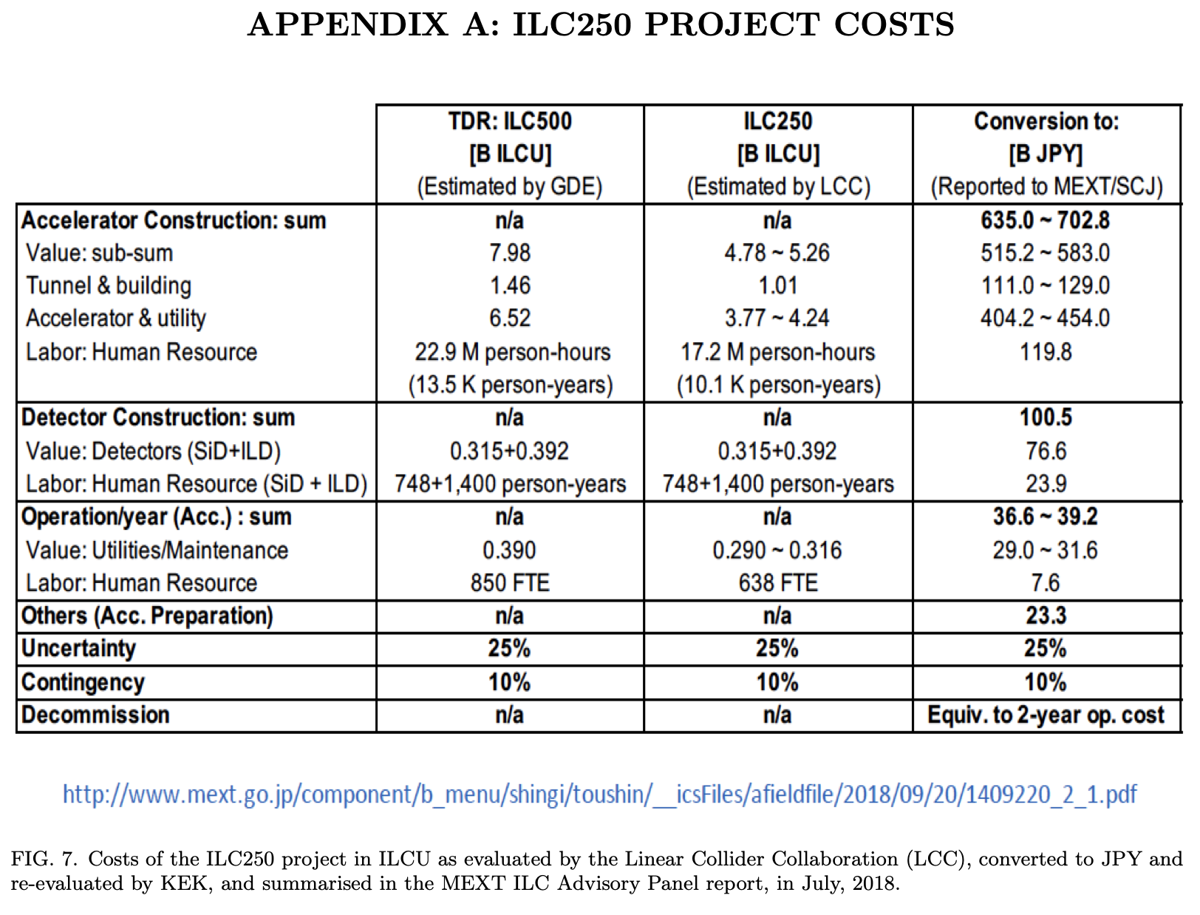
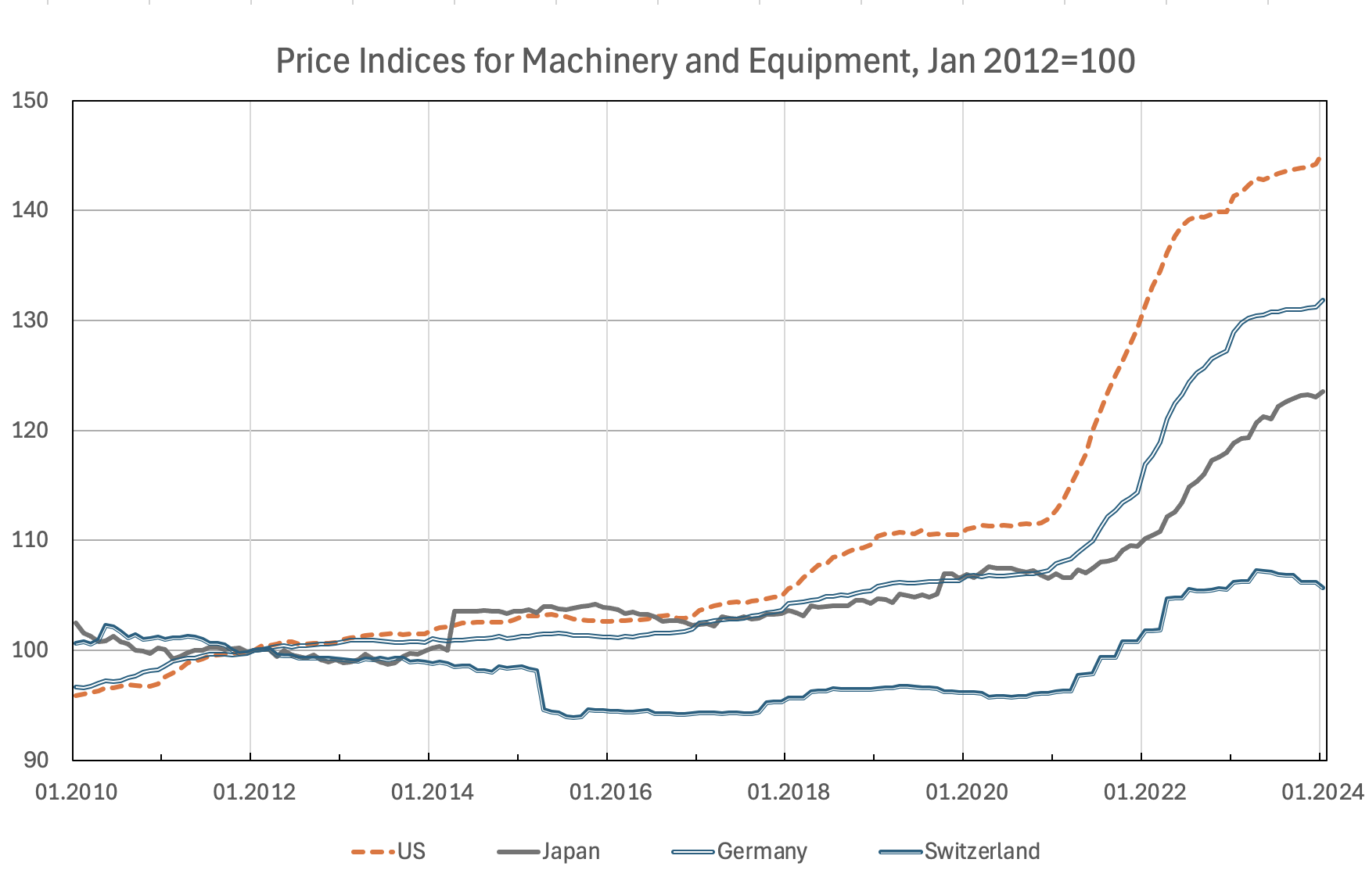
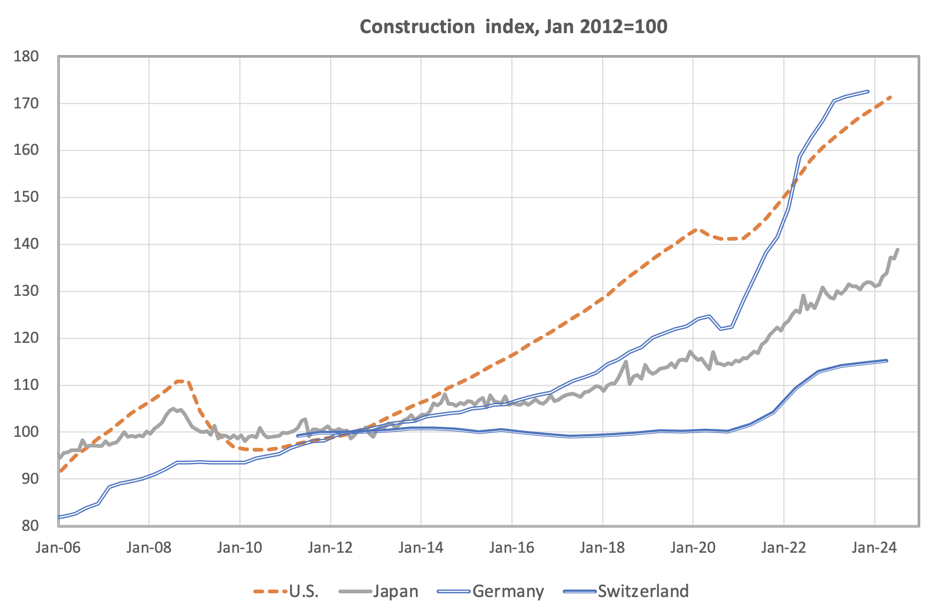
Cost Estimates - ILC
Cost estimates for ILC in 2012 US$ (today: US$ ≃ CHF)
(ILC Currency Unit ILCU), for the Japanese site:
  TDR: 500GeV, 31.5km tunnel: 7.98 BILCU + 13.5 kFTE-y,
  operation 390 MILCU/y + 850 FTE
  Higgs factory: 250GeV, 20.5km tunnel: 5.26 BILCU + 10.1 kFTE-y,
  operation 316 MILCU + 638 FTE
  + 2 detectors: 0.71 BILCU + 2.1 kFTE-y
  Costs include accelerator and civil construction,
  exclude site activation (roads, power lines) and land acquisition
  Substantial inflation since 2021
  Updated cost estimate being prepared for input to
  European Strategy update, in 2024 prices
    New estimates for main cost drivers (75% of cost):
    civil construction and SRF
    Other items scaled up for inflation
ILC 250 cost estimate
Machinery and Equipment
2012->2024
US: +45%
Construction
2012->2024
Germany: +32%
Japan: +24%
Japan: +30%
Switzerland: +6%
Switzerland: +15%

Slide 34
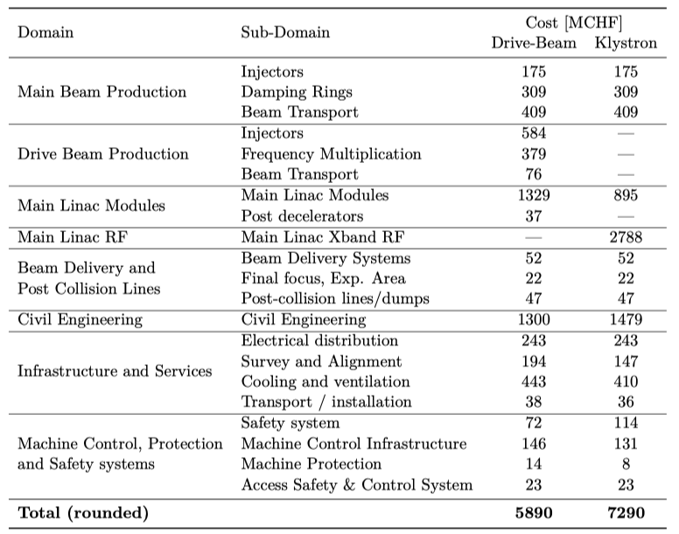
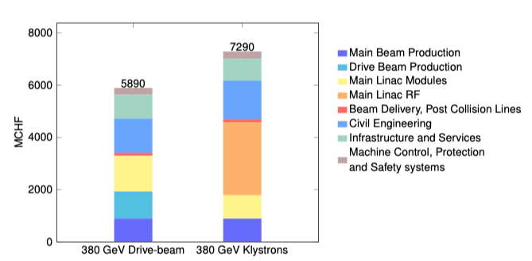
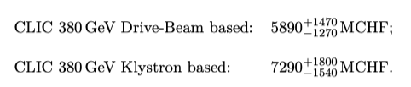
CLIC Cost
Machine has been re-costed bottom-up in 2017-18 (LINK)
Methods and costings validated at review on 7 November 2018 – similar to LHC, ILC, CLIC CDR
Technical uncertainty and commercial uncertainty estimated
From 380 GeV to 1.5 TeV, add 5.1 BCHF (drive-beam RF upgrade and lengthening of ML)
From 1.5 TeV to 3 TeV, add 7.3 BCHF (second drive-beam complex and lengthening of ML)
Labour estimate: ~11500 FTE for the 380 GeV construction
Updated cost in preparation

Slide 35



Technological Readiness and Risk
ILC can be built
Technological readiness of subsystems and key components was evaluated in preparation of ILC technology network and in Snowmass process
No show stoppers found,
  positron source is technologically most challenging
  (TRL 5-6, score 2 from Snowmass implementation task force (arXiv:2208.06030)
SRF technology fully industrialised (E-XFEL, LCLS-II)
-> low technology and cost risk

Slide 36

German Perspective
Germany has a long tradition and strong leadership position in linear accelerators
Strong participation and leadership in
  Physics studies for e+e-
  Detector development for ILC, CLIC
  Accelerator technology
Strong industrial base for superconducting technology in Germany and Europe
Lots of experience at DESY
  SC technology know how
  Construction and operation experience of E-XFEL
  Test facilities for material, cavities, cryo modules
German labs, universities and industry are strong participants for LC projects

Slide 37
Sustainability.

Slide 38


Sustainability Approach
A high priority for all planned projects
Close collaboration between ILC and CLIC on sustainability aspects, similar efforts by C3
Common lifecycle assessment (LCA) studies on
  Civil construction (finished)
  Accelerator & detectors (ongoing)
Overarching concepts for sustainable accelerator projects (“Green ILC”)
Address whole lifecycle and all aspects: overall system design, components, operation models

Slide 39




LCA of Civil Engineering Infrastructure
Evaluate the impact to improve it
LCA study of tunnels, shafts and caverns:
  Common study for ILC and CLIC (link)
  Professional consultant company: ARUP
  Include two design alternatives for CLIC:
  Two-beam acceleration or klystron driven
Results:
  CLIC 2-beam design: 127 kton CO2-e (+ surface bldgs.)
  CLIC klystron: 290 kton CO2-e
  ILC (250GeV CoM): 266 kton CO2-e
LCA helps to compare design alternatives
LCA identifies reduction potential:
  20% from using low carbon cement (CEM III/A)
  12% from thinner lining
  (9% from future electricity mix -> not a project decision)
Upgrades
Full study: https://edms.cern.ch/document/2917948/1
Reduction Potential: 41%
Further
Impact
categories

Slide 40




LCA of Accelerator
LCA of accelerator and detectors much more demanding than civil infrastructure:
  Many different components
  Many materials, also unusual materials
ILC and CLIC started LCA effort with ARUP
Study still ongoing, looking in detail on Main Linac building blocks:
  ILC Cryomodule
  CLIC two beam module
Main Linac components add several tons of CO2 per meter compared to Main Linac tunnels at 6-7 tons/m
S. Doebert, LCWS 2024
Comparison of CLIC Main Linac
for 2-beam and klystron options

Slide 41

Power Consumption: ILC and CLIC
Power consumption of ILC and CLIC:
  ILC 250: 111 / 138 MW baseline / luminosity upgrade
  ILC 500: 164 MW
  CLIC 380: 107 MW
For CERN in 2040, assume 12.5g CO₂-e/kWh (today: ~50)
Yearly energy consumption: 0.6 – 1.0 TWh
-> CERN today: 1.2TWh (LHC: ~0.6 TWh)
Power consumption of a linear collider facility is comparable to LHC power consumption today
https://accelconf.web.cern.ch/eefact2022/papers/frxas0101.pdf
 | ILC 250 |  | ILC 500 | CLIC 380
 | baseline | upgrade
Power (MW) | 111 | 138 | 164 | 107
Electricity (TWh/y) | 0.66 | 0.82 | 0.97 | 0.6
CO2 at CERN (kton/y) | 8 | 10 | 12 | 7

Slide 42


Power and Energy
Energy Consumption beyond a Higgs factory
To set a scale, 100 MW with the running scenario on the right this corresponds to ~0.6 TWh annually
CERN is currently consuming 1.2 – 1.3 TWh annually
CERN “standard” running scenario used to convert to annual energy use
Includes studies of overall designs optimisation to reduce power, SRF cavities (grad,Q), cryo efficiency, RF power system (klystrons, modulators, components), RF to beam efficiencies, permanent magnets, operation when power is abundant, heat recovery, nanobeam and more.
Recent overview for linear colliders (LINK)

Slide 43





Running on renewables and when electricity is cheap
Two studies in 2017 for CERN / CLIC (Fraunhofer institute):
Supply the annual electricity demand of the CLIC-380 by installing local wind and PV generators (this could be e.g. achieved by 330 MW-peak PV and 220 MW-peak wind generators) at a cost of slightly more than 10% of the CLIC 380 GeV cost.
  Study done for 200 MW, in reality only ~110 MW are needed
Self-sufficiency during all times can not be reached but 54% of the time
Can one run an accelerator as CLIC in a mode where one turn “on” and “off” depending prices (fluctuating with weather, demand, availability etc) ? Demand side flexibility*.
Specify transition times (relatively fast for a LC) and the annual luminosity goal
Significant savings – but the largest saving is the obvious one, not running in the winter.
Flexibility to adjust the power demand is expected to become increasingly important and in demand by energy companies.
Future availability of affordable 100MWh-size batteries will improve prospects
More information (link)
*C. Gaunand, B. Remenyi: Introduction to Demand Side Flexibility
ESSRI Workshop 2022 https://indico.esrf.fr/event/2/contributions/94/
Victor Gleim CC-BY-SA-4.0
CC-BY-4.0 IEA, batteries and secure energy transition,
https://www.iea.org/reports/batteries-and-secure-energy-transitions
Prospects to run fully on renewables are good
Operational flexibility of linear accelerators is an advantage
Less energy is always better
Heat recovery:
Already implemented in point 8 for LHC
Another approach to increase sustainability

Slide 44

Greenhouse Gas Emissions over the Full Lifecycle
Consider construction, operation, and upgrades
Work in progress – this example is closest to the CLIC drive-beam parameters, detectors and computing (and travels) not considered
This is for 11 km of tunnel, scales with length
More power (here 0.7 TWh) or more carbon (here 12g/kWh) will increase this quickly

Slide 45

CO₂ of Accelerator Projects in Perspective
How does an accelerator compare to other human activities
CO2 emissions of accelerator projects:
  100s of kton CO2 for construction
  100kton is yearly CO2 emission of CERN
  Civil construction: 250 kton
  Yearly operation in 2040 (est):
  7-10 kton (at CERN)
A linear collider facility has a sizeable
CO2 impact, dominated by civil construction
Shorter tunnel and lower power consumption
are strong sustainability arguments
CO2 footprint (kton) | LC 250 | CLIC 380
Civil construction | 266 | 127 / 290
Accelerator | tbd | tbd
Yearly operation | 10 | 7

Slide 46
Conclusions and
Outlook.

Slide 47
Conclusions
A linear collider facility for CERN, based on superconducting ILC technology
Offers a Higgs factory at at a reasonable cost and time scale, with upgrade options
Profits from a large international experience and interest – good opportunities for in-kind contributions
Offers a rich long-term physics programme with guaranteed results, and a long-term perspective through future upgrades
  Including rich opportunities for diverse non-collider experiments and R&D facilities
Can be expanded for more energy or luminosity, as needs arise and funds are available
Is a sustainable solution, with respect to embodied carbon from construction and energy usage in operation
Keeps Europe at the forefront of particle physics

Slide 48
Outlook
LCVision inputs for the EPPSU
Umbrella document of physics case & upgrade options
Proposal for Linear Collider Facility at CERN
  ILC like initial facility adapted to CERN
  Civil engineering study, based on CLIC design study plus ILC at CERN siting study of TDR
  Cost estimate based on
    Updated 2024 ILC costs
    Translated into CHF and CERN procurement model
    CERN civil engineering costs
As part of the new Strategy:
Pursue Linear Collider Facility project at CERN up to decision readiness
Engineering Design Study for a CERN based project
  Based on the ILC and CLIC designs and R&D plans
  Together with the existing ILC, CLIC and wider Linear Collider communities
  Including a specific siting proposal

Slide 49
Thank you.
Thanks to
Steinar Stapnes, Jenny List, Emilio Nanni, Brian Foster, Erik Adli, Ties Behnke, Shin Michizono, Nobuhiro Terunuma, Phil Burrows, Suzanne Evans, Maxim Titov and many others for their material and support

Slide 50
Benno List
IPP
Benno.List@desy.de

Slide 52

Luminosity and Power

Slide 53
e
LC physics opportunities - reminder
arXiv:2206.08326
e+e- colliders show very comparable performance for standard Higgs program, despite quite different assumed integrated luminosities => longitudinal beam polarization an important factor for LCs
several couplings at few-0.1% level: Z, W, g, b, τ
some more at ~1%: γ, c

Slide 54
ILC Site Selection and Civil Engineering
Detector Hall
Kitakami mountains
granite zone
Damping Ring

Slide 55

CLIC 380GeV Layout
P. Burrows, EPS 2019, https://indico.cern.ch/event/577856/contributions/3420379/
Baseline electron polarisation ±80%

Slide 56


ILC250 accelerator facility
Rotating target for e+ source
Item | Parameters
C.M. Energy | 250 GeV
Length | 20km
Luminosity | 1.35 x10³⁴ cm⁻²s⁻¹
Repetition | 5 Hz
Beam Pulse Period | 0.73 ms
Beam Current | 5.8 mA (in pulse)
Beam size (y) at FF | 7.7 nm＠250GeV
SRF Cavity G. Q₀ | 31.5 MV/m (35 MV/m) Q₀ = 1x10 ¹⁰
e- Main Linac
RTML(e-)
(Ring To ML)
e+ Source
Beam delivery system (BDS)
Main beam dump
Area systems
e-/e+ sources
DR
RTML
ML
BDS
Dump
Dump
e- Source
Damping Ring (DR)
e+ Main Liinac
Total 20.5 km
RTML(e+)
(Ring To ML)
Key Technologies
Nano-beam Technology
SRF Accelerating Technology
8,000 SRF cavities will be used.

Slide 57


The CLIC ESPP update – II

Slide 58

Siting Study for CERN, cont’d
Main linac tunnel geometry:
5.6m diameter, single tunnel, CLIC compatible
CLIC tunnel (arXiv:1903.08655)

Slide 59


The ILC250 accelerator facility
Undulator based polarized positron source
Parameters and plans for luminosity and energy upgrades are available, including information about relevant SCRF R&D for such upgrades at (Snowmass input)

Slide 60


CLIC parameters (Snowmass)

Slide 61



HALHF: A Hybrid, Asymmetric, Linear Higgs Factory
New concept, aiming for pre-CDR (LINK)
500 GeV for electrons with plasma acceleration
31 GeV positrons with RF based linac, used also to provide electron drivebeam for the plasma acceleration
Reach 250 GeV collision energy, luminosity 10³⁴
Asymmetric technologies, energies and bunch charges
Small footprint, lower cost
Several key plasma acc. challenges:
Multi-staging, emittances, energy spread, stabilities, spin polarisation preservation, efficiencies, rep rate, plasma cell cooling and more
Conventional beam(s) challenges:
Positron production, damping rings, RF linac, beam delivery system
Experimental challenges with asymmetric beams
Energy recovery options, potentially very large luminosities but early stage of development

Slide 62

The updated Priority Work Packages (WP’)
S. Michizono, LCWS 20223

Slide 63

Some recent ILC developments - I
Above: ILC Technology Network (ITN), interest/capability matrix from 28 labs/universities
European ITN studies are distributed over five main activity areas:
ML related tasks
SRF and ML elements: Cavities and Cryo Module, Crab-cavities, ML quads and cold BPMs (INFN, CEA, DESY, CERN, IJCLAB, UK, CIEMAT, IFIC)
Sources
Pulsed magnet and wheel/target (Uni.H, DESY, CERN)
Damping Ring including kickers
Low Emittance Rings (UK)
ATF activities, final focus and nanobeams
ATS and MDI (UK, DESY, IJCLAB, CERN, IFIC)
Implementation
Dump, CE, Cryo – follow up efforts at CERN
Sustainability, Life Cycle Assessment (CERN, DESY, CEA, UK groups)
EAJADE started (EU funding) (DESY, UK, CEA, CNRS, IFIC, INFN, UHH, CERN)
WPP | 1 | Cavity production
WPP | 2 | CM design
WPP | 3 | Crab cavity
WPP | 4 | E- source
WPP | 6 | Undulator target
WPP | 7 | Undulator focusing
WPP | 8 | E-driven target
WPP | 9 | E-driven focusing
WPP | 10 | E-driven capture
WPP | 11 | Target replacement
WPP | 12 | DR System design
WPP | 14 | DR Injection/extraction
WPP | 15 | Final focus
WPP | 16 | Final doublet
WPP | 17 | Main dump

Slide 64

Costs
Cost exercises and international reviews:
ILC TDR 2012-13, 500 GeV primarily (LINK)
CLIC CDR 2012-13, 3 TeV primarily and 500 GeV (LINK)
ILC in Japan 2017-18, 250 GeV, reviewed within LCC (LINK)
CLIC PiP 2018, 380 GeV primarily (LINK)
Updates and reviews underway (e.g. scheduled in December for ILC costs)
For the ESPP – concerning starting with ILC at CERN:
Updated: ILC in Japan with updated technology results, updated CFS (CE and conv. systems, SCRF) – discussed on slide 10
CERN implementation: CE costs based on CLIC and other CERN projects, same main linac footprint, change in number of shafts, add larger underground DR, remove drivebeam CE and turn arounds, slightly different BDS dimensions and cavern sizes
Notes:
Remove FCC

Slide 65



Modularity as success concept
“Get a small thing, a basic building block. Combine it with another and another until you have what you need. … Modularity delivers faster, cheaper and better … for building at a truly huge scale … modularity is not just valuable, it’s indispensable.”
Flyvbjerg, Gardner “How big things get done”
Study by B. Flyvbjerg and D. Gardner identifies modularity as key factor to success of mega projects
  “What is your lego?”
  Evidence: Most successful mega project type are solar power plants owing to inherent modularity
Cryomodules are the central building block of a superconducting accelerator, large fraction of value
  Get them right, get the project right
Study: performance of 16000 mega projects
according to project type
Solar
Less cost overrun
Better performance
Flyvbjer, Gardner: How big things get done.
https://sites.prh.com/how-big-things-get-done-book

Slide 66


Operation
Operation stage very important:
Large CO2 emissions from electricity production
Impact assessment depends on assumptions of future (reduction of) carbon intensity of electricity → assumptions still under debate
CLIC study indicates that 6 – 17 year of electricity cause as much CO2 as all tunnels/shafts/caverns
- even at very low carbon intensity in France
CLIC study in 2020 about running only on renewables (link):
Total energy is sufficient, fluctuations require grid as buffer
→ modulate operation (demand side flexibility) -> strength of linear accelerators
→ rapidly falling battery prices change the field,
GWh size storage will be affordable in 2030s
IEA (2022), World Energy Outlook 2022, IEA, Paris
https://www.iea.org/reports/world-energy-outlook-2022,
CC BY NC SA 4.0
S. Evans, LCWS 2024
C. Gaunand, B. Remenyi: ESSRI 2022

Slide 67

CLIC Project Readiness 2025-26
Project Readiness Report as a step toward a TDR – for next ESPP
Assuming ESPP in 2026, Project Approval ~ 2028, Project (tunnel) construction can start in ~ 2030.
Focusing on:
The X-band technology readiness for the 380 GeV CLIC initial phase - see earlier slides, more and more driven by use in small compact accelerators
Optimizing the luminosity at 380 GeV – already implemented for Snowmass paper, further work to provide margins will continue
Improving the power efficiency for both the initial phase and at high energies, including more general sustainability studies - see specific slides on this topic above
Goals for the studies by ~2025, key improvements:
    Luminosity numbers, covering beam-dynamics, nanobeam, and positrons - at all energies. Performance risk reduction, system level studies
Energy/power: 380 GeV well underway, 3 TeV to be done, L-band klystron efficiency
Sustainability issues, more work on running/energy models and carbon footprint
X-band progress – for CLIC, smaller machines, industry availability, including RF network
R&D for higher energies, gradient, power, prospects beyond 3 TeV
Cost update, only discuss changes wrt Project Implementation Plan in 2018
Low cost klystron version – reoptimize for power, cost and fewer klystrons

Slide 68



CLIC Civil Engineering, stages and schedules
Technology Driven Schedule from start of construction shown above.
A preparation phase of ~5 years is needed before (estimated resource need for this phase is ~4% of overall project costs)

Slide 69


C3 Power Consumption and Sustainability
Compact footprint <8 km for both underground and surface sites
  Underground – less constraints on energy upgrade
  Surface – lower cost and faster to first physics
Sustainability - construction + operations CO₂ emissions per % sensitivity on couplings
  Polarization and high energy to improve sensitivity
  Construction CO₂ emissions → minimize excavation and concrete
  Operations → limit power, decarbonization of the grid and dedicated renewable sources
250 GeV CoM - Luminosity - 1.3x10³⁴
Parameter | Units | Value
Reliquification Plant Cost | M$/MW | 18
Single Beam Power (125 GeV linac) | MW | 2
Total Beam Power | MW | 4
Total RF Power | MW | 18
Heat Load at Cryogenic Temperature | MW | 9
Electrical Power for RF | MW | 40
Cryoplant Electrical Power | MW | 60
Accelerator Complex Power | MW | ~50
Site Power | MW | ~150
Surface-Site Mockup
Precision-Weighted Carbon Footprint
Slide: E. Nanni
PRX Energy 2.4 (2023): 047001
Notes:
Sustainability lcws talk and paper

Slide 70

Long-Term Timelines in Context

