Slide 1
Linear colliders
@ CERN
Outline
LC general considerations
ILC - in Japan
CLIC - at CERN
Brief: C³ and HALHF, energy recovery options
LC options at CERN, consider ILC technology as starting point, ESPP inputs
Steinar Stapnes – CERN
Jan 23th - 2025

Slide 2
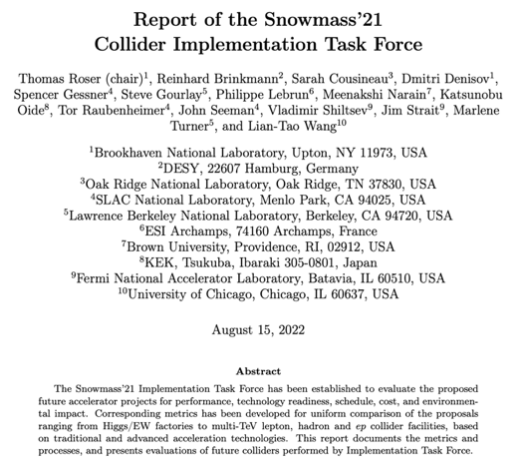
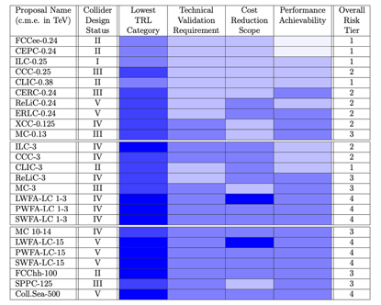
Strategies, past and future
ESPP update 2018-19:
Higgs factory next – project studies
FCC feasibility study
R&D on technologies and projects
The challenge for the EPSS update:
ILC very mature, in Japan, also possible at CERN
CLIC mature, studied for CERN
C3 progressing fast, HALHF new concept, Energy Recovery concept(s)
LC at CERN
Reminder: a LC can be upgraded in length and technology
Snowmass 2021-23 provided(s) an opportunity for formulating new ideas, updated reports, overviews and summaries – for the US and worldwide.
Many ideas, from mature to concepts.
https://arxiv.org/pdf/2208.06030.pdf

Slide 3
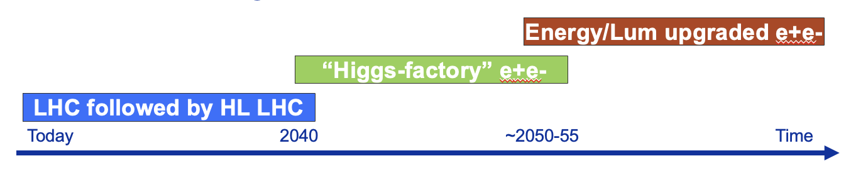
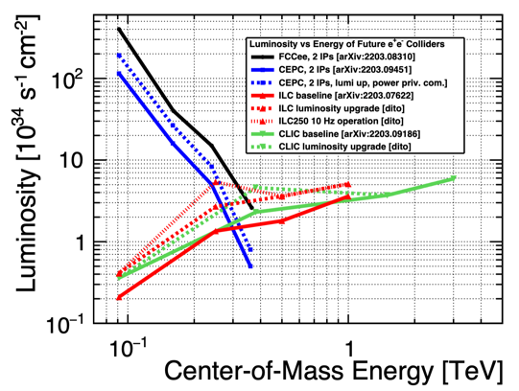
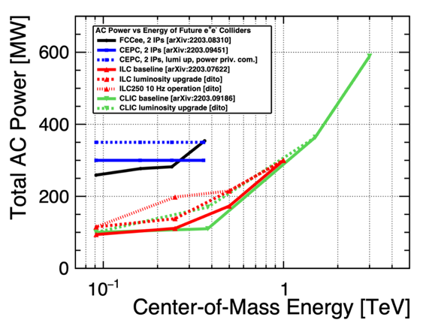
e
LC general considerations - reminder
Start with mature technology, can expand in length and/or technology
Increased luminosity with energy, e.g. 1-3 x 10³⁴ cm⁻²s⁻¹ for Higgs factories at 250 GeV, 6 x 10³⁴ at 3 TeV.
Higher energies “natural” – 3 TeV studied (for CLIC), but many TeVs challenging:
Power increases with energy and luminosity
Reach up to 50km
Higher energy means smaller beams and increasingly important beam-beam effects.

Slide 4
General goals for LCs:
Energy reach and flexibility:
Physics opportunities from Z-pole to 1-2 TeV (maybe more later on)
One can adapt – with limitations – cost, power versus E and L
Allows to adapt to development in physics
Footprint, power and cost:
Lower cost to get to Higgs and top than a circular machine
Power similar to LHC, or lower, for initial configuration
Footprint similar to LHC, CE cost risks therefore manageable
Provide many opportunities and increased flexibility for the future:
Does not determine footprint of future energy frontier machines (hadrons and muon), and it has its own upgrade opportunities
Encourage accelerator and detector R&D for all these options

Slide 5
e
LC physics opportunities - reminder
arXiv:2206.08326
e+e- colliders show very comparable performance for standard Higgs program, despite quite different assumed integrated luminosities => longitudinal beam polarization an important factor for LCs
several couplings at few-0.1% level: Z, W, g, b, τ
some more at ~1%: γ, c

Slide 6
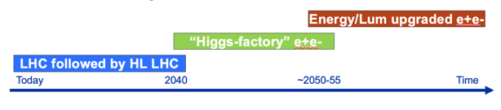
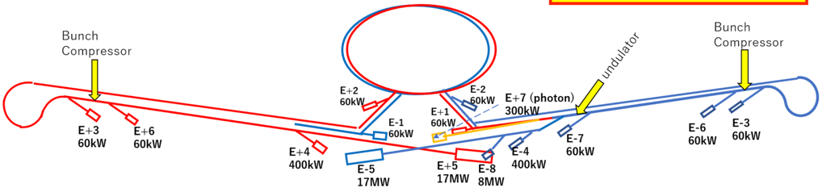
A physics-driven, polarised operating scenario for a Linear Collider
250 GeV, ~2ab-1:
  precision Higgs mass and total ZH cross-section
  Higgs -> invisible (Dark Sector portal)
  basic ffbar and WW program
  optional: WW threshold scan
Z pole, few billion Z’s: EWPOs 10-100x better than today
350 GeV, 200 fb-1:
  precision top mass from threshold scan
500…600 GeV, 4 ab-1:
  Higgs self-coupling in ZHH
  top quark ew couplings
  top Yukawa coupling incl CP structure
  improved Higgs, WW and ffbar
  probe Higgsinos up to ~300 GeV
  probe Heavy Neutral Leptons up to ~600 GeV
800…1000 GeV, 8 ab-1:
  Higgs self-coupling in VBF
  further improvements in tt, ff, WW, ….
  probe Higgsinos up to ~500 GeV
  probe Heavy Neutral Leptons up to ~1000 GeV
  searches, searches, searches, …
Beyond collider:
ILCX – e.g. beam-dump experiments, dark sector physics, light dark matter, strong QED (ILCX workshop)
Test and R&D beams for detector and accelerator studies
From J.List/M.Peskin

Slide 7
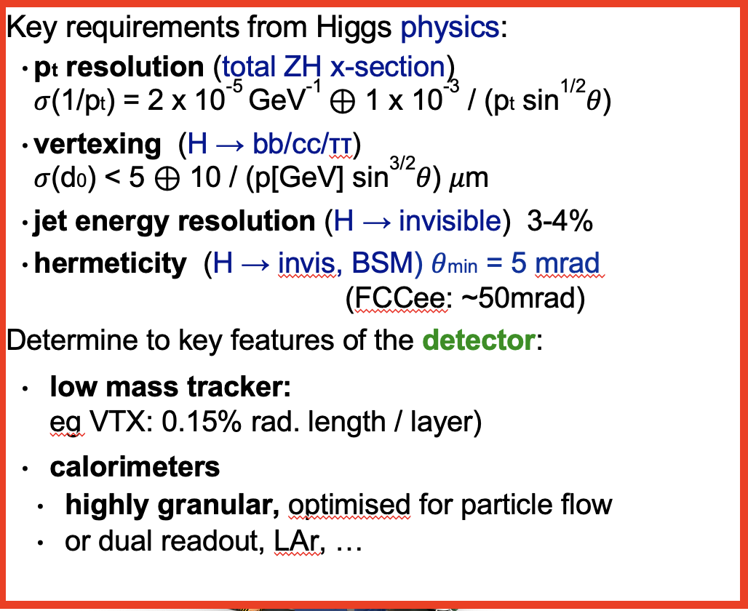
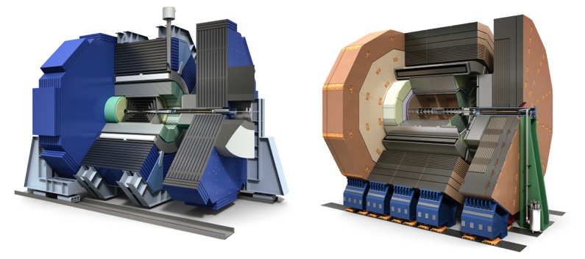
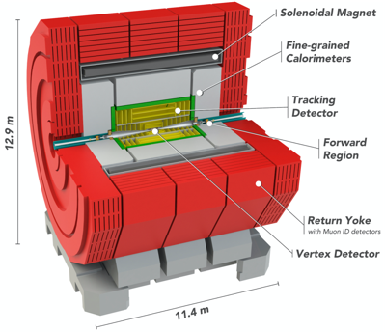
Higgs Factory Detector Concepts
For LCs, bunches inside trains
at ILC: Δtb = 554 ns; frep = 5 -10 Hz
at CLIC: Δtb = 0.5 ns; frep = 50-100 Hz
The lower collision rate enables
passive cooling only => low material budget
triggerless operation
≈ CMS / 40
≈ CMS / 4
≈ ATLAS / 2
≈ ATLAS / 3
From J.List

Slide 8
ILC – general updates and implementation in Japan, with some considerations for a CERN implementation (more later)

Slide 9
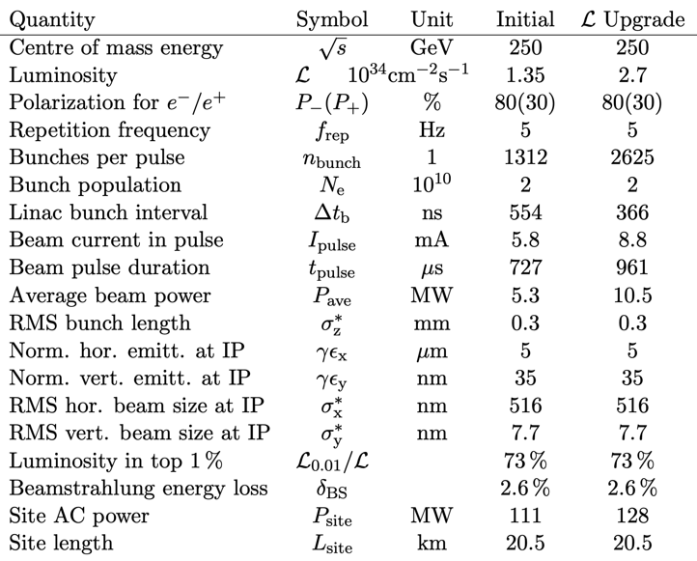
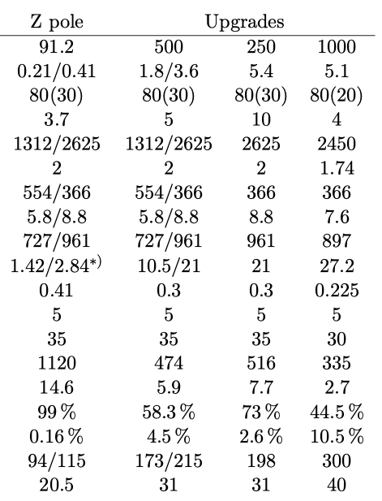
The ILC250 accelerator facility
Undulator based polarized positron source
Parameters and plans for luminosity and energy upgrades are available, including information about relevant SCRF R&D for such upgrades at (Snowmass input)

Slide 10
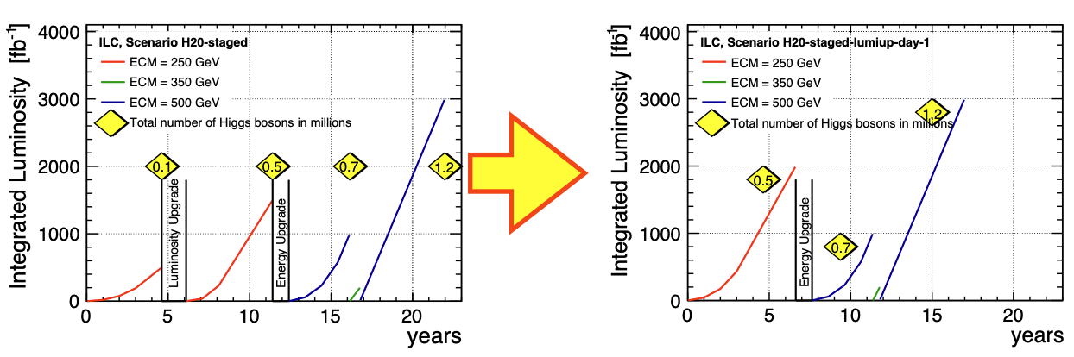
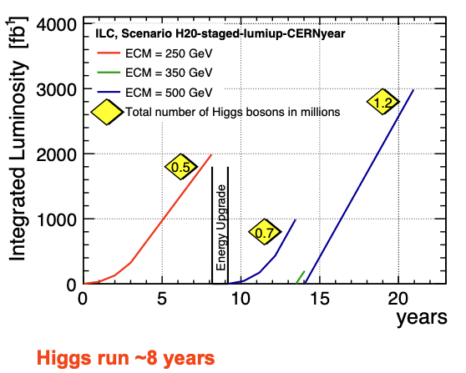
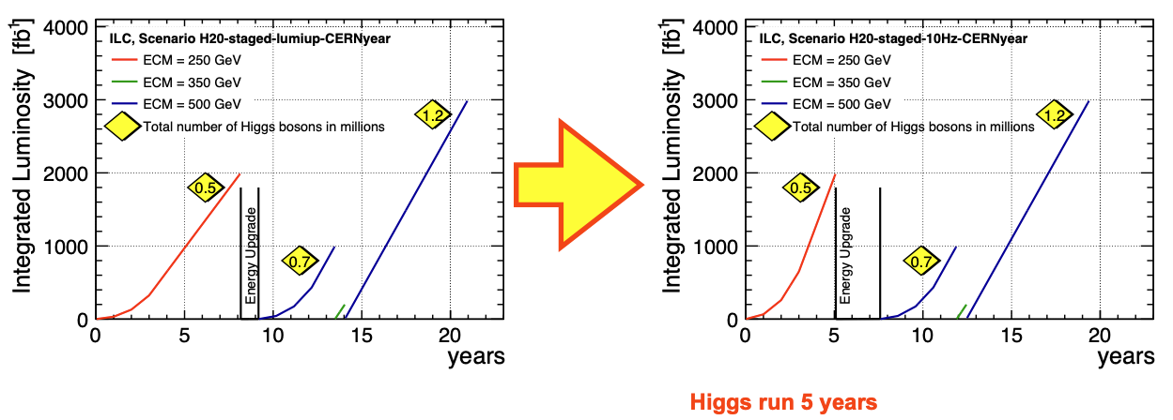
Increasing the number of bunches in a train, and adjusting to a CERN running year
ILC in Japan has a certain run-plan, but one can easily consider higher luminosities and higher energies earlier.
If starting with ILC technology at CERN for a LC this will certainly be considered.
From J.List (link)
Doubling the frequence to 10 Hz (~200 MW). Note that in all
cases a luminosity ramp up is foreseen

Slide 11
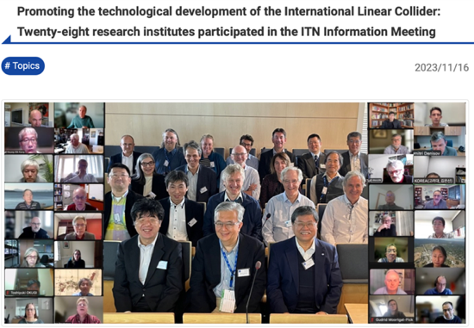
Some recent ILC developments - I
Above: ILC Technology Network (ITN), interest/capability matrix from 28 labs/universities
European ITN studies are distributed over five main activity areas:
ML related tasks
SRF and ML elements: Cavities and Cryo Module, Crab-cavities, ML quads and cold BPMs (INFN, CEA, DESY, CERN, IJCLAB, UK, CIEMAT, IFIC)
Sources
Pulsed magnet and wheel/target (Uni.H, DESY, CERN)
Damping Ring including kickers
Low Emittance Rings (UK)
ATF activities, final focus and nanobeams
ATS and MDI (UK, DESY, IJCLAB, CERN, IFIC)
Implementation
Dump, CE, Cryo – follow up efforts at CERN
Sustainability, Life Cycle Assessment (CERN, DESY, CEA, UK groups)
EAJADE started (EU funding) (DESY, UK, CEA, CNRS, IFIC, INFN, UHH, CERN)
WPP | 1 | Cavity production
WPP | 2 | CM design
WPP | 3 | Crab cavity
WPP | 4 | E- source
WPP | 6 | Undulator target
WPP | 7 | Undulator focusing
WPP | 8 | E-driven target
WPP | 9 | E-driven focusing
WPP | 10 | E-driven capture
WPP | 11 | Target replacement
WPP | 12 | DR System design
WPP | 14 | DR Injection/extraction
WPP | 15 | Final focus
WPP | 16 | Final doublet
WPP | 17 | Main dump

Slide 12
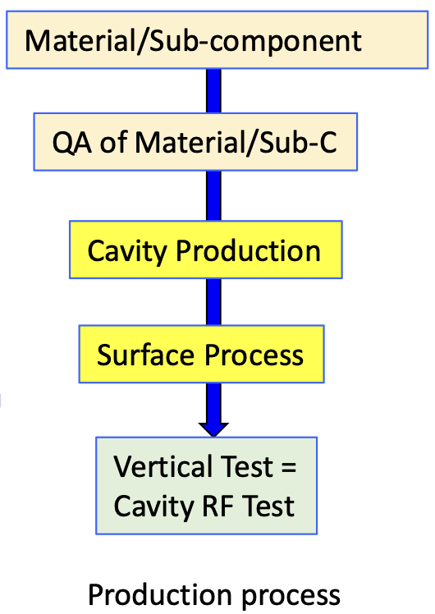
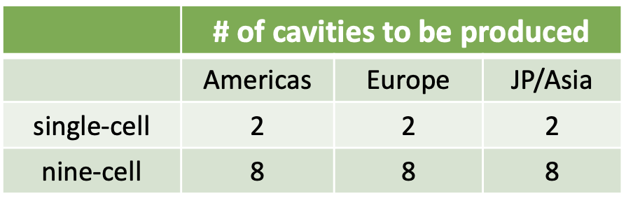
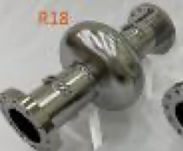
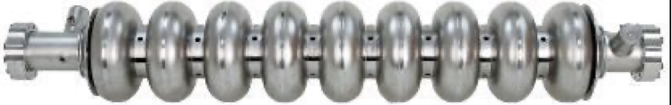
INFN in ITN
ML related tasks
SRF and ML elements: Cavities and Cryo Module, Crab-cavities, ML quads and cold BPMs (INFN, CEA, DESY, CERN, IJCLAB, UK, CIEMAT, IFIC)
Plus key industrial suppliers, R1, ZAMON, Thales, more
Implementation
Dump, CE, Cryo – follow up efforts at CERN
Sustainability, Life Cycle Assessment (CERN, DESY, CEA, UK groups)
EAJADE started (EU funding) (DESY, UK, CEA, CNRS, IFIC, INFN, UHH, CERN)
WPP | 1 | Cavity production
WPP | 2 | CM design
WPP | 3 | Crab cavity
WPP | 4 | E- source
WPP | 6 | Undulator target
WPP | 7 | Undulator focusing
WPP | 8 | E-driven target
WPP | 9 | E-driven focusing
WPP | 10 | E-driven capture
WPP | 11 | Target replacement
WPP | 12 | DR System design
WPP | 14 | DR Injection/extraction
WPP | 15 | Final focus
WPP | 16 | Final doublet
WPP | 17 | Main dump

Slide 13
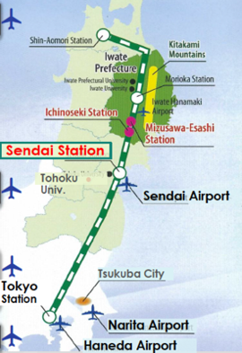
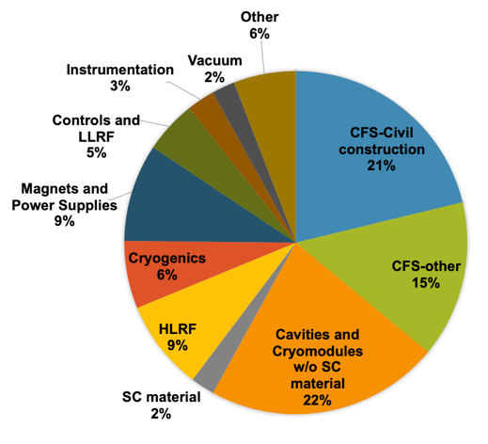
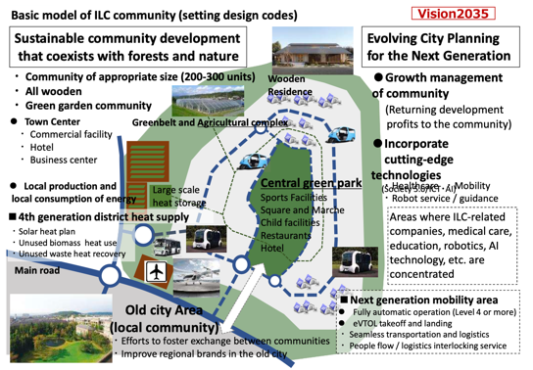
Some recent ILC developments - II
Re-evaluate CFS costs for ILC in Japan
Mountainous site -> mostly sloped access tunnels
CE based on NATM tunnelling method (blast and spayed concrete)
Includes design updates from TDR/ILC-250
Some tunnel and cavern extensions for latest acc. and utility designs
Re-evaluated to 2024 National Cost Estimating Standards
Cost matrix, updating SCRF and CFS (~75%), escalation and currency updates for the rest (~25%)
The ILC implementation is extensively studies in Japan, civil engineering, integration locally, environmental impacts, etc

Slide 14
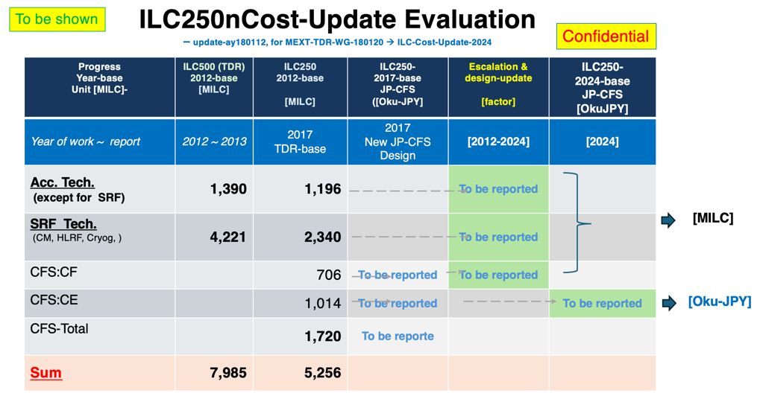
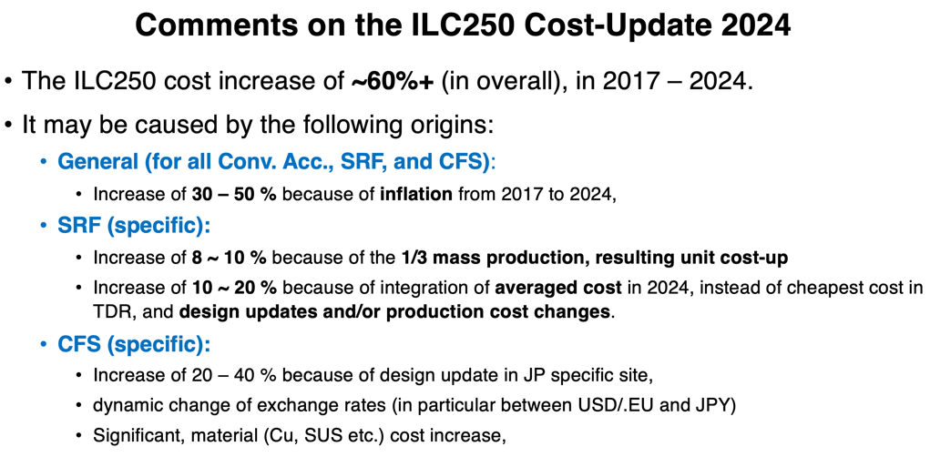
From report by A.Yamamoto (LINK)
For CERN (in progress):
Redo CE costing (see later)
Redo CF costing (EL, CV, etc)
Use 2024 costing for all components in their respective currencies, and change to CHF with exchange rate (not PPP)
Cost second IP
1 CHF = 1.10 $

Slide 15
CLIC at CERN

Slide 16
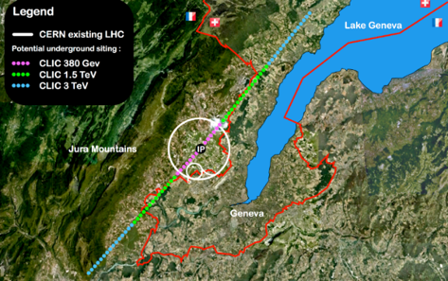
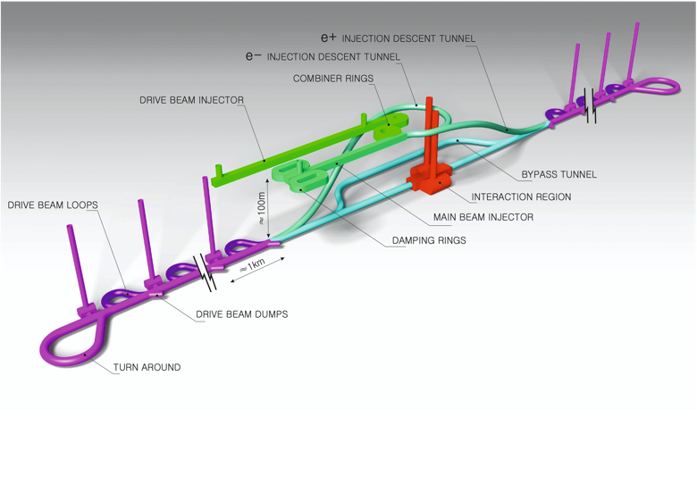
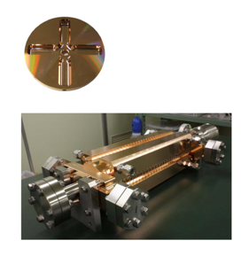
The Compact Linear Collider (CLIC)
  Timeline: Electron-positron linear collider at CERN for the era beyond HL-LHC
  Compact: Novel and unique two-beam accelerating technique with high-gradient room temperature RF cavities (~20’500 structures at 380 GeV), ~11km in its initial phase
  Expandable: Staged programme with collision energies from 380 GeV (Higgs/top) up to 3 TeV (Energy Frontier)
  CDR in 2012 with focus on 3 TeV.
  Project Implementation Plan in 2018 with focus on 380 GeV for Higgs and top.
Accelerating structure prototype for CLIC: 12 GHz (L~25 cm), 100 MV/m

Slide 17
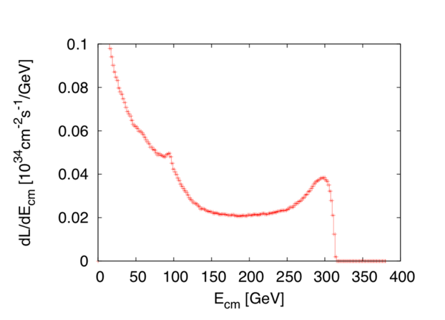
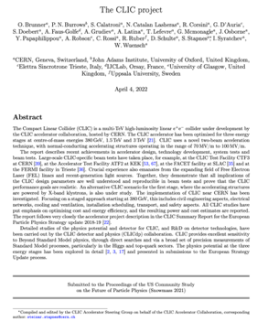
Luminosities studies 2019-22, and continued
      Luminosity margins and increases
      Initial estimates of static and dynamic degradations from damping ring to IP gave: 1.5 x 10³⁴ cm⁻² s⁻¹
      Simulations give 2.8 on average, and 90% of the machines above 2.3 x 10³⁴ cm⁻² s⁻¹
      A “perfect” machine will give : 4.3 x 10³⁴ cm⁻² s⁻¹
      In addition: doubling the frequency (50 Hz to 100 Hz) would double the luminosity, at a cost of ~55% and ~5% power and cost increase
    Z pole performance, 2.3x10³² – 0.4x10³⁴ cm⁻² s⁻¹
      The latter number when accelerator configured for Z running (e.g. early or end of first stage)
      Gamma – Gamma collision luminosity spectrum on the right (example with 190 GeV e-beams)
      These numbers are already included (but 100 Hz only mentioned in passing, not in tables) in the Snowmass report 2021. See link of previous slides.

Slide 18
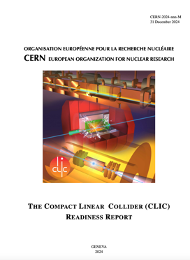
The CLIC ESPP update – I
Guidelines:
Preparing “Project Readiness Report” as a step toward a TDR
Assuming ESPP in ~ 2025-6, Project Approval ~ 2028, Project (tunnel) construction can start in ~ 2030.
Project summary for Snowmass already include some of these changes, i.e. luminosity improvements, 100 Hz study is mentioned, the power is updated for 380 GeV: LINK
Several important changes:
Energy scales: 380 GeV and 1.5 TeV with one drivebeam
Present 100 Hz running at 250 GeV and 380 GeV (i.e. two parallel experiments, two BDSs) – some increased cost and increased power wrt to one IP
New run plan, 10+10 year for two stages (380 -> 1500 GeV) – with ramp-ups
Several updates on parameters (injectors, damping rings, drive-beam) based on new designs, results and prototyping (e.g. klystrons, magnets) - however no fundamental changes beyond staying at one drivebeam
Technology use examples, including more on use of them in other projects (e.g. alignment, instrumentation, X-band RF is small linacs)
Update costing and power – interplay between inflation and CHF
Life Cycle Assessments
More detailed prep phase planning (next 5-7 years)

Slide 19
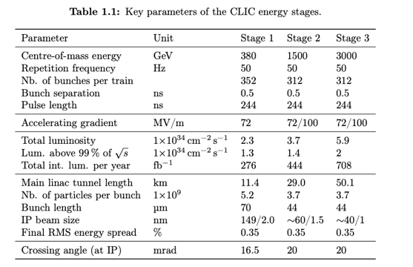
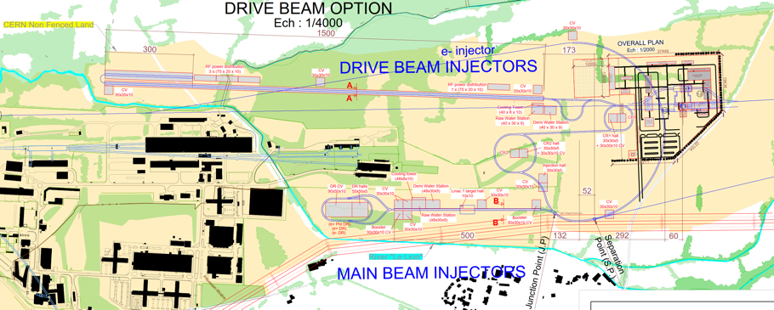
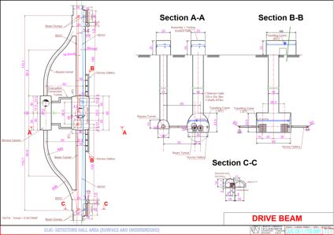
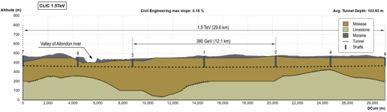
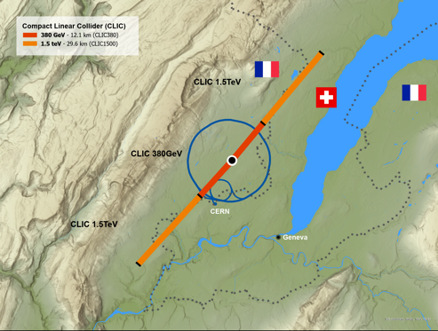

The CLIC ESPP update - II
Add:
250 GeV parameters
100 Hz running for both 250 and 380 GeV
3 TeV: refer to earlier reports

Slide 20
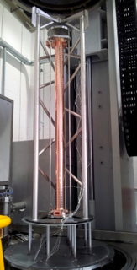
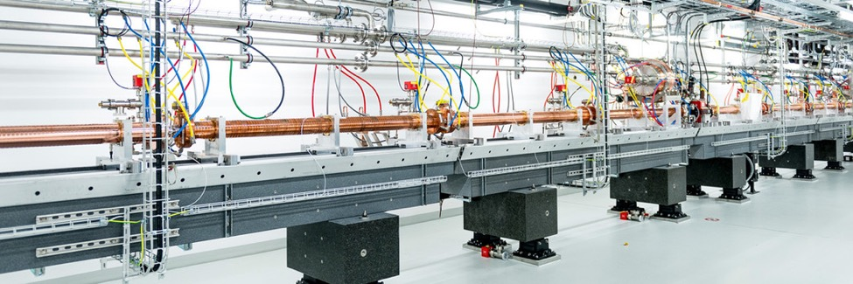
Larger NC linacs (most relevant operational ones are C-band based)
SwissFEL: C-band linac
Photo: SwissFEL/PSI
104 x 2 m-long C-band (5.7 GHz) structures (beam up to 6 GeV at 100 Hz)
Similar μm-level tolerance
Length ~ 800 CLIC structures
Being commissioned
X-band structures from PSI perform well

Slide 21
INFN and X-band
Talk of F. Cardelli July 2024 – LCWS 2024 in Tokyo (LINK)

Slide 22
C3 and other options, stand-alone but currently not site specific, or now also being considered as upgrades of initial facility

Slide 23
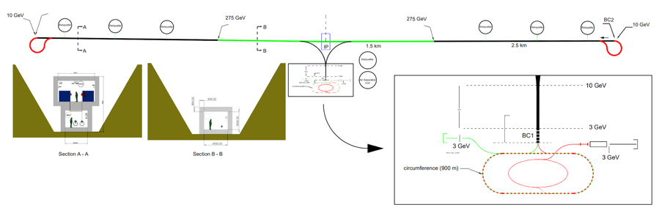
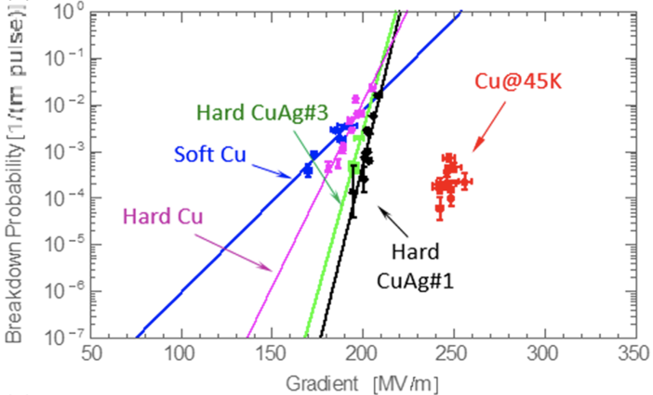
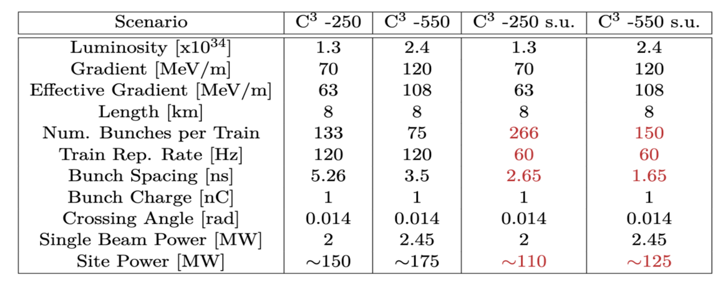
C³ Accelerator Complex
23
8 km footprint for 250/550 GeV CoM ⟹ 70/120 MeV/m
Large portions of accelerator complex compatible between LC technologies
Beam delivery / IP modified from ILC (1.5 km for 550 GeV CoM), compatible w/ ILC-like detector
Damping rings and injectors to be optimized with CLIC as baseline
Snowmass paper: https://arxiv.org/pdf/2203.07646.pdf
Cahill, A. D., et al. PRAB 21.10 (2018): 102002.

Slide 24
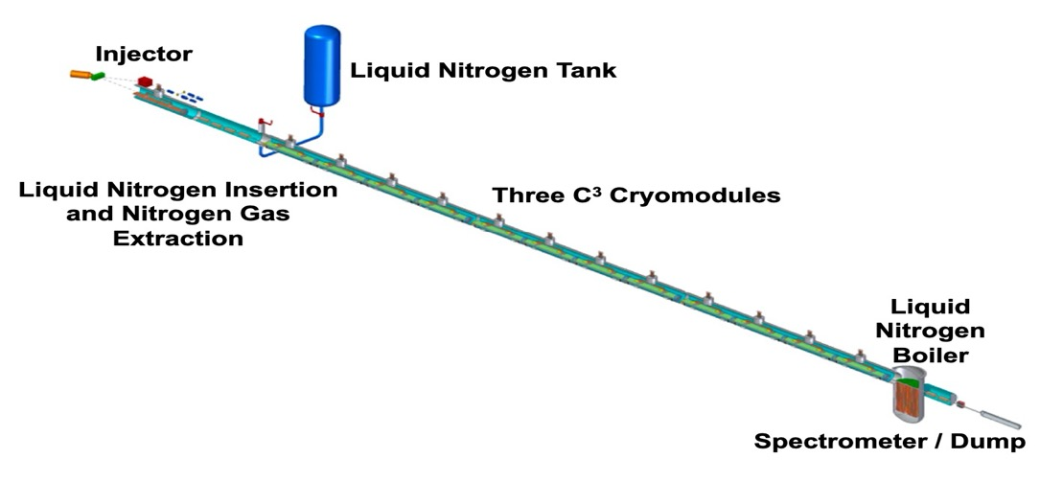
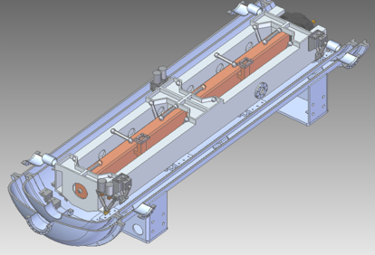
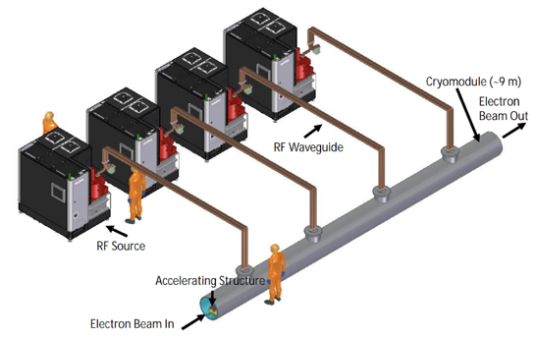
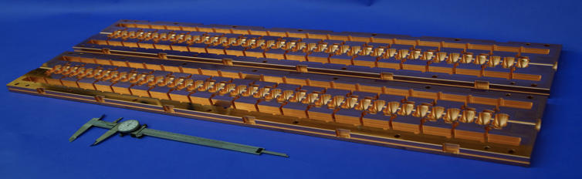
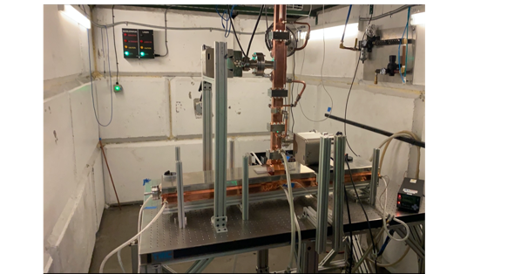
C³ recent developments and immediate plans
QCM:
Delivery of prototype quarter cryomodule (QCM) expected Fall 2024
Address Gradient, Vibrations, Damping, Alignment, Cryo, etc
Demonstrate fully engineered cryomodule
~50 m scale facility
3 GeV energy reach
C³ Main Linac Cryomodule
9 m (600 MeV/ 1 GeV)
C³ Prototype One Meter Structure
High power Test at Radiabeam

Slide 25
From talk of E.Nanni – NIKHEF July 2024 (LINK)

Slide 26
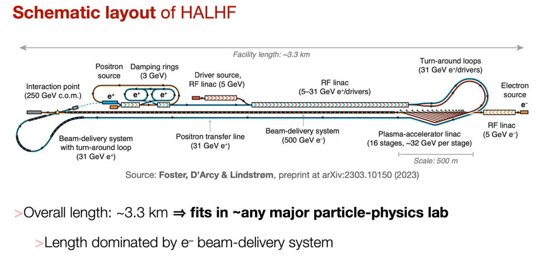
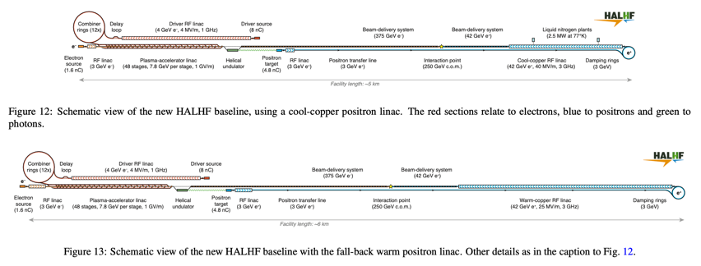
HALHF: A Hybrid, Asymmetric, Linear Higgs Factory
New concept, aiming for pre-CDR (LINK)
500 GeV for electrons with plasma acceleration
31 GeV positrons with RF based linac, used also to provide electron drivebeam for the plasma acceleration
Reach 250 GeV collision energy, luminosity 10³⁴
Asymmetric technologies, energies and bunch charges
Small footprint, lower cost
Several key plasma acc. challenges:
Multi-staging, emittances, energy spread, stabilities, spin polarisation preservation, efficiencies, rep rate, plasma cell cooling and more
Conventional beam(s) challenges:
Positron production, damping rings, RF linac, beam delivery system
Experimental challenges with asymmetric beams
New baseline at: https://arxiv.org/abs/2501.11072

Slide 27
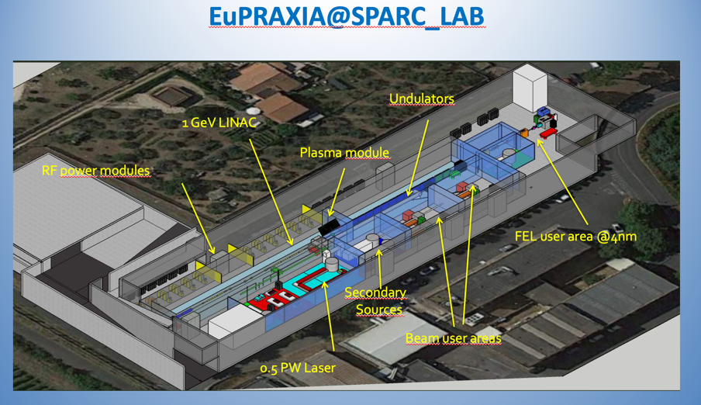
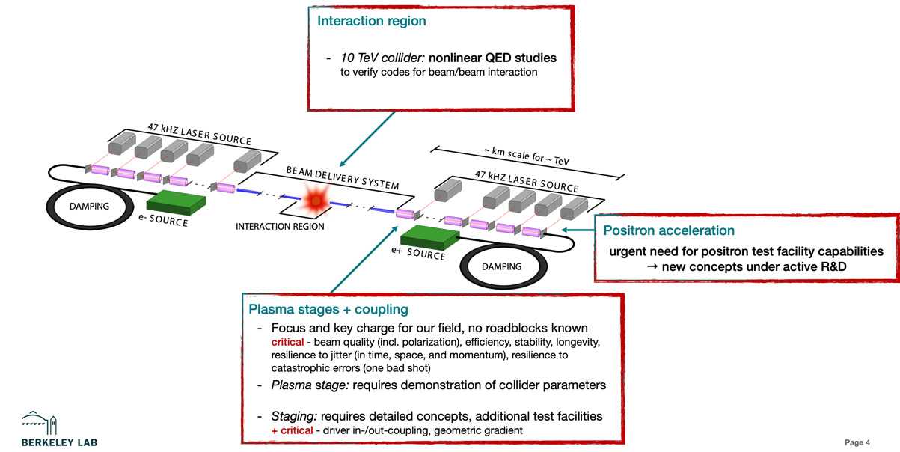
EUPRAXIA workshop September 2024:
Massimo Ferrario (LINK)
Jens Osterhoff (LINK)

Slide 28


Energy recovery options, potentially very large luminosities but early stage of development

Slide 29
ESPP inputs – I
Higgs factory focussed studies | Project input (the traditional way) See earlier slides
ILC | ILC in Japan (JAHEP/ILC-Japan and IDT)
CLIC | CLIC at CERN
C3 | Project study, focus on next phase
HALHF | Project concept, pre-CDR
Energy recovery | Project concepts and plans (tbd)

Slide 30
LC “vision”
Also as option at CERN

Slide 31
An adaptable e+e- LC facility at CERN
A LC facility can be extended in length for higher energies, using the same or improved versions of the same technology, e.g. as suggested for ILC, CLIC, C3 and HALHF.
It is also possible and realistic to change to more performant (usually higher gradient) technologies in an upgrade, e.g. from ILC to CLIC or C3, maybe even plasma and energy recovery based solutions
The physics at higher energies – Higgs sector and extended models with increased reach and precision, top in detail well above threshold, searches and hopefully new physics – will open for a very exciting long term e+e- programme
Such a programme can run in parallel with future hadron and/or muon colliders that can be developed, optimised and implemented as their key technologies mature
It keep options open, provides flexibility, encourages and motivates R&D across a broad range of technologies and potential future colliders/accelerator/detector technologies

Slide 32

ESPP inputs – II
For a LC at CERN, what would be the possible options to start with – keeping in mind technology changes can be envisaged ?
New approach for this ESPP (facility and community approach) – with three key inputs to the ESPP
Common LC physics paper covering from 90 GeV to 1000 GeV or even above. Include also non collider programme (see slide 5). Serves also the projects on previous page.
Starting with ILC technology, look at energy and luminosity extension options with improved SFR, or CLIC, C3, plasma and Energy Recovery technologies
Implementation of the above at CERN in footprint studied for CLIC (and ILC back in the TDR days), with two BDS, and experimental area at Prevessin, and considerations of upgrade options.

Slide 33

ESPP inputs – III
Why consider SRF as starting point ?
Very detailed and mature technical design and industrialisation, several FEL linacs build and being operated
Can be upgraded in Energy and Luminosity.
Worldwide interest in technology.
Large technology interest in Europe (EUXFEL and several other projects), and leading industries in Europe.
  Could it be exploited to reduce load on CERN during the HL period (lab support outside for cryomodules for example) ?
  Can this be turned into schedule advancement ?

Slide 34



Cost and Personnel estimates – Higgs factories
The estimates above from the Snowmass process includes personnel costs (usually kept separate in European project estimates, e.g. ILC and CLIC). Typically ~2 M$ on top.
Interesting to note that FCC-ee 250 estimated with this method at is 14-19 B$, in reasonably good agreement with FCC-ee mid term report.
Costs for ILC and CLIC (and others) are currently being re-costed and updated to 2023-24, including currency changes and price escalations. We will see if they also agree reasonably well with the Snowmass estimates shown above (so far reasonable)
One FTEy estimated to 200kUS$.
Notes:
Remove FCC

Slide 35


Slide 36
Costs
Cost exercises and international reviews:
ILC TDR 2012-13, 500 GeV primarily (LINK)
CLIC CDR 2012-13, 3 TeV primarily and 500 GeV (LINK)
ILC in Japan 2017-18, 250 GeV, reviewed within LCC (LINK)
CLIC PiP 2018, 380 GeV primarily (LINK)
Updates and review recently done for ILC 19-20.12.2024 (slides 12-13)
For the ESPP – concerning starting with ILC technology at CERN:
Updated: ILC in Japan with updated technology results, updated CFS (CE and conv. systems, SRF) – discussed on slide 12-13
CERN implementation: CE costs based on CLIC and other CERN projects, same main linac footprint, change in number of shafts, add larger underground DR, remove drivebeam CE and turn arounds, slightly different BDS dimensions and cavern sizes

Slide 37





Civil Engineering
CE studies for LC at CERN:
CLIC, up to 3 TeV. Contract with Amberg Engineering for CDR in 2012-2013.
ILC up 1 TeV. Contract with Amberg for the TDR in 2012-13.
CLIC up to 3 TeV, TOT (layout tool) with ARUP, for Project Implementation Report 2018
Update on-going, ILC up to 500 GeV, CLIC to 1.5 TeV, in both cases ~30km, using Geoprofiler layout tool
Injectors and experimental areas on Prevessin site (“CERN land”)
Notes:
Remove FCC

Slide 38

Power and energy
Power at 250-380 GeV in the 100-200 MW range for the projects above
With a running scenario on the right this corresponds to 0.6-1.2 TWh annually
CERN is currently consuming 1.2 – 1.3 TWh annually
CERN “standard” running scenario used to convert to annual energy use
Includes studies of overall designs optimisation to reduce power, SRF cavities (grad,Q), cryo efficiency, RF power system (klystrons, modulators, components), RF to beam efficiencies, permanent magnets, operation when power is abundant, heat recovery, nanobeam and more.
Recent overview (LINK)

Slide 39




Sustainability: Life Cycle Assessment (LCA)
What is the carbon intensity of energy in ~2050 (operation):
50% nuclear and 50% renewable give ~10-15g/kWh, to optimistic ?
France summer-months are today ~40g/kWh
Reductions predicted (LINK)
Next working on the machine parts, on top of the CE estimate
LCA report for Civil Engineering: LINK
Addressing the Civil Engineering impact

Slide 40

Towards Carbon Accounting with LCA
- example for CLIC, also (being) done for ILC, C3, HALHF, FCC -
Work in progress – this example is closest to the CLIC drive-beam parameters, detectors and computing (and travels) not considered
This plot (blue part) is for 11 km of tunnel, scales with length, injectors will add to this
Next working on machine parts (orange), here assumed hardware and infrastructure = equal civil engineering impact.
Most likely this is optimistic, i.e. orange and light blue parts will be higher
More power (here 0.7 TWh) or more carbon (here assumed 12g/kWh) will increase this quickly

Slide 41
Some key points
A LC starting with SRF technology will be proposed for CERN, with upgrade considerations (E,L, length and technologies) (New concept considered for hosting at CERN)
CLIC will be proposed with several changes wrt to 2018 (X-band also an upgrade option) (Improved wrt 2018, at CERN)
In both cases emphasis on initial ”affordable” and performant Higgs factories, emphasising the additional physics reach by going to at least 550 GeV, and possibly beyond making use of improved technologies
In the LC vision framework further R&D on all LC technologies highly encouraged (both for initial implementation with SRF and upgrades). LC vision (extended meeting at CERN 8-10.1.2025 to prepare ESPP inputs: https://indico.cern.ch/event/1471891/overview)
Thanks – most of the slides/information from:
S.Michizono, B.List, IDT and ILC colleagues, CLIC team, J.List, A.Robson, E.Nanni and the C³ team, the HALHF team, ARUP, the Snowmass Implementation Task Force (names on page 2 of the report, chair T.Roser), M.Ferrari, L.Monaco, F. Cardelli, many more

