Slide 1
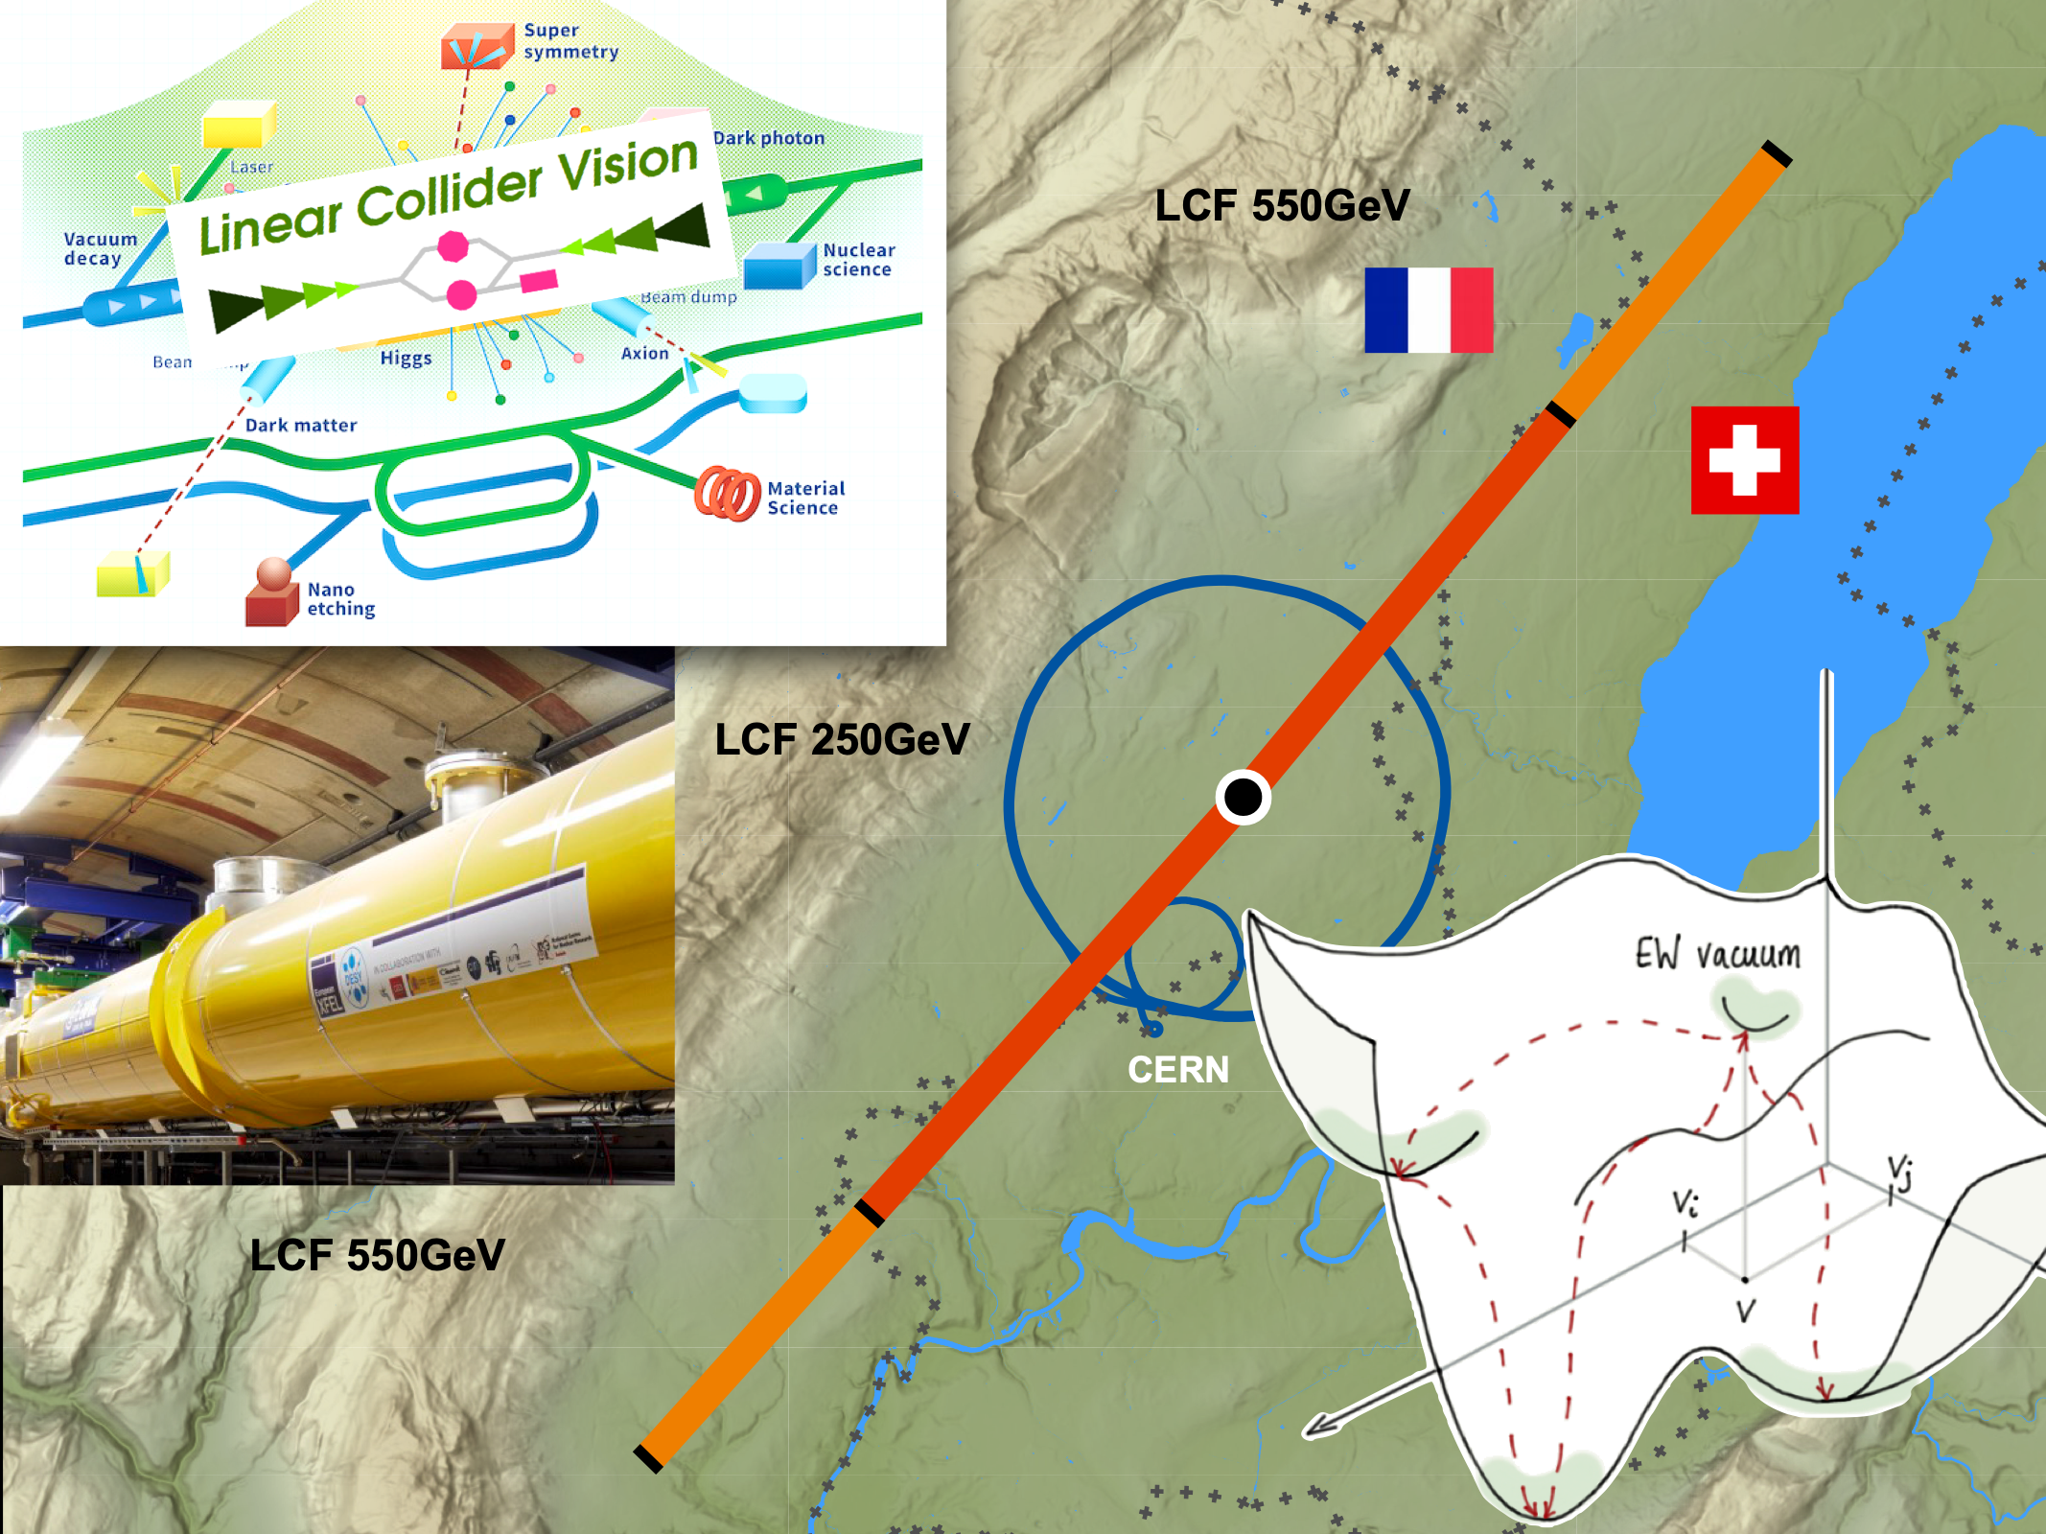
The Linear Collider Facility for CERN
US-HF-FCC Workshop FNAL
April 15, 2025
Jenny List on behalf of the LCVision Team
Outline:
Introduction
LCF@CERN
Conclusions & Invitation

Slide 2
Introduction

Slide 3

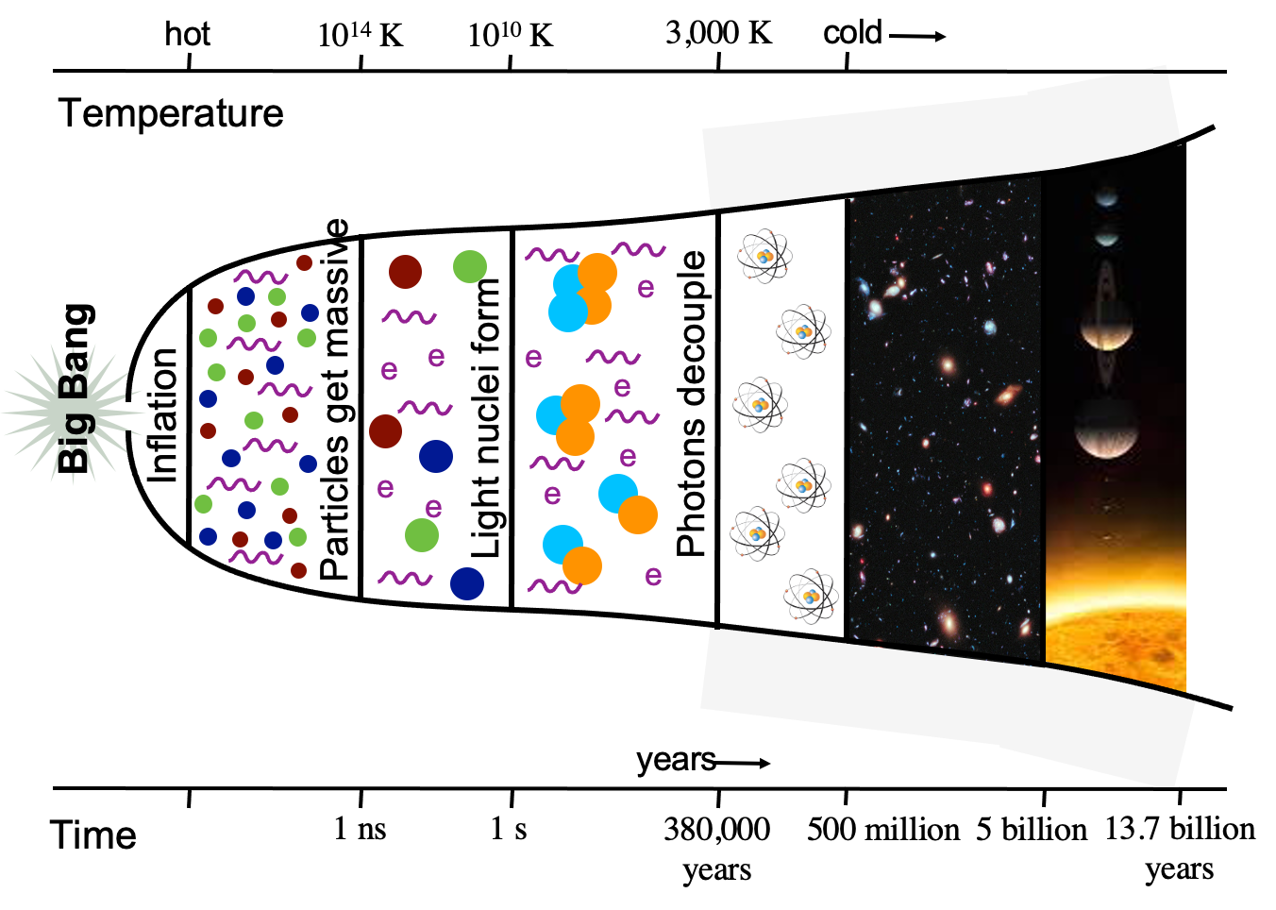
Particle Physics in 2025
At the dawn of the Update of the European Strategy for Particle Physics (EPPSU)
the discovery of a Higgs boson at the LHC in 2012 was a huge triumph
so far, the Standard Model of particle physics gives an excellent description of all particles and interactions probed at the LHC
yet, the SM is manifestly incomplete:
dark matter, dark energy, gravity, …
fermion masses and pattern, stabilisation of the Higgs mass, the origin of electroweak symmetry breaking …
actual dynamical explanations for these features must come from new interactions and particles that couple to the Higgs boson
we must continue beyond HL-LHC to scrutinize the place where new physics is most likely to be found: in precision measurements of the Higgs boson!
an e+e- collider is the ideal place to do this: collides elementary, electroweak particles => clean experiments & precise predictions
e⁺e⁻ → µ⁺µ⁻H → µ⁺µ⁻ bb in ILD

Slide 4
A Linear Collider re-doubles these advantages
Beam polarisation & high energy: let’s get it straight!
electroweak physics is intrinsically chiral:
left- and right-handed e.g. electrons give different information
Linear Colliders offer polarised beams => new observables or: “four colliders in one”
like at LHC, Higgs bosons are produced in e+e- in different reactions complementing each other:
ee->HZ, ee->WWvv->Hvv, ee->ZZee->Hee, ee->HHZ, ee->WWvv->HHvv, ee->ttH, …
to explore them all, a large span in ECM is needed
likewise for the closest relatives of the Higgs
top quark, multi-gauge boson processes, …
the full Higgs / top / electroweak program requires polarised beams & ECM up to at least 1 TeV

Slide 5
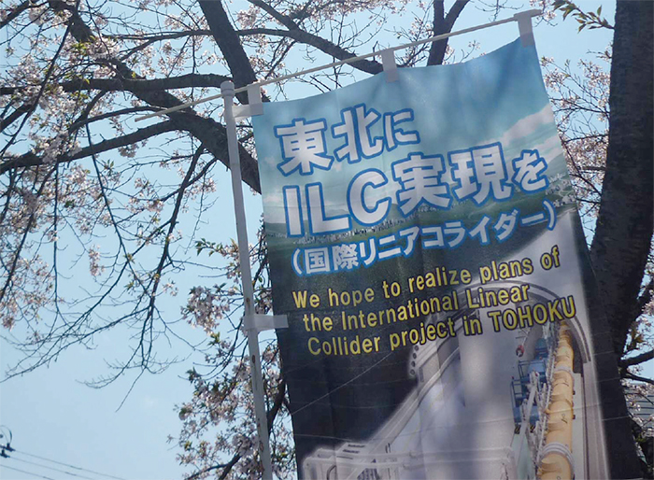
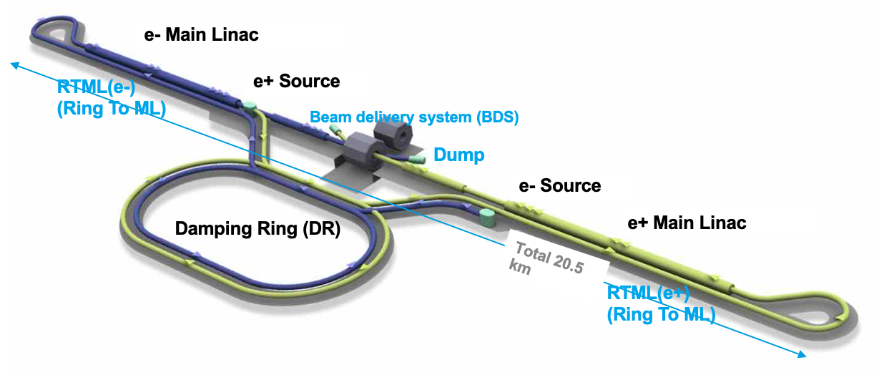
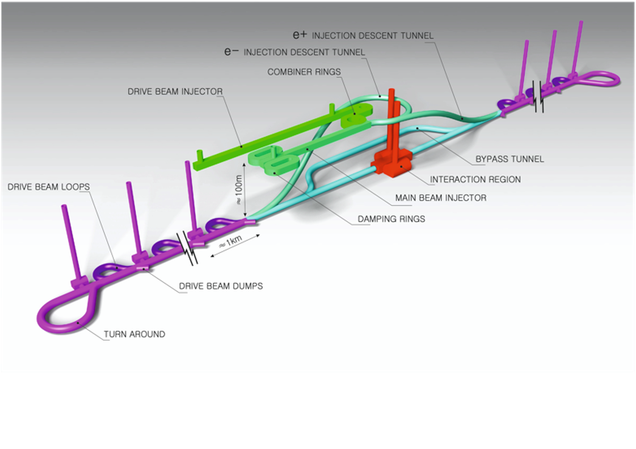
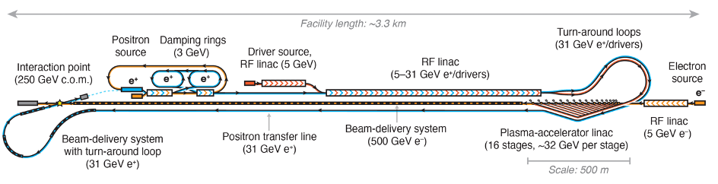
Linear Colliders
from construction-ready to advanced accelerator R&D
the most mature proposal: the ILC
superconducting RF 31-35 MV/m
proven technology: Eu.XFEL, LCLS-II, SHINE, …
up to 1 TeV, both beams polarised
since 2012 considered for construction in Japan
Compact Linear Collider (CLIC):
beam-driven warm copper RF, 70-100 MV/m
up to 3 TeV, electrons polarised
a vast number of other ideas / R&D programs
C3: cool copper collider up 150 MV/m
HELEN: advanced SCRF up to 70 MV/m
ReLiC / ERLC: energy & particle recovery
HALHF: hybrid asymmetric linear Higgs factory
ALEGRO: 10 TeV PWA ee / 𝛾𝛾
XCC: XFEL-driven 𝛾𝛾 collider
…
Can we start with ILC-technology NOW — but encourage later upgrades with advanced technologies?
=> Linear Collider Facility (LCF) @ CERN proposal arxiv:2503.24049

Slide 6
LCVision and the EPPSU
from the remit of the European Strategy Group
The aim of the strategy update should be
to develop a visionary and concrete plan
that greatly advances human knowledge in fundamental physics
through the realisation of the next flagship project at CERN.
The Strategy update should include
the preferred option for the next collider at CERN
and prioritised alternative options to be pursued if the chosen preferred plan turns out not to be feasible or competitive.
LCVision
a bottom-up initiative founded at LCWS 2024 in Tokyo
to take an across-project look at physics and technologies of Linear Colliders &
to put forward a concrete proposal for a Linear Collider Facility (LCF) @ CERN

Slide 7
LCVision: a united approach
LCWS2024: Linear Colliders teaming up in view of the upcoming EPSSU
all linear colliders share the same scientific goals:
formulate a coherent physics program
define energy stages etc science-driven
beyond an individual technology:
design a linear collider facility
infrastructure compatible with various technologies
plus beam-dump / fixed-target exp’s / R&D facilities
study the Higgs now - but maintain flexibility for the future:
start now with an affordable project
maintain scientific diversity
strengthen accelerator R&D towards 10 TeV pCoM collider
decide on upgrades / new projects based on future developments - or even break-throughs:
scientifically: HL-LHC could still discover new particles
technologically: higher gradients / muon cooling / high-field magnets

Slide 8


LCVision EPPSU documents
ILC in Japan (IDT)
arxiv:2504.XXX
… and relation to other inputs
CLIC at CERN
arxiv:2503.24168
arxiv:2503.21857
C³
arxiv:2503.20829
Technologies and upgrades
arxiv:2503.19983
LC Physics Case & long-term vision
HALHF
arxiv paper & EPPSU submission
arxiv:2503.23489
arxiv:2503.19880
LCF @ CERN
arxiv:2503.24049
10 TeV Wakefield
EPPSU submission & back-up document
arxiv:2503.20214
arxiv:2504.01434
Beyond Collider
https://cds.cern.ch/record/2927631

Slide 9
The LCF@CERN Proposal

Slide 10
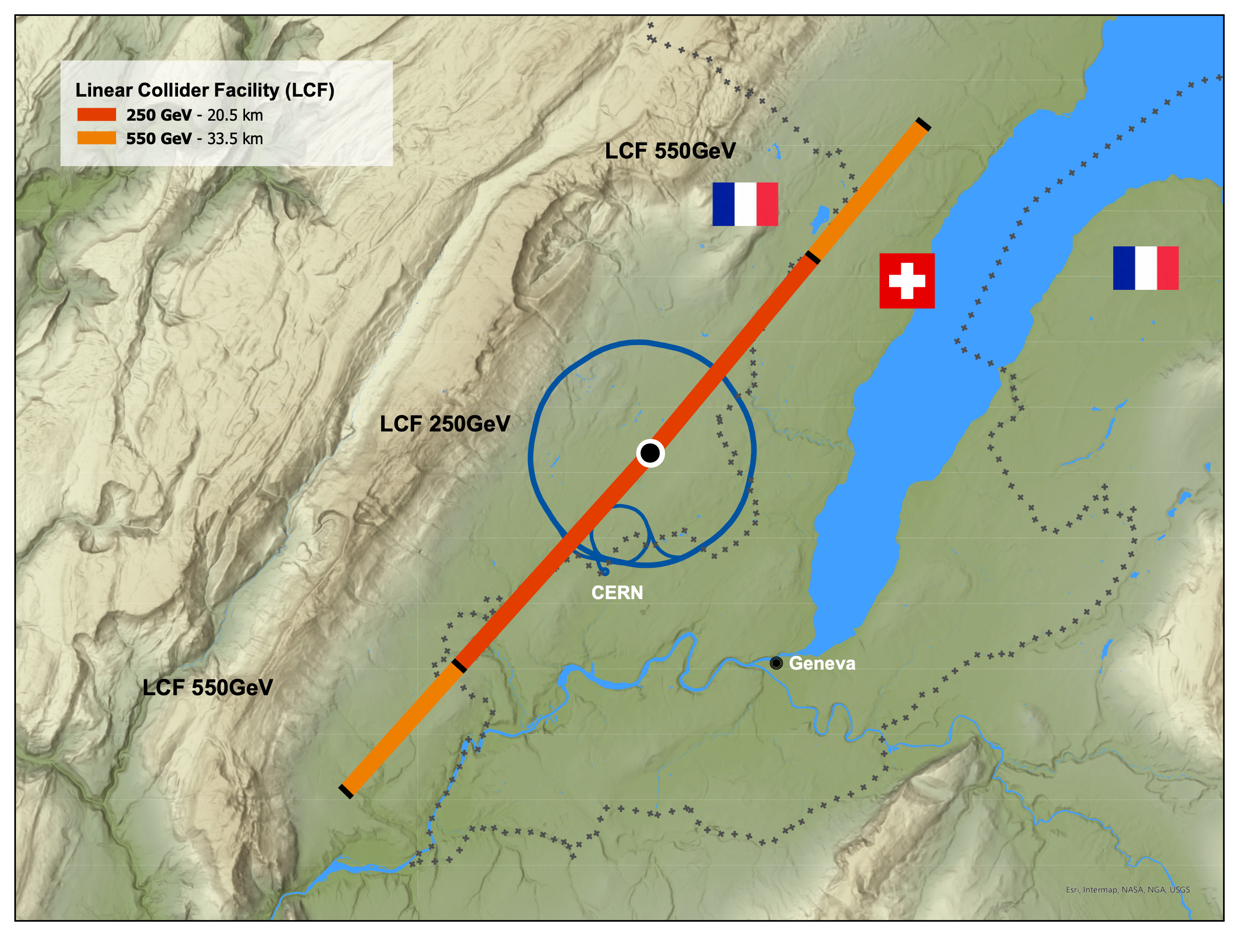
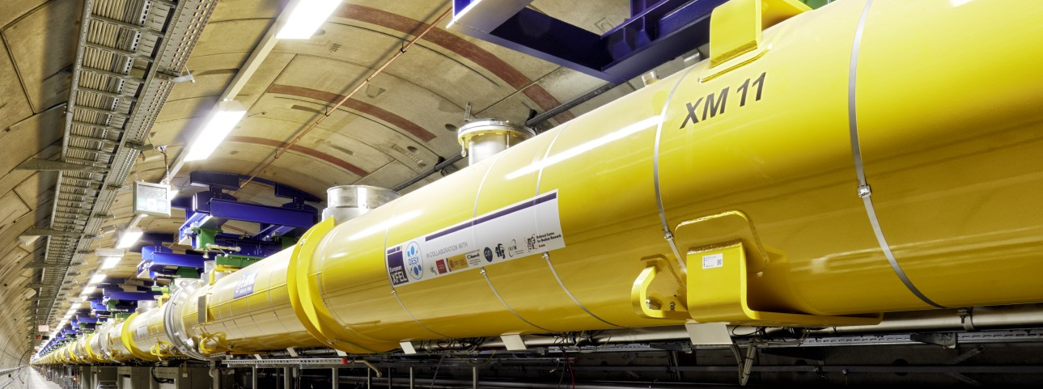
General Considerations
for the LCF@CERN
Philosophy:
leverage all the excellent work done for ILC & CLIC in the past
reliable costing etc
“ready to build”
gently modernize to turn into true flagship project for CERN
Superconducting RF technology (like ILC)
successful construction & operation of Eu.XFEL, LCLS-II… => no large-scale demonstrator step needed
lab experience and production capacities in industry globally => opportunity to take burden off CERN’s shoulders
choice for fastest implementation
Scope project to be a flagship project for CERN
2 interaction regions
2-4x higher luminosity than ILC (possible due to Q0=2E10)
add-on facilities (Beyond Collider, R&D / irradiation facilities)
attaractive upgrade perspectives with advanced technologies
but stay affordable (constr. and op.) wrt to CERN budget
LCF spec
ILC spec

Slide 11
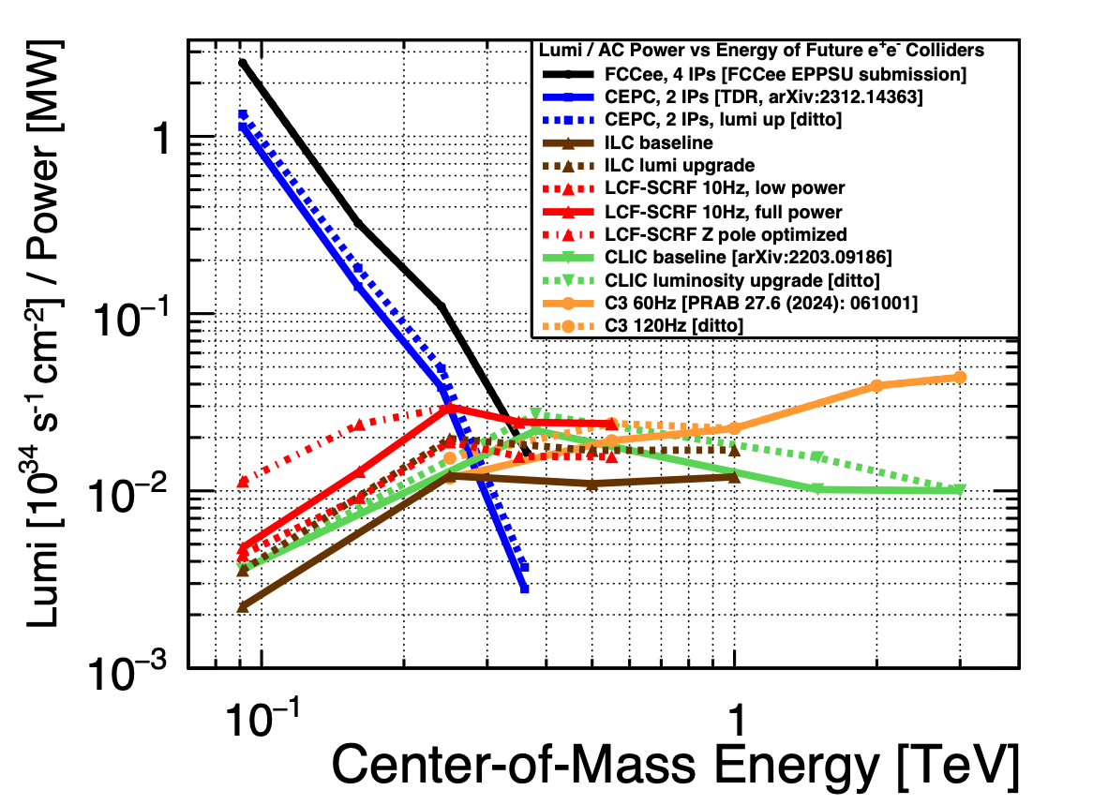
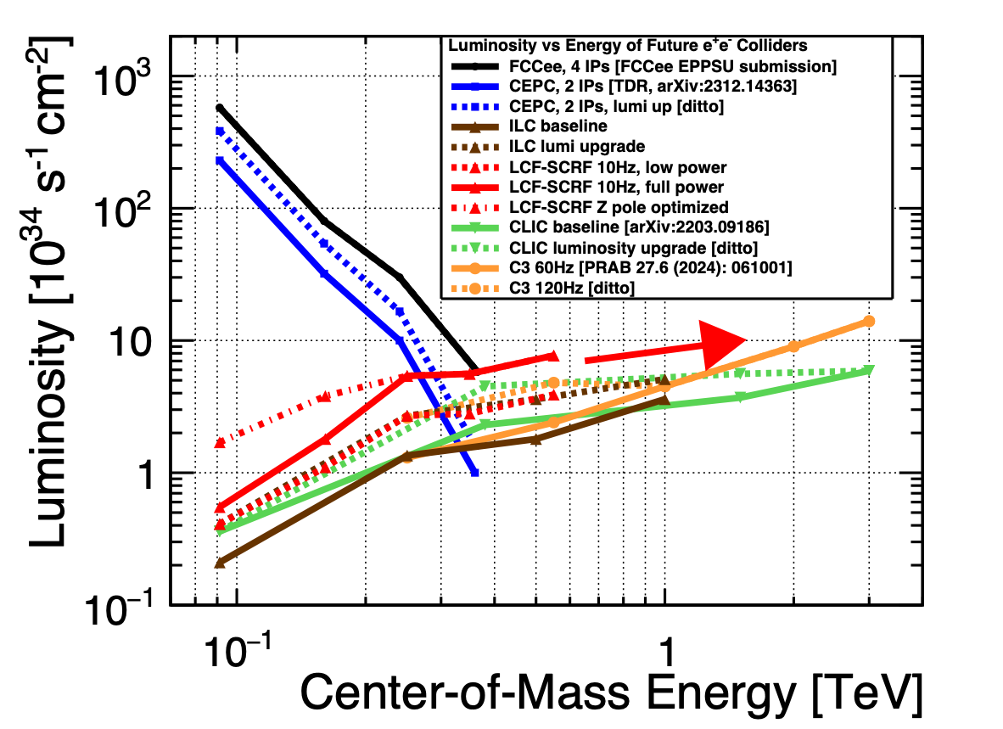
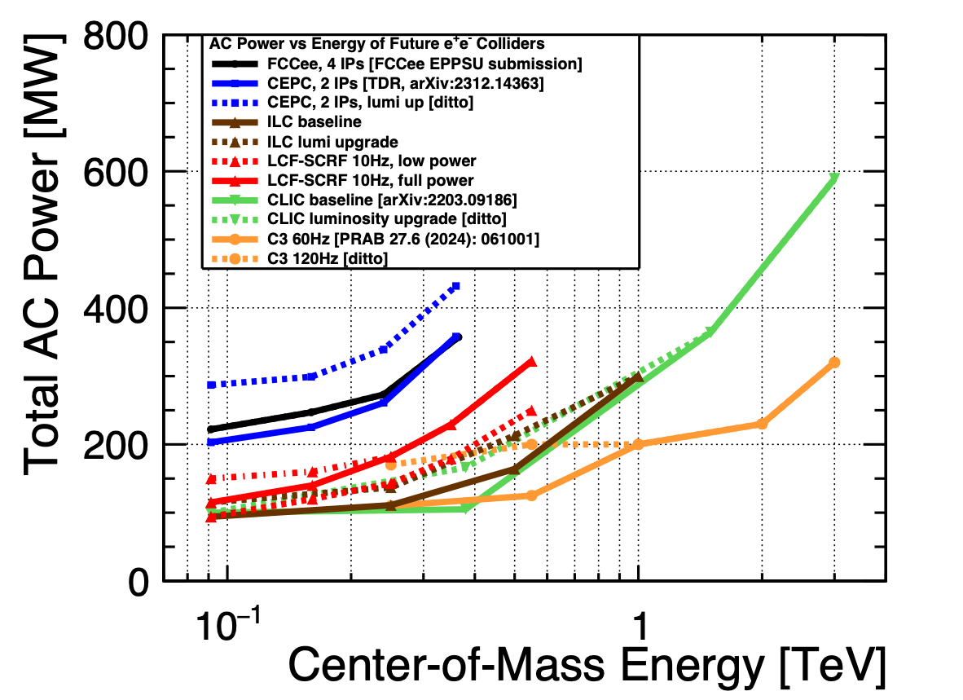
Luminosity and Power Consumption
For LCF-SCRF and other e+e- colliders

Slide 12
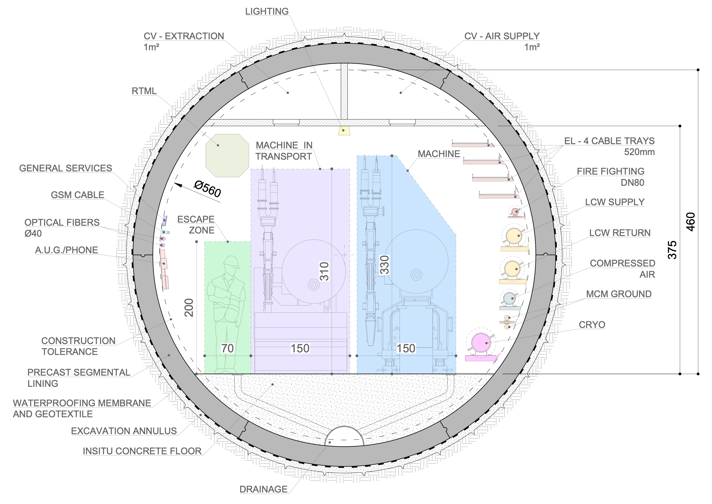
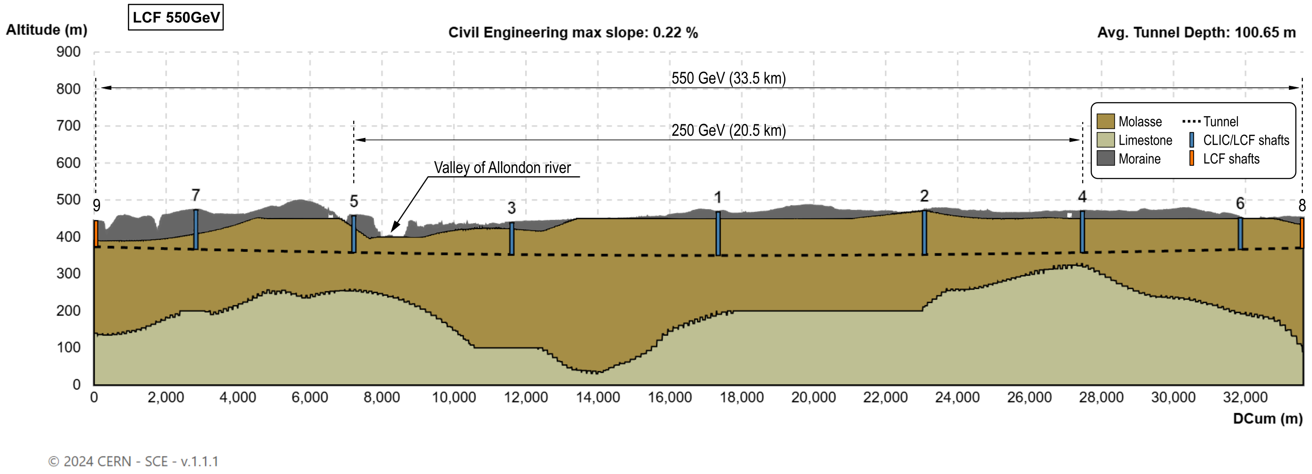
The first stage - or what can LCF offer for ~8 BCHF?
250 GeV incl Z pole - facility
33.5km long tunnel => reach 550 GeV with 31.5 MV/m SCRF
∅ 5.6m, two IPs
equipped with SCRF for 250 GeV
10Hz trains of 1312 bunches => L = 2.7 x 10³⁴ / cm² / s
construction cost: 8.29 BCHF
AC power: 143 MW
optionally: beam-dump / fixed-target
upgrade: double luminosity 2625 bunches / train: +0.77 BCHF + 39MW
both beams polarised:
e-: 80%
e+: 30%
3ab-1 @ 250 GeV
operation at Z pole (eg 100fb⁻¹) WW theshold (eg 500fb⁻¹) as needed

Slide 13
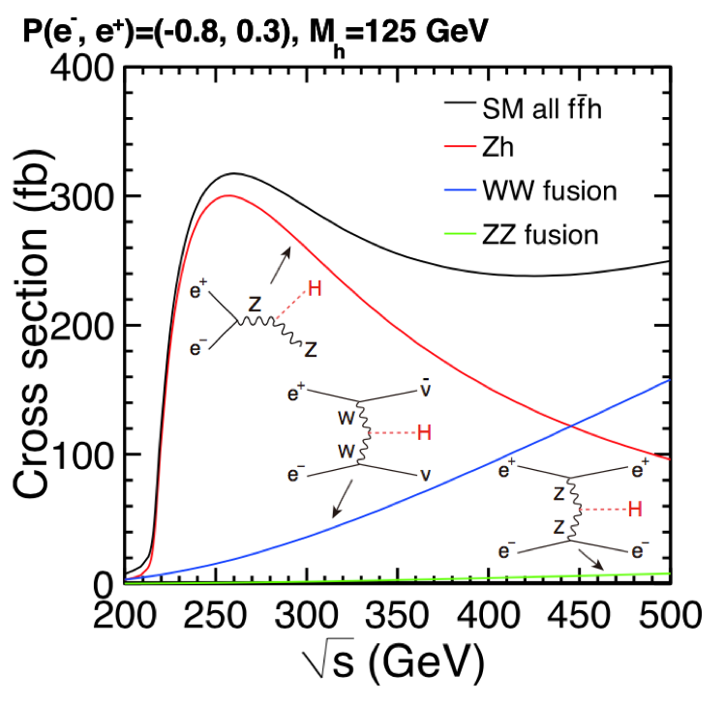
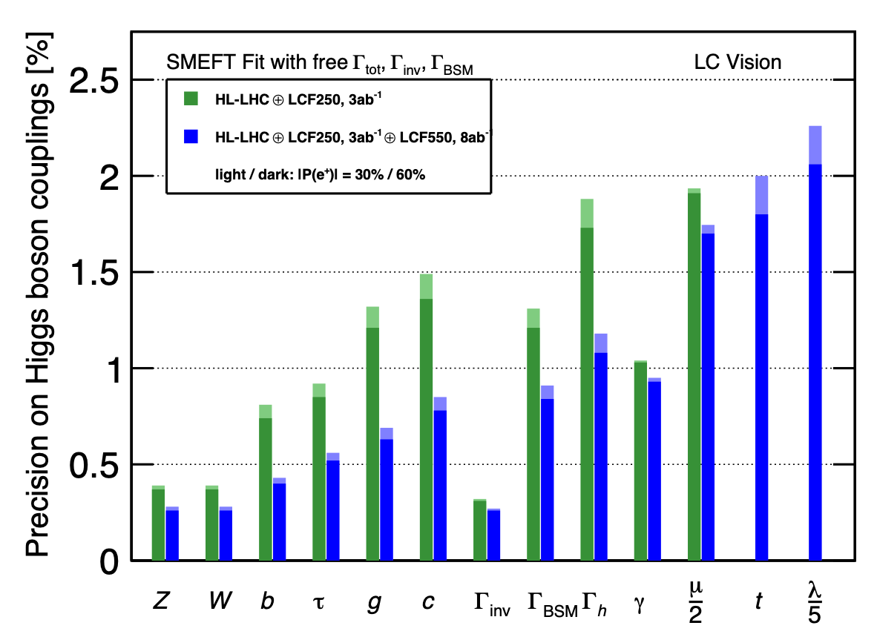
The first stage
250 GeV incl Z pole - physics
Higgs:
production via ee->ZH dominant
σtot to ~1% => absolute couplings
branching fractions to ~1%
mass to 10⁻⁴
search for invisible / exotic decays to 10⁻³
WW:
non-linear interactions (10x better than LEP)
mass to ~2 MeV (threshold: ~1.4 MeV)
CKM matrix elements (e.g. Vcs, Vcb)
f fbar:
precision measurements at 250 GeV
and Z pole => polarisation: huge increase EWPO sensitivity (~10-100x improvement over LEP/SLC)

Slide 14
The second stage
550 GeV incl ttbar theshold
Upgrade
equipping the additional tunnel with SCRF
+ 5.46 BCHF
10 Hz trains of 2625 bunches => 7.7 x 10³⁴ / cm² / s
AC power 322 MW
target 8 ab⁻¹
Higgs physics at 550 GeV and beyond:
now WW fusion dominant => complementary set of observables => independent verification of anomalies observed at 250 GeV
ttH, ZHH and even vvHH become observable:
ttH: tree-level sensitivity to top-Yukawa ~2%
di-Higgs production: tree-level sensitivity of ~10% to self-coupling 𝜆 - for any value of 𝜆 !

Slide 15
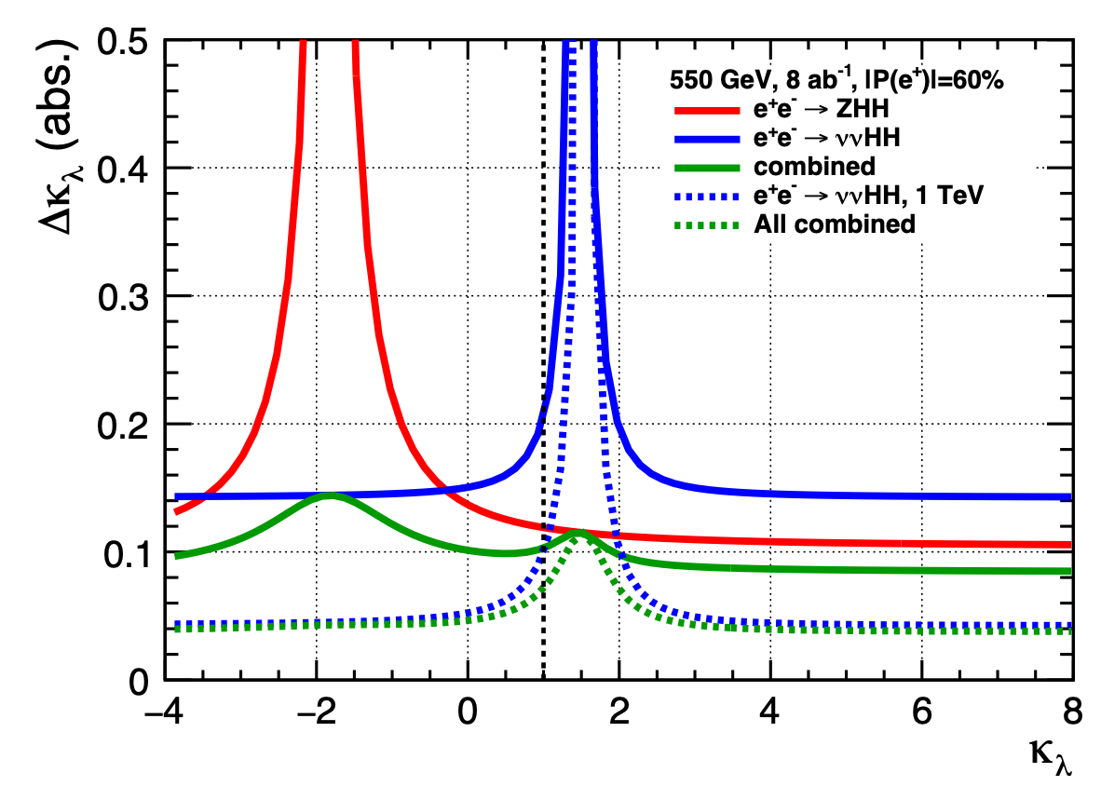
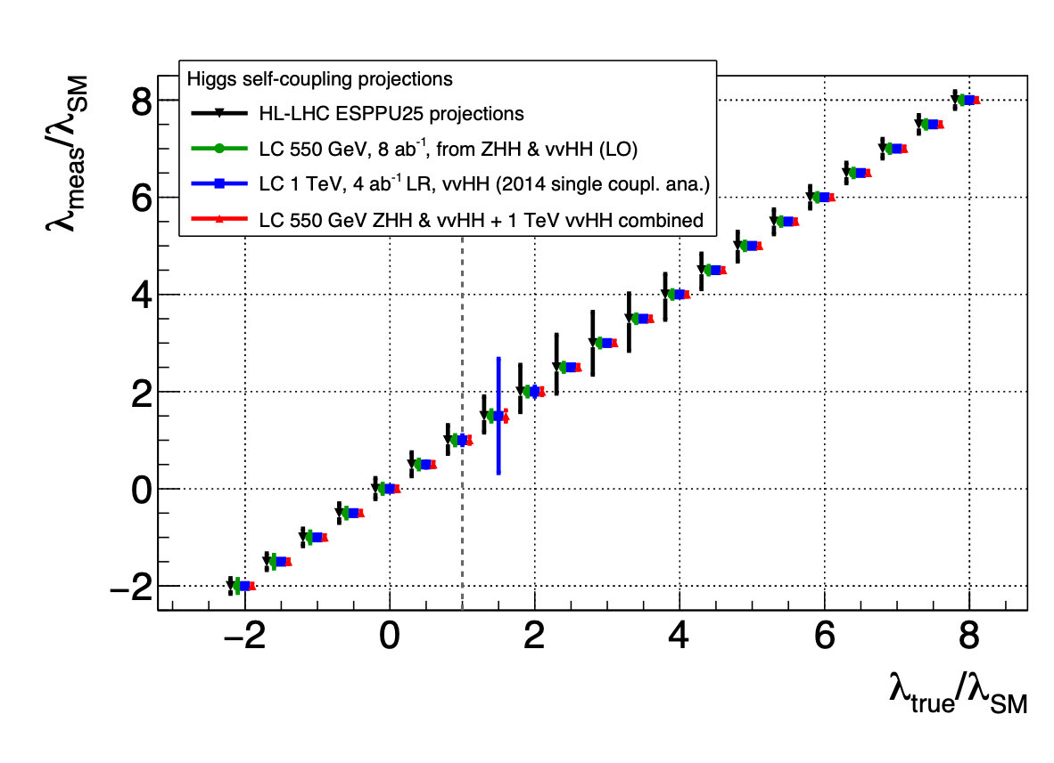
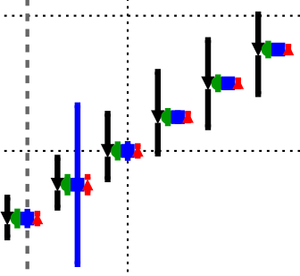
Di-Higgs Production
tree-level access to self-coupling
550 GeV
~ peak of ZHH cross-section
vvHH becomes just about visible
together for SM case: ∆𝝹𝜆 = 11% (15%) for 8ab⁻¹ (4ab⁻¹)
dependence on 𝜆:
ZHH: constructive interference
vvHH: destructive interference
together: ~const absolute precision as function of 𝜆
1-3 TeV: vvHH becoming dominant
∆𝝹𝜆 = 0.04 (8ab-1) over wide range of 𝝹𝜆 (except 𝝹𝜆 ~ 1.5)
quantitative improvement and qualitatively new information wrt
HL-LHC
loop corrections at lower ECM stages
550
EWPT: Interesting interplay with gravitational waves and/or primordial black holes - ask me if you’re interested :)

Slide 16
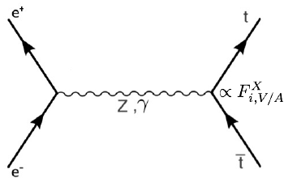
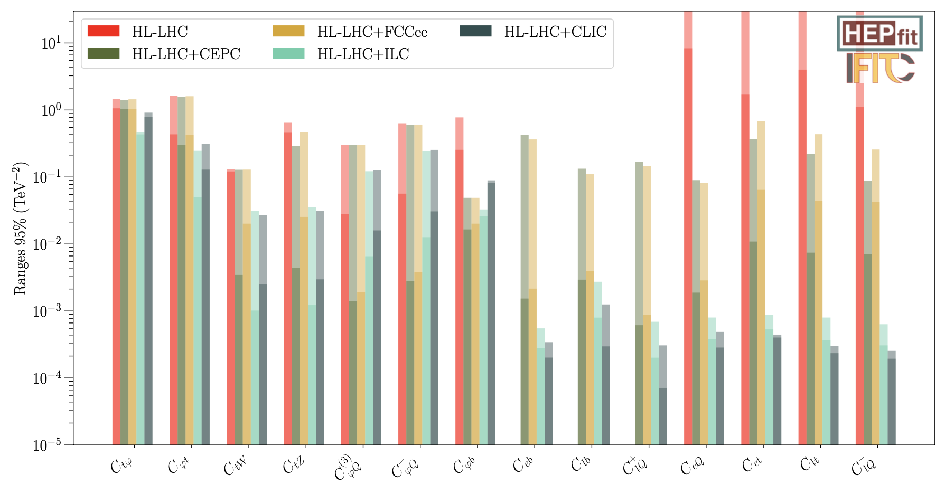
Higher energies offer so much more
g^{𝛾}L, g^{𝛾}R, g^{Z}L, g^{Z}R
Example: top physics
tt threshold ~350 GeV:
threshold mass => exp. stat. uncetainty negligible after ~100fb⁻¹
electroweak couplings need higher energies and polarised beams
polarisation disentangles couplings to Z from couplings to photon
sensitivity to “axial-vector”-type of couplings grows with energy
dim-6 SMEFT:
need measurements at two energies above tt threshold to resolve degeneracies between operators
with highE and polarisation, Linear Colliders
constrain 4-fermion operators to < 0.1%
incl. eett operators (entering ZH @ NLO)
550 GeV
350
only threshold
~10%
HighE ~0.1%

Slide 17
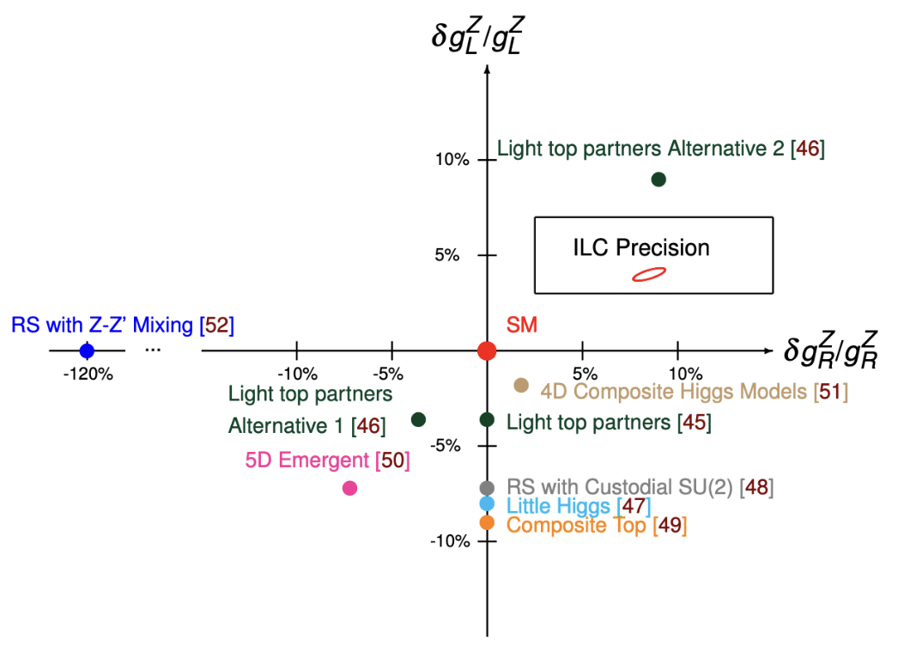
What do we learn from these?
Top and BSM
Couplings of the Top quark to the Z boson:
essential for NLO interpretation of Higgs measurements
tremendous BSM sensitivity in its own right
assuming only 4ab⁻¹ at 500 GeV
arxiv:2503.19983

Slide 18
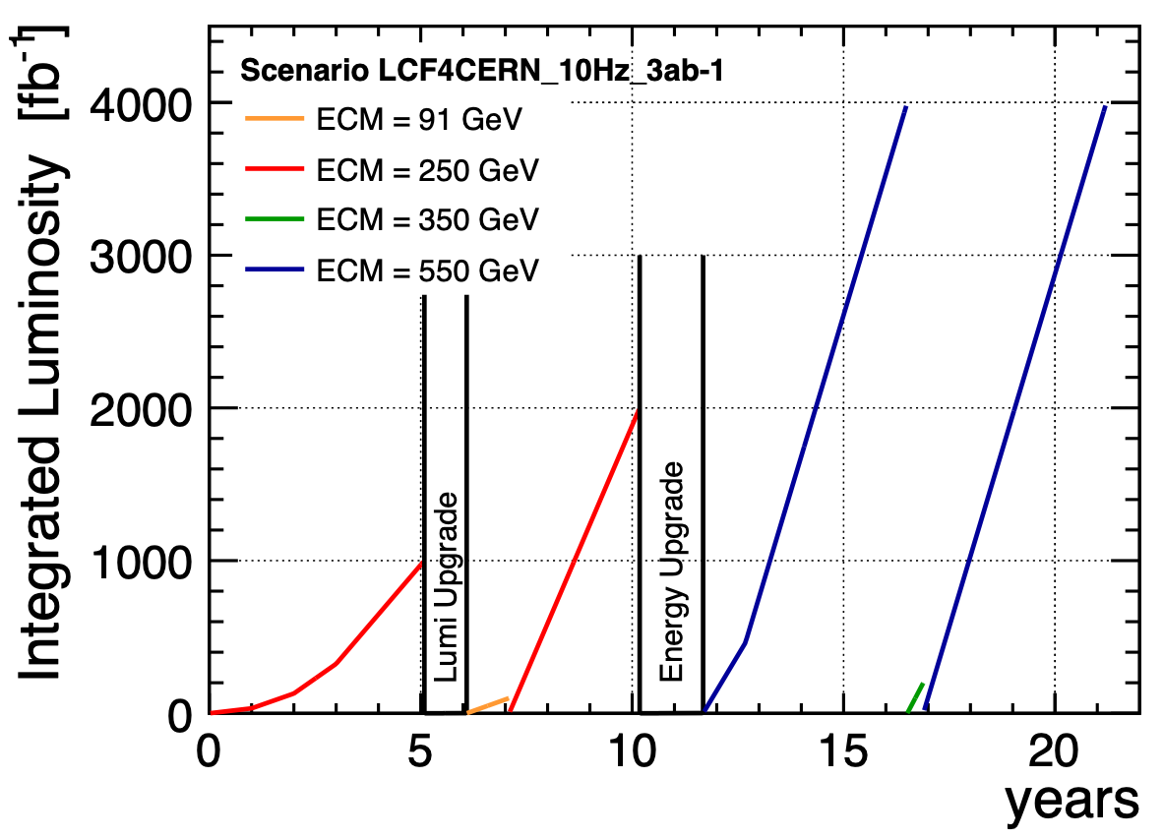
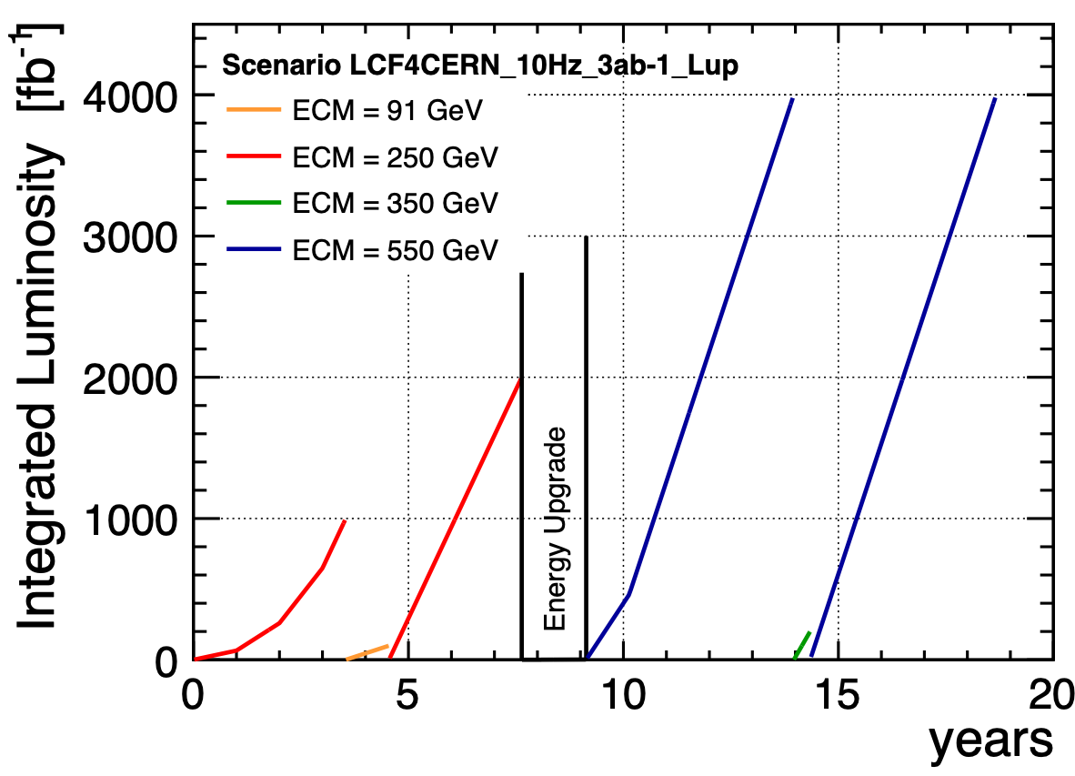
Running Scenarios up to 550 GeV
baseline
start immediately with full power
8.3 BCHF
0.8 BCHF
5.5 BCHF
9.1 BCHF
5.5 BCHF

Slide 19
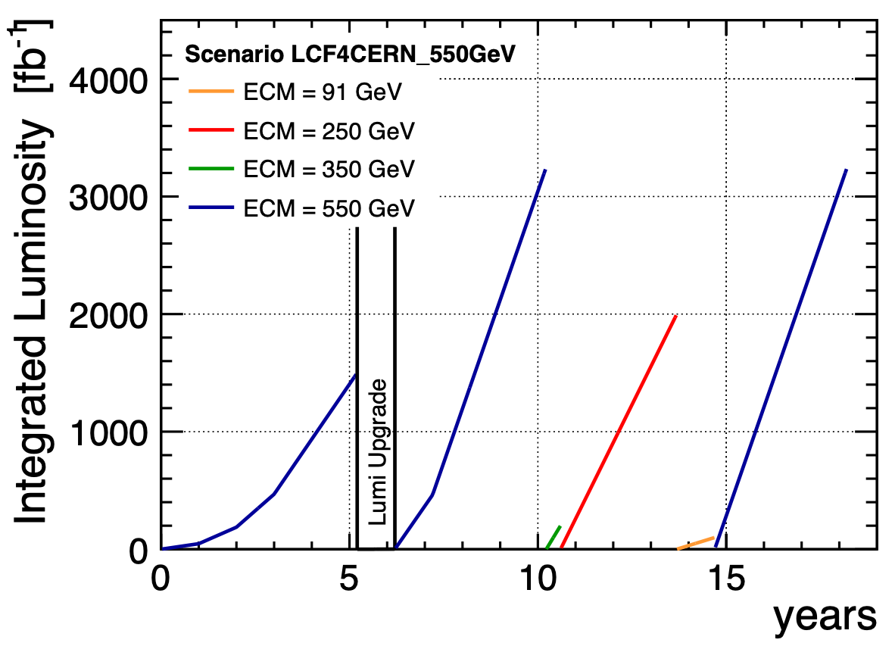
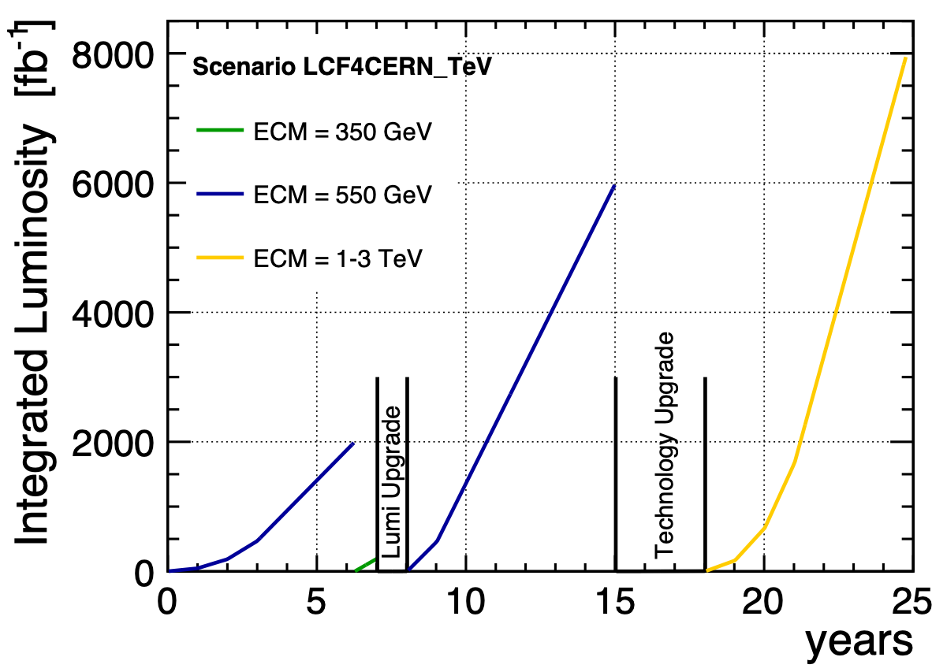
Running Scenarios - starting at 550 GeV
take some polarised data at lower energies
or go more quickly to TeV range
13.1 BCHF
1.4 BCHF

Slide 20
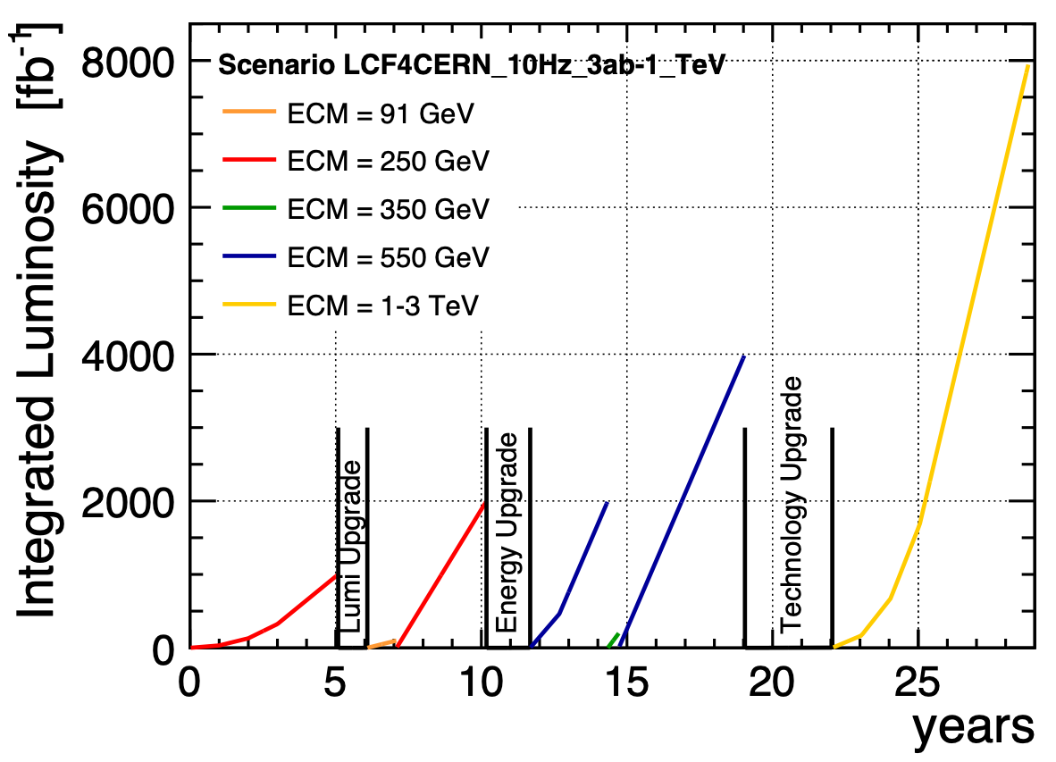
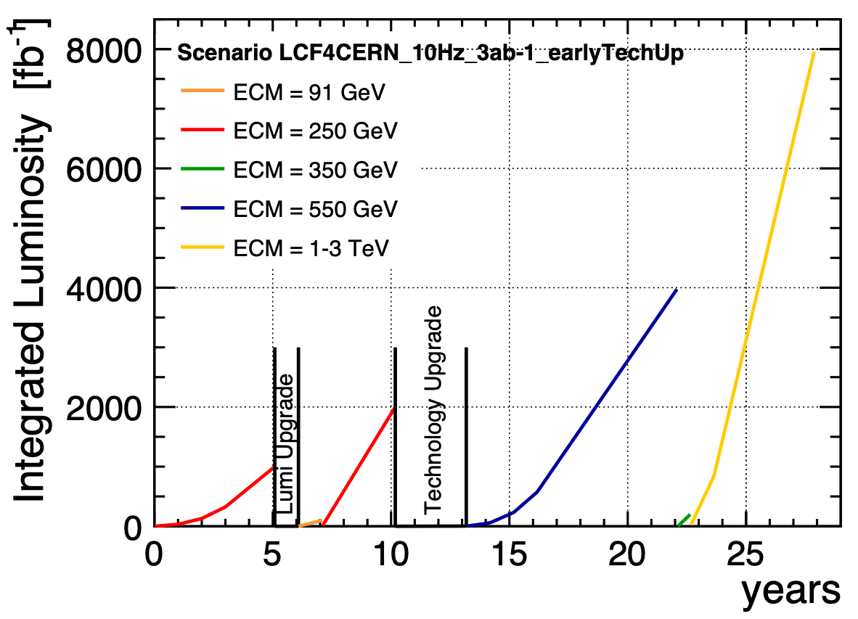
Running Scenarios - shortening 550 GeV in favour of TeV
Tech upgrade after 550 GeV
Tech upgrade after 250 GeV
An LCF gives flexibility to decide exact program based on scientific and technological progress — or even break-thoughs

Slide 21
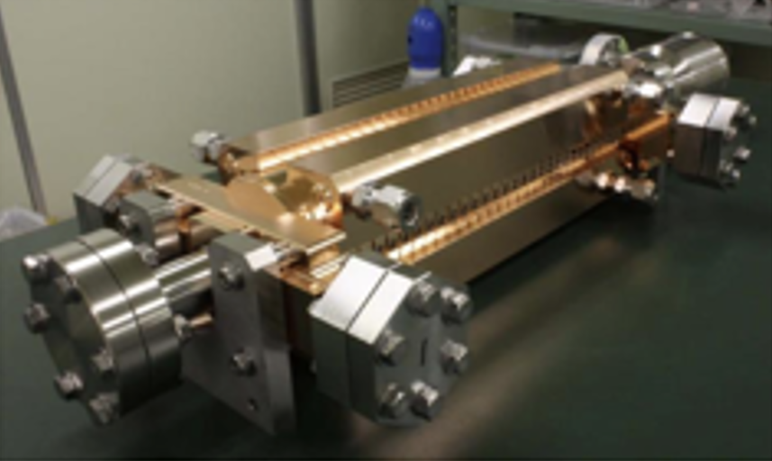

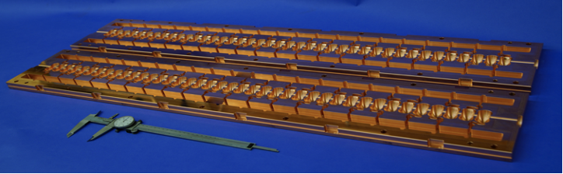
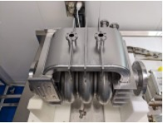
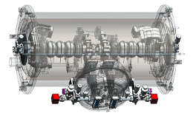
Energy Upgrades beyond 550 GeV
1 TeV and beyond
Philosophy: prioritize
advanced technologies over more civil construction
flexibility over a fixed future: choices should be made later depending on scientific and technological developments - or even revolutions
replacing the linacs, re-using as much as possible from initial machine (DRs, BDS, …)
Example options:
CLIC technology: 72-100 MV/m warm copper cavities, klystron-driven => 1.5 - 2 TeV
C3 technology: up to 150 MV/m cool copper cavities => 1.5…3 TeV
HELEN technology: traveling-wave SCRF with ~70 MV/m => at least 1 TeV
Nb3Sn technology: SCRF with ~100 MV/m => 1.5…2 TeV
LCVision reviewed for each of the options how it could be embedded as upgrade of initial facility

Slide 22
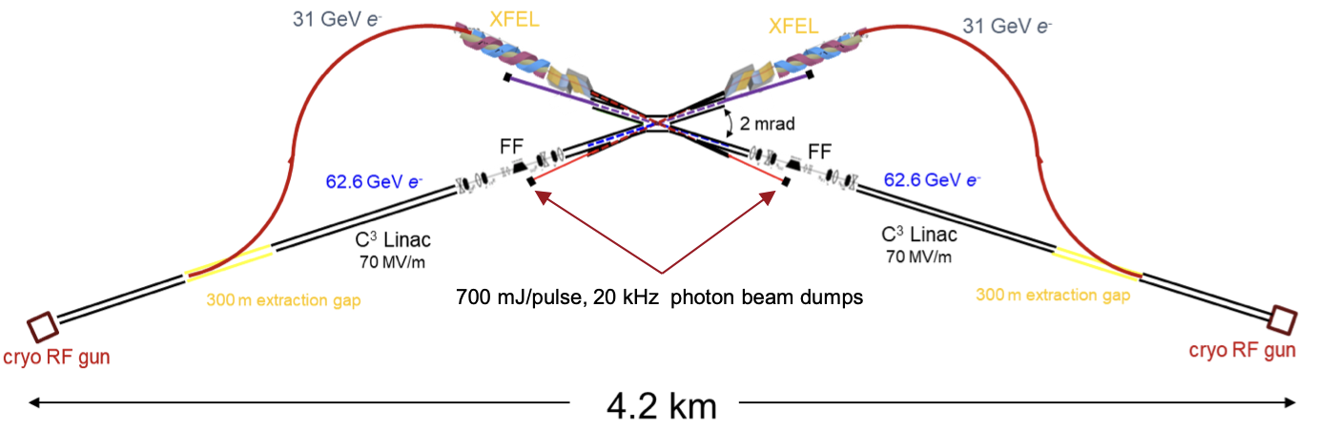
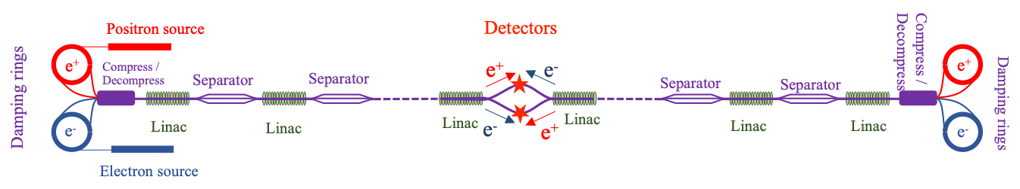
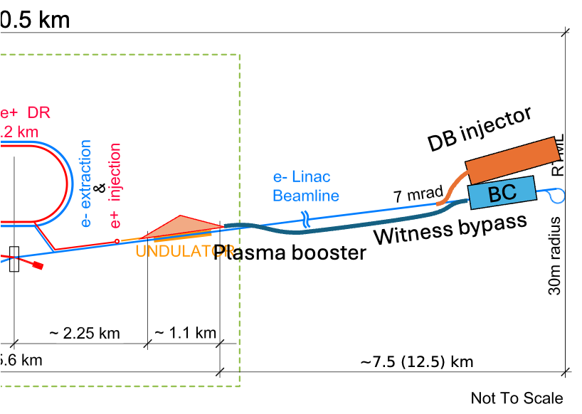
Additional Upgrade Paths
Photon Collider / higher luminosity / towards 10 TeV
Photon Collider:
complementary physics case, e.g. self-coupling in 𝛾𝛾 -> HH with different BSM behaviour than e+e- / pp
install in one IP
either classic way with optical lasers
or XCC-like with X-ray lasers
Energy and particle recovery:
boost luminosity up to 10³⁶ / cm² / s
by re-using particles and energy
eg a la ReLiC or ERLC
Plasma or Structure Wakefield Acceleration:
gradients of GV/m
either only for e-, asymmetric collisions a la HALHF
or e- and e+, paving the way towards 10 TeV 𝛾𝛾 or e+e-
LCVision reviewed for each of the options how it could be embedded as upgrade of initial facility

Slide 23
The Linear Collider Facility @ CERN and beyond
General considerations
Robust planning:
costs (construction and operation), CFS design, environmental impact etc assessed in a consistent way between all projects proposed for CERN
accelerator cost well known thanks to the 2024 update of the ILC costing, to a large extent based on new quotes from industry
Timing is important:
current young researchers are key to both the HL-LHC program and the future Higgs factory
prolonged uncertainly or delays in decision making discourage ECRs => loss of talent
clear and timely transition from HL-LHC to next collider will provide long-term research opportunities
Higgs factory and intensified R&D:
eventually, we need to explore the 10-TeV pCoM energy scale
we don’t have an affordable technology today
all routes (pp = HFM; 𝜇𝜇 = cooling; ee/𝛾𝛾 = PWA) need expensive R&D and demonstrators
costs need to be shared globally, a staged and flexible Higgs factory aligns best with R&D needs

Slide 24
Next Steps towards a Linear Collider Facility @ CERN
Short-term investment needed
project implementation: 6-year preparatory period
ideally starting after conclusion of EPPSU in mid-2026
split in two 3-year phases
prior to construction start in 2032
Phase 1 (~35 MCHF + 180FTEy)
in parallel to ILC Technology Network
placement study at CERN, review with stakeholders (local region / host states / ..)
design and technical studies to determine and confirm the LCF parameters
moderate investment from CERN, could be pursued in even parallel to FCC
Phase 2 (~120 MCHF + 420 FTEy)
only after decision to go ahead with LCF
pre-series production
engineering design
more substancial investment by CERN
world-wide expertise in SCRF-based XFELs and ILC R&D => significant contributions from outside CERN
in parallel: set-up detector collaborations, build on exiting concepts, but embrace new ideas
=> ready for construction start in 2032

Slide 25
Strategic Considerations
Resources & competition
with ~8 BCHF, the LCF is affordable for CERN without major external contributions
CERN council could decide for this project without a (potentially lengthy) period of international negociations
fast & robust way forward
nevertheless excellent opportunities for additional contributions
e.g. lumi-upgrade (2x for ~0.8 BCHF)
contributions of more SCRF cryomodules to reach higher energies faster can be incorporated anytime - either “cash” - or in-kind (more attractive for local industry etc)
but start of project independent of these under CERN council’s control
scientific flexibility
should scientifc developments point to going to higher ECM faster - e.g. LHC discovery or competition at low energies - this can be done any time, depending on resources

Slide 26
Conclusions & Invitation

Slide 27
Conclusions
As submitted on March 31
we need a new e+e- collider to study the Higgs - now
a Linear Collider has decisive physics advantages: polarisation & high-energy reach
required to do the full Higgs and Top program
with sufficient redundancies and complementarities to truely enable discovery via precision measurements
supports flexible upgrades with advanced accelerator technologies
a well-understood technology and a staged approach allows a fast start
a Higgs factory must not saturate our field - but stay affordable, in parallel to HL-LHC, SuperKEKB, smaller experiments - and R&D towards the 10-TeV pCoM scale
the EPPSU shall determine the next flagship collider project for CERN
LCVision team
contributed the physics and technology case for Linear Colliders in general
and proposed a Linear Collider Facility @ CERN as the next flagship project

Slide 28
Invitation to participate in LCVision
What you can do
sign-up for LCVision mailing list (CERN e-group): http://simba3.web.cern.ch/simba3/SelfSubscription.aspx?groupName=LCVision-General
sign up on supporter list for the LCVision documents:
either following link on https://agenda.linearcollider.org/event/10624/program
or directly on https://www.ppe.gla.ac.uk/LC/LCVision/index.php?show=instadmin&skey=etUI1visTy25
mark your calendars for LCWS2025: October 20-24 in Valencia, Spain

Slide 29
Any Questions?

Slide 30
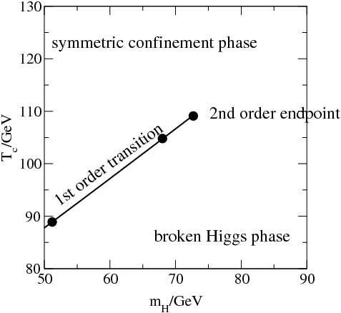
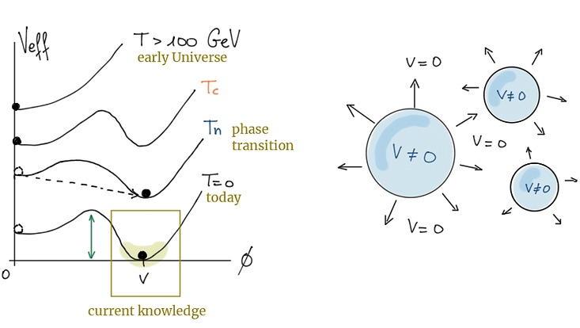
Recap: Electroweak Symmetry Breaking and Baryogenesis
Evolution of the universe
temperature evolution of Higgs potential ?
phase diagram of the SM!
for MH > 75 GeV, there is no phase transition in the SM
thus in SM no out-of-equilibrium state of the early universe for baryogenesis (requires 1st order phase transition, cf Sacharov conditions)
in many extended Higgs sectors, 1st order phase transition for 𝜆3 > 𝜆SM
need to
measure whether self-coupling 𝜆3 = 0.13 as predicted by SM - with the least possible prejudice! (eg “everything else” SM-like)
check whether Higgs field is indeed just one SU(2)L doublet
https://arxiv.org/pdf/hep-ph/0010275
Interesting interplay with gravitational waves: detect direct remnants of the phase transition?
credit: Kateryna Radchenko Serdula

Slide 31
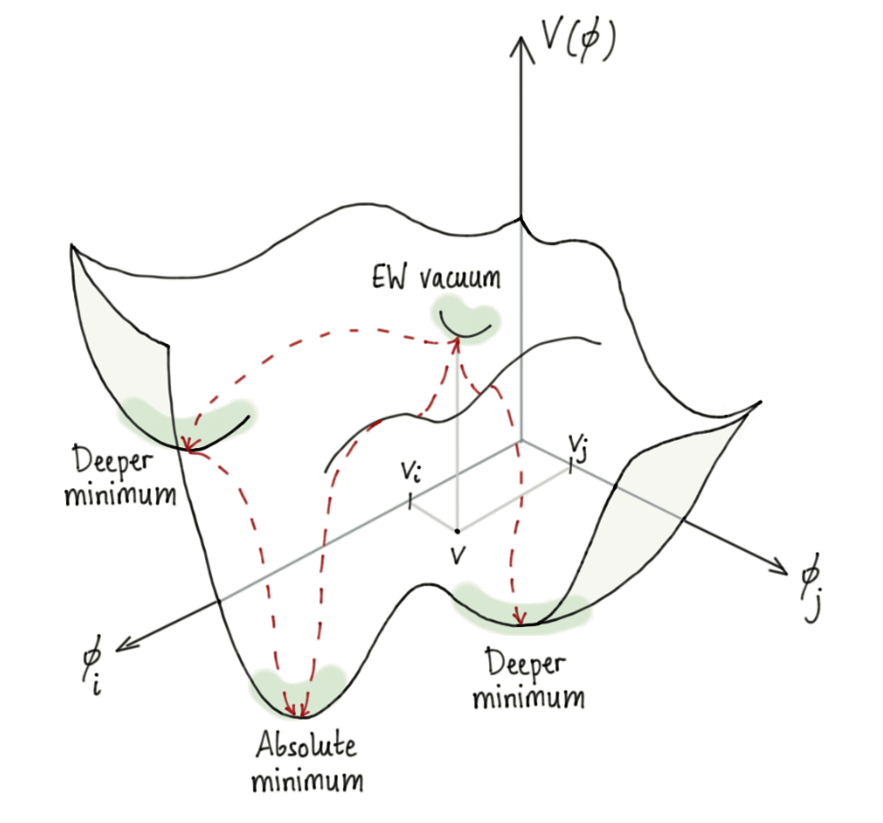
Higgs potential in extended Higgs Sectors
“Maxican hat” turns into complex landscape
more Higgs fields => much more complex potential “landscape” (even at zero-temperature)
extra Higgs bosons
several triple-Higgs couplings among them
several minima
EW vaccuum not necessarily global minimum => vacuum stability?
measure as many physical observables with least model-assumptions to explore this landscape - just assuming everything is like in the SM and extract one value is not sufficient!
credit: Kateryna Radchenko Serdula

Slide 32
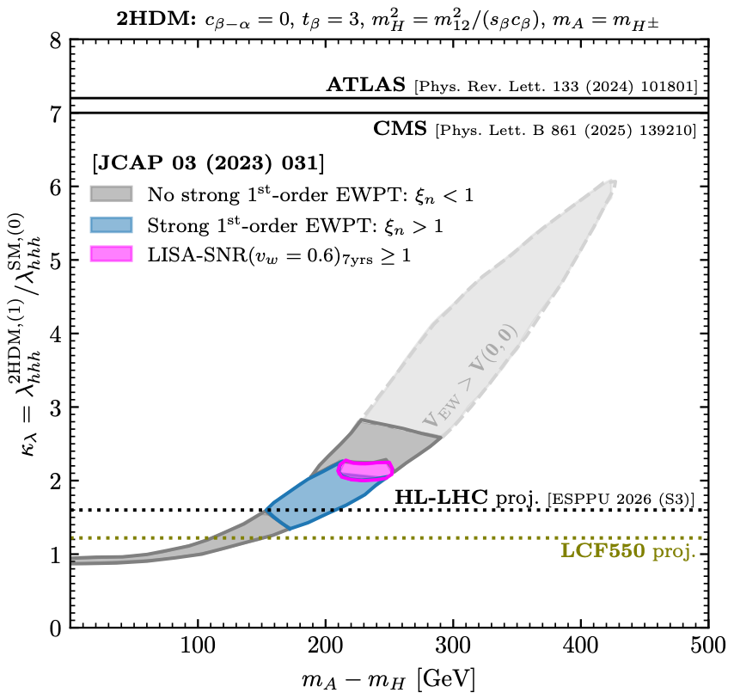
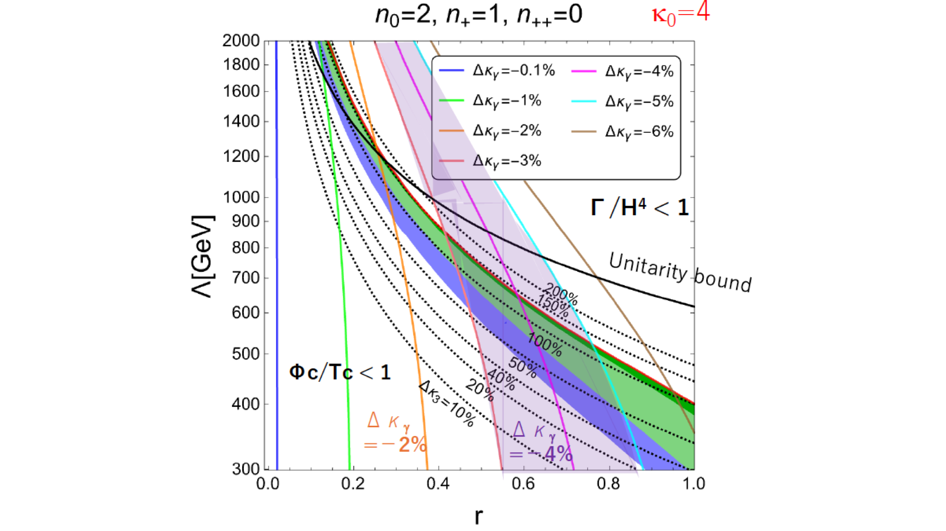
Interplay with Gravitational Wave detection
Need to assume specific extended Higgs sector to quantify effects
aligned Higgs EFT
area above dashed lines expected to be excluded if SM true
primordial black hole search
DECIGO/
LISA
FOEWPT only testable via Higgs
Phys.Lett.B 856 (2024) 138940

Slide 33
Higgs Couplings: The Snowmass SMEFT fit
Rainbow-Manhattans
all e+e- colliders show very comparable performance for standard Higgs program despite quite different assumed integrated luminosities => beam polarisation!
several couplings at few-0.1% level: Z, W, g, b, τ
some more at ~1%: γ, c
gain wrt to HL-LHC:
assuming no exotic Higgs decays exist: => all e+e- colliders gain at least an order of magnitude in precision wrt HL-LHC
allowing exotic Higgs decays: => qualitative jump since no absolute couplings from HL-LHC at all
Why do all e+e- Higgs Factories give so similar performance despite the very different assumed luminosities?
arXiv:2206.08326

Slide 34
Interlude: Chirality in Particle Physics
Just a quick reminder…
Gauge group of weak x electromagnetic interaction: SU(2)_{L} x U(1)
L: left-handed, spin anti-|| momentum* R: right-handed, spin || momentum*
left-handed particles are fundamentally different from right-handed ones:
only left-handed fermions (e–) and right-handed anti-fermions (e⁺) take part in the charged weak interaction, i.e. couple to the W bosons
there are (in the SM) no right-handed neutrinos
right-handed quarks and charged leptons are singlets under SU(2)_{L}
also couplings to the Z boson are different for left- and right-handed fermions
checking whether the differences between L and R are as predicted in the SM is a very sensitive test for new phenomena!
* for massive particles, there is of course a difference between chirality and helicity, no time for this today, ask at the end in case of doubt!

Slide 35
Physics benefits of polarised beams
General references on polarised e⁺e– physics:
arXiv:1801.02840
Phys. Rept. 460 (2008) 131-243
Much more than statistics!
background suppression:
e⁺e–→WW / 𝝂e𝝂e strongly P-dependent since t-channel only for e–_{L}e⁺_{R}
signal enhancement:
Higgs production in WW fusion
many BSM processes
have strong polarisation dependence => higher S/B
chiral analysis:
SM: Z and 𝛾 differ in couplings to left- and right-handed fermions
BSM: chiral structure unknown, needs to be determined!
redundancy & control of systematics:
“wrong” polarisation yields “signal-free” control sample
flipping positron polarisation controls nuisance effects on observables relying on electron polarisation
essential: fast helicity reversal for both beams!
g^{𝛾}L, g^{𝛾}R, g^{Z}L, g^{Z}R
f
f

Slide 36
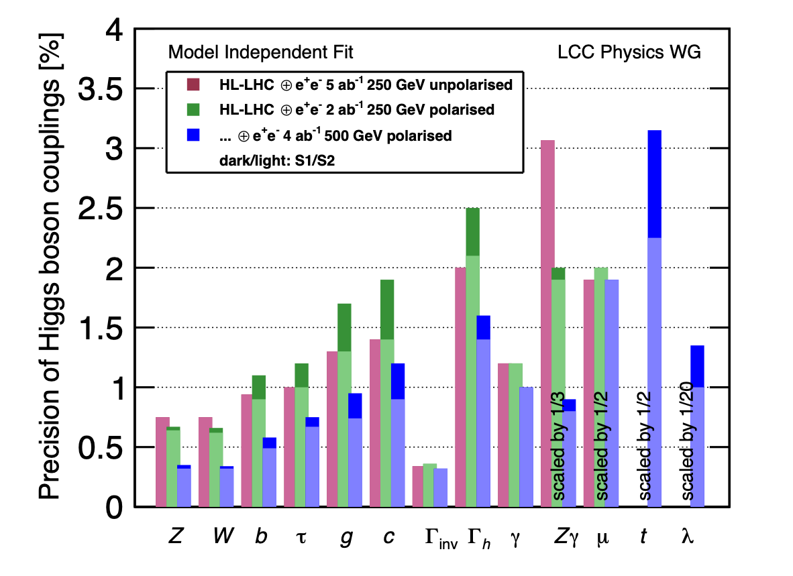
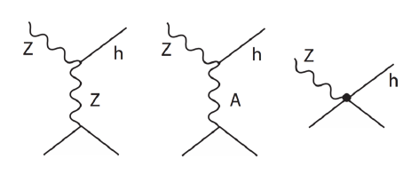
Polarisation & Higgs Couplings
A relationship only appreciated a few years ago…
THE key process at a Higgs factory: Higgsstrahlung e⁺e–→Zh
ALR of Higgsstrahlung: very important to disentangle different SMEFT operators!
arXiv:1903.01629
2 ab^{–1} polarised ≈ 5 ab^{–1} unpolarised
that’s why all e+e- Higgs factories perform so similar!
𝛄
constrained by EWPOs (*)
1%
spin reversal e–R↔︎e–L:
1st diagram flips sign
2nd diagram keeps sign
⇒ ALR lifts degeneracy between operators!
~cWW
only diagram allowed in SM

Slide 37
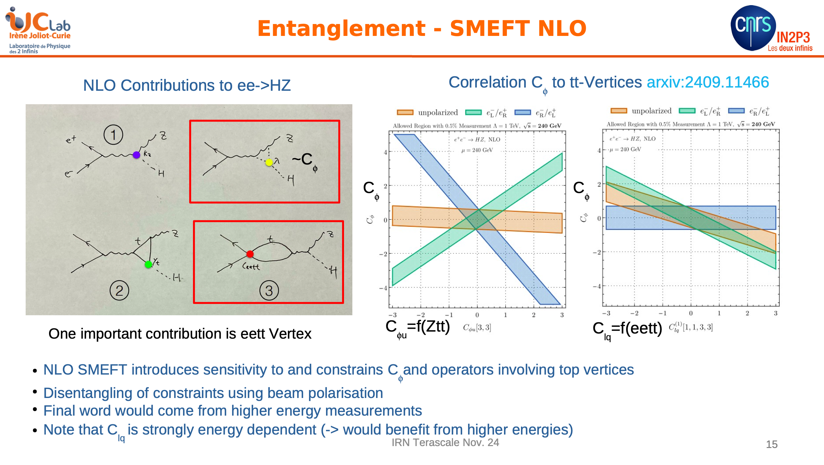
Polarisation & Higgs Couplings
A relationship only appreciated a few years ago…

Slide 38
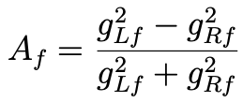

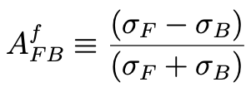




Polarisation & Electroweak Physics
let’s first recall at the Z pole situation
gLf, gRf : helicity-dependent couplings of Z to fermions - at the Z pole:
=>
specifically for the electron:
at an unpolarised collider:
=> no direct access to Ae, only via tau polarisation While at a polarised collider:
and
f
g^{𝛾}L, g^{𝛾}R, g^{Z}L, g^{Z}R
f
trading theory uncertainy: the polarised receives 7 x smaller radiative corrections than the unpolarised !
above Z pole, polarisation essential to disentangle Z / 𝛾 exchange in e⁺e–→ff

Slide 39
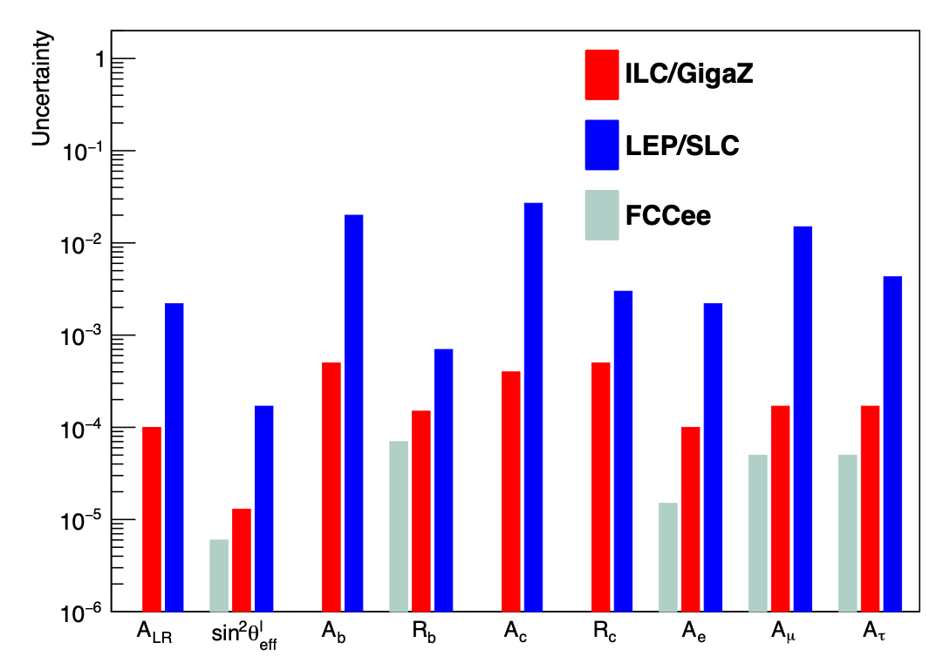
Polarisation & Electroweak Physics at the Z pole
LEP, ILC, FCCee
recent detailed studies by ILD@ILC:
at least factor 10, often ~50 improvement over LEP/SLC
note in particular:
Ac nearly 100 x better thanks to excellent charm / anti-charm tagging:
excellent vertex detector
tiny beam spot
Kaon-ID via dE/dx in ILD’s TPC
polarised “GigaZ” typically only factor 2-3 less precise than FCCee’s unpolarised TeraZ => polarisation buys a factor of ~100 in luminosity
Absolute
Note: not true for pure decay quantities!
arXiv:1908.11299

Slide 40
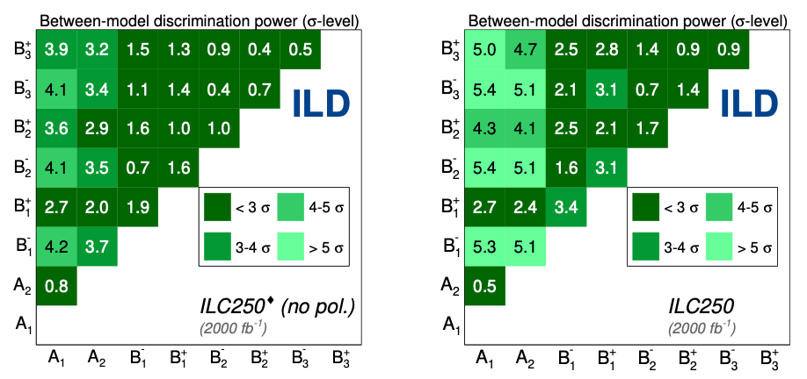
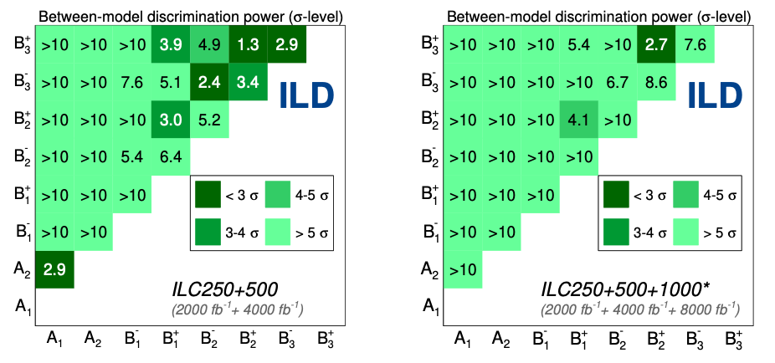
BSM reach of ee → cc / bb
arXiv:2403.09144
Forward-backward and left-right asymmetries above the Z pole
Study of ee → cc / bb
full Geant4-based simulation of ILD
TPC
BSM example: Gauge-Higgs Unification models
Higgs field = fluctuation of Aharonov-Bohm phase in warped extra dimension
Z’ as Kaluza-Klein excitations of 𝛄, Z, ZR
various model point with MZ’ = 7…20 TeV
energy
polarisation

Slide 41
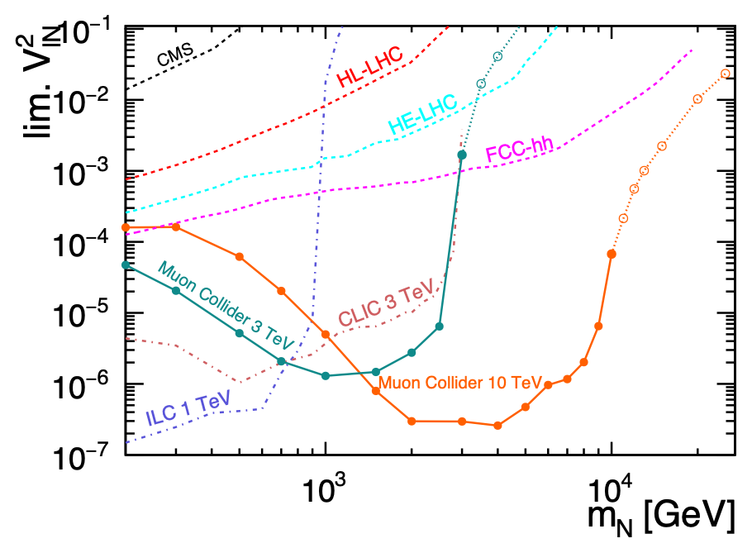
Heavy Neutral Leptons
Discovery reach for lepton colliders - complementary to FCC-hh
in Z decays with displaced vertices…
…and at high masses in prompt decays
arXiv:2203.05502
arXiv:2301.02602

Slide 42
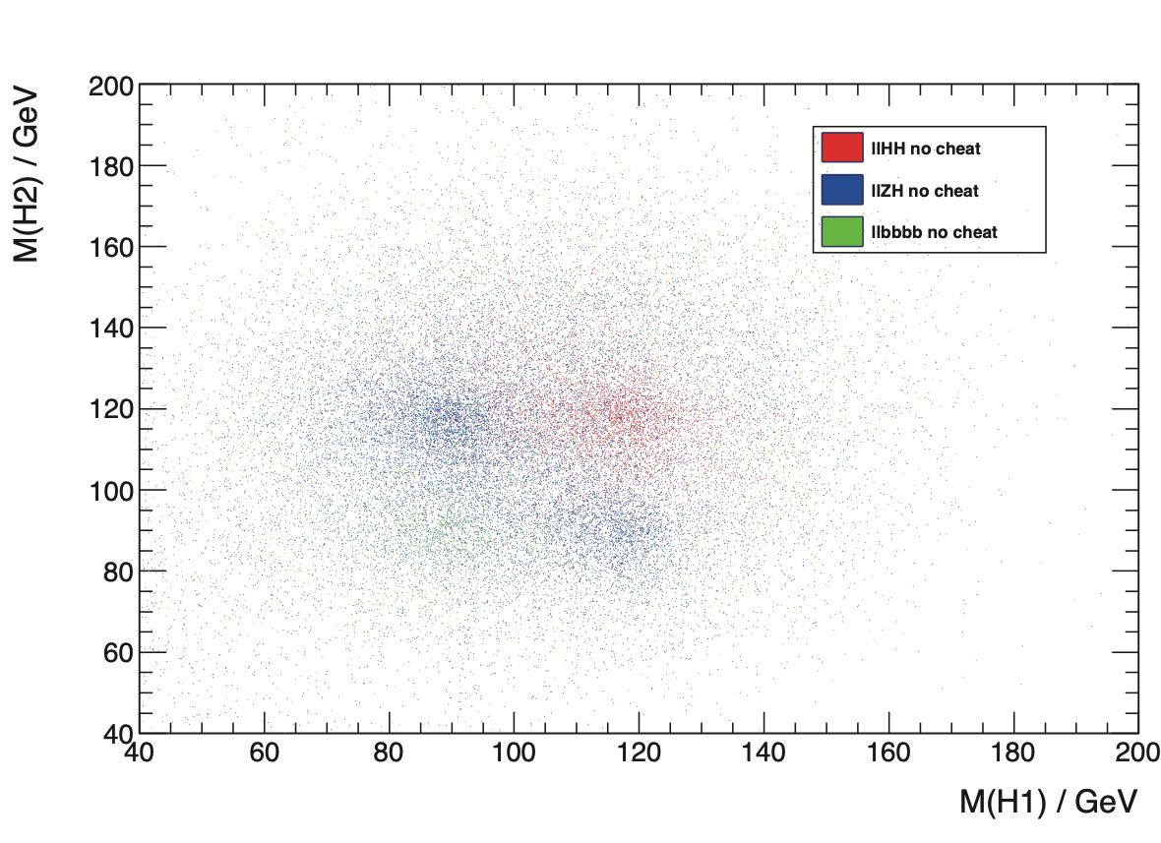
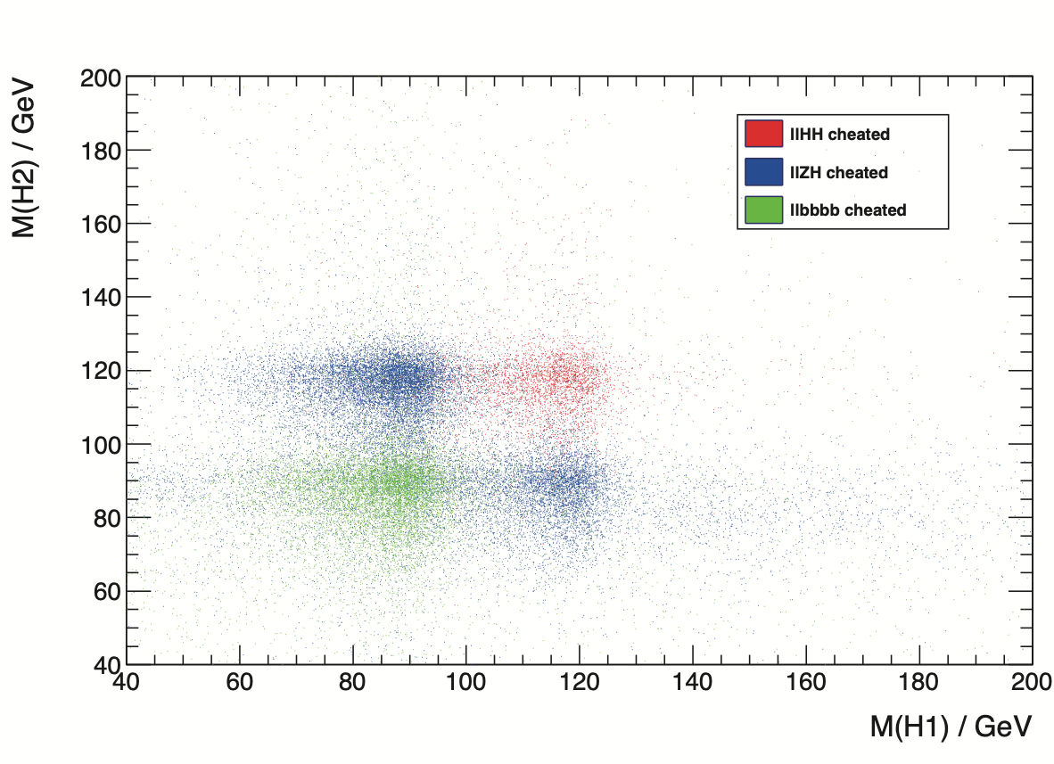
Urgently wanted: modern jet clustering
… bottle-neck for Higgs self-coupling precision
region A
Junping Tian, Claude Dürig, 2012
correctly clustered / reco energy
Julie Torndal, 2023
Potential to reduce 𝛿𝜆 by factor ~2
correctly clustered / true energy
=> Urgently needed: Advanced Jet Clustering, ML, …can we get rid of B, C, D ???
which additional detector information would help?
This has the potential to reduce 𝞭𝞴/𝞴(SM) from 20% to 10% !

Slide 43



Top Yukawa coupling
[Phys.Rev. D84 (2011) 014033 & arXiv:1506.07830]
Choosing the right energy
The Higgs and the Top
absolute size of |yt|:
HL-LHC:
𝛅𝜿t = 3.2% with |𝜿V| ≤ 1 or 3.4% in SMEFTND
e+e- LC:
current full simulation achieved 6.3% at 500 GeV
strong dependence on exact choice of ECM, e.g. 2% at 600 GeV
not included:
experimental improvement with higher energy (boost!)
other channels than H->bb
6.3%
2%
full coupling structure of tth vertex, incl. CP:
e⁺e⁻ at ECM ≥ ~600 GeV => few percent sensitivity to CP-odd admixture
beam polarisation essential!
[Eur.Phys.J. C71 (2011) 1681]
+ 1 TeV: 1.4%
to-do: real, full sim study @ 600 GeV!

Slide 44
Running Scenarios - illustrating the flexibility
start with full power

Slide 45
Running Scenarios - illustrating the flexibility
shorten 550 GeV to go to TeV range earlier

Slide 46
Running Scenarios - illustrating the flexibility
start with 550 GeV - cross-check CEPC with polarised data ?

Slide 47
Running Scenarios - illustrating the flexibility
start with 550 GeV - or go to TeV range earlier

Slide 48
Running Scenarios - illustrating the flexibility
Early Technology upgrade

