Slide 1
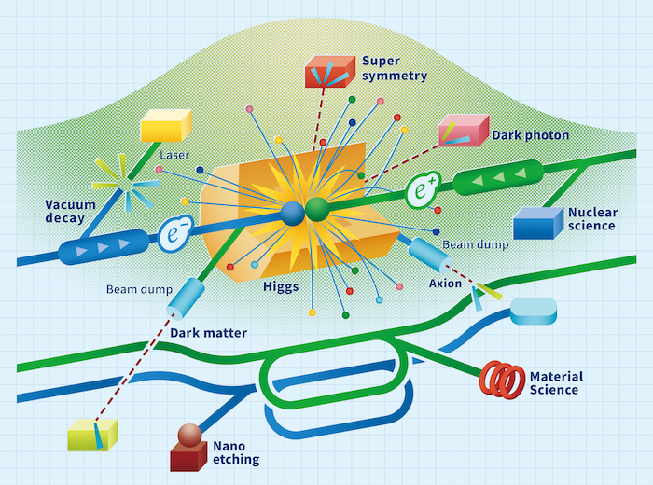
LCVision: Introduction & Goals of the Workshop
LC Vision Community Event
Jan 8, 2025
M. Ishino, J. List, T. Nakada, M. Peskin,
R. Pöschl, A. Robson, S. Stapnes

Slide 2
LCVision
Overview
LCVision originated from a bottom-up
brain-storming in spring 2024
Leading up to a first public presentation and
discussion at LCWS2024, c.f.
  https://newsline.linearcollider.org/
  https://agenda.linearcollider.org/event/10134/timetable
    => decision to develop this further into an EPPSU input
This week: taking stock here at the LC Vision Community Event
Staying in touch:
  sign-up for LCVision e-group:
  http://simba3.web.cern.ch/simba3/SelfSubscription.aspx?groupName=LCVision-General

Slide 3
LCVision
Objectives
make a strong case for Linear Colliders in general
  based on physics arguments
    capabilities at low energies (90-380GeV)
    unique added-value at high energies (500GeV … 1 TeV … 3 TeV)
  and attractive upgrade options
    based on advanced / new technologies rather than tunnel length
  independently of the exact implementation (acc. technology, site, …)
propose a versatile Linear Collider Facility (LCF)
  suited to host a long-term program, for instance at CERN
  starting from an affordable and timely realizable baseline
  building upon all the important R&D done for all the mature LC concepts
  with scientifically and technologically exciting upgrade options
aim for broad, joint support across all Linear Collider concepts
Contribute both the generic case and the LCF@CERN to the EPPSU

Slide 4
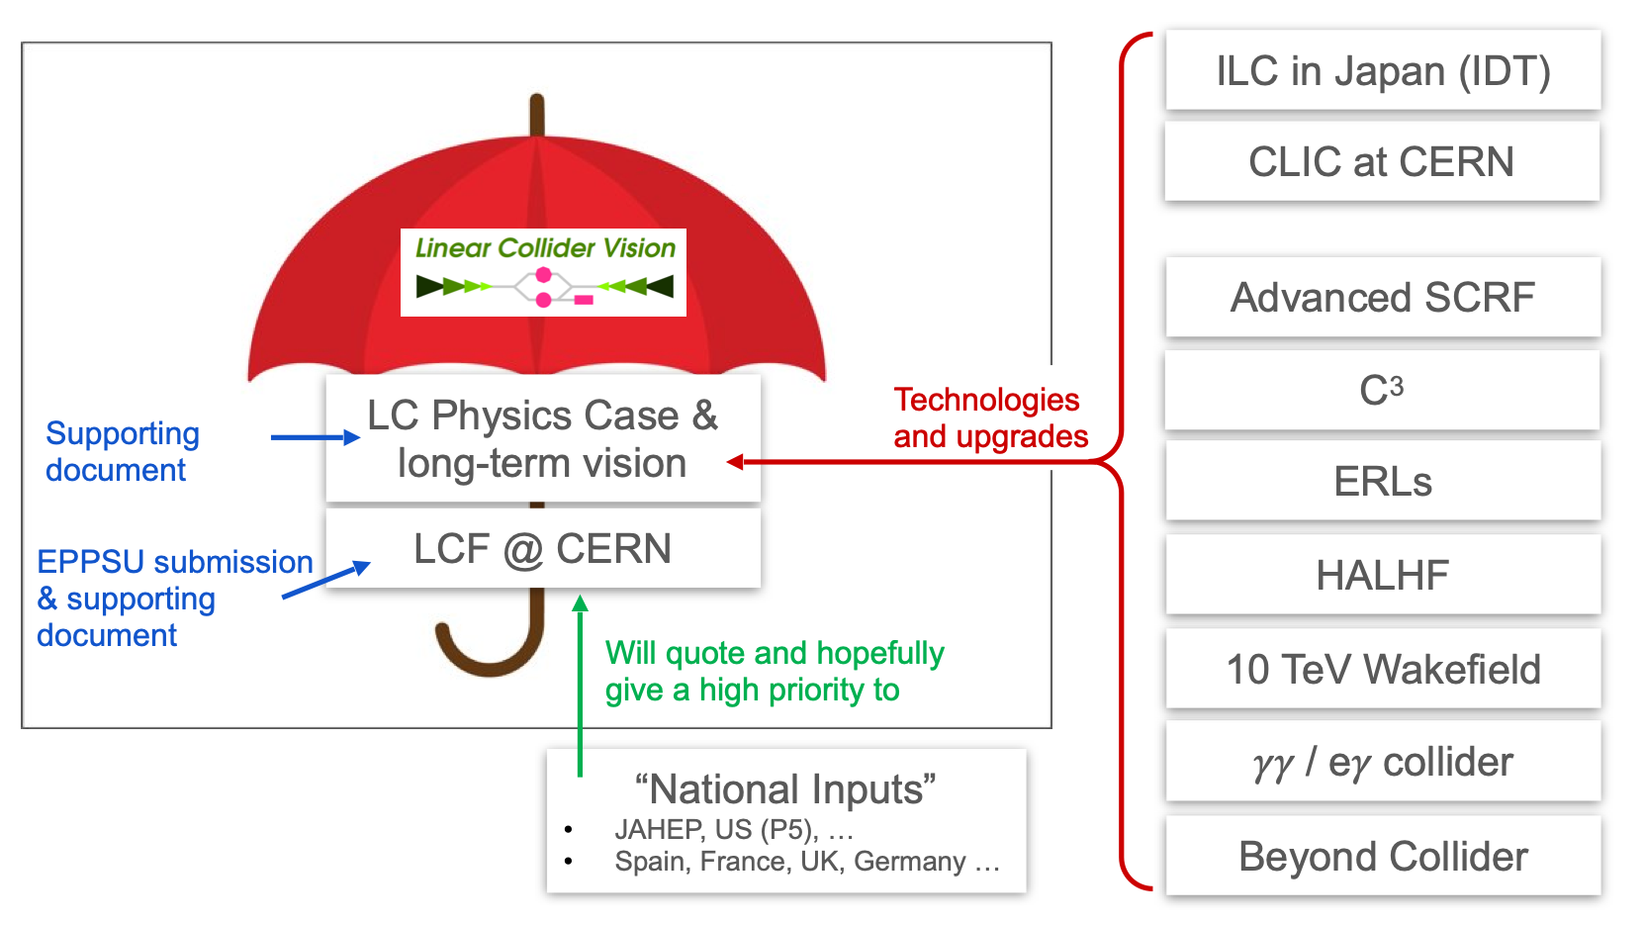
LC Vision Documents
and their relations to other EPPSU inputs

Slide 5
LCVision
Developments
Since LCWS 2024:
  Coordination Group with representatives of LC concepts / technologies, ECRs and national contacts formed
  Expert Teams working on upgrade options
  Siting / CFS / costing for CERN under preparation
  Defined which documents to prepare for EPPSU (actual submission & supporting documents)
Core Editing Team started weekly meetings from November
Author Teams for physics part started early December
Drafts are beginning to appear on overleaf…
Preparing system for signature collections for EPPSU documents

Slide 6
LCVision
Coordination Group & Expert Team Leaders
Chairs: J. List, S. Stapnes
Coordination Group
Halina Abrahmovic, Erik Adli, Ties Behnke, Ivanka Bosovic, Phil Burrows, Marcel Demarteau, Yuanning Gao, Carsten Hensel, Mark Hogan,
Masaya Ishino, Daniel Jeans, Imad Laktineh, Andy Lankford, Benno List, Kajari Mazumar, Shin Michizono, Emmanuela Musumeci, Tatsuya Nakada, Mihoko Nojiri, Dimitris Ntounis, Jens Osterhoff, Ritchie Patterson, Aidan Robson, Daniel Schulte, Taikan Suehara, Geoffrey Taylor, Caterina Vernieri, Marcel Vos, Georg Weiglein, Filip Zarnecki, Jinlong Zhang, Patrick Koppenburg, Hitoshi Murayama, Laura Monaco, Jochen Schieck
Expert Team 1
“Physics-driven run plan
and EPPSU documents”
Roman Poeschl,
Michael Peskin
Expert Team 3
“SCRF upgrades”
Sergey Belomestnykh, Hiroshi Sakai,
Marc Wenskat
Expert Team 5
“ERL upgrades”
Walid Kaabi,
Vladimir Litvinenko, Kaoru Yokoya
Expert Team 7
“Beyond Collider”
Stefania Gori,
Yasuhito Sakaki,
Ivo Schulthess
Expert Team 2
“LCF@CERN”
Steinar Stapnes,
Thomas Schörner
Expert Team 4
“C3/CLIC upgrades”
Angeles Faus-Golfe,
Enrico Nanni
Expert Team 6
“Plasma upgrades”
Brian Foster,
Spencer Gessner
Expert Team 8
“Alternative Collider Modes”
Tim Barklow, Gudi Moortgat-Pick, Ariel Schwartzman

Slide 7
LCVision
Document Writing - Core Editing Team, Physics Team & Expert Teams
Core Editing Team
Masaya Ishino, Jenny List, Tatsuya Nakada, Michael Peskin, Roman Poeschl, Aidan Robson, Steinar Stapnes
Higgs at 250 GeV
Dirk Zerwas, Caterina Vernieri, Kei Yagyu
EW from Z pole to highest E
Graham Wilson, Adrian Irles, Taikan Suehara
Higgs at high(est) E
Shinya Kanemura,
Georg Weiglein, Johannes Braathen, Margarete Muehlleitner
Global Interpretations
Junping Tian,
Jorge de Blas
Top from threshold to highest E
Marcel Vos,
Gauthier Durieux,
Ken Mimasu
Alternative Collider Modes & Beyond-Collider
=> physics covered by respective expert teams
Direct BSM
Filip Zarnecki, Sabine Kraml, Sven Heinemeyer, Howard Baer, Natsumi Nagata
ttH and VV
Juergen Reuter, Wolfgang Kilian, Jan Strube, Koji Tsumura
=> more contributors welcome, please get in touch!

Slide 8
This Workshop
Goals
Review the current status
A critical item: definition of the “baseline” — between physicists wishes and technical & cost constraints
Collect feed-back from the community
=> discussion between talk and dedicated discussion blocks
=> junior and senior colleagues are encouraged to speak up!
Define the next steps until March, for the next ~12 months, and beyond
Program overview:
  Today: Physics
  Tomorrow:
    Baseline and upgrade options - generically
    Physics and Technical Input requested by the ESG
    Detector Aspects
    Implementation in Japan
  Friday:
    Implementation at CERN: The Linear Collider Facility
    Next steps
Enjoy two days of interesting talks and constructive discussions!

Slide 9
Any Questions?

