Slide 1
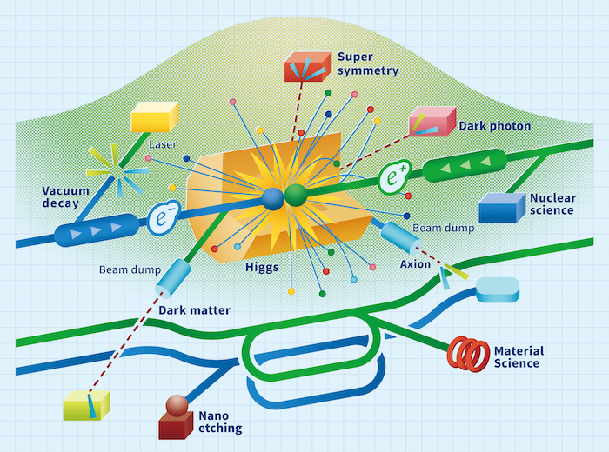
LCVision: Scenarios for Construction and Operation
LC Vision Community Event
Jan 9, 2025
M. Ishino, J. List, T. Nakada, M. Peskin,
R. Pöschl, A. Robson, S. Stapnes

Slide 2
Basic Parameters
an overview from cruising altitude
Linear Colliders are stageable in energy and luminosity
  energy scales with length for given technology => construction cost & land usage
  luminosity scales with power consumption => construction & operation cost
Pure physics optimisation:
  build facility for highest energy & highest luminosity
  run at lower energies for specific measurements if physics program demands (e.g. threshold scans)
Resources are finite:
  How to balance scientific ambitions vs realistic resource consumption?
  All Linear Colliders offer the possibility of step-wise construction — aka “staging”
  LCVision philosophy: prioritize upgrades via advanced technologies over tunnel prolongation and “more of the same”
Need to define as baseline:
  initial footprint & civil construction
  candidates for initial acceleration technology

Slide 3
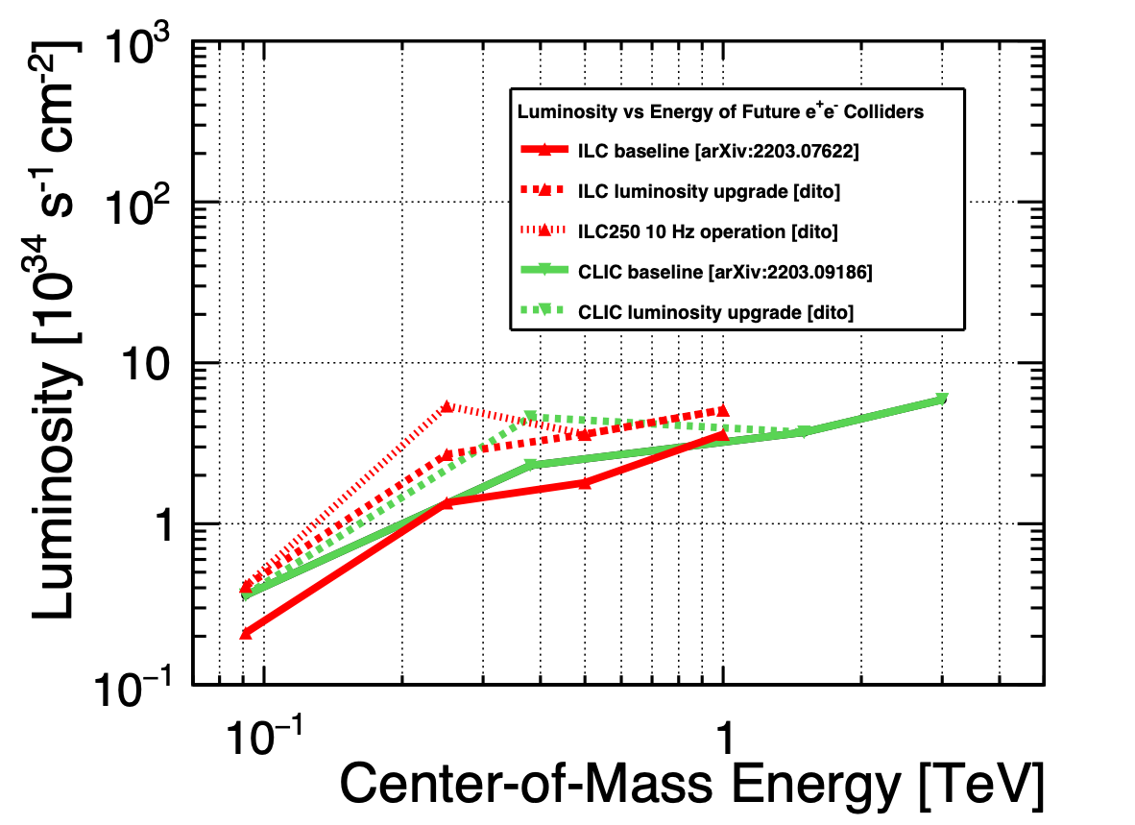
Physics vs ECM for a polarised e+e- Linear Collider
and minimal integrated luminosity - see yesterday’s talks
250 GeV, ~2ab-1:
  precision Higgs mass and total ZH cross-section
  Higgs -> invisible (Dark Sector portal)
  basic ffbar and WW program
  optional: WW threshold scan
Z pole, few billion Z’s: EWPOs 10-100x better than today
350 GeV, 200 fb-1:
  precision top mass from threshold scan
500…600 GeV, 4 ab-1:
  Higgs self-coupling in ZHH
  top quark ew couplings
  top Yukawa coupling incl CP structure
  improved Higgs, WW and ffbar
  probe Higgsinos up to ~300 GeV
  probe Heavy Neutral Leptons up to ~600 GeV
800…1000 GeV, 8 ab-1:
  Higgs self-coupling in VBF
  further improvements in tt, ff, WW, ….
  probe Higgsinos up to ~500 GeV
  probe Heavy Neutral Leptons up to ~1000 GeV
  searches, searches, searches, …
Based on classic ILC/CLIC luminosity assumptions
limited by self-allowed power budget
+ 1…3 TeV:
  more Higgs self-coupling in VBF
  further improvements in tt, ff, VV scattering
  quartic Higgs self-coupling !
  searches, searches, searches, e.g.
  probe Higgsinos up to 1.5 TeV
  probe Heavy Neutral Leptons up to 3 TeV
New results from HL-LHC might change the priorities anytime
=> flexibility is key!

Slide 4
Notes from Physics Sessions
On overall presentation aspects
present energy-ordered improvements for each measurement (rather than group all physics which can be done at one energy stage)
indicate the potential improvements with more luminosity, higher polarisations
type of projections: provide “prospects” (from full study / mild extrapolations) and “targets” (in reach with more work) — c.f. Marcel Vos’ talk
include LHC results / HL-LHC projections in comparison plots wherever possible
=> can those of you who are on ATLAS/CMS help with this?
provide up to date set of inputs for global fits to PPG and other interested colleagues
don’t forget about CP properties of the various Higgs, top and gauge boson couplings
=> important input for physics writing teams, need to see what can be done in the next few weeks…

Slide 5
Other Aspects
beyond L, E, P
Strong community wish to re-instantiate a 2nd interaction region:
  will not double the luminosity
  but add a lot of flexibility and complementarity to the facility (alternative collider modes, technology R&D for future upgrades, ….)
  designs exist for ILC and CLIC
  need updates and revision, but no fundamental show stopper (was simply eliminated to reduce cost…)
Plan extra facilities from beginning:
  Beam-dump experiments
  Extracted beam experiments (e.g. LUXE/ ELBEX @ Eu.XFEL)
  R&D facilities for detector and accelerator technology — also for later upgrades of the collider itself!
Foresee upgrades from beginning:
  Today we do not know yet which long-term R&D approach will turn out to be most suitable
  Design initial facility to be compatible with basic requirements of various advanced technologies
Will hear more details about all these ideas during today’s program!

Slide 6
Initial Scenarios given to Expert Teams
as a basis for discussion
let’s assume we start with a Linear Facility, with 2 Beam Delivery Systems (2 IRs), length
  ~20 km (e.g. 250 GeV SCRF or ~800 GeV copper)
  ~30 km (e.g. 550 GeV SCRF or ~1.5 TeV copper)
what could “your” technology offer as
  decision-ready in < 5 years (e.g. 2-3 year targeted engineering effort after EPPSU adoption in early 2026)?
    ILC-like SCRF, CLIC-like drive-beam
    alternative collider modes, beyond-collider facilities?
    anything else?
  as upgrade, decision-ready after the first years of data-taking of initial facility (e.g. 2045-2050)?
    requirements on initial facility to make upgrade viable?
    required R&D and ressources until decision-readiness?

Slide 7
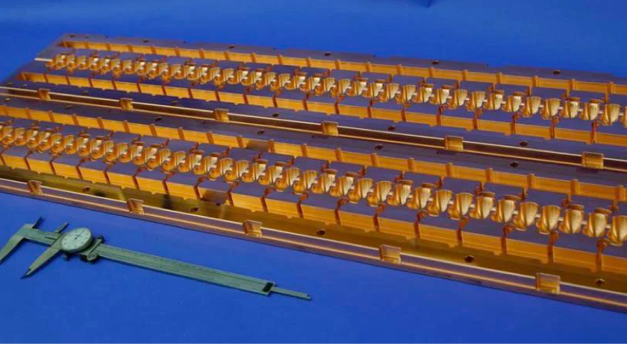
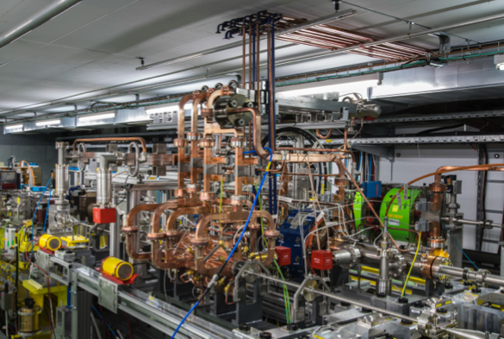
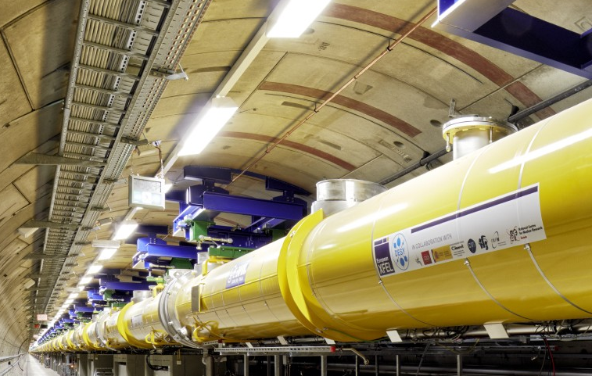
The Linear Collider Facility — Generically
What could be the initial technology?
For now, the LCF footprint is designed to be compatible with both SCRF and warm (or cool) copper cavities
The key aspect of LCVision is the need for a Linear Collider at all, able to probe e+e- collisions with polarised beams and beyond the ttbar threshold
Technology should be chosen — at the point in time when the decision is required — according to
  physics priorities
  industrial readiness
  industrial / societal interest in contributing regions
  cost, risk, sustainability, …
Due to
  the industrialisation advantage and the many running XFELs
  the strong expertise in many regions of the world
  and the number of well-defined physics targets up to 1 TeV
  LCVision for now assumes SCRF as baseline for fastest readiness

Slide 8
Now take a look at the range of energy, power and luminosity options — and the resulting running scenarios — taking ILC as example

Slide 9
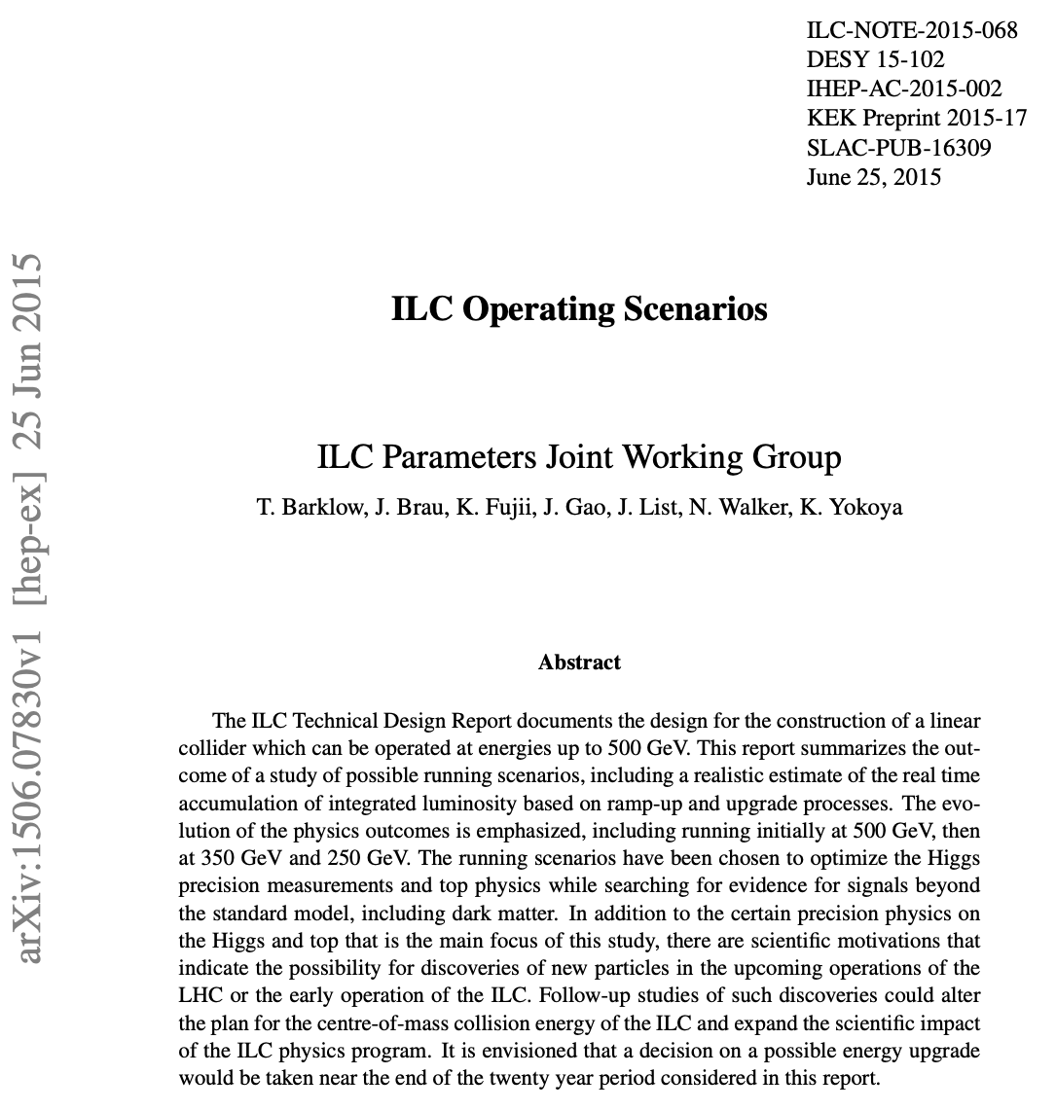
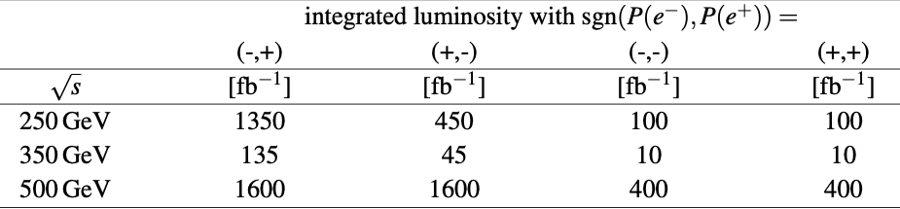
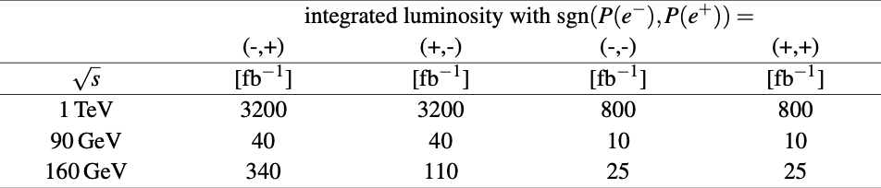
A bit of History
ILC Parameters Joint Working Group
group of accelerator and particle physics experts
charged to develop running scenarios for the ILC
integrated luminosities kept fixed ever since!

Slide 10
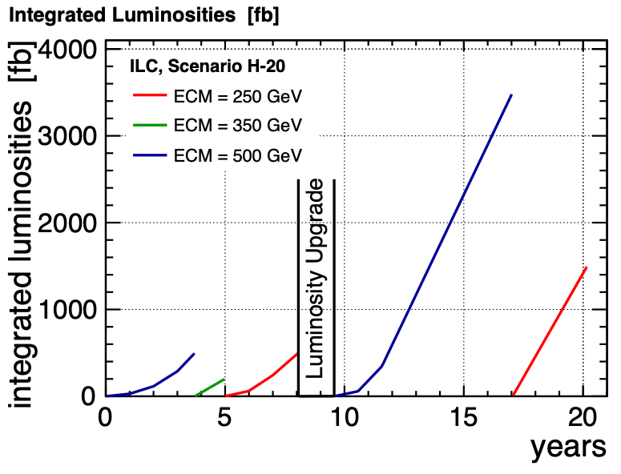
Running Scenario in 2015
ILC started still at 500 GeV, but initial luminosity had already been halved (“low power” option)
operation 1.6E7 s / year (more than std CERN assumption)
start at 500 GeV
  initial peak lumi = 1.8E34 / s / cm2
  (= 1315 bunches / train)
  luminosity upgrade 3.6E34 / s / cm2
  (= 2625 bunches / train)
at lower energies
  linac is operated at lower gradient
  use spare RF & cryogenic power to increase train repetition rate to 10 (7) Hz at 250 (350) GeV
assume slow ramp-up to peak luminosity
  0.1, 0.3, 0.6, 1.0 in years 1-4
  0.25, 0.75, 1.0 after first change to 10 Hz
  0.1, 0.5, 1.0 after lumi upgrade

Slide 11
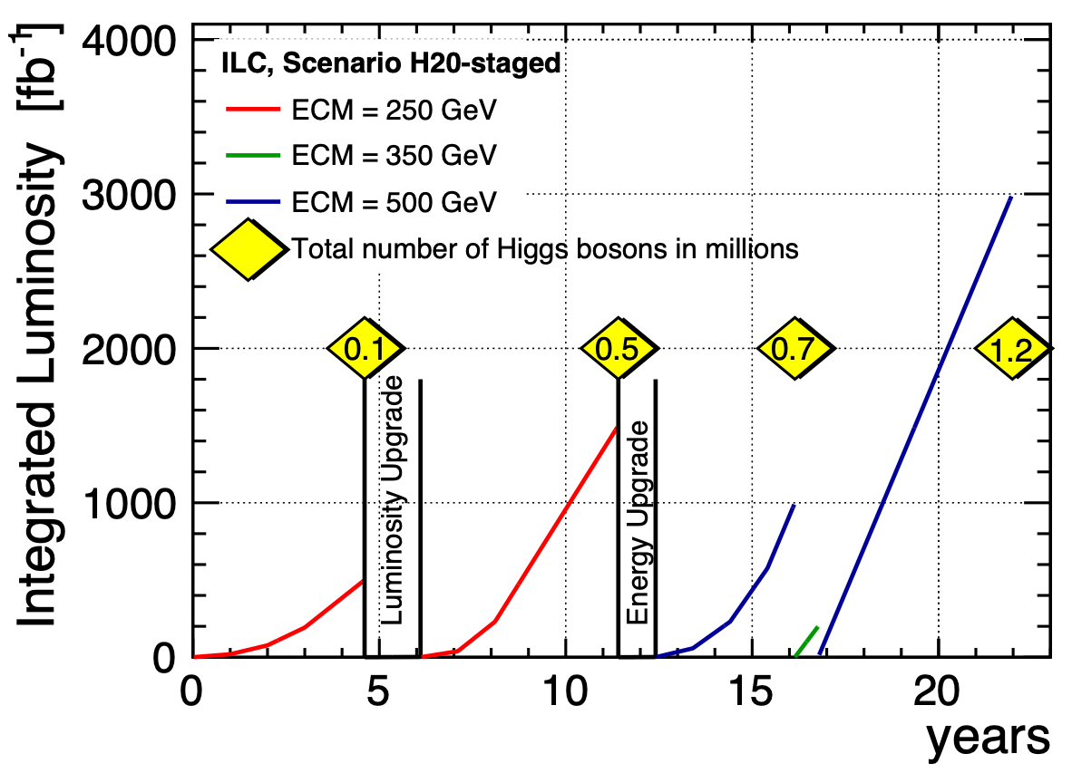
Staged machine 2017
Start at 250 GeV: half the linac length, and also reduced RF & Cryo power
no 10 Hz operation possible in initial configuration
initial peak lumi 1.35E34 /s /cm2

Slide 12
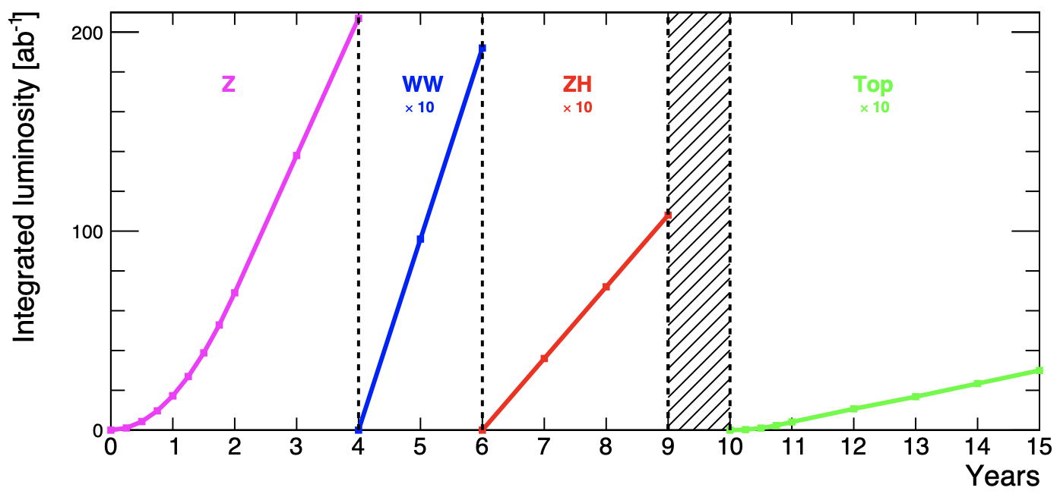
Running Scenarios
Luminosity, Power Consumption and all that
typical criticism: “low luminosity of LCs requires much more time to do the Higgs program”
  indeed, in std ILC250 run plan, ZH run takes ~11 years, vs 3 years in FCCee plan
  however: ILC250 starts with minimal power => let’s take a look!
note: no lumi ramp-up assumed apart from Z pole

Slide 13
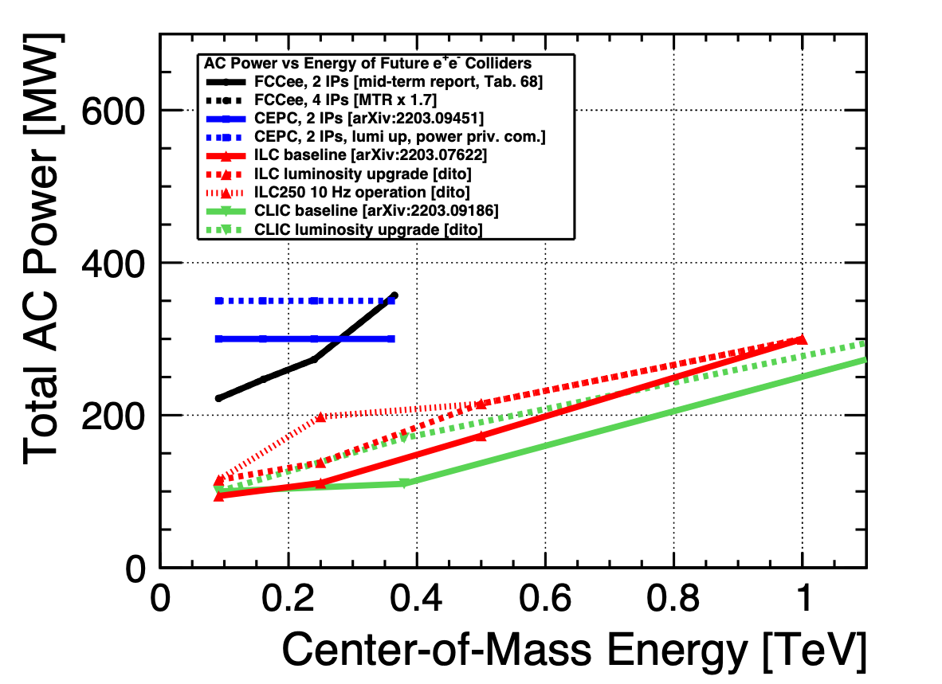
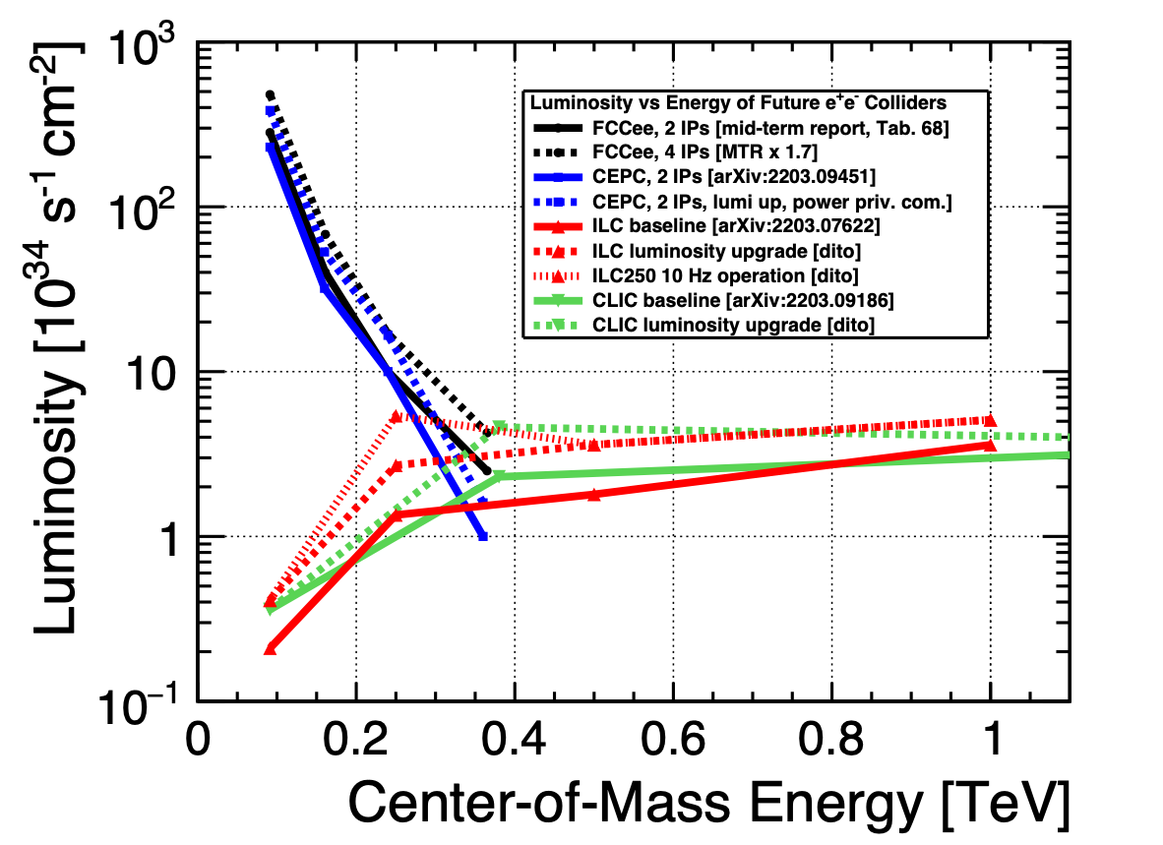
Power and Luminosity
as function of center-of-mass energy

Slide 14
Some comparisons
based on the lumi-power relations
Single-Higgs program at 240/250 GeV:
  Linear Collider luminosity restricted by self-assigned power limit (all lumis in s^-1 cm^-2)
    250 GeV ILC lumi, polarised:
    baseline 1.35E34, 100 MW => 2.7E34 => 5.4E34, 200MW
  FCCee (mid-term report): 5E34 / IP => 10 with 2IPs, 17E34 with 4 IPs with 273 MW
  Very naively: for 270 MW, could run ILC at 13 Hz => 7E34 with 270 MV, polarised
  => at comparable power consumption, instantaneous lumi at ILC would be ~2.5x less than at FCC with 4 IPs
Top threshold:
  ILC lumi-upgrade 1 (2625 bunches / train): lumi larger than FCCee with 2IPs
  7Hz running ~= FCC 4IPs - but 200 MW vs 350 MW!

Slide 15
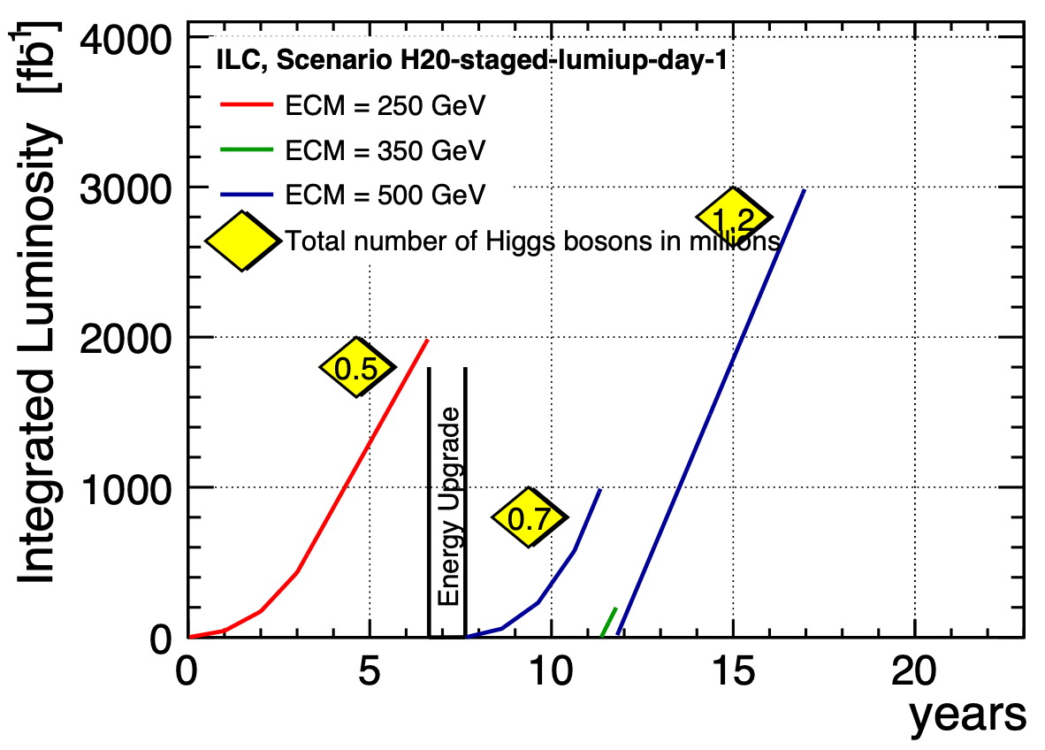
Cranking up ILC power
Full number of bunches per train from day-one “lumi upgrade” on previous page
Higgs run down to 6-7 years

Slide 16
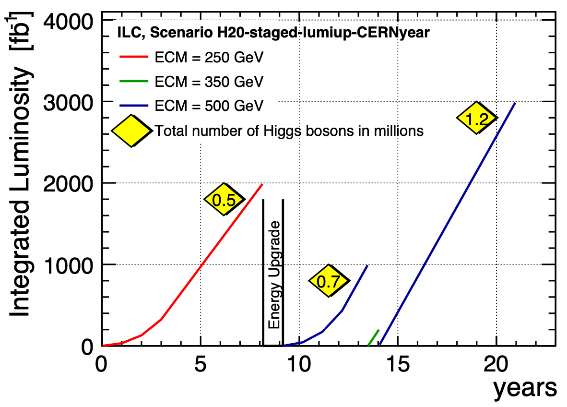
Being honest: adjusting to CERN operation year = 1.2x10^7s
Old ILC assumption used to be 1.6x10^7 s / year
Higgs run ~8 years

Slide 17
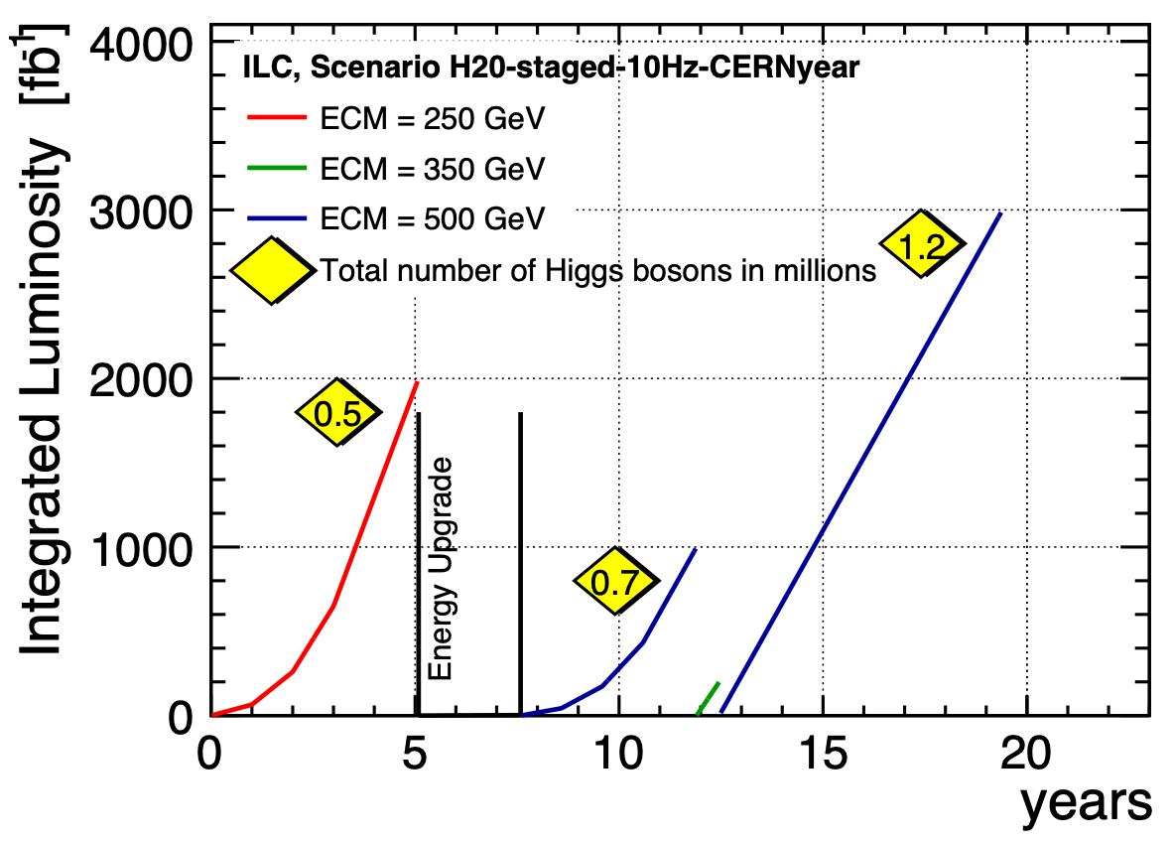
200 MW (aka 10 Hz scheme) from day 1
Remember: FCCee uses 270-350 MW
Higgs run 5 years

Slide 18
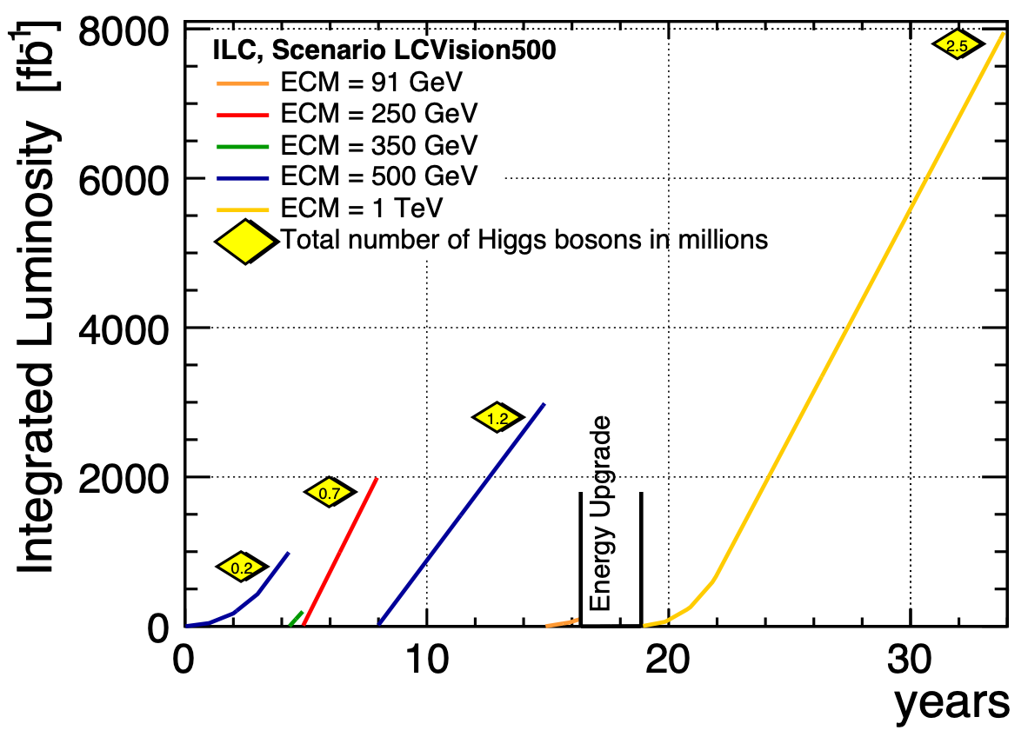
Dream a little dream…
Starting at 550 GeV
without lumi ramp-up
(i.e. like FCCee assumption):
Higgs run < 2 years

Slide 19
Conclusions on Running Scenarios
Some take-away messages
for physics results, the combination of energy, integrated luminosity and beam polarisation counts
for construction and operation costs, the total AC power counts
power and instantaneous luminosity are strongly correlated
Integrated luminosity depends on peak instantaneous luminosity and assumed operating efficiencies, learning curves etc pp
the 11years the minimal ILC250 needs to collect the 250 GeV sample is driven by all the cost reductions applied to the orginal design
If we could build a 550 GeV “2625 bunch” machine right away (still 25% less AC power than FCCee), and use the same operation assumptions as for FCC-ee, the canonic ILC250 data set could be taken in < 2 years
Would be awesome if we could find a way to pay for this!!! :)

Slide 20
On the way to a baseline definition
some food for thought & discussion
2 IPs => detailed design of BDSes and IRs needs to be revisited and updated
Tunnel laser straight
=> favoured for many technologies, not needed but can be done for SCRF
length of facility (and AC power ~lumi) needs to be balanced against initial cost
e.g. for ILC-type SCRF:
  21 km: 250 GeV
  27 km: ~380 GeV — or install initially only 250 GeV
  33 km: 550 GeV — or install initially only 380 or even 250 GeV
different approaches:
  What’s the cheapest machine to study the Higgs? the top ?
  What can we get for ~<= 10 Billion ILCU / CHF / …?
  What could we get for the cost of FCC-ee ?
intellectually all valid and interesting questions which we’ll try to answer as ingredients to the discussion

Slide 21
Any Questions?

