Slide 1

Sustainability Studies for ILC, CLIC and LCF
Benno List,
Sustainable HEP 2025
May 14, 2025

Slide 2
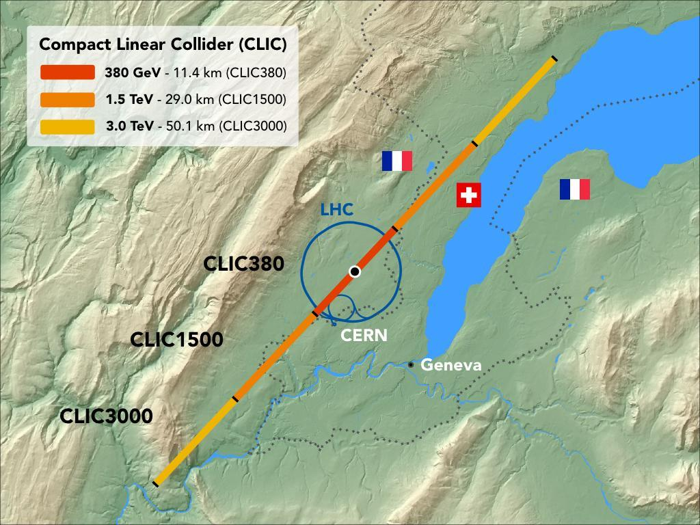
ILC and CLIC
Two e+e- linear collider designs, starting as a Higgs factory
International Linear Collider ILC
Superconducting Cavities, 1.3GHz, 31.5MV/m
250GeV CME, upgradeable to 500, 1000 GeV
L = 1.35E34 cm⁻²s⁻¹
20km length, in Tohoku / Japan
Compact Linear Collider CLIC
NC Copper Cavities, 11.4GHz, 72MV/m
Two-beam acceleration (or klystron driven initially)
380GeV CME, upgradeable to 1500, 3000 GeV
L = 2.3E34 cm⁻²s⁻¹
11.4km long, at CERN / France & Switzerland
ESPPU submission #275
https://indico.cern.ch/event/1439855/contributions/6461661/
ESPPU submission #78
https://indico.cern.ch/event/1439855/contributions/6461475/
arXiv:2503.24168

Slide 3
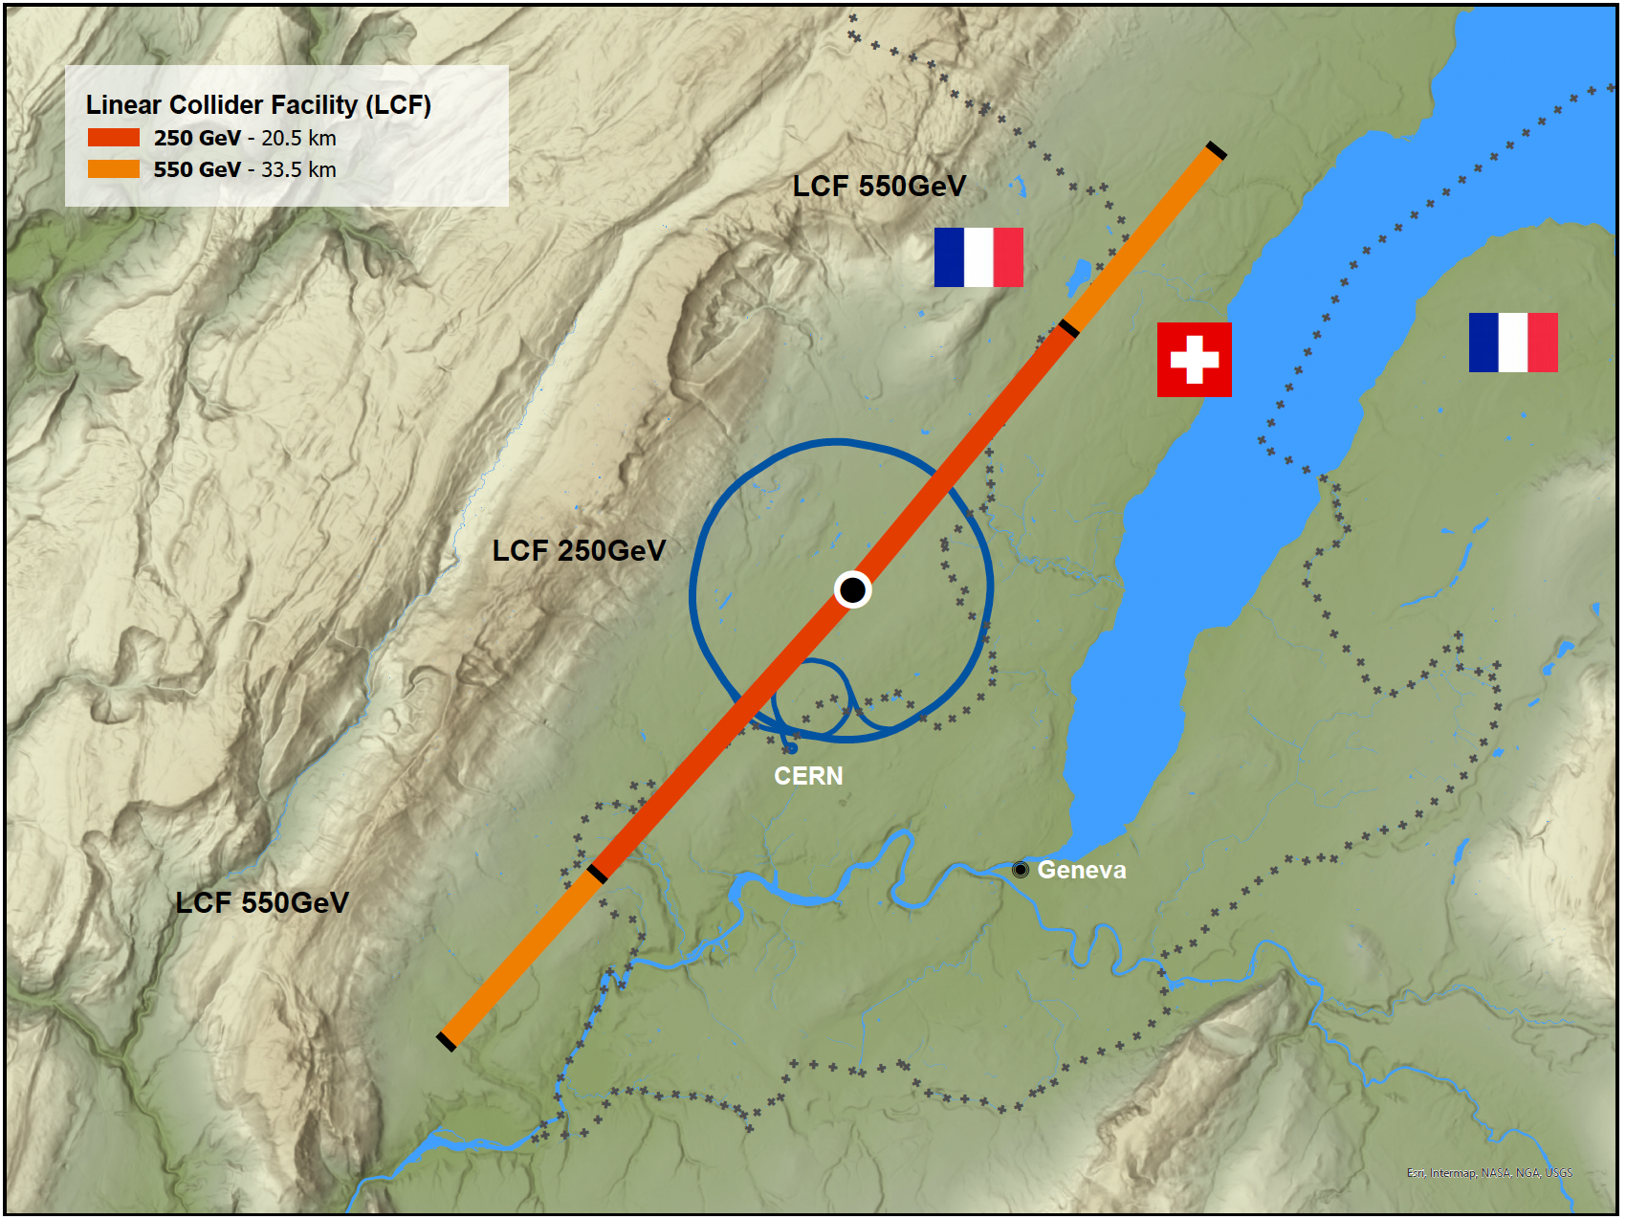
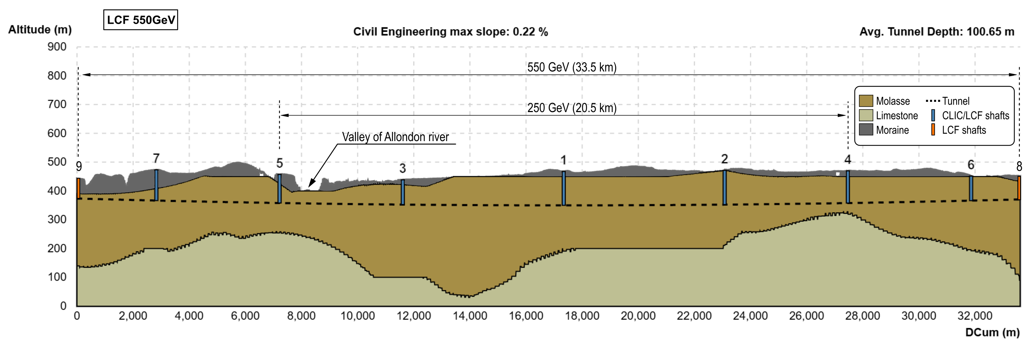
A new project: Linear Collider Facility LCF at CERN
A linear collider based on ILC technology for CERN, with technology upgrade options
Parameter | Value
CM Energy | 250 – 550 GeV
Length | 33.5 km
Luminosity | 2.7 – 7.7 x 10³⁴ cm⁻²s⁻¹
Rep. rate | 10Hz
Beam pulse | 0.73 ms
Beam current | 5.8 – 8.8 mA
Beam size | 7.7nm at 250GeV
Cavity gradient | 31.5 MV/m
Cavity Q₀ | 2 x 10¹⁰
Linear Collider Facility LCF
Superconducting Cavities, 1.3GHz, 31.5MV/m
250GeV CME, upgradeable to 550 GeV
L = 2.7 E34 cm⁻²s⁻¹ initial
33.5km length, at CERN
Upgradeable with C3 or CLIC technology
ESPPU submission #40
https://indico.cern.ch/event/1439855/contributions/6461433/
arXiv:2503.24049

Slide 4
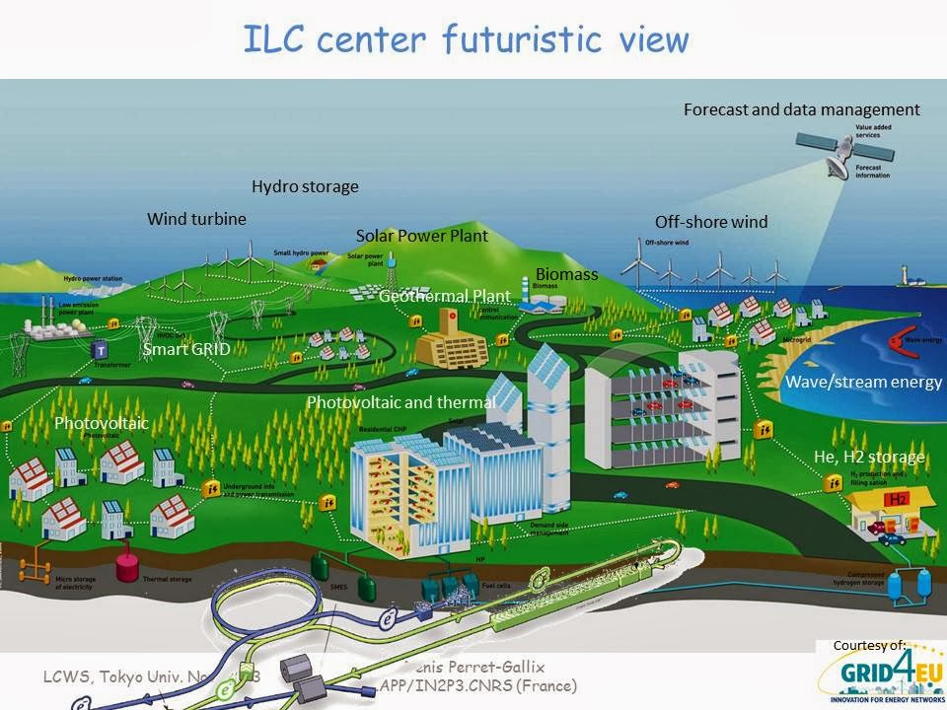
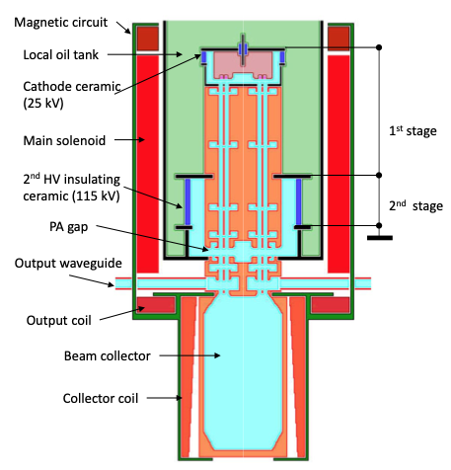
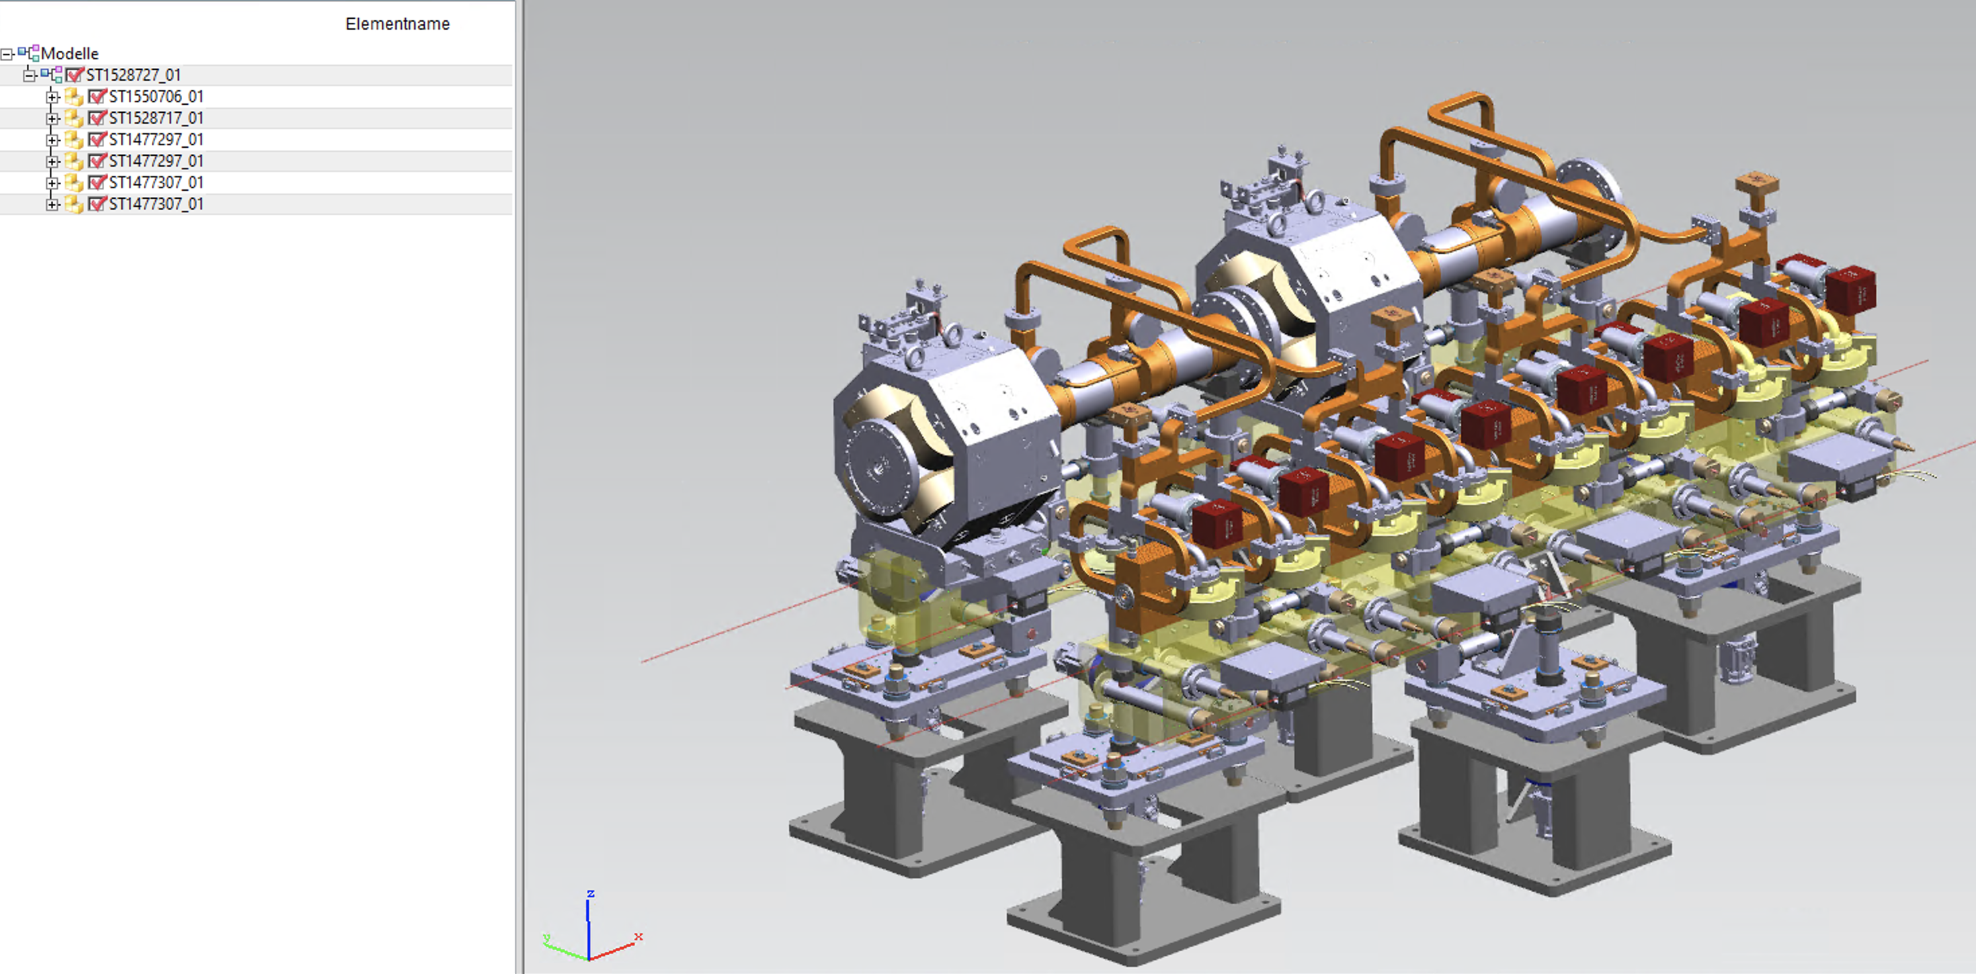
Approaches to Improve Sustainability
Accelerators for High Energy Physics are at the leading edge of technology:
beam energy, intensity, luminosity…
Ressource conservation is paramount:
Sustainability adds new cost measures: e.g. CO₂, rare earth usage -> Lifecycle Assessment!
Overall System Design
Compact (short) accelerator -> high gradient
Energy efficient -> low losses
Effective -> small beam sizes
Subsystem and Component Optimisation
High-efficiency cavities and klystrons
Permanent magnets
Heat-recovery in tunnel linings
Operation
Recycle energy (heat recovery)
Adapt to regenerative power availability
Exploit energy buffering potential
Lifecycle assessment quantifies impact
-> the first step to optimisation

Slide 5
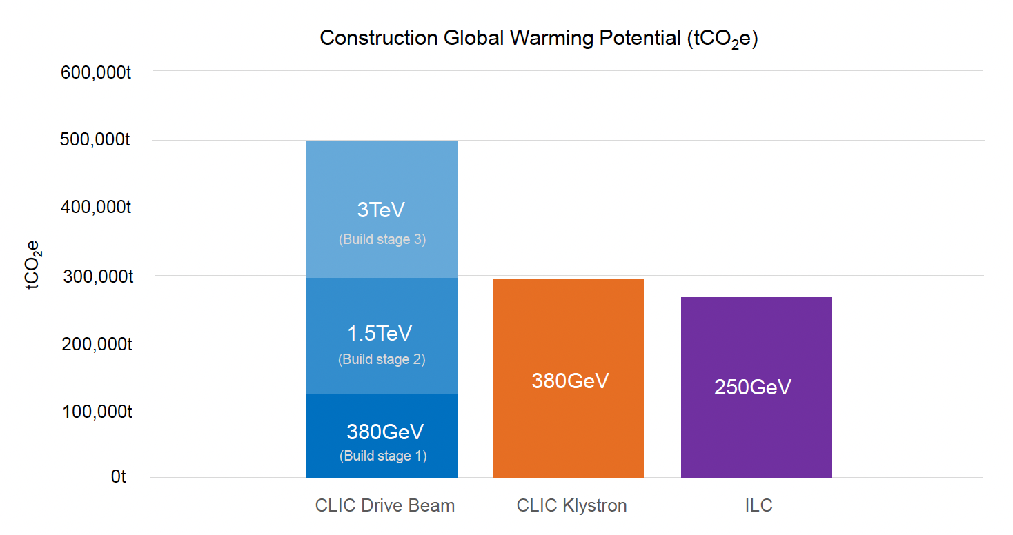
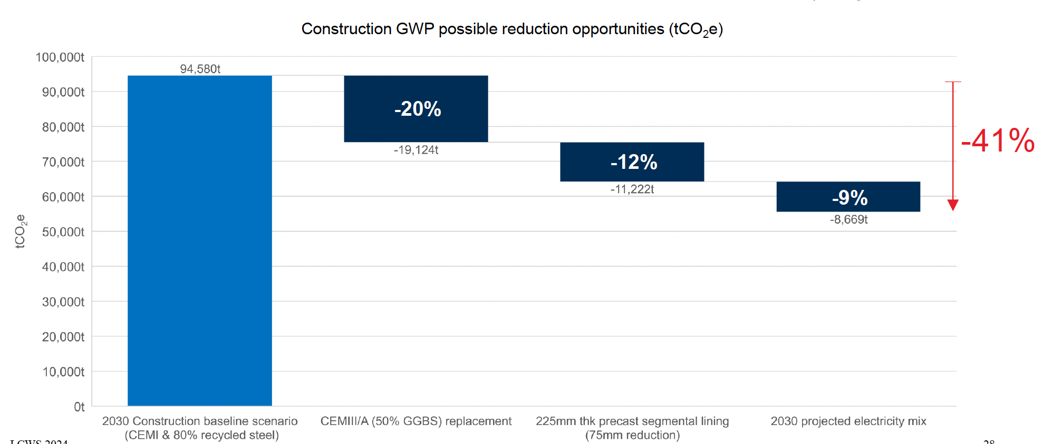
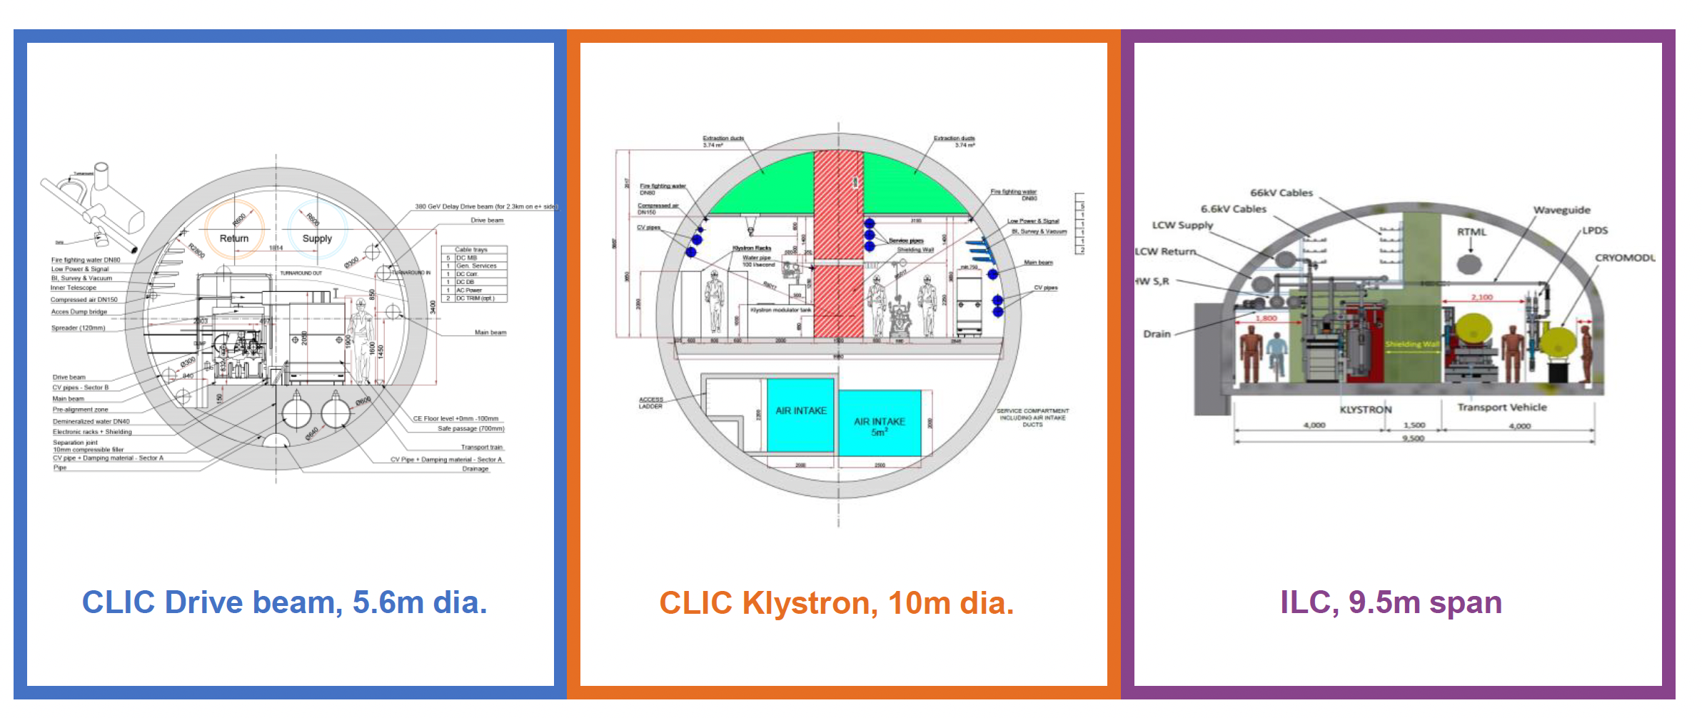
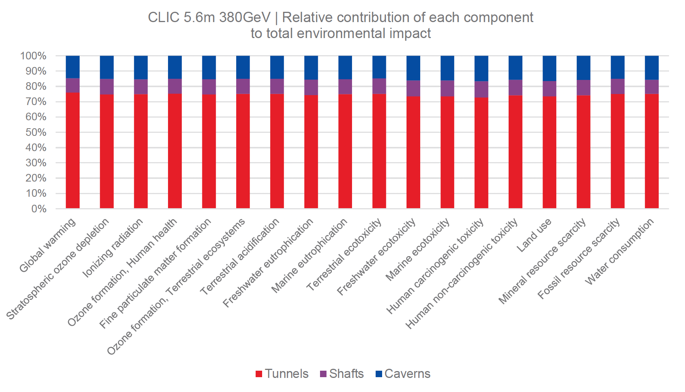
LCA of Civil Engineering Infrastructure
LCA study of tunnels, shafts and caverns:
  Common study for ILC and CLIC (link)
  Professional consultant company: ARUP
  Include two design alternatives for CLIC:
  Two-beam acceleration or klystron driven
Results:
  CLIC 2-beam design: 127 kton CO2-e
  CLIC klystron: 290 kton CO2-e
  ILC (250GeV CoM): 266 kton CO2-e
LCA helps to compare design alternatives
LCA identifies reduction potential:
  20% from using low carbon cement (CEM III/A)
  12% from thinner lining
  (9% from future electricity mix -> not a project decision)
Upgrades
Full study: https://edms.cern.ch/document/2917948/1
Reduction Potential: 41%
Further
Impact
categories

Slide 6
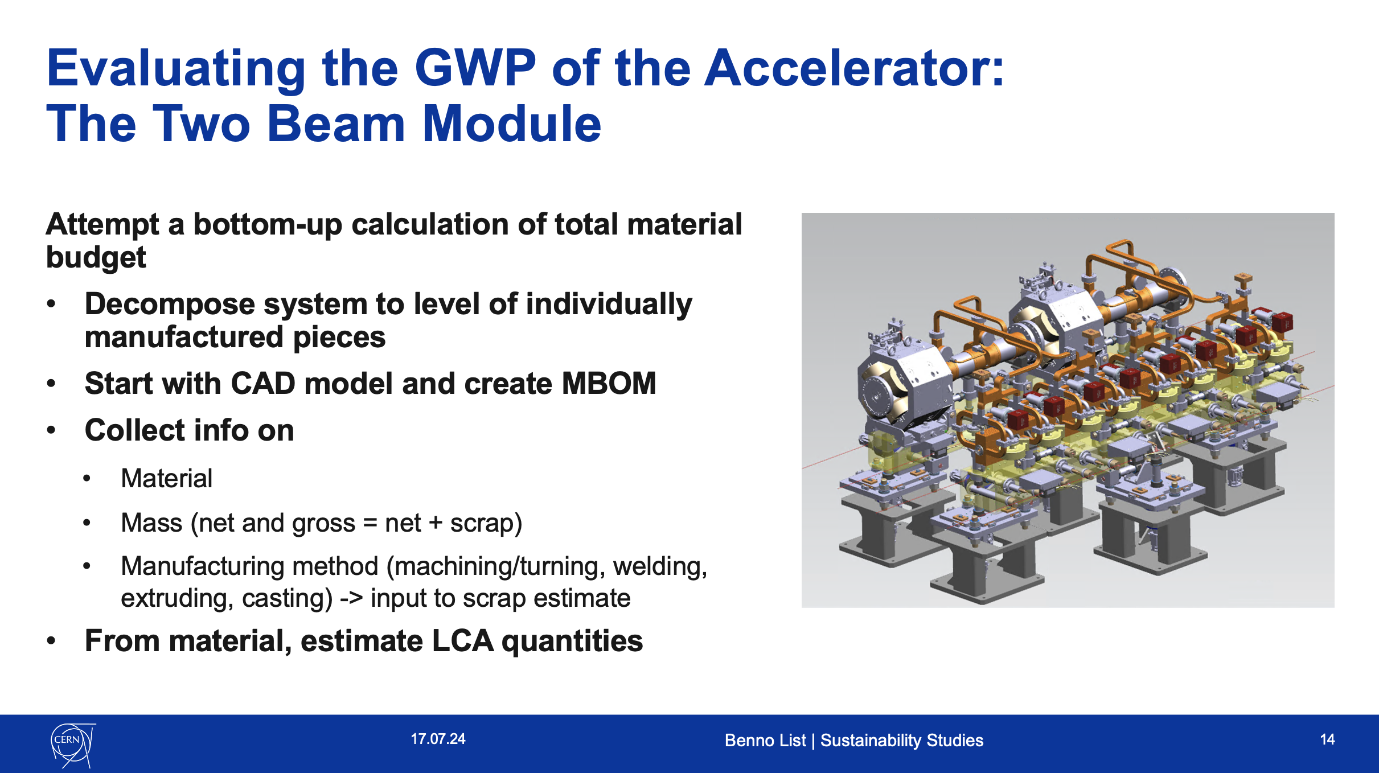
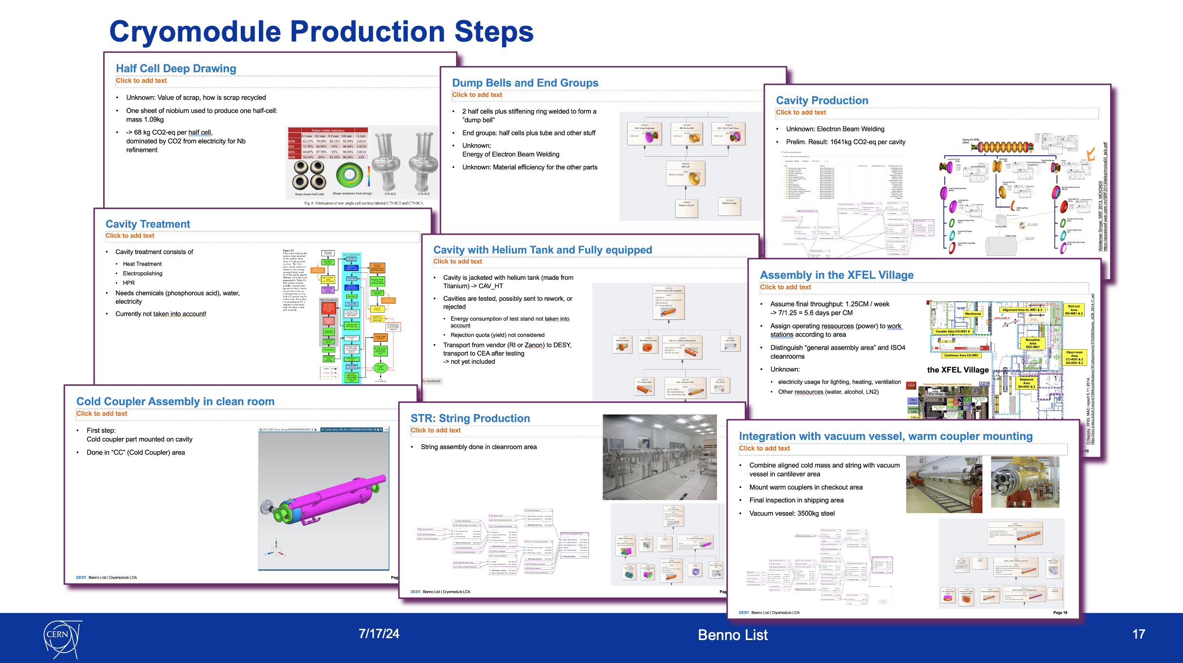
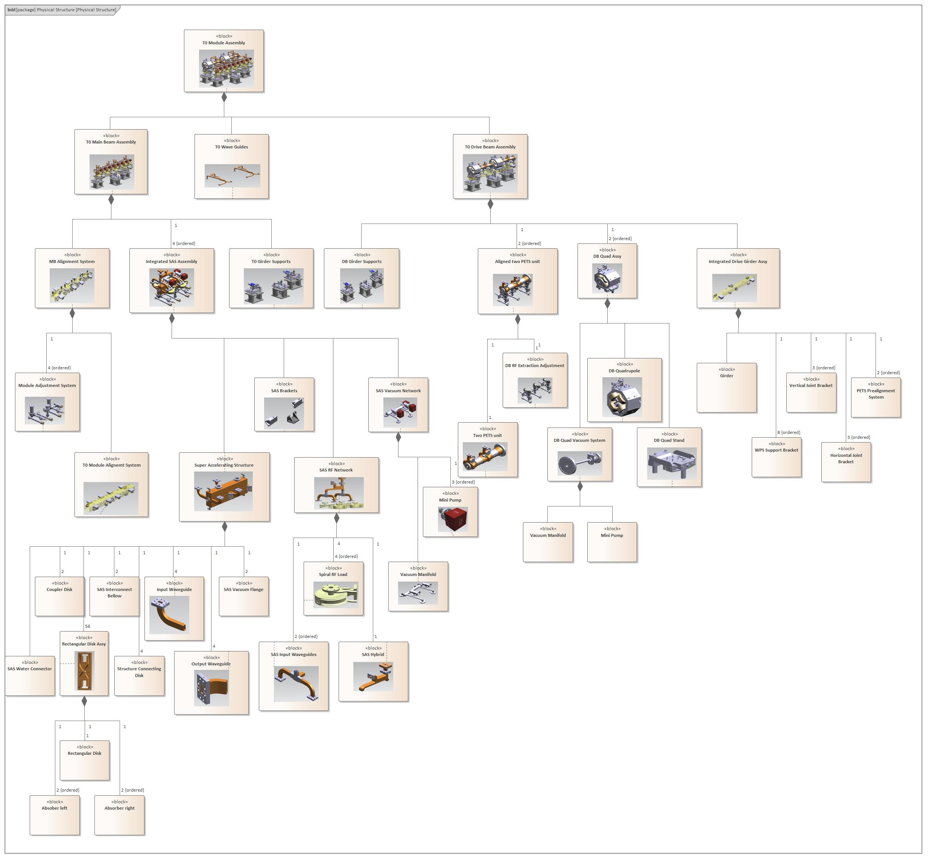
New Study: LCA of Accelerator
LCA of accelerator and detectors much more demanding than civil infrastructure:
  Many different components
  Many materials, also unusual materials
ILC and CLIC performed LCA effort with ARUP
Study almost concluded,
looking in detail on Main Linac building blocks:
  ILC Cryomodule
  CLIC two beam module
Finished study will be available at https://edms.cern.ch/document/3283864/1

Slide 7
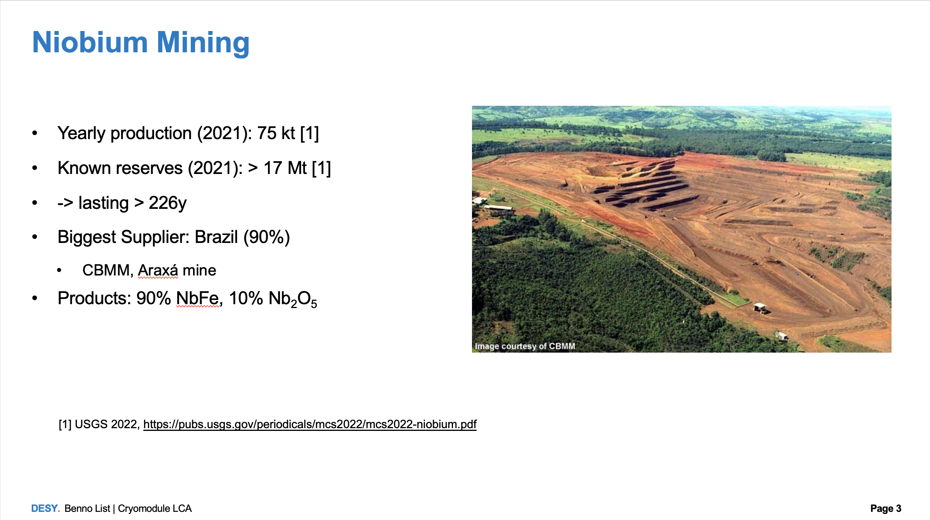
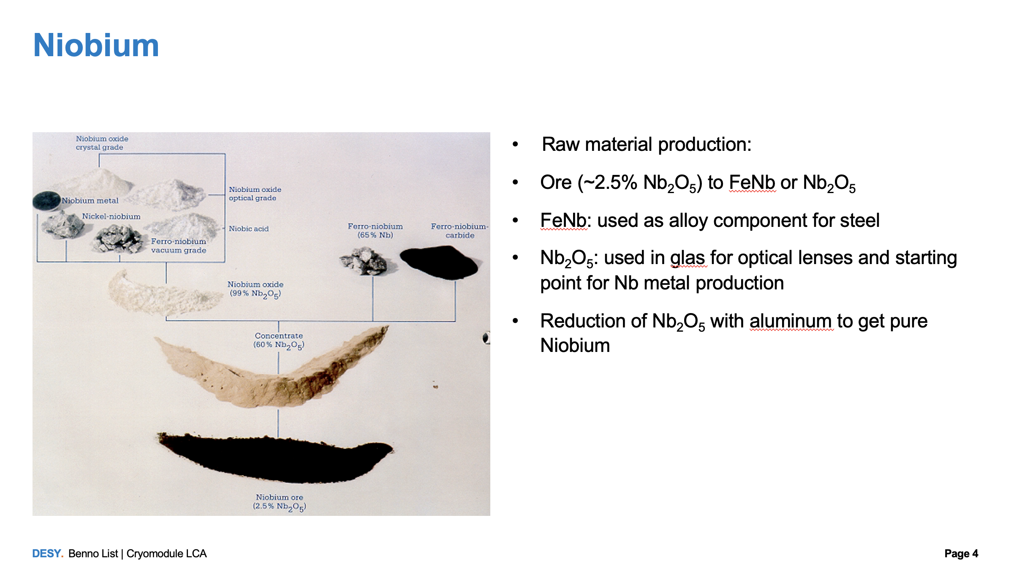
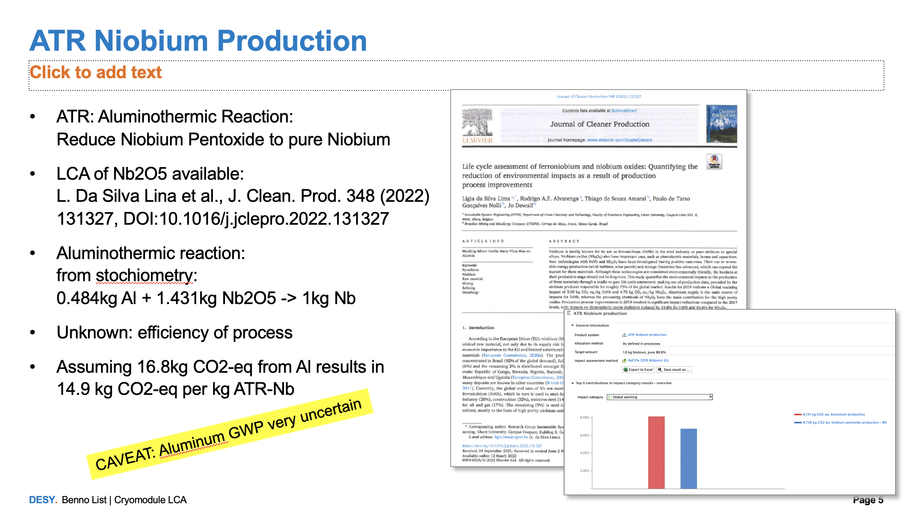
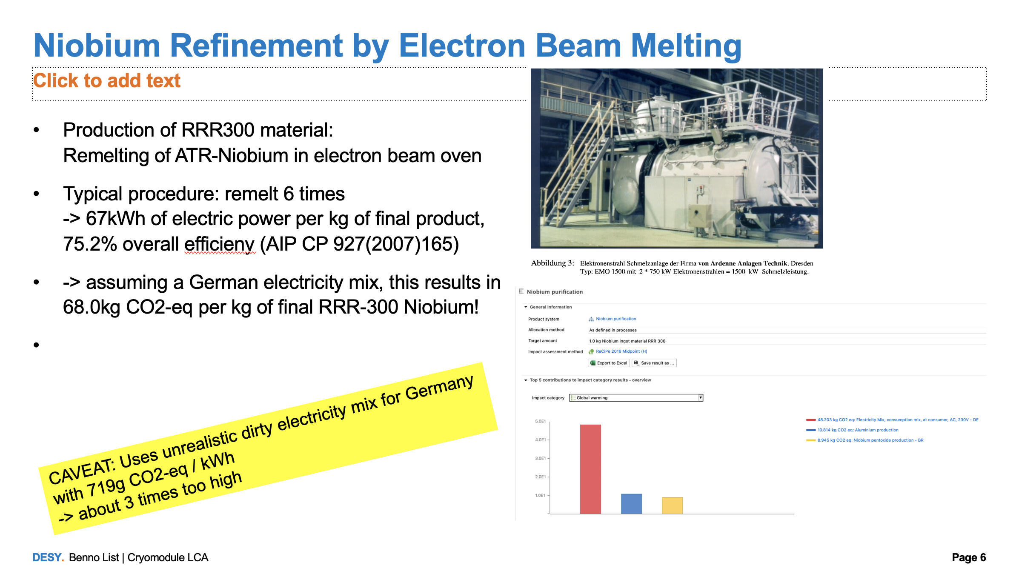
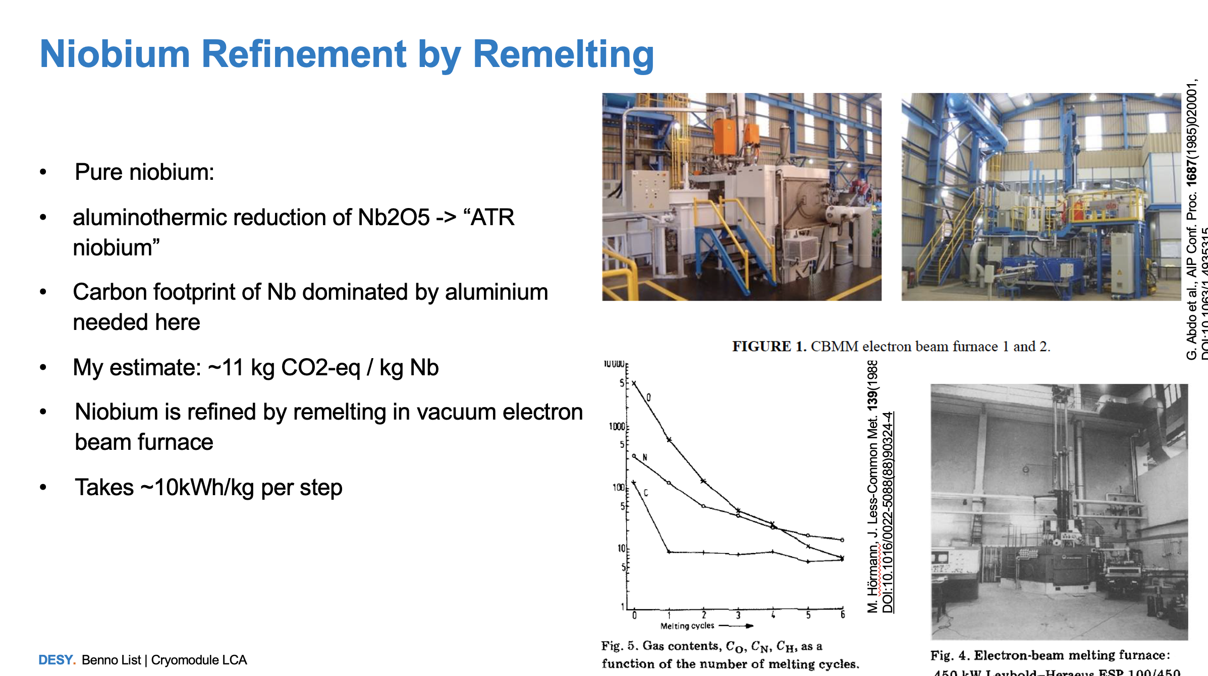
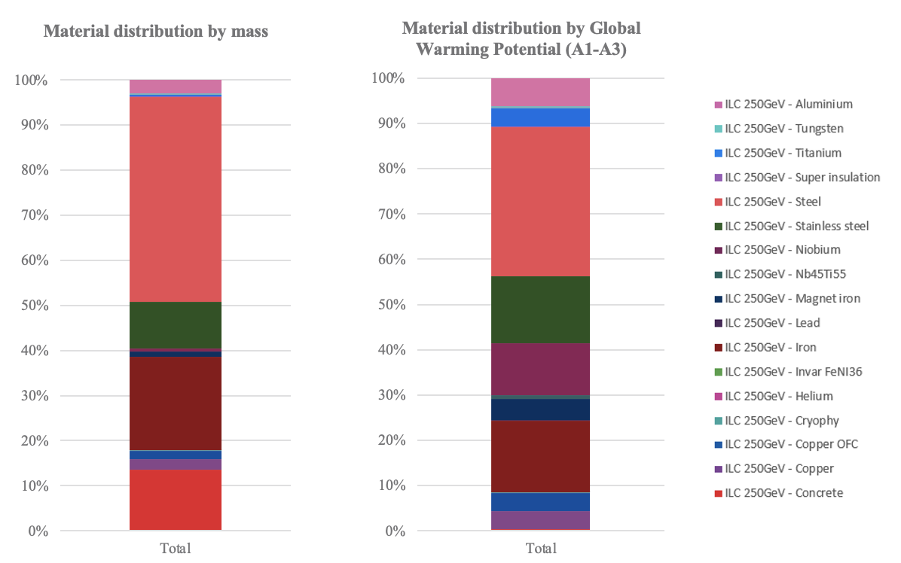
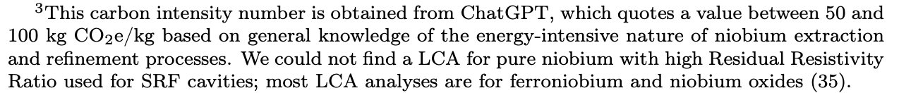
Special Materials – Example: Niobium Material
Problem for this work:
LCA data for some materials does not exist
-> here: niobium and ultra-pure niobium
No data for high-purity (“RRR300”) niobium available
Not even for 99% pure ATR (aluminothermic reduction) niobium
(processed from Nb2O5, LCA data available)
Research of niobium processing -> implementation
Dominant factor for RRR>300 niobium: electricity for electron beam remelting -> depends on local conditions (assume: China)
Results
  Niobium RRR>300, from China: 98kg CO2-e / kg
  -> 10% of total GHG for ILC250 accelerator!
  -> large impact reduction potential by lower carbon electricity
https://edms.cern.ch/document/3283864/1
Please, don’t do this

Slide 8
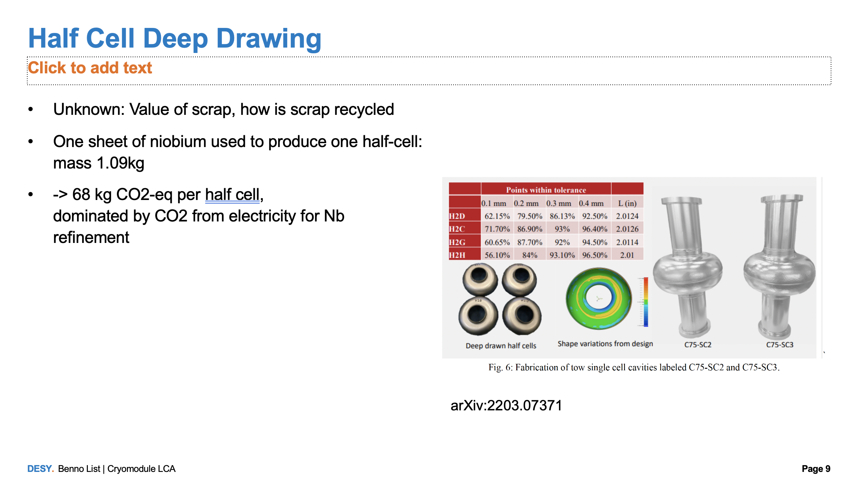
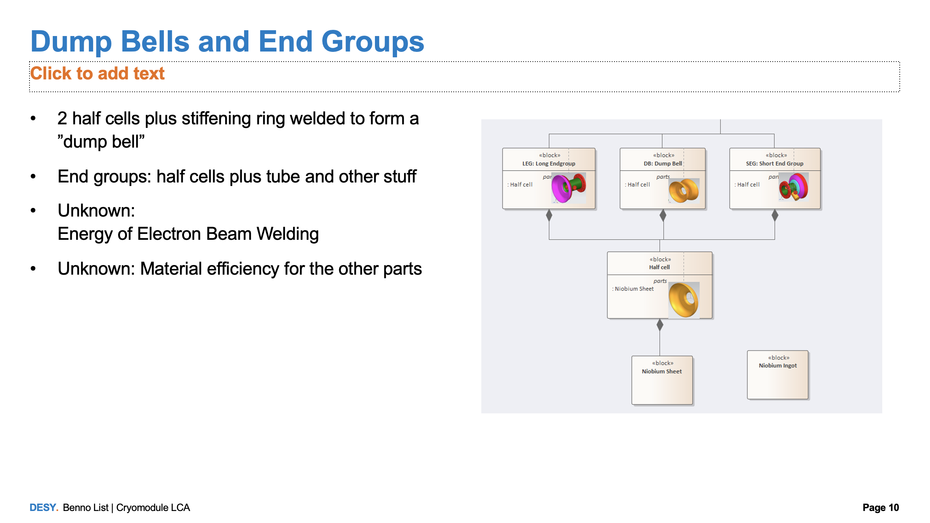
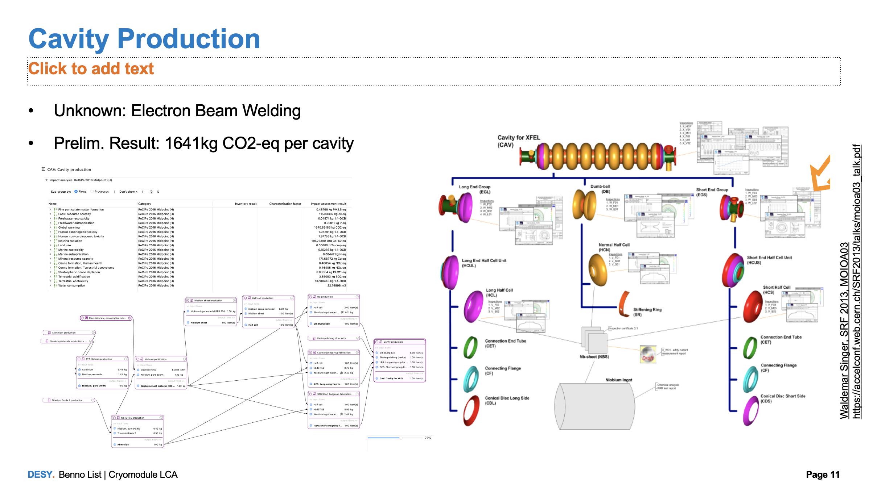
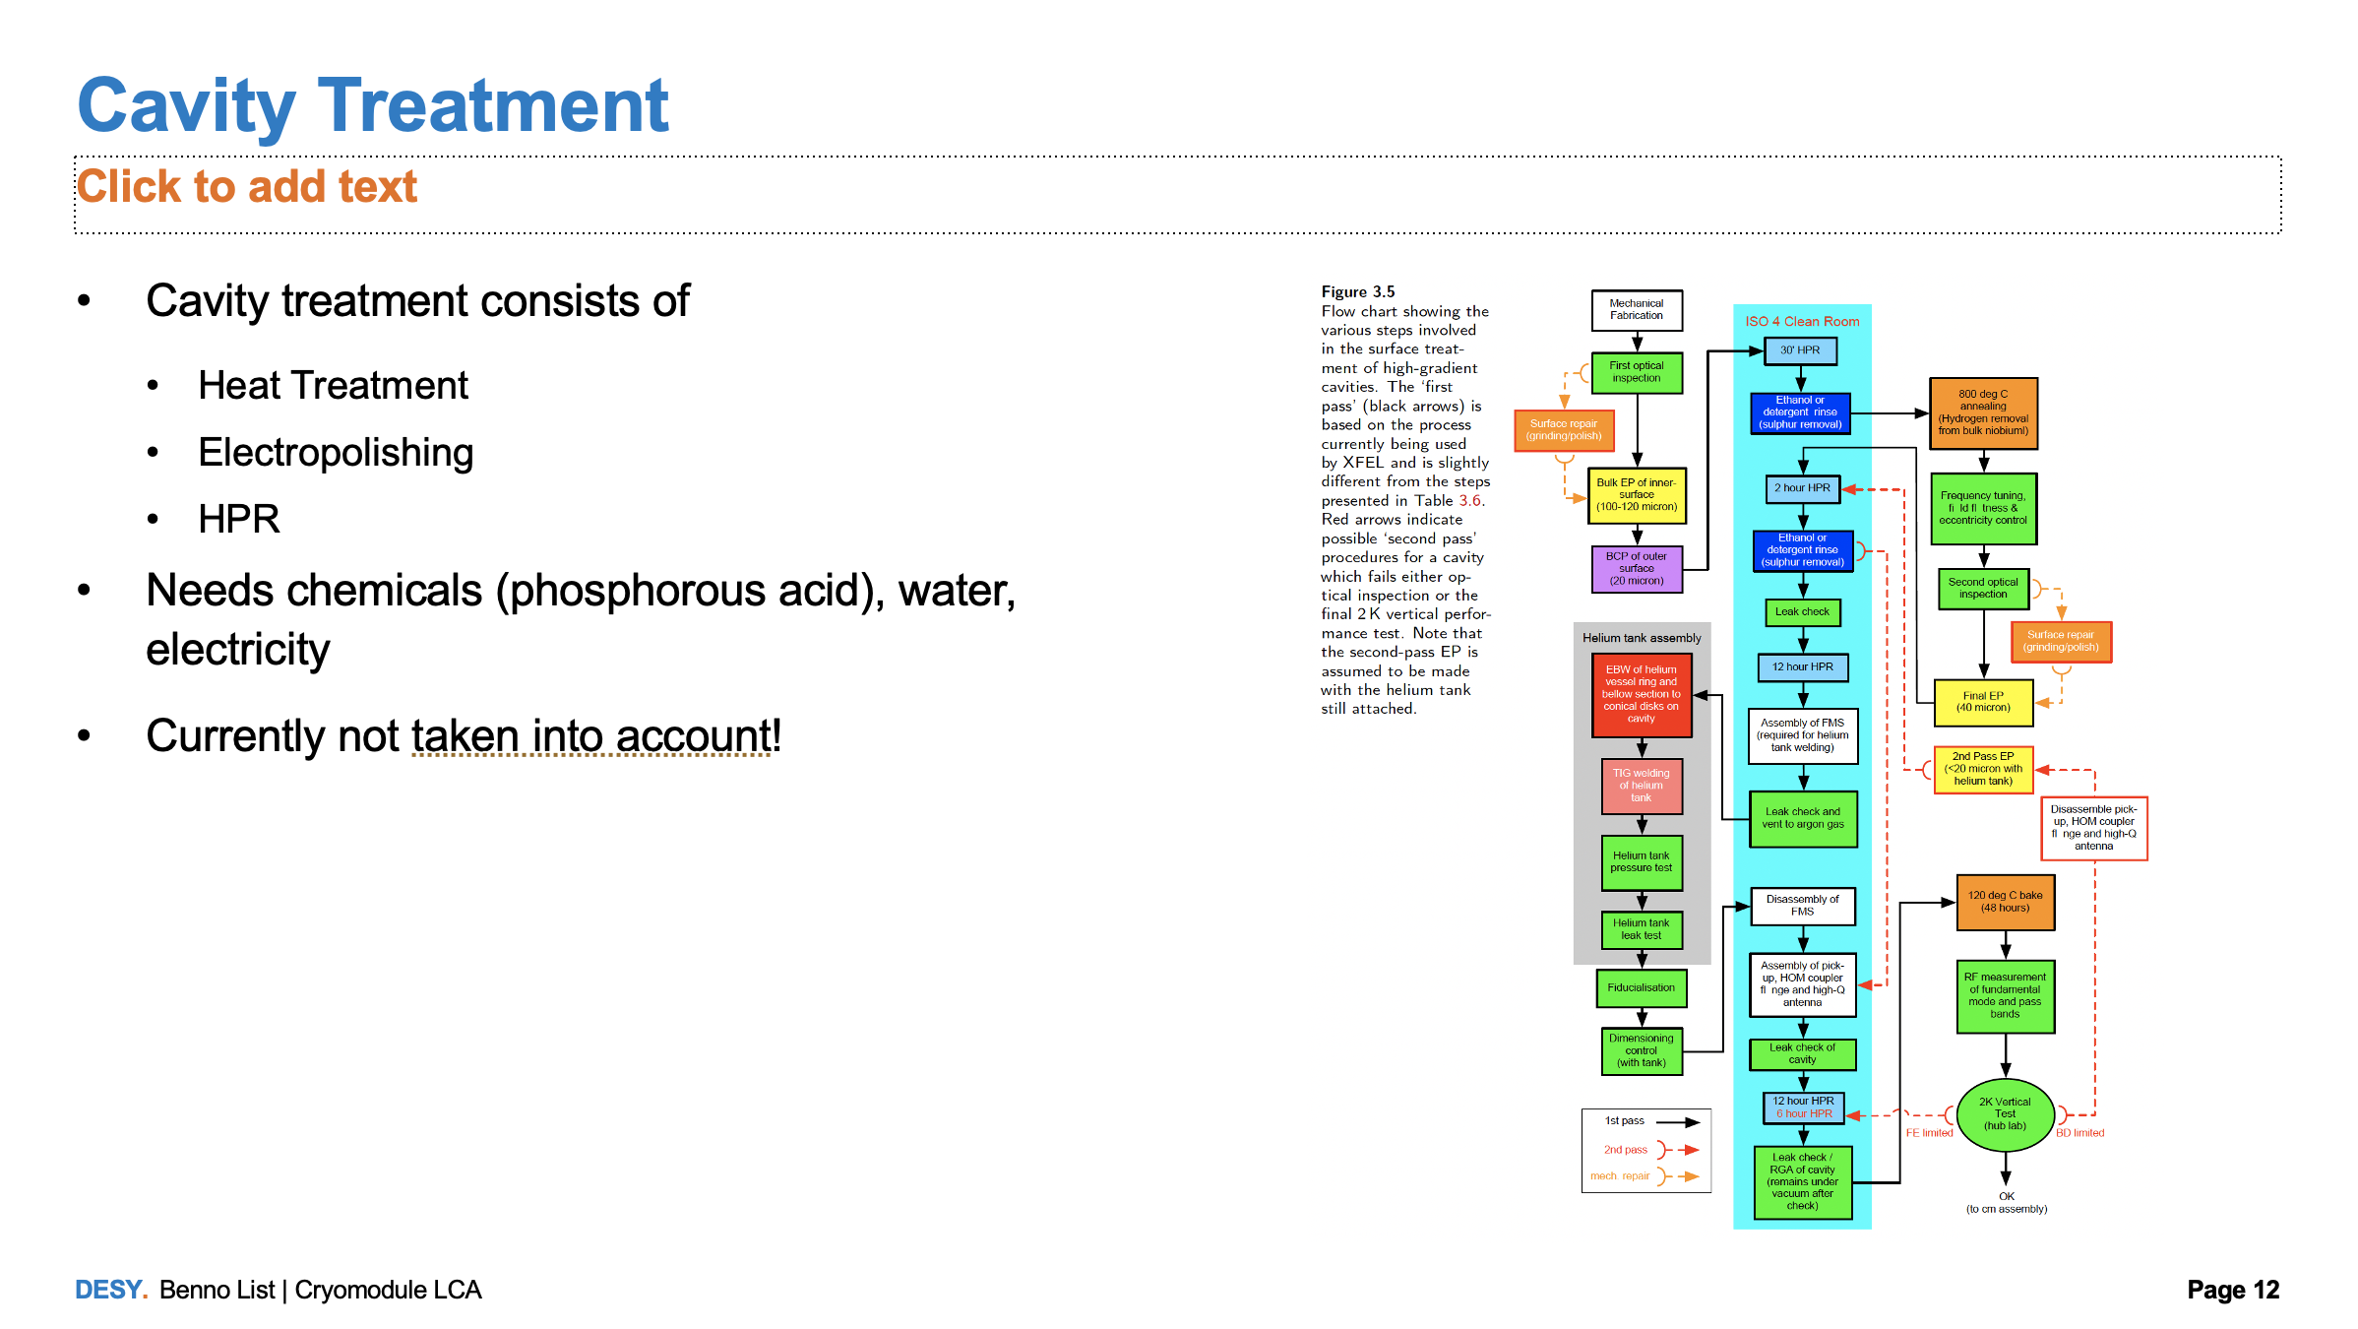
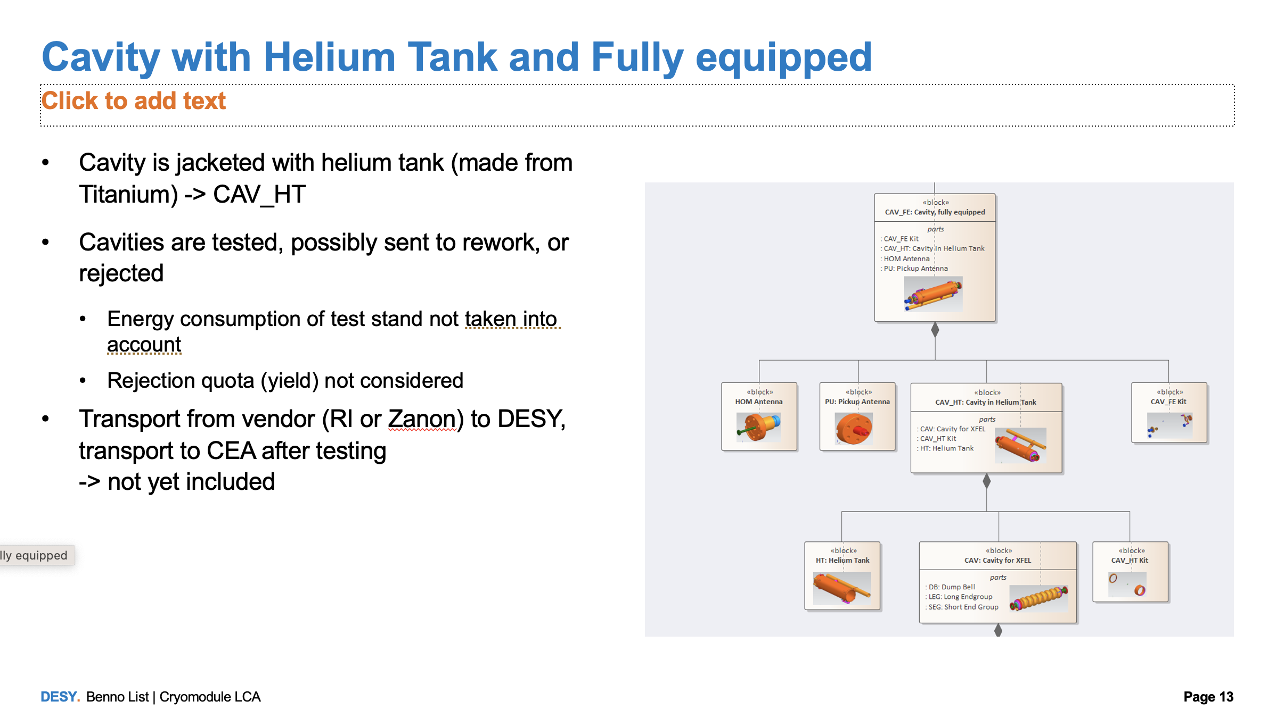
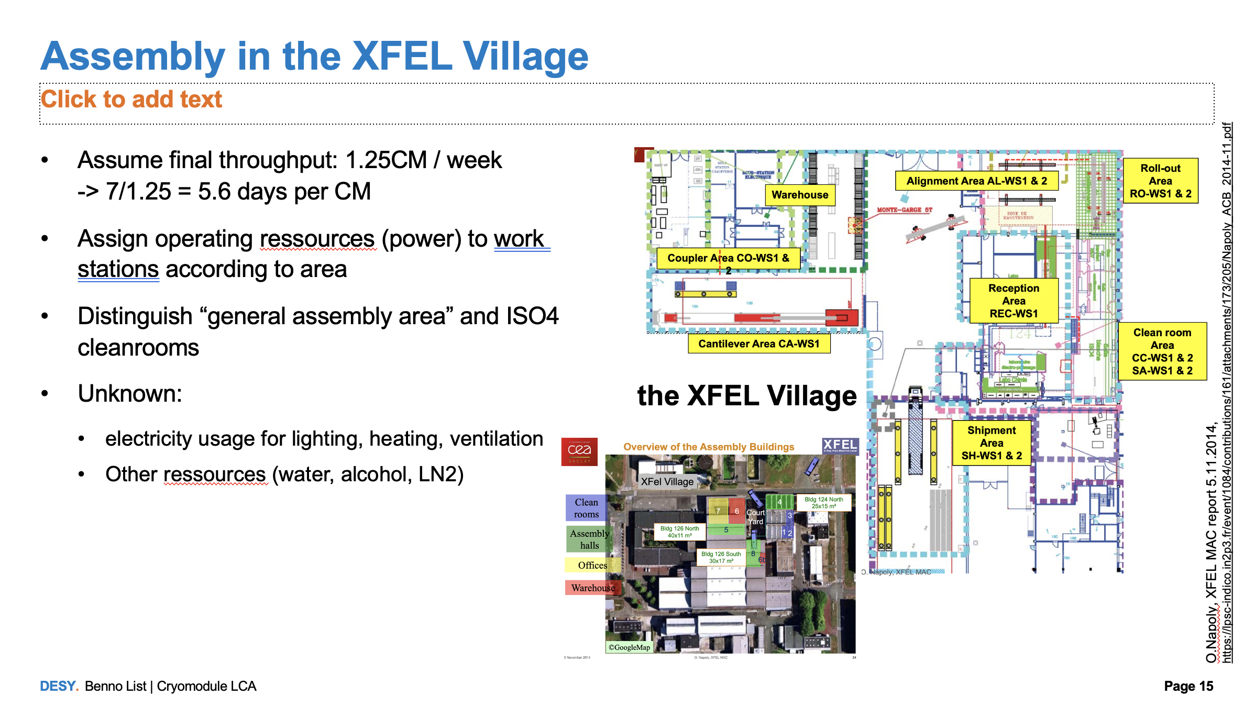
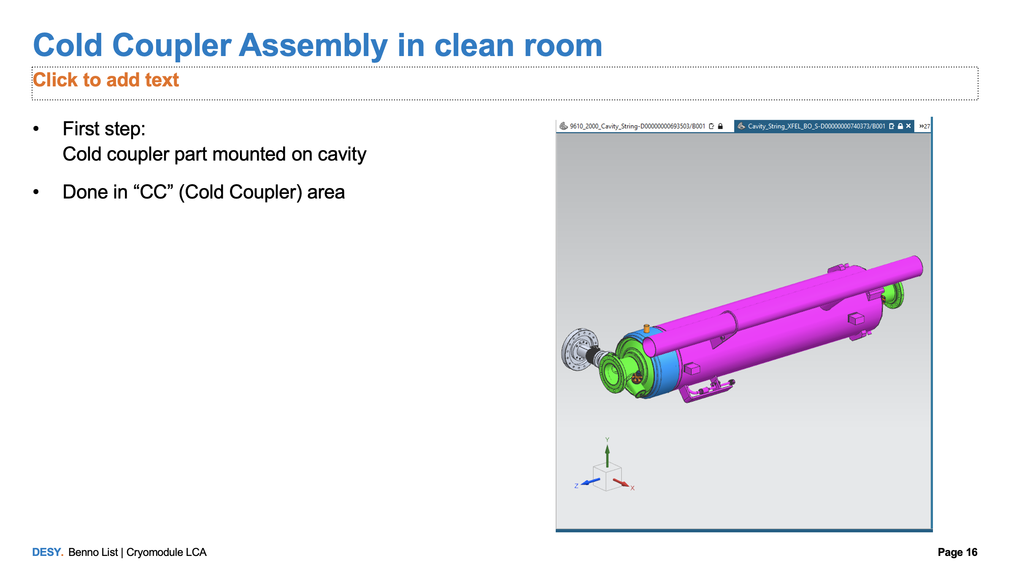
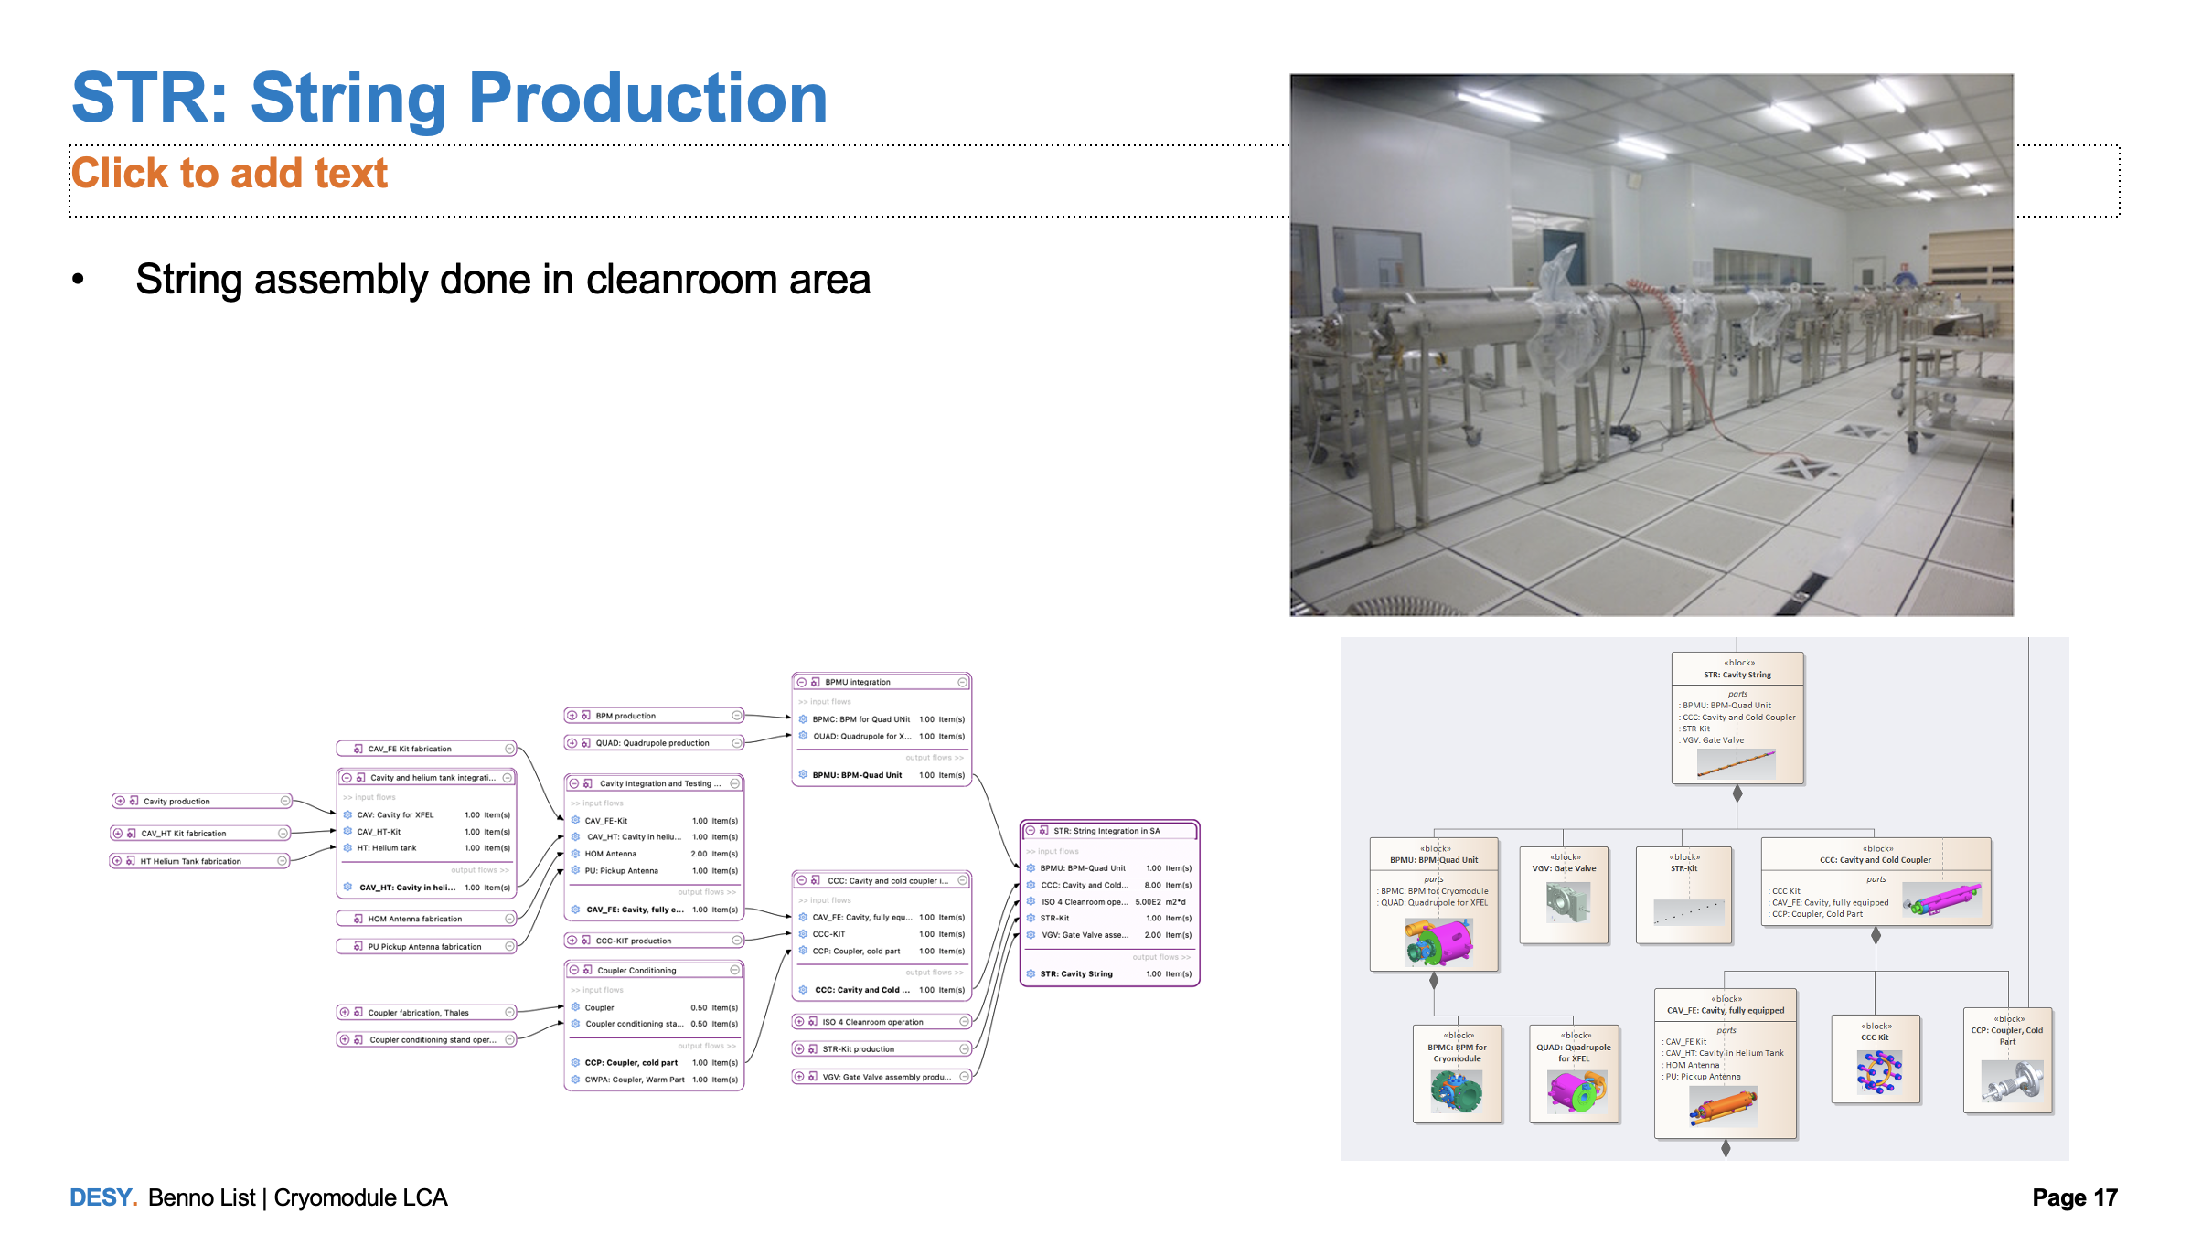
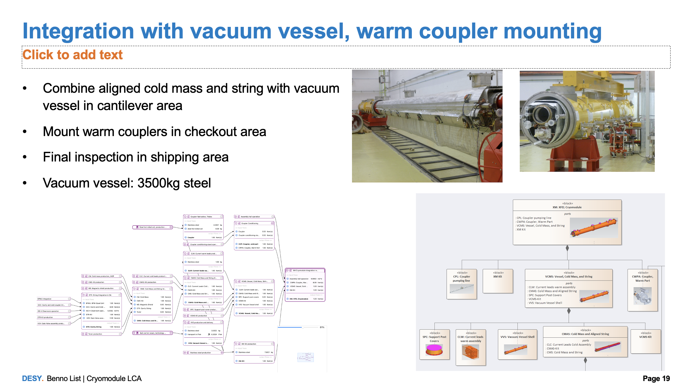
ILC Cavity and Cryomodule Production Steps: Detailed analysis
Analysis includes
Details about true material consumption and scrap, e.g. material for deep drawing of half cells from niobium sheets
Additional material and waste for treatment of cavities acids for:
buffered chemical polishing (BCP),
electro polishing (EP)

Slide 9
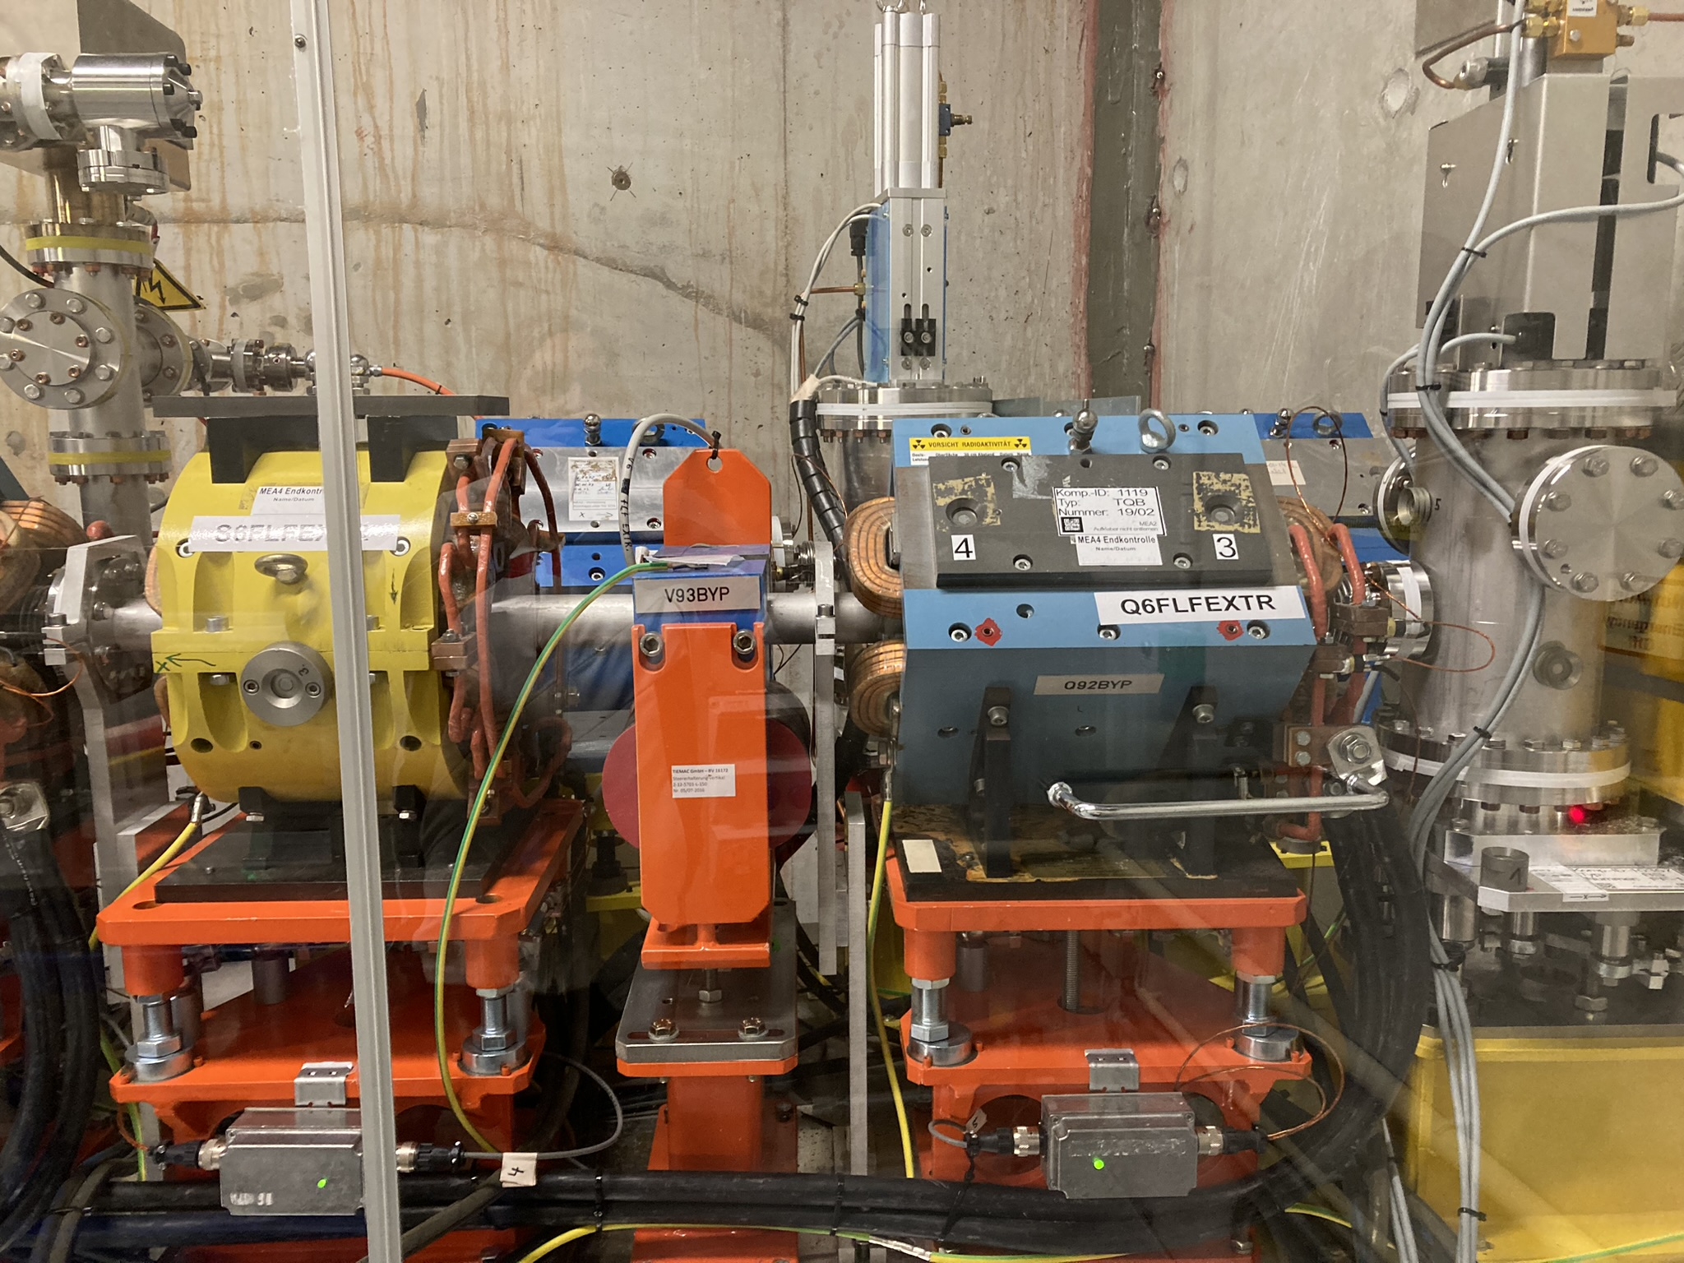
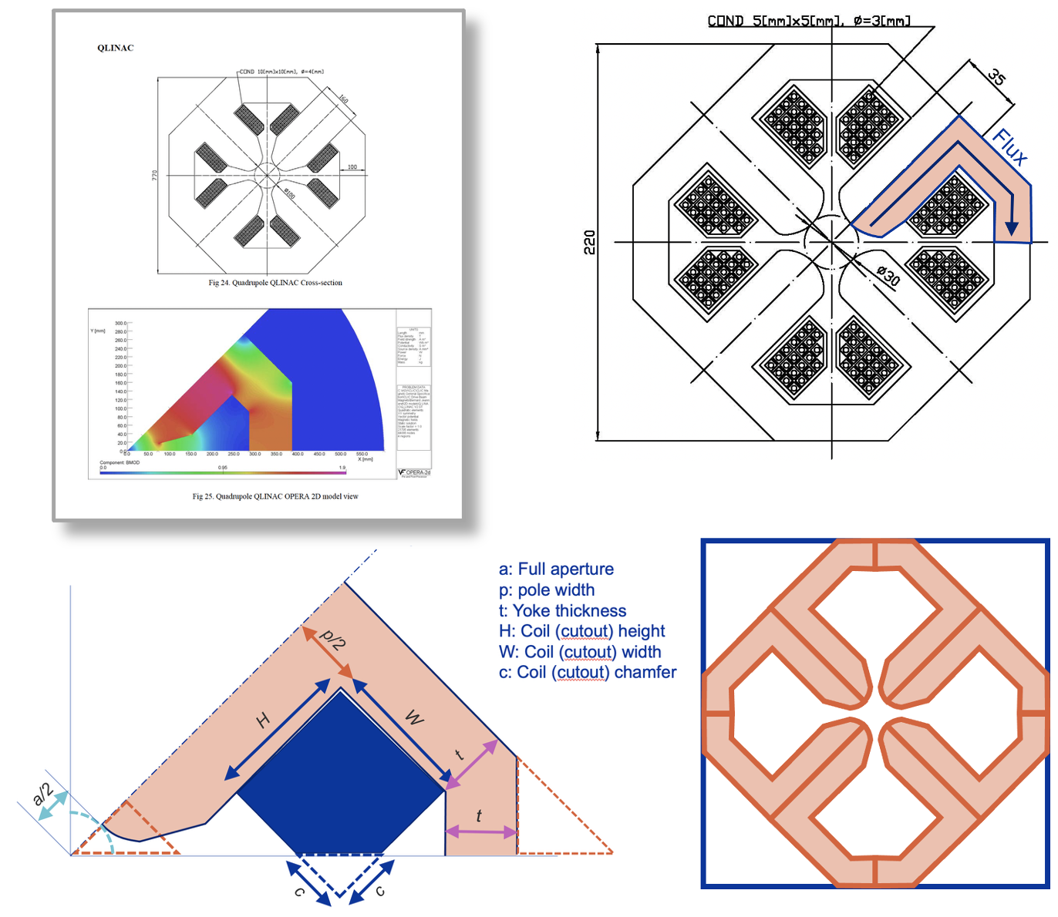
Magnets
Start from a catalogue of magnets
  CLIC: dimensions known for all magnet types
  ILC: Main design parameters known (aperture, strength coil cross section), use parametric model to determine size
Main Components considered:
  Yoke: from iron – consider also scrap fraction!
  Copper, extruded: 8.5 kg kg CO2-e / kg
Yoke materials
  Soft iron: ~3.8 kg CO2-e / kg
  For high field magnets: assume Vacoflux
    49% Fe, 49% Co, 2% V -> 22.3 kg CO2-e / kg
Conclusion:
  Yoke material dominates over copper from coils
  High field magnets with cobalt rich material have a much larger impact
Stands: assume reinforced concrete pillars steel frames, or girders on racks (ILC damping rings)
Magnets in an accelerator
Magnet model data used for LCA

Slide 10
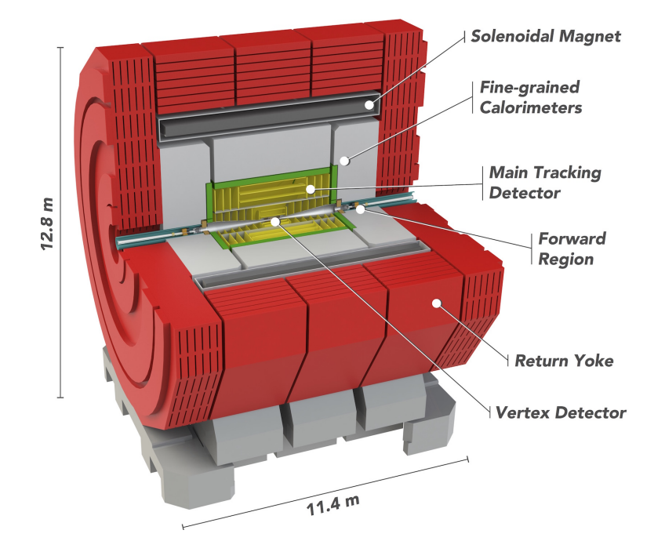
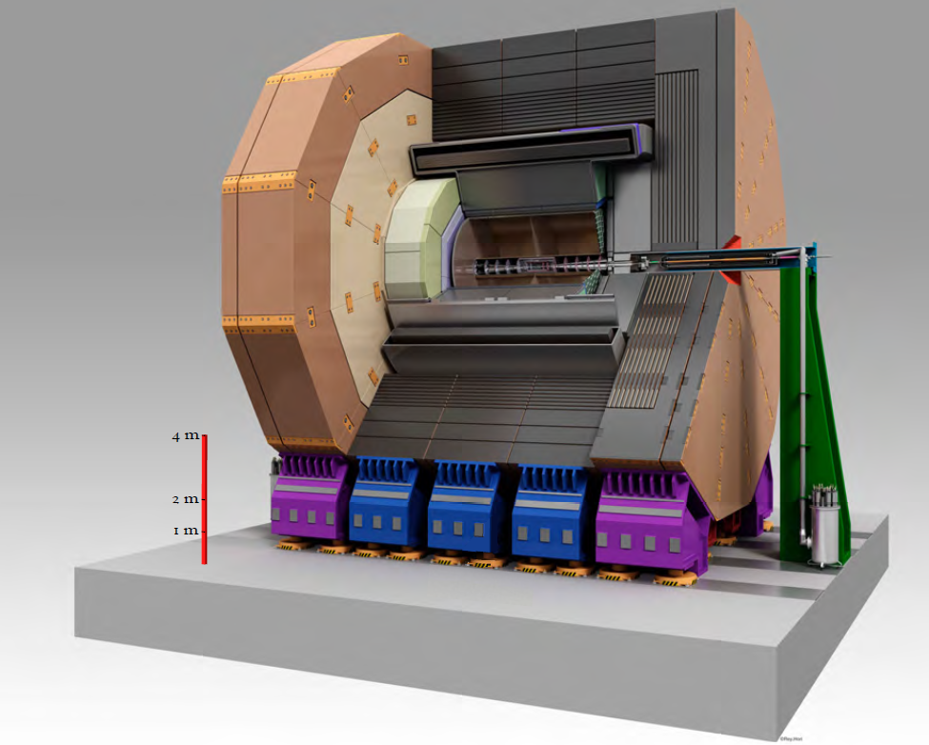
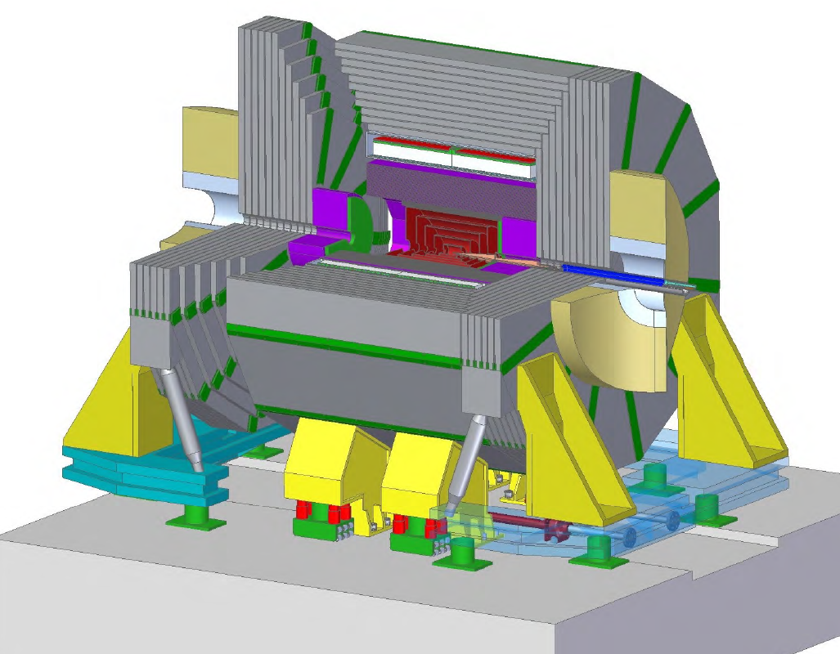
Detectors
Detectors were modelled in a simplified way:
Use net weight of most heavy components
  Yoke: Iron / Steel
  Calorimeters: Steel, Tungsten
  Reinforced concrete for support platforms
Impact is by far dominated by the huge amount of iron in return yokes:
ILD 13400t, SiD 6810t
-> huge reduction opportunities
(e.g. H1 used steel from ship scrap from Russia)
Important assumption (requirement):
No significant direct GHG emissions during operation:
  Avoid usage of CFC coolants
  And/or build gas tight system
Detector. Source: CERN (2018)The Compact Linear e+ e− Collider (CLIC): Accelerator and Detector
ILD Detector. Source: ILC TDR, volume 4
SiD Detector. Source: ILC TDR, volume 4

Slide 11
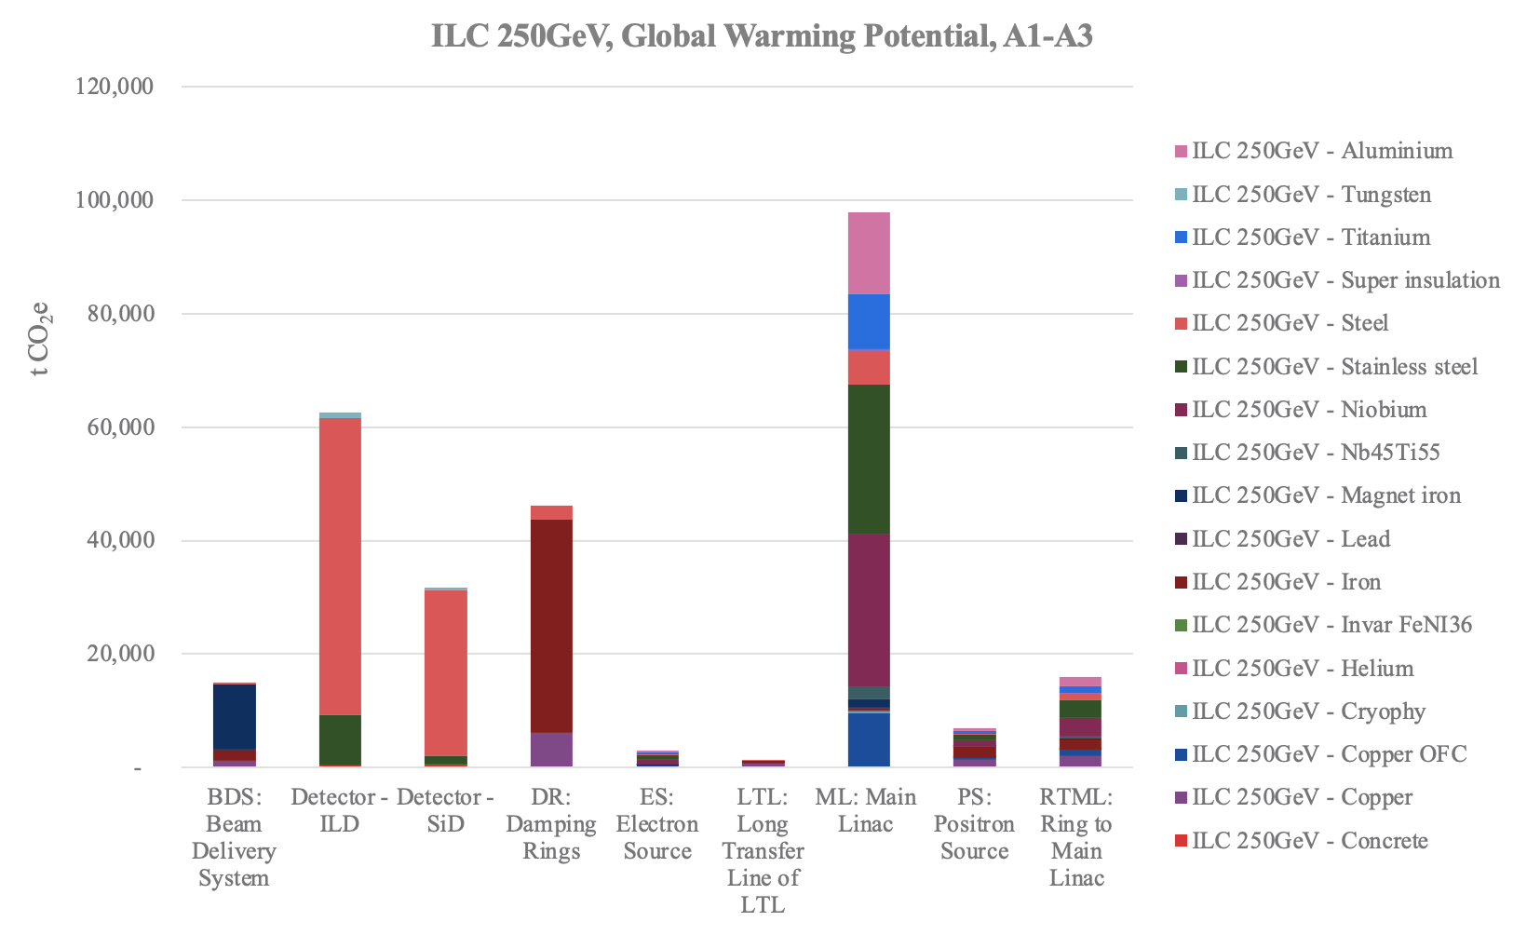
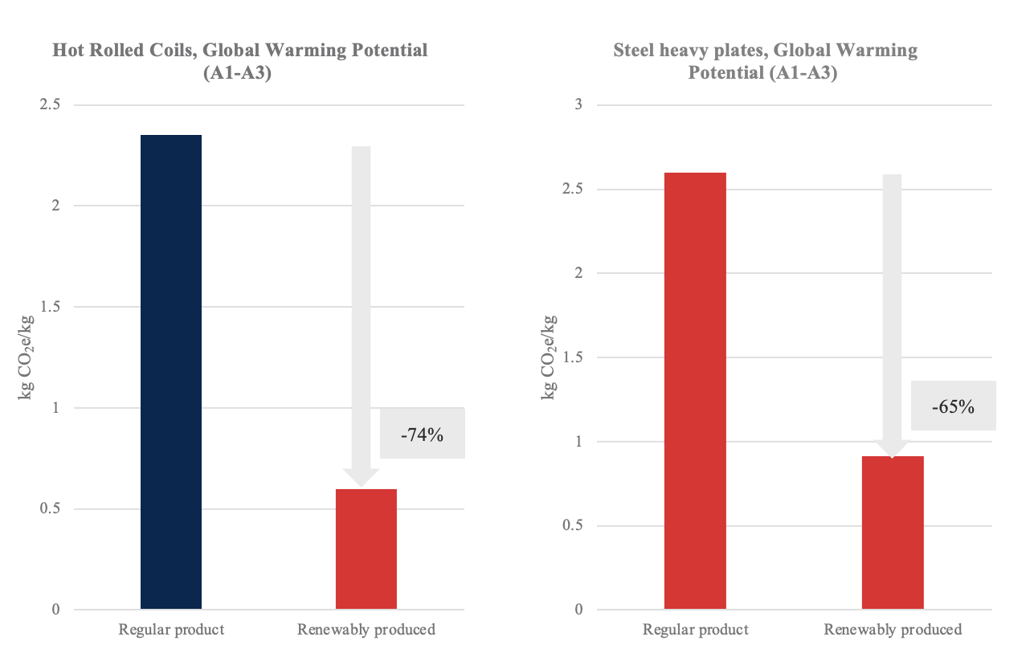
Main Results for ILC
Accelerator & detector GWP hotspots:
  Main linac: dominated by stainless steel, niobium, aluminium in cryo modules
  Damping rings:
  dominated by iron for magnet yokes
  Detectors ILC & SiD:
  Dominated by steel for magnet yokes
Iron and steel is the by far dominant source of GHG emissions! Huge impact reduction opportunity
  Dominated by iron in magnet yokes, especially detectors
  Mind high-cobalt materials
Other important materials:
  Niobium ~11%
  Copper: ~10%
  Aluminium ~ 6%
  -> have a high dependency on electricity in country of origin
  -> procurement policy important
Mass
GWP
https://edms.cern.ch/document/3283864/1

Slide 12
CLIC: 2-Beam Module
CLIC 2-beam module: The fundamental building block of the CLIC main linac
Collect material data on existing CAD model
Special material: OFC (oxygen free) copper
9.7 kg CO2-e / kg

Slide 13
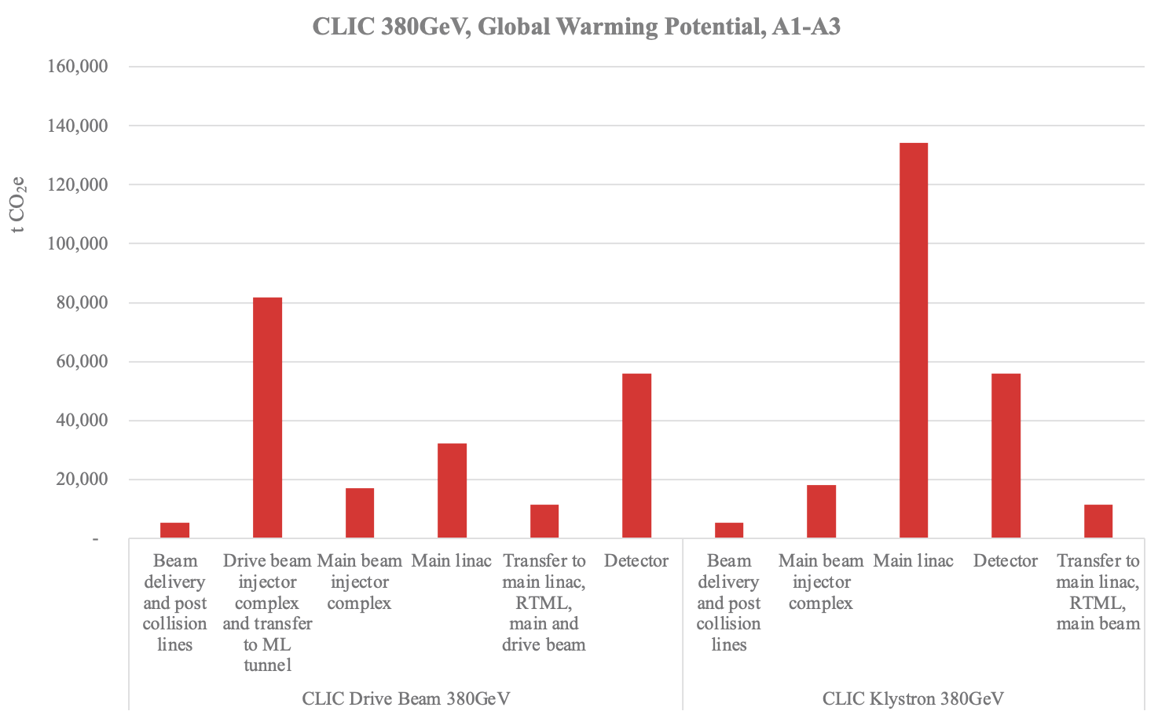
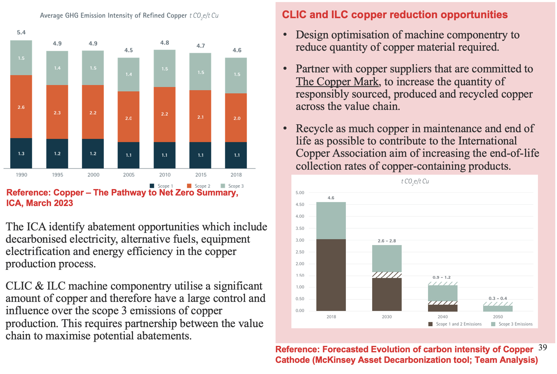
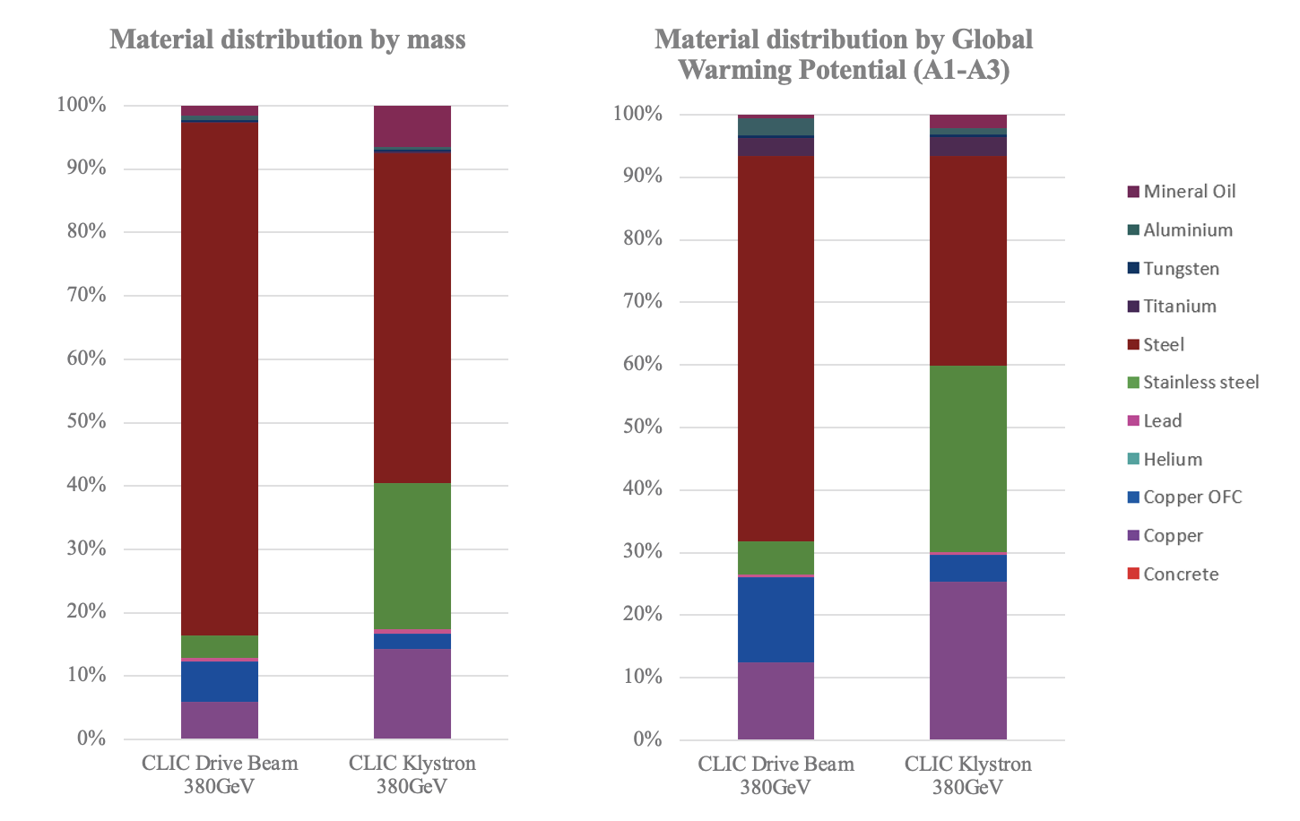
CLIC Accelerator: GHG Main Results
Main Linac dominates GHG emissions in construction
Dominant materials
  Steel: ~70%
  Copper: ~25%
-> Explore reduction opportunities for copper
DB
Kly
https://edms.cern.ch/document/3283864/1

Slide 14
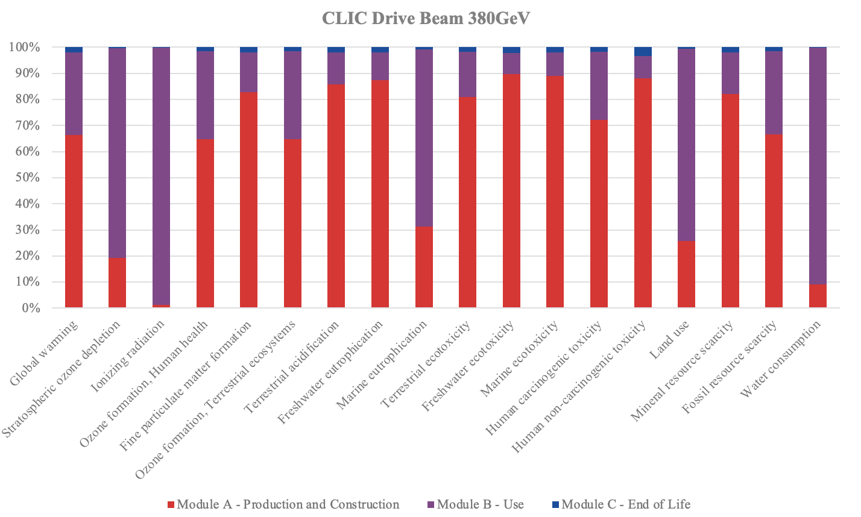
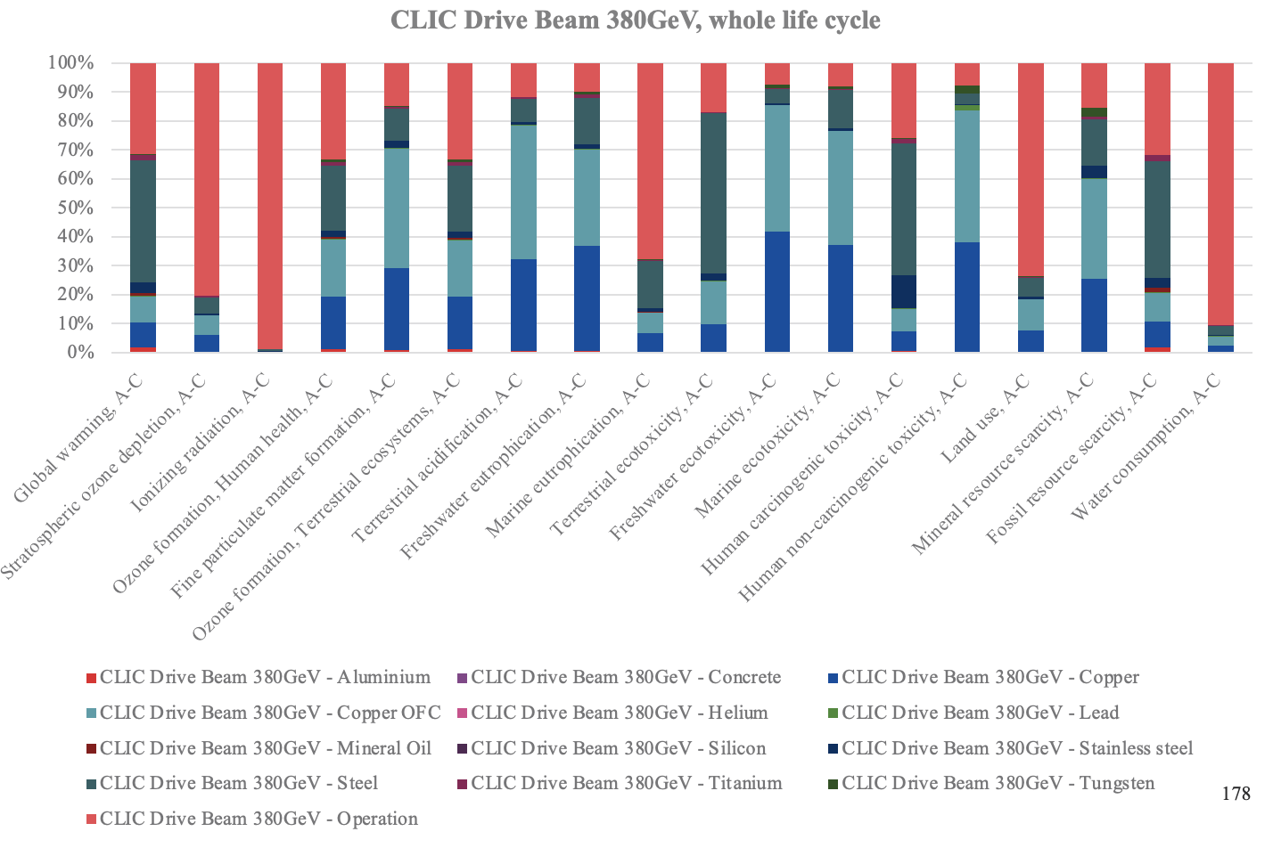
Whole lifecycle results for all ReCiPe 2016 indicators
Example: CLIC (drive beam option)
All 16 ReCiPe 2016 mid point indicators were evaluated
Which lifecycle phase dominates the impact? –
A: production and construction
- result depends on emission factor for electricity!
Which material dominates the impact?
  Steel and copper
  Operation (i.e. electricity) prominent for some categories
Results vary significantly between impact categories – which categories are the most important?
Disposal
Use
Production
Electricity
Steel
Copper OFC
Copper

Slide 15
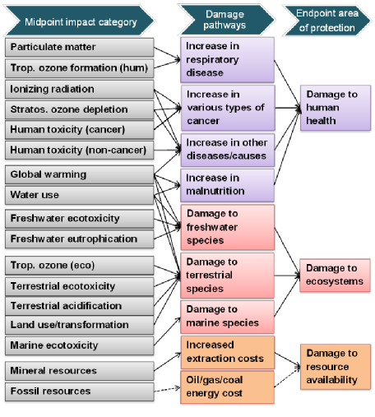
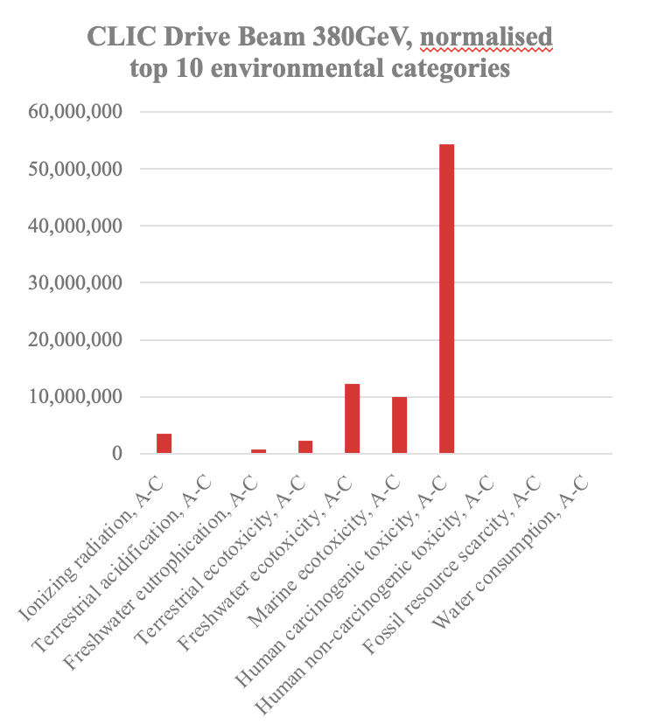
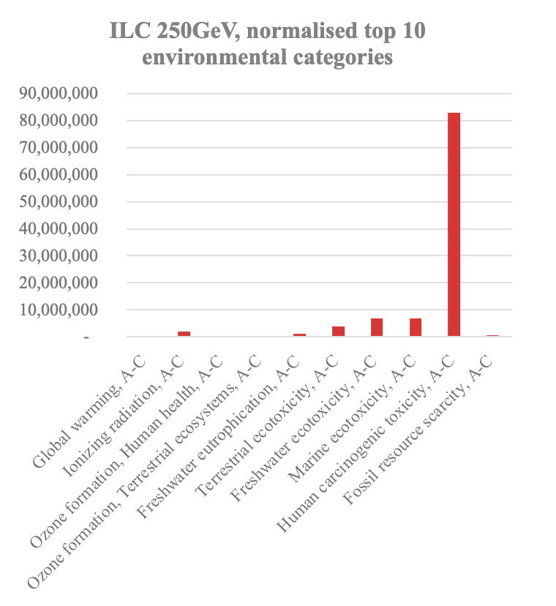
Weighting Impact Categories - Normalisation
One approach: endpoint categories
-> consider damage to
  Human health
  Eco systems
  Resource availability
Alternative approach:
weight with global impact (per person)
-> approach chosen here
Use ReCiPe World (2010) normalisation set
Human carcicogenic toxicity sticks out,
followed by marine ecotoxicity and freshwater ecotoxicity
-> where does that come from?

Slide 16
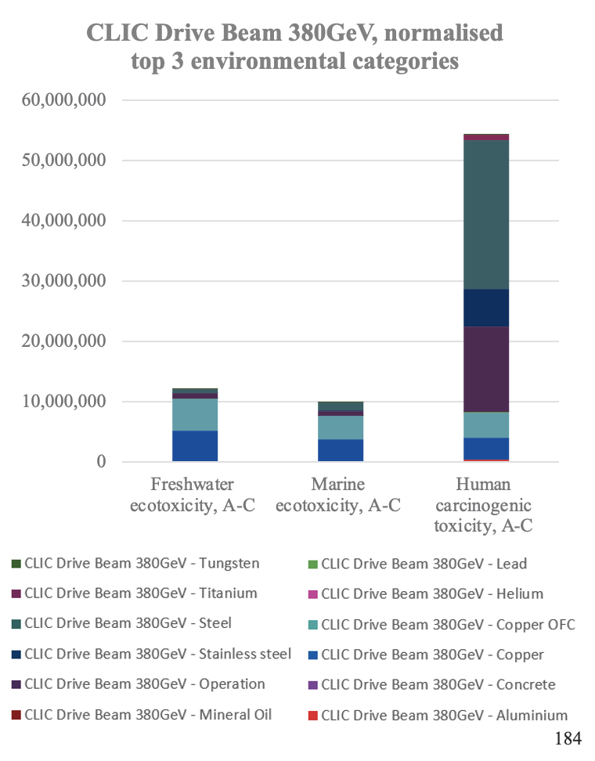
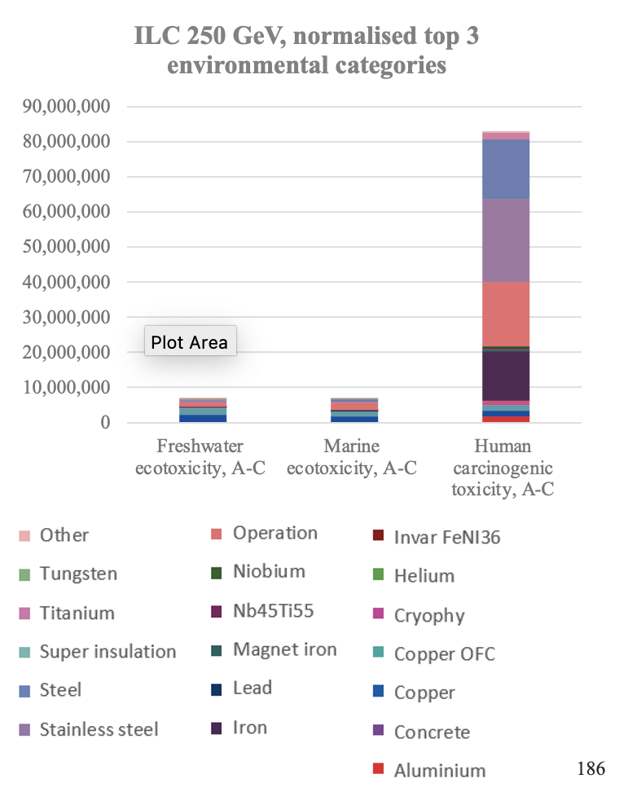
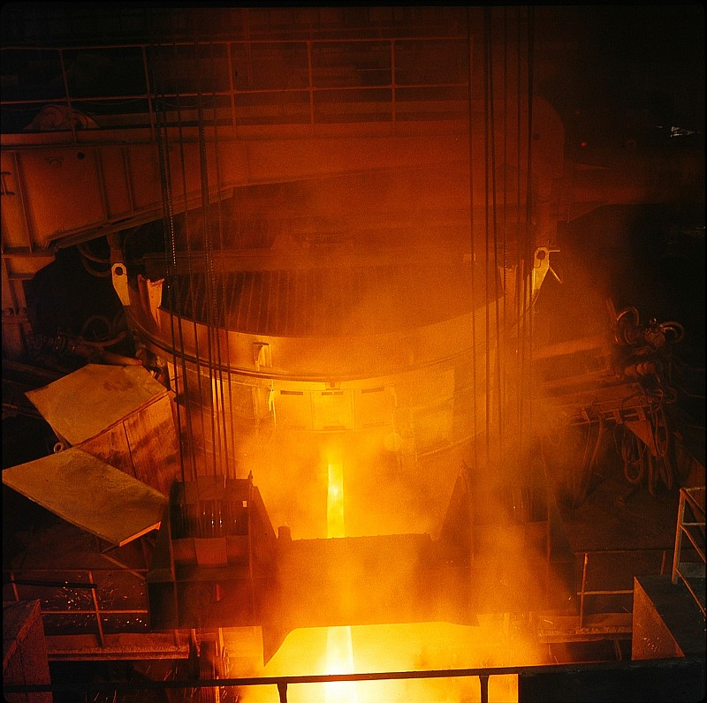
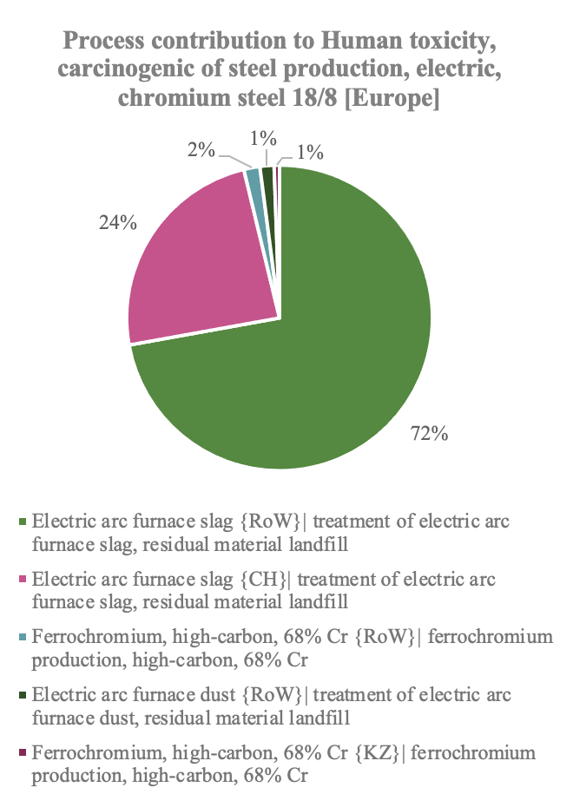
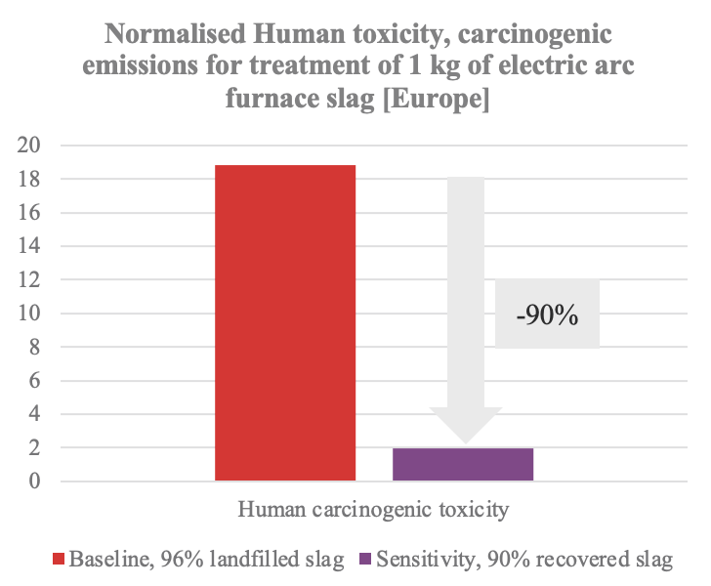
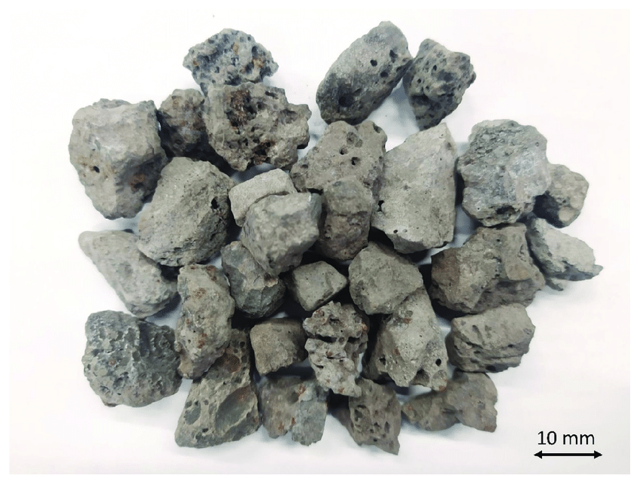
Hotspot analysis: Toxicity
Toxicity dominated by steel (incl. stainless steel), followed by operation (i.e., electricity)
Toxicity impact of steel dominated by
electric arc furnace slag, which is deposited as landfill
Hard to control in procurement process
Choose suppliers with an environmental commitment and an environmental management strategy
Reduction potential is 90%
CC-BY-3.0
Deutsche Fotothek via Wikimedia Commons
CC-BY-4.0 J.M. Terrones-Saeta et al.,
http://dx.doi.org/10.3390/ma14040782

Slide 17


Scope 2 Emissions from Operation
Define operational phases:
  Shutdown – only static cryo load and HVAC, lighting etc
  Downtime and technical stops: RF power off
  Data taking: full power
  Commissioning and machine development: 50% “data taking” and 50% downtime
Use mixture of these modes to calculate overall energy consumption over the year
Emission factors were updated:
16 g CO2-e / kWh for CERN in 2050
81 CO2-e / g/kWh for ILC in Japan in 2040:
  20% nuclear
  70% renewables (dedicated contracts)
  10% LNG
arXiv:2503.24049
S. Evans, LCWS 2024

Slide 18


Overall result for ILC and LCF at CERN, and CLIC
A comprehensive overview of GHG emissions from construction and operation
Available for ILC in Japan
Scaled / adapted for an LCF at CERN
  Tunnels: emission factors for tunnels in Japan and CLIC tunnel in Geneva almost identical – keep
  Scale up main linac and damping ring componentry for longer main linac and 3rd damping ring
Reporting in the common format proposed by the LDG sustainability working group
arXiv:2503.24049
arXiv:2503.24168

Slide 19
Some conclusions
Accelerators are generally optimised for physics performance, costs, schedule and power consumption
Sustainability goals suggest the lifecycle approach, addressing for example carbon footprint and material use from construction to decommission, and integration in the local communities (water, landscaping, traffic, waste, etc)
Changes the optimisation and also provides new opportunities
A recipe for a sustainable facility:
Reduce size
Reduce power consumption, understand/selects all materials being used carefully
Integrate within local communities
Use low carbon and renewable power, CO2 compensate
Use the facility for a long time and understand its life cycle

Slide 20
Thank you
Many thanks to
Steffen Doebert, Steinar Stapnes, Thomas Schörner-Sadenius, Maxim Titov, Shin Michizono, Takayuki Saeki, Nobuhiro Terunuma, Tomoyuki Sanuki, John Osborne, Liam Bromiley, Suzanne Evans, Yung Loo, Igor Syratchev, Ben Shepherd, Caterina Vernieri, Sergey Belomestnykh, Masakasu Yoshioka, and many others

Slide 21




Sustainability: What It Is…
Development that meets the needs of current generations without compromising the ability of future generations to meet their needs and aspirations. (WCED, 1987)
WCED (World Commission for Environment and Development) (1987) Our Common Future, Oxford University Press, Oxford.
Cover of the “Brundtland Report” 1987
R.Y. Surampalli et al. (eds), Sustainability. Wiley 2020.
Gro Harlem Brundlandt at WEF 1989
© WEF, CC-BY-SA-2.0
Three aspects:
environmental
economical
social
https://sdgs.un.org

Slide 22








… and Why It Matters
Climate is Warming
Faster than ever, leading to the highest temperatures in the last 125000 years
Due to Anthropogenic Greenhouse Gas Emissions
In particular CO₂ and methane
With Negative Consequences
Making habitable regions uninhabitable, leading to famine, heat deaths and causing mass migration
It is unequivocal that human influence has warmed the atmosphere, ocean and land. Widespread and rapid changes in the atmosphere, ocean, cryosphere and biosphere have occurred.
IPCC AR6
Nat. Sust. 6 (2023) 1237.
https://berkeleyearth.org/global-temperature-report-for-2023/
Uninhabitable
at 2.7K warming
IPCC AR6 WG1 SPM, Fig SPM 1
https://www.ipcc.ch/report/ar6/wg1/downloads/report/IPCC_AR6_WGI_SPM.pdf
Nature 599(2021)208.
worldweatherattribution.org/

Slide 23


Overall System Design
Challenge: Achieve target energy and luminosity with least possible amount of resources
Conserve resources for construction:
  compact -> high acceleration gradient
Conserve ressources in operation:
  Energy-efficiency (limit losses in cavity walls):
  superconducting RF – ILC
  high frequency & ultra-short pulses: CLIC
  Effectiveness: maximum luminosity per charge
  -> nanobeam technology
ILC and CLIC:
  different solutions to the efficiency problem
  Final power consumption similar
Inherent tension between invest and operation
requires a quantitative approach:
Lifecycle Assessment
BL: https://indico.cern.ch/event/981823/contributions/4328846/
Optimisation at CLIC: Parameter scan

Slide 24



Lifecycle Thinking and Lifecycle Assessment (LCA)
Consider the whole lifecycle and its impact
Avoid burden shifting, i.e. moving problems elsewhere: consider diverse impact categories
Lifecycle Assessment (LCA)
  Standardized approach to evaluate impact
  Quantifying total damage by endpoint indicators difficult
  ”Midpoint indicators” asses impact on environment in a quantitative way
Measure in order to improve:
  Identify hot spots
  Evaluate and choose alternatives
https://www.nist.gov/el/systems-integration-division-73400/lifecycle-graphic
https://browningday.com/news/lca-stages-matter-when-tracking-embodied-carbon/
https://www.buildingenclosureonline.com/blogs/14-the-be-blog/post/
89547-lca-stages-matter-when-tracking-embodied-carbon
M.A.J. Huijbregts et al., Int. J. Life CycleAss. 22 (2017) 138,
DOI:10.1007/s11367-016-1246-y
Lifecycle stages according to EN 15978

Slide 25



Optimisation of Components and Subsystems
Win-Win:
Better performance through better technology at same or lower cost
High efficiency klystrons through better electron optics
→ pushing to 85% efficiency
Cavities with higher gradient and lower losses
→ pushing for >45MV/m (ILC baseline: 35MV/m)
Trade-off:
Difficult: lower operating cost through higher invest / higher initial impact:
needs trade off studies → LCA
Example permanent magnets:
  Save CO2 from electricity during operation
  Materials used in production, esp. rare earths, have high impact
  ZEPTO (Zero Power Tuneable Optics) project is a collaboration between CERN and STFC Daresbury Laboratory, made an analysis:
  in case considered, production CO2 is amortized in 1 year
Klystrons
Cavities
B. Shepherd, LCWS 2023

Slide 26


Operation
Operation stage very important:
Large CO2 emissions from electricity production
Impact assessment depends on assumptions of future (reduction of) carbon intensity of electricity
→ common numbers would be helpful
CLIC study indicates that 6 – 17 year of electricity cause as much CO2 as all tunnels/shafts/caverns
- even at very low carbon intensity in France
CLIC study in 2020 about running only on renewables (link):
Energy can be provided, fluctuations require grid as buffer
→ modulate operation (demand side flexibility)
→ rapidly falling battery prices change the field,
GWh size storage will be possible in 2030
IEA (2022), World Energy Outlook 2022, IEA, Paris
https://www.iea.org/reports/world-energy-outlook-2022,
CC BY NC SA 4.0
S. Evans, LCWS 2024
C. Gaunand, B. Remenyi: ESSRI 2022

Slide 27

Greenhouse Gas Emissions over the Full Lifecycle
Towards Carbon Accounting with LCA
Work in progress – this example is closest to the CLIC drive-beam parameters, detectors and computing (and travels) not considered
This is for 11 km of tunnel, scales with length
More power (here 0.7 TWh) or more carbon (here 12g/kWh) will increase this quickly

