Slide 1
e+e- Physics program
New Physics
ee->ZH
ee->ZHH
Higgs via W-fusion
mZ
2xmW
tt-threshold
tth-threshold
LHC discovery?
1 TeV
...
Energy reach of LCF
Energy reach of CC
All Standard Model particles within reach of planned e+e- colliders
High precision tests of Standard Model over wide range to detect onset of New Physics
Machine settings can be “tailored” for specific processes
Centre-of-Mass energy
Beam polarisation (straightforward at linear colliders)
Background free searches for BSM through beam polarisation
the full Higgs / top / electroweak program requires polarised beams & ECM up to at least 1 TeV

Slide 2


Beam Polarisation
Left handed helicity
Quiz:
Helicity is frame dependent! (why?)
=> Not Lorentz invariant
-1/2
1/2
Right handed helicity
Standard Model is chiral theory, preference to left handed particle
→ Characteristic asymmetries, best tested with polarised beams
Beam Polarisation:
Beam polarisation much easier to achieve at linear colliders than at circular colliders

Slide 3
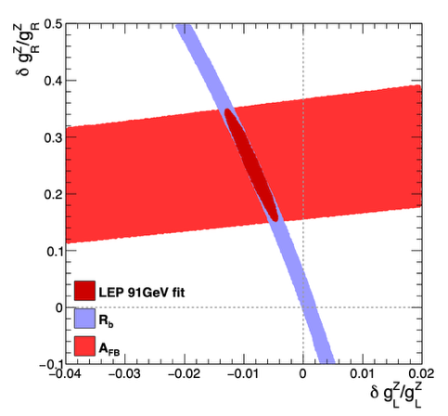
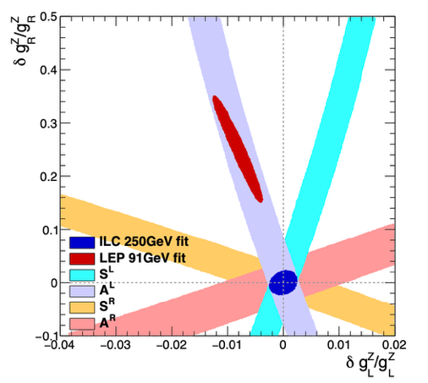
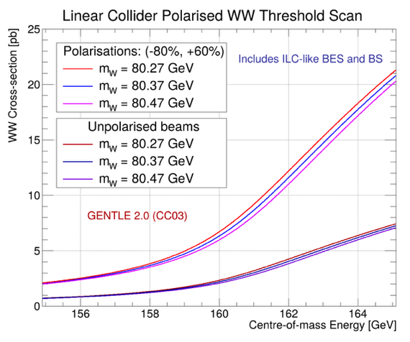
Beam Polarisation
Example electroweak couplings
More observables for constraints
“Four machines in one”
Example WW threshold
Much sharper rise at threshold
Enhanced sensitivity to W mass

Slide 4




Future Projects – Linear Colliders
HALHF and PWA
Linear Collider Facility - LCF
Linear Colliders would cover in a staged approach centre-of-mass energies between the Z-pole until multi-TeV
Polarised beams
Documents for all proposals see backup

Slide 5



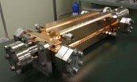

LC – Accelerator and Technology Challenges
Energy
Luminosity
Construction cost $ ~ l
Operation cost $ ~ P_{AC}
E_{CM} = l g
L
High Gradient g
High Efficiency η
Main Linac Technology
Small Beamspot σ*_{x}σ*_{y}
Losses in cavity walls
Nanobeam Technology
Damping ring (ε)
Final focus (β*)
Small duty cycle:
Pulsed operation
High frequency &
Ultra-short pulses
Low resistivity
ILC SCRF
CLIC NCRF
2 beam acceleration
Key Technologies
SCRF =
Super Conduction Radio Frequency
NCRD =
Normal Conduction Radio Frequency
Linac Technology
15 May 2025
Nanobeam Technology
5

Slide 6
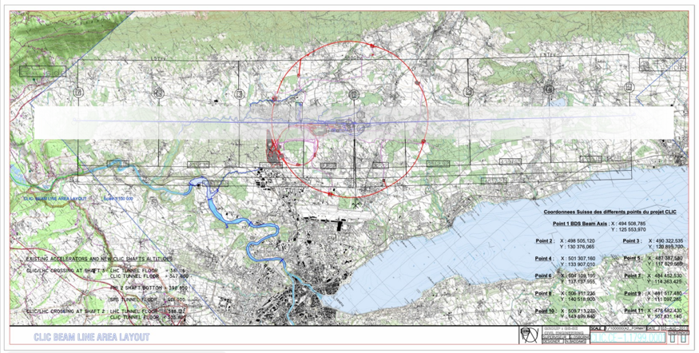
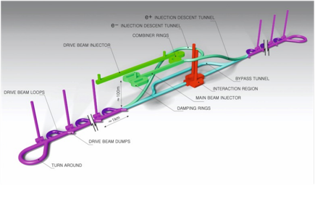
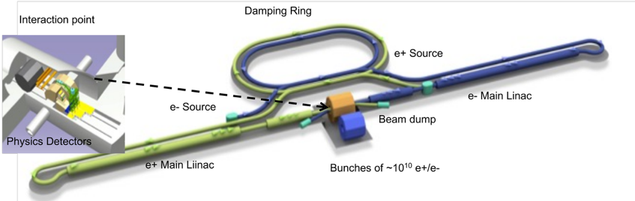
A Linear Collider at CERN
“ILC like” based on SCRF
“CLIC like” based on NCRF

Slide 7
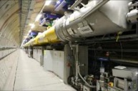

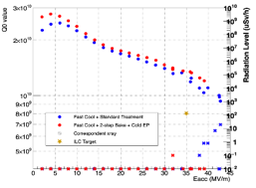
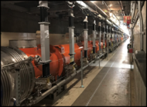

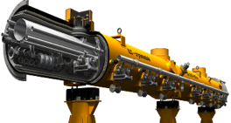
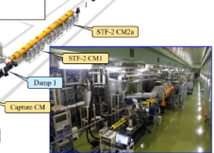



LC – Progress in SCRF
～2017
2018～2021
Pre-lab
Cavity
Yield evaluation of cavities based on TDR
High performance and cost reduction
Cavity manufacturing, performance demonstration (Yield demonstration in three areas)
Demonstration of cryomodule assembly, transfer, and performance
Euro-XFEL Operation (Europe)
~800 cavities/
~100 Modules
LCLS-II Construction (USA)
~280 cavities/
~35 Modules
US-Japan: high performance with new surface treatment, etc.
The mass production of European XFEL has reached ≥ 83% of the ILC specification yield (90%).
SCRF is mature technology benefitting from a worldwide network of expertise
ILC
Germany-Japan: Improving Efficiency in Cavity Manufacturing.
European XFEL: 29 ± 5.1 MV/m
LCLS-II: 18-21 MV/m
Q>2.7 10¹⁰
Final design is underway to comply with "High Pressure Gas Safety".
Cryomodule
Eng. design
Module assembly
Realized through international cooperation and procurement
Accelerator performance verification at KEK-STF2
7

Slide 8
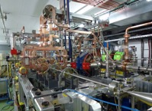
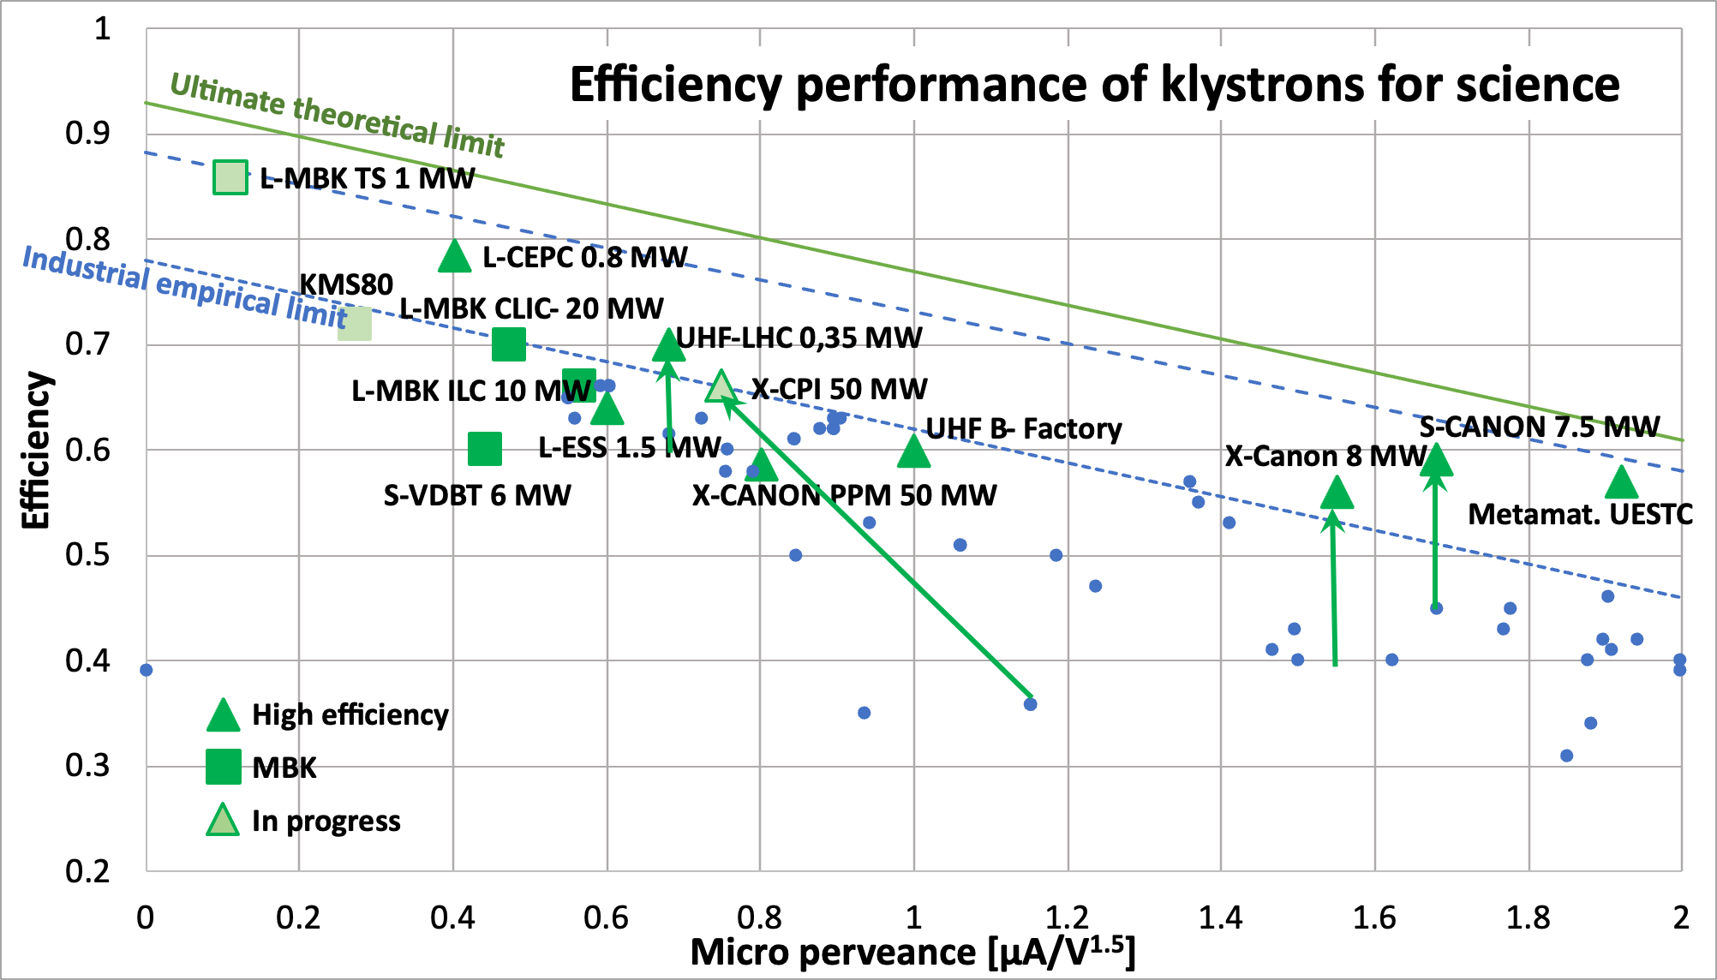
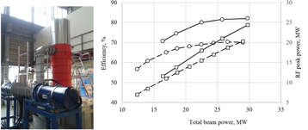

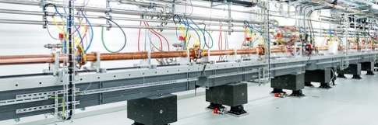
LC – Progress on CLIC technology
CLIC RF
CLIC baseline – a drive-beam based machine with an initial stage at 380 GeV
RF challenges
High-current drive beam bunched at 12 GHz
Power transfer and main-beam acceleration, efficient RF power
Towards 100 MV/m gradient in main-beam X-band cavities
The CTF3 (CLIC Test Facility at CERN) programme addressed all two-beam issues
X-band technology developed and verified with prototyping, test-stands, and use in smaller systems and linacs
Two C-band XFELS (SACLA and SwissFEL – the latter particularly relevant) now operational: large-scale demonstrations of normal-conducting, high-frequency, low-emittance linacs. Also ongoing, 1 GeV X-band linac at LNF (EUPRAXIA)
High efficiency power sources
See much more in talk by Walter Wuensch: (LINK)
8
8/24

Slide 9
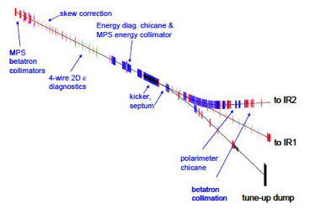
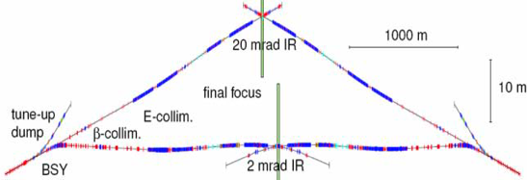
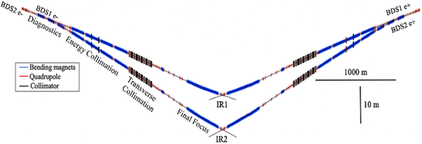
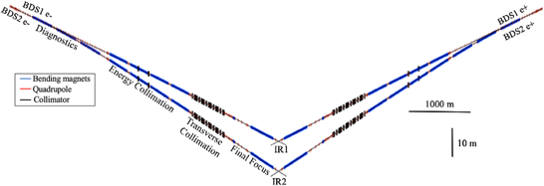
LC – Progress on CLIC technology
In the ILC Baseline Conceptual Design, the ILC was designed with 2 BDS sections and two independent IRs with 20 and 2 mrad. At that time others schemes were under study, including one of 14 mrad and a head-on scheme.
Layout of the two IRs with 20 and 2 mrad crossing angle
Layout of the BDS section after the Main Linac and the FF section
A detailed study of dual BDS serving 2 IPs has been realized in the framework of the CLIC project, this work could be taken as reference for future studies (PhD V. Cilento UPSay)
IJCLab
Layout of the two IRs at 380 GeV with 16.5 and 20 mrad crossing angle
Layout of the two IRs at 3 TeV with 20 and 25.5 mrad crossing angle
LC Vision Community
9
15 May 2025
A Linear Collider facility can have two interaction regions
Contrary to false rumours spread by highly ranked people of our discipline
… of course the luminosity is shared between the two points

Slide 10
LCVision – A Unified approach
LCWS2024: Linear Colliders teamed up for the upcoming EPSSU
all linear colliders share the same scientific goals:
formulate a coherent physics program
define energy stages etc science-driven
beyond an individual technology:
design a linear collider facility
infrastructure compatible with various technologies
plus beam-dump / fixed-target exp’s / R&D facilities
study the Higgs now - but maintain flexibility for the future:
start now with an affordable project
maintain scientific diversity
strengthen accelerator R&D towards 10 TeV pCoM collider
decide on upgrades / new projects based on future developments - or even break-throughs:
scientifically: HL-LHC could still discover new particles
technologically: higher gradients / muon cooling / high-field magnets

Slide 11
LCVision and the ESPPU
from the remit of the European Strategy Group
The aim of the Strategy update should be
to develop a visionary and concrete plan
that greatly advances human knowledge in fundamental physics
through the realisation of the next flagship project at CERN.
The Strategy update should include
the preferred option for the next collider at CERN
and prioritised alternative options to be pursued if the chosen preferred plan turns out not to be feasible or competitive.
In order to receive full attention for the LCVision idea: complement a generic, site-independent concept with
a concrete proposal for a
Linear Collider Facility (LCF) @ CERN

Slide 12
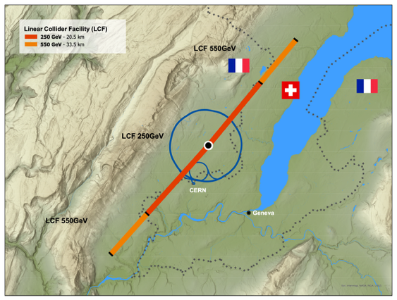
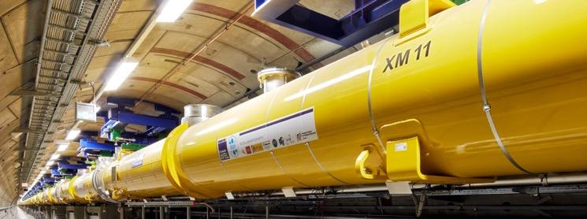
General Considerations
for the LCF@CERN
Philosophy:
leverage all the excellent work done for ILC & CLIC in the past
reliable costing etc
“ready to build”
gently modernize to turn into true flagship project for CERN
Superconducting RF technology (like ILC)
successful construction & operation of Eu.XFEL, LCLS-II… => no large-scale demonstrator step needed
lab experience and production capacities in industry globally => opportunity to take burden off CERN’s shoulders
choice for fastest implementation
Scope project to be a flagship project for CERN
2 interaction regions
higher luminosity than ILC (possible due to Q0=2E10)
add-on facilities (Beyond Collider, R&D / irradiation facilities)
attaractive upgrade perspectives with advanced technologies
but stay affordable, wrt to CERN budget
The LCF in 2025 is NOT the ILC as planned in Japan in 2016
LCF spec
ILC spec

Slide 13

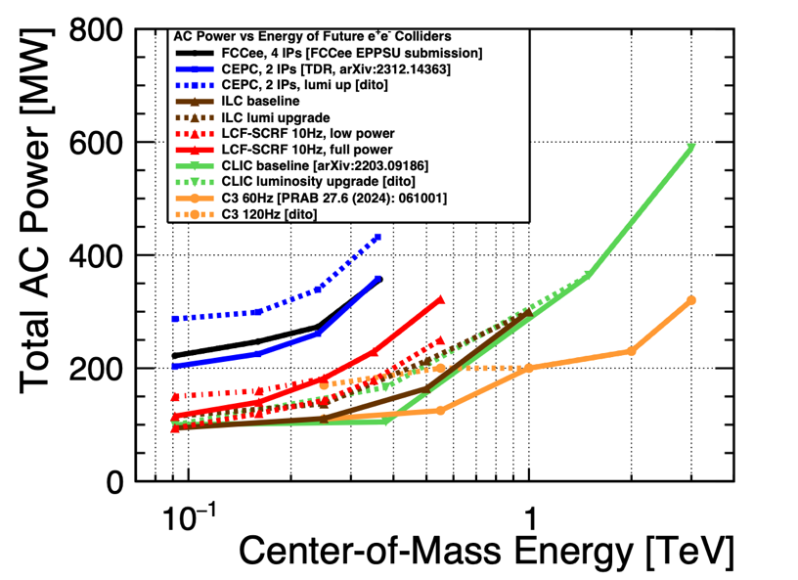
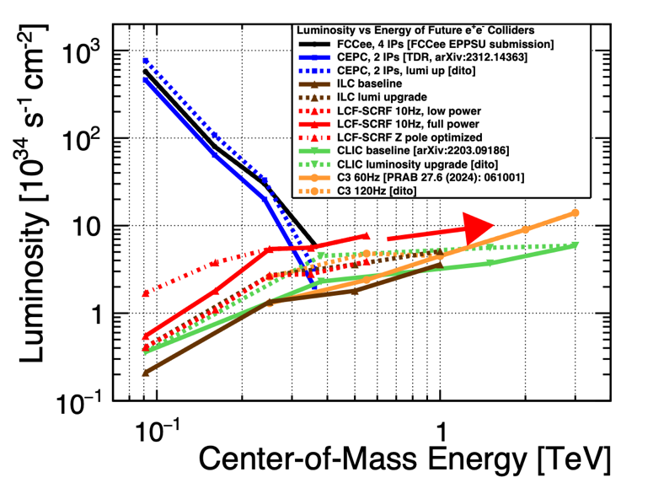

Luminosity and Power Consumption
For LCF-SCRF and other e+e- colliders
Sustainability Frontier
Luminosity and energy frontier

Slide 14
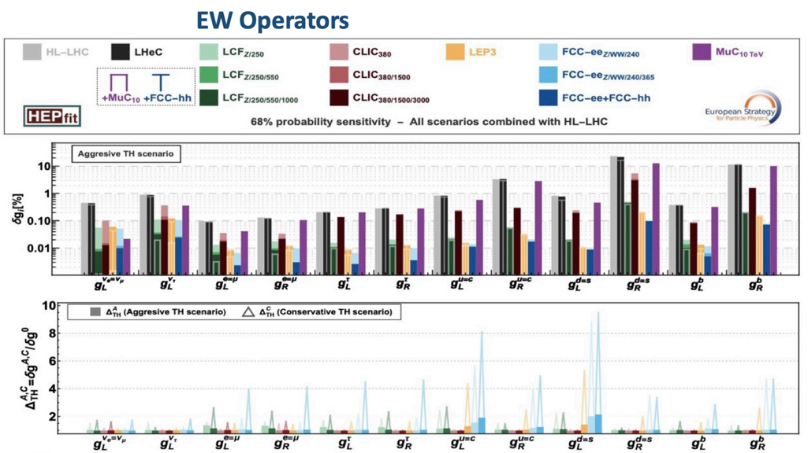
Electroweak Precision Observables
Considerable improvement by LC
Often competitive with FCCee
Beam polarisation compensates
for factor 40 in luminosity
Differences dilute further when
taking conservative (realistic?)
theory errors into account
Experimental uncertainties not taken
into account

Slide 15
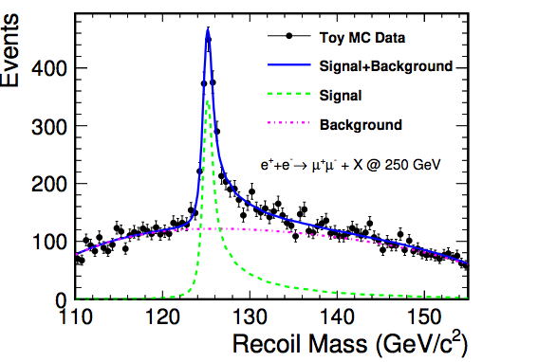
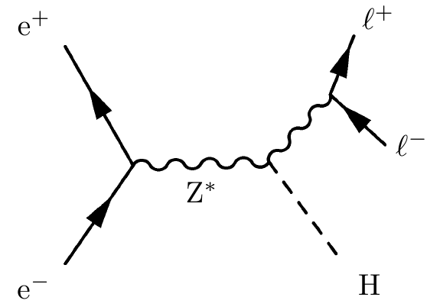

Higgs-strahlung at lepton colliders
Powerful channel for unbiased tagging of Higgs Events
Absolute normalisation of Higgs couplings
Sensitivity to invisible Higgs decays
Well measurable
decay leptons from Z
μ Pairs, e pairs
No assumption on Higgs
decay modes
$$M_{h}^{2}=M_{recoil}^{2}=s+M_{Z}^{2}−2E_{Z}\sqrt{s}$$
Clean and sharp peak in Z recoil spectrum
Illustrates precision that can be expected
from e+e- colliders
Higgs Recoil Mass:

Slide 16
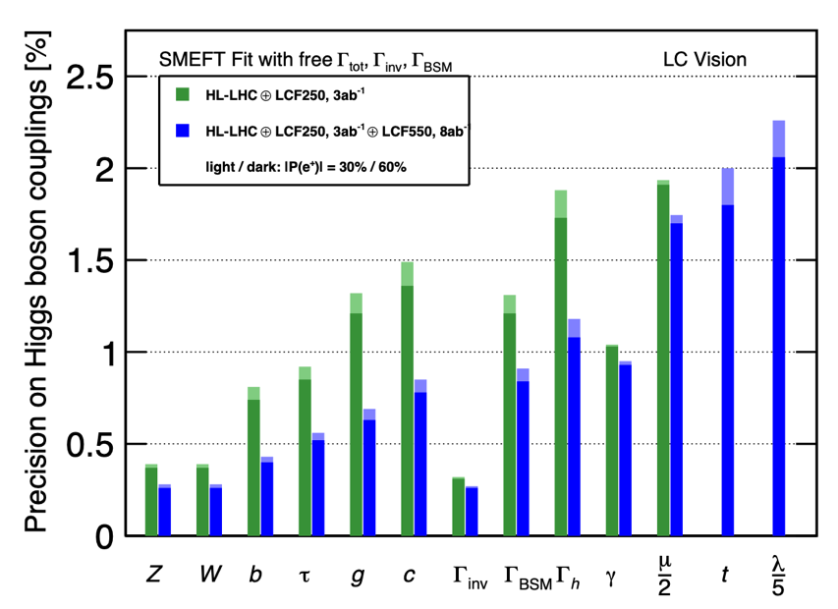
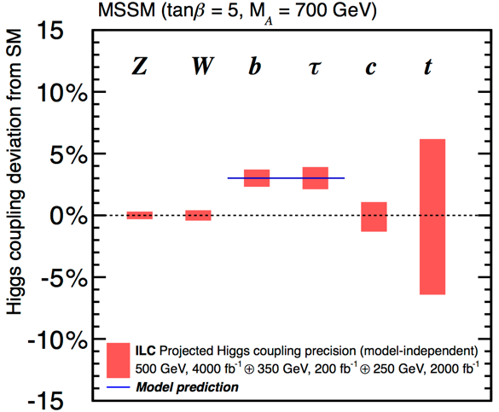
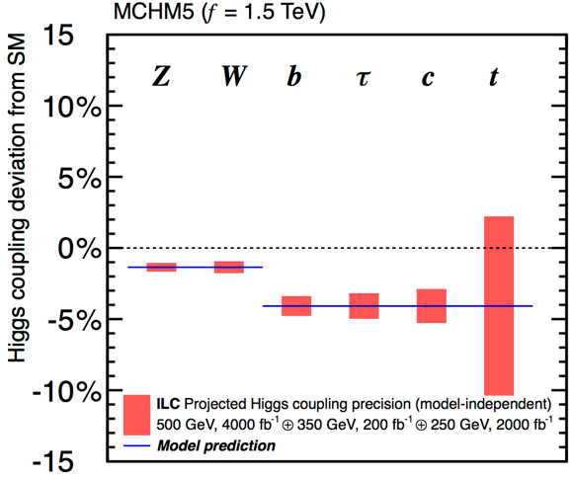
Precision matters ...
Example for illustration: Coupling precision after full LCF programme
Composite Higgs
Supersymmetry
Different new physics models lead to different patterns

Slide 17
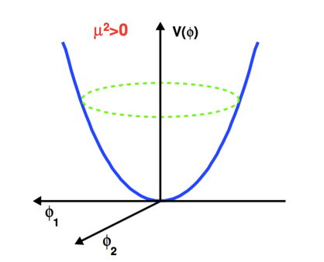
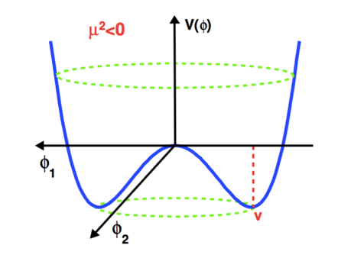
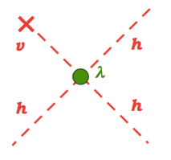

The Higgs Potential
“Today”, T=0
t=0, T>>0
Perfect (electroweak) symmetry
and massless particles
Broken (electroweak) symmetry
and massive particles
Two questions:
Shape of “today's” Higgs Potential?
Transition from symmetric, unbroken to broken phase?
=> Triple Higgs-self coupling

Slide 18
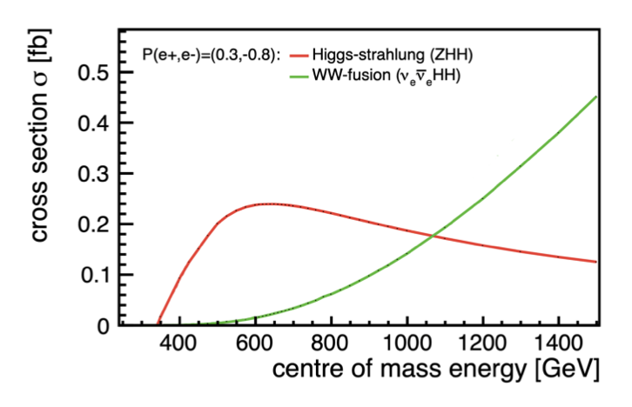
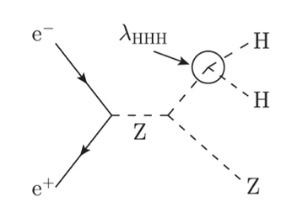
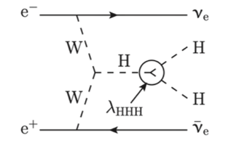
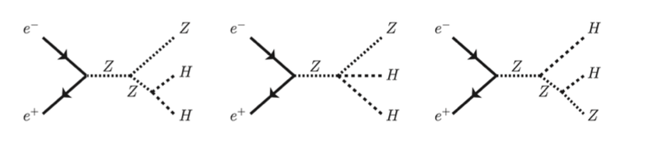
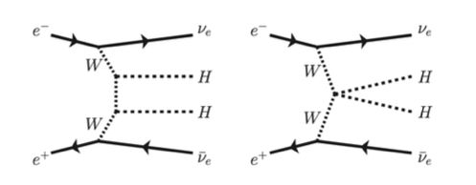
Higgs Self Coupling measurement - Ingredients to cross section
Di-Higgsstrahlung
WW Fusion
Dominates below 1 TeV
Dominates above 1 TeV
Constructive Interference
Destructive Interference
Slide from Julie Munch Torndal

Slide 19
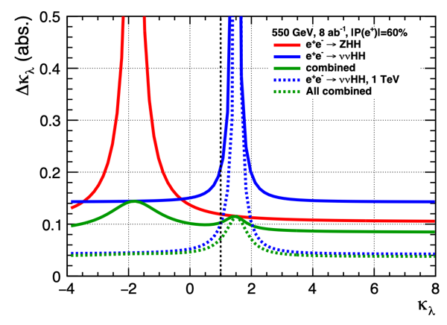
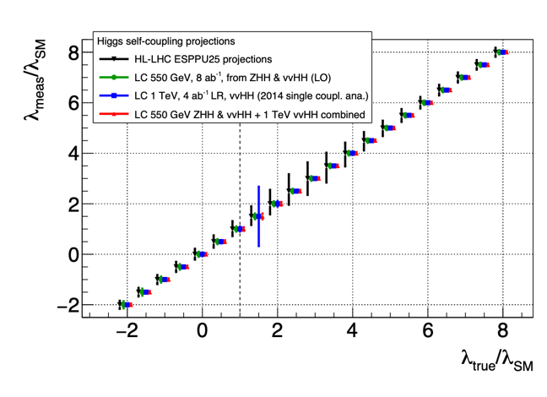
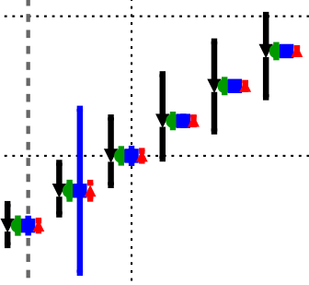
Di Higgs Production
tree-level access to self-coupling
550 GeV
~ peak of ZHH cross-section
vvHH becomes just about visible
together for SM case: ∆𝝹𝜆 = 11% (15%) for 8ab⁻¹ (4ab⁻¹)
dependence on 𝜆:
ZHH: constructive interference
vvHH: destructive interference
together: ~const absolute precision as function of 𝜆
1-3 TeV: vvHH becoming dominant
∆𝝹𝜆 = 0.04 (8ab-1) over wide range of 𝝹𝜆 (except 𝝹𝜆 ~ 1.5)
quantitative improvement and qualitatively new information wrt HL-LHC
550

Slide 20
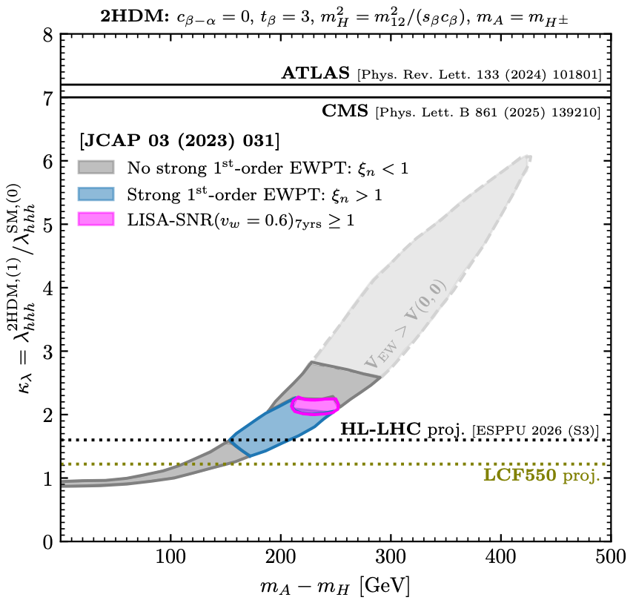
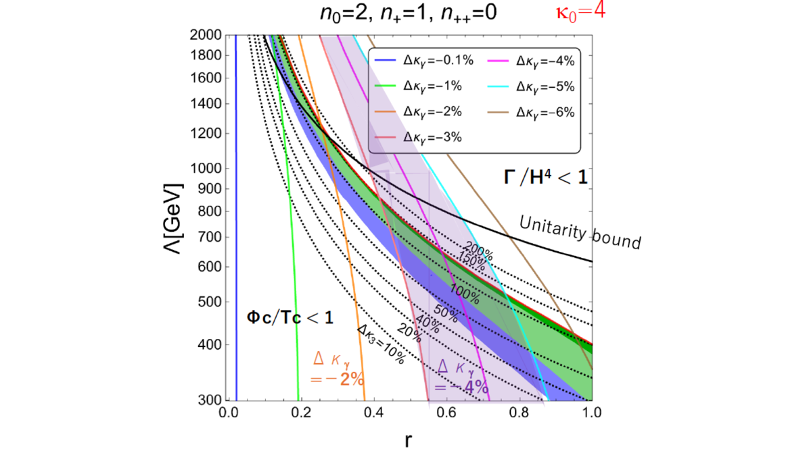
Interplay with gravitational waves
aligned Higgs EFT
area above dashed lines expected to be excluded if SM true
primordial black hole search
DECIGO/
LISA
Phys.Lett.B 856 (2024) 138940
FOEWPT only testable via Higgs

Slide 21
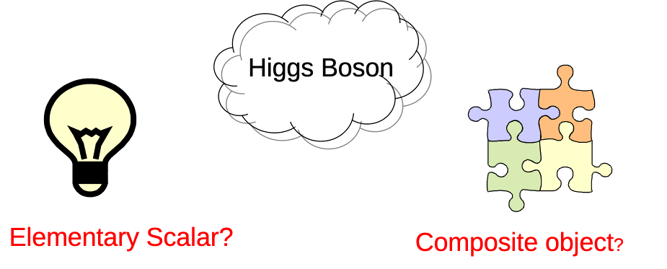
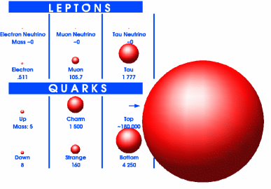
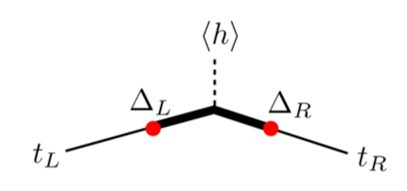
An enigmatic couple
Top quark
- Higgs and top quark are intimately coupled!
Top Yukawa coupling O(1) !
=> Top mass important SM Parameter (-> backup)
- New physics by compositeness?
Higgs and top composite objects?
- Future colliders perfectly suited to decipher both particles
Courtesy of S. Rychkov

Slide 22
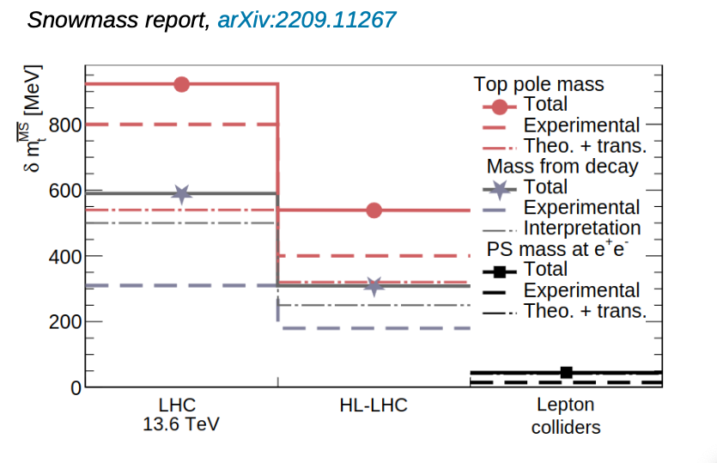
Top Mass Summary
All future lepton (e+e- colliders) will improve considerably the precision on mtop
Marcel Vos@Top23

Slide 23
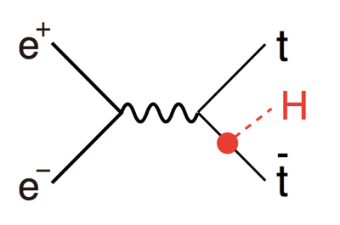
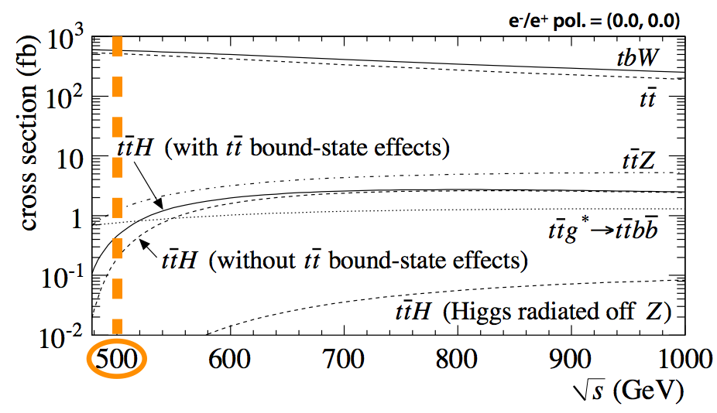
Top Yukawa Coupling – e+e-
- Coupling of Higgs to
heaviest particle known today
- Up to eight final state jets
√s[GeV] | 550 | 1000 | 1400
L[ab-1] | 4 | 8 | 2
δyt/yt[%] | 2.8 | 1.0 | 2.7

Slide 24
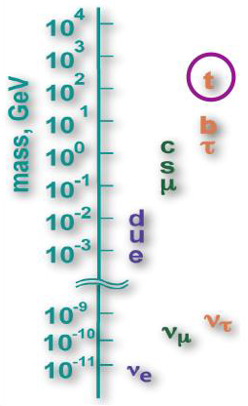

Fermion Hierarchy
- SM does not provides no explanation
for mass spectrum of fermions (and gauge bosons)
- Fermion mass generation closely related
to the origin electroweak symmetry breaking
- Expect residual effects for particles with
masses closest to symmetry breaking scale
- Heavy quark effect or effect on all fermions?
Strong motivation to study chiral structure
of (heavy) quark vertices

Slide 25


Top quark and new physics
assuming only 4ab⁻¹ at 500 GeV
Couplings of the Top quark to the Z boson:
essential for NLO interpretation of Higgs measurements
tremendous BSM sensitivity in its own right
Displayed Models take LHC Constraints into account
arxiv:2503.19983

Slide 26


What if … LHC makes a discovery?
>> 5𝜎 narrow resonance seen in top pairs by CMS
Candidates: A(365), CP-odd toponium, KK graviton T(350) seen in hh
T(690) a narrow resonance, 20 GeV wide, seen in ZZ/WW/h125h95/γγ/e+e- which could also be a KK graviton
Combined significance > 5 sd
A(450) indicated in ttZ, tt and T(350)Z->hhZ
RUN3 data should confirm/dismiss these indications
Series of KK resonances at LCF?
Slide provided by F. Richard
26
N. Walker, ILC School 2013

Slide 27


Staging I
250 GeV incl Z pole - facility
33.5km long tunnel => reach 550 GeV with 31.5 MV/m SCRF
∅ 5.6m, two IPs
equipped with SCRF for 250 GeV
10Hz trains of 1312 bunches => L = 2.7 x 10³⁴ / cm² / s
construction cost: 8.29 BCHF
AC power: 143 MW
optionally: beam-dump / fixed-target
upgrade: double luminosity 2625 bunches / train: +0.77 BCHF + 39MW
both beams polarised:
e-: 80%
e+: 30%
3ab-1 @ 250 GeV
operation at Z pole (eg 100fb⁻¹) WW theshold (eg 500fb⁻¹) as needed

Slide 28
Staging II
250 GeV incl Z pole - facility
550 GeV incl ttbar theshold
33.5km long tunnel => reach 550 GeV with 31.5 MV/m SCRF
∅ 5.6m, two IPs
equipped with SCRF for 250 GeV
10Hz trains of 1312 bunches => L = 2.7 x 10³⁴ / cm² / s
construction cost: 8.29 BCHF
AC power: 143 MW
optionally: beam-dump / fixed-target
upgrade: double luminosity 2625 bunches / train: +0.77 BCHF + 39MW
both beams polarised:
e-: 80%
e+: 30%
3ab-1 @ 250 GeV
operation at Z pole (eg 100fb⁻¹) WW theshold (eg 500fb⁻¹) as needed
Upgrade
equipping the additional tunnel with SCRF
+ 5.46 BCHF
10 Hz trains of 2625 bunches => 7.7 x 10³⁴ / cm² / s
AC power 322 MW
target 8 ab⁻¹

Slide 29


Running Scenarios up to 550 GeV
baseline
start immediately with full power

Slide 30


Running Scenarios starting at 550 GeV
take some polarised data at lower energies
or go more quickly to TeV range
An LCF gives flexibility to decide exact program based on scientific and technological progress / break-thoughs
What would/could be
technological progress / break-throughs?

Slide 31




Beyond 550 GeV – Upgrades with SCRF
IJCLab
31

Slide 32
Beyond 550 GeV – Upgrades with SCRF
50 MV/m
~1.5xILC
70 MV/m
~2.3xILC
IJCLab
90 - 100MV/m
>3xILC
Longer Term
70 MV/m
>2.3xILC
Longer Term
32

Slide 33







Beyond 550 GeV – Upgrade with C³
1-m prototype structure
Cool Copper Technology
Idea and R&D
C3 technology:
normal-conducting C-band copper cavities
operated at cryogenic temperatures (LN2 ~80K)
gradients demonstrated up to 155 MV/m
R&D:
plan towards demonstrator established during Snowmass
since then significant progress on system design, accelerator structure design, high gradient testing, vibration measurements, damping materials, alignment system, low- level rf & klystrons, … and cryo-module design
stand-alone facility 8km: 250 /550 GeV (70 /120 MV/m)
single-cell gradient
demo
Quarter-cryo-module
10

Slide 34




Beyond 550 GeV – Plasma acceleration
•
Includes all concepts that can achieve an acceleration gradient > 1 GeV/m
•
High gradients → Compact accelerators → Potentially lower cost & environmental footprint
Wakefields in
Wakefields in
Dielectric
Plasma
Structures
Laser Driven
Beam Driven
Laser Driven
Beam Driven
•
Accelerating gradient 1-100 GeV/m

Slide 35
Beyond 550 GeV – Plasma acceleration
To be a Candidate for a Linear Collider,
Wakefield Acceleration Must Offer a Path To…
High
High
High
Energy
Luminosity
Efficiency
Exciting prospects but still a lot to do …
We (You) should consider this as an opportunity and not as a risk

Slide 36






Beyond 550 GeV – Plasma acceleration
Hybrid-Asymmetric Linear Higgs Factory
e+e- LC using e-beam-driven plasma wakefield acceleration for the e- beam…
=> asymmetric collisions with 𝛾 = 1.67
(HERA 𝛾 = 3)
…and RF cavities for the e+ beam
luminosity ~ILC baseline
site-length and cost - small & cheap:
250 GeV: 4.9 km, 3.8 BCHF
550 GeV: 8.4 km, 6.3 BCHF
if R&D successful - estimated need:
213 MCHF & 341 FTEyrs over ~15 years
G
G
G
HALHF
250 GeV - 4.9 km
380 GeV - 6.5 km
550 GeV - 8.4 km
G
G
G
G
G
G
G
G
G
Ñ
G
G
G
G
G
G
G
G
G
HALHF 550GeV
G
G
G
G
G
G
HALHF 250GeV !!
G
G
G
G
G
G
G
G
HALHF 380GeV
G
G
G
G
G
G
G
G
G G G
G
G
G
G
G
G
G
G
G
G
G
G
G
G
G
G
CERN
G
G
G
G
G

Slide 37

Alternative Collider Mode
Photon Collider
Layout of the XCC photon collider
complementary physics case, e.g. self-coupling in 𝛾𝛾 -> HH with different BSM behavior than e+e- / pp
install in one of the IPs
either classic way with optical lasers or XCC-like with X-ray lasers

Slide 38




Luminosity Booster – Recovery Linacs
Energy- & Particle Recovery as path to High Luminosities
higher luminosity
Energy and particle recovery:
boost luminosity up to 10³⁶ / cm² / s and high e+ polarisation
by re-using particles and energy
=> requires to limit beam-strahlung, far from disruption limit
several concepts - e.g. ReLiC, ERLC
physics motivations for high luminosity in e+e- LC:
most measurements statistics limited => gain everywhere
e.g. few 0.1% on trilinear, few 10% quartic self-coupling…
also: electron Yukawa - effective absence of beam-strahlung allows
mono-chromatisation
Direct HIGS production
Positron source
ReLiC
Detectors
_{e}+ _{e}-
Compress / Decompress
Damping rings
_{e}+
Compress / Decompress
_{e}+
Damping rings
Separator
Separator
Separator
Separator
_{e}-
Linac
Linac
Linac _{e}-
Linac
_{e}+
Linac
Linac
_{e}-
*
Electron source
ReLiC
ERLC
Figure is courtesy of David d’Enterria
16
A Linear Collider Vision | J.List | ESPPU Open Symposium | Lido di Venezia June 24, 2025

Slide 39

Very high energy (lepton) collisions in a circular machine?
Remember:
Increase the radius of the ring
LEP (27 km)→ FCCee (92 km) with gain in √s of ~365/210 = 1.73
… and allowing for 50 MW of loss by SR → to be compensated by additional acceleration power
Increase the mass of the colliding particles
mμ = 200xme
=> At high energies muon is “quasi stable” particle
Though still decaying
Muon colliders (may) allow for lepton collisions at mulit-TeV in circular colliders

Slide 40















μ⁺μ⁻ collider – Two “types of collisions”
“Valence” Leptons
“Weak boson collisions
“Reach for now particles up to √s/2
Weak boson Collider
Eµ » 100 GeV
“Increasing lepton energy “facilitates” radiation of W (and Z) => Weak jets
Ultimative tests of electroweak theory
N.B.: Same arguments apply to high-energy electron-positron colliders, e.g. linear colliders

Slide 41













μ⁺μ⁻ collider – Physics programme in a nutshell
DIRECT SEARCHES
production of SM and new physics in direct µ⁺µ⁻ annihilation
HIGH-INTENSITY PROBES
production of SM and new physics using beam constituents (e.g. bosons)
HIGH-ENERGY PROBES
indirect probes of new physics in direct
µ⁺µ⁻ annihilation
s 2-3 TeV center of mass brings significant extension compared to HL-LHC

Slide 42


μ⁺μ⁻ collider – Heavy new physics
Compares pretty well with a pp collider
Muon – elementary object
Proton - composed object
Can produce heavy new physics (colored or not)
Ratio of
partonic
xsections
in principle can probe directly new states at √s/2
3 TeV µ⁺µ⁻ roughly equivalent to 20+ TeV pp

Slide 43

μ⁺μ⁻ collider – Higgs Physics

Slide 44

μ⁺μ⁻ collider – Higgs and additional light scalars
2Higgs Doublet Model (2HDM)
“SM like” Higgs + 4 more
tanβ = v1/v2 (v1,2 VEV of 2 Higgs Doublets)
At LHC There is in general a weak sensitivity to new scalars, since
“small” cross-sections
large backgrounds
it is hard to explore the scalar sector and the only big discovery of the LHC may be left unmatched … even if light scalars may exist.

Slide 45



μ⁺μ⁻ collider – Higgs and additional light scalars
2Higgs Doublet Model (2HDM)
“SM like” Higgs + 4 more
tanβ = v1/v2 (v1,2 VEV of 2 Higgs Doublets)

Slide 46

Muon collider concept
The main challenge is the short muon lifetime τ = γ x 2.2 μs
Short, intense proton bunch
Protons produce pions which decay into muons which are captured
Ionisation cooling of muon in matter
Acceleration to collision energy
Collision
46
Unprecedented Collider Complex
Muon cooling is maybe most complex challenge

Slide 47






Muon cooling

Slide 48

Muon Collider - Implementation

Slide 49







Interplay of project’s – “Karl’s view”
Potential for development: future 10 TeV parton-scale collider options
FCC-ee LEP3 LHeC LCF, CLIC
FCC
91 km circumference
PERLE
FCC
91 km circumference
FCC-hh,
Muon Collider (3, 10 TeV)
R&D
e⁺e⁻ with improved acceleration technologies
LCF, C³ (à 1 TeV), CLIC (1.5 TeV), HALHF, …
baseline 85 TeV (à 120 TeV)
à plasma acceleration for higher energies
(can !(10) TeV be reached? on what timescale?)
+ possibility for HI collisions
[original: K. Jakobs]
49

Slide 50
Interplay of project’s – Alternative view
Potential for development: future 10 TeV parton-scale collider options
FCC-ee LEP3 LHeC LCF, CLIC
FCC
91 km circumference
PERLE
FCC
91 km circumference
FCC-hh,
Muon Collider (3, 10 TeV)
R&D
e⁺e⁻ with improved acceleration technologies
LCF, C³ (à 1 TeV), CLIC (1.5 TeV), HALHF, …
baseline 85 TeV (à 120 TeV)
à plasma acceleration for higher energies
(can !(10) TeV be reached? on what timescale?)
+ possibility for HI collisions
[original: K. Jakobs]
50

Slide 51

Reminder – The traffic light plot
51

Slide 52
Backup

Slide 53


LCVision EPPSU documents
ILC in Japan (IDT)
arxiv:2504.XXX
… and relation to other inputs
CLIC at CERN
arxiv:2503.24168
arxiv:2503.21857
C³
arxiv:2503.20829
Technologies and upgrades
arxiv:2503.19983
LC Physics Case & long-term vision
HALHF
arxiv paper & EPPSU submission
arxiv:2503.23489
arxiv:2503.19880
LCF @ CERN
arxiv:2503.24049
10 TeV Wakefield
EPPSU submission & back-up document
arxiv:2503.20214
arxiv:2504.01434
Beyond Collider
https://cds.cern.ch/record/2927631

