Slide 1
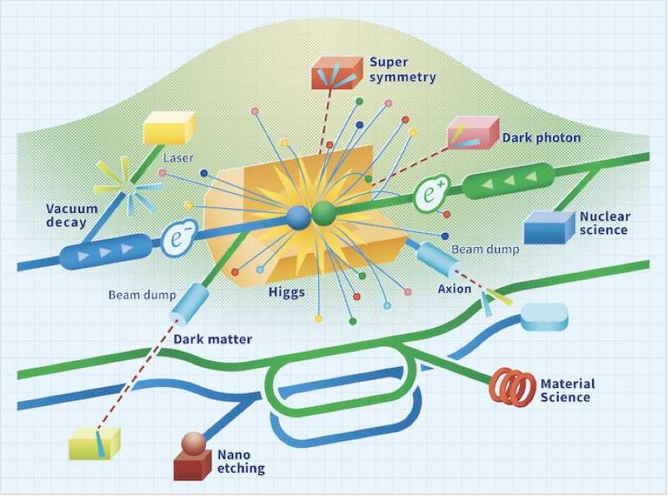
LCVision and
LCF at CERN
ESPPU Submissions
Benno List, DESY
IDT WG2 Meeting
15.4.2025

Slide 2
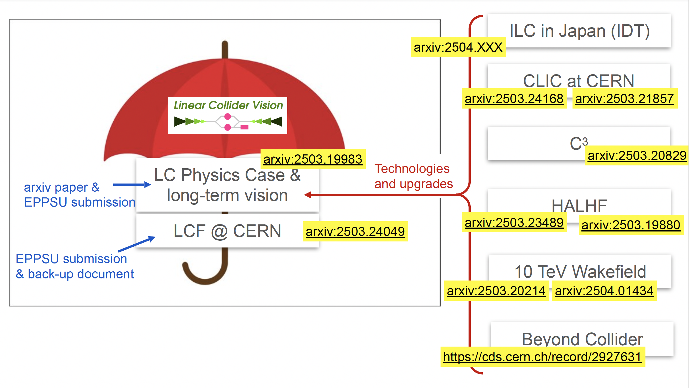
LC Vision Umbrella Document

Slide 3
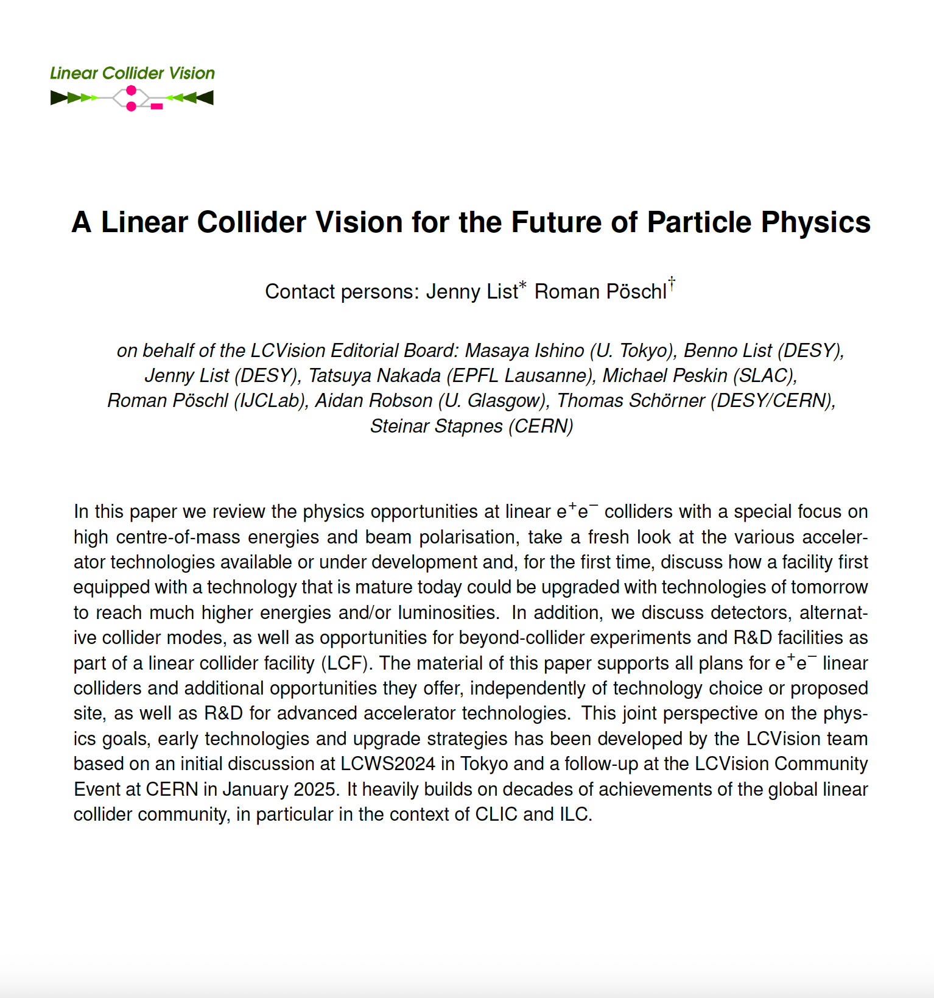
LC Vision Submission
Presents the physics case for a linear e+e- linear collider
  Provides a Higgs factory at 250GeV – highest priority
  Offers polarisation – chirality of weak interactions
  Energy upgrades for
    Top physics (t-tbar at 350-380GeV, tth at 550 GeV)
    Higgs self coupling at 500 GeV
  Linear colliders are upgradeable and flexible (react to physics needs, e.g. from HL-LHC, and competition, e.g. CEPC)
Document covers physics potential and technological potential of ILC, CLIC, LCF, C3, HALHF, ERLs
More than 400 supporters!
Signature list:
https://www.ppe.gla.ac.uk/LC/LCVision/index.php?show=instadmin&skey=etUI1visTy25
https://indico.cern.ch/event/1439855/contributions/6461548/
arXiv:2503.19983

Slide 4
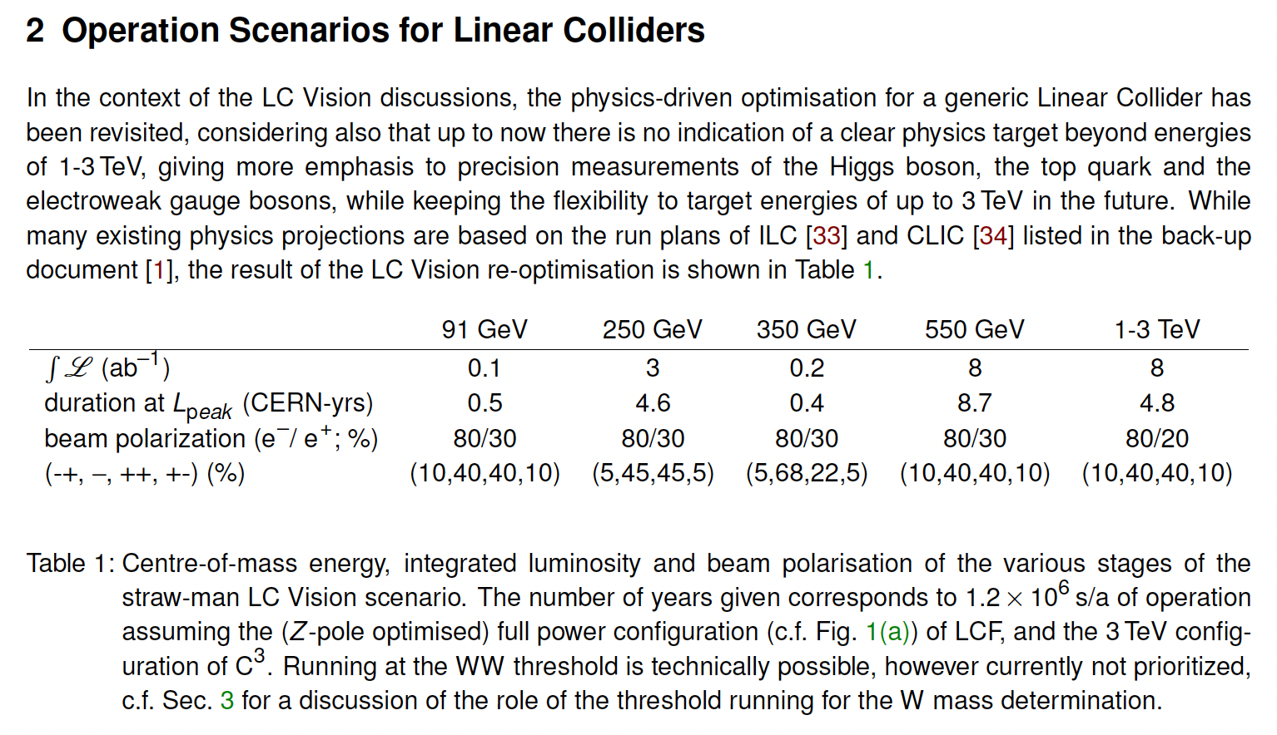
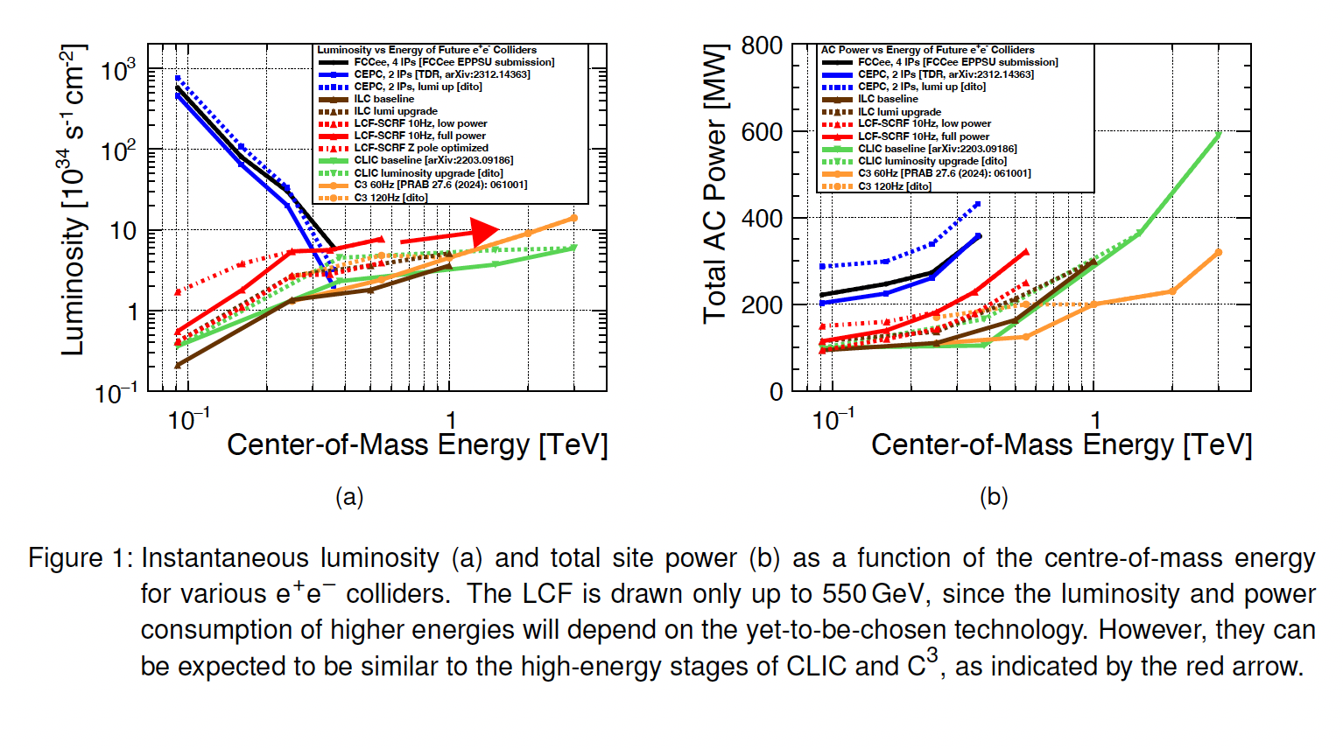
Operating Scenarios / Run Plans
Operating Scenarios / Run Plans updated with more optimistic / ambitious luminosities for a generic facility

Slide 5
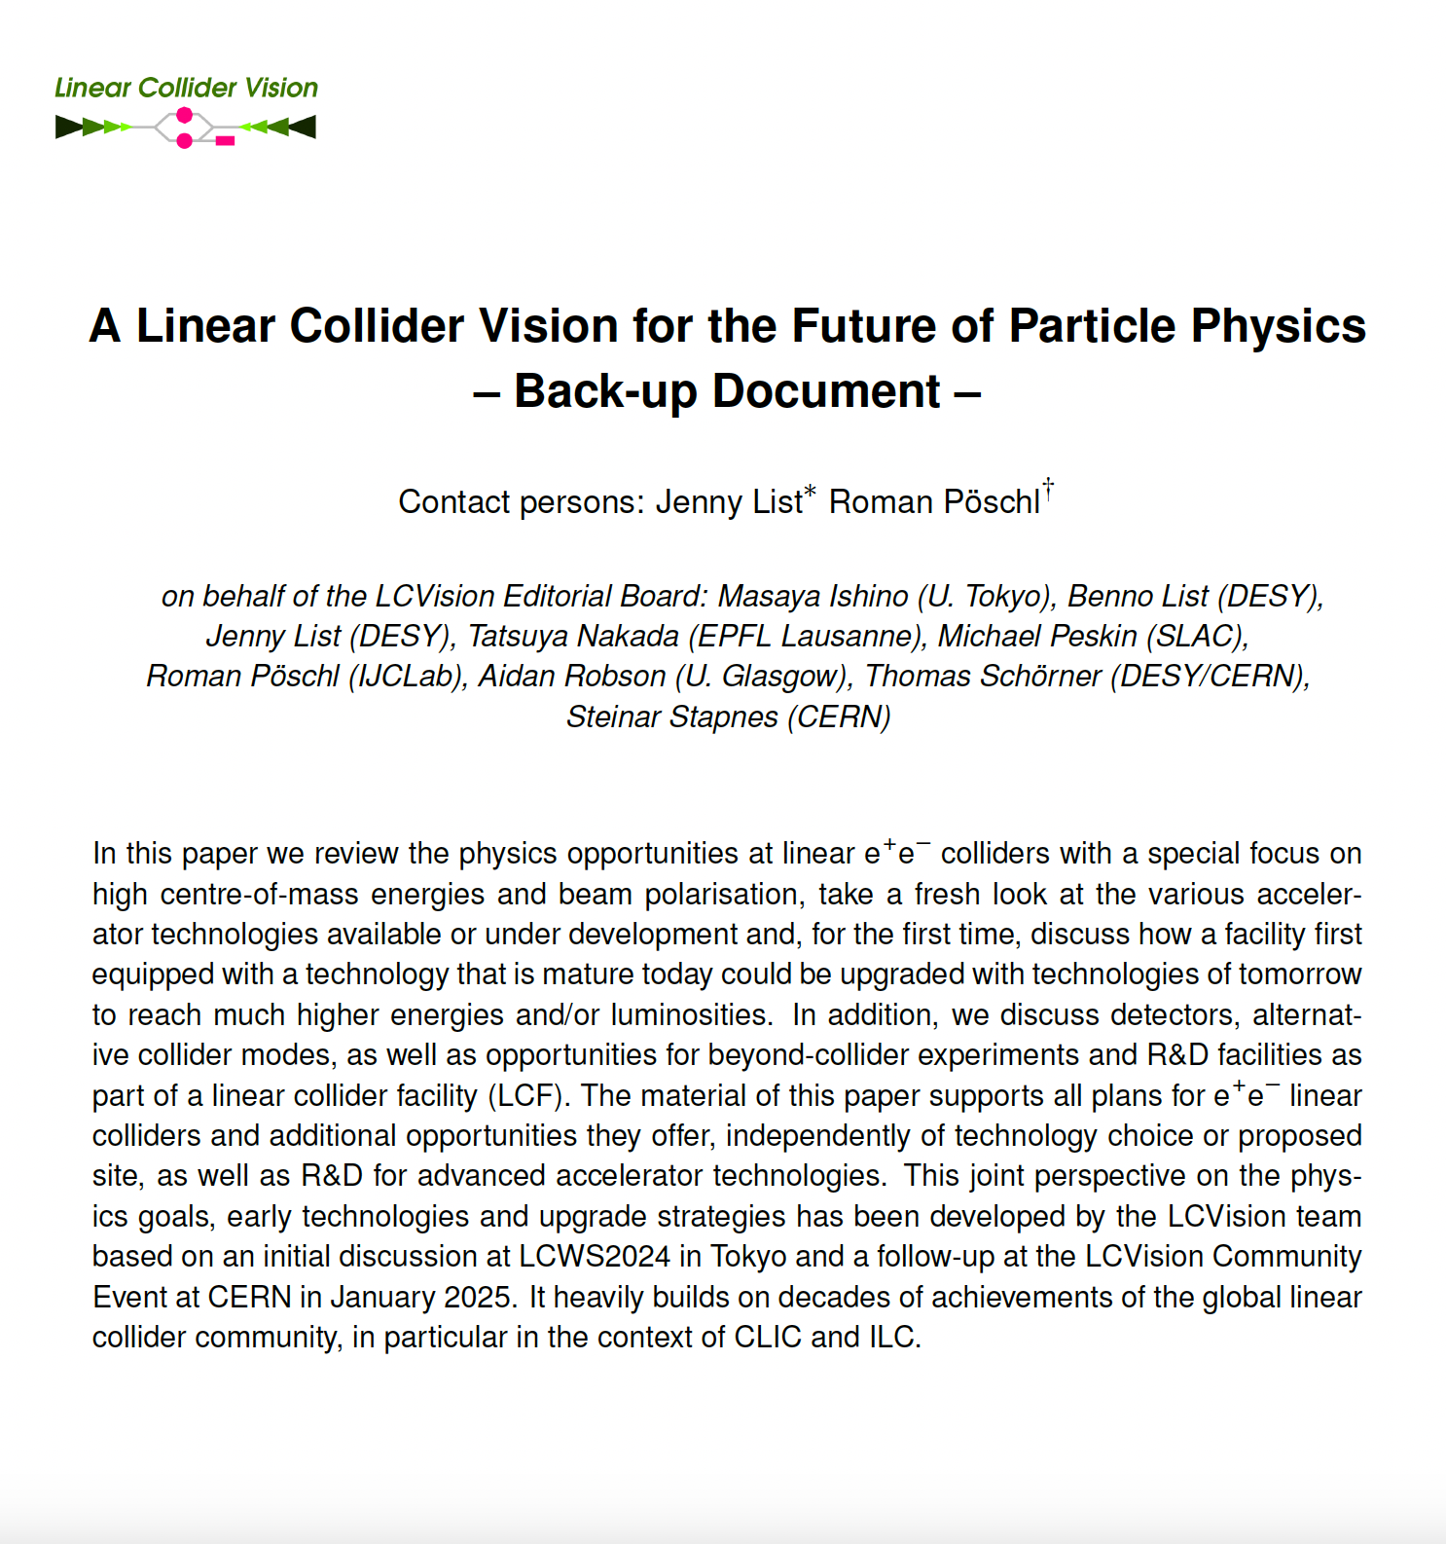
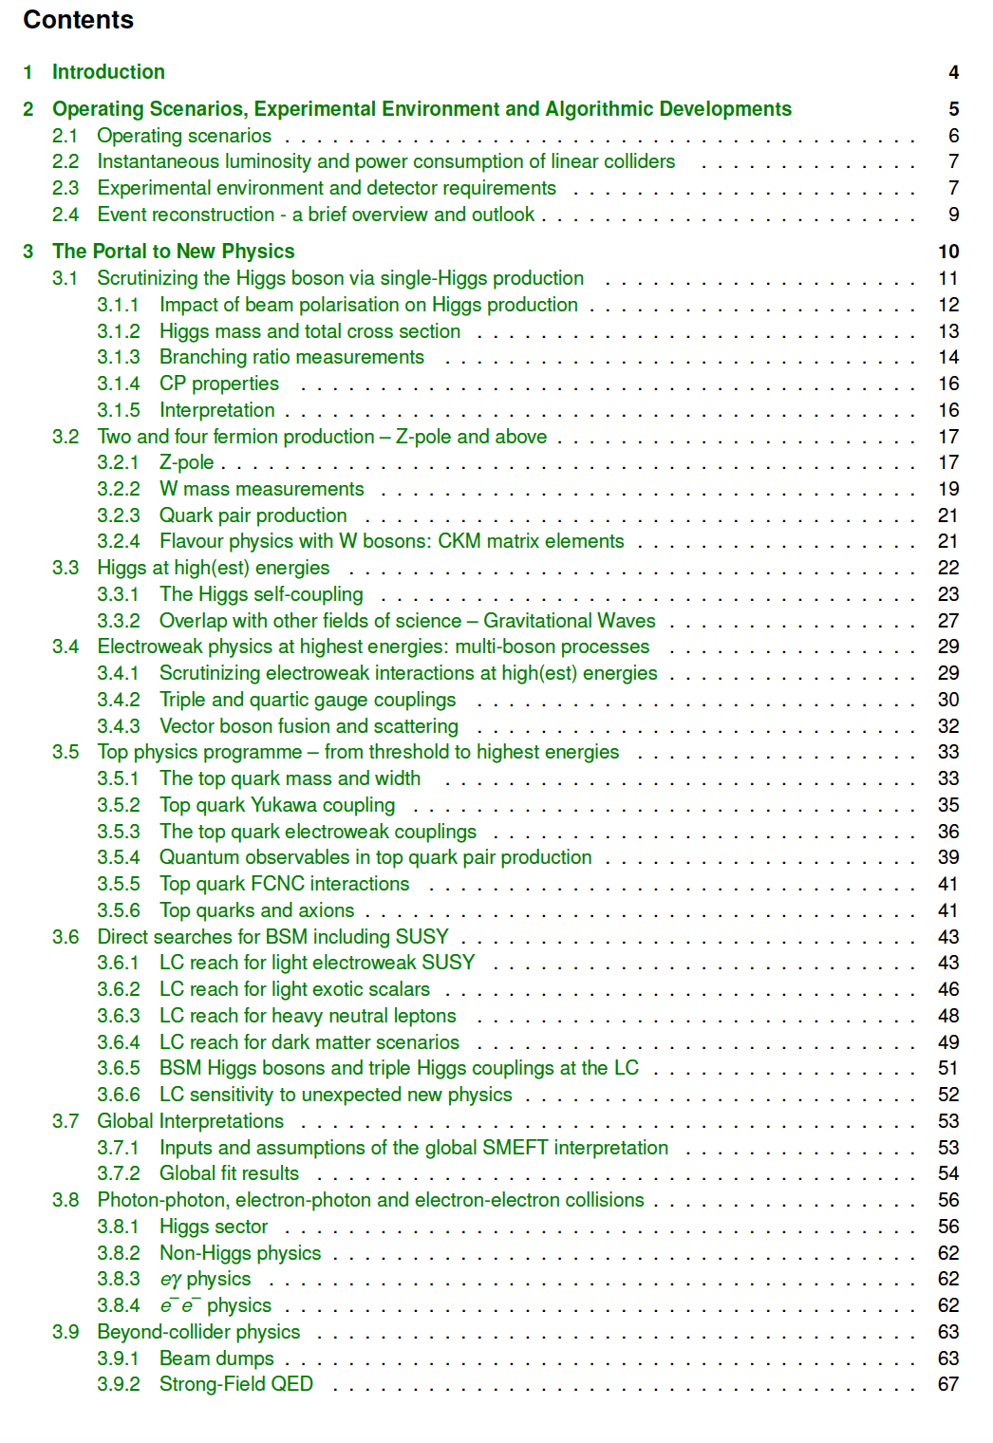
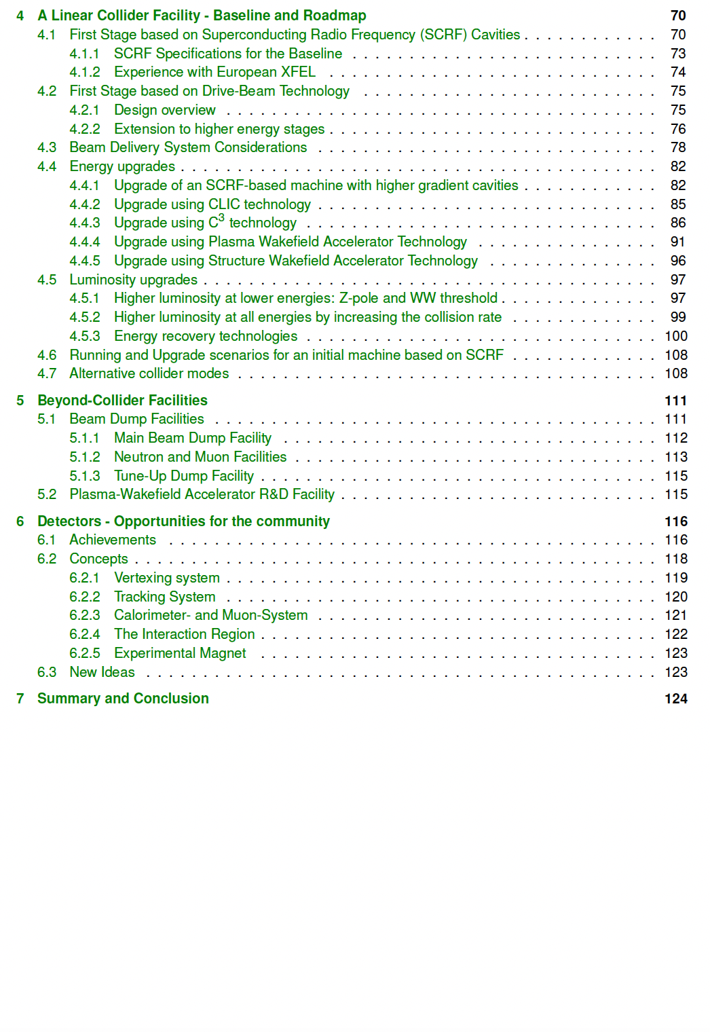
LCVision: Backup Document
Covers Physics and
Linear Collider technology

Slide 6
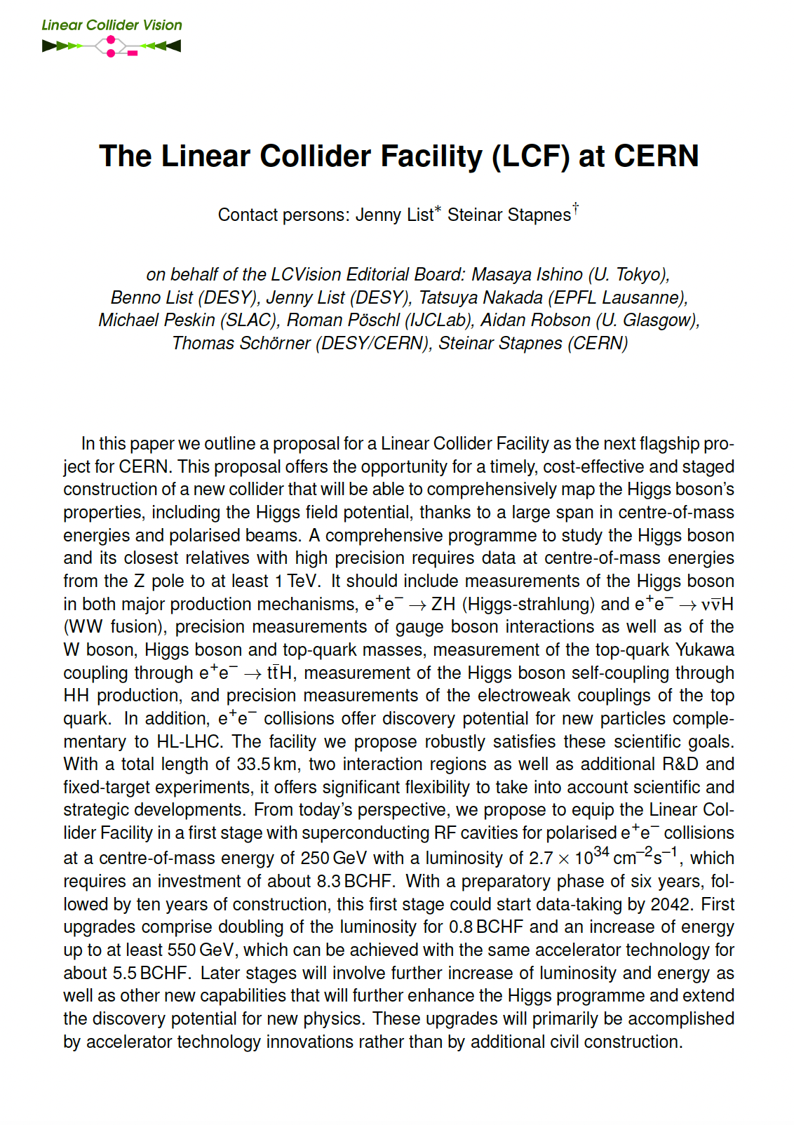
Linear Collider Facility LCF at CERN
Concise description of a linear collider facility based on ILC technology for CERN
  Initial energy 250 GeV
  Rep-rate 10 Hz -> 2x ILC luminosity, assume Q₀=2E10
  Gradient: assume 31.5MV/m
  2nd BDS with different crossing angle
  33.5km tunnel
  Initial cost: 8.3 BCHF
  Upgrades:
    Lumi: go to 2625 bunches -> 4x luminosity + 0.8 BCHF
    Energy: Go to 550 GeV +5.4 BCHF
Cost estimate: Based on ILC Cost Update 2024
  Translated to CHF and CERN procurement (no PPP)
  Separate CFS Cost estimate for CERN site
https://indico.cern.ch/event/1439855/contributions/6461433/
arXiv:2503.24049

Slide 7
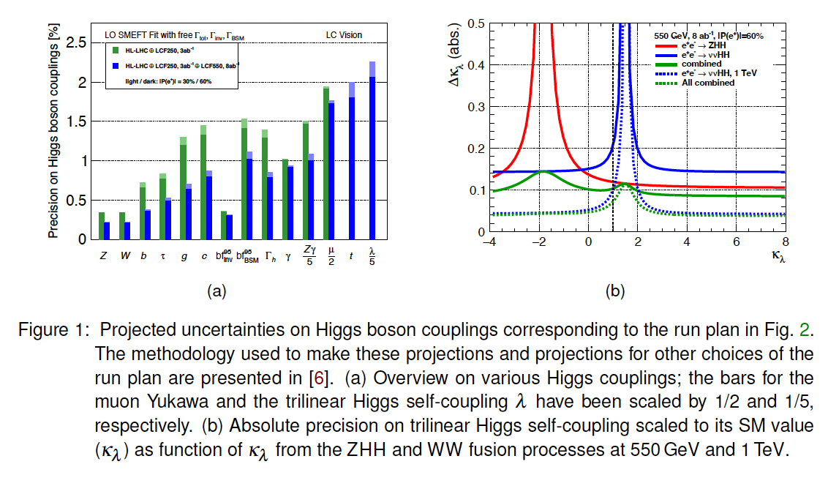
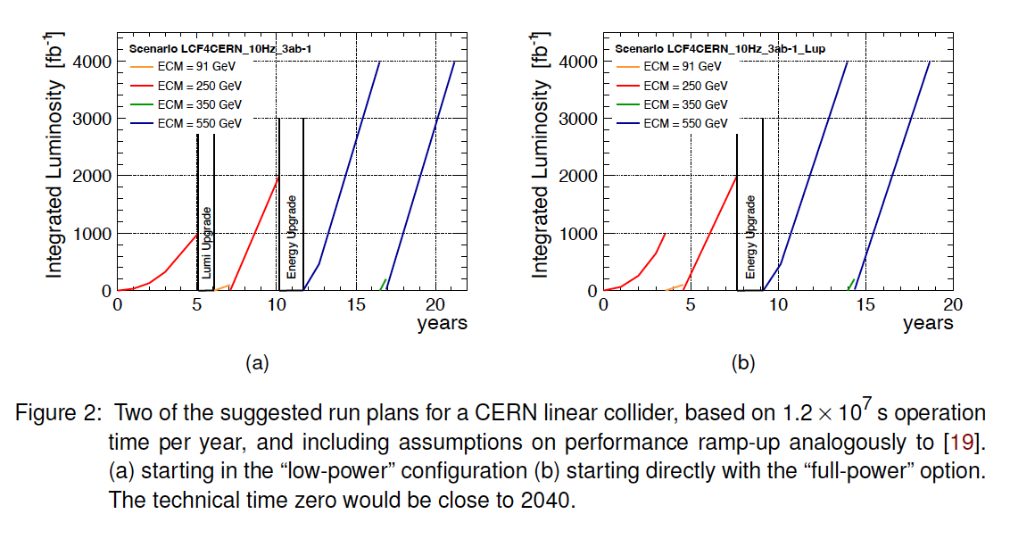
Highligh: Updated Higgs Self Coupling Projection
New Higgs Self Coupling projection:
based on 8ab⁻¹ at 550 GeV
-> 11% (9σ) for SM, 15% (6σ) for all values
A linear collider with 8ab⁻¹ at 550 GeV is able to firmly establish Higgs self coupling for all scenarios and measure the Higgs potential
(before 2060)

Slide 8
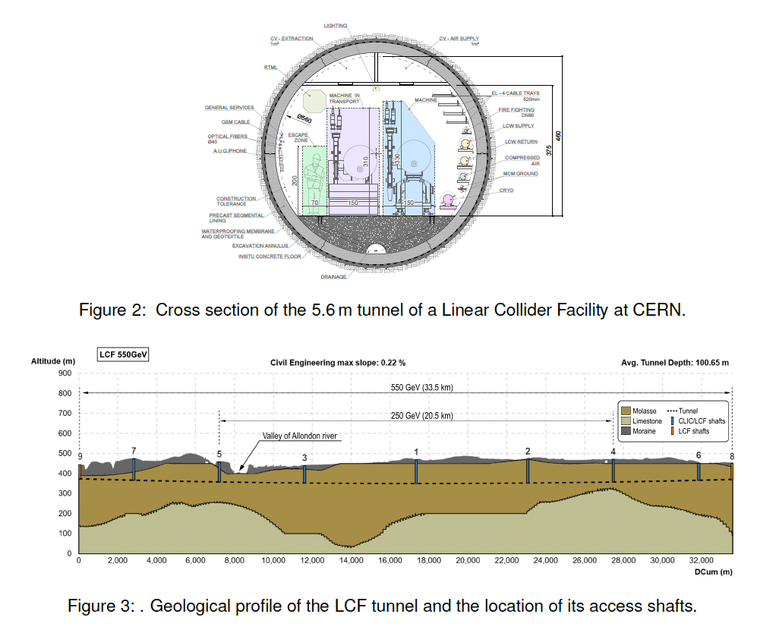
Siting, CFS Study
CFS Study for CERN site was prepared, with cost estimate
Tunnel dimension same as for CLIC (drive beam)

Slide 9
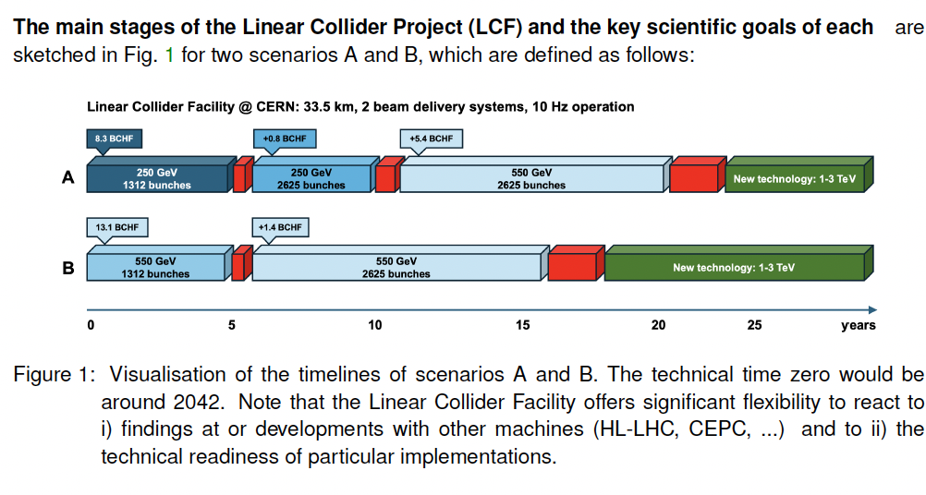
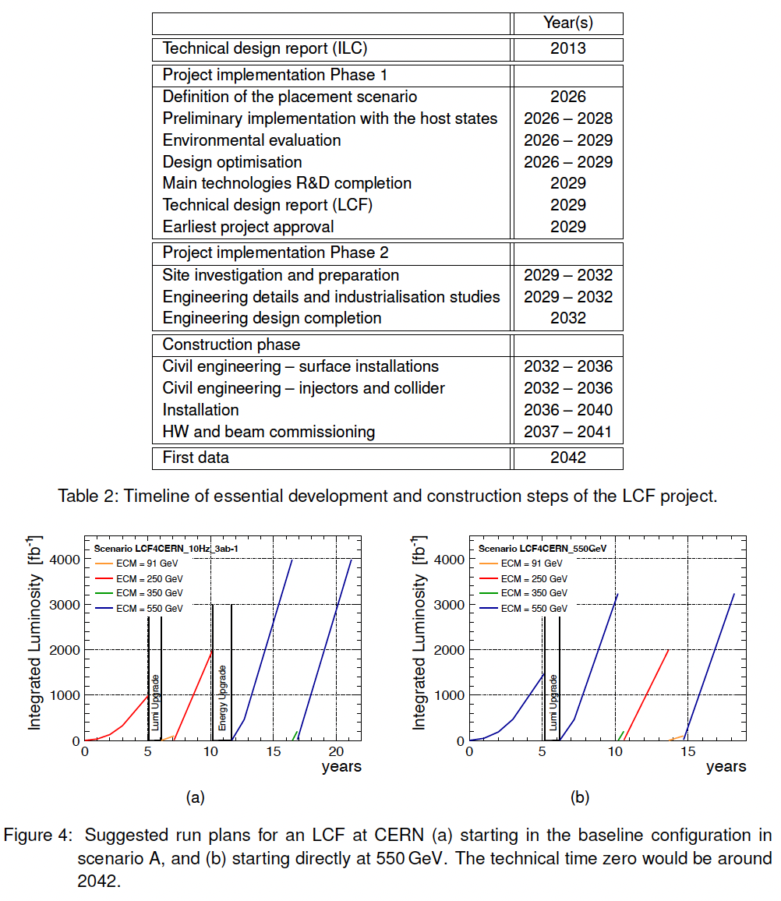
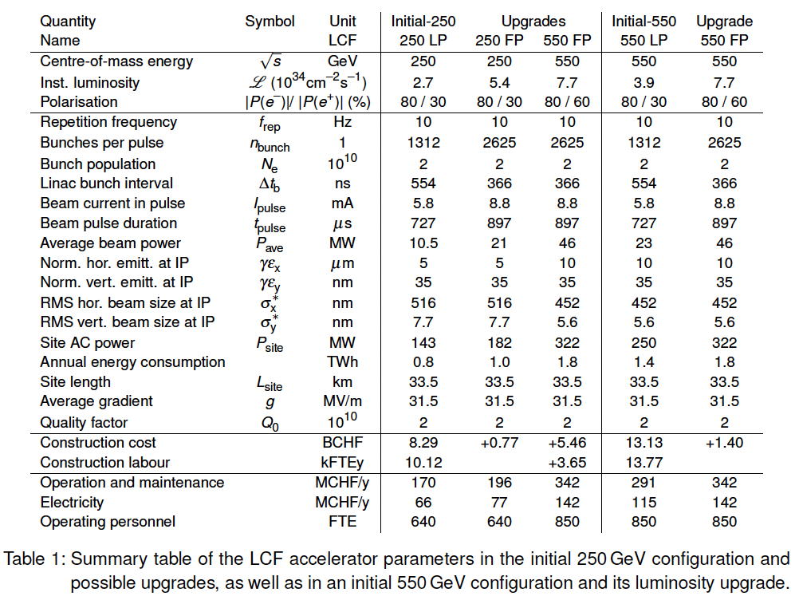
Timelines and parameters

Slide 10
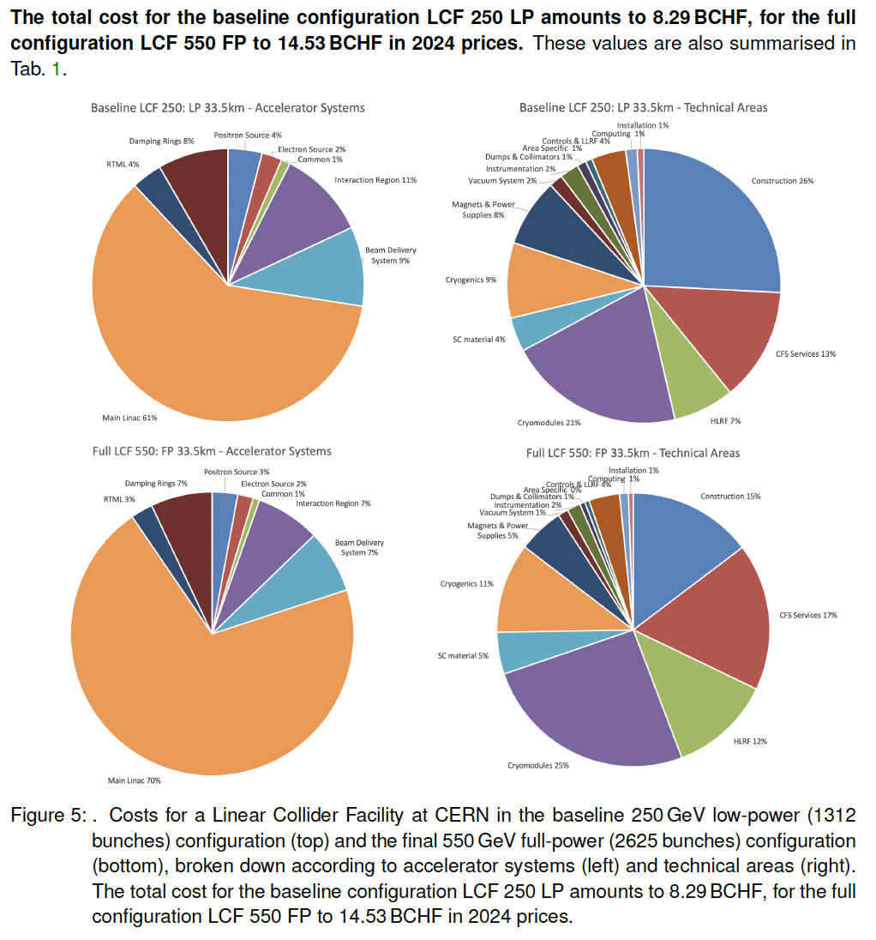
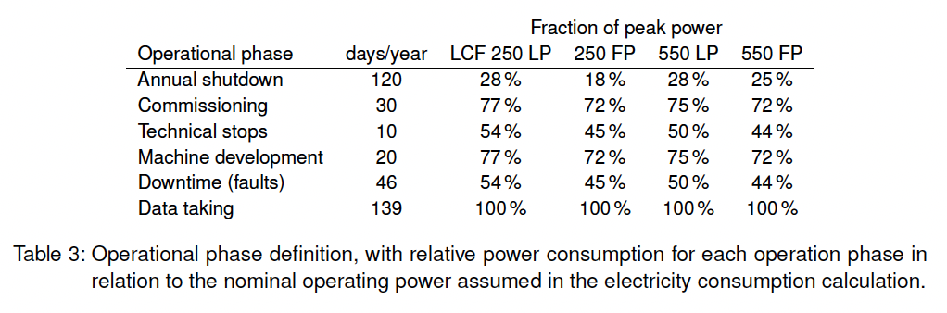
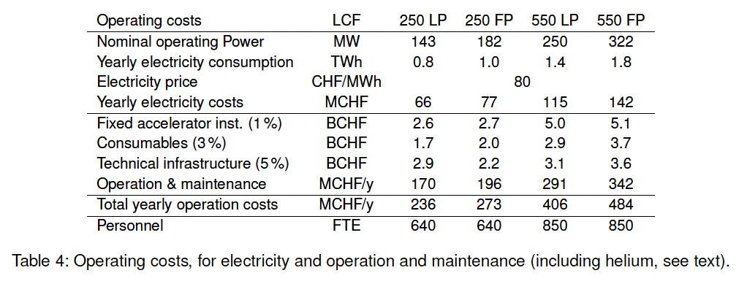
Costs

Slide 11
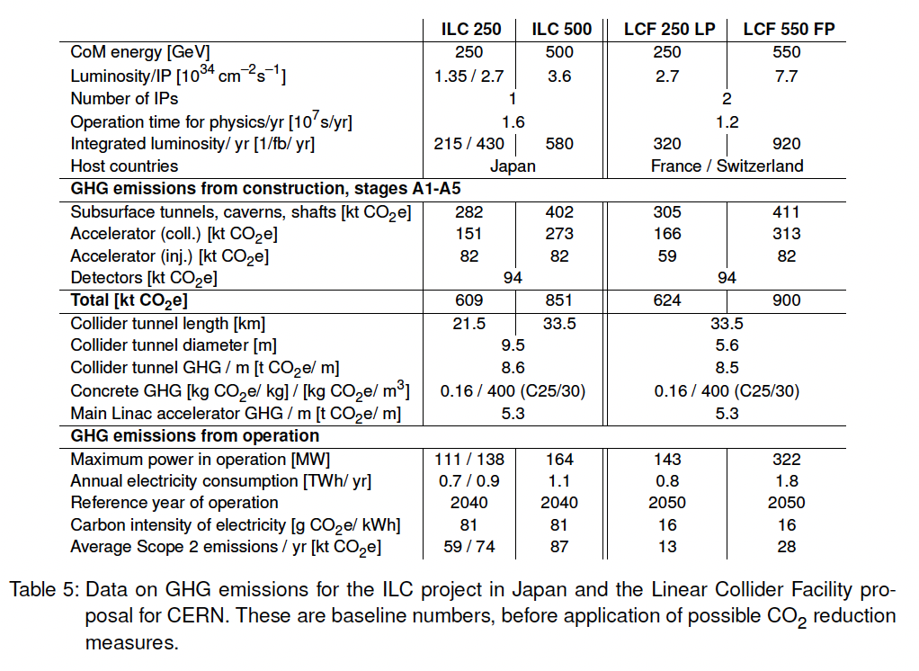
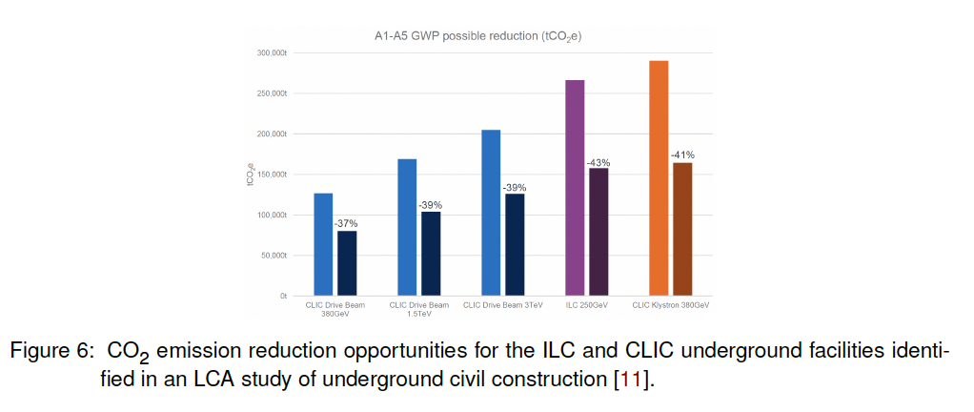
Sustainability
Greenhouse Gas emissions from construction and operation reported following new report from ARUP
(will be available on CERN EDMS soon:
https://edms.cern.ch/document/3283864/1 )

Slide 12
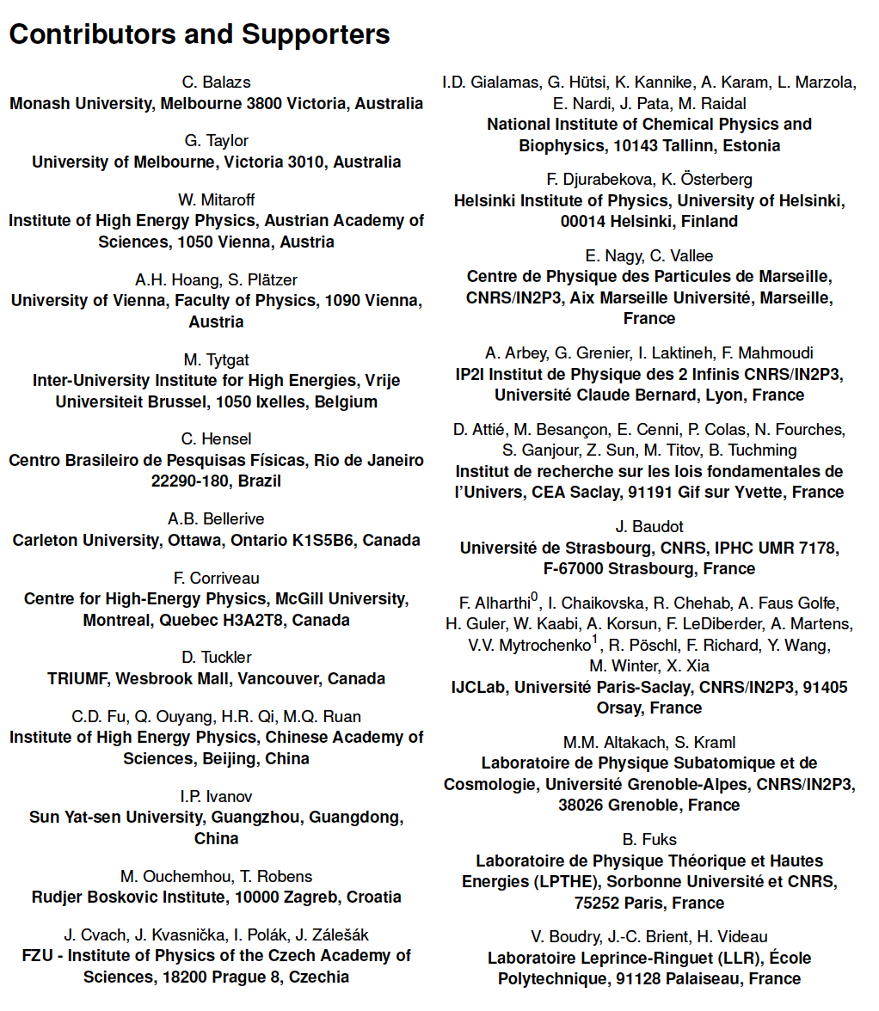
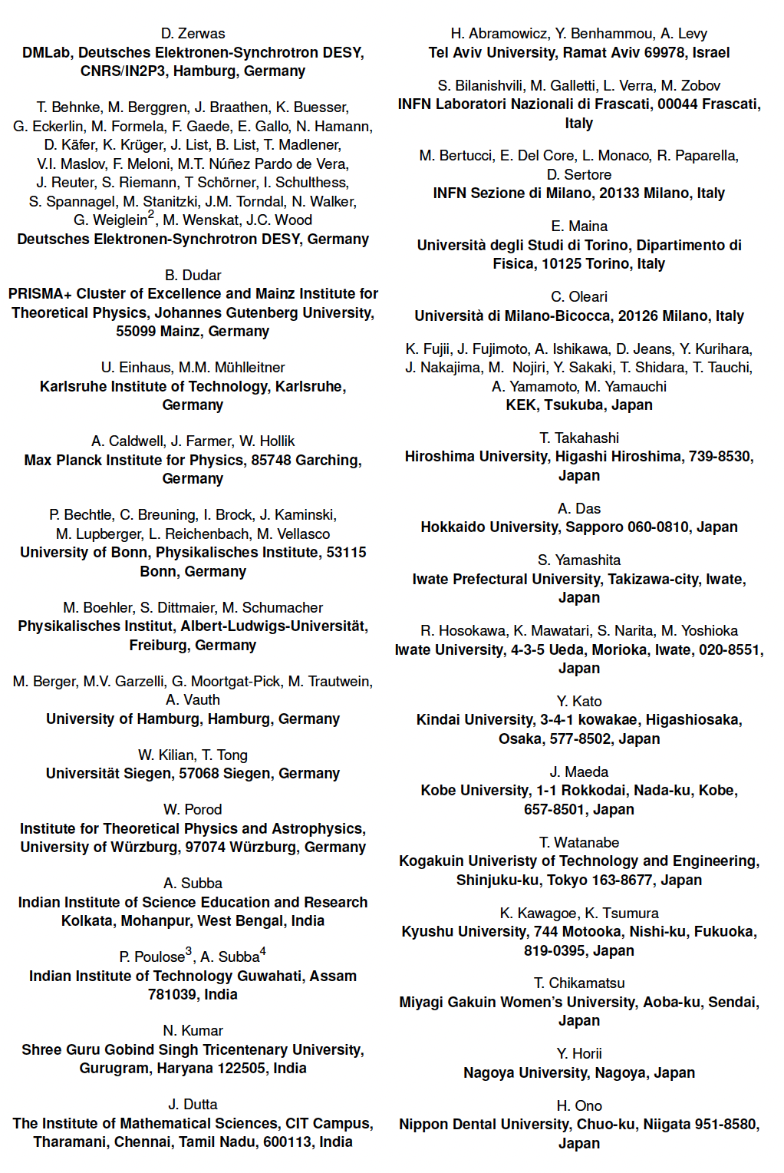
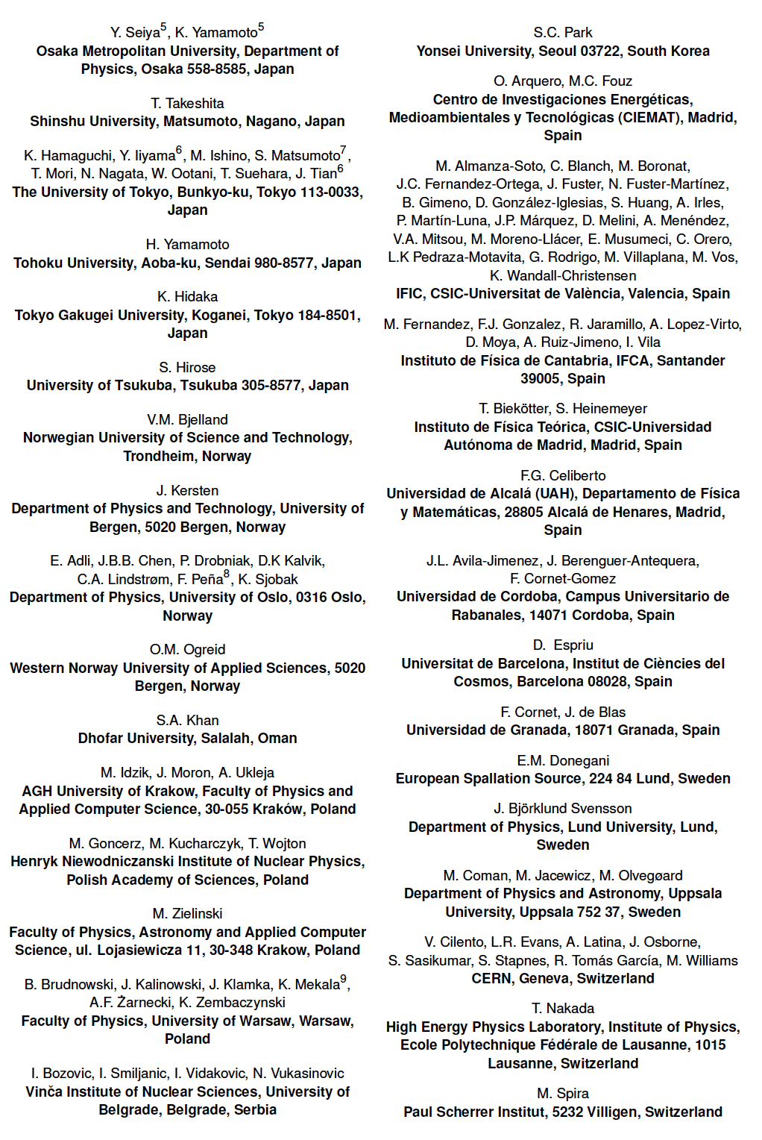
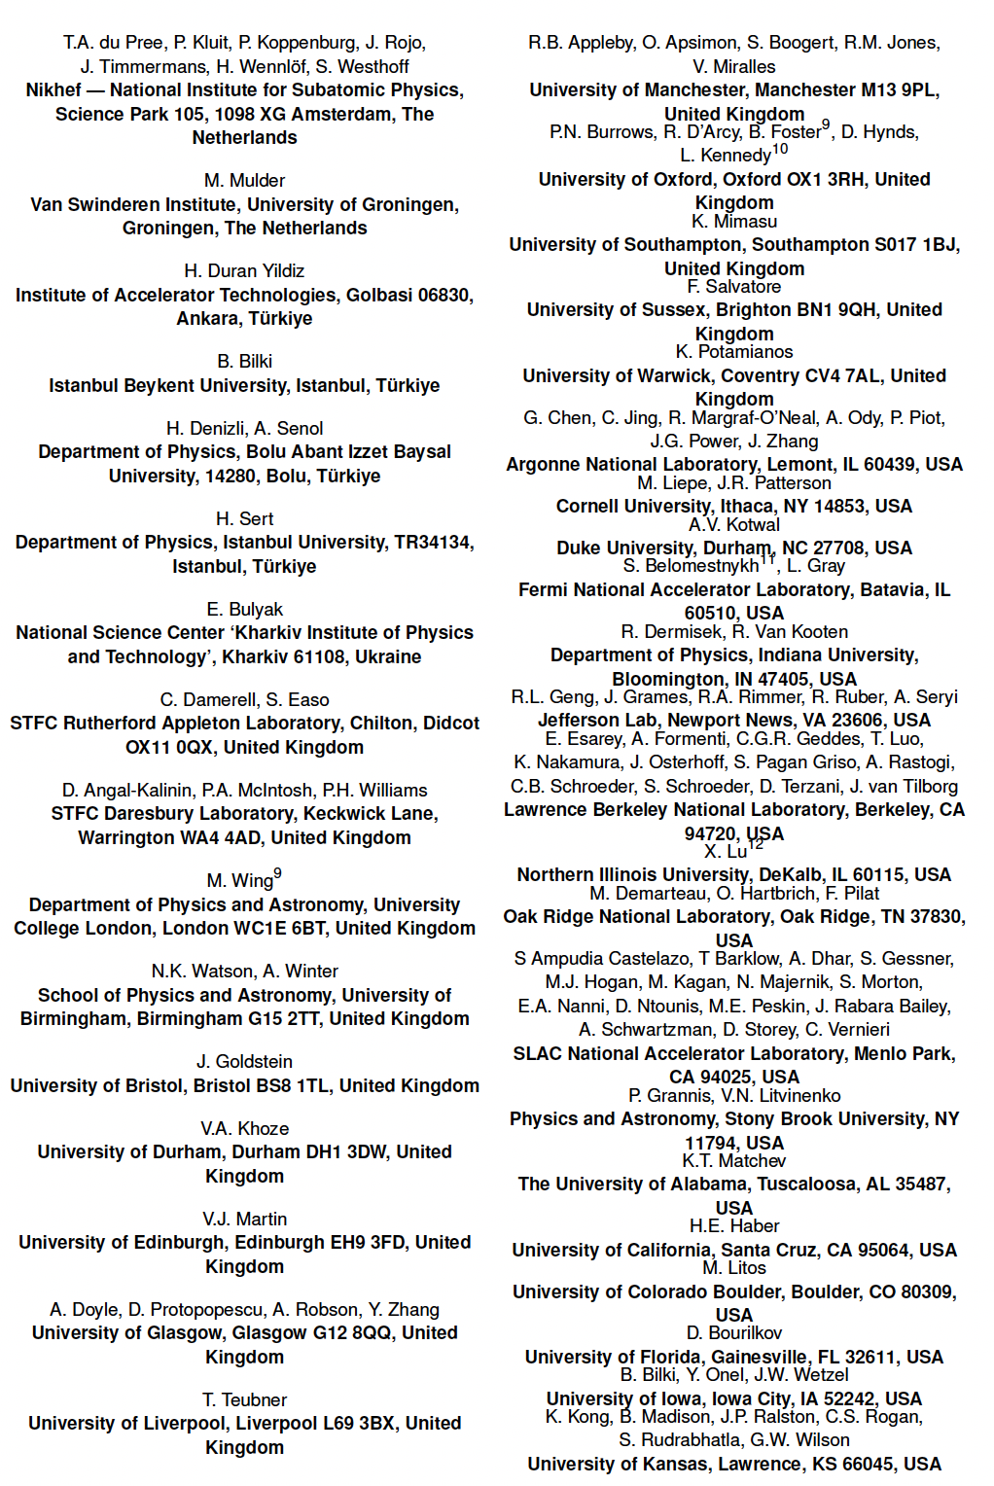
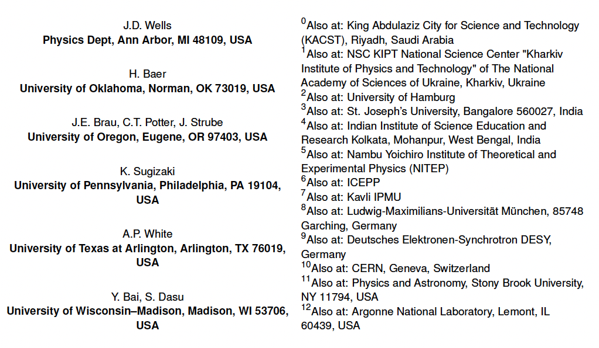
Supporter List
More than 400 supporters for LCF proposal
Supporter list will be updated from time to time on arXiv
Signature list:
https://www.ppe.gla.ac.uk/LC/LCVision/index.php?show=instadmin&skey=etUI1visTy25

