Slide 1
Comparison with LCWS2024 and present plan
H.Sakai
2025.7.3

Slide 2
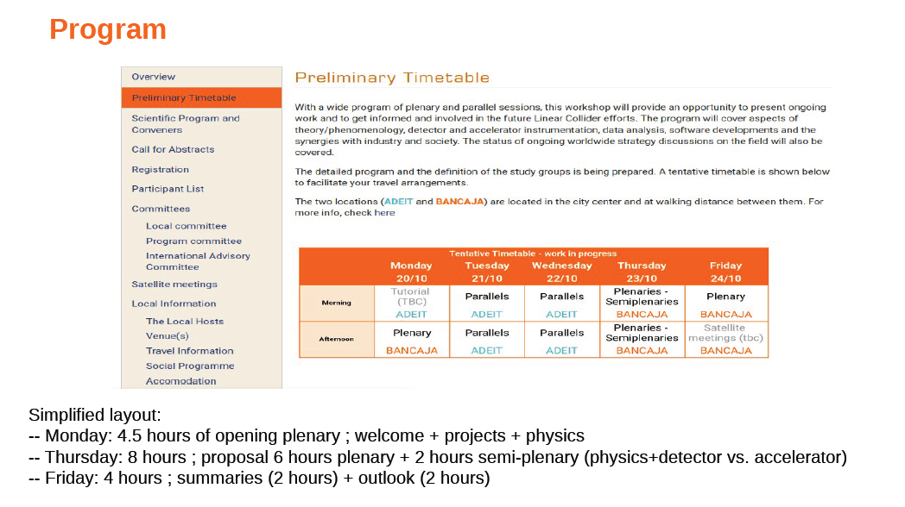
LCWS2025 all

Slide 3
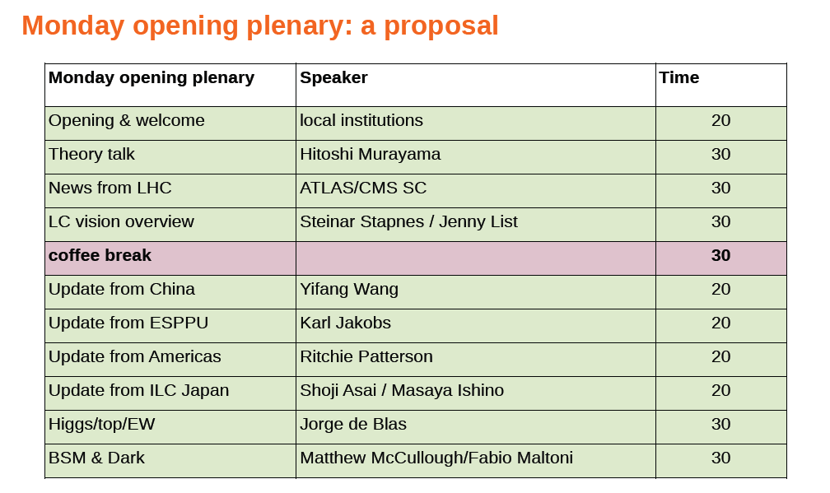
現状：LCWS2025 Mon Morning

Slide 4
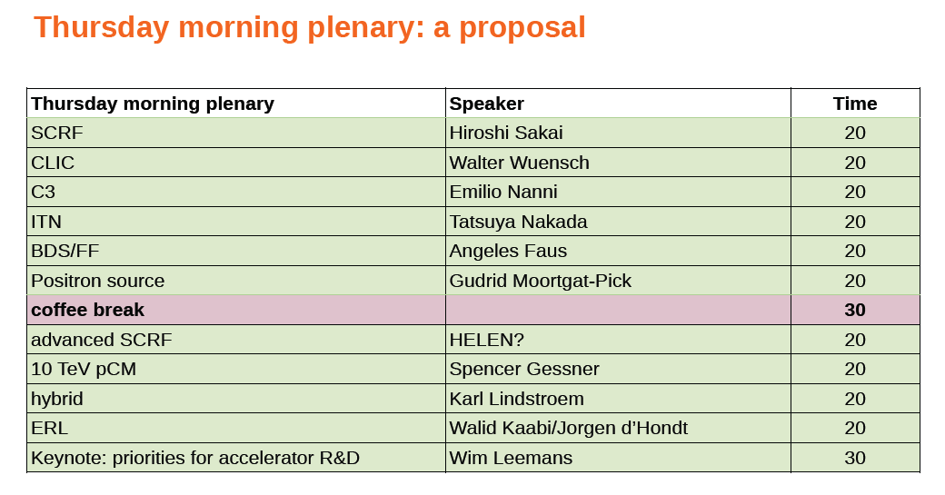
LCWS2025 Thu morning

Slide 5
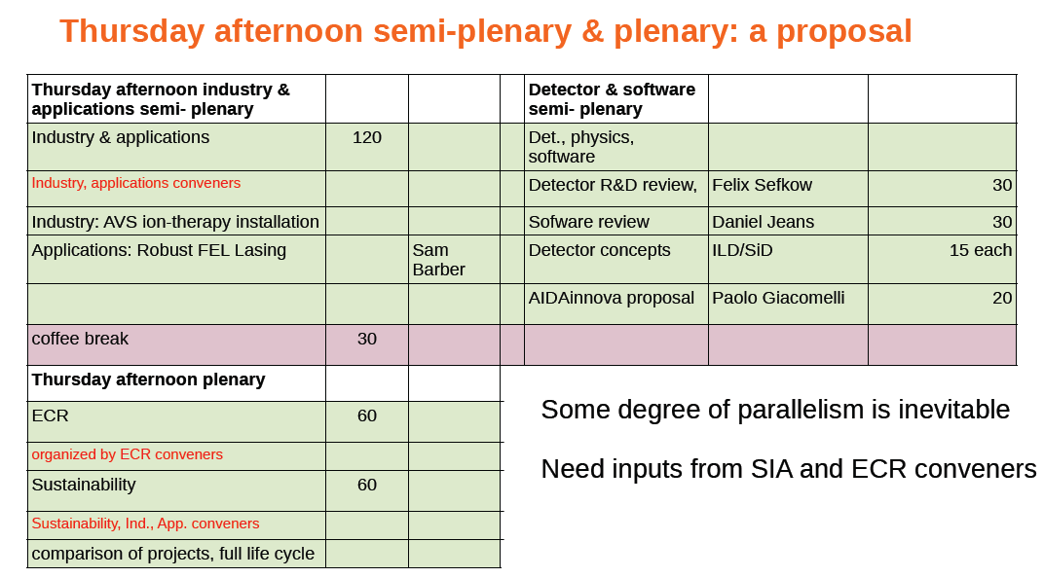
LCWS2025 Thu afternoon

Slide 6
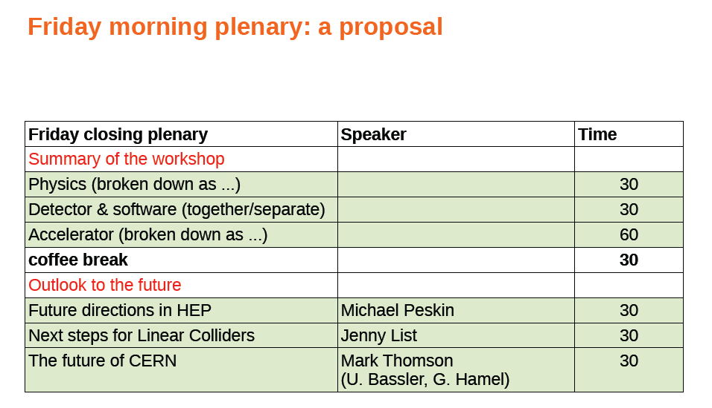
LCWS2025 Fri Morning (summary)

Slide 7
LCWS2024
Monday and Thursday are prenary
Only 4days

Slide 8
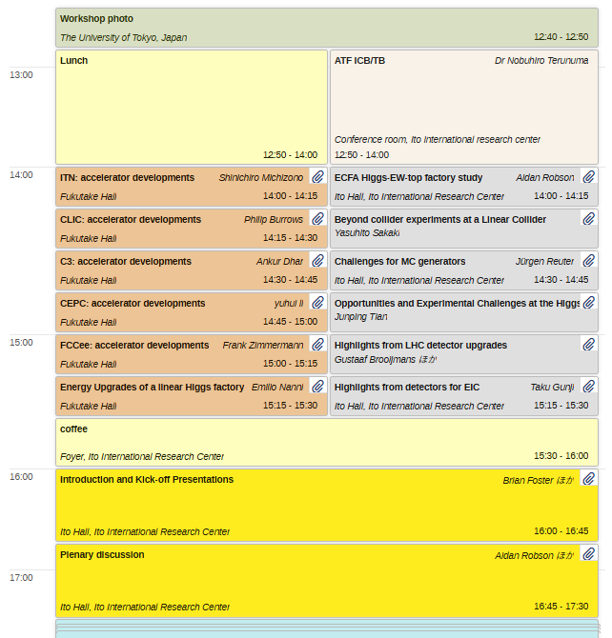
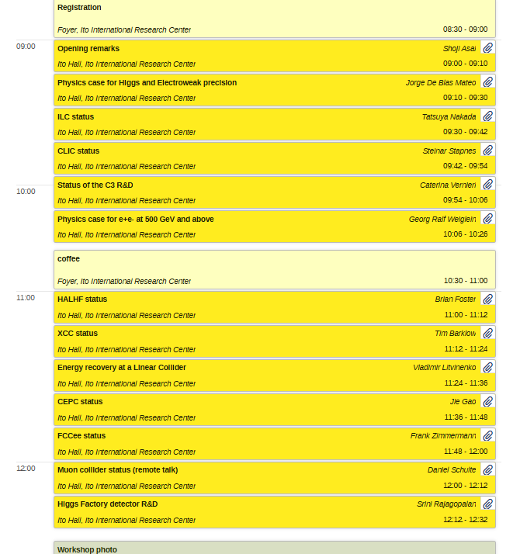
LCWS2024 Monday all

Slide 9
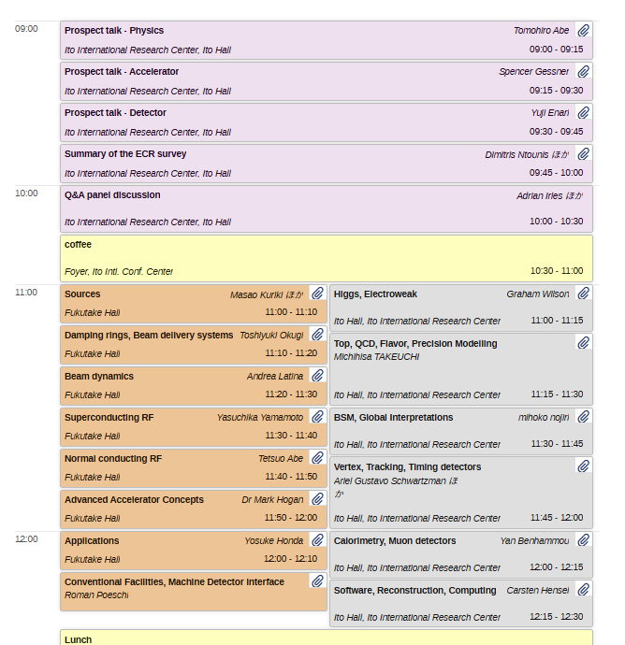
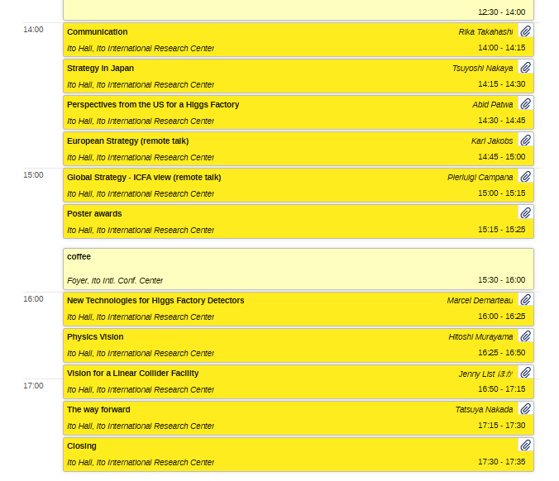
LCWS2024 Thursday all

Slide 10
Recommendation about Acc session

Slide 11
How to modify of LCWS2025
Refer to LCWS2024 afternoon
Project (first):
ITN: Michizono
SCRF including advanced : Sakai,
CLIC Walter
C3 : Emilio
HALHF : ??
Energy recovery : Walid
10 Tev pCM : Spencer
Pickup technology
BDS/FF : Angeles
Positron : Gudrid ?
Keynote: priorities for Accelerator R&D : ??
Do you need more ?

