Slide 1
ATF contribution to ITN
Hiroshi Sakai (KEK)
Contents
ILC technology Network (ITN)
ILC Accelerator
R&D of ILC Technology Network (ITN)
Worldwide ITN status
Others
Summary
This presentation is based on LCWS2025 presentation of
Steinar Stepnes, “A linear collider @ CERN“
Shin Michizono, “ILC Technology Network (ITN)”
https://agenda.linearcollider.org/event/10594/timetable/#20251020

Slide 2
ILC technology Network (ITN)
ILC Accelerator
R&D of ILC Technology Network (ITN)
Worldwide ITN status
Others
Summary

Slide 3
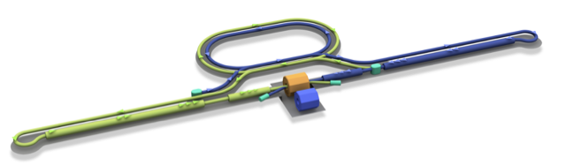
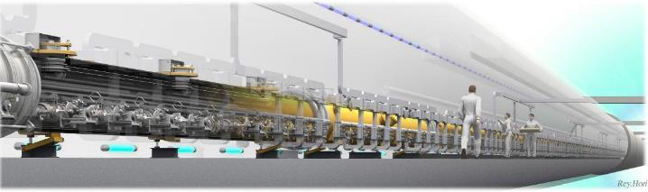

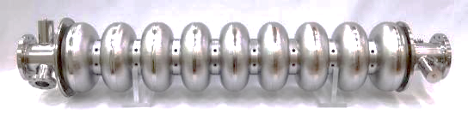
ILC and the Accelerator Technology
Damping Ring
e+ Source
e- Source
e- Main Linac
Interaction point
e+ Main Liinac
Detectors
Parameters | Value
Beam Energy | 125 + 125 GeV
Luminosity | 1.35 / 2.7 x 10³⁴ cm²/s
Beam rep. rate | 5 Hz
Pulse duration | 0.73 / 0.961 ms
# bunch / pulse | 1312 / 2625
Beam Current | 5.8 / 8.8 mA
Beam size (y) at FF | 7.7 nm
SRF Field gradient | < 31.5 > MV/m (+/-20%) Q₀ = 1x10¹⁰
#SRF 9-cell cavities (CM) | ~ 8,000 (~ 900)
AC-plug Power | 111 / 138 MW
e+
e-
Sources
Nano-Beam
SRF
3

Slide 4
Overview of linear collider
ILC technology Network (ITN)
ILC Accelerator
R&D of ILC Technology Network (ITN)
SRF
Sources
Nanobeam
Worldwide ITN status
Others
Summary

Slide 5
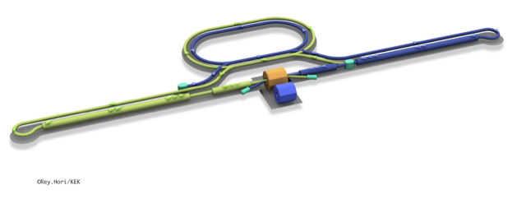
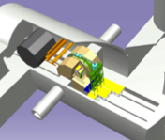
ILC Technology Network
Time-consuming and essential work packages for ILC are summarized as ILC Technology Network (ITN). (from 2023 ~4-year plan)
https://linearcollider.org/wp-content/uploads/2023/09/IDT-EB-2023-002.pdf
ILC Technology Network (ITN)
-- global collaboration program--
Acc. R&Ds focusing on
SRF
e- & e+ Sources
Nano-beam
Interaction point
Damping Ring
e+ Source
e- Source
e- Main Linac
Beam dump
Physics Detectors
SRF
WPP | 1 | Cavity production | Jp., Eu. ,Kr.
WPP | 2 | CM design | Jp., Eu. ,Kr.
WPP | 3 | Crab cavity
WPP | 4 | E- source
WPP | 6 | Undulator target | Ger.
WPP | 7 | Undulator focusing | Ger.
WPP | 8 | E-driven target | Jp.
WPP | 9 | E-driven focusing | Jp.
WPP | 10 | E-driven capture | Jp.
WPP | 11 | Target replacement | Jp.
WPP | 12 | DR System design | Jp. Kr., Au.
WPP | 14 | DR Injection/extraction | UK
WPP | 15 | Final focus | Jp., Eu., Kr.
WPP | 16 | Final doublet
WPP | 17 | Main dump | Jp.
e+ Main Liinac
Creating particles Sources
polarized elections / positrons
High quality beams Damping ring
Low emittance beams
Small beam size (small beam spread)
Parallel beam (small momentum spread)
Acceleration Main linac
superconducting radio frequency (SRF)
Getting them collided Final focus
nano-meter beams
Go to Beam dumps
e-, e+
Sources
ITN is useful not only for the ILC but also for various advanced accelerators.
Nano-
Beam

Slide 6
KEK’s efforts
Interaction point
Damping Ring
e+ Source
e- Source
e- Main Linac
Beam dump
Physics Detectors
e+ Main Liinac
KEK started the activity from April,2023.
WPP | 1 | Cavity production
WPP | 2 | CM design
WPP | 3 | Crab cavity
WPP | 4 | E- source
WPP | 6 | Undulator target
WPP | 7 | Undulator focusing
WPP | 8 | E-driven target
WPP | 9 | E-driven focusing
WPP | 10 | E-driven capture
WPP | 11 | Target replacement
WPP | 12 | DR System design
WPP | 14 | DR Injection/extraction
WPP | 15 | Final focus
WPP | 16 | Final doublet
WPP | 17 | Main dump
Collaboration with
Europe, Korea,
SRF
e-, e+
Sources
Experiences at SuperKEKB
MEXT development of key element technologies to improve the performance of future accelerators program
文科省補助金 将来加速器の性能向上に向けた重要素技術開発
advanced Accelerator element Technology Development (MEXT-ATD) funded by MEXT (7oku-yen(5M dollars)/year)
(2023-2027) -> important budget to operate ATF
Nano-
Beam
ATF collaboration

Slide 7
ILC Technology Network (ITN) since 2023
Global framework
Agreement: KEK and CERN
Agreement: KEK and Korean Univ.
US Labs. join
using Japan-US funding frame (2023-2025)
CERN, German, UK,
France, Italy, Spain
KEK, Korea,
Australia

Slide 8
Overview of linear collider
ILC technology Network (ITN)
ILC Accelerator
R&D of ILC Technology Network (ITN)
SRF
Sources
Nanobeam
Worldwide ITN status
Others
Summary

Slide 9
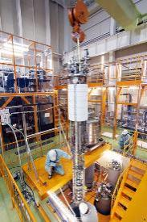
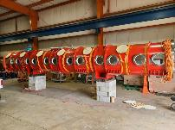
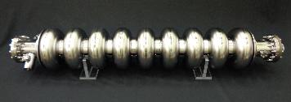

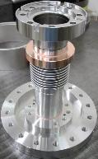
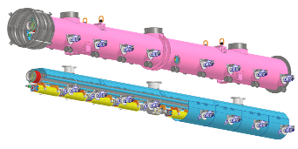
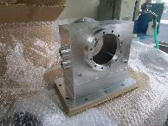
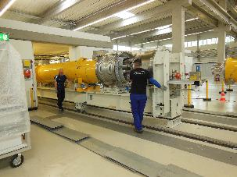
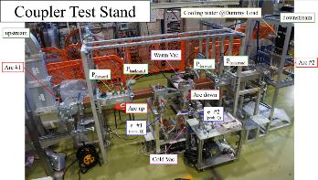
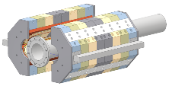
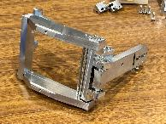
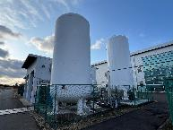
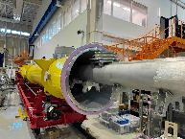
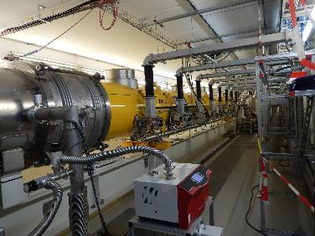
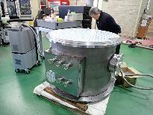
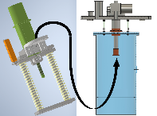
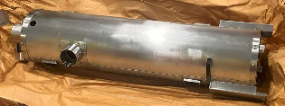
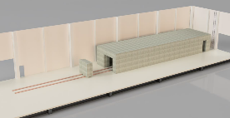
WPP-1/2 cavity fabrication & cryomodule (KEK plan)
Production
~2025
Component Test
2025/26
Installation
~2026
CM Test
~2027
L-band SC 9-cell cavity
Demagnetization of cryo-vessel
Vertical test for cavity
Waveguide assembly
Cryomodule assembly
Installation into bunker
Power coupler
High power test for coupler
SCQ magnet
Preparation
Frequency tuner
Cryogenic
CM assembly hall
Cold test at bunker
Conduction cooling system for SCQ
Cold test for motor
Magnetic shield
Radiation shield

Slide 10
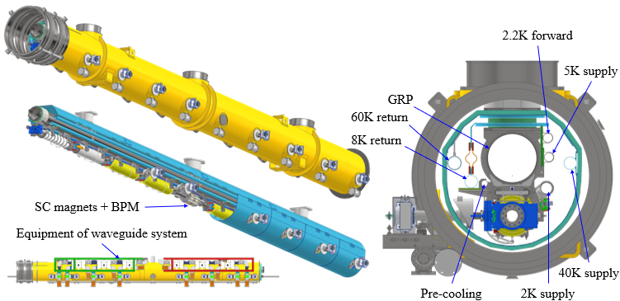
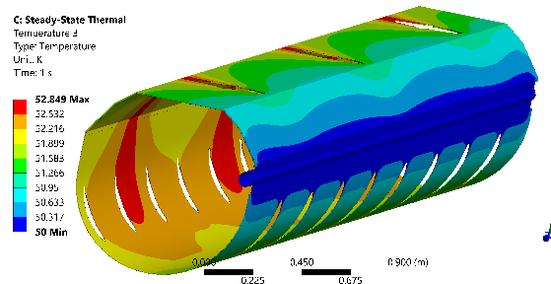
WPP-2 Cryomodule design in KEK
BPM design and test is important for this cryomodule → to be test in ATF
ILC “Type B” CM chosen (eight cavities + one SC magnet/BPM)
Single thermal shield @40K (5K dropped (t.b.d.))
Tuner access available
3D model completed
Heat load simulation done (dynamic under progress)
Waveguide support frame designed
Total cost for contract under estimation
Specifications
Type | B
Thermal shield | Single
Vacuum vessel length | 12,652 m
Vacuum vessel diameter | OD965mm, ID946mm
Coupler pitch distance | 1326.7 mm
Cavity length | 1247.4 mm
3D model of CM with waveguide system
Thermal analysis for 40K shield
A. Kumar
Takeshi Dohmae/Tomohiro Yamada/Takafumi Hara

Slide 11
Overview of linear collider
ILC technology Network (ITN)
ILC Accelerator
R&D of ILC Technology Network (ITN)
SRF
Sources
Nanobeam
Worldwide ITN status
Others
Summary

Slide 12
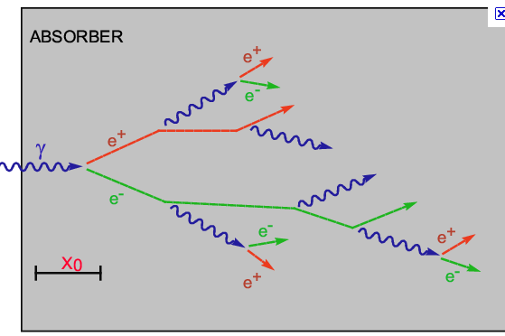
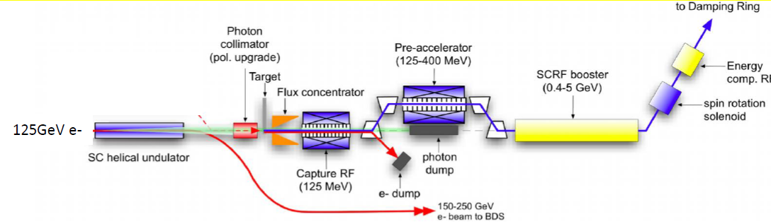
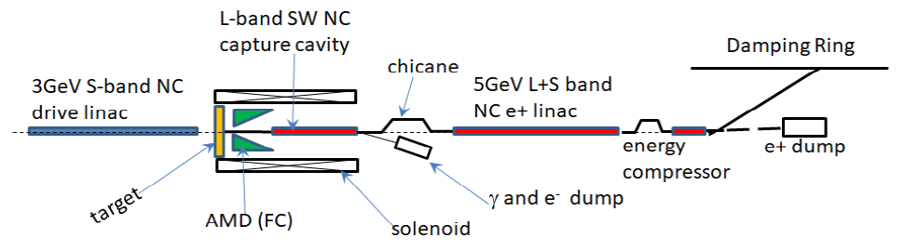
Undulator scheme and e-driven scheme positron source
Undulator method (baseline): 125 GeV electrons are passed through a helical undulator, and the produced gamma rays hit the target to produce electron-positron pairs. Polarized positrons (30%) are obtained. Need 125 GeV electron beam.
Developed in mainly EU.
Electron driven method：3GeV electrons hit the target to produce electron-positron pairs. High-energy electrons are not required, and the commissioning of the positron production is independent from electron beam commissioning.
Developed mainly in Japan.
Both needs strong target and sophisticated design of Flux concentrator and capture section (cavity and solenoid) → In KEK, prototype of positron source based on e-driven method start to develop.

Slide 13
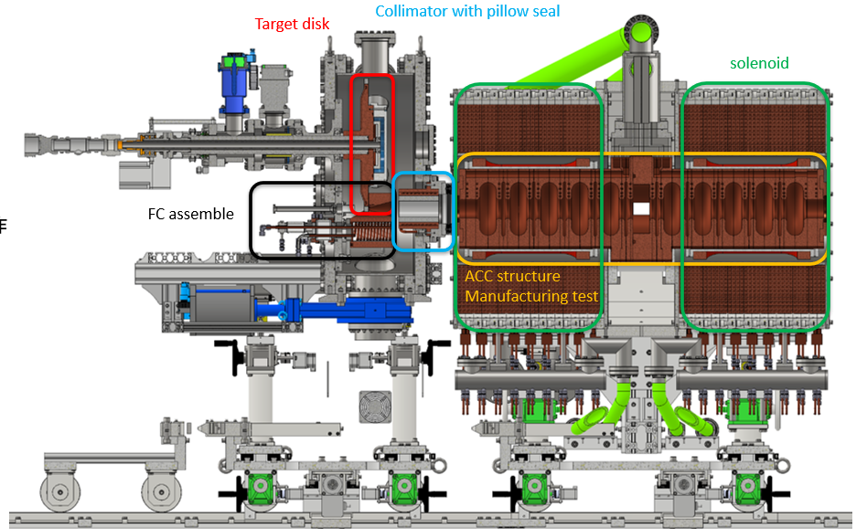
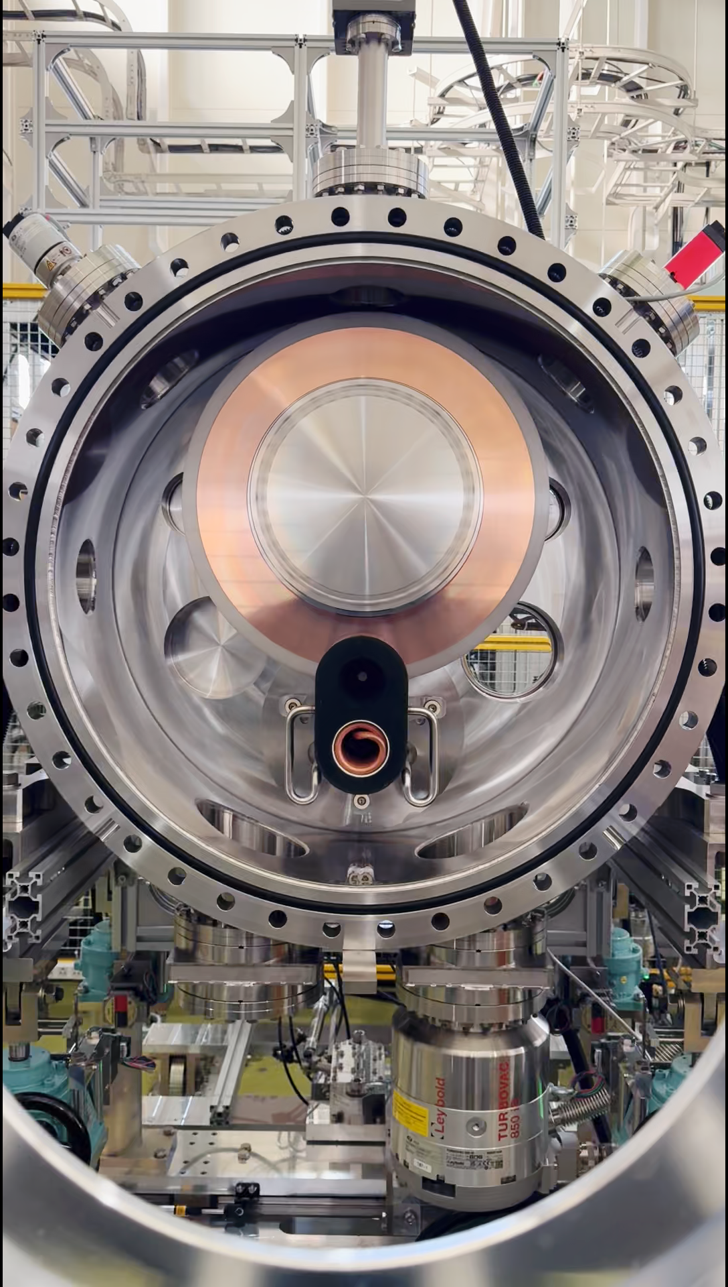
WPP-8/9/10: e-Driven positron source in KEK
Fabrication of Target disk (W-Cu)
Install Flux Concentrator (FC)
Fabrication of collimator with pillow seal
Fabrication of solenoid
Build these parts
Until FY2024
rotating target.
Flux concentrator
About 200 r p m
with water cooling.
Vacuum is around 10^-6 Pa level. (last year & this year)
The infrastructure for positron test stand was developed until JFY2024, including a cold fit test of the W-Cu target. From 2025, we will conduct the accelerator structure fabrication.
Movie
Stable rotating target was produced under good vacuum condition. → impressive progress for future e+e- colliders

Slide 14
Overview of linear collider
ILC technology Network (ITN)
ILC Accelerator
R&D of ILC Technology Network (ITN)
SRF
Sources
Nanobeam
Worldwide ITN status
Others
Summary

Slide 15





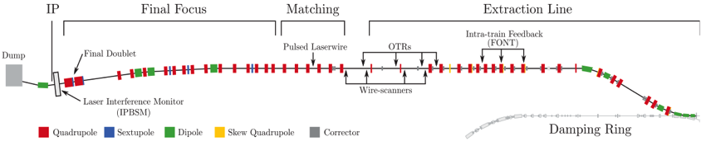
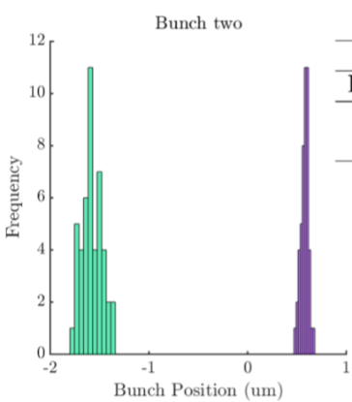
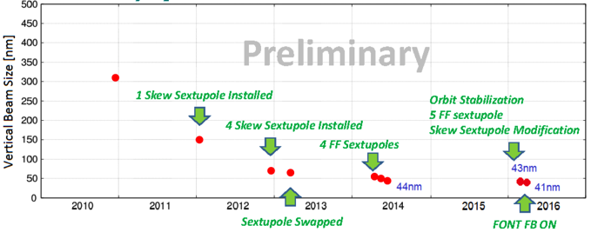
WPP-15: Final focus at ATF in KEK
Goal 1: Establish the ILC final focus method with same optics and comparable beamline tolerances
ATF2 Goal : 37 nm → ILC 7.7 nm (ILC250); achieved 41 nm (2016)
Goal 2: Develop the position stabilization for the ILC collision
FB latency 133 nsec achieved (target: < 366 nsec)
positon jitter at IP: 106 → 41 nm (2018) (limited by the BPM resolution)
Nano-meter stabilization at IP
(2018)
Long-term (a few days) stabilization is the goal of WPP-15
FB off
FB on
History of ATF2 small beam

Slide 16
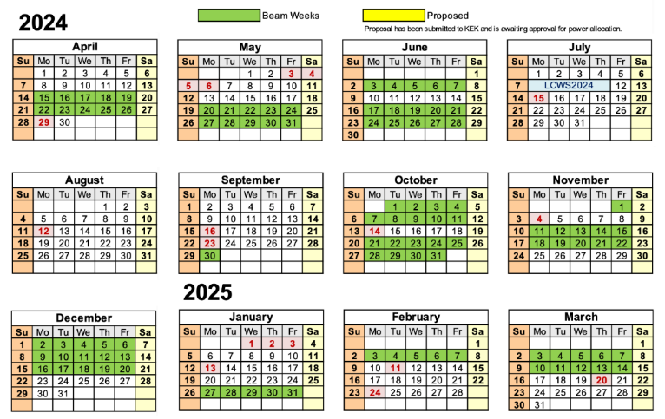
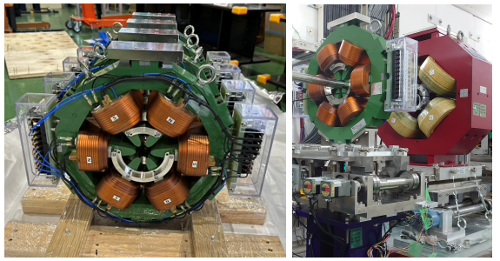
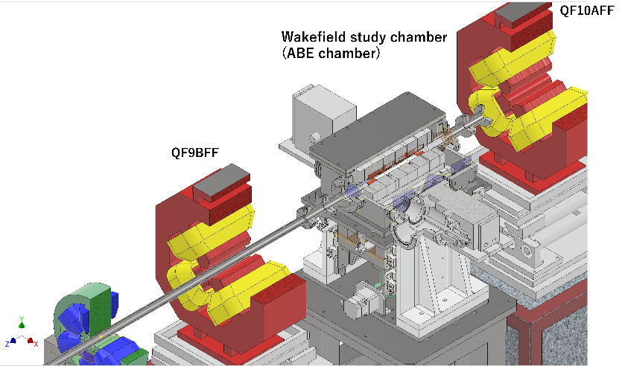
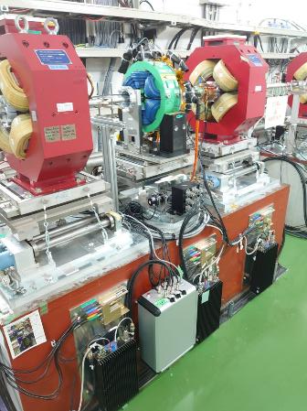
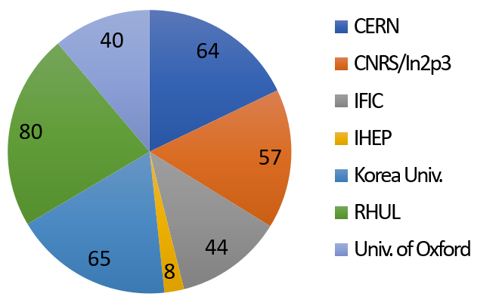
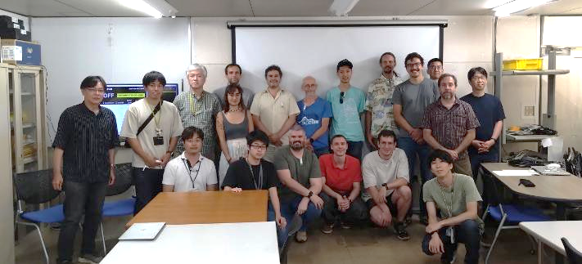
WPP-15: Final focus at ATF in KEK
Increased operating weeks to 20 weeks in JFY2024.
Wakefield evaluation
Skew Sextupole magnets
JFY2024
Install to ATF beamline step-by-step
Magnet mover control system
Details will be discussed in this project meeting
16

Slide 17
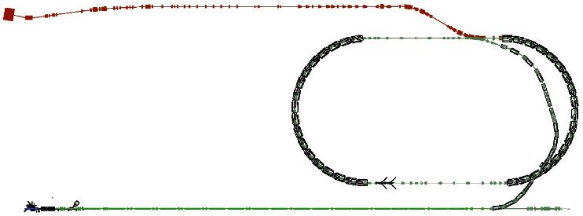
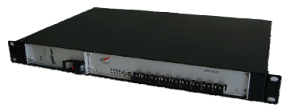
Five-Year Plan and Progress in midterm (nanobeam) (ATF)
under MEXT-ATD program → our mission
 | 2023 | 2024 | 2025 | 2026 | 2027
Nanobeam | Procurement of High-Order magnets Upgrade of beam operation and equipment | Reduction of wake field and higher order aberration Upgrade of beam operation and equipment | Precise measurement of nanobeam, Upgrade of beam operation and equipment | Improvement of beam turning method (incl. AI) Vertical beam size on IP <37nm | Improvement of beam turning method (incl. AI) Long-term stabilization of nanobeam (for a few days)
The first three years (FY2023-2025) will focus primarily on updating ATF equipment necessary for advancing the nanobeam. The subsequent two years will realize nanobeam generation and stabilization using the updated equipment.
The procurement of equipment, its installation on the beamline, and performance test of the installed equipment have proceeded on schedule until now.
Following picture is our progress of preparing items. Procurement of major equipment for the ATF2 beamline will be completed in JFY2025.
Upgrade focal magnet
（JFY2024 buy、JFY2025 install）
Upgrade Skew sextupole magnet for beam size adjustment (JFY2023 buy、JFY2024 install)
Development Extraction kicker（JFY2023 buy ceramic chamber、JFY2024 install ceramic chamber、JFY2025 test kicker）
(important message)
Next two years is very important to fulfill nanobeam generation (<37nm) and stabilization (for a few days)
(Mission of MEXT-ATD program (ATF operation budget come from this MEXT-ATD program)
Improvement of timing system（JFY2023 partially upgrade、JFY2024 upgrade completed）
Upgrade vacuum chamber to suppress wakefield （JFY2023 prototype、JFY2024 install）
Upgrade precise position control system of magnet（JFY2023 prototype、JFY2024 upgrade、JFY2025 upgrade all）
Upgrade beam size monitor in IP（JFY2024 Upgrade target, JFY2025 Buy Laser）
The current status is as planned.
ITN goal is same as our MEXT-ATD program

Slide 18
Overview of linear collider
ILC technology Network (ITN)
ILC Accelerator
R&D of ILC Technology Network (ITN)
SRF
Sources
Nanobeam
Worldwide ITN status
Others
Summary

Slide 19
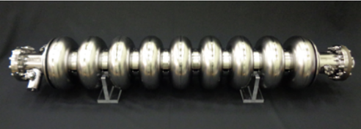
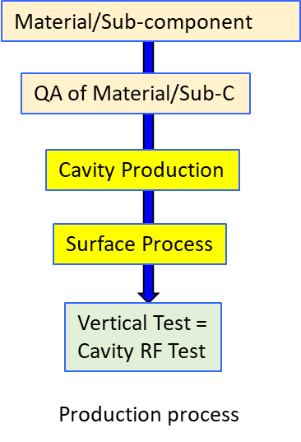
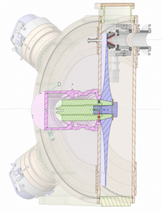
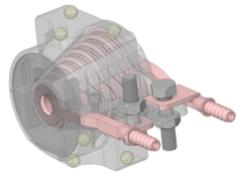
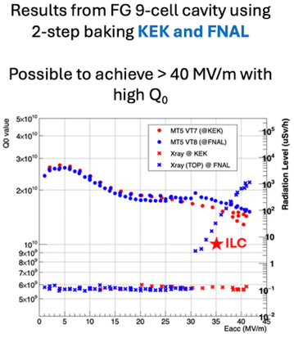
On-going technical studies in Europe – the ILC technology network topics
European ITN related studies (dedicated funding from Japan combined with European resources) are distributed over five main activity areas:
ML related tasks
SRF and ML elements: Cavities and Cryo Module,
Crab-cavities, ML quads and cold BPMs
Sources
Pulsed magnet and wheel/target for undulator scheme
Damping Ring including kickers
Low Emittance Rings
ATF activities, final focus and nanobeams
ATS and MDI
Implementation
CE, Cryogenics
Sustainability, Life Cycle Assessments
EAJADE (EU funding) for training of young scientists (linear and circular machines)
Studies in labs distributed across CERN, UK, Germany, France, Italy, Spain
See more details in the Venice presentation of Peter McIntosh (LINK)
and
Angeles Faus-Golfe on ATF2-3 (LINK)
Steinar Stapnes

Slide 20
Worldwide ITN activity
For WPP-1&2 (SRF cavity, CM), single cell cavity production in Korea/Europe started.
U. Hamburg is working for WPP-6/7 (undulator scheme).
JAI (UK) started WPP-14 (DR Injection/extraction, synergy with Diamond Light Source upgrade)
For WPP-15 (Final Focus System), European and Korean researchers have joined to the ATF experiments since 2023.
Important contribution to ITN from ATF
WPP-1/2 in Asia
WPP-1 in Europe
WPP-2 in Europe
The recent status will be reported at the ITN information meeting this week!
WPP-6 in Europe
WPP-7 in Europe
WPP-8 in Japan
WPP-9 in Japan
WPP-10 in Japan
WPP-11 in Japan
WPP-14 in Europe
WPP-15 (ATF in KEK)
WPP-17 in Japan

Slide 21
Overview of linear collider
ILC technology Network (ITN)
ILC Accelerator
R&D of ILC Technology Network (ITN)
SRF
Sources
Nanobeam
Worldwide ITN status
Others (Application & KEK-CERN collaboration)
Summary

Slide 22
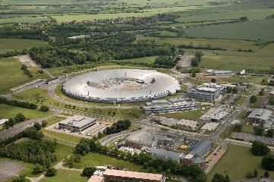
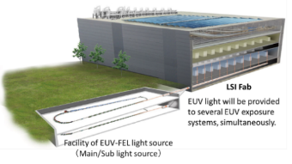
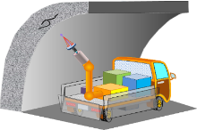
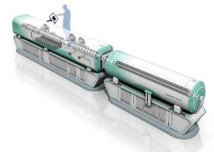
Advanced Accelerator Development through ITN
ITN WPs can be applied not only to ILC but also to a wide range of advanced accelerators
① SRF
Superior energy efficiency has been demonstrated and is expected to be deployed in a wide range of applications (such as semiconductor lithography, compact accelerator for medical/industrial applications)
② Source (especially positron source)
High-intensity positron sources will be required for future collider accelerators (circular colliders such as FCCee and CEPC, linear colliders such as ILC and CLIC, muon colliders (LEMMA), etc.).
Positrons are also useful for exploring physical properties, and high-intensity, slow-positrons are expected for surface structure analysis.
Positron source targets and beam dumps are also closely related to targets for neutron generation and beam irradiation targets used in industrial/medical applications.
③ Nanobeam
Nano-beam technology can be applied to new-generation synchrotron radiation facilities, etc..
Advanced beam tuning techniques such as machine learning can be applied to a wide range of accelerators.
We want to express our nanobeam technology to other application.
Do you have some other idea except for the following items ?
Extreme ultraviolet (EUV) lithography based on ERL technology
Determination of atomic arrangement using slow positrons
https://www.kek.jp/ja/newsroom/attic/PR20191114.pdf
Mobile accelerator
Synergy about new-generation light source (ex. Diamond Light source)
Compact accelerator

Slide 23
Overview of linear collider
ILC technology Network (ITN)
ILC Accelerator
R&D of ILC Technology Network (ITN)
SRF
Sources
Nanobeam
Worldwide ITN status
Others
Summary

Slide 24
Summary
Linear colliders such as ILC, LCF and CLIC are promising to realize higher CM energy than 350 GeV.
ILC is a global project to realize 250 GeV CM by using SRF technology.
Current ILC global organization is ILC International Development Team (IDT) .
The ILC key technologies are “SRF”, “Sources” and “Nano-beam”, which are carried out through “ILC Technology Network” (ITN) by IDT.
KEK obtained a budget for these R&Ds and started the activity from April,2023.
Worldwide ITN activities - the European part - is well underway (ref page 25).
ITN WPs (SRF, Sources and Nano-beam) can be applied to various advanced accelerators (and industry/medical).
Future development of LCF at CERN strongly linked to the ITN technical WPs
(Now we are summarizing “ITN midterm report”.)

Slide 25
Thank you for your attention

Slide 26
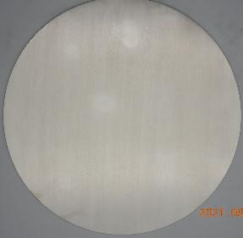




Manufacture methods of Fine-Grain / Medium-Grain Nb discs
Fine Grain Nb fabrication
Nb melting
FG Nb
Nb Ingot
Forging
Rolling
Fine Grain (FG) Disc
Grain Size: 50 - 100 um
Aiming for clean, mechanically stable, and cost-effective SRF cavity production.
Direct slice of MG ingot
Ingot
MG Nb
Niobium ingot
(Raw material)
Ingot, forged
and annealed
Slicing image by wire-saw
A New Approach:
Medium Grain (MG) Disc
Grain Size < 1 mm

Slide 27






WPP-1 cavity fabrication by KEK
Three 9-cell cavity produced
Six 9-cell cavities are under production
The world’s first MG cavity!
Six 1-cell cavities produced
Large/Small EBW machines
New cryopump replaced
These cavities are made by RI!
(for the first time at KEK)
Cavity Fabrication Facility
Large EBW
Small EBW
Chemical polish
Press machine
3D measurement device
Categories related to HPGS
Takayuki Saeki/Takeshi Dohmae

Slide 28









Surface treatment recipe at KEK
Based on the results of past R&D, we chose 2-step baking for this project.
VT for six 1-cell cavities was successfully done, 9-cell cavities will start from next year.
KEK’s recipe
Heat treatment
Cold EP
Baking
VT
Kensei Umemori/Ryo Katayama
All cavities passed the spec. ±20%!

