Slide 1
KEKATF251127ENakamura.pptx
ATF project meeting : E. Nakamura (KEK acc iCASA) on Nov. 27th 2025.
Kicker systems for ATF
Various types of kicker magnets,
ATF operation : timing/ bunch gap/ kicker field rise&fall&flattop,
Two tasks: [A] to prepare a spare; [B] to develop a new concept kicker system,
Progress for preparation and
Attempts for suppression of transverse emittance growth.
Notes:
Ns-kicker is most attractive especially for for the ILC project, and many groups have attempted to develop the ns-kicker system.

Slide 2
Various kicker magnets for high-energy particle accelerators
KEKATF251127ENakamura.pptx
Cyclotron
DA IJK
For Injection / Extraction / Selection
ES-ring
Static Kicker
KEKB Injection by SK
KEKB DK, J-PARC MR DK
Matched: ATF, KEK-PS BK, MR IJK, JPARC MR IJK, KEK-PF IJK, Strip-line
Reflection: KEK-PS MR FXK, J-PARC RCS, MR IJK
No-Yoke Magnet
KUFFAG MR EXT
(multi-turn coil)
Super short pulse Kicker
ns-Kicker for ILC
NIM-A 624 (2010) 554–559
Notes:
Overview of kicker types which are used in high-energy particle accelerators.
Ns-kicker is most attractive especially for for the ILC project, and many groups have attempted to develop the ns-kicker system.

Slide 3
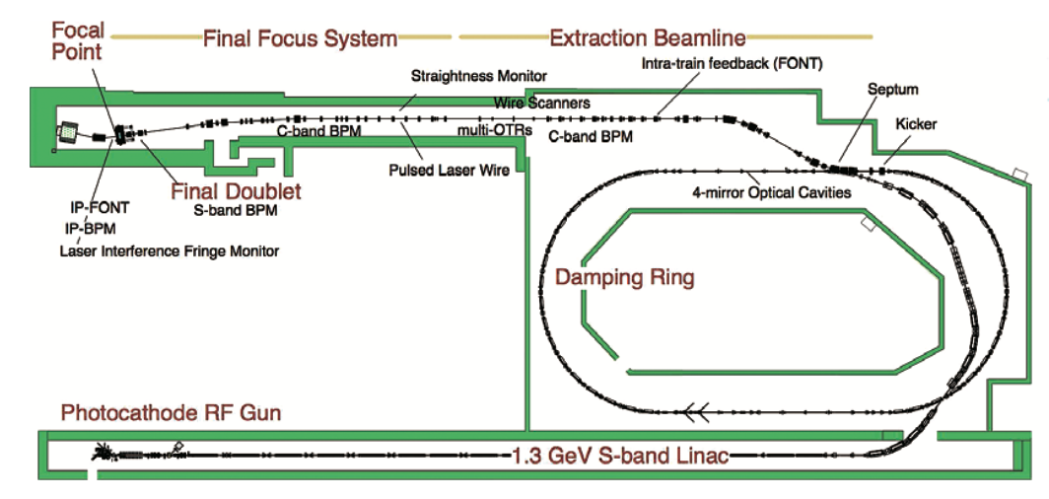
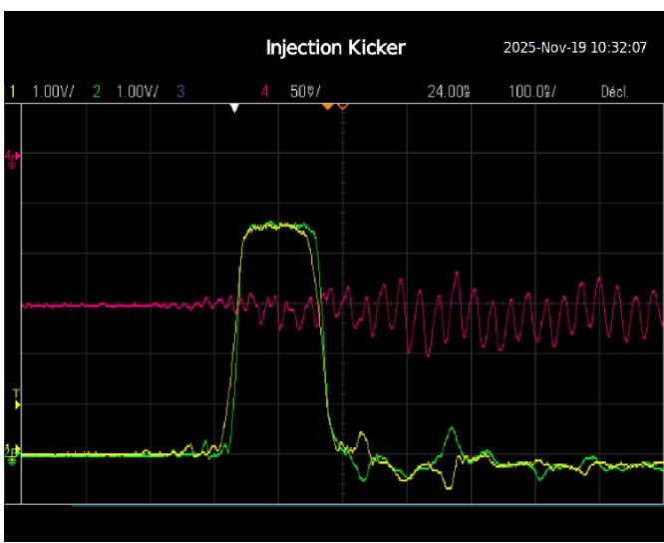
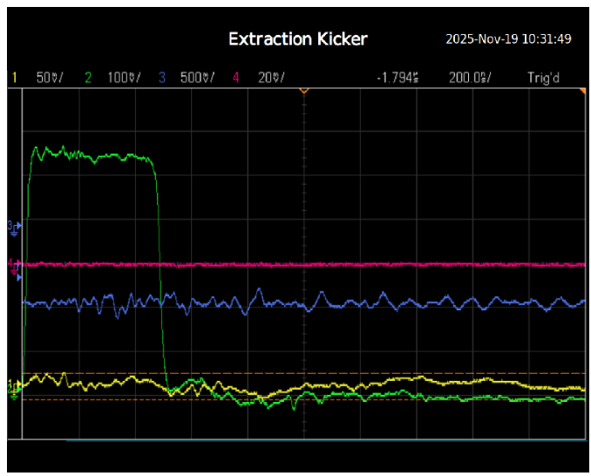
Bunch spacing in time in the ATF accelerator.
KEKATF251127ENakamura.pptx
Injection
1.3 GeV electron
γ = 2545 ; Bρ = 4.338 Tm
C_DR = 138.6 m ; T = 462.3 ns
f = 3.125 Hz (0.32s cycle)
f_RF_LINAC = 2.856 GHz
---
5mrad for 0.31m magnet ~ 0.070 T
1.28 kAt is required for a gap height of 23mm.
Extraction
Max. 3 trains x 10 bunches/train = 30 bunches.
Bunch time gap is 150ns.
450ns bunch spacing for a single-bunch operation.
EXK
IJK
IJK
EXK
462.3ns
100ns/div.
200ns/div.
Slow-rise kicker with 450ns is applicable for a single bunch extraction.
Notes:
It is most important to know the bunch gap when we think or design kicker systems. Maximum number of bunches is 30 in 3 trains, so bunch gap is 150ns. For these five year, single bunch experiment is most operation case so, slow rise kicker system would be useful with a rise of 450ns. Single-bunch operation is applied for almost beam studies for these recent five years. In such an operation, slow-rise kicker can be applied with a rise of 450ns. Supposing some serious trouble in the working kicker system, the recovering time would be very long, years, but slow-rise kicker system can be applied soon, if limited to a single-bunch operation. It is easier to assemble slow-kicker magnet.

Slide 4
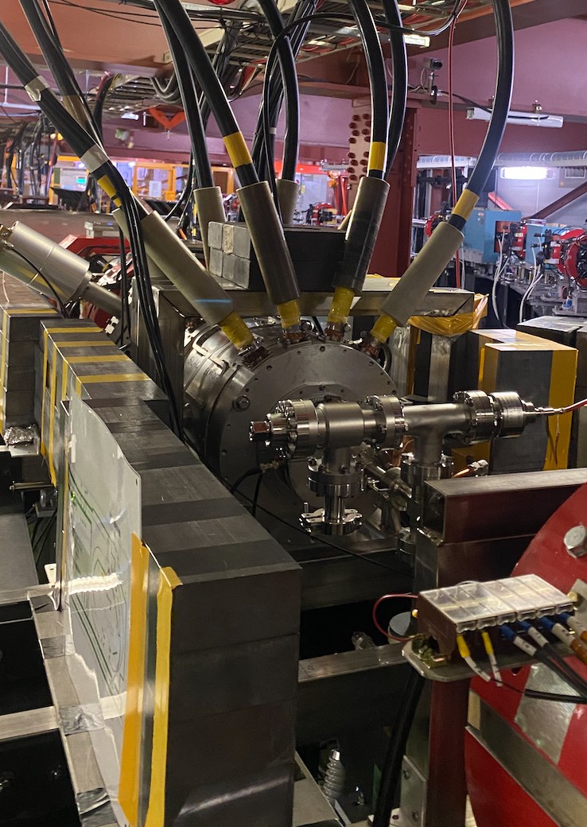
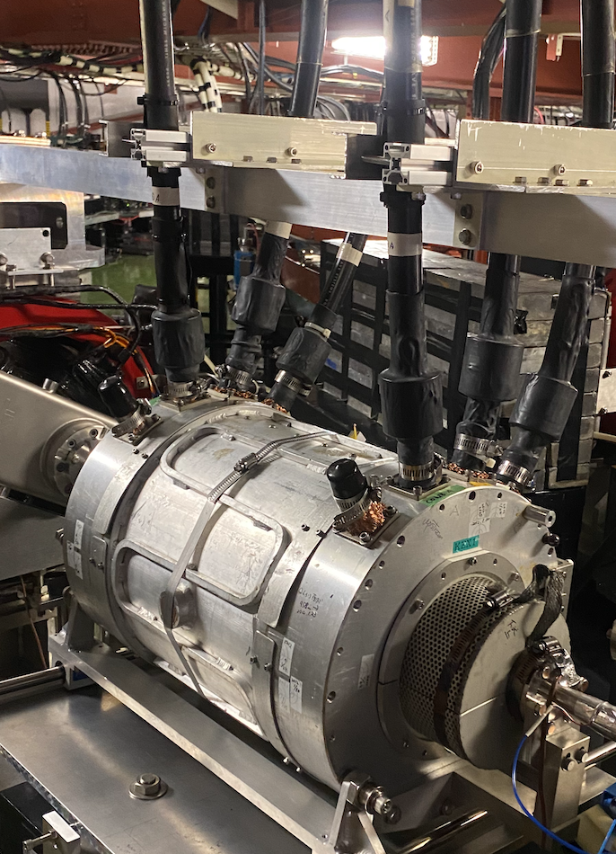
My two tasks in the ATF project
[A] To prepare a spare kicker magnet system at a low cost and as soon as possible.
It is expensive to produce a kicker system with same performance for the ATF project.
~ Existing three kicker magnets made by SLAC long ago. ~
KEKATF251127ENakamura.pptx
IJK
Parameters | ATF-Inj. (IJK) | ATF-Ext. (EXK) and Spare magnet | Slow-rise Extraction Kicker (SREK)
*** Required ***
θ (mrad.) | 5 | 5 | 5
Rise time (ns) | < 60 | < 60 | < 450
Fall time (ns) | < 60 | (none: <0.1s) | (none: <0.1s)
Flattop (ns) | 60 | > 310 | (for single-bunch)
*** Devices ***
Vf/If (kV/kA) = Z0 | 12.5 | 16.7 | 25
V_charging (kV) : Max./Operated. | 70/55 | 70/55 | 30/30
Magnet type | Distributed | (same as IJK) | Lumped (L//C)
Number of excitation coil | 1 | (same as IJK) | 3 / 4
Gap height (mm) | 23 | (same as IJK) | 30
Magnet length (mm) Effective / Mechanical | 310 / 450 | (same as IJK) | 0.23
Required magnetic flux density (T) | 0.070 | (same as IJK) | 0.100
Required excitation current (kAt) | 1.28 | (same as IJK) | 3.0 / 4.0
4.6 x L/Z0/2 |  |  | 230ns / 425ns (4nF/6nF)
EXK
[B] Development of new kicker concepts: (under selection; you can apply if you have a noble idea).
Saturation kicker developed by KAKENHI for suppression of the transverse emittance growth.
…
Notes:
There are three kicker magnets and two power supplies among which two systems are working for injection into and extraction from the damping ring. The performance of those systems are excellent, but were old produced long time ago thirty years? By SLAC. There are some minor defects such as a slow-leakage of insulation oil from Thyratron housing. It is not easy to repair due to a specific structure in designing level. I think that it is important to prepare one more kicker system as soon as possible. It is best to produce a kicker magnet with a same performance as the working kickers, but it would be very expensive for the ATF project, and I guess that it takes two years for production at least.
There are some candidates and also you can apply if you have noble idea. I plan the suppression trial of transverse emittance by using a kicker magnet system in which the return yoke is operated around saturation.

Slide 5
KEKATF251127ENakamura.pptx
Current status and schedule
1st trial : Preparation of a spare magnet which is able to operate a single-bunch operation, a slow kicker system (SKS).
Almost all devices are ready except for a magnet. Beam experiment with a small kick by using a temporal dummy magnet has been conducted successfully.
JFY2026: Beam trial by a simple Lumped kicker magnet will be scheduled.
---
2nd trial for new concept will
be scheduled in JFY2027.
JFY2023~
Fundamental Designs
(continued)
Structure of main kicker magnets
Complicated structure like bellows works earth plates for formation of capacitance for LC-ladder against high-voltage coil. Some dielectric materials such as polyethylene are immersed.
JFY2024~
Preparation of devices/materials
(continued)
JFY2024~
Preliminary test of Power supply
completed
JFY2024
Installation of new ceramic chamber
completed
JFY2025
Preliminary beam test using dummy coil
completed
JFY2025~
Assemble and Install 1st magnet
Beam study
JFY2026~
Assemble and Install 2nd magnet
Beam study
Notes:
It is best to produce a kicker magnet with a same performance as the working kickers, but it is very expensive for the ATF project.
There are some candidates and also you can apply if you have noble idea. I plan the suppression trial of transverse emittance by using a kicker magnet system in which the return yoke is operated around saturation.

Slide 6
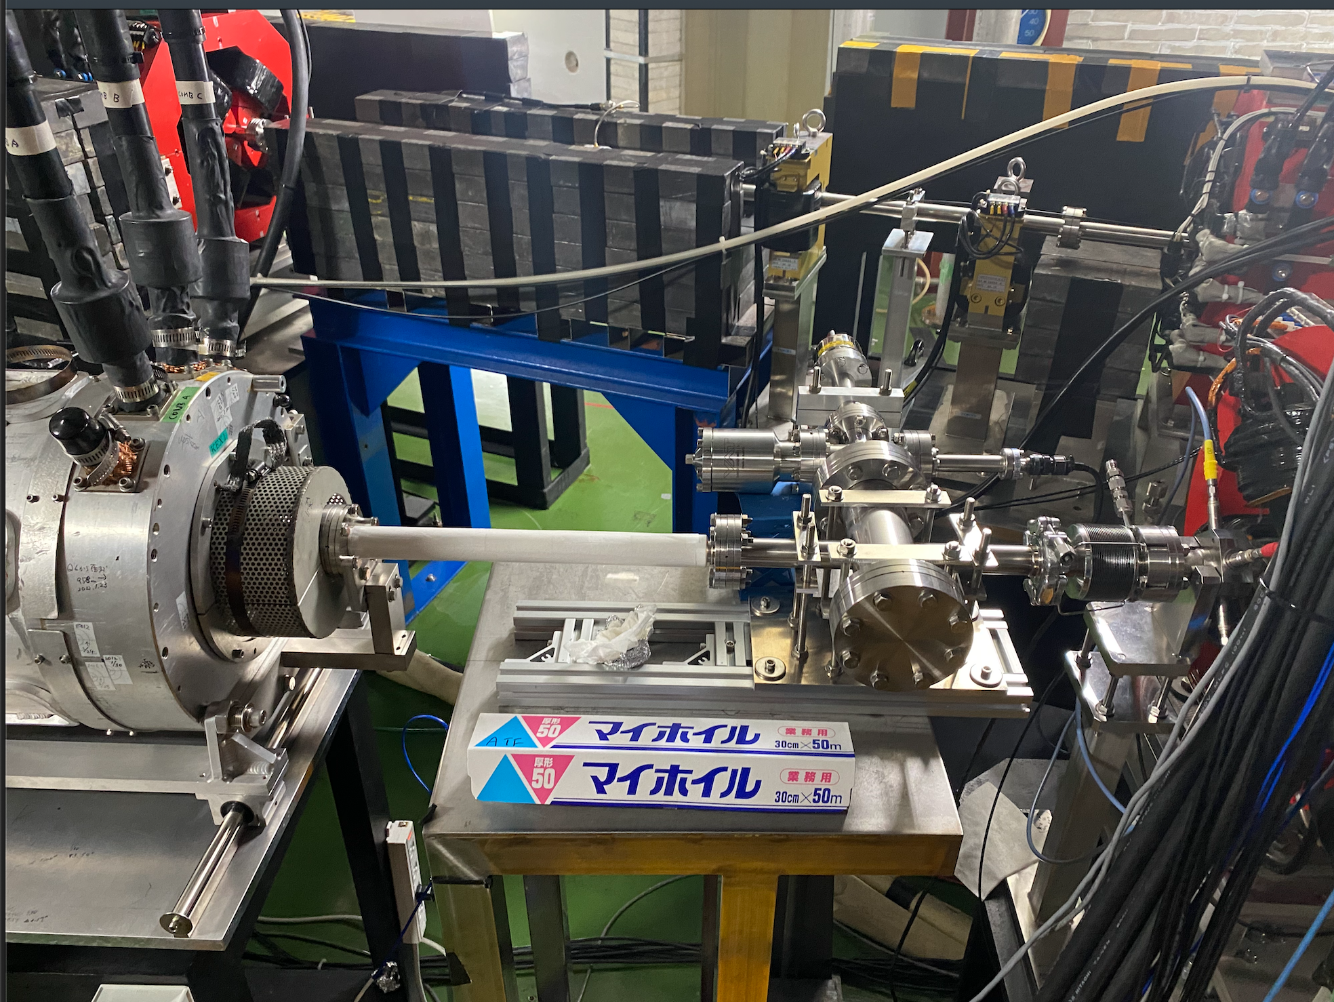
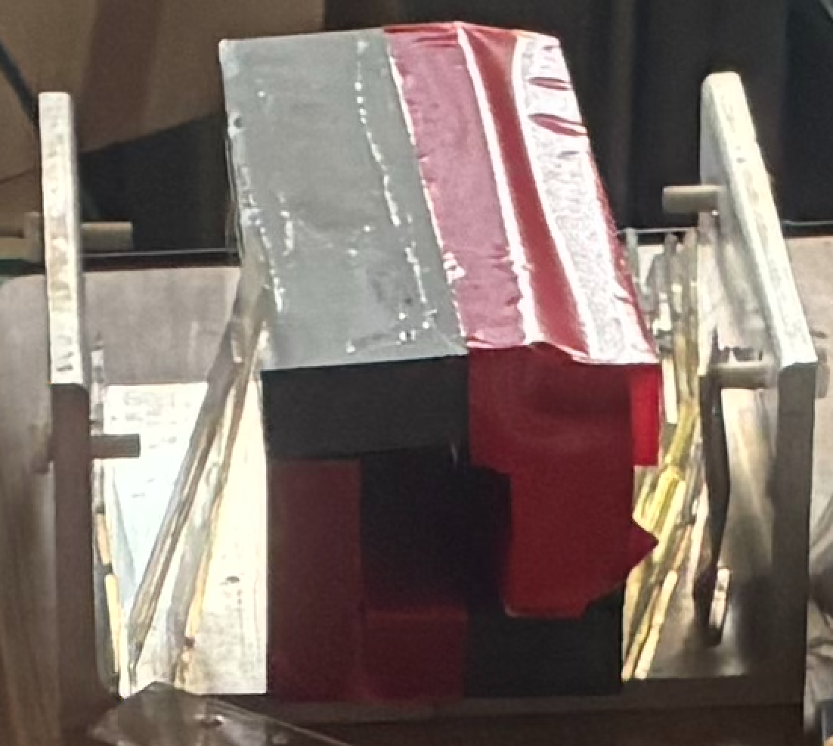
KEKATF251127ENakamura.pptx
Preparation of a slow-rise kicker system (Sub-EXT.-kicker system: SEK).
Devices |  | Source | Status now
Power supply | Reuse to save cost | 12GeV-PS : BK/IJK/FXK CX1171 or CX2171 | Ready
Magnet | Reuse & handmade | 12GeV-PS FXK prototype magnet, KAKENHI21540310/25286089/26610074 | Not yet (now under assembling)
Ceramic Chamber | New | MEXT-ATD | Already installed
Timing system | New | Dr.Aryshev, Dr.Popov. | Ready
Remote Control | New | Dr.Aryshev, Man.staffs | Ready
Assembling |  | Man.staffs
Thermocouple sensor | New | Dr.Abe, Eng.S.Araki | Ready
Slow-rise kicker magnet of a simple Lumped-type magnet with a Window-frame type return Yoke of magnetic material of L6H, now under re-designing and assembling.
Notes:
This slide shows a current status of preparation of 1st trial. I would like to save cost for sub-kicker system. Many main devices were reused.

Slide 7
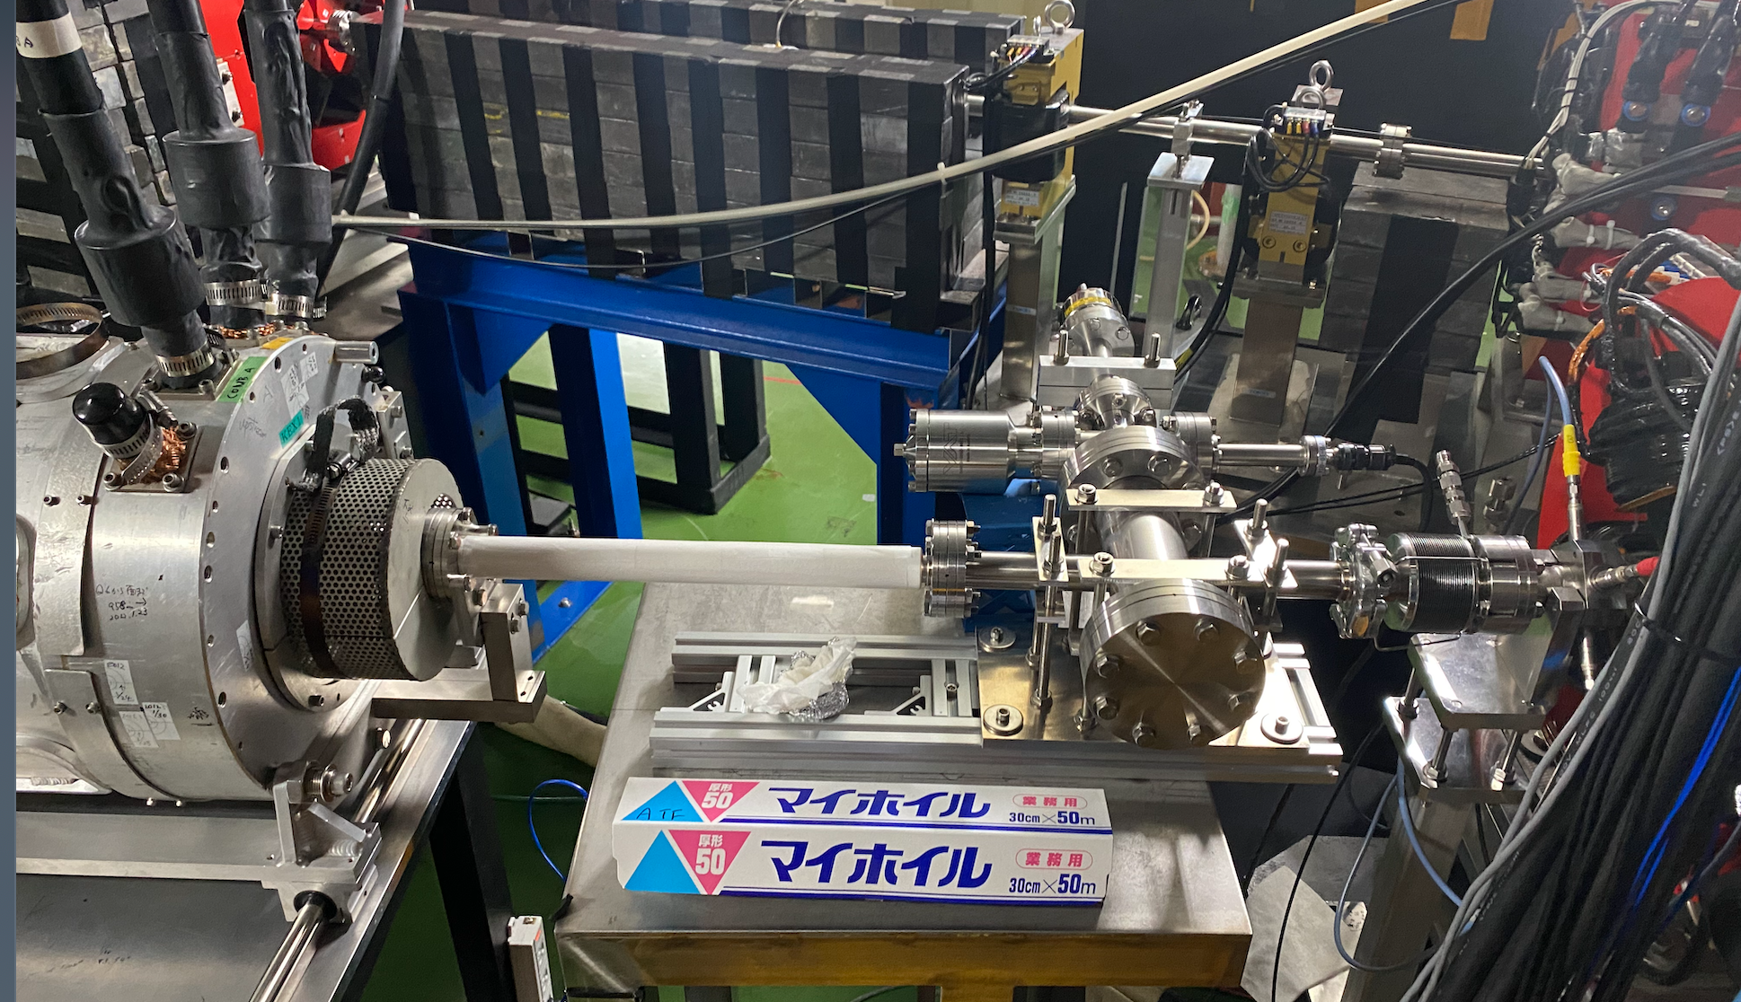
KEKATF251127ENakamura.pptx
https://atf.kek.jp/atfbin/view/ATFlogbook/Log20250314s
Ceramic Chambers
Main extraction kicker (SLAC)
Kovar 6µm
f_cutoff ~ 3.5GHz
R_des. < 1.2Ω
Sub-extraction kicker
Titanium 7µm / 0.35m
f_cutoff ~ 2GHz
R_meas. ~ 0.9Ω
→ Max.1W induced by 1E+10electrons per bunch.
Notes:
I worried about temperature rise by electromagnetic field induced by high-energy electron beam. The SLAC kicker magnet has air-forced cooling system because of high-intensity and high-repetition rate of 100Hz. In the ATF case, Maximum power is roughly estimated 1W for 1E10 electrons in a single bunch operation. For full bunch, 30, operation I have to suppose some treatment due to 30W.

Slide 8
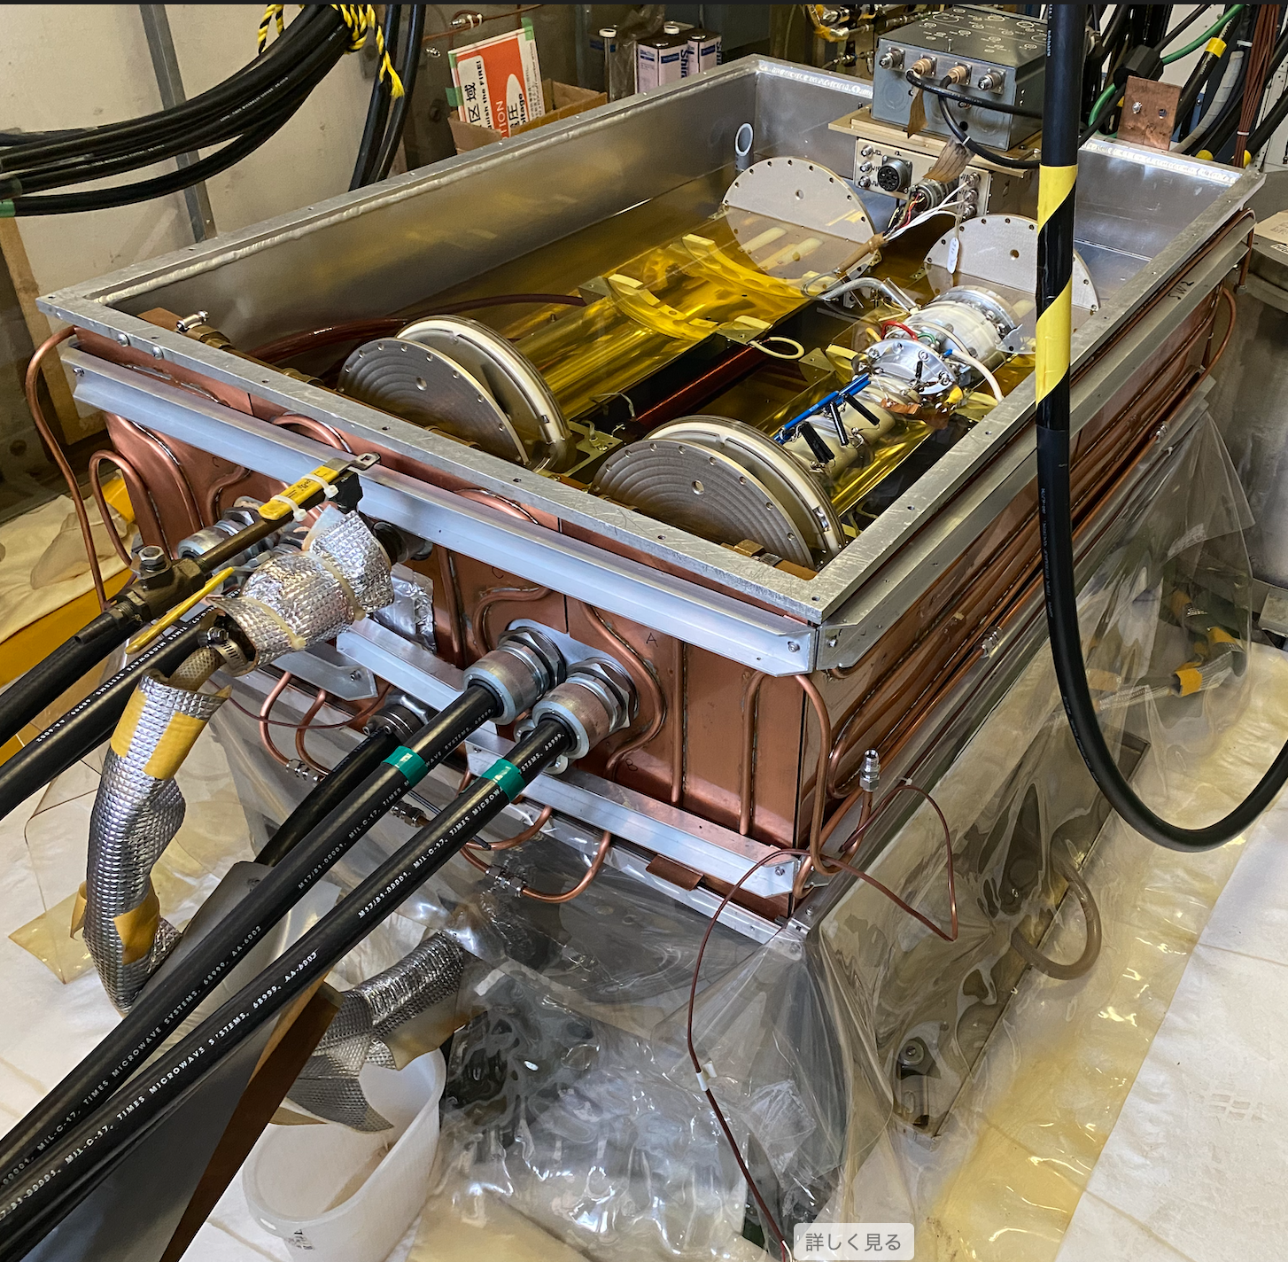
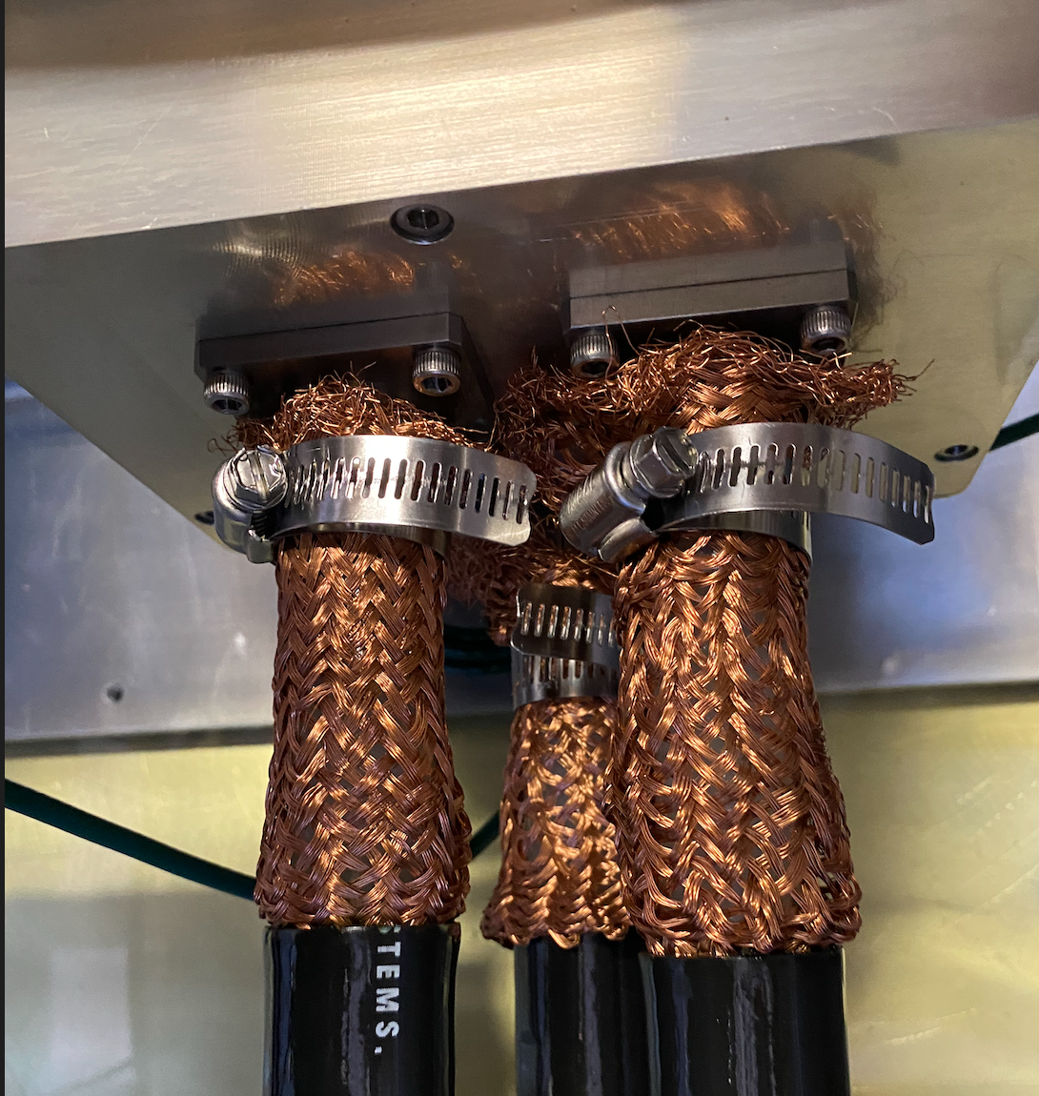
KEKATF251127ENakamura.pptx
Inside of the thyratron housing
with a half of insulation oil immersed.
Slow leakage occurs through mesh wires for ground.
Notes:
I worried about temperature rise by electromagnetic field induced by high-energy electron beam. The SLAC kicker magnet has air-forced cooling system because of high-intensity and high-repetition rate of 100Hz. In the ATF case, Maximum power is roughly estimated 1W for 1E10 electrons in a single bunch operation. For full bunch, 30, operation I have to suppose some treatment due to 30W.

Slide 9
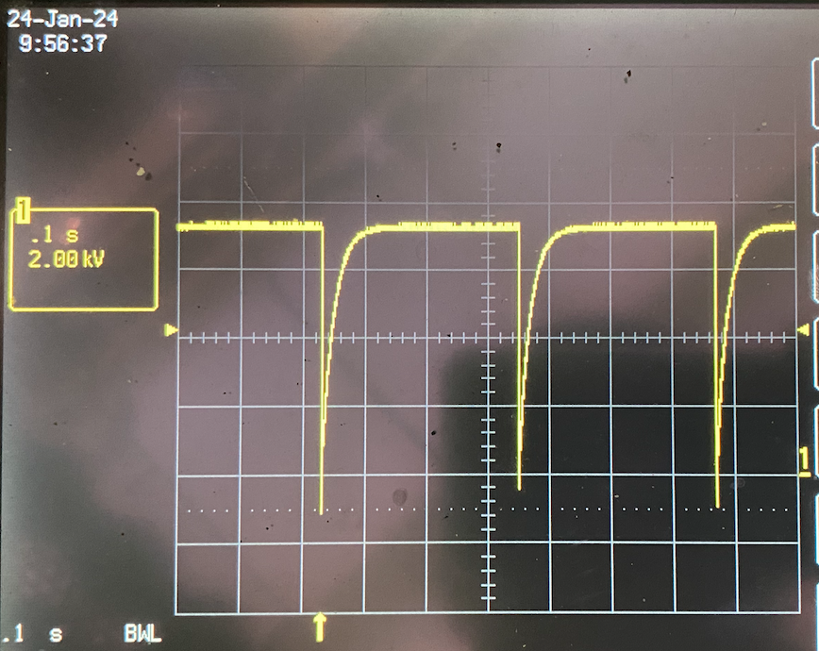
1st trial
KEKATF251127ENakamura.pptx
Limited upto 30kV because of old devices, although upto70kV was used for KEK 12GeV-PS.
Ready
Reused HV coaxial cables (Hitachi) of 50Ω 20m 2p2s, which produce a 0.45µs Z0 = 25Ω PFL.
Conventional Lumped magnet
If < 0.6kA
DC80kV
2MΩ
CX1171
4nF semi-matching ceramic capacitors
Transmission line
Hitachi 50Ω 20m 2p
→ RFG220 50Ω 2p used for ATF project
30MΩ
25 (or 12.5) Ω
ATF machine cycle is 3.125Hz (0.32s).
PFL voltage by DC charging : 0.1s/div.

Slide 10
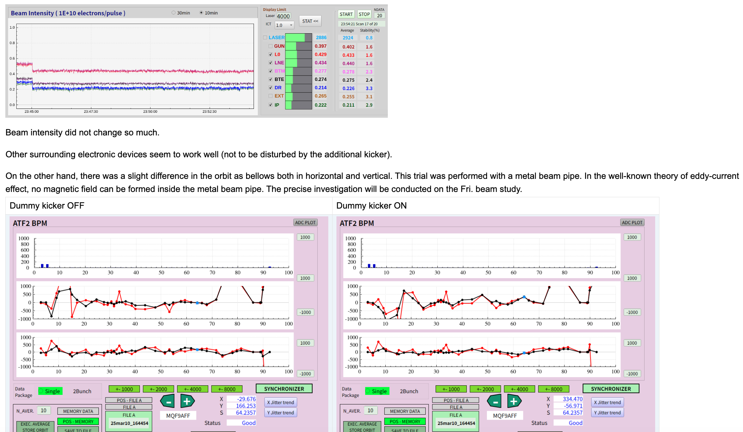
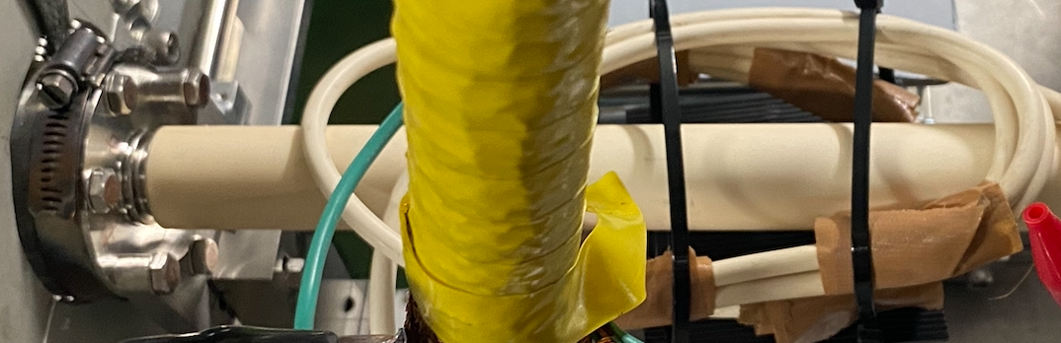
Preliminary beam studies to confirm the status of power supply for sub-kicker system.
KEKATF251127ENakamura.pptx
as one of the extraction kickers.
Weak-field kick trial has been succeeded onto a metal vacuum tube to confirm the power supple of sub-system;
Survey thru a metal beam pipe:
Pulse field can not immerse inside of the metal pipe by Eddy-current in theory, but a little field may be able to go in.
System check of the power supply
by using temporal coil windings.
Middle-field kick trial has been succeeded through a ceramic vacuum chamber too: 70% main + sub-system with dummy coil.
https://atf.kek.jp/atfbin/view/ATFlogbook/Log20250423s
30% kick of the main extraction kicker could produce by the temporal dummy kicker.
Power supply system works well. * Temporal six-turn coil with a startup capacitor was set and excited; L_meas. ~ 5.7µH ; Z0 = 25Ω ; tau ~ 230ns ; C = 1,700pF. (Circuit : Z_TL ➔ C // L)
* Two kicker magnets, which were excited at half field of main extraction kicker (SLAC) and 15kV excitation of the additional kicker, gave a same extraction condition, although timing had not been adjusted because this beam time was finished.
Notes:
It is a favorable result. I will continue to make a magnet.

Slide 11
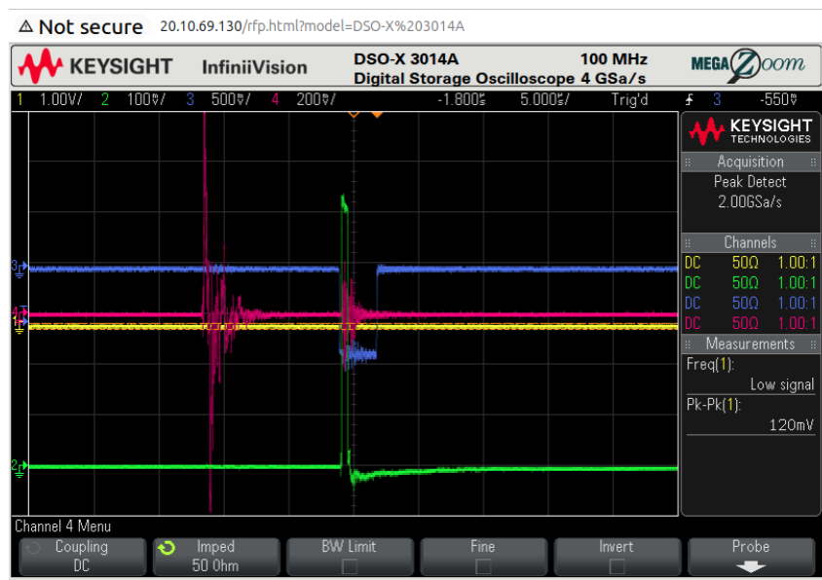
https://atf.kek.jp/atfbin/view/ATFlogbook/Log20250312s
KEKATF251127ENakamura.pptx
The additional kicker was excited at V_ch = 30 kV (Vf ~ 13kV; Z0 =25Ω; If~0.5kA; NI~4 x 2 x If ~ 4kAt; pulse dulation is 0.5µs) after 23:50. The output signal, d[BS]/dt, from a simple pickup coil which was set near the magnet is shown in Ch.2 (read purple) of the OSC for the working main extraction SLAC kicker as follows. It is noisy but is useful for delay/timing adjusting: Ch1(green): output current from the power supply for the main extraction kicker magnet (SLAC); Ch.3 (blue): Trigger source signal for the main kicker.

Slide 12
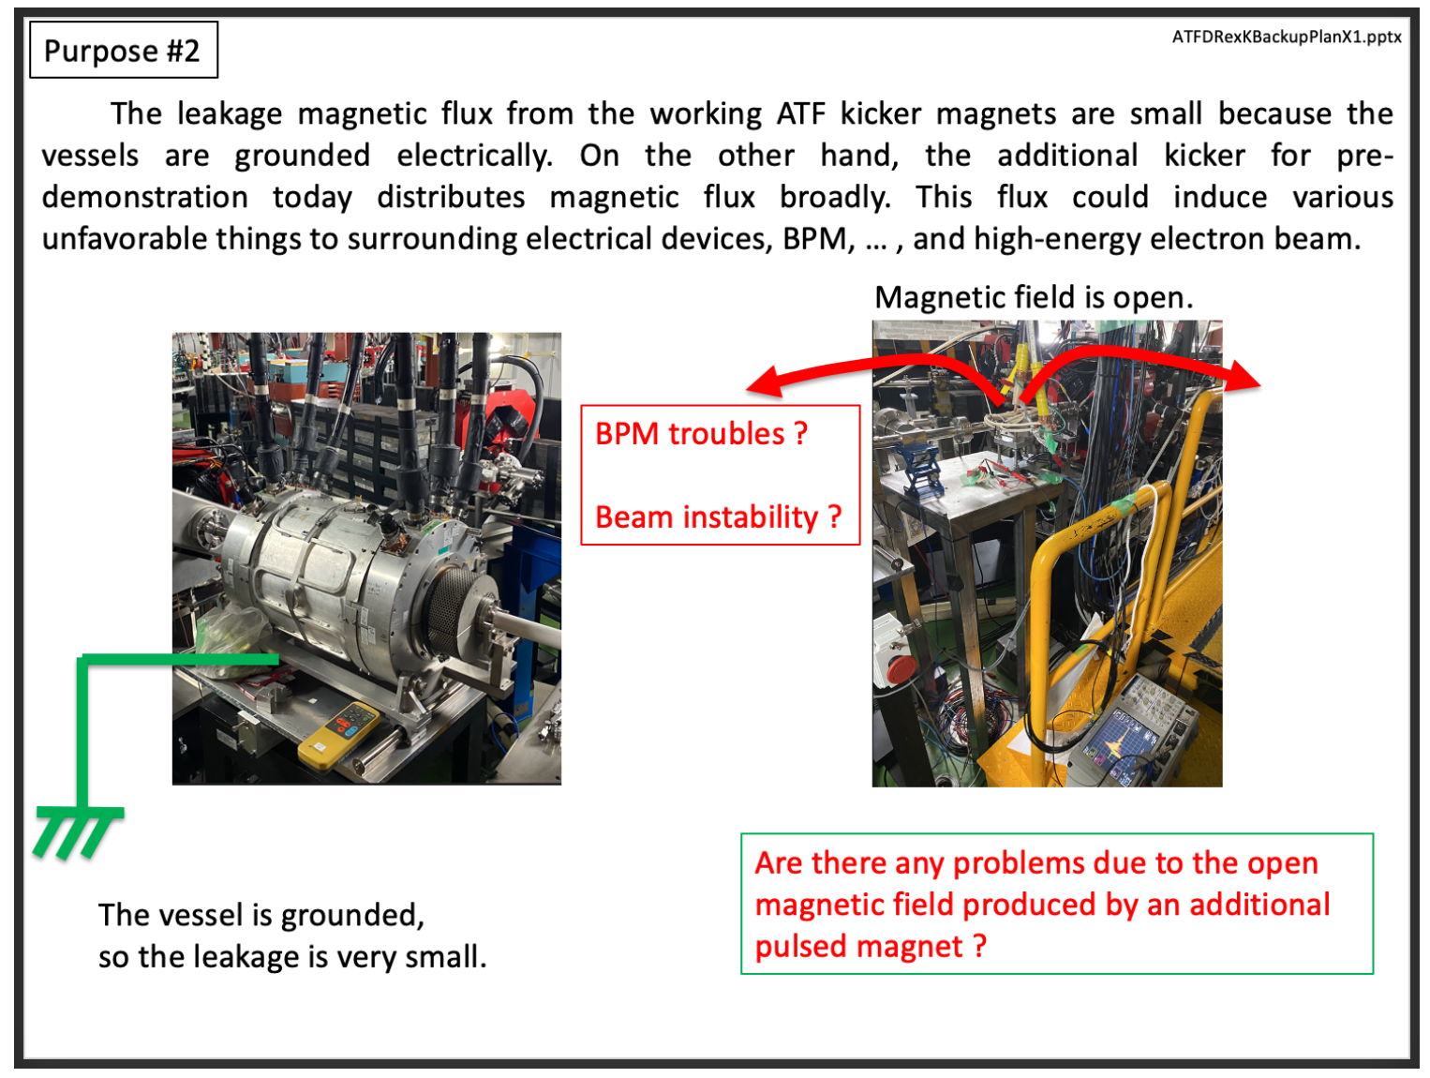
KEKATF251127ENakamura.pptx

Slide 13
KEKATF251127ENakamura.pptx
2nd trial: SYK
High accuracy on magnetic field is required to improve a nano-beam quality.
The stability/instability such as a minor ringing at the flattop is one of the problem to be solved.
Charging error is now under 1/30,000 which is equivalent to one digital step for the command charging of HV.
Jitter of the main switch, thyratron, 5 ~ 10ns. The main HV step pulse is formed using HV coaxial cables. There is a slight droop, but it is not significant large problem, although a term to be improved. I suppose that the problem lies on the structure of the distributed magnet, it would be seen a field ringing by each cell of the magnet for short/nano-beam.
Notes:
If 1st step for preparation of spare kicker system completed. I would like to attempt the new concept kicker system. At first, I would like to try saturation kicker to produce a slow-rise but high- and stable in flattop field in order to investigate the effect on the transverse emittance growth at extraction. Instability at a kicker flattop like a ringing or a droop might affect onto the transeverse beam emittance induced by jitter of power supply for 5~10ns at thyratron, 1ns for semiconductor switches. Similar trial has been attempted by using the double kicker method.

Slide 14
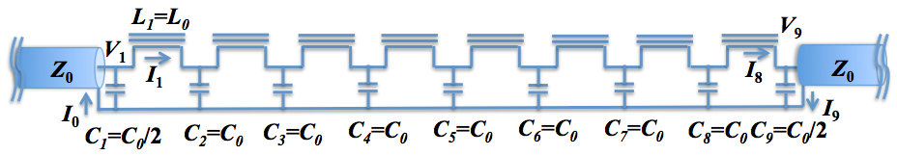
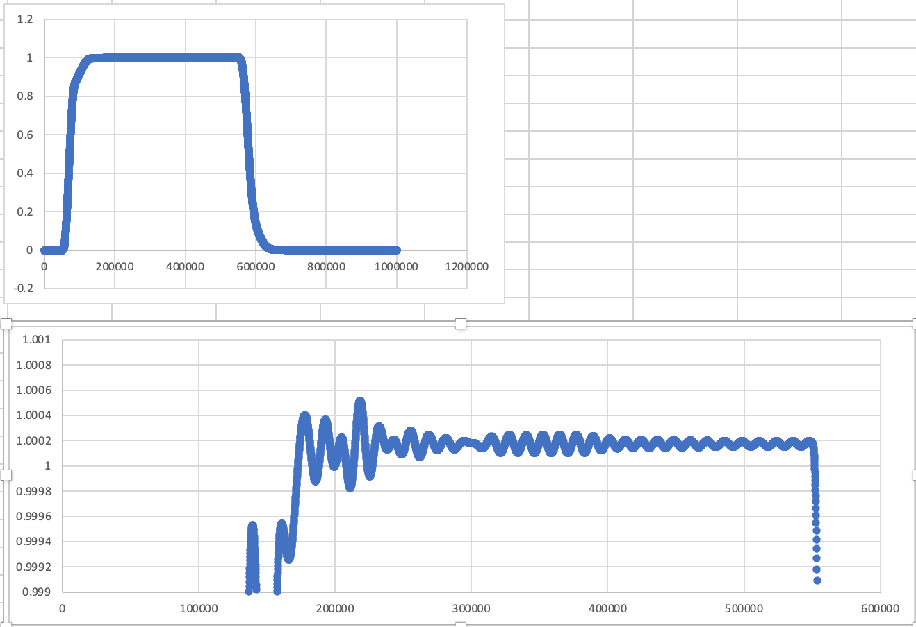

KEKATF251127ENakamura.pptx
2nd trial: SYK
High accuracy on magnetic field is required to improve a nano-beam quality.
Double kicker trial
Main extraction kicker
Ring
closeup
FF Beam Transport Line
Ringing is less than 0.1%, but it should be improved more for nano-beam.
Double kicker method was applied and I hear that it was success to some extent, but it would be difficult to improve more due to the above cell structure.

Slide 15
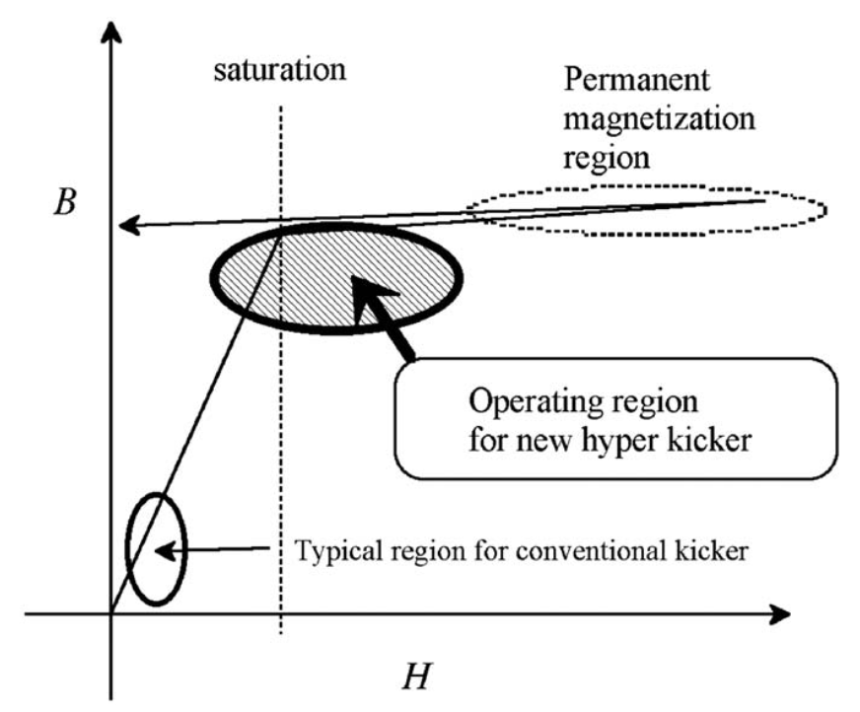
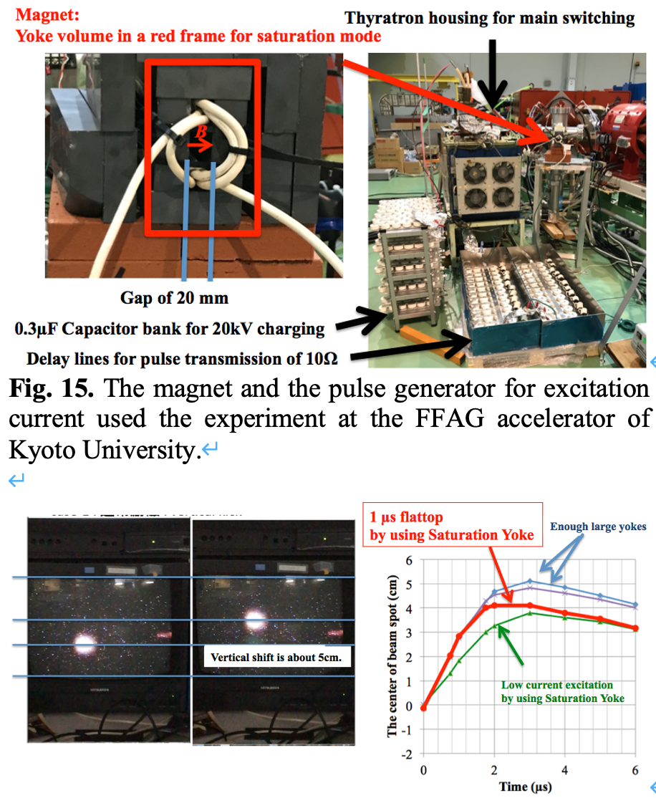
KEKATF251127ENakamura.pptx
2nd trial: SYK
PoP experiment by using 100MeV protons.
dB/dI is small
dB/dI is large
The ringing effect of power supply will be expected to be suppressed over saturation.
Notes:
I could not fine investigation due to the machine time limitation, so I would like to attempt in the ATF.

Slide 16

SLAC kicker magnet working for injection into/extraction from the DR of the ATF.
KEKATF251127ENakamura.pptx
2nd trial
(SYK)
Thin layers of tapes of amorphous will be required.
1st trial
Conventional
Lumped type
9cm x 9cm
Ferrite Return Yoke
L6H used for 12GeV-S
Ceramic Chamber : Khobar 6µm; < 1.2Ω
New Ceramic Chamber
(OD30/ID20/Ti 7µm : 0.9Ω)

Slide 17
KEKATF251127ENakamura.pptx
Summary
1st trial : Preparation of a spare magnet which is able to operate a single-bunch operation, a slow kicker system (SKS).
Almost all devices are ready except for a magnet. Beam experiment with a small kick by using a temporal dummy magnet has been conducted successfully.
JFY2026: Beam trial by a simple Lumped kicker magnet will be scheduled.
---
2nd trial for new concept will
be scheduled in JFY2027.
JFY2023~
Fundamental Designs
(continued)
Structure of main kicker magnets
Complicated structure like bellows works earth plates for formation of capacitance for LC-ladder against high-voltage coil. Some dielectric materials such as polyethylene are immersed.
JFY2024~
Preparation of devices/materials
(continued)
JFY2024~
Preliminary test of Power supply
completed
JFY2024
Installation of new ceramic chamber
completed
JFY2025
Preliminary beam test using dummy coil
completed
JFY2025~
Assemble and Install 1st magnet
Beam study
JFY2026~
Assemble and Install 2nd magnet
Beam study
Notes:
It is best to produce a kicker magnet with a same performance as the working kickers, but it is very expensive for the ATF project.
There are some candidates and also you can apply if you have noble idea. I plan the suppression trial of transverse emittance by using a kicker magnet system in which the return yoke is operated around saturation.

Slide 18
KEKATF251127ENakamura.pptx
Other materials

Slide 19
KEKATF251127ENakamura.pptx

Slide 20
おさらい： Requirements for ATF DR kickers
Parameters | Injection | Extraction
Field rise time | tight (150ns) | loose (it depends on train/bunch mode.)
Field flatness | (standard) | severe
Field fall time | tight (150ns) | loose
運転における実務的な観点では
問題点： 致命的な問題は今のところ無い
細かい点としては
・油環境：サイラトロンタンクの入出力高耐圧同軸ケーブルからの電気絶縁油の染み出し
・電源ONが遠隔でできない。
・スペア電源が動くかどうか
・その他、制御ユニット等の予備品
（サイラトロンの予備はある）

Slide 21
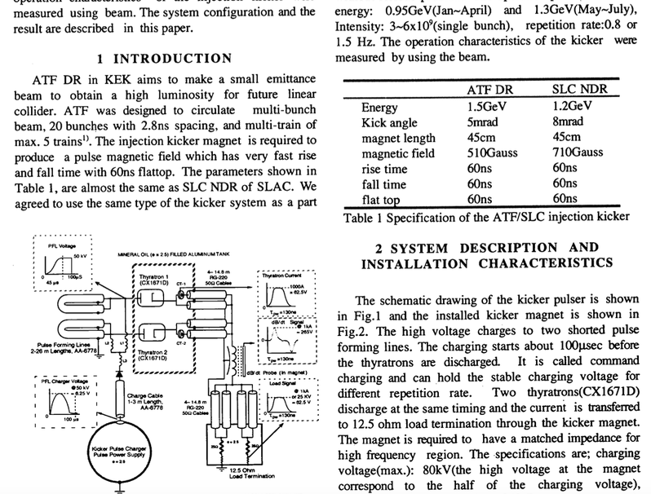
ATFDRexKBackupPlan1.pptx
Recent Magnets
Injection Kicker Magnet #1
12.5 Ω : working
Extraction Kicker Magnet #1
16.7Ω : working
Spare magnet #1:
16.7Ω ? : used for jitter correction trial ?
現状：
磁石３台中２台を稼働
電源３台中２台を稼働
現存スペアは、時間の制約が厳しい入射キッカー用にし、取出しキッカーのスペアを新たに（可能な限りお金のかからない範囲で）用意する。
It is easier to make an extraction kicker magnet than that an injection magnet.

Slide 22
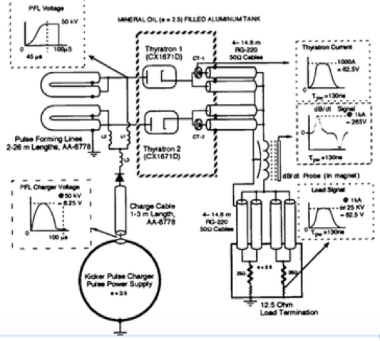
ATFDRexKBackupPlan1.pptx
マグネット入力部で、給電高耐圧同軸線を全て抜き、整合抵抗器50Ωを４本、それぞれに接続し、1:100 高圧プローブで、電源から送られてくるパルス波形を観測した。

Slide 23
KEKATF251127ENakamura.pptx
Backup Plan on Extraction Kicker Magnet System in Damping Ring of ATF, KEK.
Abstract:
There are several plans for backup systems for the DR extraction kicker system, if the existing vacuum chamber can be reused. Some of the plans are introduced in this talk.
E. Nakamura, June 2021
Required parameters of existing systems
 | Existing | KEK-PS FX Kicker as Backup
B (T) | 0.055 (± 0.1) | 0.100 → 0.060
L_effective (m) | 0.31 | 0.28
BL (mT m) | 17 | → 17
θ (mrad.) | 4 | 4
Vf/If (kV/kA) = Z0 | 16.7/1 = 16.7 | 30/4.7 ~ 6.3 → 30/1.8 ~ 16.7
V_charging (kV) | 40 | 60
BL risetime (ns) | < 150 | < 150

Slide 24
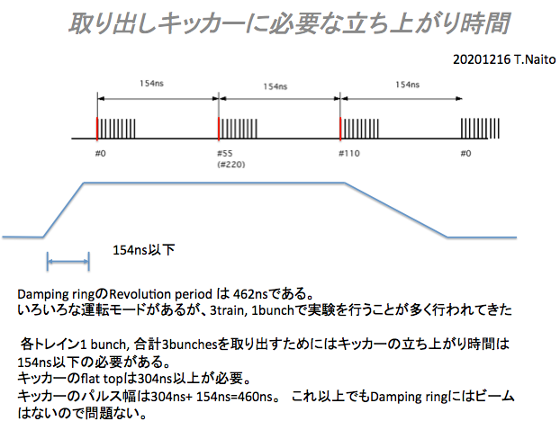
Time Requirement for ATF DR extraction kicker system.
ATFDRexKBackupPlan1.pptx
出射キッカーへの時間に関する要求：
・Field Rise Time ： 150ns (450ns for 1train-1bunch mode）
・Field Fall Time : not so fast ( < next injection)

Slide 25
ATFDRexKBackupPlan1.pptx
Proposal for ATF DR extraction kicker system.
 | Existing | New lumped magnet | Saturable Magnet
B (T) | 0.055 (± 0.1) | 0.055 (± 0.1) | 0.055 (± 0.1)
L_effective (m) | 0.31 | 0.31 | 0.31
BL (mT m) | 17 | 17 | 17
θ (mrad.) | 4 | 4 | 4
Vf/If (kV/kA) = Z0 | 20/1.2 = 16.7 | 10/0.6 =16.7 | 20/1.6=16.7
V_charging (kV) | 40 | 20 | 40
BL risetime (ns) | < 150 | < 150 | <150
w x h (mm x mm) | 23 x 23 | 23 x 23 | 23 x 23
L (µH) | 0.4 | 0.4 | 0.4
L/Z0 (ns) | 24 | 24 | 24
4.6 L/Z0 |  | 110 | 110

Slide 26
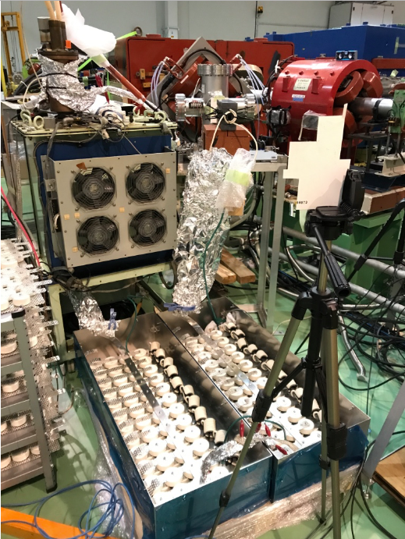

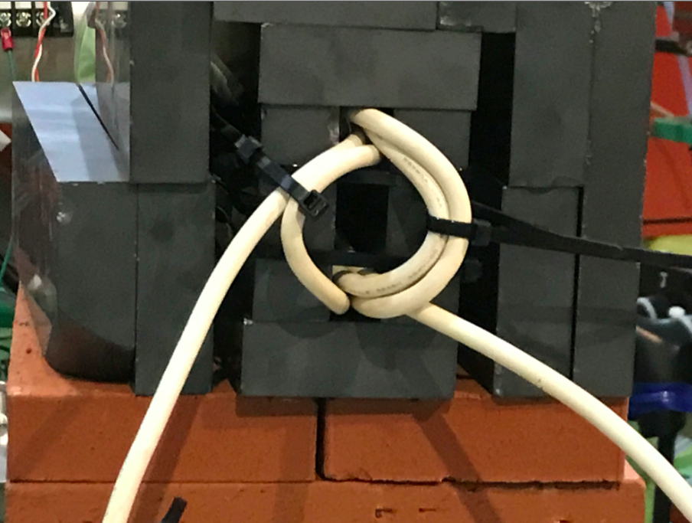
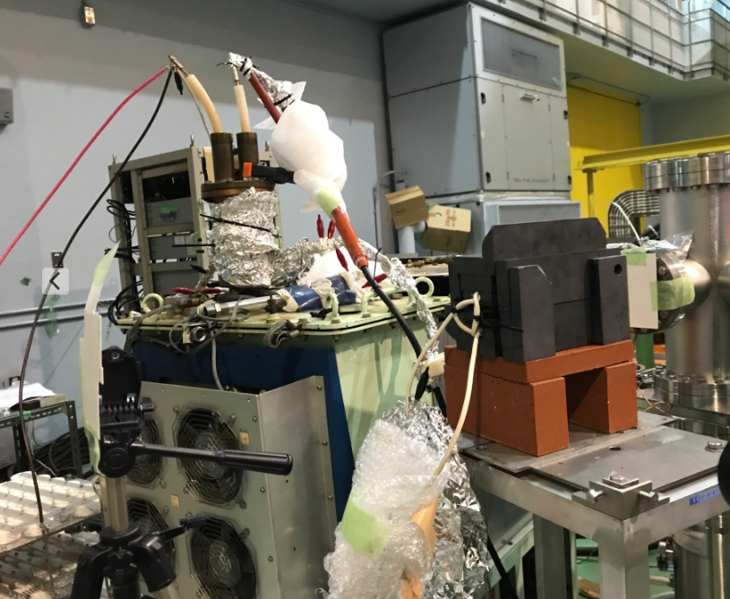
できれば、もう１つの選択肢をトライしたい： saturation kicker
京大FFAGでのテスト例 : 40kV 充電, Ncoil=3, h~20mm, B_MAX = 0.45 T
ATFDRexKBackupPlan1.pptx
8cm x 8cm
6cm x 6cm

Slide 27
ATFDRexKBackupPlan1.pptx
6cm x 6cm
9cm x 9cm
Ceramic Chamber
(OD30/ID20/7µm Ti)
現状のセラミックダクトを磁石から切り離せる構造なら、色々とやりようがありそうです。

