Slide 1


Flight Simulator (CERN)
P. Korysko*, A. Latina, Wiktoria Malek
ATF Project Meeting
November 28, 2025
*pierre.korysko@cern.ch

Slide 2
Outline
CERN Python ATF Flight Simulator.
DFS & WFS Results.
RF-Track Simulation Results.
Future Steps.
Plans for ATF3.
Conclusions
P. Korysko - ATF Project Meeting - Nov. 28, 2025
2

Slide 3

One-to-One,
Dispersion Free Steering (DFS)
and Wakefield Free Steering (WFS)

Slide 4
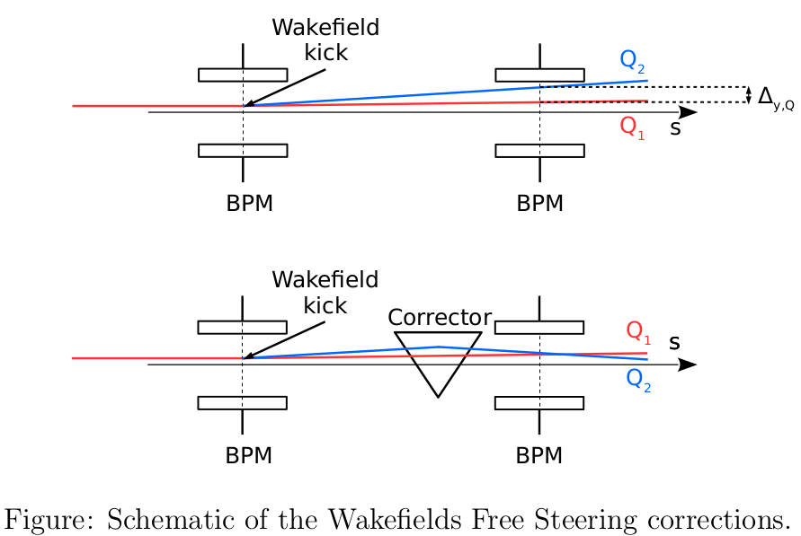
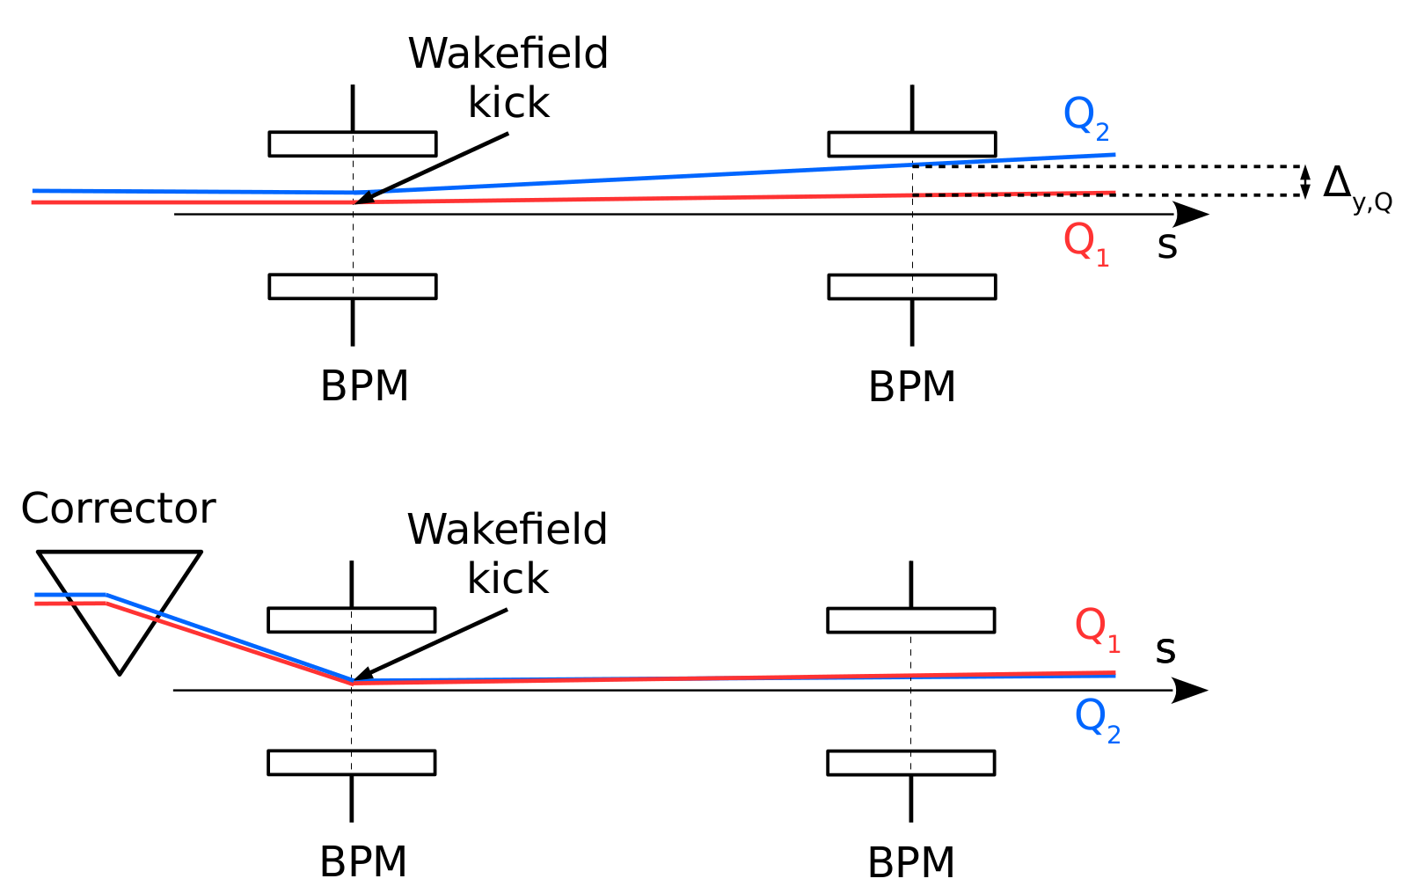
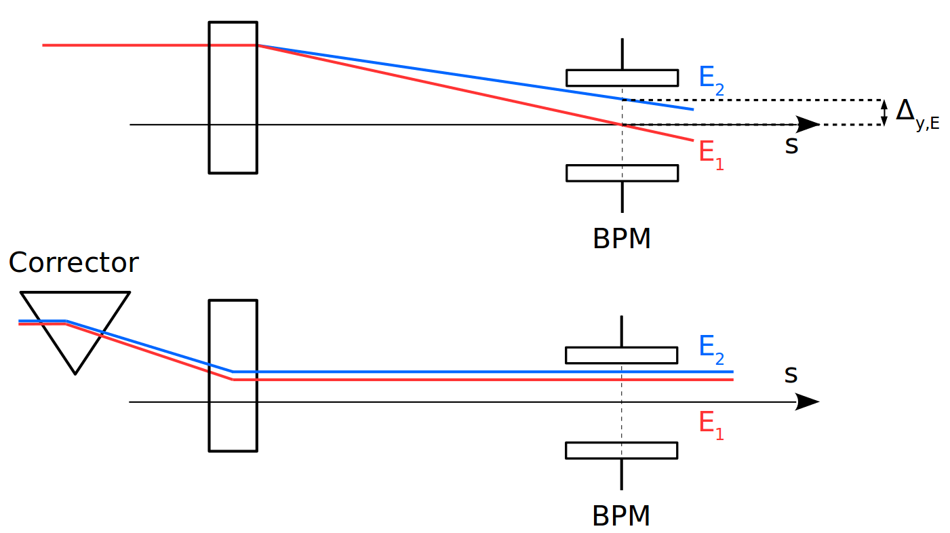
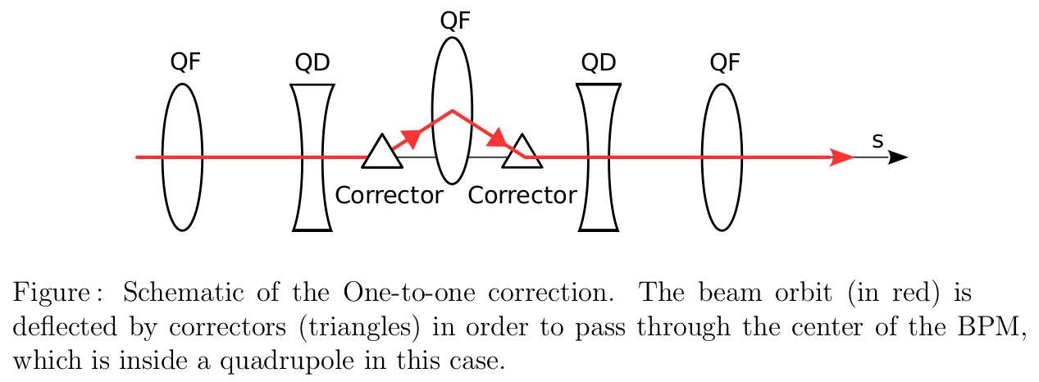
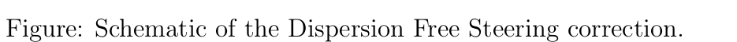
One-to-One, DFS and WFS
One-to-One
Dispersion Free Steering
Wakefield Free Steering
The One-to-One correction consists of minimizing the transverse position of the beam, with respect to the beam pipe centre measured at BPMs (inside quadrupoles in this case), using steering magnets [3].
The DFS correction consists of minimizing the dispersion effect. In practice, it reduces the orbit difference between two beams with different energies [4].
The WFS correction consists of minimizing the orbit difference introduced by wakefields. In practice, it reduces the orbit difference between two beams with different charges [5].
P. Korysko - ATF Project Meeting - Nov. 28, 2025
4

Slide 5
The ATF Flight Simulator

Slide 6
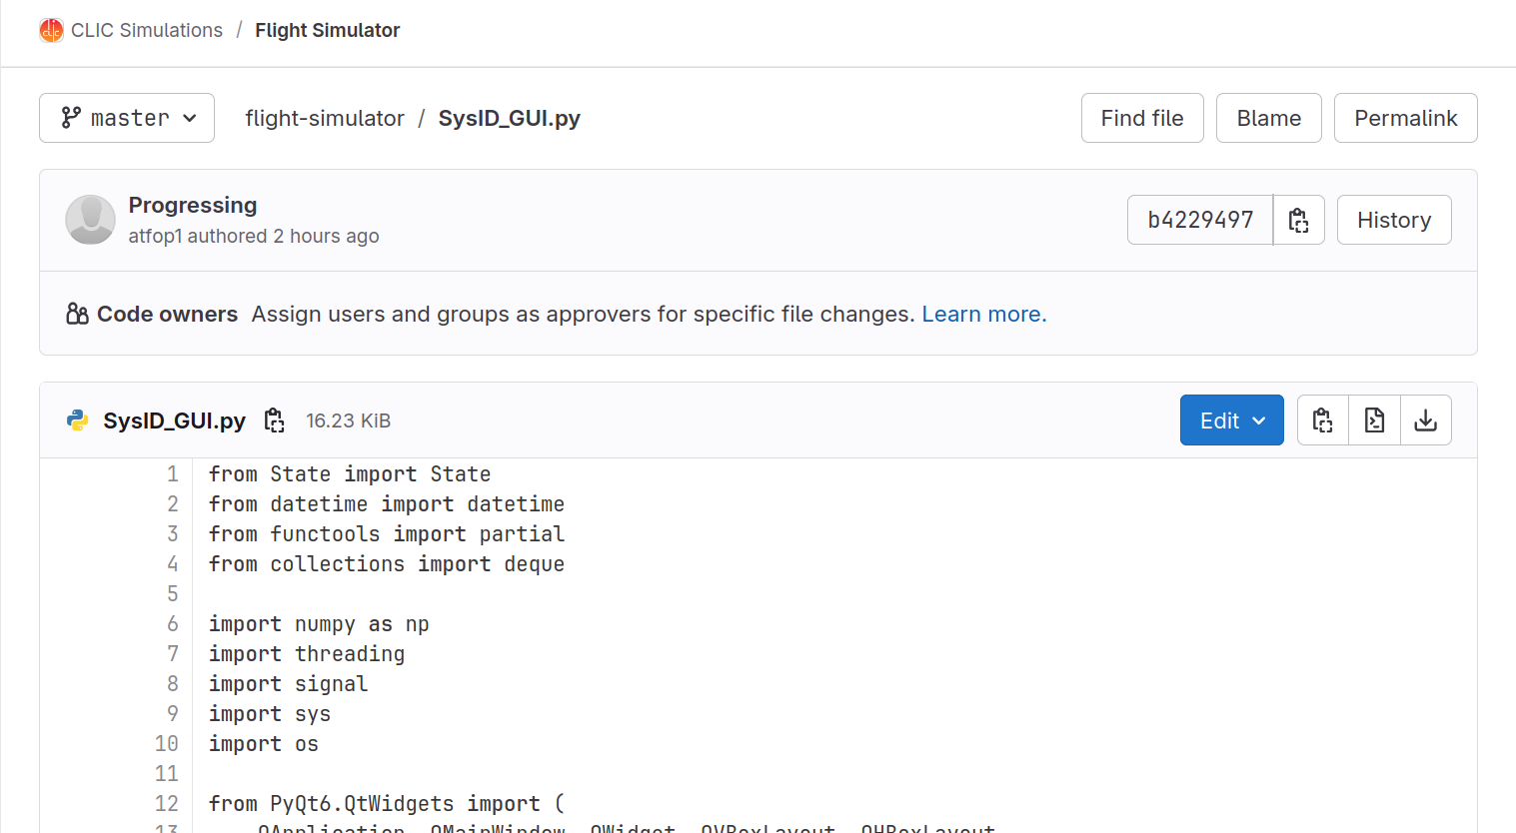
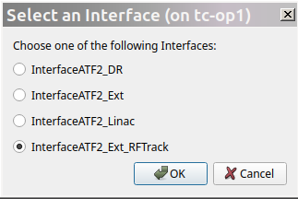
The ATF Flight Simulator
A first version of the ATF Flight Simulator has been written and tested at ATF2 (called SysID for System Identification).
4 available interfaces for now:
- ATF Damping Ring
- ATF Extraction Line
- ATF LINAC
- RF-Track Simulations
P. Korysko - ATF2 Weekly Meeting - June 20, 2025
6

Slide 7
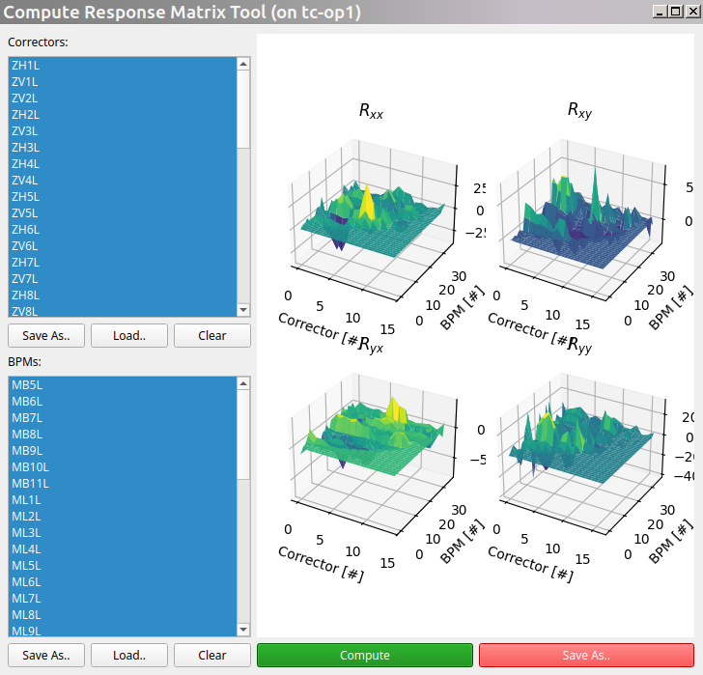
A tool dedicated to compute Response Matrices
List of
correctors
to use.
List of
BPMs
to use.
P. Korysko - ATF2 Weekly Meeting - June 20, 2025
7

Slide 8
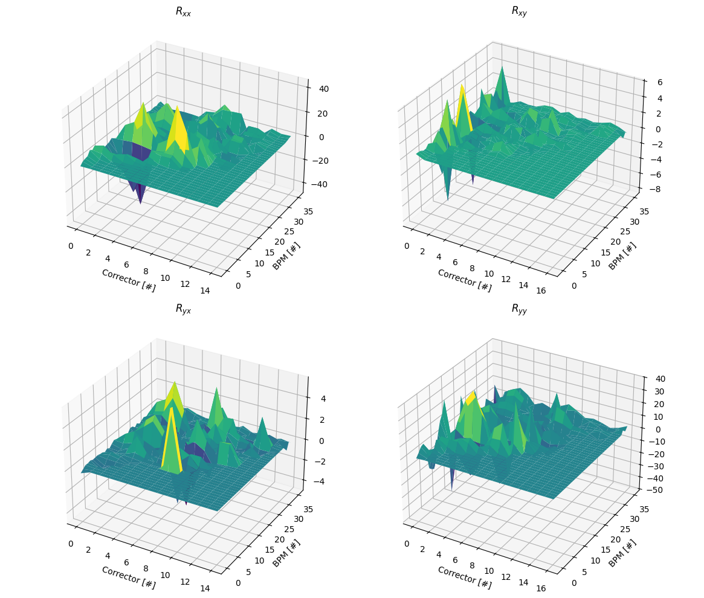
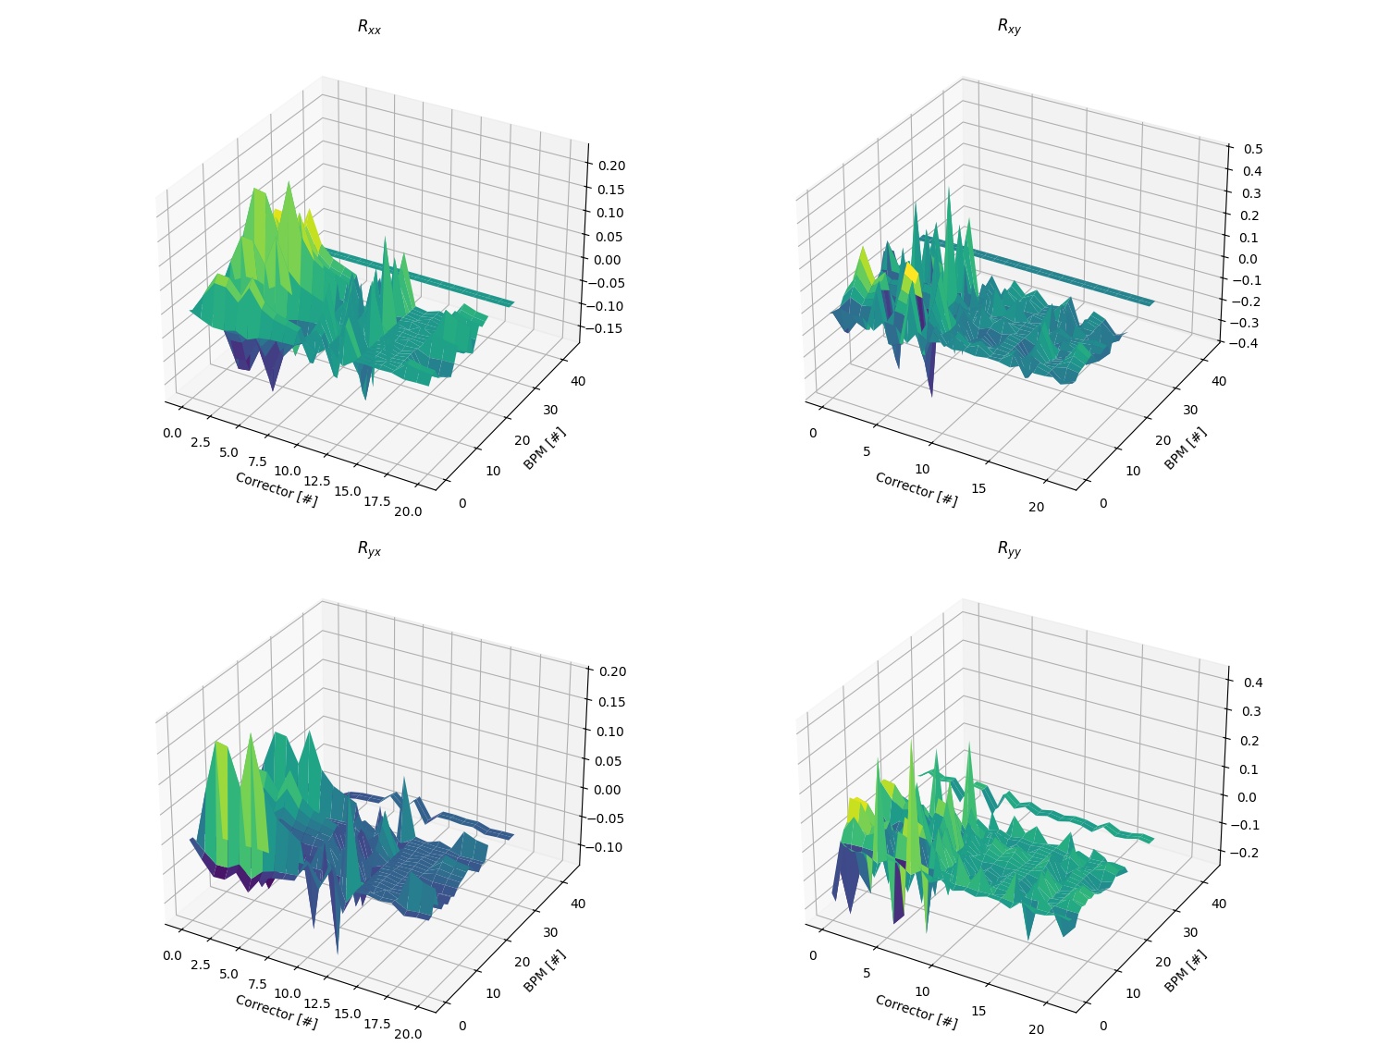
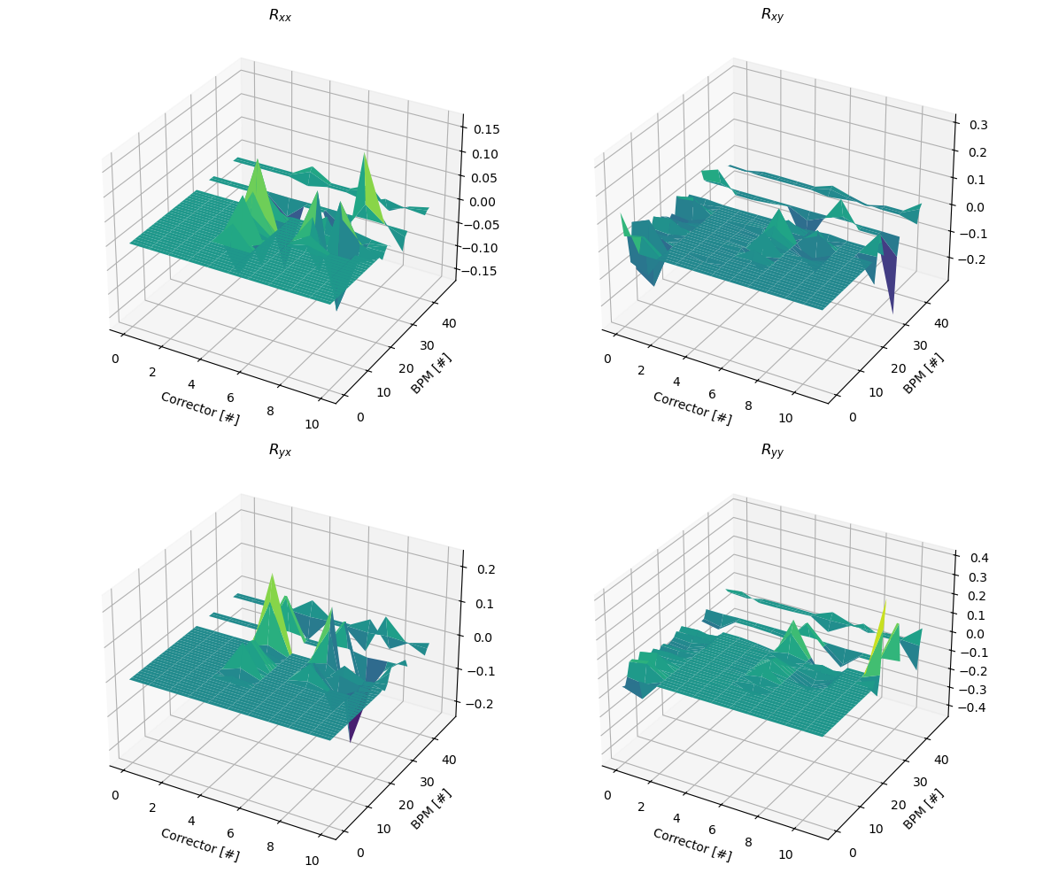
Response Matrices measured in ATF
LINAC Damping Ring ATF2 Beamline
P. Korysko - ATF Project Meeting - Nov. 28, 2025
8

Slide 9
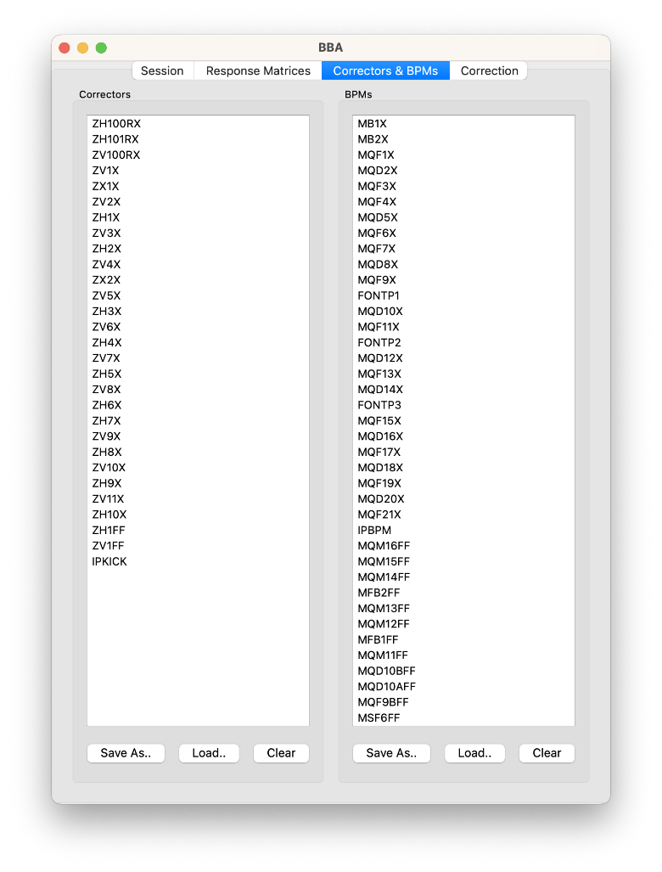
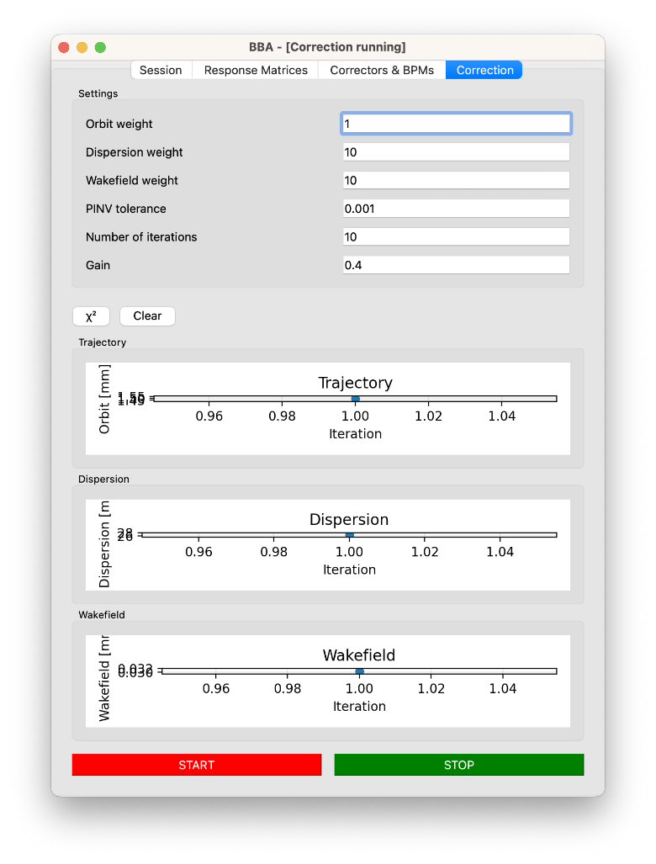
A tool dedicated to corrections
Orbit weight Dispersion weight Wakefield weight
Nb. of iteration
etc
List of
correctors
to use.
List of
BPMs
to use.
P. Korysko - ATF Project Meeting - Nov. 28, 2025
9

Slide 10
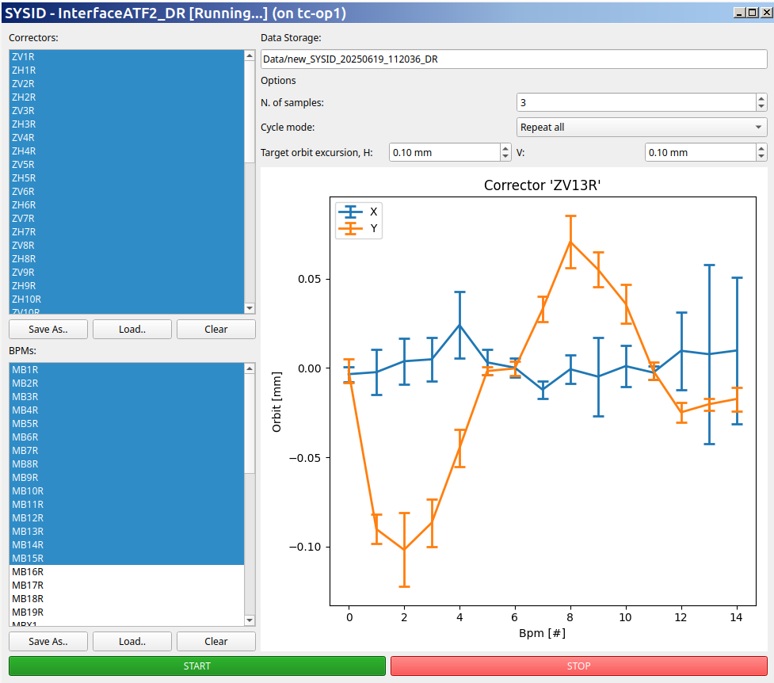
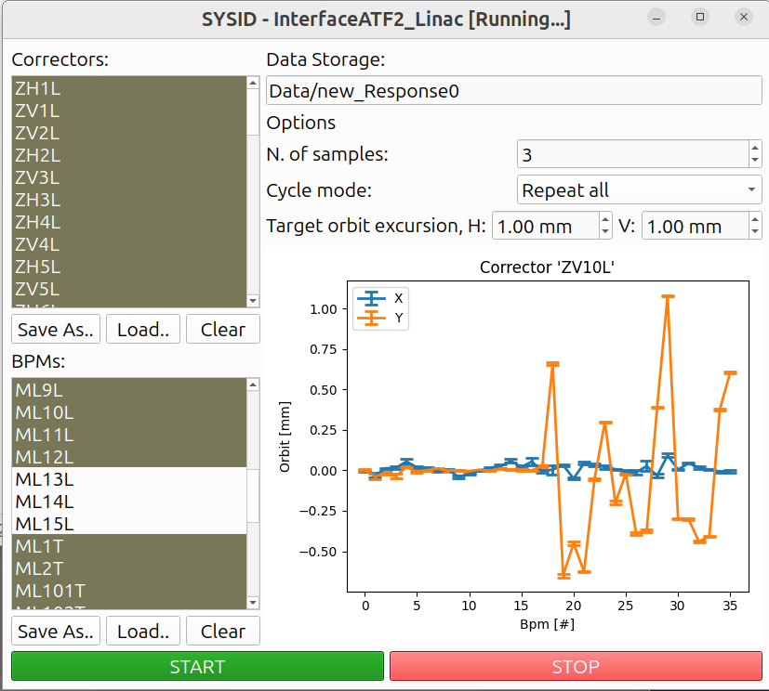
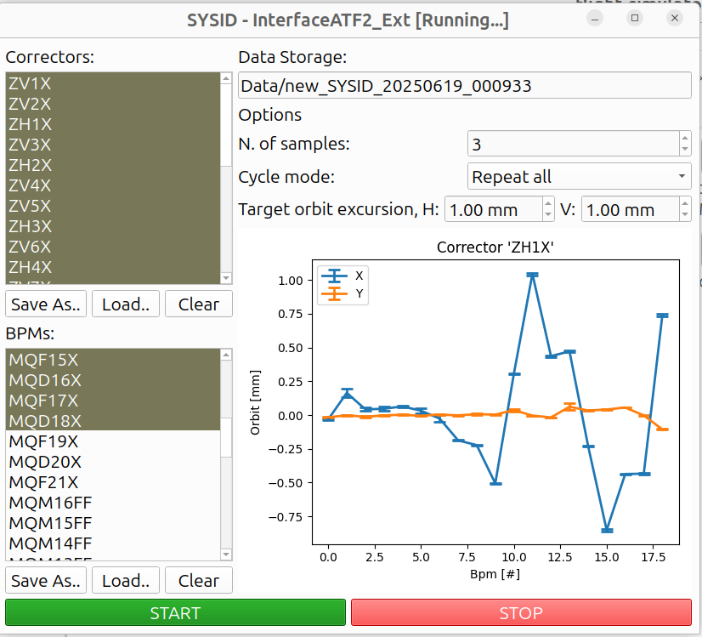
One-to-One correction in ATF
LINAC Damping Ring ATF2 Beamline
P. Korysko - ATF Project Meeting - Nov. 28, 2025
10

Slide 11
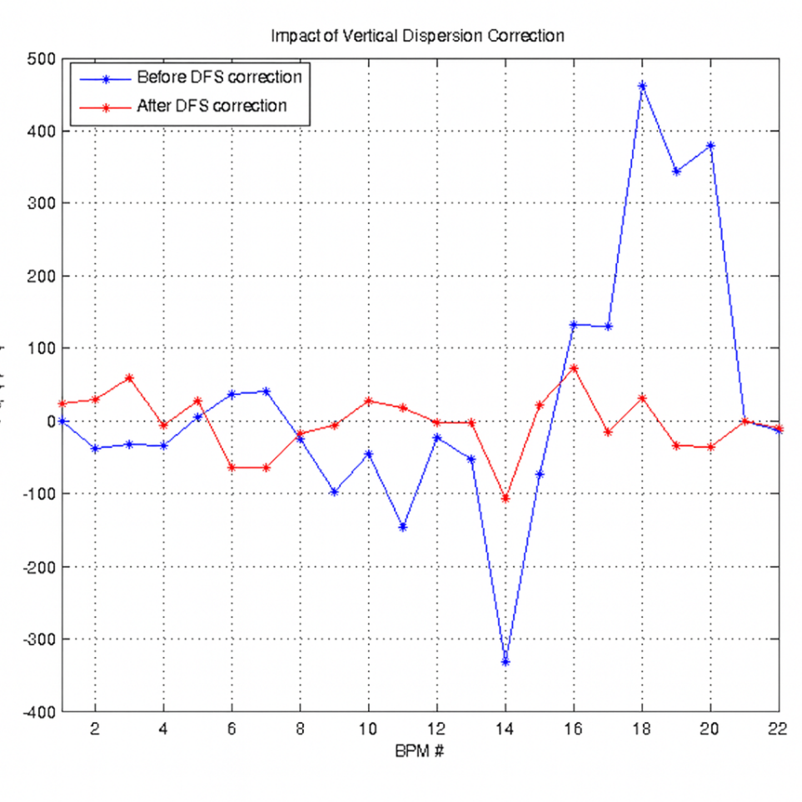
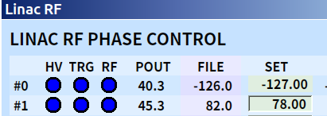
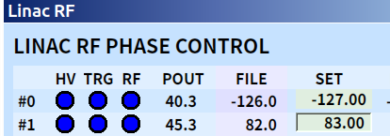
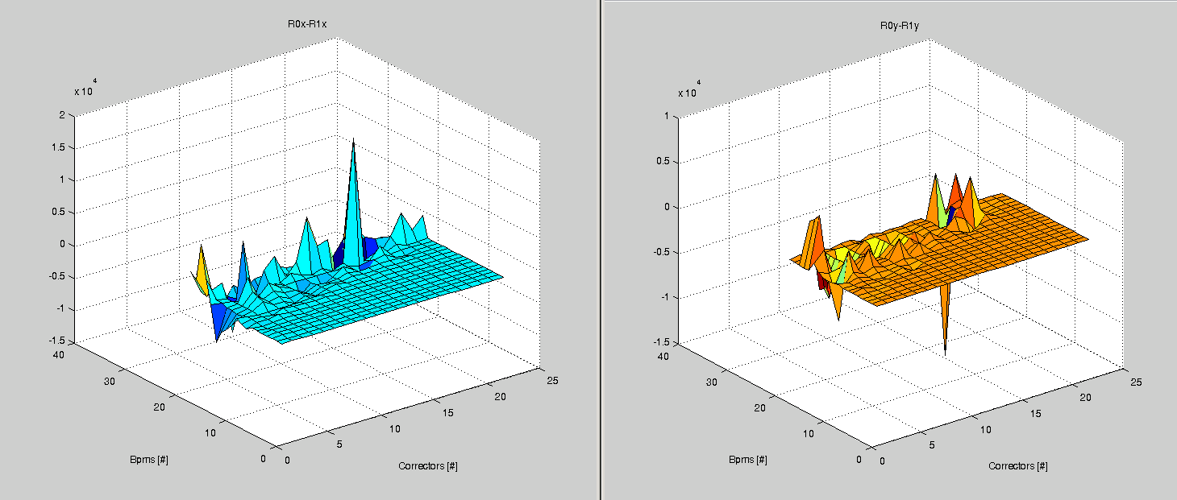
DFS in the ATF LINAC
To change the beam energy in the LINAC, the Phase of the Klystron #1 is increased by 5 degrees:
Response Matrix for DFS in the ATF LINAC with R0 (nominal energy) and R1 (lower energy)
R1 – R0
P. Korysko - ATF Project Meeting - Nov. 28, 2025
11

Slide 12
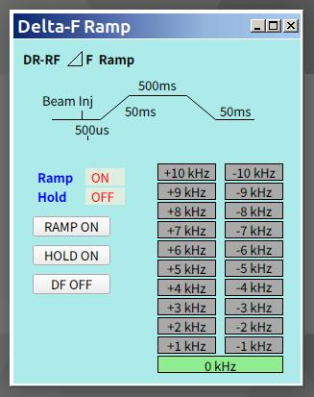
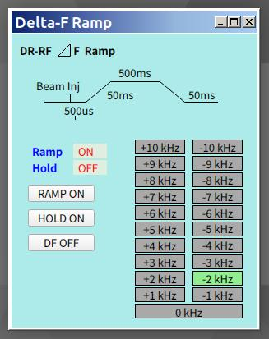
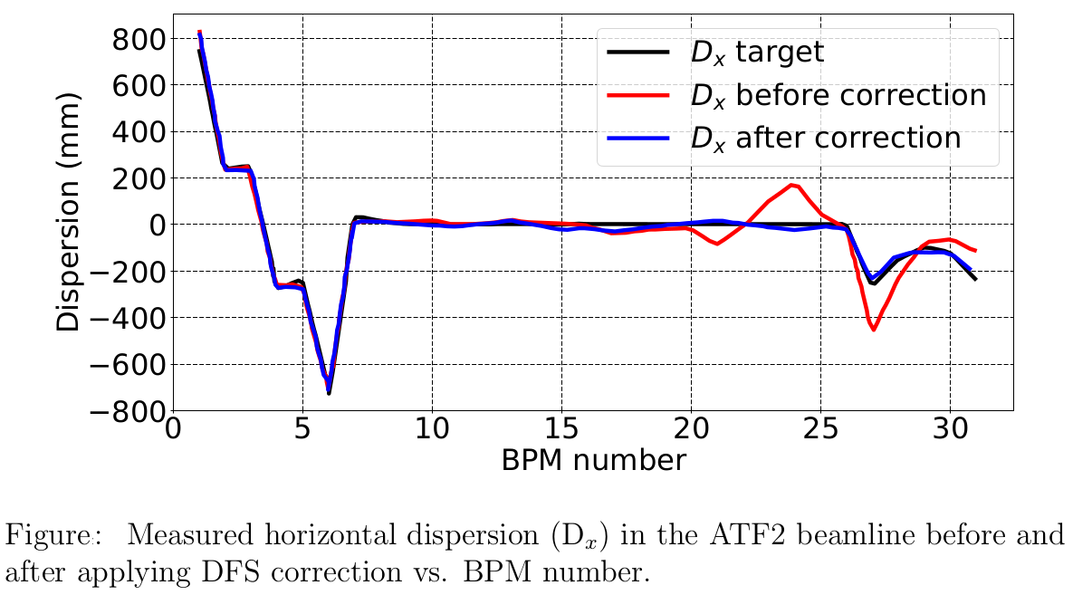
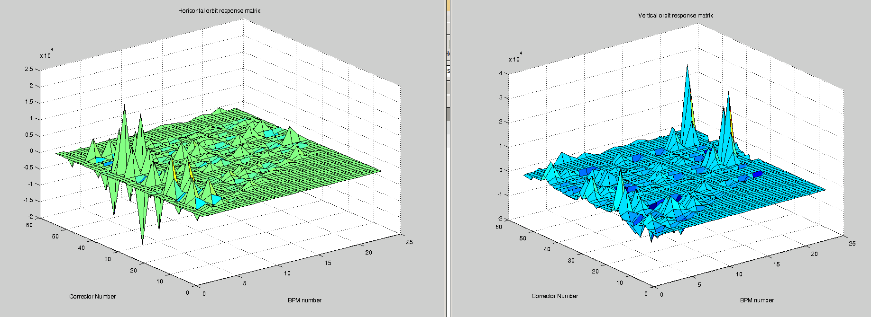
DFS in the ATF2 Beamline
To change the beam energy in the ATF2 beamline, the DR Delta-F is decreased by 2 kHz:
Response Matrix for DFS in the ATF2 Beamline with R0 (nominal energy) and R1 (lower energy)
R1 – R0
P. Korysko - ATF Project Meeting - Nov. 28, 2025
12

Slide 13
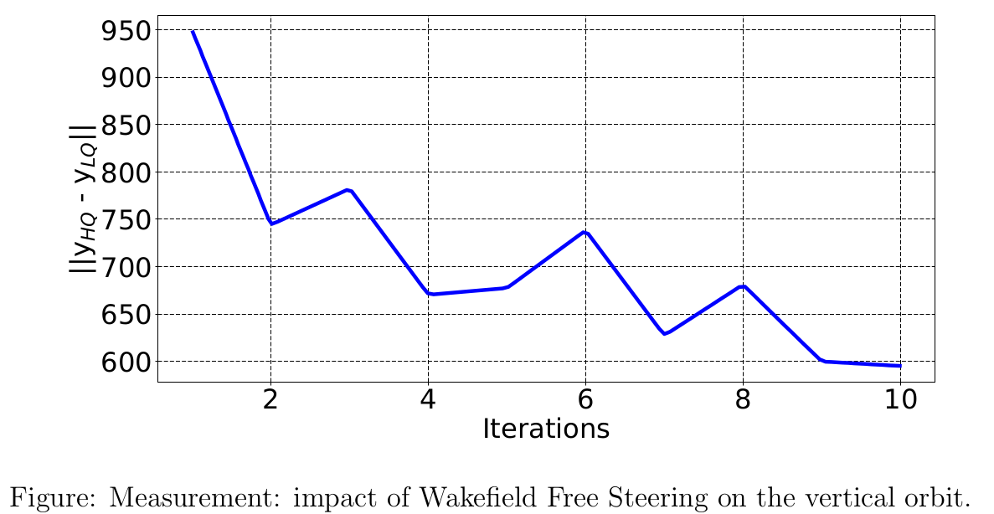
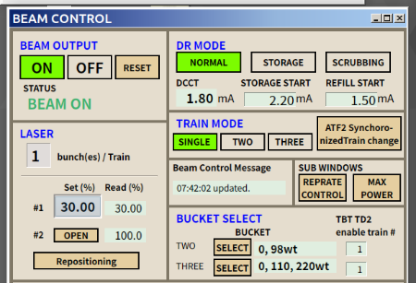

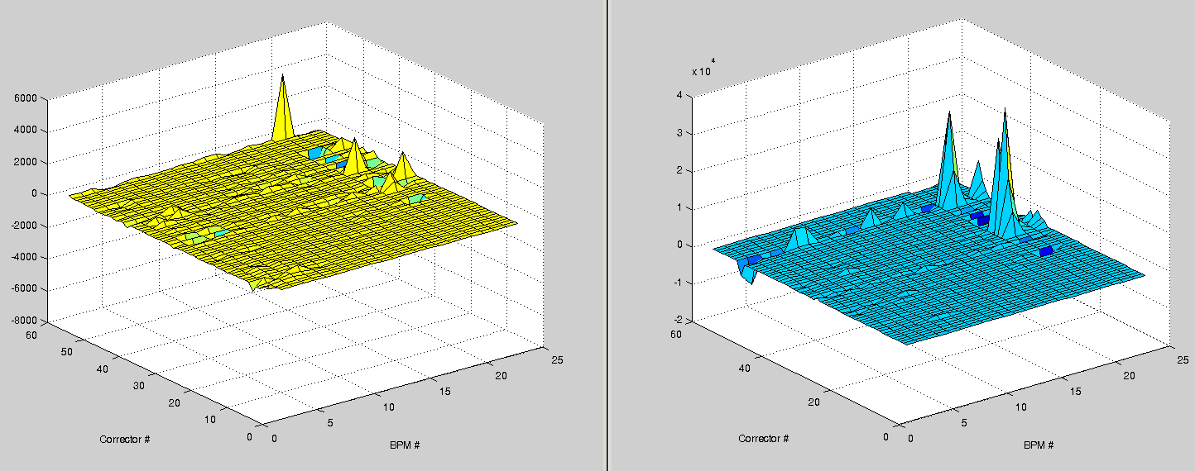
WFS in the ATF2 Beamline
To change the beam charge in the LINAC/ATF2 beamline, the Laser amplitude is decreased by 20%:
Response Matrix for WFS in the ATF2 Beamline with R0 (nominal charge) and R1 (lower charge)
R1 – R0
P. Korysko - ATF Project Meeting - Nov. 28, 2025
13

Slide 14
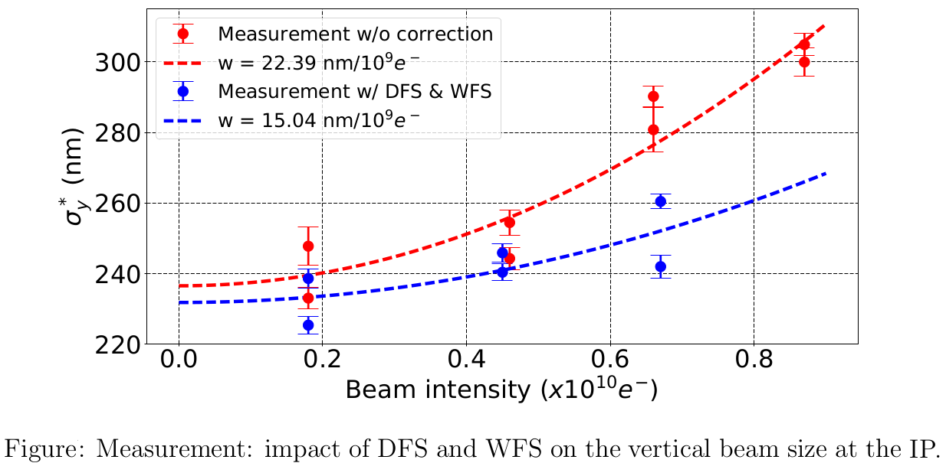
DFS and WFS Impact
P. Korysko - ATF Project Meeting - Nov. 28, 2025
14

Slide 15
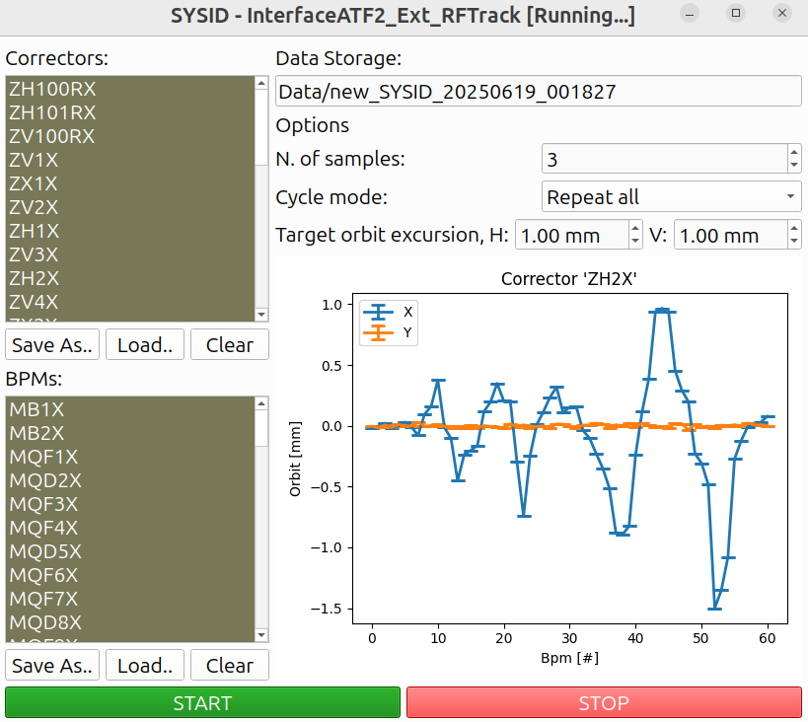
RF-Track Simulations Interface
RF-Track is a tracking code developed at CERN for the design and optimisation of particle accelerators, offering outstanding flexibility and rapid simulation speed.
Path to file
List of
correctors
to use.
Maximum transverse orbit excursion
List of
BPMs
to use.
https://gitlab.cern.ch/rf-track
P. Korysko - ATF Project Meeting - Nov. 28, 2025
15

Slide 16
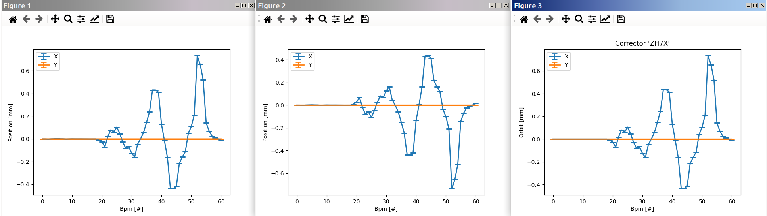
RF-Track Simulations Interface
Simulation of the excitation of ATF2 beamline correctors with RF-Track:
https://gitlab.cern.ch/rf-track
P. Korysko - ATF Project Meeting - Nov. 28, 2025
16

Slide 17
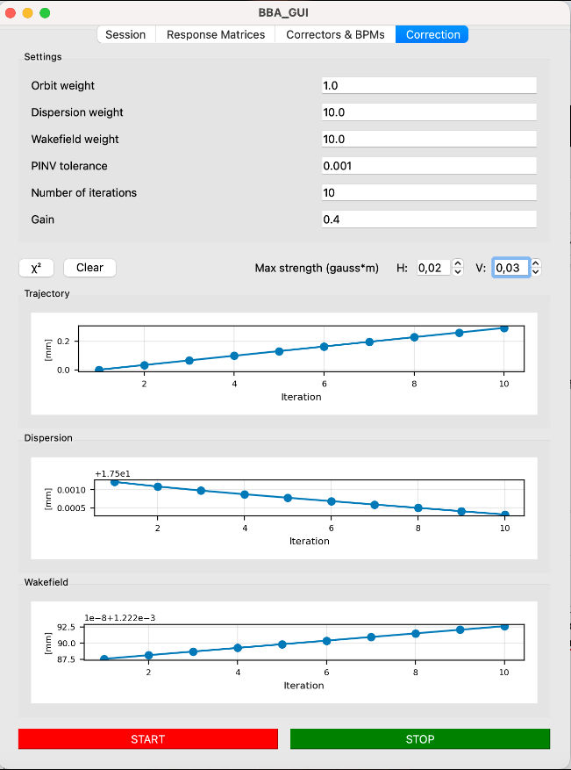
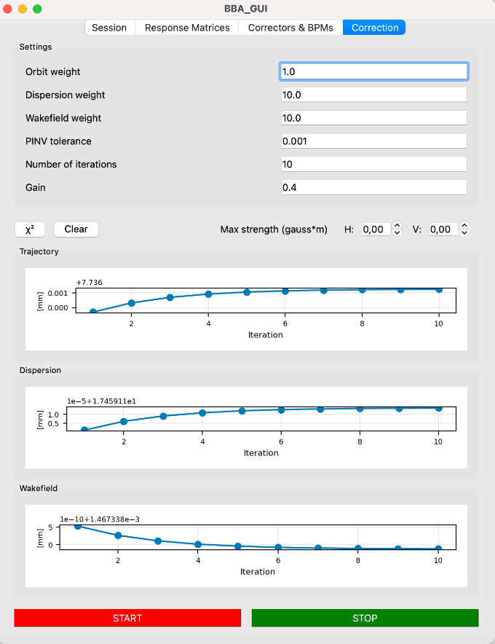
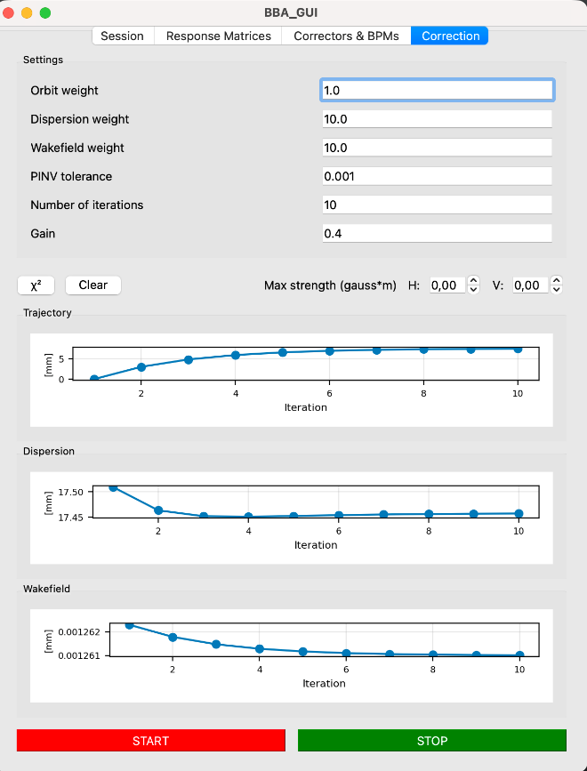
RF-Track Simulation Results
Simulations of the one-to-one/DFS/WFS corrections with RF-Track:
P. Korysko - ATF Project Meeting - Nov. 28, 2025
17

Slide 18
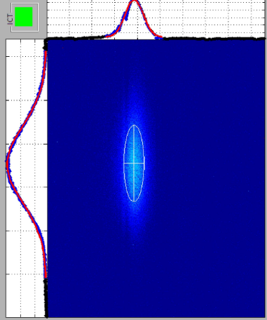
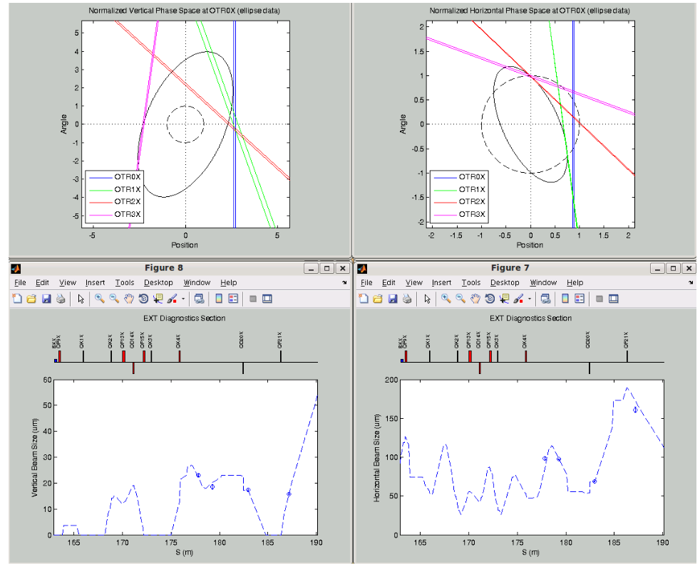
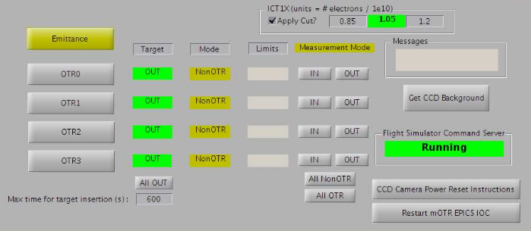
Next Steps?
The following modules could be added to the CERN Flight Simulator:
Control of the mOTR system.
TWISS parameters measurement.
Emittance measurement.
GUI for CCD Cameras (OTR/YAG screens).
Wakefield Knobs.
EXT/FF Orbit Bump
P. Korysko - ATF Project Meeting - Nov. 28, 2025
18

Slide 19
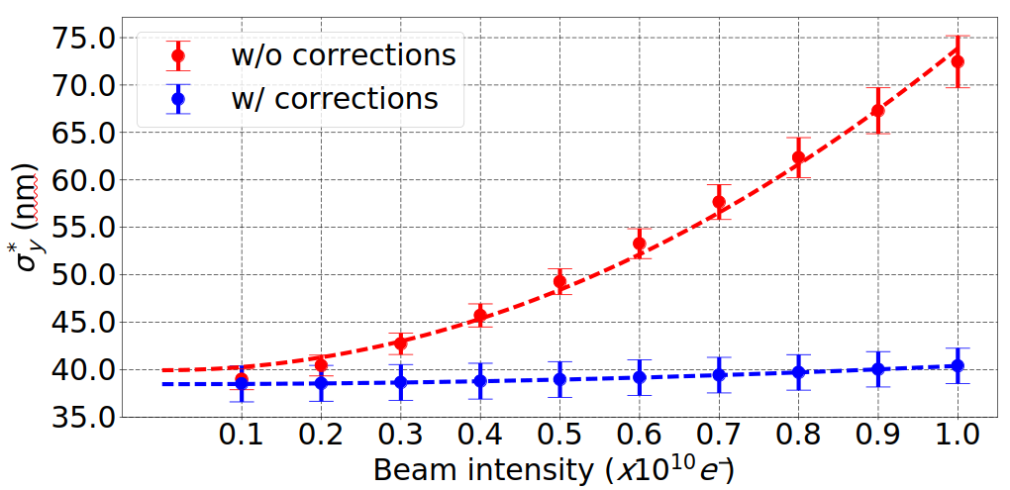
Towards ATF3 goals
The Flight Simulator and the embedded corrections will be useful tools to sustain a 37nm beam for couple days by:
Correcting the Dispersion and Wakefield effects.
Correcting the impact of the slow drifts.
Correcting the incoming position and angle jitters.
Simulation
P. Korysko - ATF Project Meeting - Nov. 28, 2025
19

Slide 20
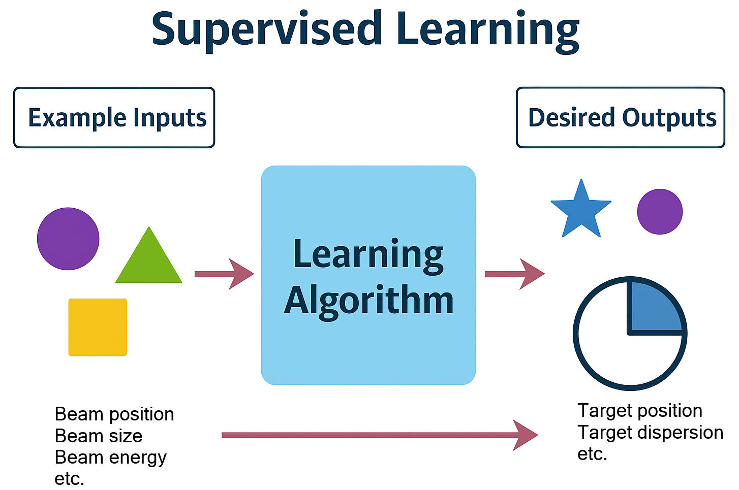
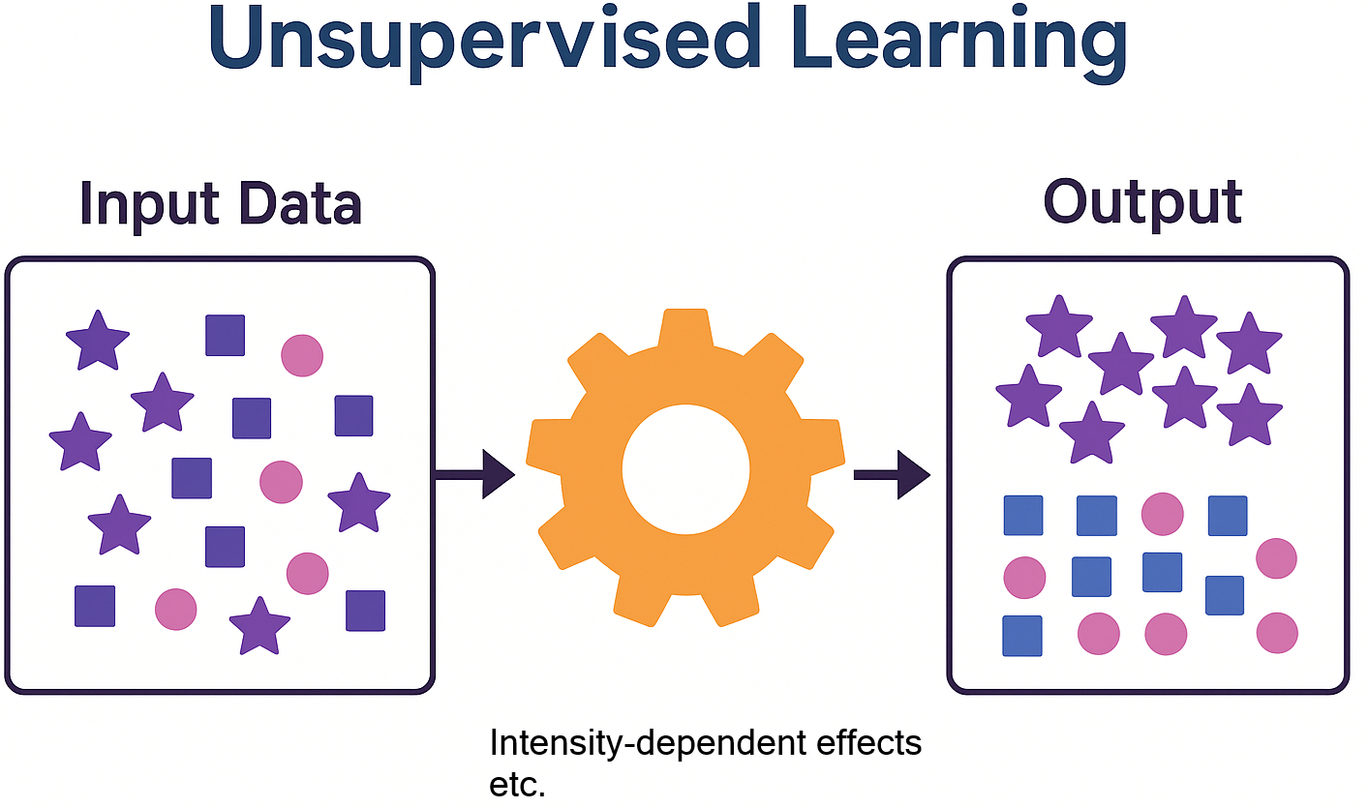
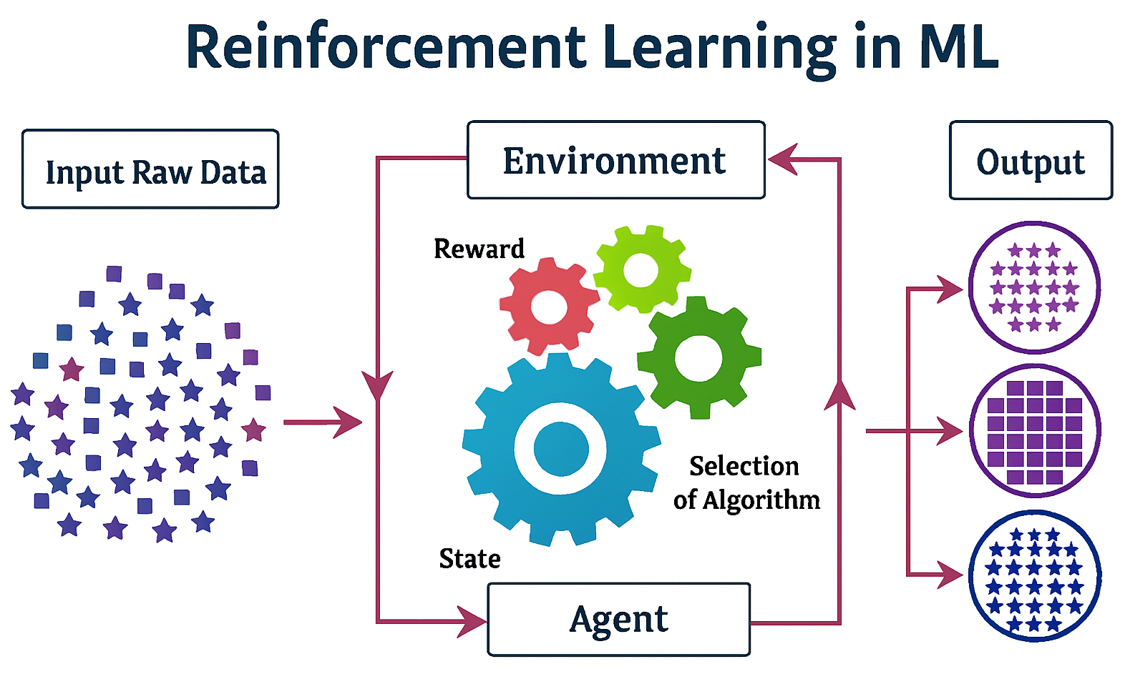
Plans for ATF3
Use of Machine Learning, directly implemented to the Flight Simulator for a better and faster tuning and correction. There would be 3 approaches:
Supervised Learning: The computer is presented with example inputs and their desired outputs (useful for corrections like one-to-one, DFS, WFS).
Unsupervised Learning: No labels are given to the learning algorithm, leaving it on its own to find structure in its input (useful to understand problems like intensity-dependent effects).
Reinforcement Learning: a raw data input is given to a “agents” who learn to make decisions by interacting with their environment.
P. Korysko - ATF Project Meeting - Nov. 28, 2025
20

Slide 21
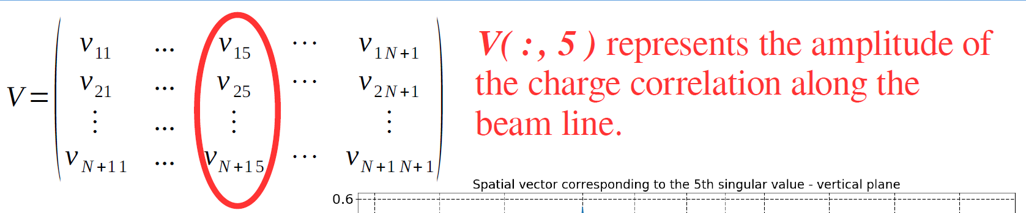
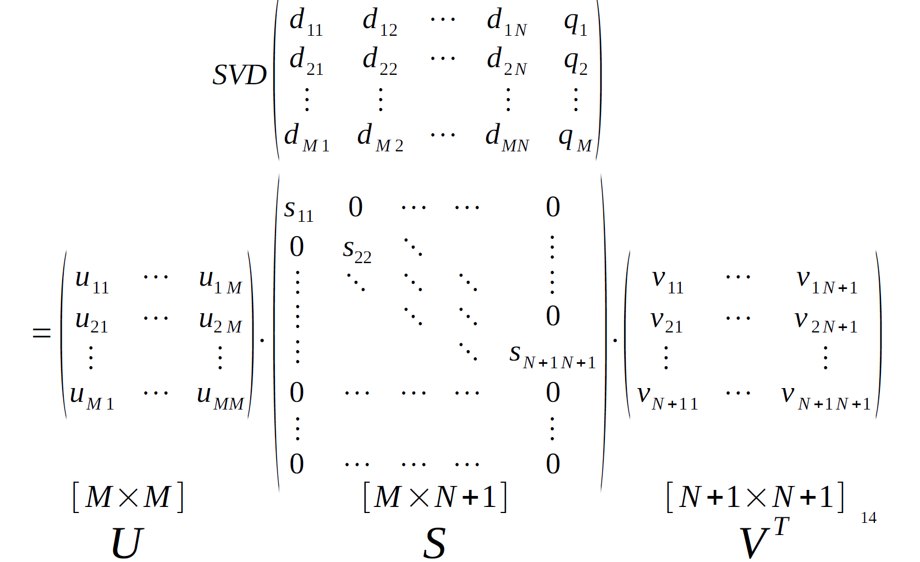
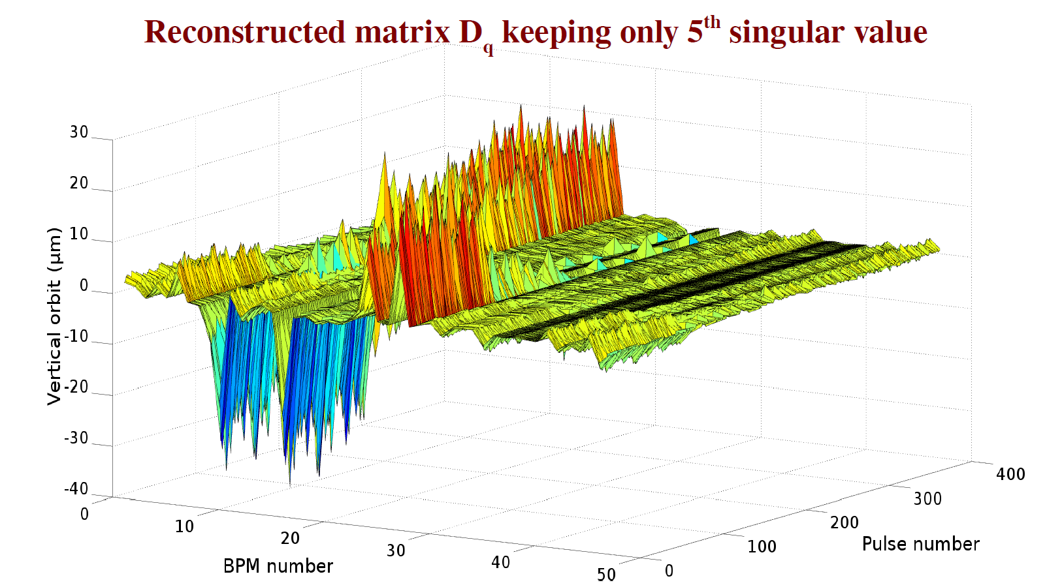
Plans for ATF3
Example of Unsupervised Learning: Singular Value Decomposition (SVD)
P. Korysko - ATF Project Meeting - Nov. 28, 2025
21

Slide 22
Conclusions
A new Python Flight Simulator has been developed and tested at ATF.
Dedicated tools for Response Matrix calculations and One-to-One correction were implemented in the Flight Simulator and give good results.
Other BBA corrections (DFS and WFS) were tested and give promising results.
They will soon be implemented in the Flight Simulator.
A new RF-Track interface has been implemented and tested to simulate, compare and optimise the results directly on the control room computers.
New tools could be implemented in the next version (mOTR system, emittance calculations, etc.).
Several Machine Learning techniques for tuning & corrections are being studied.
The Flight Simulator would be a useful tool to help achieving ATF3 goals.
P. Korysko - ATF Project Meeting - Nov. 28, 2025
22

Slide 23
Thank you

