Slide 1

ILD Status and News
Ties Behnke/ Kiyotomo Kawagoe
2025/12/02
ILD group meeting

Slide 2
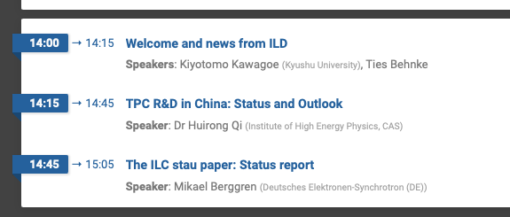
Agenda for today
K.K. chairs today’s meting, as Ties has became unavailable to attend it.

Slide 3
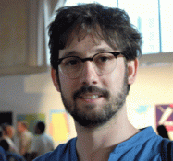
ILD organization
Election of new IA chair
Two candidates selected by the election board (chair: Juan Fuster)
Voting period: 2025 Nov 11-18
Adrian Irles has been elected with a small majority, and accepted.
Taikan Suehara has gracefully accepted the election result.
We would like to thank Daniel Jeans for his excellent work as IA chair for 5 years.
Next steps
election of spokesperson of ILD
Then: election of elected ET members
Then: formation of new management

Slide 4
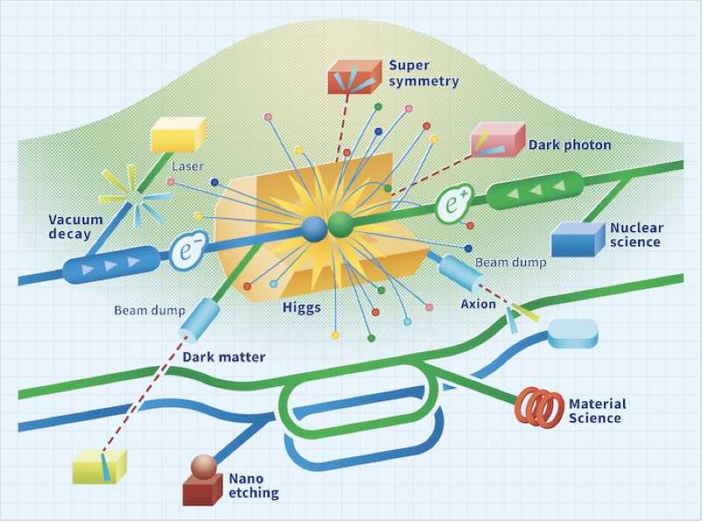
Linear Collider @ CERN workshop 2026
2026 January 7-9, CERN
Website https://indico.cern.ch/event/1602105/
Registration deadline December 15, remote participation possible
Already more than 100 people registered
Some number of people from CERN accelerator group have registered
Large part will focus on accelerator and project planning: there will also be talks and discussion sessions on detector

Slide 5

9th FCC Physics WORSHOP
2026 January 26-30, @ MPI Munich
Website https://indico.cern.ch/event/1588696/
Registration deadline December 15
Request for an ILD talk: Daniel Jeans will give the talk.
There will be other related talks, such as TPC R&D

Slide 6
Agenda for today

