Slide 1
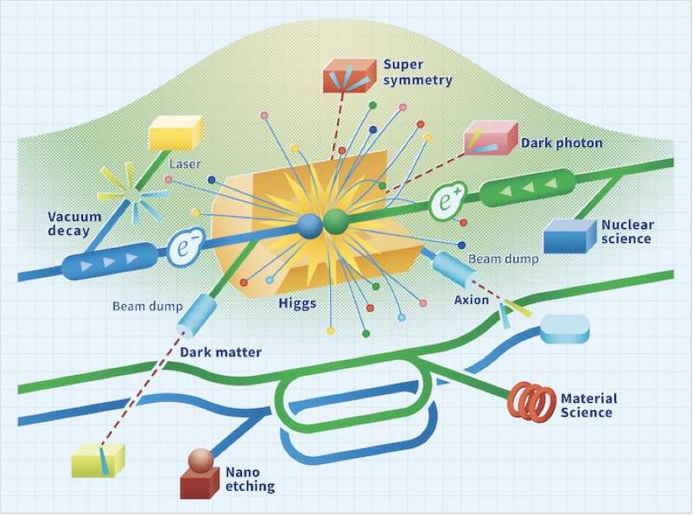
LCF@CERN
B. List
IDT WG2 Meeting
9.12.2025

Slide 2
ESPPU Status and Work Plan for CERN
Last week Dec 1-5 ESG drafting session in Ascona
This week CERN council -> Expect some statement on Friday Dec 12
Work plan for CERN activities has been prepared:
Assume a linear collider project (technology choice may be SRF, or CLIC, or undefined)
Assume budget ~35MCHF over 3 years 2026-2028, as in ESPPU submssions
Structure (WP definitions given here for SRF case):
WP1: Accelerator design and parameters Updated start-to-end simulations, injectors, damping rings, RTML, main linac and BDS for initial parameters and upgrades.
WP2: Implementation – Civil Engineering and Conventional Systems Siting incl. shaft/access points, CE layout and infrastructure for the machine. Study of tunnel diameter.
WP3: Technology developments (together with ITN) SCRF including cryomodule components. Klystrons, positron source, ATF, Damping Rings, Crab cavitiess, dumps.
WP4: Beyond Collider and Upgrade Options Studies of the implications for civil engineering and the equipment used in the initial facility, in order to allow collider upgrades in the future (e.g. C3, plasma, energy recovery), and to accommodate the "beyond colliders" programme.
WP5: Management Management of the project. Deliverables: Project plan, costs, schedule, risk assessment, LCA; planning of phase II

