Slide 1
The Lund-group:
Leif Jönsson (retired)
Björn Lundberg (electronics, self- employed, previously the Lund group)
Ulf Mjörnmark (retired, research engineer)
Jonas Nilsson (FPGA-programmer, self-employed)
Anders Oskarsson (retired)
Lennart Österman (electronics)
Matthias Holl (physicist, research engineer)
Blahoslav Rataj (PhD student)

Slide 2
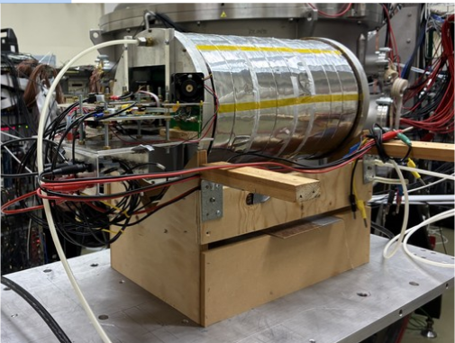
TPC Prototype - Overview
Cylindrical prototype
Ar/CO2 mix
Projected track length 10cm
Longest drift 23cm
Readout:
Triple GEM
Zigzag pad plane
SALTRO + MCM + SRU

Slide 3
Beamtest for HIBEAM in December 2025 at CCB Krakow
Test of TPC with zig-zag pads
Data for a large number of incident angles relative to drift field
Scintillator bars with WLS fiber and SiPM readout for calorimetry
TPV
TPC
Pair of trigger scint
p,d
190 MeV protons
Scint bar
CD2
target
p,d

Slide 4
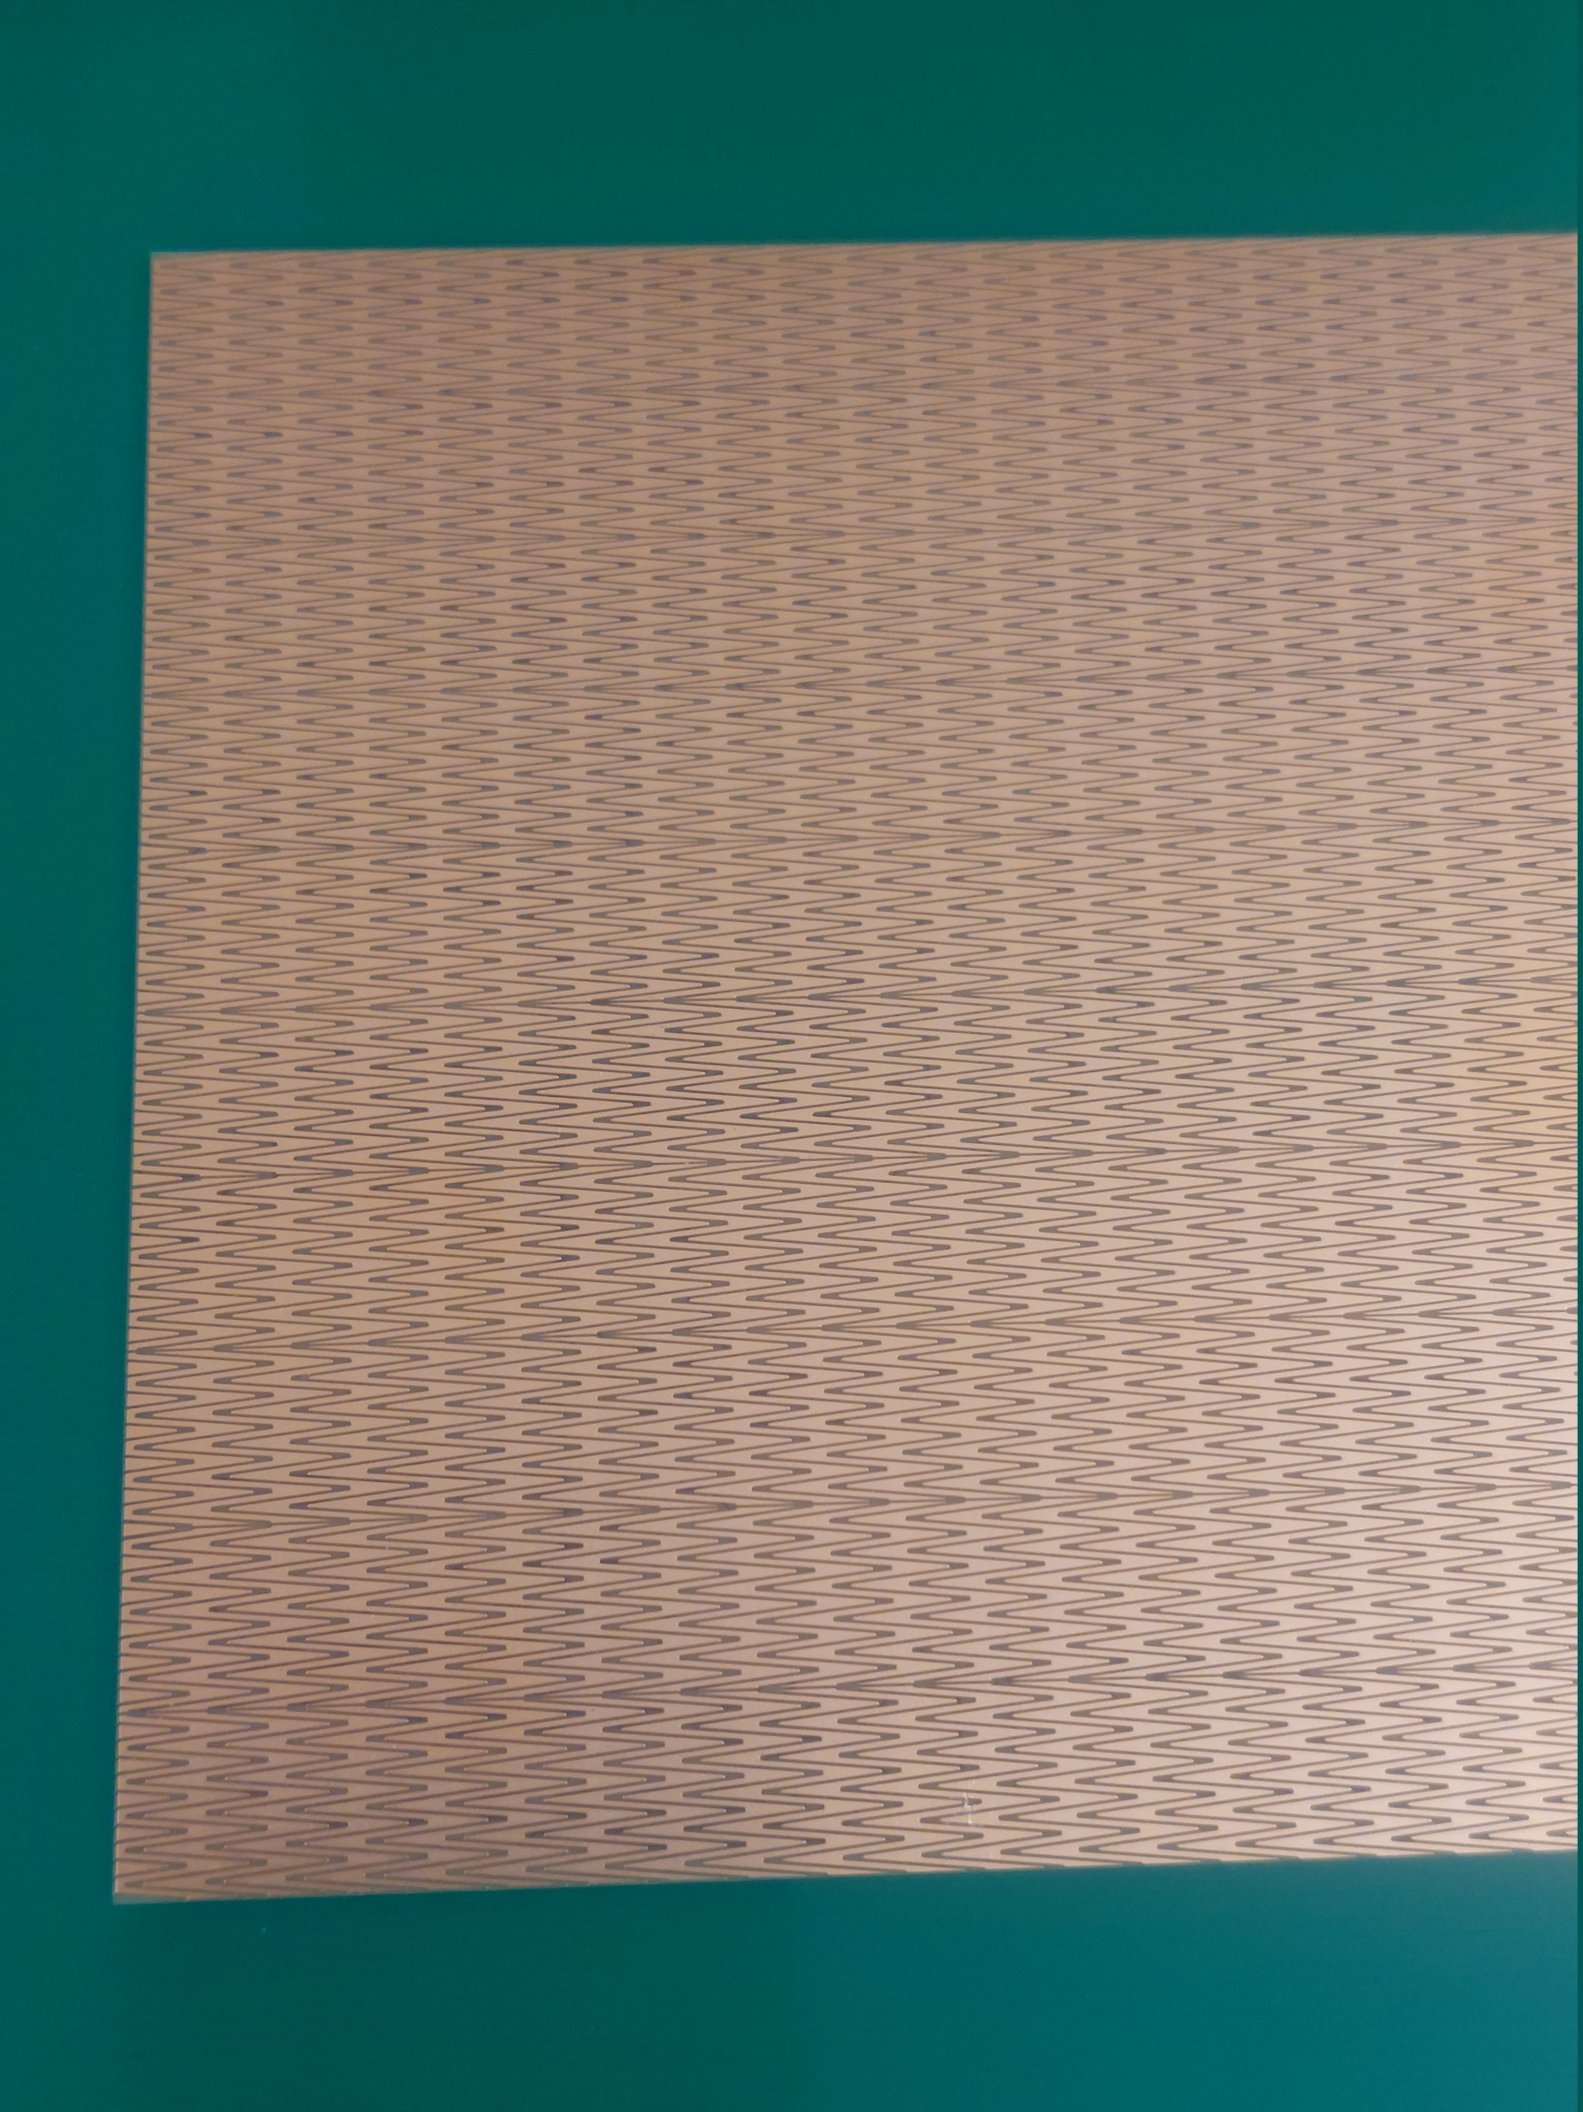
The new Pad Plane
10 mm
4 mm

Slide 5
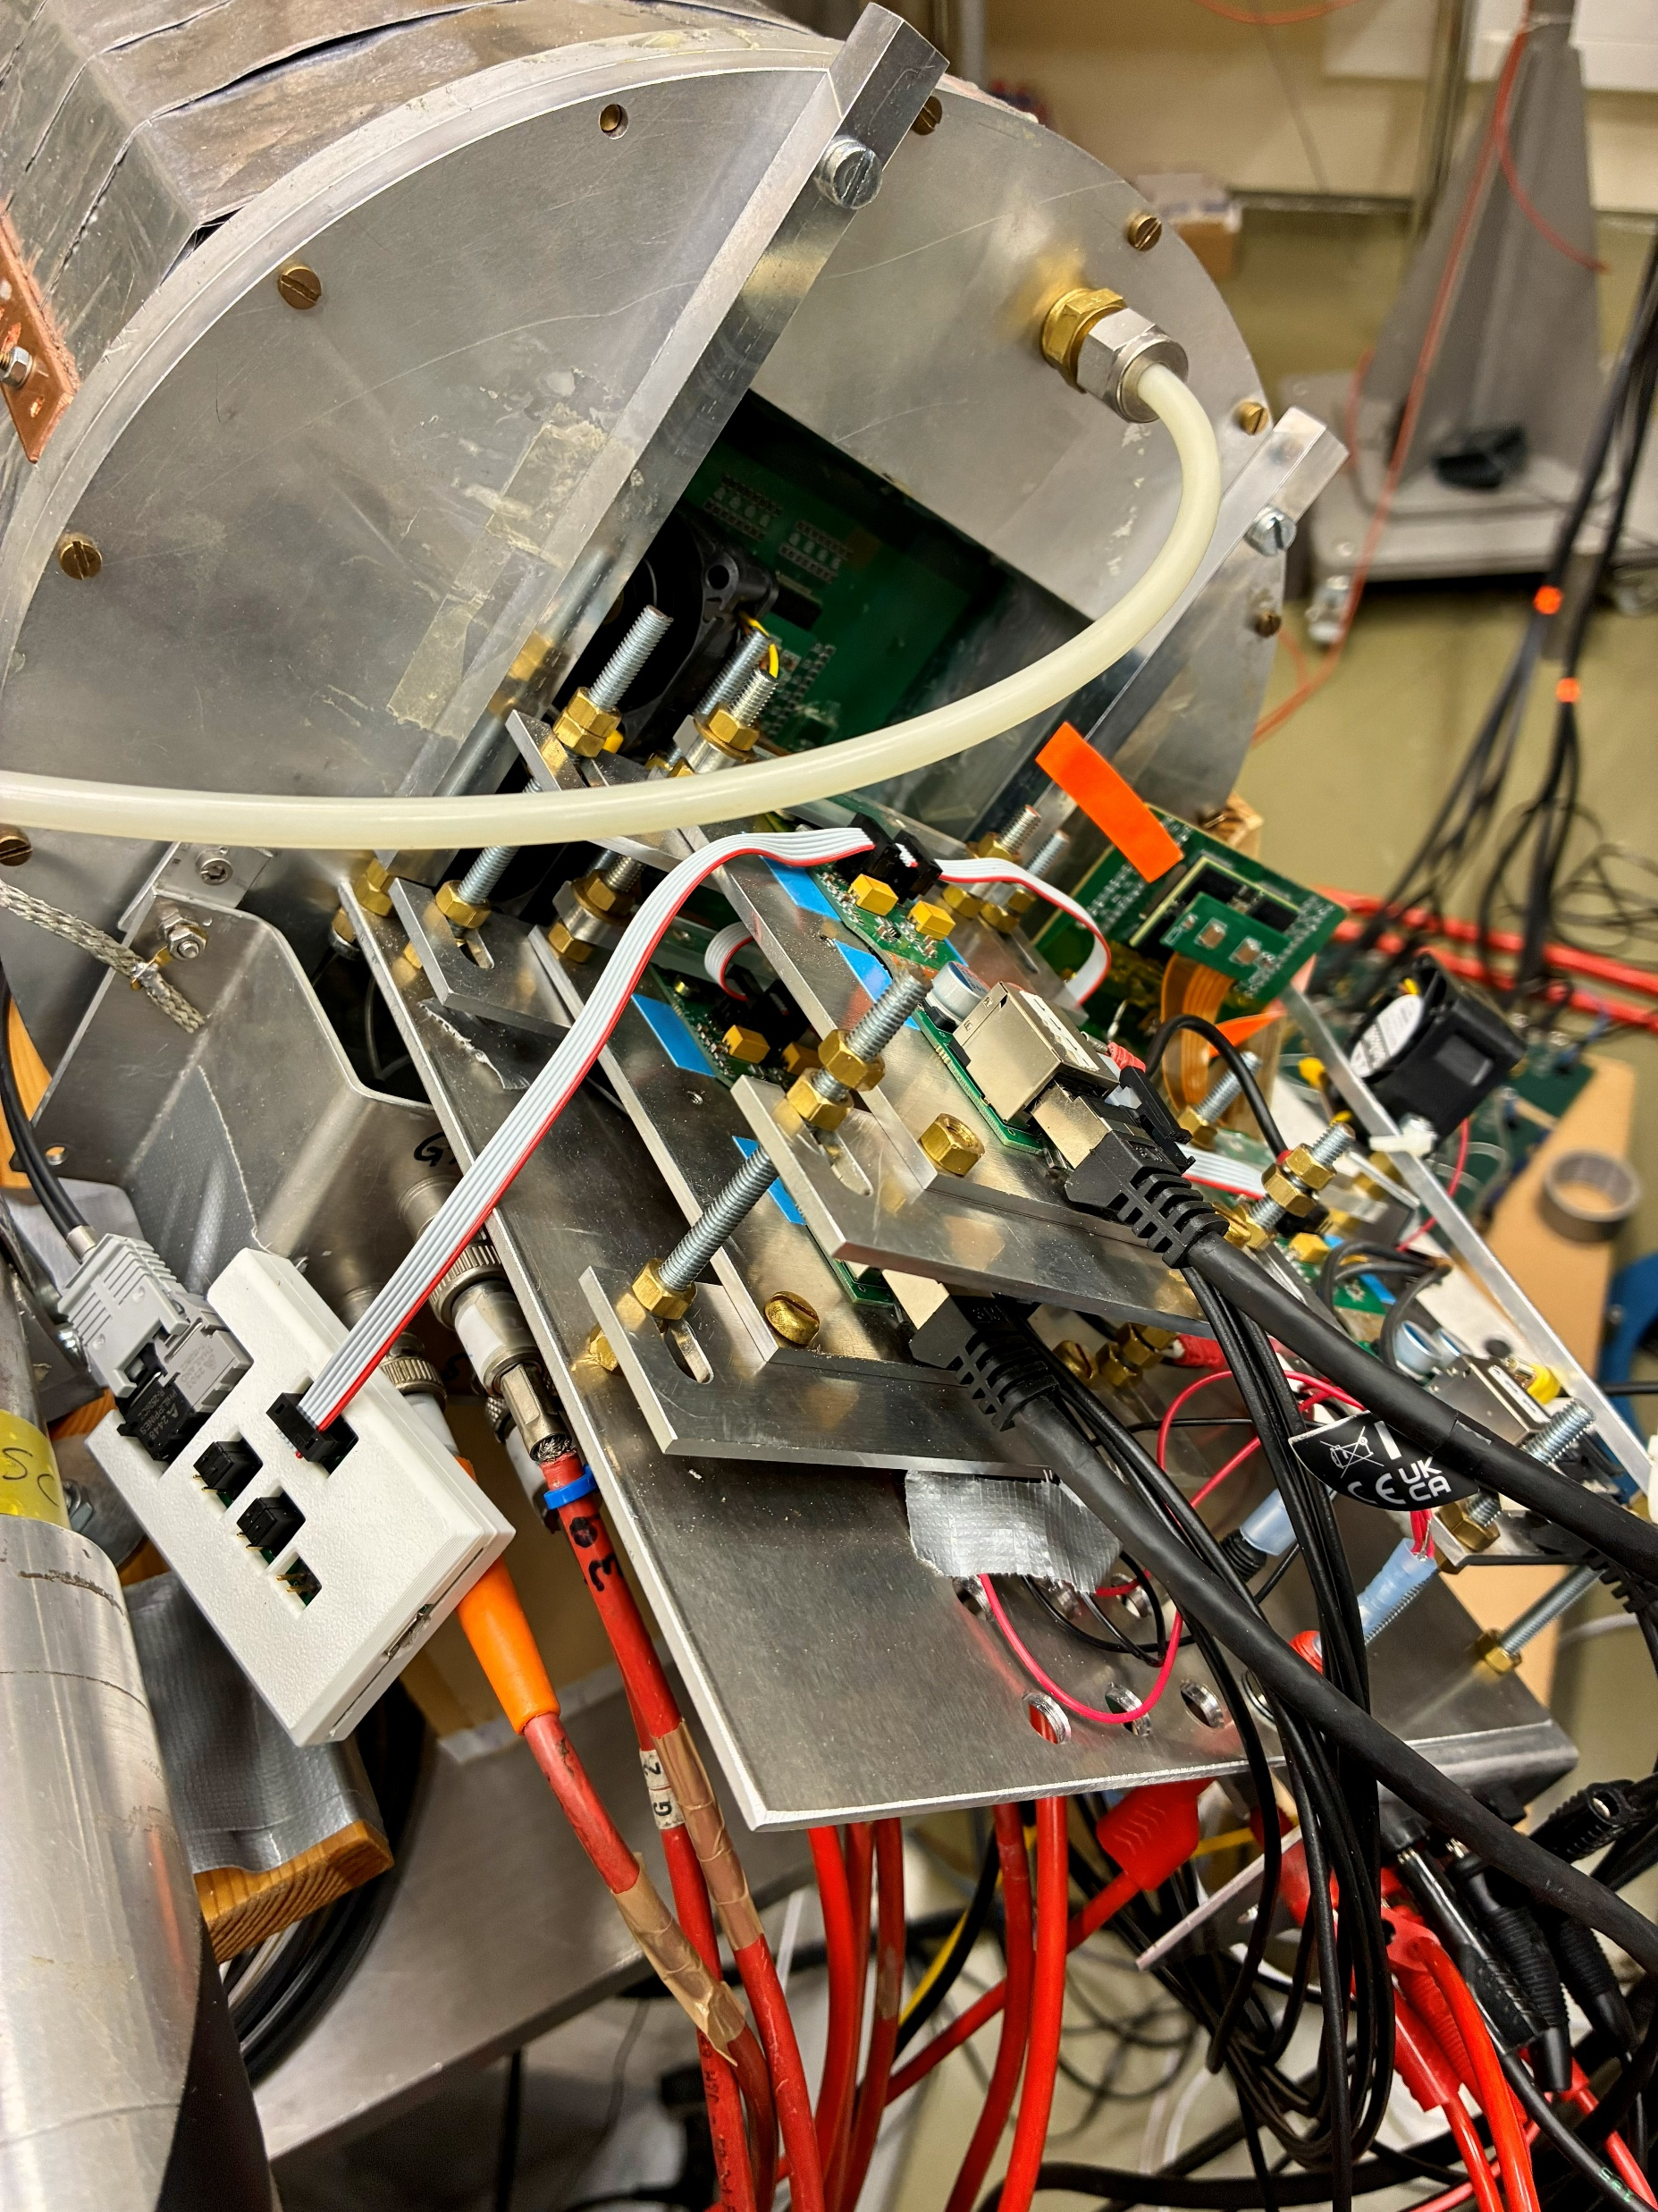

Slide 6
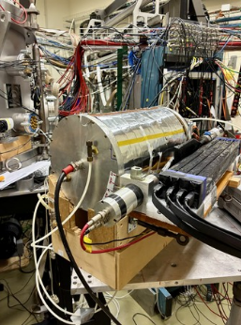

Slide 7
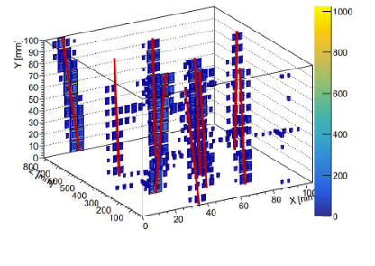

Slide 8
The principle of charge division with zigzag pads
1 cm
4 mm
Pad area

Slide 9
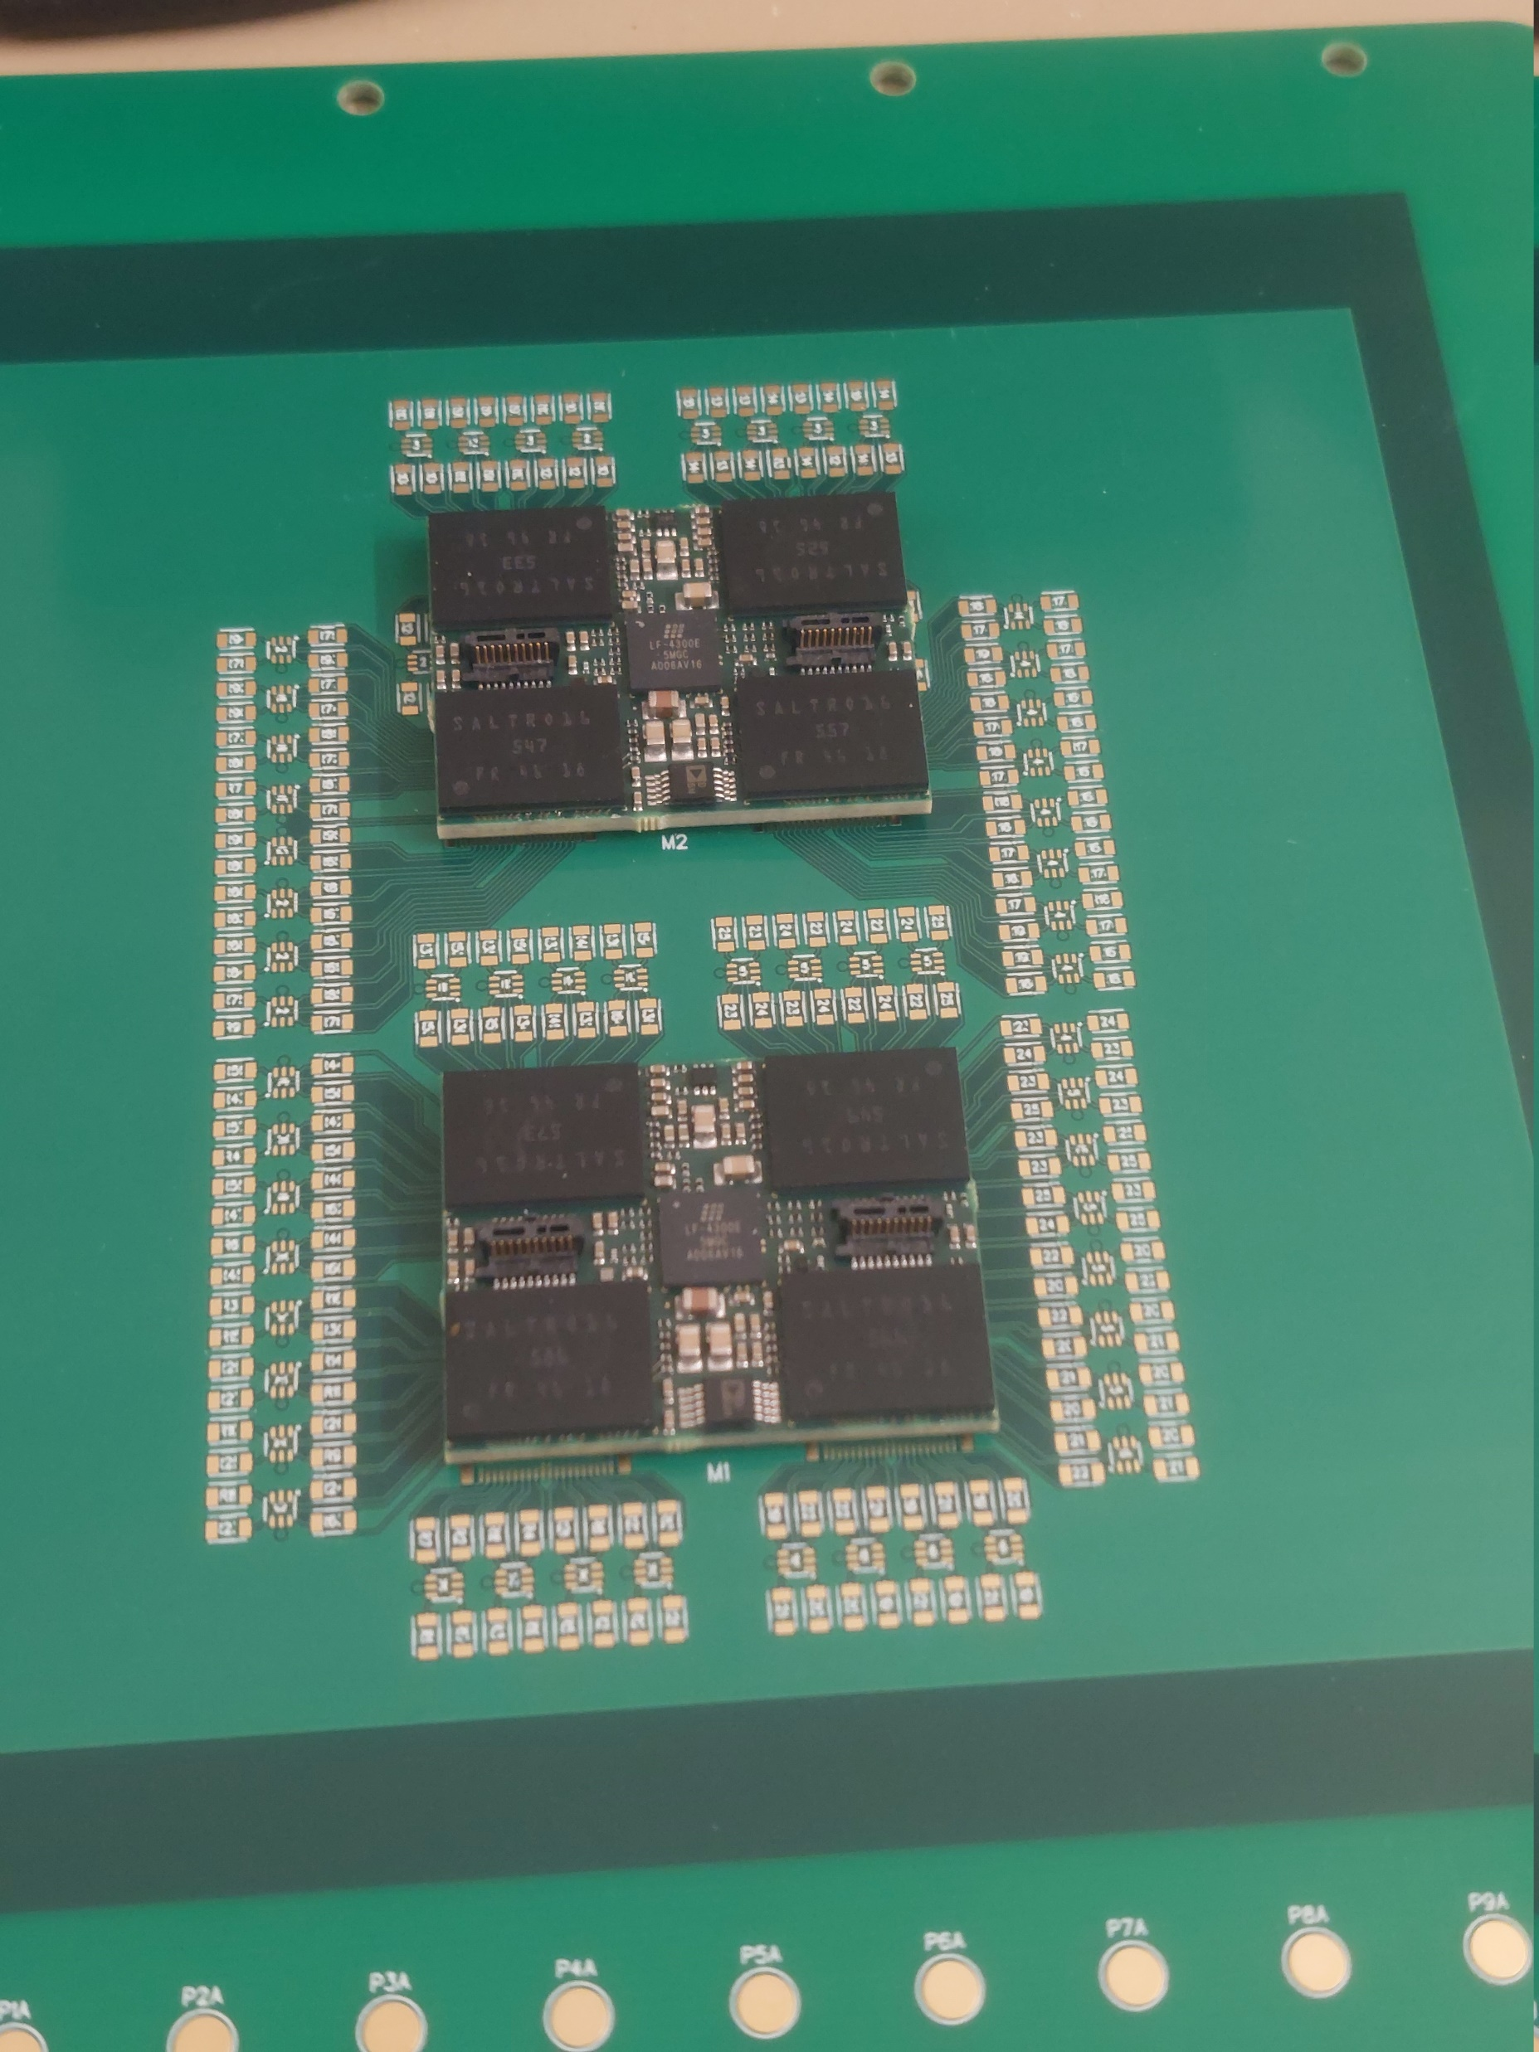
2 MCM boards mounted on the pad plane

