Slide 1
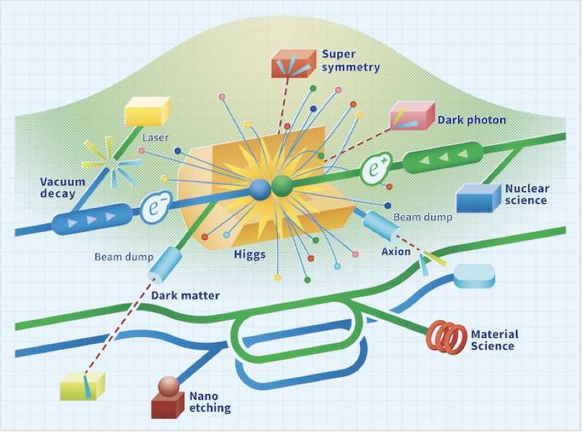
LCF@CERN
B. List
IDT WG2 Meeting
20.1.2026

Slide 2
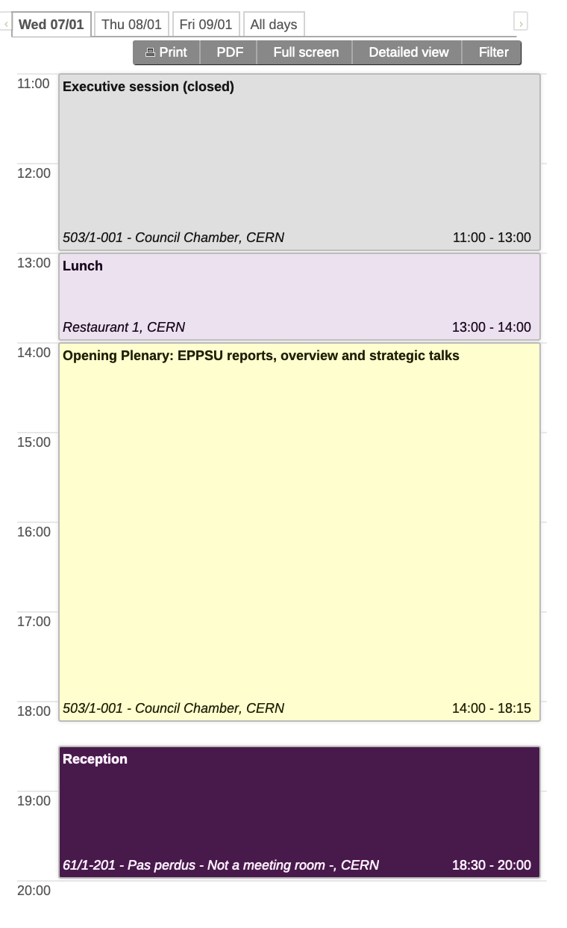
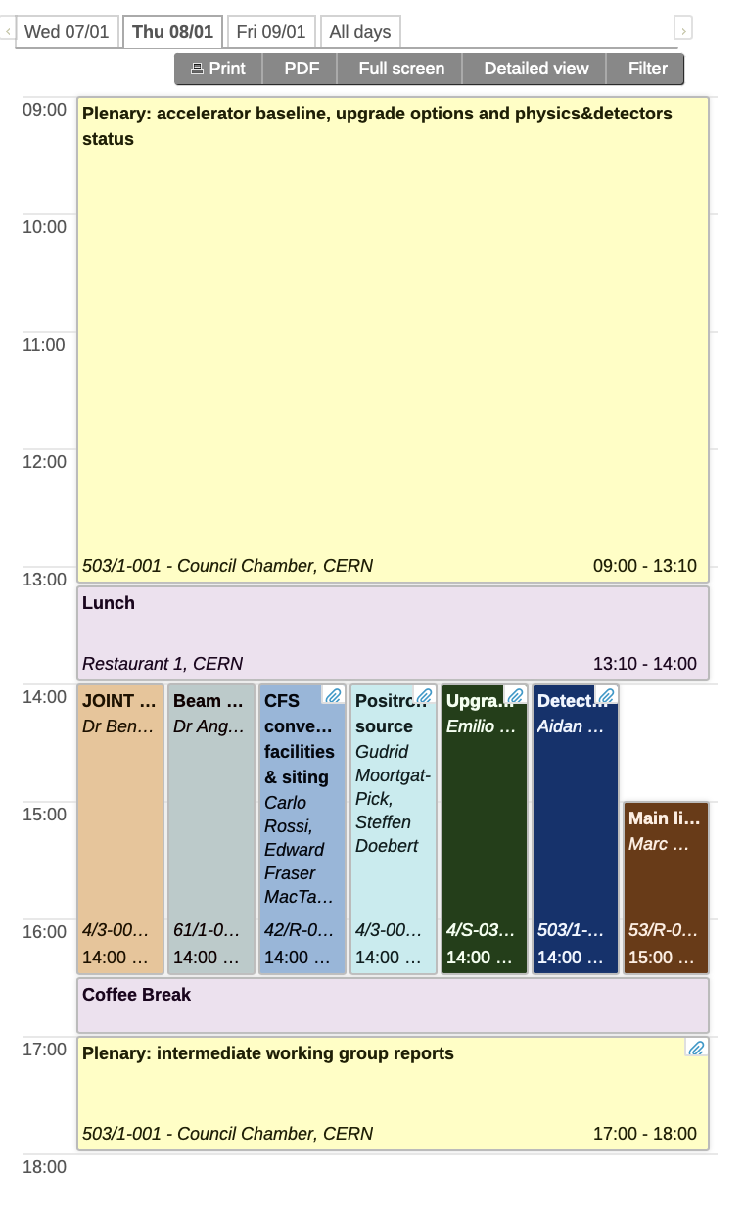
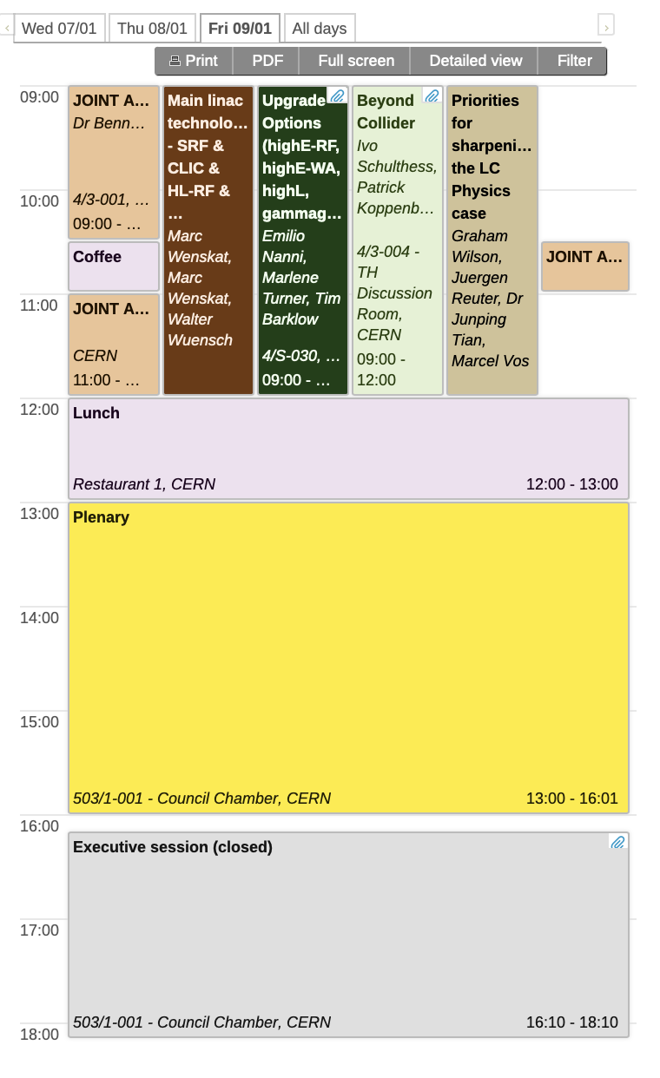
Linear Collider at CERN Workshop: Agenda
221 registered participants, about 80 in person
https://indico.cern.ch/event/1602105/

Slide 3
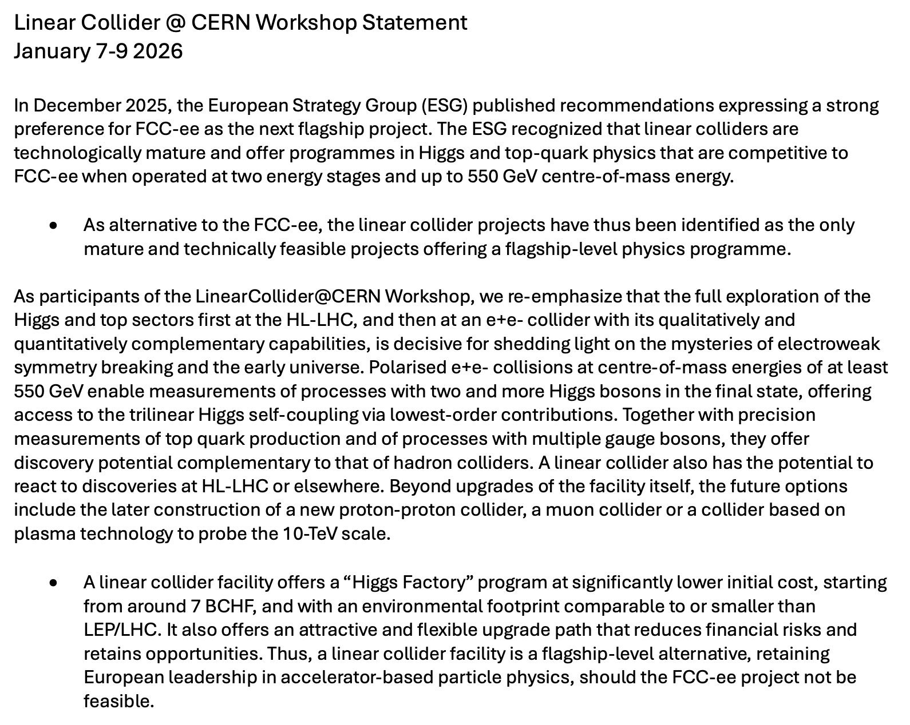
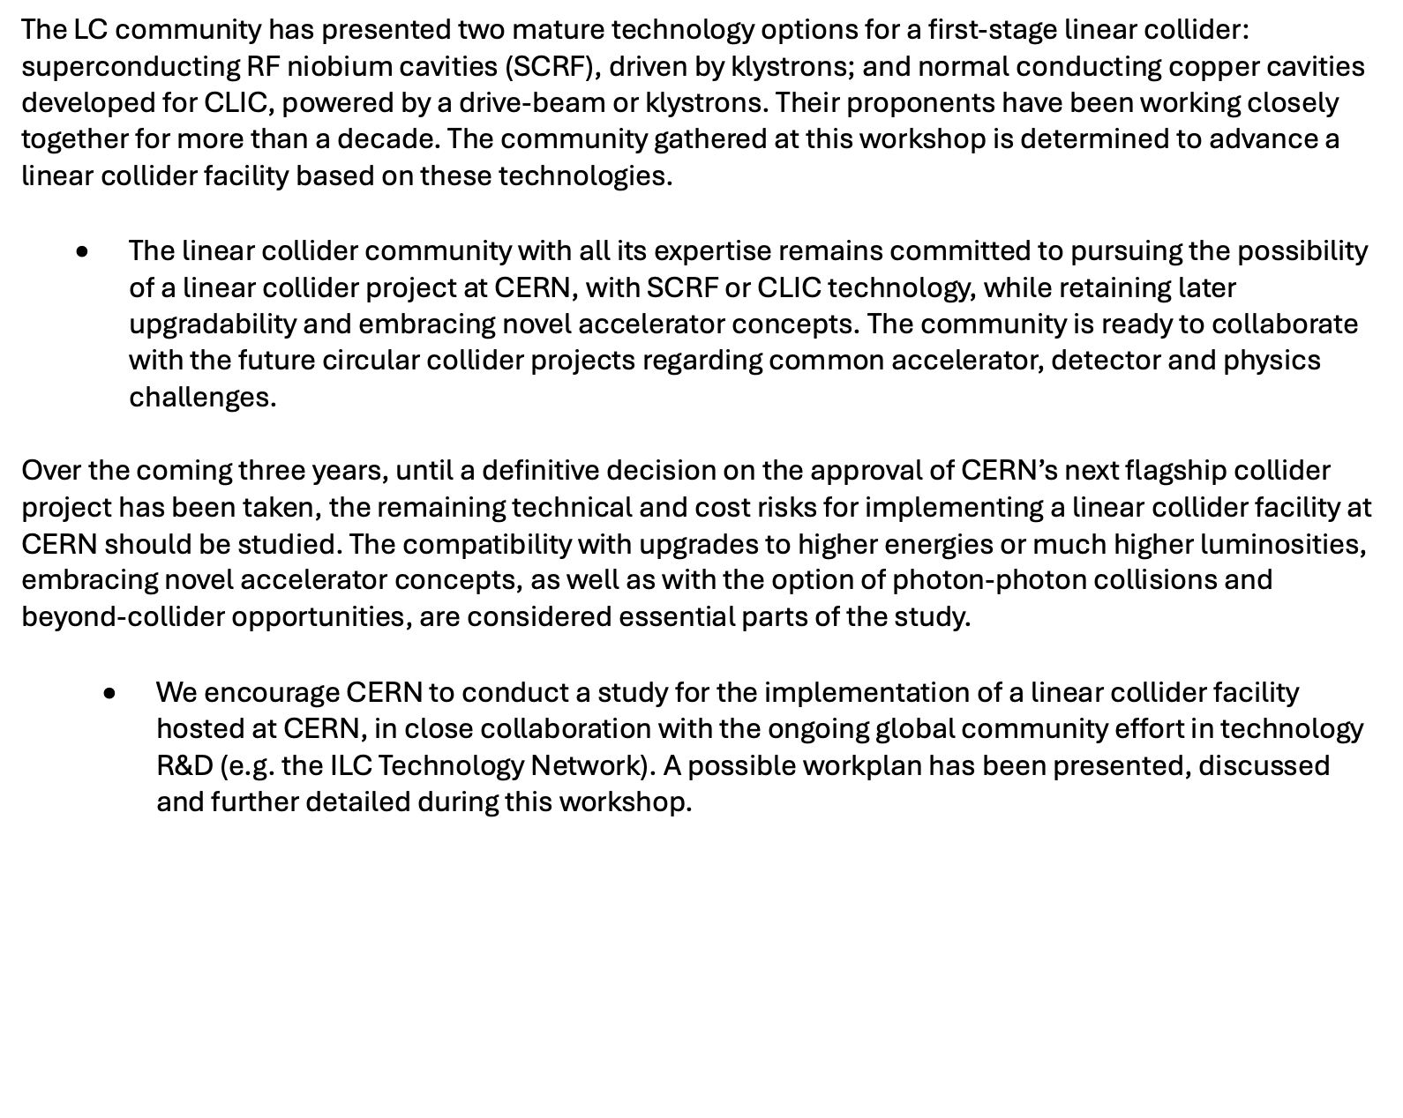
Workshop Statement
https://indico.cern.ch/event/1602105/attachments/3198205/5693101/LCatCERN_statement_final.pdf

Slide 4
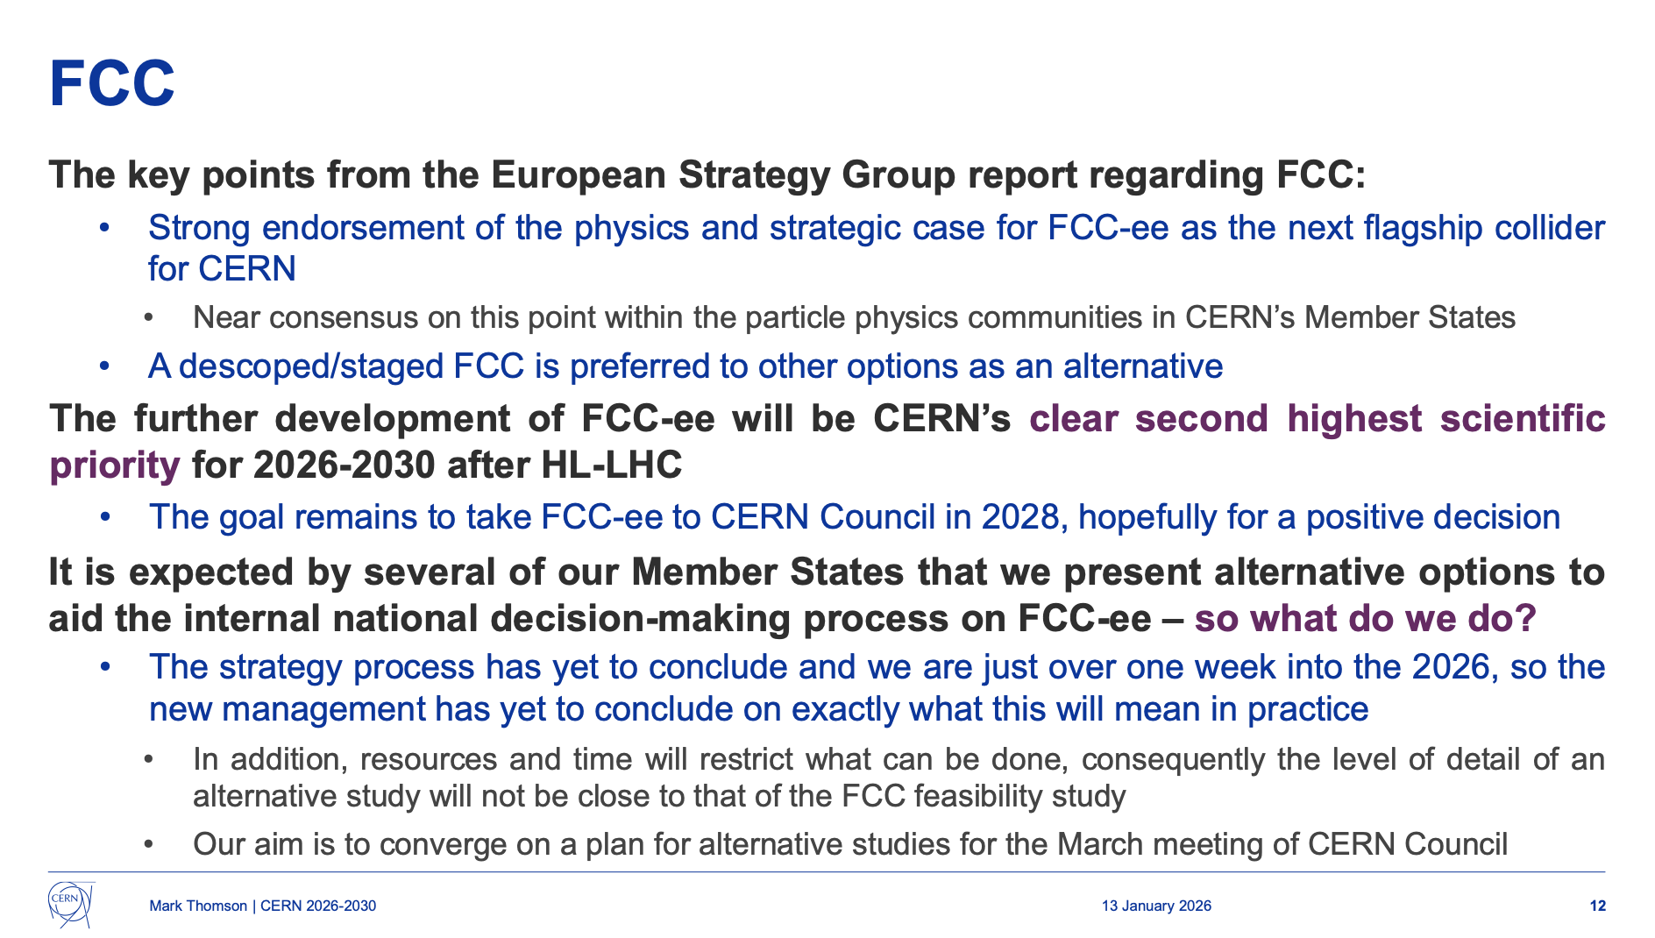
Linear Collider Work Plan
Welcome address by M. Thomson:
Clear commitment to FCC-ee as the CERN plan
Recognised need for a Plan B – to be defined in March
This was reiterated in New Years’ address to CERN staff by M. Thomson, and in ATS Sector meeting
We propose a linear collider as Plan B (LCF=superconducting or CLIC)
Requires a work plan for 2026-2028
Resources (esp. CERN resources)
Priorities
Synergies
Based on work plan prepared in December, taking into account results from the workshop
Focus on cost uncertainties and risk reduction
https://indico.cern.ch/event/1623724/

Slide 5
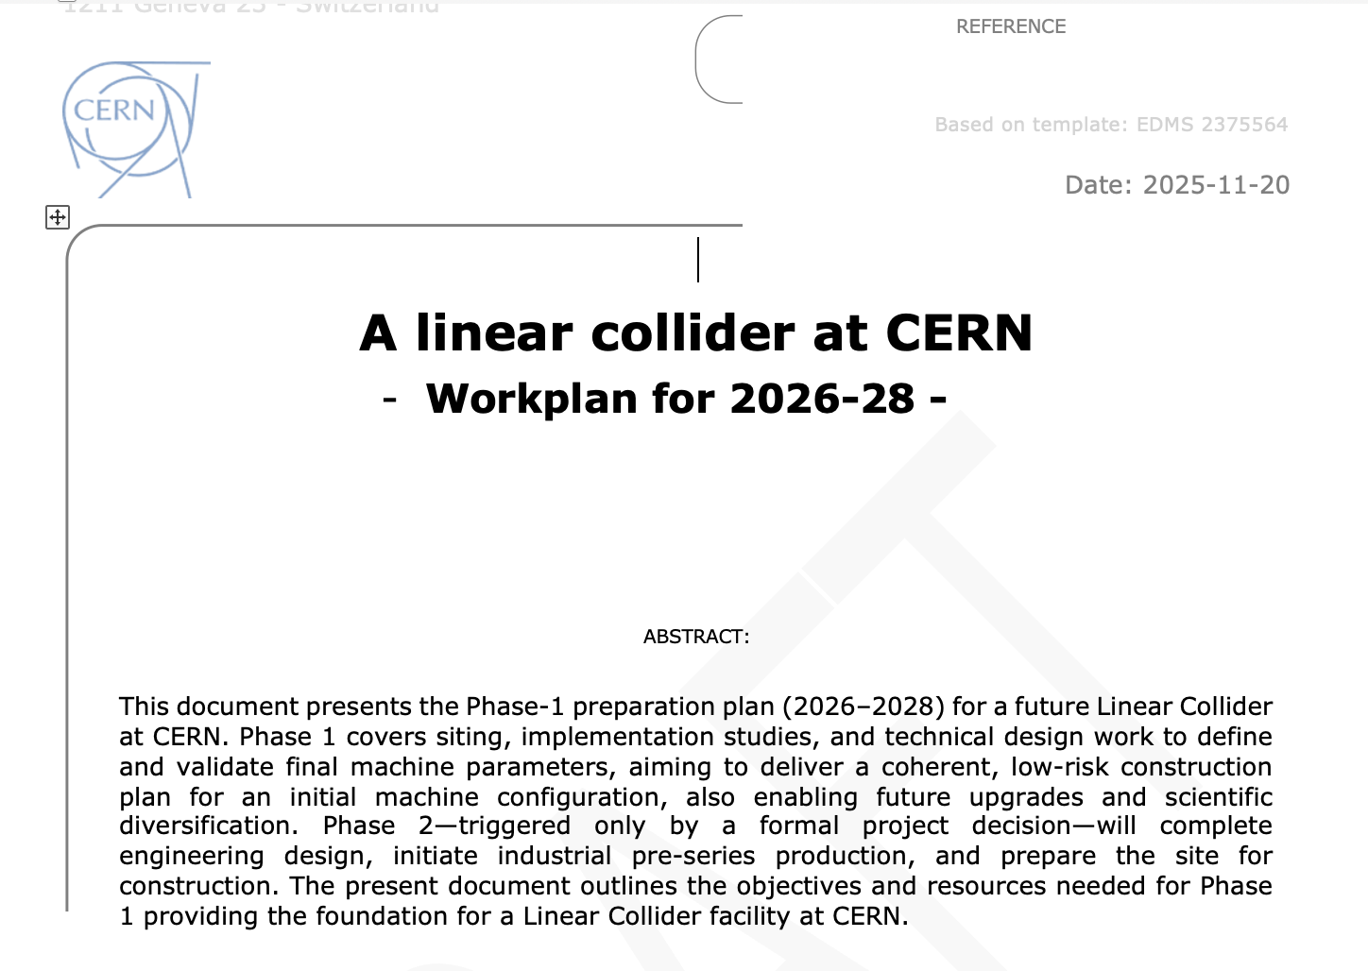
WP1 – Accelerator Design and Parameters
WG1 defines and validates final LC parameters for SCRF and NCRF options through updated start-to-end simulations. It delivers robust machine layouts, performance margins and upgrade scenarios, providing essential input to civil engineering, infrastructure, power and cost studies.
WP2 – Implementation: Civil Engineering and Conventional Systems
WG2 covers siting, tunnel and shaft layouts, and all conventional systems. It adapts existing CERN layouts to updated machine parameters and energy upgrades, delivering CE and infrastructure designs fully consistent with WG1.
WP3 – Technology Developments
WG3 addresses the main technical risks through targeted R&D on RF systems, drive-beam components, klystrons/modulators, positron sources, damping rings, crab cavities, beam dumps and key components. The objective is to reach TRL 6–7 via extensive international collaboration and shared funding.
WP4 – Beyond-Collider and Upgrade Options
WG4 ensures that the initial LC design remains compatible with future upgrades (plasma, energy recovery, gamma-gamma) and beyond-collider programmes by studying interfaces, civil-engineering implications and infrastructure flexibility.
WP5 – Management and Integration
WG5 provides overall project management and integration, delivering a coherent Phase-1 plan including schedules, costing, power and LCA estimates, risk management and preparation for Phase-2 decision making.
Requested/drafted in November (CERN focus)
In this WS:
Improve/detail and check
Prioritize
Syn-energies (other projects, R&D plans (i.e. LDG), ITN
CERN/wider community
Timeline
5/9
S. Stapnes https://indico.cern.ch/event/1602105/contributions/6836111/

Slide 6
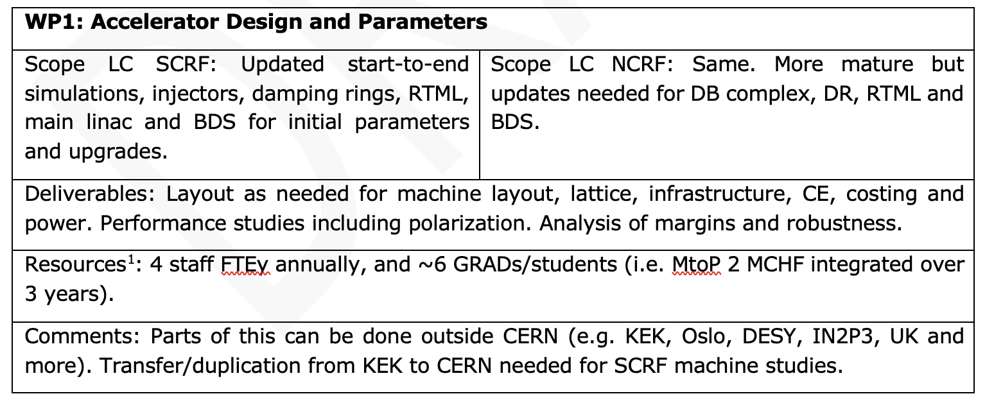
Concerning the footnote (applies to all WPs):
The resources are estimated for doing this work for one of the two options. Even though the studies and skills required are similar for two options doing both would add around 30-40%.
S. Stapnes https://indico.cern.ch/event/1602105/contributions/6836111/

Slide 7
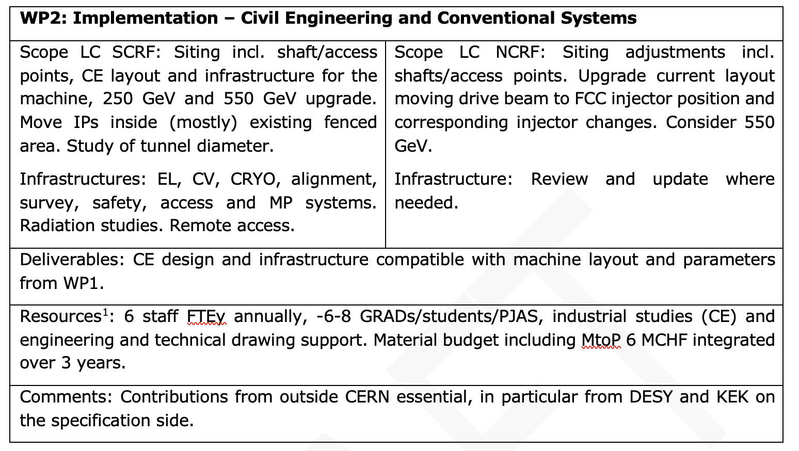
S. Stapnes https://indico.cern.ch/event/1602105/contributions/6836111/

Slide 8
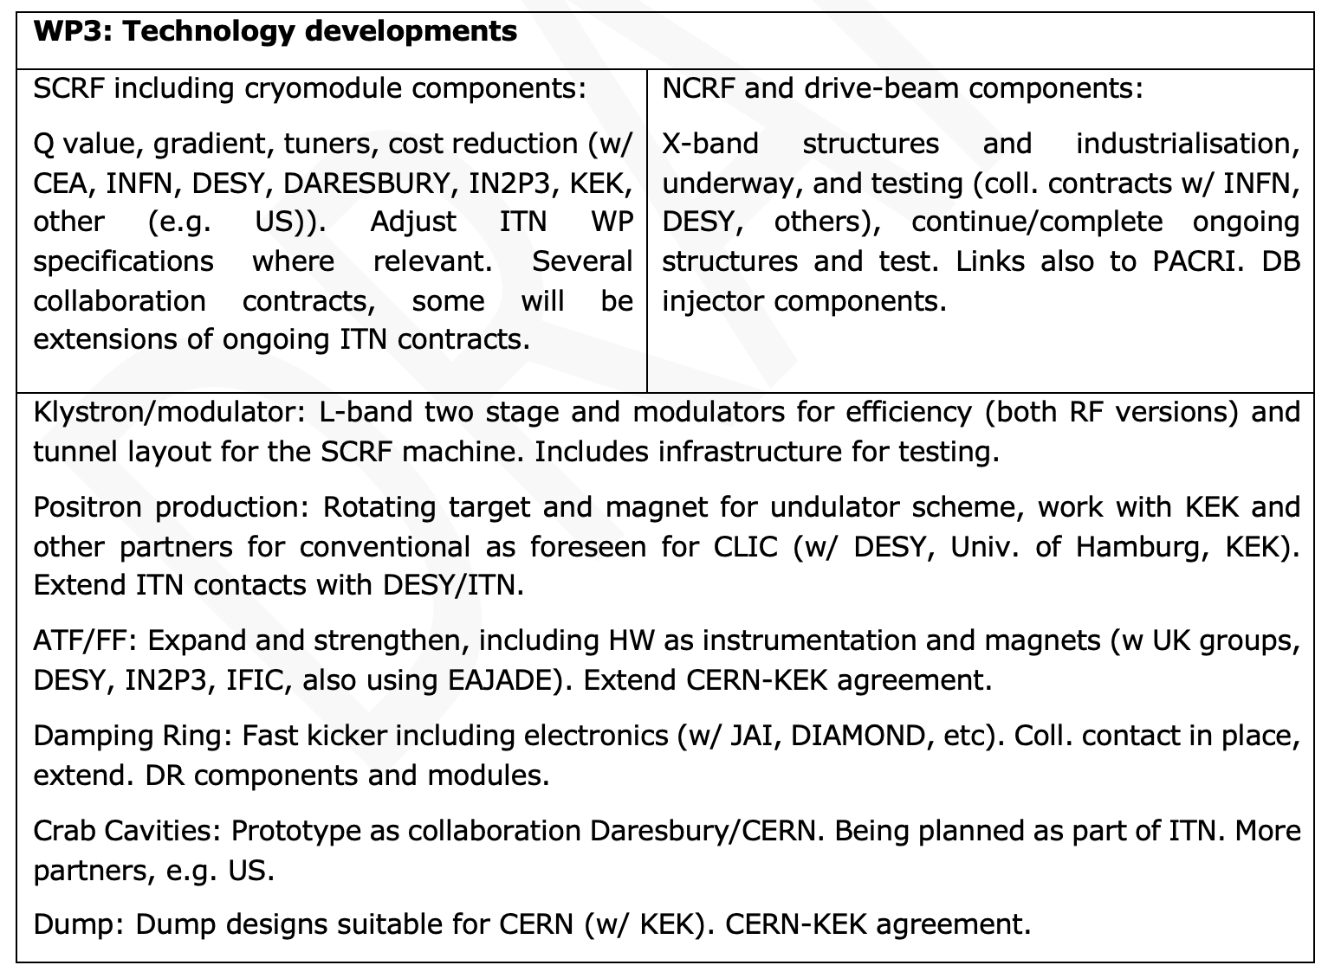
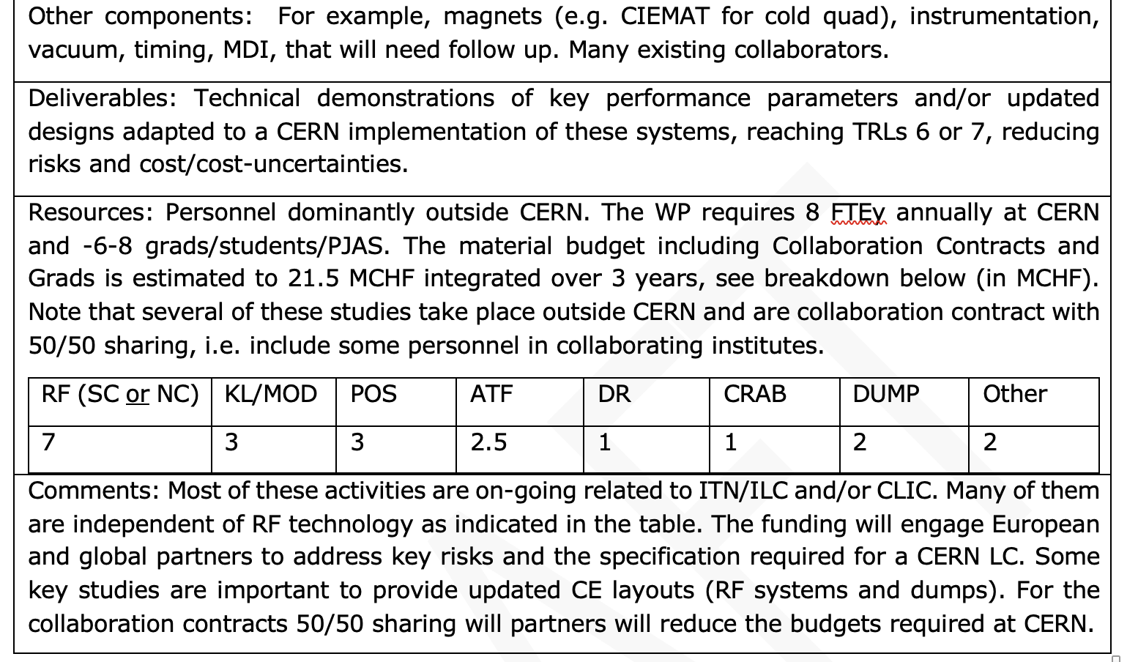
S. Stapnes https://indico.cern.ch/event/1602105/contributions/6836111/

Slide 9
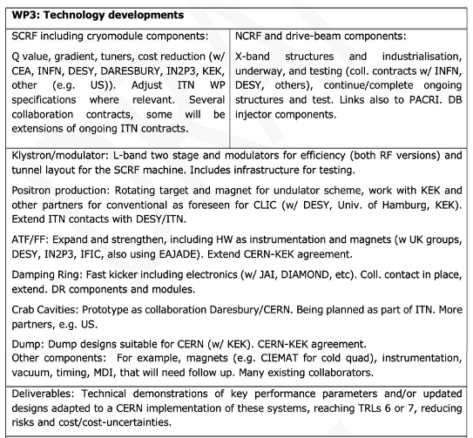
S. Stapnes https://indico.cern.ch/event/1602105/contributions/6836111/

Slide 10
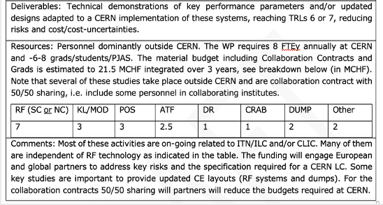
S. Stapnes https://indico.cern.ch/event/1602105/contributions/6836111/

Slide 11
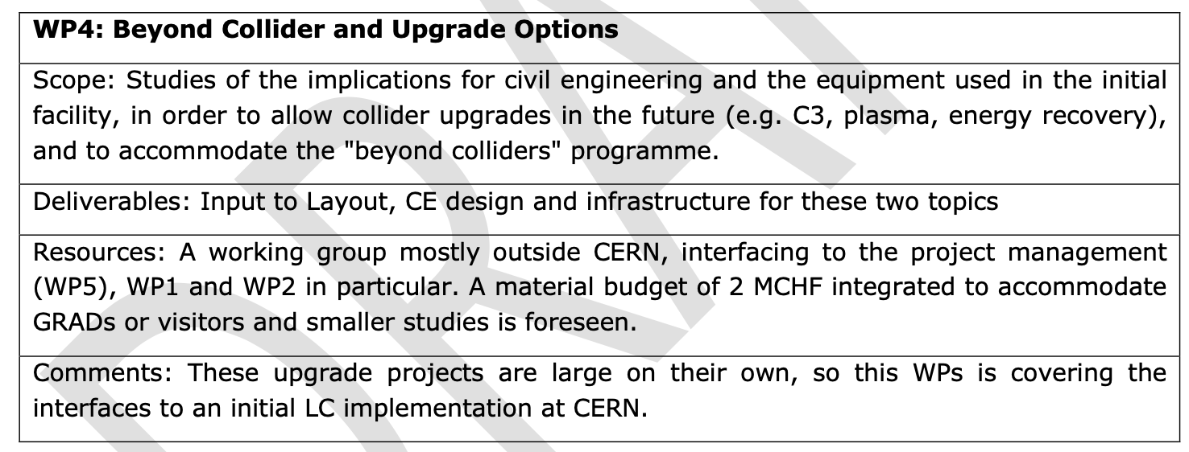
S. Stapnes https://indico.cern.ch/event/1602105/contributions/6836111/

Slide 12
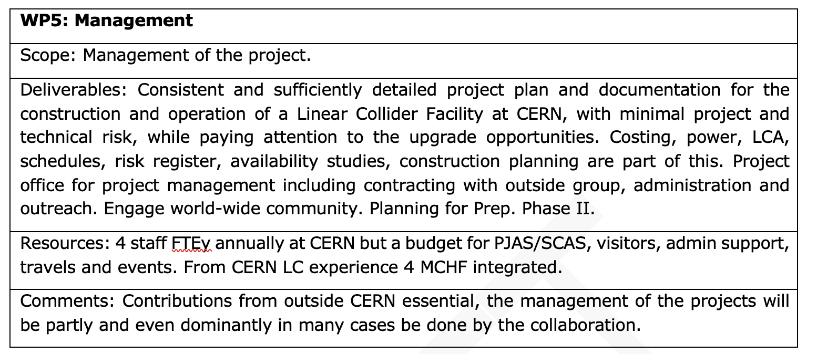
S. Stapnes https://indico.cern.ch/event/1602105/contributions/6836111/

Slide 13
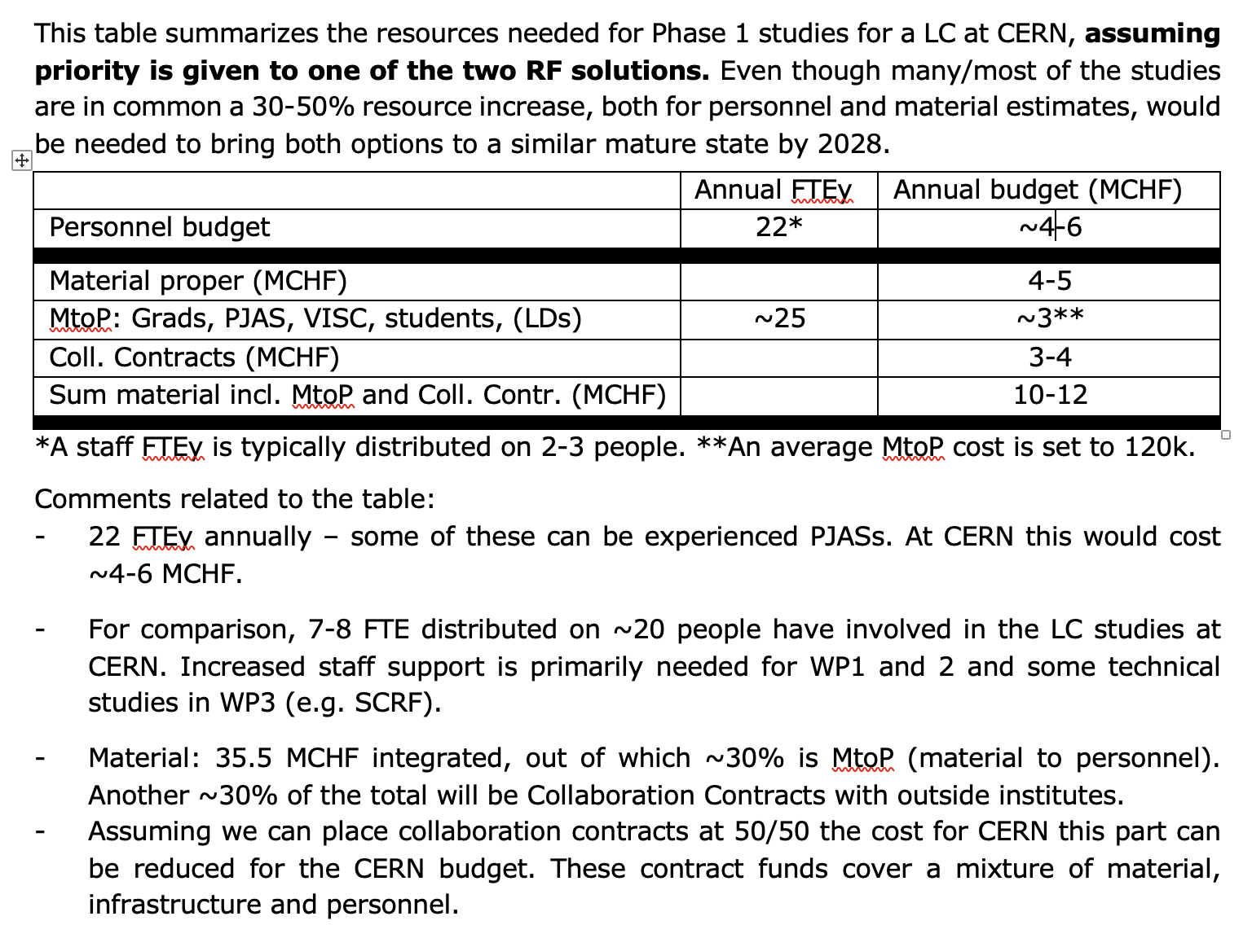
Again, in this WS:
Improve/detail and check
Prioritize
Syn-energies (other projects, R&D plans (e.g. LDG), ITN
CERN/wider community
Timeline
S. Stapnes https://indico.cern.ch/event/1602105/contributions/6836111/

Slide 14
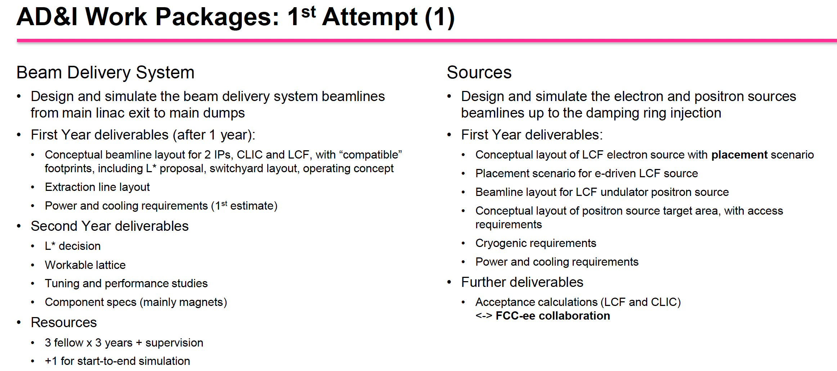
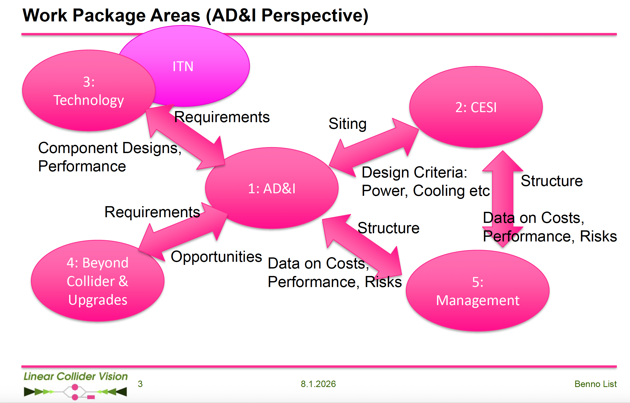
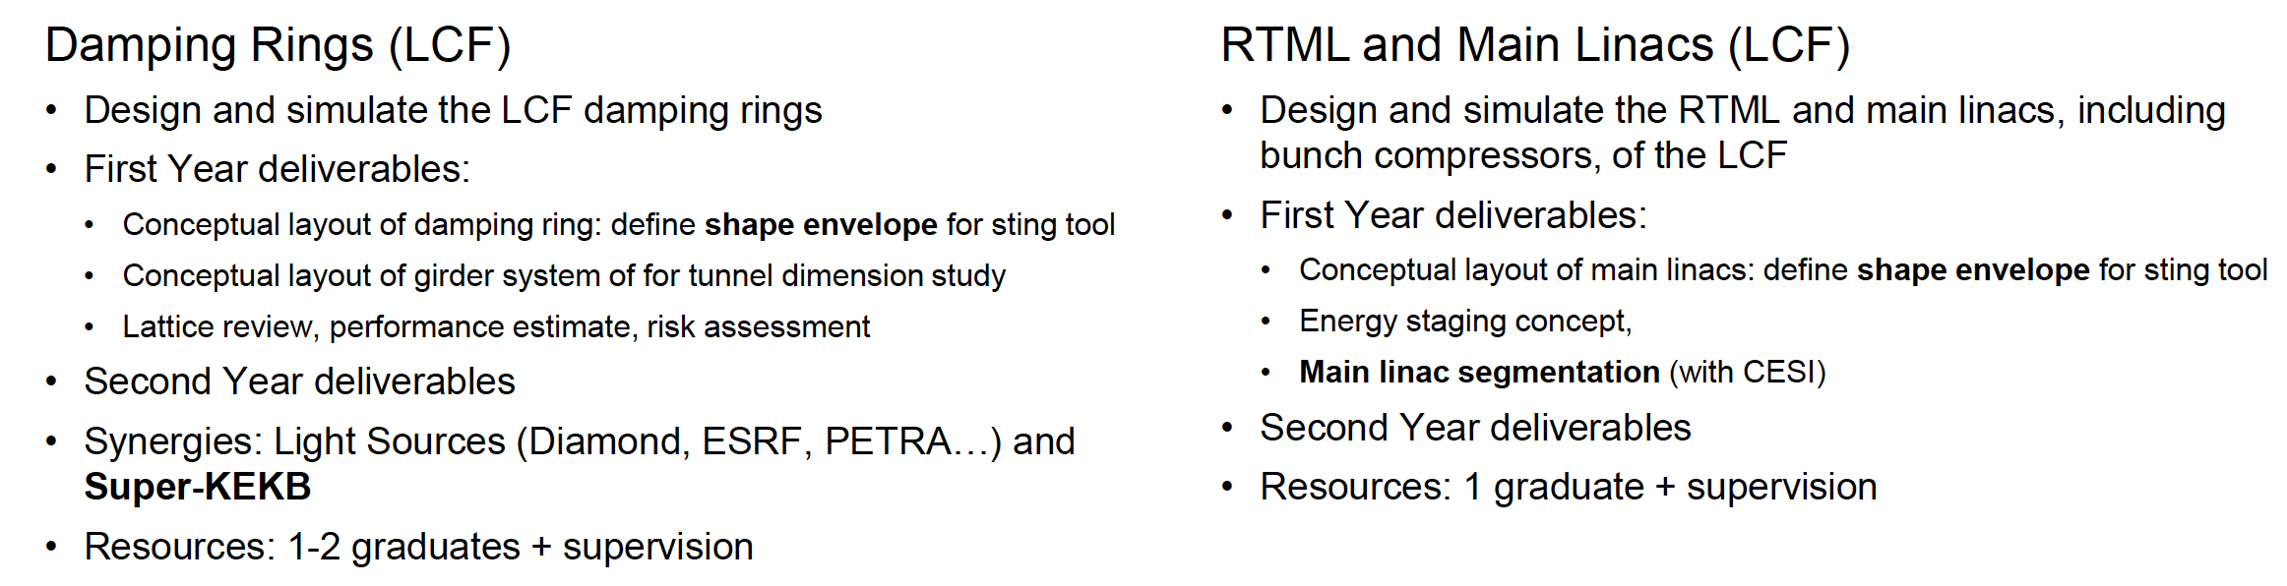
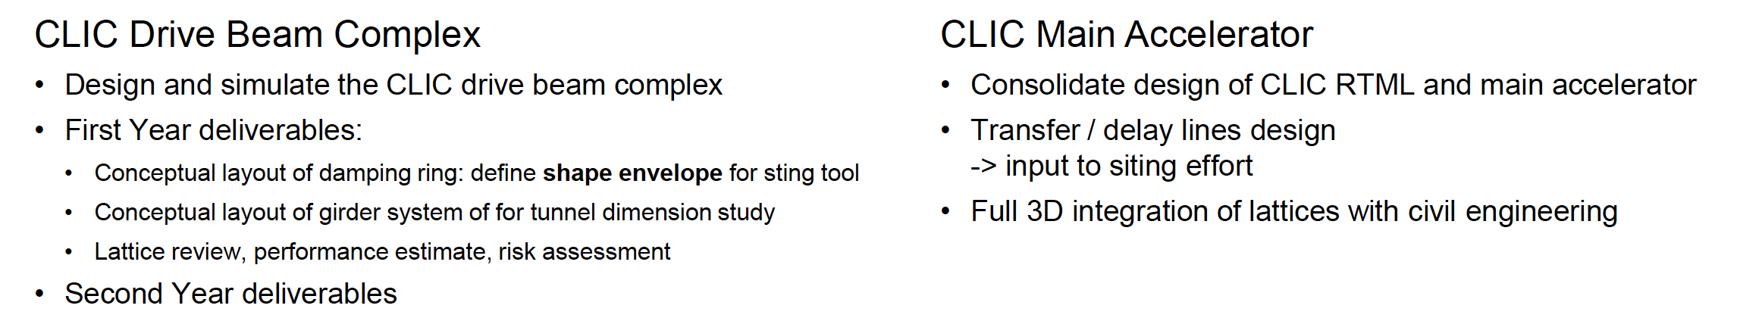
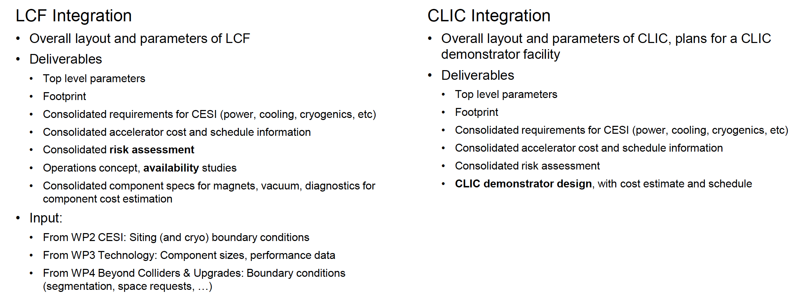
AD&I Work Packages

Slide 15
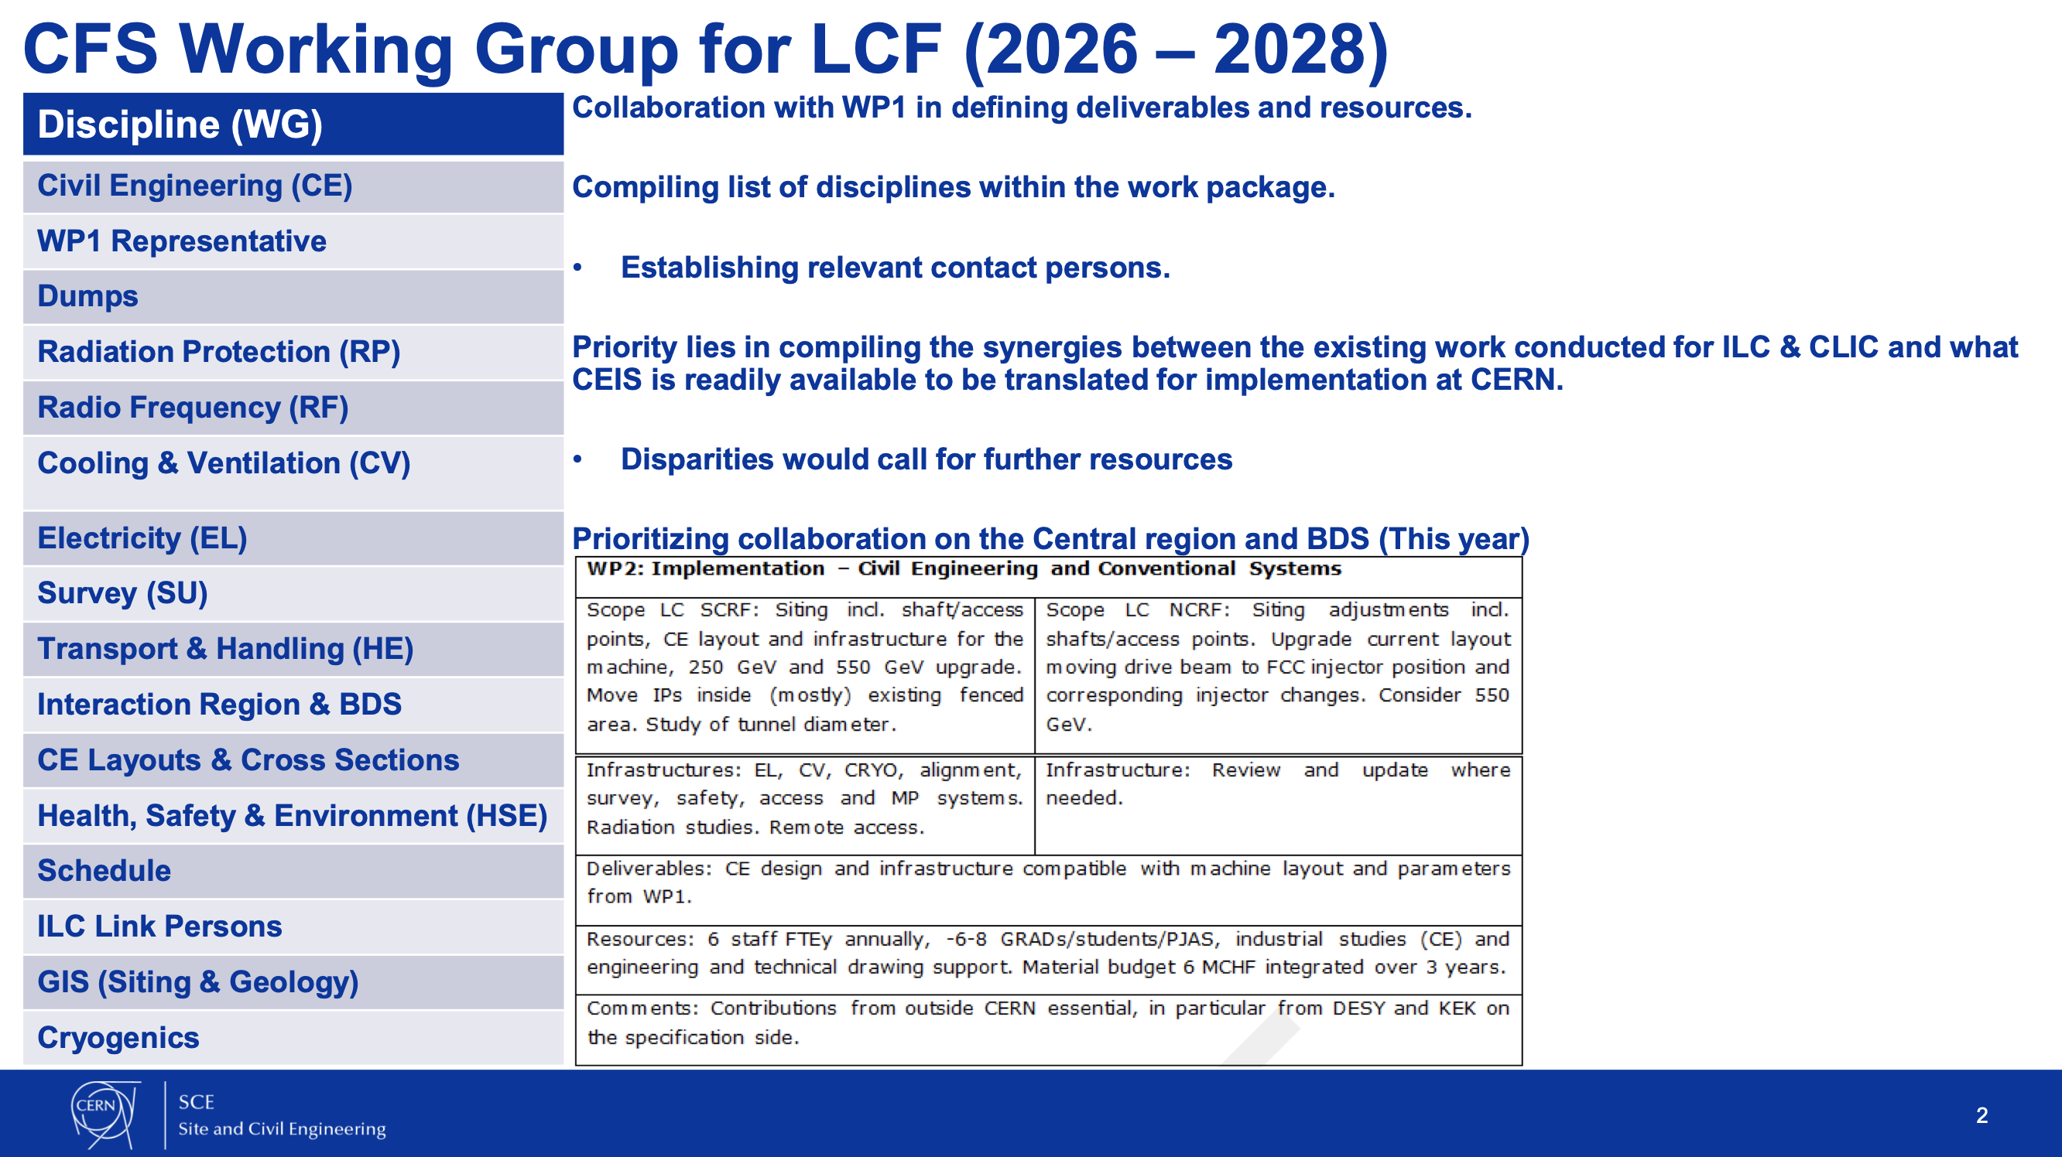
CFS
E. MacTavish: https://indico.cern.ch/event/1602105/contributions/6857189/

Slide 16
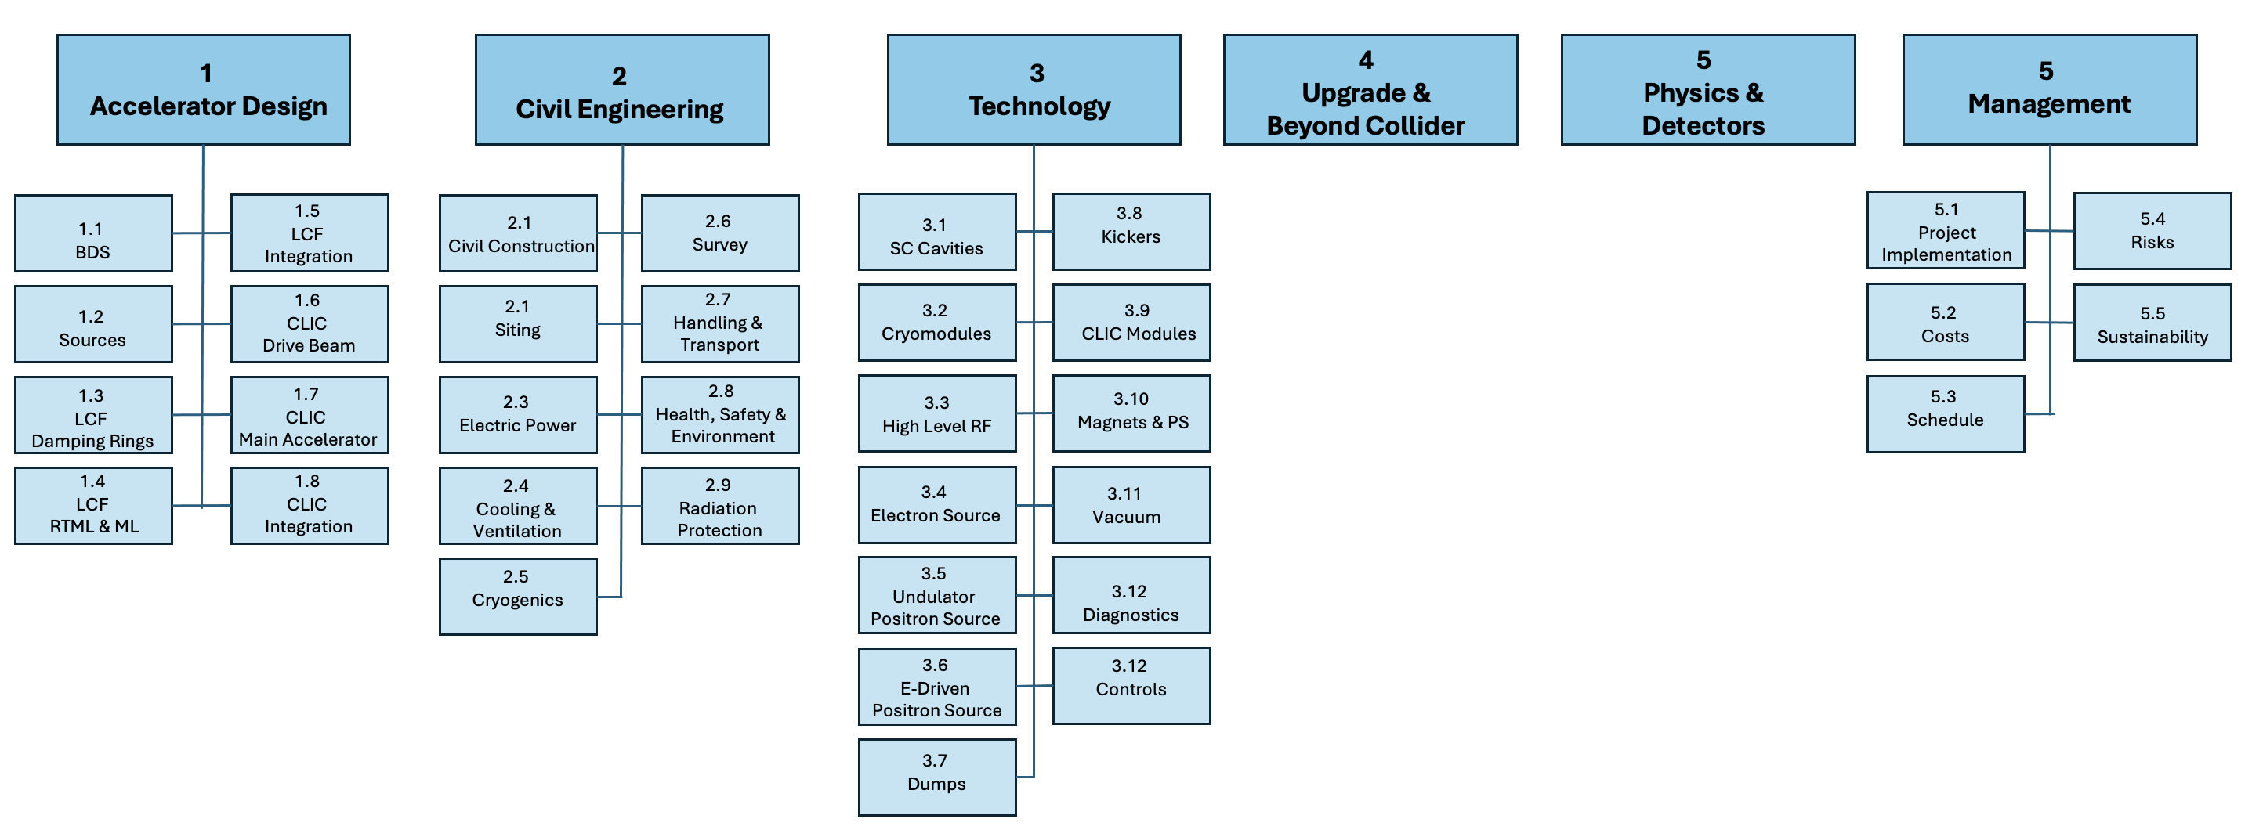
Very first sketch of work packages
Next Steps:
Evolve Work Plan
Consolidate work statements
Add priorities and synergies
Addendum with a work package structure

