Slide 1

Toward Work Plan for LCF@CERN
Needs for Detector Studies
Roman Pöschl, Aidan Robson, Frank Gaede
Slides mainly from parallel session report, Friday 9 January
… and subsequent e-mail exchanges
LC@CERN Detector Meeting – February 2026

Slide 2
Introduction – The overall “framework”
New CERN Management has invited all potential future projects to establish a workplan to bring projects to “decision readiness” status in 2028
  In coordination with CERN Council the CERN Management may allocated resources to these projects
Jenny, Steinar and Eric have compiled a workplan and a first version has been submitted to Mark Thomson and Oliver Brüning
The workplan comprises studies for an LCF implementation à la CLIC and an LCF implementation based on SCRF (“ILC like”)
The workplan will be based on concrete implementation scenarios of the accelerator(s) as e.g. the BDS
The consequences for the detectors and therefore of the physics output will have to be studied
Therefore, detectors and physics are a work package within the workplan
The mission is thus to carry out the relevant detector studies until the end of 2027 in the most efficient way
  The mission “started” with a short questionnaire before Christmas 2025 which gave input to the LC@CERN Meeting in January 2026
  … and to the working document that was distributed yesterday.
  The next step to get organised to implement the necessary studies
  → purpose of today’s meeting

Slide 3
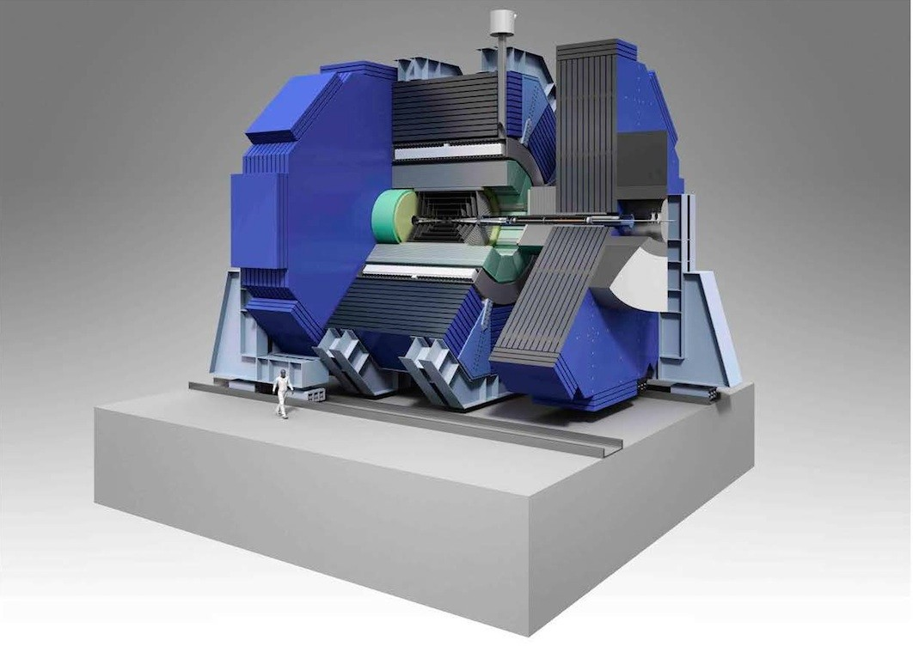
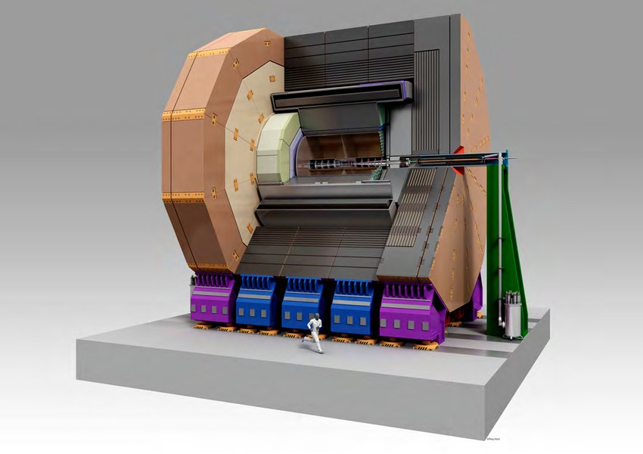
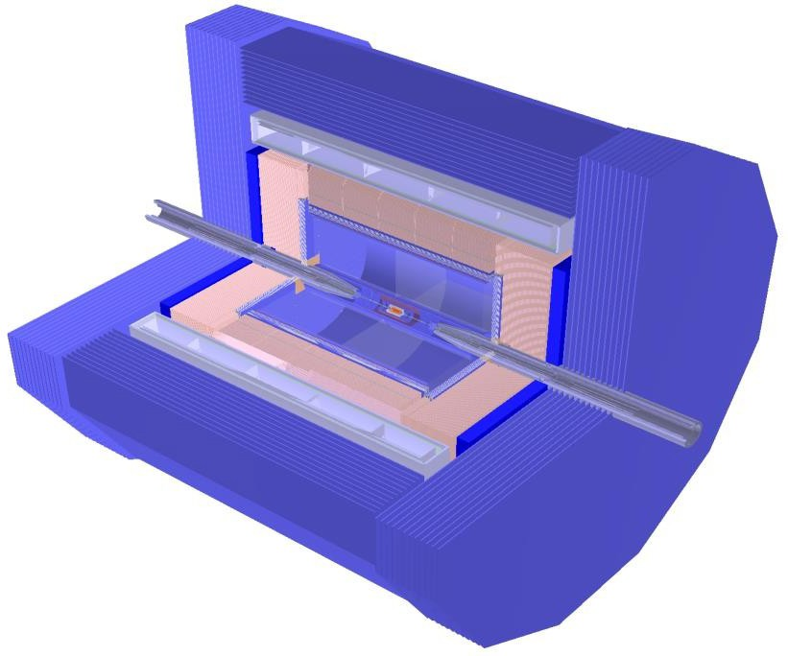
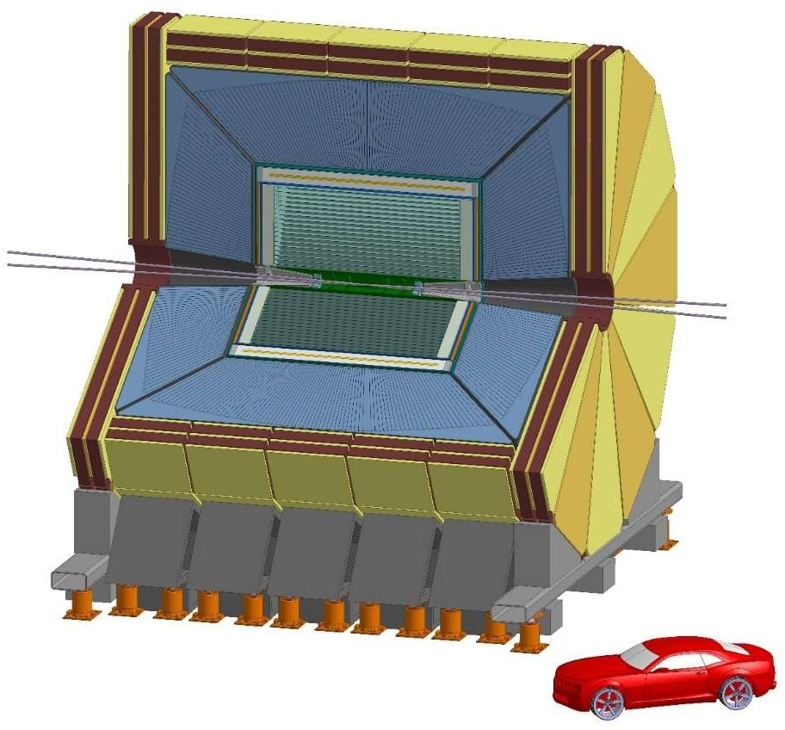
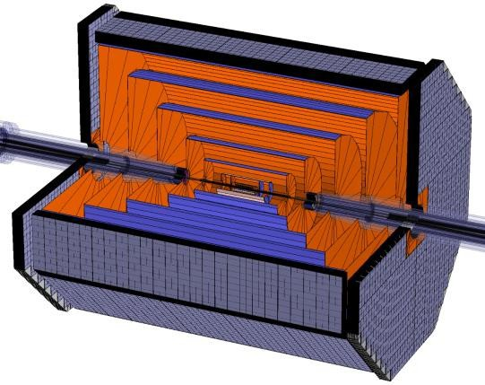
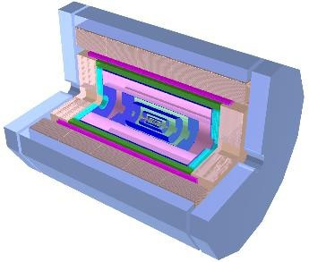
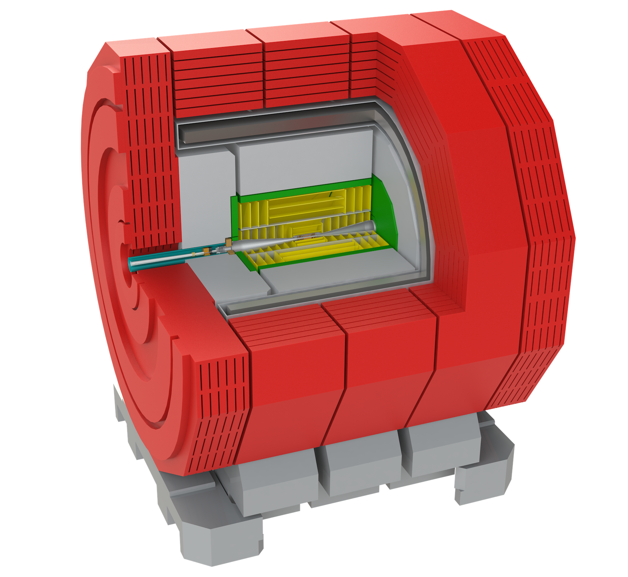
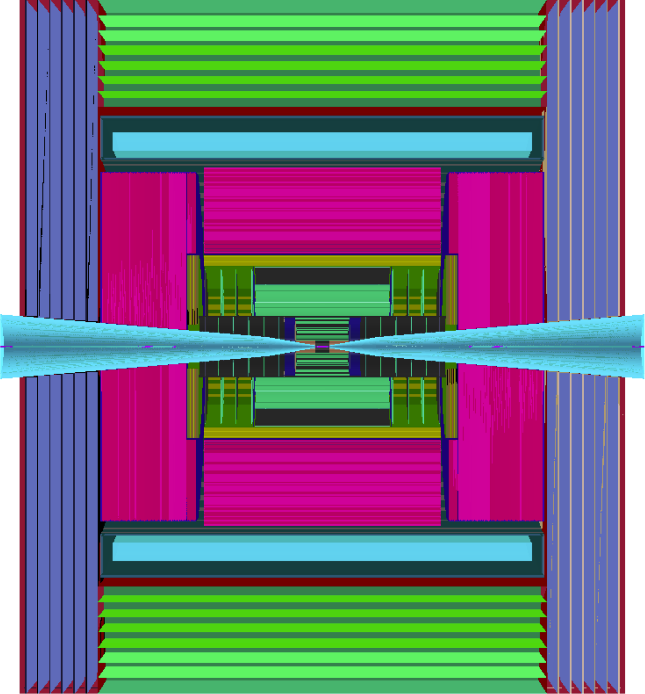
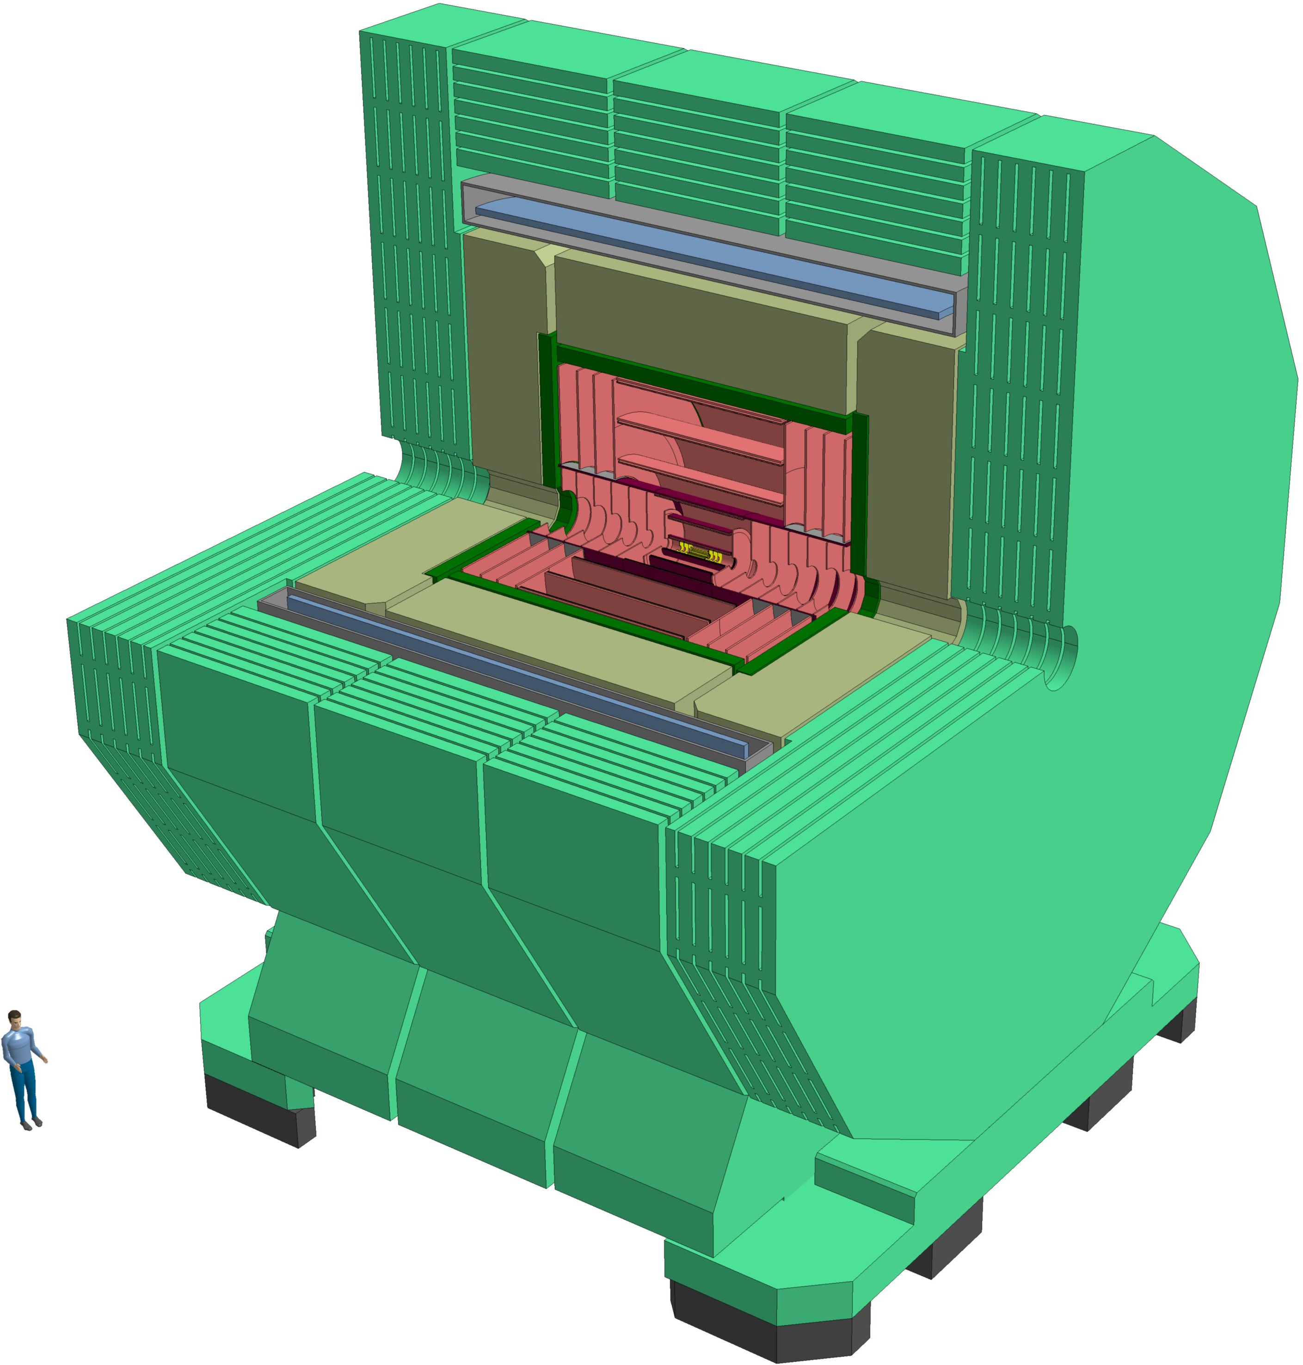
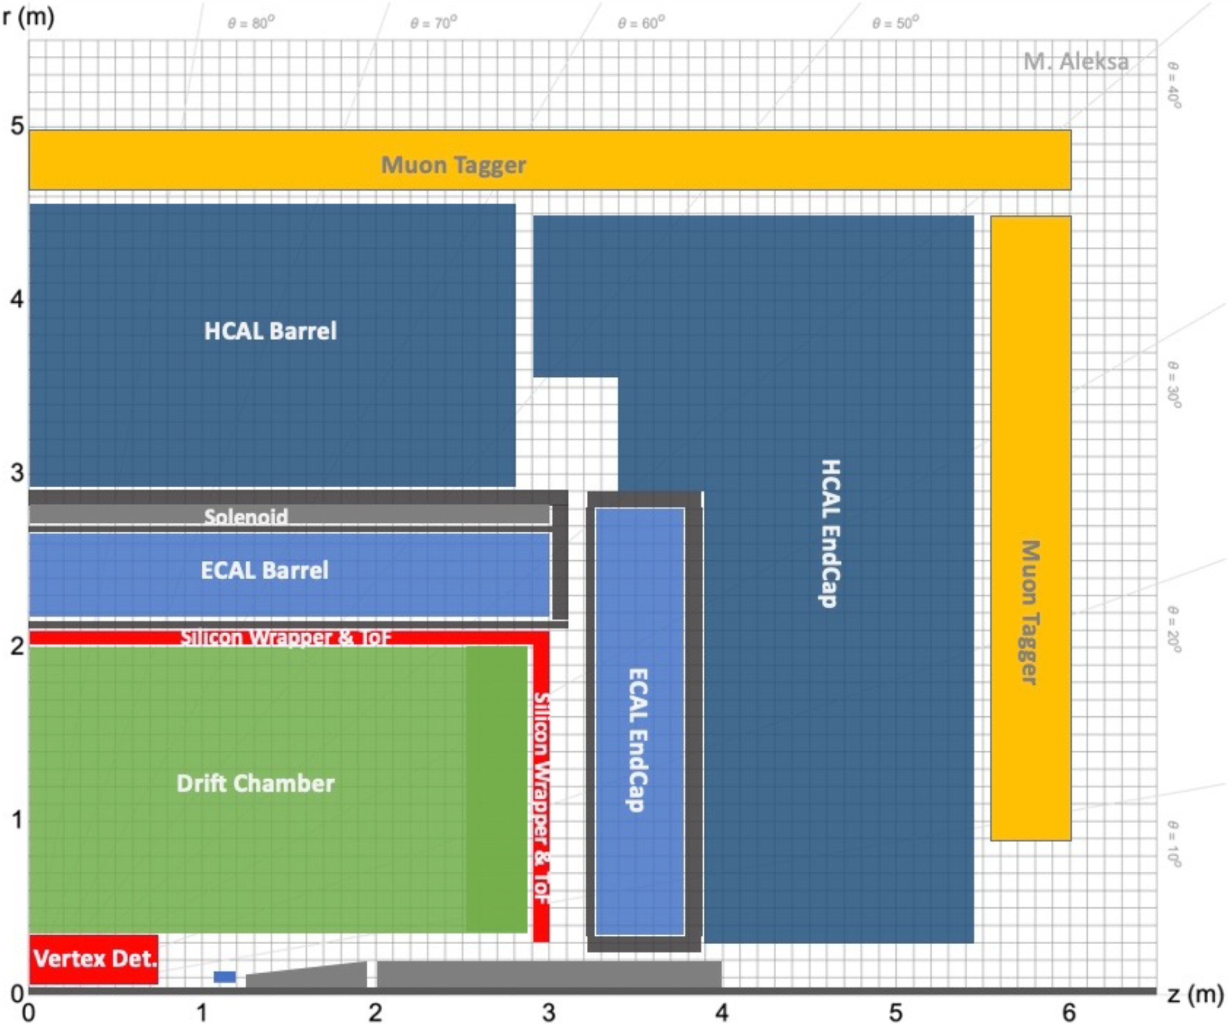
Detector Concepts
LC detector concepts mature and well-studied
… though in some cases baseline technology already ’old’ with ambitions to update
Much active detector R&D ongoing despite very limited dedicated funding :
– 3d-integration of pixel detectors
– monolithic active pixel sensors (MAPS)
demonstrators (–> ALICE ITS3)
– LGAD timing detectors
– large-scale high-granularity calorimeter
development (–> CMS HGCal)
– …
– very important, but not the focus at this workshop
ILC
CEPC
CLIC
IMCC
A. Tolosa Delgado
3rd ECFA Higgs/elw/top
Workshop
Paris 2024
FCC
Instead, consider what is high-priority for 2-year workplan, particularly in light of changed footprint for SCRF machine and move to 2IPs

Slide 4


Crossing angles – “Symmetry breaking”
CLIC BDS has been extensively studied during the recent last years in the energy range from 250, 380, 3000 GeV (1 IP).
The work to be made in the next 3 years:
CLIC 550 GeV BDS design including compatibility with lower energies and 2 IPs, with 16/25 mrad crossing angles (+/- mrad )
For the LCF BDS dedicated design is not existing, one realistic scenario will be:
LCF a la CLIC
Energy range: 250, 550, 3000 GeV (1 IP)
L* = 6 m
2 IPs with 16/25 mrad
Taking into account the bunch/intensity beam structure for a SCRF Main Linac
1 FTE/y
2 FTE/y
BDS working group at LC@CERN Meeting

Slide 5
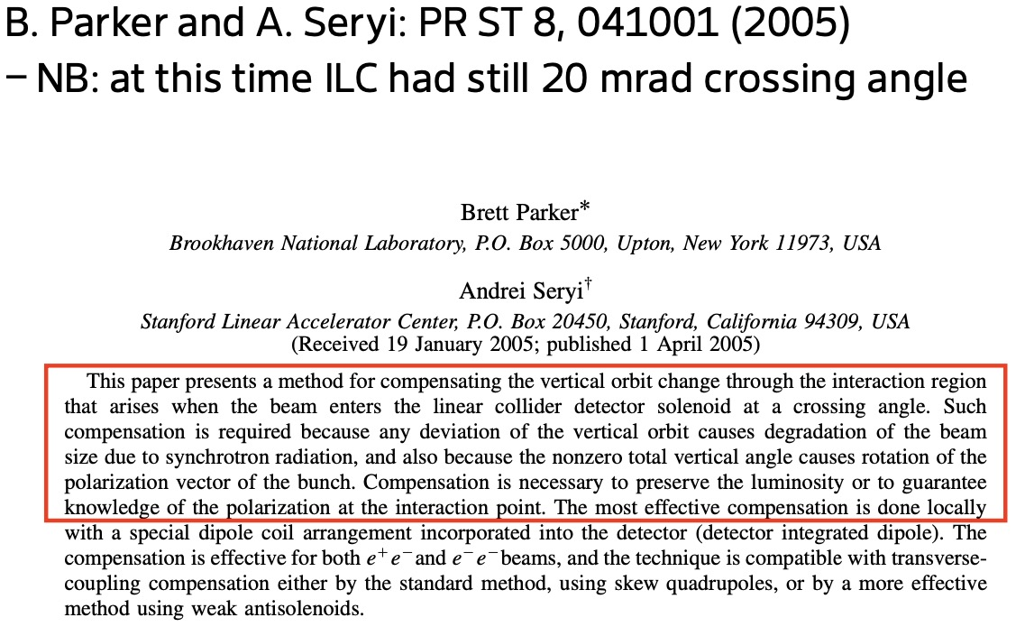
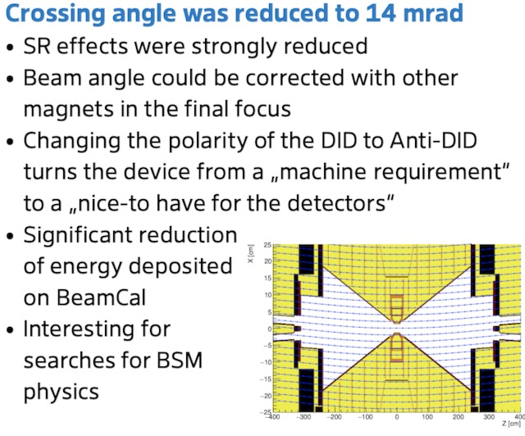
DID / anti-DID
Detector-integrated Dipole (DID)
Large crossing angle could be a problem for beams running
off-axis and under an angle through detector solenoid fields
–> then crossing angle reduced to 14mrad
From Karsten Büßer's talk at LCWS2025:
https://agenda.linearcollider.org/event/10594/contributions/57451/
– choices may need to be revisited

Slide 6
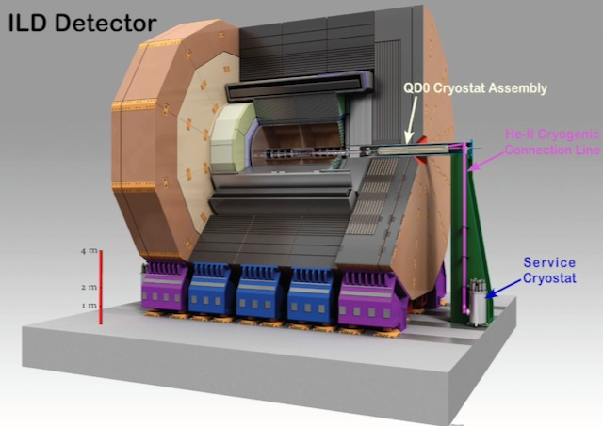
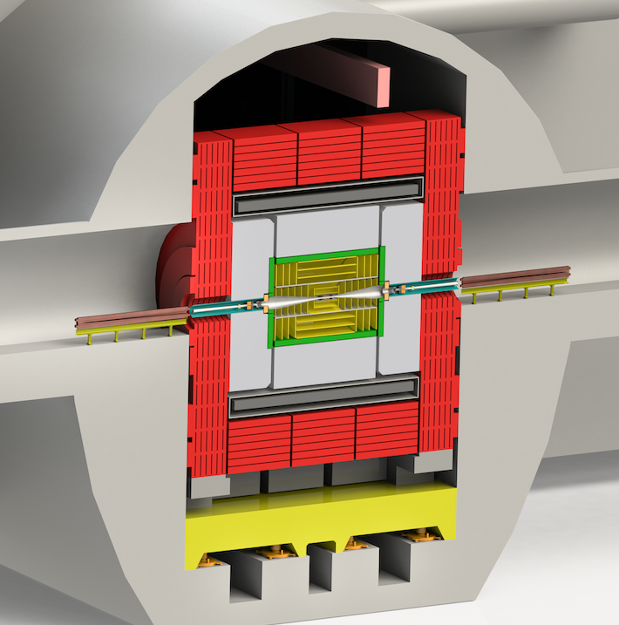
L*
Concepts previously preferred different values of L*:
– lower L* could be beneficial for luminosity
– higher L* removes machine elements from the detector
ILD and SiD previously ‘compromised’ on L*=4m for push-pull paradigm
ILD preference had been L*=4.4m; SiD preference had been L*=3.5m
CLICdet moved to L*=6m to remove QD0 from the detector volume and provide better forward calorimeter coverage
(CLD has L*=2.2m)
ILD: QD0 on support pillar
CLICdet: QD0 in accelerator tunnel; to keep L* down, iron yoke endcap thickness reduced; compensated by a set of end coils.
Without push–pull constraint : need to understand whether constraints come from the machine or civil engineering, or whether concepts are “free to choose” preferred L*

Slide 7
Other backgrounds
Beyond incoherent e+e- pairs and 𝛄𝛄->hadrons, also not to be forgotten:
Neutron backgrounds
reflection from forward detectors and beam dump
– requires FLUKA ; consider shielding options
Synchrotron radiation
(issue for FCC at ttbar)
Beam-charge pickup
potential background in low-radius detectors

Slide 8
Current status
Current status:
– ILD, SiD for ILC, and CLICdet detailed background studies done ~5 years ago
– ILD@FCCee, CLD, and SiD@C³ are currently active on background studies -> Synergies !!
– studies have been done before, and know-how is available
– tools all available (GuineaPig, CIRCE, full detector simulation and reconstruction)
(interest also in WARPX as alternative to GuineaPig)
– using software frameworks that are common cross-project and well-supported (key4HEP, …)
– computing resources are not really a limit
– but requires (quite significant) person power
– and of course all needs close interaction with accelerator / BDS designers

Slide 9
Toward workplan – Assumptions/Hypothesis/Observations
    16 mrad is close enough to the 14 mrad that was intensively studied by the most recent studies of ILD and SiD;
    CLICdet also covered 16 mrad for √s = 380 GeV. It has to be assumed that this study would be also representative for √s = 550 GeV;
    The CLICdet study carried out at √s = 3 TeV for 20 mrad can be extrapolated down to energies below √s = 1 TeV
    25 mrad may still be reduced to a value closer to 20 mrad
      → SiD and CLICdet studies remain pertinent

Slide 10
Toward workplan – Proposal on how to proceed
1. Understand whether the studies carried out for CLICdet are representative enough for the default scenario;
2. Review of the 20 mrad study by SiD;
3. Decide for which detector concepts a study should be launched and how this study could be best supported
Proposal:
A detailed study is carried out for one detector concept only that is supported by the others
ILD would have the “biggest jump” from 14 mrad to 25 mrad (plus the removal of the QD0 magnet due to L*=6m !)
  ILD may therefore have the largest interest for implementing the 25 mrad scenario in its simulation
  Beamfiles could be prepared by members from other concepts
  Support with file processing
  Support with analysis with focus on elements relevant for all concepts (vertex, beam/lumi detectors)
Other scenarios are possible (→ to be discussed but also to be decided rapidly)
All concepts are of course free to carry as much studies as desired but in the work package we have to ensure the most efficient way to results

Slide 11
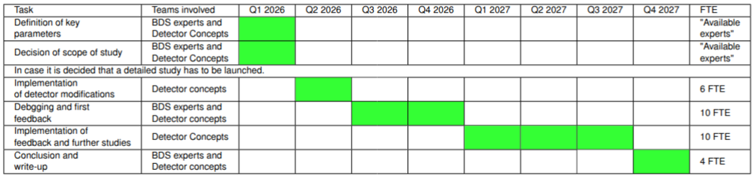
Workplan – Timeline and Workforce
Updated version of table distributed yesterday
ILD Management has estimated the need of 10 FTE to carry out a study for a new detector model
This constitutes the starting point of the estimation of the workforce needs
Most likely not all 10 FTE are needed all the time
Table above assumes that 10 FTE the need during the core phase of the study (Q2 2026 – Q3 2027)
  … and the profile may/will change over time from core experts (software, beamfiles, engineering ...) to analysis workforce
supported by experts

Slide 12
Summary and Outlook
Current assumption is that a study on a LC@CERN will be conducted over the next two years
  Detector studies are integral part of such a study
  Accelerator working groups will study the implementation of a detailed design
Detectors have to give feedback on this design
Compilation of existing know how for LC@CERN Meeting → basis for a workplan
Proposals of scope of studies and workplan presented today
Proposed calendar
  Today: first proposal of organisation and workplan
  Near future (~13th of March 2026): Iteration of first proposal and agreement on organisation and workplan
  Mid-term future (~middle of April): Assignment of tasks and start of study/studies
In particular for the latter it is important to convey that a serious LC study is in the interest of CERN

Slide 13
Backup

Slide 14
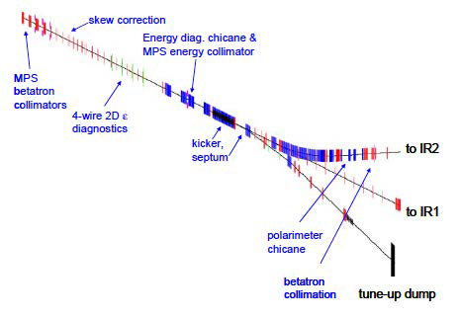
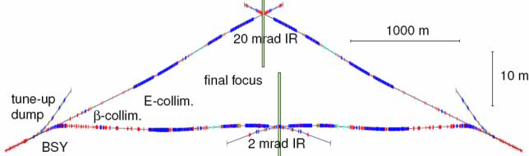
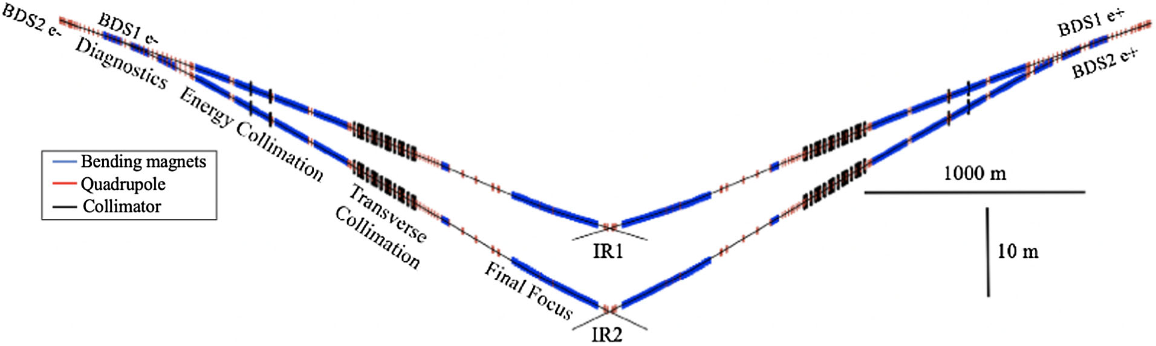
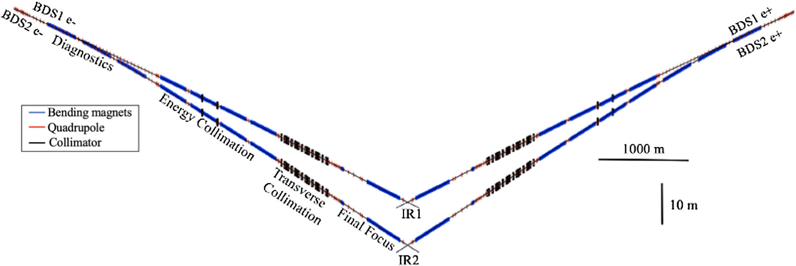
LCVision – (again) two interaction regions
In the ILC Baseline Conceptual Design, the ILC was designed with 2 BDS sections and two independent IRs with 20 and 2 mrad. At that time other schemes were under study, including one of 14 mrad and a head-on scheme.
Layout of the BDS section after the Main Linac and the FF section
Layout of the two IRs with 20 and 2 mrad crossing angle
A detailed study of dual BDS serving 2 IPs has been realized in the framework of the CLIC project, this work could be taken as reference for future studies (PhD V. Cilento UPSay)
IJCLab
ILD and SiD have studied 14mrad
crossing angle
CLICdet studied 20mrad crossing-angle necessary for 3TeV collisions (16.5mrad assumed for 380GeV)
Crossing angles not yet fixed for proposed LCF; CLIC study taken as starting reference
Layout of the two IRs at 380 GeV with 16.5 and 20 mrad crossing angle
Layout of the two IRs at 3 TeV with 20 and 25.5 mrad crossing angle
LC Vision Community
<number>
15 May 2025

Slide 15
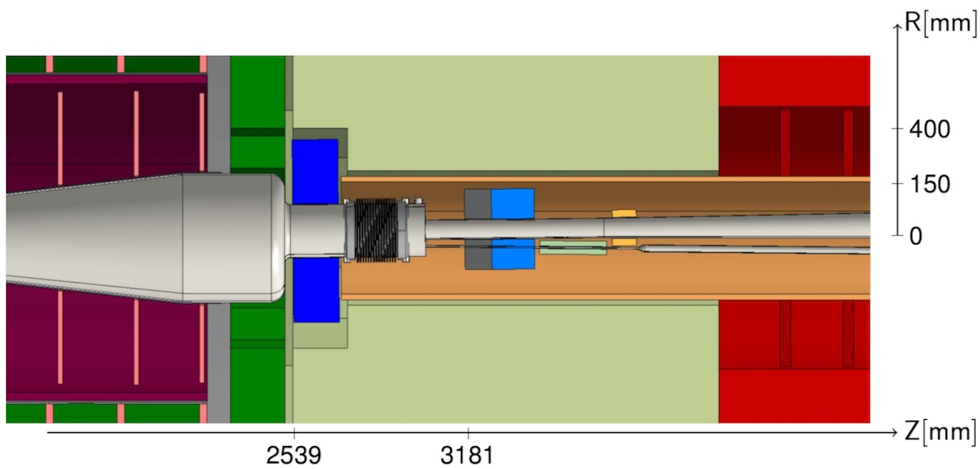
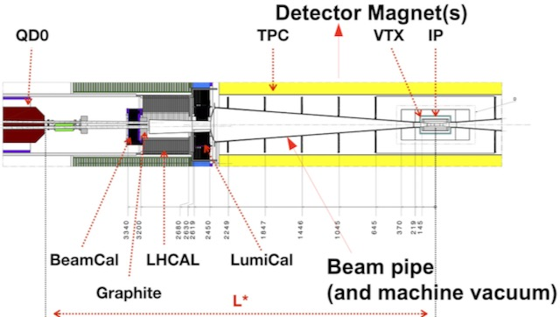
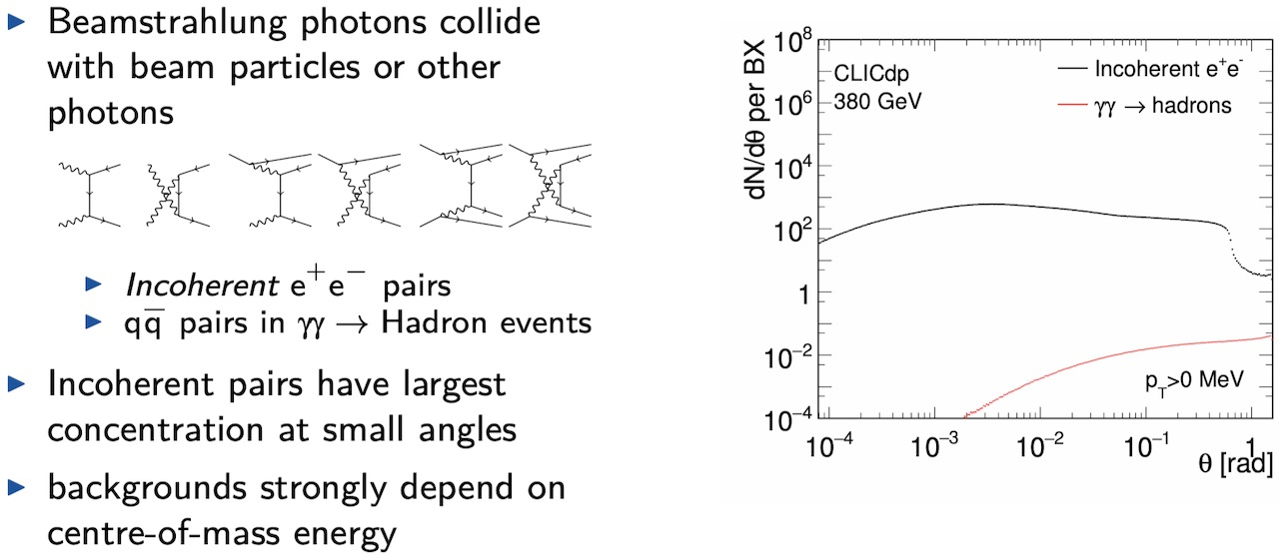
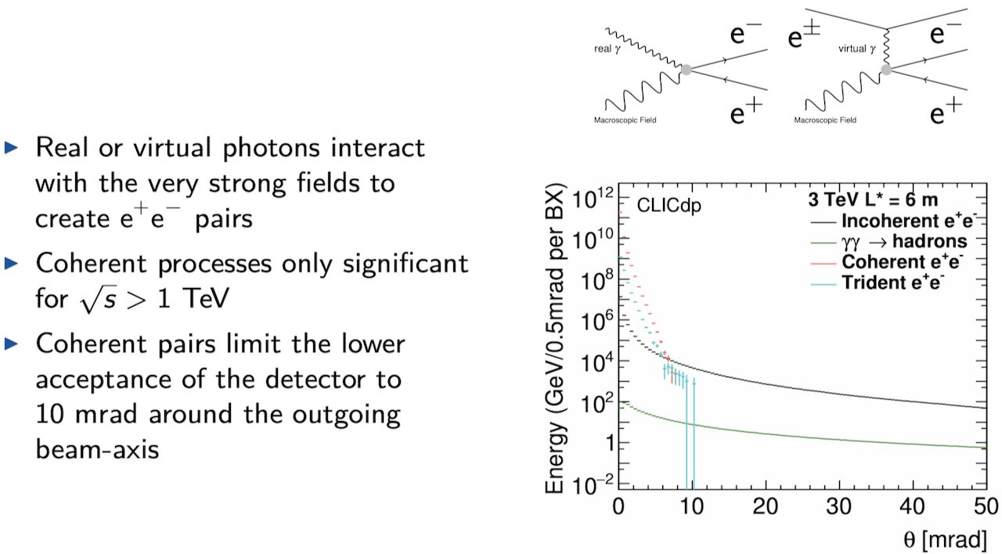
Focus on MDI
CLICdet
ILD
LumiCal and BeamCal, ECal and HCal endcaps
– constrained zone
– wish to maximise detector acceptance
Beam-induced backgrounds
…and at higher energies:
– design of this area strongly depends on machine choices
– backgrounds / occupancies strongly depend on detailed layout

