Slide 1
ITN (ILC technology Network) activity at KEK
Hiroshi Sakai (on behalf of IDT members in Japan)
Innovation Center for Applied Superconducting Accelerators (iCASA), Accelerator Laboratory
High Energy Accelerator Research Organization (KEK)
I only talk about ILC Accelerator parts and progress.
Contents :
A) ILC Overview & ILC Technology Network (ITN)
B) ILC activities until JFY2025 (mainly Japanese activities on MEXT-ATD)
C) Summary and Future plan (JFY2026 ~)
20 min (talk)
2026.Apr.28 IDT-WG2 meeting
24 pages

Slide 2
(A)
Contents :
A) Overview & ILC Technology Network (ITN)
B) ILC activities in JFY2025 (mainly Japanese activities on MEXT-ATD
C) Summary and Future plan (JFY2026 ~)

Slide 3

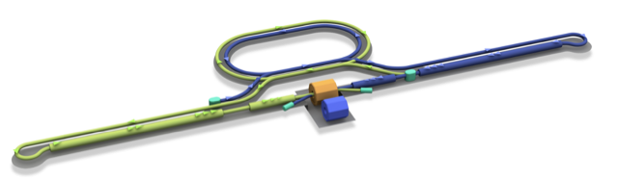
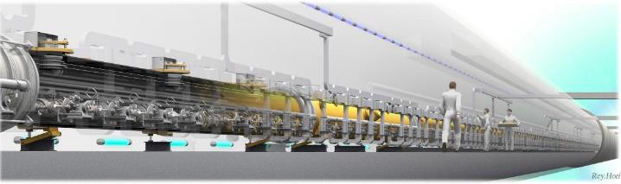

ILC and the Accelerator Technology
From 2023, key technologies of WPPs are developed under ILC Technology Network(ITN)
Damping Ring
e+ Source
e- Source
e- Main Linac
Interaction point
e+ Main Liinac
Detectors
Parameters | Value
Beam Energy | 125 + 125 GeV
Luminosity | 1.35 / 2.7 x 10³⁴ cm²/s
Beam rep. rate | 5 Hz
Pulse duration | 0.73 / 0.961 ms
# bunch / pulse | 1312 / 2625
Beam Current | 5.8 / 8.8 mA
Beam size (y) at FF | 7.7 nm
SRF Field gradient | < 31.5 > MV/m (+/-20%) Q₀ = 1x10¹⁰
#SRF 9-cell cavities (CM) | ~ 8,000 (~ 900)
AC-plug Power | 111 / 138 MW
e+
e-
Nano-Beam Technology
SRF Technology
（ILC key technologies) done under ITN
1. SRF cavities of 9000 numbers
2. Nanobeam production and stability。
3. Huge electron and positrons production
Recently LCF@CERN also follow SRF technology of ILC.

Slide 4
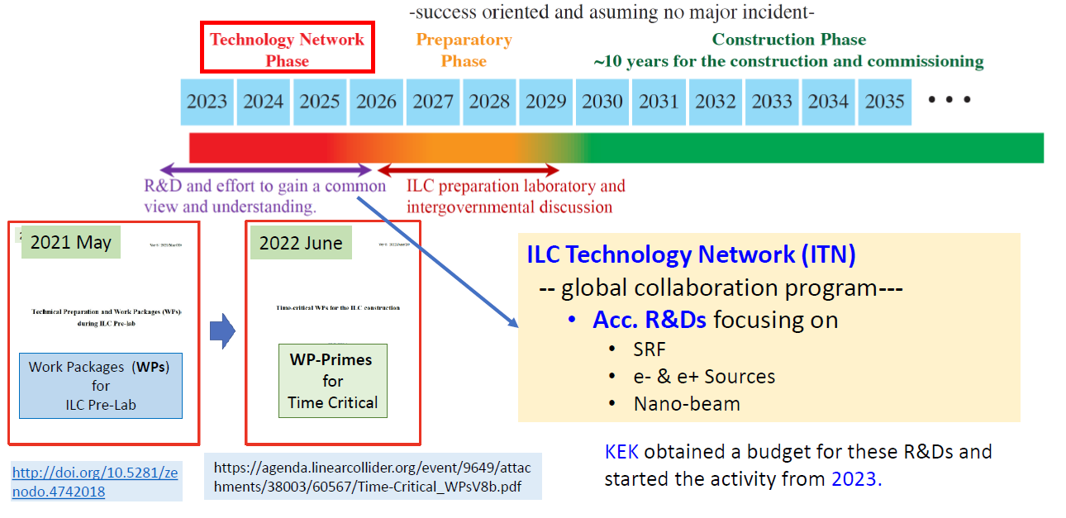
IDT Scope for ILC Realization (in 2023)

Slide 5
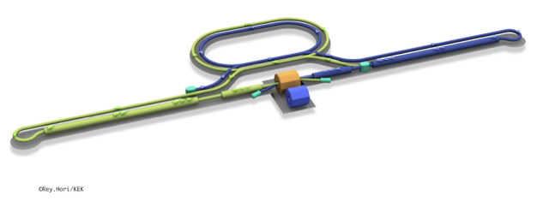
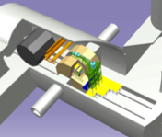
ILC Technology Network & KEK’s efforts
Interaction point
Damping Ring
e+ Source
Details are explained as follows in
“(B) ILC activities until JFY2025 (in Japan)”
e- Source
e- Main Linac
Beam dump
Physics Detectors
e+ Main Liinac
WPP | 1 | Cavity production
WPP | 2 | CM design
WPP | 3 | Crab cavity
WPP | 4 | E- source
WPP | 6 | Undulator target
WPP | 7 | Undulator focusing
WPP | 8 | E-driven target
WPP | 9 | E-driven focusing
WPP | 10 | E-driven capture
WPP | 11 | Target replacement
WPP | 12 | DR System design
WPP | 14 | DR Injection/extraction
WPP | 15 | Final focus
WPP | 16 | Final doublet
WPP | 17 | Main dump
Collaboration with
Europe, Korea,
KEK started the activity from April,2023.
SRF
～6.6Oku-yen/year x5 years (~4.7M$/year)
For 3 critical components development (SRF, Source & nanobeam)
e-, e+
Sources
Experiences at SuperKEKB
MEXT development of key element technologies to improve the performance of future accelerators program
文科省補助金 将来加速器の性能向上に向けた重要素技術開発
advanced Accelerator element Technology Development (MEXT-ATD) funded by MEXT
Nano-
Beam
ATF collaboration
We held Advisory board meeting for MEXT-ATD every half year to check our progress.
In JFY2025, & 5th meeting held 2024/10 online
& 6th meeting was held on 2026/Mar./3-5 in person in KEK

Slide 6
(B)
Contents :
A) Overview & ILC Technology Network (ITN)
B) ILC activities in JFY2025 (mainly Japanese activities on MEXT-ATD)
Introduction of MEXT-ATD
R&D of SRF, Positron, Nanobeam
C) Summary and Future plan (JFY2026 ~)

Slide 7
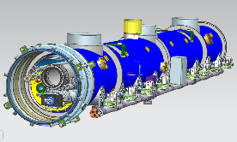
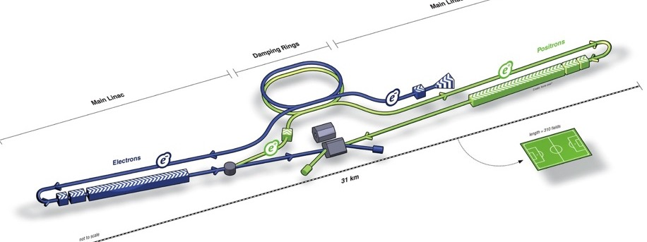
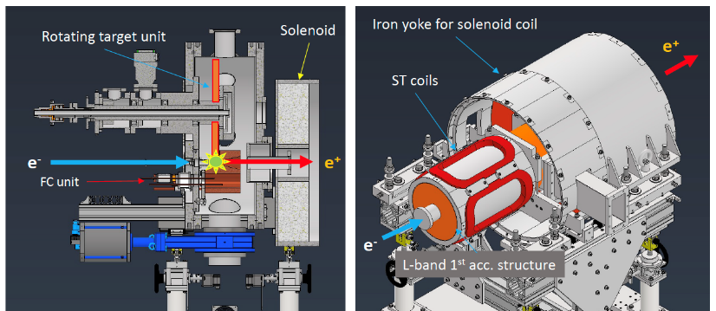
introduction of MEXT-ATD program
MEXT-ATD activities are broadly classified into (1) nanobeam, (2) superconducting radio-frequency (SRF), and (3) positron .
SRF
Present our goals
nanobeam
 | Goals of MEXT-ATD (2023-2027)
Nanobeam | Demonstration of long-term stability in ATF
SRF | Evaluation of one cryomodule (CM)(including fabrication of CM components such as cavity and couplers）
Positron | Evaluation of target, flux concentrator (FC) and cavity
ILC configuration
positron
We were able to make progress as originally planned. Although we anticipate that the next fiscal year and beyond may be more challenging, depending on future price trends and so on, we will strive to achieve our goals.

Slide 8
(Re)scheduled plan from FY2026
Details of change will be shown in SRF session
 | 2023 | 2024 | 2025 | 2026 | 2027
Nanobeam | Procurement of High-Order magnets Upgrade of beam operation and equipment | Reduction of wake field and higher order aberration Upgrade of beam operation and equipment | Precise measurement of nanobeam, Upgrade of beam operation and equipment | Improvement of beam turning method (incl. AI) Vertical beam size on IP <37nm | Improvement of beam turning method (incl. AI) Long-term stabilization of nanobeam (for a few days)
Superconducting RF cavities | Nb Material Procurement Cavity Development High-Pressure Gas action | Cavity development(0) Single cell (6) Vertical test (single cell) High-Pressure Gas action (continue) | Cavity development (4+2+2) From abroad (2) Vertical test （35MV/m, 1E10） High-Pressure Gas action (continue) | Cavity development（35MV/m, 1E10） Welding Helium tank Further High Performance High-Pressure Gas action (continue) | Further High Performance High-Pressure Gas action (continue)
SRF Cryomodule | Drawing module and each components High-Pressure Gas action | Coupler fabrication (4) Tuner prototype magnetic shield prototype SC magnet fabrication Fabrication CM | Coupler fabrication (4) Tuner fabrication (4) magnetic shield fabrication (2) SC magnet fabrication (Cont’) Fabrication CM | Coupler fabrication (8) Tuner fabrication (4) magnetic shield fabrication (6) Fabrication CM (Cont’） String assembly High-Pressure Gas | Coupler power test String assembly Construction CM High-Pressure Gas （inspection） Performance test of CM （31.5MV/m, 1E10）
Positron source | Preparation test bench Design W-Cu joint test | Development W target | Development of rotating target Fabrication of FC | Development of accelerating structure | Total high power test
Due to the cavity fabrication under the HPGS law and power coupler fabrication trouble and increasing the price since 2022, we plan to reschedule as shown above. Our new plan is the completion of cryomodule. We plan to conduct high power test in the additional two years after finising MEXT-ATD program.

Slide 9
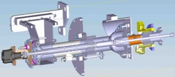
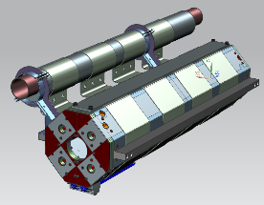
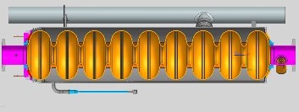
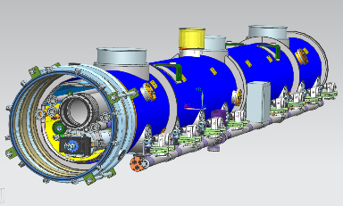
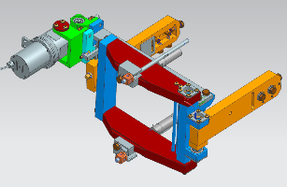
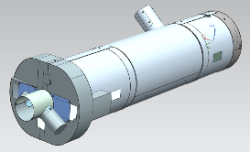
SRF development
We also continue cavity fabrication & test some ancillaries in JFY2025
WPP-1: cavity surface treatment
WPP-2: Cryomodule test
One CM design by global collaboration, production and test in Japan
Cavity performance for vertical test E_{acc} = <35.0 MV/m >, Q₀ = 1.0 x 10¹⁰
8 cavities produced/evaluated in WPP-1 to be assembled, including some cavities from overseas. Globally common design applicable to high pressure gas safety (HPGS) regulation under ITN collaboration (world wide)
Ancillaries production/evaluation:
input power coupler, frequency tuner, SCQ+cold BPM, magnetic shield, advanced clean work
After assemble all parts to one cryomodule, we test high power test
Cavity performance in cryomodule: E_{acc} = <31.5 MV/m >, Q₀ = 1.0 x 10¹⁰
Cavity fabrication
↓
Surface treatment
↓
Performance test （cavity only）
(called as vertical test)
↓
(WPP-2: to cryomodule)
Design of CM and ancillaries
↓
Production of components
↓
Cavity string assembly
↓
CM assembly
↓
CM test
Supercondcuting magnet
cavity
Input coupler
Build high performance SRF cryomodule
Freqency Tuner
Magnetic shield
We perform the cryomodule test by gathering Japan and other countries (EU and so on) (under ITN collaboration)
design ILC-CM under ITN
9

Slide 10
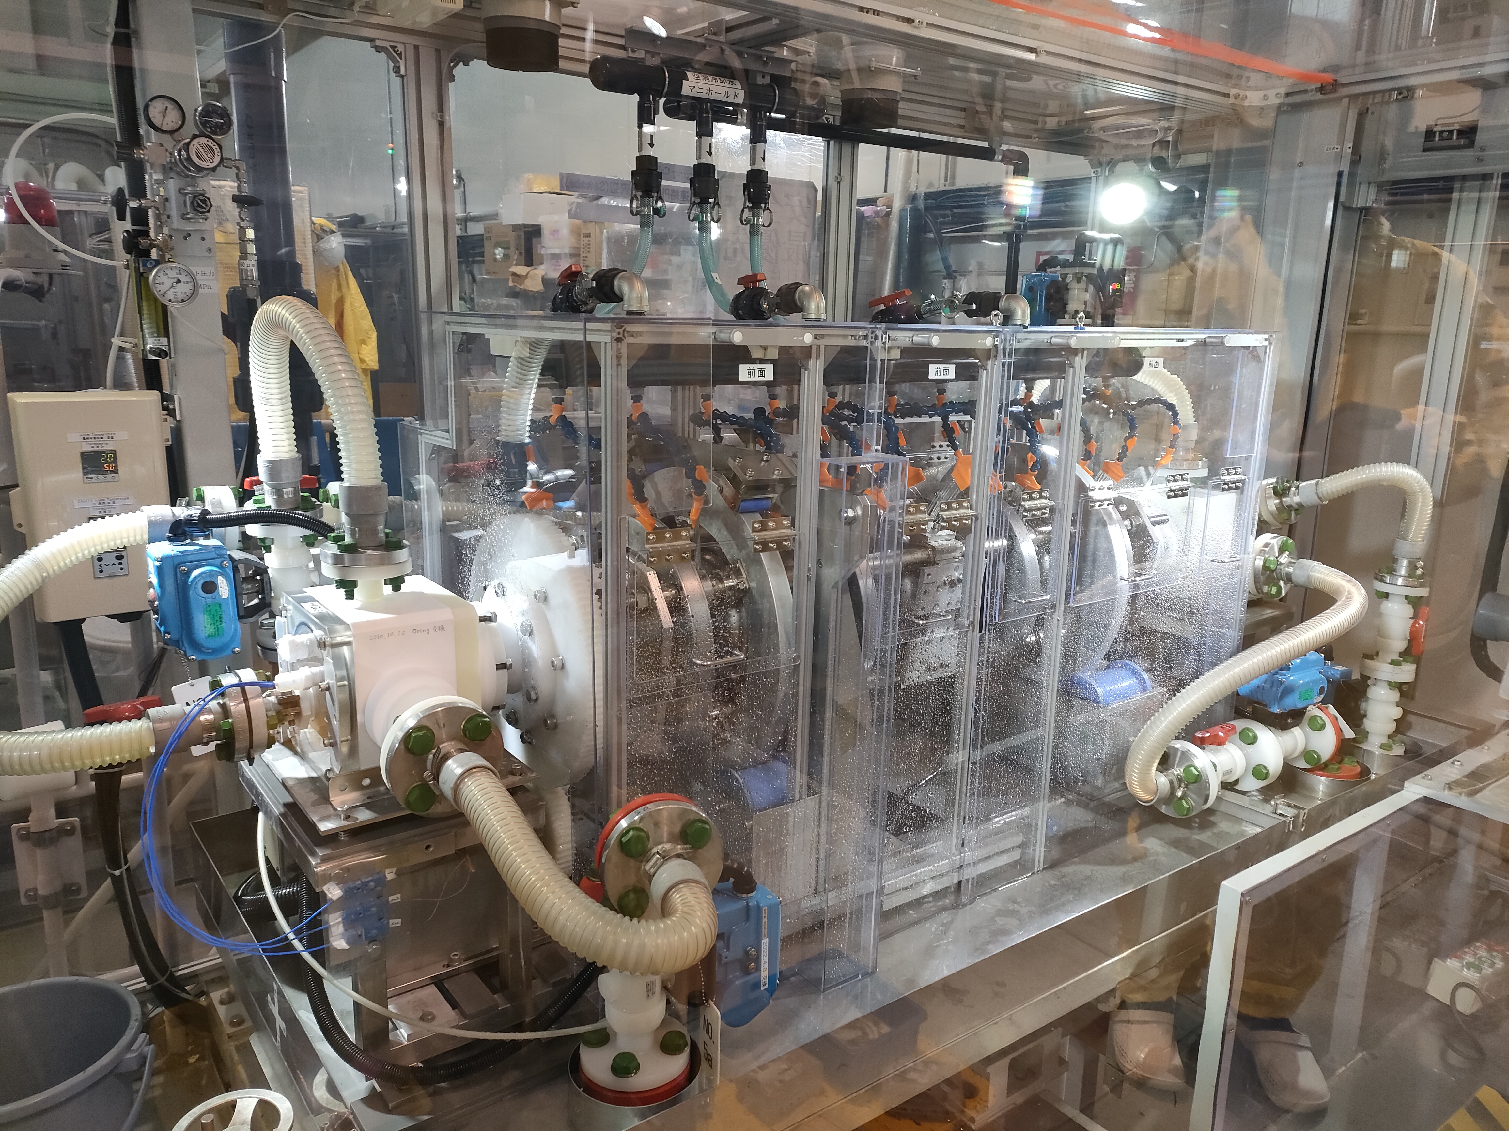
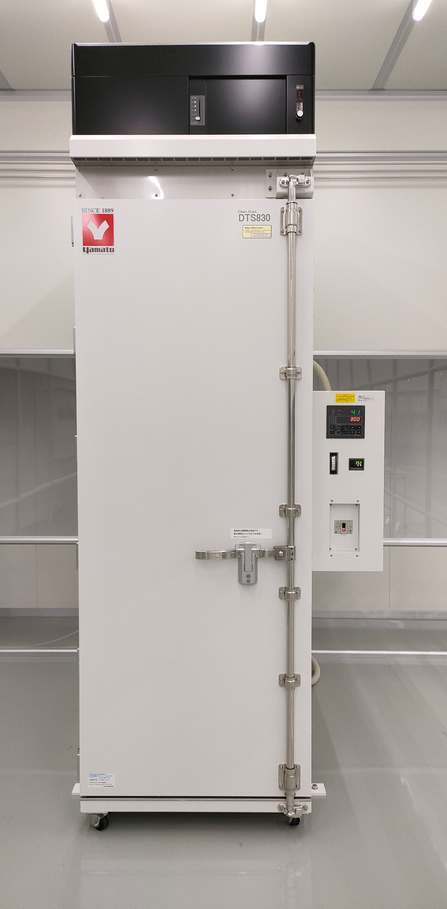
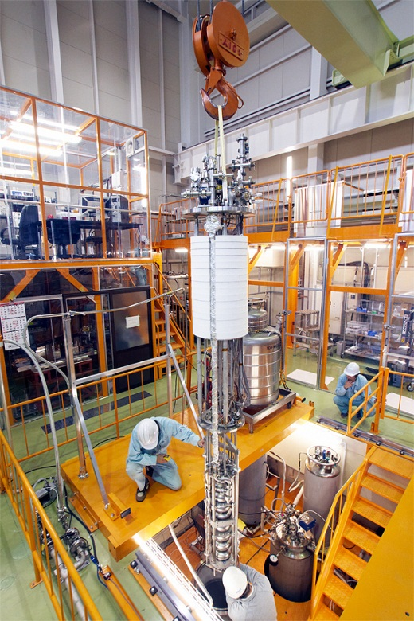
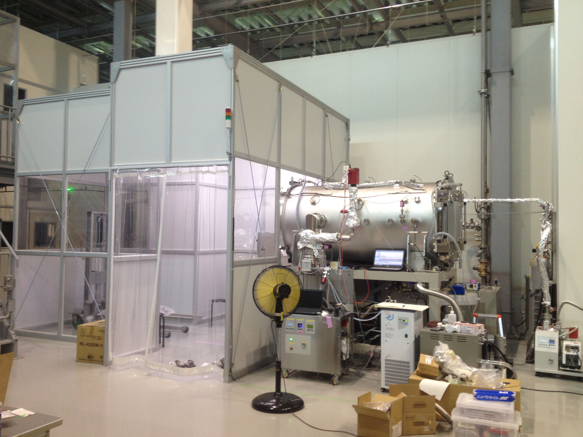
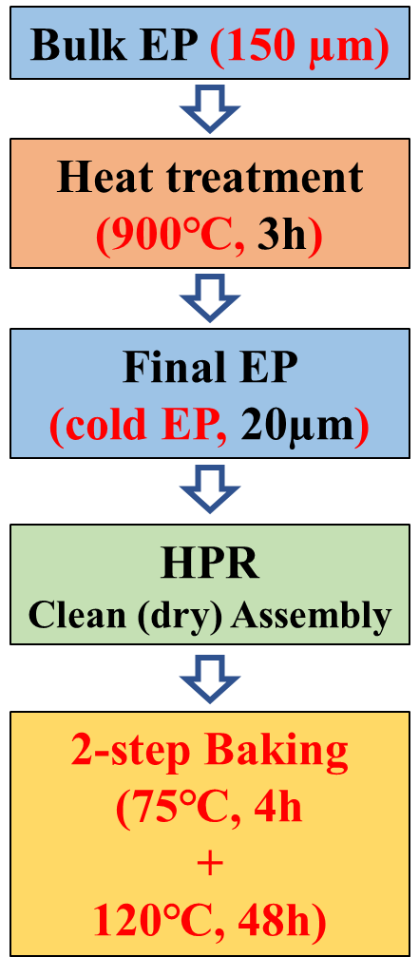
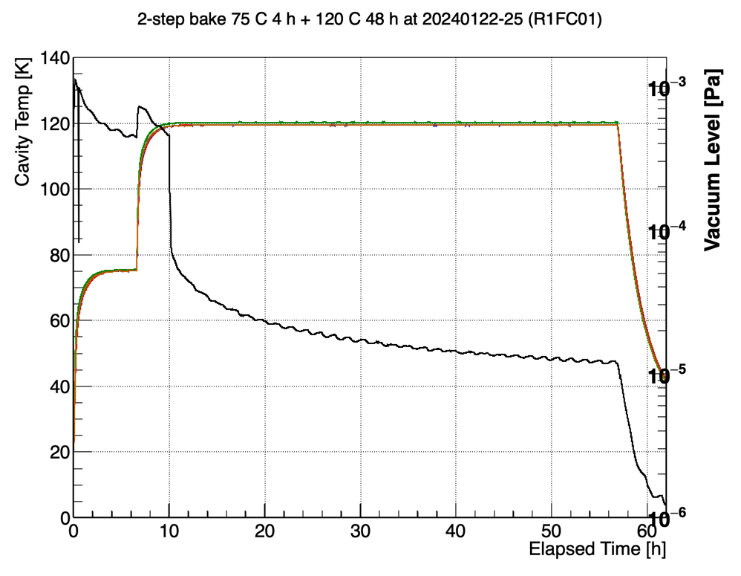
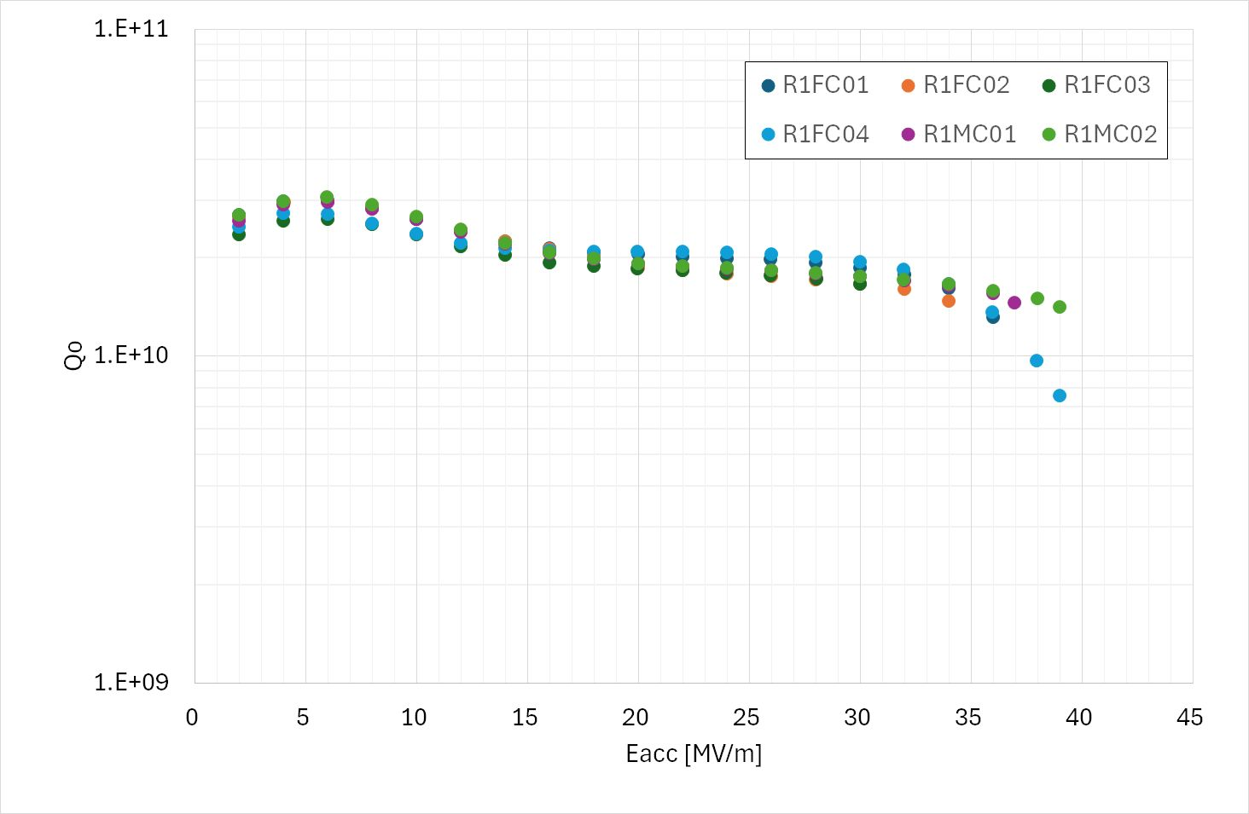
(FY2025) (1)WPP1: Results of surface treatment by 2-step baking
Based on the results of past R&D, we chose 2-step baking for this project.
VT for six 1-cell cavities was successfully done, going to 9-cell cavities in KEK.
(FY2025) All 6 cavities passed the spec
KEK’s recipe
Heat treatment
Cold EP
2 step Baking
VT
In a clean room
Kensei Umemori/Ryo Katayama
Q₀ = 1x10¹⁰
All 6 cavities reached 35 MV/m and 1x10¹⁰ of Q₀
75 C, 4h + 120 C, 48h
35 MV/m

Slide 11
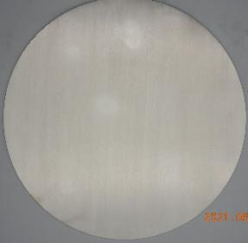
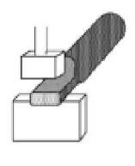
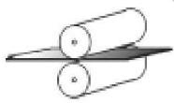
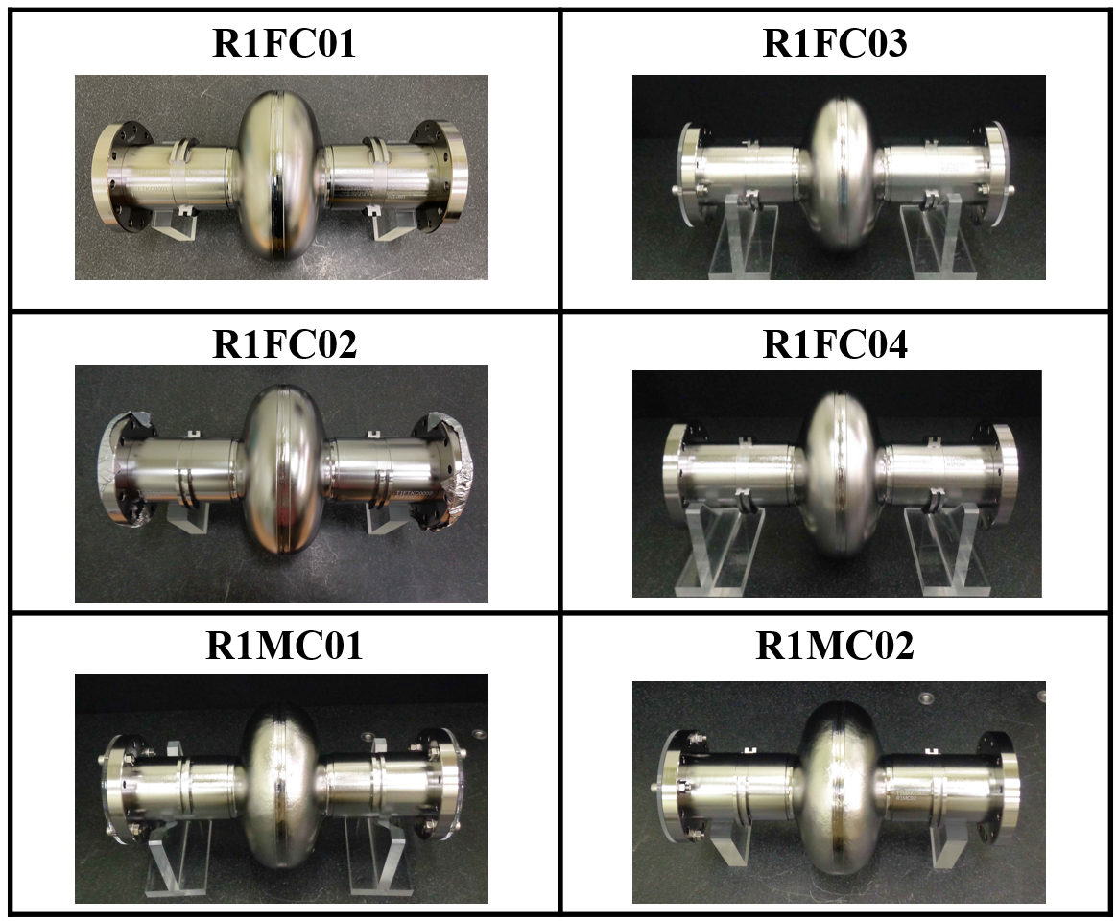
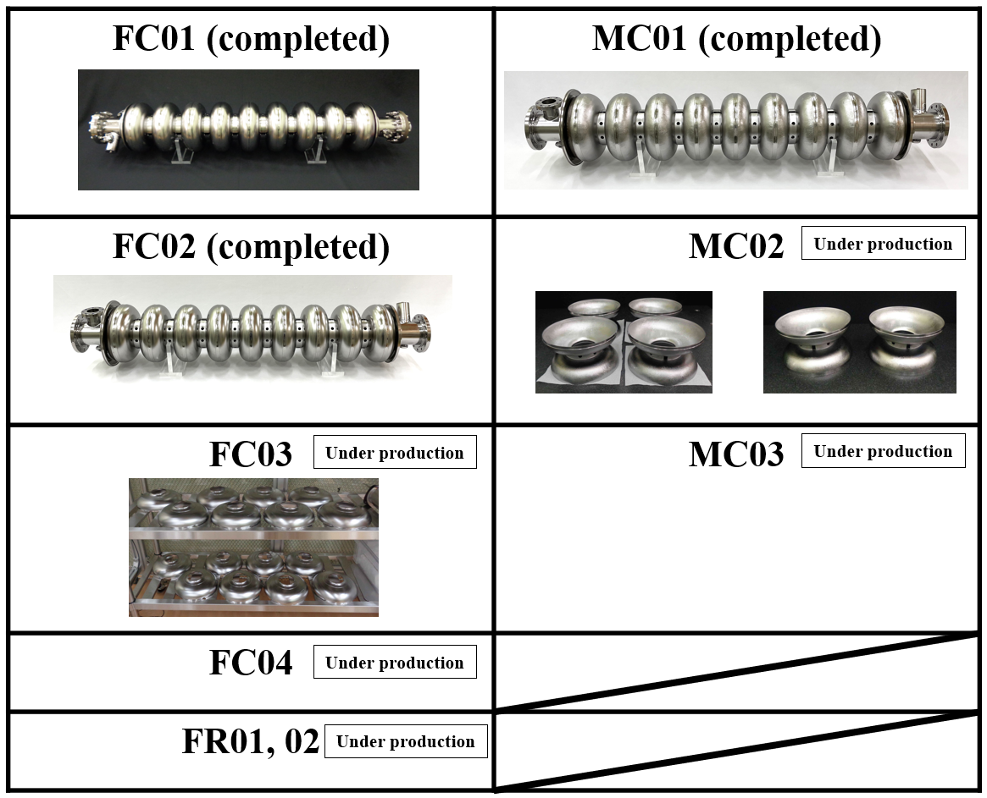
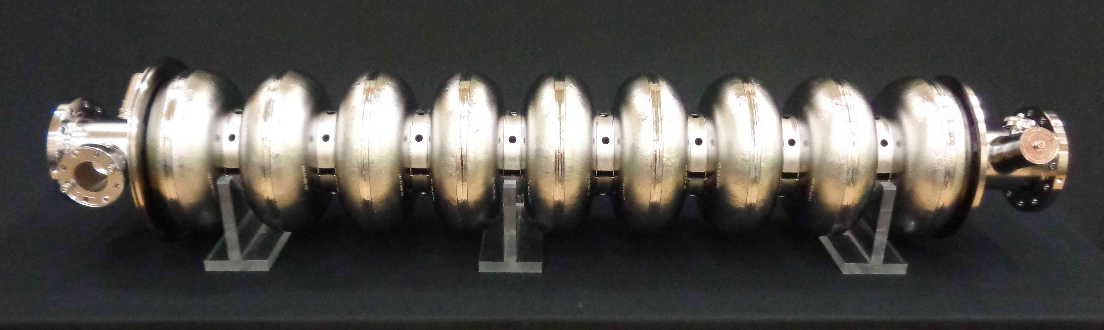
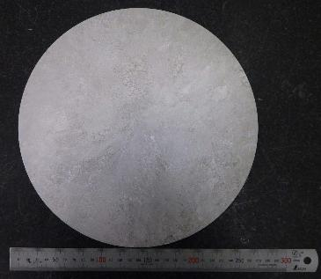
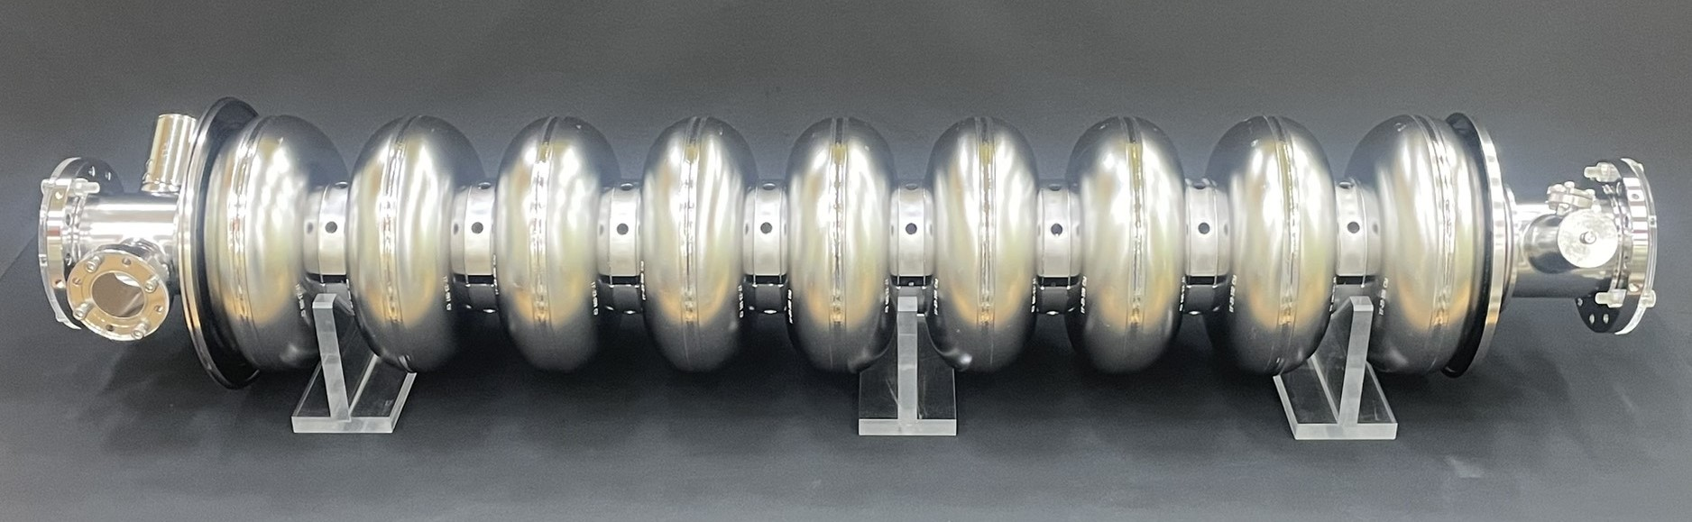
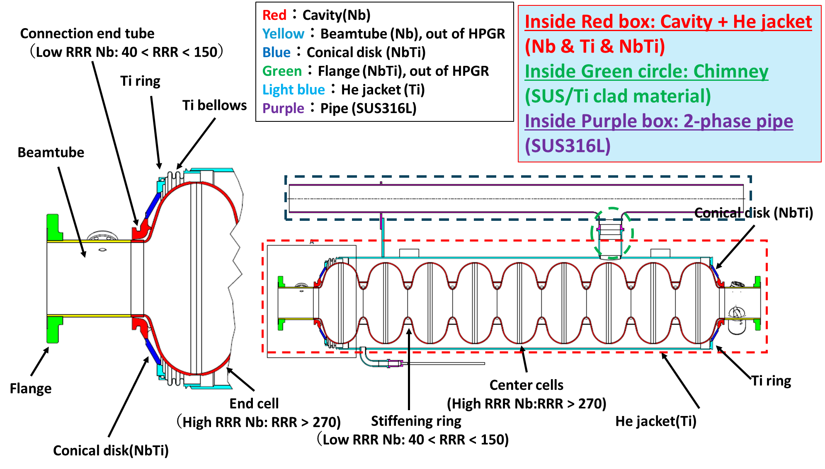
(FY2025) (1)WPP1: Progress of Cavity production at CFF/oversea
FG Nb
The last few year one-cell MG Nb cavity reached more than 35 MV/m.
The world’s first MG cavity!
Six 1-cell cavities produced
Five 9-cell cavity produced
Nb Ingot
Rolling
Forging
Fine Grain (FG) Disc
Grain Size: 50 - 100 um
MG Nb
Ingot
Change FC05
Slicing image by wire-saw
A New Approach:
Medium Grain (MG) Disc
Grain Size < 1 mm
These cavities are made by RI!
(at the first time for KEK)
MG can reduce the cost
(Results of FY2025)
World’s first MG 9cell cavity was fabricated.
2 oversea 9-cell cavities were fabricated.
Apply High Pressure Gas Safety regulation (HPGS) of KEK cavity.
Categories related to HPGS
Takayuki Saeki/Takeshi Dohmae/Kensei Umemori

Slide 12
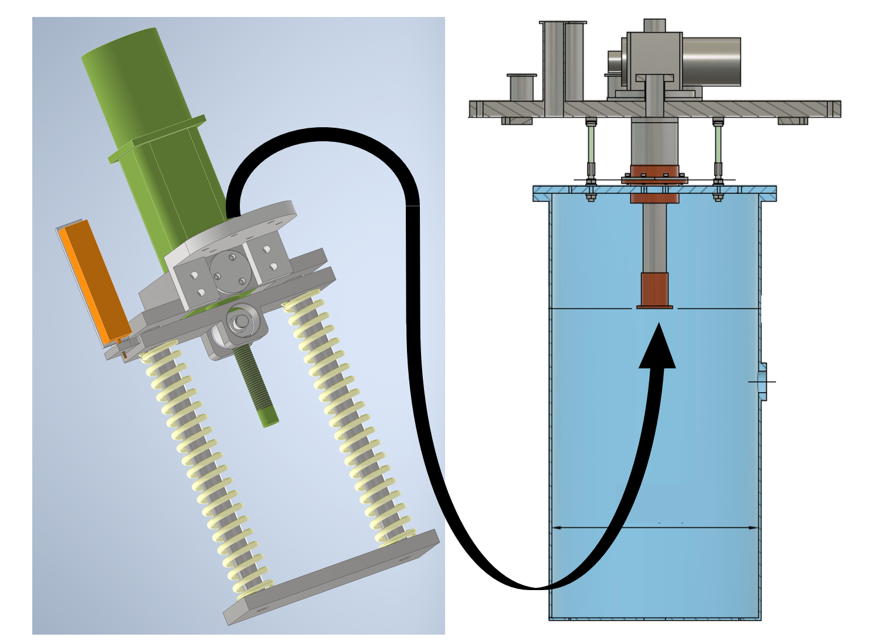
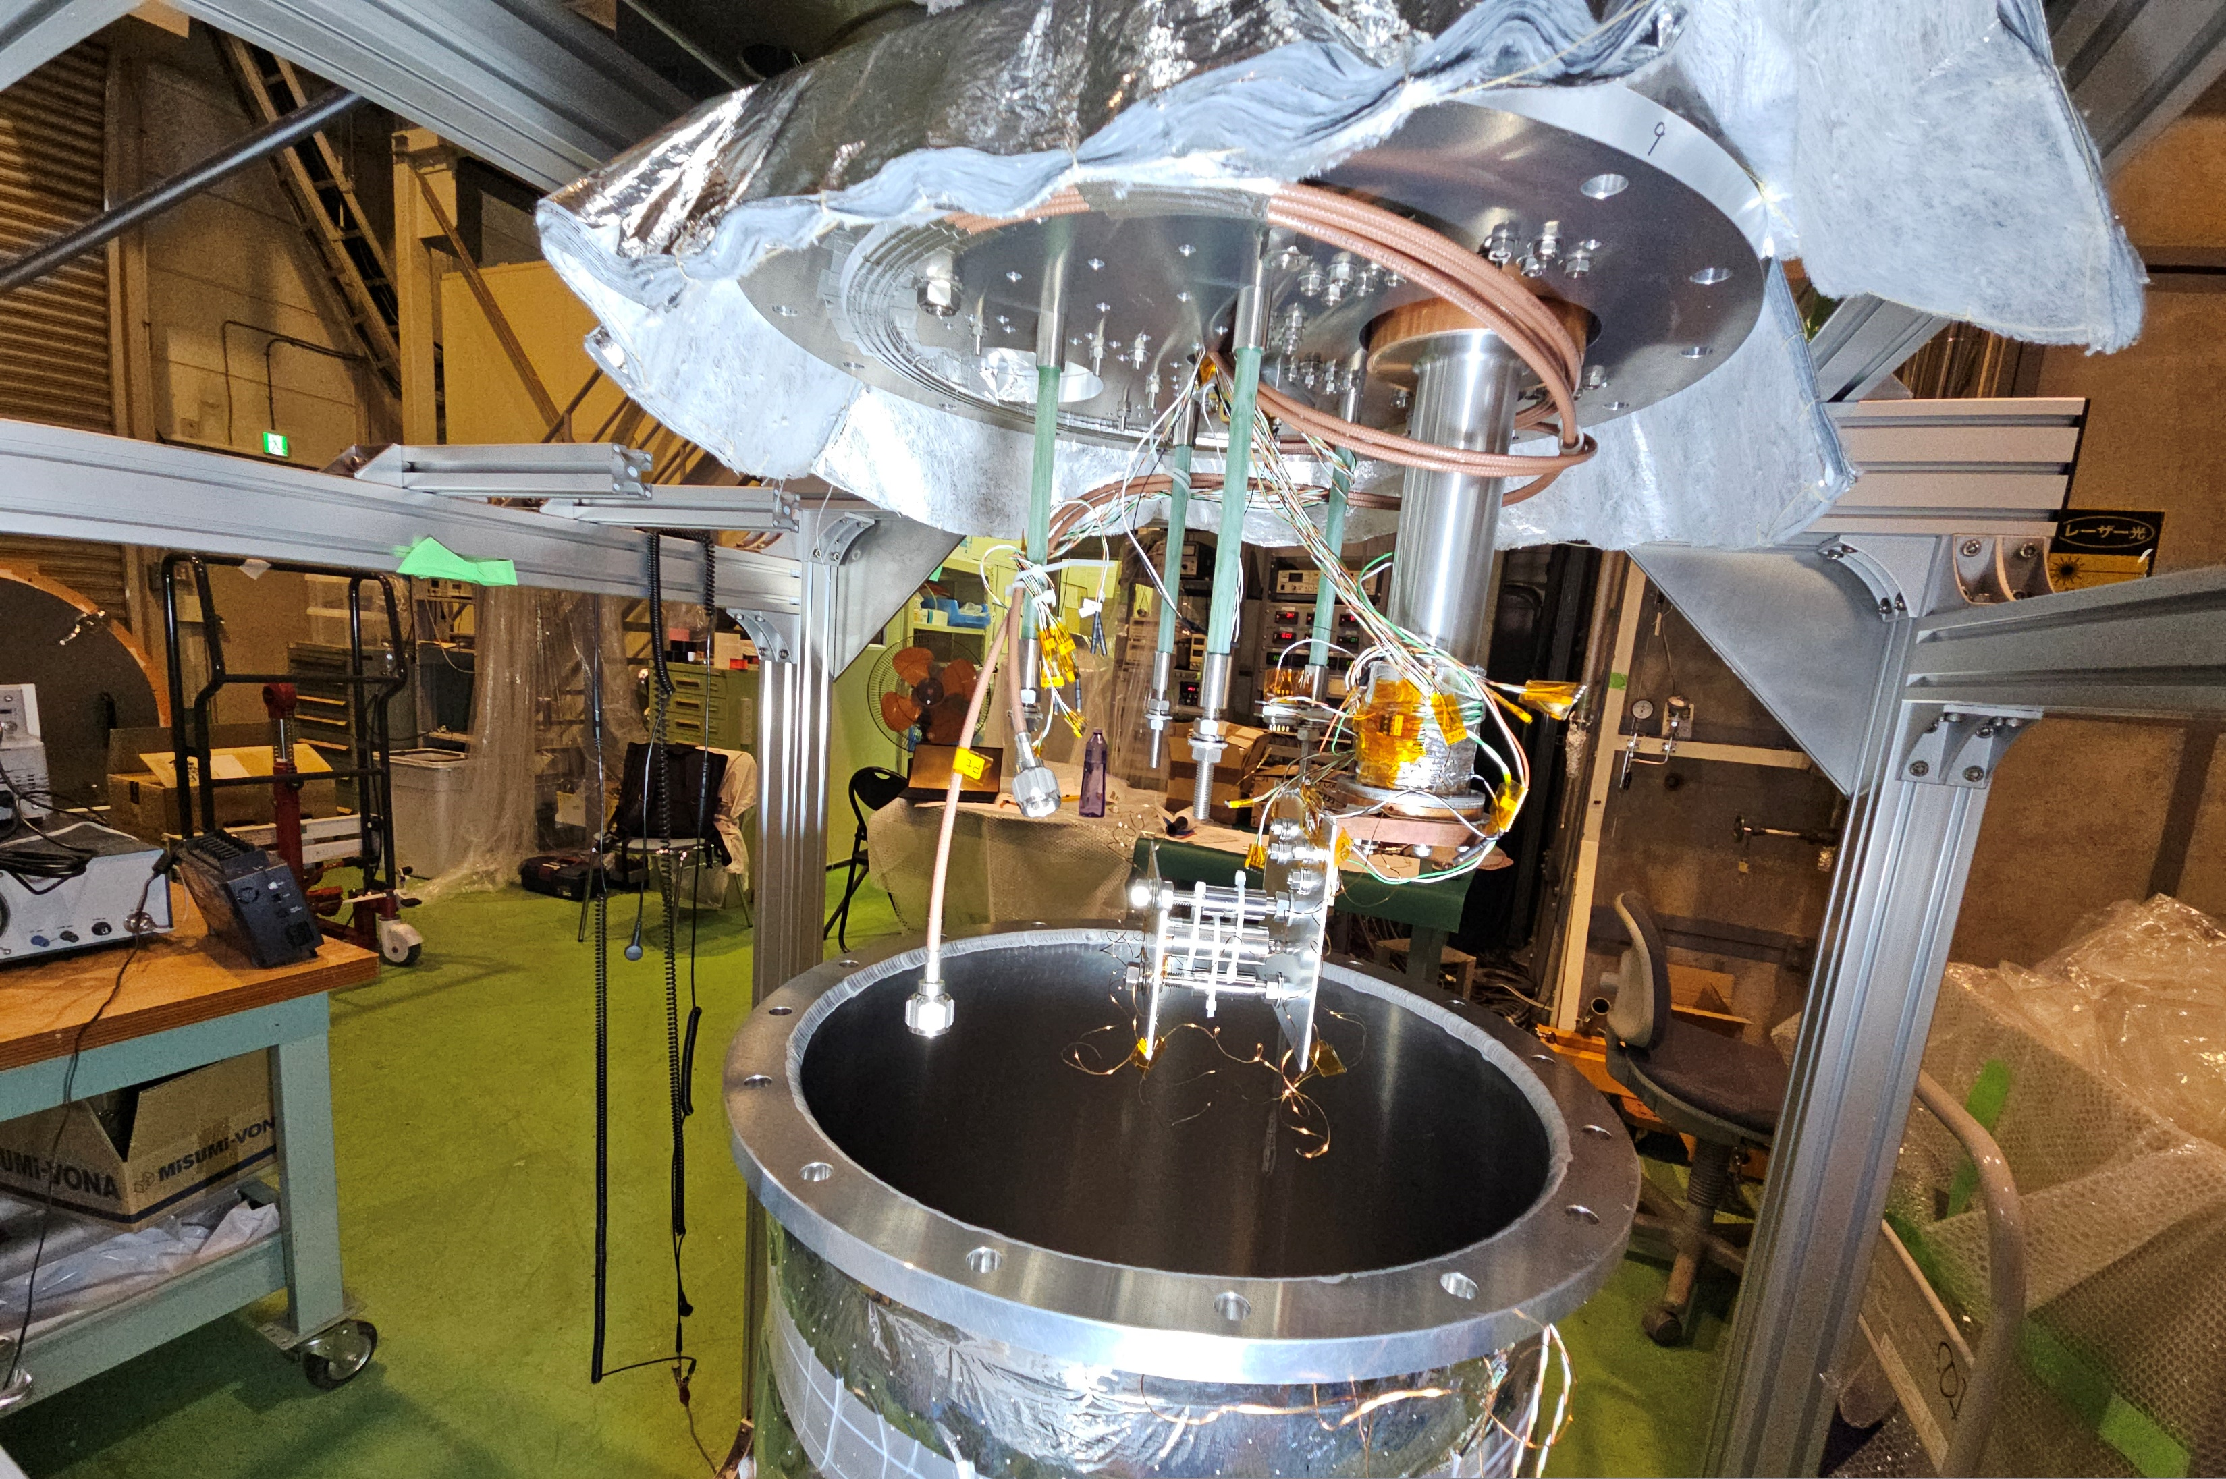
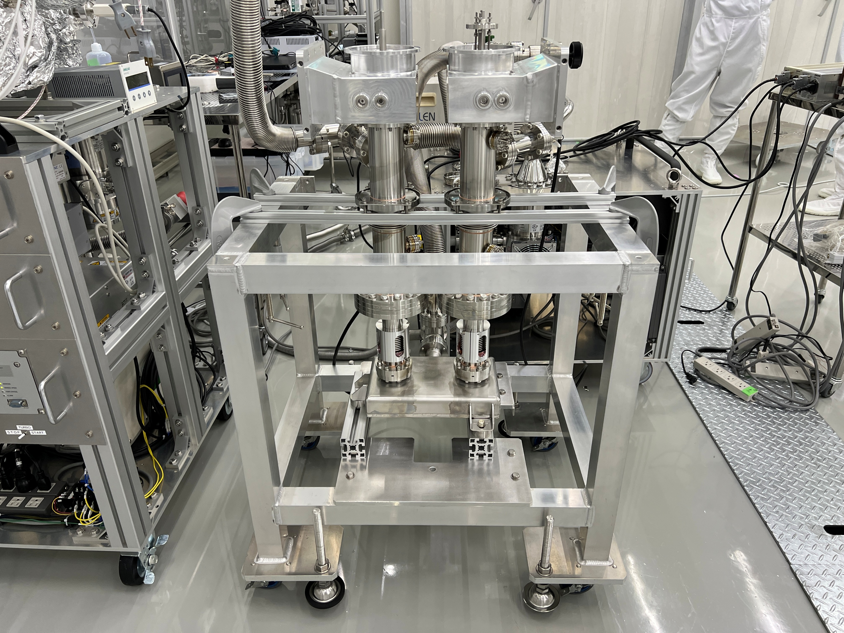
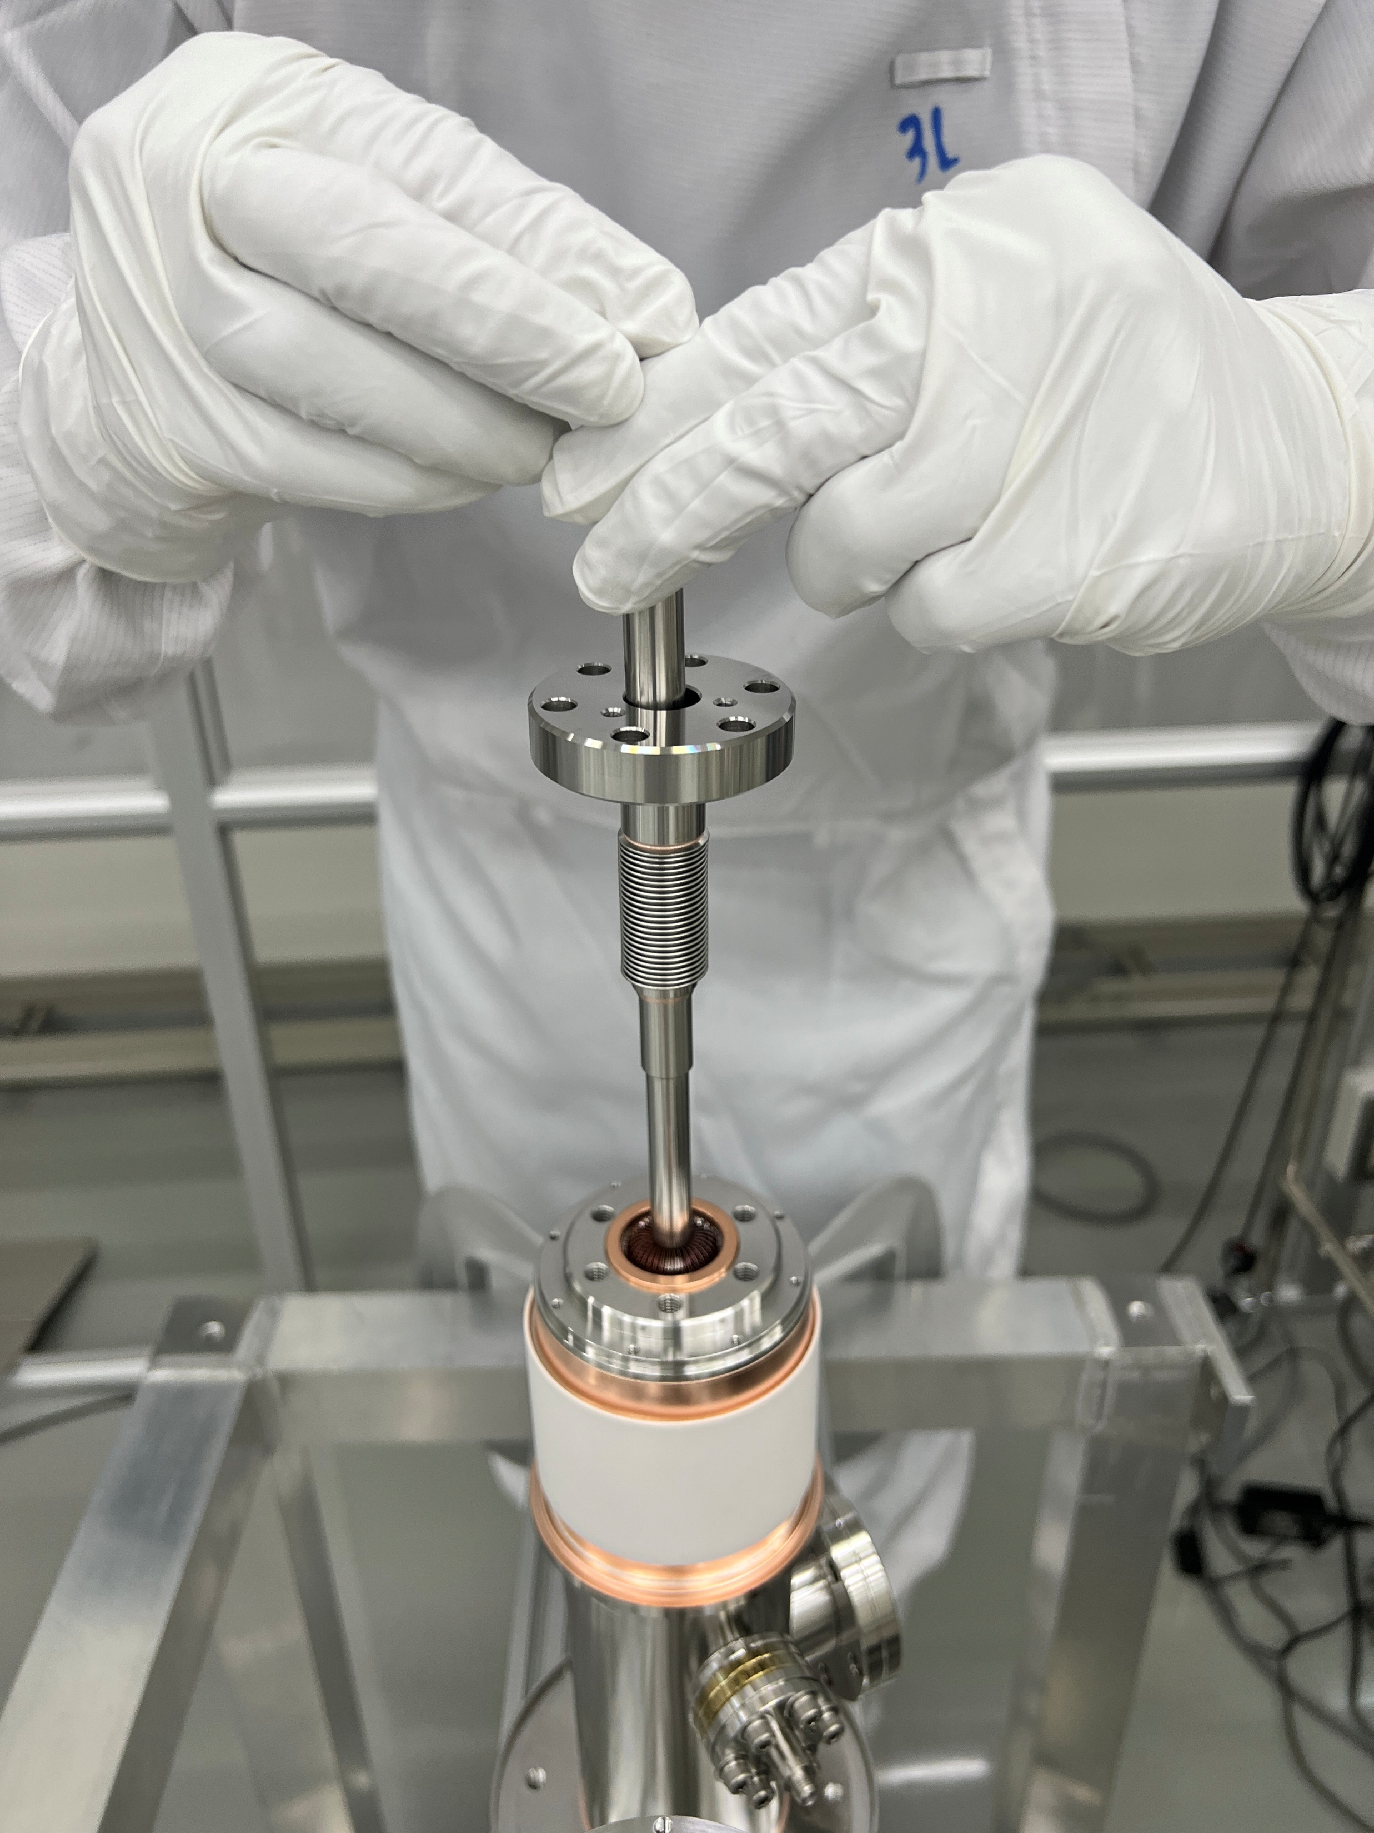
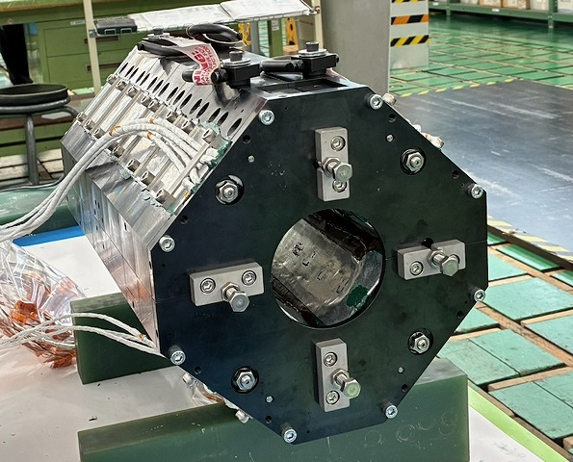
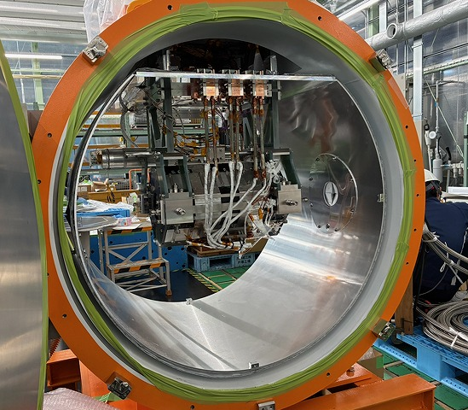
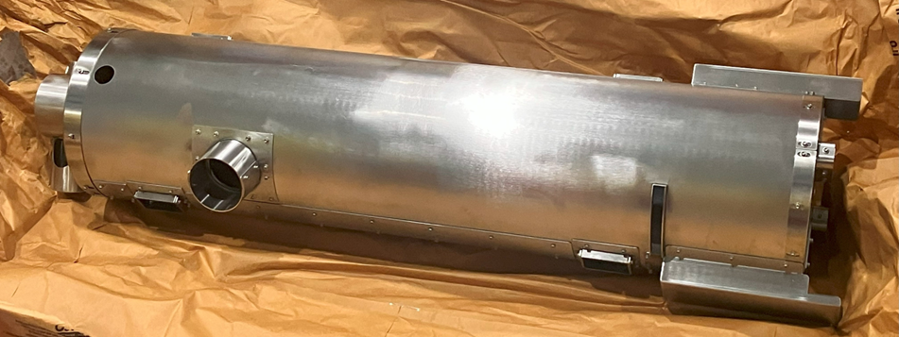
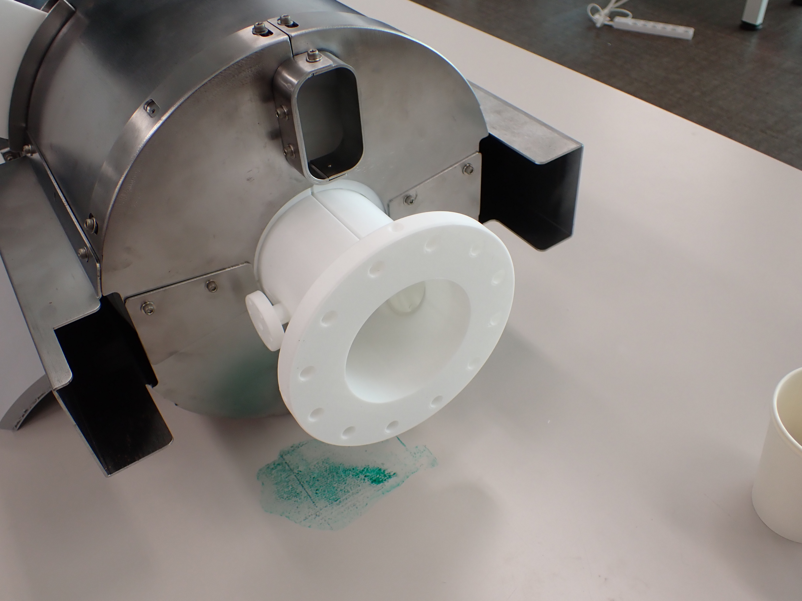
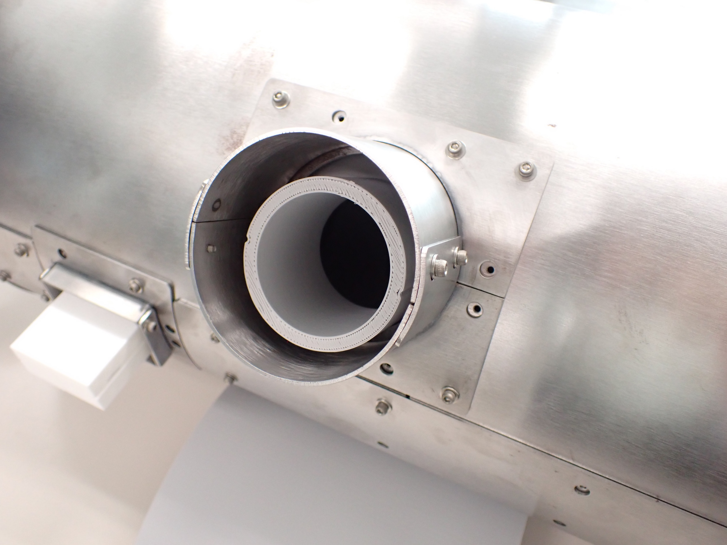
(FY2025) (2)WPP2: Ancillaries
We saw the bad transmission. Unexpectedly big RF loss observed in low power test! Production another four sets of power couplers stopped and will make new 8 couplers. | Cold test for each component under progress Procurement of real tuners under progress Some simulation works under progress
Prototype magnetic shield was manufactured and delivered. Performance test of the prototype magnetic shield was completed. (After a minor design change) One real magnetic shield was delivered. | Real magnet under production to be completed in this FY Test cryostat produced and cold test was conducted. Simulation for leak field under progress

Slide 13
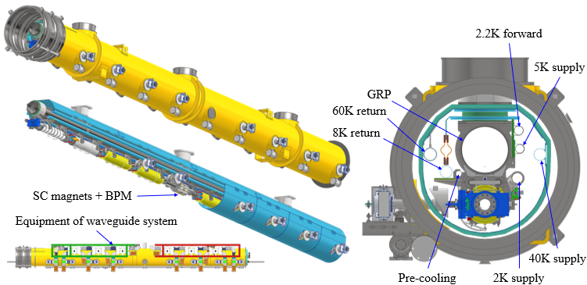
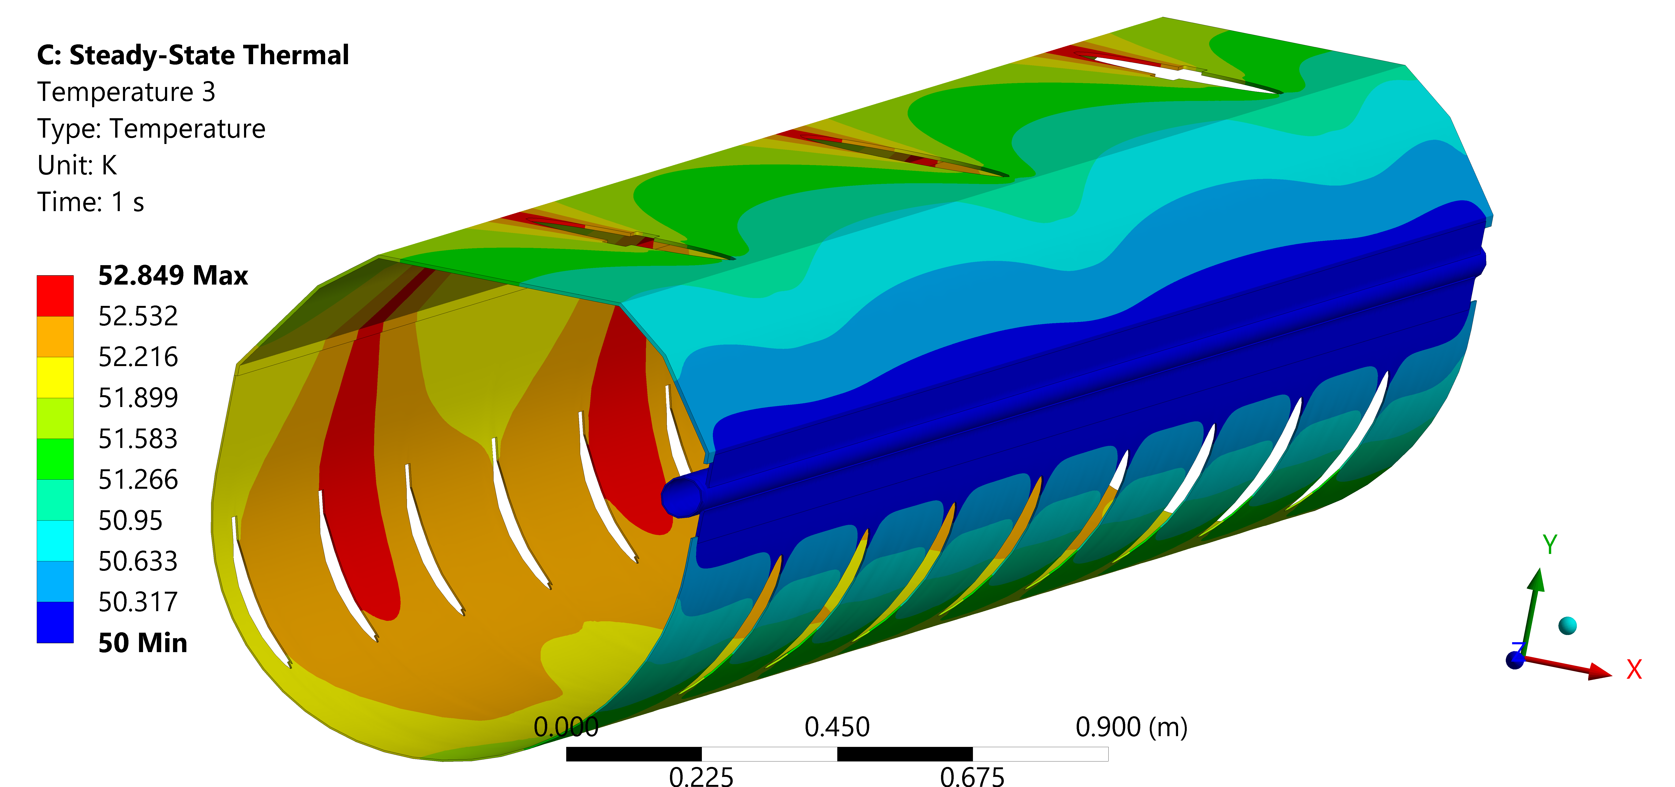
(FY2025) (2)WPP2: Progress of Cryomodule design
ILC “Type B” CM chosen (eight cavities + one SC magnet/BPM)
Single thermal shield @40K (5K dropped)
Tuner access available
3D model completed
Heat load simulation done (dynamic under progress)
Waveguide support frame designed
Total cost for contract under estimation
Specifications
Type | B
Thermal shield | Single
Vacuum vessel length | 12,652 m
Vacuum vessel diameter | OD965mm, ID946mm
Coupler pitch distance | 1326.7 mm
Cavity length | 1247.4 mm
3D model of CM with waveguide system
Thermal analysis for 40K shield
A. Kumar
Takeshi Dohmae/Tomohiro Yamada/Takafumi Hara

Slide 14
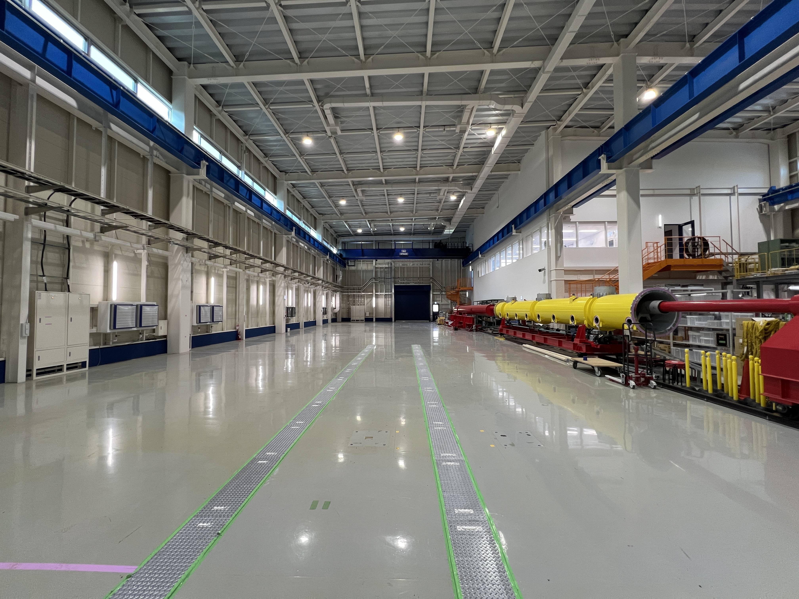
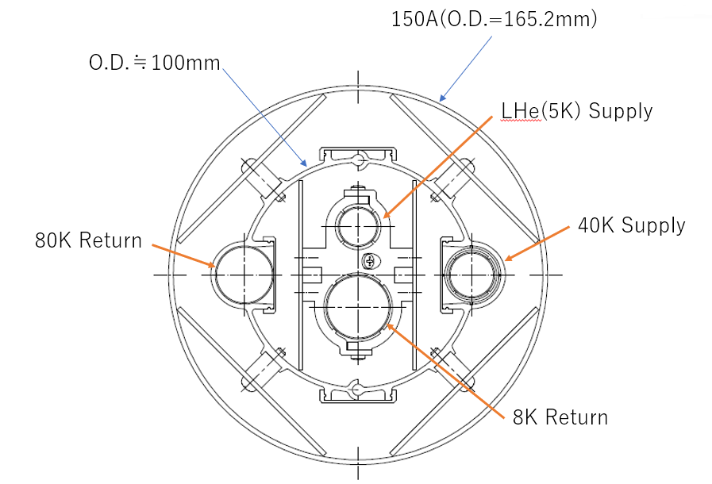
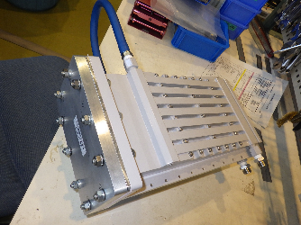
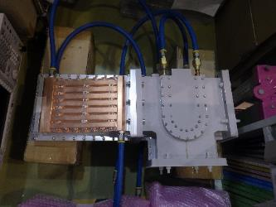
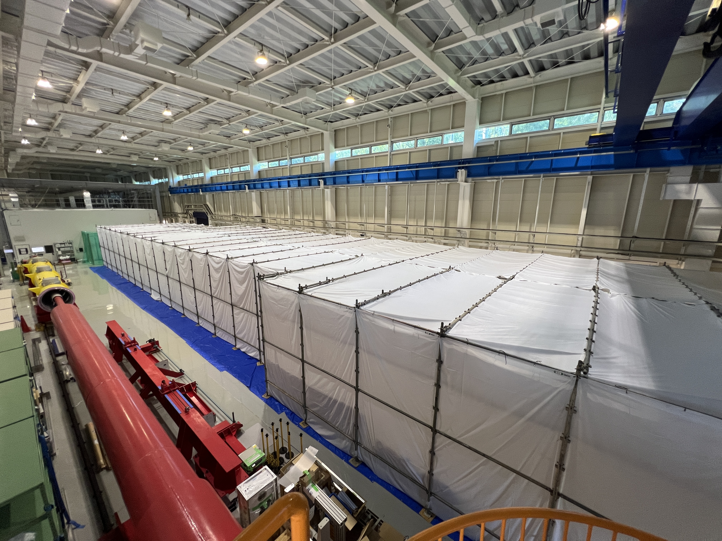
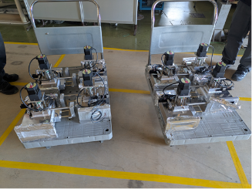
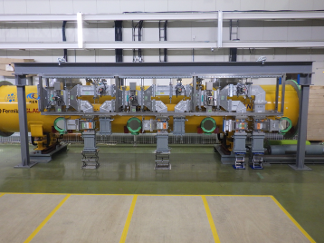
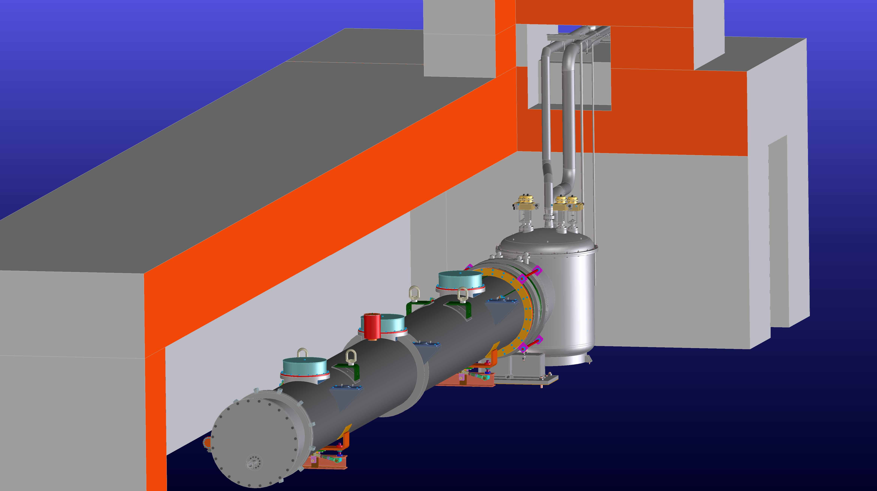
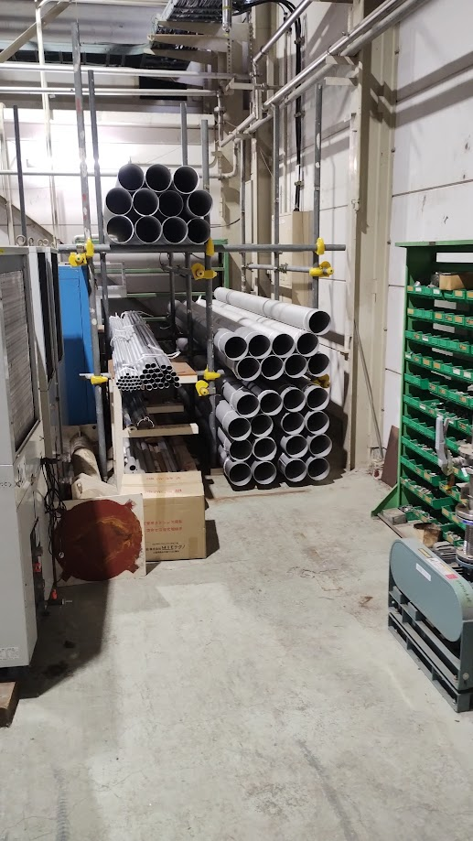



(FY2025) (2)WPP2: Progress of infrastructure in COI building
Cryogenics TRT under production, to be installed in next FY Design of 2K cold box finished High pressure gas safety act Control system under updating | RF system RF components under production/testing Resonant ring system ready for high power test Design of waveguide system attached to CM Design of long-distance waveguide system from STF to COI | Cryomodule Test Bunker Floor reinforcement work was complete (750t) Design of concrete shielding Consideration on CM transport
Toshihiro Matsumoto/Kota Nakanishi/Kirk Yamamoto

Slide 15



Undulator scheme and e-driven scheme positron source
Undulator method (baseline): 125 GeV electrons are passed through a helical undulator, and the produced gamma rays hit the target to produce electron-positron pairs. Polarized positrons (30%) are obtained. Need 125 GeV electron beam.
WPP 6,7
Developed in mainly EU.
Electron driven method：3GeV electrons hit the target to produce electron-positron pairs. High-energy electrons are not required, and the commissioning of the positron production is independent from electron beam commissioning.
Developed mainly in Japan.
WPP 8,9,10,11
Both needs strong target and sophisticated design of Flux concentrator and capture section (cavity and solenoid) → In KEK, prototype of positron source based on e-driven method start to develop.

Slide 16




Positron source in KEK
Build these parts
& test them
Under fabrication In FY2025-FY2026
Made test stand to evaluate the following items
Evaluation of rotating target is in progress
Thermal test by adding heat load of 20 kW (next page)
Continuous operation of rotating for more than one Start to fabricate accelerator structure
Test cell and all cells of Acc structure under fabrication and test of brazing.
Test of power supply of solenoid
Start to fabrication of power supply of Flux Concentrator .
Tracking simulation is in progress.
Accelerator structure under fabrication of each cell & brazing. continue to FY2026.
rotating target.
Plan view of our test stand
Acc. cell
About 200 r p m with water cooling. Vacuum is around 10^-6 Pa level. (FY2024-2025). Now continue long-term operation.

Slide 17

Positron source (rotating target heat load) FY2025
Temperature distribution and thermal conductivity of target disk were evaluated.
This test was done two times and finally in Jan. 2026.
Increase input power to the target up to 20 kW and temperature is less than 200 deg. (see the following figure)
No drastic temperature increase was found → W/Cu smoothly contact and can cooled via the shrink fit of W/Cu.
We think that this target will satisfy our requirement of 27 kW beam deposit for positron production.
2026.Mar.3-5 Advisory board

Slide 18








WPP-15: Final focus at ATF in KEK
Goal 1: Establish the ILC final focus method with same optics and comparable beamline tolerances
ATF2 Goal : 37 nm → ILC 7.7 nm (ILC250); achieved 41 nm (2016)
Goal 2: Develop the position stabilization for the ILC collision
FB latency 133 nsec achieved (target: < 366 nsec)
positon jitter at IP: 106 → 41 nm (2018) (limited by the BPM resolution)
Nano-meter stabilization at IP
(2018)
Long-term (a few days) stabilization is the goal of WPP-15
FB off
FB on
History of ATF2 small beam

Slide 19





ATF activities in FY2025
Final focus system (FFS)
(goal 37nm@1.28GeV,
which equals to 7.7nm @125GeV)
FFS
1.28 GeV
Flight simulator for FFS
linac
Damping ring
Keep international collaboration
Development of beam technology applicable to ILC
AI nano-beam tuning under international collaboration with flight simulator (CERN, KEK and so on)
→ This will improve beam tuning
Upgrading Beam Monitor
→Continue upgrading ATF2 (ATF3) Beamline to be optimized for ILC.
Continue development of nanobeam technology
14 week beam operation in for international collaboration and more reliable operation
Install of multipole magnets to reduce higher-order aberrations on FFS.
Upgrade vacuum chamber to suppress wakefield
Upgrading of all magnet position control system
Upgrade beam size monitor in IP (Buy laser)
Recently, we produce 60-70 nm on FFS in 2026.Mar..
New laser system for IP beam size monitor
On November 2025, we held ATF project meeting under our international collaboration to focus nanobeam generation and stabilization for next two years.
https://agenda.linearcollider.org/event/10859/
Wake field measurement

Slide 20




Advancing of the IP beam size measurement after the IP-BSM laser renewal
The accuracy of the beam size monitor improved after the laser was replaced.
With the hardware upgrade, preparations for beam adjustment starting in fiscal year 2026 are now complete.
Dynamic range of ATF IP-BSM
ATF IP beam size monitor
Small beam
30 deg. mode
2-8 deg. mode
By comparing the beam
with the laser interference pattern,
the beam size can be evaluated.
174 deg. mode
The same beam size was measured in different cross angle modes, the modulation in each mode was as expected.
It became possible to generate ideal interference fringes at ATF IP after the laser was replaced, .
Large beam
66nm beam size measurement stably was done in 2026.Mar.
(important message)
JFY2026-2027 is very important to fulfill nanobeam generation (<37nm) and stabilization (for a few days)

Slide 21



Future expected applications after this program → impact of this projects
SRF technology applications:
• ex. Semiconductor lithography (EUV-FEL), medical application, environmental remediation, etc. → cERL in KEK
Applications of Sources technology (positron)
• In the future, more intense positron sources will be needed not only for linear collider but also for circular colliders such as FCCee and CEPC.
• High-intensity slow positrons are expected for surface structure analysis.
• Positron targets are also closely related to targets for neutron and beam irradiation used in industrial medical applications.
Applications of nano-beam technology (ATF):
• Synergy about nanobeam operation in new-generation synchrotron light source,
• Advancement of beam diagnostics, beam tuning by machine learning, beam control technology on the nanosecond scale can be applied to a wide range of accelerators.
EUV-FEL by advanced SRF technology
Slow positron facility by advanced source technology
Synergy about new-generation light source

Slide 22
(C)
Contents :
A) Overview & ILC Technology Network (ITN)
B) ILC activities in JFY2025 (mainly Japanese activities on MEXT-ATD)
C) Summary and Future plan (JFY2026 ~)

Slide 23
Summary & future
ILC accelerator development is on-going under the framework of ITN and mainly supported on MEXT-ATD program, JFY2023-2027 in Japan.
Until JFY2025, we conducted 3 critical accelerator technologies, such as SRF, nanobeam and positron under MEXT-ATD program.
Worldwide ITN activities - the European & Korean contribution - are well underway.
Many activities of ITN about this SRF, nanobeam and positron were on going in Japan under MEXT-ATD with world wide contribution.
In JFY2026, we also continue to develop these 3 critical accelerator technologies to realize ILC under ITN.

Slide 24

Acknowledgements
KEK iCASA members (+α) (2026.Apr.)
This work was supported by “MEXT Development of key element technologies to improve the performance of future accelerators Program”, Japan Grant Number JPMXP1423812204
This work was partially supported by U.S.-Japan Science and Technology Cooperation Program in High Energy Physics (2022-19-3) (2025-04-3).

Slide 25
Backup

Slide 26








History of ILC Collaboration
2004
’06 ’07 ’08 ‘09 ‘10 ’11 ‘12 ‘13 ‘14 ‘15 ‘16 ‘17 ’18 ‘19 ‘20 ’21 ’22 ’23 ’24 ’25 ‘26
International
Development
Team
RDR
TDR
LCC
IDT
ILC-GDE
Technology
Selection
by ITRP
ILC technical design
ILC Technology Network (ITN)
TDR
Lyn Evans
LCC director
(former LHC project manager)
Tatsuya Nakada (EPFL)
IDT chair
ILC-250
(2017)
TDR:
49 countries
392 institutions
>2400 researchers
Barry Barish
GDE director
(the Nobel Prize winner in 2017)
Pre-lab workpackages
(May 2021)
ILC Technology Network
(July 2023)

Slide 27

ITN in progress all over the world
For WPP-1&2 (SRF cavity, CM), single cell cavity production in Korea/Europe and 9-cell cavity production in Europe started.
For WPP3 (Crab cavity), Prototype designs down selected under world wide review.
JAI (UK) started WPP-14 (DR Injection/extraction, synergy with Diamond Light Source upgrade)
For WPP-15 (Final Focus System), European and Korean researchers have joined to the ATF experiments since 2023.
(published to arXiv on 2026.Mar.1st)
https://doi.org/10.48550/arXiv.2603.01172
(Mar.2026)
(published)

Slide 28





On-going technical studies in Europe – the ILC technology network topics
European ITN related studies (dedicated funding from Japan combined with European resources) are distributed over five main activity areas:
ML related tasks
SRF and ML elements: Cavities and Cryo Module,
Crab-cavities, ML quads and cold BPMs
→ at least 2 nine cell cavities under fabrication by EU (CERN, INFN, CEA)
Sources
Pulsed magnet and wheel/target for undulator scheme
Damping Ring including kickers
Low Emittance Rings
ATF activities, final focus and nanobeams
ATS and MDI
Implementation
CE(civil engineering), Cryogenics
Sustainability, Life Cycle Assessments
EAJADE (EU funding) for training of young scientists (linear and circular machines)
Studies in labs distributed across CERN, UK, Germany, France, Italy, Spain
See more details in the Venice presentation of Peter McIntosh (LINK)
and
Angeles Faus-Golfe on ATF2-3 (LINK)
Steinar Stapnes

Slide 29






About human resources for MEXT-ATD ( ~ FY2025)
For completing this MEXT-ATD project, we hired many young researchers. (in total 6 persons)
In JFY2023, one postdoctoral fellow was hired.
Popov Konstantin (nanobeam ATF), From 2023.Oct. → Assistant professor from 2024.Oct.
→ moved to company (Kazakhstan) from 2026.Jan.
In JFY2024, four special assistant professors were hired.
Takafumi Hara (SRF), from 2024.Apr.
Motoki Sato (Positron), from 2024.Apr. → (nanobeam ATF) from 2025.Jun.
Bajipai Rishabh (SRF), from 2024.Dec.
Eric Viklund (SRF), from 2025.Jan.
In JFY2024, one postdoctoral fellow was hired.
Yuki Abe (nanobeam ATF), from 2024.Apr. → Assistant professor from 2025.Jul.
Popov Konstantin
(nanobeam ATF)
(2023.Oct. ~ 2026.Jan.)
Takafumi Hara
(SRF)
(2024.Apr. ~)
Motoki Sato
(Positron →
Nanobeam ATF)
(2024.Apr. ~)
Yuki Abe
(nanobeam ATF)
(2024.Apr. ~)
Bajpai Rishabh
(SRF)
(2024.Dec. ~)
Eric Viklund
(SRF)
(2025.Jan.. ~)

Slide 30

The latest beam size in ATF after improvement laser monitor
Typical IP-BSM measurement on 2026.Mar. operation
3/23
Crossing mode | Typical measured modulation | Modulation of 75nm beam | Modulation of 65nm beam
6.4 degree | 90 % | 98.9% | 99.0%
30 degree | 75-80% | 78% | 80%
174 degree | 20-30% | 20% | 30%
We can stably measure the beam size at FF in ATF with beam size tuning
(important message)
JFY2026-2027 is very important to fulfill nanobeam generation (<37nm) and stabilization (for a few days)

Slide 31


Five-Year Plan and Progress in midterm (nanobeam) (ATF)
under MEXT-ATD program (FY2025) → our mission
 | 2023 | 2024 | 2025 | 2026 | 2027
Nanobeam | Procurement of High-Order magnets Upgrade of beam operation and equipment | Reduction of wake field and higher order aberration Upgrade of beam operation and equipment | Precise measurement of nanobeam, Upgrade of beam operation and equipment | Improvement of beam turning method (incl. AI) Vertical beam size on IP <37nm | Improvement of beam turning method (incl. AI) Long-term stabilization of nanobeam (for a few days)
The first three years (FY2023-2025) will focus primarily on updating ATF equipment necessary for advancing the nanobeam. The subsequent two years will realize nanobeam generation and stabilization using the updated equipment.
The procurement of equipment, its installation on the beamline, and performance test of the installed equipment have proceeded on schedule until now.
Following picture is our progress of preparing items. Procurement of major equipment for the ATF2 beamline will be completed in JFY2025.
Upgrade focal magnet
（JFY2024 buy、JFY2025 install）
Upgrade Skew sextupole magnet for beam size adjustment (JFY2023 buy、JFY2024 install)
Development Extraction kicker（JFY2023 buy ceramic chamber、JFY2024 install ceramic chamber、JFY2025 test kicker）
(important message)
Next two years is very important to fulfill nanobeam generation (<37nm) and stabilization (for a few days)
(Mission of MEXT-ATD program (ATF operation budget come from this MEXT-ATD program)
Improvement of timing system（JFY2023 partially upgrade、JFY2024 upgrade completed）
Upgrade vacuum chamber to suppress wakefield （JFY2023 prototype、JFY2024 install）
Upgrade precise position control system of magnet（JFY2023 prototype、JFY2024 upgrade、JFY2025 upgrade all）
Upgrade beam size monitor in IP（JFY2024 Upgrade target, JFY2025 Buy Laser）
The current status is as planned.
ITN goal is same as our MEXT-ATD program

