Slide 1



Vertex detectors for FCC-ee and the FCC-SEED concept
Armin Ilg, Jeremy Andrea
IPHC (Strasbourg)

Slide 2
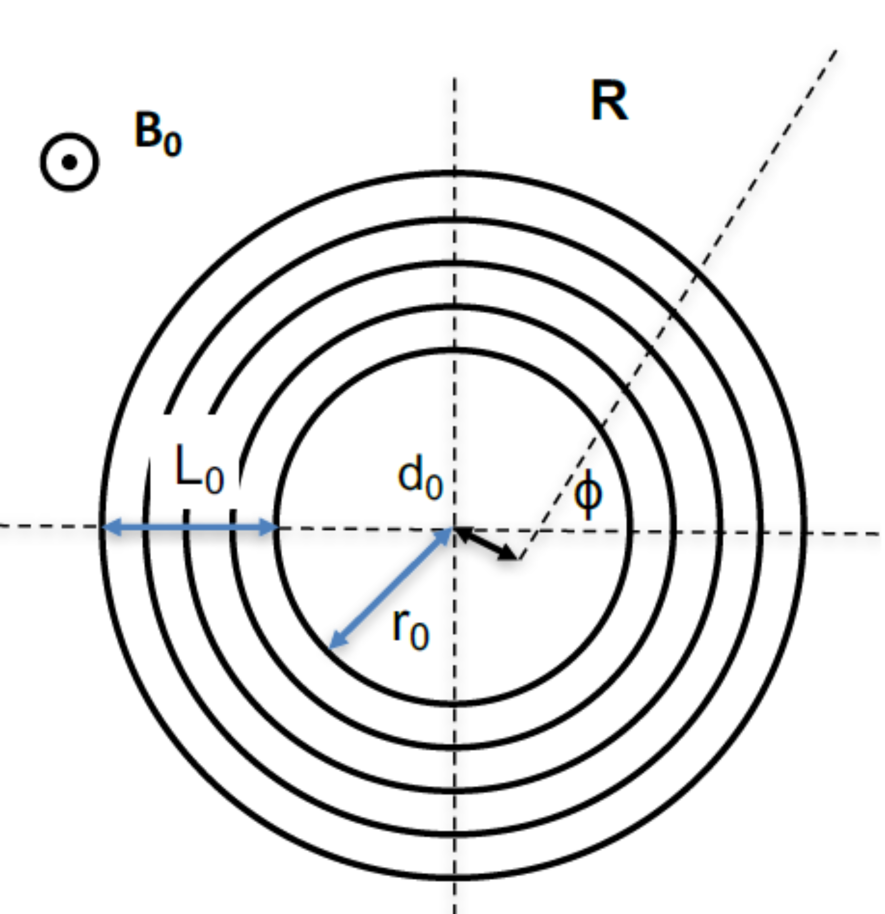
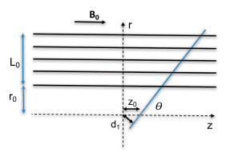




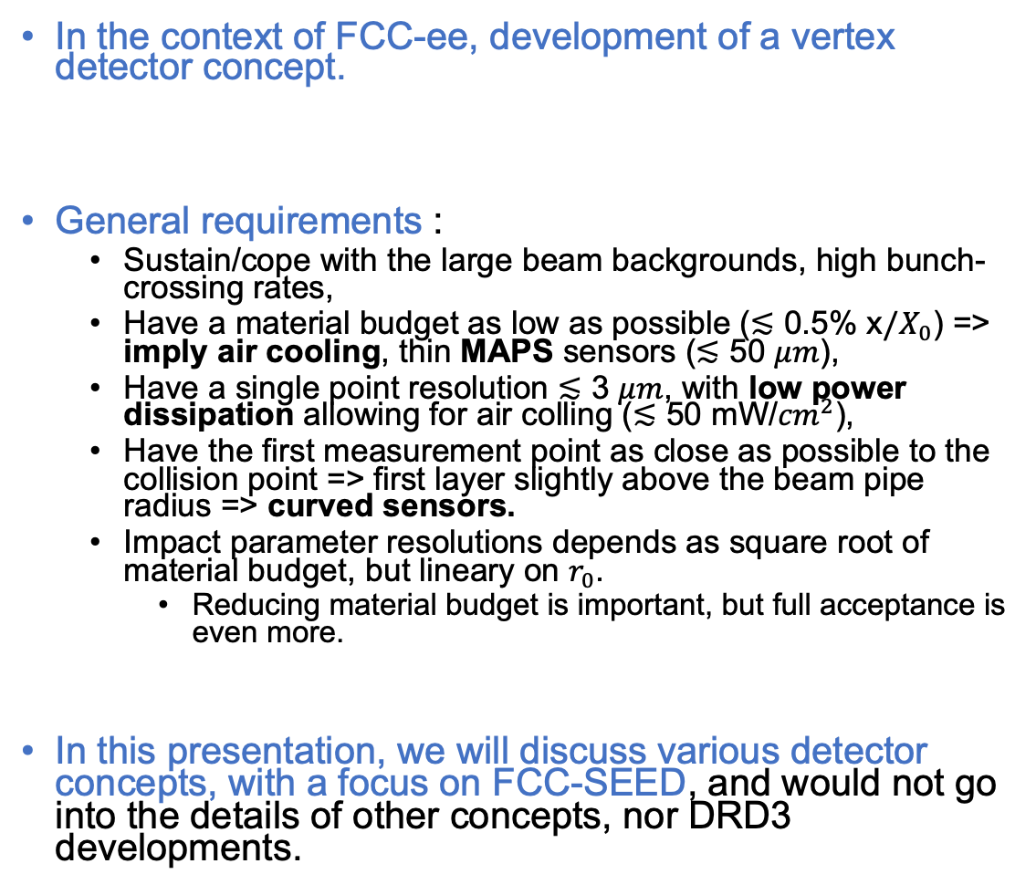
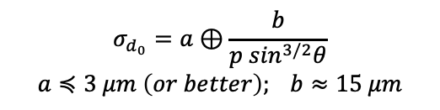
Introduction
In the context of FCC-ee, development of a vertex detector concept.
General requirements :
  Sustain/cope with the large beam backgrounds, high bunch-crossing rates,
  Have a material budget as low as possible ($≲$ 0.5% x$/X_{0}$) => imply air cooling, thin MAPS sensors ($≲$ 50 $μm$),
  Have a single point resolution $≲$ 3 $μm$, with low power dissipation allowing for air colling ($≲$ 50 mW/${cm}^{2}$),
  Have the first measurement point as close as possible to the collision point => first layer slightly above the beam pipe radius => curved sensors.
  Impact parameter resolutions depends as square root of material budget, but lineary on $r_{0}$.
    Reducing material budget is important, but full acceptance is even more.
In this presentation, we will discuss various detector concepts, with a focus on FCC-SEED, and would not go into the details of other concepts, nor DRD3 developments.
FCCee
$$σ_{d_{0}}=a⊕\frac{b}{p \sin^{3/2}θ}$$
$$a≼3 μm \left(or better\right); b≈15 μm$$

Slide 3
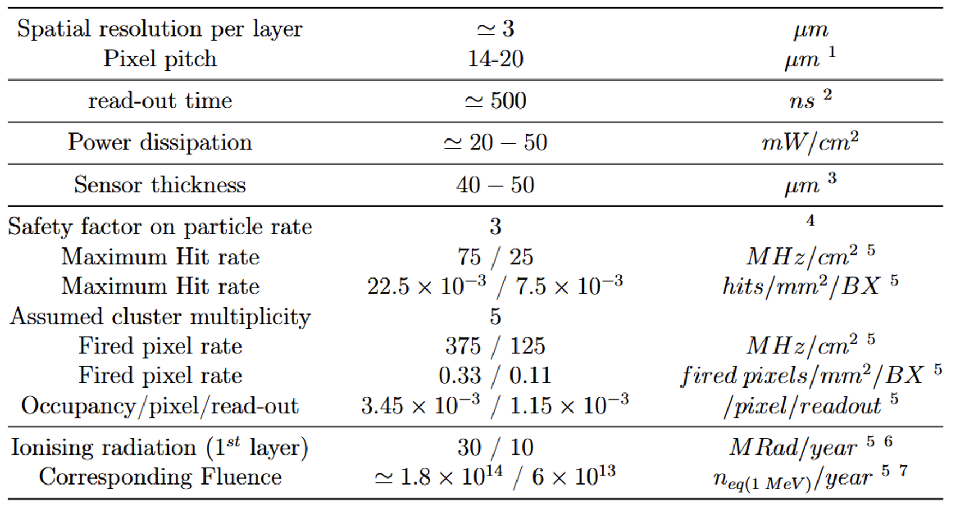
Vertex sensor specifications
Depends on pitch, charge sharing and encoding
Balance between power dissipation and particle rate
To be compatible with air cooling
Reduced material budget, allows for bending
Related to max particle rates at the Z energy
5
Expected max fluence per year

Slide 4
Vertex detector design ”spaghetti” diagram
As illustration
Chip design
Pitch
Size/geometry
digitization
Readout speed/timing
Cables/flex
Integration
Assembly procedure
Mechanics
Geometry
Material budget
Material type
Services supports
Cooling power
Cooling
Cooling type

Slide 5
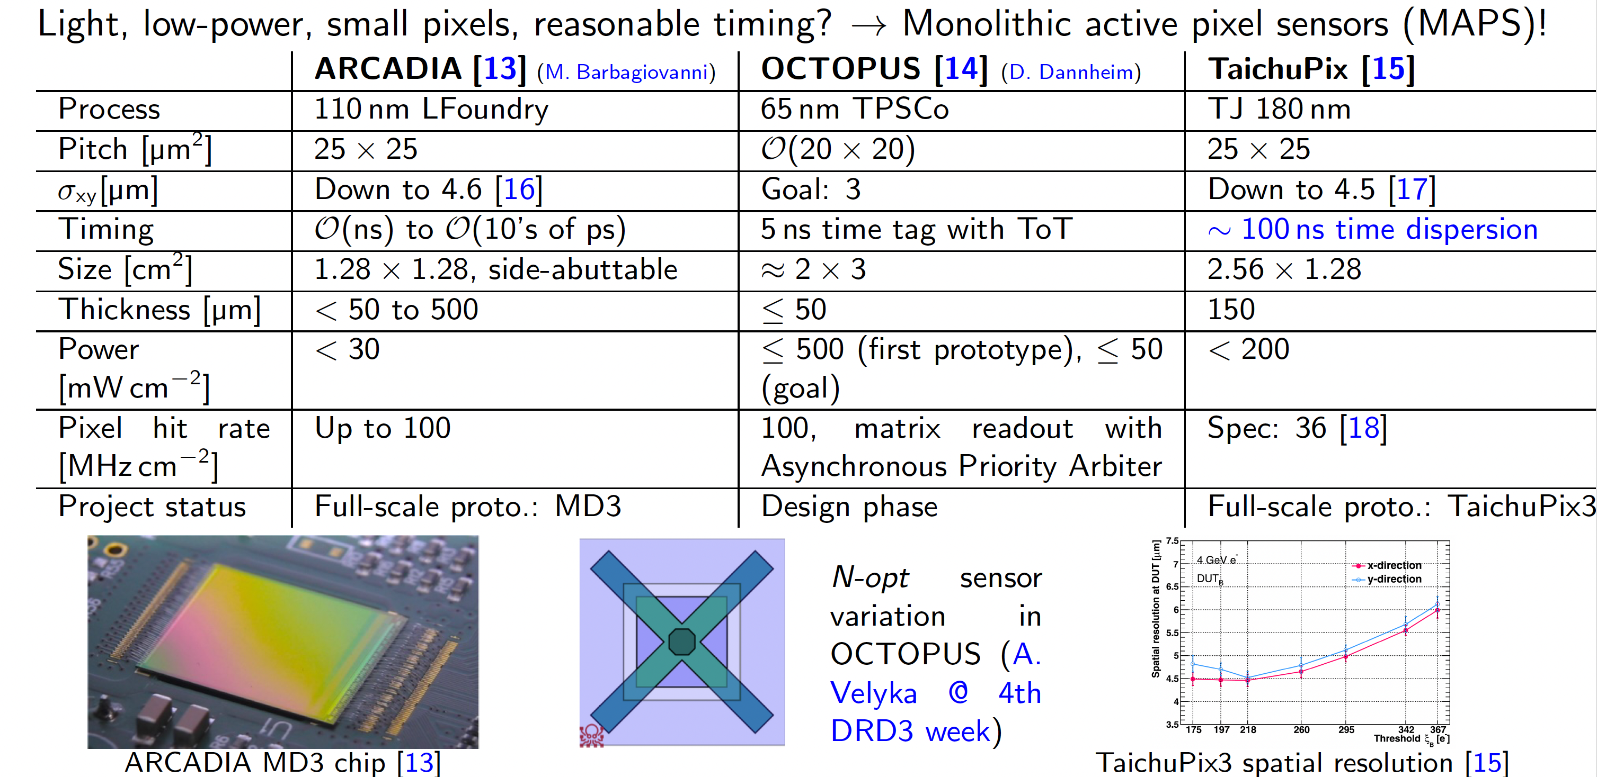
Technologies for Vertex detector

Slide 6
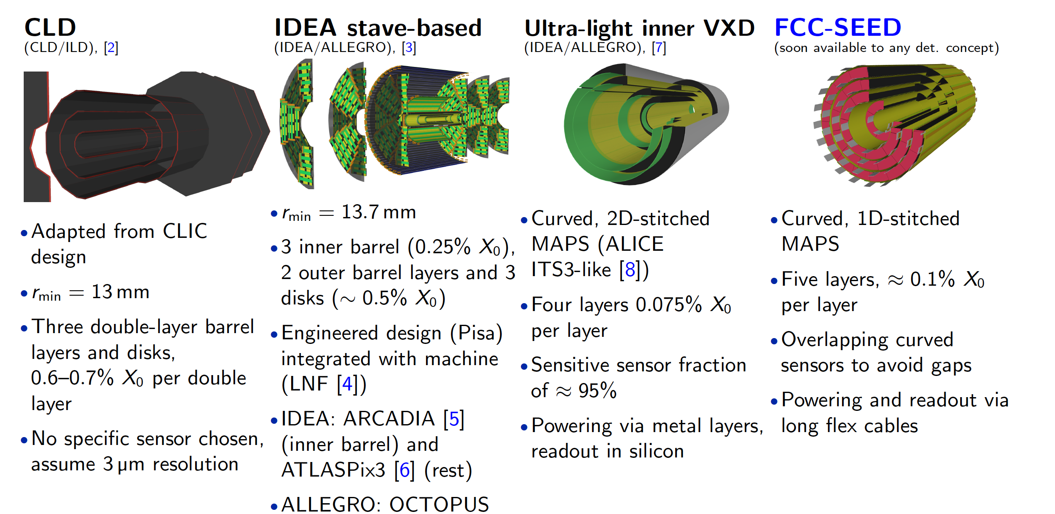
Vertex detector layouts for FCCee in DD4hep full simulation
ALFA det. concept: 5-layer curved inner VXD (long barrel)
AGORA det. concept: 4-layer curved inner VXD (long barrel + 2 layers of ladders

Slide 7


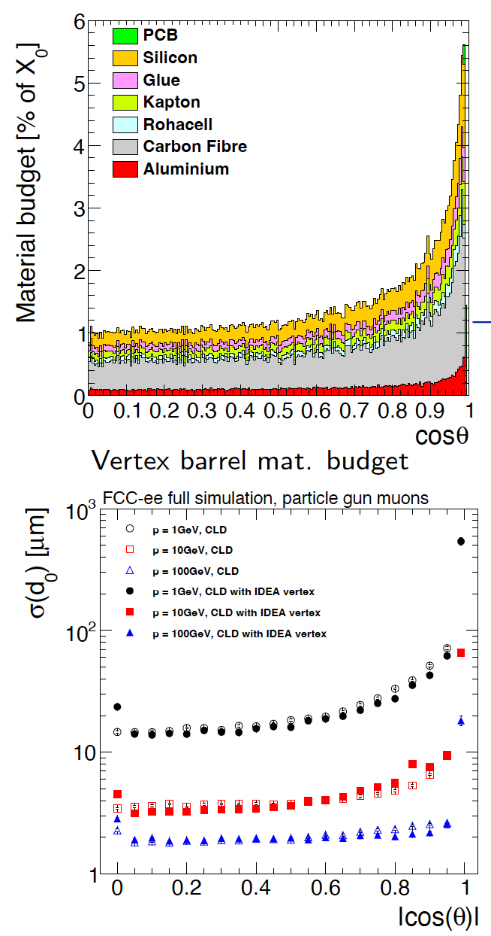
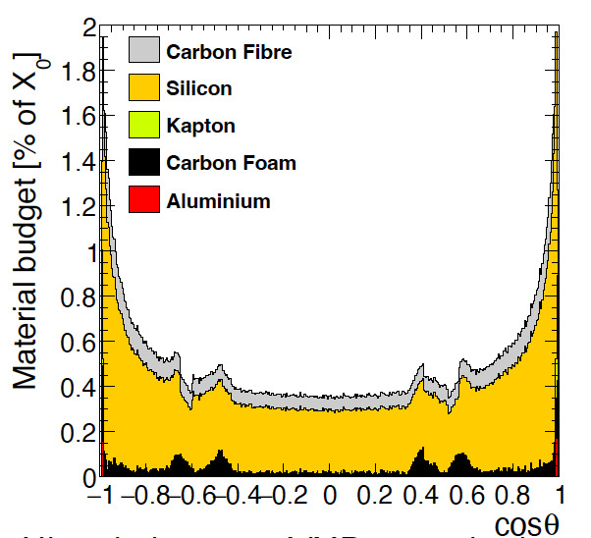
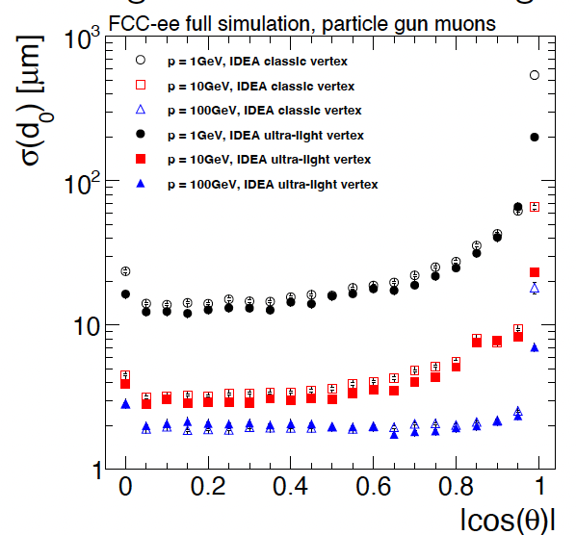
Vertex detector layouts for FCCee in DD4hep full simulation
ALFA det. concept: 5-layer curved inner VXD (long barrel)
AGORA det. concept: 4-layer curved inner VXD (long barrel + 2 layers of ladders

Slide 8
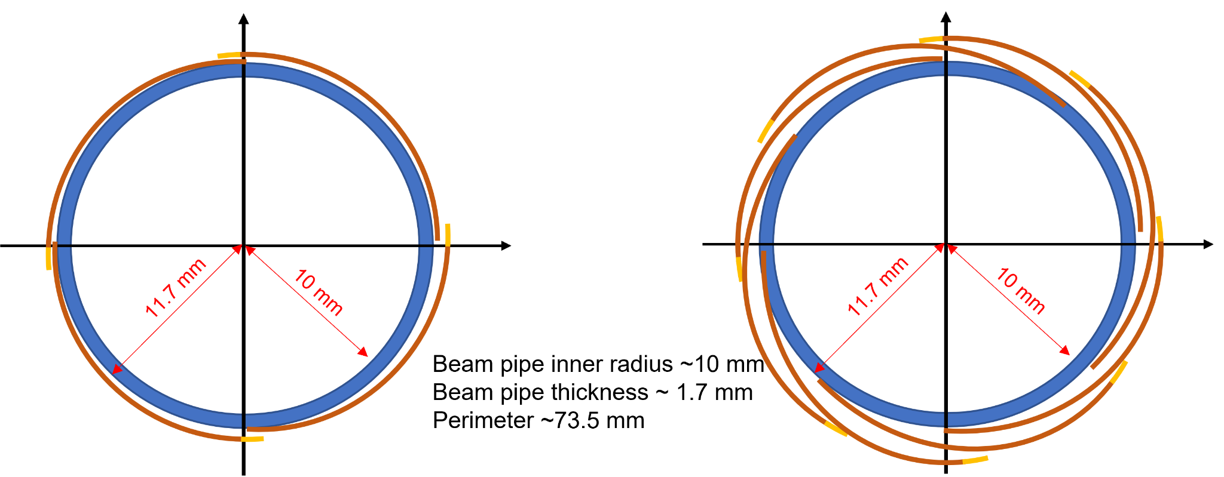
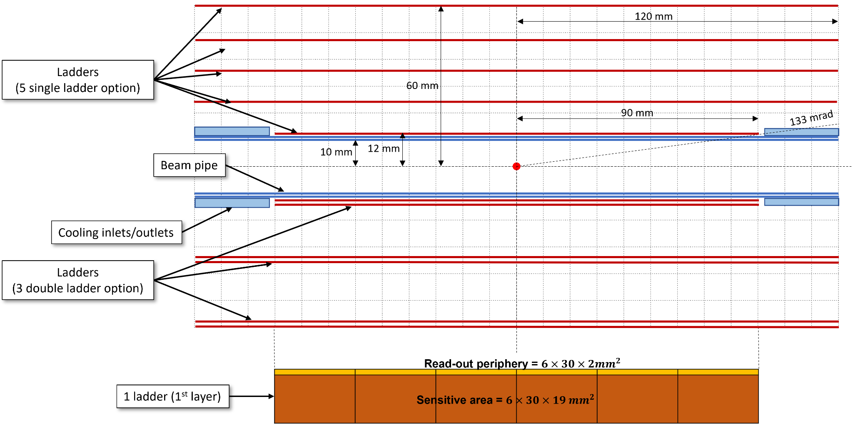
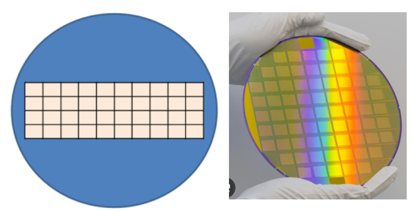
FCC-SEED, general approach
General approach : curved sensors, favour hermeticity.
Main concept :
  Have curved “ladders” (a la ALICE),
  Have octopus-like sensors,
  Bend wafer “slice”, have bonding along the Z-axis, stitching as an option,
  Overlap to avoid holes in the acceptance,
  Barrel+endcaps.
Option 1
Option 2
48 mm
Option 1
36 mm
24 mm
Very first steps :
  Mastering the techniques for bending sensor,
  Learn “basics” for mechanics and integration (gluing, wire bonding),
  Measure impact of the bending on the chip's properties.
Option 2

Slide 9
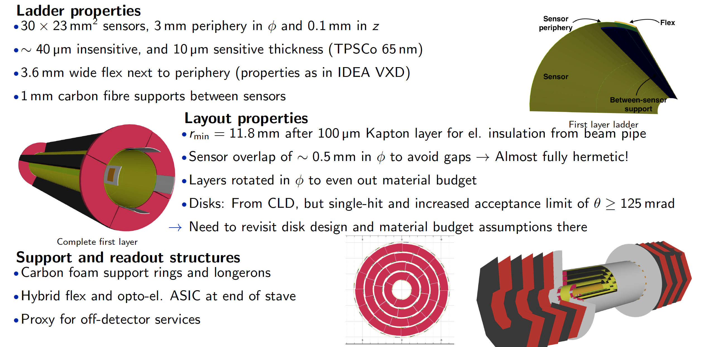
FCC-SEED: full simulation layout
Air cooling tubes and fixations to be added !

Slide 10
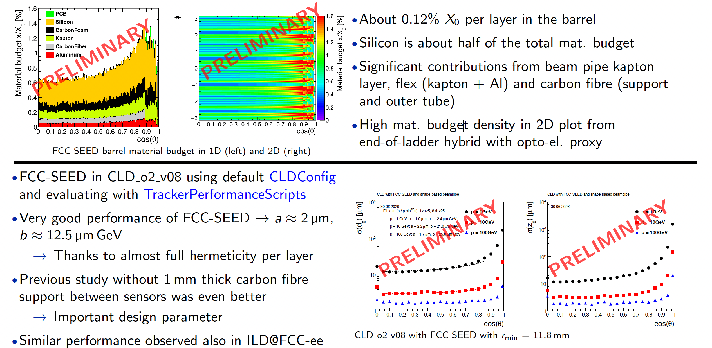
FCC-SEED: full simulation performance

Slide 11

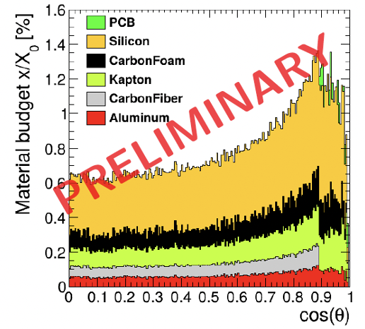
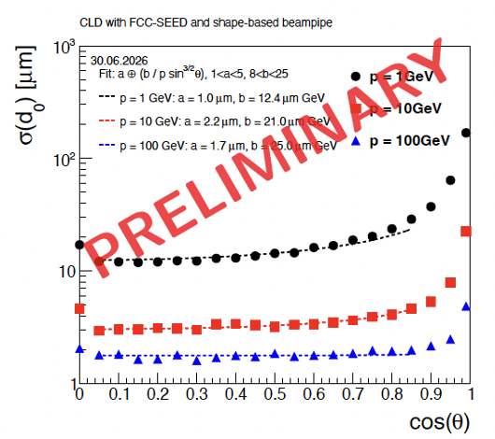
Vertex detector layouts for FCCee in DD4hep full simulation
ALFA det. concept: 5-layer curved inner VXD (long barrel)
AGORA det. concept: 4-layer curved inner VXD (long barrel + 2 layers of ladders

Slide 12
Prototyping and test strategy
Designs made on CAD and simulations need to be confronted to reality : can we build such detectors ? How to interface it properly with MDI ? How to mechanically support it ? How to cool it down efficiently? Where to pass cables ? Etc… etc…
Prototyping and assembly tests are essential to ensure the detector concepts are making any sense.
Vast campaigns of prototyping and test to be realised. FCC-SEED will benefit from the CBM chips developed at IPHC : Mimosis.
  Mimosis has already specs close to what is needed at FCCee,
  Existing Mimosis helped us already to practice sensor bending,
  Sharing production with CBM can allow to have large quantities of sensors to tests,
  Use Mimosis to understand performance changes with different bending radius,
  Prepare a demonstrator, potentially with a fully functional layer 1.
Simulations and realisation of FCC-SEED demonstrator, based on Mimosis, recently received support from French funding agency (ANR).

Slide 13
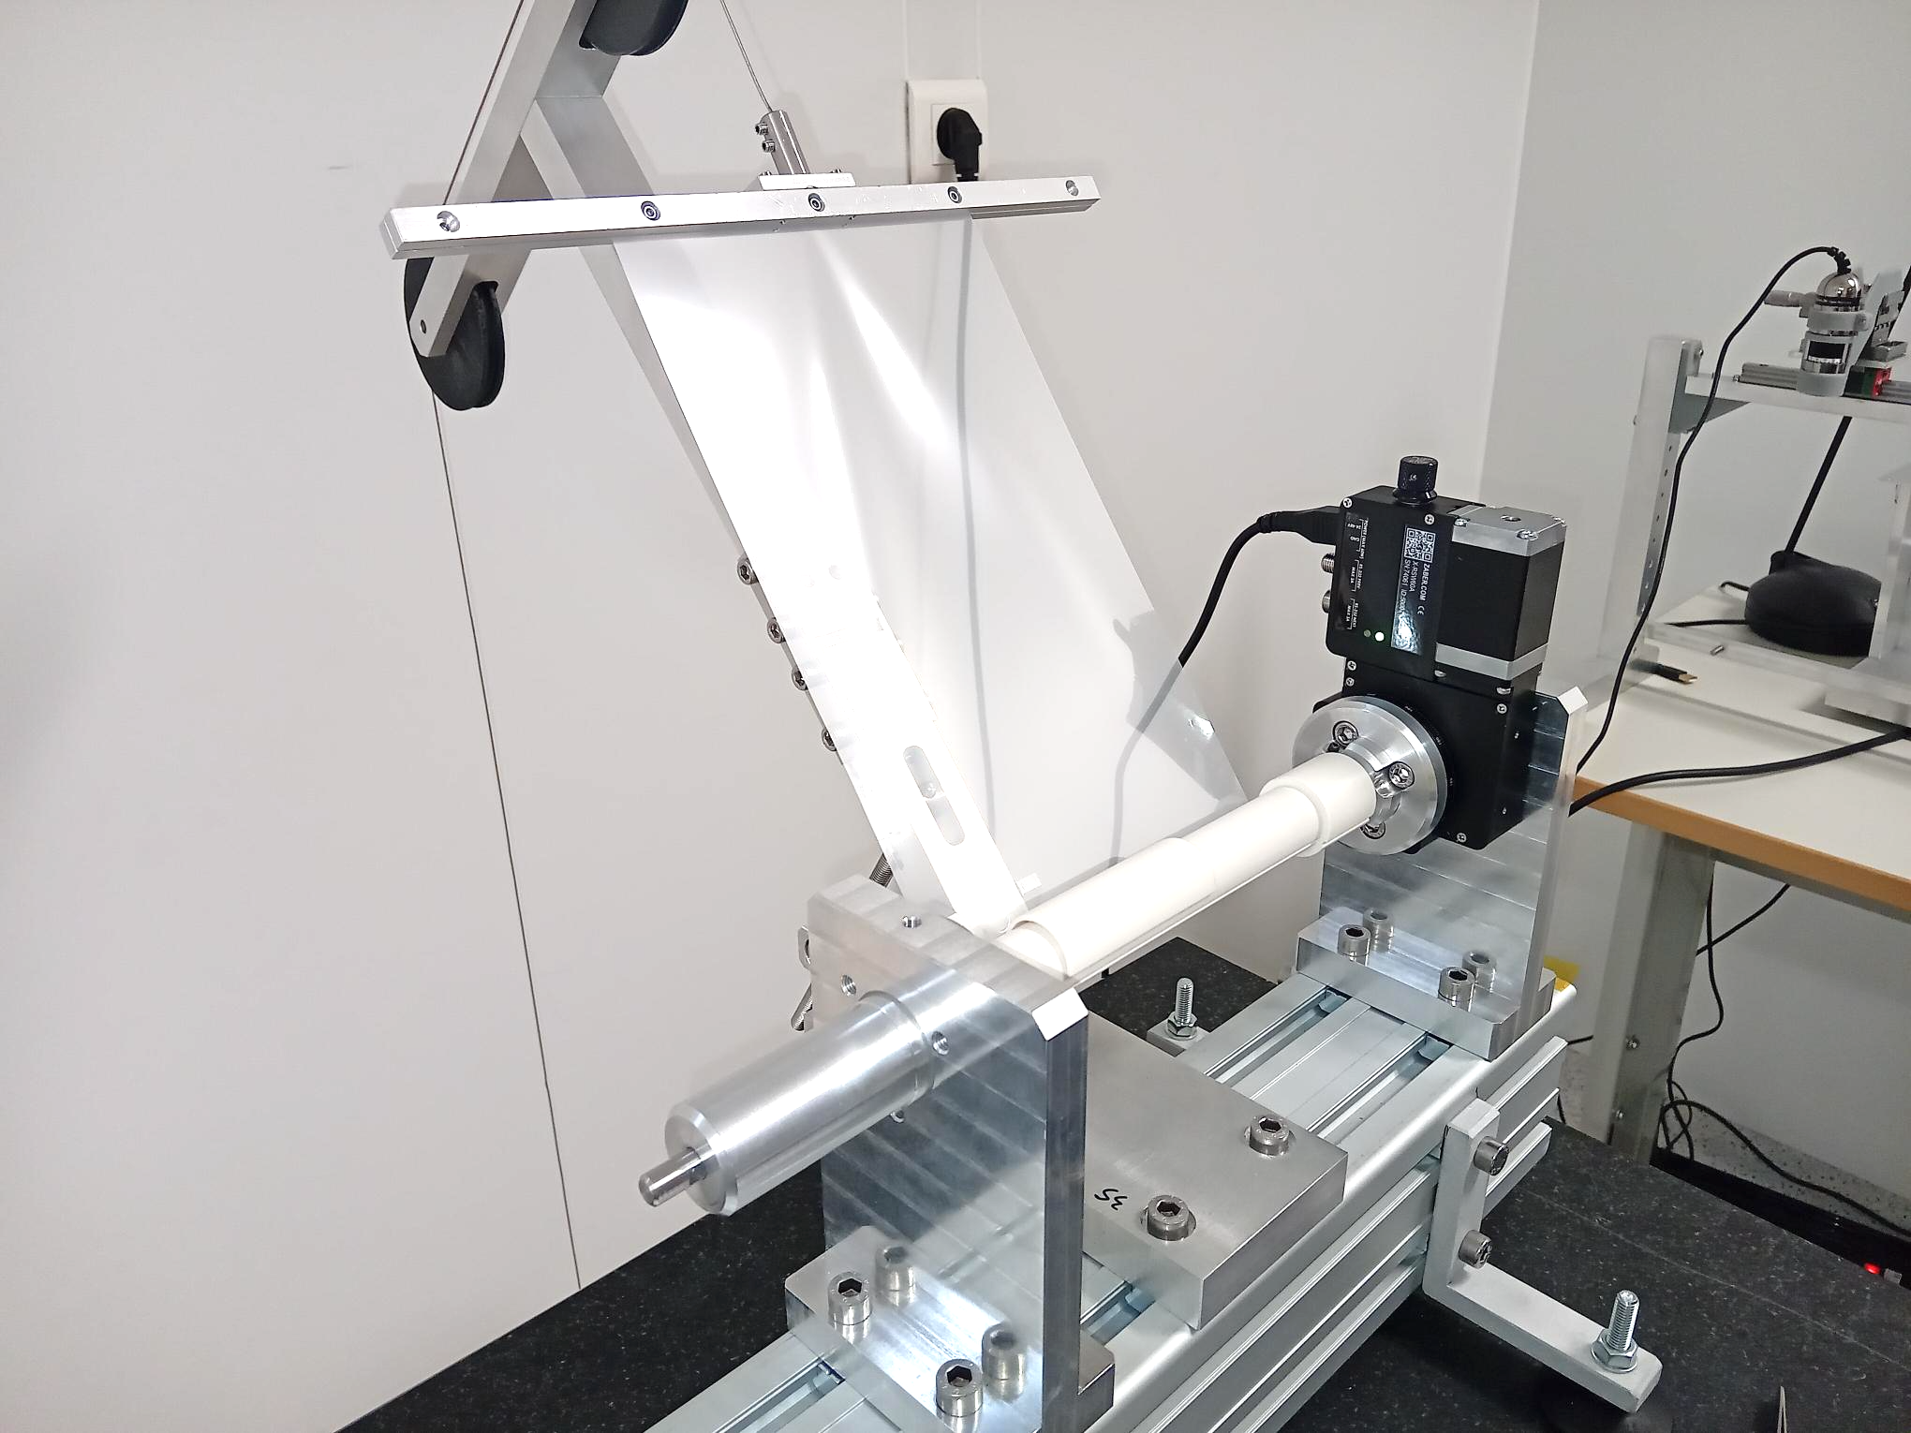
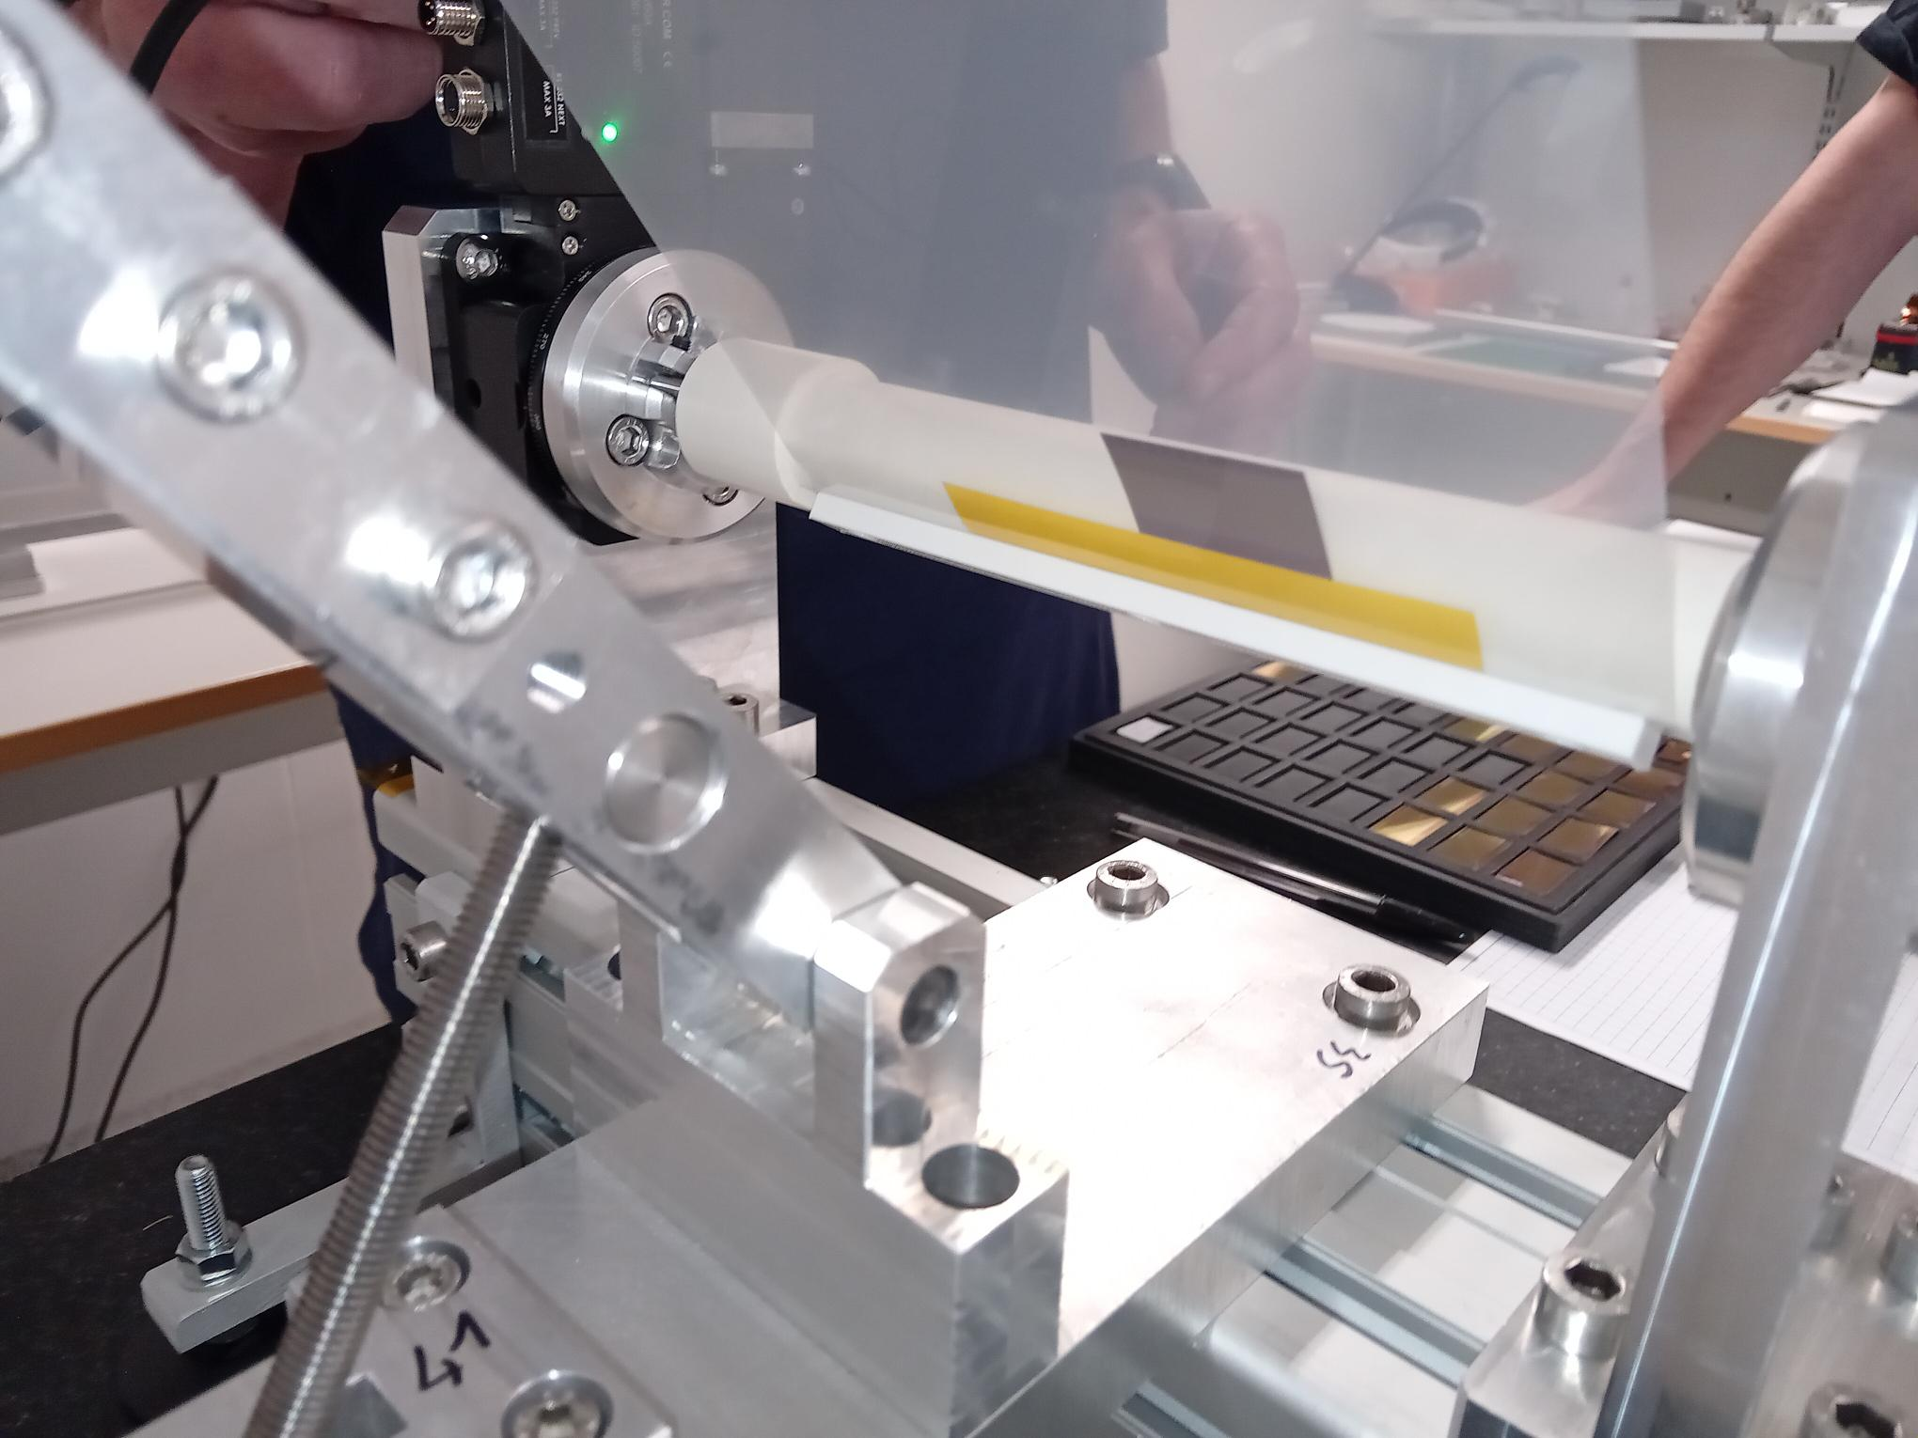
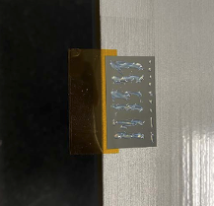

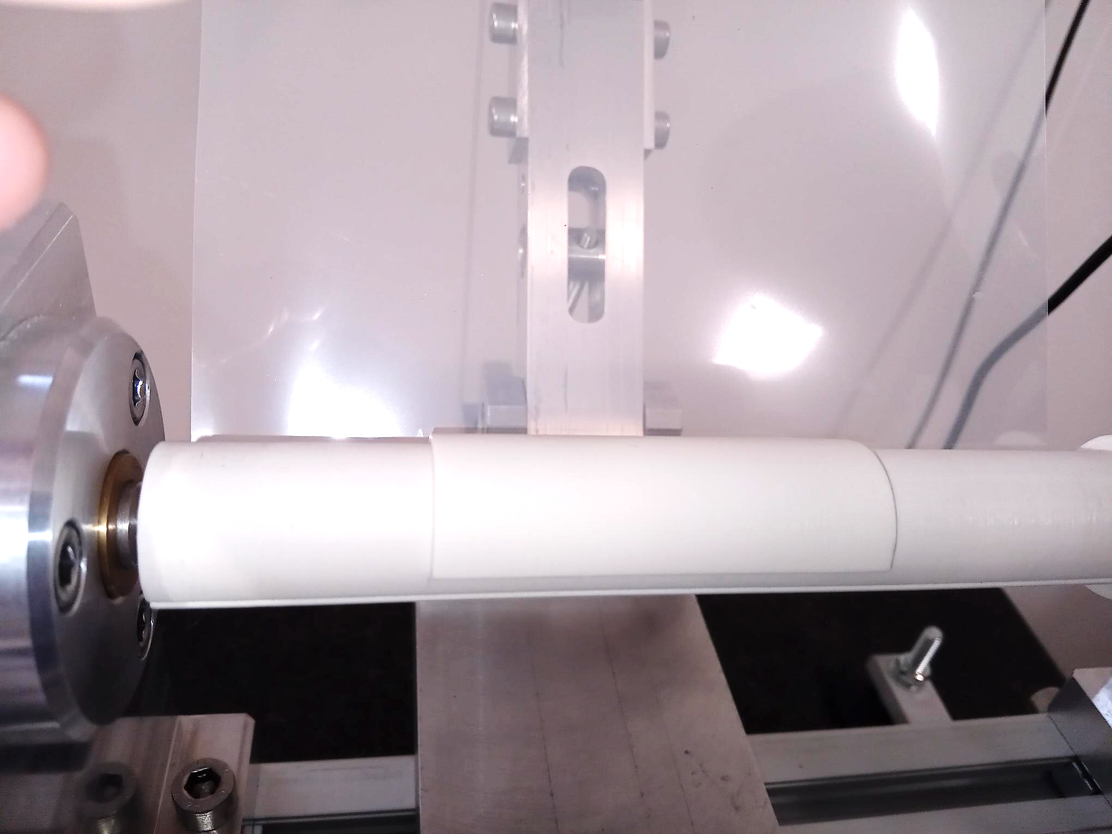
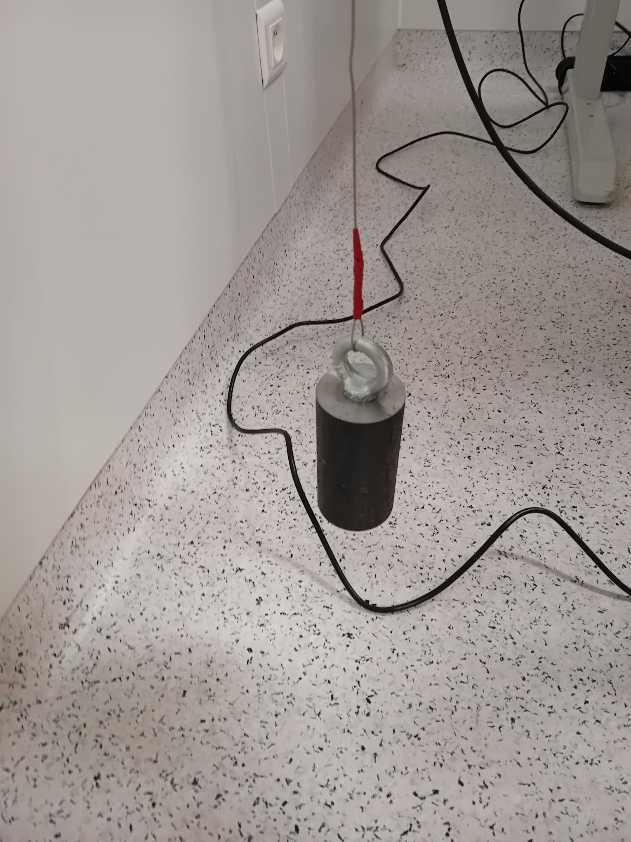
Sensor Bending setup
(strongly inspired from ALICE)
Millar foil
Sensor
Sensor support
Mandrell
counterweight
3D printed Mandrell and sensor support

Slide 14
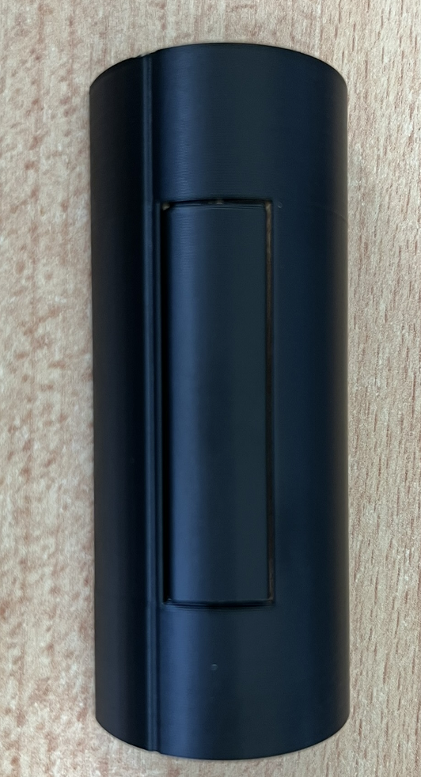
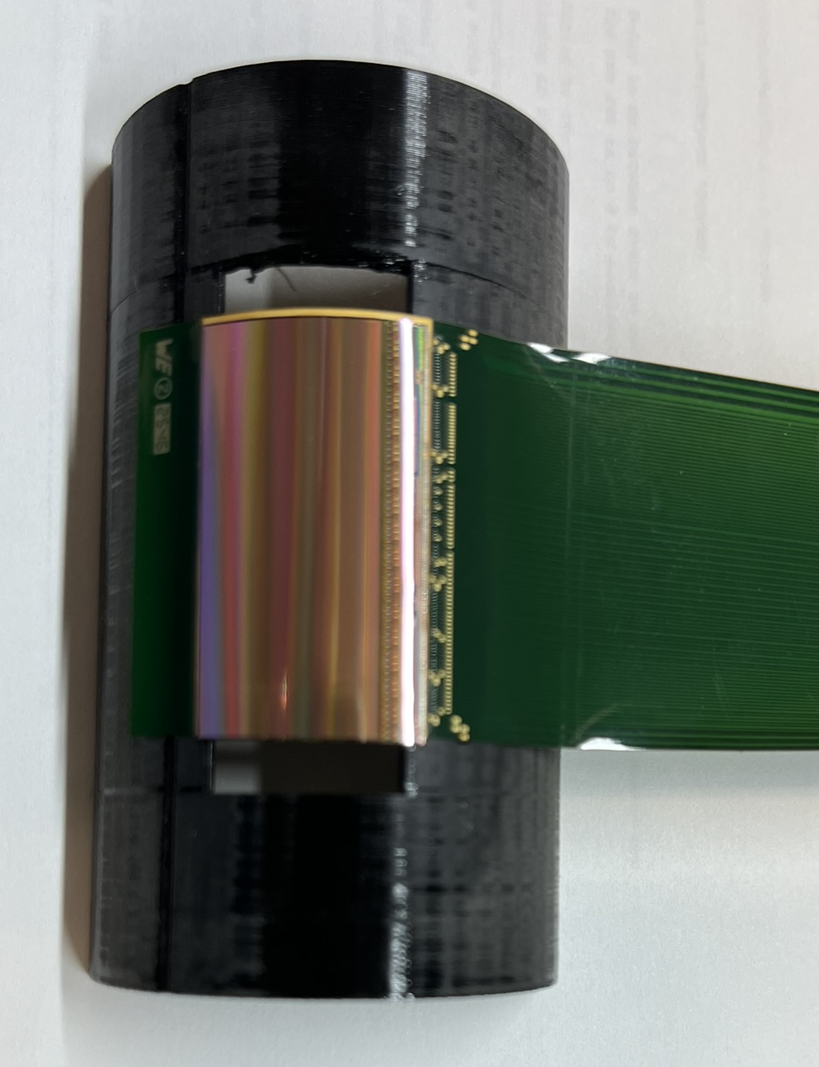
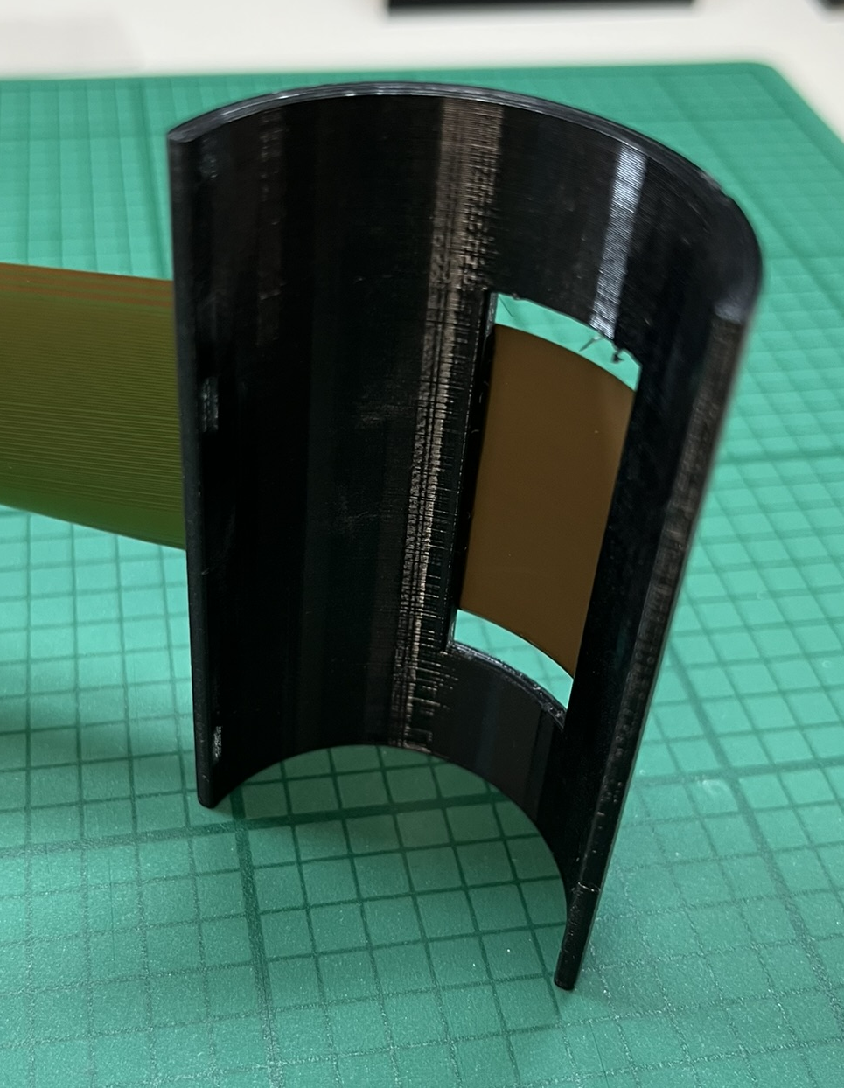
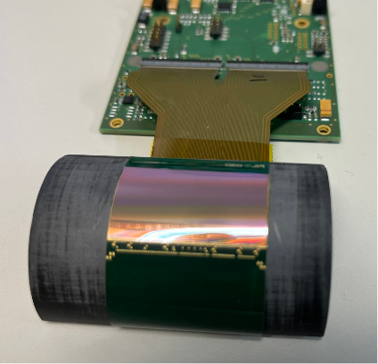
Test beam preparation
A different version of half-shelf developped for test beam.
Removable part.
  allowing for a safe bending,
  opening for the passage of the beam.
Glue positioned only on the contact surfaces.

Slide 15
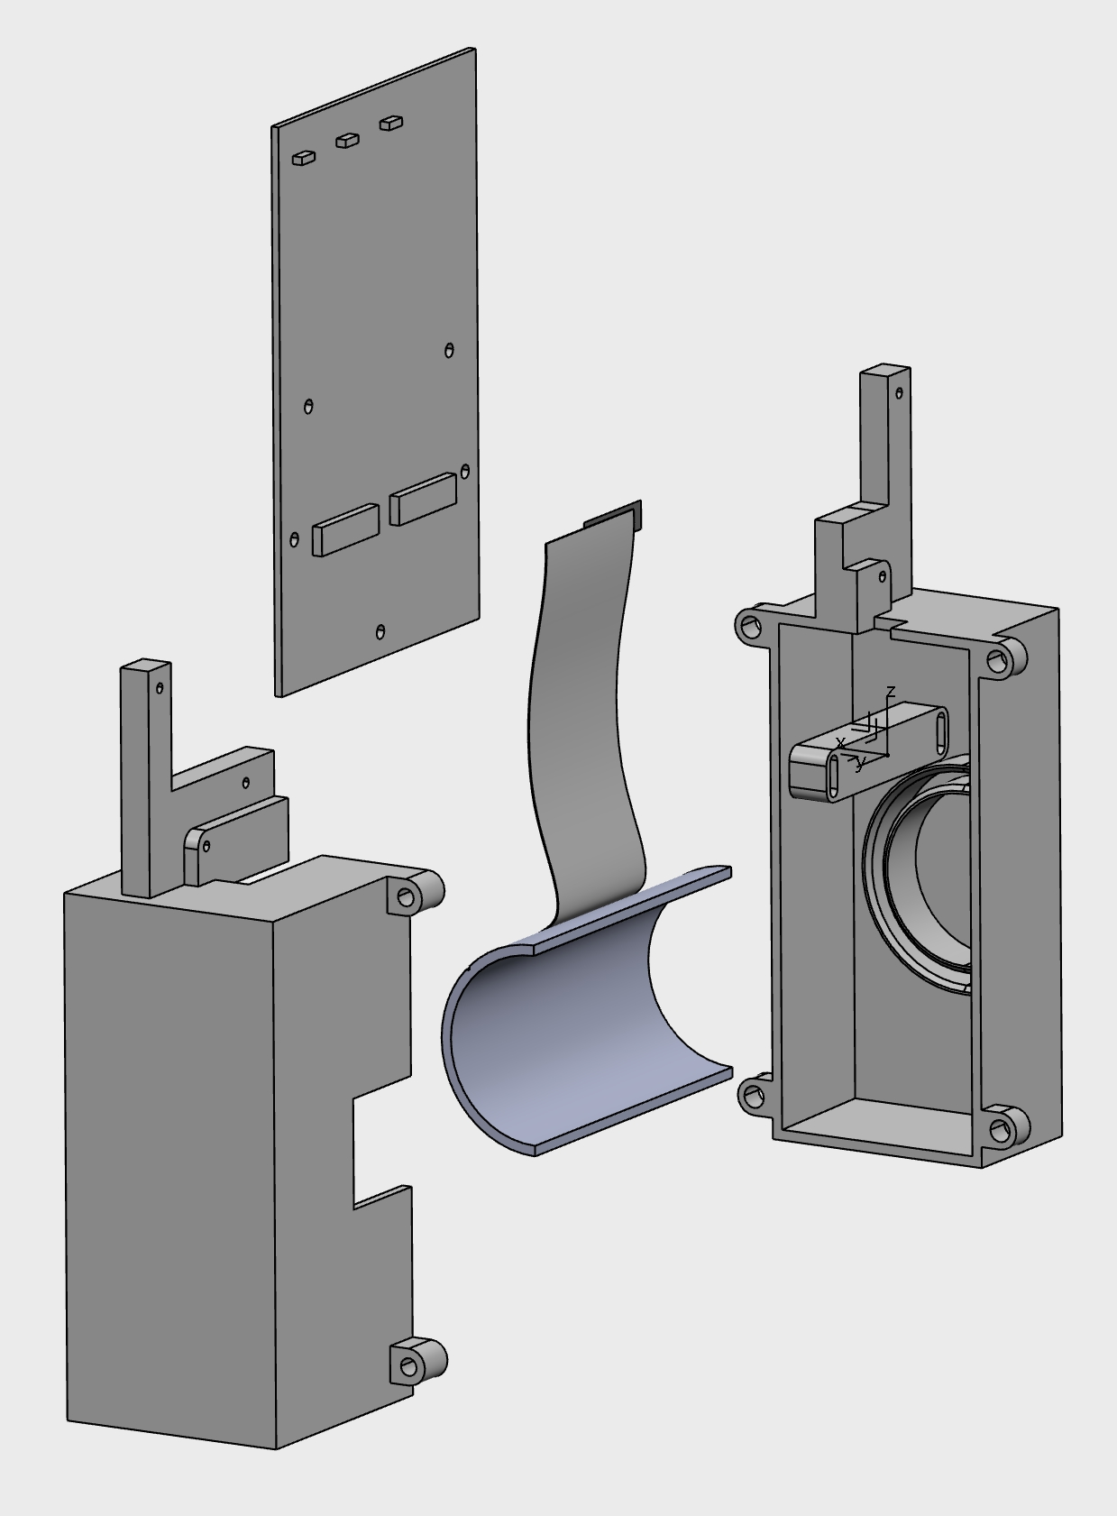
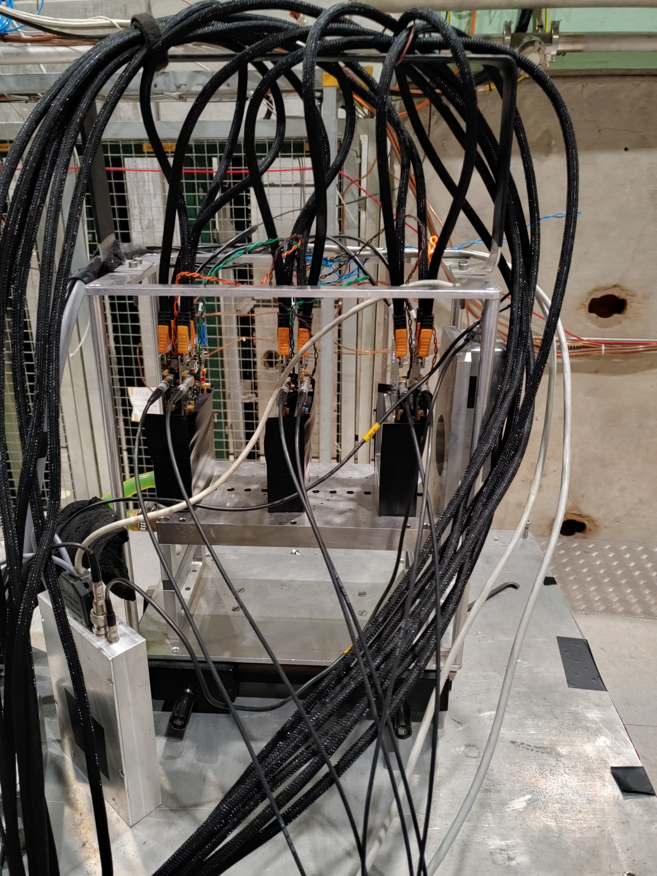
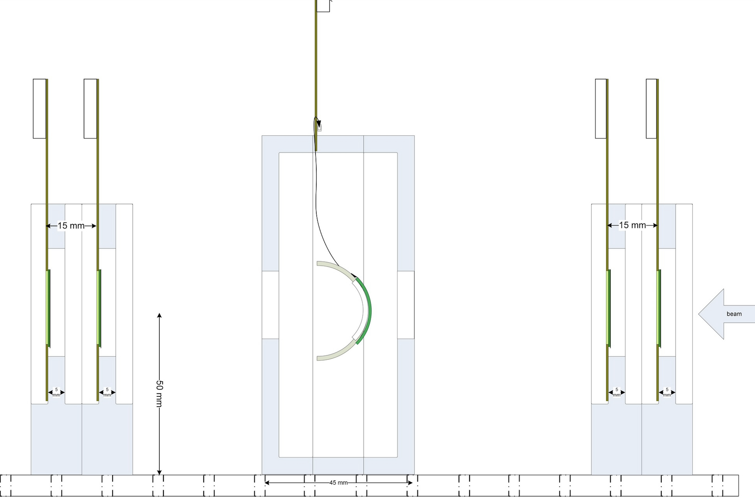
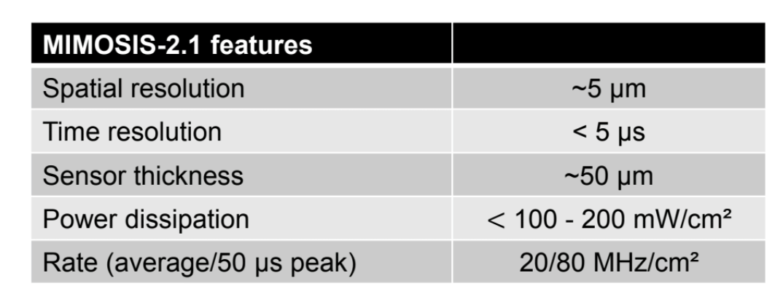
Beam test preparation
Reference planes
2 Mimosis per layer
Testing with beams to be performed with a Mimosis-based telescope.
Two layers with two Mimosis sensors each, sandwiching the Detector Under Test (DUT).
Synchronisation “for free”, uses same DAQ and software.
Key point to address : alignment with bend sensors.
scintillator
Location of the DUT

Slide 16
Summary and next steps
FCC-ee puts very stringent requirements on vertex detectors, mainly driven by Z pole collision environment and high-precision physics program
Multiple vertex detector layouts available. FCC-SEED soon available in Key4hep full simulation framework as well (pull request made to FCC-SEED as option to ILD)
  Trend towards lower material budget and curved sensors,
  Redundancy and hermeticity as antagonist to low material budget.
Vertex detector that provide nice resolution “in simulation” is a starting point. A lot of effort has to be spent on ensuring the feasibility of these nice detectors :
  Can it be constructed, integrated,
  how to design cooling,
  minimise mechanical support while maintaining rigidity,
  how to interface with MDI and other detectors.
  etc… etc…
Realisation of prototypes and demonstrator will be of utmost importance.

Slide 17
Backups

Slide 18
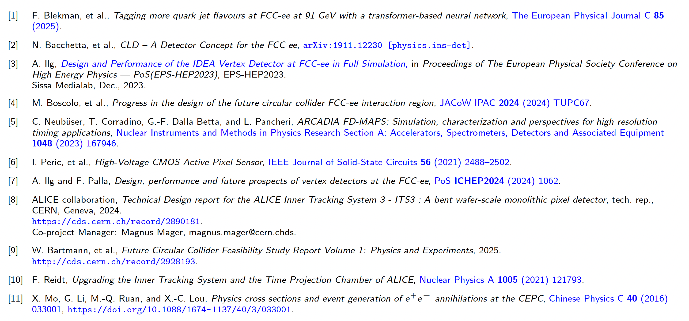
references

Slide 19
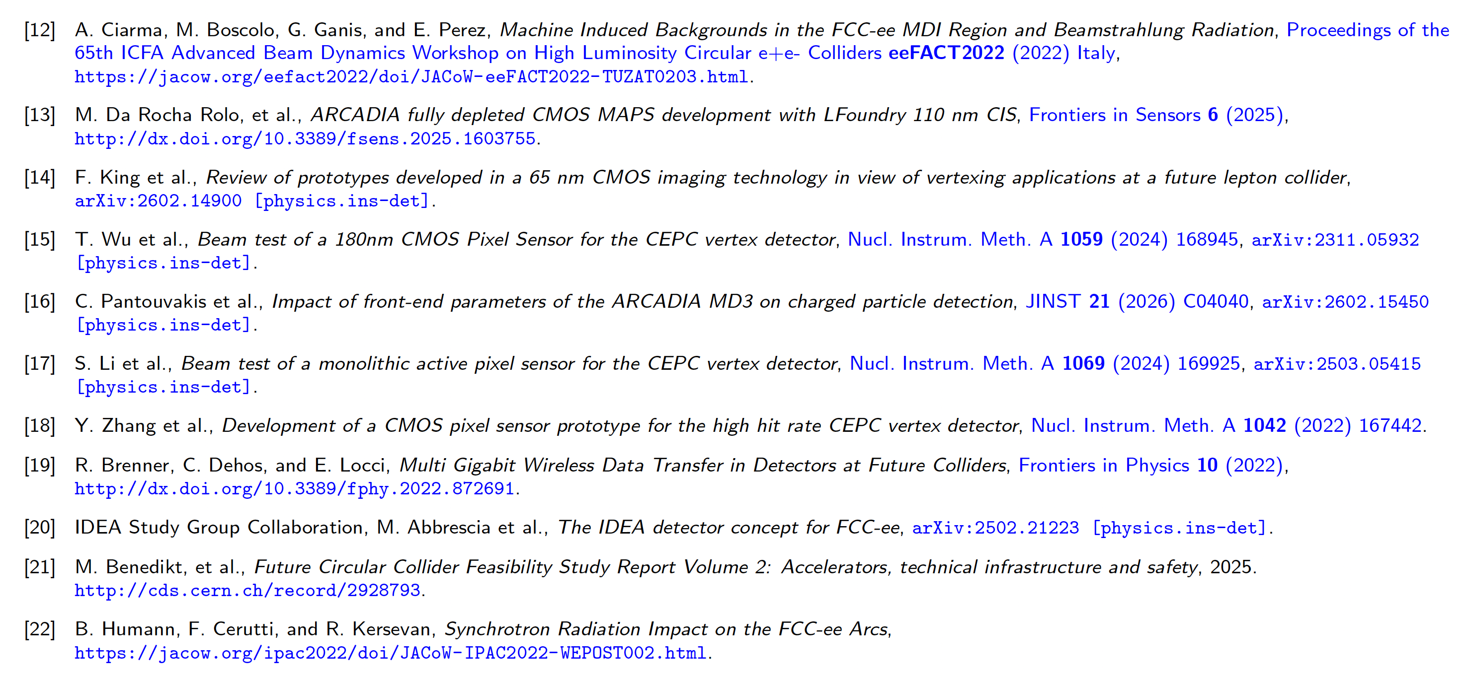
References 2

Slide 20
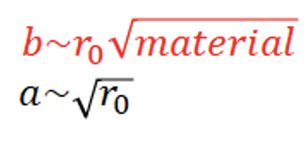





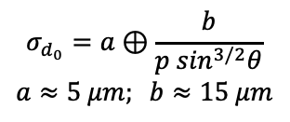
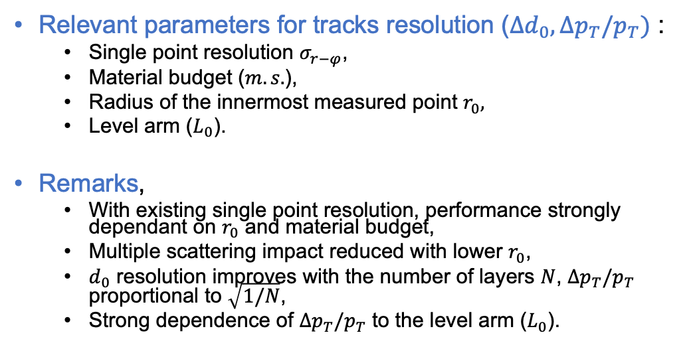
Main parameters of tracks resolution
Relevant parameters for tracks resolution ($Δd_{0}, Δp_{T}/p_{T})$ :
  Single point resolution $σ_{r−φ}$,
  Material budget ($m.s.$),
  Radius of the innermost measured point $r_{0},$
  Level arm ($L_{0}$).
Remarks,
  With existing single point resolution, performance strongly dependant on $r_{0}$ and material budget,
  Multiple scattering impact reduced with lower $r_{0}$,
  $d_{0}$ resolution improves with the number of layers $N$, $Δp_{T}/p_{T}$ proportional to $\sqrt{1/N}$,
  Strong dependence of $Δp_{T}/p_{T}$ to the level arm ($L_{0}$).
FCCee
$$σ_{d_{0}}=a⊕\frac{b}{p \sin^{3/2}θ}$$
$$a≈5 μm; b≈15 μm$$
ALICE ITS2
Material budget is a key parameter !

Slide 21
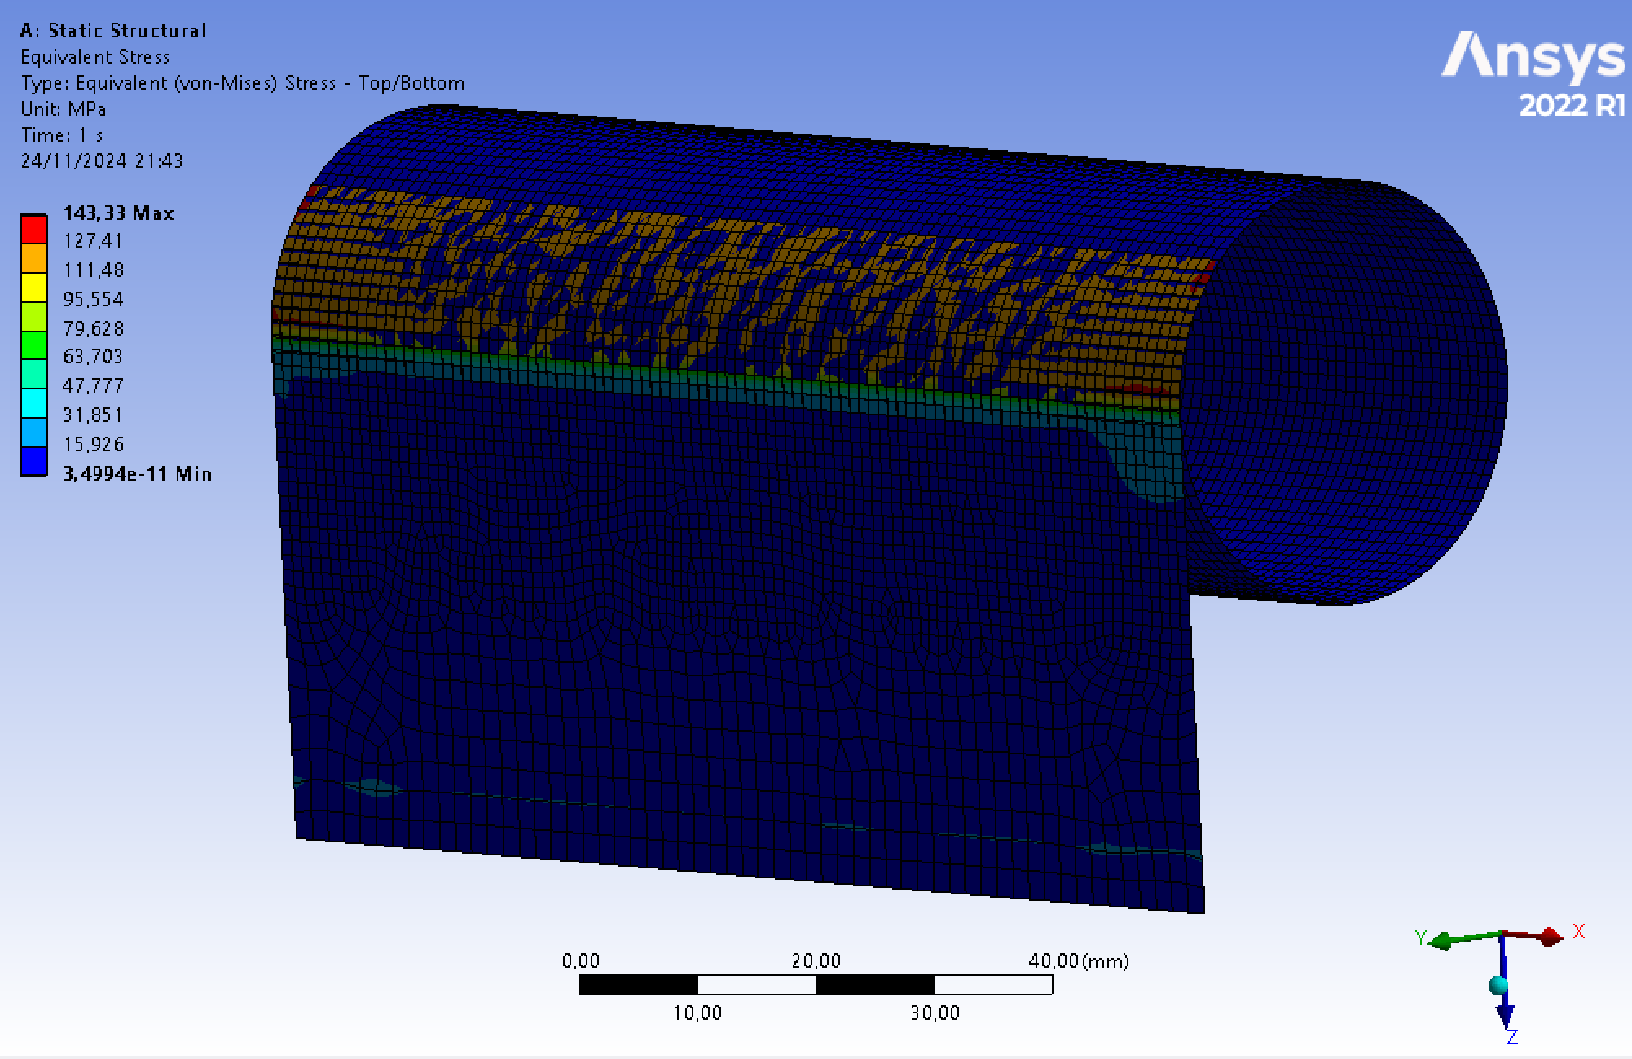
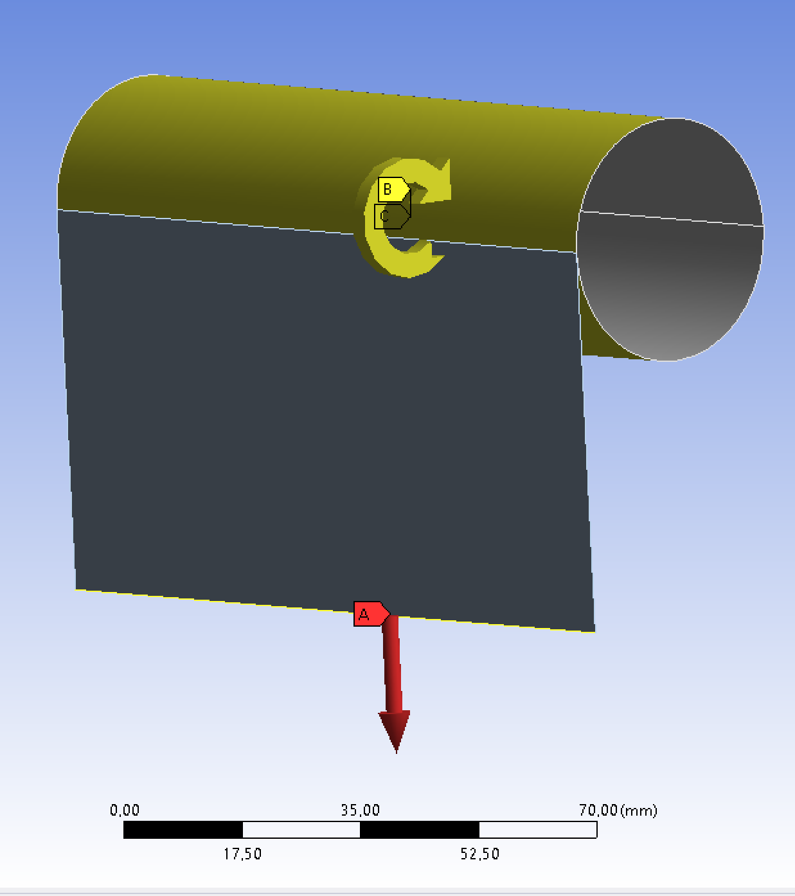
Mecanical simulations
M.Krauth, T.Sommen
Preliminary
Goal : simulate the bending of a silicon sensor, to determine the breaking points vs thickness and inner radius.
Start with the modelling of a simple leaf of silicon, but mechanical characteristics of chips might be different :
  Simulation of a complete chips might be difficult,
  Considering measuring the mechanical characteristic of Mimosis and feed the simulation with the results.
Preliminary studies with ANSYS being performed, but much more work is needed.
More simulations (thermo-fluidic) related to thermal aspects are also required.
Preliminary

Slide 22
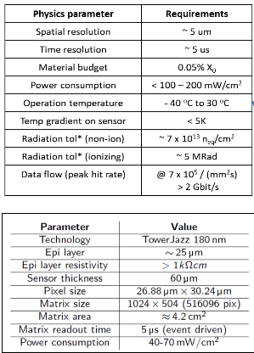
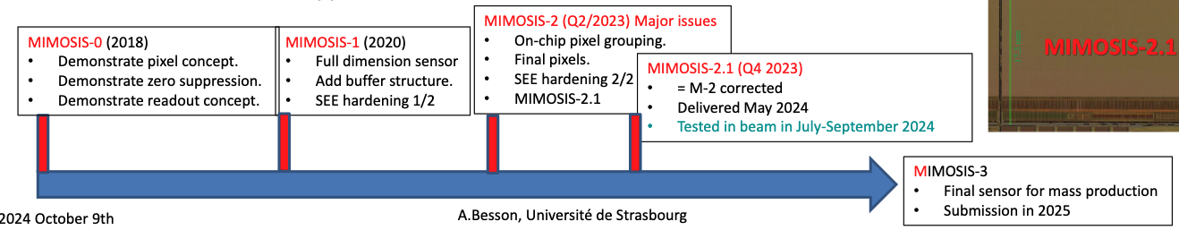
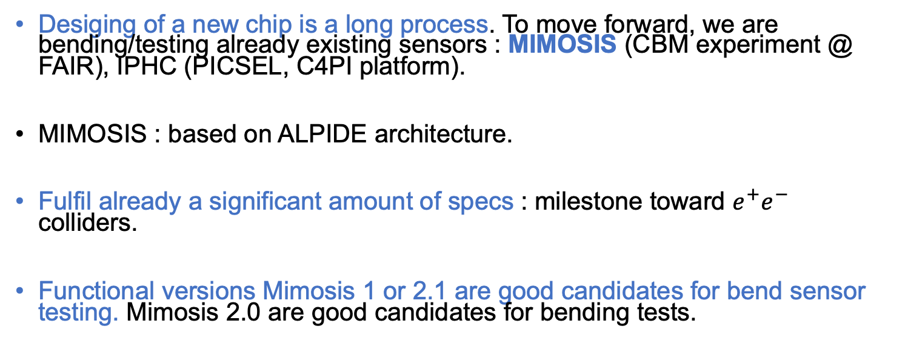
MIMOSIS
Desiging of a new chip is a long process. To move forward, we are bending/testing already existing sensors : MIMOSIS (CBM experiment @ FAIR), IPHC (PICSEL, C4PI platform).
MIMOSIS : based on ALPIDE architecture.
Fulfil already a significant amount of specs : milestone toward $e^{+}e^{−}$ colliders.
Functional versions Mimosis 1 or 2.1 are good candidates for bend sensor testing. Mimosis 2.0 are good candidates for bending tests.
Submission Q1 2026

Slide 23
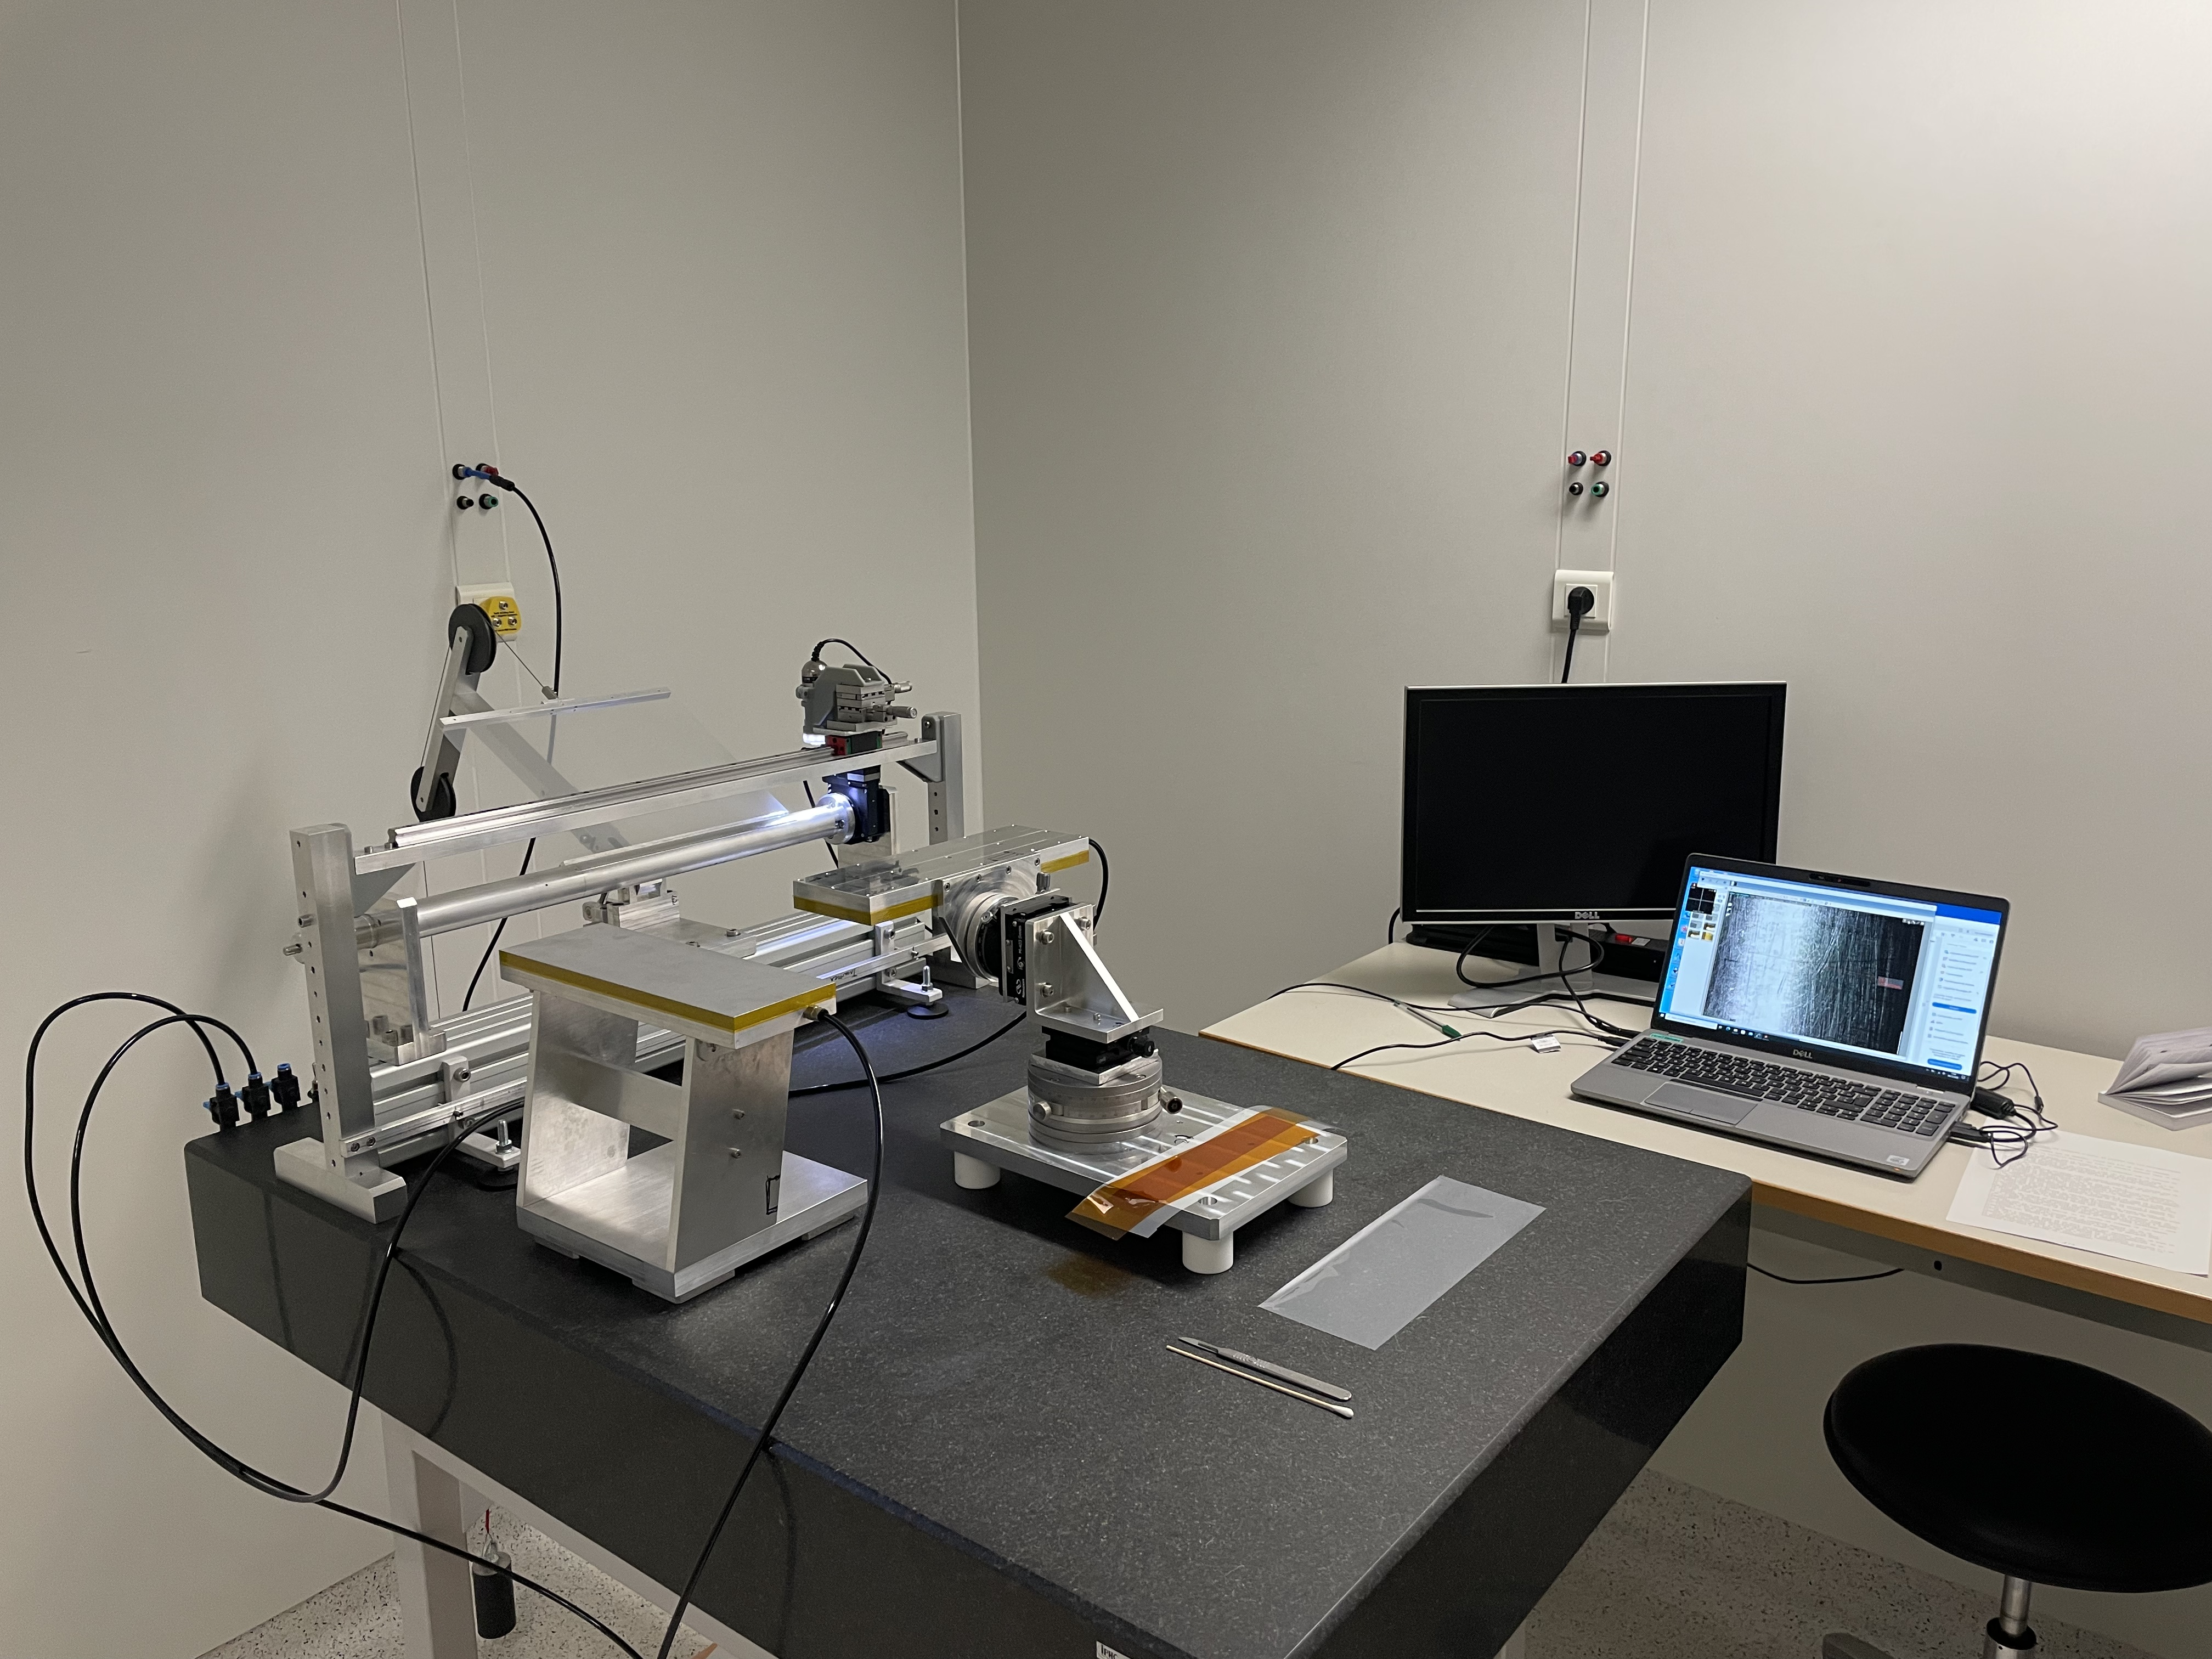
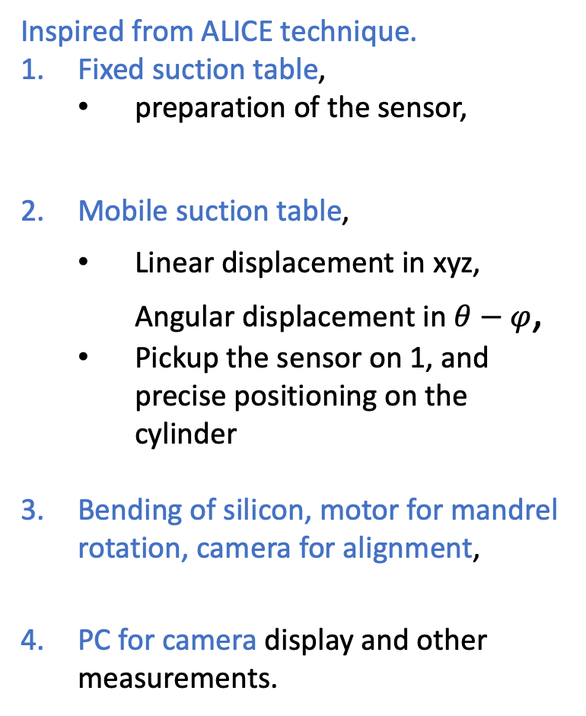
Bending bench setup
Inspired from ALICE technique.
Fixed suction table,
  preparation of the sensor,
Mobile suction table,
  Linear displacement in xyz, Angular displacement in $θ−φ$,
  Pickup the sensor on 1, and precise positioning on the cylinder
Bending of silicon, motor for mandrel rotation, camera for alignment,
PC for camera display and other measurements.
3
2
4
1

Slide 24
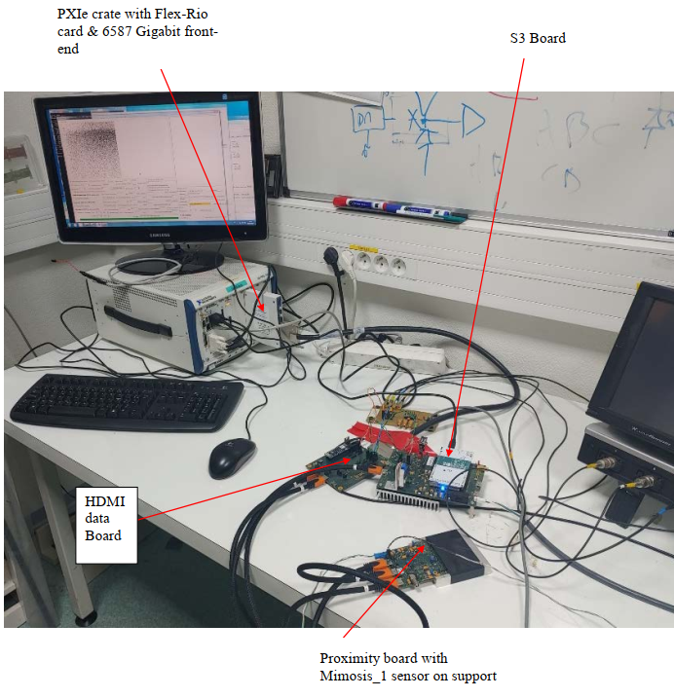
Test bench for Mimosis testing
Le slow control & DAQ
  NI PXIe crate
  CPU + DAQ board FlexRio (FPGA)
  SW under Windows 7 Pro
  DAQ : GUI executable (C++ Builder)
  SC : GUI Python Q
DATA board transmission links to Mimosis / DAQ, 8 links at 320 Mb/s.
S3 board (Slow control Steering Synchro)
provides slow control I2C and clock to Mimosis
Mimosis is mounted on a “Proximity board”
Effort started (LPNHE) to develop a FPGA-based DAQ system for Mimosis.

Slide 25
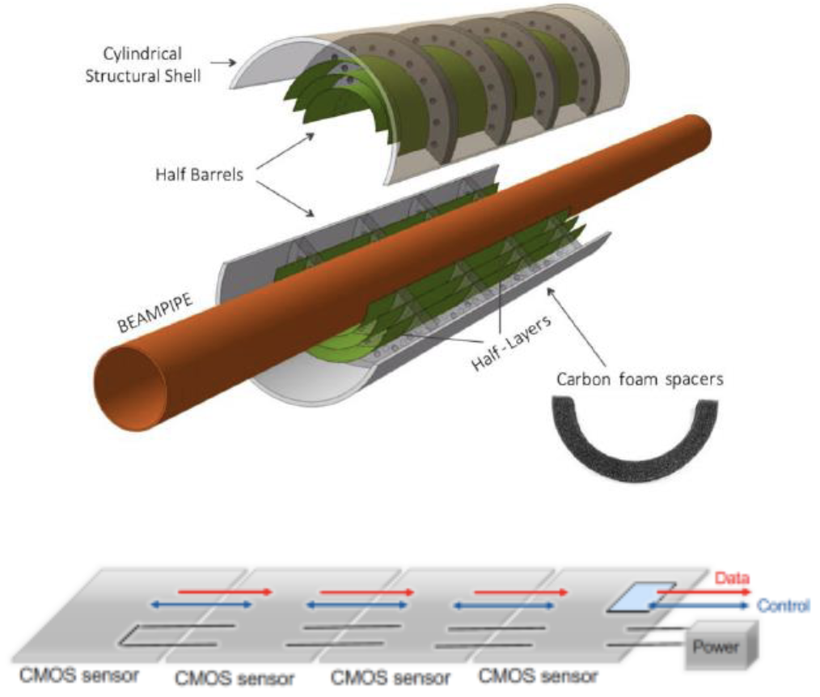
Alice ITS3

Slide 26
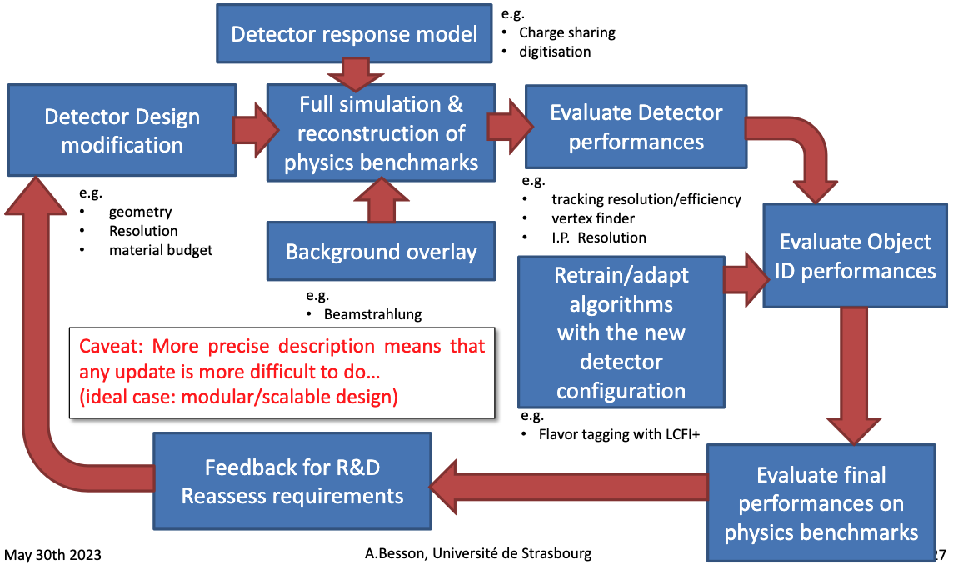
FCC-SEED : setting up the program
Goals for mechanics and integration: work toward a robust vertex concepts for FCCee in the coming years.
Mains topics to worked on :
  Master curved sensor fabrication and testing,
  Explore mechanical options, type of material, stress and cooling, etc…
  Design a full mechanical geometry, to be tested in full simulation,
Iterative process !

Slide 27
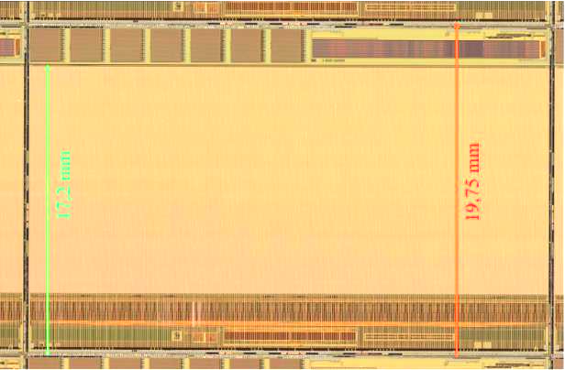
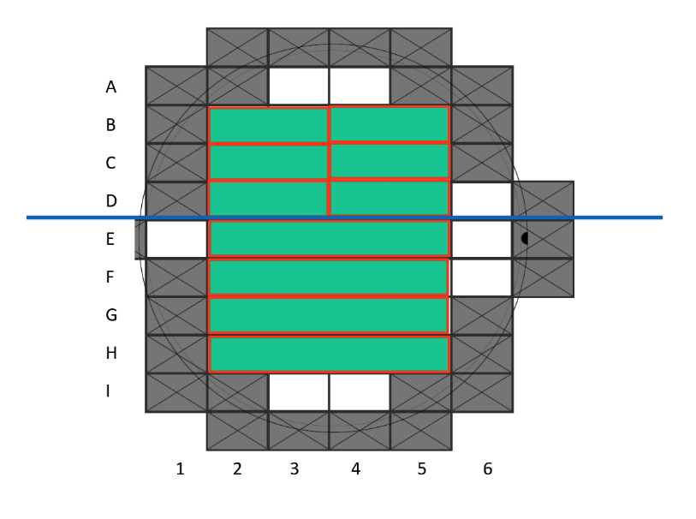
Toward curved Mimosis ladder
Design of FCC-SEED requires a gain of expertise in curved sensors. Many aspects to investigate, questions to answer.
  To what minimal inner radius can we bend sensors ?
  And for what sensors thickness ?
  Does the bending change the chip performances ? Silicon properties ?
  How to curve the sensors, and maintain the curvature ?
  How to glue sensors on mechanical structure ?
  How to make the bonding with curved sensors?
  Etc… etc…
Strategy/working plan.
  Waiting for final chips to come (in many years), use existing and available chips : Mimosis (CBM) prototype versions,
  Setup and practice sensors bending (different radii and different thicknesses), using sacrificial sensors,
  Bend single functional Mimosis, and tests them (lab+source, beam). Requires flex and running DAQ,
  Bend a Mimosis ladder, integrated on simplified mechanical structure, tests,
  Design and realise a demonstrator/mock-up for the first FCC-SEED layer. Require mechanical designs work.
MIMOSIS-2.1
30mm
Cutting of Mimosis wafer

Slide 28
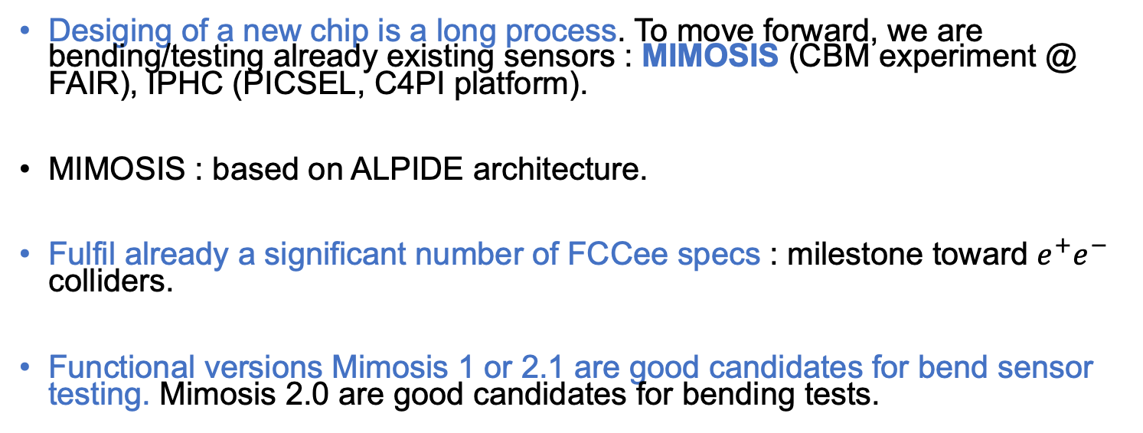
MIMOSIS
Desiging of a new chip is a long process. To move forward, we are bending/testing already existing sensors : MIMOSIS (CBM experiment @ FAIR), IPHC (PICSEL, C4PI platform).
MIMOSIS : based on ALPIDE architecture.
Fulfil already a significant number of FCCee specs : milestone toward $e^{+}e^{−}$ colliders.
Functional versions Mimosis 1 or 2.1 are good candidates for bend sensor testing. Mimosis 2.0 are good candidates for bending tests.
Submission before end of 2026 ?

Slide 29
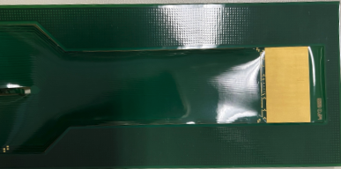
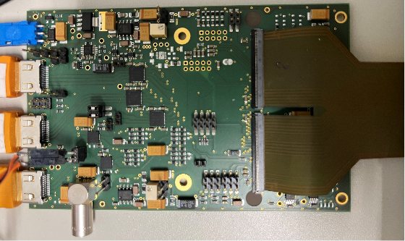

Design of a flex cable and board for curved Mimosis testing
Wire bonding
Test board and flex for tests :
  Developed for testing purpose only,
  After first iteration, new flex and proximity board designed and produced (bug-fix + improved connectivity).
First tests performed on MIMOSIS vs curved-MIMOSIS
Where sensors are glued
For the final detector, the flex design is a key element.
  Should allow for a robust and easy bonding,
  Should be well integrated within the mechanics,
  Should be as small and as light as possible.

Slide 30



Toward functional bend Mimosis
Observed difficulties while performing bonding.
Glue was flowing out of the silicon back surface : contamination of the bonding pads, went on the Millar leaf.
Several tests were performed, with different glue viscosities and glue doses.
Sensor covered with Kapton foil,
after rolling the Millar foil
Curved sensor glued on it support, ready for bonding
Sensor taping on the mandrel

Slide 31




Toward functional bend Mimosis
Optimisation of glue deposition.
New approach found to be working well
  Glue deposited with an automated dispenser machine, perfect control of the glue quantity and glued surface,
  Glue deposited on the flex,
  Then gluing and bending of the ship performed.
Found to be conclusive, and allowed us to move on.
  But not suitable for the final detector (no flex wanted in the back of the sensor).

Slide 32


Firsts comparisons of flat and bent Mimosis 2.0
Several tests of bending+bonding+electrical tests performed.
  Bonding performed while the sensor is on the mandrel.
Conclusive results with power consumption similar to flat sensors.
Validation of the process, lead to the bending of 3 Mimosis 1.0.
  2 Mimosis bent and connected with success, partially functional (some bad bonding pads, nothing to do with curving),
  3rd Mimosis bent, connected, but does not provide correct data. Currently investigated by it is believed the chip had an issue before bending.
Next step (ongoing):
  bend more sensors after passing probe station, test the same sensors before and after bending.
  Get ready for test beam mid-agust at DESY
Different sensors
 | IDigital | IAnalog
Reset ON | 39,9mA | 11mA
Reset OFF | 116,6mA | 8,4mA
 | IDigital | IAnalog
Reset ON | 39mA | 12mA
Reset OFF | 119mA | 9,2mA

Slide 33




DD4HEP Implementation of the
FCC-SEED geometry
Current geometry being tested in full simulation
  In between overlapping sensor regions : 0.5 mm CF + 250 μm Flex (200 μm Kapton, 50 μm Al).
  Carbon foam longerons along Z direction, support the edges,
  5 layers,
  6 single side disks, extended down to θ = 135 mrad (7.7◦).
  a hybrid flex at the end of the ladders (250 μm), with a 5 × 5 mm opto-el. ASIC on top (orange, 100 μm of Si)
Very significant design work needed, but requires mechanical realisations : simulation and prototyping !
Sensor flex
Bonds
silicon
CF spacer
opto-hybrid PCB
Design will surely evolve as we progress !

Slide 34
FCC-SEED : geometry concept
Not at scale !
y
z
Flex
Mechanical supports.
Include the flex
Pros :
Bonding on a “flat” surface,
Improved acceptance,
Options without stitching possible.
Cons:
Extra material budget in bands along Z,
Design of the mechanical structure challenging,
Assembly and integration procedure challenging.
Wire bond
x
Beam pipe
Bend sensor
R=12mm
Assembly of quarters (hemi) of cylinders : assemble individual frames together around the beam pipe

