Slide 1
ILD muon system
I.Laktineh
On belhlf of the ILD collaboration

Slide 2
Disclaimer:
In this presentation I report a study that was performed a few years ago on the role of muon system in ILD concept. The work was led by V. Saveliev (National Research Nuclear University, Russia). All the merit is his and that of the colleagues who contributed to.
I dd my grain of salt by mentioning the work we did within ILD to develop RPC and MRPC that can be excellent candidates, but not the only ones, to equip the muon system

Slide 3
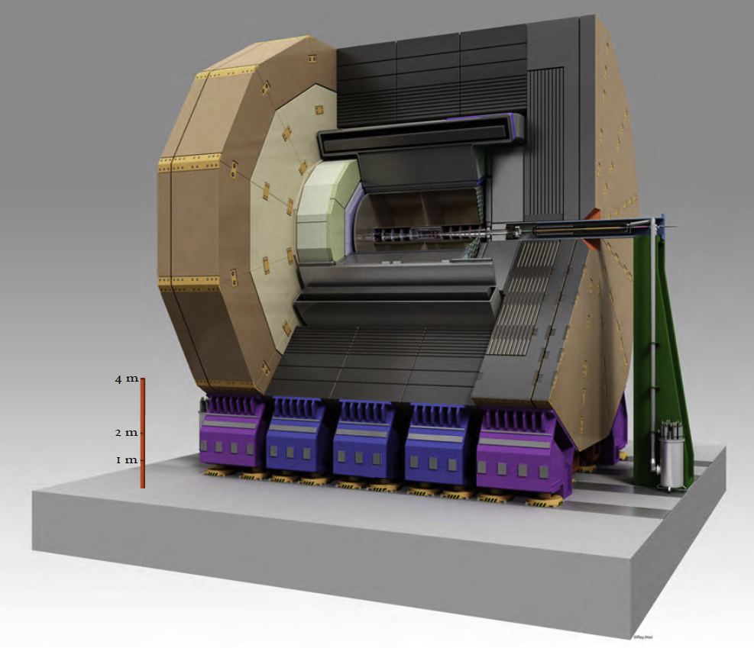
Muon system in ILD
It was conceived to fulfil a few goals
- Identification of muons/punch-crossing hadrons
- Tracking for PFA. The momentum precision is provided by inner tracker
(VTX, Si, TPC)
- Tail catcher for HCAL: showers that are not fully contained (6 λ_{I})
could be better reconstructed and their energy better estimated thanks
to the information they leave in the muon system.
- Long Lived Particle. Muon system could contribute to their discovery/study
- Trigger: This function was absent in the ILD@ILC but for FCCee it needs to be considered

Slide 4
Muon system in ILD
Several questions were on the table for the muon detectors
1- Where to place it
2-Which granularity
3-Which technologies

Slide 5
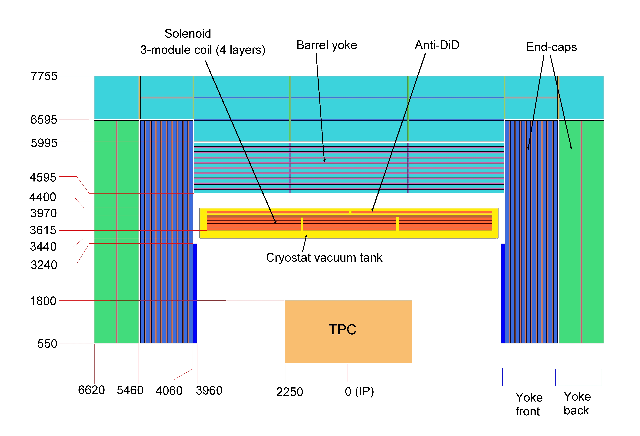
Muon system @ ILD
Yoke:
- Barrel: 10x100 +3x560 mm
- EndCup: 10x100 +2x560 mm
Cryostat:
- Cylinder with 40 mm thick inner wall
and 30 mm thick outer wall
- 750 mm distance between walls
- Coil:
- 3x1650à mm + 2x1200 mm
Muon Detector System:
- Double Sensitive Layers in the Yoke Gaps

Slide 6
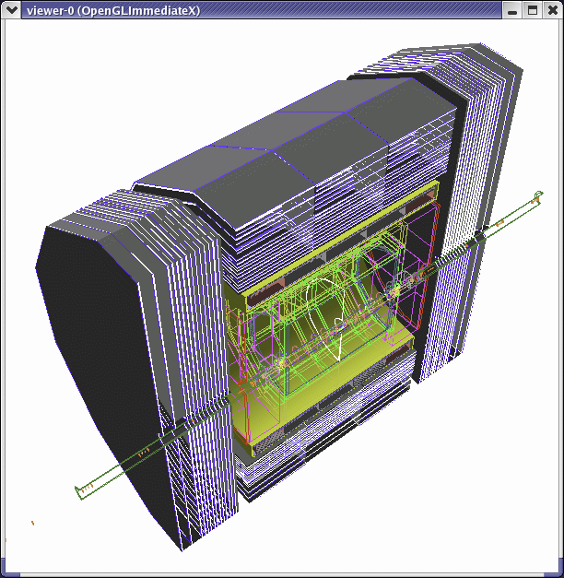
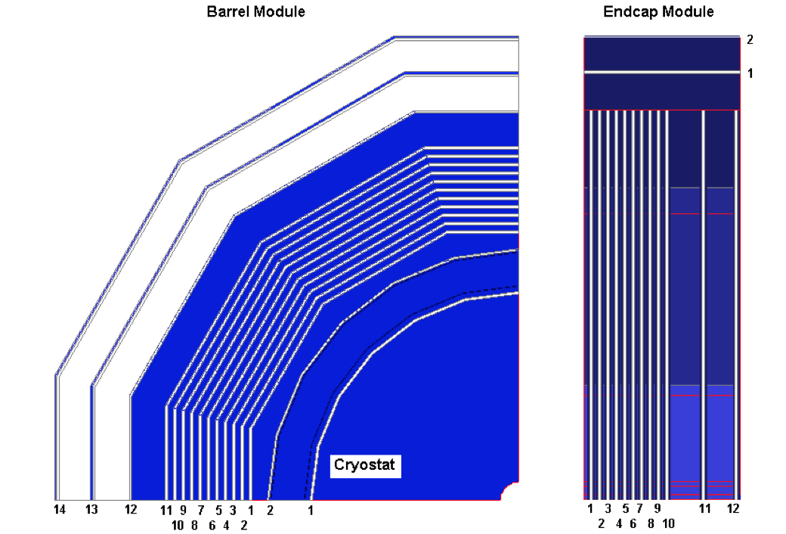
Muon system @ ILD
14 (12) active layer for the barrel (endcap ) region, interleaved with iron slabs of return yoke.
scintillator strips read out by SiPM through WLS or RPC (X&Y)
The simulation was made with Scint of 3 cm width

Slide 7
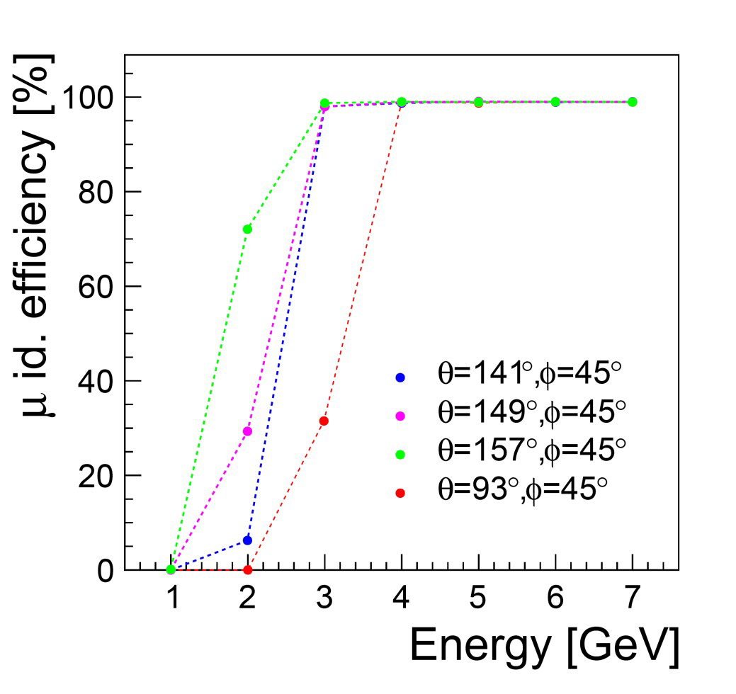
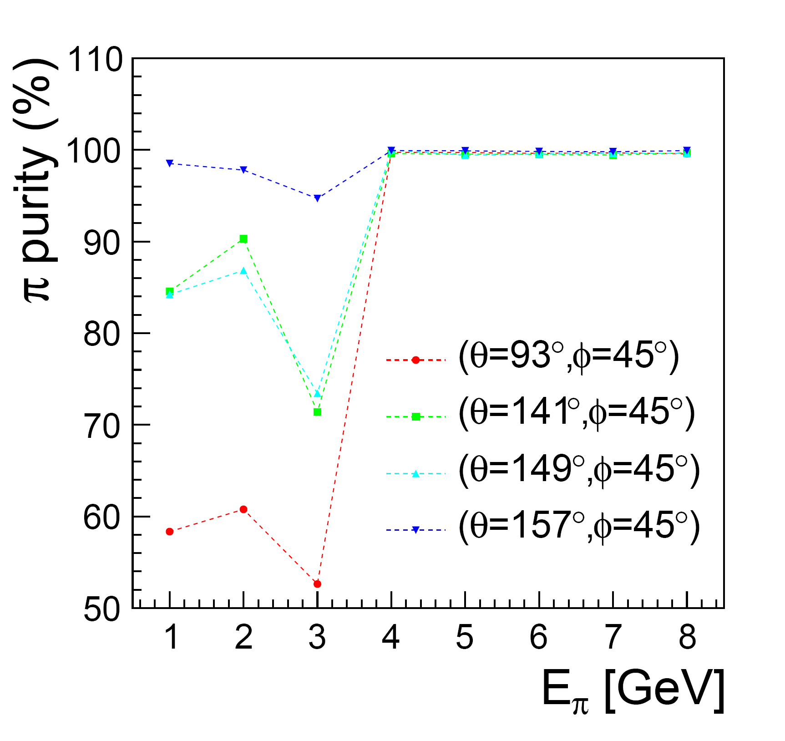
Muon system impact
Excellent pion/muon separation at energies > 4 GeV
Effect of the coil material for soft muons: the µ-id based only on the muon system is
weak for energy lower than 4 GeV.
π ◊ μ + ν can be misidentified as muon granularity could be helpful

Slide 8
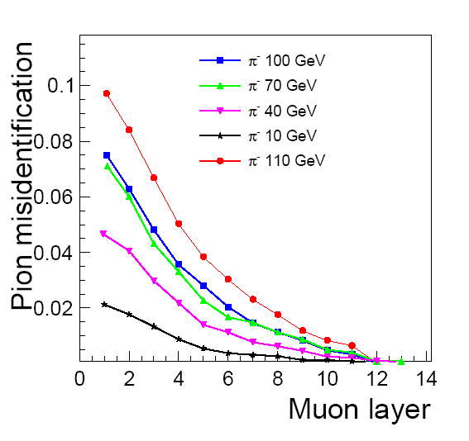
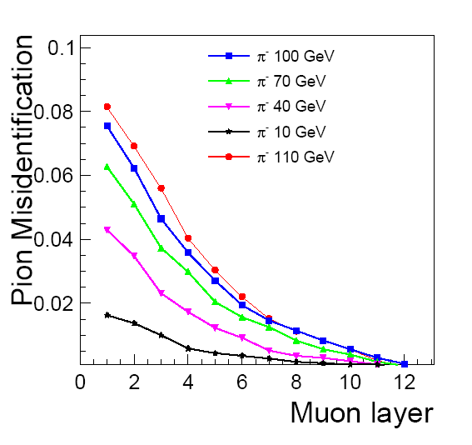
Muon system impact
The pion misidentification as a function of the number of instrumented layers
Pion misidentification

Slide 9
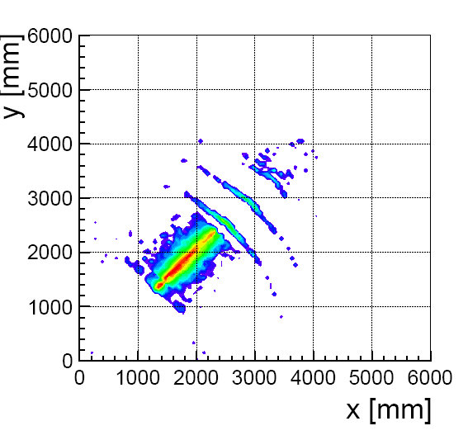
Muon system impact
Tail catcher role
Barrel 140 GeV pions
Having good granularity of the muon system could help to reconstruct the tail shape and then improve on energy reconstruction using MVT

Slide 10
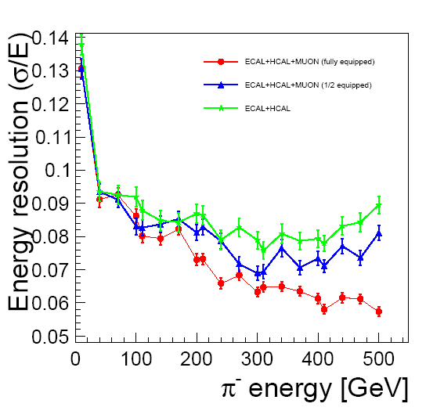
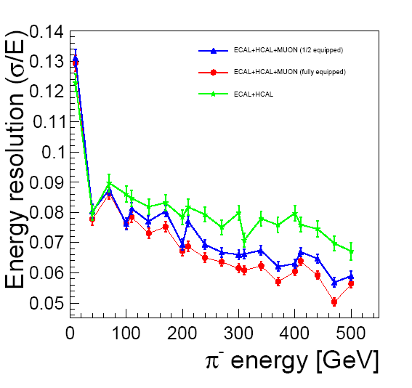
Muon system impact
Tail catcher role
Barrel
EndCup

Slide 11
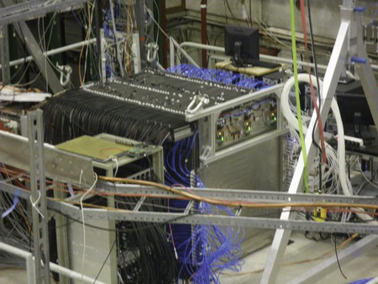
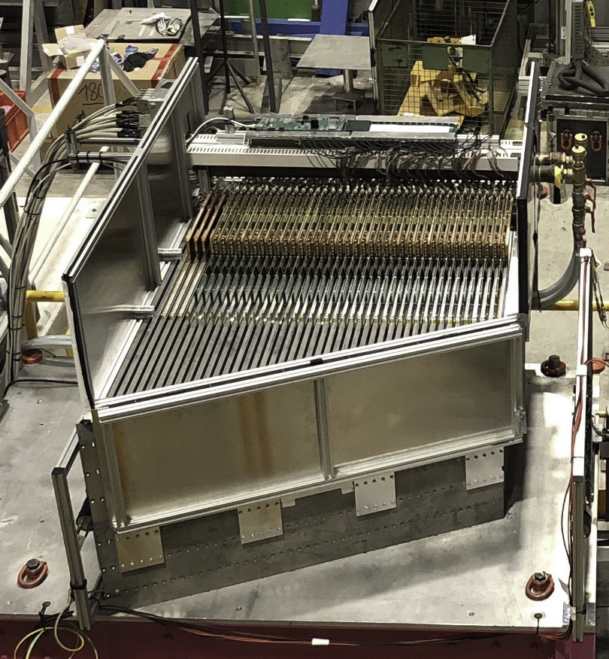
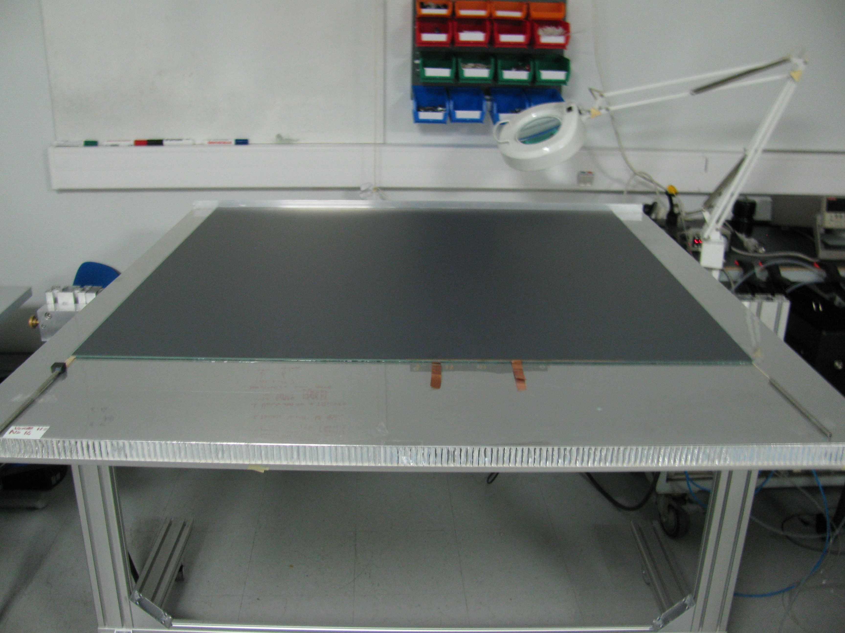
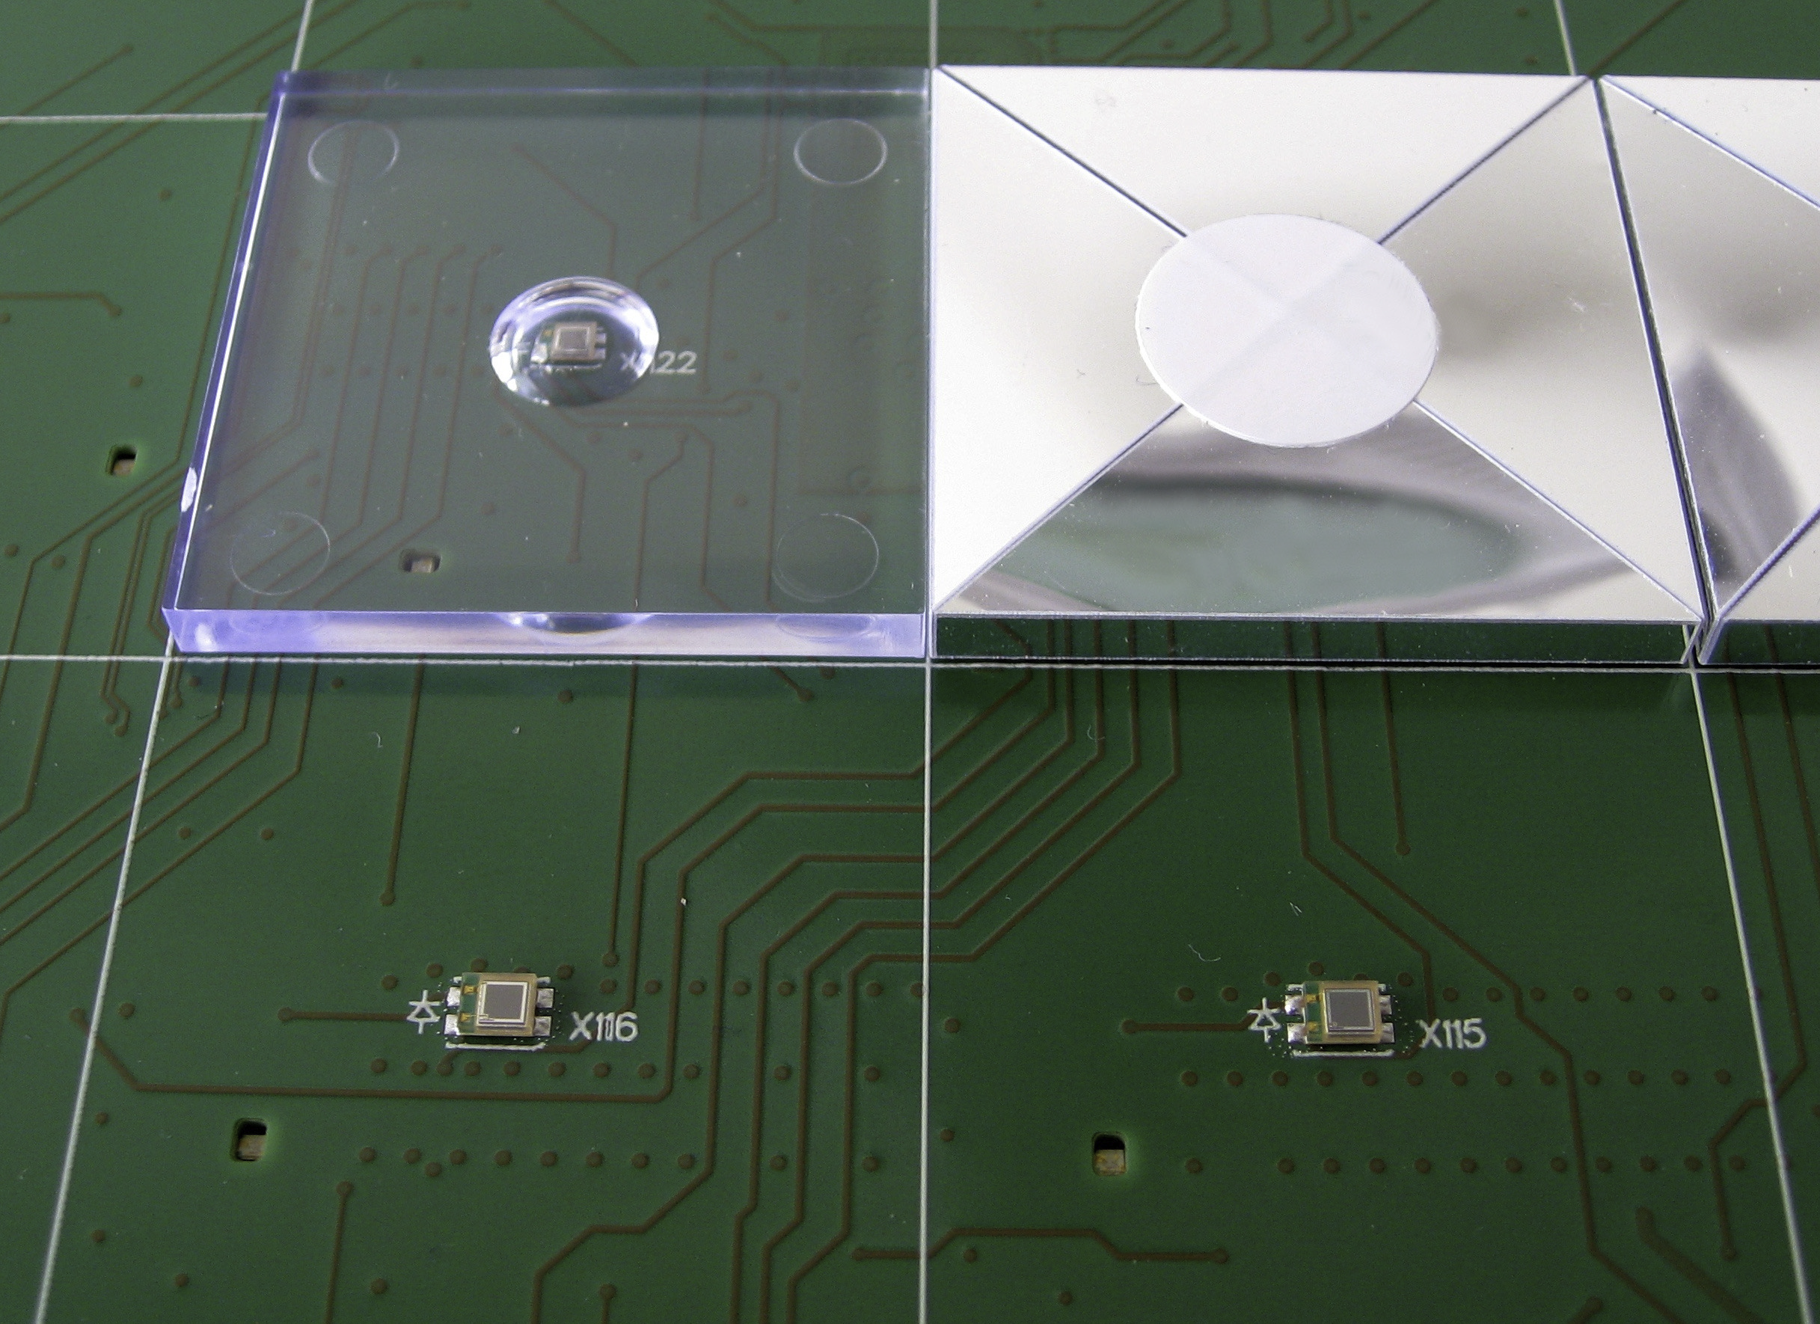
Which technology?
Two HCAL technologies are proposed for ILD
(T)-SDHCAL based on (M)RPC of 1 cm x 1cm
AHCAL based on scintillating tiles of 3 cm x 3 cm
The active medium of each can be used as a muon detector
The readout needs not to be as granular as the HCAL for the muon system
Nevertheless all other technologies could be proposed for ILD muon system

Slide 12
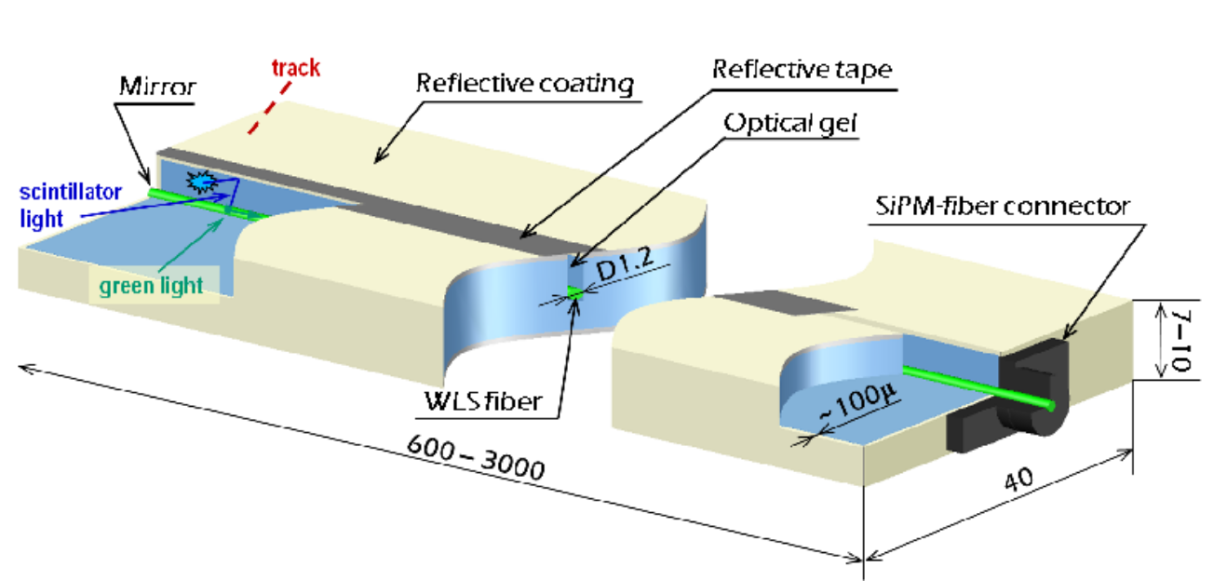
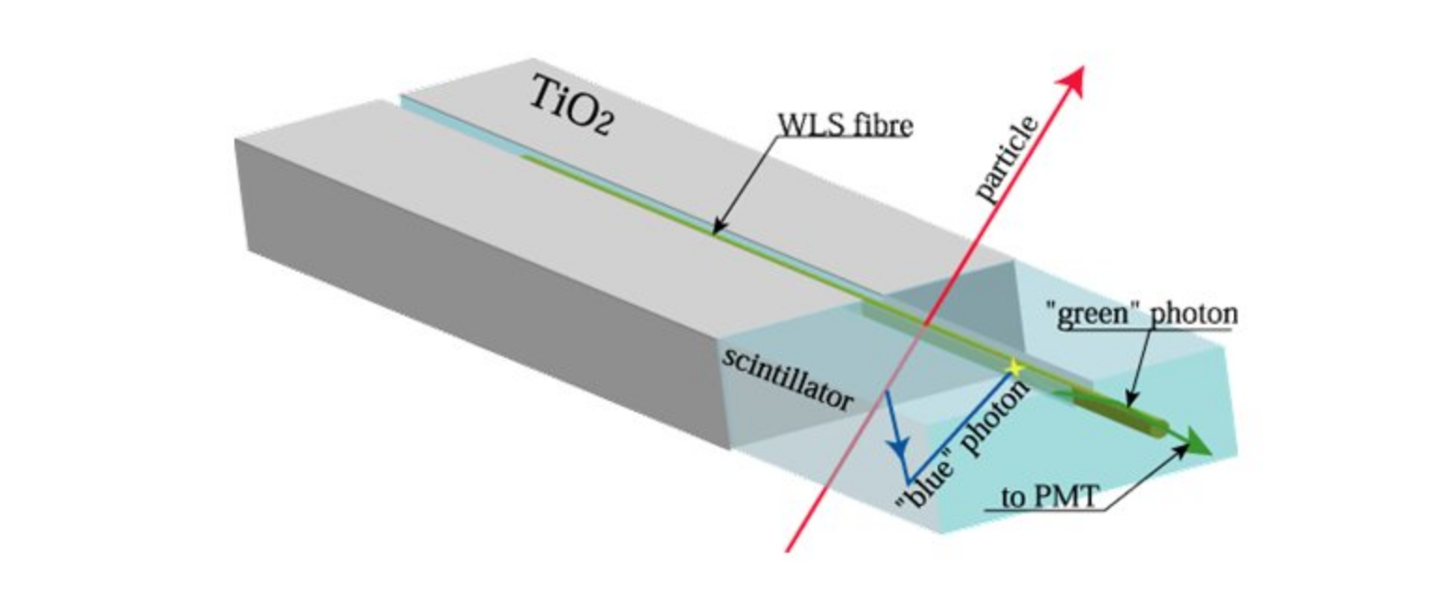
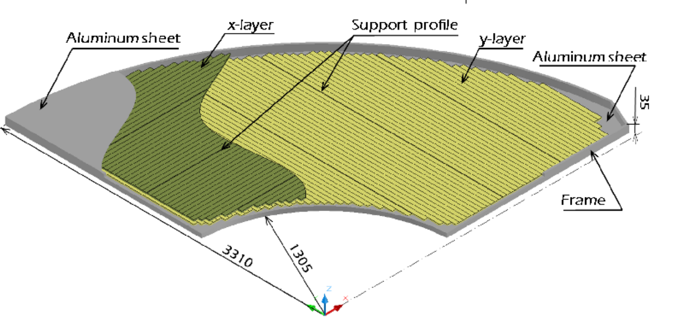
Scintillators
Advantages
Robustness, efficiency, high rate capability
Limitations
segmentation, cost, SiPM rather noisy
Scintillators are not very often used as a muon detector in big experiments
They are used essentially as Bars equipped
with WLS and read out by photo-detectors :
MaPMT as in OPERA or SiPM as
intended in Belle2 and SiD.
Tiles proposed for AHCAL could be also used

Slide 13
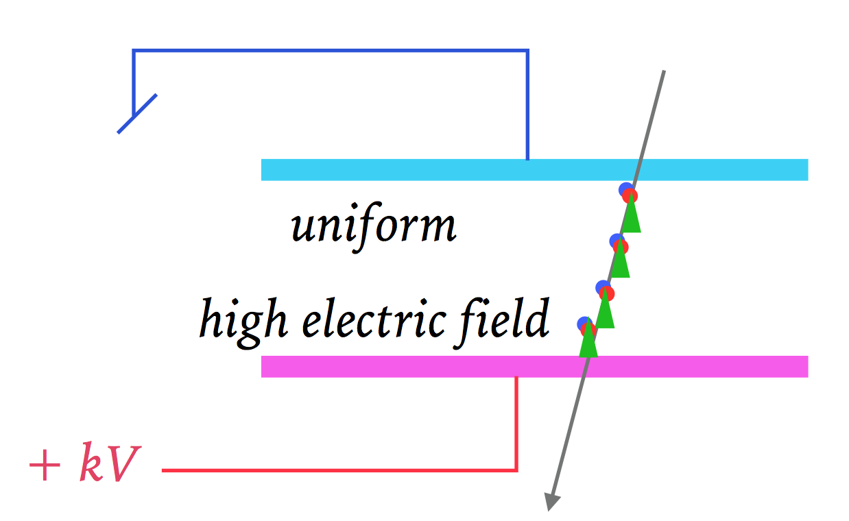
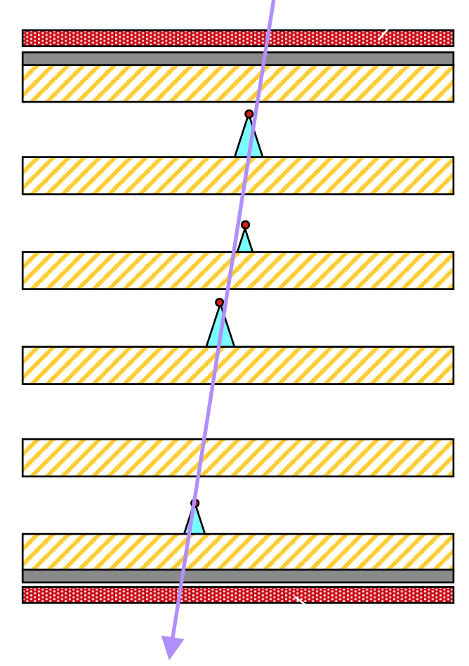
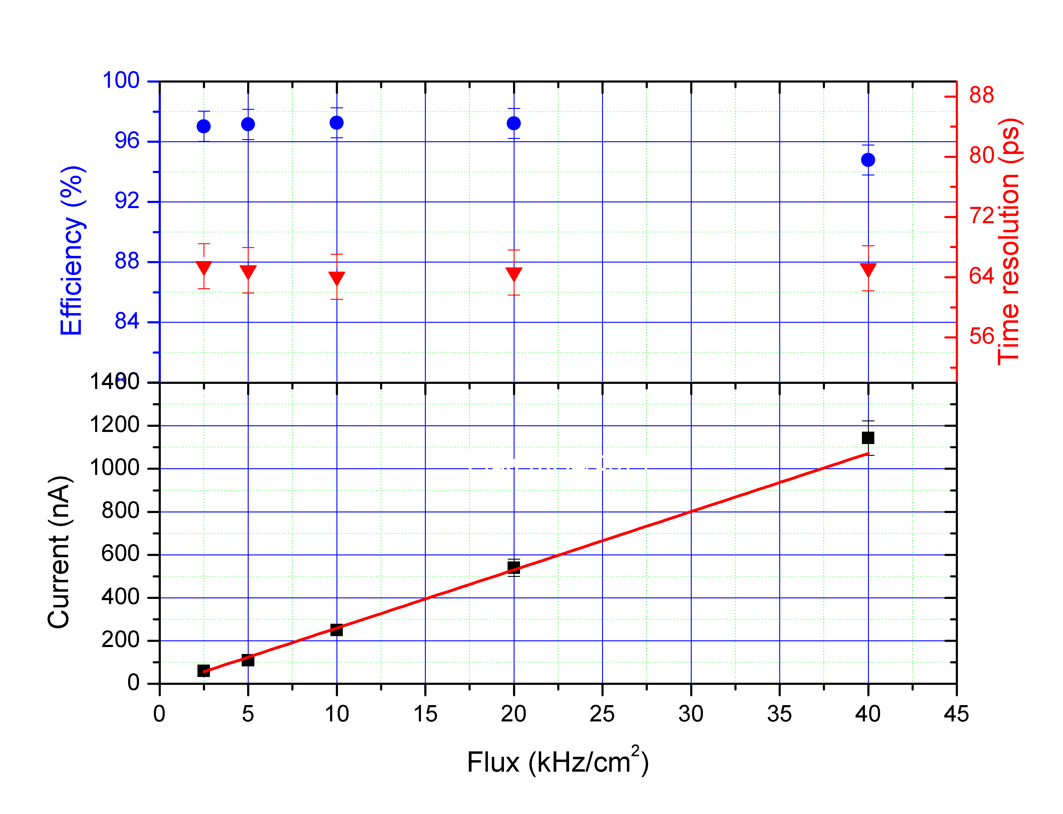
Resistive Plate Chamber
Advantages
Simplicity, robustness, efficiency, sparks free, fast timing (in particular in MRPC)
and cost effectiveness
Limitations
Rate detection capability , gas mixtures currently used are not eco-friendly
Two kinds of electrodes have been used up to now
HPL (Bakelite) : L3, BaBar, OPERA, CMS, ATLAS, ALICE, DAYABAY
needs “good” linseed oil treatment and humidity
Glass : Belle, ALICE, STAR
Limited rate capability (unless moderate resistivity electrodes are used or MRPC)
MRPC provides excellent timing and higher rate capabilities ( low charge)
High rate capabilities could be obtained using low resistive electrode materials
(Tsinghua glass, dopped PEEK, etc)

Slide 14
(M)RPC

Slide 15
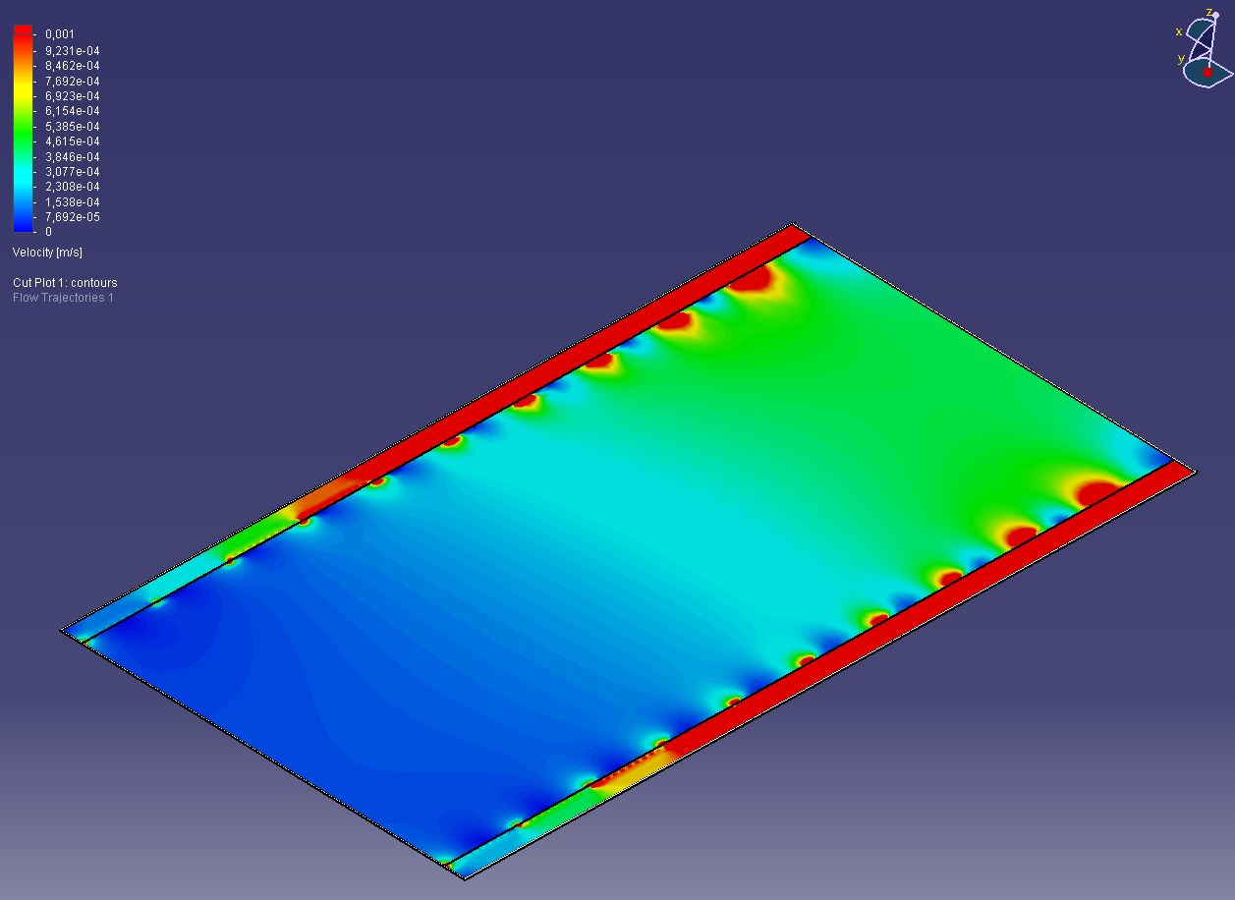
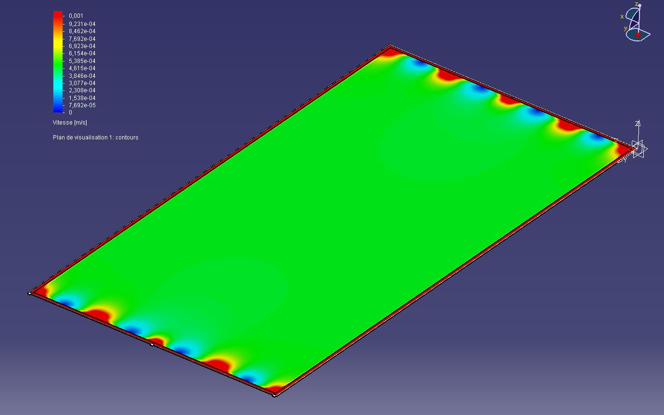
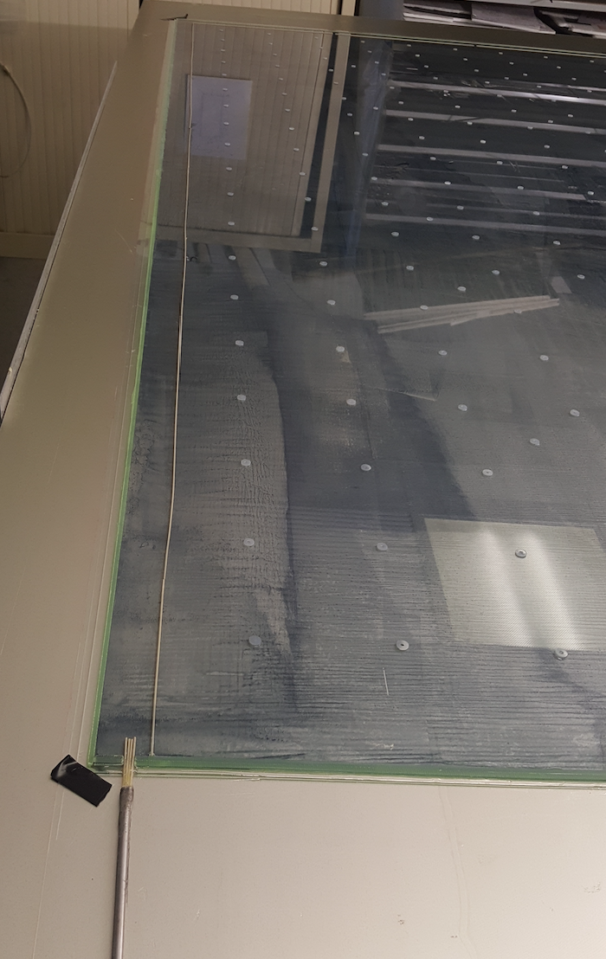
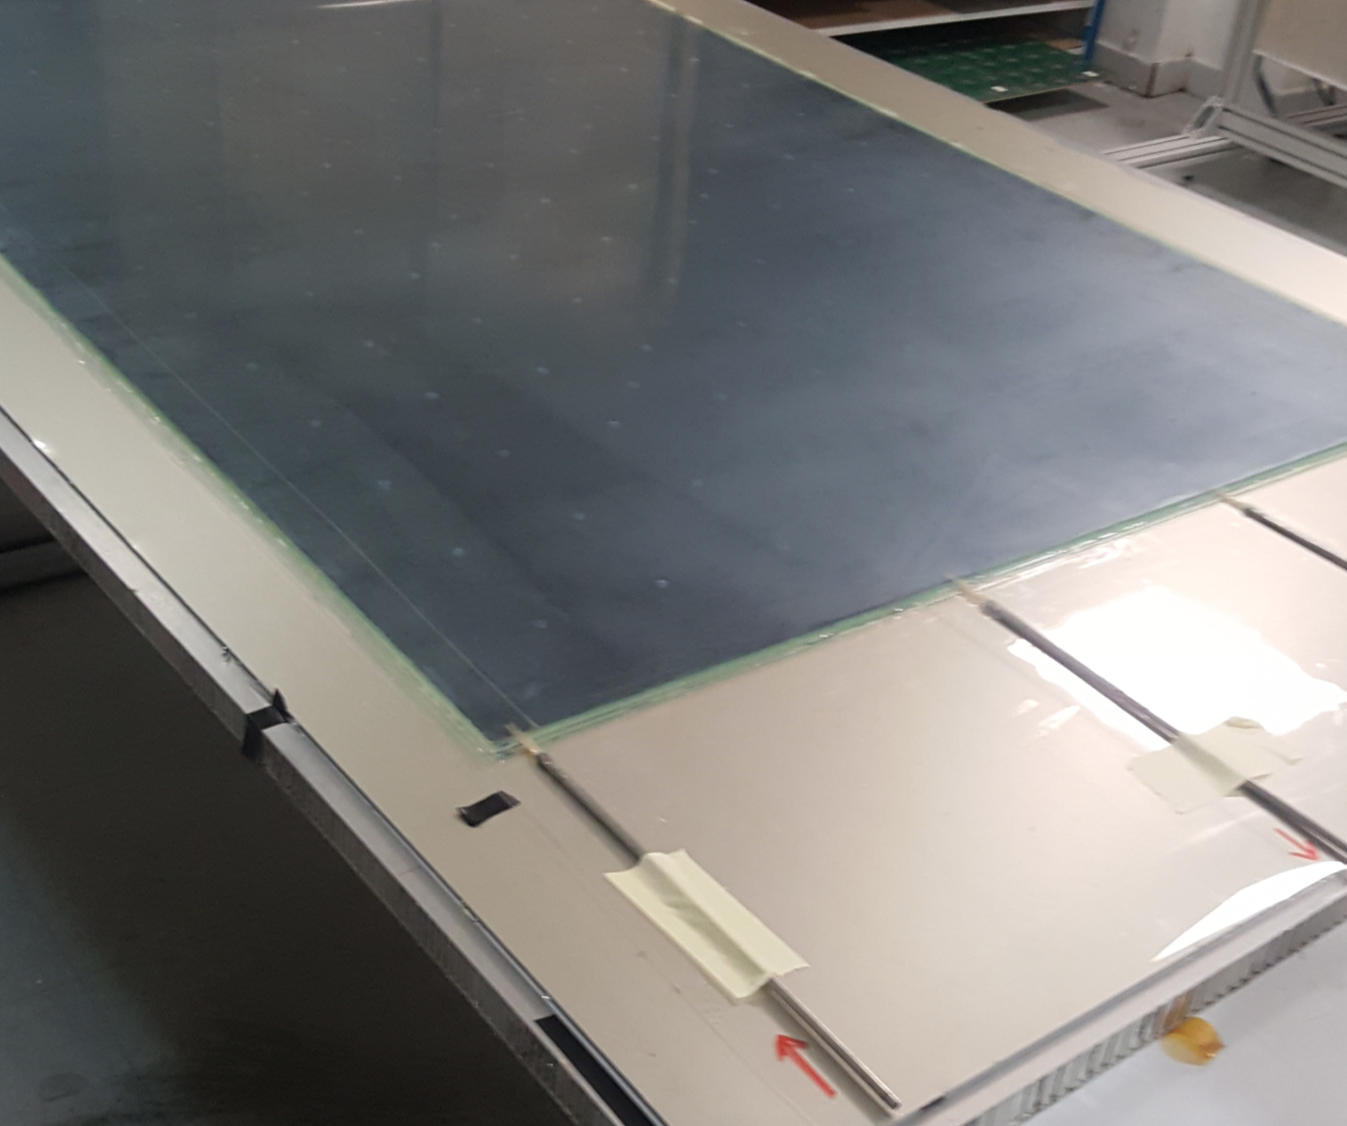
RPC
Construction and operation of efficient and precise large single GRPC is now well known
Prototype circulation system
New circulation system
inlet
outlet
1 m
2 m
Cassette conception to ensure good contact between the detector and electronics is still to be improved

Slide 16
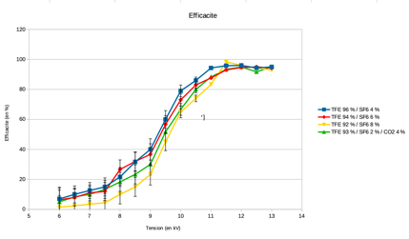
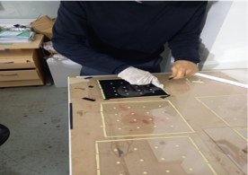
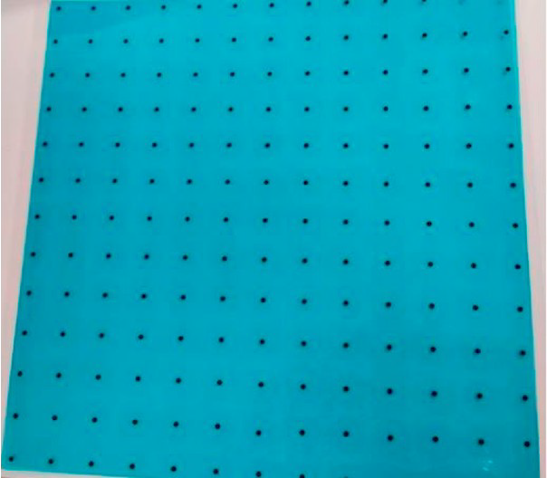
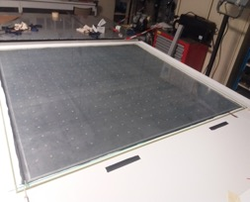
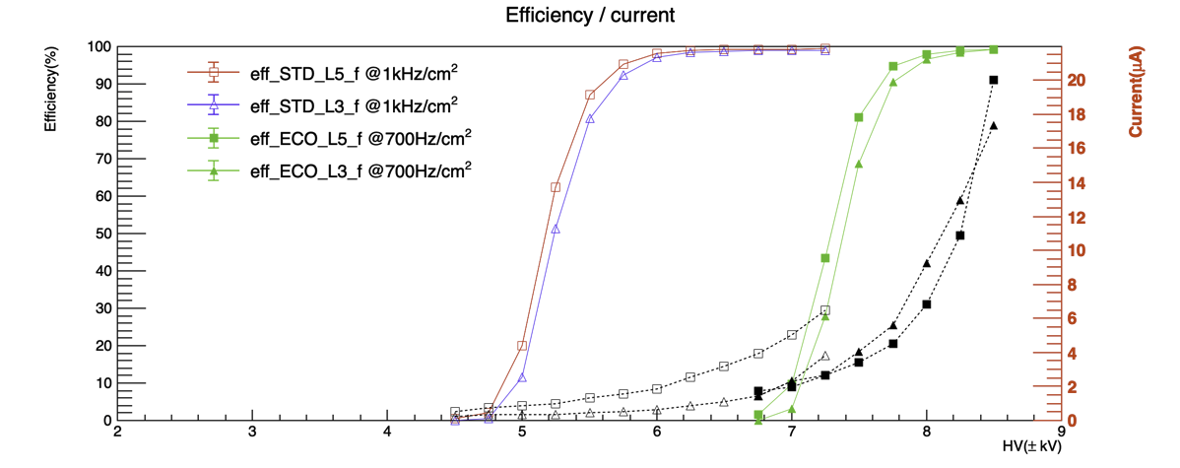
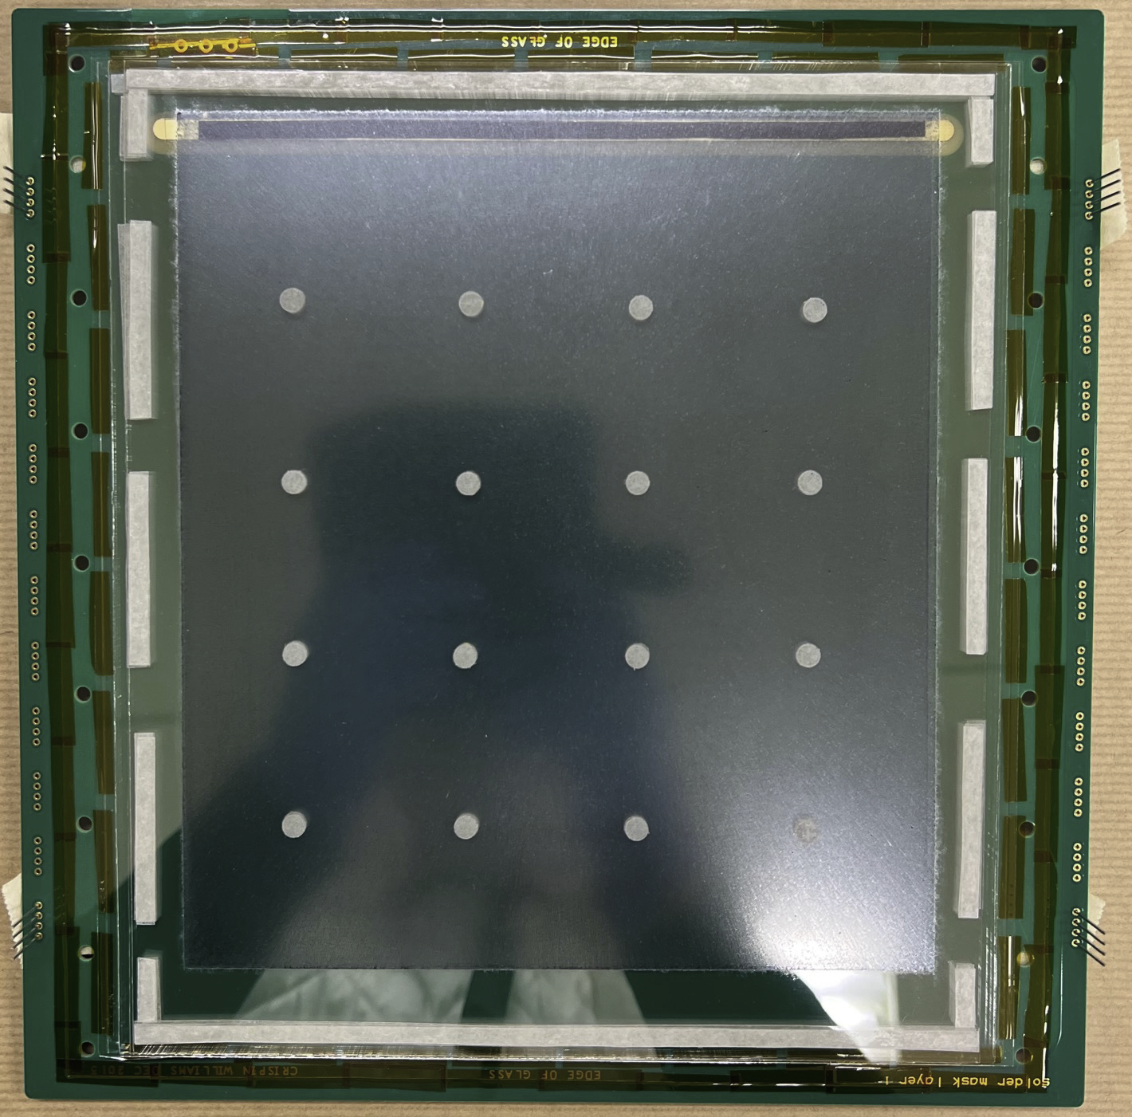
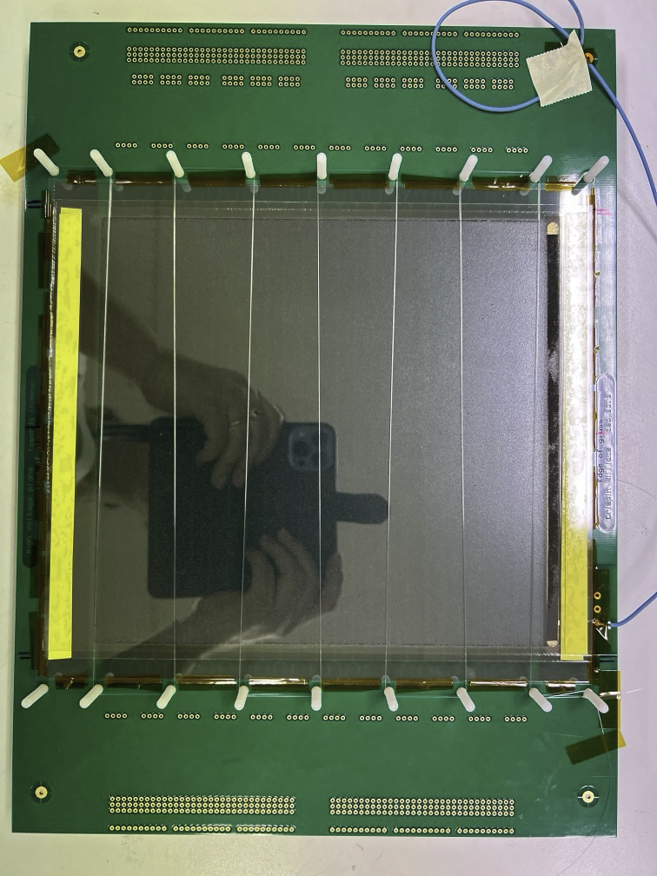
RPC→ MRPC
MRPC provides excellent time resolution (down to 50-70 ps with 2x4 gpas)→ ToF, LLP,….
MRPC has higher detection rate
New way of producing MRPC was developed in Lyon→ easy production, cheap detector
preliminary
LRG5
LRG3
Credit:
Yw. Baek
Js. Kim

Slide 17
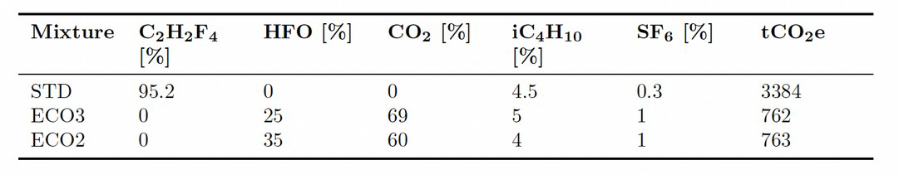
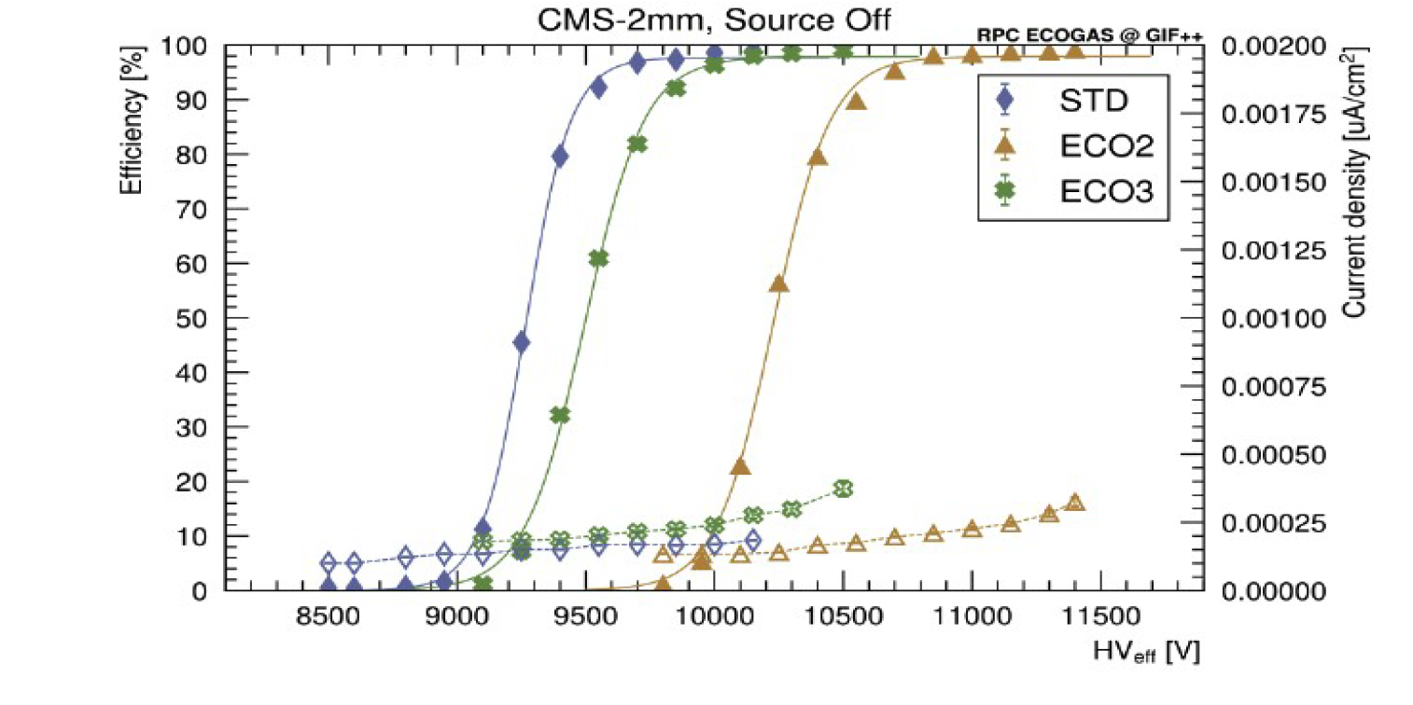
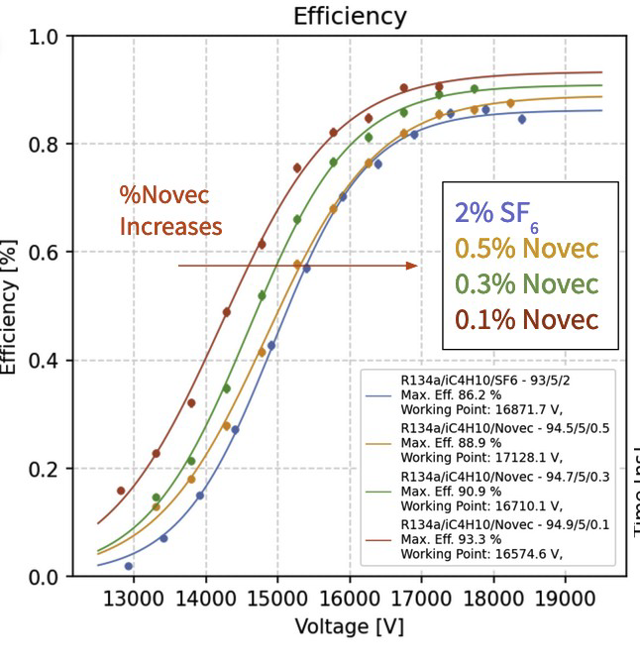
Eco-friendly gas mixtures
M. Verzeroli
HFO+NOVEC+CO2 to be tested in near future

Slide 18
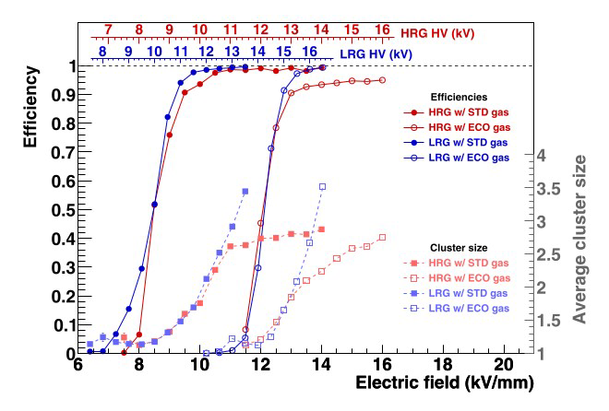
Eco-friendly gas mixtures
MRPC with pure HFO: Nuclear Inst. and Methods in Physics Research, A 1061 (2024) 169104

Slide 19
(M)RPC Readout

Slide 20
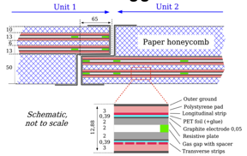
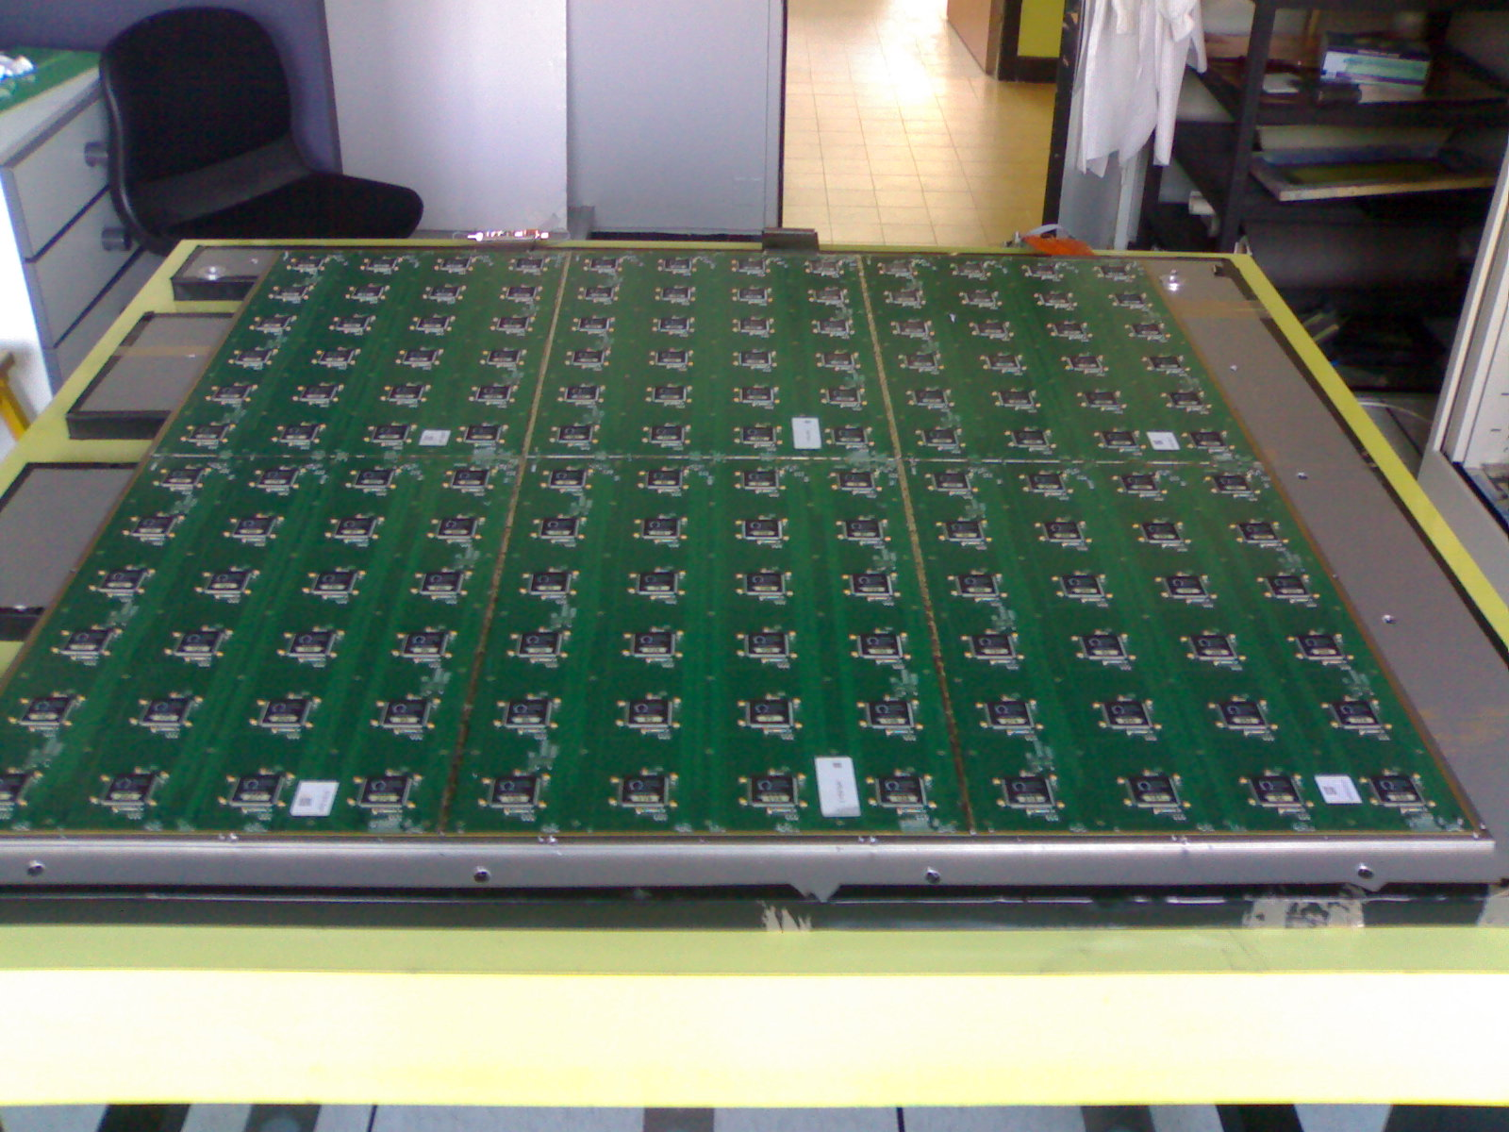
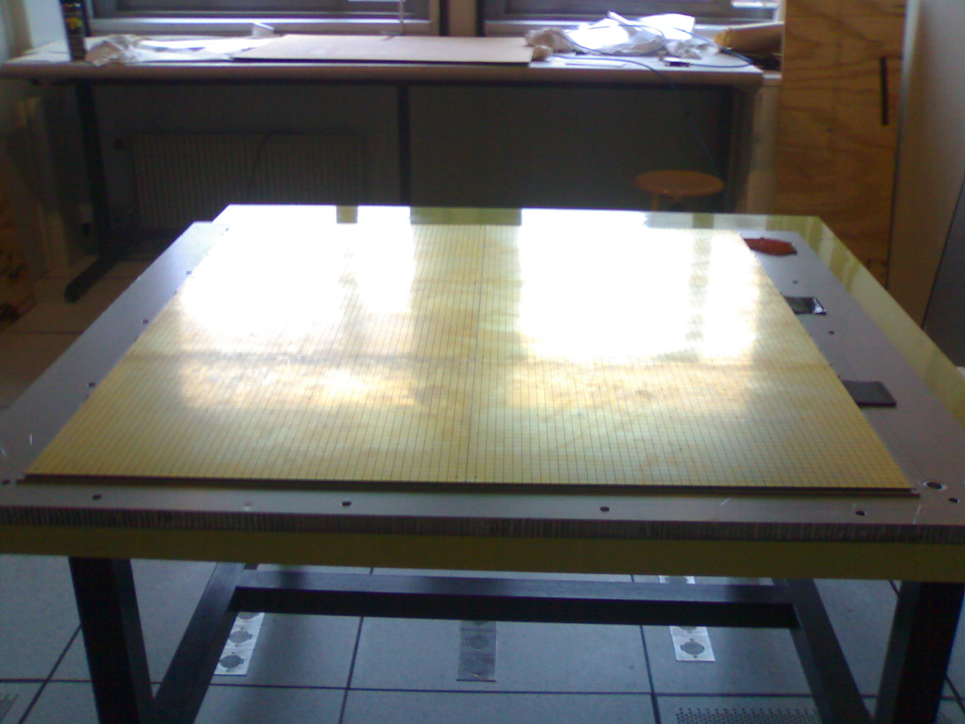
Readout of RPC
There are several ways to read out RPC:
Using one-end readout pick-up strips (either one direction on the anode side as for current CMS RPC or two directions: one on the anode and one on the cathode as for ATLAS)
two-end readout using excellent time measurement as the one proposed for CMS iRPC upgrade project
Using pick-up PADs as for SDHCAL (CALICE)
σ_{x} :0.4 cm
σ_{y :} 1.6 cm
σ_{x} = σ_{y} ~. 0.3 cm

Slide 21
There is another solution
Use pickup pads/pixels to have excellent granularity
Connect the pads/pixels in a special way: woven strips
Two neighboring pixels are connected to two different strips of different directions
Each strip is connected to one electronic channel
Share the charge among a few ones
Cross the fired strip to determine the position
NXN → 3N : Reduction of electronic channels, power consumption and occupancy

Slide 22
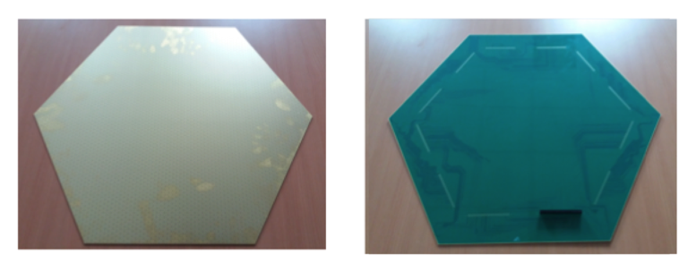
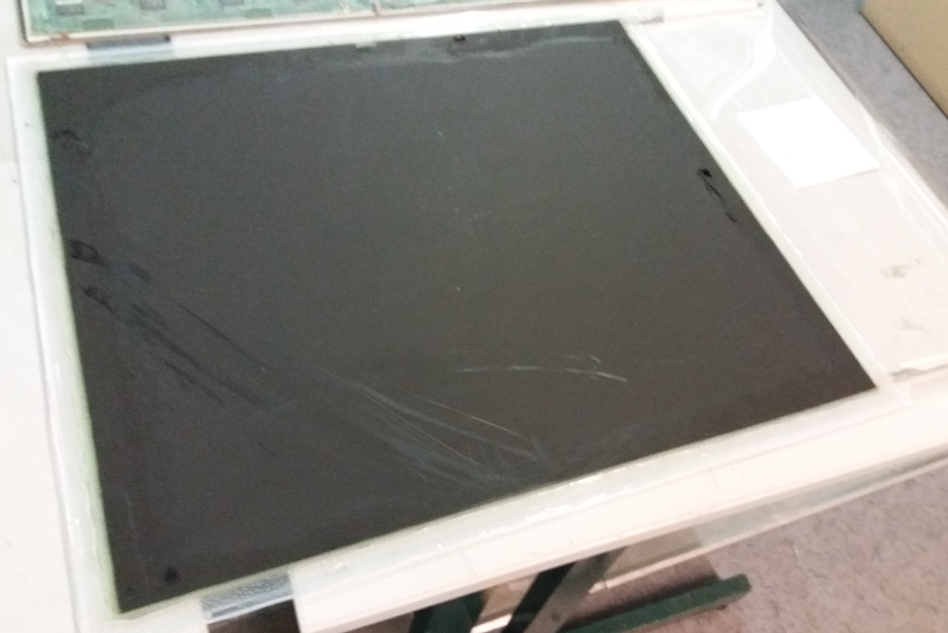
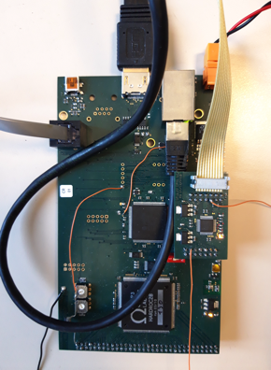
70cm x 70 cm
62 cm
A board hosting
One Hardroc ASIC
One Microcontroller
To be plugged directly on the back of the PCB, on the edge to read out 64 woven strips.

Slide 23
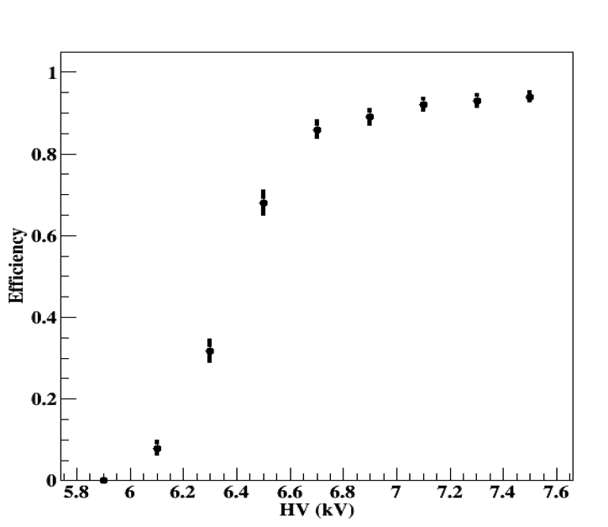
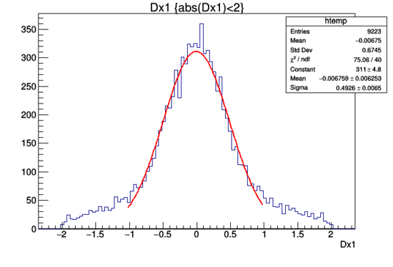
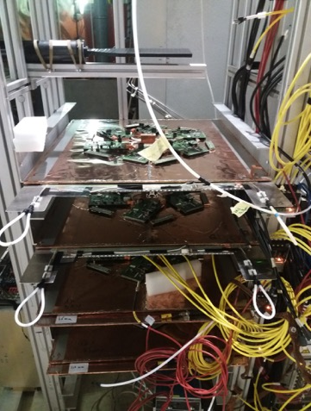

Slide 24
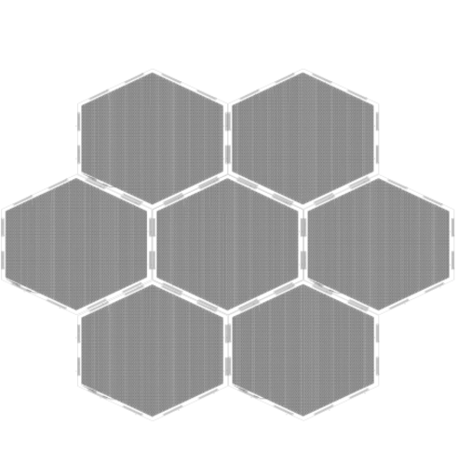
Large surface detectors
To instrument (very) large gaseous detectors a simple scheme is proposed:
FEB
“Well matched impedance will help to keep the signal in good shape for long distances”

Slide 25
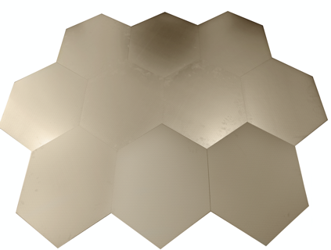

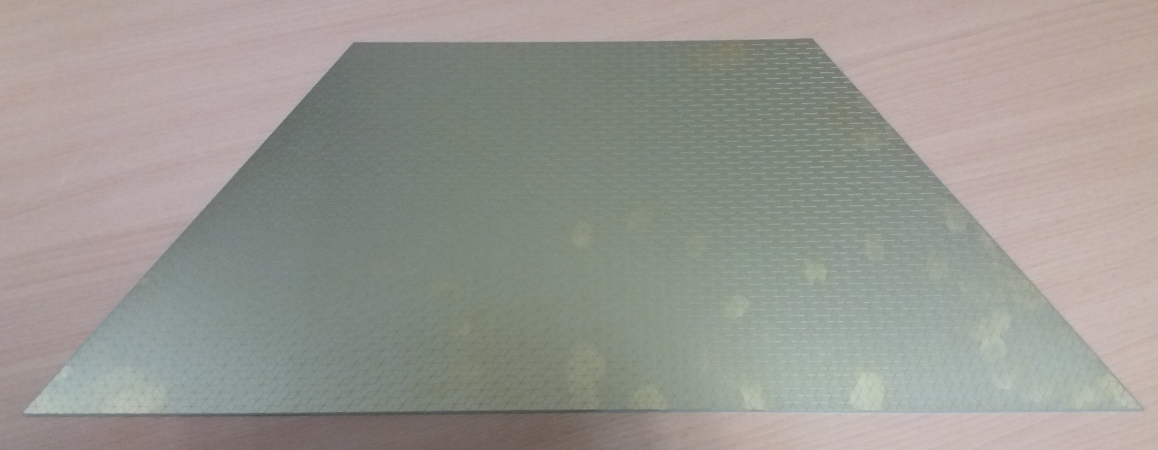
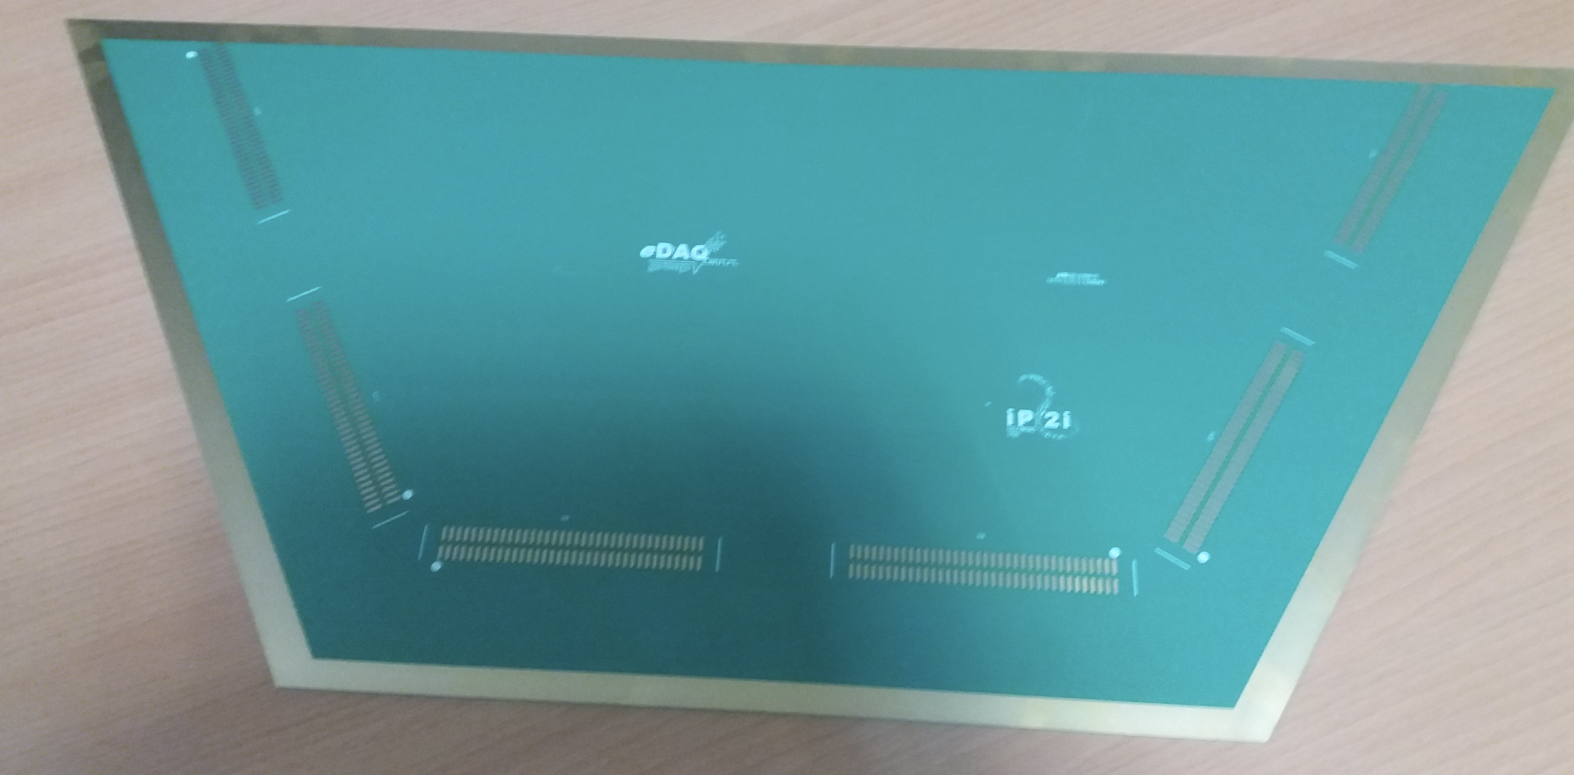
Large surface detectors
Large detection area can be instrumented by assembling easily many PCB.

Slide 26
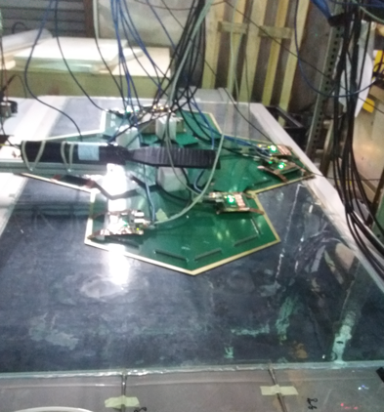


Large surface detectors
The new scheme is being tested on a large GRPC (2m x 1 m) with several PCBs
Reconstruction efficiency (1 direction efficiency is not included) is around 90%.

Slide 27

In addition the woven strips could be used to build a very large detector surrounding the whole experiment
( ILD and the others) to look for LLP ( Z→ N ν). A work was already done with FCCee LLP group

Slide 28
Conclusions
Simulation work has been done a few years ago within the ILD framework to show the role of muon detectors
The segmentation (longitudinal and transversal) is not yet fixed
The technology options are still open even if tose proposed for HCAL were studied
New generations of muon detectors could offer additional assets ( timing, granularity at affordable cost..etc)

