Slide 1
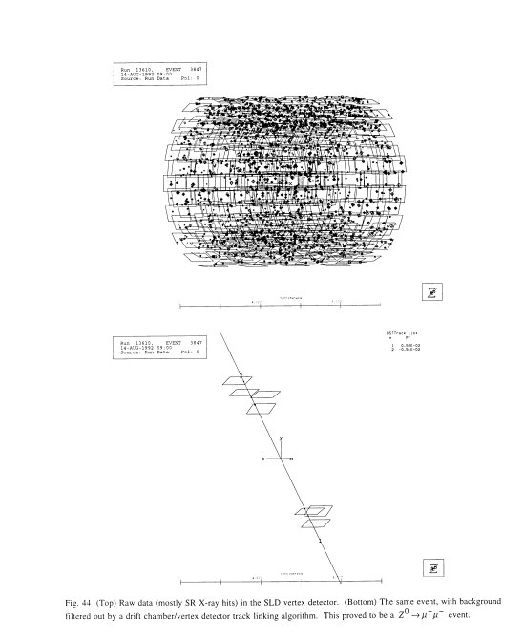
Vertex detector bgds at FCC-ee(Z0) – concerns based on experience at SLC
Chris Damerell, RAL: c.damerell@rl.ac.uk
8th July 2026
SLD’s first vertex detector, VXD2 1992 120 Mpixels
Unexpected even scary background, given clean conditions with Mark II microstrips that preceded us, integrating over 19 bunch crossings, readout time 152 ms.
~2100 hits, mostly compact few-pixel clusters. Size of blobs represents cluster signal charge, which extends far above MIP peak.
Occupancy ~0.01% - negligible, so track reconstruction worked fine.
SLD was running at ~1,000 Z/wk, 5.95 Z/hr
L(SLD) = 6.0E28 cm⁻² s⁻¹
L(goal) of FCC-ee(Z) = 140E34 cm⁻² s⁻¹
But FCC vertex pioneers hope to read out out in 1 μs, so a similar FCC-ee(Z) detector might see 2100 x L(goal)/L(SLD) x 1.0E-6/152E-3 = 322,000 hits. Occupancy would still be ‘only’ ~1.0%, but would this be feasible, given the requirement of air cooling to keep the material budget under control?
VXD3 at SLD (307 Mpixels) added important details, most importantly that these hits were almost exclusively from x-rays up to at least 20 keV, above which the silicon is rather transparent.
Background being predominantly x-rays seems reasonable, given the radial confinement of charged particles by the solenoid field.
Our guess is that the source is annihilation of positrons from Incoherent Pair Creation (IPC) which fly through the Beam Volume into solid material.
After track finding, Z⁰→μ⁺ μ⁻

Slide 2
Slide added Wednesday 8th July. A possible blunder on my part, or (if not) a possible escape route from the legacy of SLD
A CCD and a simple MAPS DAQ have in common one or other variant of ‘rolling shutter readout’, with readout time T_R. You cycle round all the rows as fast as possible. So for a simple MAPS you read the hits in a row, perform a ‘row reset’ and return a time T_R later.
If a physics event happened during the preceding T_R (seen by whatever fast triggers, typically calorimetry, muon detectors) you preserve the contents of that row. If there was no such trigger, you discard them and move to the next row. The background hits come along all the time, but the ‘row resets’ minimize their population when you next interrogate that row at a time when it might contain event-related hits.
This means that the raw event from a given bunch crossing has superimposed the hits from out-of-time bunch crossings over the duration of the readout time T_R.
A more sophisticated approach is to have intelligence in every pixel, so that when an above-threshold hit occurs, the signal amplitude AND TIME are stored in the pixel. So when the rolling shutter for that row comes along, it collects only the hit information for pixels which have the correct time stamp, ideally with precision of the bunch-crossing interval, say 25 ns.
This of course dramatically reduces the background compared with the simple MAPS and SLD DAQ. If this is what the FCC detector people are already planning, I apologise for my ‘false alarm’. If it’s not the case, then they should perhaps think about it as an escape route.
The challenge is often to do it while preserving the power restrictions of air cooling. In this case, I’d look into the possibilities of stacked pixel devices (Walter Snoeys, DRD 7.6 b).

Slide 3
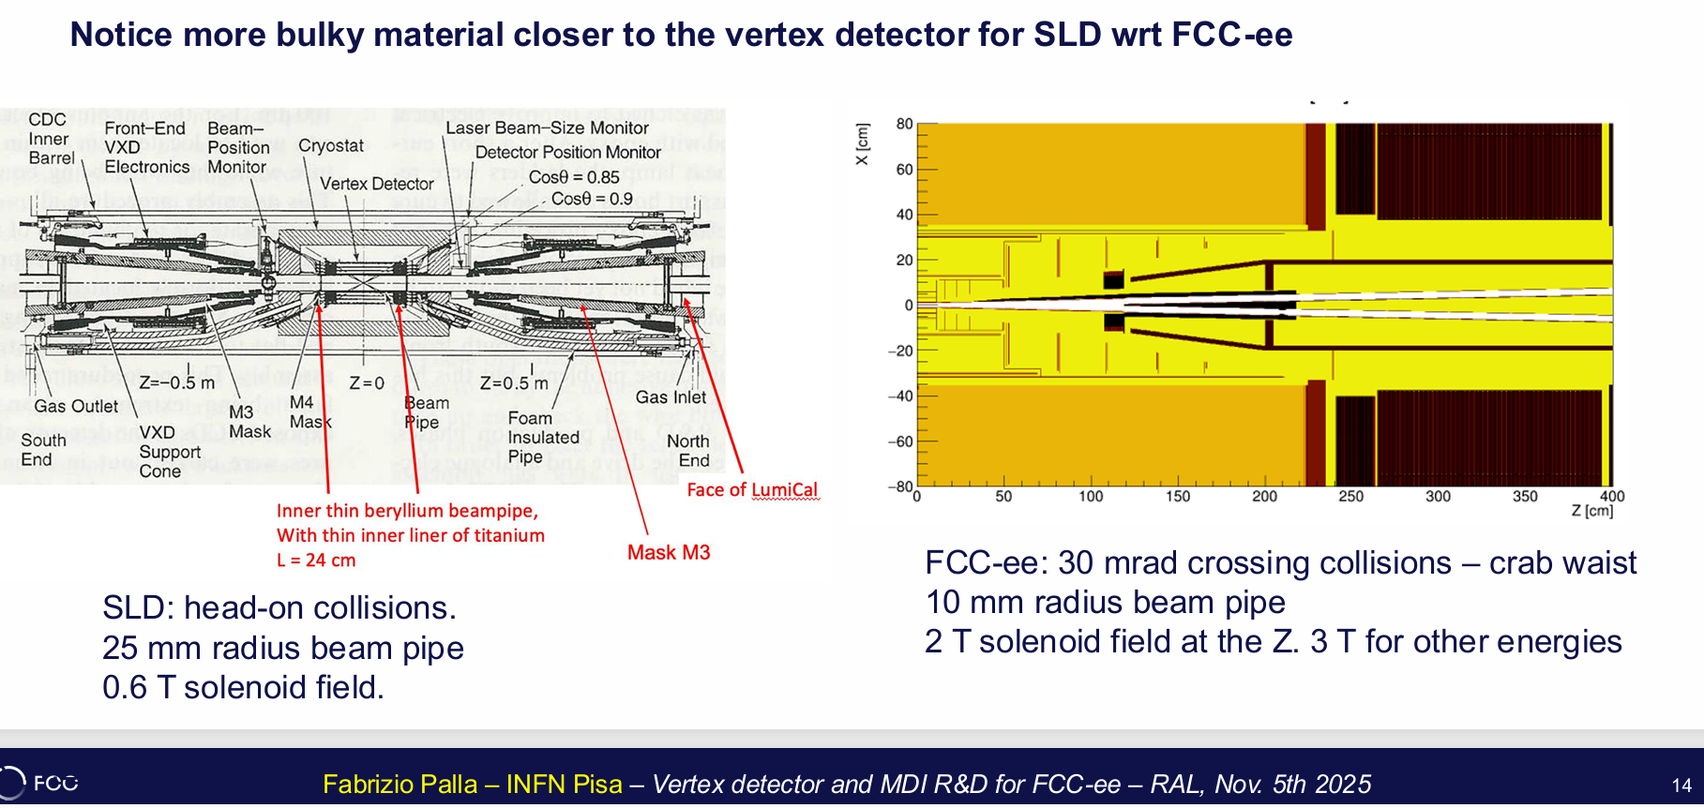
Fabrizio Palla asserts that in the simulations of the MDI Group, this backsplash background does not exist. All they see are the feeble tails of the distribution of IPC electrons and positrons which penetrate the beampipe and generate signals in the detector. There are some handwaving arguments, but basically their implementation in Geant 4 sees no backsplash.

Slide 4
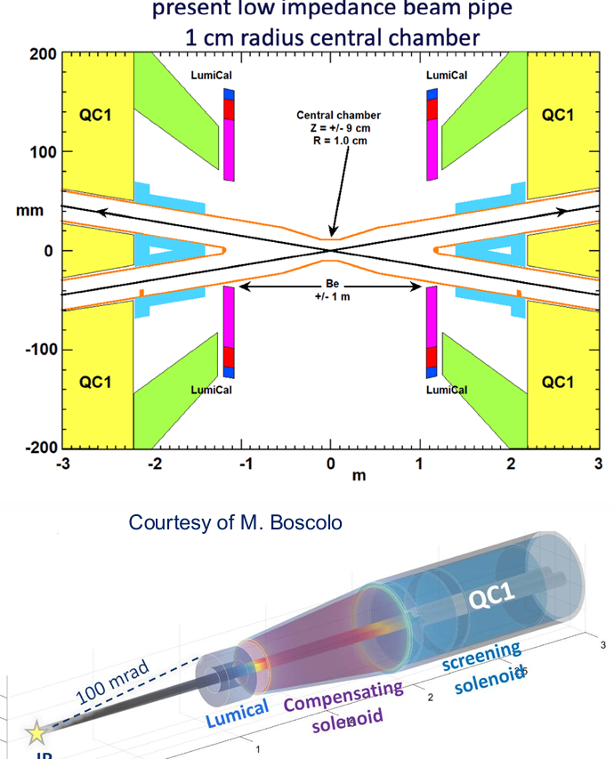
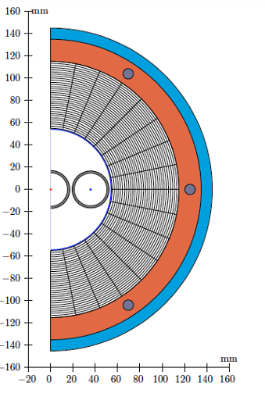
A positive feature of SLD: M3 mask which aimed to confine backsplash within the hermetic Beam Volume.
FCC-ee is more open – more susceptible to backsplash?
How important was M3? Find out by investigating with G4, and possibly give guidance to FCC.
Too open?
Heavymet?
For FCC-ee, positron annihilation will occur along a column of radius ~1 cm, centred on the Z axis, starting at Z~ 1 m. All surfaces ‘visible’ to 500 keV x-rays will shine with Compton scattered photons and fluorescence x-rays of diminishing energy. Some will penetrate the thin beampipe section into the Detector Volume, generating an increasing flux at lower energy. Geant4 should reveal precisely how much of the parent x-ray energy will create low energy hits in the detector, indistinguishable from min-I clusters. How will this compare with what Nature showed us with the SLD vertex detectors? If we, like the MDI Group, find no backsplash, what next?

Slide 5
Suggestions for how to proceed: (all modulo my possible blunder noted on Slide 2!)
Use a detector description that includes Brett Parker’s screening solenoid or similar. Probably important for simulating the positron annihilation distribution in z.
Use currently preferred machine optics: LCC v106.2, with crossing fcy 37.04 MHz, 91 GeV
Check all 3 IPC processes properly included (including LL!) and stability of each of them wrt granularity of Guinea-Pig grid in y, and possible sensitivity to z position for handover to G4. Does current version of GP include bending in solenoid field? With handover to G4 at say z~10 mm, I doubt it matters.
Use fine-grained stepping to observe advance of IPC electrons and positrons separately, all the way to their absorption or annihilation points. Then follow the positron annihilation products in detail.
Have X-ray fluorescence switched on in G4, and observe the evolution of the ‘messy showers’. Compare also with it switched off.
Observe sensitivity of results (hit density and energies in detector sensors) while changing materials: tungsten vs heavymet, components of thin beampipe section, detector mechanical supports (beryllium vs carbon fibre composite) etc.
Consider a few options for detector layers, maybe 50 microns thick and fully depleted, or 12 microns depleted on 38 microns inert, among currently suggested examples. In general, thinner active silicon delivers better tracking precision, specially for oblique tracks, but requires lower threshold (lower than you’d expect for Landau distribution – refer to Hans Bichsel studies (Su Dong for ATLAS), hence greater sensitivity to low energy x-ray background.

Slide 6
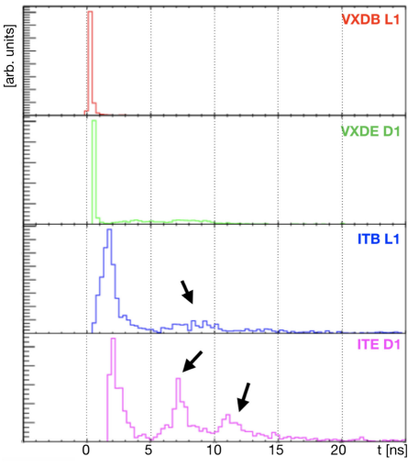
In the paper on which the FCC Feasibility Study Report is based (Boscolo and Ciarma Phys Rev Accelerators and Beams 26, 111002 2023, the vertex detector background is minimal: just the tail of pair electrons and positrons which penetrate the beampipe and leave signals.
They see no hint of backsplash, so my first guess was that they had ignored the later behaviour of pair particles inside the Beam Volume. For example, their timing plot for VXD hits (at left) is totally clean. However, they have asserted that it is in their implementation of Geant 4, and always has been.
If our work confirms their assertion of no significant backsplash, I will of course apologise humbly to our MDI colleagues.
However, this will leave the mystery of what was the source of the intense x-ray background observed in SLD? The MDI people concocted a few explanations, including SR, but this ignores the fact that the SLD background disappeared whenever SLC lost one or other of the beams, EXCEPT on the one occasion when a member of their machine group brought an UNDAMPED beam through the IR, which nearly destroyed the newly installed VXD3 in one shift of running, before the detector was even cabled up! We got it back, thanks to the Lazarus Effect.
So the lesson from SLD was that SLC could indeed produce dangerous levels of SR, but we saw none at all during normal running conditions. But recall Nan Phinney’s warning: beams always have tails, and if they don’t they will grow them.

Slide 7

Poster at Helsinki. Of interest?
Also Jan Eysermans is pushing ahead with WarpX …Might we need it?

