Slide 1

ILC physics & software meeting
2026/7/6
Kanako Watanabe
Iwate University
Notes:
Good morning everyone.
I’m Kanako Watanabe, from Iwate University.
Today, I’d like to talk about my study on Evaluation of hit point distortion due to beamstrahlung in the ILD-TPC using a new 3-d code.
This work is part of our effort to understand the background and performance of the TPC at the International Linear Collider, or ILC.
今日は、ILD-TPCにおけるイオンバックフローと空間電荷効果の研究についてお話しします。
この研究は、国際リニアコライダー（ILC）のTPC性能やバックグラウンドを理解するための一部です。

Slide 2
What I did
Jet pairing
→ s-jet pairing
Generate event
→ Generating h->bs for 100,000 events

Slide 3
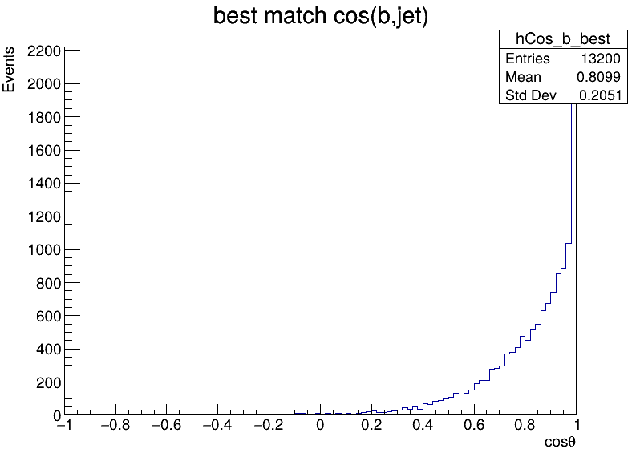
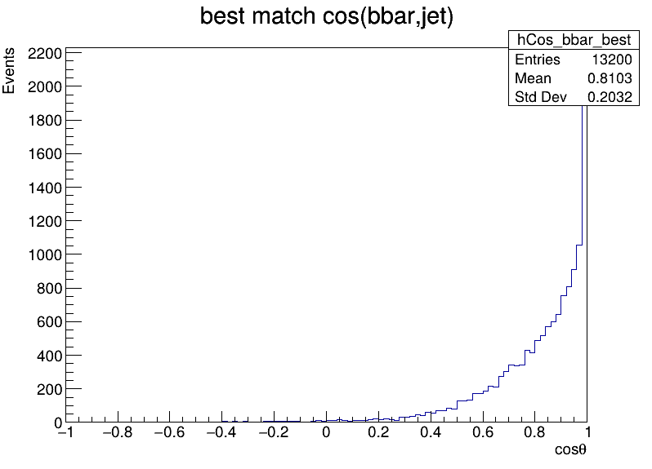
My strategy for jet pairing
Get b_px, b_py, b_pz, bbar_px, bbar_py, bbar_pz (truth quark)
Get px1,py1,pz1, px2, py2, pz2 (reconstructed jet)
Check at the Jet's vector and the quark's vector, and match those that are pointing in similar directions.
  Compare cos(Jet0-b)+ cos(jet1-bbar) & cos(Jet1-b)+ cos(jet0-bbar)
  ➡ Select the combination with the highest value
  Cosθ＝1 Same
  Cosθ=-1 Opposite
  It's mostly 1,
  but some is near 0.

Slide 4
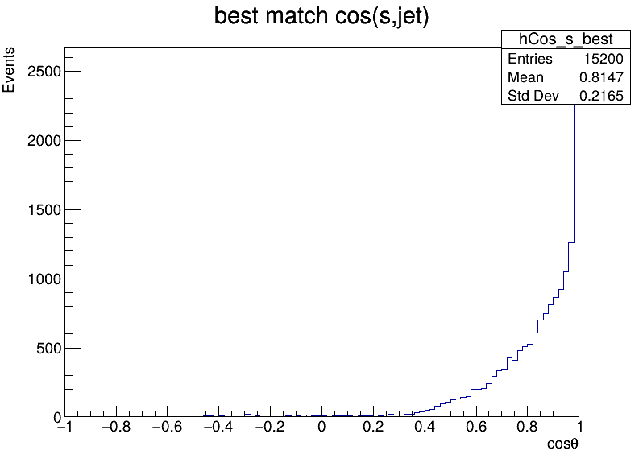
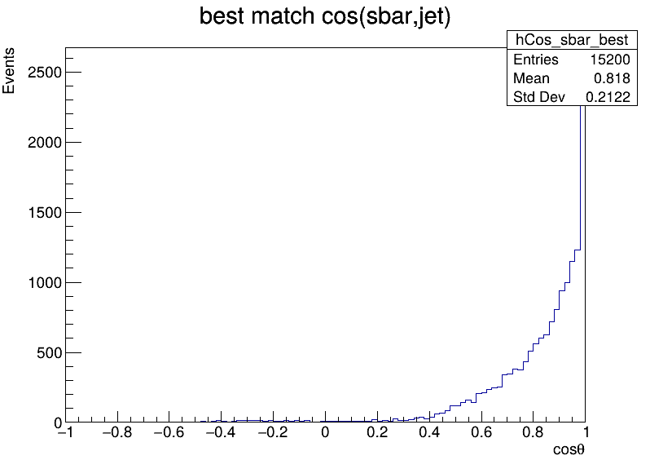
Jet pairing
H->ss/Z->μμ
Separate
PDG = 3 & -3
for s-jet
Is it slightly closer to 0 than when it was b?
It's almost the same...
ss
bb

Slide 5
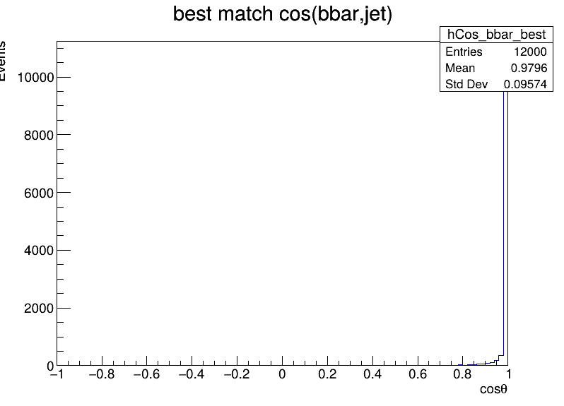
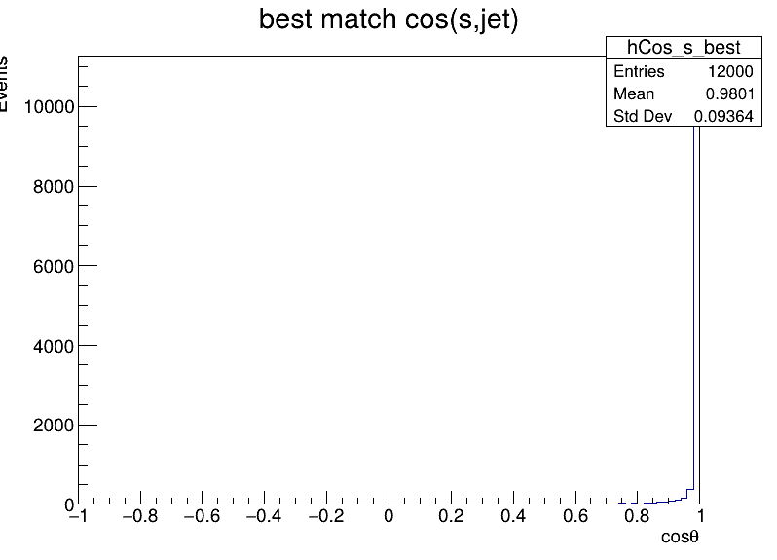
H->bs
For both bsbar and bbars: (H->bs/Z->νν)
Generate 100,000 events through the following :
Generate event→ detector simulation→ Marlinreco → Hilevelreco
➡ Verify using JetClustering, etc.
Is it correct that this results in very good separation?
The cause?
  Is it the difference between Z→μ and Z→ν?
  Does it include pileup or not?
  → try to check

Slide 6
Comments
H->bb/ss
“Reconstruct jet” uses jet information from the after the detector simulation.
Include overlay(pile-up)?➡ check
H->bs
Pile-up is not large at ILC? → not large, but not negligible (depends on energy)
Include ISR?
√s = 250GeV
Check reconstruct Z mass, used for pre-selection

