Slide 1
Particle Flow Reconstruction for
the International Linear Collider
Using Graph Neural Networks and Object Condensation
Trinh Cédric
Suehara Taikan, Schaeffer Arpad, Tatsuki Murata
University of Tokyo, ICEPP, École Polytechnique

Slide 2
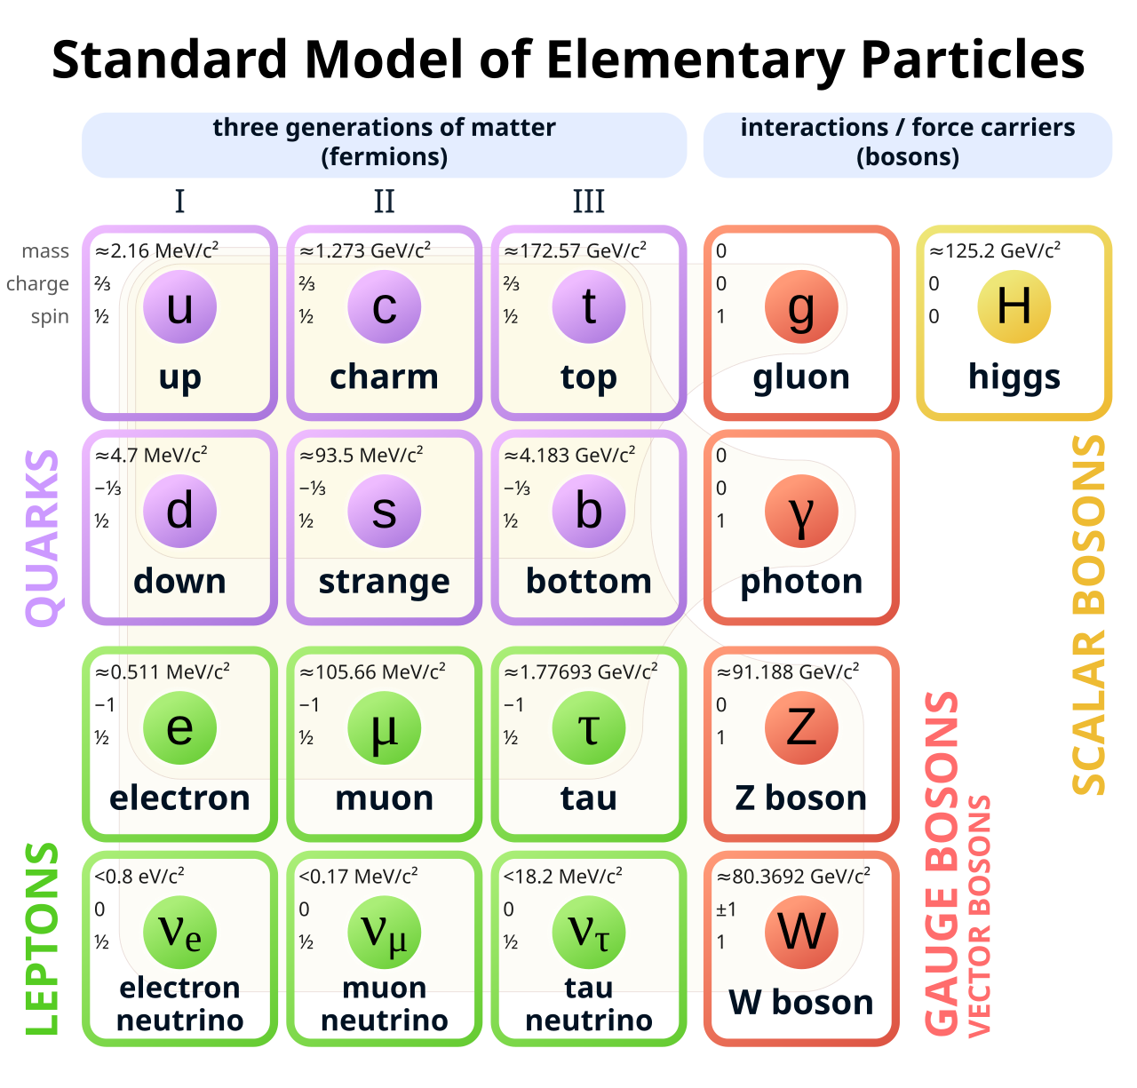
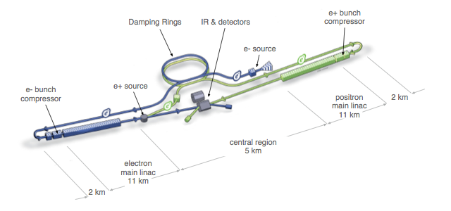
International Linear Collider (ILC)
Physics goal: precise measurements of Higgs, Z, W, and top.
ILC layout

Slide 3
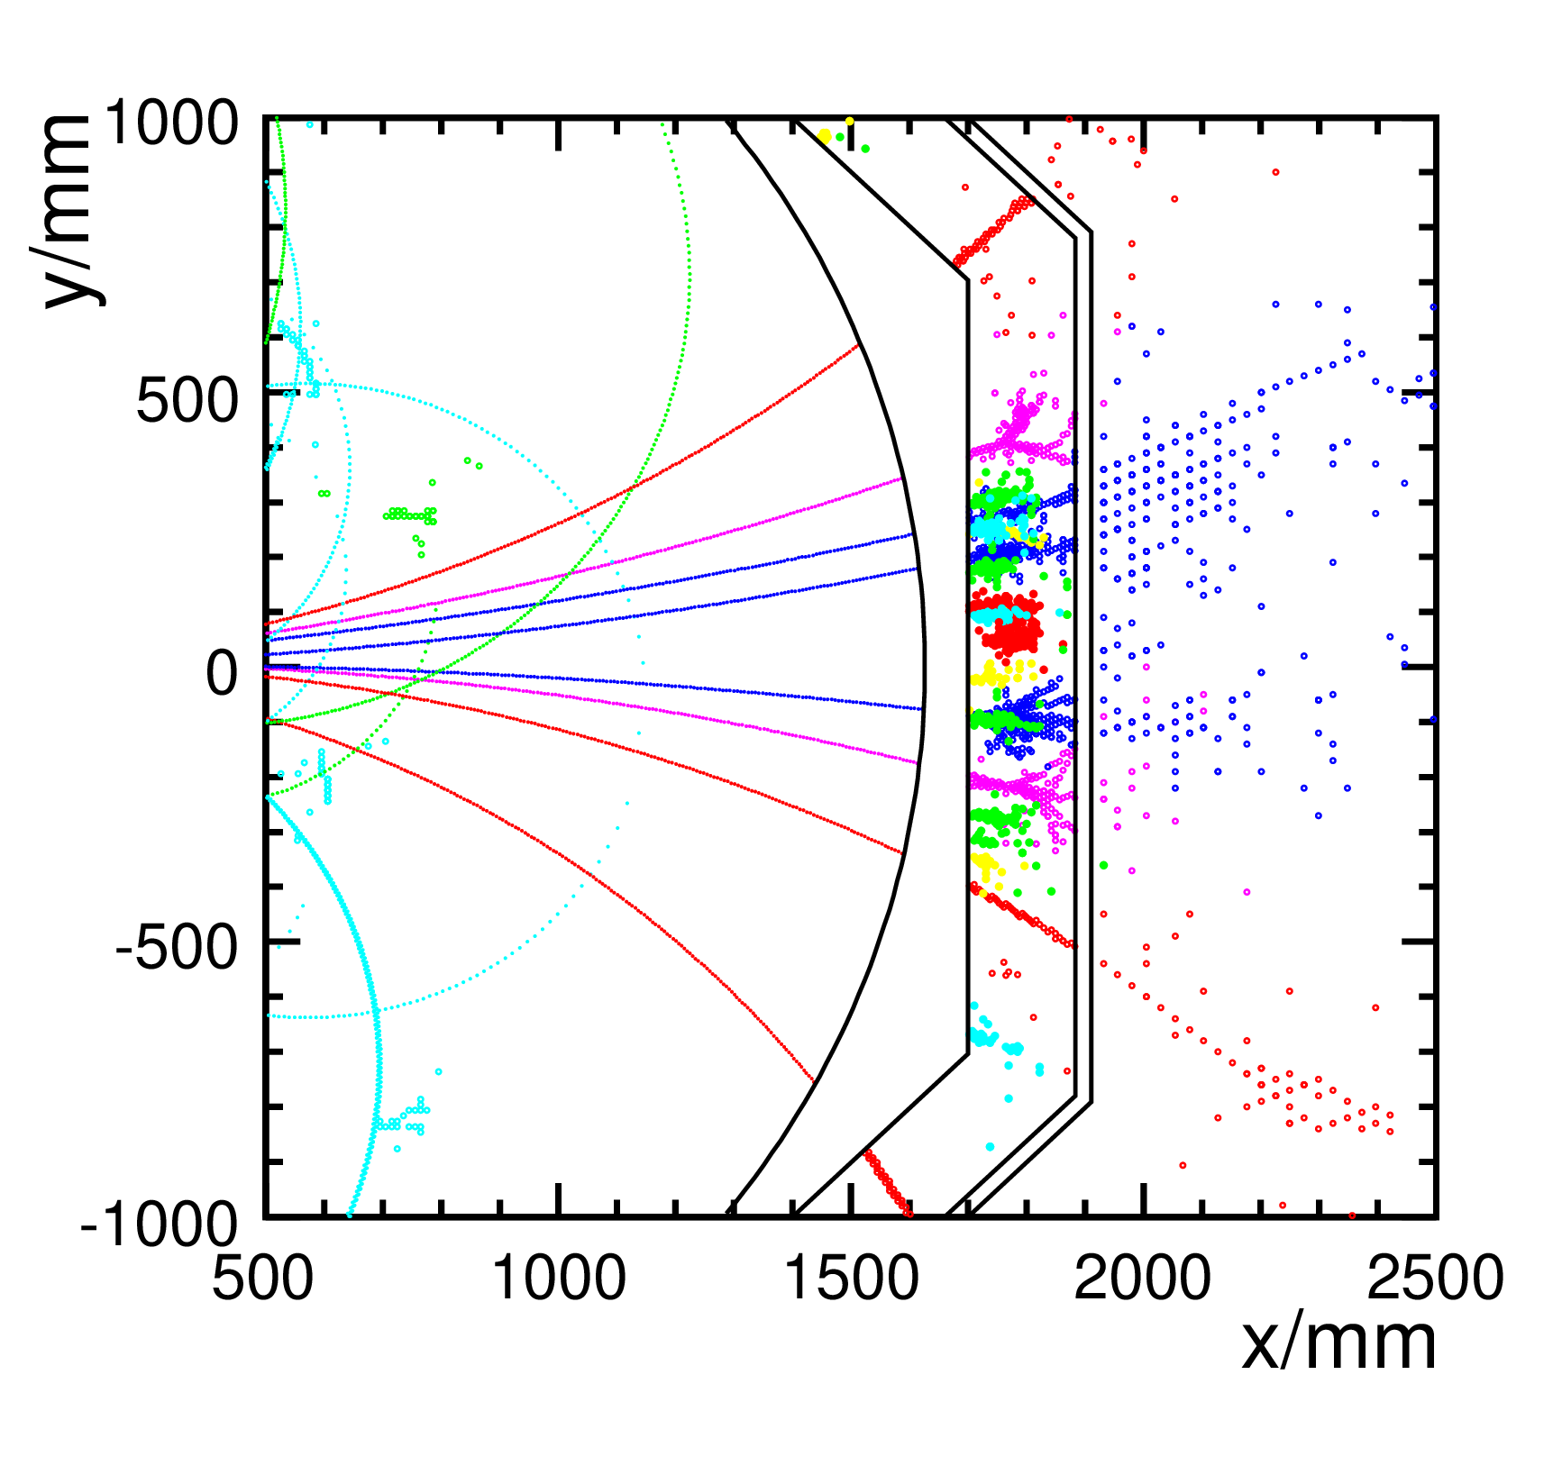
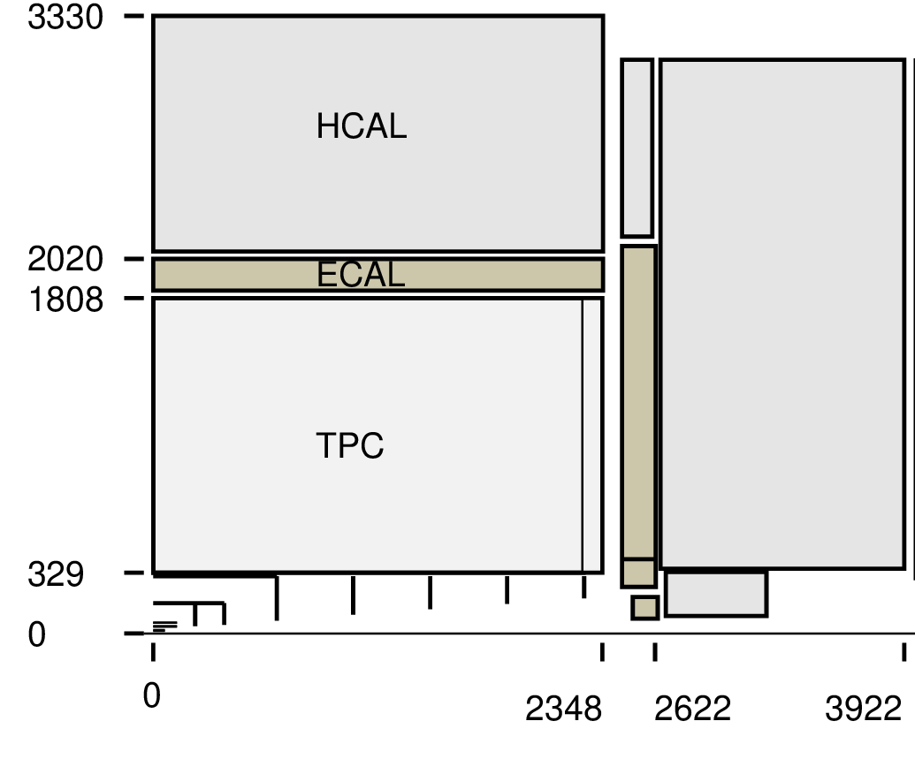
International Large Detector (ILD)
ILD subdetectors
Jet showers in the ILD

Slide 4
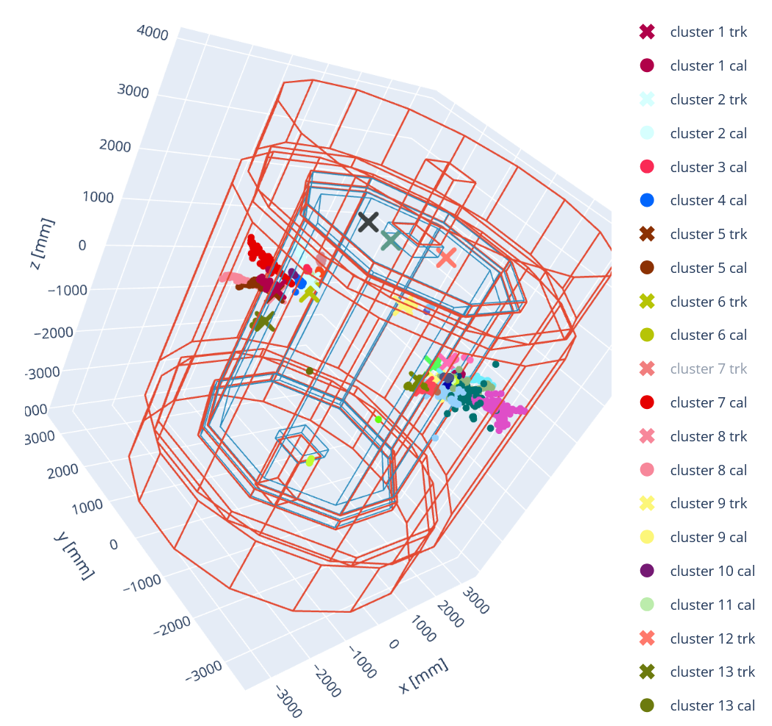
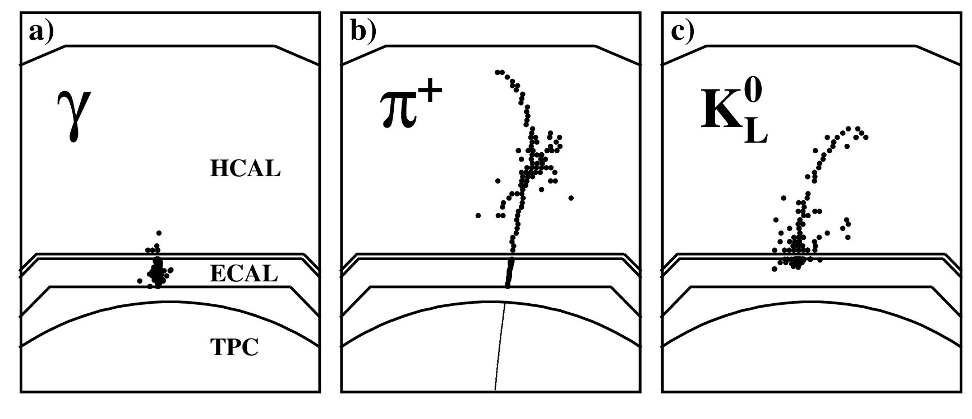
Hit clustering
Detector signature of single particles
Jet event clusters inside the ILD

Slide 5
PandoraPFA and GNN
Pandora PFA
Physical model
Tracks and calorimeter topology
Detector-specific rules
Reference baseline for clustering
and energy regression
GNN
Deep Neural Network
Reconstruction from detector hits
Graph representation
Alternative tested in this work
for clustering

Slide 6
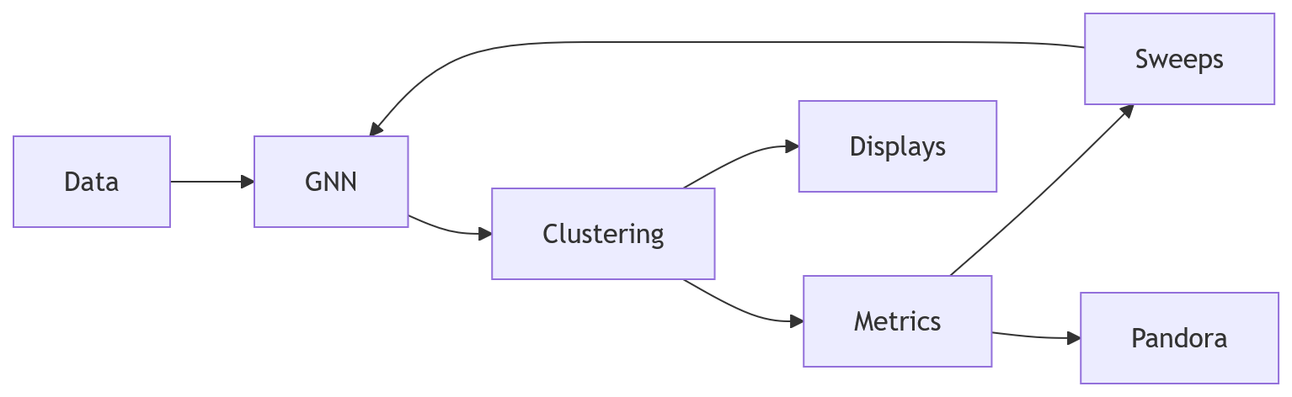
Objective and Personal Contribution

Slide 7
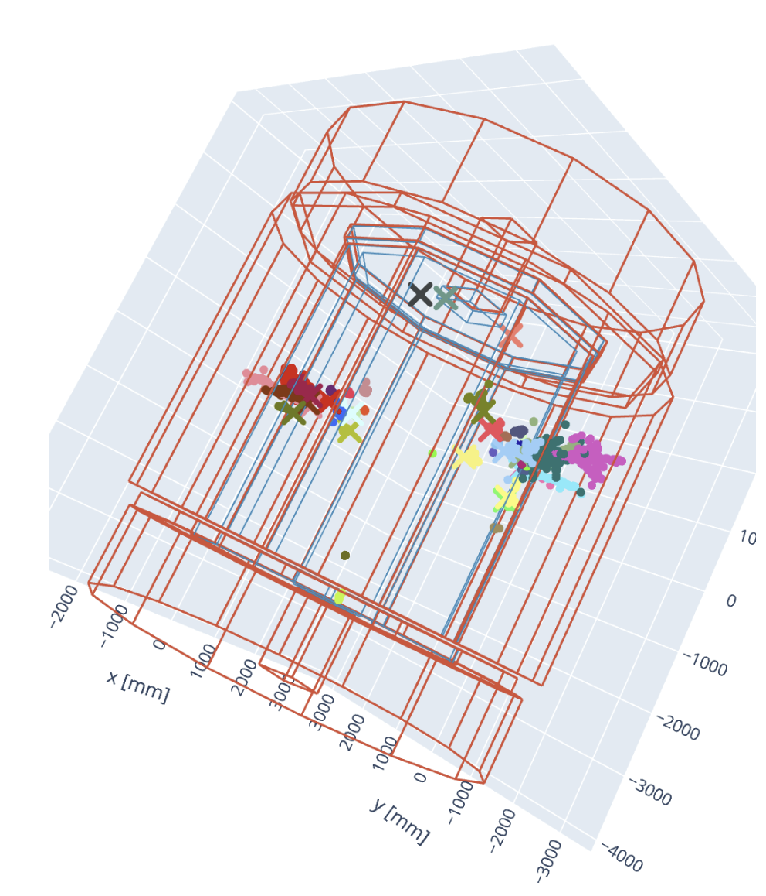
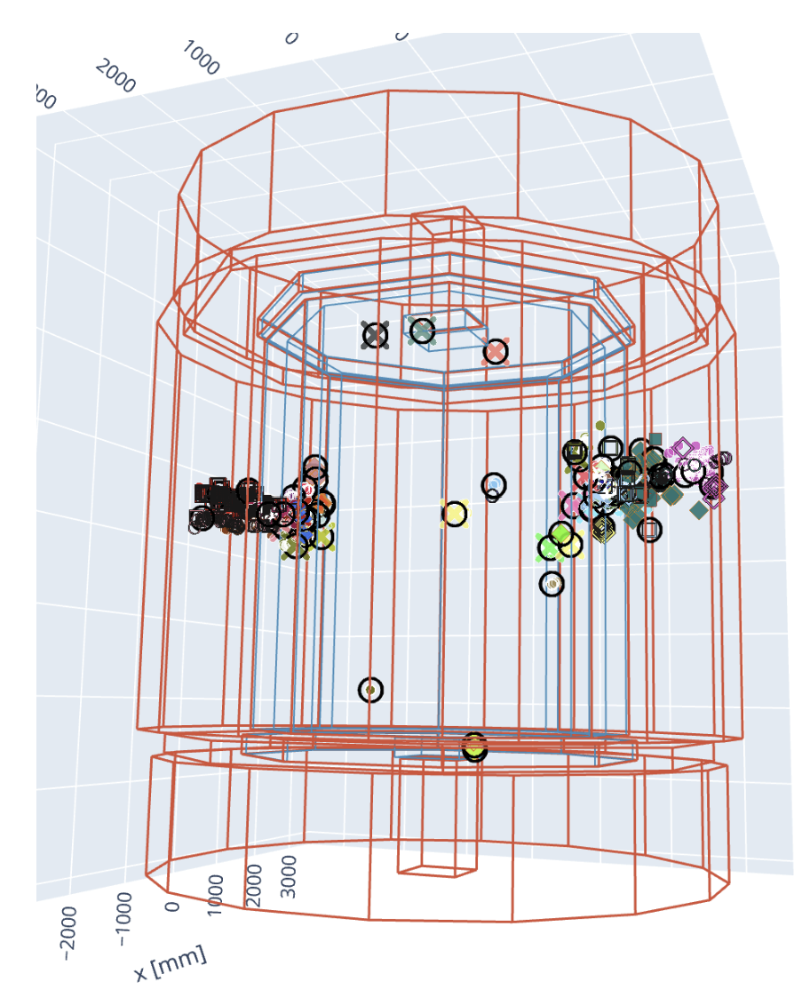
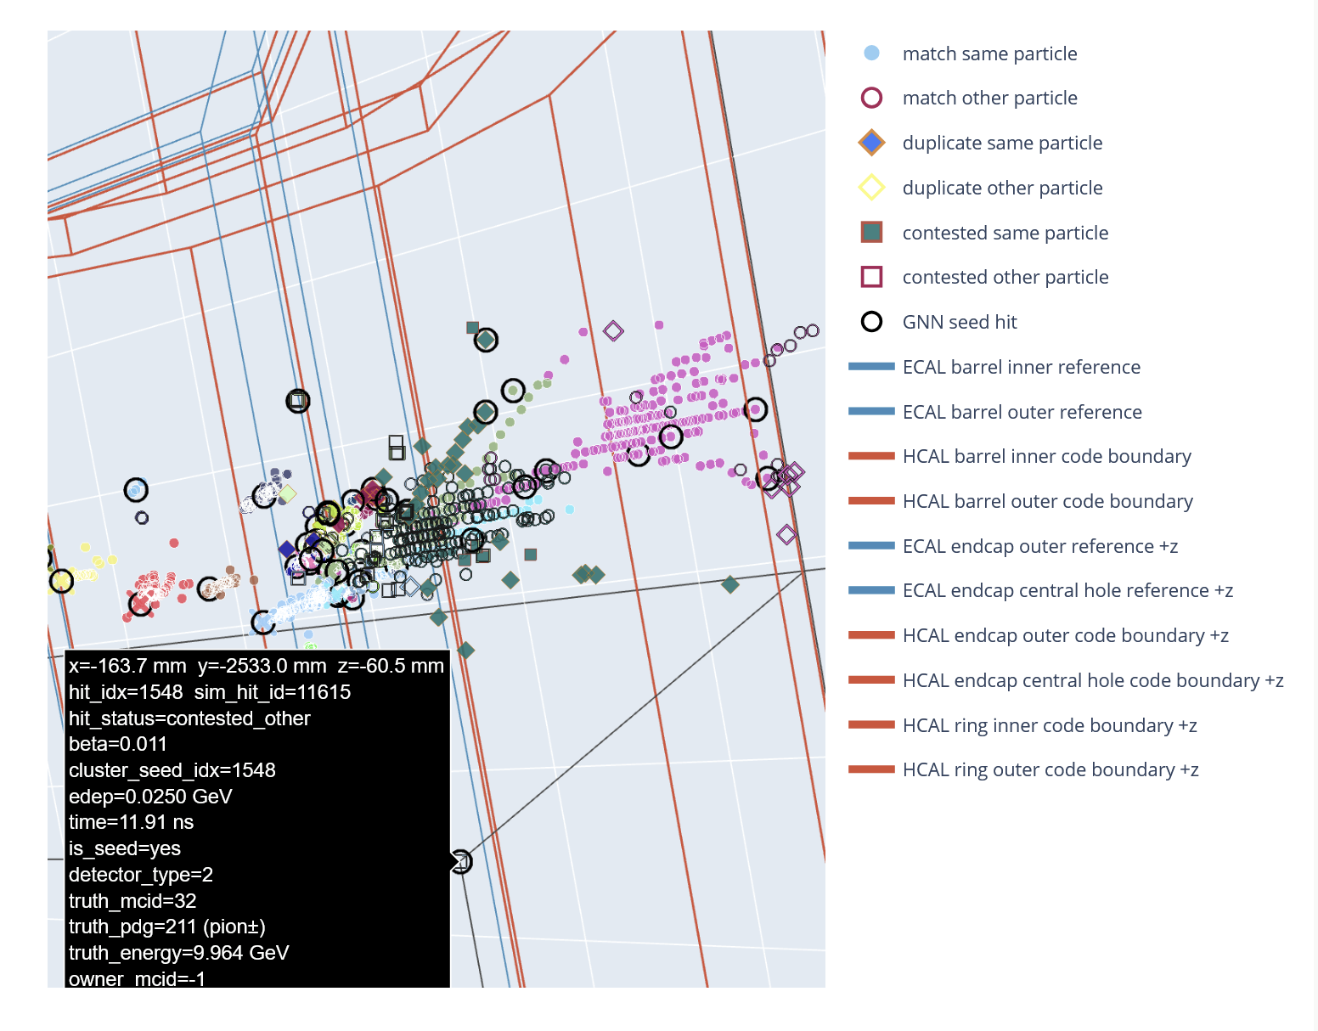

Visualization
Interactive event display

Slide 8
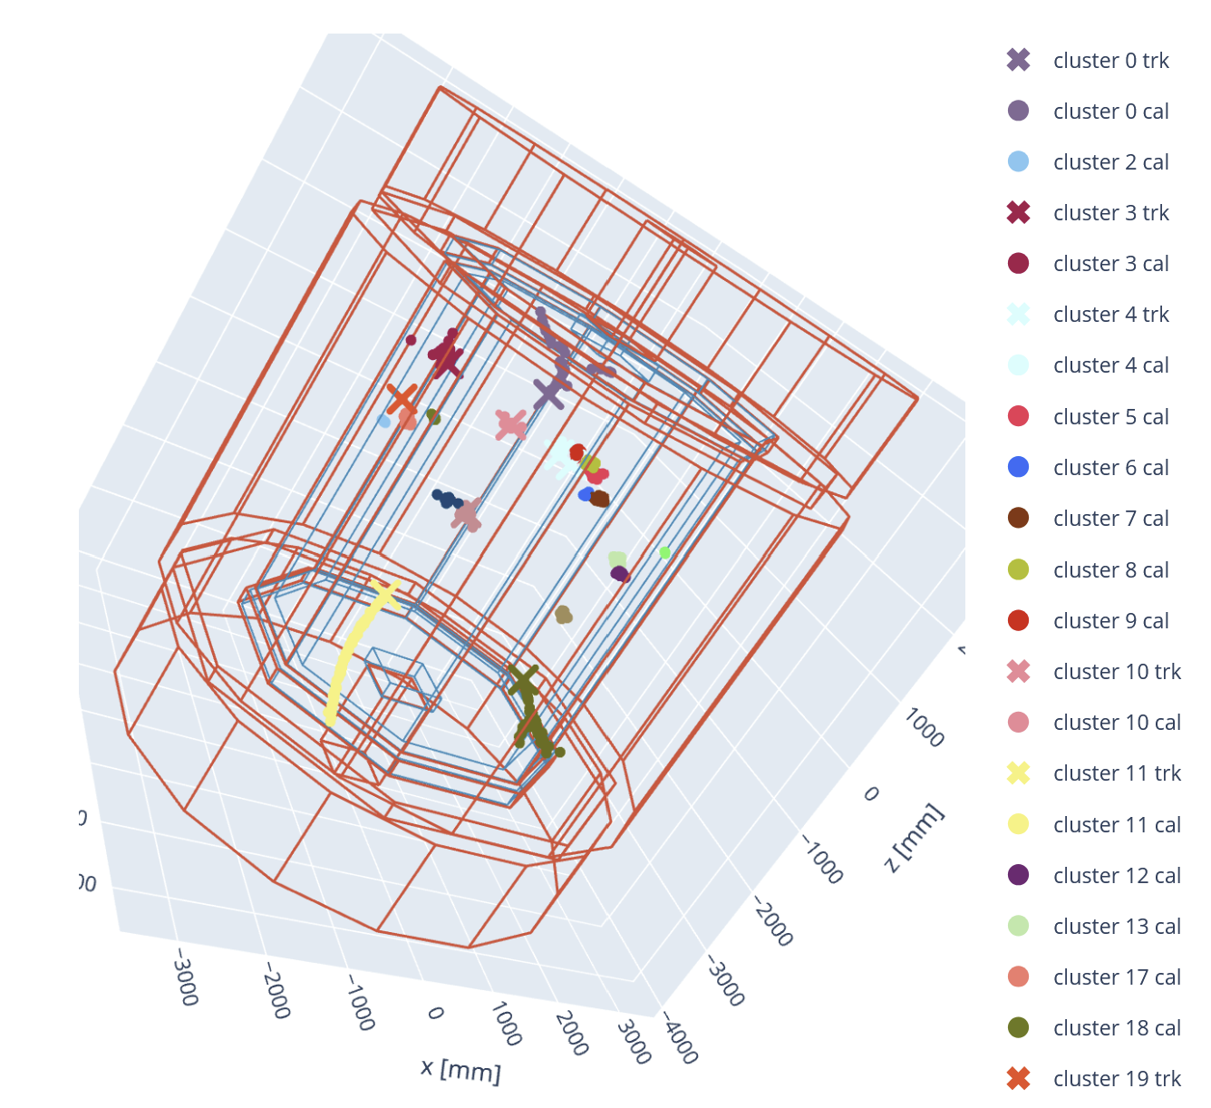
Datasets
Split of Train/Validation/Test by 80/10/10
tau dataset
τ events
100.000 events
~25 particles and ~1.5k per event
nnqq dataset
e+e- -> 𝜈𝜈 qq dijet events
120.000 events
~50 particles and ~3k hits per event

Slide 9
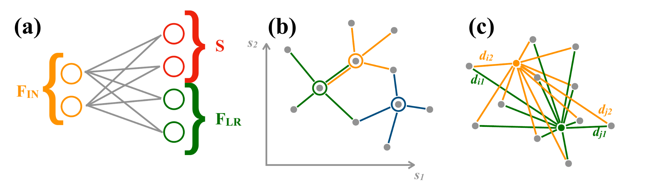
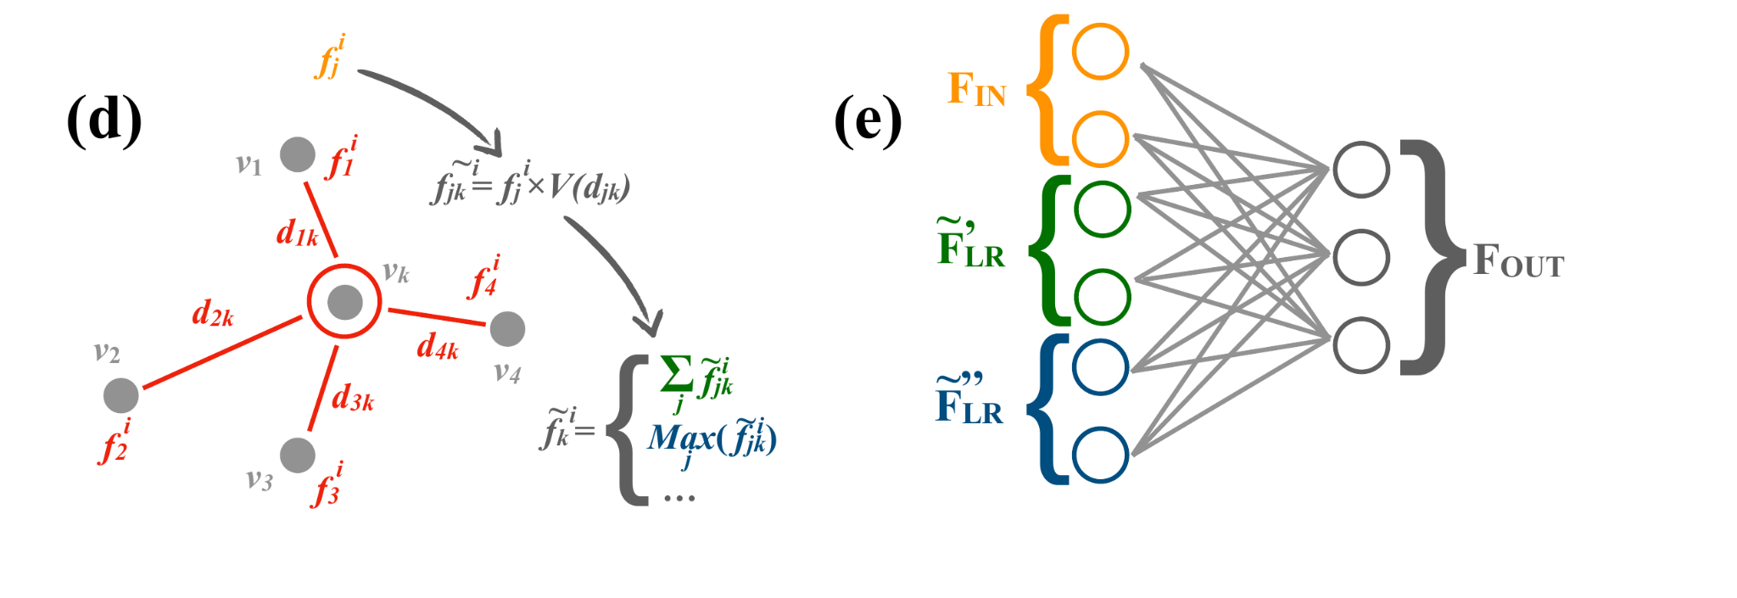
GNN: Gravnet

Slide 10
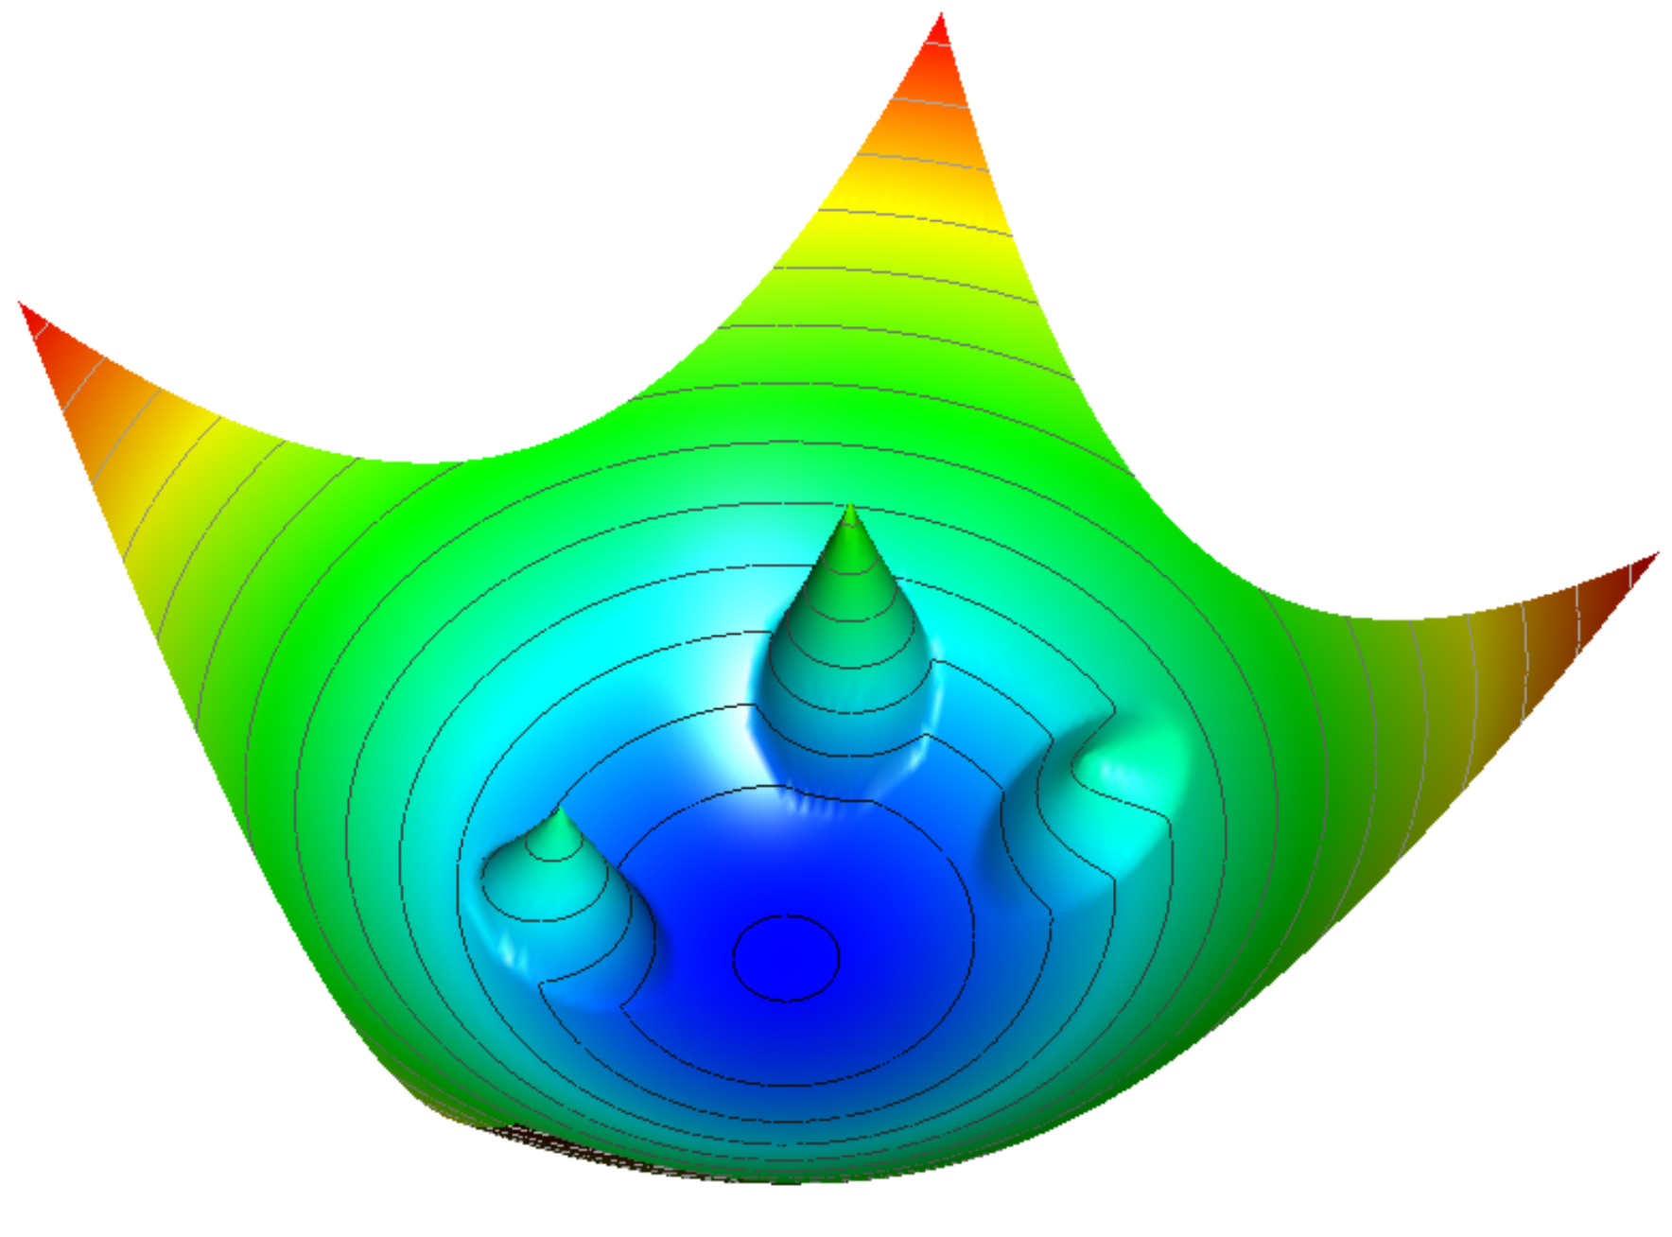
GNN: Object Condensation
Hit → (seed score beta, condensation-space coordinate)
Beta control = high beta on seeds + low beta on non-seeds
Seed charge = increasing function of beta + minimum charge
Attraction = Σ(hit charge × own-seed charge × distance to own seed²) / number of hits
Repulsion = Σ(hit charge × other-seed charge × penalty if too close) / number of hits
Potential = Attraction + Repulsion
OC loss = Potential + Beta control
Note: Annex with detailed formulas available

Slide 11
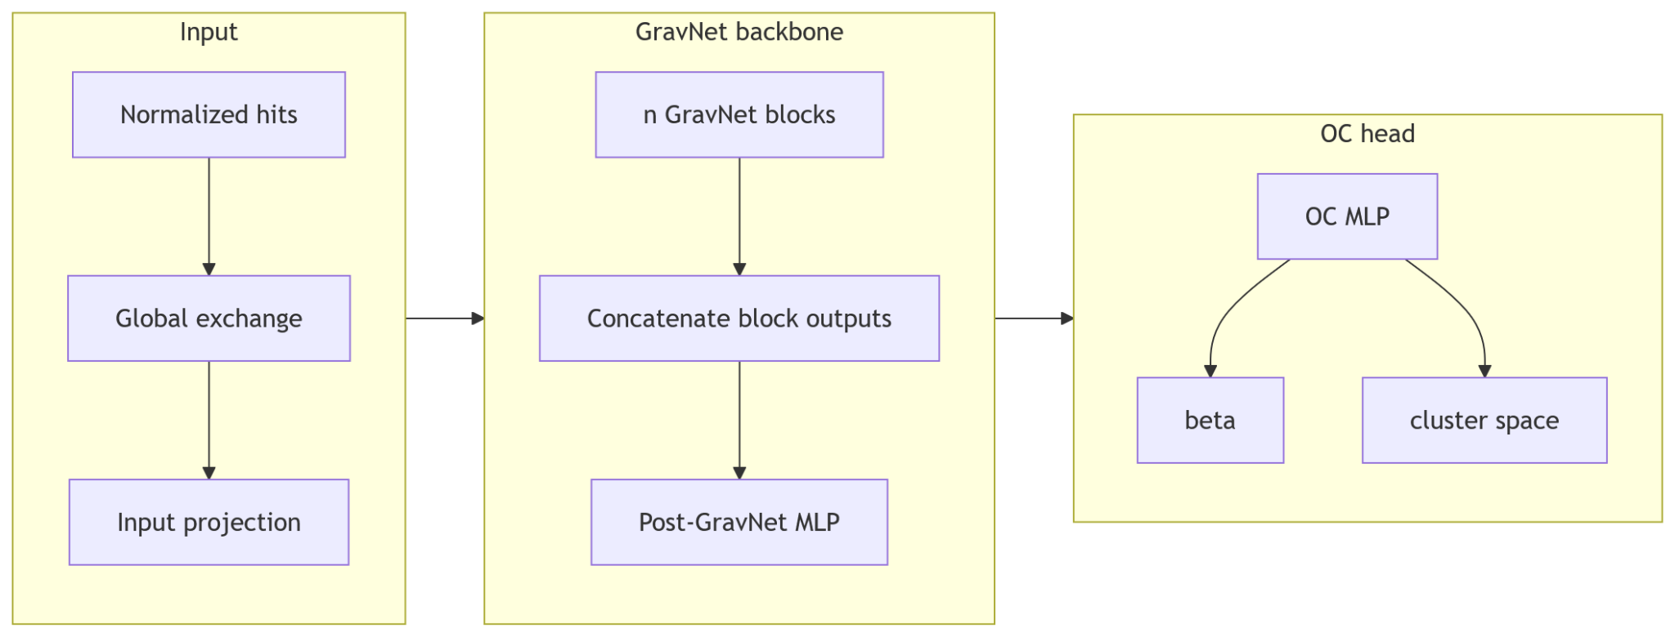
GNN: Pipeline

Slide 12
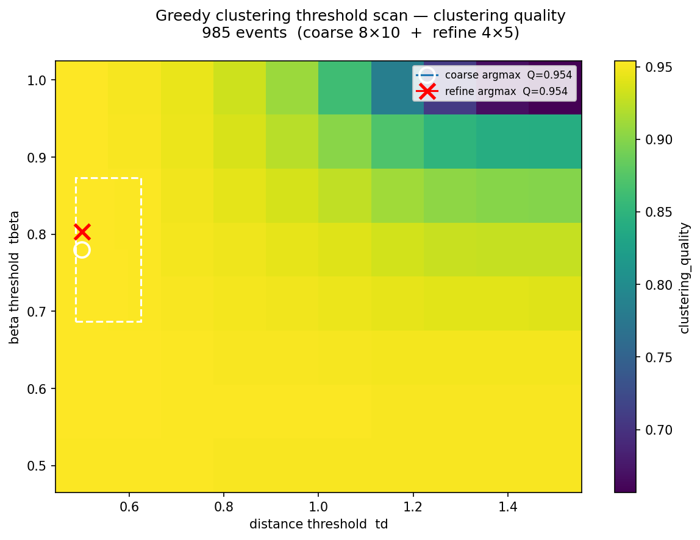
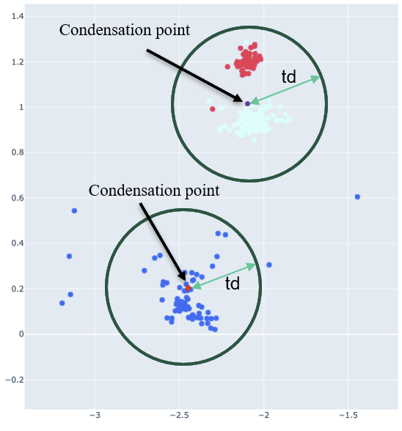
Greedy Clustering

Slide 13
Metrics: OCQuality, ClusteringQuality, EnergyQuality
SeedQuality = sqrt(MeanSeedBeta × (1 - MeanNonSeedBeta))
SpaceQuality = SeedSeparation / (SeedSeparation + HitCompactness + ε)
OCQuality = sqrt(SeedQuality × SpaceQuality)
Efficiency = RecoveredTrueEnergy / TotalTrueEnergy
Purity = CorrectEnergyInMatchedClusters / TotalEnergyInMatchedClusters
ConfusionQuality = sqrt((1 - ChargedToNeutralConfusion) × (1 - NeutralToChargedConfusion))
ClusteringQuality = Efficiency^{0.40} × Purity^{0.40} × ConfusionQuality^{0.20}
RelativeEnergyRMSE = sqrt(mean(((PredictedEnergy - TrueEnergy) / max(TrueEnergy, ε))²))
AbsoluteEnergyRMSE = sqrt(mean((PredictedEnergy - TrueEnergy)²))
Note: Annex with detailed formulas available
Notes:
- Metric design: decide what to optimize, what to monitor, and what to report.
- OCQuality: fast diagnostic before expensive clustering.
- OCQuality components: seed quality, compact same-particle groups, separated
different-particle groups.
- ClusteringQuality: main physics-facing clustering score.
- Efficiency: recovered true-particle energy.
- Purity: cleanliness of matched reconstructed clusters.
- Confusion: charged energy assigned to neutral clusters, and neutral energy
assigned to charged clusters.
- EnergyQuality: relative and absolute RMSE for the later regression extension.
- Boundary: clustering claim uses clustering metrics; energy metrics belong to
the exploratory energy slides.

Slide 14
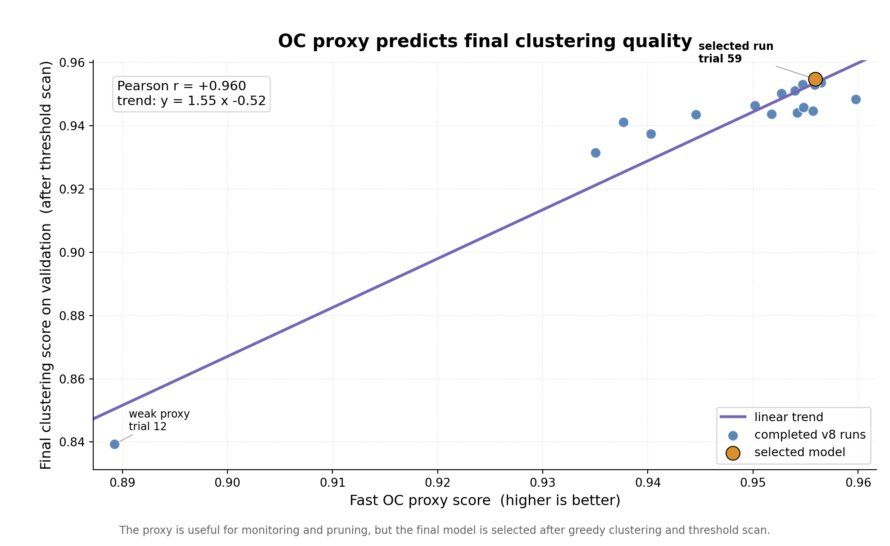
Proxy Metrics

Slide 15
Bayesian Hyperparameters Tuning
Sweep | GPU* time | Data | Main swept axes | Best result | Conclusion
v1 | ~308h | tau | OC loss modes, qmin, LR, restart period | oc_quality 0.9475 | Pipeline becomes trainable
v2 | ~281h | tau | More conservative OC/loss search, OC dim, LR, weight decay | oc_quality 0.9326 | Confirms stability
v4 | ~4,034h | nnqq | OC dim, LR, weight decay, qmin, beta stabilization, OC loss modes | clustering_quality 0.8993 | First useful dense-event result
v7 | ~5,578h | nnqq | GravNet blocks, k for knn, space/propagate dims, post layers, OC head | clustering_quality 0.9456 | Main architecture jump; better geometry and seed selection
v8 | ~10,912h | nnqq | Refined v7 basin: blocks, k for knn, compression, post dim, OC dim, beta/track/background coefficients | clustering_quality 0.9531 | Final selected model
*Note: A100-40GB-equivalent order of magnitude

Slide 16
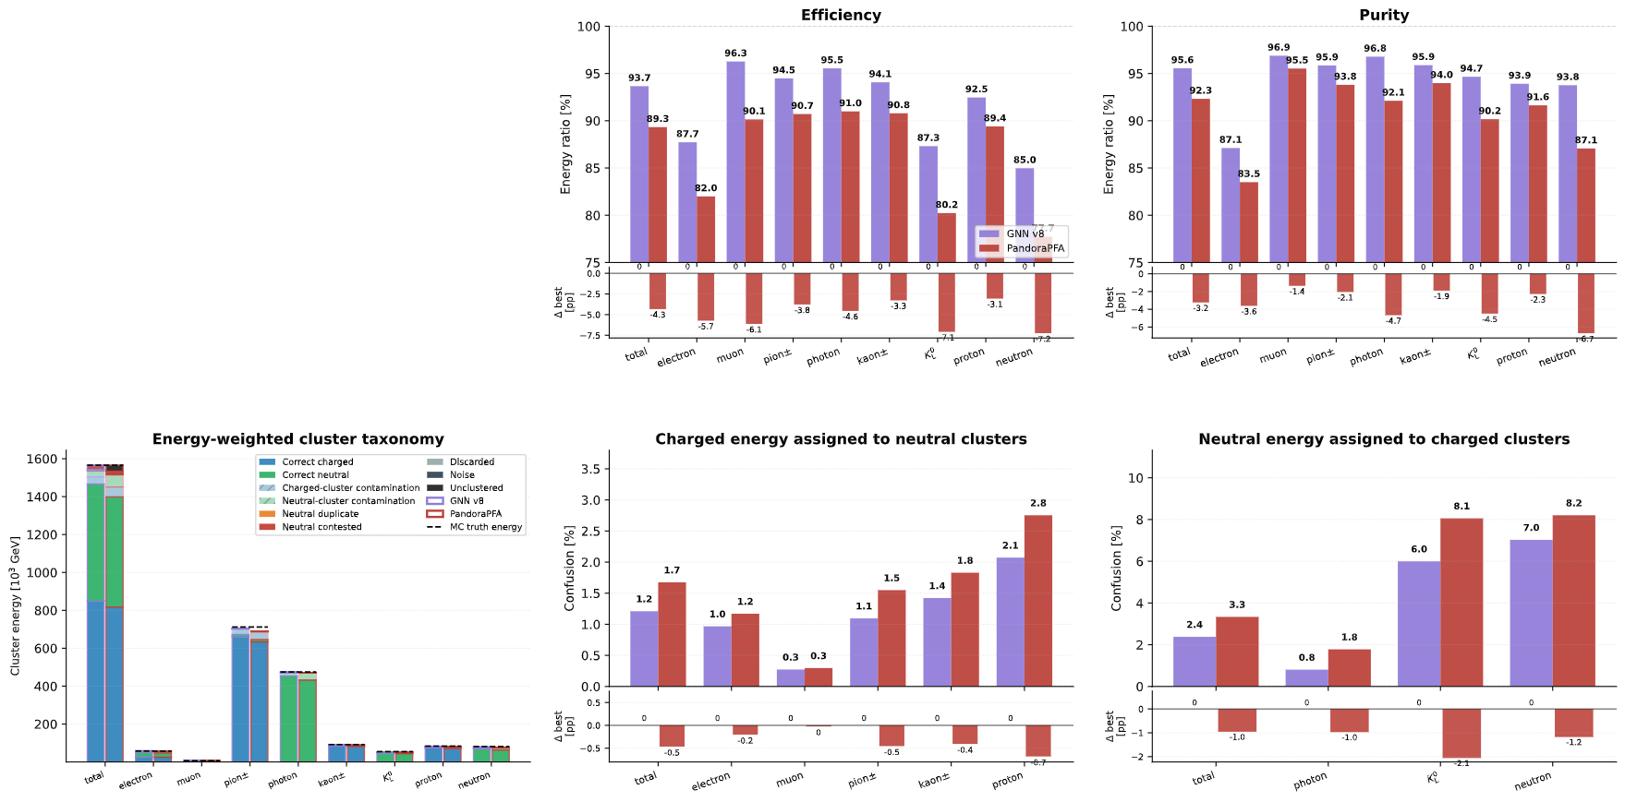
Main Result on nnqq dataset
Clustering Quality
GNN v8: 0.95309
PandoraPFA: 0.92109
Note: Annex with detailed sweep analysis available

Slide 17
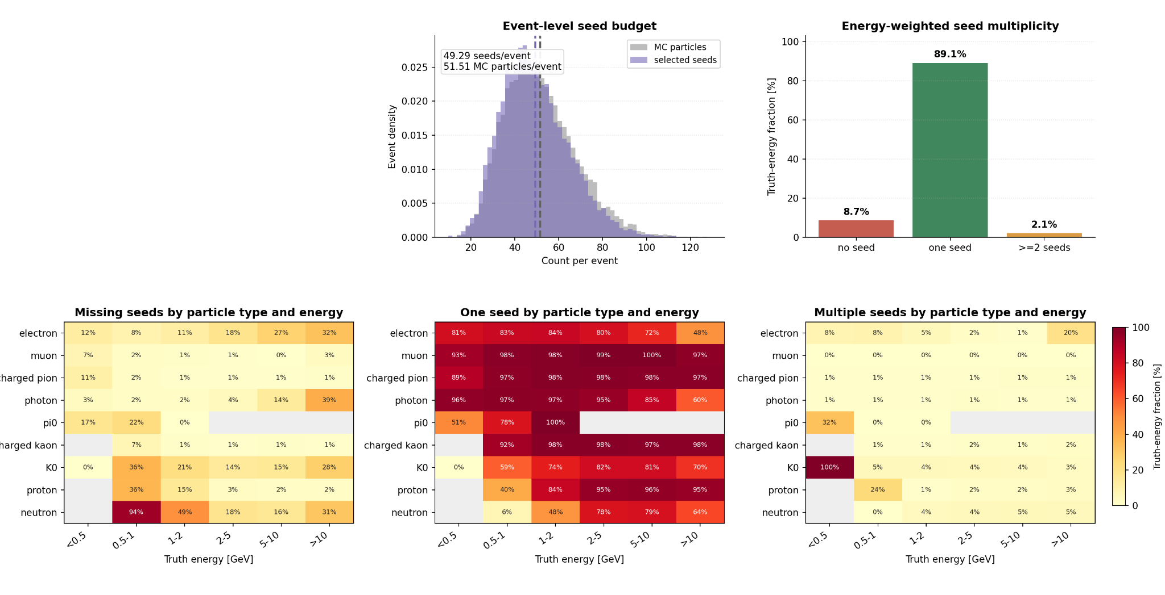
Seeding
Note: Seed analysis on the nnqq test dataset for GNN v8

Slide 18
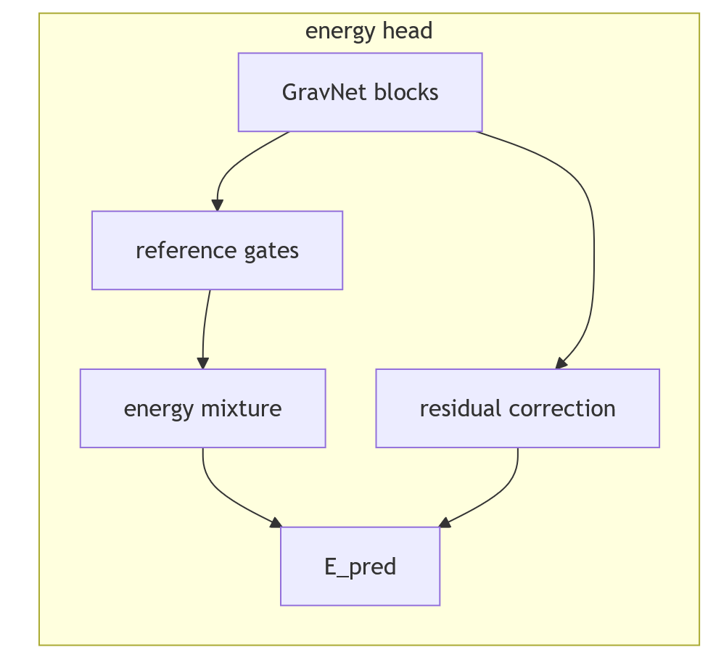
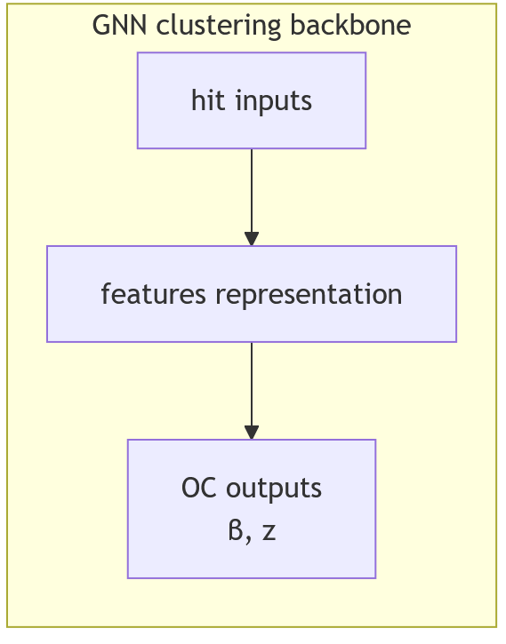
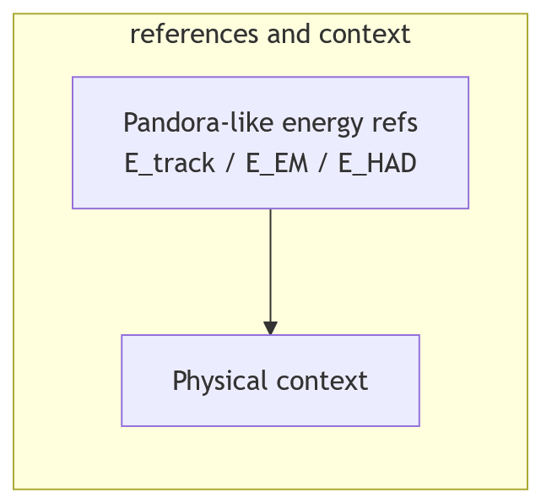
GNN Energy Regression Extension

Slide 19
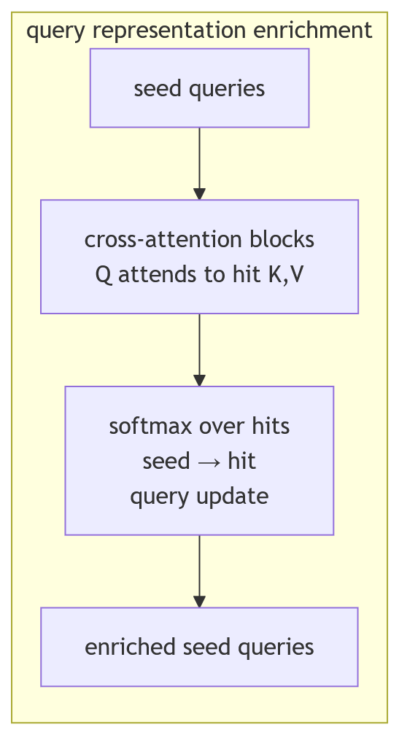
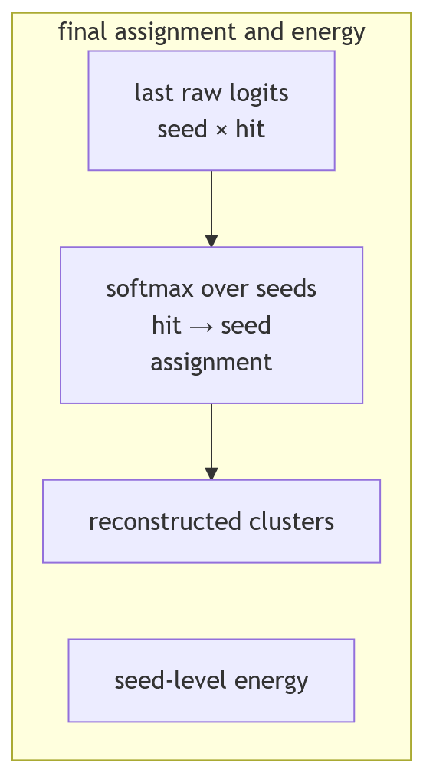
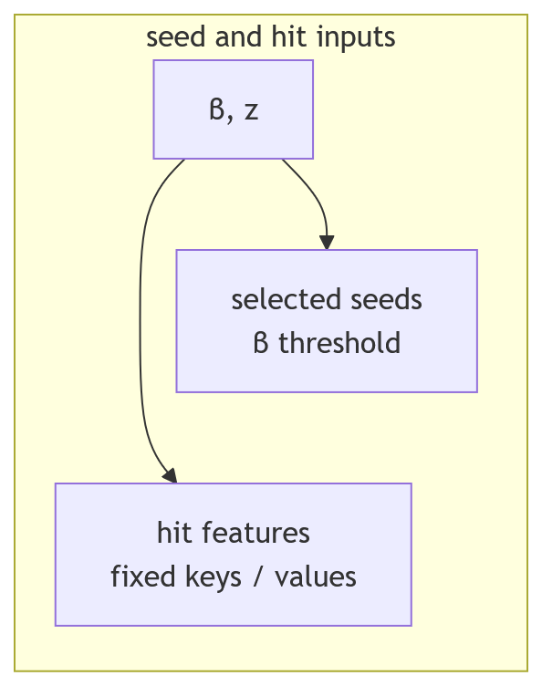
Cross-Attention Clustering (CAC) and Energy Regression

Slide 20
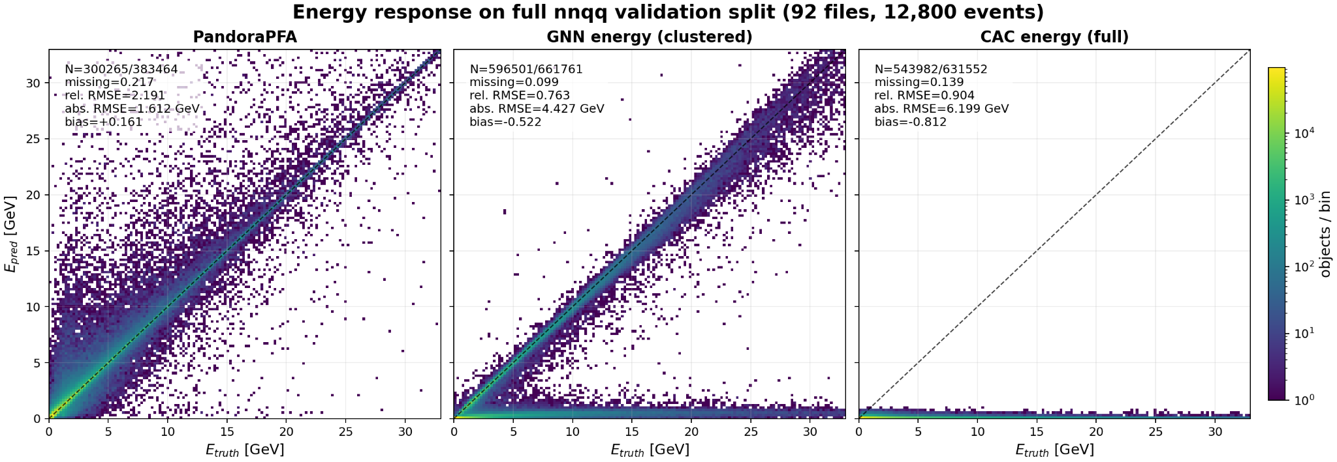
Energy Regression Preliminary Results

Slide 21
Conclusion and Perspectives
Contributions
End-to-end GNN + Object Condensation clustering pipeline.
Metrics, threshold scans, and interactive event review.
Robust sweeps with restart, pruning, logs, and Pandora comparison.
Results
Full nnqq test: clustering quality 0.9531 vs 0.9211 for PandoraPFA.
Higher efficiency and purity, lower charged-neutral confusion.
Energy and CAC chains validated technically, but still preliminary.
Perspectives
Finish energy comparison and seed-variance checks.
Couple seed selection with CAC-style assignment.
Move from particle-level diagnostics to jet-energy resolution.

Slide 22
Annex Object Condensation
Symbol | Meaning
𝑖 | hit index
𝑏 | event index
𝑘,ℓ | truth object / particle indices inside one event
𝐻_{𝑏} | hits in event 𝑏
𝐻_{𝑘} | valid hits belonging to object 𝑘
𝑂_{𝑏} | valid truth objects in event 𝑏
𝑁_{𝑏} | number of hits in event 𝑏
𝐾_{𝑏} | number of valid objects in event 𝑏
𝛽_{𝑖} | seed score predicted for hit 𝑖
𝑧_{𝑖} | Object Condensation coordinate of hit 𝑖
𝑞_{𝑖} | condensation charge derived from 𝛽𝑖
𝛼_{𝑘} | selected condensation point for object 𝑘
𝑒⁡(𝑖) | event containing hit 𝑖
𝑡⁡(𝑖) | truth object of hit 𝑖 if it is not noise

Slide 23
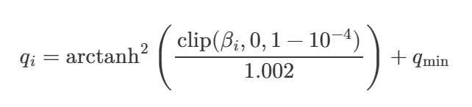
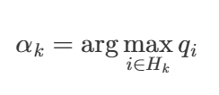

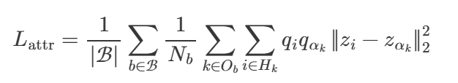
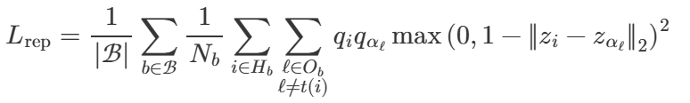

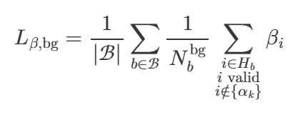
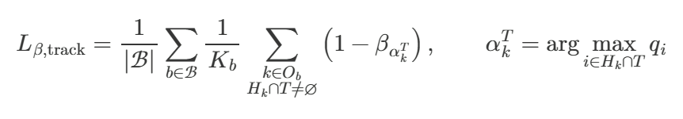

Annex Object Condensation

Slide 24
Annex Metrics
Symbol | Meaning
ℎ | one detector hit
𝐸_{dep⁡}(ℎ) | energy deposited by hit ℎ
𝑃 | one Monte Carlo truth particle
𝐶 | one reconstructed cluster
𝐻⁡(𝑃),𝐻⁡(𝐶) | hits belonging to truth particle 𝑃 or cluster 𝐶
𝐶∗⁡(𝑃) | representative reconstructed cluster matched to truth particle 𝑃
P | set of truth particles
C, C_{match} | set of kept reconstructed clusters, clusters matched to a truth particle
𝛽_{𝑖} | Object Condensation seed score for hit 𝑖
𝑧_{𝑖} | learned Object Condensation coordinates for hit 𝑖
𝛼⁡(𝑖) | truth seed hit associated with hit 𝑖's truth particle
𝐷 | dimension of the learned clustering space

Slide 25
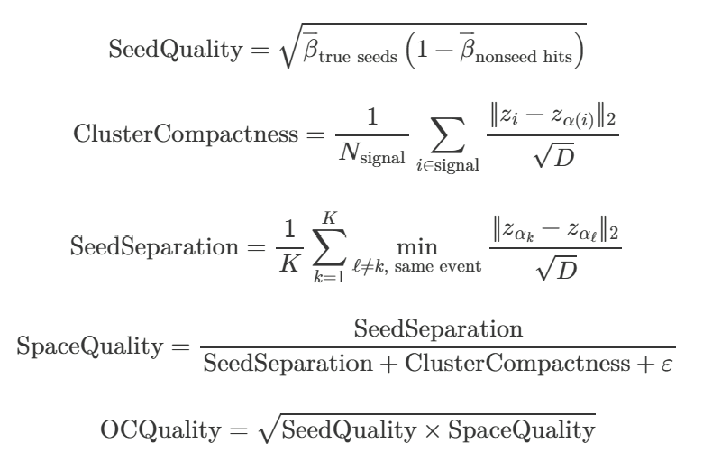
Annex Metrics

Slide 26
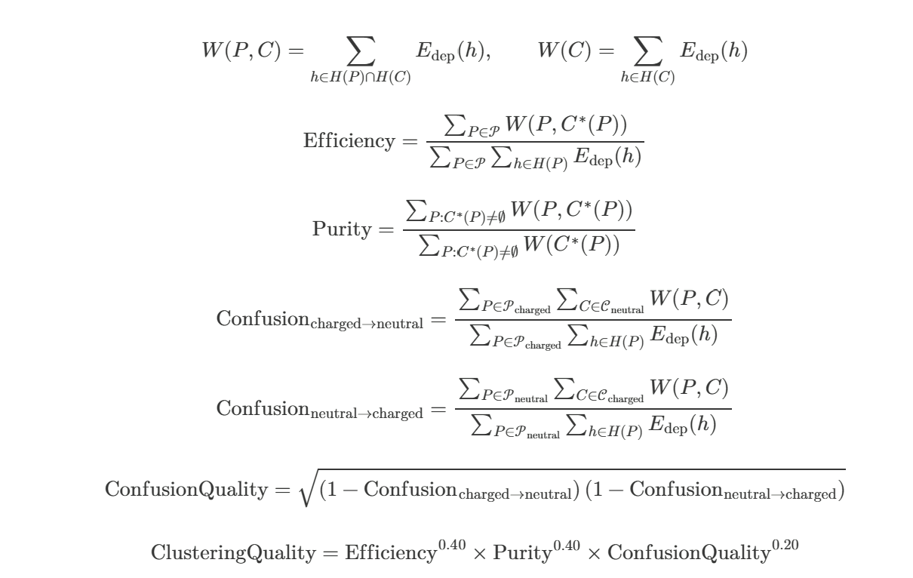
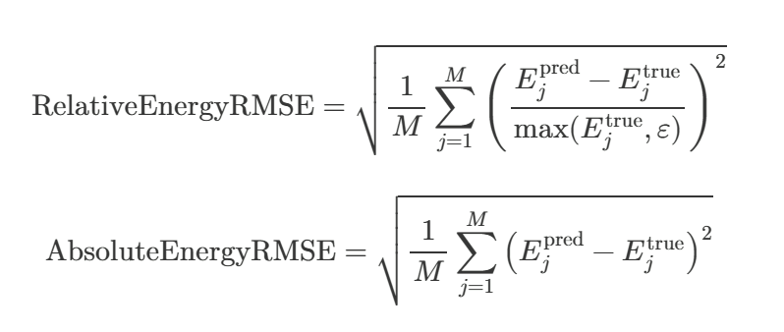
Annex Metrics

Slide 27
Annex Sweep
Family | Hyperparameters | Viable* values / range | Practical reading
Input | energy mode, projection | edep dominant; mip_response possible; projection 96 - 160 | edep safest; capacity is flexible.
GravNet depth | num_blocks | 6-8 | Useful, not monotonic.
GravNet graph | k, space_dim, propagate_dim | k 32 - 96; space_dim 6 - 8; propagate_dim 48 - 64 | Dense events need larger neighbourhoods.
GravNet output | compression, post hidden, post layers | compression 32 - 96; hidden 128 - 192; layers 4 - 6 | Moderate width is enough.
OC head | MLP depth, clustering-space dim | 4 - 6 layers; D_z 9 - 14 | Flexible after a strong backbone.
OC beta scale | qmin, beta.coef | qmin 0.1364 - 0.2368 beta coef 0.608 - 1.130 | Broad stable basin.
OC seed control | background suppression, track seed, compactness | background 0.5 - 2.0; track 0.25/0.5/1.0; compactness 0.75 - 1.5 | Seed control is critical.
Optimisation | learning_rate.max, weight_decay | LR 1.52 ⋅10⁻⁴ - 6.40 ⋅10⁻⁴ WD 1.63 ⋅10⁻⁴ - 8.89 ⋅10⁻⁴ | Avoid extreme LR.
*Note: values observed nnqq sweep that reached validation clustering_quality >= 0.94

Slide 28
Annex Sweep
Family | Field | Exact value
Data | dataset | nnqq
Inputs | enabled features | position, deposited energy, detector type, time-of-flight
Inputs | energy mode, normalization, global exchange | edep, batchnorm, mean/min/max
Input projection | input_projection_dim | 160
GravNet | blocks, k, space_dim, propagate_dim | 7, 96, 6, 64
GravNet | output dim, compression, post hidden | 128, 96, 128
GravNet / post MLP | normalization and activations | GravNet batchnorm + tanh; post MLP batchnorm + relu
Post-GravNet | layers, hidden dim | 5, 128
OC head | layers, hidden dim, output dim | 4, 64, D_{z}=10
Physics branch | status | disabled for the clustering model

Slide 29
Annex Sweep
Family | Field | Exact value
Training | epochs, batch size, early stopping | 500, 48, patience 60
Optimisation | max LR, min LR ratio, weight decay | 3.9829 ⋅10⁻⁴; 10⁻⁴: 8.2405 ⋅10⁻⁴
Optimisation | dropout, gradient clip | 0.0, 1.0
OC loss | global coefficient, potential coefficient | 1.0, 1.0
OC potential | attractive, repulsive | paper, paper
OC beta | coefficient, epoch start, qmin | 0.782359, 6, 0.167863
OC beta | stabilization, forced track point | soft_q_scaling, true
OC seed | mode, kernel, compactness, log-beta | positive_short_range, 20.0, 1.0, 0.2
OC seed control | background suppression, track seed | 2.0, 0.5 from epoch 6
Scheduler | cyclic restarts | cosineReduce, period 30, t_mult=1.1, decay 0.7

