Slide 1

ILC physics & software meeting
2026/7/13
Kanako Watanabe
Iwate University
Notes:
Good morning everyone.
I’m Kanako Watanabe, from Iwate University.
Today, I’d like to talk about my study on Evaluation of hit point distortion due to beamstrahlung in the ILD-TPC using a new 3-d code.
This work is part of our effort to understand the background and performance of the TPC at the International Linear Collider, or ILC.
今日は、ILD-TPCにおけるイオンバックフローと空間電荷効果の研究についてお話しします。
この研究は、国際リニアコライダー（ILC）のTPC性能やバックグラウンドを理解するための一部です。

Slide 2
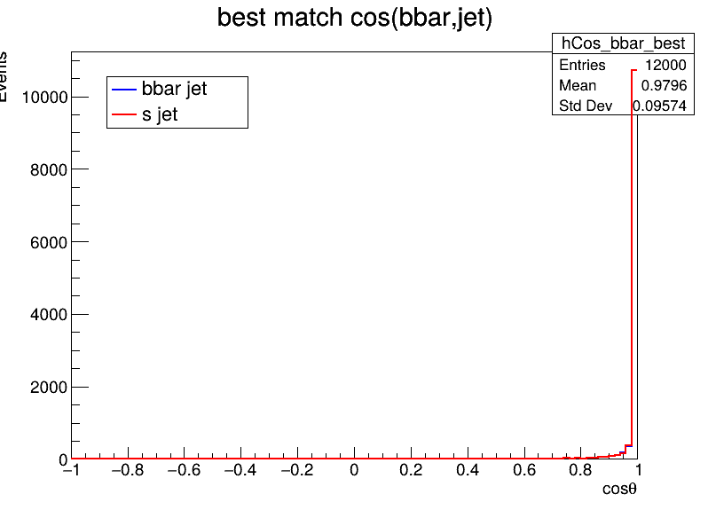
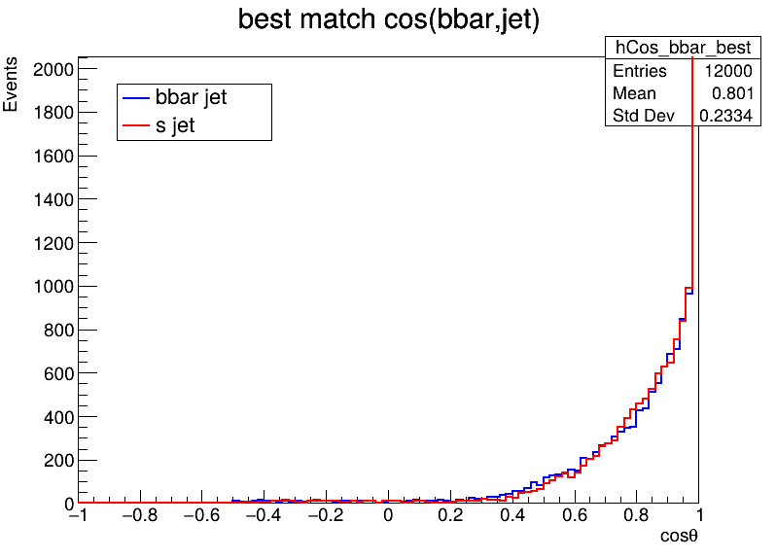
Jet pairing
H->bs/Z->νν
H->bs/Z->μμ
Z -> νν is pretty much in the same direction.
I just set the Z decay destination for WHIZARD to e2e2 (μμ).
➡ The distribution has widened.
➡ I hadn't excluded Isolep…. I'll exclude it and try again.
(And check with junping to make sure the μμ event is set up correctly)

Slide 3
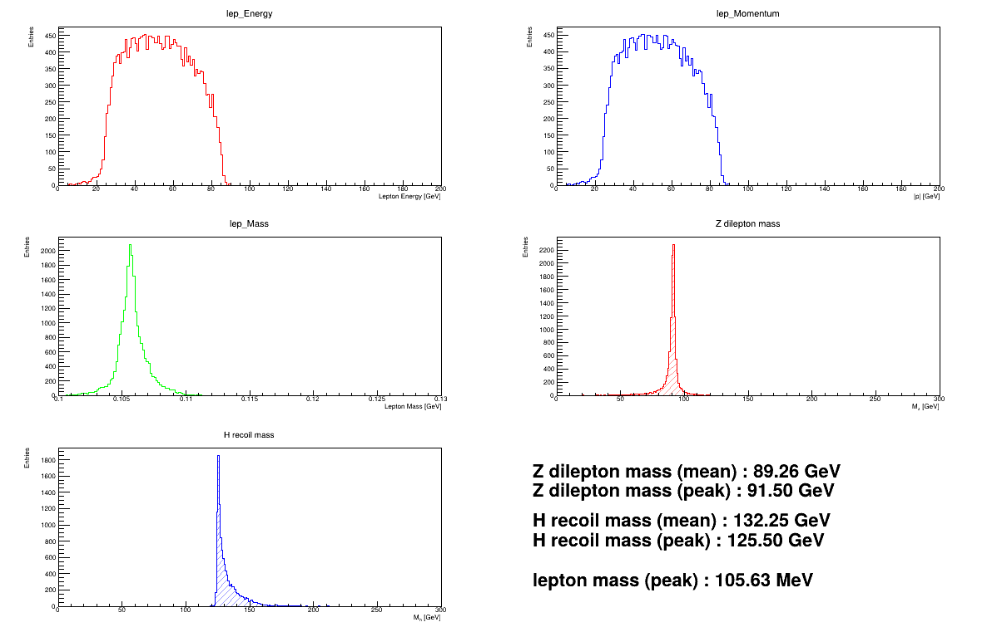
Check : dilepton mass
Z->μμ
Dilepton mass
Recoil mass
Z->νν
Dilepton mass
is 0.

