Slide 1

ILC physics & software meeting
2026/7/27
Kanako Watanabe
Iwate University
Notes:
Good morning everyone.
I’m Kanako Watanabe, from Iwate University.
Today, I’d like to talk about my study on Evaluation of hit point distortion due to beamstrahlung in the ILD-TPC using a new 3-d code.
This work is part of our effort to understand the background and performance of the TPC at the International Linear Collider, or ILC.
今日は、ILD-TPCにおけるイオンバックフローと空間電荷効果の研究についてお話しします。
この研究は、国際リニアコライダー（ILC）のTPC性能やバックグラウンドを理解するための一部です。

Slide 2
Jet Clustering method
How is the jet reconstructed?
➡ Determine the jet core → Combine the components
How is the jet axis determined?
➡ Take the momentum of the particles that make up the jet and sum them

Slide 3
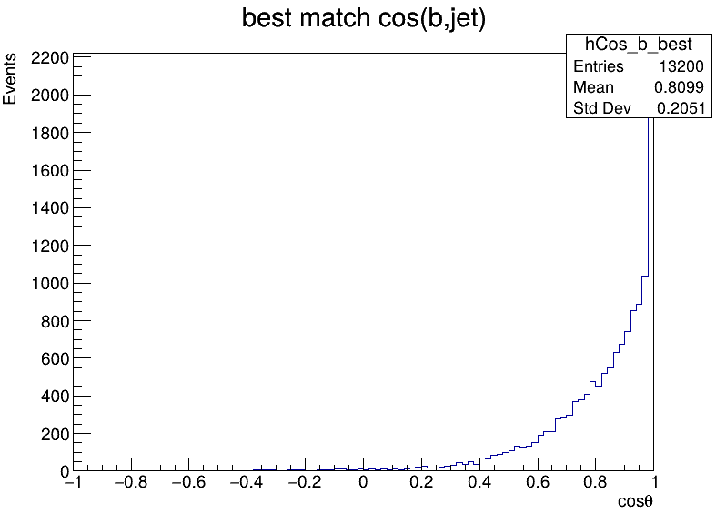
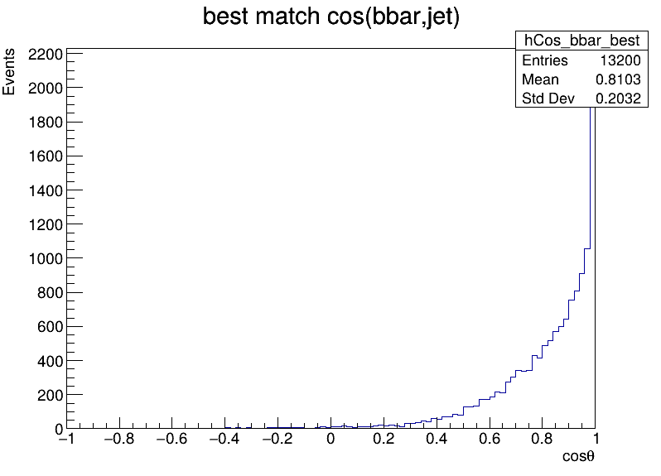
My strategy for jet pairing
Get b_px, b_py, b_pz, bbar_px, bbar_py, bbar_pz (truth quark)
Get px1,py1,pz1, px2, py2, pz2 (reconstructed jet)
Check at the Jet's vector and the quark's vector, and match those that are pointing in similar directions.
  Compare cos(Jet0-b)+ cos(jet1-bbar) & cos(Jet1-b)+ cos(jet0-bbar)
  ➡ Select the combination with the highest value
  Cosθ＝1 Same
  Cosθ=-1 Opposite
  It's mostly 1,
  but some is near 0.
Isn‘t it possible that one jet matches “truth q,” while the other is completely different? ➡

Slide 4
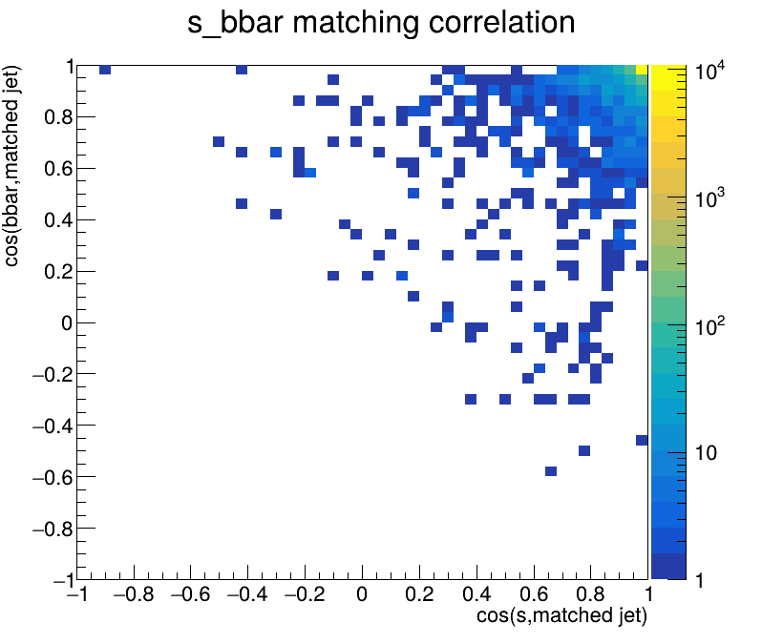
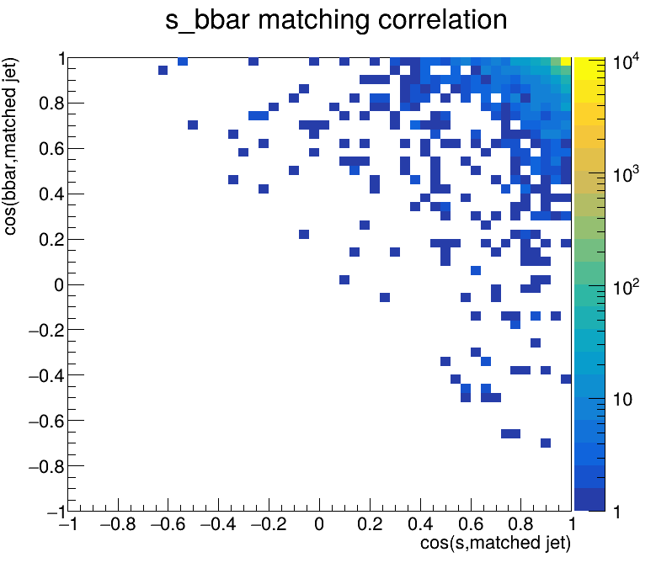
Jet pairing
H->bs/Z->νν
H->bs/Z->μμ
The directions of both jets coincide with their respective quark directions.
While there are a few cases where only one jet shows a high match rate with the quark (and the other shows a low match rate), no differences attributable to variations in Z decays are apparent.

Slide 5
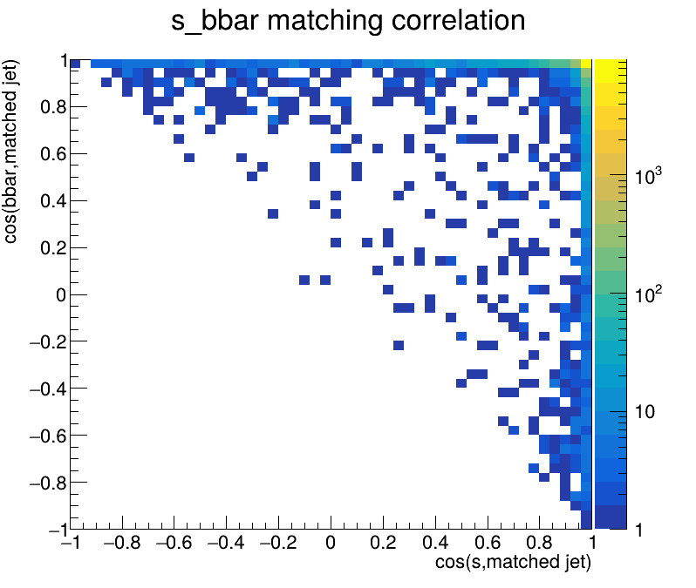
Jet-truth quark matching (H->bs/Z->μμ)
Motivation
: ensure that the cut conditions are consistent when analyzing the data in conjunction with BG dataset.
UseBeamJet =0
(in JetClusteringAndFlavortag processor)
UseBeamJet =1
(in JetClusteringAndFlavortag processor)
jet
Beam
・Pile-up refers to beam-induced effects that could be classified as BG.
・When performing jet clustering, “Usebeamjet” parameter determines whether the jet axis lies on the beam axis side.
There were more events in which only one jet had a high match rate with a quark (the other jet was pointing in almost the opposite direction)
I accidentally used the “Usebeamjet” setting for this event even though I hadn't applied an overlay.
➡ It's possible that objects close to the beam axis were deleted, and those with a value of -1 were interpreted as two objects when there was actually only one remaining.
➡ I'll consult with Daniel about how to configure the overlay settings.
JetClustering’s parameter
UseBeamJet =0 … include pile-up
UseBeamJet =1 … Reduce pile-up

Slide 6
Jet-truth quark matching (H->bs/Z->μμ)
If you want to check the accuracy of the flavor tag,
f.e.) ・ just the range where the sum of cos > 1.6.
To what extent are events removed?
H->bs
========================
Total events : 12000
Score >= 1.4 : 11768
Efficiency 1.4 : 98.0667 %
Score >= 1.6 : 11606
Efficiency 1.6 : 96.7167 %
Score >= 1.8 : 11332
Efficiency 1.8 : 94.4333 %
========================
← H->bs
: No overlay
H->bb
========================
Total events : 13200
Score >= 1.4 : 12942
Efficiency 1.4 : 98.0455 %
Score >= 1.6 : 12791
Efficiency 1.6 : 96.9015 %
Score >= 1.8 : 12406
Efficiency 1.8 : 93.9848 %
========================
H->ss
========================
Total events : 15200
Score >= 1.4 : 13625
Efficiency 1.4 : 89.6382 %
Score >= 1.6 : 10699
Efficiency 1.6 : 70.3882 %
Score >= 1.8 : 4280
Efficiency 1.8 : 28.1579 %
========================
Check the distribution
& the overlay status of the data used as bb/ss

Slide 7
Next
Check at the correspondence the number of K in each Jets.
I'll consult with Daniel about how to configure the overlay settings.
Why is the directional match rate for s s lower than that for jet?
  Check the distribution
  Check the overlay status of the data used as bb/ss

Slide 8
Backup

Slide 9
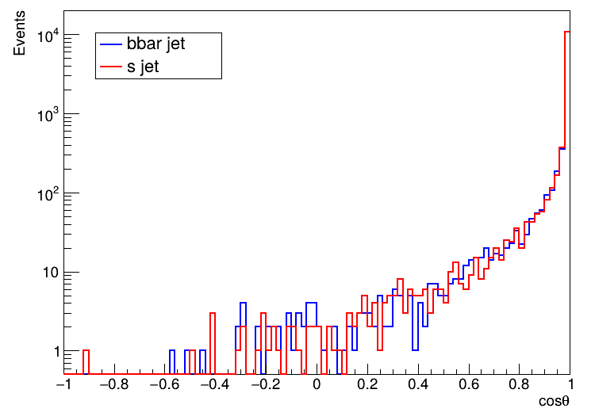
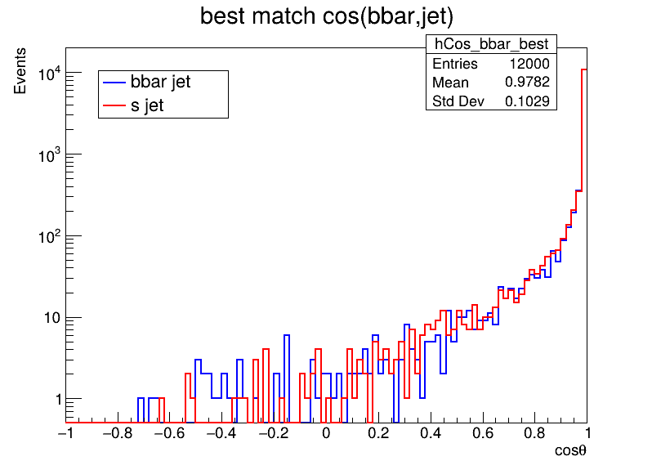
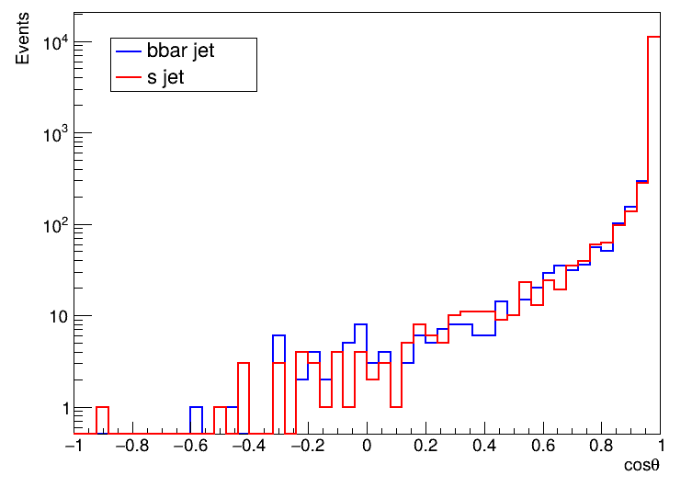
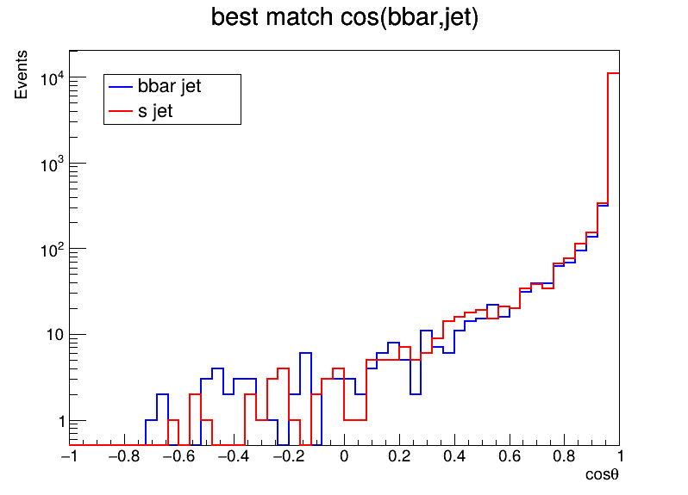
Jet pairing
H->bs/Z->νν
H->bs/Z->μμ
When plotted on a log scale, events where cosθ ≳0 also become visible (about 1%).
Events where cosθ＜1 account for about 10–20%.
Θ≈25° Cosθ=0.9
Θ≈37° Cosθ=0.8
Number of bin
: 100
Number of bin
: 50

