Slide 1
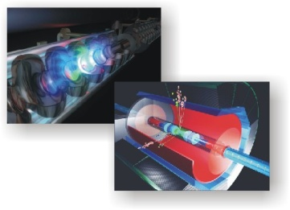
Dual Read out Calorimeter in SLIC
July 24th 2007
Status of cherenkov Calorimeter in SLIC
SLIC installation on ILCSIM, how to run it
lcioframe/Calohit/root installation on ILCSIM
Available data sets on ILCSIM
to be done

Slide 2
Lead Glass Dual read out Calorimeter in SLIC
(Simulator for the Linear Collider)
Lead Glass Calorimeter with dual read out
  Good EM Calorimeter
  hadronic interactions: Dual readout to correct for energy lost in nuclear break ups. Achieve good energy resolution for hadrons. (similar to dream)
  Longitudinal and transverse segmentation (PFA).
Decided to put it into SLIC to become familiar with the framework → Benefits: event display, event browser, Visualization of geometry, xml geometry description, LCIO output.

Slide 3
Lead Glass Dual read out Calorimeter in SLIC
Adding to SLIC required:
  Adding optical physics processes.
  Adding optical material properties (refraction index) → new version of gdml/fix bug in gdml. (thanks to Witold Pokorski)
  Create LCDD detector description.
  Create new detector (SD) sensitive to Cerenkov light. (photons need special treatment)
  Add LCIO output, Root output.
  LCIO to Root converter.
Thanks to Jeremy all this is now part of SLIC/SIMDIST!! (all but one file)

Slide 4
Installation available on ILCSIM
/grid/app/CherSimDist_current
Setup the environment:
source setup.sh (or source setup.csh for csh)
Calohit: lcioframe (lcio to root converter, root calohit/event classes, example scripts to access the .root files)
example: example .lcdd detector descriptions and .mac macros
root: Root installation compatible with Calohit
scripts: scripts for batch processing (condor), grid will follow subito
SimDist: slic,lcdd,lcio,geant4,lcphys, bdsim, gdml, mokka, xerces,clhep
tmp: temporary files

Slide 5
Available data sets on ILCSIM
Various single particle files of different energies in lcio and root format
/ilc/detector/chercal/SLIC/

Slide 6
Data flow
STDHEP
SLIC
Macro: .mac
geometry description: .lcdd
LCIO: .slcio
HEPREP
lcioframe
lcioframe.steer
.root

Slide 7
Geometry description
Lcdd: consisting of gdml and extensions for sensitive Detectors and readout
GeomConverter
Compact.xml

Slide 8
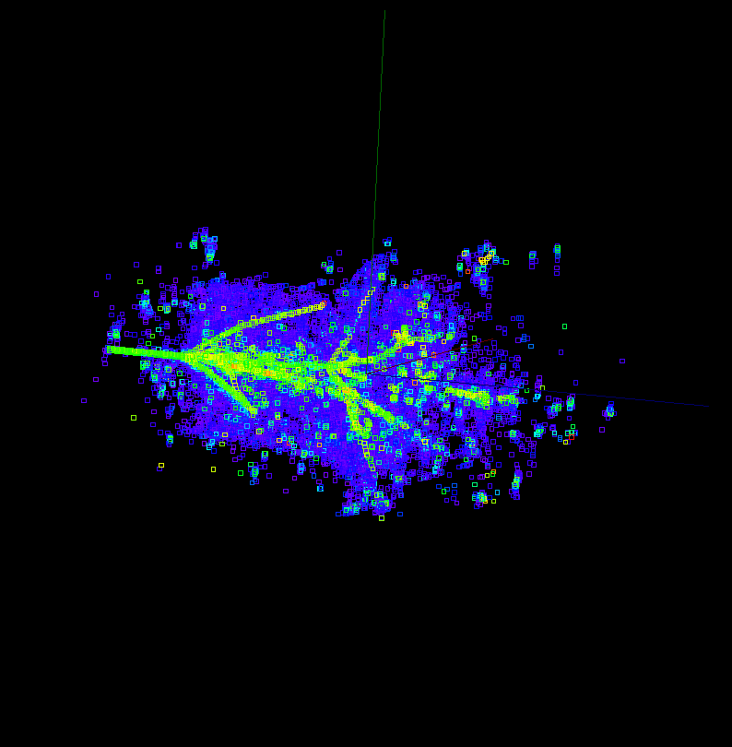
20 GeV Pion Cereenkov and Scintilator

Slide 9
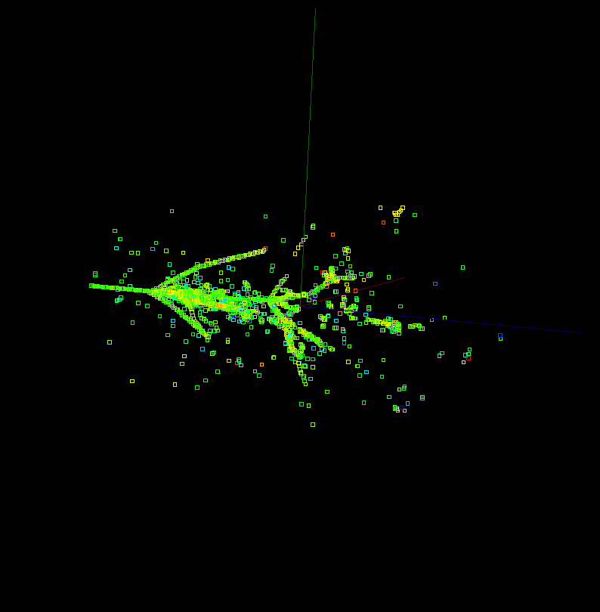
20 Gev Pion in Scintilator

Slide 10
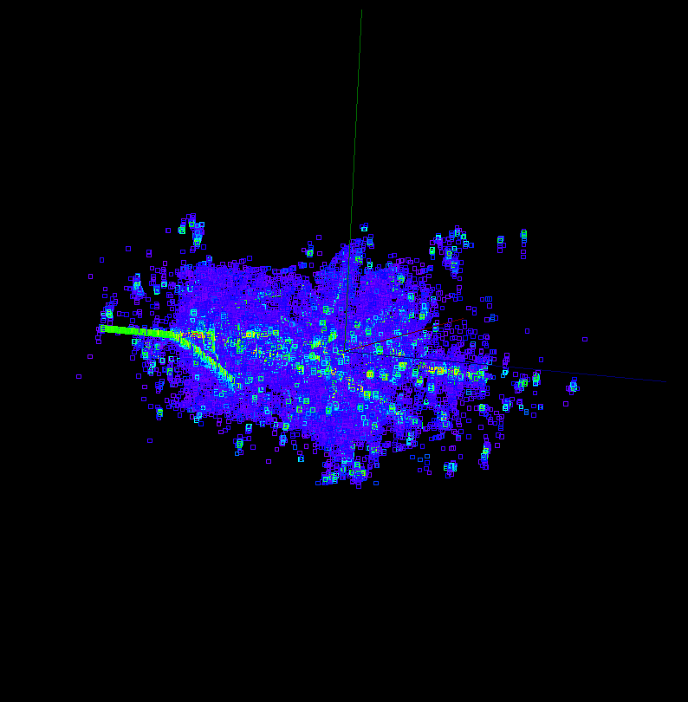
20 GeV Pion in Cerenkov

Slide 11
To be done
Compact description (currently lcdd)
Having more than one sensitive detector per sensitive volume.
Check that things make sense!

Slide 12
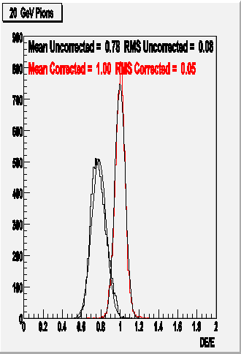

Slide 13
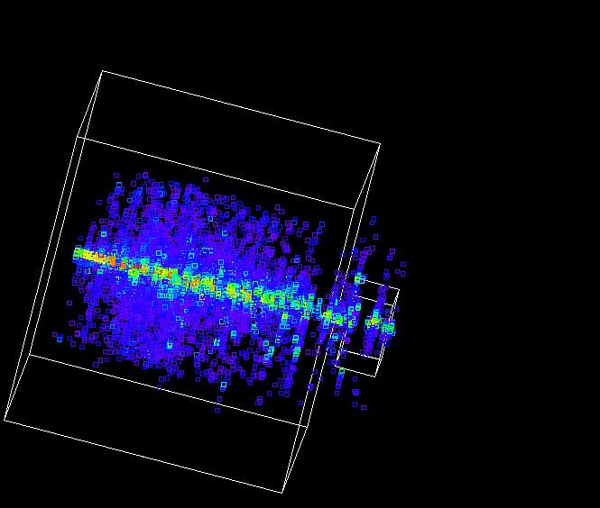
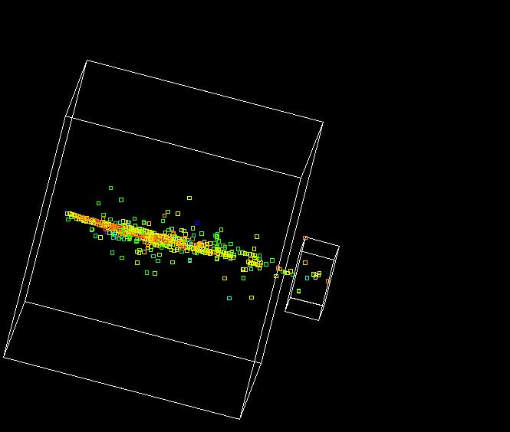
Dual read out Calorimeter
Cerenkov (em component)
Ld Glass
Alternating layers of lead glass and scintilator
read out segmentation 1 cm²
e⁻ 5GeV
Ionization (scintillator)
Two Components

