Slide 1
ATF2 Flight Simulator –
A Resource For Efficient International Participation
Glen White
SLAC
Nov. 27 2007

Slide 2
Overview
I think my ideas on what the “flight simulator” concept should be is not compatible with the current plans for the ATF2 control system. I would first like to discuss this more abstract concept.
  This talk concerns “high-level” controls
    Access to database values containing e.g. BPM readings
    Access to database values controlling e.g. orbit correctors.
  Examination of proposed implementation of high-level controls.
A Flight Simulator for ATF2
  What can this be?
  How will this help?
Lucretia.

Slide 3
Planned ATF Controls Support
ATF – Local Client (atfmenu Controls)
All Software Implemented Here
V_{ACCESS}
IOC
IOC
IOC
IOC
Existing local IOC’s- CAMAC, PLC’s, EPICS
New supplied sub-systems (EPICS) (QBPMs, Magnet Movers, HAPS)

Slide 4
International Contributions to Writing Tuning Algorithms?
Simulation design work exists (and will hopefully continue) on algorithm design for, e.g.
  Commissioning and BBA (Ring and EXT+FFS).
  FFS tuning knobs to reach design IP beam size.
  Diagnostics.
  Feedback.
  …
We would like to contribute to the writing and implementation of beam tuning algorithms. What is going to be the infrastructure for allowing this to happen?

Slide 5
Current Plans?
Existing plans (as I understand them)
  Tuning algorithms developed by team led by Kuroda-san.
    Completely in-house, or will a coordinated working group be set up here?
  These algorithms are then written into the control system by outside contractors supervised by Terunuma-san. They connect to hardware using ATF database access libraries through V-System layers.
What is the interface between user-developed algorithms (given to or co-developed with Kuroda-san group) and hardware access layers developed by Terunuma-san led group? How is this managed?

Slide 6
Some Personal Comments
I would call this a ‘closed’ control-system
  This way of doing things is very appropriate for ‘production’ machines: PEP, KEKB…
  Means very good control over machine state, maximizes reliability and ‘up-time’
ATF2 -> the T is for “TEST”
  Purpose of this machine is to learn how to tune ILC-like optics to give very small spot size
  Unknown how best to do this
  Will require constant algorithmic changes as we attempt to find newer and cleverer ways of doing things.
  Very difficult if no simple way to write control-interfaces and have to go through non-expert contractors (via Terunuma-san) every time a change or debugging required.
I would urge us to adopt a more ‘open’ approach to the high-level control interface.
  With proper planning this can be achieved with all the stability and safety requirements fulfilled.
  This is what the flight simulator should achieve.

Slide 7
Past Experience
LCLS
Originally started with the ‘closed’ high-level controls mentality
Quickly became apparent that in the development stage where the machine is being commissioned this is very inefficient.
  Software middle-layer developed (in Matlab) to provide common open interface to controls
  Middle-layer also provided unified access to controls supported under EPICS (main interface) and older custom SLC controls.
Software middle-layer approach common in modern accelerators.

Slide 8
Flight Simulator Concept for ATF2
Provide a common software middle-layer (SML) between user-written code (algorithms) and the control system database.
Routines in the SML should read + write to control system database records.
The (SML + Flight Simulator) should be portable.
  Contains an emulation mode which allows offsite code-writing in a supported way which can be deployed at ATF2 with a minimum of debugging and support.
Should contain tools in the form of one or more existing tracking codes to allow common Accelerator Physics tasks (e.g. optics calculations for bumps etc, high-order particle tracking…).
The “online” SML should maintain an up-to-date and detailed state of the machine in one or more codes.

Slide 9
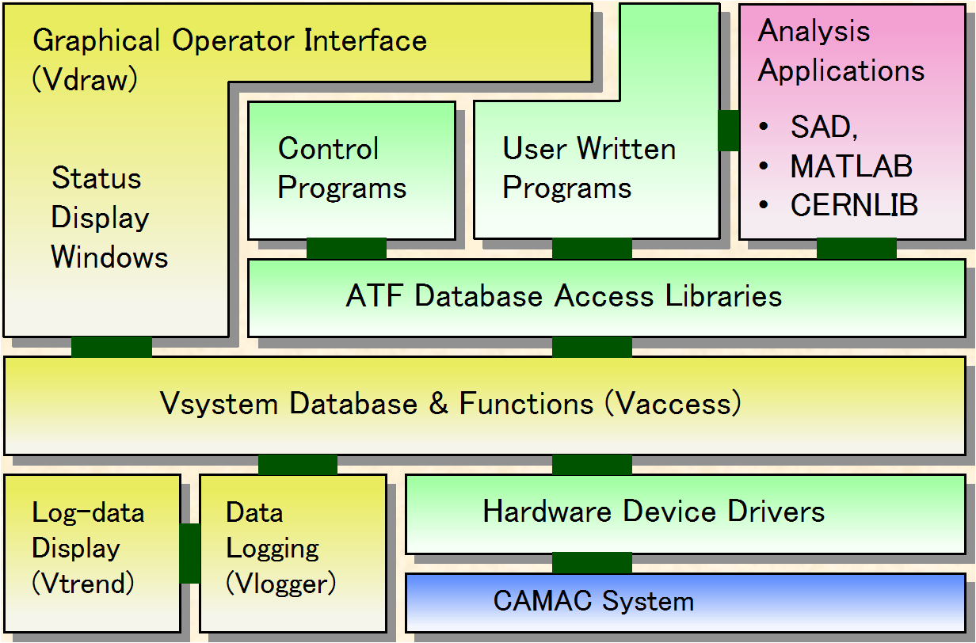
SML ⬄ Flight Simulator
ATF – Local Client (atfmenu Controls etc..)
Software Middle-Layer + Flight Simulator
SML + Flight Simulator
V_{ACCESS}
IOC
IOC
IOC
IOC

Slide 10
SML ⬄ Flight Simulator
ATF – Local Client (atfmenu Controls etc..)
Software Middle-Layer + Flight Simulator
V_{ACCESS}
IOC
IOC
IOC
IOC

Slide 11
Software Flow
High-level Applications
(scripts, functions, GUI’s…)
Software Middle-Layer
Flight Simulator
SML-> Controls Channel Access
Accelerator Model (SAD, Lucretia …)
Channel Access to Hardware
CA server simulation

Slide 12
Flight Simulator Properties
Code can be written and tested externally.
Everyone writing to the same standard.
Fast turn-around for trying different algorithms and debugging faults.
High level of re-use of routines.
Easy to do things like: set up demonstration of complete ATF2 operations in simulation for training purposes for example.
Robust
  Complete control over how user code integration happens.
  Easy to understand interface between different control algorithms written by different parties.
Secure
  Could be integrated into current controls scheme.
  No remote access etc…

Slide 13
Example from Users Perspective
A user wants to write a beam-dynamics algorithm, test it on an up-to-date model of the ATF2, then use it during his/her shift at ATF2 for real.
They download the flight simulator software (set to “simulation mode”) and run the simulated control-system on their PC.
The algorithm is written and tested on the flight simulator and tweaked until the desired performance is attained.
Any step-by-step user controls that will be needed on shift (gui’s etc) are written and tested. As the flight simulator environment looks the same in simulation to the user as the one in use at ATF2 (with just a “sim mode” switch enabled), they can be sure the behaviour will be identical upon deployment on shift.
Their code is taken out to KEK, and on shift is loaded into the online flight simulator.
The code is run from the ATF control-room (along with user-interface gui’s etc programmed by the user).
After management checks on suitability of code, this is then eventually merged into the online control system.

Slide 14
Work Required and Decisions Needed
Need to decide on type of interface for SML
  Matlab
    Can compile c or Fortran API for database links into mex routines.
    Lots of existing experience -> MML used by dozens of light-sources Worldwide
  Something else
    Custom software, c/java/Fortran…?
Supported tracking/beam dynamics package(s)?
  Lucretia (used in ATF2 simulations at SLAC).
  PLACET (used a lot in Europe).
  SAD (in use at ATF).
  MAD, BDSIM, Merlin…
Supported optics deck format(s)?
  XSIF
  Lucretia (Matlab)
  AML
  … ?
Who available for this kind of work?

Slide 15
Work Required and Decisions Needed
Most useful and novel feature of proposed flight simulator is “simulation mode” required for portability and offsite algorithm generation and testing.
If SML written with direct hooks to V-System (via V_{ACCESS} calls etc)
  Work needs to be performed and tested at KEK
  V-System itself not portable easily (not open-source)
    Simulation layer will have to be written from “ground-up” as a complete piece of self-contained software.
Use EPICS as the simulator
  Supplied IOC DB’s come pre-packaged with “simulation modes” used for development testing.
  Open source -> portable.
  Work required writing “soft” IOC’s which communicate with and simulate non-EPICS IOC’s.

Slide 16
Lucretia Flight Simulator Implementation
High-level Applications
(scripts, functions, GUI’s…)
Flight Simulator
Matlab Middle-Layer
Matlab to EPICS
(LabCA)
Lucretia Toolbox and ATF2 Model
V_{ACCESS}
EPICS CA
EPICS in “sim” mode

Slide 17
What is Lucretia?
A Matlab-based toolkit for simulations of beam dynamics in single-pass electron beamlines
  Most components are Matlab scripts or functions
  A handful of compiled C functions which run under Matlab (“mex files”)
    Compute intensive activities like tracking
      Tracks point-like rays with user-defined charge
    R-matrix calculation, Twiss propagation, lattice verification
      Share a lot of code with Tracking
Designed with the ILC in mind
  Somewhat useful for other applications – LCLS, XFEL, (ATF2?)
  Designed from the ground up to be an all-in-one tool for LET studies
  As “bulletproof” as we can make it
    Careful memory management
    Careful error handling
    Runs under Matlab
      Matlab data (i.e., beamline state, etc) preserved even if a fault is detected

Slide 18
What is in Lucretia?
Fairly sophisticated beamline representation
  Includes power supplies, klystrons, girders with or without movers, short range and long range wakefields, incoherent synchrotron radiation (several methods), crab cavities
Beam representation
  Multi-bunch representation
  Several pre-defined distributions of rays, and users can define their own
Instrumentation
  Read-out of “observable” and “non-observable” stuff at each instrument
  Bunch-by-bunch or train-by-train readback
  BPM resolution and electrical offsets

Slide 19
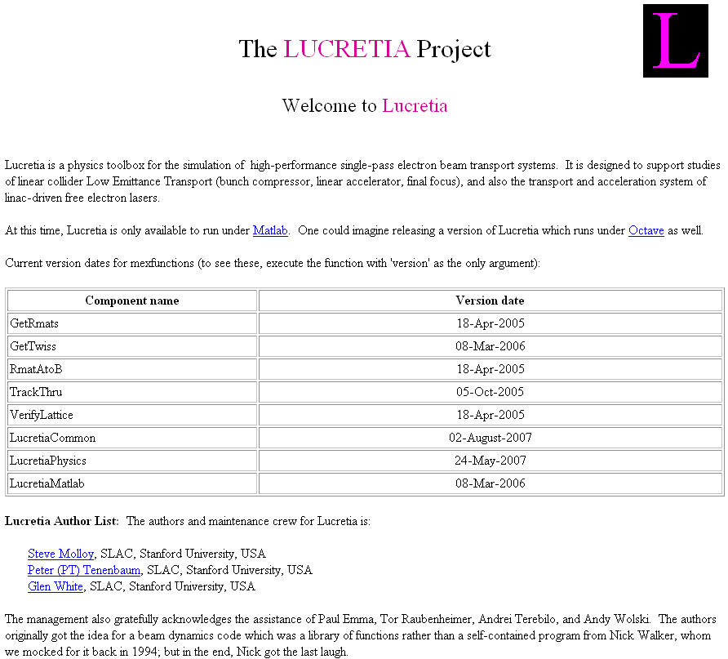
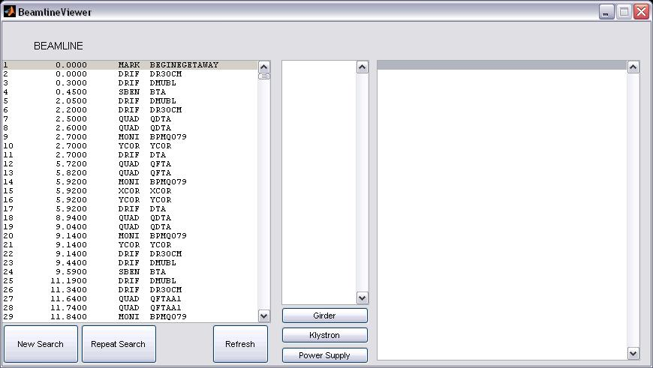
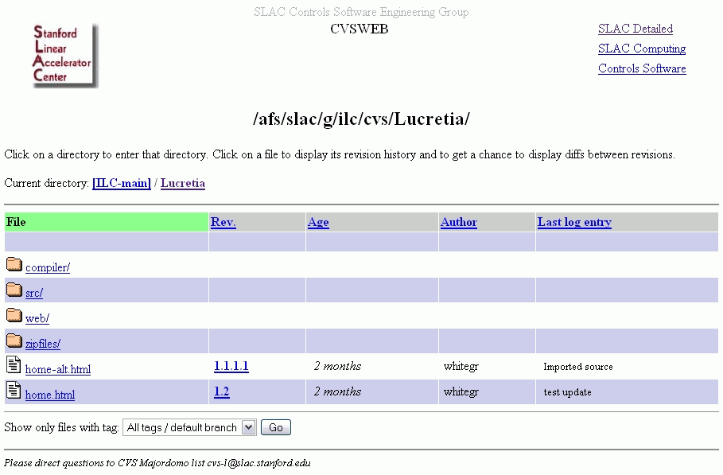
Other Lucretia Features
An online manual in the form of a heavily cross-linked website:
http://www.slac.stanford.edu/accel/ilc/codes/Lucretia/
A GUI for studying the beamline data structures
CVS control via a CVSWEB interface

Slide 20
Why Use Lucretia for the Flight Simulator?
Designed to provide the user with a system that closely represents a real accelerator environment
  Encourages development of code that is realistic, with minimal ‘cheats’.
  e.g. treatment of errors, finite instrumentation resolutions etc built-in.
Matlab provides a very easy and quick framework for writing and testing algorithms.
  Interpretive language
  Built around matrix math and linear algebra
  Built-in debugging and profiling tools
  Compilable for speed and portability.
Very easy to integrate GUI’s using GUIDE: built-in gui designer.

Slide 21
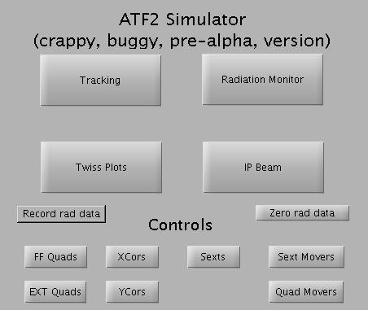
ATF2 Simulator GUI

Slide 22
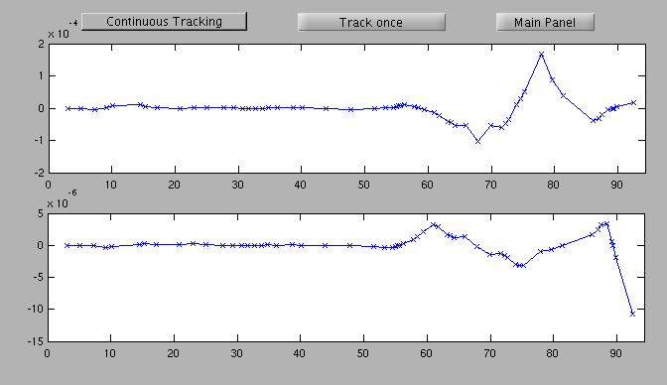
ATF2 Simulator GUI

Slide 23
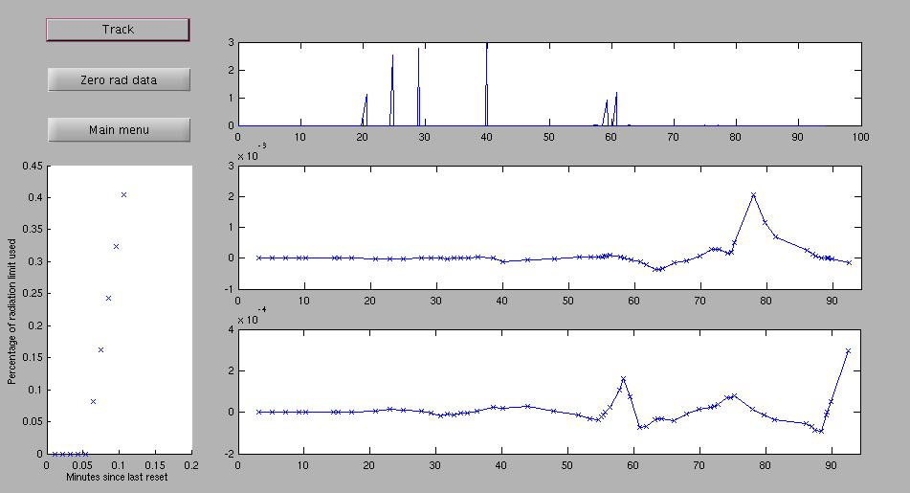
ATF2 Simulator GUI

Slide 24
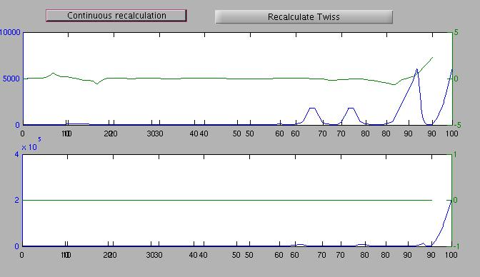
ATF2 Simulator GUI

Slide 25
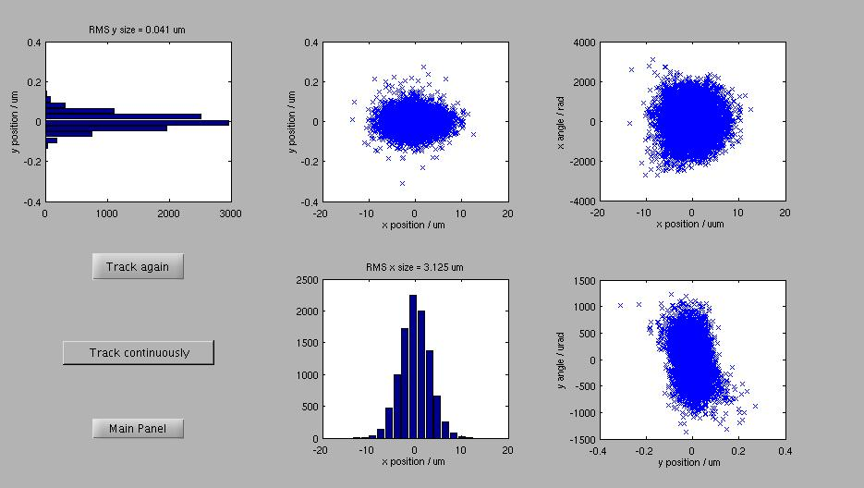
ATF2 Simulator GUI

Slide 26
Final Remarks
Have ~ 1 year before ATF2 operations
Good opportunity to formalise the most efficient way forward for international collaboration for machine tuning development is NOW.
On paper- lots of man hours available over next year to work on this world-wide?
I strongly urge the approach where the high-level controls are designed and managed in an open fashion. This could be critical to the success of the project.
Can give more detailed presentations on implementation details, arrange talks from experts etc if requested…
If nothing else, can some standards be worked out and DETAILED documentation started?
Can we hear from Kuroda-san on what the proposed management of ATF2 algorithm development and implementation is going to be?

